Slide 1
Waived Testing
Chapter 15
©McGraw-Hill Education. All rights reserved. Authorized only for instructor use in the classroom. No reproduction or further distribution permitted without the prior written consent of McGraw-Hill Education.

Slide 2
Learning Outcomes 1
15.1 Differentiate among waived tests, moderately complex tests, and high complexity tests.
15.2 Identify methods of performing an erythrocyte sedimentation rate.
15.3 Describe the waived procedure to test for fecal occult blood.
15.4 Explain the procedure for performing a microhematocrit and the reasons why this test is performed.
15.5 Describe the general procedure for performing a strep screening test.
Notes:
Introduction
Laboratory tests and procedures are classified into categories based on complexity of the test and the training required to perform the test. Phlebotomists may be specially trained to perform laboratory testing that is classified as “waived.”

Slide 3
Learning Outcomes 2
15.6 List the types of waived tests that are commonly performed on urine specimens.
15.7 Explain the purpose of point-of-care testing.

Slide 4
NAACLS Competencies 1
4.2 Describe the types of patient specimens that are analyzed in the clinical laboratory.
4.5 Explain the importance of timed, fasting, and stat specimens, as related to specimen integrity and patient care.
5.00 Demonstrate knowledge of collection equipment, various types of additives used, special precautions necessary, and substances that can interfere in clinical analysis of blood constituents.
5.1 Identify the various types of additives used in blood collection, and explain the reasons for their use.

Slide 5
NAACLS Competencies 2
5.4 Describe substances that can interfere in clinical analysis of blood constituents and ways in which the phlebotomist can help to avoid these occurrences.
7.00 Demonstrate understanding of requisitioning, specimen transport, and specimen processing.
7.2 Instruct patients in the proper collection and preservation of various samples, including blood, sputum, and stools.

Slide 6
Key Terms 1
Certificate of Waiver
Clinical Laboratory Improvement Advisory Committee (CLIAC)
Clinical Laboratory Improvement Amendments (CLIA ’88)
Dipstick test
Erythrocyte sedimentation rate (ESR)
Glucose testing
Hematocrit
High complexity
Human chorionic gonadotropin (hCG)
Microhematocrit
Moderate complexity
Packed cell volume (PCV)
Point-of-care testing (POCT)
Provider-performed microscopy procedures (PPMP)
Reagents

Slide 7
Key Terms 2
Rouleaux formation
Standard operating procedures (SOP)
Strep screening
Urinalysis
Urine chemical screening
Urine pregnancy tests
Waived tests

Slide 8
Levels of Laboratory Testing
Learning Outcome 15.1

Slide 9
Clinical Laboratory Improvement Act of 1988
High complexity tests
Moderate complexity tests
Provider-performed microscopy procedures (PPMP)
Waived tests
Notes:
LO 15.1 Differentiate among waived tests, moderately complex tests, and high complexity testing.
Notes:
The Clinical Laboratory Improvement Act of 1988 (CLIA ’88) identified three levels of complexity for medical laboratory tests. Provider-performed microscopy procedures (PPMP) was added to this law in 1997 as a subcategory of moderate complexity tests.
The following slides describe each type of test.

Slide 10
High Complexity Tests
Require close attention to detail
Require specialized training and substantial experience
Involve manual manipulation of complex equipment and reagents
Require interpretation and troubleshooting skills
Notes:
LO 15.1 Differentiate among waived tests, moderately complex tests, and high complexity testing.
Notes:
High complexity tests: Classification of laboratory tests that require close attention to detail and specialized training
Reagents: Lab test chemicals
Examples of high complexity tests:
Manual DNA extraction procedures
Special staining procedures
Complex analyzers that require detailed setup or operator interaction

Slide 11
Moderate Complexity Tests
Steps not highly complex but require formal training
Require little manual manipulation
Personnel required to have proper training and experience
May require direct supervision
Notes:
LO 15.1 Differentiate among waived tests, moderately complex tests, and high complexity testing.
Notes:
Moderate complexity tests: Classification of laboratory tests that fall between low (waived) and high complexity tests with respect to the complexity of the test and the training required
Examples of moderate complexity tests: Tests that involve running simple automated instruments

Slide 12
Provider-Performed Microscopy Procedures
Subcategory of moderate complexity testing
Tests performed by healthcare providers only for their own patients
Examples
Direct wet mounts
Potassium hydroxide (KOH) preparations
Pinworm examinations
Fern tests
Notes:
LO 15.1 Differentiate among waived tests, moderately complex tests, and high complexity testing.
Notes:
Provider-performed microscopy procedures: Subcategory of moderate complexity testing that allows healthcare providers to perform certain tests only for their own patients
Additional examples:
Post-coital qualitative tests
Urine sediment examinations
Nasal smears for granulocyte
Fecal leukocyte examinations
Qualitative semen evaluation

Slide 13
Waived Tests
Simple procedures
FDA-approved for home use
Pose no reasonable risk of harm if performed incorrectly
Require less training than higher complexity tests
On-the-job training possible
Notes:
LO 15.1 Differentiate among waived tests, moderately complex tests, and high complexity testing.
Notes:
Waived tests: FDA-approved laboratory tests that are minimally complicated and pose little risk of harm to the patient
Examples:
Blood glucose levels by glucose monitoring devices cleared by the FDA specifically for home use
Erythrocyte sedimentation rate—non-automated
Fecal occult blood
Spun microhematocrit (manual procedure for determining hematocrit that requires only a small amount of blood)
Urine chemical testing
Urine pregnancy tests—visual color comparison tests; the testing of urine for the presence of human chorionic gonadotropin, indicating pregnancy

Slide 14
Regulatory Compliance
All medical laboratories must comply with CLIA ’88
Certificate of Accreditation (COA)
Certificate of Compliance (COC)
Certificate of Registration (COR)
Certificate for Provider-Performed Microscopy Procedures
Certificate of Waiver
Notes:
LO 15.1 Differentiate among waived tests, moderately complex tests, and high complexity testing.
Notes:
A Certificate of Accreditation (COA) is awarded to laboratories that perform moderate and/or high complexity testing and meet the standards of a private not-for-profit accreditation program. These labs must be surveyed every other year.
A Certificate of Compliance (COC) is awarded to laboratories that perform moderate and/or high complexity testing after inspectors find that the laboratory is in compliance with all applicable CLIA requirements. These labs must also be surveyed every other year.
A Certificate of Registration (COR) is granted to laboratories that have applied for either COA or COC and enables the laboratory to perform moderate and/or high complexity testing until it has been inspected and verified to meet all requirements for COA or COC.
A Certificate for Provider-Performed Microscopy Procedures is granted to laboratories at facilities where physicians, mid-level practitioners, or dentists perform only certain microscopy procedures.
A Certificate of Waiver must be granted before a laboratory can perform waived tests. These labs must submit to random inspections and investigation if indicated.
The Clinical Laboratory Improvement Advisory Committee (CLIAC) has made several recommendations for good practice in a Certificate of Waiver laboratory.

Slide 15
Waived Testing Regulations
Follow federal, state, and local regulations
Perform waived tests only
Follow manufacturer instructions
Do not modify instructions
Allow random inspections
Establish laboratory safety plan that follows OSHA guidelines
Have a designated area with adequate space and conditions
Have enough personnel and train them appropriately
Have written documentation of each test performed
Notes:
LO 15.1 Differentiate among waived tests, moderately complex tests, and high complexity testing.
Notes:
Facilities that perform waived laboratory tests must have a designated person—usually a physician or experienced laboratory supervisor—that is responsible for laboratory supervision. All personnel must follow the guidelines, regulations, and requirements listed here.

Slide 16
Standard Operating Procedure
Required for laboratories performing waived tests
Applies to all steps in the testing process
Pre-examination
Examination
Post-examination
Notes:
LO 15.1 Differentiate among waived tests, moderately complex tests, and high complexity testing.
Notes:
Standard operating procedure (SOP): Requires the person performing waived testing to follow designated steps during all phases of the testing process

Slide 17
SOP: Pre-Examination
Confirm written test orders
Establish procedure for patient ID
Give pre-test instructions and determine whether patients followed them
Collect specimens according to package insert instructions
Label specimens appropriately
Never use expired reagents or test kits
Notes:
LO 15.1 Differentiate among waived tests, moderately complex tests, and high complexity testing.
Notes:
These are guidelines for standard operating procedure during the pre-examination phase (before the test).

Slide 18
SOP: Examination
Perform quality control testing
Correct problems discovered during QC testing before testing patient samples
Establish policy for control testing frequency
Follow test-timing recommendations
Interpret test results as directed
Record test results according to office policy
Notes:
LO 15.1 Differentiate among waived tests, moderately complex tests, and high complexity testing.
Notes:
These are guidelines for standard operating procedure during the examination phase (during the test).

Slide 19
SOP: Post-Examination
Report test results to the physician in a timely manner
Follow package insert recommendations for follow-up or confirmatory testing
Follow OSHA regulations for disposing of biohazardous waste
Notes:
LO 15.1 Differentiate among waived tests, moderately complex tests, and high complexity testing.
Notes:
These are guidelines for standard operating procedure during the post-examination phase (after the test).
To help ensure the quality of testing, Certificate of Waiver laboratories are also required to participate in quality assurance/assessment programs for each test they perform.

Slide 20
Erythrocyte Sedimentation Rate
Learning Outcome 15.2

Slide 21
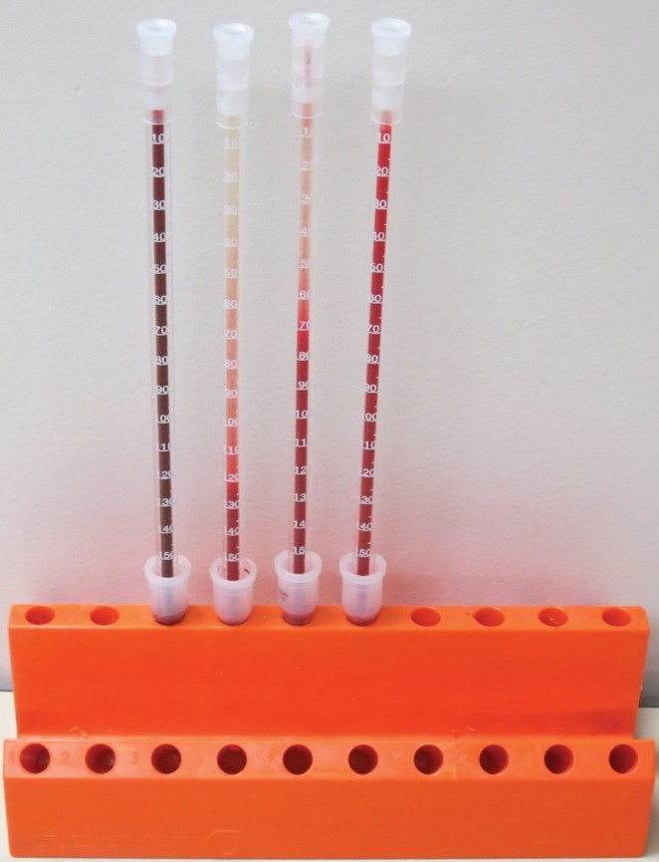
Erythrocyte Sedimentation Rate (ESR)
Rate at which RBCs settle in whole blood
Screens for inflammation
Methods
Wintrobe
Westergren
Modified Westergren
©Lillian Mundt
Notes:
LO 15.2 Identify methods of performing an erythrocyte sedimentation rate.
Notes:
Erythrocyte sedimentation rate (ESR): Rate at which red blood cells settle in whole blood; measured as the distance, in millimeters, that RBCs fall in one hour when allowed to settle in a calibrated tube
This is a nonspecific test that screens for inflammation:
When inflammation is present, plasma proteins such as albumin and globulin are increased.
Increased plasma proteins cause RBCs to come closer and may result in rouleaux formation, in which the RBCs stick to each other.
Several cells sticking together sink faster than a single RBC does, so an elevated sedimentation rate indicates inflammation.

Slide 22
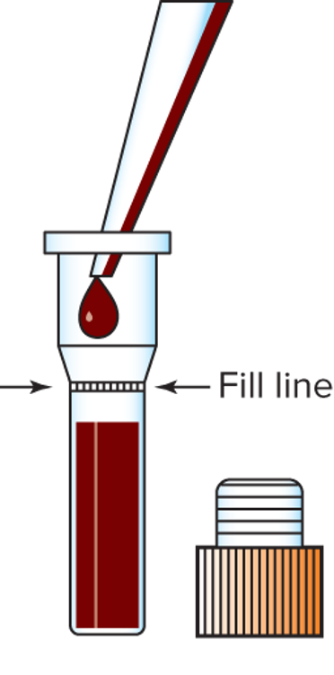
Check Your Competency 15-1: Erythrocyte Sedimentation Rate Testing 1
Transfer the blood from an appropriate specimen to the diluent vial and fill it to the mark on the vial (amounts vary by manufacturer).
Replace the vial cap and gently mix the blood with the diluent by inversion.
Copyright © McGraw-Hill Education
Notes:
LO 15.2 Identify methods of performing an erythrocyte sedimentation rate.
Notes:
The equipment needed for a simple ESR test include:
Specimen transfer pipettes
ESR kit
ESR vials containing a premeasured amount of diluent (usually saline)
Calibrated ESR tubes
ESR testing rack
The amount of blood needed for the test varies by kit manufacturer. Be sure to fill the diluent vial to the mark on the vial.

Slide 23

Check Your Competency 15-1: Erythrocyte Sedimentation Rate Testing 2
Insert a calibrated ESR tube through the vial cap and into the blood-diluent mixture; adjust the tube until the blood is even with the 0-mm mark.
Place the ESR tube in the testing rack (it should be absolutely level).
Label the ESR tube or vial with the patient’s identification.
Allow the blood to settle for 1 hour.
Copyright © McGraw-Hill Education
Notes:
LO 15.2 Identify methods of performing an erythrocyte sedimentation rate.

Slide 24
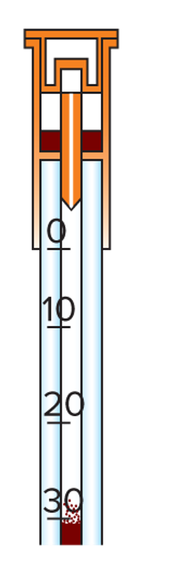
Check Your Competency 15-1: Erythrocyte Sedimentation Rate Testing 3
After 1 hour, read the level to which the red blood cells have fallen and record this information as millimeters per hour.
Consult the manufacturer’s instructions for the proper interpretation of the results. Normal values vary by method and may vary by gender.
Copyright © McGraw-Hill Education
Notes:
LO 15.2 Identify methods of performing an erythrocyte sedimentation rate.
Notes:
Other factors that may affect ESR results:
Testing time
Temperature
Tilting
Vibrations

Slide 25
Factors Affecting ESR Results
Time from collection to testing
Testing time
Temperature
Tilting
Vibrations
Notes:
LO 15.2 Identify methods of performing an erythrocyte sedimentation rate.

Slide 26
Fecal Occult Blood Testing
Learning Outcome 15.3

Slide 27
Testing for Fecal Occult Blood
Cardboard holder contains paper impregnated with guaiac
Apply stool to cardboard
Apply hydrogen peroxide
Presence of hemoglobin in blood makes guaiac paper turn blue
Notes:
LO 15.3 Describe the waived procedure to test for fecal occult blood.
Notes:
Fecal occult blood is blood that is found in the feces/stool and may not be visible (therefore occult).
Guaiac is a chemical that turns blue when blood (hemoglobin) is present.
Several portions of the stool sample are usually processed in order to maximize blood detection.
False-positive fecal occult blood results may occur if patients have ingested:
Fish
Heme-laden meat (such as beef and lamb)
Fruits that contain peroxidase (bananas, cantaloupe, pears, plums)
Vegetables that contain peroxidase (broccoli, cauliflower, horseradish, turnips)

Slide 28
Microhematocrit
Learning Outcome 15.4

Slide 29
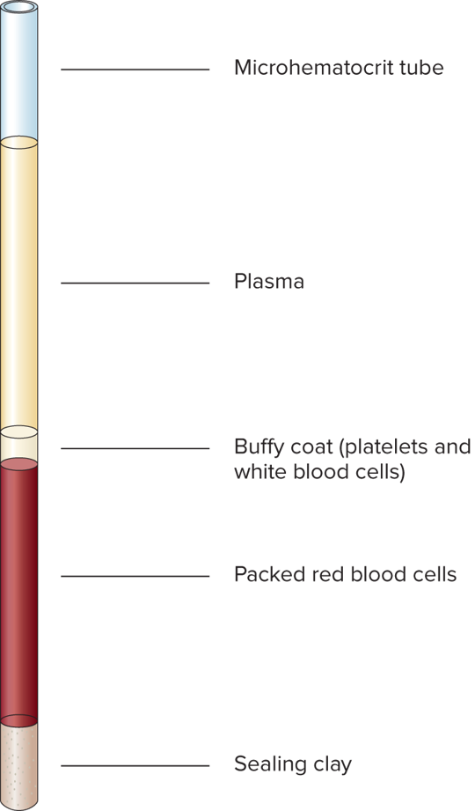
Microhematocrit2
Measured as packed cell volume (PCV)
Can be performed directly from puncture or from EDTA tube
Blood placed in capillary tube
Centrifuged to pack RBCs
Hematocrit determined using reading device
Copyright © McGraw-Hill Education
Notes:
LO 15.4 Explain the procedure for performing a microhematocrit and the reasons why this test is performed.
Notes:
Hematocrit: The percentage of whole blood that is made up of red blood cells
Measured as packed cell volume (PCV) of red blood cells (percentage of red blood cells in whole blood)
Used as a screening test for anemia

Slide 30
Microhematocrit Procedure 1
Fill the capillary tubes Directly from dermal puncture:
Wipe away first drop
Touch a red-tipped capillary tube to the edge of the next blood drop without touching the skin
Keep the capillary tube angled upward to avoid air bubbles
Notes:
LO 15.4 Explain the procedure for performing a microhematocrit and the reasons why this test is performed.
Notes:
Microhematocrit procedure uses capillary tubes, which are narrow-diameter tubes that take up blood by capillary action.
Avoid air bubbles because they may cause erroneous results.

Slide 31
Microhematocrit Procedure 2
Fill the capillary tubes From EDTA tube:
Remove the cap from an EDTA tube filled with blood
Tilt the specimen tube slightly and insert one end of the capillary tube
Keep the capillary tube angled upward to avoid air bubbles
Notes:
LO 15.4 Explain the procedure for performing a microhematocrit and the reasons why this test is performed.
Notes:
Fill two capillary tubes three-quarters full.
Because microhematocrit/capillary tubes are very slender and are usually made of glass, they break easily. For safety, some tubes are either plastic or have a plastic coating. However, always use caution when handling capillary tubes. A broken sharp edge can cause a break in the glove and skin, exposing the phlebotomist to blood.

Slide 32
Microhematocrit Procedure 3
Place gloved finger over dry end of capillary tube
Hold tube horizontal so no blood can spill out
Embed clean end of tube in clay sealant and remove finger
Place filled and sealed capillary tubes into microcentrifuge (with sealed end toward outer rim)
After centrifugation, remove tubes from centrifuge and read on hematocrit scale
Notes:
LO 15.4 Explain the procedure for performing a microhematocrit and the reasons why this test is performed.
Notes:
Some microhematocrit tubes are self-sealing and do not require sealing clay. Refer to the manufacturer’s directions.
A microhematocrit centrifuge is used to spin the capillary tubes, and then the packed cell volume is read using a microhematocrit reading device. Many microhematocrit centrifuges have these reading devices built in.

Slide 33
Reading a Microhematocrit
Place bottom of RBC layer at 0% mark
Adjust scale so top of plasma layer is at 100% mark
Read hematocrit value at top of RBC layer on scale
Notes:
LO 15.4 Explain the procedure for performing a microhematocrit and the reasons why this test is performed.
Notes:
Correct placement of the tube on the hematocrit scale is critical to obtaining an accurate result. The bottom of the RBCs should be placed on the “0” mark. The top of the plasma should be placed on the “100” mark, NOT the top of the tube. The hematocrit is the line at the top of the RBCs.
Watch the video “Measuring Hematocrit Percentage after Centrifuge” for more information about reading a hematocrit result accurately.

Slide 34
Strep Screening
Learning Outcome 15.5

Slide 35
Strep Screening2
Determines presence of Group A Streptococcus
Waived testing labs use strep test kits with built-in controls
Procedures vary with manufacturer
Read instructions carefully
Notes:
LO 15.5 Describe the general procedure for performing a strep screening test.
Notes:
Strep screening is used to determine if a patient’s sore throat is caused by the bacteria Group A Streptococcus. Detection is important because untreated Streptococcus infections can lead to rheumatic fever and autoimmune disease.
Testing devices contain:
Antibodies to Group A Strep
A color developer
Built-in controls
General procedure for the test kits used in Certificate of Waiver laboratories:
Swab specimen is taken from back of throat.
Swab is placed in a vial that contains premeasured amounts of extraction reagent to remove the bacteria from the swab.
Vial is set onto a testing device treated with antibodies to the bacterial antigens and color developers.
Results are read after a specified period of time, usually less than 10 minutes.
For the results to be valid, the control (“C” in the tests shown on this slide) must show a positive result.

Slide 36
Urine Testing
Learning Outcome 15.6

Slide 37
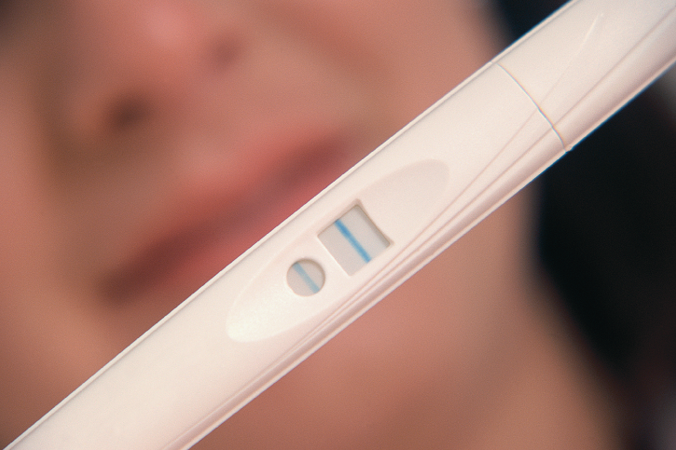
Urine Pregnancy Test
Confirms or rules out pregnancy
Tests for human chorionic gonadotropin (hCG)
Tests vary by manufacturer
©Getty Images RF
Notes:
LO 15.6 List the types of waived tests that are commonly performed on urine specimens.
Notes:
Human chorionic gonadotropin (hCG): Hormone produced by the placenta
General procedure for the test kits used in Certificate of Waiver laboratories:
Place required number of drops of urine onto the testing device.
Read the results according to the manufacturer’s directions. (The test shown on this slide is negative.)
Built-in control verifies that the test has been performed correctly.

Slide 38
Urine Chemical Screening: Part of a Complete Urinalysis 1
Physical Components
Microscopic Components
Color
Clarity
Casts
Cells
Crystals
Notes:
LO 15.6 List the types of waived tests that are commonly performed on urine specimens.
Notes:
Urine chemical screening: The testing of urine for various chemicals, most not normally present in the urine; part of a urinalysis
Urinalysis: The testing of urine for physical, chemical, and microscopic characteristics

Slide 39
Urine Chemical Screening: Part of a Complete Urinalysis 2
Chemical Components
pH
Specific gravity
Blood
Bilirubin
Glucose
Ketones
Leukocytes
Nitrite
Protein
Urobilinogen
Notes:
LO 15.6 List the types of waived tests that are commonly performed on urine specimens.

Slide 40
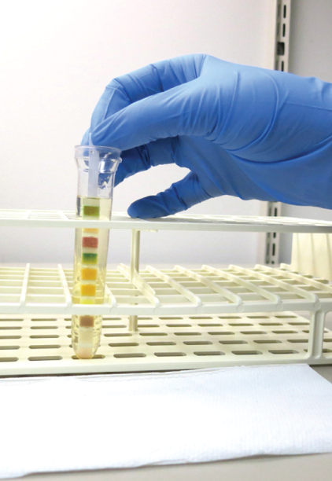
Check Your Competency 15-2: Urine Chemical Screening 1
Double check that the specimen is correctly identified and matches the chart where you will record the results.
Allow the urine to come to room temperature; then mix the urine thoroughly.
Remove the reagent strip from the bottle and replace the cap.
Remove the cap from the urine container and dip the reagent strip into the urine, making sure that all the reagent pads come into contact with the urine.
©Lillian Mundt
Notes:
LO 15.6 List the types of waived tests that are commonly performed on urine specimens.
Notes:
Use all appropriate PPE as required by your facility.
For quality assurance, follow these precautions:
Keep strips in tightly closed containers in a cool, dry area.
Never remove strips from the container until immediately before testing.
Never touch the pads on the strip with your fingers or gloved hands.
Examine strips for discoloration before use; discard discolored strips.
Check the expiration date on the bottle; do not use strips that have expired.
Use strips within six months of opening the container.
Every time you open a new supply of reagent strips, run control samples to check for proper operation. Write the date opened on the bottle.

Slide 41
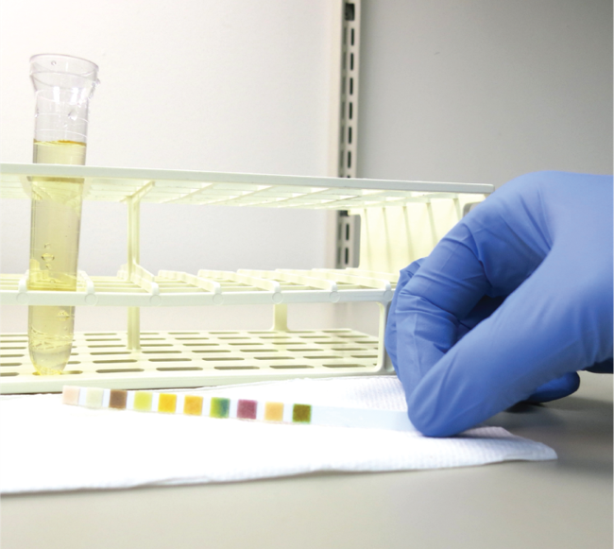
Check Your Competency 15-2: Urine Chemical Screening 2
Remove the reagent strip by dragging it across the top of the container and/or touching the side edge to an absorbent material to prevent dripping. Never blot the tops of the pads on the strip and do not allow urine from one pad to run over onto another.
Begin timing immediately.
©Lillian Mundt
Notes:
LO 15.6 List the types of waived tests that are commonly performed on urine specimens.

Slide 42
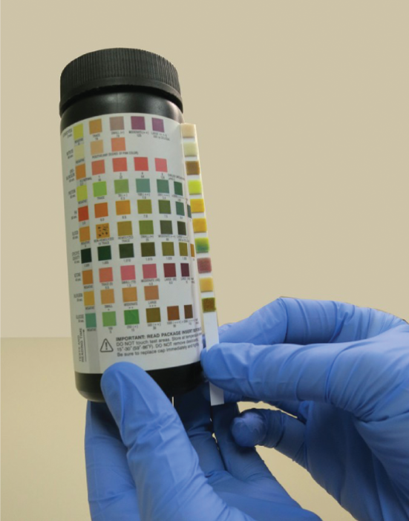
Check Your Competency 15-2: Urine Chemical Screening 3
Compare the colors of the reagent pads to those of the color chart on the reagent strip bottle at the time designated by the manufacturer to avoid erroneous results.
Record the test result for each chemical component in the patient’s medical record.
©Lillian Mundt
Notes:
LO 15.6 List the types of waived tests that are commonly performed on urine specimens.
Notes:
Watch the video, “Performing a Reagent Strip Test,” for more information about this topic.

Slide 43
Point-of-Care Testing
Learning Outcome 15.7

Slide 44
Point-of-Care Testing (POCT)
Designed to:
Reduce healthcare costs
Enhance patient care
Sample tested immediately after collection at patient’s side
Typically requires small amount of blood from dermal puncture
Notes:
LO 15.7 Explain the purpose of point-of-care testing.
Notes:
Typical POCT tests:
Glucose
Hemoglobin
Electrolytes (sodium, potassium, chloride, bicarbonate)
Ionized calcium
Cholesterol
Blood ketones
Blood gases
Coagulation studies (such as prothrombin time)
Urine dipstick (plastic strip with reagent pads containing chemicals for urine or blood testing)
Urine pregnancy
Fecal occult blood
Strep screening
Watch the video, “Point of Care Testing,” for more information about this topic.

Slide 45
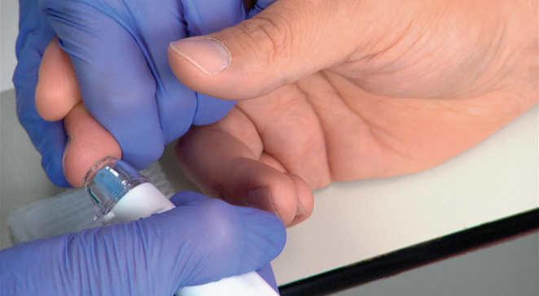
Check Your Competency 15-3: Glucose Point-of-Care Testing 1
Properly identify the patient.
Use PPE appropriate to the procedure and as required by your facility.
Assemble the dermal/capillary puncture equipment.
Verify that controls have been run on the glucose instrument and are in range.
Prepare the glucose instrument for testing (insert strip).
Perform a routine dermal/capillary puncture.
©McGraw-Hill Education/Take One Digital Media, photographer
Notes:
LO 15.7 Explain the purpose of point-of-care testing.
Notes:
Glucose testing: Screening for abnormal glucose levels and to monitor glucose levels in patients with diabetes mellitus
This is a representative procedure. Be sure to follow the procedure required at your facility.

Slide 46
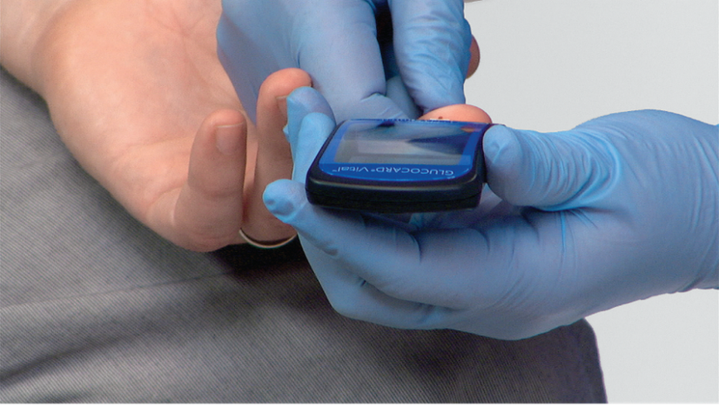
Check Your Competency 15-3: Glucose Point-of-Care Testing 2
Wipe away the first drop (the first drop may contain fluid from the tissue and give elevated results).
Apply a drop of blood to the test strip (following the manufacturer’s requirements).
Testing should begin automatically.
Provide post-puncture patient care.
©McGraw-Hill Education/Take One Digital Media, photographer
Notes:
LO 15.7 Explain the purpose of point-of-care testing.

Slide 47
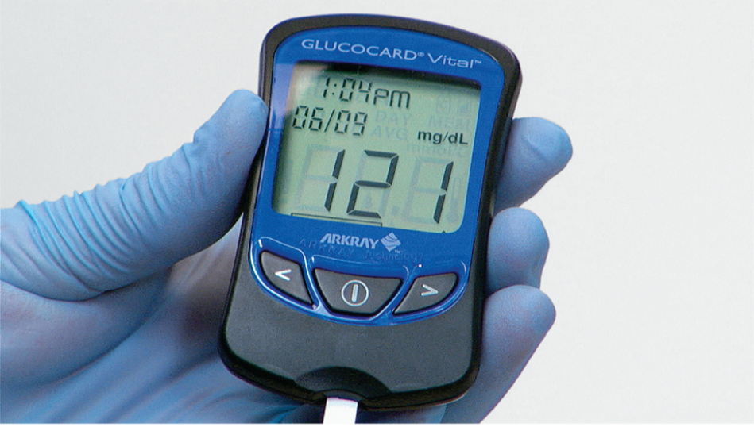
Check Your Competency 15-3: Glucose Point-of-Care Testing 3
Properly dispose of biohazards.
After the test is complete, read and record the results.
©McGraw-Hill Education/Take One Digital Media, photographer
Notes:
LO 15.7 Explain the purpose of point-of-care testing.

Slide 48
Chapter Summary 1
The Clinical Laboratory Improvement Amendments of 1988 (CLIA ’88) identified three levels of complexity for medical laboratory tests: waived tests, moderately complex tests, and high complexity tests. A subcategory of provider-performed microscopy procedures was later added to the moderately complex level.
A Certificate of Waiver is needed for facilities wishing to perform waived testing.
Methods of performing an erythrocyte sedimentation rate include Wintrobe, Westergren, and Modified Westergren.
The waived method of testing stool for occult blood is done using guaiac, a chemical that turns blue when blood is present.
Notes:
15.1 Differentiate among waived tests, moderately complex tests, and high complexity testing.
15.2 Identify methods of performing an erythrocyte sedimentation rate.
15.3 Describe the waived procedure to test for fecal occult blood.

Slide 49
Chapter Summary 2
Microhematocrit testing, which involves centrifuging capillary tubes of blood to determine packed cell volume, is performed to screen for anemia.
Kit tests for Group A Streptococcus screening are used to test for strep throat, rheumatic fever, and autoimmune disease.
Tests are performed on urine to determine pregnancy and to identify various chemical and physical components.
Point-of-care testing (POCT) is designed to reduce healthcare costs while enhancing patient care by making results available quickly.
Notes:
15.4 Explain the procedure for performing a microhematocrit and the reasons why this test is performed.
15.5 Describe the general procedure for performing a strep screening test.
15.6 List the types of waived tests that are commonly performed on urine specimens.
15.7 Explain the purpose of point-of-care testing.

