Slide 1
Chapter 2
Safety and Preparedness

Slide 2
Learning Outcomes
2.1 Discuss practices to ensure safety and reduce the risk of infection from medical biohazards in compliance with state and federal standards and regulations.
2.2 Recognize symbols and systems and apply techniques to ensure the physical safety of healthcare workers and patients.
Notes:
Introduction:
All healthcare personnel must provide for their own safety, as well as the safety of patients and coworkers. This chapter presents the various hazards that may be present in the clinical setting including methods to maintain safety and preparedness for these hazards.

Slide 3
N A A C L S Competencies 1
2.1 Demonstrate knowledge of infection control and safety.
2.2 Identify policies and procedures for maintaining laboratory safety.
2.4 Comply with federal, state, and locally mandated regulations regarding safety practices.
2.4.1 Observe the O S H A Blood borne Pathogens Standard and Needle Safety Precautions Act.
2.4.2 Use prescribed procedures to handle electrical, radiation, biological and fire hazards.

Slide 4
N A A C L S Competencies 2
2.4.3 Use appropriate practices, as outlined in the O S H A Hazard Communications Standard, including the correct use of the Material Safety Data Sheet as directed.
2.5 Describe measures used to ensure patient safety in various patient settings, example, inpatient, outpatient, pediatrics, etcetera.

Slide 5
Key Terms 1
Biohazards.
Bloodborne Pathogens Standard.
Chemical hazards.
Chemical hygiene plan.
Electrical hazards.
Emergency preparedness.
Ergonomics.
Exposure control plan.
Fire and explosive hazards.
Globally Harmonized System (G H S).
Hazardous materials (H A Z M A T S).
Hazard statement.
Needlestick injury.
Needlestick Safety and Prevention Act.
Other potentially infectious materials (O P I M).
Physical hazards.

Slide 6
Key Terms 2
Physical hazards.
Pictogram.
Precautionary statement.
Radioactive hazard.
Safety data sheets (S D S).
Signal word.

Slide 7
Learning Outcome 2.1
Medical Biohazards

Slide 8
Definition of Biohazards
Biohazards.
Biological substances that can threaten human health.
Medical biohazards.
Any materials contaminated with infectious agents.
Blood and body fluids.
Medical waste.
Laboratory specimens and cultures.
Notes:
LO 2.1: Implement safety practices to reduce the risk of infection from medical biohazards in compliance with state and federal standards and regulations.
Notes:
The handling and disposal of biohazardous wastes are regulated both by state regulatory committees and by OSHA and CDC at the federal level. State regulations often exceed federal requirements, so be sure you understand the applicable laws in your state.
General rules:
Always wear gloves when handling biohazardous waste.
Place biohazardous waste only in bags or containers that are red and are clearly labeled as biohazards.

Slide 9
Occupational Safety and Health Administration (O S H A)
O S H A is the federal organization responsible for preventing or minimizing employee exposure to bloodborne pathogens such as hepatitis and H I V (Bloodborne Pathogens Standard).
O S H A requires that healthcare facilities provide the necessary personal protective equipment to prevent exposure.
O S H A mandates that healthcare facilities provide annual training on preventing exposure to bloodborne pathogens.
Notes:
LO 2.1: Implement safety practices to reduce the risk of infection from medical biohazards in compliance with state and federal standards and regulations.
Notes:
The Occupational Safety and Health Administration (OSHA) is the federal agency that maintains standards for preventing occupational exposure to bloodborne pathogens, including annual training for healthcare workers and the correct use of PPE.
OSHA requirements include annual training for healthcare workers on minimizing exposure to bloodborne pathogens, the use of PPE, and free hepatitis (HBV) vaccination for healthcare workers.
Bloodborne pathogens: Microorganisms that cause disease states such as HIV, hepatitis C, and hepatitis B
Bloodborne Pathogens Standard: standard developed by OSHA in 1991 requiring healthcare facilities to provide annual employee training on preventing exposure to bloodborne pathogens as well as using the necessary PPE
Other requirements include: employers must offer the hepatitis B vaccine (HBV) at no charge to all employees who are reasonably expected to come in contact with blood or other potentially infectious materials (OPIM). Healthcare facilities are required to have an occupational exposure control plan, which is a protocol to be followed in the event an employee is exposed to blood-borne pathogens.

Slide 10
Consequences of Needlestick Injuries
Financial.
Emotional.
Health.
Notes:
LO 2.1: Implement safety practices to reduce the risk of infection from medical biohazards in compliance with state and federal standards and regulations.
Notes:
Needlestick injuries are piercing wounds caused when the point of a needle or other sharp instrument perforates the skin.

Slide 11
Needlestick Safety and Prevention Act of 2001
Established through recommendation of N I O S H and O S H A.
Mandated use of safety devices on needles for prevention of exposure to bloodborne pathogens.
Notes:
LO 2.1: Implement safety practices to reduce the risk of infection from medical biohazards in compliance with state and federal standards and regulations.
Notes:
Through the efforts of the National Institute for Occupational Safety and Health (NIOSH) and OSHA, the Needlestick Safety and Prevention Act was passed in 2001.

Slide 12
Needlestick Prevention
Use only safety devices designed to reduce needlestick injuries.
Never break off, recap, or reuse needles.
Immediately after using a needle or other sharp device, engage the safety feature and place it in the sharps container.
Empty sharps container when it becomes 2/3 to 3/4 full.
Notes:
LO 2.1: Implement safety practices to reduce the risk of infection from medical biohazards in compliance with state and federal standards and regulations.
Notes:
Methods of reducing needlestick injuries:
Using needleless equipment
Using safety devices such as one-handed needle covering devices and retractable needles (“engineering controls”)
Using a sharps container for disposal of needles and other sharps

Slide 13
Exposure to Hazardous Drugs
Long–term exposure to hazardous drugs can cause acute and chronic illness.
Antiviral drugs.
Cancer drugs.
Be aware of hazardous drugs listed in N I O S H Alert: Preventing Occupational Exposures to Antineoplastic and Other Hazardous Drugs in Health Care Settings.
Follow recommendations for safe handling.
Notes:
LO 2.1: Implement safety practices to reduce the risk of infection from medical biohazards in compliance with state and federal standards and regulations.

Slide 14
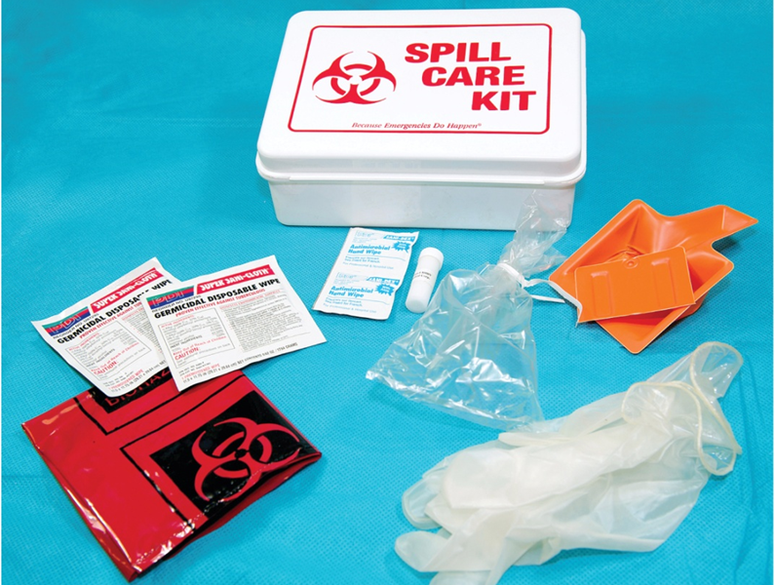
Cleaning Up Biohazardous Spills
Clean up all biohazardous spills or splatters immediately using an appropriate biohazard spill cleanup kit.
Always use appropriate P P E.
Never allow hazardous substances to contact your skin.
Access the text alternative for slide images.
©McGraw-Hill Education/Sandra Mesrine, photographer
Notes:
LO 2.1: Implement safety practices to reduce the risk of infection from medical biohazards in compliance with state and federal standards and regulations.

Slide 15
Learning Outcome 2.2
Personal Safety and Preparedness

Slide 16
Common Sense
Avoid running or rushing.
Be aware of wet floors.
Avoid wearing dangling jewelry.
Tie back long hair.
Use thermal gloves when handling heated or cooled specimens.
Be cautious when using pneumatic tube systems.
Notes:
LO 2.2: Apply techniques to ensure the physical safety of healthcare workers and patients.
Notes:
Using common sense can greatly reduce the risk of danger to both yourself and the patient. Think about what you are doing at all times and look for possible safety hazards. Do not let your mind wander while you are working.

Slide 17
Ergonomics
Adapting tasks to be performed safely.
Applications in phlebotomy.
Sitting while drawing blood.
Lowering bedrails.
Placing equipment close to procedure area.
Bending knees when lifting.
Ensuring proper fit of gloves.
Notes:
LO 2.2: Apply techniques to ensure the physical safety of healthcare workers and patients.
Notes:
Ergonomics is the process of adapting tasks so that you can perform them safely and productively. In general, it includes positioning yourself to avoid bending or awkward positions, as well as lifting objects properly.
Proper fit of gloves is an important part of ergonomics.
Gloves that are too small may tear, exposing you to pathogens.
Gloves that are too large may cause you to drop items, or they may interfere with safe performance of procedures.

Slide 18
Allergen Exposure
Latex.
Gloves.
Tourniquets.
Adhesive bandages.
Tape.
Non–latex gloves.
Alcohol prep pad.
Notes:
LO 2.2: Apply techniques to ensure the physical safety of healthcare workers and patients.
Notes:
Possible symptoms of latex allergy:
Itchy, red, watery eyes
Chest tightness
Shortness of breath
Shock
Bumps, sores, or red, raised areas on the skin
Never use powdered latex gloves for phlebotomy.

Slide 19
Electrical Hazards
Use fuses, circuit breakers, and ground fault interrupters properly to prevent circuit overload.
Use three–pronged, grounded plugs.
Avoid touching electrical equipment that is wet.
Do not touch equipment with wet hands.
If equipment is damaged, malfunctions, smells unusual, or makes a loud noise, turn it off.
Do not stretch electrical cords.
Do not use extension cords.
Do not use equipment with damaged electrical cords.
Turn off equipment during power failures.
Notes:
LO 2.2: Apply techniques to ensure the physical safety of healthcare workers and patients.
Notes:
Electrical hazards: Contact with electrical equipment or the failure of equipment that creates a dangerous condition
Improper use of electrical equipment can result in shock, burn, electrocution, or even explosion.
Additional precautions:
Always check equipment carefully before using it.
Follow safety guidelines, including facility policy and manufacturer’s instructions.
Become familiar with each piece of equipment before using it.
Avoid plugging too many devices into a single electrical outlet.

Slide 20
Fire and Explosive Hazards
Correct response to fire:
R: Rescue those who need immediate help.
A: Activate the fire alarm or phone in the alarm.
C: Contain the fire as much as possible.
E: Extinguish the fire, if possible.
Notes:
LO 2.2: Apply techniques to ensure the physical safety of healthcare workers and patients.
Notes:
Potential fire and explosive hazards:
Blocked escape routes
Overloaded electrical circuits
Misuse of chemicals
Lack of training
Carelessness

Slide 21
Fire Extinguishers 1
Class of Fire | Type of Fire | Type of Extinguisher
A | Cloth, paper, or wood | Pressurized water, dry chemical
B | Oils, alcohol, or grease | Dry chemical, carbon dioxide
C | Appliances and electronic devices | Dry chemical, carbon dioxide, halon
D | Combustible metals | Sand or special extinguishing agent
Notes:
LO 2.2: Apply techniques to ensure the physical safety of healthcare workers and patients.
Notes:
Use the proper type of extinguisher for each class of fire. Using the wrong type of extinguisher may cause the fire to become worse.

Slide 22
Fire Extinguishers 2
Class of Fire | Memory Jogger
A | A is for ashes. Use on anything that will turn to ashes when burned.
B | B is bubbles and boils. Use on flammable liquids.
C | C is for circuit. Use on appliances and electronic devices.
ABC | Use on all of the above.
Notes:
LO 2.2: Apply techniques to ensure the physical safety of healthcare workers and patients.
Notes:
Use the proper type of extinguisher for each class of fire. Using the wrong type of extinguisher may cause the fire to become worse.

Slide 23
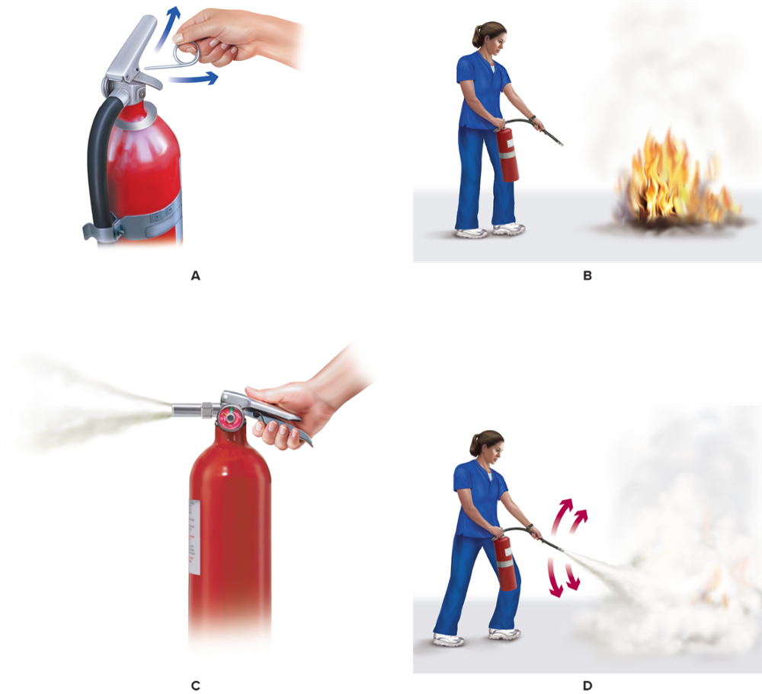
Using PASS to Extinguish a Fire
Notes:
LO 2.2: Apply techniques to ensure the physical safety of healthcare workers and patients.
Notes:
Use the proper type of extinguisher for each class of fire. Using the wrong type of extinguisher may cause the fire to become worse.

Slide 24
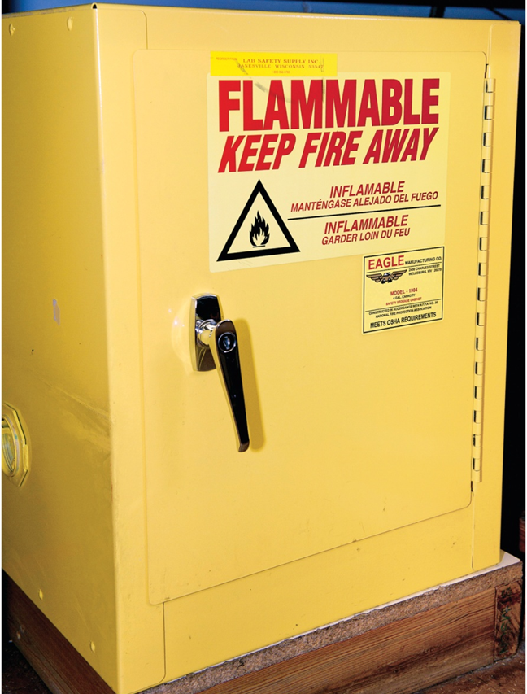
Chemical Hazards Overview
Be aware of requirements.
Store chemicals securely.
Use chemicals safely.
©McGraw-Hill Education/Sandra Mesrine, photographer
Notes:
LO 2.2: Apply techniques to ensure the physical safety of healthcare workers and patients.
Notes:
Chemical hazards: Harmful or potentially harmful chemicals used by healthcare employees
Chemicals must be labeled with:
Contents
Date of purchase or preparation
Initials of preparer

Slide 25
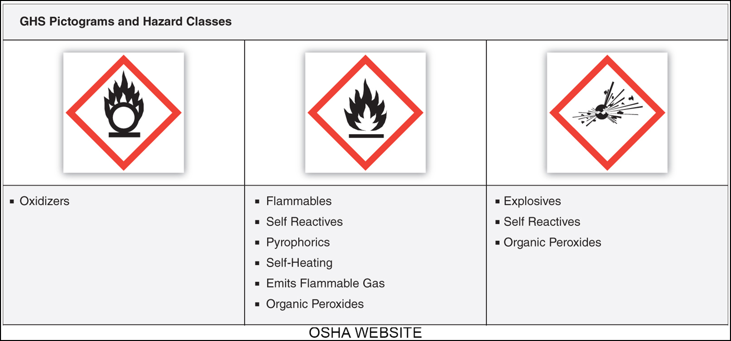
Globally Harmonized System (G H S) Pictograms and Hazard Classes 1
Access the text alternative for slide images.
Notes:
LO 2.2: Apply techniques to ensure the physical safety of healthcare workers and patients.
Notes:
OSHA recently modified its Hazard Communication Standard (HCS) to include the Globally Harmonized System (GHS), which is an internationally accepted system for communicating chemical hazards to improve safety and health in the workplace. The GHS includes criteria for:
Determining a chemical’s hazardous effects
Standardizing labeling criteria
A harmonized format for safety data sheets

Slide 26
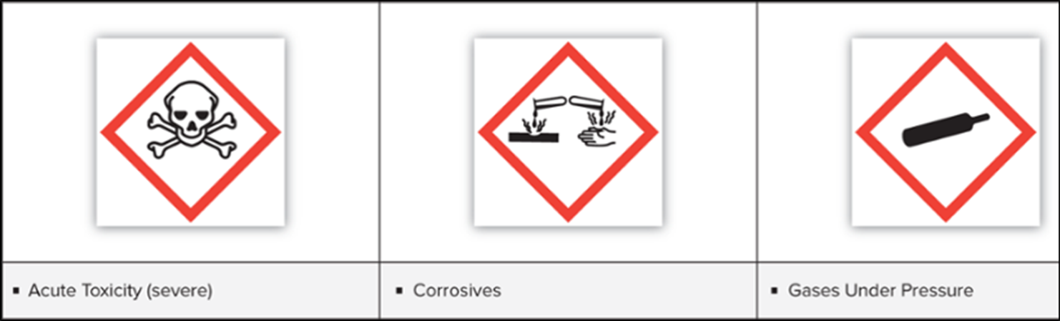
Globally Harmonized System (G H S) Pictograms and Hazard Classes 2
Access the text alternative for slide images.
Notes:
LO 2.2: Apply techniques to ensure the physical safety of healthcare workers and patients.
Notes:
Under the current HCS, the label must include the chemical’s identity and appropriate hazard warnings by displaying the following:
Harmonized signal word
Pictogram
Hazard statement
The label may also include a precautionary statement.
Signal word: Word such as “danger” or “warning” placed on a label to indicate the relative severity of the hazard
Pictogram: A symbol (including border and background color) that is intended to convey specific information about the hazards of a chemical
Hazard statement: Statement that describes the nature and degree of chemical hazard
Precautionary statement: Statement that lists measures to minimize or prevent adverse effects resulting from exposure to a hazardous chemical

Slide 27
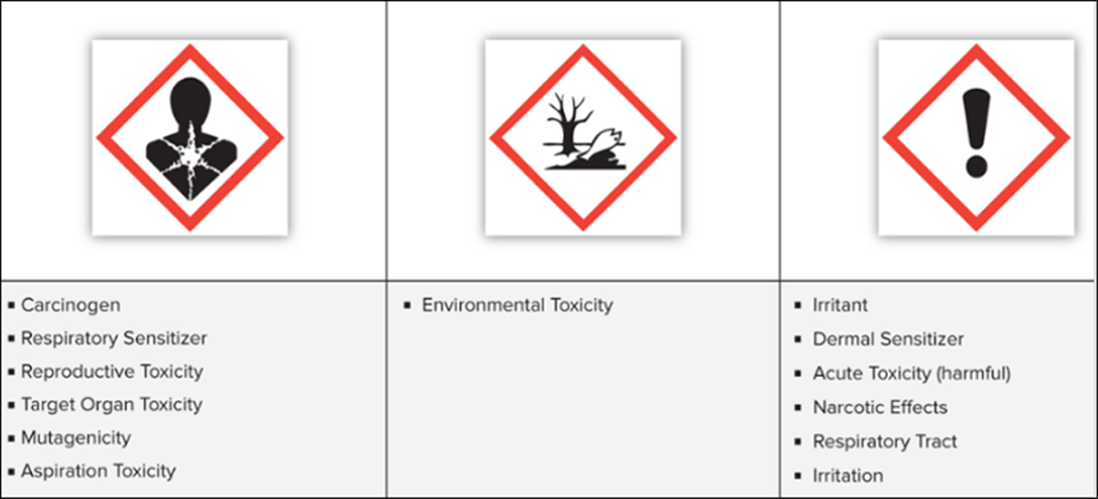
Globally Harmonized System (G H S) Pictograms and Hazard Classes 3
Access the text alternative for slide images.
Notes:
LO 2.2: Apply techniques to ensure the physical safety of healthcare workers and patients.

Slide 28
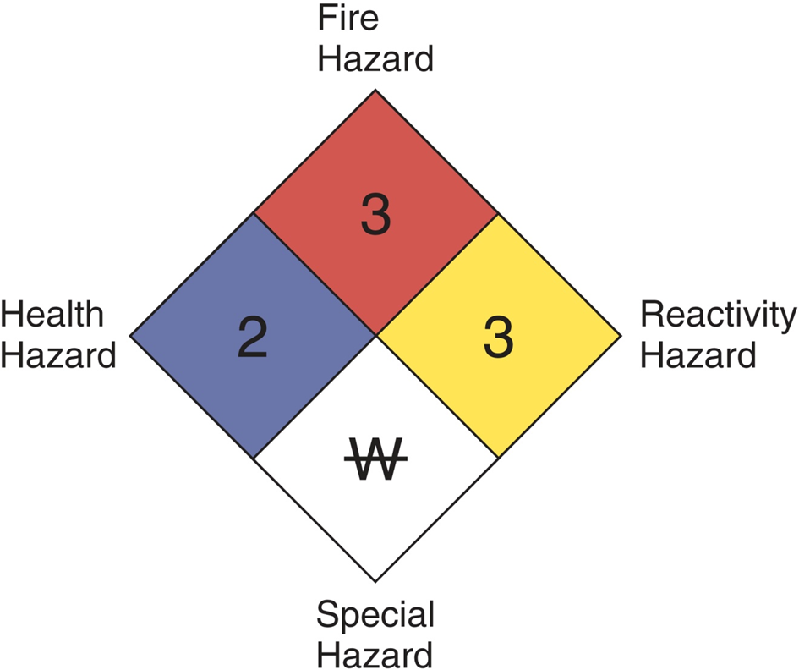
N F P A Diamond Hazard Symbol
Notes:
LO 2.2: Apply techniques to ensure the physical safety of healthcare workers and patients.
Notes:
NFPA: National Fire Protection Agency
The hazard identification system developed by the National Fire Protection Agency (NFPA):
Red (upper quadrant): Degree of flammability
Numbers represent relative flash point:
0 = will not burn
1 = not exceeding 200°F
2 = above 100°F
3 = below 100°F
4 = below 73°F
Blue (left middle quadrant): Level of health hazard
0 = no health concerns
1 = slightly hazardous
2 = hazardous
3 = extreme danger
4 = deadly

Slide 29
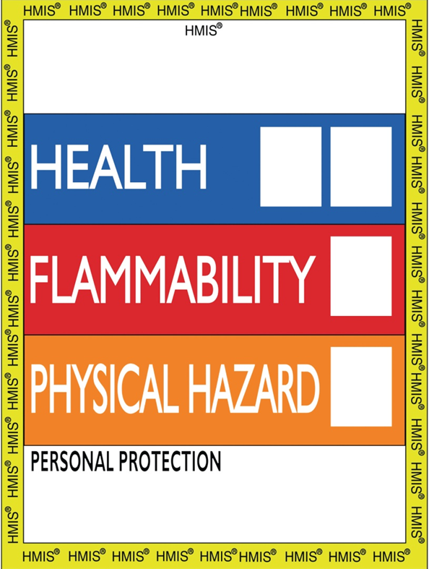
Hazardous Materials Identification System (H M I S)
Notes:
LO 2.2: Apply techniques to ensure the physical safety of healthcare workers and patients.
Notes:
HMIS refers to broader health warnings, not just emergencies. It is similar to the NFPA diamond colors, but the white bar conveys the type of protective equipment needed. Also, some newer labels have replaced yellow with orange.
Color meanings:
Blue: Level of hazard the chemical poses to health
Red: Chemical’s degree of flammability hazard
Yellow/orange: Chemical’s level of physical hazard
White: Types of personal protection needed

Slide 30

Chemical Hazards: Eyes
Use appropriate procedures if spill or splash occurs.
Emergency shower.
Emergency eyewash.
©McGraw-Hill Education/Sandra Mesrine, photographer
Notes:
LO 2.2: Apply techniques to ensure the physical safety of healthcare workers and patients.

Slide 31

O S H A Mandates
Healthcare facilities must develop and implement plans.
Chemical hygiene plan.
Biohazard exposure control plan.
Hazardous materials (H A Z M A T S) plan.
Employers must provide safety data sheets (S D S).
Notes:
LO 2.2: Apply techniques to ensure the physical safety of healthcare workers and patients.
Notes:
Safety data sheets were formerly called material safety data sheets (MSDS). Employers are required to provide an SDS for every chemical purchased by or kept in a facility.
Chemical hygiene plan: A plan that specifies practices to ensure safe handling of chemicals

Slide 32
Information on Safety Data Sheets (S D S)
Identification.
Hazard(s) identification.
Composition/information on ingredients.
First–aid measures.
Firefighting measures.
Accidental release measures.
Handling and storage.
Exposure controls/personal protection.
Physical and chemical. properties.
Stability and reactivity.
Toxicological information.
Ecological information.
Disposal considerations.
Transport information.
Regulatory information.
Other information, including date of preparation or last revision.
Notes:
LO 2.2: Apply techniques to ensure the physical safety of healthcare workers and patients.
Notes:
SDS must be available in print or on the company’s website.
Individual employees are responsible for knowing the location of the SDS for the chemicals they handle and for understanding what to do in case of spills or accidents.

Slide 33
Radioactive Hazards
Be aware of areas where radiation is used.
Safety precautions.
Limit exposure to source of radiation.
Keep a safe distance.
Use appropriate radiation shielding.
Notes:
LO 2.2: Apply techniques to ensure the physical safety of healthcare workers and patients.
Notes:
Radiation sources in the healthcare setting include:
Diagnostic imaging
Radiation therapy
Medical laboratories

Slide 34
Reporting Hazards
When an incident occurs, an incident report must be filed.
Follow facility’s procedures for reporting and filing.
Notes:
LO 2.2: Apply techniques to ensure the physical safety of healthcare workers and patients.

Slide 35
Emergency Preparedness
Providing safety for patients, personnel, and visitors is mandatory.
Maintain state of professional readiness for:
Weather disaster.
Bioterrorist attack.
Mass casualties.
Severe emergencies caused by chemicals, radiation, or fire.
Additional training may be required.
Notes:
LO 2.2: Apply techniques to ensure the physical safety of healthcare workers and patients.
Notes:
Radiation sources in the healthcare setting include:
Diagnostic imaging
Radiation therapy
Medical laboratories
Emergency preparedness: Readiness for response during times of crisis.

Slide 36



Signs, Symbols, and Labels: Biohazards
Indicates the actual or potential presence of a biohazard including equipment, containers, rooms, and materials that present a risk or potential risk.
The biohazard symbol is black. The background is typically fluorescent orange, orange–red, or other contrasting color.
Notes:
LO 2.2: Apply techniques to ensure the physical safety of healthcare workers and patients.
Notes:
Phlebotomists need to be familiar with common warning and safety information signs such as these.

Slide 37

Signs, Symbols, and Labels: Fire Safety
A fire extinguisher sign is placed at the location of the extinguisher. An exit sign like this one indicates the appropriate method of exit in case of a fire. Elevators and escalators are not typically in use during an emergency.
Notes:
LO 2.2: Apply techniques to ensure the physical safety of healthcare workers and patients.

Slide 38

Signs, Symbols, and Labels: First Aid and A E D
First aid and A E D signs are placed at the location of the equipment to make the equipment easier to find.
Notes:
LO 2.2: Apply techniques to ensure the physical safety of healthcare workers and patients.

Slide 39

Signs, Symbols, and Labels: Wash Your Hands
Hands should be washed frequently. This reminder is usually placed in locations where contamination to hands can occur and handwashing equipment is available nearby.
Notes:
LO 2.2: Apply techniques to ensure the physical safety of healthcare workers and patients.

Slide 40

Signs, Symbols, and Labels: Handicap
This symbol indicates the route a person with a disability should take. Consider this for patients who are unable to walk or need to avoid steps for any reason.
Notes:
LO 2.2: Apply techniques to ensure the physical safety of healthcare workers and patients.

Slide 41

Signs, Symbols, and Labels: Emergency Eyewash Station
An eyewash station is used when chemicals, blood, or other foreign items get in the eye.
Notes:
LO 2.2: Apply techniques to ensure the physical safety of healthcare workers and patients.

Slide 42

Signs, Symbols, and Labels: Radiation Hazard
Indicates radiation in use that is damaging to cells. Limit exposure or wear protective gear. If working in these areas, wear a film badge or dosimeter to measure amount of exposure.
Notes:
LO 2.2: Apply techniques to ensure the physical safety of healthcare workers and patients.

Slide 43
Emergency Code Colors and Plain Language Recommendations 1
Overhead Emergency Codes
Facility Alert
Incident / Event | Recommended Plain Language | Alternative Code
Evacuation | "Facility Alert + Evacuation + Descriptor (location)" | No color code: Use plain language only!
Plant facility system alert | Facility Alert + Descriptor (location) | No color code: language only
Fire | "Code Red + Descriptor (location)” "Code Orange + Descriptor (location)" | Code Red
Hazardous spill | -or- Facility Alert + Hazardous Spill + Descriptor (location) | Code Orange
Notes:
LO 2.2: Apply techniques to ensure the physical safety of healthcare workers and patients.
Notes:
RED: Procedures staff should follow to protect patients, visitors, themselves, and property from a confirmed or suspected fire.
BLUE: Facilitate the arrival of equipment and specialized personnel to the location of an adult medical emergency. Provide life support and emergency care.
PINK: Activate response to protect infants and children from removal by unauthorized persons, and identify the physical descriptions and actions of someone attempting to kidnap an infant from the medical facility.
GRAY: Activate facility and staff response when staff members are confronted by an abusive/assaultive person.
GREEN: Activate response to a bomb threat or the discovery of a suspicious package.

Slide 44
Emergency Code Colors and Plain Language Recommendations 2
Security Alert
Incident / Event | Recommended Plain Language | Alternative Code
Active shooter | "Security Alert + Active Shooter + Descriptor (location)" | No color code; Use plain language only
Armed, violent intruder | "Security Alert + Descriptor (threat/location)" | No color code; Use plain language only
Hostage situation | "Security Alert + Descriptor (threat/location)“ Code Gray + Descriptor (threat/location) -or- | No color code; Use plain language only
Need for security personnel | "Security Alert + Descriptor (threat/location)“ -or- "Security Alert + Security Assistance Needed + Descriptor (threat/location)“ "Code Pink + Descriptor (age) + Descriptor (threat/location)“ | Code Gray
Notes:
LO 2.2: Apply techniques to ensure the physical safety of healthcare workers and patients.
Notes:
RED: Procedures staff should follow to protect patients, visitors, themselves, and property from a confirmed or suspected fire.
BLUE: Facilitate the arrival of equipment and specialized personnel to the location of an adult medical emergency. Provide life support and emergency care.
PINK: Activate response to protect infants and children from removal by unauthorized persons, and identify the physical descriptions and actions of someone attempting to kidnap an infant from the medical facility.
GRAY: Activate facility and staff response when staff members are confronted by an abusive/assaultive person.
GREEN: Activate response to a bomb threat or the discovery of a suspicious package.

Slide 45
Emergency Code Colors and Plain Language Recommendations 3
Overhead Emergency Codes
Infant / child abduction | -or- Security Alert + Descriptor (threat/location) + Descriptor (age) "Code Pink + Descriptor (threat/location)" | Code Pink
Bomb threat | -or- Security Alert + Descriptor (threat/location) | Code Black
Medical Alert
Incident / Event | Recommended Plain Language | Alternative Code
Emergency Operations Plan Activation | -or- "Medical Alert + Mass Casualty / Disaster Scenario + Descriptor“ "Code Orange + Medical Decontamination (or Decontamination) + Descriptor (location)" | Code Green
Medical decontamination (Includes chemical and radiological exposure for small and large incidents) | -or- "Medical Alert + Medical Decontamination (or Decontamination) + Descriptor (location)“ "Code Blue + Location" | Code Orange
Medical emergency | -or- "Medical Alert + Medical Emergency + Location" | Code Blue
Notes:
LO 2.2: Apply techniques to ensure the physical safety of healthcare workers and patients.
Notes:
SILVER: Activate facility and staff response to event in which staff members are confronted by persons brandishing a weapon or who have taken hostages in the medical facility.
YELLOW: Identify unsafe exposure conditions, safely evacuate an area, and protect others from exposure due to a hazardous materials spill. Procedures to be performed in response to a minor or major spill.
ORANGE: Triage Internal: Activate response to incidents that require or may require significant support from several departments in order to continue patient care.
ORANGE: Triage External: Activate response to external emergencies that require or may require significant support from several departments in order to continue patient care.
BLACK: Code Edison: Activate response to a rolling power failure.

Slide 46
Simple Language Codes
Code | Replaces
Fire Alarm | Code Red
Cardiac Arrest | Code Blue
Infant/Child Abduction | Code Pink
Armed Intruder | Code Silver
Severe Weather Alert | Code Black
Notes:
LO 2.2: Apply techniques to ensure the physical safety of healthcare workers and patients.

Slide 47
Evacuation and Shelter-in-Place
Evacuation.
Facility maps.
Visible, clearly–marked exit routes.
Shelter–in–place.
Interior rooms.
Rooms with few or no windows.
Notes:
LO 2.2: Apply techniques to ensure the physical safety of healthcare workers and patients.
Notes:
Radiation sources in the healthcare setting include:
Diagnostic imaging
Radiation therapy
Medical laboratories

Slide 48
Chapter Summary
Safety practices include compliance with the Bloodborne Pathogens Standard, the Needlestick Safety and Prevention Act, and all other state and federal guidelines for preventing bloodborne and other diseases.
Physical hazards found in healthcare settings include exposure to allergy–causing equipment and supplies, including those containing latex; electrical and fire hazards; and exposure to hazardous chemicals and radiation.
Many hazards can be avoided by taking commonsense precautions.
Special training should be provided for fire safety, evacuation, and shelter–in–place events.
Notes:
LO 2.1: Implement safety practices to reduce the risk of infection from medical biohazards in compliance with state and federal standards and regulations.
LO 2.2: Apply techniques to ensure the physical safety of healthcare workers and patients.

Slide 49
End of Main Content
© McGraw Hill LLC. All rights reserved. No reproduction or distribution without the prior written consent of McGraw Hill LLC.

Slide 50
Accessibility Content: Text Alternatives for Images

Slide 51
Cleaning Up Biohazardous Spills – Text Alternative
Return to parent-slide containing images.
Spill care kit with contents displayed: biohazard bag, germicidal disposable wipes, antimicrobial wipes, plastic bag with tie, disposable plastic brush and dustpan, disposable gloves.
Return to parent-slide containing images.

Slide 52
Globally Harmonized System (G H S) Pictograms and Hazard Classes 1 – Text Alternative
Return to parent-slide containing images.
G H S pictograms show the following hazard classes. 1. Oxidizers. 2. Flammables, Self Reactives, Pyrophorics, Self-Heating, Emits Flammable Gas, Organic Peroxides. 3. Explosives, Self Reactives, Organic Peroxides.
Return to parent-slide containing images.

Slide 53
Globally Harmonized System (G H S) Pictograms and Hazard Classes 2 – Text Alternative
Return to parent-slide containing images.
Pictograms for acute toxicity, corrosives, and gases under pressure.
Return to parent-slide containing images.

Slide 54
Globally Harmonized System (G H S) Pictograms and Hazard Classes 3 – Text Alternative
Return to parent-slide containing images.
1. Carcinogen, Respiratory Sensitizer, Reproductive Toxicity, Target Organ Toxicity, Mutagenicity, Aspiration Toxicity. 2. Environmental Toxicity. 3. Irritant, Dermal Sensitizer, Acute Toxicity harmful, Narcotic Effects, Respiratory Tract, Irritation.
Return to parent-slide containing images.

