Slide 1
Infection Control
Chapter 3
©McGraw-Hill Education. All rights reserved. Authorized only for instructor use in the classroom. No reproduction or further distribution permitted without the prior written consent of McGraw-Hill Education.

Slide 2
Learning Outcomes
3.1 Identify the elements in the chain of infection and the ways in which disease can be transmitted.
3.2 Demonstrate knowledge of infection control practices and guidelines related to phlebotomy.
Notes:
Introduction:
All healthcare personnel must help to prevent infection by providing a clean environment while caring for patients. Doing so reduces the chances of infecting patients, visitors, and heathcare workers.

Slide 3
NAACLS Competencies
2.00 Demonstrate knowledge of infection control and safety.
2.1 Identify policies and procedures for maintaining laboratory safety.
2.2 Demonstrate accepted practices for infection control, isolation techniques, aseptic techniques, and methods for disease prevention
2.3 Comply with federal, state, and locally mandated regulations regarding safety practices.
2.4 Describe measures used to ensure patient safety in various patient settings, e.g., inpatient, outpatient, pediatrics, etc.

Slide 4
Key Terms
Aerosols
Airborne transmission
Bloodborne pathogens
Chain of infection
Contact transmission
Double-bagging
Droplet transmission
Fomite
Hand hygiene
Healthcare-associated infections (HAIs)
Isolation precautions
Occupational Safety and Health Administration (OSHA)
Personal protective equipment (PPE)
Sepsis
Standard precautions
Transmission-based precautions
Vector-borne transmission
Vehicle-borne transmission

Slide 5
Disease Transmission
Learning Outcome 3.1
©McGraw-Hill Education. All rights reserved. Authorized only for instructor use in the classroom. No reproduction or further distribution permitted without the prior written consent of McGraw-Hill Education.

Slide 6
Preventing Infections
Protecting the safety of patients, colleagues, and yourself is a key aspect of your health career.
To prevent infections acquired in a hospital or other medical setting, phlebotomists should be aware of all possible biohazards and must adhere to standards set by the Centers for Disease Control and Prevention (CDC).
Phlebotomists should be aware of various nonbiological hazards that may cause injury or illness to healthcare employees, patients, or visitors.
Notes:
LO 3.1 Identify the elements in the chain of infection and the ways in which each disease can be transmitted.
Notes:
As a phlebotomist, you should:
Adhere to CDC standards
Be aware of all possible biohazards
Be aware of all possible nonbiological hazards that may cause injury or illness to patients or the healthcare team

Slide 7
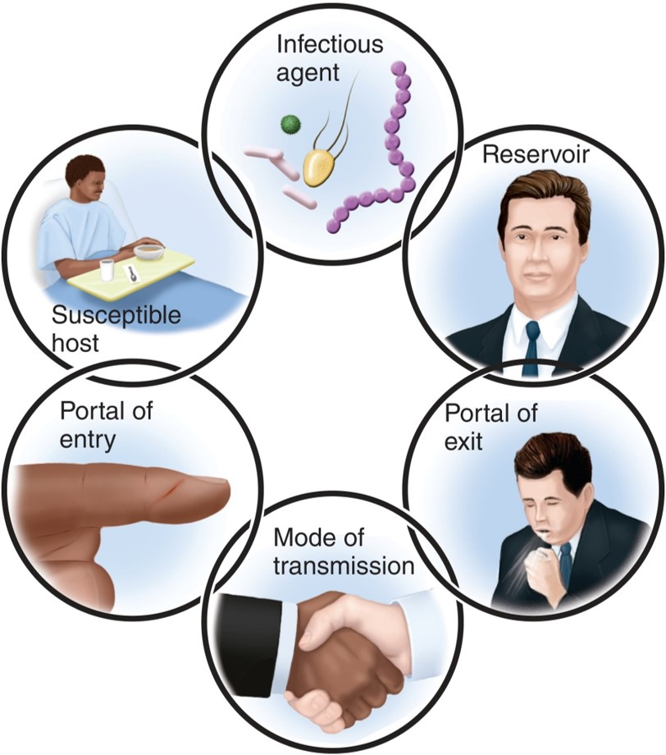
Breaking the Chain of Infection
The Six Links
Breaking the chain of infection at any of these links will prevent an infection from developing.
Copyright © McGraw-Hill Education
Notes:
LO 3.1 Identify the elements in the chain of infection and the ways in which each disease can be transmitted.
Notes:
Infectious agent: A disease-causing microorganism
Reservoir: Site where the organism grows and multiplies
Portal of exit: Skin, respiratory tract, gastrointestinal tract, eyes, ears, urinary tract, or reproductive tract
Mode of transmission: Direct or indirect contact, droplet, or air
Portal of entry: Break in skin, respiratory tract, eyes, ears, urinary tract, or reproductive tract that allows the pathogen to enter the body
Susceptible host: Anyone at risk for developing an infection from the pathogen

Slide 8
Contact Transmission
Direct contact
Person to person
Reservoir to susceptible host
Indirect contact
Fomite: contaminated item
Person to contaminated item to person
Notes:
LO 3.1 Identify the elements in the chain of infection and the ways in which each disease can be transmitted.
Notes:
Contact transmission occurs when a susceptible host comes in contact with a reservoir of pathogens.
Direct contact occurs when a susceptible host touches an infected person (reservoir) directly.
Indirect contact occurs when a susceptible host comes in contact with an item that has been handled by an infected person.
The most common cause of indirect contact transmission is failure of healthcare personnel to wash their hands and change gloves between patients.

Slide 9
Droplet Transmission
Droplets from an infected person are propelled short distances
Droplets are propelled by coughing, sneezing, breathing, and talking
Droplets are not suspended in air
Absorbed by susceptible host
Nasal mucosa
Mouth
Conjunctiva of eye
Notes:
LO 3.1 Identify the elements in the chain of infection and the ways in which each disease can be transmitted.
Notes:
Droplet transmission is a form of contact transmission that occurs when an infected person coughs, sneezes, or breathes near (usually within three feet of) a susceptible host or when infected blood or body fluid splashes onto a susceptible host during specimen handling. The droplets are not suspended in the air as they are in airborne transmission.
Diseases transmitted by droplet transmission include:
Influenza
Mumps
Rubella

Slide 10
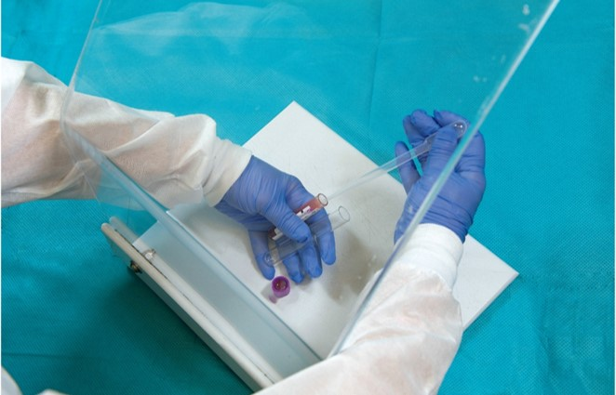
Airborne Transmission
Small particles carried on air currents and inhaled by hosts
Aerosols created during medication cap removal
Inhaled by susceptible host
Protection from aerosols
Using a shield
Wearing personal
protection equipment
©McGraw-Hill Education/Sandra Mesrine, photographer
Notes:
LO 3.1 Identify the elements in the chain of infection and the ways in which each disease can be transmitted.
Notes:
Airborne transmission is different from droplet transmission in that the particles that contain the pathogens are airborne and may be widely dispersed on air currents before reaching a susceptible host.
Airborne transmission can also occur when the top of a tube of infected blood or other body fluid is removed, creating an aerosol. Protection from aerosols during specimen handling includes wearing appropriate PPE and using a specimen shield.
Aerosols: tiny, airborne droplets of fluid that are often so small that they go unnoticed because you cannot smell or feel them, yet they can carry microorganisms
Diseases transmitted by airborne transmission include:
Legionnaire’s disease
Chickenpox
Shingles
Tuberculosis

Slide 11
Vehicle-Borne and Vector-Borne Transmission
Vehicle-Borne Transmission
Fomite comes in contact with contaminated item
Fomite is touched or ingested by susceptible host
Vector-Borne Transmission
Living host comes in contact with contaminated item
Living host carries and transmits disease to susceptible host
Notes:
LO 3.1 Identify the elements in the chain of infection and the ways in which each disease can be transmitted.
Notes:
Vehicle-borne transmission occurs when a fomite comes in contact with contaminated items, such as used dressings. The fomite then serves as the vehicle to transmit the disease to a susceptible host. To prevent vehicle-borne transmission, dispose of soiled dressings properly, and clean equipment thoroughly according to the facility’s policy.
Vector-borne transmission occurs when an insect, such as a mosquito, serves as an intermediate host. The pathogen survives inside the insect until it is transmitted to a susceptible host.
Diseases transmitted by vector-borne transmission include:
West Nile virus
Malaria

Slide 12
Drug-Resistant Bacteria
Clostridium difficile (C-diff)
Resistant to ciprofloxacin (Cipro) and levofloxacin (Levaquin)
Methicillin-resistant Staphylococcus aureus (MRSA)
Multidrug-resistant Acinetobacter baumannii (MDRAB)
Pseudomonas aeruginosa
Resistant to multiple drugs
Vancomycin-resistant enterococci (VRE)
Notes:
LO 3.1 Identify the elements in the chain of infection and the ways in which each disease can be transmitted.
Notes:
One of the most disturbing trends in recent years has been the increasing resistance of some pathogens to known antibiotics. Once acquired, infections caused by these pathogens are difficult to treat. For example, MRSA infection can lead to tissue loss and sepsis. Therefore, the best way to deal with these infections is to prevent them entirely.
Sepsis: A life-threatening response of the body to infection.
Ordinary precautions include:
Correct hand hygiene. Remember to use alcohol-based hand sanitizers only if there is no visible soilage on the skin.
Keeping nonintact skin covered with bandages until healed.
Wearing appropriate PPE when working with other people’s wounds or bandages.
Using a biohazard spill cleanup kit when blood or body fluid is spilled onto a surface.

Slide 13
Controlling Infection
Learning Outcome 3.2

Slide 14
Hospital-Acquired Infections (HAIs)
Previously known as nosocomial infections
Occur while patients are hospitalized or receiving treatments in any healthcare facility.
1 in every 25 patients will develop an HAI.
Notes:
LO 3.2 Demonstrate knowledge of infection control practices and guidelines related to phlebotomy.

Slide 15
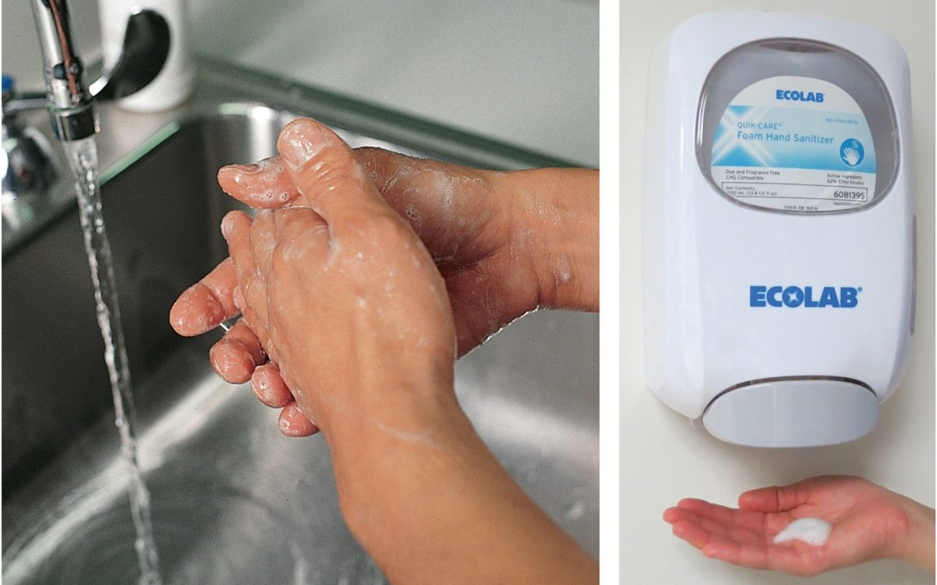
Hand Hygiene
Reduces risk of transmitting infection
Must be performed correctly
©McGraw-Hill Education/Jill Braaten, photographer/©Lillian Mundt
Notes:
LO 3.2 Demonstrate knowledge of infection control practices and guidelines related to phlebotomy.
Notes:
Hand hygiene: A general term that includes both handwashing and the use of alcohol-based hand rubs

Slide 16
Check Your Competency 3-1:
Hand Hygiene 1
Hand Washing
Remove all rings and jewelry
Turn on water and adjust temperature
to warm
Wet hands liberally with fingertips
pointing down; do not lean against
sink area
Apply soap and work up lather, using circular motions and friction and interlacing fingers to clean between them
Rinse each hand, allowing water to run from wrist to fingertips
Notes:
LO 3.2 Demonstrate knowledge of infection control practices and guidelines related to phlebotomy.
Notes:
Handwashing has been proven to be the most effective way to prevent the spread of infection.
Wash times:
Start of day: 2 minutes
Between patients or procedures on same patient: 20 seconds
When hands are soiled: 1 to 2 minutes

Slide 17
Check Your Competency 3-1:
Hand Hygiene 2
Hand Washing (Continued)
Use an orange stick or other tool to remove contamination from under fingernails
Repeat preceding steps if hands are very soiled
Thoroughly wash wrists
Dry hands thoroughly by patting with paper towels; discard towels without touching receptacle
Turn off water with clean, dry paper towel if indicated
Clean area using dry paper towels as needed
Notes:
LO 3.2 Demonstrate knowledge of infection control practices and guidelines related to phlebotomy.

Slide 18
Check Your Competency 3-1:
Hand Hygiene 3
Alcohol-Based Hand Rubs
Make sure there is no visible dirt or contamination
Apply ½ to 1 tsp alcohol cleanser to hands
Rub hands together vigorously, making sure all surfaces are covered, including backs and fronts of hands and between fingers
Continue rubbing until hands are dry
Notes:
LO 3.2 Demonstrate knowledge of infection control practices and guidelines related to phlebotomy.
Notes:
Advantages of Alcohol-Based Hand Rubs:
Alcohol-based hand rubs kill more effectively and more quickly than hand washing with soap and water when there is no visible contamination.
They are less damaging to the skin than soap and water, resulting in less skin irritation.
They require less time.
Dispensers can be placed in more accessible areas.

Slide 19
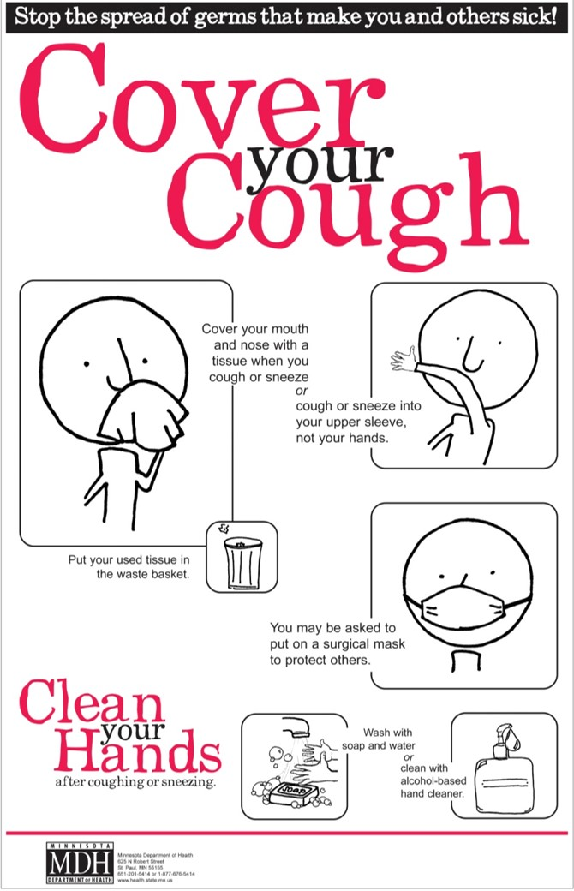
Respiratory Hygiene and Cough Etiquette Standard
Created by CDC
Applies to everyone
Jump to Respiratory Hygiene and Cough Etiquette Standard Appendix
"Cover Your Cough Poster for Health Care," Minnesota Department of Health, http://www.health.state.mn.us. Copyright © by MDH. All rights reserved. Used with permission.
Notes:
LO 3.2 Demonstrate knowledge of infection control practices and guidelines related to phlebotomy.

Slide 20
Personal Protective Equipment (PPE)
Order for Donning PPE
Order for Removing PPE
Gown
Mask
Goggles or face shield
Gloves
Gloves
Goggles or face shield
Mask
Gown
Notes:
LO 3.2 Demonstrate knowledge of infection control practices and guidelines related to phlebotomy.
Notes:
View the video, “Use of Personal Protective Equipment,” to understand how to use PPE correctly.

Slide 21
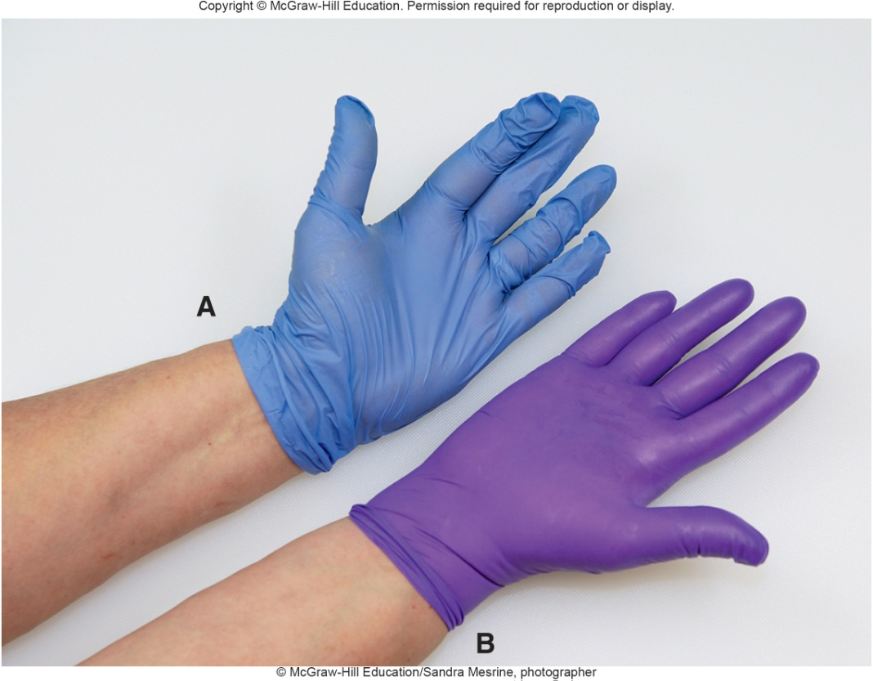
Personal Protective Equipment (PPE):
Gloves
Be sure to use gloves that fit you properly
Poorly fitting gloves can cause clumsy handling of equipment and a potential for biohazard exposure
Poorly fitting glove
Well-fitting glove
©McGraw-Hill Education/Sandra Mesrine, photographer
Notes:
LO 3.2 Demonstrate knowledge of infection control practices and guidelines related to phlebotomy.

Slide 22
Check Your Competency 3-2:
Donning and Removing PPE 1
Gloves
Wash your hands before putting on gloves
Remove gloves by using your (gloved) dominant hand to grasp the palm of the glove of your nondominant hand
Gently pull the glove off the nondominant hand, turning it inside out and holding it in your dominant hand
Encase the removed glove completely in the dominant
hand to prevent the spread of contaminants
Notes:
LO 3.2 Demonstrate knowledge of infection control practices and guidelines related to phlebotomy.
Notes:
Do not touch the outer, contaminated surfaces of the gloves with your ungloved hands during glove removal.

Slide 23
Check Your Competency 3-2:
Donning and Removing PPE 2
Gloves (continued)
Place the thumb or two fingers of the ungloved hand under the cuff of the remaining glove, being careful not to touch the contaminated outside of the glove with your bare hand
Pull the glove over your other hand, turning it inside out over the other glove, leaving none of the outside surface exposed
Throw the gloves away in the appropriate waste container
Wash your hands
Notes:
LO 3.2 Demonstrate knowledge of infection control practices and guidelines related to phlebotomy.
Notes:
Do not touch the outer, contaminated surfaces of the gloves with your ungloved hands during glove removal.

Slide 24
Check Your Competency 3-2:
Donning and Removing PPE 3
Gown
Put on a gown with the opening in the back
Secure at the neck and waist
Remove the gown by unfastening the ties
Peel the gown away from the neck and shoulder and do not touch the outside
Turn the contaminated gown outside toward the inside
Fold or roll the gown into a bundle
Discard the contaminated gown
Notes:
LO 3.2 Demonstrate knowledge of infection control practices and guidelines related to phlebotomy.

Slide 25
Check Your Competency 3-2:
Donning and Removing PPE 4
Mask
To put on the mask, place it over the nose, mouth and chin
Fit the flexible nose piece over the nose bridge
Secure the mask on the head with ties or elastic
Adjust the mask to fit
To remove the mask, untie the bottom, then top tie
Remove the mask from the face without touching the outside
Discard the mask
Notes:
LO 3.2 Demonstrate knowledge of infection control practices and guidelines related to phlebotomy.

Slide 26
Check Your Competency 3-2:
Donning and Removing PPE 5
Eye Protection
To remove goggles or face shield, grasp the ear or headpieces with ungloved hands
Lift them away from the face without touching the outside
Place in designated receptacle for reprocessing or disposal
Notes:
LO 3.2 Demonstrate knowledge of infection control practices and guidelines related to phlebotomy.

Slide 27
CDC Levels of Protection for Prevention of Nosocomial Infections (HAIs)
Standard Precautions
Isolation Precautions
Combines good hand hygiene and the use of gloves when workers are exposed to contaminated products
Based on how the infectious agent is transmitted:
Airborne
Droplet
Contact
Notes:
LO 3.2 Demonstrate knowledge of infection control practices and guidelines related to phlebotomy.
Notes:
Isolation and transmission-based precautions are the second level of precautions that are based upon on how infectious agents are transmitted.

Slide 28
Standard Precautions
First level of CDC-specified precautions
Good hand hygiene
Use of gloves when exposed to contamination
Formerly called universal precautions
Always follow standard precautions with every
patient when performing phlebotomy!
Notes:
LO 3.2 Demonstrate knowledge of infection control practices and guidelines related to phlebotomy.
Notes:
Standard precautions are similar to the older universal precautions, but universal precautions were applied only when blood was visible. Standard precautions are used whenever there is a chance of contact with nonintact skin, mucous membranes, blood, or any body fluid, secretion, or excretion, except sweat.
In addition to hand hygiene and wearing gloves, the CDC advises against artificial nails and recommends that natural nails be no longer than ¼ inch past the fingertips.

Slide 29
Isolation Precautions
Second level of CDC-specified precautions
Based on method of transmission
Wear required PPE
Never take phlebotomy equipment tray into isolation room
Take only equipment needed for draw
Remove only phlebotomy tubes after draw
Leave unused supplies in room
Double-bag contaminated waste and equipment before removal
Notes:
LO 3.2 Demonstrate knowledge of infection control practices and guidelines related to phlebotomy.
Notes:
Isolation precautions are used with patients who have or are suspected to have specific infections.
Isolation precautions vary with the method of possible transmission.
Airborne precautions: HEPA or N95 respirators
Droplet precautions: goggles and masks
Contact precautions: gloves and gowns
Protective environment (PE) precautions: gloves and gowns
Double-bagging is used to remove contaminated waste and equipment from an isolation room to avoid spreading pathogens.
One person, wearing PPE, is in the room and places all contaminated items in a biohazard-labeled bag and closes the bag.
The second person, also wearing appropriate PPE, stands in the doorway to the room, holding a second biohazard-labeled bag wide open.
The first person carefully places the first bag into the second bag without contaminating the outside of the second bag.
The second person closes the second bag and transports it to the disposal area.

Slide 30
Chapter Summary
The chain of infection consists of the infectious agent, reservoir, portal of exit, mode of transmission, portal of entry, and susceptible host.
Modes of transmission include contact, droplet, airborne, vehicle-borne, and vector-borne transmission.
Infection control practices include using appropriate hand hygiene, following respiratory hygiene and cough etiquette, wearing personal protective equipment (PPE), following standard precautions, and following appropriate isolation precautions when indicated.
Notes:
LO 3.1: Identify the elements in the chain of infection and the ways in which disease can be transmitted.
LO 3.2: Demonstrate knowledge of infection control practices and guidelines related to phlebotomy.

Slide 31
Appendix Slides

Slide 32
Respiratory Hygiene and Cough Etiquette Appendix
“Cover Your Cough” poster
Stop the spread of germs that make you and others sick!
Cover your mouth and nose with a tissue when you cough or sneeze, OR cough or sneeze into your upper sleeve, not your hands.
Put your used tissue in the waste basket.
You may be asked to put on a surgical mask to protect others.
Wash with soap and water OR clean with alcohol-based hand cleaner.
Clean your hands after coughing or sneezing.
Jump to Respiratory Hygiene and Cough Etiquette

