Slide 1
Medical Terminology and Abbreviations
Chapter 4
©McGraw-Hill Education. All rights reserved. Authorized only for instructor use in the classroom. No reproduction or further distribution permitted without the prior written consent of McGraw-Hill Education.

Slide 2
Learning Outcomes
4.1 Recognize medical prefixes, word roots, and suffixes to build commonly used medical terms.
4.2 Define common medical abbreviations.
4.3 Explain body position, direction, and parts using medical terms.
Notes:
Introduction:
This chapter presents the basic principles on which medical words are formed. Phlebotomists need to understand the medical terminology that pertains to phlebotomy, as well as abbreviations they will encounter in the workplace.

Slide 3
NAACLS Competencies
1.00 Demonstrate knowledge of the healthcare delivery system and medical terminology.
1.7 Use common medical terminology.
3.00 Demonstrate basic understanding of the anatomy and physiology of body systems and anatomic terminology in order to relate major areas of the clinical laboratory to general pathologic conditions associated with the body systems.

Slide 4
Key Terms 1
Abdominopelvic
Anatomical position
Anatomy
Anterior
Atoms
Brachial
Caudal plane
Cells
Combining vowel
Coronal
Cranial
Deep
Deoxyribonucleic acid (DNA)
Diaphragm
Distal
Dorsal
Electrolytes
Femoral
Frontal plan
Inferior

Slide 5
Key Terms 2
Lateral
Medial
Midsagittal plane
Molecules
Organelles
Organism
Organs
Physiology
Posterior
Prefix
Prone
Proximal
Ribonucleic acid (RNA)
Sagittal plane
Suffix
Superficial
Supine
Thoracic

Slide 6
Key Terms 32
Tissues
Transverse plane
Ventral
Word root

Slide 7
Medical Language
Learning Outcome 4.1

Slide 8

Basis of Medical Language
Formed from Greek and Latin words
Basic word parts
Word root
Suffix
Prefix
Combining vowel
Copyright © McGraw-Hill Education
Notes:
LO 4.1 Recognize medical prefixes, word roots, and suffixes to build commonly used medical terms.
Notes:
At first, medical terminology may seem like a foreign language because many words are formed from Greek and Latin words. However, once you learn the basic word parts and understand how they fit together to form words, you will be able to “decode” or figure out the meaning of many medical words quickly, including words you have never seen before.
Basic word parts:
Word root: The basic meaning of the word
Suffix: Placed at the end of the word root to alter its meaning and sometimes to alter the part of speech (for example, adding the suffix “-al” to the end of the word root “neuron” changes the noun “neuron” into an adjective that modifies another word)
Prefix: Placed before the word root to modify its meaning
Combining vowel: A vowel added between other word parts to make the word easier to pronounce; combining vowels do not change the meaning of the word

Slide 9
Decoding Medical Words
Start by finding the meaning of the suffix
Add the meaning of the word root
Add the meaning of the prefix
Notes:
LO 4.1 Recognize medical prefixes, word roots, and suffixes to build commonly used medical terms.
Notes:
To decode the meaning of a medical word, find the meaning of each word part that makes up the word. In many cases, it is easiest to start with the meaning of the suffix. You will quickly become familiar with common suffixes, such as:
-al: pertaining to
-itis: inflammation of
-logy: knowledge or study of
-osis: condition
-tomy: to cut into
-cyte: cell
Next, add the meaning of the word root.
Finally, add the meaning of the prefix. You will quickly become familiar with common prefixes, such as:
pre-: before
post-: after
leuk-: white
tachy-: rapid
hypo-: below
hyper-: above

Slide 10
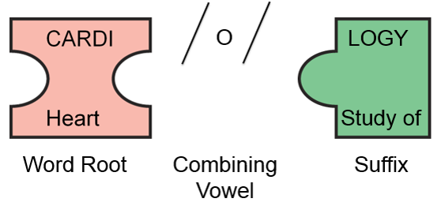
Decoding Example 1
Cardiology: Knowledge or study of the heart
Decoding Example 1 Appendix
Copyright © McGraw-Hill Education
Notes:
LO 4.1 Recognize medical prefixes, word roots, and suffixes to build commonly used medical terms.
Notes:
To decode the word cardiology, begin by determining that the suffix -logy means “study or knowledge of.”
Next, recall that the word root cardi/o means heart.
So, cardiology means “study or knowledge of the heart.”

Slide 11
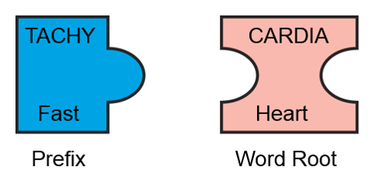
Decoding Example 2
Tachycardia: Rapid heart rate
Decoding Example 2 Appendix
Copyright © McGraw-Hill Education
Notes:
LO 4.1 Recognize medical prefixes, word roots, and suffixes to build commonly used medical terms.
Notes:
The word tachycardia does not have a suffix, so start with the word root. As you know, cardi/o means “heart.”
The prefix tachy- means “fast.”
Therefore, tachycardia means “rapid heart rate.”

Slide 12
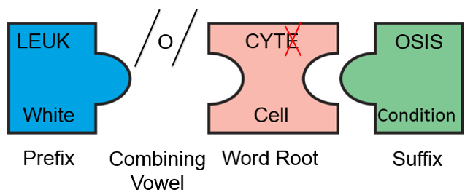
Decoding Example 3
Leukocytosis: Condition of increased white blood cells
Decoding Example 3 Appendix
Copyright © McGraw-Hill Education
Notes:
LO 4.1 Recognize medical prefixes, word roots, and suffixes to build commonly used medical terms.
Notes:
The word leukocytosis has all four word parts: a prefix, combining vowel, word root, and suffix.
Start with the suffix: -osis means “condition.”
Next, look at the word root, cyte, which means “cell.” Now you know that this word refers to a condition that involves cells. Notice that in this word, the “e” in cyte is dropped to make the word easier to pronounce.
Finally, recall that the prefix leuk- means “white.”
Leukocytosis is a condition of increased white blood cells.

Slide 13
Phlebotomy Terminology: Prefix Examples
a- Aseptic
ante- Antecubital
anti- Anticoagulant
cyan- Cyanosis / Cyanotic
epi- Epidermis
per- Percutaneous
post- Postprandial
sub- Subcutaneous
Notes:
LO 4.1 Recognize medical prefixes, word roots, and suffixes to build commonly used medical terms.
Notes:
To decode the meaning of a medical word, find the meaning of each word part that makes up the word. In many cases, it is easiest to start with the meaning of the suffix. You will quickly become familiar with common suffixes, such as:
-al: pertaining to
-itis: inflammation of
-logy: knowledge or study of
-osis: condition
-tomy: to cut into
-cyte: cell
Next, add the meaning of the word root.
Finally, add the meaning of the prefix. You will quickly become familiar with common prefixes, such as:
pre-: before
post-: after
leuk-: white
tachy-: rapid
hypo-: below
hyper-: above

Slide 14
Phlebotomy Terminology: Suffix Examples
-algia Neuralgia
-emia Hypoglycemia
-ist Phlebotomist
-lysis Glycolosis
-ous Infectious
-stasis Hemostasis
-otomy Phlebotomy
-ule Venule
Notes:
LO 4.1 Recognize medical prefixes, word roots, and suffixes to build commonly used medical terms.
Notes:
To decode the meaning of a medical word, find the meaning of each word part that makes up the word. In many cases, it is easiest to start with the meaning of the suffix. You will quickly become familiar with common suffixes, such as:
-al: pertaining to
-itis: inflammation of
-logy: knowledge or study of
-osis: condition
-tomy: to cut into
-cyte: cell
Next, add the meaning of the word root.
Finally, add the meaning of the prefix. You will quickly become familiar with common prefixes, such as:
pre-: before
post-: after
leuk-: white
tachy-: rapid
hypo-: below
hyper-: above

Slide 15
Medical Abbreviations
Learning Outcome 4.2

Slide 16
Purpose of Medical Abbreviations
Help shorten information to be recorded
Medical records
Prescriptions
Medical orders
Bills for medical procedures
Notes:
LO 4.2 Define common medical abbreviations.
Notes:
The use of medical abbreviations is a time-saving device that shortens the amount of information to be recorded in various medical documents. Abbreviations also shorten long terms so that they can be read at a glance by healthcare professionals.
However, many of the abbreviations that were used in the past were unclear or could easily be mistaken for other abbreviations. Therefore, you should use only those abbreviations that have been approved by your facility. If you do not know the correct abbreviation for a word or term, do not guess. When you are in doubt, write out the full term.

Slide 17
Error-Prone Abbreviations
Some abbreviations are prone to misinterpretation.
TJC and ISMP have created a list of these abbreviations
Only use abbreviations approved by your facility
“When in doubt, write it out”
Notes:
LO 4.2 Define common medical abbreviations.
Notes:
The Joint Commission (TJC) and the Institute for Safe Medication Practice (ISMP) have identified abbreviations that should not be used in healthcare settings. For a complete list of error-prone abbreviations, go to www.ismp.org.

Slide 18
Common Abbreviations
NPO (“nil per os”): nothing by mouth
CBC: complete blood count
WBC: white blood cell count
ABG: arterial blood gases
BMP: basic metabolic panel
LDL: low-density lipoprotein
HDL: high-density lipoprotein
Notes:
LO 4.2 Define common medical abbreviations.
Notes:
Refer to the Abbreviations and Symbols Commonly Used in Medical Notations appendix in the textbook for a more complete list of abbreviations and symbols used in medical practice.

Slide 19
Anatomical Terminology
Learning Outcome 4.3

Slide 20
Anatomy and Physiology
Anatomy
Scientific study of body structure
Normal positions of body parts
Physiology
Function of the body’s organs
Notes:
LO 4.3 Explain body position, direction, and parts using medical terms.
Notes:
Phlebotomists must have a good understanding of human anatomy and physiology. For example, they must know the positions of the veins and arteries at the common phlebotomy sites.

Slide 21
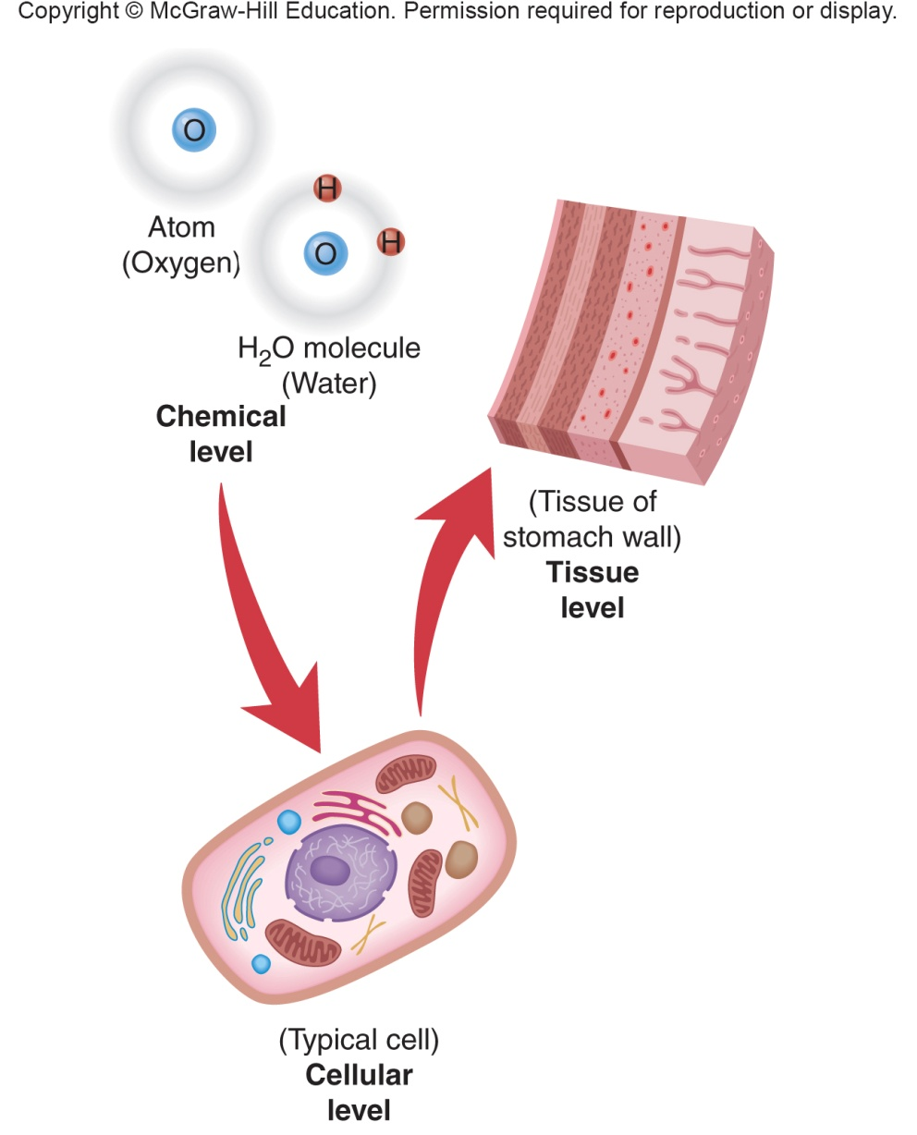
Organization of the Body 1
Organization of the Body 1 Appendix
Copyright © McGraw-Hill Education
Notes:
LO 4.3 Explain body position, direction, and parts using medical terms.
Notes:
Atoms: The simplest units of all matter
Molecules: Units of matter made up of at least two atoms
Organelles: Cell parts
Cells: The smallest living units in the body
Tissues: Cells of the same type organized together

Slide 22
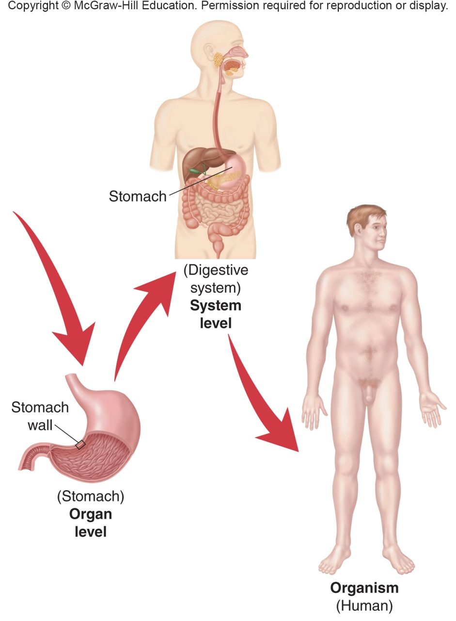
Organization of the Body 2
Organization of the Body 2 Appendix
Copyright © McGraw-Hill Education
Notes:
LO 4.3 Explain body position, direction, and parts using medical terms.
Notes:
Organs: Two or more tissue types working together
Organ systems: Two or more organs working together
Organism: Two or more organ systems working together

Slide 23
Four Types of Body Tissue
Epithelial tissue
Skin
Linings for body passages
Connective tissue
Supports and binds other tissues
Nervous tissue
Carries information to and from body parts
Muscle tissue
Striated
Smooth
Moves body parts
Notes:
LO 4.3 Explain body position, direction, and parts using medical terms.

Slide 24
Electrolytes
Substances that release ions
Most commonly sodium (Na+), potassium (K+), chloride (Cl-), and carbon dioxide (CO2)
Regulate or trigger physiologic changes
Essential for
Fluid balance
Muscle contraction
Nerve impulse conduction
Notes:
LO 4.3 Explain body position, direction, and parts using medical terms.
Notes:
Ions: Positively or negatively charged particles.
Electrolytes: substances that release ions when put into water.

Slide 25
Genetics
Control body processes
Cell differentiation
Growth and development
Deoxyribonucleic acid (DNA)
Ribonucleic acid (RNA)
Genes
Genetic disorders
Notes:
LO 4.3 Explain body position, direction, and parts using medical terms.
Notes:
Deoxyribonucleic acid (DNA) holds the genetic code that contains all the information needed for all body processes. Ribonucleic acid (RNA) helps cells translate DNA messages and prompts the cells to perform various tasks. Sequences of DNA and RNA that code for a specific type of protein or function are known as genes.
Genetic disorders are caused by altered forms of genes and may be inherited or may occur randomly or as a result of environmental exposure to a carcinogen.

Slide 26
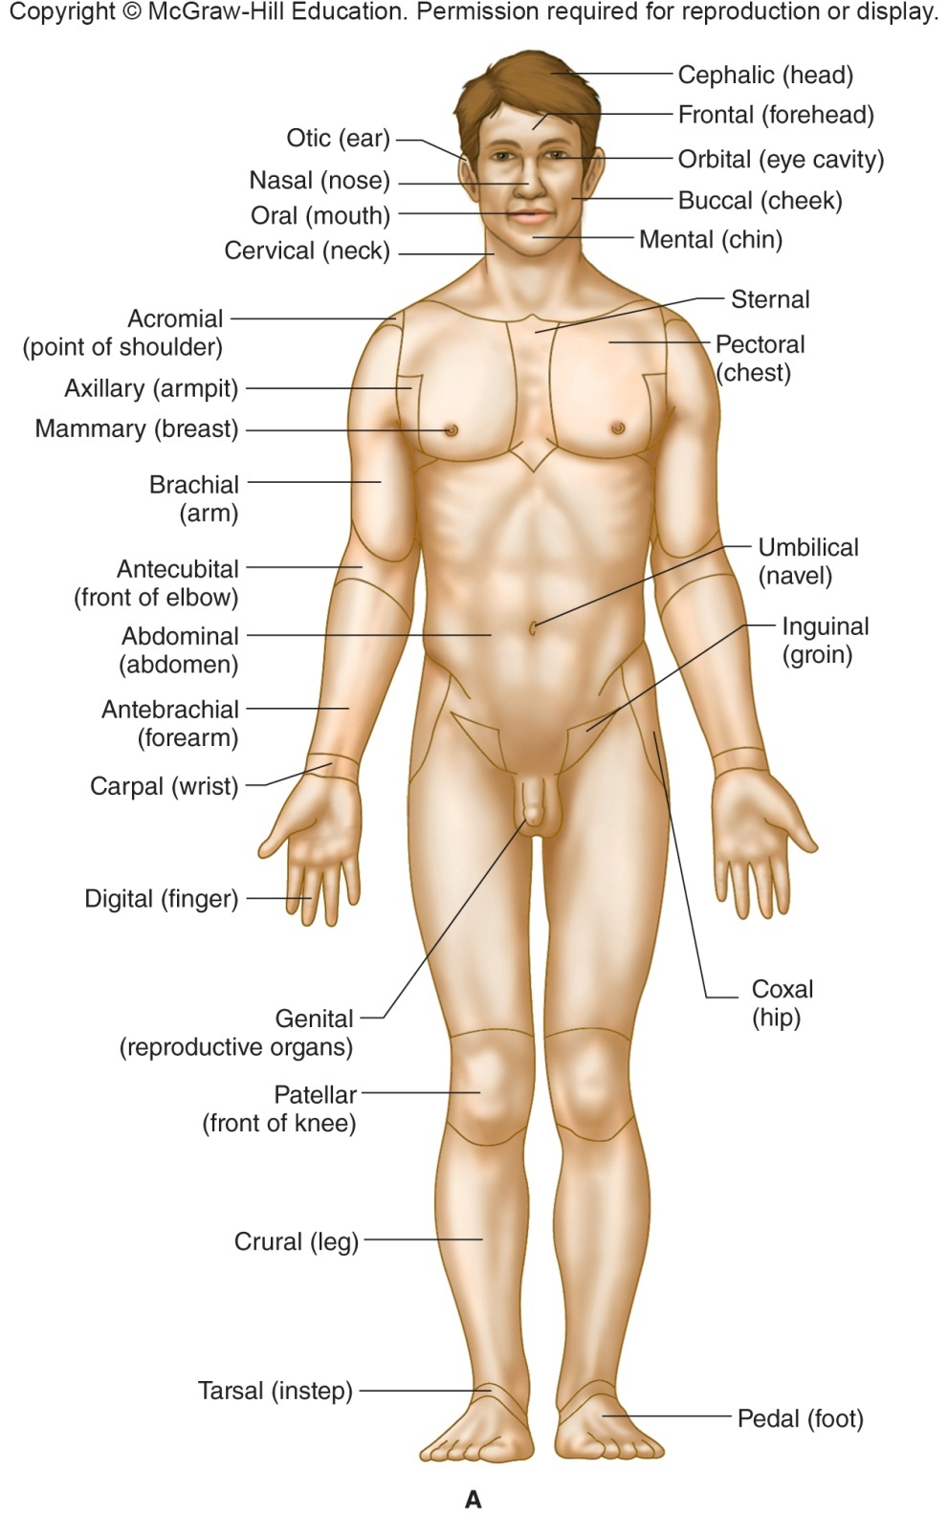
Anatomical Terms
Anatomical position
Standing upright
Facing forward
Arms at sides of body
Palms facing forward
Anatomical Terms Appendix
Copyright © McGraw-Hill Education
Notes:
LO 4.3 Explain body position, direction, and parts using medical terms.
Notes:
Anatomical terms describe the location of body parts and regions. For consistency when using anatomical terms, assume that the body is in the anatomical position.
Refer to patients as if they were in the anatomical position even when they are in other positions, such as lying prone (face down) or supine (face up).
(Note: The terms on the slide may be too small to read. See Figure 4-3 in the textbook for more detail.)

Slide 27
Directional Terms 1
Term | Definition | Example
Superior (cranial) | Above or close to the head | The thoracic cavity is superior to the abdominal cavity.
Inferior (caudal) | Below or closer to the feet | The neck is inferior to the head.
Anterior (ventral) | Toward the front of the body | The nose is anterior to the ears.
Posterior (dorsal) | Toward the back of the body | The brain is posterior to the eyes.
Medial | Close to the midline of the body | The nose is medial to the ears.
Lateral | Farther away from the midline of the body | The ears are lateral to the nose.
Proximal | Close to a point of attachment or to the trunk of the body | The knee is proximal to the toes.
Notes:
LO 4.3 Explain body position, direction, and parts using medical terms.

Slide 28
Directional Terms 2
Term | Definition | Example
Distal | Farther away from a point of attachment or from the trunk of the body | The fingers are distal to the elbow.
Superficial | Close to the surface of the body | Skin is superficial to muscles.
Deep | More internal | Bones are deep to the skin.
Notes:
LO 4.3 Explain body position, direction, and parts using medical terms.

Slide 29
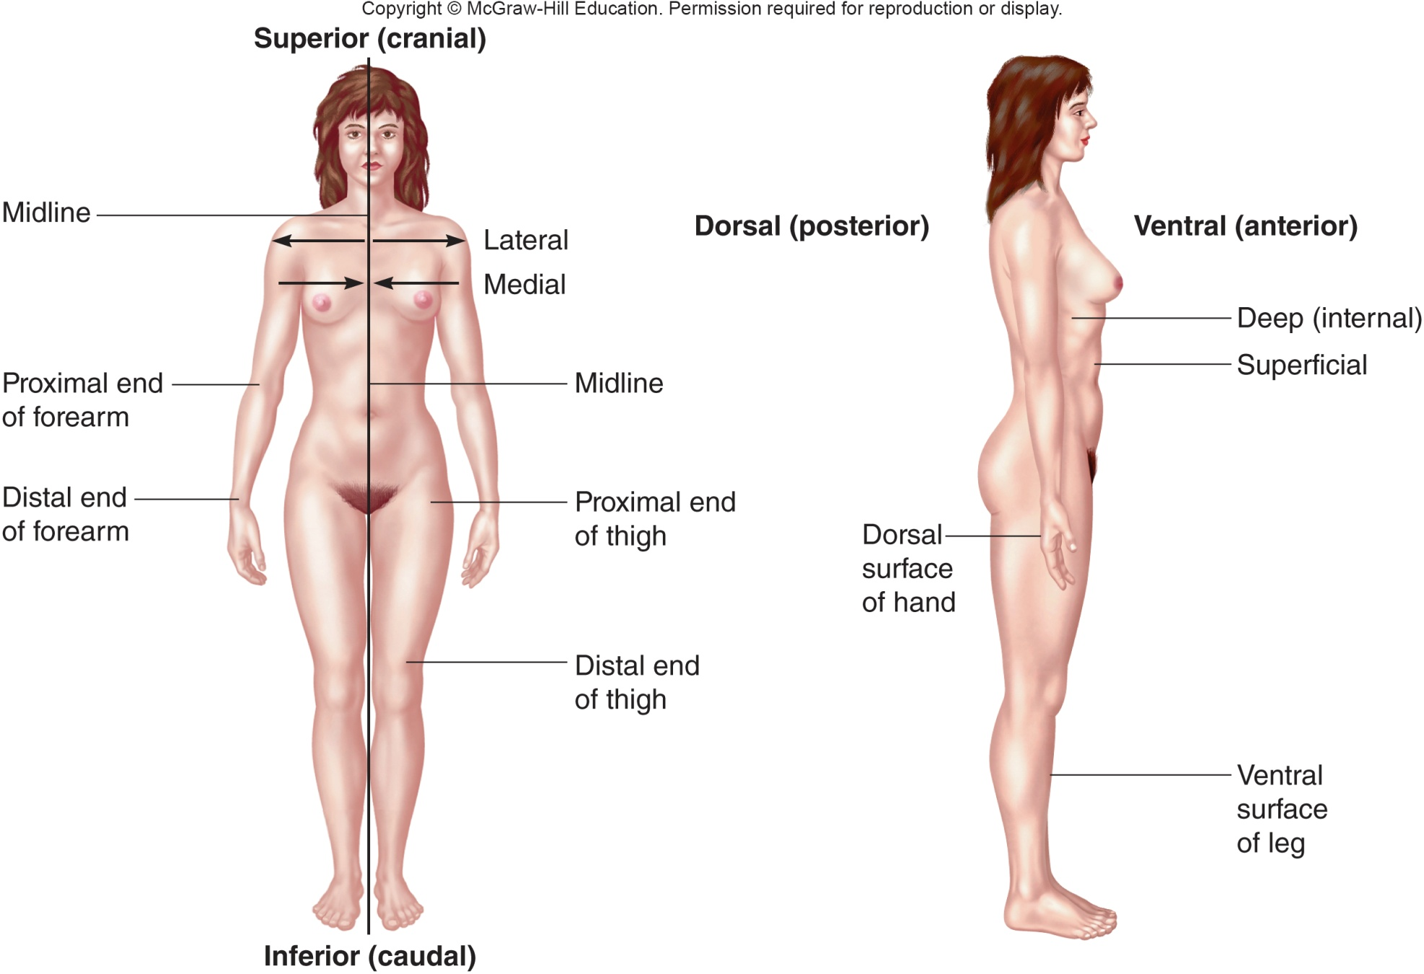
Directional Terms 3
Directional Terms 3 Appendix
Copyright © McGraw-Hill Education
Notes:
LO 4.3 Explain body position, direction, and parts using medical terms.
Notes:
Superior (cranial): Above or toward the head
Midline: Imaginary line running vertically from head to toe at the midpoint of the body
Proximal: Closer to the point of attachment or toward the trunk of the body
Distal: Away from the point of attachment or farther from the trunk of the body
Inferior (caudal): Below or toward the feet
Lateral: Away from the middle of the body
Medial: Close to the middle of the body
Dorsal (posterior): Pertaining to the backside
Ventral (anterior): Toward the front of the body
Deep: Internally; away from the surface of the body
Superficial: Close to the surface of the body
Deep: More internal
(Note: If the terms on the slide are too small to read, refer to Figure 4-4 in the textbook.)

Slide 30
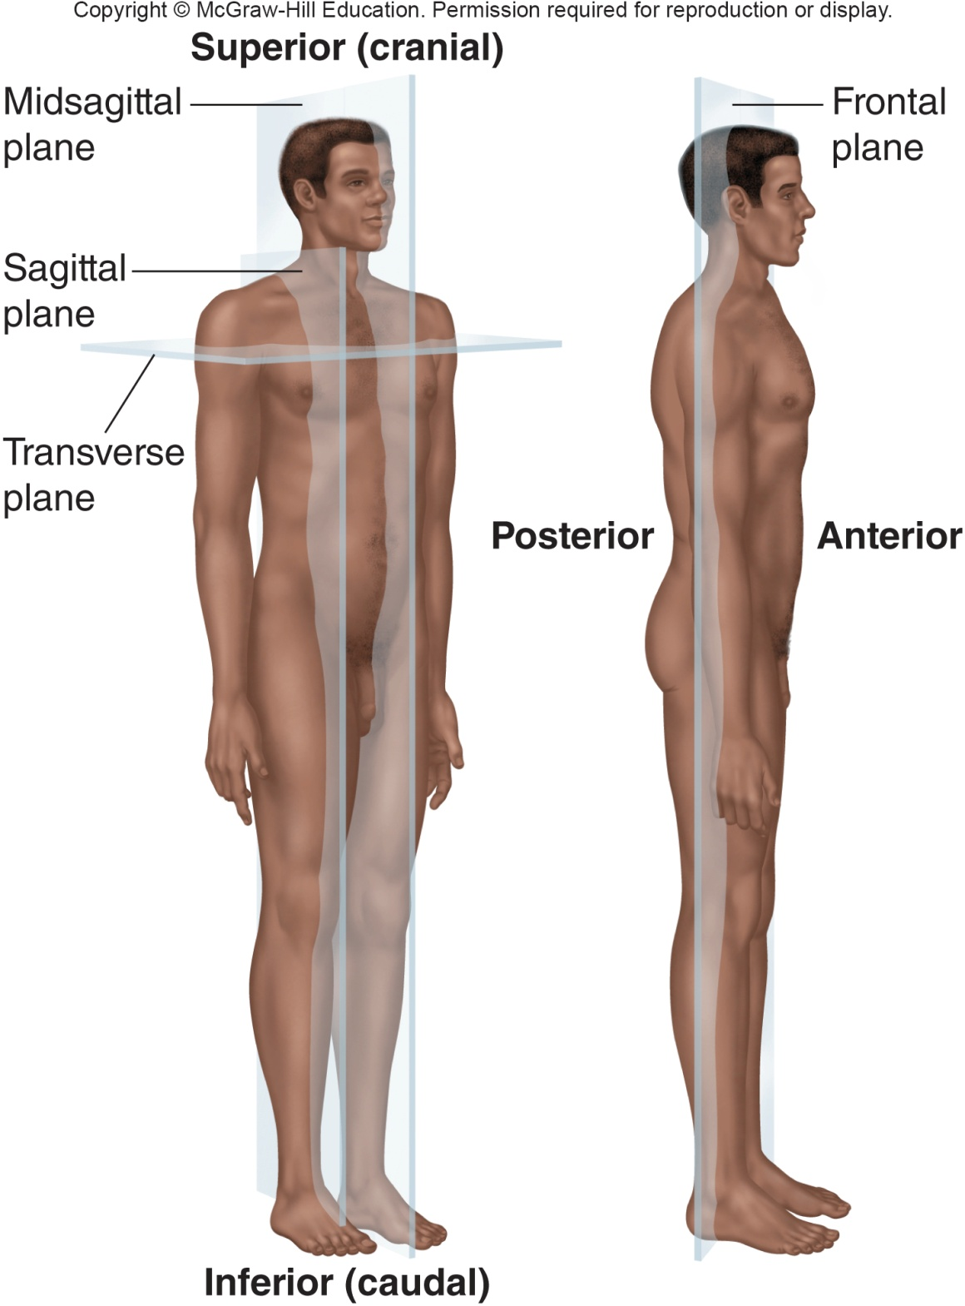
Anatomical Planes
Anatomical Planes Appendix
Copyright © McGraw-Hill Education
Notes:
LO 4.3 Explain body position, direction, and parts using medical terms.
Notes:
Sagittal plane: Divides the body into left and right portions
Midsagittal plane: Runs lengthwise down the midline of the body and divides it into equal left and right halves
Transverse plane: Divides the body into superior and inferior portions
Frontal plane: Divides the body into anterior (frontal) and posterior (rear) portions; note that another term for the frontal plane is Coronal plane
(Note: If the terms on the slide are too small to read, refer to Figure 4-5 in the textbook.)

Slide 31
Regions of the Body
Most bones, muscles, blood vessels, and nerves have specific names.
Regions are often named for the body parts near them.
Examples:
Brachial
Femoral
Digital
Cervical
Notes:
LO 4.3 Explain body position, direction, and parts using medical terms.
Notes:
Brachial refers to the arm.
Femoral refers to the thigh or the femur bone.
Digital refers to the fingers or toes.
Cervical refers to the neck.
See Figure 4-3 for more terms that are used to describe regions of the body.

Slide 32
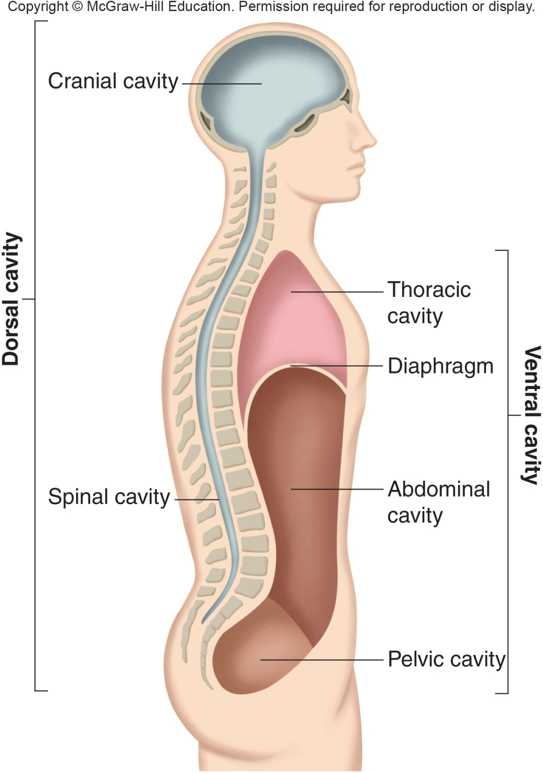
Body Cavities
Dorsal cavity
Cranial cavity
Spinal cavity
Ventral cavity
Thoracic cavity
Abdominopelvic cavity
Body Cavities Appendix
Copyright © McGraw-Hill Education
Notes:
LO 4.3 Explain body position, direction, and parts using medical terms.
Notes:
The dorsal and ventral cavities are the two largest body cavities.
The dorsal cavity contains the brain and spinal cord and is further divided into the cranial and spinal cavities.
The ventral cavity contains the thoracic and abdominopelvic cavities. These cavities are separated by the diaphragm. The abdominopelvic cavity is further divided into the abdominal cavity and the pelvic cavity.

Slide 33
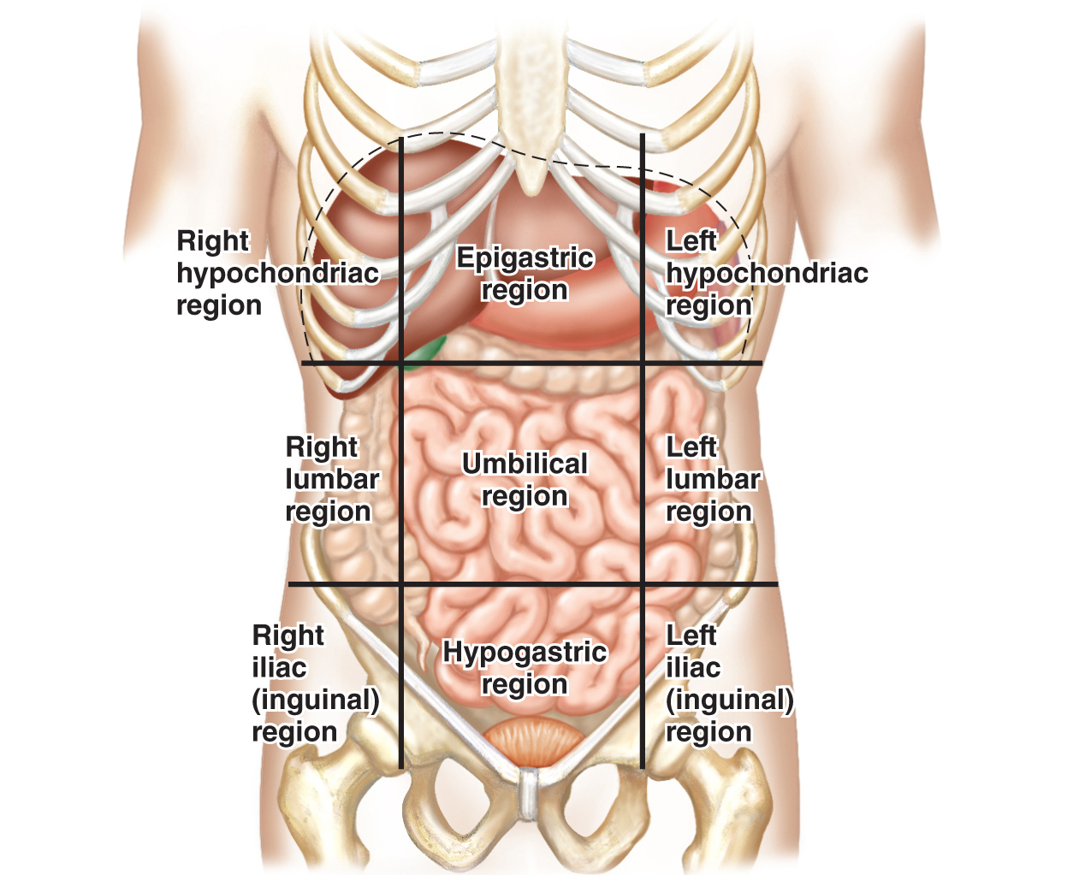
Abdominal Regions: Nine Divisions
Abdominal Regions: Nine Divisions Appendix
Copyright © McGraw-Hill Education
Notes:
LO 4.3 Explain body position, direction, and parts using medical terms.
Notes:
It is often necessary to specify a specific area of the abdominopelvic cavity. Healthcare professionals use standard regions to describe nine different regions. The regions are arranged similar to a tic-tac-toe board, as shown. The regions are:
Right hypochondriac region
Epigastric region
Left hypochondriac region
Right lumbar region
Umbilical region
Left lumbar region
Right iliac (inguinal) region
Hypogastric region
Left iliac (inguinal) region
Remember that the “right” and “left” refer to the patient’s right and left.

Slide 34
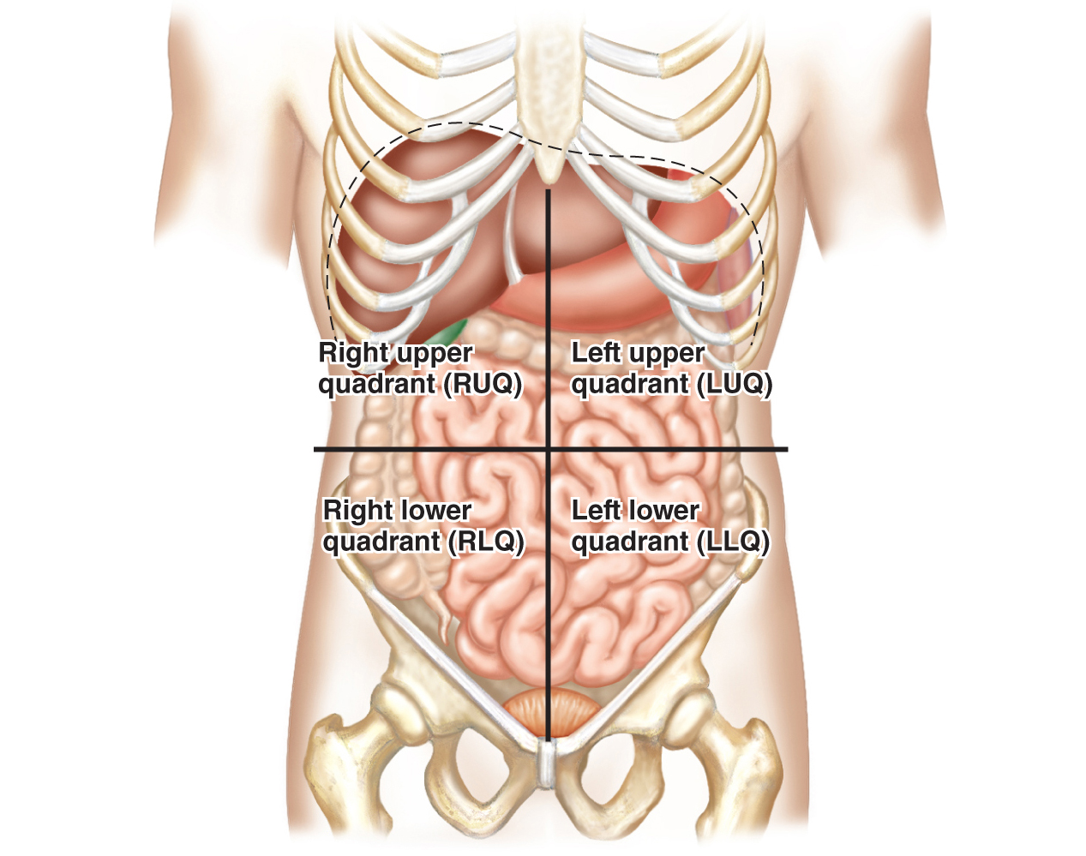
Abdominal Regions: Four Divisions
Abdominal Regions: Four Divisions Appendix
Copyright © McGraw-Hill Education
Notes:
LO 4.3 Explain body position, direction, and parts using medical terms.
Notes:
It is often necessary to specify a specific area of the abdominopelvic cavity. Healthcare professionals use standard regions to describe nine different regions. The regions are arranged similar to a tic-tac-toe board, as shown. The regions are:
Right hypochondriac region
Epigastric region
Left hypochondriac region
Right lumbar region
Umbilical region
Left lumbar region
Right iliac (inguinal) region
Hypogastric region
Left iliac (inguinal) region
Remember that the “right” and “left” refer to the patient’s right and left.

Slide 35
Chapter Summary
Medical terminology comes from Greek and Latin words.
Medical words consist of a word root, a prefix and/or suffix, and sometimes a combining vowel.
Abbreviations and symbols help shorten and simplify the information communicated in medical settings.
Certain abbreviations are prone to errors and should not be used.
Specific anatomical medical terms are used to identify body parts, planes, and positions.
Notes:
LO 4.1 Recognize medical prefixes, word roots, and suffixes to build commonly used medical terms.
LO 4.2 Define common medical abbreviations.
LO 4.3 Explain body position, direction, and parts using medical terms.

Slide 36
Appendix Slides

Slide 37
Decoding Example 1 Appendix
Two interlocking puzzle pieces. Puzzle piece on the left contains the words C-A-R-D-I and Heart and is labeled Word Root. Puzzle piece on the right contains the words L-O-G-Y and Study of and is labeled Suffix. The two pieces are separated by the vowel o, labeled Combining Vowel.
Decoding Example 1

Slide 38
Decoding Example 2 Appendix
Two interlocking puzzle pieces. Puzzle piece on the left contains the words T-A-C-H-Y and Fast and is labeled Prefix. Puzzle piece on the right contains the words C-A-R-D-I-A and Heart and is labeled Word Root.
Decoding Example 2

Slide 39
Decoding Example 3 Appendix
Three interlocking puzzle pieces. Piece on the left contains the words L-E-U-K and White and is labeled Prefix. To the right of this piece is the letter o, labeled Combining Vowel. To the right of the o is a piece containing the words C-Y-T-E (with the E crossed out) and Cell, labeled Word Root. The piece on the extreme right contains the words O-S-I-S and Condition and is labeled Suffix.
Decoding Example 3

Slide 40
Organization of the Body 1 Appendix
At the lowest (chemical) level, an atom of oxygen and a water molecule are displayed. An arrow points from the chemical level to the cellular level, which has a diagram of a typical cell with its internal parts. Another arrow points from the cellular level to the tissue level, which shows a slice of tissue from the stomach wall.
Organization of the Body 1

Slide 41
Organization of the Body 2 Appendix
An arrow coming in from the previous slide (tissue level) points to the organ level, with a picture of the stomach. The stomach wall is labeled. An arrow from the stomach points to the system level with an illustration of a person's torso showing the stomach, liver, and large and small intestines. Another arrow points from the system level to the organism (human) level, with an illustration of a man standing in anatomical position.
Organization of the Body 2

Slide 42
Anatomical Terms Appendix
Man standing in anatomical position with the following terms labeled: Otic (ear), Nasal (nose), Oral (mouth), Cervical (neck), Acromial (point of shoulder), Axillary (armpit), Mammary (breast), Brachial (arm), Antecubital (front of elbow), Abdominal (abdomen), Antebrachial (forearm), Carpal (wrist), Digital (finger), Genital (reproductive organs), Patellar (front of knee), Crural (leg), Tarsal (instep), Cephalic (head), Frontal (forehead), Orbital (eye cavity), Buccal (cheek), Mental (chin), Sternal, Pectoral (chest), Umbilical (navel), Inguinal (groin), Coxal (hip), Pedal (foot)
Anatomical Terms

Slide 43
Directional Terms 3 Appendix
Frontal and side views of a woman with the following directional terms labeled: Superior (cranial), Midline, Proximal end of forearm, Distal end of forearm, Lateral, Medial, Midline, Proximal end of thigh, Distal end of thigh, Dorsal (posterior), Ventral (anterior), Deep (internal), Superficial, Dorsal surface of hand, Ventral surface of leg
Directional Terms 3

Slide 44
Anatomical Planes Appendix
Three-quarter and side views of a man with the following anatomical planes labeled: Midsagittal plane, Sagittal plane, Transverse plane, Frontal plane. Three-quarter view has Superior (cranial) and Inferior (caudal) labels. Side view has Posterior and Anterior labels.
Anatomical Planes

Slide 45
Body Cavities Appendix
Side sectional view of a human showing the position of the body cavities, with the following items labeled: Cranial cavity, Spinal cavity, Dorsal cavity, Thoracic cavity, Diaphragm, Abdominal cavity, pelvic cavity, and ventral cavity
Body Cavities

Slide 46
Abdominal Regions: Nine Divisions Appendix
Frontal sectional view of a human torso showing the nine divisions of the abdomen and the organs in each. The regions are labeled as follows: top row, left to right: Right hypochondriac region, Epigastric region, Left hypochondriac region. Middle row, left to right: Right lumbar region, Umbilical region, Left lumbar region. Bottom row, left to right: Right iliac (inguinal) region, Hypogastric region, Left iliac (inguinal) region.
Abdominal Regions: Nine Divisions

Slide 47
Abdominal Regions: Four Divisions Appendix
Frontal sectional view of human torso showing the four abdominal quadrants and the organs in each. Regions are labeled as follows: top row, left to right: Right upper quadrant (RUQ), Left upper quadrant (LUQ). Bottom row, left to right: Right lower quadrant (RLQ), Left lower quadrant (LLQ).
Abdominal Regions: Four Divisions

