Slide 1
Body Systems and Related Laboratory Tests
Chapter 5
©McGraw-Hill Education. All rights reserved. Authorized only for instructor use in the classroom. No reproduction or further distribution permitted without the prior written consent of McGraw-Hill Education.

Slide 2
Learning Outcomes 1
5.1 Describe the functions of the integumentary system, common diseases and disorders that affect this system, and related laboratory tests.
5.2 Describe the functions of the skeletal system, common diseases and disorders that affect this system, and related laboratory tests.
5.3 Describe the functions of the muscular system, common diseases and disorders that affect this system, and related laboratory tests.
5.4 Describe the functions of the lymphatic and immune systems, common diseases and disorders that affect these systems, and related laboratory tests.
Notes:
Introduction:
Human diseases and disorders, as well as the laboratory tests used to diagnose them, can be classified according to which of the 12 body systems they affect:
Integumentary
Skeletal
Muscular
Lymphatic
Immune
Respiratory
Digestive
Nervous
Endocrine
Cardiovascular
Urinary
Male and female reproductive
This chapter reviews the anatomy and physiology of each body system, diseases and disorders that commonly affect each system, and the laboratory tests used to diagnose or monitor them.
Anatomy: study of the structure of body systems
Physiology: study of the function of body systems

Slide 3
Learning Outcomes 2
5.5 Describe the functions of the respiratory system, common diseases and disorders that affect this system, and related laboratory tests.
5.6 Describe the functions of the digestive system, common diseases and disorders that affect this system, and related laboratory tests.
5.7 Describe the functions of the nervous system, common diseases and disorders that affect this system, and related laboratory tests.
5.8 Describe the functions of the endocrine system, common diseases and disorders that affect this system, and related laboratory tests.
Notes:
Introduction:
Human diseases and disorders, as well as the laboratory tests used to diagnose them, can be classified according to which of the 12 body systems they affect:
Integumentary
Skeletal
Muscular
Lymphatic
Immune
Respiratory
Digestive
Nervous
Endocrine
Cardiovascular
Urinary
Male and female reproductive
This chapter reviews the anatomy and physiology of each body system, diseases and disorders that commonly affect each system, and the laboratory tests used to diagnose or monitor them.
Anatomy: study of the structure of body systems
Physiology: study of the function of body systems

Slide 4
Learning Outcomes 3
5.9 Describe the functions of the cardiovascular system, common diseases and disorders that affect this system, and related laboratory tests.
5.10 Describe the functions of the urinary system, common diseases and disorders that affect this system, and related laboratory tests.
5.11 Describe the functions of the female and male reproductive systems, common diseases and disorders that affect these systems, and related laboratory tests.
5.12 Explain the use of test panels in the assessment of specific body systems and general health screening.
Notes:
Introduction:
Human diseases and disorders, as well as the laboratory tests used to diagnose them, can be classified according to which of the 12 body systems they affect:
Integumentary
Skeletal
Muscular
Lymphatic
Immune
Respiratory
Digestive
Nervous
Endocrine
Cardiovascular
Urinary
Male and female reproductive
This chapter reviews the anatomy and physiology of each body system, diseases and disorders that commonly affect each system, and the laboratory tests used to diagnose or monitor them.
Anatomy: study of the structure of body systems
Physiology: study of the function of body systems

Slide 5
NAACLS Competencies
1.00 Demonstrate knowledge of the healthcare delivery system and medical terminology.
1.6 Describe how laboratory testing is used to assess body functions and disease.
3.00 Demonstrate basic understanding of the anatomy and physiology of body systems and anatomical terminology in order to relate major areas of the clinical laboratory to general pathologic conditions associated with the body systems.
3.1 Describe the basic functions of each main body system, and demonstrate basic knowledge of the circulatory, urinary, and other body systems necessary to perform assigned specimen collection tasks.

Slide 6
Key Terms 1
Anatomy
Acidosis
Alkalosis
Autoimmune disease
Cardiovascular system
Digestive system
Endocrine system
External respiration
Female reproductive system
Immune system
Integumentary system
Internal respiration
Ligaments
Lymphatic system
Male reproductive system
Muscular system
Nervous system
Panels
Physiology
Profile

Slide 7
Key Terms 2
Respiratory system
Skeletal system
Tendons
Urinary system

Slide 8
Integumentary System
Learning Outcome 5.1

Slide 9
Structures and Functions of the Integumentary System
Structures
Skin
Hair and nails
Sweat glands
Functions
Protection
Temperature regulation
Sensory perception
Notes:
LO 5.1 Describe the functions of the integumentary system, common diseases and disorders that affect this system, and related laboratory tests.
Notes:
The integumentary system is the body’s first line of defense against disease. It provides protection, regulates temperature, and prevents water loss.
In the presence of sunlight, the skin converts 7-dehydrocholesterol to vitamin D.
Nerve endings in the skin create your sense of touch. Touch is one way in which we perceive the world around us.

Slide 10
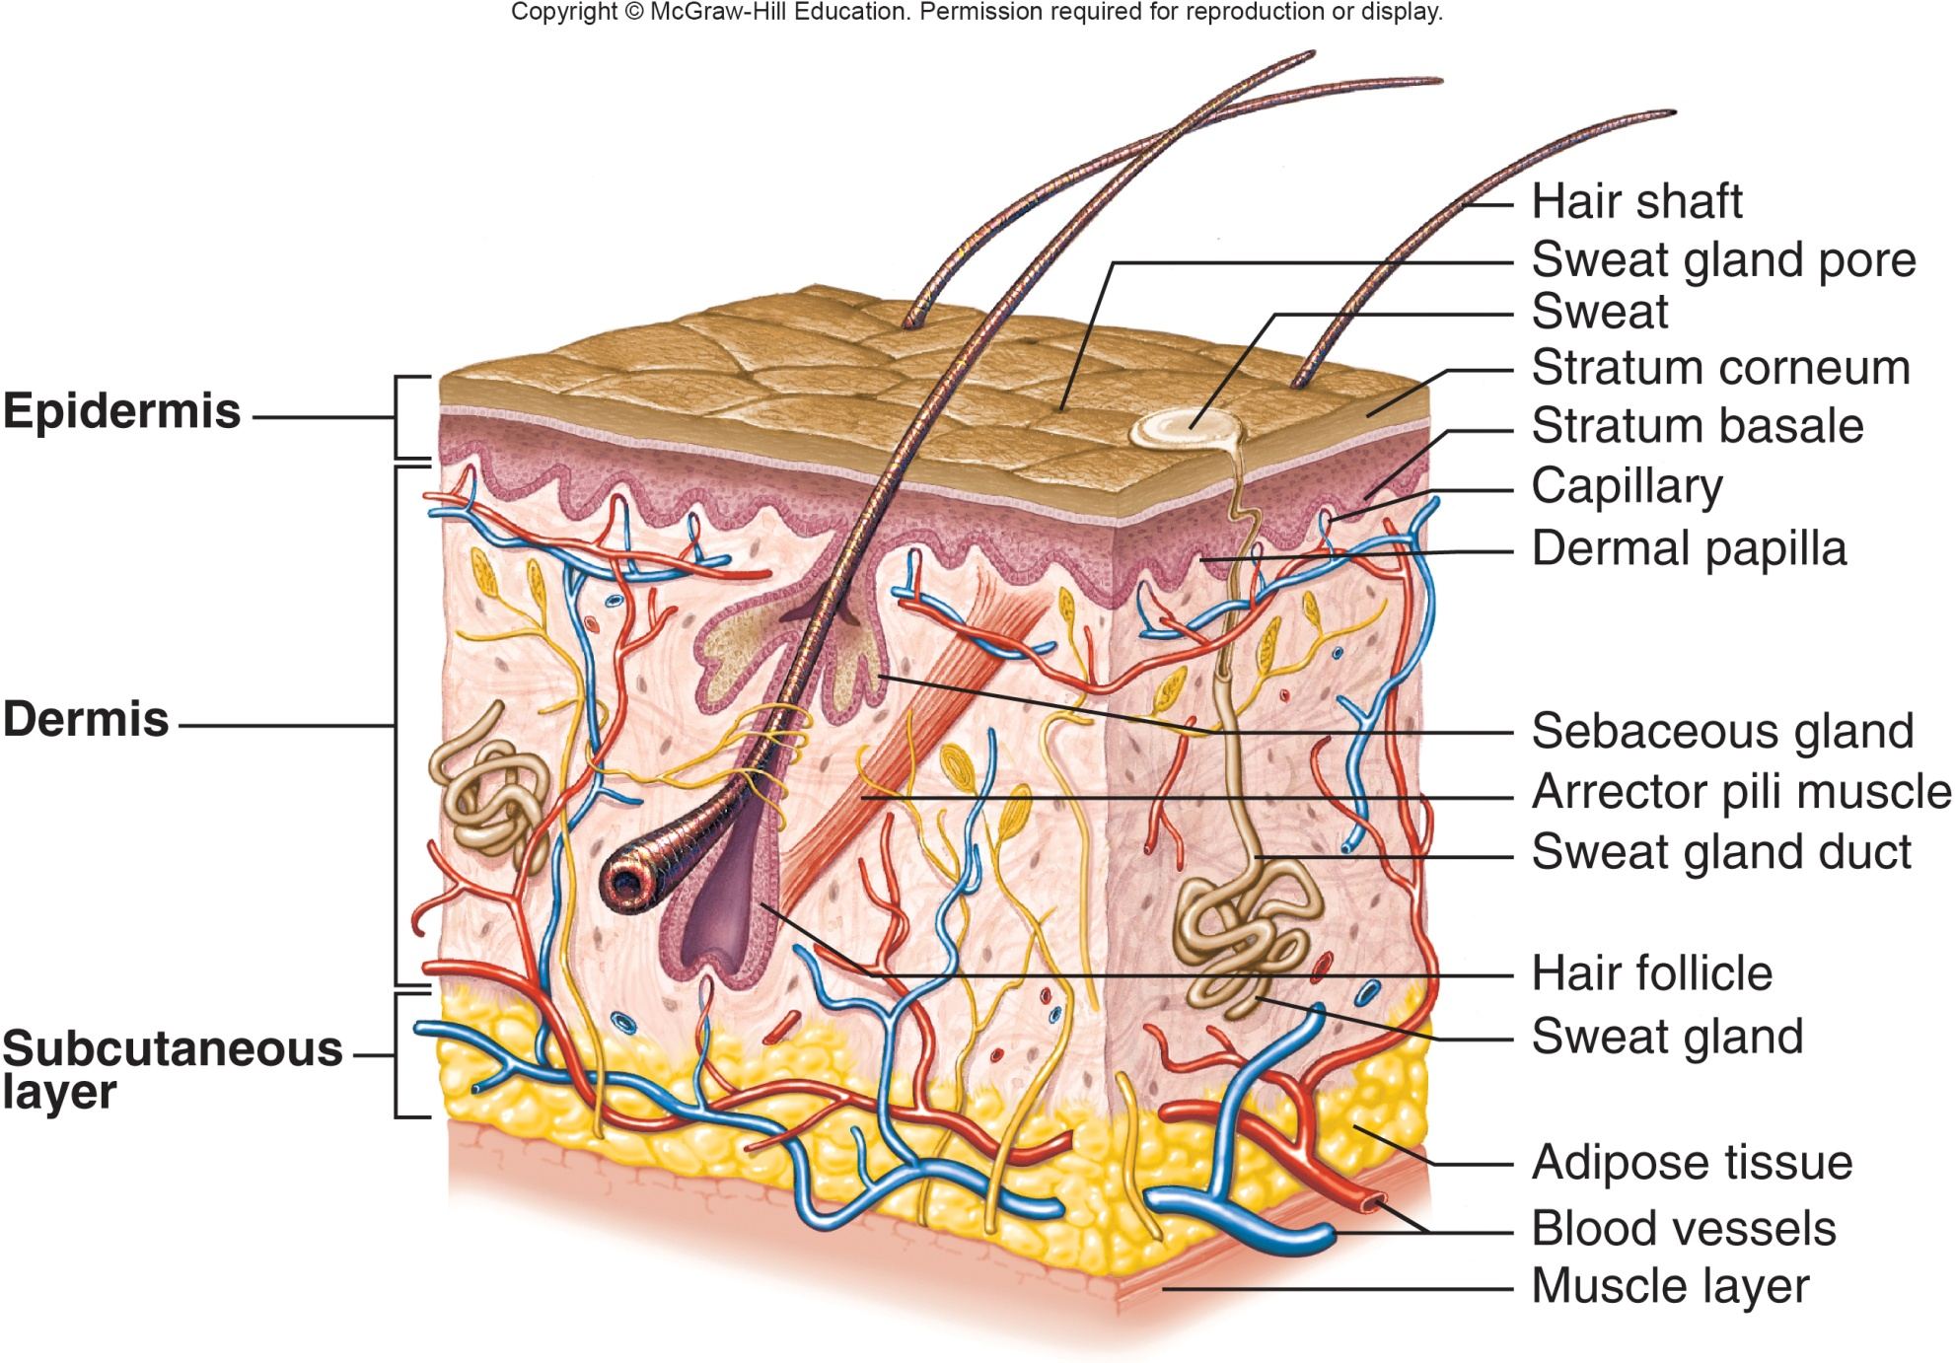
Structures of the Skin
Structures of the Skin Appendix
Copyright © McGraw-Hill Education
Notes:
LO 5.1 Describe the functions of the integumentary system, common diseases and disorders that affect this system, and related laboratory tests.
Notes:
The skin is the largest organ of the body. It contains many structures, including nerve endings, glands and ducts to secrete sweat, hair follicles, and blood vessels, as well as adipose tissue to help cushion the body.

Slide 11
Integumentary System: Blood Tests
Test | Related Diseases and Disorders
Antibody titers | Viruses: Rubella Rubeola Chickenpox Shingles Mononucleosis Other: Immune deficiencies Autoimmune disease
Immunoglobulin levels | Seasonal allergies Immunodeficiencies
Notes:
LO 5.1 Describe the functions of the integumentary system, common diseases and disorders that affect this system, and related laboratory tests.
-----
Notes:
Blood tests that are performed to evaluate the integumentary system include titers, or levels of measurement, for viruses. In addition to those listed above, viruses include:
Viral hepatitis
Systemic lupus erythematosus (SLE)
Immunoglobulin levels are blood tests that are done to test for allergic reactions.

Slide 12
Integumentary System: Other Tests
Test | Related Diseases and Disorders
Wet prep | Fungal infections of the skin or nails
Culture of scraping | Staphylococcus (“staph”) infection Athlete’s foot Ringworm Fingernail or toenail infection
Skin biopsy | Skin cancer
Urine melanin | Skin cancer (melanoma)
Notes:
LO 5.1 Describe the functions of the integumentary system, common diseases and disorders that affect this system, and related laboratory tests.
Notes:
Other (non-blood) tests are performed to test for the presence of fungal, bacterial, or parasitic infections and for malignancy. These include:
Wet prep of skin scraping: The skin is scraped to loosen skin cells, which are prepared on a slide with sterile or distilled water and examined under a microscope for possible fungal infection.
Culture of skin scraping: Skin cells are placed in a growth medium to detect the presence of bacterial, fungal, or parasitic infections.
Skin biopsy: A small amount of intact skin tissue is removed and examined for signs of skin cancer.
Urine melanin: Urine is evaluated for the presence of melanin, a skin pigment that may be present if the patient has melanoma.

Slide 13
Skeletal System
Learning Outcome 5.2

Slide 14
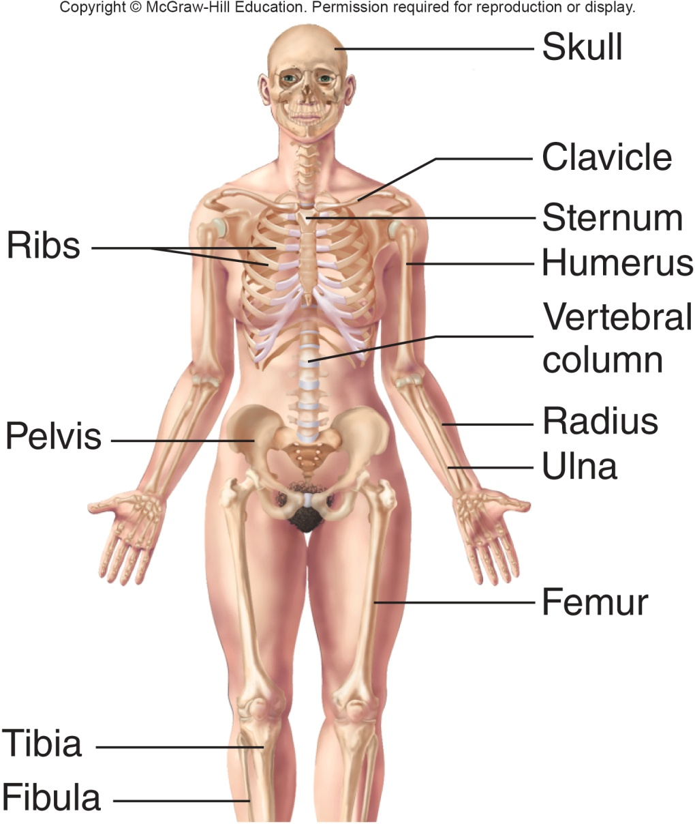
Structures and Functions of the Skeletal System
Structures
Bones
Cartilages
Ligaments
Joints
Functions
Protection
Support
Structures and Functions of the Skeletal System Appendix
Copyright © McGraw-Hill Education
Notes:
LO 5.2 Describe the functions of the skeletal system, common diseases and disorders that affect this system, and related laboratory tests.
Notes:
The skeletal system provides support as well as protection for the body.
Bones:
Provide a place for muscles to attach
Protect the internal organs
Produce blood cells
Store minerals and fat
Cartilage cushions bones and protects them from rubbing against each other.
Ligaments attach bones to other bones.
Joints allow movement.

Slide 15
Skeletal System: Blood Tests
Test | Related Diseases and Disorders
Alkaline phosphatase (ALP) | Bone tumors Paget’s disease
Calcium (Ca) | Rickets (children) Osteomalacia (adults)
Erythrocyte sedimentation rate (ESR) | Rheumatoid arthritis Some other types of arthritis
Phosphorus (P) | Gastrointestinal problems Malabsorption
Rheumatoid factor (RF) | Rheumatoid arthritis
Uric acid | Gout
Notes:
LO 5.2 Describe the functions of the skeletal system, common diseases and disorders that affect this system, and related laboratory tests.
Notes:
Alkaline phosphatase (ALP): Screens for abnormal bone growth due to bone tumors or Paget’s disease (abnormal bone enlargement and deformation)
Calcium (Ca): Screens for lower calcium levels, which may indicate softening of the bones
Erythrocyte sedimentation rate (ESR): Red blood cell test that helps determine infection, tumors, and inflammation
Phosphorus (P): Measures phosphorus levels in serum, which contains only 15% of the body’s phosphorus. The majority (85%) is stored in the bones.
Rheumatoid factor (RF): Tests for the autoantibody that is present in rheumatoid arthritis
Uric acid: Helps diagnose gout, a type of arthritis in which the body does not break down uric acid adequately

Slide 16
Skeletal System: Other Tests
Test | Related Diseases and Disorders
Bone marrow biopsy | Multiple myeloma (cancer that starts in bone marrow)
Synovial fluid analysis | Gout Other types of arthritis Joint infections
Urine uric acid | Gout
Notes:
LO 5.2 Describe the functions of the skeletal system, common diseases and disorders that affect this system, and related laboratory tests.
Notes:
Bone marrow biopsy may be performed if blood counts are abnormal and the physician wants to rule out bone marrow abnormalities as a cause. It is also performed to diagnose some types of cancer. Multiple myeloma is a cancer that starts in bone marrow.
Synovial fluid is found in joints. It is tested to help determine the cause of joint inflammation, fluid accumulation, or swelling at a joint. Synovial fluid analysis consists of multiple tests including visual and microscopic analysis and measurement of glucose proteins, LDH, and uric acid, as well as a bacterial culture.
Urine uric acid: Screens for excessive uric acid in urine collected over a 24 hour period.

Slide 17
Muscular System
Learning Outcome 5.3

Slide 18
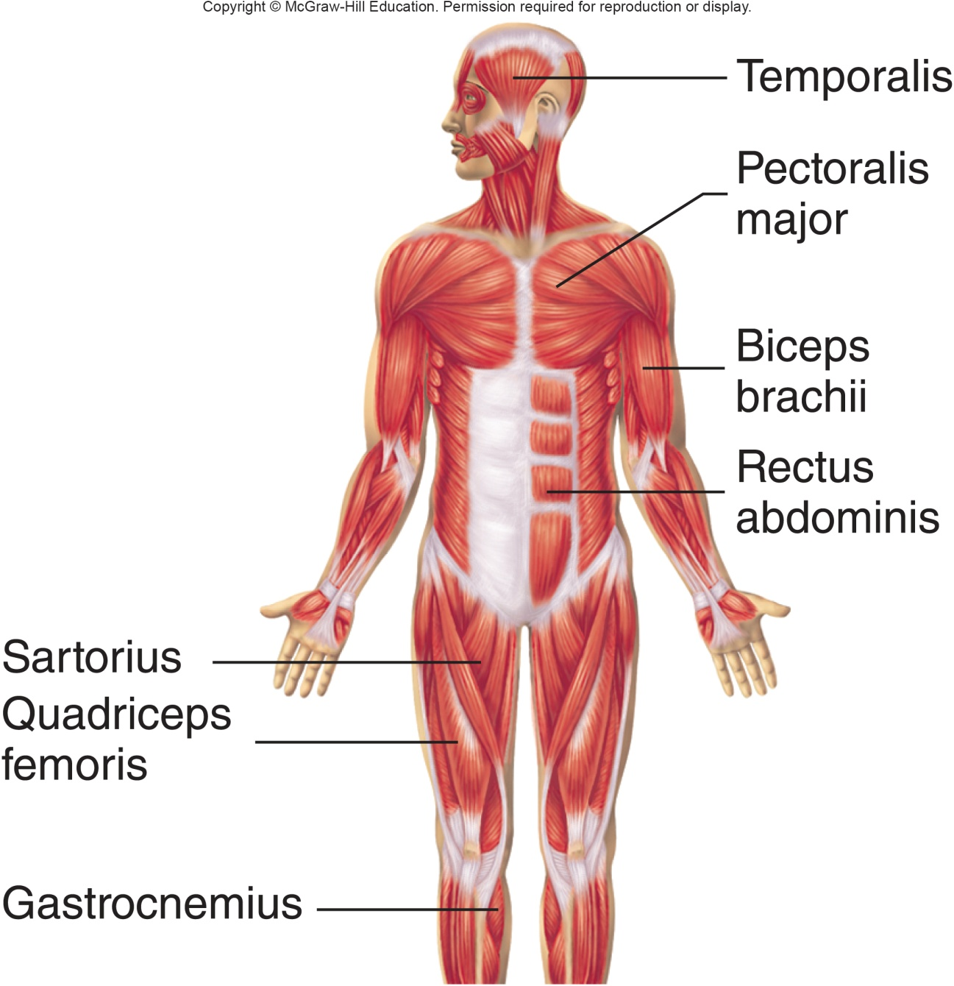
Structures and Functions of the Muscular System
Structures
Muscles
Tendons
Functions
Movement
Maintain body posture
Produce heat
Structures and Functions of the Muscular System Appendix
Copyright © McGraw-Hill Education
Notes:
LO 5.3 Describe the functions of the muscular system, common diseases and disorders that affect this system, and related laboratory tests.
Notes:
Muscles attach to bones and other muscles. By contracting and relaxing, they allow us to move. Tendons attach muscles to bones, and ligaments attach bones to other bones.
Some muscle movements are involuntary, such as those of the heart. The rhythmic contraction and relaxation of the heart pumps blood throughout the body.
Other muscle movements are voluntary, or under our conscious control. For example, raising your arm to throw a ball involves voluntary muscle movements.

Slide 19
Types of Muscles
Voluntary
Skeletal muscles produce movement
Involuntary
Contract without conscious awareness
Muscles lining blood vessels and the walls of hollow organs such as the intestines
Cardiac muscles pump blood through the heart
Notes:
LO 5.3 Describe the functions of the muscular system, common diseases and disorders that affect this system, and related laboratory tests.
Notes:
Voluntary muscles can be consciously controlled.
Smooth muscle and cardiac muscle are both involuntary: they contract without you being consciously aware.

Slide 20
Muscular System: Blood Tests
Test | Related Diseases and Disorders
Aldolase | Muscular dystrophy Muscle cell damage/infection
Autoimmune antibodies | Myasthenia gravis Polymyalgia rheumatica
Creatine kinase (CK) | Muscle damage, including damage due to myocardial infarction (MI, heart attack) Muscular dystrophy Skeletal muscle disease
Lactate/lactic acid | Heart failure
Lactate dehydrogenase (LH/LDH) | Muscle injury Muscular dystrophy Blood flow deficiency (ischemia)
Magnesium (Mg) | Mg intoxication, neuromuscular problems
Myoglobin | Skeletal muscle inflammation or trauma, MI, muscular dystrophy, rhabdomyolysis
Notes:
LO 5.3 Describe the functions of the muscular system, common diseases and disorders that affect this system, and related laboratory tests.
Notes:
Aldolase: Screens for blood levels of aldolase, which is used in glycolysis.
Autoimmune antibody tests: Screens for abnormal antibody levels that may indicate various autoimmune diseases
Creatine kinase: CK tests level of enzyme that indicates muscle damage; CK-MM tests specifically for skeletal muscle damage, while CK-MB is also affected by skeletal muscle disorders
Lactate/lactic acid: Lactic acid increases in the muscles during exercise, with certain medications, and in some diseases, including heart failure
Lactate dehydrogenase (LD/LDH): Measures the level of the protein LDH in the blood; performed when tissue damage is suspected
Magnesium: Measures the amount of magnesium in the blood.
Myoglobin: Measures the level of the protein myoglobin in the blood; myoglobin is released into the bloodstream when muscle tissue has been damaged
Rhabdomyolysis: Breakdown of muscle fibers

Slide 21
Muscular System: Other Tests
Test | Related Diseases and Disorders
Muscle biopsy | Trichinosis Toxoplasmosis Other muscle infections Muscular dystrophy Muscle atrophy or necrosis Polymyositis
Urine myoglobin | Skeletal muscle inflammation or trauma Myocardial infarction Muscular dystrophy Rhabdomyolysis
Notes:
LO 5.3 Describe the functions of the muscular system, common diseases and disorders that affect this system, and related laboratory tests.
Notes:
Muscle biopsy: Performed to diagnose muscle abnormalities caused by disease or infection
Urine myoglobin: Measures myoglobin in the urine (myoglobin enters the urine when kidneys filter it out of the blood); performed to evaluate extensive damage to skeletal muscle

Slide 22
Lymphatic and Immune Systems
Learning Outcome 5.4

Slide 23
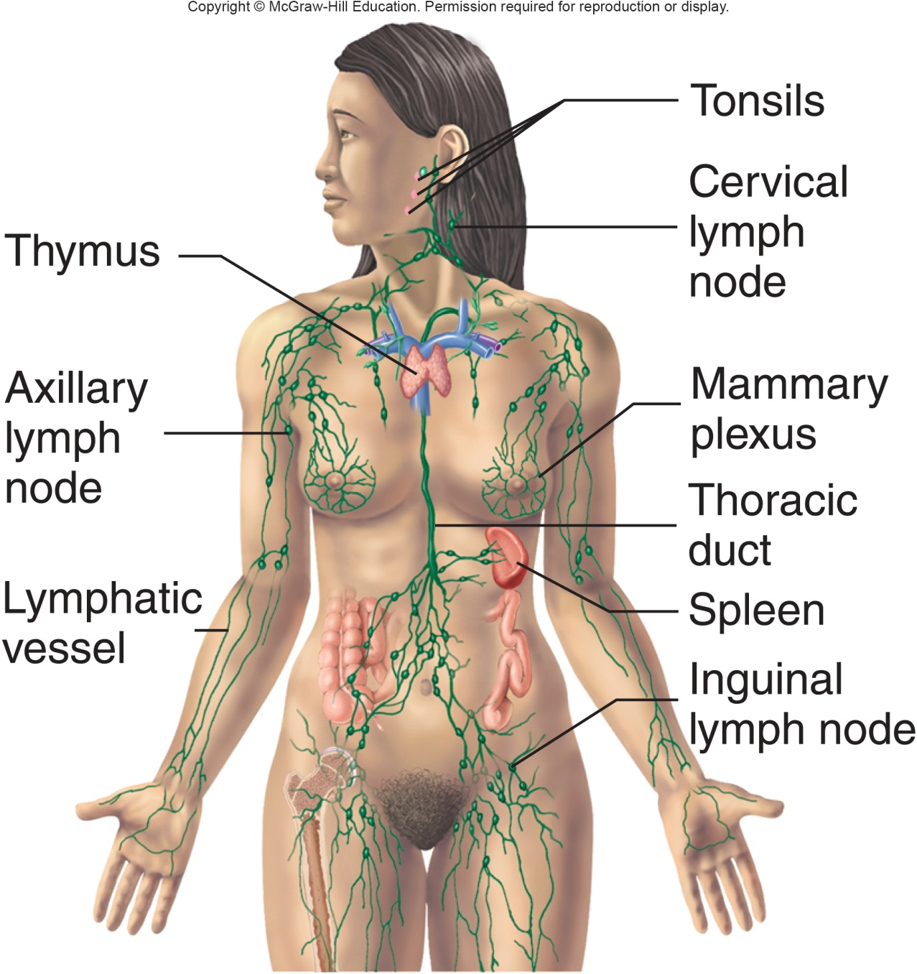
Structures of the Lymphatic and Immune Systems
Lymphatic vessels
Lymph nodes
Glands
Thymus
Tonsils
Spleen
Structures of the Lymphatic and Immune Systems Appendix
Copyright © McGraw-Hill Education
Notes:
LO 5.4 Describe the functions of the lymphatic and immune systems, common diseases and disorders that affect these systems, and related laboratory tests.
Notes:
The immune system protects the body against bacteria, viruses, fungi, toxins, parasites, and cancer. It includes a circulatory system called the lymphatic system that circulates white blood cells and antibodies throughout the body to attack foreign substances.
The lymphatic vessels form a circulatory system much like the blood circulatory system, except that the contents are lymph. Lymph is made up of fluid that has leaked out of blood capillaries, as well as lipids and fat-soluble vitamins from the digestive tract.

Slide 24
Functions of the Lymphatic and Immune Systems
Remove foreign substances
Combat disease
Maintain tissue fluid balance
Absorb fats f rom digestive tract
Functions of the Lymphatic and Immune Systems Appendix
Copyright © McGraw-Hill Education
Notes:
LO 5.4 Describe the functions of the lymphatic and immune systems, common diseases and disorders that affect these systems, and related laboratory tests.
Notes:
The immune system and lymphatic system work together to protect the body against bacteria, viruses, fungi, toxins, parasites, and cancer.
Immune system: White blood cells and formation of antibodies
Lymphatic system: Lymphatic vessels and accessory organs collect and filter fluid to remove harmful pathogens

Slide 25
Lymphatic and Immune Systems: Blood Tests
Test | Related Diseases and Disorders
Antinuclear antibody panel (ANA) | Rheumatoid arthritis Systemic lupus erythematosus Scleroderma Thyroid disease
Complete blood count (CBC) | Allergies Infections Anemia
C-reactive protein | Infections Rheumatic fever Rheumatoid arthritis
Monospot | Mononucleosis
Notes:
LO 5.4 Describe the functions of the lymphatic and immune systems, common diseases and disorders that affect these systems, and related laboratory tests.
Notes:
Antinuclear antibodies (ANA): Measures the levels of antibodies produced by the immune system that attack body systems (autoimmune disease)
Complete blood count (CBC): Count of red and white blood cells and platelets, amount of hemoglobin in the blood, and hematocrit (fraction of blood composed of red blood cells); abnormal red cell counts may indicate various forms of anemia; abnormal white cell counts may result from infection or many other causes
C-reactive protein: Measures the level of C-reactive protein, a marker for tissue necrosis.
Monospot: Checks for two antibodies that appear when a person has mononucleosis

Slide 26
Lymphatic and Immune Systems: Other Tests
Test | Related Diseases and Disorders
Biopsy of lymph node or other lymphatic tissues | Cancer Sarcoidosis Tuberculosis
Lymphatic fluid culture | Various bacterial infections
Notes:
LO 5.4 Describe the functions of the lymphatic and immune systems, common diseases and disorders that affect these systems, and related laboratory tests.
Notes:
Biopsy: Performed on the lymph nodes and other lymphatic tissues to check for abnormal cells that may indicate cancer
Culture of lymphatic fluid: Microbiological culture performed to check for pathogens

Slide 27
Respiratory System
Learning Outcome 5.5

Slide 28
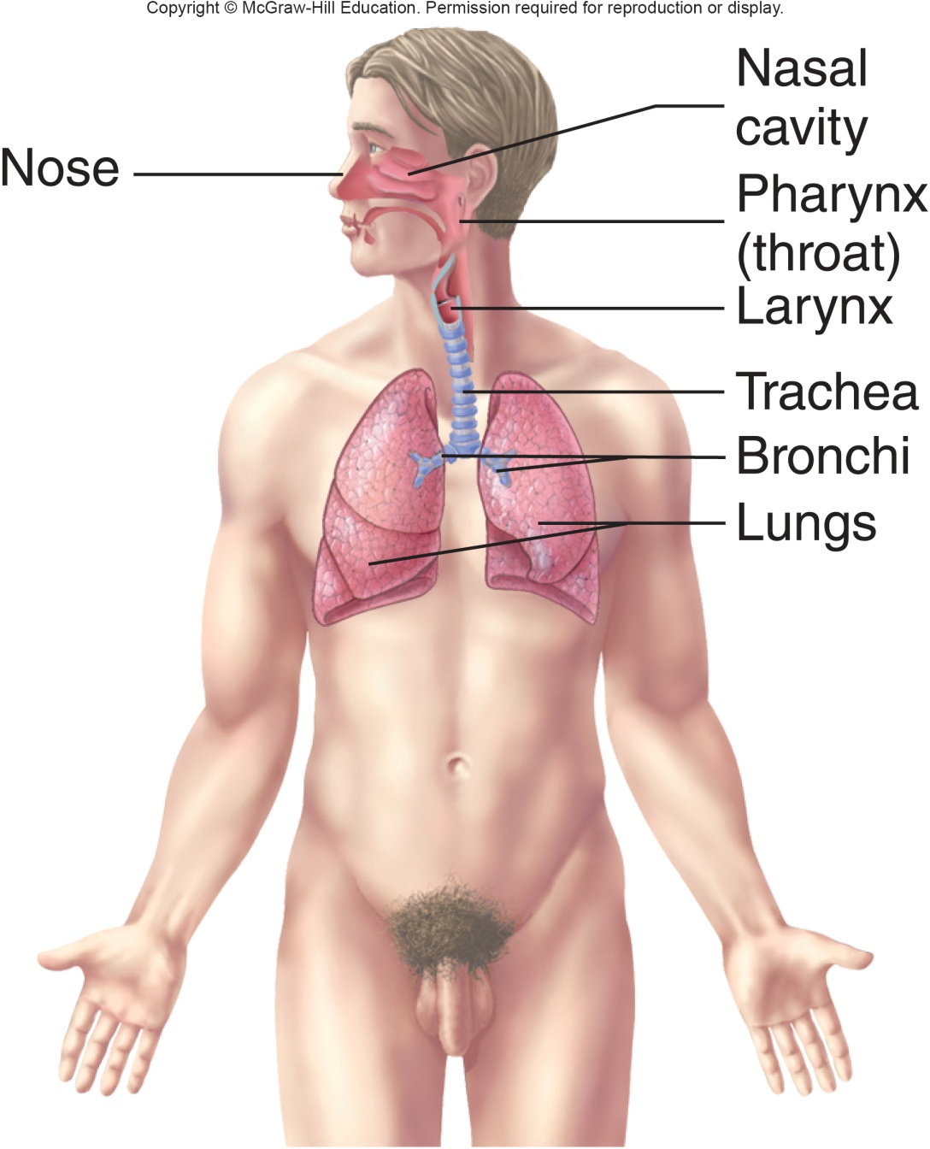
Structures of the Respiratory System
Nasal cavity
Oral cavity
Pharynx
Larynx
Trachea
Bronchi
Lungs
Structures of the Respiratory System Appendix
Copyright © McGraw-Hill Education
Notes:
LO 5.5 Describe the functions of the respiratory system, common diseases and disorders that affect this system, and related laboratory tests.
Notes:
The respiratory system begins at the nasal and oral cavities, where air is taken into the body. The air moves through the pharynx (throat) and larynx and then through the trachea to the bronchi, which are the major airways leading to the lungs.
The bronchi branch to become smaller, more numerous bronchioles inside the lungs. The bronchioles, in turn, branch to form tiny alveoli.

Slide 29
Functions of the Respiratory System
Exchange O₂ and CO₂ between blood and air
Regulate blood pH
Acidosis
Alkalosis
Functions of the Respiratory System Appendix
Copyright © McGraw-Hill Education
Notes:
LO 5.5 Describe the functions of the respiratory system, common diseases and disorders that affect this system, and related laboratory tests.
Notes:
In the lungs, the alveoli (alveolar sacs) are surrounded by blood capillaries, and it is here that the exchange of gases takes place. Oxygen from the alveoli passes to the blood, and carbon dioxide from the blood – a waste gas transported from the body tissues – passes to the alveoli. The carbon dioxide then travels back up the airways, through the bronchi, trachea, larynx, and pharynx, and out of the body through the nasal and oral cavities.
Internal respiration: Gas exchange between the blood and body cells
External respiration: Exchange of air between the lungs and the outside environment
Respiratory acidosis: Condition that results when the lungs do not adequately remove carbon dioxide from the blood and the blood becomes too acidic.
Respiratory alkalosis: Condition that results when the lungs remove too much carbon dioxide from the blood and the blood becomes to alkaline.

Slide 30
Respiratory System: Blood Tests
Test | Related Diseases and Disorders
Arterial blood gases (ABG) | Acidosis Alkalosis Emphysema
Complete blood count (CBC) | Various infections
DNA study | Cystic fibrosis
Electrolytes (Na, K, Cl, CO₂) | Electrolyte imbalances Cushing syndrome COPD Ketoacidosis Methanol poisoning Aspirin overdose
Notes:
LO 5.5 Describe the functions of the respiratory system, common diseases and disorders that affect this system, and related laboratory tests.
Notes:
Arterial blood gases (ABG): Measures the level of oxygen, carbon dioxide, and other gases in the arteries
Complete blood count (CBC): Count of red and white blood cells; abnormal red cell counts may indicate various forms of anemia; abnormal white cell counts may result from infection or many other causes
DNA studies: Analyzes DNA samples to look for gene sequences that suggest specific diseases, such as cystic fibrosis
Electrolytes (Na, K, Cl, CO₂): The concentration of electrolytes sodium, potassium, chlorine, and carbon dioxide (in the form of bicarbonate HCO₃) play a role in maintaining the pH balance in the blood; calcium, magnesium, and phosphorus are sometimes monitored as well

Slide 31
Respiratory System: Other Tests
Test | Related Diseases and Disorders
Bronchial washing | Asbestosis Other environment-related respiratory disorders Lung cancer
Nasopharyngeal specimens | Influenza H1N1 RSVa, RSVb
Pleural fluid analysis | Lung cancer Infection
Sputum culture | Bronchitis Lung abscess Pneumonia Tuberculosis
Throat culture | Various bacterial infections
Notes:
LO 5.5 Describe the functions of the respiratory system, common diseases and disorders that affect this system, and related laboratory tests.
Notes:
The purpose of the listed non-blood tests for the respiratory system is to determine the presence of pathogens in various parts of the respiratory system.
Bronchial washing: The patient’s respiratory tract is flushed with a saline solution, which is then analyzed and examined under a microscope for the presence of foreign particles.
Nasopharyngeal specimens: Nasopharyngeal swabs are tested using DNA probes to detect various viral infections.
Pleural fluid analysis: Analysis of fluid that has collected in the pleural cavity
Sputum culture: Secretions from the lungs and bronchi are placed on a culture medium; any microbial growth is examined microscopically; often includes sensitivity testing (culture and sensitivity or C&S) to determine effectiveness of various antibiotics
Throat culture: Material swabbed from the back of the patient’s throat is placed on a culture medium; any microbial growth is examined microscopically; often includes sensitivity testing

Slide 32
Digestive System
Learning Outcome 5.6

Slide 33
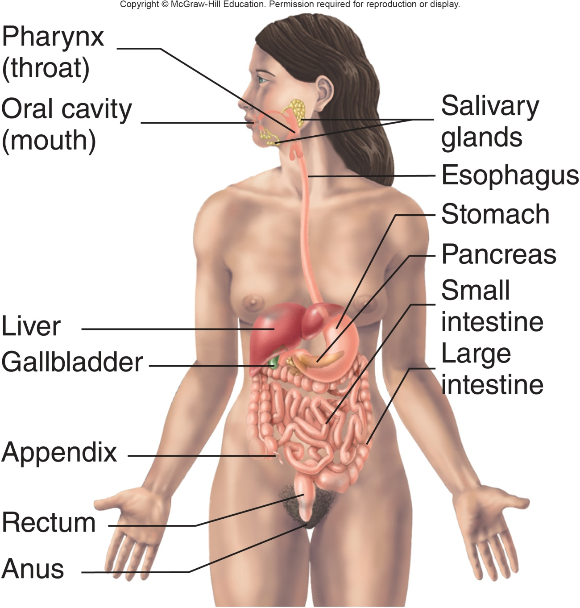
Structures of the Digestive System
Mouth
Esophagus
Stomach
Intestines
Accessory organs
Structures of the Digestive System Appendix
Copyright © McGraw-Hill Education
Notes:
LO 5.6 Describe the functions of the digestive system, common diseases and disorders that affect this system, and related laboratory tests.
Notes:
The digestive system is responsible for the intake and digestion of food, the absorption of nutrients, and the removal of solid waste.
The accessory organs of the digestive system are the teeth, tongue, salivary glands, liver, gallbladder, and pancreas. Although food does not pass through these organs, they help in the process of digestion.

Slide 34
Functions of the Digestive System
Digestion
Absorption of nutrients
Elimination of wastes
Functions of the Digestive System Appendix
Copyright © McGraw-Hill Education
Notes:
LO 5.6 Describe the functions of the digestive system, common diseases and disorders that affect this system, and related laboratory tests.
Notes:
People eat food for nourishment, but the food we eat has to be digested, or broken down into usable chemicals and absorbed into the body. This is the purpose of the digestive system. The breakdown begins in the mouth when we chew and is assisted by salivary glands that contain digestive enzymes. The food moves through the esophagus to the stomach, where it is further broken down, and then to the small intestine, where most digestion takes place. Accessory organs such as the liver, pancreas, and gallbladder produce additional enzymes to help with the digestive process. Indigestible parts of the food proceed to the large intestine, where water and certain chemicals are reabsorbed into the body. The waste mass that is left is called feces. The feces move through the rectum and leave the body through the anus.

Slide 35
Digestive System: Blood Tests 1
Test | Related Diseases and Disorders
Albumin | Malnutrition Malabsorption CID Liver disease
Aldolase | Chronic hepatitis Obstructive jaundice
Alkaline phosphatase (ALP) | Biliary cirrhosis Bile duct obstruction Liver disease
Ammonia (NH₃) | Hepatic encephalopathy
Amylase | Pancreatic disorders
Carcinoembryonic antigen (CEA) | Intestinal, pancreatic, thyroid, lung, and breast cancer Cancers of the reproductive and urinary tracts
Carotene | Vitamin A deficiency
Notes:
LO 5.6 Describe the functions of the digestive system, common diseases and disorders that affect this system, and related laboratory tests.
Notes:
Because the digestive system involves many different organs and handles a large number of chemicals from outside the body (in the form of food), many kinds of tests are performed to diagnose various problems pertaining to the digestive system.
Albumin: Measures the amount of albumin in the blood
Aldolase: Screens for blood levels of aldolase, which is used in glycolysis
Alkaline phosphatase (ALP): Screens for abnormal levels of ALP in the blood
Ammonia (NH₃): Measures ammonia buildup in the blood
Amylase: Measure the amount of the enzyme amylase in the blood
Carcinoembryonic antigen (CEA): An antigen associated with some types of cancer
Carotene: Determines the level of carotene in the blood

Slide 36
Digestive System: Blood Tests 2
Test | Related Diseases and Disorders
Glucose | Type 2 diabetes Overactive or underactive thyroid gland Pancreatic cancer Cushing syndrome
Glucose tolerance test (GTT) | Type 2 diabetes Gestational diabetes Cushing syndrome
Lipase | Pancreatic disorders
Liver function tests (hepatic function panel) | Hepatitis Cirrhosis Other chronic liver diseases
Magnesium (Mg) | Malnutrition Malabsorption Alcoholism Diabetic acidosis
Notes:
LO 5.6 Describe the functions of the digestive system, common diseases and disorders that affect this system, and related laboratory tests.
Notes:
Glucose and glucose tolerance tests (GTT): Performed to identify insulin-related or pancreatic disorders
Ceruloplasmin: Helps diagnose Wilson disease and other causes of abnormal copper levels
Lipase: Measure the amount of this enzyme in the blood to help diagnose pancreatic disorders
Liver function tests : Determines the level of albumin, bilirubin, alanine aminotransferase (ALT), aspartate aminotransferase (AST), gamma-glutamyl transferase (GGT), alkaline phosphatase (ALP), and total protein; these tests may also be ordered individually
Additional tests used to diagnose liver disorders: alanine aminotransferase (ALT), aspartate aminotransferase (AST), and gamma-glutamyltransferase (GGT).
Magnesium: Measures the amount of magnesium in the blood

Slide 37
Digestive System: Blood Tests 3
Test | Related Diseases and Disorders
Methyltetrahydrofolate reductase (MTHFR) gene mutation | Enzyme deficiency, causing poor folate metabolism
Potassium (K) | Cushing syndrome Gastrointestinal disorders
Triglycerides | Decreased in malnutrition, malabsorption Increased in glycogen storage disease, high-carbohydrate diets, uncontrolled diabetes
Vitamins | Malnutrition, malabsorption, nutritional imbalance related to specific enzyme deficiencies
Zinc | Deficiency can cause stunted growth, diarrhea, increased infections
Notes:
LO 5.6 Describe the functions of the digestive system, common diseases and disorders that affect this system, and related laboratory tests.
Notes:
Methyltetrahydrofolate reductase (MTHFR) gene mutation: Detects genetic mutation of the MTHFR gene
Potassium (K): Measures the amount of potassium in the blood
Triglycerides: Measures the blood level of triglycerides
Vitamins: Measures the levels of various vitamins (A, B, C, etc.) in the blood
Zinc: Measures the blood level of zinc

Slide 38
Digestive System: Other Tests 1
Test | Related Diseases and Disorders
Biopsies of various gastrointestinal organs | Cancers associated with the individual organs
Fecal fat | Pancreatitis Gallstones Crohn’s disease Pancreatic cancer Celiac disease
Fecal occult blood | Colon cancer Other gastrointestinal cancers Esophagitis Gastritis Hemorrhoids Inflammatory bowel disease
Fecal white blood cells | Ulcerative colitis Salmonellosis Shigellosis
Notes:
LO 5.6 Describe the functions of the digestive system, common diseases and disorders that affect this system, and related laboratory tests.
Notes:
Non-blood tests are performed on other fluids and substances throughout the digestive tract. Feces are tested for fat, occult blood, white blood cells, ova, and parasites. They may also be cultured to determine the presence of pathogens.
Fecal fat: Determines how well fat is being absorbed by the body
Fecal occult blood: Determines whether red blood cells are present in the feces
Fecal white blood cells: Checks for white blood cells in the feces to help determine the cause of inflammatory diarrhea

Slide 39
Digestive System: Other Tests 2
Test | Related Diseases and Disorders
Gastric fluid analysis | Gastric ulcer Gastric cancer Tuberculosis Pernicious anemia
Peritoneal fluid analysis | Peritonitis Cirrhosis of the liver Lymphoma Other gastrointestinal cancers
Stool culture | Bacterial gastroenteritis E. coli, C. difficile, and other bacterial infections
Stool for ova and parasites (O&P) | Amebiasis Giardiasis Other parasitic infections
Notes:
LO 5.6 Describe the functions of the digestive system, common diseases and disorders that affect this system, and related laboratory tests.
Notes:
Gastric fluid analysis: Determines the pH and content of residual gastric fluid in the stomach
Peritoneal fluid analysis: Examines fluid taken from the abdominal cavity (peritoneal space) for presence of albumin, protein, and red and white blood cells
Stool culture: Stool sample is placed on culture medium; any microbial growth is examined microscopically to determine which type of bacteria may be responsible for a bacterial infection
Stool O&P: Microscopic examination of stool sample to determine whether certain parasites or their eggs (ova) are present

Slide 40
Digestive System: Other Tests 3
Test | Related Diseases and Disorders
Urine chemistries | Gastrointestinal infections Type 1 diabetes Anorexia Malnutrition Hyperthyroidism
Notes:
LO 5.6 Describe the functions of the digestive system, common diseases and disorders that affect this system, and related laboratory tests.
Notes:
Urine chemistries include tests for glucose, ketones, and protein in the urine. The presence of these substances is abnormal and may indicate diseases such as diabetes mellitus.

Slide 41
Nervous System
Learning Outcome 5.7

Slide 42
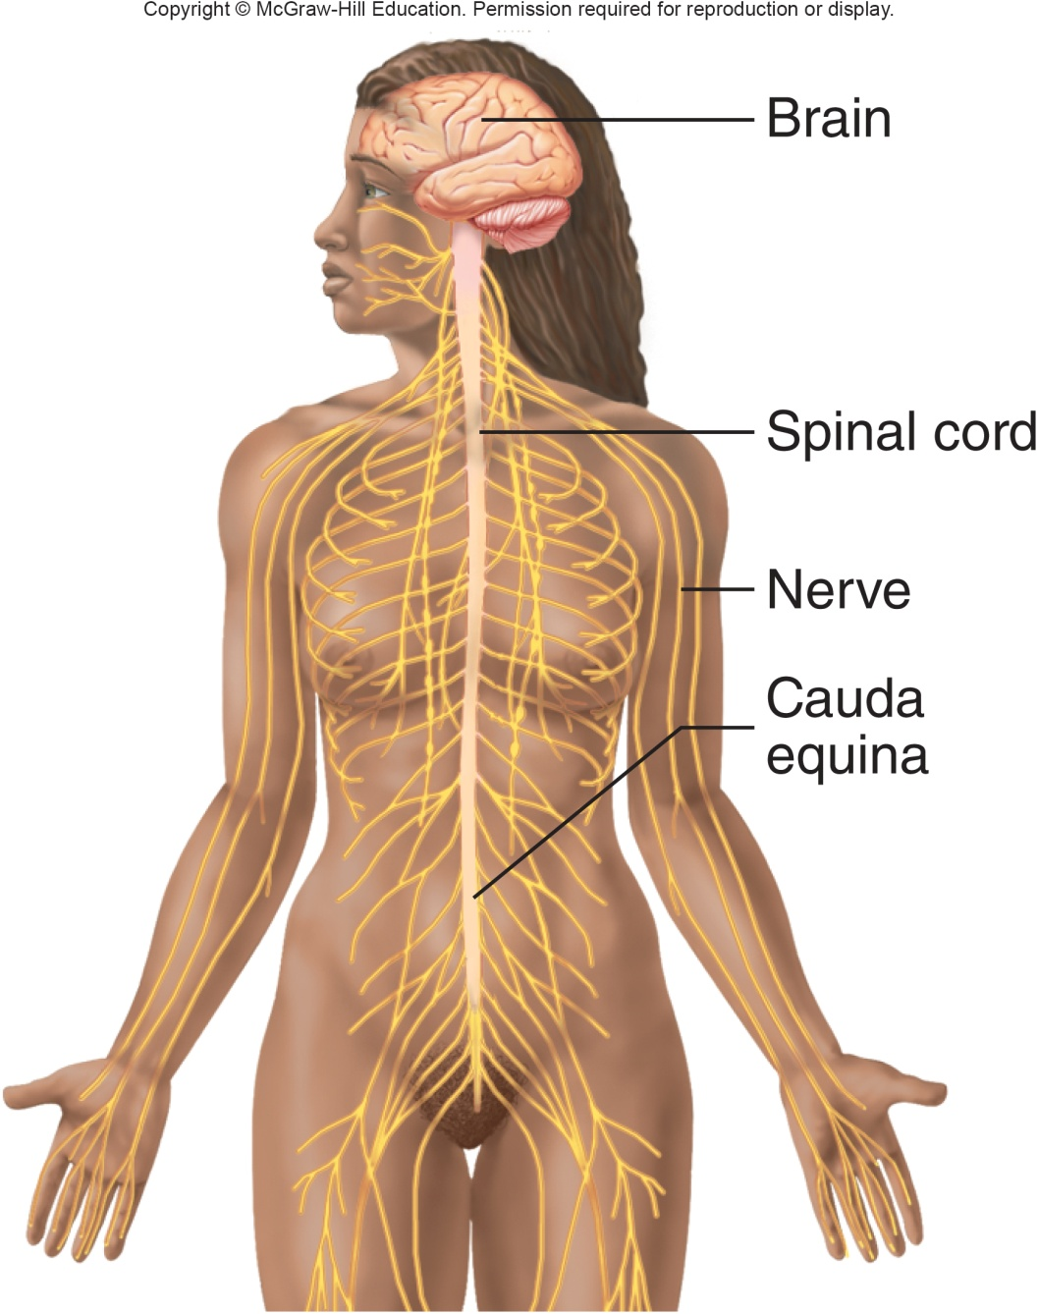
Structures and Functions of the Nervous System
Structures
Brain
Spinal cord
Nerves
Functions
Detect sensations
Control movements and processes
Intellectual functions
Structures and Functions of the Nervous System Appendix
Copyright © McGraw-Hill Education
Notes:
LO 5.7 Describe the functions of the nervous system, common diseases and disorders that affect this system, and related laboratory tests.
Notes:
The two major divisions of the nervous system are the central nervous system (CNS), which includes the brain and spinal cord, and the peripheral nervous system (PNS), which includes the cranial and spinal nerves.
Three types of neurons:
Sensory neurons take stimuli from the environment or inside the body to the CNS.
Interneurons interpret the information from the sensory neurons and pass it on to the motor neurons.
Motor neurons take the interpreted information from the CNS to the PNS to a muscle or gland to react to the stimuli.
The nervous system controls both voluntary and involuntary actions, including breathing and digestion. It detects sensations through sensory receptors and is responsible for our intellectual functions.

Slide 43
Nervous System: Blood Tests
Test | Related Diseases and Disorders
Acetylcholine receptor antibody | Myasthenia gravis
Creatine kinase brain/smooth muscle isoenzyme | Cerebrovascular accident (CVA, stroke) Lung cancer
Drug levels | Epilepsy Other brain disorders
Zinc | Mental confusion, depression
Notes:
LO 5.7 Describe the functions of the nervous system, common diseases and disorders that affect this system, and related laboratory tests.
Notes:
Acetylcholine receptor antibody: Determines the presence or absence of this antibody, which prevents the transfer of signals from nerves to muscles; seen in myasthenia gravis
Creatine kinase brain/smooth muscle isoenzyme (CK-BB): Tests for enzymes that help the nervous system function
Drug levels: Measures the blood levels of various therapeutic drugs to monitor patient response and to help determine therapeutic levels
Zinc: Measures the blood level of zinc

Slide 44
Nervous System: Other Tests
Test | Related Diseases and Disorders
Cerebrospinal fluid (CSF) analysis | Meningitis Encephalitis Cancer Reye syndrome
CSF culture | Aseptic meningitis Tuberculosis Cryptococcosis Fungal infections
CSF immunoglobulin levels | Acute bacterial meningitis
Notes:
LO 5.7 Describe the functions of the nervous system, common diseases and disorders that affect this system, and related laboratory tests.
Notes:
Cerebrospinal fluid is the clear, colorless fluid that surrounds the brain and spinal cord to protect and cushion them. It also helps maintain a constant level of pressure on the brain. The CSF sample for any of the above tests is gathered using a “spinal tap” or lumbar puncture, in which a needle is inserted into the lumbar region of the spine to withdraw the fluid.

Slide 45
Endocrine System
Learning Outcome 5.8

Slide 46
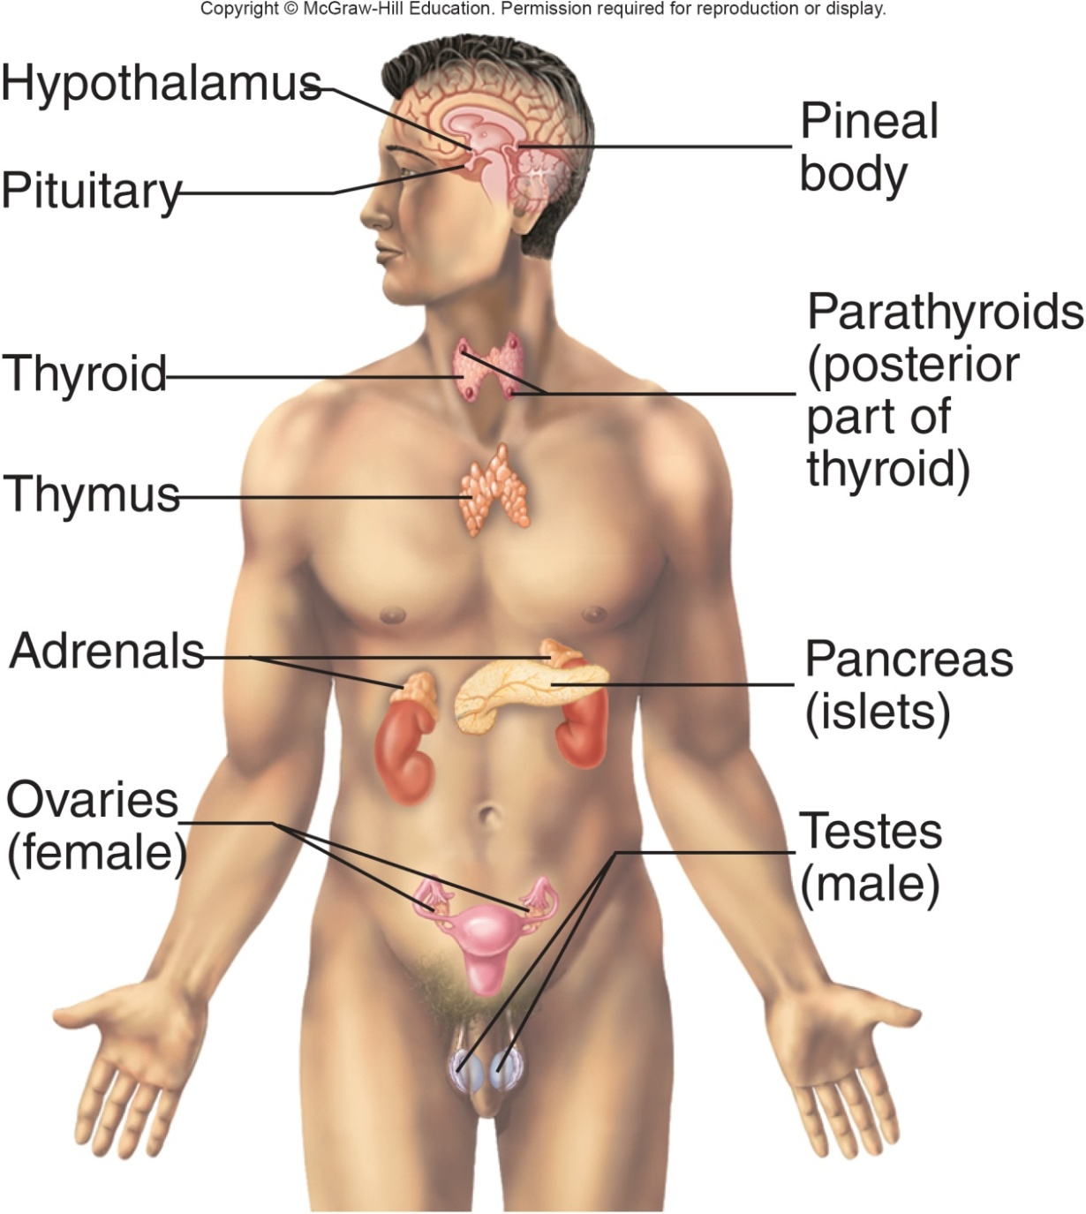
Structures of the Endocrine System
Hypothalamus
Pineal body
Pituitary
Thyroid
Parathyroid
Adrenal glands
Pancreas
Gonads
Structures of the Endocrine System Appendix
Copyright © McGraw-Hill Education
Notes:
LO 5.8 Describe the functions of the endocrine system, common diseases and disorders that affect this system, and related laboratory tests.
Notes:
The endocrine system is made up of glands that secrete various types of hormones directly into body fluids, including the blood. These hormones control the functions of organs and tissues at the cellular level.
Hypothalamus: Antidiuretic hormone (ADH), oxytocin
Pineal body: Melatonin
Anterior pituitary: Growth hormone (GH), melanocyte-stimulating hormone (MSH), adrenocorticotropic hormone (ACTH), thyroid-stimulating hormone (TSH), follicle-stimulating hormone (FSH), luteinizing hormone (LH), and prolactin (PRL)
Posterior pituitary: Antidiuretic hormone (ADH) and oxytocin (OT)
Thyroid: T3, T4, and calcitonin
Parathyroid: Parathyroid hormone (PTH)
Thymus: Thymosin and thymopoietin
Adrenal cortex: Aldosterone and cortisol
Adrenal medulla: Epinephrine and norepinephrine
Pancreas: Glucagon and insulin
Gonads (female): Estrogen and progesterone
Gonads (male): Testosterone

Slide 47
Function of the Endocrine System
Regulation of body processes
Function of the Endocrine System Appendix
Copyright © McGraw-Hill Education
Notes:
LO 5.8 Describe the functions of the endocrine system, common diseases and disorders that affect this system, and related laboratory tests.
Notes:
The hormones secreted by the endocrine system regulate metabolism, growth, reproduction, and many other body processes. The endocrine system is similar to the nervous system in that it exerts control over body processes, but unlike the immediate effects of the nervous system, the effects of the endocrine system occur over time.

Slide 48
Endocrine System: Blood Tests 1
Test | Related Diseases and Disorders
A1c | Diabetes mellitus, Types 1 and 2 Prediabetes
Adrenocorticotropic hormone (ATCH) | Addison’s disease Cushing’s syndrome Tumor of the adrenal gland Hypopituitarism
Antidiuretic hormone (ADH) | Diabetes insipidus Primary polydipsia Brain tumor or infection Lung cancer (certain types) Cerebrovascular accident (CVA, stroke)
Aldosterone (Ald) | Addison’s disease Congenital adrenal hyperplasia
Notes:
LO 5.8 Describe the functions of the endocrine system, common diseases and disorders that affect this system, and related laboratory tests.
Notes:
Laboratory blood tests for the endocrine system consist of testing for the blood level of the individual hormone. Because each hormone helps regulate a specific body function, the blood level of the hormone can help physicians diagnose various diseases and disorders. For example, if a thyroid problem is suspected, blood would be examined for levels of thyroid-stimulating hormone (TSH), T3, T4, and possibly calcitonin.
A1c (glycated hemoglobin): Determines the patient’s average blood glucose level over the past 2 to 3 months
Adrenocorticotropic hormone (ACTH): Measures the level of the ACTH hormone in the blood
Antidiuretic hormone (ADH): Measures the blood level of ADH, which is produced by the hypothalamus in the brain
Aldosterone (ALD): Measures the level of aldosterone in the blood

Slide 49
Endocrine System: Blood Tests 2
Test | Related Diseases and Disorders
Calcitonin | Thyroid tumors, pancreatic tumors, hyperparathyroidism, thyroiditis
Cortisol | Addison’s disease Cushing’s syndrome Tumor of the adrenal gland Hypopituitarism Acute adrenal crisis
Fasting blood glucose (fasting blood sugar, FBS) | Prediabetes and Type 2 diabetes Overactive or underactive thyroid gland Pancreatic cancer Pancreatitis
Notes:
LO 5.8 Describe the functions of the endocrine system, common diseases and disorders that affect this system, and related laboratory tests.
Notes:
Calcitonin: Measures blood levels of calcitonin
Cortisol: Measures the level of the steroid hormone cortisol in the blood
Fasting blood glucose (also called fasting blood sugar or FBS): Measures the level of glucose in the blood after the patient has fasted for at least 8 hours

Slide 50
Endocrine System: Blood Tests 3
Test | Related Diseases and Disorders
Follicle-stimulating hormone (FSH) | Female: Menopause Polycystic ovary syndrome Ovarian cysts Infertility Anorexia Turner syndrome
Follicle-stimulating hormone (FSH) | Male: Klinefelter syndrome Infertility
Luteinizing hormone (LH) | Female: Menopause Polycystic ovary syndrome Ovarian cysts Turner syndrome
Notes:
LO 5.8 Describe the functions of the endocrine system, common diseases and disorders that affect this system, and related laboratory tests.
Notes:
Follicle-stimulating hormone (FSH): Measures the level of FSH in the blood
Luteinizing hormone (LH): Measures the level of LH in the blood

Slide 51
Endocrine System: Blood Tests 4
Test | Related Diseases and Disorders
Luteinizing hormone (LH) | Male: Anorchia Hypogonadism Klinefelter syndrome
Glucagon | Diabetes Cushing’s syndrome Cirrhosis of the liver Hypoglycemia Pancreatitis
Glucose tolerance test (GTT) | Prediabetes Type 2 diabetes Gestational diabetes
Notes:
LO 5.8 Describe the functions of the endocrine system, common diseases and disorders that affect this system, and related laboratory tests.
Notes:
Luteinizing hormone (LH): Measures the level of LH in the blood
Glucagon: Measures the level of the hormone glucagon in the blood
Glucose tolerance test (GTT): Determines how well the body breaks down glucose over a 2- to 3-hour period

Slide 52
Endocrine System: Blood Tests 5
Test | Related Diseases and Disorders
Growth hormone (GH) | Acromegaly, Giantism Dwarfism, Pituitary tumor
Insulin | Diabetes
Renin | Hypertension (high blood pressure) Kidney disorders
Thyroid function panel | Thyroid cancer, Goiter Overactive or underactive thyroid gland Graves’ disease Hypopituitarism Thyroid nodule
Zinc | Low thyroid hormones Insulin-like growth factor Low testosterone
Notes:
LO 5.8 Describe the functions of the endocrine system, common diseases and disorders that affect this system, and related laboratory tests.
Notes:
Growth hormone (GH): Measures the level of GH in the blood
Insulin: Measures the level of insulin in the blood
Renin: Measures the level of renin in the blood
Thyroid function panel: Measures the level of T3, T4, and TSH; often includes a thyroid scan with a radioactive iodine tracer as well
Zinc: Measures blood level of zinc

Slide 53
Endocrine System: Other Tests
Test | Related Diseases and Disorders
Urine ketones | Type 2 diabetes
Tissue biopsy of individual glands | Cancer of the various glands
Notes:
LO 5.8 Describe the functions of the endocrine system, common diseases and disorders that affect this system, and related laboratory tests.
Notes:
Non-blood tests consist of microbiology cultures to determine the presence of pathogens, and biopsies, when needed, of the various glands themselves.
Urine ketones: Measures the level of ketones in the urine
Tissue biopsy of individual glands: Removal of a small piece of tissue through a biopsy needle for examination

Slide 54
Cardiovascular System
Learning Outcome 5.9

Slide 55
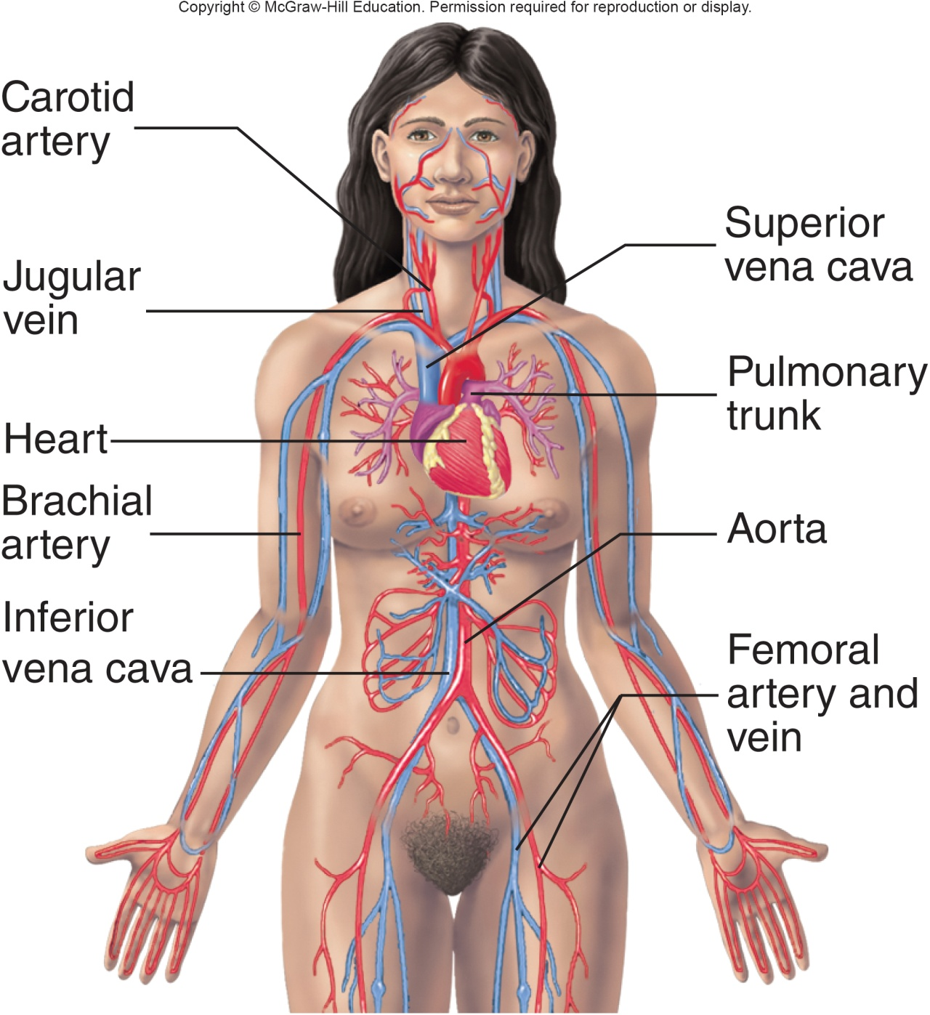
Structures and Functions of the Cardiovascular System
Structures
Heart
Blood vessels
Blood
Functions
Transport
Immune response
Body temperature
Structures and Functions of the Cardiovascular System Appendix
Copyright © McGraw-Hill Education
Notes:
LO 5.9 Describe the functions of the cardiovascular system, common diseases and disorders that affect this system, and related laboratory tests.
Notes:
The cardiovascular system does more than just pump blood to all areas of the body. Its functions include:
Carrying nutrients and oxygen to the body cells
Carrying wastes, including waste gases, from the body cells to the appropriate systems for removal from the body
Carbon dioxide to the lungs for exhalation
Urea and other waste products to the kidneys for excretion
Carrying hormones to various parts of the body
Playing a part in the body’s immune response
Regulating body temperature

Slide 56
Cardiovascular System: Blood Tests Related to the Heart and Circulation
Test | Related Diseases and Disorders
Arterial blood gases | Hypoxia, COPD
Aspartate aminotransferase (AST) | Myocardial infarction, cardiac operations and cauterizations, angioplasty
B-type natriuretic peptide (BNP) | Heart failure
Creatine kinase (CK) | Myocardial infarctions Heart trauma Myocarditis
Lipid profile | Heart disease Cerebrovascular accident (CVA, stroke) Conditions related to blocked arteries
Notes:
LO 5.9 Describe the functions of the cardiovascular system, common diseases and disorders that affect this system, and related laboratory tests.
Notes:
Arterial blood gases: Measures level of oxygen (O₂), carbon dioxide (CO₂, and bicarbonate (HCO₃) as well as the pH (acidity or alkalinity) of arterial blood
Aspartate aminotransferase (AST): Measures the amount of AST in the blood
B-type natriuretic peptide (BNP): Helps determine heart failure
Creatine kinase (CK): For cardiovascular disorders, the level of CK-MB – the isoenzyme mostly found in the heart – is measured; this isoenzyme is also affected during myocardial infarction
A lipid profile, which includes HDL, LDL, and VLDL cholesterol as well as triglycerides, checks the condition of the entire system for risk of atherosclerosis and plaque buildup.
Troponin levels are elevated when the heart muscle is damaged due to myocardial infarction.

Slide 57
Cardiovascular System: Blood Tests Related to the Blood Vessels and Hemostasis 1
Test | Related Diseases and Disorders
Clotting factor assays | Hemophilia Von Willebrand disease
Clotting inhibitor and antibody studies | Congenital factor deficiencies Cancer Immunologic disorders
D-dimer and other fibrin degradation/split products (FDP/FSP) | Deep vein thrombosis Pulmonary embolism Hypercoagulability
Electrolytes (Na, K, Cl, CO₂) | Congestive heart failure Monitoring of diuretic medications
Notes:
LO 5.9 Describe the functions of the cardiovascular system, common diseases and disorders that affect this system, and related laboratory tests.
Notes:
Clotting factor assays: Determine levels of specific clotting proteins; performed when PT or APTT test results are abnormal
Clotting inhibitor and antibody studies: Determines the presence of and measures the level of various coagulation (clotting) factors in the blood
D-Dimer and other fibrin degradation/split products (FDP/FSP): Measures the blood levels of the byproducts generated when the body breaks down blood clots
Electrolytes (Na, K, Cl, CO₂): Measures blood levels of sodium, potassium

Slide 58
Cardiovascular System: Blood Tests Related to the Blood Vessels and Hemostasis 2
Test | Related Diseases and Disorders
Fibrinogen | Afibrinogenemia Fibrinolysis Disseminated intravascular coagulation
Homocysteine | Risk factor for atherosclerotic vascular disease
Methylene tetrahydrofolate reductase (MTHFR) | Failure to metabolize homocysteine
Notes:
LO 5.9 Describe the functions of the cardiovascular system, common diseases and disorders that affect this system, and related laboratory tests.
Notes:
Fibrinogen: Measures the amount of fibrinogen in the blood
Homocysteine: Measures the amount of homocysteine in the blood
Methylene tetrahydrofolate reductase (MTHFR): DNA test for mutation of MTHFR gene

Slide 59
Cardiovascular System: Blood Tests Related to the Blood Vessels and Hemostasis 3
Test | Related Diseases and Disorders
Platelet count | Disseminated intravascular coagulation Hemolytic anemia Leukemia Polycythemia vera Thrombocythemia
Platelet function studies | Coronary artery disease Unstable angina Myocardial infarction
Prothrombin time (PT) | Clotting factor deficiencies Vitamin K deficiency Disseminated intravascular coagulation
Notes:
LO 5.9 Describe the functions of the cardiovascular system, common diseases and disorders that affect this system, and related laboratory tests.
Notes:
Platelet count: Determines the number of platelets in the blood
Platelet function studies: Assess various functions of the platelets
Prothrombin time (PT): Measures the time it takes blood plasma to clot

Slide 60
Cardiovascular System: Blood Tests Related to the Blood Cells 1
Test | Related Diseases and Disorders
ABO, Rh factor | Blood typing
Complete blood count (CBC) | Blood clotting problems Anemia Systemic lupus erythematosus Leukemia and other blood cancers
Differential | Myelocytic leukemia Aplastic anemia Septicemia
Erythrocyte sedimentation rate (ESR) | Anemia Lymphoma Multiple myeloma Autoimmune disorders Infections Inflammation Arthritis
Notes:
LO 5.9 Describe the functions of the cardiovascular system, common diseases and disorders that affect this system, and related laboratory tests.
Notes:
ABO and Rh factor: Determines the presence of specific antigens on red blood cells for blood typing purposes
Complete blood count (CBC): Measures white blood cells (WBC), red blood cells (RBC), hemoglobin (Hgb), hematocrit (Hct), mean corpuscular volume (MCV), mean corpuscular hemoglobin (MCH), mean corpuscular hemoglobin concentration (MCHC), red cell distribution width (RDW), and platelet count (Plat)
Differential: Determines the percentage of individual types of white blood cells: neutrophils, lymphocytes, monocytes, eosinophils, and basophils; also counts hematopoietic cells (e.g., nucleated RBCs and early stages of WBCs)
Erythrocyte sedimentation rate (ESR): Measures the rate at which red blood cells fall to the bottom of a calibrated tube; RBCs fall more quickly during times of inflammation and other disorders because of the increase in plasma protein during these times

Slide 61
Cardiovascular System: Blood Tests Related to the Blood Cells 2
Test | Related Diseases and Disorders
Flow cytometry | Leukemia, lymphoma, myeloma
Hemoglobin electrophoresis (HbEP) | Various hemoglobinopathies and thalassemia
Iron studies (Fe and TIBC) | Iron deficiency Iron-deficient anemia
Malaria test | Malaria
Reticulocyte count (Retic) | Bone marrow failure Erythroblastosis fetalis Hemolytic anemia Aplastic anemia Pernicious anemia Vitamin B₁₂ deficiency
Sickle cell screening | Sickle cell anemia, sickle cell disease
Notes:
LO 5.9 Describe the functions of the cardiovascular system, common diseases and disorders that affect this system, and related laboratory tests.
Notes:
Flow cytometry: Used to detect cell identification proteins on the surface of blood cells known as cluster designation (CD) markers
Iron studies: Series of tests to measure the level of iron in the serum, blood’s total iron-binding capacity, unsaturated iron-binding capacity, and amount of iron stored in the body
Hemoglobin electrophoresis (HbEP): Used to detect abnormal forms of hemoglobin
Malaria test: Microscopic examination of the blood to detect malaria parasites; in some cases, the individual species of parasite is determined
Reticulocyte count (Retic): Measures the percentage of immature red blood cells (reticulocytes) in the blood
Sickle cell screening: Screens for abnormal hemoglobin S

Slide 62
Cardiovascular System: Other Tests
Test | Related Diseases and Disorders
Blood culture | Septicemia
Bone marrow analysis | Anemia Leukopenia Leukocytosis Polycythemia Thrombocytopenia Cancer of the blood or bone marrow Hemochromatosis
Pericardial fluid analysis | Congestive heart failure Lymphoma Mesothelioma Metastatic cancer Pericarditis
Notes:
LO 5.9 Describe the functions of the cardiovascular system, common diseases and disorders that affect this system, and related laboratory tests.
Notes:
Blood culture: Determines whether bacteria or other microorganisms are present in the blood
Bone marrow analysis: Ordered when blood counts are abnormal
Pericardial fluid analysis: Evaluates the fluid in the pericardium that lubricates the movement of the heart (pericardial fluid) to determine the cause of increased fluid levels

Slide 63
Urinary system
Learning Outcome 5.10

Slide 64
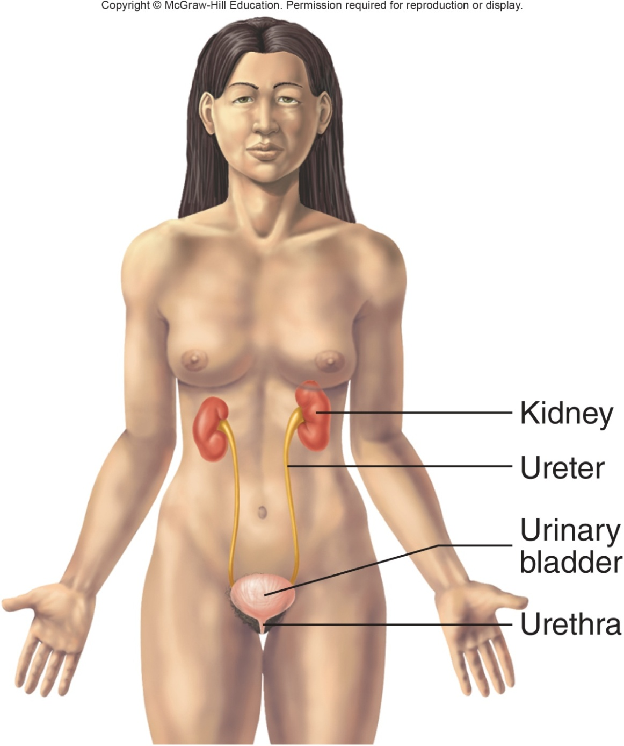
Structures and Functions of the Urinary System
Structures
Kidneys
Ureters
Bladder
Urethra
Functions
Remove wastes
Regulate pH and ion balance
Maintain water balance
Structures and Functions of the Urinary System Appendix
Copyright © McGraw-Hill Education
Notes:
LO 5.10 Describe the functions of the urinary system, common diseases and disorders that affect this system, and related laboratory tests.
Notes:
The urinary system removes liquid wastes, such as urea, from the blood. Wastes are filtered out of the blood in the kidneys to form urine, which then travels through the ureters to the urinary bladder. It is held there until micturition, when the urine travels through the urethra and is excreted from the body.
Metabolic acidosis: A serious condition that results when the body retains too much acid or the kidneys eliminate too much bicarbonate, making the blood too acidic (a lower pH).
Metabolic alkalosis: A serious condition that results when the body retains too much bicarbonate, making the blood too alkaline (a higher pH).
The kidneys also play an important part in homeostasis by secreting hormones:
Erythropoietin, which stimulates red bone marrow to produce red blood cells
Renin, which helps regulate blood pressure

Slide 65
Urinary System: Blood Tests 1
Test | Related Diseases and Disorders
Albumin | Chronic renal failure Glomerulonephritis
Arterial blood gases | Metabolic acidosis, metabolic alkalosis
Blood urea nitrogen (BUN) | Glomerulonephritis Acute tubular necrosis Pyelonephritis Kidney failure Urinary tract obstruction Acute nephritic syndrome Medullary cystic kidney disease
Creatinine | Acute tubular necrosis Glomerulonephritis Urinary tract obstruction Diabetic nephropathy Hemolytic-uremic syndrome
Notes:
LO 5.10 Describe the functions of the urinary system, common diseases and disorders that affect this system, and related laboratory tests.
Notes:
In general, blood tests for the urinary system help determine how efficiently the system is removing wastes from the blood.
Albumin: Measures the level of albumin in blood serum
Blood urea nitrogen (BUN): Measures the level of urea nitrogen in the blood; urea nitrogen is formed when proteins break down
Creatinine: Measures the level of creatinine in the blood; creatinine is formed when creatine in the muscles breaks down

Slide 66
Urinary System: Blood Tests 2
Test | Related Diseases and Disorders
Electrolytes (Na, K, Cl, CO₂) | Decreased levels in chronic renal insufficiency; increases in body water, diuretic administration
Glomerular filtration rate | Chronic renal failure Acute renal failure
Serum osmolality | Uremia
Notes:
LO 5.10 Describe the functions of the urinary system, common diseases and disorders that affect this system, and related laboratory tests.
Notes:
Electrolytes (Na, K, Cl, CO₂): Measures blood levels of sodium, potassium, chloride, and carbon dioxide (in the form of bicarbonate (HCO₃−)
Glomerular filtration rate: Estimates how much blood passes through the glomeruli in the kidneys per minute; glomeruli are the structures in the kidneys that filter waste product from the blood
Serum osmolality: Measures the amounts of chemicals in blood serum to determine the water balance in the body

Slide 67
Urinary System: Other Tests
Test | Related Diseases and Disorders
Creatinine clearance | Acute tubular necrosis Bladder obstruction End-stage renal failure Glomerulonephritis Renal ischemia
Renal stone analysis | Nephrolithiasis
Urine culture | Urinary tract infections
Urinalysis | Acute nephritic syndrome Acute tubular necrosis Atheroembolic renal disease Bladder stones Chronic glomerulonephritis Chronic renal failure Cystinuria Enuresis Acute pyelonephritis Urethritis
Notes:
LO 5.10 Describe the functions of the urinary system, common diseases and disorders that affect this system, and related laboratory tests.
-----
Notes:
Non-blood tests examine the urine for abnormalities that may indicate a disorder of the urinary or other body system.
Creatinine clearance: Compares the level of creatinine in the blood and urine; requires both a blood sample and a urine sample
Renal stone analysis: Stones and crystals passed in the urine are examined and chemically identified
Urine culture: Urine is placed in a culture medium, and any microbial growth is examined microscopically; a sensitivity (culture and sensitivity or C&S) is often done on the microbial growth to help determine the most effective antimicrobial agent to remove the infection
Urinalysis: Examination of the physical and chemical properties of urine, including a microscopic evaluation

Slide 68
Female and Male Reproductive Systems
Learning Outcome 5.11

Slide 69
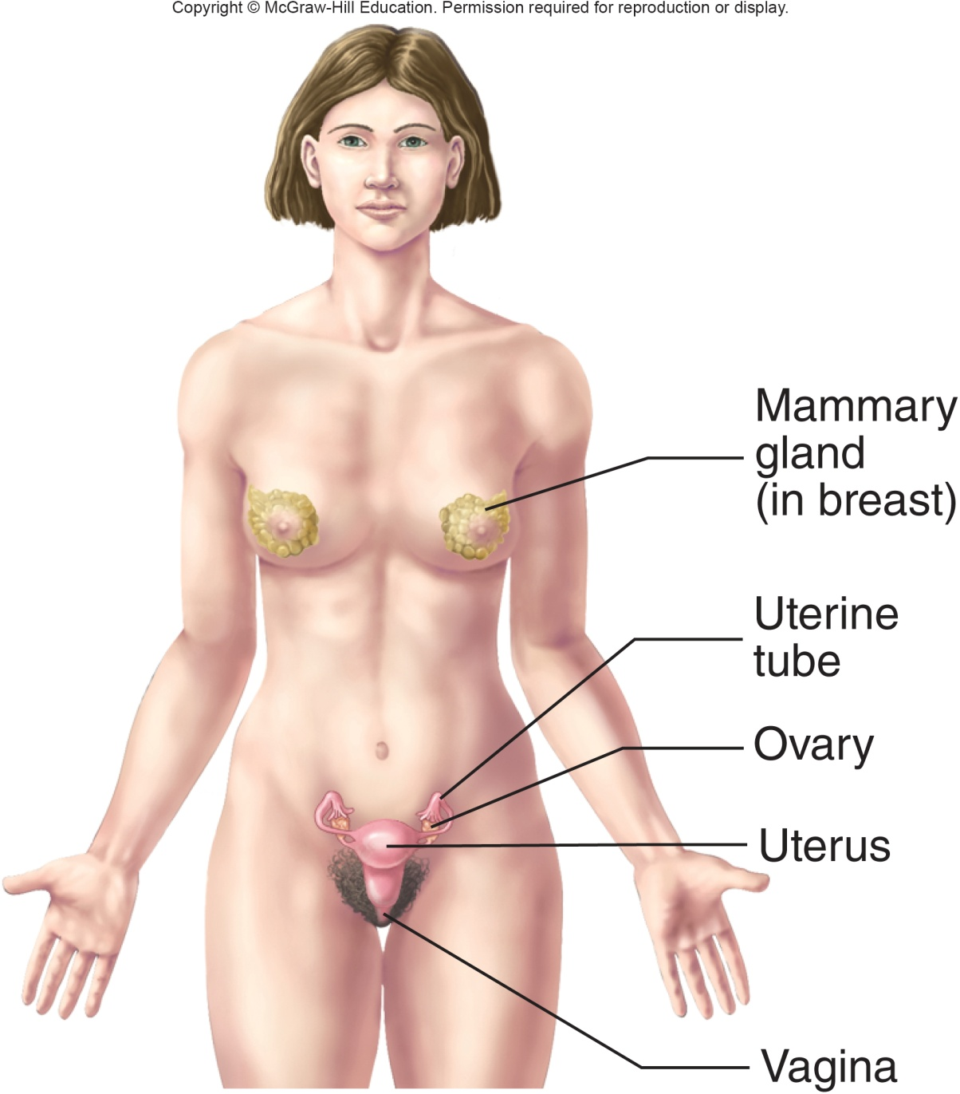
Structures and Functions of the Female Reproductive System
Structures
Ovaries
Vagina
Uterus
Mammary glands
Associated structures
Functions
Produce oocytes, ova, and hormones
Fetal development
Structures and Functions of the Female Reproductive System Appendix
Copyright © McGraw-Hill Education
Notes:
LO 5.11 Describe the functions of the female and male reproductive systems, common diseases and disorders that affect these systems, and related laboratory tests.
Notes:
The female reproductive system produces the oocytes, which develop into the female sex cells (ova, or eggs). If an egg is fertilized by sperm, this system nurtures the resulting fetus until birth. After birth, it produces milk for the newborn. The female reproductive system also produces hormones that influence sexual function and behaviors.

Slide 70
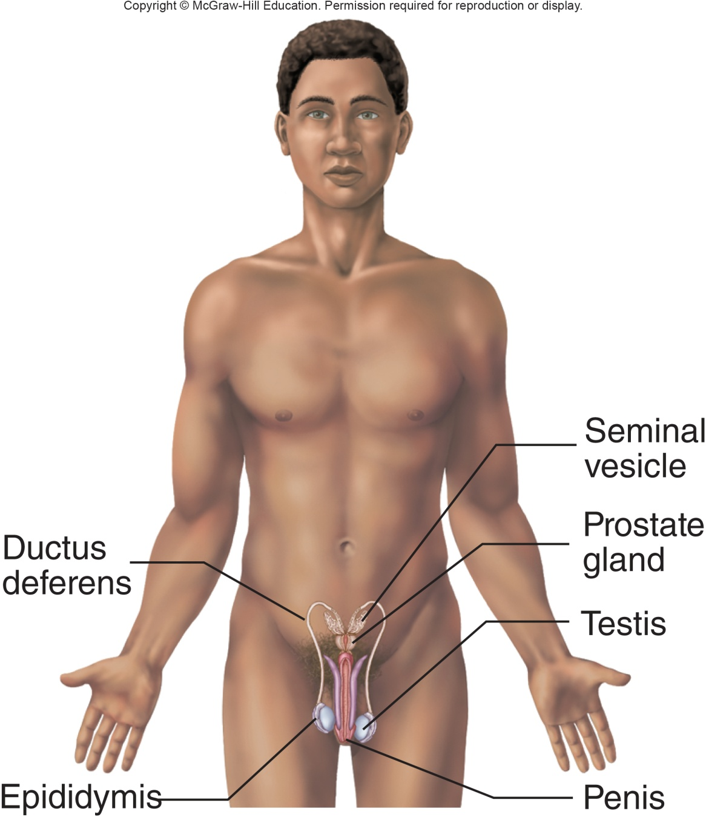
Structures and Functions of the Male Reproductive System
Structures
Testes
Accessory structures
Ducts
Penis
Functions
Produce and transport sperm
Produce hormones
Structures and Functions of the Male Reproductive System Appendix
Copyright © McGraw-Hill Education
Notes:
LO 5.11 Describe the functions of the female and male reproductive systems, common diseases and disorders that affect these systems, and related laboratory tests.
Notes:
The male reproductive system produces the male sex cells (sperm) and transports them through the penis and into the female vagina to fertilize a female egg. It also produces hormones that influence sexual functions and behaviors.

Slide 71
Reproductive Systems: Blood Tests 1
Test | Related Diseases and Disorders
Acid phosphatase | Prostate cancer, prostatic hypertrophy, prostatitis
Cancer antigens | Breast cancer, ovarian cancer
Human chorionic gonadotropin (hCG) | Normal or ectopic pregnancy Miscarriage Ovarian cancer Hydatidiform mole of the uterus Uterine cancer Testicular cancer
Estradiol | Abnormal sexual development Ovarian cancer Menstrual abnormalities Turner syndrome
Notes:
LO 5.11 Describe the functions of the female and male reproductive systems, common diseases and disorders that affect these systems, and related laboratory tests.
Notes:
Acid phosphatase: Measures the amount of acid phosphatase in the blood
Cancer antigens: Detects the presence of cancer antigen CA-15-3 or CA-125
Human chorionic gonadotropin (hCG): Qualitative test determines whether the hormone is present; quantitative measures its level in the blood
Estradiol : Measure the amount of this hormone in the blood

Slide 72
Reproductive Systems: Blood Tests 2
Test | Related Diseases and Disorders
Follicle-stimulating hormone (FSH) | Abnormal sexual development Menopause Polycystic ovary syndrome Ovarian cysts Infertility
Human chorionic gonadotropin (hCG) | Normal or ectopic pregnancy Miscarriage Ovarian cancer Hydatidiform mole of the uterus Uterine cancer Testicular cancer
Luteinizing hormone | Females: Menopause Polycystic ovary disease Turner syndrome
Notes:
LO 5.11 Describe the functions of the female and male reproductive systems, common diseases and disorders that affect these systems, and related laboratory tests.
Notes:
Follicle-stimulating hormone (FSH): Measure the amount of this hormone in the blood
Human chorionic gonadotropin (hCG): Qualitative test determines whether the hormone is present; quantitative measures its level in the blood
Luteinizing hormone (LH) and progesterone: Measure the amount of these hormones in the blood

Slide 73
Reproductive Systems: Blood Tests 32
Test | Related Diseases and Disorders
Luteinizing hormone | Males: Anorchia Hypogonadism Klinefelter syndrome
Progesterone | Pregnancy Ovarian cancer Amenorrhea Ectopic pregnancy Adrenal cancer
Prolactin | Galactorrhea Headaches Infertility Erectile dysfunction
Notes:
LO 5.11 Describe the functions of the female and male reproductive systems, common diseases and disorders that affect these systems, and related laboratory tests.
Notes:
Luteinizing hormone (LH) and progesterone: Measure the amount of these hormones in the blood
Prolactin: measures the amount of these hormones in the blood

Slide 74
Reproductive Systems: Blood Tests 43
Test | Related Diseases and Disorders
Prostate-specific antigen (PSA) | Prostate cancer
Rapid plasma reagin (RPR) and VDRL tests | Syphilis
Testosterone | Cancer of the testes or ovaries
Notes:
LO 5.11 Describe the functions of the female and male reproductive systems, common diseases and disorders that affect these systems, and related laboratory tests.
Notes:
Prostate-specific antigen (PSA): Measures the level of PSA in the blood
Rapid plasma reagin and VDRL tests: Determine whether antibodies are present to Treponema pallidum, the organism that causes syphilis
Testosterone: Measures the level of testosterone in the blood

Slide 75
Reproductive Systems: Other Tests
Test | Related Diseases and Disorders
Microbiology cultures | Cystitis Epididymitis Other reproductive system infections
PAP smear | Cervical cancer
Semen analysis | Infertility Klinefelter syndrome
Tissue biopsy | Cancer of various reproductive organs
Tumor markers | Cancer of various reproductive organs
Notes:
LO 5.11 Describe the functions of the female and male reproductive systems, common diseases and disorders that affect these systems, and related laboratory tests.
Notes:
Microbiology cultures are performed on semen and other secretions to isolate and identify infection-causing bacteria.
In a PAP smear, cells are scraped from the opening of the cervix and are examined microscopically for evidence of abnormal cells that might indicate cervical cancer.
Semen analysis: Measures the amount and quality of semen and sperm
Tissue biopsy: Removal of a small piece of tissue through a biopsy needle for examination
Tumor markers: Determines whether substances called tumor markers are present in blood or body fluids; tumor markers indicate specific types of tumors

Slide 76
Test Panels and Profiles
Learning Outcome 5.12

Slide 77
Test Panels vs. Test Profiles
Test Panels
Group of tests that assess one organ or system
Test Panels
Group of tests that assess at least two body system
May be designed to assess overall health and well-being.
Notes:
LO 5.12 Explain the use of test panels in the assessment of specific body systems or general health screening.
Notes:
Test panel: Laboratory tests associated with one organ or body system.
Test profile: Group of laboratory tests that provide assessment over at least two body systems.

Slide 78
Examples of Test Panels
Test | Related Diseases and Disorders
Coagulation panel | (Activated) partial thromboplastin time (APPT, PTT) Fibrinogen (Fibr) Prothrombin time (PT) Platelet count
Lipid panel | Cholesterol (Chol) HDL LDL VLDL Triglycerides (Trig)
Liver panel | Albumin Alkaline phosphatase (ALP) Alanine aminotransferase (ALT) Aspartate aminotransferase (AST) Gamma-glutamyltransferase (GGT)
Notes:
LO 5.12 Explain the use of test panels in the assessment of specific body systems or general health screening.
Notes:
Other examples of test panels
Hepatitis panel: Hepatitis A virus antibody, IgM; hepatitis B virus core antibody, IgM; hepatitis B virus surface antigen; hepatitis C virus antibody
Hypercoagulation panel: All tests in the coagulation panel, plus: anticardiolipin antibody; APC resistance; inhibitor status (ATIII, protein C, protein S); factor assays (V, VIII); gene mutation studies (prothrombin, Factor V Leiden); homocysteine; lupus anticoagulant studies; methyltetrahydrofolate reductase (MTHFR)
Obstetrics (OB) panel: ABO group / Rh type, antibody screen; complete blood count (CBC, including differential); cystic fibrosis gene mutation (according to family history); hepatitis B surface antigen; rapid plasma reagin (RPR); rubella IgG
Renal panel: Albumin; blood urea nitrogen (BUN); calcium; creatinine; glucose; electrolytes (Cl, CO₂, Na, K); phosphorus
Respiratory virus panel: Adenovirus; coronaviruses (HKU1, NL63, 229E, OC43); human rhinovirus/enterovirus; influenza (A, A/H1, A/H3, B, H1N1); parainfluenza virus (1, 2, 3, 4); respiratory syncytial virus (A, B)

Slide 79
Examples of Test Profiles
Test | Related Diseases and Disorders
Basic metabolic profile (BMP) | Blood urea nitrogen (BUN) Calcium (Ca) Carbon dioxide (CO₂) in the form of bicarbonate (HCO3) Chloride Creatinine Glucose Potassium (K) Sodium (Na)
Comprehensive metabolic profile (CMP) | All tests in the basic metabolic profile, plus: Albumin Alanine amino transferase (ALT) Alkaline phosphatase (ALP) Aspartate amino transferase (AST) Bilirubin Total protein
Notes:
LO 5.12 Explain the use of test panels in the assessment of specific body systems or general health screening.

Slide 80
Chapter Summary 1
The integumentary system consists of the skin, hair, and nails; common disorders include viruses that affect the skin, allergies, and cancer. Common laboratory tests are listed in Table 5-1.
The skeletal system consists of bones, associated cartilages, ligaments, and joints; common disorders include osteoporosis, osteoarthritis, rheumatoid arthritis, gout, osteosarcoma, and nutritional deficiencies. Common laboratory tests are listed in Table 5-2.
The muscular system consists of the muscles and connective tissue, including tendons and ligaments. Common disorders include strains and sprains, tendonitis, torticollis, fibromyalgia, myasthenia gravis, and muscular dystrophy. Common laboratory tests are listed in Table 5-3.
Notes:
LO 5.1 Describe the functions of the integumentary system, common diseases and disorders that affect this system, and related laboratory tests.
LO 5.2 Describe the functions of the skeletal system, common diseases and disorders that affect this system, and related laboratory tests.
LO 5.3 Describe the functions of the muscular system, common diseases and disorders that affect this system, and related laboratory tests.

Slide 81
Chapter Summary 2
The organs of the lymphatic and immune systems include the thymus, lymph nodes, lymphatic vessels, glands, tonsils, and spleen.
The immune system protects the body against harmful microorganisms by producing antibodies against specific antigens.
The lymphatic system removes foreign substances from the blood and lymph.
Diseases that affect the lymphatic and immune systems include mononucleosis, HIV/AIDS, and lymphedema. Common laboratory tests are listed in Table 5-4.
Notes:
LO 5.4 Describe the functions of the lymphatic and immune systems, common diseases and disorders that affect these systems, and related laboratory tests.

Slide 82
Chapter Summary 3
The respiratory system includes the lungs, trachea, bronchi, bronchioles, and nasal and oral cavities. Common disorders include upper respiratory infections, bronchitis, pneumonia, lung cancer, and chronic obstructive pulmonary disease (COPD). Common laboratory tests are listed in Table 5-5.
The digestive system organs are the mouth, pharynx, esophagus, stomach, small intestine, large intestine, rectum, and anus; the accessory organs are the teeth, tongue, salivary glands, liver, gallbladder, and pancreas. Common disorders include diabetes mellitus, ulcers, gastroesophageal reflux disease (GERD), and hepatitis. Common laboratory tests are listed in Table 5-6.
Notes:
LO 5.5 Describe the functions of the respiratory system, common diseases and disorders that affect this system, and related laboratory tests.
LO 5.6 Describe the functions of the digestive system, common diseases and disorders that affect this system, and related laboratory tests.

Slide 83
Chapter Summary 4
The central nervous system consists of the brain and the spinal cord; the peripheral nervous system consists of the cranial nerves and spinal nerves. Disorders include cerebrovascular accident, Alzheimer’s disease, and sciatica. Common laboratory tests are listed in Table 5-7.
The endocrine glands include the hypothalamus, pituitary, pineal body, thyroid, parathyroid, thymus, adrenal cortex, adrenal medulla, pancreas, ovaries, and testes. Most disorders are caused by glands over- or under-secreting hormones. Common laboratory tests are listed in Table 5-8.
Notes:
LO 5.7 Describe the functions of the nervous system, common diseases and disorders that affect this system, and related laboratory tests.
LO 5.8 Describe the functions of the muscular system, common diseases and disorders that affect this system, and related laboratory tests.

Slide 84
Chapter Summary 5
The cardiovascular system includes the heart and blood vessels. Diseases and disorders include heart failure, myocardial infarction, and coronary artery disease. Common laboratory tests are listed in Table 5-9.
The urinary system includes the kidneys, bladder, ureters, and urethra. Common diseases and disorders include renal failure, glomerulonephritis, urinary tract infections, kidney stones, and cystitis. Common laboratory tests are listed in Table 5-10.
Notes:
LO 5.9 Describe the functions of the cardiovascular system, common diseases and disorders that affect this system, and related laboratory tests.
LO 5.10 Describe the functions of the urinary system, common diseases and disorders that affect this system, and related laboratory tests.

Slide 85
Chapter Summary 6
The female reproductive system consists of the ovaries, vagina, uterus, mammary glands, and associated structures.
The male reproductive system consists of the testes, accessory structures, ducts, and penis.
Diseases and disorders of the reproductive systems include infertility, sexually transmitted infections (STIs), and cancer of the various organs. Common laboratory tests are listed in Table 5-11.
Notes:
LO 4.11 Describe the functions of the female and male reproductive systems, common diseases and disorders that affect these systems, and related laboratory tests.

Slide 86
Chapter Summary 7
Test panels provide physicians with an efficient way to order several tests that assess a specific organ or body system.
Test profiles provide physicians with an efficient way to order several tests that assess two or more body systems and look at overall well-being.
Table 5-12 provides examples of test panels and profiles.
Notes:
LO 5.12 Explain the use of test panels in the assessment of specific body systems or general health screening.

Slide 87
Appendix Slides

Slide 88
Structures of the Skin Appendix
Section view of the skin showing the three layers and the structures in each. The following items are labeled: Epidermis, Dermis, Subcutaneous layer, Hair shaft, Sweat gland pore, Sweat, Stratum corneum, Stratum basale, Capillary, Dermal papilla, Sebaceous gland, Arrector pili muscle, Sweat gland duct, Hair follicle, Sweat gland, Adipose tissue, Blood vessels, Muscle layer.
Structures of the Skin

Slide 89
Structures and Functions of the Skeletal System Appendix
Female in the anatomical position with major bones labeled as follows: Ribs, Pelvis, Tibia, Fibula, Skull, Clavicle, Sternum, Humerus, Vertebral column, Radius, Ulna, Femur.
Structures and Functions of the Skeletal System

Slide 90
Structures and Functions of the Muscular System Appendix
Human in anatomical position with major muscles labeled as follows: Sartorius, Quadriceps femoris, Gastrocnemius, Temporalis, Pectoralis major, Biceps brachii, Rectus abdominis.
Structures and Functions of the Muscular System

Slide 91
Structures of the Lymphatic and Immune Systems Appendix
Human in anatomical position with structures of the lymphatic and immune systems labeled as follows: Thymus, Axillary lymph node, Lymphatic vessel, Tonsils, Cervical lymph node, Mammary plexus, Thoracic duct, Spleen, Inguinal lymph node.
Structures of the Lymphatic and Immune Systems

Slide 92
Functions of the Lymphatic and Immune Systems Appendix
Human in anatomical position with structures of the lymphatic and immune systems labeled as follows: Thymus, Axillary lymph node, Lymphatic vessel, Tonsils, Cervical lymph node, Mammary plexus, Thoracic duct, Spleen, Inguinal lymph node.
Functions of the Lymphatic and Immune Systems

Slide 93
Structures of the Respiratory System Appendix
Human in anatomical position with the structures of the respiratory system labeled as follows: Nose, Nasal cavity, Pharynx (throat), Larynx, Trachea, Bronchi, Lungs.
Structures of the Respiratory System

Slide 94
Functions of the Respiratory System Appendix
Human in anatomical position with the structures of the respiratory system labeled as follows: Nose, Nasal cavity, Pharynx (throat), Larynx, Trachea, Bronchi, Lungs.
Functions of the Respiratory System

Slide 95
Structures of the Digestive System Appendix
Human in anatomical position with the structures of the digestive system labeled as follows: Pharynx (throat), Oral cavity (mouth), Liver, Gallbladder, Appendix, Rectum, Anus, Salivary glands, Esophagus, Stomach, Pancreas, Small intestine, Large intestine
Structures of the Digestive System

Slide 96
Functions of the Digestive System Appendix
Human in anatomical position with the structures of the digestive system labeled as follows: Pharynx (throat), Oral cavity (mouth), Liver, Gallbladder, Appendix, Rectum, Anus, Salivary glands, Esophagus, Stomach, Pancreas, Small intestine, Large intestine
Functions of the Digestive System

Slide 97
Structures and Functions of the Nervous System Appendix
Human in anatomical position with structures of the nervous system labeled as follows: Brain, Spinal cord, Nerve, Cauda equina
Structures and Functions of the Nervous System

Slide 98
Structures of the Endocrine System Appendix
Human in anatomic position with structures of the endocrine system labeled as follows: Hypothalamus, Pituitary, Thyroid, Thymus, Adrenals, Ovaries (female), Pineal body, Parathyroids (posterior part of thyroid), Pancreas (islets), Testes (male)
Structures of the Endocrine System

Slide 99
Function of the Endocrine System Appendix
Human in anatomic position with structures of the endocrine system labeled as follows: Hypothalamus, Pituitary, Thyroid, Thymus, Adrenals, Ovaries (female), Pineal body, Parathyroids (posterior part of thyroid), Pancreas (islets), Testes (male)
Functions of the Endocrine System

Slide 100
Structures and Functions of the Cardiovascular System Appendix
Human in anatomic position with structures of the cardiovascular system labeled as follows: Carotid artery, Jugular vein, Heart, Brachial artery, Inferior vena cava, Superior vena cava, Pulmonary trunk, Aorta, Femoral artery and vein
Structures and Functions of the Cardiovascular System

Slide 101
Structures and Functions of the Urinary System Appendix
Human in anatomical position with structures of the urinary system labeled as follows: Kidney, Ureter, Urinary bladder, Urethra
Structures and Functions of the Urinary System

Slide 102
Structures and Functions of the Female Reproductive System Appendix
Female in anatomical position with structures of the female reproductive system labeled as follows: Mammary gland (in breast), Uterine tube, Ovary, Uterus, Vagina
Structures and Functions of the Female Reproduction System

Slide 103
Structures and Functions of the Male Reproductive System Appendix
Male in anatomical position with structures of the male reproductive system labeled as follows: Ductus deferens, Epididymis, Seminal vesicle, Prostate gland, Testis, Penis
Structures and Functions of the Male Reproduction System

