Slide 1
Chapter 7
Patient and Specimen Requirements

Slide 2
Learning Outcomes
7.1 Identify the parts and functions of a laboratory requisition.
7.2 Identify the professional communication techniques of the phlebotomist.
7.3 Comply with ethical and legal standards for professional communication.
7.4 Carry out proper patient identification.
7.5 Define the legal/ethical importance of specimen identification.
7.6 Recognize patient factors that may affect specimen quality and test results.
7.7 Explain the phlebotomist’s role in maintaining accurate and secure blood collection documentation.
Notes:
Introduction:
The phlebotomist’s role begins with receiving an order for a laboratory test on a requisition. The most important part of the phlebotomist’s job is properly identifying the patient, followed by correctly obtaining and labeling all specimens. Phlebotomists should be aware of various patient, procedure, and other factors that affect laboratory test results.

Slide 3
N A A C L S Competencies 1
4.1 Demonstrate understanding of the importance of specimen collection and specimen integrity in the delivery of patient care.
4.2 Describe the legal and ethical importance of proper patient/sample identification.
4.3 Describe the types of patient specimens that are analyzied in the clinical laboratory.
4.4 Define the phlebotomist’s role in collecting and/or transporting these specimens to the laboratory.
4.5 List the general criteria for suitability of a specimen for analysis, and reasons for specimen rejection or re–collection.

Slide 4
N A A C L S Competencies 2
4.6 Explain the importance of timed, fasting, and S T A T specimens, as related to specimen integrity and patient care.
7.1 Demonstrate understanding of requisitioning, specimen transport, and specimen processing.
7.2 Describe the process by which a request for a laboratory test is generated.
7.3 Instruct patients in the proper collection and preservation for nonblood specimens.
9.5 Demonstrate an understanding of the major points of the American Hospital Association’s Patient’s Bill of Rights and the Patient’s Bill of Rights from the workplace.

Slide 5
N A A C L S Competencies 3
9.6 Comply with the American Hospital Association’s Patient’s Bill of Rights and the Patient’s Bill of Rights from the workplace. (Patient Care Partnership)
9.9 Define and use medicolegal terms and discuss policies and protocol designed to avoid medicolegal problems.
9.11 Demonstrate basic understanding of age specific or psychosocial considerations involved in the performance of phlebotomy procedures on various age groups of patients.

Slide 6
Key Terms 1
Accession number.
Ambulatory.
Analyte.
A S A P.
Assault.
Basal state.
Battery.
Bedside manner.
Code of ethics.
Confidentiality.
Diurnal variation.
Edema.
Electronic health record (E H R).
Electronic medical record (E M R).
Ethics.
Fasting.
Health Insurance Portability and Accountability Act (H I P A A).
Hemoconcentration.
6

Slide 7
Key Terms 2
Hemodilution.
Informed consent.
Interfering substances.
Law.
Lipemic.
Peak level.
Postprandial.
Rapport.
Requisition.
Respondeat superior.
Sedentary.
STAT (S T).
Therapeutic drug monitoring (T D M).
Trough level.
7

Slide 8
Learning Outcome 7.1
Laboratory Requisitions

Slide 9
Laboratory Requisitions 1
Tests must be ordered by a qualified healthcare practitioner.
Inpatient orders.
Chart.
Electronic medical record.
Electronic health record.
Outpatient orders.
Prescription/requisition.
Telephone or fax.
Laboratory information system (L I S).
Notes:
LO 7.1 Identify the parts and functions of a laboratory requisition.
Notes:
Electronic health record (EHR): Medical information stored in computerized formats
Electronic medical record (EMR): Another term used to describe computerized documents
The federal government mandated the adoption of EMR/EHR by 2015 as part of the Health Information Technology for Economic and Clinical Health (HITECH) Act, enacted as part of the American Recovery and Reinvestment Act of 2009.
Requisition: Documentation of a blood test order, usually generated by or at the request of a physician

Slide 10
Processing Laboratory Requisitions
Entered in H I S or L I S.
Documentation of tests ordered.
Computer provides accession number.
Notes:
LO 7.1 Identify the parts and functions of a laboratory requisition.
Notes:
All test orders result in the generation of a laboratory requisition, which serves as hard copy documentation of the tests ordered. When the order is entered into the computer, the computer auto-assigns an accession number. This number is assigned sequentially in the order in which the test orders are received and often consists of a Julian date (the day of the year) followed by the test number. For example, the 110th test order received on June 15, 2012 would be 12-167-110. The “12” indicates the year (2012); the “167” indicates June 15, which is the 167th day of the year; and the “110” indicates that this is the 110th test order received on this date. A test ordered to be done on June 15, 2012 would begin with the numbers for the year (12) and day of the year (167), followed by a number indicating what number test it is for that day, in this case, test number 110.
HIS (hospital information system): Stores EHRs for patients seen in the hospital; communicates with computer systems specifically designed for individual hospital departments, including the laboratory
LIS (laboratory information system): Maintains a database of laboratory-related information on all patient lab orders, including:
Specimen collection
Test results
Whether the specimen was sent to another lab for testing
Follow-up information on discrepancies

Slide 11
Required Information for Requisitions
Patient’s name.
Patient’s date of birth.
Patient’s medical record number.
Patient’s location (if inpatient).
Ordering physician’s name.
Type of test to be performed.
Test status.
Date and time test is to be performed.
Notes:
LO 7.1 Identify the parts and functions of a laboratory requisition.
Notes:
Every requisition must contain the basic information listed on this slide. Additional information is needed for special testing conditions:
Fasting (no food or liquids except water) prior to the draw
Need for blood to be drawn at an exact time
Timing of tests:
STAT (ST): Collect and deliver to the laboratory immediately
ASAP: Collect as soon as possible, after any STAT collections are completed
TIMED: Collect as close to the time indicated as possible
Routine (RT): Collect and deliver to the laboratory in a timely manner, in accordance with facility policy

Slide 12
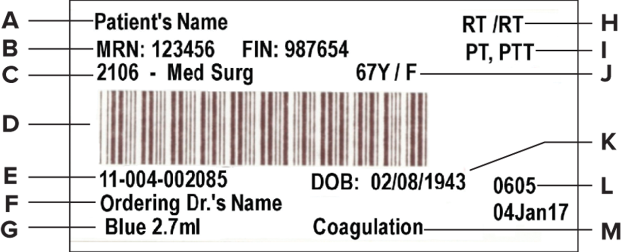
Computer–Generated Requisition Label
Access the text alternative for these images
Notes:
LO 7.1 Identify the parts and functions of a laboratory requisition.
Notes:
Example of a computer-generated laboratory test requisition for a prothrombin time test.
Computer-generated requisitions that are used as specimen labels may also contain the following items:
Computerized barcode
Laboratory accession number
Type of tube required
Volume required
Laboratory section performing the test

Slide 13
Learning Outcome 7.2
Professional Communication

Slide 14

Greeting the Patient
Smile.
Behave professionally.
Introduce yourself.
Show courtesy and respect.
Bedside manner.
Rapport.
©Plush Studios/Blend Images LLC R F
Notes:
LO 7.2 Identify the professional communication techniques of the phlebotomist.
Notes:
The phlebotomist’s greeting sets the tone for a venipuncture procedure. Developing a good bedside manner or rapport can make the phlebotomist’s job more pleasant and the patient more comfortable.
Smile and use a pleasant tone of voice.
Behave in a professional, confident manner.
Show courtesy and respect for the patient.
Be aware of cultural differences.
Bedside manner: Behavior that puts a patient at ease while healthcare personnel perform a procedure
Rapport: Behavior, courtesy, and respect given a patient
Outpatient settings include clinics, outpatient departments of hospitals, patients’ homes, long-term healthcare facilities, and physician offices. In these settings, the patient may not be expecting a phlebotomist and may therefore become anxious. Behave kindly and professionally to help reduce the patient’s anxiety.
Inpatients may not be surprised at a phlebotomist’s visit, but the phlebotomist should behave courteously. Knock and wait a few seconds for a response before entering a room, even if the patient’s door is open. If the curtain is pulled around the patient’s bed, talk to the patient through the curtain before pulling it back and entering.
View the video, “Identifying the Patient Prior to Venipuncture or Skin Puncture,” for more information about interacting and communicating with the patient before performing specimen collection.

Slide 15
Patient Interaction
Patients may attempt to take out frustration or anger on the phlebotomist.
Remain polite and professional.
Do not take patient comments personally.
Be aware of unsafe situations.
If patient becomes hostile, leave the room as quickly and calmly as possible.
Notes:
LO 7.2 Identify the professional communication techniques of the phlebotomist.
Notes:
Patients often do not feel well and may be angry or scared about their medical condition. Be considerate and polite, but always be aware of your surroundings and your personal safety.

Slide 16
Life Span Considerations
Pediatric patients.
Talk directly to child.
Never lie.
Keep distracted.
Geriatric patients.
Repeat questions or instructions as necessary.
Be compassionate.
Notes:
LO 7.2 Identify the professional communication techniques of the phlebotomist.
Notes:
Tips for dealing professionally with pediatric patients:
Talk to pediatric patients directly, even if the child’s parents are present. This helps the child feel involved in the process.
If the child is too young to respond appropriately to questions, it is okay to ask the parents.
Never tell a child that the procedure will not hurt. Be honest. The procedure will probably hurt but only for a few seconds.
Keep the child distracted during the procedure. Keep him/her talking while you quickly perform the procedure.
Enlist the parents to help reassure the child.
Tips for dealing with geriatric patients:
Be prepared to deal with seeing- or hearing-impaired patients. Talk at a normal rate and tone, but face the patient directly.
Repeat questions or instructions as necessary.
Be compassionate and patient. Some geriatric patients may be confused; they may require more time and repeated explanations of who you are, where they are, and what you are about to do.
Do not discuss the actual tests with the patient. If the patient wants to know the purpose of the blood tests, the best response is usually to state that the tests are routine tests ordered by the physician. Refer the patient to the physician for further information.

Slide 17

Sleeping Patients
Awaken gently.
Try not to startle.
Talk softly.
Inform patient before turning on lights.
Never attempt to collect a specimen from a sleeping patient!
©Purestock/Getty Images R F
Notes:
LO 7.2 Identify the professional communication techniques of the phlebotomist.
Notes:
If a patient is asleep when you arrive, wake the patient gently and explain why you are there. You may try nudging the bed instead of touching the patient. Warn the patient to shield his/her eyes before turning on bright lights.
It is important never to attempt to collect a specimen from a sleeping patient. Doing so could cause injury to you and the patient if the patient wakes up and jerks his/her arm.

Slide 18
Learning Outcome 7.3
Healthcare Ethics and Law

Slide 19
Ethics versus. Law
Code of ethics.
Set of written or unwritten rules, procedures, or guidelines.
Examine values, actions, and choices.
Help us determine right from wrong.
Law.
Rule of conduct or action enforced by a controlling authority.
Notes:
LO 7.3 Comply with ethical and legal standards for professional communication.
Notes:
Ethics is a moral philosophy. Acting morally toward others requires putting yourself in their place. How would you feel if you were the patient?
Laws are different from ethics. They are legally enforceable rules of conduct. Laws are necessary to keep society functioning. When a law is violated, a civil or criminal case may be brought against the offender. If the defendant is found guilty of breaking a law, the result may be a fine, imprisonment, or loss of license.

Slide 20
Legal Terms
Respondeat superior.
“Let the master answer”
Employers are responsible for employee actions if performed within scope of practice.
Assault.
Threat or “reasonable apprehension” of bodily harm.
Battery.
Action that causes bodily harm.
Bodily contact made without permission.
Notes:
LO 7.3 Comply with ethical and legal standards for professional communication.
Notes:
Respondeat superior: “Let the master answer;” employers are responsible for their employees’ actions if those actions are performed within their scope of practice
Assault: Threat of bodily harm to another or “reasonable apprehension of bodily harm”
Battery: The action that causes bodily harm; bodily contact made without permission; this includes drawing blood without the patient’s consent

Slide 21
Negligence and Malpractice
Negligence.
Professional neglects to perform in the manner expected by the profession.
Basis for professional malpractice claims.
Malpractice elements.
Duty.
Derelict.
Direct cause.
Damages.
Notes:
LO 7.3 Comply with ethical and legal standards for professional communication.
Notes:
Negligence: The professional fails to perform in the manner expected by the profession; negligence is often the basis for malpractice claims
Malpractice cases must satisfy the following four Ds:
Duty: The healthcare professional must owe a duty of care to the patient.
Derelict: The professional must have breached the duty of care, such as by acting outside the expected standards. An example is a phlebotomist probing repeatedly with a needle when drawing blood.
Direct cause: The breach of duty must have been the direct cause of the patient’s injury.
Damages: The patient must have a legally recognizable injury that is deemed severe enough for compensation.

Slide 22
Preventing Malpractice Cases
Burden of proof is on patient.
Guidelines to prevent malpractice.
Caring.
Communication.
Competence.
Notes:
LO 7.3 Comply with ethical and legal standards for professional communication.
Notes:
The plaintiff, or patient making the accusation of malpractice, bears the burden of proving the malpractice case.
The best way to avoid malpractice cases is to keep the following guidelines in mind as you work:
Caring: Genuinely caring for your patients is one of your most important jobs.
Communication: The more clearly you communicate, the more likely you are to earn your patient’s trust.
Competence: Know your scope of practice, the standards of care, and your own limitations. Participate in job-related continuing education to keep your skills up-to-date.

Slide 23
Patients’ Rights
Patients have the right to:
Refuse care.
Be treated with respect.
Have all records and information classified as confidential.
Be informed about the purpose and expected results of treatments.
Access their medical records.
Notes:
LO 7.3 Comply with ethical and legal standards for professional communication.
Notes:
The American Hospital Association clearly defines patients’ rights in the document, The Patient Care Partnership: Understanding Expectations, Rights and Responsibilities.
To maintain confidentiality, you may need to communicate with the patient’s visitors. If too many visitors are present or if they appear to make the patient anxious, you may ask them politely to leave the room for a few minutes.

Slide 24
Informed Consent
Explain the procedure.
Interpret if necessary.
Gain the attention of distracted patients.
Get parental consent for minor children.
Inform the nurse or healthcare provider if patient refuses.
Notes:
LO 7.3 Comply with ethical and legal standards for professional communication.
Notes:
To provide informed consent, the patient must understand the procedure. Explain the procedure in nonmedical terms, using very simple language.
If the patient does not speak English, use sign language or demonstration, ask an English-speaking family member to interpret, or find an interpreter before continuing with the procedure.
Written consent– not just implied consent– must be obtained when a specimen requires a legal chain of custody, such as a specimen that constitutes legal evidence. In these cases, you must obtain expressed consent. Inform the patient clearly of the procedure and its process, and obtain the patient’s signature on a consent form.
Three instances in which a patient cannot refuse to consent:
The patient is a minor under age 18, and the parent or guardian has given consent.
The patient has a mental impairment.
The patient has been ordered by law to have blood drawn.

Slide 25
Confidentiality
Health Insurance Portability and Accountability Act (H I P A A).
Guidelines that apply to phlebotomists:
Close patients’ room doors when caring for them or discussing their health.
Do not talk about patients in public places.
Turn computer screens so passersby cannot see patient information.
Log off computers when you finish using them.
Do not walk away from patient medical records; close them when leaving.
Notes:
LO 7.3 Comply with ethical and legal standards for professional communication.
Notes:
The Health Insurance Portability and Accountability Act (HIPAA):
Establishes a national standard for electronic healthcare transactions
Protects privacy and confidentiality of patient information
Mandates that patient information cannot be discussed with anyone except the patient unless the patient gives permission
Mandates that patient information cannot be shared among healthcare professionals except for patient treatment
Violation of the provisions of HIPAA can result in fines and/or termination of employment.
Confidentiality: Privacy regarding patient information

Slide 26
Learning Outcome 7.4
Patient Identification

Slide 27
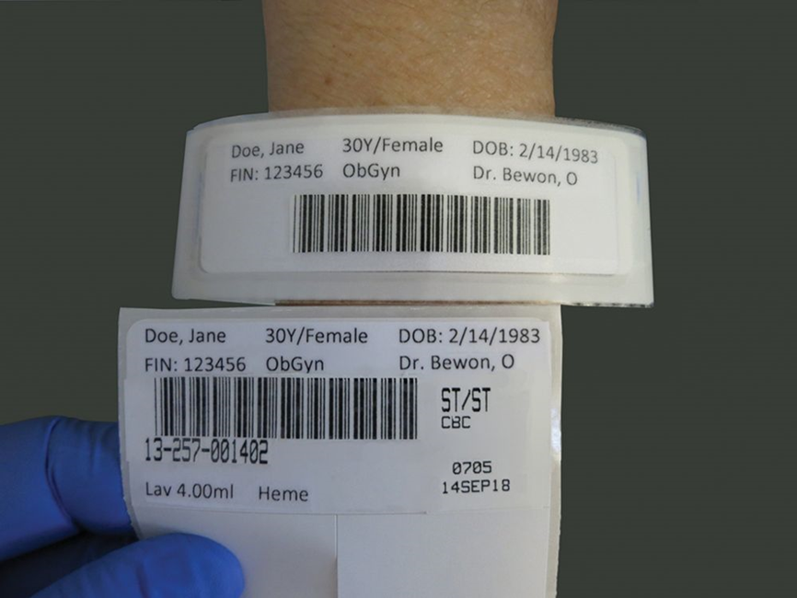
Three–Step Process to Correct Patient Identification
Ask.
Compare.
Confirm or validate.
©Lillian Mundt
Notes:
LO 7.4 Carry out proper patient identification.
Notes:
Patient identification is the most important step in the venipuncture procedure. Proper patient identification is a three-step process.
Ask:
Ask the patient to state his name and date of birth.
Do not call the patient by name until after he states his name.
Compare:
Compare the name on the test requisition form to the patient’s response.
If the patient cannot answer, find another person (nurse or family member) to state the name for you.
Validate:
Confirm the patient’s identification by checking the medical record number on an inpatient’s ID bracelet.
For outpatients, use another form of identification, such as a driver’s license.
If the ID bracelet is not on the patient’s arm, check the ankle. The bracelet is sometimes placed there because of burns, amputation, or edema (swelling) of the arm.
If you have any doubt about the patient’s identity during the three-step check, you must investigate further before proceeding.

Slide 28
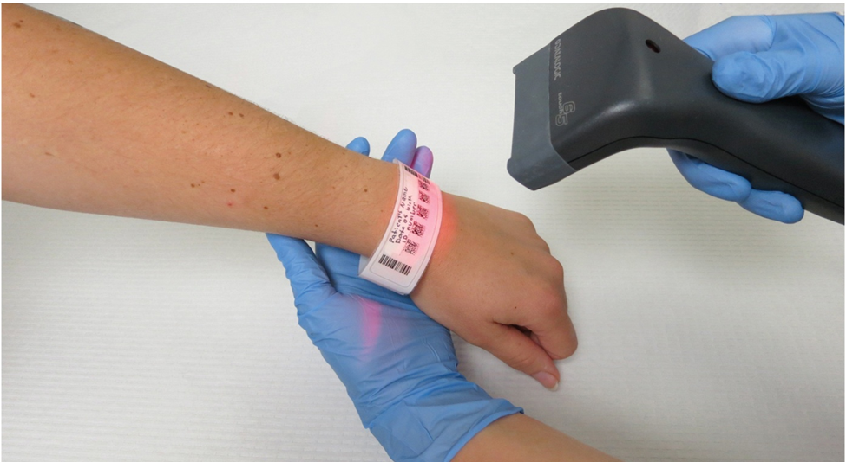
Inpatient Identification
Check ID bracelet.
Compare with requisition.
Ask nurse for verification if patient is unable to respond.
©Lillian Mundt
Notes:
LO 7.4 Carry out proper patient identification.
Notes:
Even if the facility uses a barcode system of identification, you should still ask the patient for name and date of birth if the patient is able to respond. All the identifiers must match exactly. Even if there is only one number or letter difference, you cannot proceed with the venipuncture.
Never rely on a card taped to the door, wall, or end of the bed.
If you find a discrepancy or contradiction, ask the patient’s nurse for assistance. Never proceed if ANY information does not match.
If the patient is not in the assigned room, go to the nurses’ station to find out where the patient is. This is especially important for STAT or timed specimens. If you cannot locate the patient, document the time and the name of the person you spoke with at the nurses’ station and inform the laboratory supervisor.

Slide 29
Outpatient Identification
Identify patients BEFORE they are registered and tests are ordered.
Ask for formal identification.
Ask patient to state full name and date of birth.
If there is any doubt, request further information.
Physician’s name.
Patient’s home address and telephone number.
Notes:
LO 7.4 Carry out proper patient identification.
Notes:
Ask outpatients for some sort of identification card, such as a driver’s license. Ask the patient to verify his or her date of birth, the physician’s name, or home address and phone number. Always use at least two or three verification items.
In an emergency room, if the patient has no ID and cannot respond, ensure correct identification through the licensed practitioner at the bedside.
If any of the information is contradictory, do not proceed.

Slide 30
Identification of Children
Parent or legal guardian must:
State child’s full name and date of birth.
Provide valid photo identification with physician’s written order (if not ordered electronically).
Notes:
LO 7.4 Carry out proper patient identification.

Slide 31
Learn How 7–1: Patient Identification
Ask the patient to state his or her full name and date of birth. Be sure that you do not call the patient by name prior to this because patients with altered mental states may simply repeat the name they hear.
Compare the name on the test requisition form/slip and preprinted labels (if provided) to the patient’s response.
Confirm the patient’s identity by checking the medical record number, patient armband, or some other form of identification, such as a driver’s license.
Notes:
LO 7.4 Carry out proper patient identification.

Slide 32
Learning Outcome 7.5
Specimen Identification

Slide 33
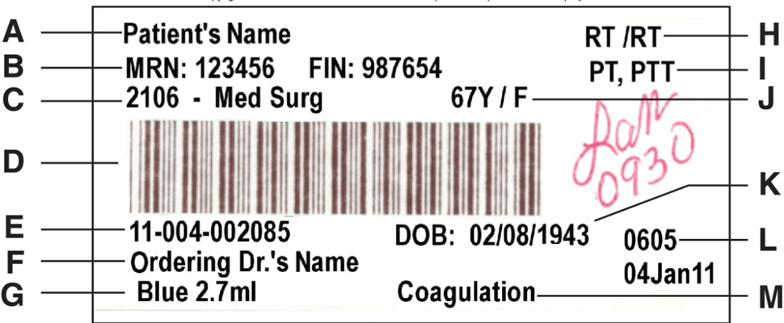
Labeling the Specimen
Label specimens immediately.
After collection.
Before leaving the patient.
Apply label properly.
Never label specimens you did not collect.
Access the text alternative for these images
Notes:
LO 7.5 Define the legal/ethical importance of specimen identification.
Notes:
Use a computer-generated or handwritten label, depending on your facility’s policy.
Never label tubes before collecting the specimen; this may result in the mislabeling of specimens and dire consequences for patients, hospitals, and phlebotomists.

Slide 34

Required Information
Patient’s name.
Patient’s date of birth.
Unique patient identifier.
Specimen collection time and date.
Collector’s identification.
Access the text alternative for these images
Notes:
LO 7.5 Define the legal/ethical importance of specimen identification.
Notes:
Use a computer-generated or handwritten label, depending on your facility’s policy.
Never label tubes before collecting the specimen; this may result in the mislabeling of specimens and dire consequences for patients, hospitals, and phlebotomists.

Slide 35
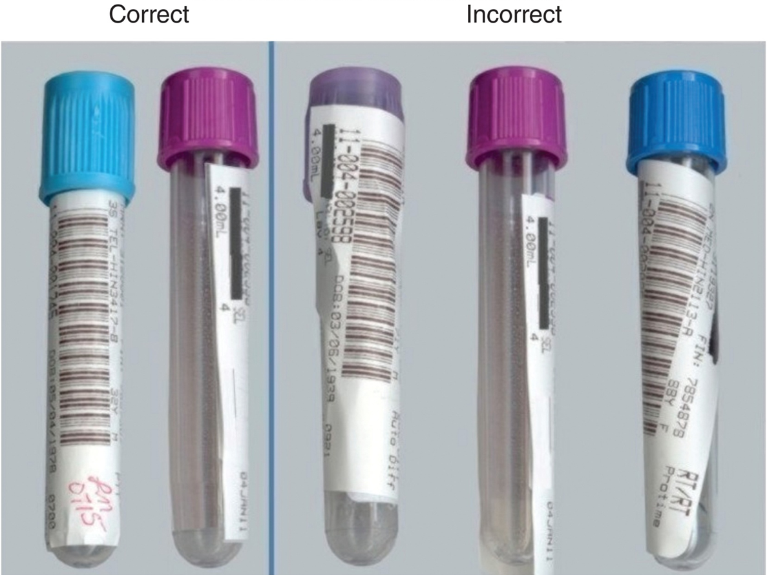
Applying the Label
Access the text alternative for these images
Notes:
LO 7.5 Define the legal/ethical importance of specimen identification.
Notes:
Apply the label properly:
Center the label on the tube.
Do not allow the label to extend over the cap.
Do not allow the label to extend below the bottom of the tube.
Keep the label straight, not crooked on the tube.

Slide 36
Learning Outcome 7.6
Factors Affecting Specimen Quality and Results

Slide 37
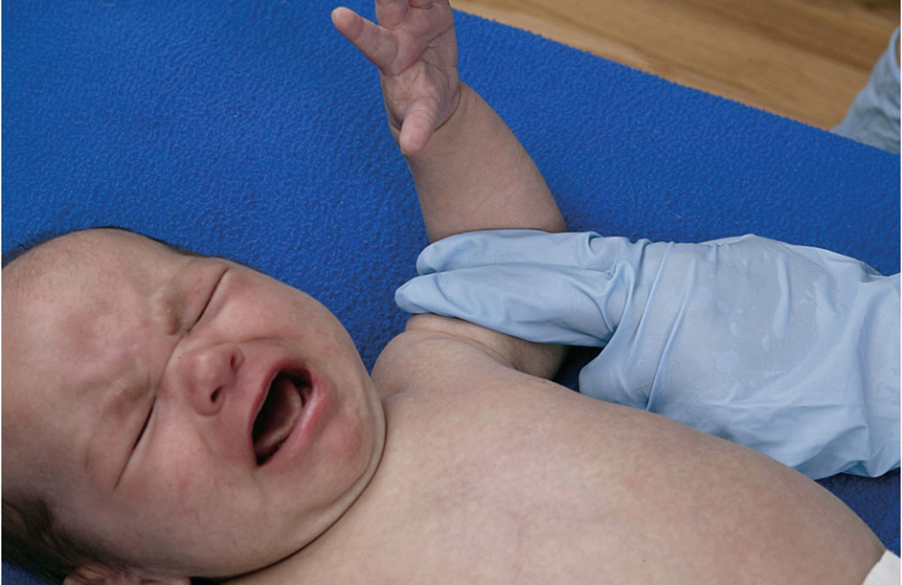
Patient Factors
Nonfasting.
Stress.
Posture.
Exercise.
Diurnal variations.
Alcohol.
Tobacco.
©McGraw-Hill Education/Rick Brady, photographer
Notes:
LO 7.6 Recognize patient factors that may affect specimen quality and test results.
Notes:
Stress:
Anxiety, fear, or nervousness can affect analyte levels.
Effects are similar to those of strenuous exercise.
If you are asked to collect a specimen for a crying infant or for someone who just completed strenuous exercise, add a note to the specimen collection documentation indicating the patient’s situation.
Posture:
Changes in activity from ambulatory to sedentary affect analyte levels.
Lack of activity causes the body’s tissues to allow more water to enter the circulation, which increases plasma volume.
Calcium may decrease in bedridden patients.
Strenuous exercise:
Elevated white blood cell counts
Alterations in the coagulation system
Fluctuations in various enzyme and other chemical levels

Slide 38



Environmental Factors
Altitude.
Geographic location.
Temperature.
Hydration.
Posture, exercise, stress.
Clockwise from top: ©GOODSHOOT/Alamy Stock Photo RF; ©Stockbyte/Getty Images R F; ©JGI/Blend Images LLC R F
Notes:
LO 7.6 Recognize patient factors that may affect specimen quality and test results.
Notes:
High altitude:
Increased RBC count
Increased hemoglobin level
Increased level of urates
Geographical location:
Areas with high automobile traffic (increased lead and carboxyhemoglobin levels)
Areas near smelting plants (increased lead and zinc levels)
Areas with “hard” water (increased lipid and magnesium levels)
Temperature:
Changes in environmental temperature affect the distribution of water between the tissues and blood.
Plasma protein levels may drop slightly during severe exposure to heat.
Electrolytes may be out of balance during profuse sweating.
Hydration:
Dehydration leads to hemoconcentration (substances in the blood increase). This may occur due to persistent vomiting, diarrhea, diabetic acidosis, or inadequate fluid intake.
Overhydration leads to hemodilution (decreased levels of substances in the blood). This may occur due to water intoxication, salt retention syndromes, or infusion of massive amounts of intravenous fluids.

Slide 39
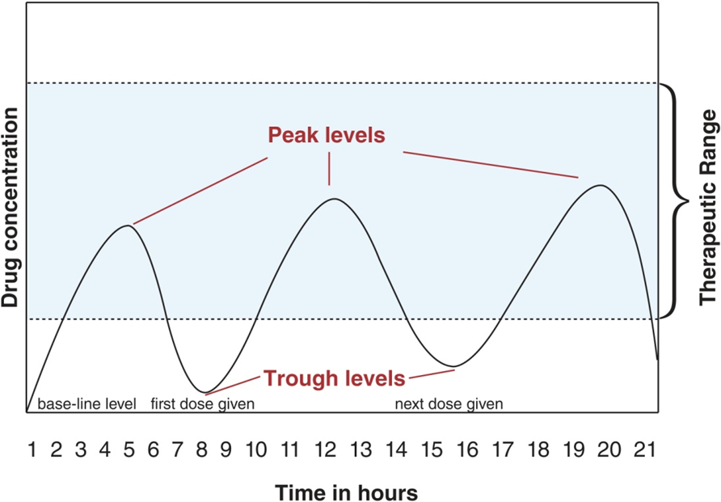
Timing of Specimen Collection
Patient basal state.
Diurnal variation.
Timing for drug levels.
Access the text alternative for these images
Notes:
LO 7.6 Recognize patient factors that may affect specimen quality and test results.
Notes:
Basal state:
Patient who has been fasting and not exercising for at least 12 hours
Some specimens should be drawn in the early morning to provide the most accurate assessment of analytes such as electrolytes, glucose, lipids, and proteins.
Diurnal variation:
Refers to variation in the analyte at different times throughout the day
Affects hormones and some white blood cell types
Analyte: Substance being tested
Timing:
Specimens for most laboratory tests can be drawn at any time throughout the day.
Some tests require special patient preparation, such as fasting (nothing to eat or drink, except plain water) and timing of the sample collection, such as basal or postprandial (after eating).
Therapeutic drug monitoring (TDM): Monitoring the amount of a therapeutic drug in the blood
Peak level: Specimen collected when serum drug level is at its highest, shortly after a medication is given
Trough level: Specimen collected when the drug level in the blood is at its lowest, usually immediately before the next scheduled dose

Slide 40
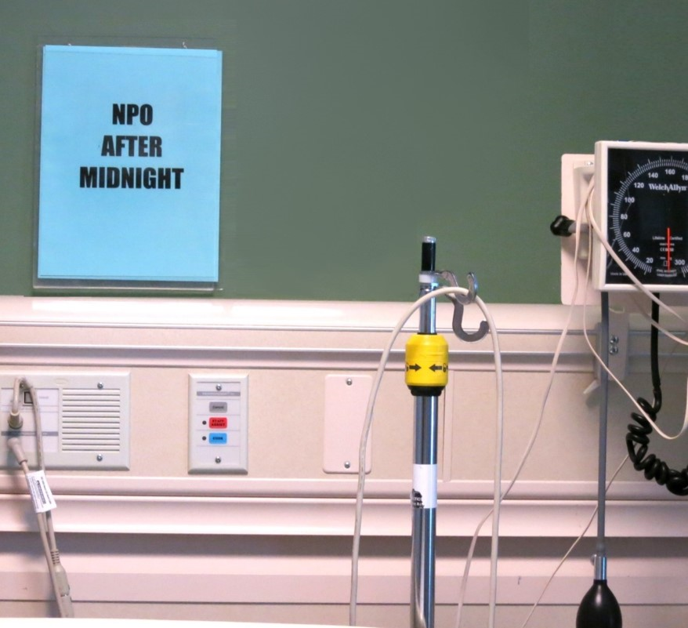
Dietary Factors
Dietary restrictions.
Food.
Liquids.
Smoking.
Special diets.
Notes:
LO 7.6 Recognize patient factors that may affect specimen quality and test results.
Notes:
Dietary restrictions:
Food, drink, and even smoking can affect the results of many blood tests.
Check any special dietary restrictions required for the tests.
Note the last time the patient had anything to eat, drink, or smoke and if special dietary restrictions were followed.
Special diets:
Some tests require that the patient follow a special diet prior to the test. Patients may be told to eat or not eat certain foods for several days before the test.
Note whether the patient has followed these requirements on the requisition slip.
Other factors:
If blood is drawn shortly after a meal, the serum may appear cloudy, or lipemic. Lipemia is due to the large amount of fatty compounds in the blood after a meal, and it interferes with many laboratory tests.

Slide 41
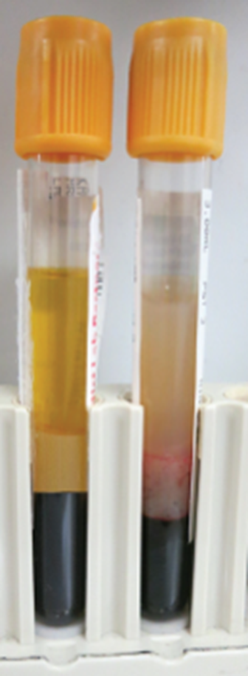
Lipemia and Lab Tests
Large amounts of fats.
May be present shortly after a meal.
Can interfere with lab tests.
Serum appears milky.
Notes:
LO 7.6 Recognize patient factors that may affect specimen quality and test results.
Notes:
Interfering substances are substances (including medications) that can alter laboratory test results.
Erythromycin causes an orange color in blood and urine.
Vitamin B₁₂ causes a yellow color in blood and urine.
Other medications have an effect on various body systems and may alter the level of chemicals they produce. For example, statins affect liver enzymes in the blood.
Additives in collection tubes are also interfering substances, but they are used by the phlebotomist for specific purposes. This will be discussed in the Blood Collection Equipment chapter.

Slide 42
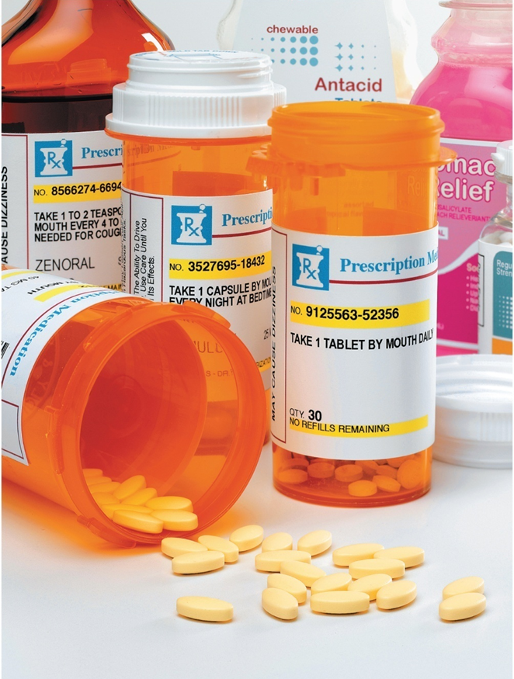
Medications and Lab Tests
Interfering substances (medications).
Cause abnormal color in blood or urine.
Alter the level of chemicals.
Additives in collection tubes.
Notes:
LO 7.6 Recognize patient factors that may affect specimen quality and test results.
Notes:
Interfering substances are substances (including medications) that can alter laboratory test results.
Erythromycin causes an orange color in blood and urine.
Vitamin B₁₂ causes a yellow color in blood and urine.
Other medications have an effect on various body systems and may alter the level of chemicals they produce. For example, statins affect liver enzymes in the blood.
Additives in collection tubes are also interfering substances, but they are used by the phlebotomist for specific purposes. This will be discussed in the Blood Collection Equipment chapter.

Slide 43
Specimen Transporting and Processing
Specimens must be transported to the laboratory.
In a timely manner.
Under test-specific conditions.
Notes:
LO 7.6 Recognize patient factors that may affect specimen quality and test results.
Notes:
Proper specimen handling is the responsibility of the phlebotomist. Various tests may have different handling requirements.
STAT tests must be performed within 1 hour of collection and transported to the laboratory immediately.
Some specimens must be centrifuged within a specified amount of time.
Some specimens must be kept warm or cold.
Some specimens must be protected from light.
Further details about specimen processing and transport are included in the Blood Specimen Handling chapter.

Slide 44
Learning Outcome 7.7
Documenting Specimen Collection

Slide 45
Electronic Health Records
Health Information Technology for Economic and Clinical Health (H I T E C H).
Encourages use of electronic health records (E H Rs).
Establishes standards for E H Rs.
Purpose of E H Rs.
Provide secure, real–time access to patient–centered information.
Reduce delays in planning, treatment, quality management, and billing.
Notes:
LO 7.7 Explain the phlebotomist’s role in maintaining accurate and secure blood collection documentation.
Notes:
EHR vs. EMR: These terms are not exactly the same.
EMR: Medical records only, used by doctors for diagnosis and treatment
EHR: Includes medical records and other information, encompassing the total health of the patient; EHRs have the ability to travel from facility to facility and from one healthcare provider to another in a secure way.

Slide 46
Specimen Tracking
Record identification.
Update lab records.
Questions about specimen quality.
Status of test collections.
Completion times.
Notes:
LO 7.7 Explain the phlebotomist’s role in maintaining accurate and secure blood collection documentation.
Notes:
Phlebotomist’s documentation responsibilities:
Record own identification on requisitions and specimen labels
Enter collection information and comments into the laboratory log book or laboratory information system (LIS)
This information allows for specimen tracking. It allows the lab to follow up on questions about specimen quality and to answer questions about the status of laboratory test collections and anticipated completion times.

Slide 47
Chapter Summary 1
Laboratory tests may be ordered only by a licensed healthcare practitioner.
Laboratory requisitions must include physician’s name; patient’s name, age, D O B, and I D number; tests to be performed; and date and time for specimen collection.
Communicating with patients in a professional manner helps instill patient confidence.
Following a code of ethics during patient interactions helps prevent accusations of malpractice.
Patients must give consent to and have the right to refuse any procedures.
Notes:
7.1 Identify the parts and functions of a laboratory requisition.
7.2 Identify the professional communication techniques of the phlebotomist.
7.3 Comply with ethical and legal standards for professional communication.

Slide 48
Chapter Summary 2
Patients must be identified using at least two unique patient identifiers.
Specimen labels must include the patient’s name, D O B, and unique patient identifier; the actual collection time and date; and the collector’s I D.
Phlebotomists must document patient situations that can compromise specimen quality.
Factors that may affect results include altitude, geographic location, temperature, hydration, posture, exercise, stress, and deviation from basal state.
Notes:
7.4 Carry out proper patient identification.
7.5 Define the legal/ethical importance of specimen identification.
7.6 Recognize patient factors that may affect specimen quality and test results.

Slide 49
Chapter Summary 3
Specimens must be handled properly and delivered to the lab promptly.
Proper documentation allows for test and specimen tracking.
Patient information is stored in hospital and laboratory computers as part of the patient’s E H R.
Notes:
7.6 Recognize patient factors that may affect specimen quality and test results.
7.7 Explain the phlebotomist’s role in maintaining accurate and secure blood collection documentation.

Slide 50
End of Main Content
© McGraw Hill LLC. All rights reserved. No reproduction or distribution without the prior written consent of McGraw Hill LLC.

Slide 51
Accessibility Content: Text Alternatives for Images

Slide 52
Computer–Generated Requisition Label – Text Alternative
Return to parent-slide containing images.
Requisition label showing the patient’s name, patient’s medical record number, patient’s location, bar code, laboratory accession number, requesting physician, blood volume and tube type, test status, test to be performed, patient’s age and gender, patient’s date of birth, date and time the test is to be performed, and laboratory section to which the specimen should be delivered.
Return to parent-slide containing images.

Slide 53
Labeling the Specimen – Text Alternative
Return to parent-slide containing images.
The same computerized patient label shown earlier in this presentation, but now with handwritten initials and the time: 0930. Green circles appear around the patient's name, the M R N number, the patient's date of birth, the specimen collection time and date, and the collector's initials.
Return to parent-slide containing images.

Slide 54
Required Information – Text Alternative
Return to parent-slide containing images.
The same computerized patient label shown earlier in this presentation, but now with handwritten initials and the time: 0930. Green circles appear around the patient's name, the M R N number, the patient's date of birth, the specimen collection time and date, and the collector's initials.
Return to parent-slide containing images.

Slide 55
Applying the Label – Text Alternative
Return to parent-slide containing images.
Five specimen tubes:
The two on the left are correctly labeled with the label applied squarely on the tube, neither running off the bottom nor covering the stopper.
The third tube from the left is incorrectly labeled because the label covers the stopper as well as the tube.
The fourth tube from the left is incorrectly labeled because the label sticks off the bottom of the tube.
The fifth tube from the left is incorrectly labeled because the label is applied to the tube at an angle, so that the bar code cannot be read by a bar code reader.
Return to parent-slide containing images.

Slide 56
Timing of Specimen Collection – Text Alternative
Return to parent-slide containing images.
The x axis plots time in hours from 1 to 21. The peak occur at hour, 5, 12 and 20 and the troughs at 8 and 16.
Return to parent-slide containing images.

