Slide 1
Chapter 8
Blood Collection Equipment

Slide 2
Learning Outcomes
8.1 Identify equipment used for both venipuncture and capillary puncture.
8.2 Identify equipment specific for venipuncture procedures.
8.3 Identify equipment specific for dermal/capillary puncture procedures.
8.4 Identify the various types of additives and color-coding used in blood collection and explain the reasons for their use.
8.5 Implement the correct order of draw for venipuncture and capillary puncture procedures.
8.6 Compare blood collection equipment from various manufacturers.
Notes:
Introduction
Phlebotomy procedures are also known as “drawing blood,” and each procedure has a standard set of equipment. Most blood collection containers have additives that make a specific order of draw important to accurate test results. Proper handling of phlebotomy equipment is of the utmost importance for the safety of both the phlebotomist and the patient.

Slide 3
N A A C L S Competencies 1
5.1 Demonstrate knowledge of collection equipment, various types of additives used, special precautions necessary, and substances that can interfere in clinical analysis of blood constituents.
5.2 Identify the various types of additives used in blood collection, and explain the reasons for their use.
5.3 Identify the evacuated tube color codes associated with the additives.
5.4 Describe the proper order of draw for specimen collections.

Slide 4
N A A C L S Competencies 2
5.5 Describe substances that can interfere in clinical analysis of blood constituents and ways in which the phlebotomist can help to avoid these occurrences.
5.6 List and select the types of equipment needed to collect blood by venipuncture and capillary (dermal) puncture.
5.7 Identify special precautions necessary during blood collections by venipuncture and capillary (dermal) puncture.
9.11 Demonstrate basic understanding of age-specific or psychosocial considerations involved in the performance of phlebotomy procedures on various age groups of patients.

Slide 5
Key Terms 1
A C D.
Additive.
Aerosol.
Aliquot.
Antiglycolytic.
Antiseptic.
Bacteriostatic.
Bevel.
Capillary action.
Citrate.
Clot activator.
Dermal puncture.
E D T A.
Evacuated collection tube.
Evacuated tube holder.
Gauge.
Heel warmer.
Heparin.
Lancet.
Microcollection.

Slide 6
Key Terms 2
Sharps container.
Sterile.
Thixotropic separator gel.
Tourniquet.
Venipuncture.
Winged infusion set.

Slide 7
Learning Outcome 8.1
Common Blood Collection Equipment

Slide 8
Introduction to Blood Collection Equipment
Two procedures.
Venipuncture.
Capillary (dermal) puncture (microcollection).
Some equipment is used for both procedures
Notes:
LO 8.1 Select equipment used for both venipuncture and capillary puncture.
Notes:
Venipuncture: puncture of a vein
Capillary (dermal) puncture: skin puncture; also called microcollection.
Proper handling of all phlebotomy equipment is of the utmost importance for the safety of both the phlebotomist and the patient.

Slide 9
Blood Collection Equipment 1
Venipuncture
Capillary (Dermal) Puncture
Both
Evacuated tube holder or syringe.
Evacuated tubes.
Tourniquet.
Needles.
Winged infusion set*
Syringe*
Lancets.
Capillary tubes and sealant.
Microcollection tubes.
Tray or cart.
Gloves.
Hand sanitizer.
Alcohol prep pads.
Gauze pads.
Adhesive bandage/tape.
Sharps container.
Marking pen.
Preprinted labels.
Specimen transport bags.
Notes:
LO 8.1 Select equipment used for both venipuncture and capillary puncture.
Notes:
Some equipment is specific to either venipuncture or capillary (dermal) puncture, but most phlebotomy equipment is used for both procedures.
*This equipment is used only for difficult venipuncture.

Slide 10
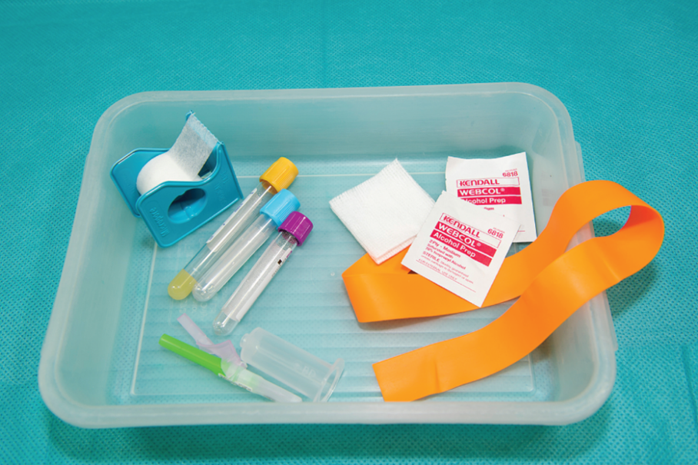
Common Equipment
Phlebotomy tray
Store equipment needed for most procedures.
Keep well-stocked.
Some include.
Computer.
©McGraw-Hill Education/Sandra Mesrine, photographer
Notes:
LO 8.1 Select equipment used for both venipuncture and capillary puncture.
Notes:
Phlebotomy tray or cart:
The phlebotomy tray or cart stores and transports the equipment and supplies needed for routine blood collection. It is important to make sure your tray is stocked with enough equipment and supplies for each patient and procedure. Some carts include a computer that provides continuous access to the LIS.

Slide 11
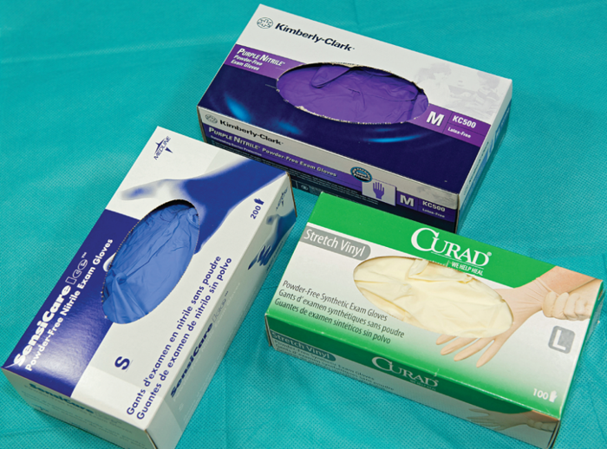
Gloves and Glove Liners
Gloves
Sterile and nonsterile.
Powder-free.
Glove liners
For long-term use of gloves.
©McGraw-Hill Education/Sandra Mesrine, photographer
Notes:
LO 8.1 Select equipment used for both venipuncture and capillary puncture.
Notes:
Gloves:
OSHA regulations require that gloves be worn during phlebotomy procedures.
Gloves are available in latex, vinyl, and nitrile. Be sure to select nonlatex gloves if you are allergic to latex.
For phlebotomy, powder-free gloves are recommended because the powder can become a specimen contaminant.

Slide 12
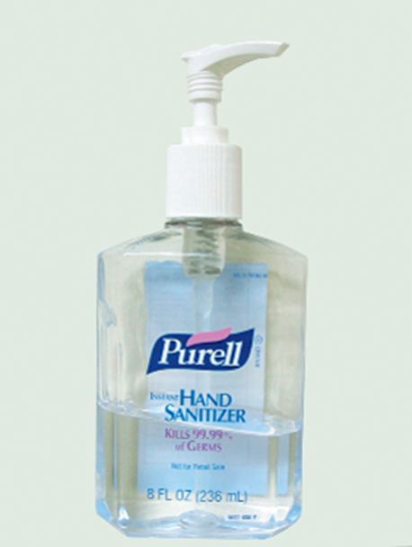
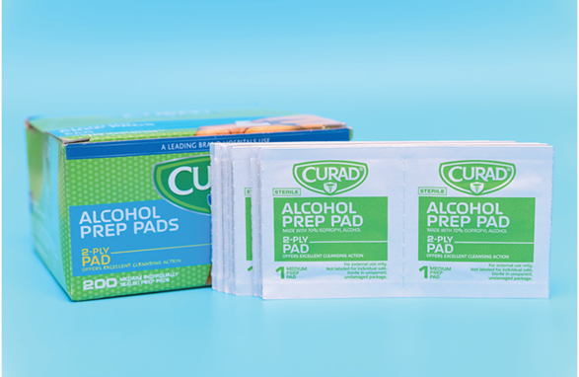
Hand Sanitizers and Alcohol Prep Pads
Hand sanitizers
Use when no visible contamination is present.
Alcohol prep pads
Clean the site.
Not recommended for some tests.
Ask patient if allergic to alcohol.
Left: ©Lillian Mundt; right: ©McGraw-Hill Education/Sandra Mesrine, photographer
Notes:
LO 8.1 Select equipment used for both venipuncture and capillary puncture.
Notes:
Hand sanitizers:
Hands must be washed between patients. If soap and water is not readily available, alcohol-based hand sanitizers may be used if no visible contamination is present. If visible contamination is present, you must wash your hands with soap and water.
Alcohol prep pads:
For most procedures, the site should be cleaned with an alcohol prep pad.
Saturated with 70% isopropyl alcohol
Antiseptic: Germicidal solution
Bacteriostatic: Solution that inhibits the growth of bacteria
Alcohol prep pads are not used for the collection of blood alcohol levels and some blood glucose tests.

Slide 13
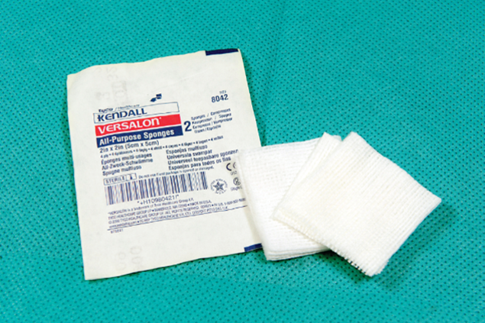
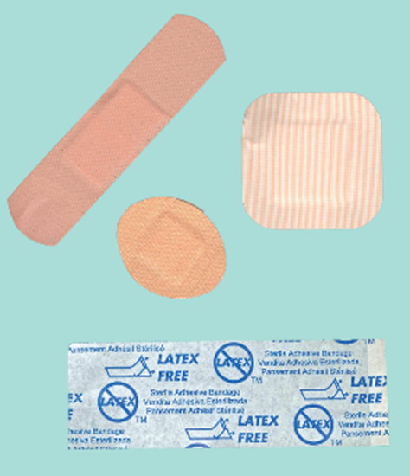
Gauze Pads and Adhesive Bandages
Gauze pads
Loosely woven fabric.
Applied after procedure is complete.
Adhesive bandages
Placed over puncture site.
Not used on children under 2 years.
Left: ©McGraw-Hill Education/Sandra Mesrine, photographer; right: ©Lillian Mundt
Notes:
LO 8.1 Select equipment used for both venipuncture and capillary puncture.
Notes:
Gauze pads:
Applied after the procedure has been completed:
Removal of needle for venipuncture
Completion of collection for dermal puncture
Adhesive bandages:
Placed on the puncture site to stop the bleeding
Special considerations:
Do not place adhesive directly on the skin if the patient is elderly or is a small child
Use only latex-free tape and bandages if the patient is allergic to latex

Slide 14
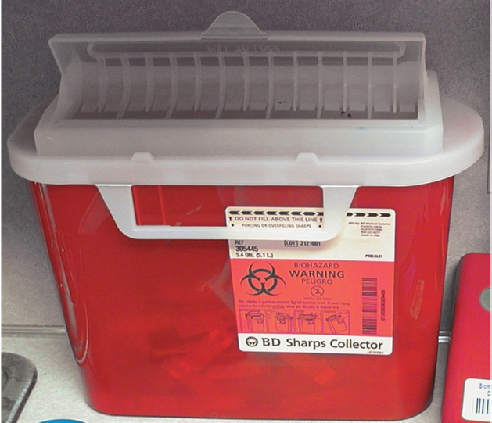
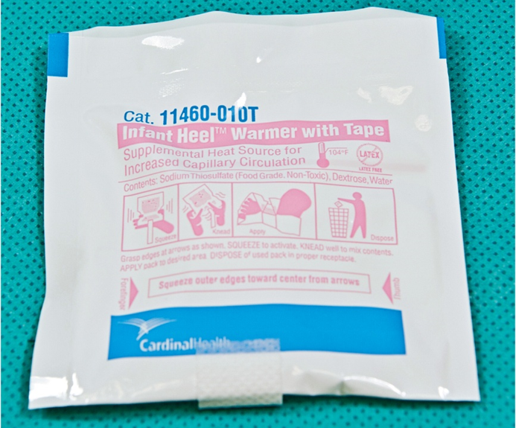
Sharps Container and Tissue Warmers
Sharps container
For needles and other sharps.
Tissue warmers
Heel warmer.
Warm towel or cloth.
Left: ©Total Care Programming; right: ©McGraw-Hill Education/Sandra Mesrine, photographer
Notes:
LO 8.1 Select equipment used for both venipuncture and capillary puncture.
Notes:
Sharps Container:
Designed to protect healthcare personnel from accidental needlesticks from contaminated needles
Place used needles (with holders), lancets, and other sharp items in the sharps container immediately after using.
Seal and dispose of container when it is ¾ full. To avoid injury, never fill to the top. Dispose of sharps containers according to the biohazard guidelines established by OSHA.
Heel (tissue) warmers:
Used especially for dermal punctures
Warming the puncture site increases blood flow to the capillaries

Slide 15
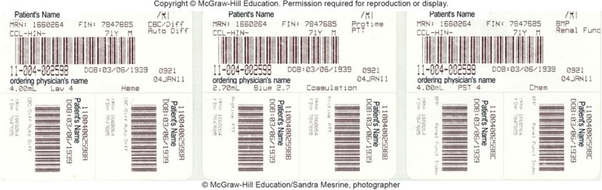
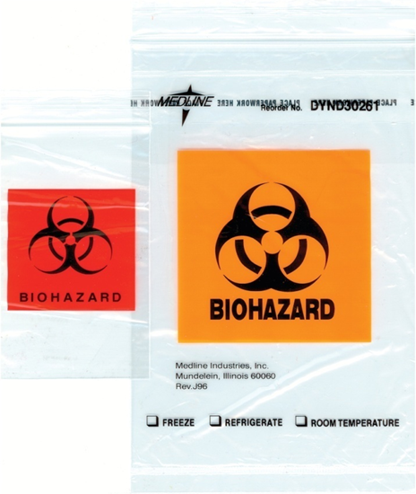
Computer Label and Specimen Transport Bags
Computer label
After drawing blood.
Before leaving patient.
Use permanent marking pen.
Specimen transport bags.
©Lillian Mundt
Notes:
LO 8.1 Select equipment used for both venipuncture and capillary puncture.
Notes:
Computer label/permanent marking pen:
Apply and initial computer labels immediately after drawing blood but before leaving the patient.
Some facilities now use barcodes.
If computer labels are not supplied, write all of the necessary information by hand: patient name, specimen collection time and date, and your identification.
Specimen transport bags:
Specimens are placed in specially marked biohazard bags for transport.
Bags have a zip closure and a separate compartment for paperwork.
Always use the most appropriate size bag for the specimen.

Slide 16
Learning Outcome 8.2
Venipuncture Equipment

Slide 17
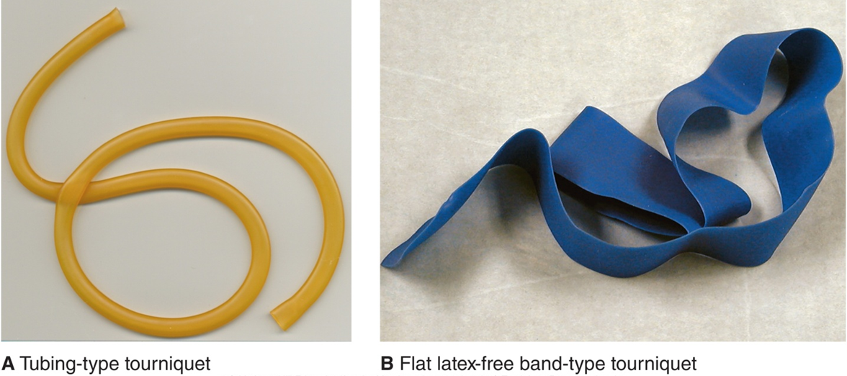
Tourniquet
Temporarily stops blood flow.
Applied 3 to 4 inches above puncture site.
Used to locate veins more easily.
A Tubing-type tourniquet
B. Flat latex-free band-type tourniquet
Never apply a tourniquet for longer than 1 minute.
©Lillian Mundt
Notes:
LO 8.2 Select equipment specific for venipuncture procedures.
Notes:
Tourniquet:
Applied to stop the flow of venous blood temporarily, making it easier to locate a patient’s veins
Tourniquets are disposable. Use a new tourniquet for each patient.
If a tourniquet is not available, you can use a blood pressure cuff instead.

Slide 18
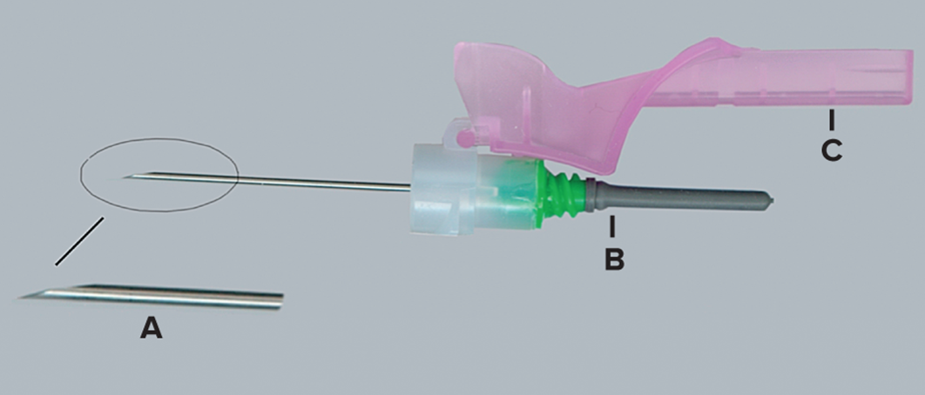
Needles
Needle parts
Hub.
Shaft.
Bevel.
Needlestick prevention device.
©Lillian Mundt
Notes:
LO 8.2 Select equipment specific for venipuncture procedures.
Notes:
The hub of a needle is the plastic part at the base. The shaft is the tubular portion of the needle. The bevel, or slanted tip, must always be facing upward (you should be able to see it when you look down).
Sterile needles (those free of microorganisms) are packaged in peel-apart packages or plastic cases.
Since the Needlestick Safety and Prevention Act was put into place in 2001, all phlebotomy needles must have safety features to protect the phlebotomist from accidental puncture with a contaminated needle. Always activate the device as soon as the procedure is completed.

Slide 19
Needles Used in Phlebotomy
Multiple-sample needle.
Double-pointed.
Part of evacuated collection system.
Hypodermic needle.
Used with syringe.
Winged infusion set (butterfly needle).
Used with either syringe or evacuated tube systems.
Notes:
LO 8.2 Select equipment specific for venipuncture procedures.
Notes:
A multiple-sample needle is a double-pointed needle. The longer side is beveled and is used for drawing the patient’s blood. The shorter side is blunt and punctures the cap of the evacuation tube to draw blood from the patient’s vein into the tube. The hub has a screw adapter for attachment to the evacuated tube holder.
Hypodermic needles are used with a syringe to draw blood. The blood must then be transferred to evacuated tubes using a syringe transfer device.
Winged infusion sets are commonly called butterfly needle sets because the plastic needle holder resembles butterfly wings. These “wings” provide stability for the needle against the patient’s skin.

Slide 20
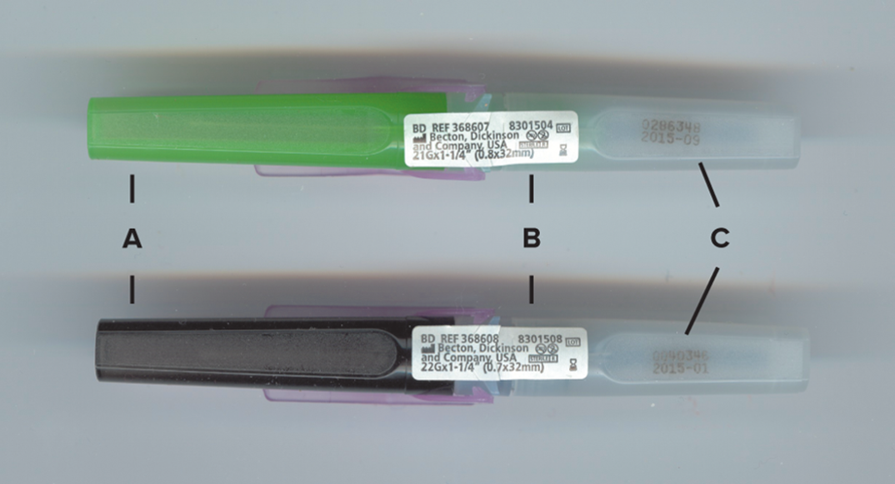
Needle Gauge and Sterility
Gauge is the bore size or lumen of the needle.
Some brands color-code gauge size.
Safety and sterility.
©Lillian Mundt
Notes:
LO 8.2 Select equipment specific for venipuncture procedures.
Notes:
The gauge of a needle is its size. The larger the gauge, the smaller the needle. For example, a 22-gauge needle is smaller than a 16-gauge needle.
Some brands color-code gauge size. In the photo shown here, the needle on the top is a 21-gauge, and the needle on the bottom is a 22-gauge.
All needles have a sterility safety label; when you open the needle, the label is broken and the needle is no longer sterile. The white labels in this photo are the sterility safety labels.
Needles also have an expiration date after which sterility is not guaranteed. The sterility safety labels on the needles in this photo provide the expiration date. Do not use needles that are past their expiration date.

Slide 21
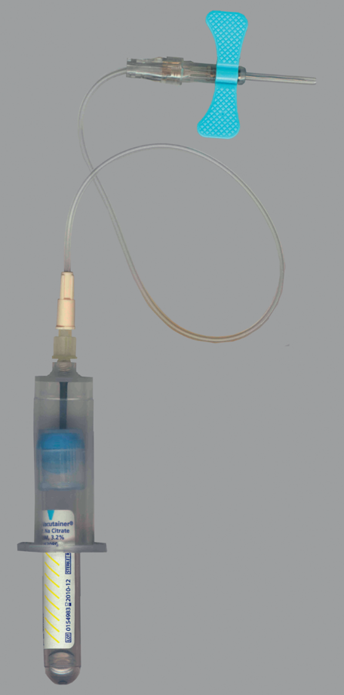
Winged Infusion Set
Patients with small or fragile veins.
Wings provide stability.
©Lillian Mundt
Notes:
LO 8.2 Select equipment specific for venipuncture procedures.
Notes:
Winged infusion sets are commonly called butterfly needle sets because the plastic needle holder resembles butterfly wings. These “wings” provide stability for the needle against the patient’s skin.
Most facilities now recommend using syringes with small-gauge needles instead of winged infusion sets for patients with smaller veins unless greater stability is needed for non-stable patients.

Slide 22
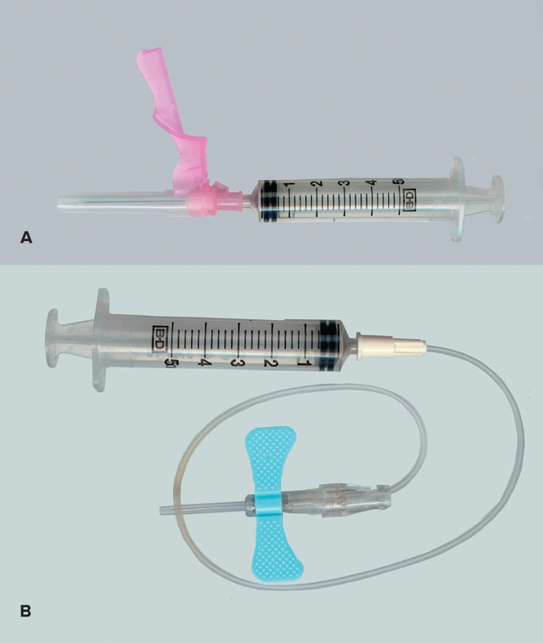
Syringe
Consists of barrel and plunger
Two types:
Slip tip.
Luer lock.
Used with hypodermic and butterfly needles.
©McGraw-Hill Education/Sandra Mesrine, photographer
Notes:
LO 8.2 Select equipment specific for venipuncture procedures.
Notes:
Luer lock needles are preferred over the slip tip type because there is no danger of the syringe slipping off during the procedure.

Slide 23
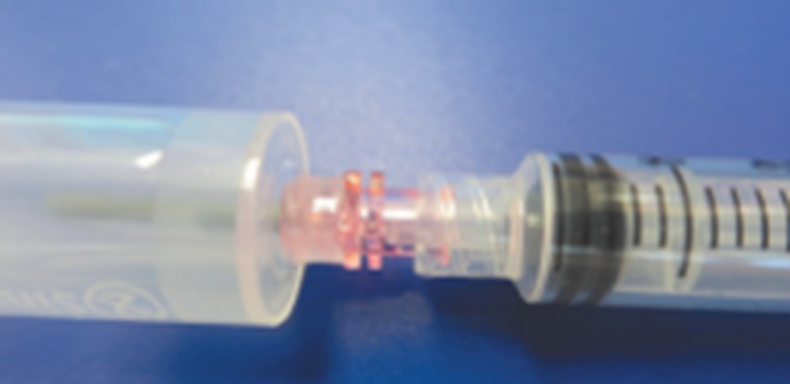
Transfer Adapters
Transfer blood from syringe to evacuated tubes
Hypodermic needle is removed.
Syringe is attached to transfer device.
Evacuated tubes are inserted in order of draw.
©Lillian Mundt
Notes:
LO 8.2 Select equipment specific for venipuncture procedures.

Slide 24
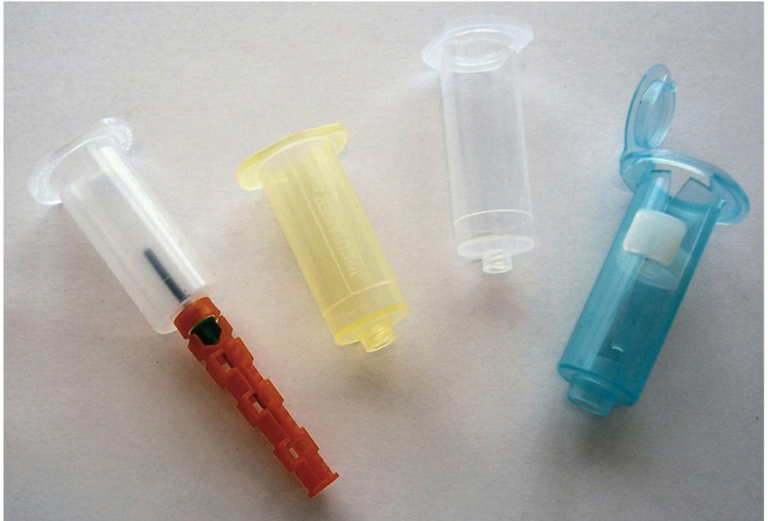
Evacuated Tube Holder
Holds needle and tube.
Dispose of with needle after use.
Courtesy and ©Becton Dickinson
Notes:
LO 8.2 Select equipment specific for venipuncture procedures.
Notes:
Evacuated tube holders are called barrels or adapters. Multiple-sample needles screw onto the narrow end of the barrel so that the beveled needle extends outside the barrel and the shorter, blunt needle is inside the barrel. Evacuated tubes are then inserted inside the barrel so that the blunt needle punctures the cap. The barrel design helps protect the phlebotomist from any blood spray that might occur when the cap is punctured.
Some multiple-sample needles do not have a safety device; when using these needles, the phlebotomist must use a tube holder that has a built-in safety device.
After blood collection, the evacuated tube holder is placed in the sharps container with the needle still attached.

Slide 25
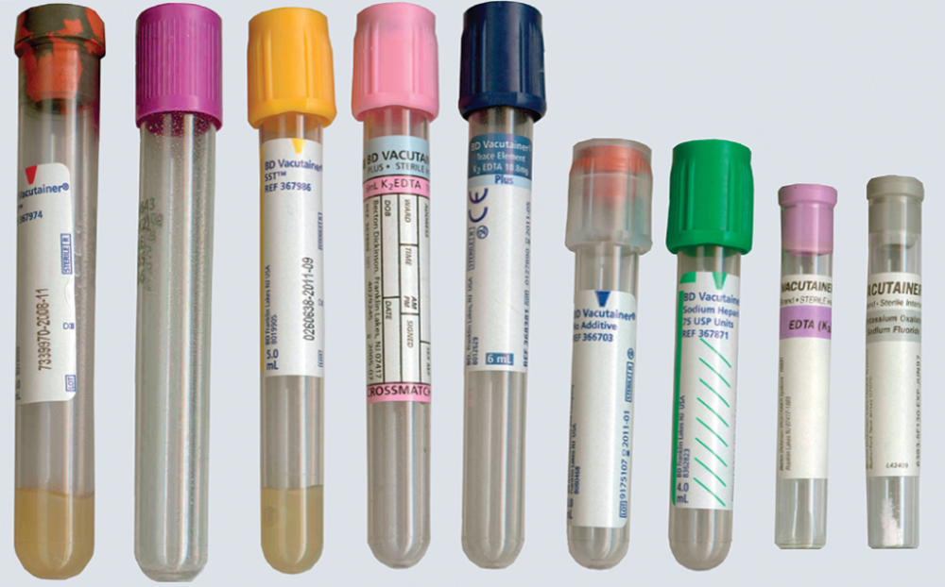
Evacuated Tubes
Premeasured vacuum.
Some contain additives.
Some have splashguards.
Access the text alternative for slide images.
©Lillian Mundt
Notes:
LO 8.2 Select equipment specific for venipuncture procedures.
Notes:
The evacuated collection tube system is the most widely used collection system for several reasons.
The premeasured vacuum inside the tubes ensures that the right amount of blood is drawn.
Tubes are prefilled with various additives in measured amounts that assist in laboratory tests. Additives are identified by cap color.
The patient’s blood flows directly from the patient’s vein into the collection tube, without being exposed to air.
Many tubes of blood can be collected with just one venipuncture.
Some tubes have a plastic splashguard to help protect against the aerosol mist that may be generated when the tube’s stopper is removed in the lab.
Evacuated tubes are sterile inside to prevent contamination of the specimen and the patient. Do not use evacuation tubes after their expiration date. The sterilization, vacuum, and additives are not guaranteed past that date.

Slide 26
Serum versus. Plasma Collection
Serum forms when blood is collected in a tube with no anticoagulant.
Clot activator added in plastic tubes.
Plasma results when blood is collected in a tube with anticoagulant added.
Thixotropic separator gel separates cells from serum or plasma.
Notes:
LO 8.2 Select equipment specific for venipuncture procedures.
Notes:
When blood is collected in a tube without an anticoagulant, the blood clots. When the tube is centrifuged, the clot separates from the remaining serum. Because blood does not clot as quickly in plastic tubes, a clot activator is often added to reduce the time the blood takes to clot.
When blood is collected in a tube that has an added anticoagulant, the blood does not clot, so when the tube is centrifuged, plasma separates from the formed elements of the blood.
In some tubes, a thixotropic separator gel is added to create a barrier between the packed cells and the serum or plasma.

Slide 27
Learning Outcome 8.3
Microcollection Equipment

Slide 28
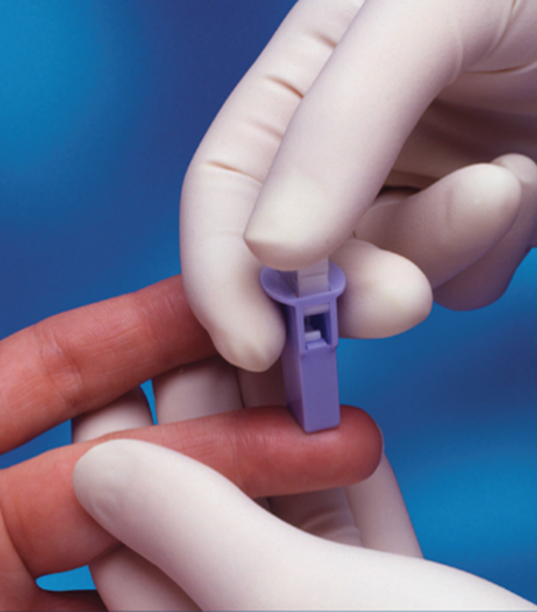
Lancets
Most have retractable blade. Available in various depths.
1.5 mm.
1.8 mm.
2.0 mm.
Do not use lancets with depths of more than 2.0 mm.
©Total Care Programming, Inc.
Notes:
LO 8.3 Select equipment specific for dermal/capillary puncture procedures.
Notes:
Lancets:
Small cutting instruments for dermal puncture
Designed to control the depth of the puncture
Available in several depths; the phlebotomist must choose the correct depth based on the amount of blood needed and the puncture site
Available in several widths to provide different amounts of blood
A warm towel or heel warmer can be used to increase the flow of blood to the site.

Slide 29
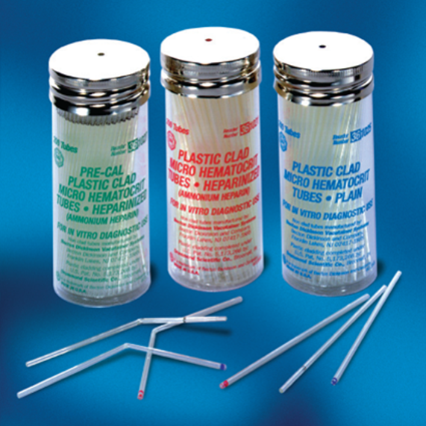
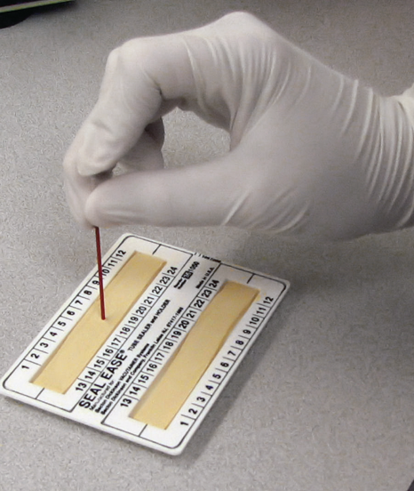
Capillary Tubes and Sealant
Used when only a small amount of blood is required
Pull blood into tube using capillary action
Three types
Red-tipped.
Blue-tipped.
Black-tipped.
©Total Care Programming, Inc.
Notes:
LO 8.3 Select equipment specific for dermal/capillary puncture procedures.
Notes:
Capillary tubes:
Also called microhematocrit tubes
Used to collect a small amount of blood
Use capillary action to draw blood from the dermal puncture
Red-tipped tubes contain heparin and are used to measure hematocrit.
Blue-tipped tubes have no coagulant.
Black-tipped tubes have a smaller diameter and are used to collect a smaller amount of blood.
Sealant:
Shallow bed of clay
When enough blood has been collected, one end of the capillary tube is stuck in the clay to close it.

Slide 30
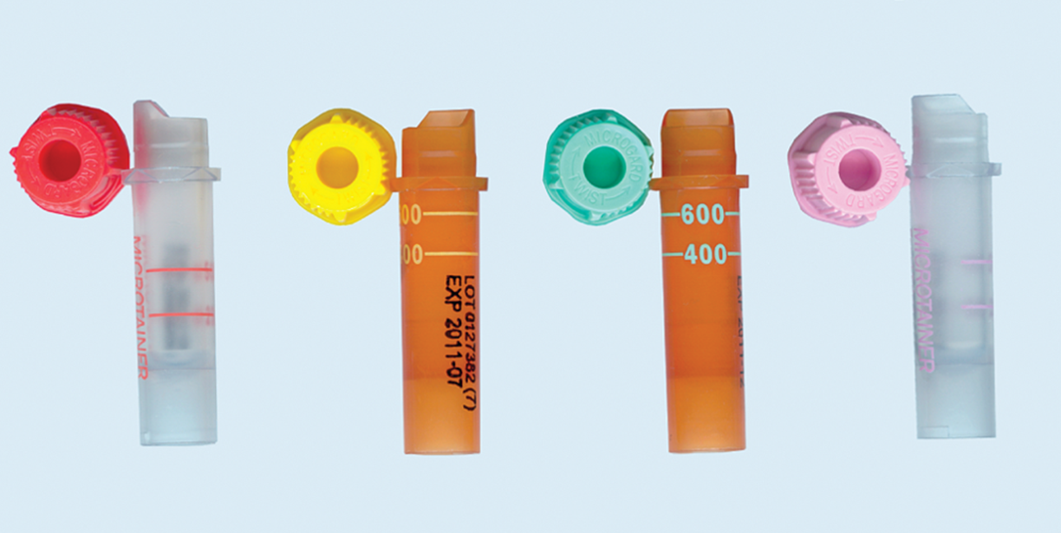
Microcollection Tubes
Larger volume than capillary tubes.
Available with various additives (color-coded).
Amber tubes help protect specimens from light.
©Lillian Mundt
Notes:
LO 8.3 Select equipment specific for dermal/capillary puncture procedures.
Notes:
Microcollection tubes:
Provide larger collection volume than capillary tubes
May be designed for general use or for a specific test
Come with the same variety of anticoagulants as do evacuated tubes, including separator gels
Immediate and proper mixing is required with microcollection tubes because the coagulation system is initiated during dermal puncture. Without proper mixing of tubes drawn for tests on whole blood, the specimen will clot and cannot be used for testing.

Slide 31
Learning Outcome 8.4
Additives and Color-Coding

Slide 32
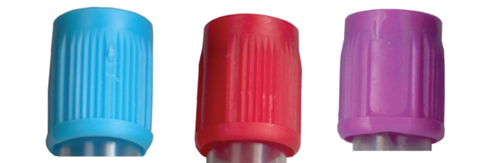
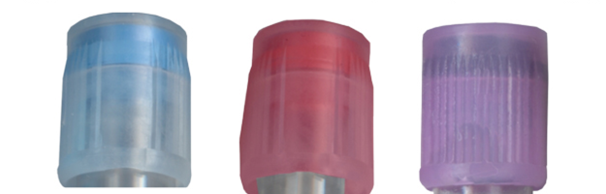
Cap Colors
Identify additive in tube
Solid caps
Regular vacuum.
Sufficient to fill the tube.
Translucent caps
Reduced vacuum.
Used to collect blood from children or adults with fragile veins.
Courtesy and ©Becton Dickinson
Notes:
LO 8.4 Identify the various types of additives and color-coding used in blood collection and explain the reasons for their use.
Notes:
Additive: Any substance in a blood collection tube that acts as an anticoagulant, a clot activator, or a preservative
Different additives are needed for different types of laboratory tests. After drawing blood, be sure to mix or invert tubes that contain additives according to the manufacturer’s recommendation.
Cap colors are fairly standard, but shades may vary from manufacturer to manufacturer. The Becton Dickinson brand colors are shown in this presentation.
Tubes that have solid caps contain enough vacuum to fill the tube with blood.
Tubes that have translucent caps have a reduced vacuum that is appropriate for use with small children or people with fragile veins.

Slide 33
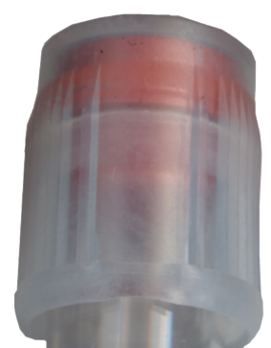
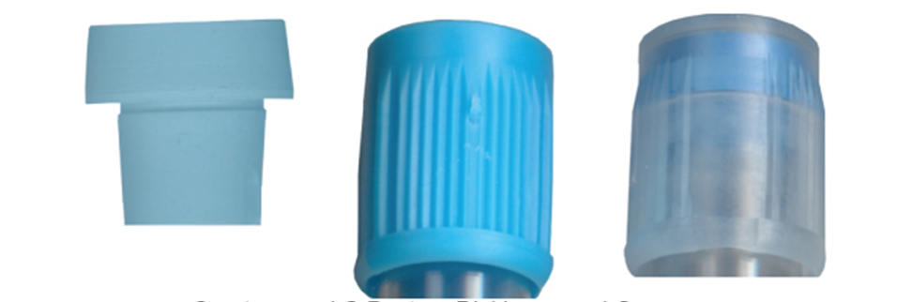
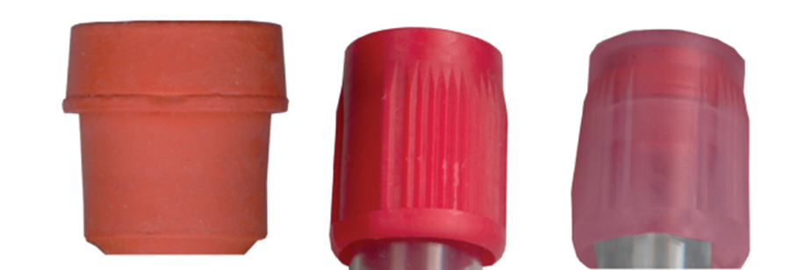
Routinely Used Tubes 1
Light-Blue-Topped
Discard Tube
Red-Topped
Courtesy and ©Becton Dickinson
Notes:
LO 8.4 Identify the various types of additives and color-coding used in blood collection and explain the reasons for their use.
Notes:
Discard tubes:
Used to purge the air out of the line when using a winged insertion set (butterfly needle)
Used to discard blood prior to collecting specimens for coagulation testing
Light-blue-topped:
Additive: Sodium citrate (binds calcium to prevent coagulation from occurring)
Binds calcium to prevent clotting
Tube must be completely filled to maintain blood-to-coagulant ratio of 9:1 (9 times as much blood as citrate).
Primarily used for coagulation testing (PT, APTT, D-dimer, fibrinogen, and platelet function)
Should be inverted several times immediately after collection to prevent clotting
Not available for microcollection
Red-topped:
Used for most chemistry blood tests
Plastic tubes may contain a clot activator.
Glass tubes have no additive.
Red-topped tubes are available for microcollection.

Slide 34
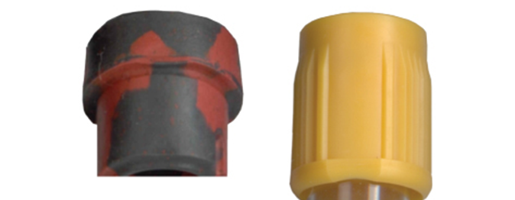
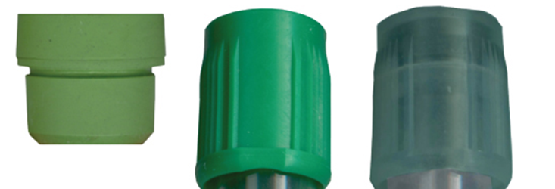
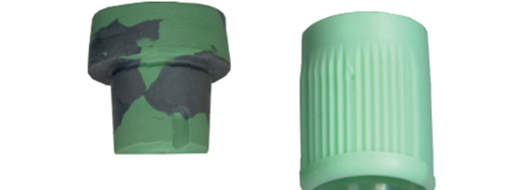
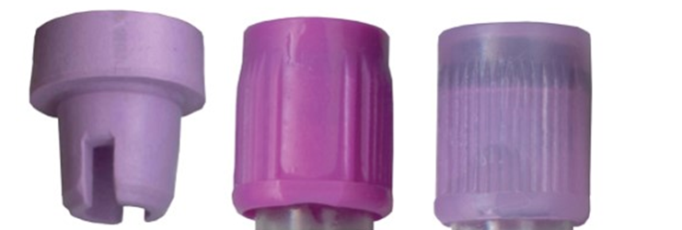
Routinely Used Tubes 2
Serum Separator
Green-Topped
Plasma Separator
Lavender-Topped
Courtesy and ©Becton Dickinson
Notes:
LO 8.4 Identify the various types of additives and color-coding used in blood collection and explain the reasons for their use.
Notes:
Serum separator tubes (SST):
Contain a clot activator and a thixotropic separator gel
Gel separates serum from blood cells by getting between the clot and serum during centrifugation
Prevent changes in the blood due to cellular metabolism and fibrinolysis, glucose consumption, and the creation of waste products
Make it easier to aliquot the liquid (remove small samples from it for testing)
Used for tests involving electrolytes, enzymes, glucose, hormones, lipids, and proteins
Green-topped:
Contain the anticoagulant heparin (sodium heparin, lithium heparin, or ammonium heparin), a chemical that stops the coagulation process mainly by inactivating thrombin, thereby preventing clot formation
Available for microcollection
Plasma separator:
Light green (mint) or green and gray tops
Contain lithium heparin and thixotropic gel for plasma separation
Often used for STAT chemistry tests
Available for microcollection
Lavender-topped:
Contain liquid EDTA (ethylenediaminetetraacetic acid), which combines with calcium to prevent blood from clotting
Used for hematology tests because EDTA preserves cellular proteins, maintaining the cells’ shape better than other anticoagulants
Commonly used for CBC, differential, reticulocyte counts, and erythrocyte sedimentation rate
Available for microcollection

Slide 35
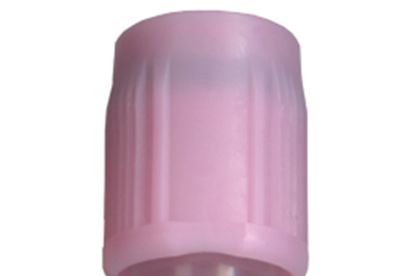
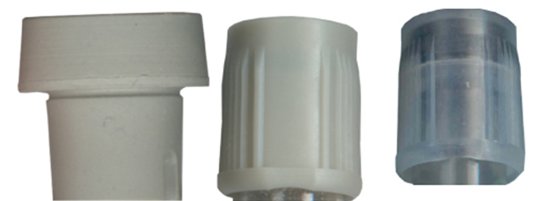
Routinely Used Tubes 3
Pink-Topped
Gray-Topped
Courtesy and ©Becton Dickinson
Notes:
LO 8.4 Identify the various types of additives and color-coding used in blood collection and explain the reasons for their use.
Notes:
Pink-topped:
Contain powdered, sprayed-on EDTA
Used in immunohematology (blood bank) section of the lab for blood typing, donor blood testing, cross-matching blood, and preparation of blood and blood products for transfusion
Label contains additional lines for information required by the American Association of Blood Banks (AABB)
Available for microcollection
Gray-topped:
Contain potassium oxalate (anticoagulant) and an antiglycolytic agent, such as sodium fluoride
Antiglycolytic agent (glycolytic inhibitor) prevents the red blood cells from using glucose and changing it to lactic acid
Used for glucose levels, lactic acid analysis, and sometimes for blood alcohol levels
Available for microcollection

Slide 36
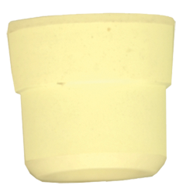
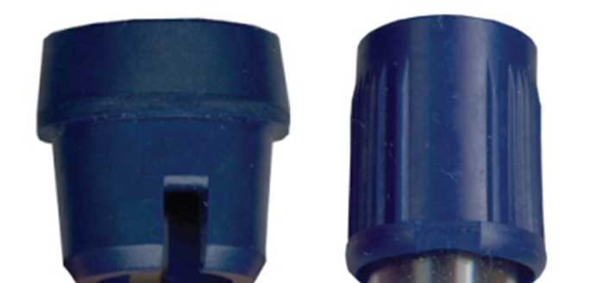
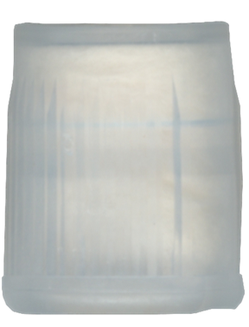
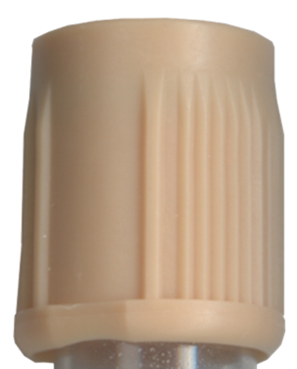
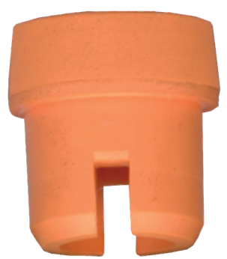
Specialty Tubes
Yellow-Topped
Royal-Blue-Topped
White-Topped
Orange-Topped
Tan-Topped
Courtesy and ©Becton Dickinson
Notes:
LO 8.4 Identify the various types of additives and color-coding used in blood collection and explain the reasons for their use.
Notes:
Yellow-topped:
Available with two different additives, but the tubes look identical; always be careful to select the correct one!
SPS (sodium polyanethol sulfonate): Used for blood culture collections to neutralize the effect of bacterial growth inhibitors, such as antibiotics, to maintain bacterial viability
ACD (acid citrate dextrose): Used for cellular studies in blood banks or human leukocyte antigen (HLA) typing; ACD maintains red cell viability or growth
Royal-blue-topped:
Cap (stopper) is certified to have very low levels of trace elements, such as aluminum, lead, mercury, zinc, and other metals
Used for trace element studies
Available with different additives distinguished by additive-specific color-coding in the label; always be careful to select the correct one!
Red bar on label: Clot activator
Lavender bar on label: EDTA
Green bar on label: Heparin
Tan-topped:
Cap is certified to have very low levels of lead
Contain EDTA
Used primarily for blood lead level tests
White-topped:
Contain EDTA and a plasma separator gel
Required by laboratories performing molecular diagnostic tests that involve DNA-based methods
Orange-topped:
Contain thrombin (a powerful clotting factor)
Used for specimen collections for STAT tests in which serum is required

Slide 37
Miscellaneous Tubes
Tubes designed for specific test kits.
Fibrin degradation products (F D P), also known as fibrin split products (F S P).
Erythrocyte sedimentation rate kits.
Notes:
LO 8.4 Identify the various types of additives and color-coding used in blood collection and explain the reasons for their use.
Notes:
Fibrin degradation products (FDP):
Usually have light-blue or black top, with label specifying that it is for FDP testing
Contain thrombin and a fibrinolytic inhibitor that prevents the clot from breaking down
Unused tubes are generally kept refrigerated until needed
Erythrocyte sedimentation rate kits:
Black top
Contain a specific amount of citrate anticoagulant
Provide the correct ratio of additive to perform the ESR test directly in the tube

Slide 38
Microcollection Tubes 1
Colors and additives generally the same as those for evacuated tubes.
Exceptions:
No citrated (light-blue) microcollection containers.
Amber color available for gold-stoppered serum separator and light-green plasma separator containers.
Notes:
LO 8.4 Identify the various types of additives and color-coding used in blood collection and explain the reasons for their use.
Notes:
There is no light-blue (citrated) microcollection container, which is used for coagulation tests, because the dermal puncture method activates the coagulation system.
The amber-colored plastic tubes available for gold- and mint-green-topped tubes protect the specimen from light. These tubes are used primarily for bilirubin testing.

Slide 39
Learning Outcome 8.5
Order of Draw

Slide 40
Order of Draw: Routine
Nonadditive (red or clear).
Citrate (light blue).
Serum tube (clot activator tube: red, royal blue, or orange).
Serum separator (gold or red/black speckled).
Plasma separator (light green or green/black speckled).
Heparin (green, mint, green/black).
E D T A (lavender, pink, royal blue, tan, or white).
Sodium fluoride (gray).
Notes:
LO 8.5 Implement the correct order of draw for venipuncture and capillary puncture procedures.
Notes:
The order shown here is the order recommended by the CLSI for uncomplicated blood draws. The order of draw is important because the additives in one tube may carry over into the next, thus affecting tests performed on that tube.

Slide 41
Order of Draw: Sterile
Sterile tubes (S P S yellow or blood culture bottles).
Citrate (light blue).
Serum tube (clot activator tube: red, royal blue, or orange).
Serum separator (gold or red/black speckled).
Plasma separator (light green or green/black speckled).
Heparin (green, mint, green/black).
E D T A (lavender, pink, royal blue, tan, or white).
Sodium fluoride (gray).
Notes:
LO 8.5 Implement the correct order of draw for venipuncture and capillary puncture procedures.
Notes:
When a blood culture is included with orders for other blood draws, the tubes for the blood culture must be drawn first to avoid contamination. Blood cultures may be drawn into yellow-topped SPS tubes or blood culture bottles.

Slide 42
Order of Draw Mnemonic
Tube Cap | Acronym | Memonic Meaning
Yellow | STOP | Sterile specimens for blood culture
Light-blue | LIGHT | Light-blue-topped citrate tubes
Red | RED | Red-topped clot activator tubes
Gold | STAY | Serum separator tubes
Light-green | PUT | Plasma separator tubes
Green | GREEN | Green-topped heparin tubes
Lavender | LIGHT | Lavender-topped EDTA tubes
Pink | PLEASE | Pink-topped EDTA tubes
Gray | GO | Gray-topped potassium oxalate/sodium fluoride tubes
Notes:
LO 8.4 Identify the various types of additives and color-coding used in blood collection and explain the reasons for their use.
Notes:
Yellow-topped:
Available with two different additives, but the tubes look identical; always be careful to select the correct one!
SPS (sodium polyanethol sulfonate): Used for blood culture collections to neutralize the effect of bacterial growth inhibitors, such as antibiotics, to maintain bacterial viability
ACD (acid citrate dextrose): Used for cellular studies in blood banks or human leukocyte antigen (HLA) typing; ACD maintains red cell viability or growth
Royal-blue-topped:
Cap (stopper) is certified to have very low levels of trace elements, such as aluminum, lead, mercury, zinc, and other metals
Used for trace element studies
Available with different additives distinguished by additive-specific color-coding in the label; always be careful to select the correct one!
Red bar on label: Clot activator
Lavender bar on label: EDTA
Green bar on label: Heparin
Tan-topped:
Cap is certified to have very low levels of lead
Contain EDTA
Used primarily for blood lead level tests
White-topped:
Contain EDTA and a plasma separator gel
Required by laboratories performing molecular diagnostic tests that involve DNA-based methods
Orange-topped:
Contain thrombin (a powerful clotting factor)
Used for specimen collections for STAT tests in which serum is required

Slide 43
Order of Draw: Butterfly
Discard tube.
Sterile tubes (S P S yellow).
Nonadditive (red or clear).
Citrate (light blue).
Serum tube (red, royal, orange).
Serum separator (gold or red/black speckled).
Plasma separator (light green or green/black speckled).
Heparin (green, mint, green/black).
E D T A (lavender, pink, white).
Sodium fluoride (gray).
Notes:
LO 8.5 Implement the correct order of draw for venipuncture and capillary puncture procedures.
Notes:
The discard tube is necessary to remove air from the butterfly tubing. If not removed, this air reduces the vacuum in the subsequent tubes and they will not fill with the proper amount of blood.

Slide 44
Order of Draw: Dermal (Capillary) Puncture
First drop of blood is not collected.
Order for filling tubes:
E D T A (lavender, pink).
Heparin (green, mint).
Sodium fluoride (gray).
Nonadditive (red) or serum separator (gold).
Notes:
LO 8.5 Implement the correct order of draw for venipuncture and capillary puncture procedures.
Notes:
Wipe away the first drop of blood from a dermal puncture and begin collecting the specimen with the second drop.

Slide 45
Interfering Substances
Contaminants that produce incorrect test results.
Can be introduced by:
Improper patient preparation.
Incorrect draw order.
Always use correct draw order to avoid contamination
Notes:
LO 8.5 Implement the correct order of draw for venipuncture and capillary puncture procedures.
Notes:
Additives from one tube can contaminate subsequent tubes. This makes it imperative that the correct draw order be followed in every venipuncture.

Slide 46
Learning Outcome 8.6
Blood Collection Equipment Manufacturers

Slide 47
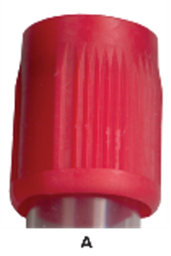
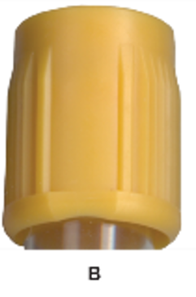
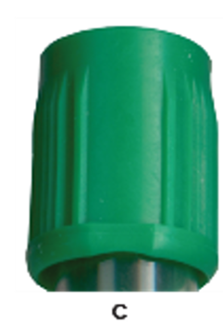
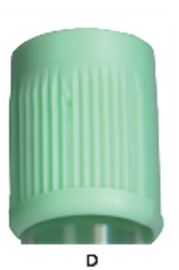
Becton Dickinson
Vacutainer® and Microtainer® systems.
Color-coded for adult and pediatric (solid versus. translucent).
Color-coded for separator gel.
Clot Activator
Clot Activator and Separator Gel
Heparin
Heparin and Separator Gel
Courtesy and ©Becton Dickinson
Notes:
LO 8.6 Compare blood collection equipment from various manufacturers.
Notes:
As described earlier, BD Vacutainer® tubes for routine blood collection from adults have a solid cap; caps for pediatric tubes are translucent.

Slide 48
Greiner Bio-One
VACUETTE® and MiniCollect® tubes.
Tube tops are solid regardless of vacuum amount.
Notes:
LO 8.6 Compare blood collection equipment from various manufacturers.
Notes:
Tubes for adult blood collection have a black ring on the cap top.
Tubes for pediatric blood collection have a white ring on the cap top.
Tubes with separator gel have a yellow ring on the cap top.

Slide 49
Sarstedt
S-Monovette®
Microvette®
Multivette®
Notes:
LO 8.6 Compare blood collection equipment from various manufacturers.
Notes:
S-Monovette ® can be used either for syringe aspiration or vacuum draw.
Microvette ® can be filled using capillary action or gravity fill.
Multivette ® can be used for small samples of venous blood or capillary blood.

Slide 50
Chapter Summary 1
Common equipment and supplies for phlebotomy include a cart or tray; gloves; alcohol prep pads; tissue warmers; adhesive bandages; sharps container, marker or computer labels; and specimen transport bags.
Venipuncture-specific equipment includes tourniquets, needles, and evacuated tubes and holders.
A winged infusion set is used for people with small veins and for stability.
A hypodermic needle attached to a syringe can be used for people with small veins.
Notes:
8.1 Select equipment used for both venipuncture and capillary puncture.
8.2 Select equipment specific for venipuncture procedures.

Slide 51
Chapter Summary 2
Blood drawn with winged infusion sets and syringes must be transferred to evacuated tubes.
Evacuated tube collection systems allow for multiple tubes to be collected with one venipuncture.
Evacuated tubes come prefilled with various additives for specific tests.
Additives in evacuated tubes are identified by color-coded stoppers or caps.
Equipment specific to capillary/dermal puncture includes lancets, capillary tubes, sealant, and microcollection tubes.
Notes:
8.2 Select equipment specific for venipuncture procedures.
8.3 Select equipment specific for dermal/capillary puncture procedures.
8.4 Identify the various types of additives and color-coding used in blood collection and explain the reasons for their use.
8.5 Implement the correct order of draw for venipuncture and capillary puncture procedures.
8.6 Compare blood collection equipment from various manufacturers.

Slide 52
Chapter Summary 3
Commonly used additives and the colors that identify them: no additive (red); citrate (light blue); clot activator and gel (gold); heparin (green); heparin and gel (mint); E D T A (lavender); potassium oxalate with sodium fluoride (gray).
The order of draw is very important to prevent cross-contamination by interfering substances.
Each manufacturer of blood collection equipment uses the same general color scheme for cap colors, but specifics such as indication of vacuum amount and the presence of gel separators may differ.
Notes:
8.4 Identify the various types of additives and color-coding used in blood collection and explain the reasons for their use.
8.5 Implement the correct order of draw for venipuncture and capillary puncture procedures.
8.6 Compare blood collection equipment from various manufacturers.

Slide 53
End of Main Content
© McGraw Hill LLC. All rights reserved. No reproduction or distribution without the prior written consent of McGraw Hill LLC.

Slide 54
Accessibility Content: Text Alternatives for Images

Slide 55
Evacuated Tubes – Text Alternative
Return to parent-slide containing images.
Examples of evacuated tubes. Left to right: red-and-black-topped, lavender-topped, yellow-topped, pink-topped, and royal-blue-topped full-sized tubes, then red-topped, green-topped, lavender-topped, and gray-topped smaller tubes.
Return to parent-slide containing images.

