Slide 1
Chapter 9
Venipuncture

Slide 2
Learning Outcomes
9.1 Summarize the steps necessary to perform a competent/effective venipuncture.
9.2 Describe special procedures needed for venipuncture on difficult-to-draw veins.
9.3 Describe signs and symptoms of venipuncture complications.
Notes:
Introduction:
This chapter outlines the procedures for both routine and difficult venipunctures as well as the complications that may occur during these procedures.

Slide 3
N A A C L S Competencies 1
5.1 Demonstrate knowledge of collection equipment, various types of additives used, special precautions necessary, and substances that can interfere in clinical analysis of blood constituents.
5.6 List and select the types of equipment needed to collect blood by venipuncture and capillary (dermal) puncture.
5.7 Identify special precautions necessary during blood collections by venipuncture and capillary (dermal) puncture.
6.1 Follow standard operating procedures to collect specimens.
6.2 Identify potential sites for venipuncture and capillary (dermal) puncture.

Slide 4
N A A C L S Competencies 2
6.3 Differentiate between sterile and antiseptic techniques.
6.4 Describe and demonstrate the steps in the preparation of a puncture site.
6.5 List the effects of tourniquet, hand squeezing, and heating pads on specimens collected by venipuncture and capillary (dermal) puncture.
6.6 Recognize proper needle insertion and withdrawal techniques, including direction, angle, depth, and aspiration, for venipuncture.
6.8 Describe the limitations and precautions of alternate collection sites for venipuncture and capillary (dermal) puncture.

Slide 5
N A A C L S Competencies 3
6.9 Explain the causes of phlebotomy complications.
6.10 Describe signs and symptoms of physical problems that may occur during blood collection.
6.11 List the steps necessary to perform a venipuncture and a capillary (dermal) puncture in order.
6.12 Demonstrate a successful venipuncture following standard operating procedures.
9.11 Demonstrate basic understanding of age specific or psycho-social considerations involved in the performance of phlebotomy procedures on various age groups of patients.

Slide 6
Key Terms
Antecubital.
Anticoagulant.
Aseptic.
Collapsed vein.
Concentric circles.
Ecchymosis.
Edematous.
Exsanguination.
Hematoma.
Hemoconcentration.
Iatrogenic anemia.
Lymphostasis.
Palpate.
Petechiae.
Sclerosis.
Syncope.
Venous reflux.

Slide 7
Learning Outcome 9.1
Venipuncture

Slide 8
Introduction to Venipuncture
Most common technique to obtain blood specimens.
Consists of steps described in Learn How 9-1.
All steps must be performed safely and accurately.
Notes:
LO 9.1 Summarize the steps necessary to perform a competent/effective venipuncture.
Notes:
Phlebotomists use a variety of techniques to acquire blood specimens, the most common being venipuncture. Routine venipuncture procedure consists of a series of detailed steps that must be performed safely and accurately. Adjustments to procedures may be required for patients whose blood is difficult to collect.

Slide 9
Learn How 9-1: Basic Blood Collection
Greet and properly identify the patient.
Select and assemble the appropriate equipment.
Use aseptic technique and standard precautions during venipuncture and blood specimen collection.
Provide proper post-puncture patient care.
Adhere to specimen labeling requirements.
Correctly handle and transport specimens.
Notes:
LO 9.1 Summarize the steps necessary to perform a competent/effective venipuncture.
Notes:
Step 1: See the chapter Patient and Specimen Requirements.
Step 2: See the chapter Blood Collection Equipment.
Step 3: See the chapter Infection Control.
Step 5: See the chapter Patient and Specimen Requirements.
Step 6: See the chapter Blood Specimen Handling.

Slide 10
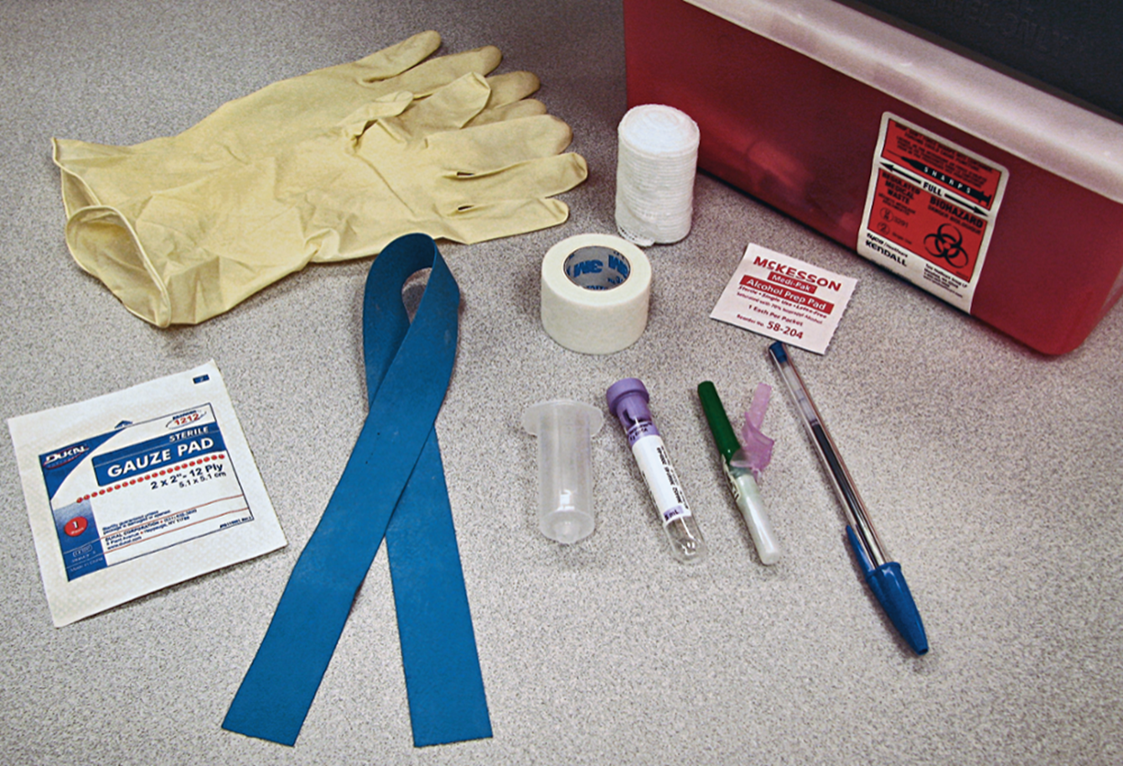
Assembling Venipuncture Equipment
Notes:
LO 9.1 Summarize the steps necessary to perform a competent/effective venipuncture.
Notes:
The equipment needed for venipuncture was described in Chapter 7. Review the necessary equipment before proceeding with this section of Chapter 9:
Gloves
Tourniquet
Alcohol prep pads
Gauze pads
Needle
Evacuated tube holder or syringe
Evacuated tubes
Sharps container
Adhesive bandage or tape
Permanent marker, pen, or computer labels

Slide 11
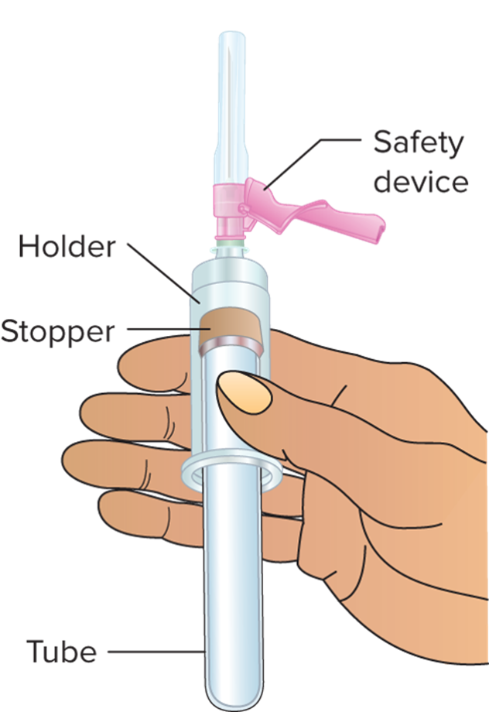
Preparing the Equipment
Line up the equipment near the patient with the tubes assembled in the order of draw.
Attach needle into tube adapter.
Notes:
LO 9.1 Summarize the steps necessary to perform a competent/effective venipuncture.
Notes:
Make sure that the tube adapter and needle are compatible. Items made by different manufacturers may not fit together properly.
Screw the needle all the way into the adapter, making sure that it is secure.
Push the tube into the tube adapter but only up to the adapter guideline. Do not push the tube all the way into the needle because this will cause a loss of vacuum in the tube.
Do not remove the needle cap yet.

Slide 12
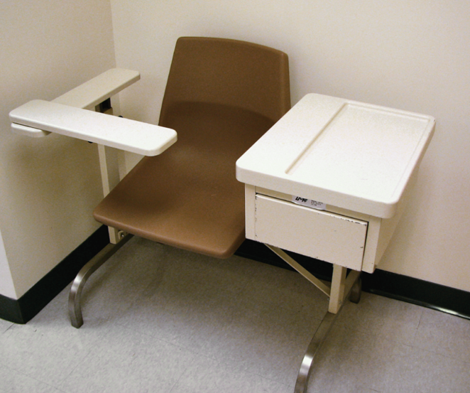
Positioning the Patient
Patient should lie supine or sit in a phlebotomy chair.
Straight chair with arm.
Use pillow or towel if necessary.
Notes:
LO 9.1 Summarize the steps necessary to perform a competent/effective venipuncture.
Notes:
Make sure that the tube adapter and needle are compatible. Items made by different manufacturers may not fit together properly.
Screw the needle all the way into the adapter, making sure that it is secure.
Push the tube into the tube adapter but only up to the adapter guideline. Do not push the tube all the way into the needle because this will cause a loss of vacuum in the tube.
Do not remove the needle cap yet.

Slide 13
Learn How 9-2: Tourniquet Application 1
Position the tourniquet under the arm while grasping the ends above the arm and venipuncture area.
Cross the left end over the right end and apply a small amount of tension to the tourniquet by pulling on each half of the tourniquet.
Grasp both ends of the tourniquet close to the patient’s arm between the thumb and forefinger of the left hand.
Using the right middle finger or index finger, tuck the left end under the right end. The loose end of the tourniquet will be pointing toward the shoulder and the loop will be pointed toward the hand.
Notes:
LO 9.1 Summarize the steps necessary to perform a competent/effective venipuncture.

Slide 14
Learn How 9-2: Tourniquet Application 2
When tugged after the venipuncture procedure, the loose end will easily release the tourniquet from the arm.
Notes:
LO 9.1 Summarize the steps necessary to perform a competent/effective venipuncture.

Slide 15
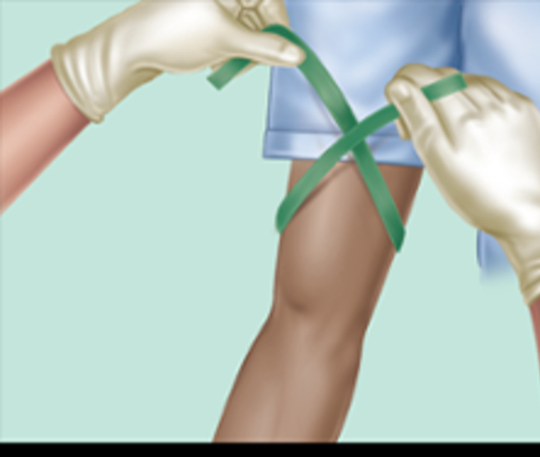
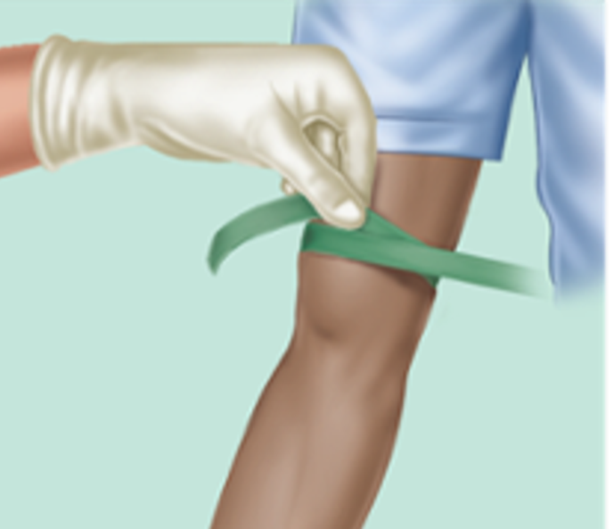
Applying the Tourniquet 1
Position tourniquet
Cross left end over right
Notes:
LO 9.1 Summarize the steps necessary to perform a competent/effective venipuncture.
Notes:
To apply the tourniquet:
Position the tourniquet under the arm while grasping the ends above the arm.
The tourniquet should be applied 3 to 4 inches above the venipuncture site.
Pull the ends upward, away from the puncture site.
Cross the left end over the right end and apply a small amount of tension to the tourniquet.
(Continues on next slide.)

Slide 16
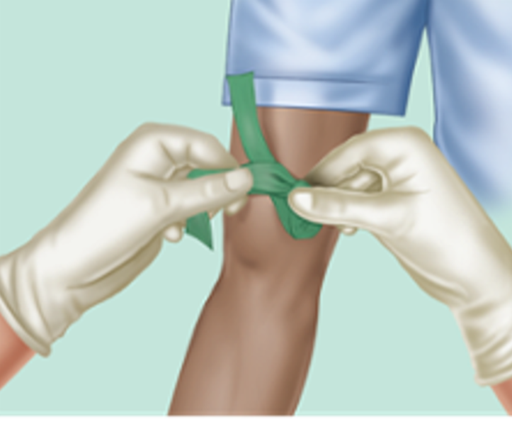
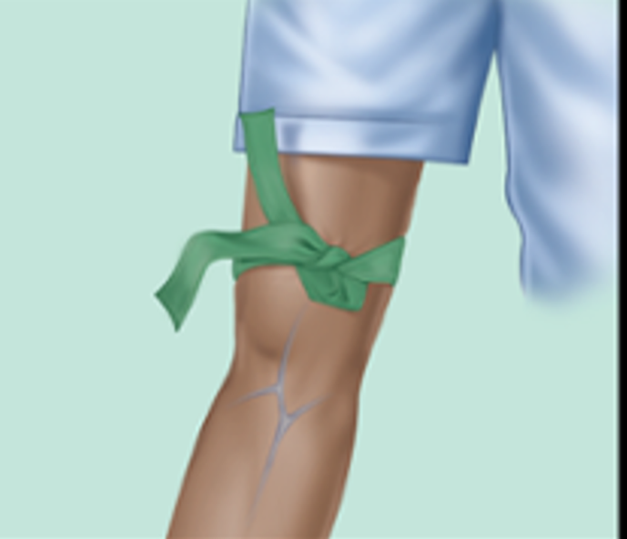
Applying the Tourniquet 2
Tuck left end under right end
Loose ends point toward shoulder
Notes:
LO 9.1 Summarize the steps necessary to perform a competent/effective venipuncture.
Notes:
To apply the tourniquet (continued):
Using your right index finger or right middle finger, tuck the left end of the tourniquet under the right end.
The loop of the tourniquet should be pointing downward.
The ends of the tourniquet should be pointing upward, toward the patient’s shoulder.
Proper positioning:
The tourniquet should be tight enough to make veins more visible but should not pinch the skin.
Keep the tourniquet flat against the skin.
Never leave the tourniquet on for more than one minute.
Petechiae may develop if the tourniquet is left on too long.
Hemoconcentration (temporary increase in cells and chemicals in the blood) may result, which alters the results of laboratory tests.
If it takes longer than a minute to find the vein, release the tourniquet and let the arm rest for two minutes before reapplying the tourniquet.
View the video, “Tourniquet Application,” for more information about using a tourniquet

Slide 17
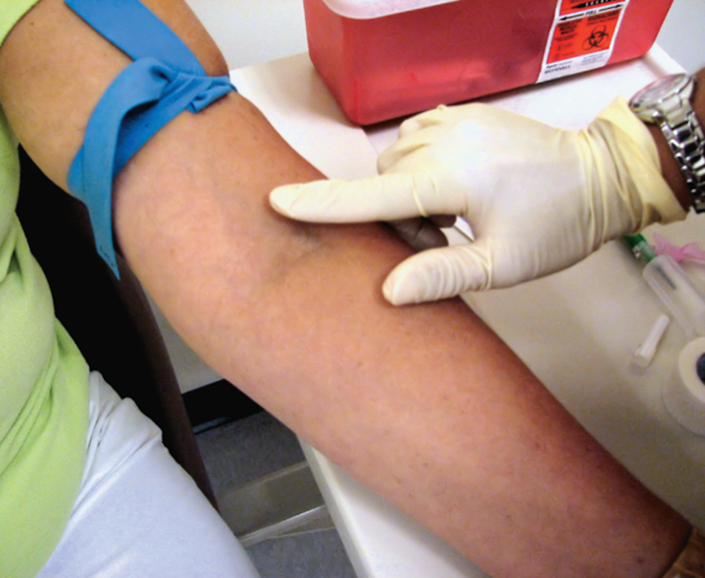
Selecting the Site
Position arm at downward angle.
Ask patient to make a fist.
Examine the antecubital area first.
Palpate vein with fingertip.
Always adhere to standard precautions when collecting blood by venipuncture, capillary (dermal) puncture, or venous access devices in order to prevent the transfer of infectious diseases.
Notes:
LO 9.1 Summarize the steps necessary to perform a competent/effective venipuncture.
Notes:
Antecubital area (antecubital fossa): Area in the middle of the arm, in front of the elbow, that houses the veins most commonly used for venipuncture
Select a large, well-anchored vein that does not roll.
Palpate, or feel, the veins for possible venipuncture.
To find deep veins, a venoscope may be needed. A venoscope uses LED technology to illuminate the path of the vein.
If it is necessary to increase blood flow through the site, use a warming device such as a warm moist compress or a heel warmer.
Veins are bouncy and do not have a pulse. Do not select:
Arteries (have a pulse)
Tendons (feel tough and stringy)
Site that is swollen or has lesions
Site above an IV site
Site on the side of a mastectomy
If you cannot find a suitable vein in the antecubital area, you may use the dorsal veins in the back of the hand if necessary. Never use the veins on the anterior side of the wrist or hand because of their proximity to nerves and the possibility of causing nerve damage.

Slide 18
1-2-3-2-1 Method
Used in locations not typically used for blood collection.
1—pair of gloves.
2—tourniquet and alcohol swab.
3—needle, holder, and tubes (in draw order).
2—gauze/cotton swab and bandage.
1—sharps container.
Notes:
LO 9.1 Summarize the steps necessary to perform a competent/effective venipuncture.
Notes:
Organization is the key to safety in unusual or nonroutine environments. Use this method to ensure that you have all of the equipment you need. Also be certain to have additional tubes and needles available and close at hand in case you need them during the procedure.

Slide 19
Special Considerations for Children
Squat down to child’s height to reduce intimidation.
Never lie.
Ask the child’s caregiver to help.
Use restraining chairs or arm boards if necessary.
Have special bandages or stickers available as rewards.
Always be honest and direct.
Notes:
LO 9.1 Summarize the steps necessary to perform a competent/effective venipuncture.
Notes:
Children may become even more anxious about a phlebotomy procedure than adults. Allow the child to view the needle for as short a time as possible to help reduce anxiety.

Slide 20
Special Considerations for Geriatric Patients
Allow extra time for communication if sensory impairment exists.
Skin is fragile and veins tend to roll; hold skin taut.
If using a butterfly needle, a shallower angle is required during insertion.
Notes:
LO 9.1 Summarize the steps necessary to perform a competent/effective venipuncture.
Notes:
Geriatric patients often have physical challenges not present in younger patients, including arthritis and diseases that cause tremors.
The needle may need to be held at a shallower angle with any type of needle if the patient’s muscles have become smaller.

Slide 21
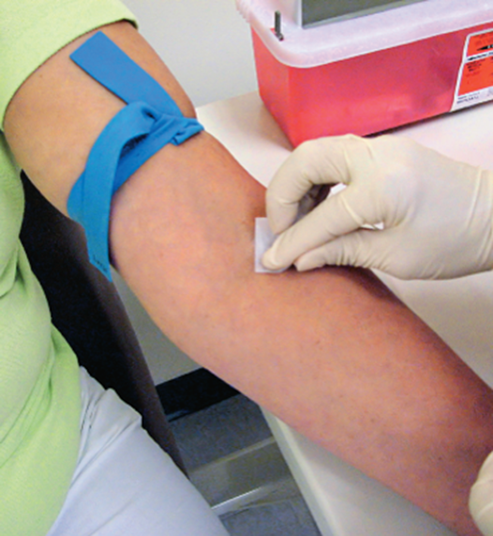
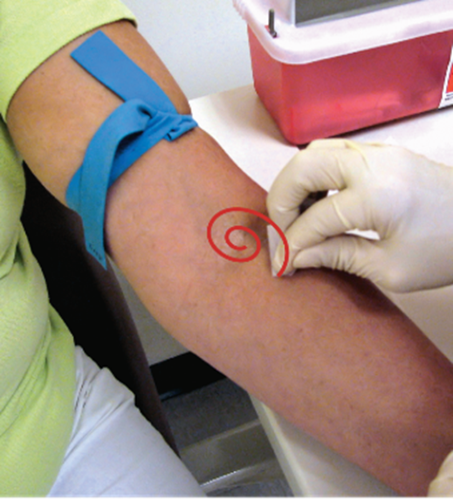
Cleansing the Venipuncture Site
Use aseptic technique.
Use antiseptic (70% alcohol pad).
Use concentric circles.
Begin at the site
Move outward
Notes:
LO 9.1 Summarize the steps necessary to perform a competent/effective venipuncture.
Notes:
Aseptic technique is a procedure for minimizing contamination by pathogens.
Concentric circles: Circular motion starting from the center and moving outward in ever-widening, even circles
Rubbing an antiseptic back and forth over a puncture site may bring bacteria from areas distal to (away from) the site and deposit them on the site of blood collection. Drawing concentric circles with the antiseptic, from the center point outward, pushes microorganisms farther and farther away from the puncture site.
Cleansing the site helps prevent contamination of both the specimen and the patient’s venipuncture site.
While cleansing, apply sufficient pressure to remove surface dirt.
If the site is especially dirty, repeat the procedure with a new alcohol pad.
Allow the alcohol to dry completely before continuing with venipuncture. If the alcohol has not completely evaporated when you perform the venipuncture, the alcohol may mix with the specimen, causing hemolyzation and affecting test results.
Do not blow on or fan the site to hasten the alcohol drying process.
View the video, “Skin Preparation and Decontamination,” for more information about preparing the venipuncture site.

Slide 22
Use of Alcohol
Allow alcohol to air dry or use a gauze pad.
NEVER blow on the site to dry the alcohol.
Be sure alcohol has dried before attempting venipuncture.
Wet alcohol can hemolyze the specimen and affect laboratory results.
Prevent burning sensation when needle enters the skin, which patient may perceive as injury.
Notes:
LO 9.1 Summarize the steps necessary to perform a competent/effective venipuncture.
Notes:
In addition to the reasons listed above, drawing blood before the alcohol has dried may subject the patient to another blood collection unnecessarily if the alcohol hemolyzes the blood specimen.

Slide 23
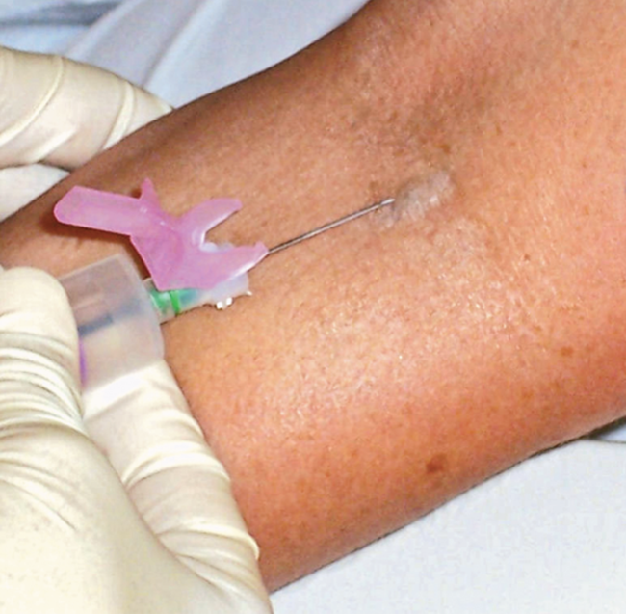
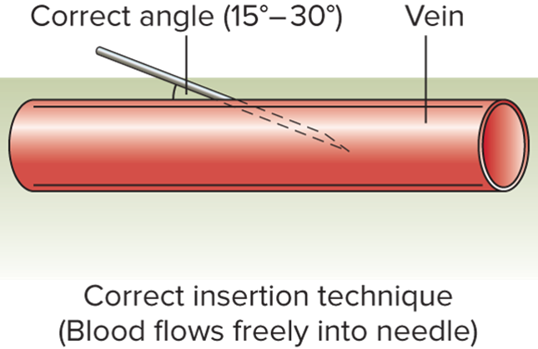
Performing the Venipuncture
Reapply the tourniquet.
Visually confirm the site.
Anchor the vein.
Insert the needle.
Access the text alternative for these images
Notes:
LO 9.1 Summarize the steps necessary to perform a competent/effective venipuncture.
Notes:
Reapply the tourniquet before inserting the needle.
In addition to reconfirming the site visually, check the needle. Look for obstructions, imperfections, or barbs on the needle shaft and tip. If you notice abnormalities, replace the needle with a new sterile needle.
Anchor the vein by grasping the patient’s arm with your nondominant hand and using the thumb to pull the skin taut 1 to 2 inches below the venipuncture site.
Line up the needle with the vein and with the bevel facing up.
Warn the patient, “You may feel a pinch now.”
Insert the needle smoothly at a 15- to 30-degree angle until you feel a decrease in resistance or a slight “pop” as the needle enters the vein.

Slide 24
Causes of Unsuccessful Venipuncture
Poor site selection (vein hard and sclerosed).
Patient fails to remain still.
Tourniquet too tight.
Use of expired evacuated tubes.
Use of a tube that has lost vacuum.
Notes:
LO 9.1 Summarize the steps necessary to perform a competent/effective venipuncture.
Notes:
NEVER probe for a vein or move the needle from side to side once it is in the arm. Doing so may cause pain, injury, and a lawsuit.

Slide 25
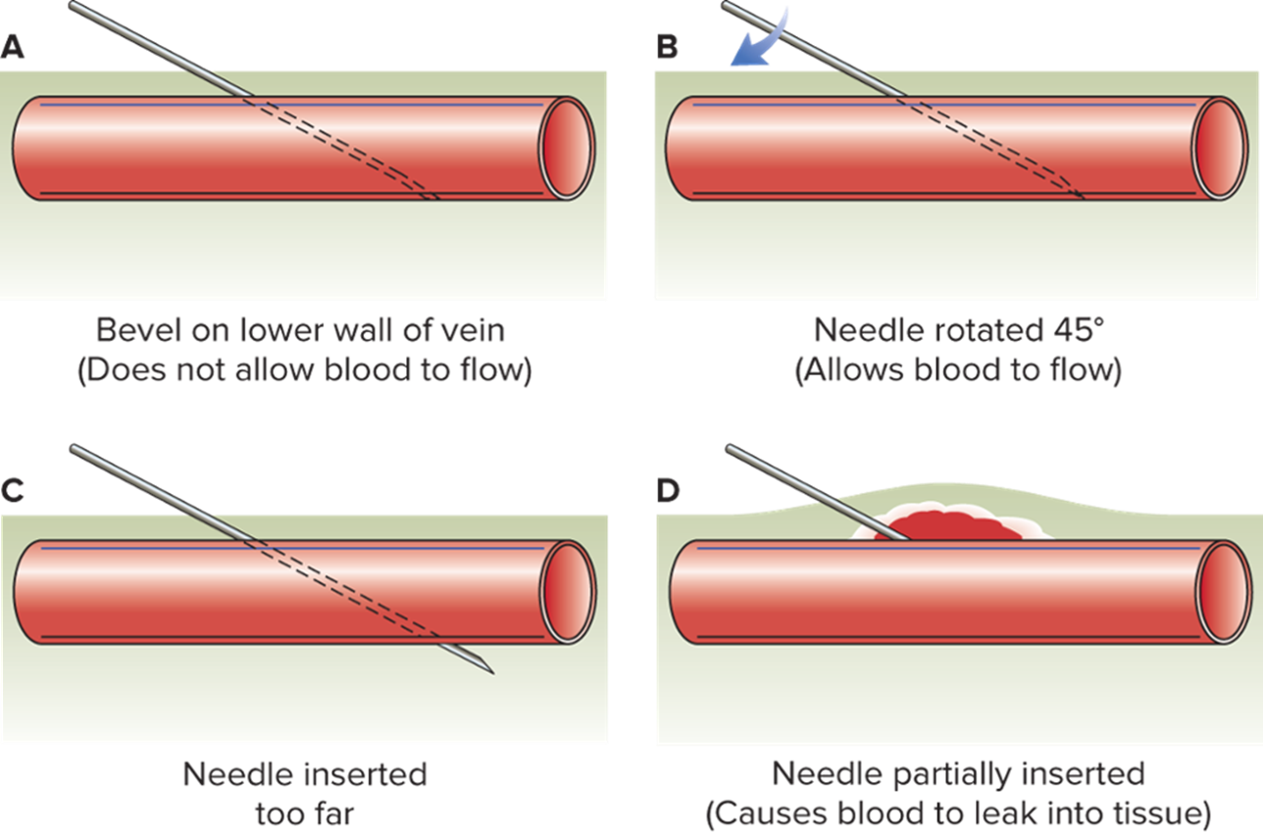
Causes of Unsuccessful Venipuncture: Improper Technique
Access the text alternative for these images
Notes:
LO 9.1 Summarize the steps necessary to perform a competent/effective venipuncture.
Notes:
If the initial venipuncture is not successful:
Replace the tube if you suspect a defective tube/vacuum.
Pull back slightly on the needle. If the bevel is against the wall of the vein or if the needle has been inserted too far, this will correct the position and allow blood to flow. Stop pulling back when blood begins to flow.
Advance the needle a little farther into the vein in case the needle has not fully penetrated the vein. Do this ONLY if the vein is not yet punctured and a hematoma is not forming.
Try releasing the tourniquet slightly to improve blood flow.
Remember, NEVER probe the site with the needle.
Each facility has its own policy regarding the number of times a phlebotomist may attempt to get a blood specimen. Generally, the maximum number of attempts is two. If you are unsuccessful after two tries, ask for assistance.

Slide 26
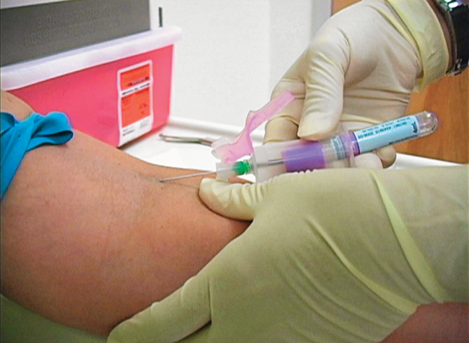
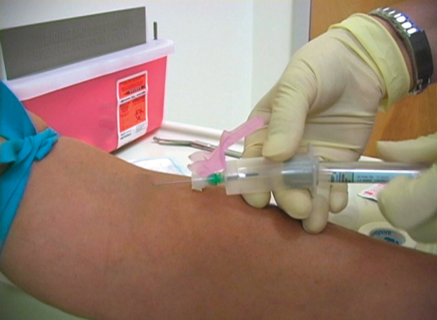
Collecting the Specimen
Insert the first evacuated tube to start blood flow.
Hold equipment steady during tube changes.
Allow each tube to fill completely.
Mix tubes with additives immediately.
Notes:
LO 9.1 Summarize the steps necessary to perform a competent/effective venipuncture.
Notes:
Remember that the tourniquet should not be left on the arm for more than one minute. You may need to use your free hand to loosen the tourniquet while the tubes are filling.
The evacuated tubes have a vacuum calculated to draw exactly the right amount of blood. Allow each tube to fill completely before removing it from the tube holder.
To change tubes, brace the thumb against the flange of the holder and remove the tube with a pulling and twisting motion.
Be sure to use the correct draw order. Placing the tubes in the proper order before you begin will help ensure this.
If you are collecting specimens into tubes that contain additives, mix the tubes by inversion. Invert the tubes the number of times recommended by the manufacturer, usually 8 to 10 times.
View the videos “Venipuncture Methods” and “Venipuncture Using Blood Collection Systems (Evacuated Tube System)” for more information about routine venipuncture.

Slide 27
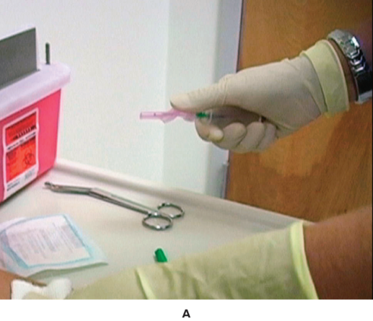
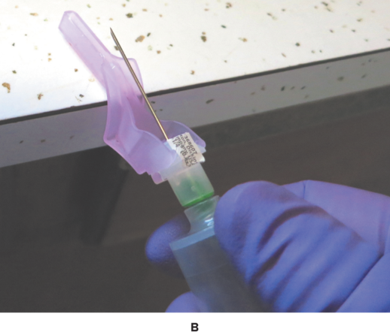
Removing the Tourniquet
Release the tourniquet.
Place gauze on puncture site.
Remove needle smoothly.
Engage needle safety mechanism.
Apply gentle pressure to patient’s arm.
Left: ©Total Care Programming, Inc.; right: ©Lillian Mundt
Notes:
LO 9.1 Summarize the steps necessary to perform a competent/effective venipuncture.
Notes:
After you have removed the last tube from the tube holder, release the tourniquet if you have not already done so.
Fold gauze and place it over the venipuncture site, but do not apply pressure while the needle is still in the arm.
Remove the needle smoothly, retaining the same 15- to 30-degree angle at which the needle was inserted.
With the hand that is holding the needle, engage the needle safety mechanism.
At the same time, your other hand should apply gentle pressure to the gauze at the venipuncture site. Hold pressure to the site for 3 to 5 minutes or until the bleeding stops. The arm should remain straight (not bent) during this time to prevent ecchymosis or hematoma formation. You may ask the patient to apply firm pressure while you complete the final tasks.
Ecchymosis: Bruising or discoloration caused by blood seeping beneath the skin; can spread over a large area
Hematoma: Bloody mass that forms when blood seeping beneath the skin remains localized in the immediate area

Slide 28
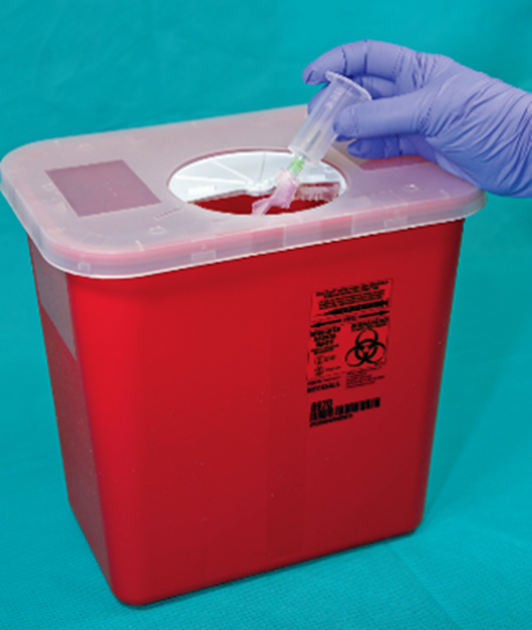
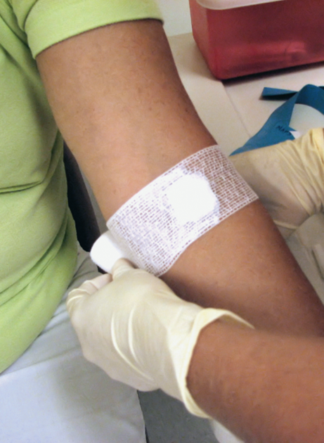
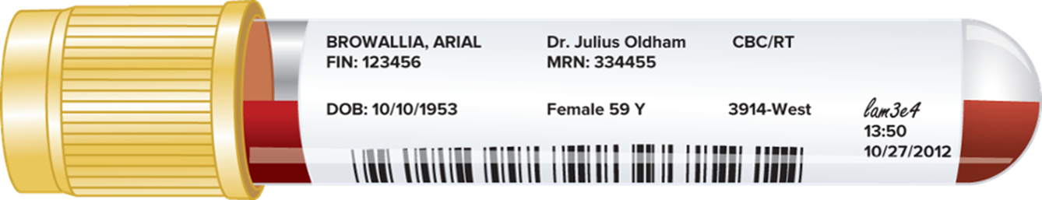
Completing the Procedure
Left: ©McGraw-Hill Education/Sandra Mesrine, photographer; right: (cL)Total Care Programming, Inc.
Notes:
LO 9.1 Summarize the steps necessary to perform a competent/effective venipuncture.
Notes:
If the patient is competent and willing, you may ask the patient to continue holding pressure on the site while you complete the procedure.
Dispose of the needle and adapter in the sharps container. Do not remove the needle from the adapter.
Label the specimens with computer-generated labels or use a permanent marker. Mark the tube after collection with the date, time, and your initials or identification code. Be sure to label the tubes after specimen collection but before leaving the patient.
Check the patient’s arm to be sure that the bleeding has stopped.
Apply the bandage.
Properly dispose of or put away all other equipment.
Thank the patient.
For inpatients, restore the bedrail to the same position it was in when you entered the room, and leave the door to the room as it was when you entered (open or closed).

Slide 29
Learning Outcome 9.2
Difficult Blood Draws

Slide 30
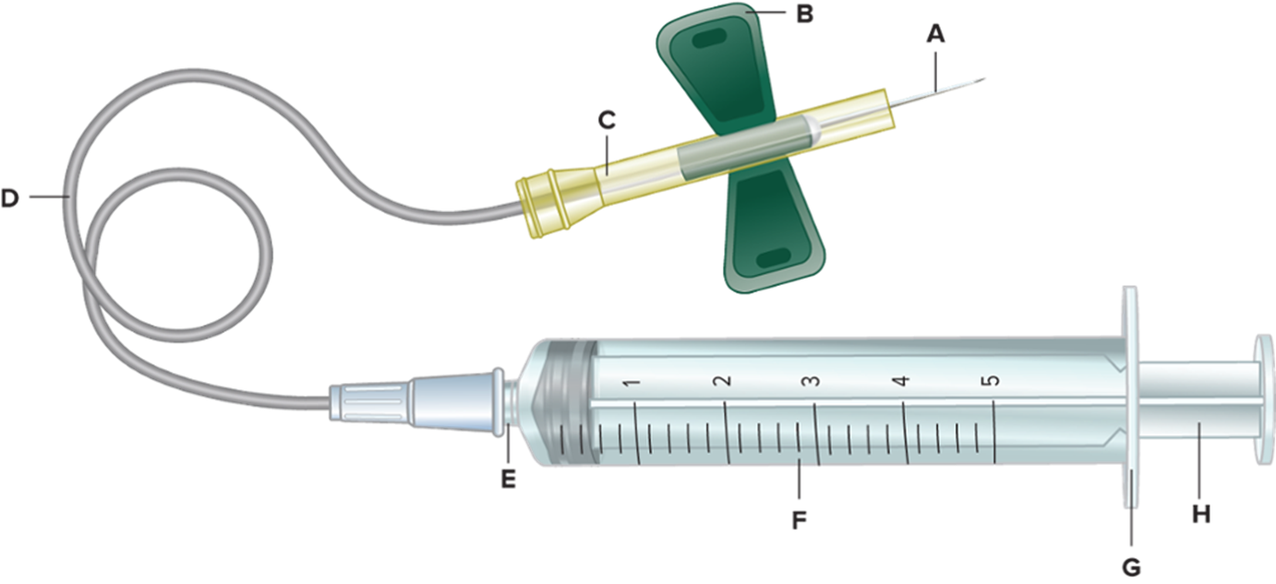
Butterfly Set
Use only when standard draw is not possible.
Do not use with evacuated tubes if patient has fragile veins.
Notes:
LO 9.2 Describe special procedures needed for venipuncture on difficult-to-draw veins.
Notes:
For children, patients who have very small or difficult-to-access veins, and patients who have conditions in which they are not able to control tremors or shaking, you will need to adapt the procedure to the patient’s situation.
A butterfly or winged infusion set is possibly less painful, and the wings provide more stability for the needle. Since this method results in more accidental needlesticks, you should use it only when standard venipuncture cannot be performed.
Although a butterfly set can be adapted for use with evacuated tubes, if the patient has small or fragile veins, the evacuation system may cause the vein to collapse. Therefore, a syringe is preferred so that the phlebotomist can control the amount of pressure applied to the vein.

Slide 31
Using a Butterfly Set
Assemble evacuated tubes for specimen transfer.
Follow same procedure as for standard venipuncture.
Notes:
LO 9.2 Describe special procedures needed for venipuncture on difficult-to-draw veins.
Notes:
The steps for performing venipuncture using a butterfly set are the same as those for routine venipuncture, but you will need to perform a few extra steps.
Before you begin, assemble the correct evacuated tubes for the tests to be performed. After you draw the blood into the syringe, you will need to transfer it to these tubes for processing.
Remove the syringe from the sterile packaging and push the plunger in and out to ensure free and smooth movement.
Make sure the plunger is pushed completely in before proceeding.
Do not apply too much pressure to the syringe; doing so may make the blood hemolyze as it rushes through the needle.
The first sign of a successful venipuncture is blood in the hub, or clear area, of the needle.
Once the needle is successfully inserted, the wings may be taped to the skin to prevent movement of the needle.
If you are using evacuated tubes, remember to use a discard tube first to purge the air from the assembly tubing.
If you are using a syringe, pull the syringe plunger back slowly. A hard pull can cause the vein to collapse and hemolyze the specimen.
View the video “Venipuncture Using Blood Collection Systems—Butterfly Systems” for more information about using a butterfly set.

Slide 32
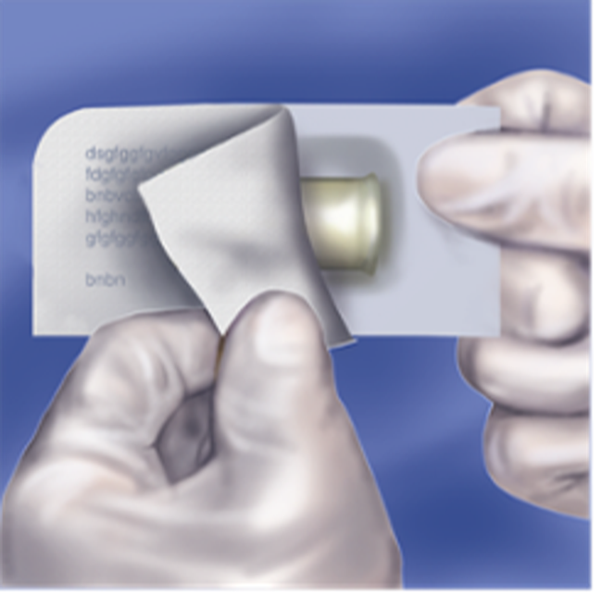
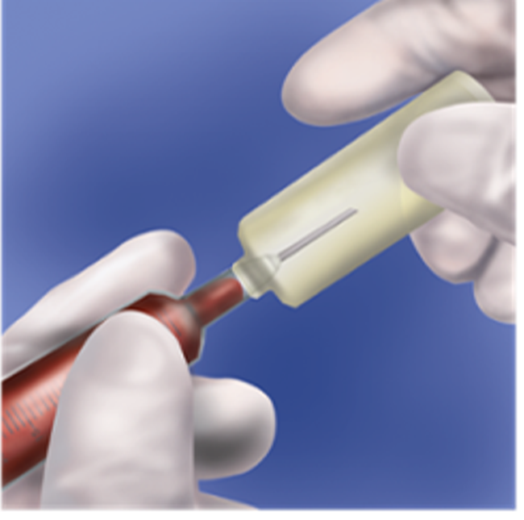
Transferring the Specimen from Syringe to Evacuated Tubes 1
1. Peel off backing from transfer device.
2. Insert syringe tip into hub and rotate syringe clockwise
Notes:
LO 9.2 Describe special procedures needed for venipuncture on difficult-to-draw veins.
Notes:
To transfer blood from a syringe to an evacuation tube, first engage the needle safety device, remove the hypodermic needle, and dispose of it properly. Then follow these steps:
Peel the backing from the transfer device. Insert the syringe tip into the hub of the device and rotate the syringe clockwise to secure it.
Attach the syringe to the transfer device. The transfer device has a blunt needle similar to the one in an evacuation set that punctures the cap of the evacuation tube.
(Procedure continues on next slide.)

Slide 33
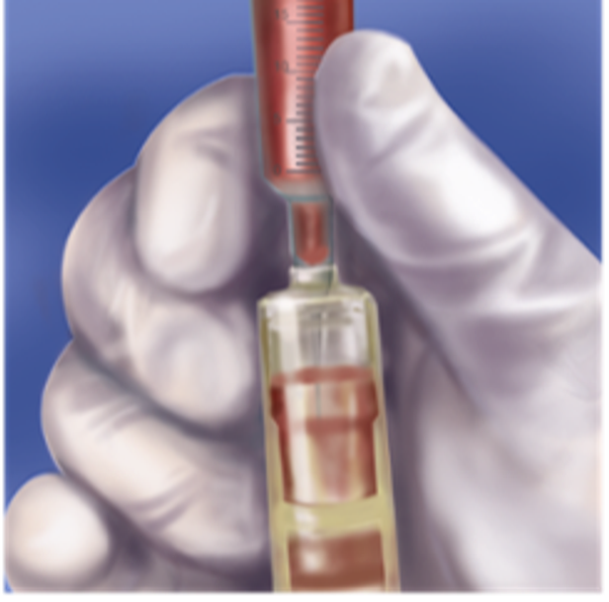
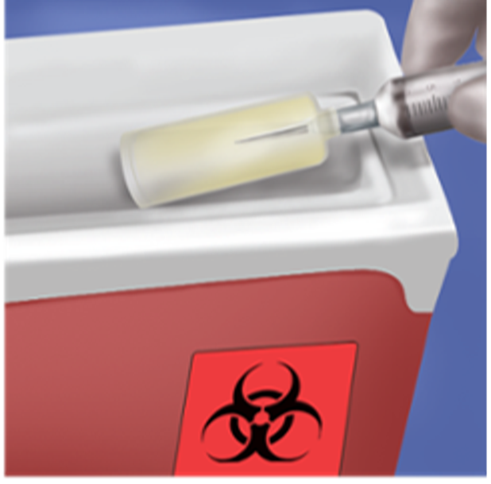
Transferring the Specimen from Syringe to Evacuated Tubes 2
3. Hold the syringe facing down and push the evacuated tube into the holder. Do not depress the plunger of the syringe.
4. After removing the evacuated tube, discard the tube holder and syringe in an approved sharps container.
Access the text alternative for these images
Notes:
LO 9.2 Describe special procedures needed for venipuncture on difficult-to-draw veins.
Notes:
To transfer blood from a syringe to an evacuation tube, first engage the needle safety device, remove the hypodermic needle, and dispose of it properly. Then follow these steps:
Peel the backing from the transfer device. Insert the syringe tip into the hub of the device and rotate the syringe clockwise to secure it.
Attach the syringe to the transfer device. The transfer device has a blunt needle similar to the one in an evacuation set that punctures the cap of the evacuation tube.
(Procedure continues on next slide.)

Slide 34
Learning Outcome 9.3
Venipuncture Complications

Slide 35
Patient Complications: Allergies
Allergic reactions.
Latex.
Alcohol.
Notes:
LO 9.3 Describe signs and symptoms of venipuncture complications.
Notes:
Use only nonlatex tourniquets and adhesive bandages. If the patient is allergic to alcohol, use an alternate antiseptic. If the patient is allergic to many types of antiseptics, use warm water on a gauze pad to clean the puncture site.

Slide 36
Patient Complications: Syncope
Symptoms of impending syncope.
Heavy perspiration.
Pale skin.
Shallow or fast breathing.
Phlebotomist actions.
Remove tourniquet and needle.
Call for help.
Apply pressure to venipuncture site.
Notes:
LO 9.3 Describe signs and symptoms of venipuncture complications.
Notes:
Syncope, or fainting, may occur during phlebotomy. If the patient faints:
Remove the tourniquet and needle to prevent patient injury.
Do not attempt to handle the situation alone; call for help.
Never leave the patient.
Position yourself in front of the phlebotomy chair or next to the bedside to block the patient from falling of sliding out of the chair or bed.
If the patient is sitting, lower the patient’s head and arms to between his or her knees.
Wipe the patient’s forehead and back of the neck with a cold compress if a sink is available near the patient.
Syncopal episodes are sometimes accompanied by nausea and vomiting; place a trashcan or other container near the patient.
If a seizure or convulsion occurs, protect the patient from injury and notify the appropriate personnel to assist and administer first aid.

Slide 37
Patient Complications: Petechiae and Bleeding
Petechiae.
Make sure tourniquet is not too tight.
Apply tourniquet for only 1 minute at a time.
Bleeding.
Arm movement may cause bleeding to recur.
Check the arm before leaving the patient.
Apply adhesive bandage over clean piece of gauze.
Notes:
LO 9.3 Describe signs and symptoms of venipuncture complications.
Notes:
Petechiae: Small, nonraised red spots on the skin; usually due to an overly tight tourniquet or tourniquet being left on too long
Perform procedures as quickly as possible to avoid delays that may cause the tourniquet to be on for longer than one minute.
Bleeding may recur at the puncture site even if it appears to have stopped.

Slide 38
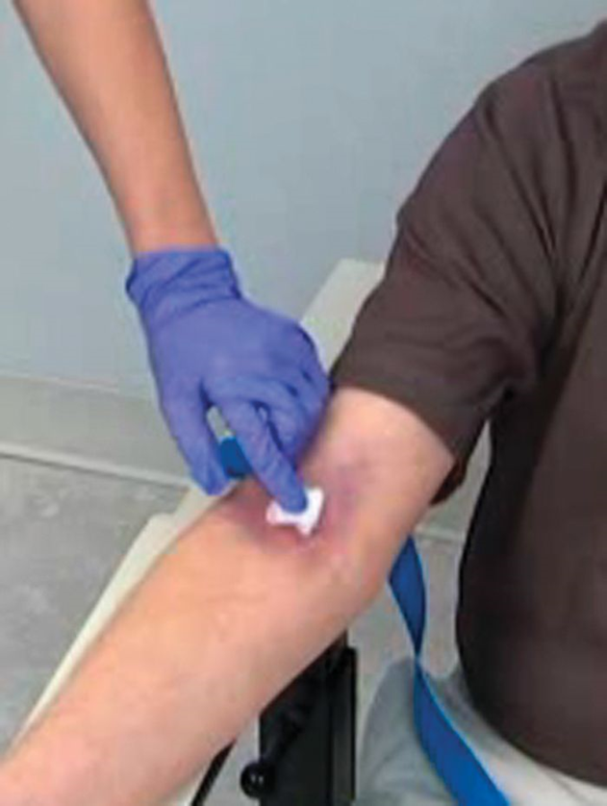
Patient Complications: Hematoma
If a hematoma occurs:
Release the tourniquet.
Pull the needle out.
Apply firm pressure at the site.
If patient complains of discomfort, apply ice.
©McGraw-Hill Education/Take One Digital Media, photographer
Notes:
LO 9.3 Describe signs and symptoms of venipuncture complications.
Notes:
A hematoma is a mass of blood caused by leakage of blood into the tissues. This may occur if:
The needle has gone through the vein
The bevel of the needle is not fully inserted into the vein
You forget to release the tourniquet prior to removing the needle

Slide 39
Patient Complications: Iatrogenic Anemia and Exsanguination
Iatrogenic anemia.
Anemic response to removal of large amount of blood over short time period.
More than 10% blood loss may become life-threatening.
Exsanguination.
Life-threatening amount of blood loss.
Occurs easily in small patients, children, and infants.
Notes:
LO 9.3 Describe signs and symptoms of venipuncture complications.

Slide 40
Patient Complications: Infection and Injury
To avoid puncture site infections:
Ensure sterility of all equipment used.
Do not touch puncture site after it is cleansed.
Apply pressure until all bleeding has stopped.
Never puncture through a previous puncture site.
Injury.
Do not insert the needle too deeply.
NEVER probe for a vein.
Notes:
LO 9.3 Describe signs and symptoms of venipuncture complications.
Notes:
Puncture site infections are not common, but they do occur. Follow these guidelines to help prevent them:
Do not remove the cap from the needle until you are ready to insert the needle into the vein.
Never remove a needle cap or lancet cover and then set the needle or device on the bed or other surface.
Ask the patient to keep the bandage on the puncture site until bleeding has completely stopped. Microorganisms may be present in scar tissue and can be introduced deeper into the puncture site by the needle.
Injuries include accidental puncture of a nerve or tendon, causing tissue damage.
A “vein” that feels very tight and stringy may not be a vein but rather a tendon.
Nerves lie close to blood vessels and may be punctured if you insert the needle too deeply or probe with the needle after an unsuccessful venipuncture.

Slide 41
Patient Complications: Additive Reflux and Choking
Additive Reflux.
Blood mixed with tube additive flows back into patient’s vein.
May cause adverse reactions.
To avoid, always collect blood with patient’s arm and evacuated tubes in a downward position.
Choking—during the procedure, patients should not:
Chew gum.
Eat or drink anything.
Notes:
LO 9.3 Describe signs and symptoms of venipuncture complications.
Notes:
Additive reflux is the flowing of blood mixed with tube additive back into the patient’s vein.

Slide 42
Situations That Affect Specimen Quality: Arterial Puncture
Results in bright red blood pulsing into tube
In case of arterial puncture:
End the procedure immediately.
Apply pressure for at least 5 minutes.
Apply pressure dressing.
Arterial blood is not usable for some tests.
If given to lab, mark clearly as ARTERIAL BLOOD.
Notes:
LO 9.3 Describe signs and symptoms of venipuncture complications.
Notes:
The flow of blood from an arterial puncture may be great enough to push the tube out of the tube holder. After removing the needle, apply firm pressure for at least 5 minutes, or longer if bleeding continues. In addition:
Instruct the patient to keep the arm still to minimize the flow of blood.
Notify a nurse or other licensed professional to assist with prevention of hematoma formation.
In most cases, arterial blood cannot be used for testing; if it can be, the normal values will be different than for venous blood, so the specimen must be clearly labeled as arterial.
If the specimen cannot be used for the intended laboratory tests, the specimen must be redrawn.

Slide 43
Situations That Affect Specimen Quality: Hemoconcentration
Rapid increase in ratio of blood components to plasma.
Water leaves the vein and enters the tissues.
Water that remains in the vein contains a falsely higher level of cells and chemicals.
Can cause erroneous results in some laboratory tests
Protein levels.
Cell counts.
Coagulation studies.
Notes:
LO 9.3 Describe signs and symptoms of venipuncture complications.
Notes:
Causes of hemoconcentration include:
Patient pumping the fist
Tourniquet left on for longer than one minute
Tourniquet too tight

Slide 44
Chapter Summary 1
Routine venipuncture includes a series of detailed steps that must be performed safely and accurately.
Equipment is selected based on the method of collection to be used: routine or difficult venipuncture.
Properly identify patients and prepare them for blood collection by explaining the procedure and positioning them in a supported seated or lying position.
Tourniquets slow blood flow to the site, but if left on for more than one minute can cause patient pain and hemoconcentration of the blood specimen.
Notes:
9.1 Summarize the steps necessary to perform a competent/effective venipuncture.

Slide 45
Chapter Summary 2
Venipuncture sites are selected based on their location and appearance and with consideration of the patient’s age, the accessibility of appropriate veins, and varying patient situations.
Venipuncture is typically performed in the antecubital area of the arm.
Properly cleanse the puncture site by using an alcohol prep pad or other appropriate antiseptic and wiping in a circular motion from the center outward. The site must dry thoroughly before blood collection.
Notes:
9.1 Summarize the steps necessary to perform a competent/effective venipuncture.

Slide 46
Chapter Summary 3
Follow aseptic technique and standard precautions, and obtain the venipuncture specimen in the correct container.
Using the proper angle, depth, and speed of needle insertion will help ensure a successful puncture.
Reasons for failed venipuncture include needle position is too deep, too shallow, or alongside the vein; loss of vacuum; collapsed vein; and needle slipping out of the vein.
Complete the procedure by filling tubes in the appropriate order, safely removing and disposing of the needle, labeling the specimen, and applying a bandage.
Notes:
9.1 Summarize the steps necessary to perform a competent/effective venipuncture.

Slide 47
Chapter Summary 4
Difficult blood draws may require selection of alternate puncture sites, equipment, and techniques.
A butterfly needle set is normally a last resort when attempting blood collection.
Patient complications during venipuncture include allergic reactions, choking, syncope, petechiae, bleeding, hematoma, iatrogenic anemia, exsanguination, infection, injury, and additive reflux.
Situations that affect the quality of the blood specimen include accidental arterial puncture and hemoconcentration.
Notes:
9.2 Describe special procedures needed for venipuncture on difficult-to-draw veins.
9.3 Describe signs and symptoms of venipuncature complications.

Slide 48
End of Main Content
© McGraw Hill LLC. All rights reserved. No reproduction or distribution without the prior written consent of McGraw Hill LLC.

Slide 49
Accessibility Content: Text Alternatives for Images

Slide 50
Performing the Venipuncture – Text Alternative
Return to parent-slide containing images.
The correct angle of insertion into a vein when performing a venipuncture is 15 to 30 degrees. With a correct insertion technique, blood flows freely into needle.
Return to parent-slide containing images.

Slide 51
Causes of Unsuccessful Venipuncture: Improper Technique – Text Alternative
Return to parent-slide containing images.
The causes of an unsuccessful venipuncture. They are all due to improper technique. Image a shows the bevel on the lower wall of the vein which does not allow the blood to flow. Image b shows the needle rotated by 45 degrees in such a case which allows the blood to flow. Image c shows the needle inserted too far into the vein. Image D shows the needle partially inserted in the vein which causes the blood to leak into tissue.
Return to parent-slide containing images.

Slide 52
Transferring the Specimen from Syringe to Evacuated Tubes 2 – Text Alternative
Return to parent-slide containing images.
Gloved hand holding syringe and evacuated tube holder with evacuated tube in place. Label: 3. Hold the syringe facing down and push the evacuated tube into the holder. Do not depress the plunger of the syringe.
Return to parent-slide containing images.

