Slide 2
Chapter 10, LO1, content 1
Describe how to find a job
NAs seeking work can locate potential employers using these resources:
  Internet
  Job websites
  Google
  Local newspaper's website
  Classified ads
  Instructors and their employers and personal contacts

Slide 3
LO1, content 2
Describe how to find a job
Think about these questions:
Do you know of any other resources for finding jobs?
How did you hear about this NA course?

Slide 4
LO1, content 3
Describe how to find a job
When applying for a job it is important to have the following documents on hand:
  Identification such as driver’s license, social security card, birth certificate, or passport
  Proof of legal ability to work in this country
  Credentials such as school diplomas (course completion/graduation certificates, NA certification, other certification), including the names of instructors
  Letters of reference from former employers or teachers, not family or friends

Slide 5
LO1, content 4
Describe how to find a job
A résumé should include
  Contact details
  Educational experience, starting with most recent
  Work experience, starting with most recent
  Special skills
  Memberships in professional organizations
  Volunteer work

Slide 6
LO1, content 5
Describe how to find a job
The following general information is needed for a job application:
  Your address, phone number, and email address
  Birth date and social security number
  Training school and dates, certification numbers
  Previous employers’ names, addresses, phone numbers, and email addresses; and dates of employment
  Salary information from previous jobs
  Reasons why you left former jobs
  References, including phone numbers and email addresses
  Availability (days and hours)
  Brief statement about why you are changing jobs

Slide 7
LO1, content 6
Describe how to find a job
REMEMBER:
It is essential to be honest when completing job applications, even if that means including negative information like a criminal history. Not doing so may be considered fraud.

Slide 8
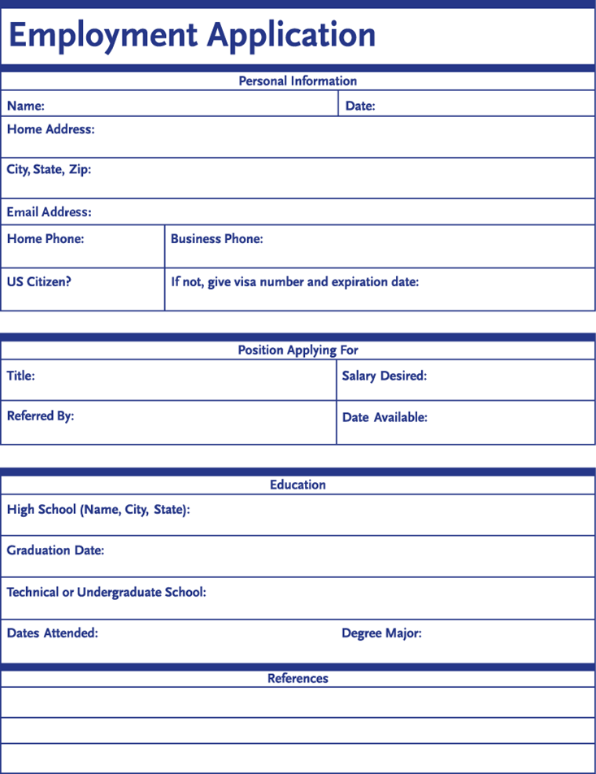
LO1, content 7
Handout 10-1: Job Application

Slide 9
LO1, content 8
Describe how to find a job
REMEMBER:
A criminal background check will be completed before an NA is hired.

Slide 10
LO1, content 9
Describe how to find a job
REMEMBER:
Neatness and appearance and paperwork will be considered in the hiring process. It is important to make an effort to look professional and to fill out all forms carefully and legibly.

Slide 11
LO1, content 10
Describe how to find a job
These tips will help a candidate make a good impression at a job interview:
  Shower or bathe and use deodorant.
  Brush your teeth.
  Wash your hands. Clean and file your nails. Do not wear artificial nails.
  Wear only simple makeup and jewelry or none at all.
  Clean and file your nails. Do not wear artificial nails.
  Style clean hair simply.
  Shave or trim facial hair before interview.
  Dress neatly and appropriately.
  Do not wear perfume or cologne.

Slide 12
LO1, content 11
Describe how to find a job
Tips for making a good impression at a job interview (cont’d):
  Do not smoke beforehand.
  Arrive 10 or 15 minutes early.
  Do not bring friends or children with you.
  Turn off your phone.
  Introduce yourself.
  Answer questions clearly and completely.
  Make eye contact.
  Avoid slang expressions
  Never eat, drink, chew gum, or smoke.
  Sit up or stand up straight.
  Relax and be confident.

Slide 13
LO2, content 1
Describe a standard job description and explain how to manage time and assignments
It is important to know these points about job descriptions:
  Agreement between employer and employee
  States responsibilities and tasks
  Includes skills required, to whom employee reports, salary
  Protects both parties
  Protects employee from change in duties without notification

Slide 14
LO2, content 2
Describe a standard job description and explain how to manage time and assignments
Points about job descriptions (cont’d):
  Protects employee from being fired for something unrelated to job description
  Protects employer from employee saying she did not know certain duties were required
  Reduces misunderstandings
  Can be used if legal issues arise

Slide 15
LO2, content 3
Describe a standard job description and explain how to manage time and assignments
REMEMBER:
When taking care of residents, NAs must be able to manage time well. Managing time properly ensures all tasks can be completed during a shift.

Slide 16
LO2, content 4
Describe a standard job description and explain how to manage time and assignments
In order to manage time properly an NA must
  Plan ahead.
  Prioritize.
  Make a schedule.
  Combine activities.
  Get help when needed.

Slide 17
LO2, content 5
Describe a standard job description and explain how to manage time and assignments
Think about these questions:
When might an NA need to get help?
Where can an NA find help if she needs it?

Slide 18
LO3, content 1
Discuss how to manage and resolve conflict
REMEMBER:
Everyone experiences conflict at some point, but conflict at work may harm productivity and the workplace environment if it is not managed or resolved.

Slide 19
LO3, content 2
Discuss how to manage and resolve conflict
Think about this question:
What impact do you think unresolved workplace conflict might have on the quality of care residents receive?

Slide 20
LO3, content 3
Discuss how to manage and resolve conflict
NAs should remember these guidelines for resolving conflict:
  Plan to discuss at the right time and in the right place.
  Do not interrupt.
  Do not get emotional.
  Check body language.
  Keep focus on the issue at hand.
  Be prepared to brainstorm solutions and to compromise.

Slide 21
LO4, content 1
Describe employee evaluations and discuss appropriate responses to criticism
REMEMBER:
There is a difference between hostile criticism, which is angry and negative, and constructive criticism, which is meant to help a person improve. The best response to hostile criticism is something like, “I’m sorry you are so disappointed” and nothing more.

Slide 22
LO4, content 2
Describe employee evaluations and discuss appropriate responses to criticism
To get the most out of constructive criticism
  Ask for details.
  Ask for suggestions.
  Apologize and move on.

Slide 23
LO4, content 3
Describe employee evaluations and discuss appropriate responses to criticism
REMEMBER:
Evaluations are often the basis for advancement and salary increases. It is helpful for NAs to be open to constructive criticism and to use their employers’ suggestions for improvement.

Slide 24
LO4, content 4
Describe employee evaluations and discuss appropriate responses to criticism
REMEMBER:
It is very important to give at least two weeks’ written notice before leaving a job. Both residents and staff will suffer if the facility is understaffed, and leaving without proper notice will make it more difficult to get hired in the future.

Slide 25
LO5, content 1
Discuss certification and explain the state’s registry
NAs should remember these guidelines regarding certification:
  OBRA requires 75 hours of initial training and 12 annual hours of continuing education
  There is a set time frame during which the state test must be taken or the NA will have to take a new training course.
  NA must work for pay within first 24 months.
  NA usually has three chances to pass test
  NA must keep certification current.

Slide 26
LO5, content 2
Discuss certification and explain the state’s registry
Important facts about state registries:
  Required by OBRA
  Often maintained by state’s Board of Nursing or Department of Health
  Contains NA’s training information, results of exams, and any findings of abuse, neglect or theft
  Employers can access to verify certification and check for abuse investigations/findings.

Slide 27
LO6, content 1
Describe continuing education
REMEMBER:
The government requires that NAs receive 12 hours of continuing education every year.

Slide 28
LO6, content 2
Describe continuing education
REMEMBER:
NAs have the following areas of responsibility when receiving continuing education:
  Sign up and know the location.
  Attend class.
  Pay attention and complete requirements.
  Participate.
  Keep records of attendance.

Slide 29
LO7, key terms 1
Explain ways to manage stress
Define the following terms:
stress
  the state of being frightened, excited, confused, in danger, or irritated.
stressor
  something that causes stress.

Slide 30
LO7, content 1
Explain ways to manage stress
REMEMBER:
It is not just negative situations that can cause stress. Positive events like a wedding or a new baby’s arrival can also cause stress from the changes they bring to a person’s life.

Slide 31
LO7, content 2
Explain ways to manage stress
Think about this question:
Look at the stressors listed on page 247. Can you think of any other possible stressors?

Slide 32
LO7, content 3
Explain ways to manage stress
NAs should remember these guidelines for managing stress:
  Healthy diet
  Exercise
  Enough sleep
  Drinking in moderation
  Not smoking
  Doing something relaxing (bath, reading, movie, being in nature, something artistic, yoga, exercise, massage, music, meditation)

Slide 33
LO7, content 4
Explain ways to manage stress
When stress is not managed, possible problems include
  Showing anger or being abusive toward residents
  Arguing with your supervisor
  Having poor relationships with coworkers and residents
  Complaining about your job and your responsibilities
  Feeling work-related burnout
  Feeling tired even when you are rested
  Having a difficult time focusing

Slide 34
LO7, content 5
Explain ways to manage stress
The following are appropriate sources for managing stress:
  Supervisor/care team member
  Family
  Friends
  Support group
  Place of worship
  Doctor
  Mental health agency
  Phone hotline

Slide 35
LO7, content 6
Explain ways to manage stress
REMEMBER:
NAs must not discuss their stress with residents or with residents friends or family members.

Slide 36
LO7, content 7
Explain ways to manage stress
Think about these questions:
Why did you choose to become an NA?
What does it mean to you to be able to help others?
How will you remind yourself of how valuable your work is?

