Slide 2
Chapter 4, LO1, key terms 1
Define the following terms:
homeostasis
  the condition in which all of the body’s systems are working at their best.
metabolism
  physical and chemical processes by which substances are broken down or transformed into energy or products for use by the body.
dilate
  to widen.
constrict
  to narrow.

Slide 3
Chapter 4, content 1
REMEMBER:
Signs are what the NA actually sees, hears, feels, or smells. Symptoms are not directly seen by the NA, but are reported by the resident who experiences them.

Slide 4
Chapter 4, content 2
NAs should know these anatomical terms of location:
  Anterior or ventral: the front of the body or body part
  Posterior or dorsal: the back of the body or body part
  Superior: toward the head
  Inferior: away from the head
  Medial: toward the midline of the body
  Lateral: to the side, away from the midline of the body
  Proximal: closer to the torso
  Distal: farther away from the torso

Slide 5
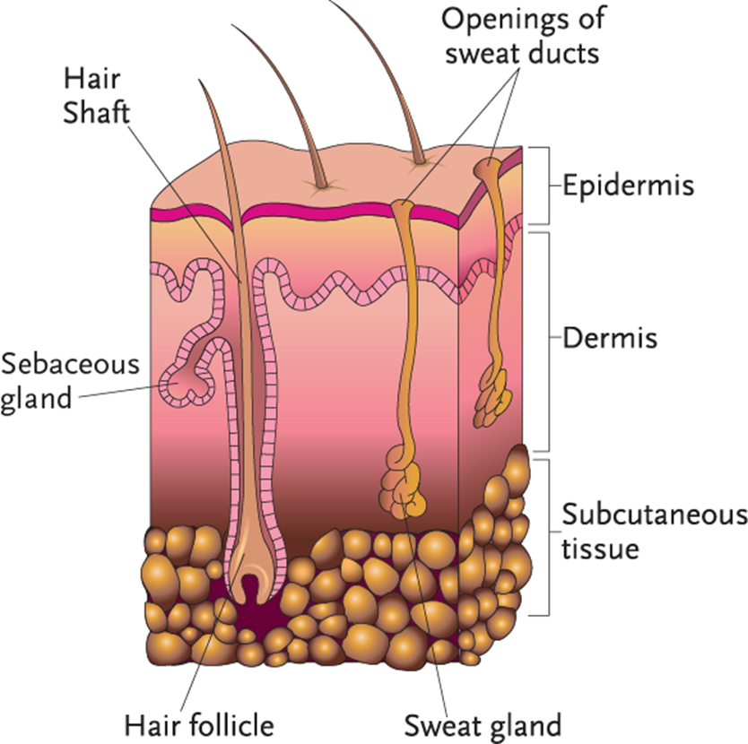
Chapter 4, content 3
Handout 4-1:The Integumentary System

Slide 6
LO1, content 4
Describe the integumentary system
Remember these points about the integumentary system:
  Largest organ and system
  Natural protective covering
  Prevents excessive loss of water and injury to internal organs
  Skin made of tissue and glands
  Skin is a sense organ
  Regulates body temperature

Slide 7
LO1, content 5
Describe the integumentary system
Normal changes of aging to the integumentary system include the following:
  Thinner, drier, more fragile skin
  Less elastic skin
  Thinning fatty tissue can cause person to feel colder
  Thinner, gray hair
  Wrinkles and brown spots
  Harder, more brittle nails
  Dry, itchy skin due to lack of oil from sebaceous glands

Slide 8
LO1, content 6
Describe the integumentary system
NAs can help by
  Assisting with bathing only as needed (as ordered)
  Using lotions as ordered to relieve dry skin
  Being especially gentle, as skin may be fragile
  Shampoo hair less frequently
  Brushing hair gently
  Assisting residents to layer clothing and bed covers
  Keeping bed linens wrinkle-free
  Encouraging fluid intake

Slide 9
LO1, content 7
Describe the integumentary system
Think about this question:
Are there any other ways NAs can help with changes of aging relating to the integumentary system?

Slide 10
LO1, content 8
Describe the integumentary system
It is important to observe for and report the following:
  Pale, white, reddened, or purple areas
  Blisters or bruises
  Complaints of tingling, warmth, or burning
  Dry or flaking skin
  Itching or scratching
  Rashes or discoloration
  Swelling
  Cuts, boils, sores, wounds, abrasions
  Fluid or blood draining from skin

Slide 11
LO1, content 9
Describe the integumentary system
Observe and report (cont’d):
  Broken skin
  Changes in moistness/dryness
  Changes in an injury or wound (size, depth, drainage, color, odor)
  Redness or broken skin between toes or around toenails
  Scalp or hair changes
  Skin that appears different from normal or that has changed
  In darker complexions, changes in tone, skin temperature, and the feel of the tissue as compared to the skin nearby

Slide 12
LO1, content 10
Describe the integumentary system
REMEMBER:
Pressure injuries (also called pressure ulcers or decubitus ulcers) occur where blood has poor circulation and bone is close to skin. They can be very dangerous to residents’ health. Skin receives less oxygen and nutrients, cells die and tissue breaks down. (More information about pressure injuries may be found in Chapter 6.)

Slide 13
LO1, content 11
Describe the integumentary system
NAs should know these facts about scabies:
  It is a skin infection caused by a tiny mite called Sarcoptes scabiei.
  The mite burrows into the skin, where it lays eggs, which cause itching and a rash that looks like thin burrow tracks. These tracks typically appear in the folds of the skin.
  Scabies is contagious and spread through direct contact with an infected person.
  Scabies can spread quickly in crowded places, such as LTC facilities and childcare facilities.
  Treatment involves medications, often in the form of prescription creams and lotions.
  Oral medications may be used if the person does not
  respond to the creams/lotions.

Slide 14
LO2, key terms 1
Describe the musculoskeletal system and related conditions
Define the following terms:
atrophy
  the wasting away, decreasing in size, and weakening of muscles from lack of use.
contracture
  the permanent and often painful shortening of a muscle or tendon, usually due to lack of activity.

Slide 15
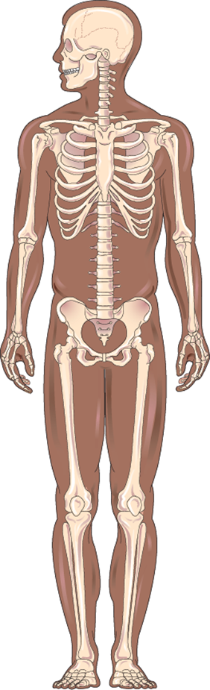
LO2, content 1
Transparency 4-2: The Musculoskeletal System

Slide 16
LO2, content 2
Describe the musculoskeletal system and related conditions
Remember these points about the musculoskeletal system:
  The human body has 206 bones.
  Two bones meet at joint (for movement). Joints make movement possible in either all directions or in one direction only.
  Muscles provide movement and produce body heat.
  Physical activity/exercise increases circulation, increasing blood flow to organs and tissues.
  Inactivity can cause depression, pneumonia, constipation, UTIs, loss of self-esteem, and blood clots.
  Muscles develop atrophy or contractures from inactivity.
  ROM exercises help prevent atrophy or contractures.

Slide 17
LO2, content 3
Describe the musculoskeletal system and related conditions
Normal changes of aging to the musculoskeletal system include the following:
  Weaker, less toned muscles
  Slower body movement
  Less dense and more brittle bones
  Stiffer, painful joints
  Loss of height

Slide 18
LO2, content 4
Describe the musculoskeletal system and related conditions
NAs can help by
  Answering call lights promptly to prevent falls
  Keeping pathways clear, cleaning up spills, and not moving furniture
  Placing walkers and canes where residents can easily reach them
  Ensuring that residents wear non-skid shoes that are securely fastened
  Encouraging regular movement and self-care
  Assisting with range of motion (ROM) exercises as ordered

Slide 19
LO2, content 5
Describe the musculoskeletal system and related conditions
Think about this question:
Are there any other ways NAs can help with changes of aging relating to the musculoskeletal system?

Slide 20
LO2, content 6
Describe the musculoskeletal system and related conditions
It is important to observe for and report the following:
  Changes in movement and activity
  Changes in ability to do ROM exercises
  Pain during movement
  New or increased swelling of joints
  White, shiny, red, or warm areas over joints
  Bruising
  Aches and pains reported by resident

Slide 21
LO2, key terms 2
Describe the musculoskeletal system and related conditions
Define the following terms:
inflammation
  swelling.
autoimmune illness
  an illness in which the body’s immune system attacks normal tissue in the body.

Slide 22
LO2, key terms 3
Describe the musculoskeletal system and related conditions
Define the following terms:
rheumatoid arthritis
  a type of arthritis in which joints become inflamed, red, swollen, and very painful, resulting in restricted movement and possible deformities.
osteoarthritis
  common type of arthritis that usually affects the hips, knees, fingers, thumbs, and spine; also called degenerative joint disease (DJD) or degenerative arthritis.

Slide 23
LO2, content 7
Describe the musculoskeletal system and related conditions
NAs should know these facts about arthritis:
  Arthritis is inflammation of the joints, causing stiffness, pain, and decreased mobility.
  Arthritis may be caused by aging, injury, or autoimmune illness.
  Two types are osteoarthritis and rheumatoid arthritis.
  Pain and stiffness increase in cold or damp weather.

Slide 24
LO2, content 8
Describe the musculoskeletal system and related conditions
Treatments for arthritis include the following:
  Anti-inflammatory medications (aspirin or ibuprofen)
  Local applications of heat
  ROM exercises
  Exercise and activity
  Diet

Slide 25
LO2, content 9
Transparency 4-3: Care Guidelines for Arthritis
Watch for stomach irritation or heartburn.
Encourage activity. Use walking aids as needed.
Adapt activities of daily living to allow independence.
Choose clothing that is easy to put on and fasten.
Encourage use of handrails and safety bars.
Promote person-centered care. Treat each resident as an individual.
Help self-esteem by encouraging self-care. Have a positive attitude.

Slide 26
LO2, key terms 4
Describe the musculoskeletal system and related conditions
Define the following terms:
osteoporosis
  a disease that causes bones to become porous and brittle, causing them to break easily.
menopause
  the end of menstruation; occurs when a woman has not had a menstrual period for 12 months.

Slide 27
LO2, content 10
Describe the musculoskeletal system and related conditions
NAs should know these facts about osteoporosis:
  Causes bones to become brittle
  May be due to age, lack of hormones, lack of calcium, alcohol consumption, or lack of exercise
  Occurs more commonly in women after menopause

Slide 28
LO2, content 11
Describe the musculoskeletal system and related conditions
Signs and symptoms of osteoporosis include
  Low back pain
  Stooped posture
  Loss of height
  Fractures

Slide 29
LO2, content 12
Describe the musculoskeletal system and related conditions
Ways to prevent or slow osteoporosis include the following:
  Encourage residents to walk and do other light exercise as ordered.
  Move residents with osteoporosis very carefully.
  Follow care plan regarding medication and supplements, which might be used to treat osteoporosis.

Slide 30
LO2, key terms 5
Describe the musculoskeletal system and related conditions
Define the following terms:
partial weight-bearing (PWB)
  a doctor’s order stating that a person is able to support some body weight on one or both legs.
non-weight-bearing (NWB)
  a doctor’s order stating that a person is unable to touch the floor or support any body weight on one or both legs.
full weight-bearing (FWB)
  a doctor’s order stating that a person has the ability to support full body weight (100%) on both legs.

Slide 31
LO2, content 13
Describe the musculoskeletal system and related conditions
REMEMBER:
Fall prevention is the key to preventing fractures.

Slide 32
LO2, content 14
Describe the musculoskeletal system and related conditions
Remember these guidelines for the care of a new cast:
  Cast must be completely dry before a person can bear weight on it.
  Elevate extremity in cast to stop swelling
  Observe for swelling, skin discoloration, tightness, sores, skin temperature, burning, numbness or tingling, drainage, bleeding, or odor.
  Protect resident’s skin from edges of cast.
  Keep the cast dry.
  Do not insert anything into cast.
  Tell the nurse if pain medication is needed.
  Use bed cradles as needed.

Slide 33
LO2, content 15
Describe the musculoskeletal system and related conditions
NAs should know these facts about hip fractures:
  Cause may be a fall or weakened bones
  Elderly bones heal slowly

Slide 34
LO2, content 16
Describe the musculoskeletal system and related conditions
Hip replacement surgery may be performed for these reasons:
  Fractured hip that does not heal properly
  Weakened hip due to aging
  Painful and stiff hip

Slide 35
LO2, content 17
Transparency 4-4: Care Guidelines for Hip Replacement
Keep often-used items within reach.
Dress affected (weaker) side first.
Do not rush the resident. Use praise and encouragement.
Ask the nurse to give pain medication if needed.
Have the resident sit to do tasks.
Follow the care plan exactly.
Do not perform ROM exercises on the operative leg.
The legs should not be crossed. The toes should not be turned inward or outward. The hip cannot be bent or flexed more than 90 degrees. It cannot be turned inward or outward.
Follow orders for application and positioning with an abduction pillow.
Transfer resident carefully, with strong side leading when standing, pivoting, and sitting.
With chair or toilet transfers, operative leg/knee should be straightened. Strong leg should stand first.

Slide 36
LO2, content 18
Describe the musculoskeletal system and related conditions
Observe for and report the following after hip replacement surgery:
  Red, draining, warm, or bleeding incision
  Increase in pain
  Numbness or tingling
  Tenderness or swelling in calf of the affected leg
  Shortening and/or external rotation of affected leg
  Abnormal vital signs, especially a change in temperature
  Inability to use equipment properly and safely
  Unwillingness of resident to follow doctor’s orders for activity and exercise
  Problems with appetite
  Improvements, such as increasing strength and improved ability to walk

Slide 37
LO2, content 19
Describe the musculoskeletal system and related conditions
Knee replacement surgery is performed for these reasons:
  Relieves severe pain
  Restores motion to damaged knee
  Helps stabilize a knee that buckles or gives out

Slide 38
LO2, content 20
Describe the musculoskeletal system and related conditions
REMEMBER:
Recovery time for knee replacement is generally shorter than for hip replacement.

Slide 39
LO2, content 21
Transparency 4-5: Care Guidelines for Knee Replacement
Apply special stockings as ordered.
Perform ankle pumps as ordered.
Encourage fluids, especially fluids high in vitamin C.
Assist with deep breathing exercises.
Ask for pain medication if needed.
Report to nurse if you notice redness, swelling, heat, or deep tenderness in one or both calves.

Slide 40
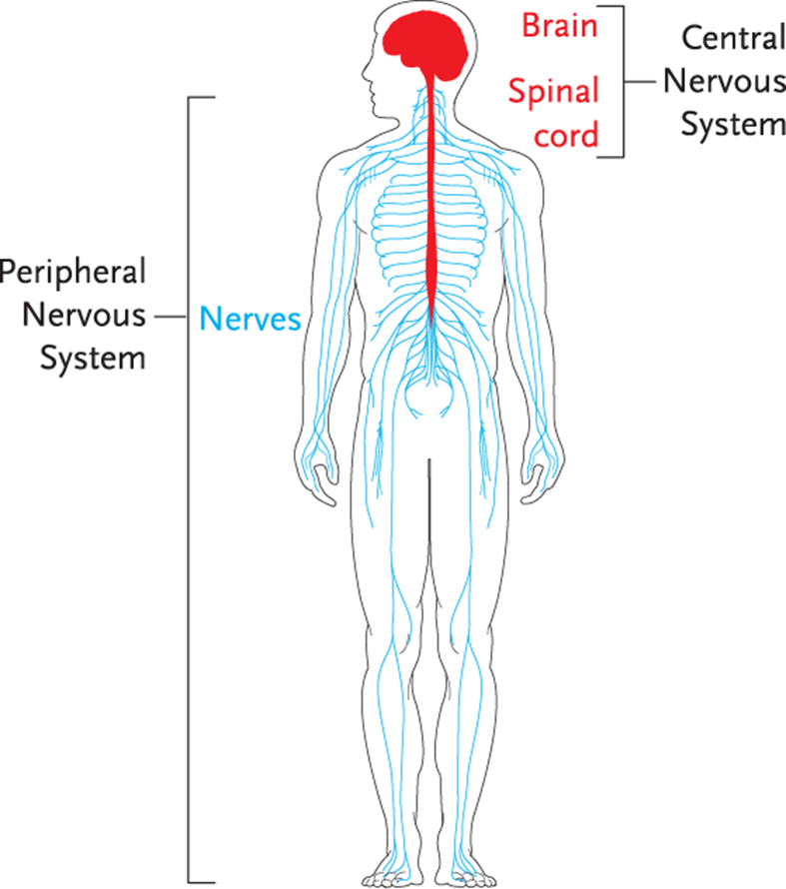
LO3, content 1
Transparency 4-6: The Nervous System

Slide 41
LO3, content 2
Describe the nervous system and related conditions
Remember these points about the nervous system:
  Control and message center of body
  Controls and coordinates all body functions
  Senses information from outside the body
  Two main parts: central nervous system (brain) and peripheral nervous system (nerves)

Slide 42
LO3, content 3
Describe the nervous system and related conditions
Normal changes of aging to the nervous system include the following:
  Slower responses and reflexes
  Decrease in sensitivity of nerve endings in skin
  Some memory loss, more often with short-term memory

Slide 43
LO3, content 4
Describe the nervous system and related conditions
NAs can help by
  Suggesting residents make lists or write notes about things they want to remember
  Placing a calendar where the resident can see it
  Taking an interest in residents’ past by asking to see photos or hear stories
  Allowing time for decision-making and avoiding sudden changes in schedule
  Allowing plenty of time for movement
  Encouraging reading, thinking, and other mental activities

Slide 44
LO3, content 5
Describe the nervous system and related conditions
Think about this question:
Are there any other ways NAs can help with changes of aging relating to the nervous system?

Slide 45
LO3, content 6
Describe the nervous system and related conditions
It is important to observe for and report the following:
  Fatigue or pain with movement
  Shaking or trembling
  Inability to move one side of body
  Difficulty speaking or slurring of speech
  Numbness or tingling
  Disturbance or change in vision or hearing
  Dizziness or loss of balance

Slide 46
LO3, content 7
Describe the nervous system and related conditions
Observe and report (cont’d):
  Changes in eating or fluid intake
  Difficulty swallowing
  Bowel or bladder changes
  Depression or mood changes
  Memory loss or confusion
  Violent behavior
  Unusual or unexplained change in behavior
  Decreased ability to perform ADLs

Slide 47
LO3, content 8
Describe the nervous system and related conditions
Dementia and Alzheimer’s disease, which are common disorders of the nervous system, are covered in detail in Chapter 5.

Slide 48
LO3, key terms 1
Describe the nervous system and related conditions
Define the following terms:
hemiplegia
  paralysis on one side of the body.
hemiparesis
  weakness on one side of the body.
expressive aphasia
  trouble communicating thoughts through speech or writing.

Slide 49
LO3, key terms 2
Describe the nervous system and related conditions
Define the following terms:
receptive aphasia
  difficulty understanding spoken or written words.
emotional lability
  Inappropriate or unprovoked emotional responses, including laughing, crying, and anger.
dysphagia
  difficulty swallowing.

Slide 50
LO3, content 9
Describe the nervous system and related conditions
NAs should know these facts about CVA:
  CVA occurs when blood supply to a part of the brain is blocked or a blood vessel leaks or ruptures within the brain.
  Results in lack of oxygen to tissues, causing cells to die.
  Swelling, leaking blood, and clots affect surrounding healthy brain tissue.
  Weakness occurs opposite affected side of brain.
  Mild stroke may result in few, if any, complications.

Slide 51
LO3, content 10
Transparency 4-7: Care Guidelines for CVA
Assist with exercises as ordered, keeping safety in mind.
Use terms weaker or involved, not bad, to refer to the affected side.
Assist with speech therapy as needed.
Residents may experience confusion, memory loss, and heightened emotions. Be patient and understanding. Keep a routine of care.
Encourage independence and self-esteem.
Always check on resident’s body alignment.
Pay special attention to skin care.
If residents have lost sense of touch or sensation, be aware of potentially harmful situations, such as proximity to heat and sharp objects.
Adapt procedures when caring for residents with one-sided paralysis or weakness.

Slide 52
LO3, content 11
Transparency 4-7: Care Guidelines for CVA (cont’d)
For transfers:
Always use gait belt.
Stand on and support the weaker side.
Lead with stronger side.
For assisting with dressing:
Dress weaker side first. Undress stronger side first.
Use assistive equipment to help resident dress himself.

Slide 53
LO3, content 12
Transparency 4-7: Care Guidelines for CVA (cont’d)
For assisting with communication:
  Keep questions and directions simple.
  Phrase questions so they can be answered with a “yes” or “no.”
  Agree on signals, such as shaking or nodding the head or raising a hand or finger for “yes” or “no.”
  Give residents time to respond. Listen attentively.
  Use a pencil and paper if the resident can write.
  Use verbal and nonverbal communication to express your positive attitude.
  Keep the call signal within reach of residents.
  Use verbal and nonverbal communication to express your positive attitude. Use pictures, gestures, or pointing.
  Use communication boards or special cards to aid communication.

Slide 54
LO3, key term 3
Describe the nervous system and related conditions
Define the following term:
gait
  manner of walking.

Slide 55
LO3, content 13
Describe the nervous system and related conditions
NAs should know these facts about Parkinson’s disease:
  It is a progressive, degenerative disease
  Causes stiff muscles, stooped posture, shuffling gait, pill-rolling, tremors, and mask-like facial expression
  Tremors can make ADLs difficult

Slide 56
LO3, content 14
Transparency 4-8: Care Guidelines for Parkinson’s Disease
Protect residents from falls.
Help with ADLs as needed.
Assist with ROM exercises as ordered.
Observe for any swallowing problems and report them to the nurse.
Encourage self-care and be patient.

Slide 57
LO3, content 15
Describe the nervous system and related conditions
NAs should know these facts about multiple sclerosis (MS):
  MS is a progressive disease affecting the central nervous system.
  Protective sheath breaks down over time and nerves cannot send messages properly.
  Residents will have varying abilities.
  Symptoms can include blurred vision, fatigue, tremors, poor balance, trouble walking, weakness, numbness, tingling, incontinence, and behavior changes.
  MS can cause blindness, contractures, and loss of function in arms and legs.

Slide 58
LO3, content 16
Transparency 4-9: Care Guidelines for Multiple Sclerosis
Assist with ADLs. Be patient with self-care and movement. Allow time for tasks. Offer rest periods.
Give resident time to communicate.
Prevent falls.
Help avoid stressful situations. Listen to residents. Be calm.
Encourage a healthy diet with plenty of fluids.
Give regular skin care to prevent pressure injuries.
Assist with ROM exercises to prevent contractures and strengthen muscles.

Slide 59
LO3, content 17
Describe the nervous system and related conditions
Define the following terms:
  paraplegia
  loss of function of lower body and legs.
  quadriplegia
  loss of function of legs, trunk, and arms.

Slide 60
LO3, content 18
Describe the nervous system and related conditions
NAs should know these facts about head and spinal cord injuries:
  May result from diving, sports injuries, falls, car and motorcycle accidents, industrial accidents, war, and criminal violence
  Can cause permanent brain damage, intellectual disability, personality changes, trouble breathing, seizures, coma, memory loss, loss of consciousness, paresis, paralysis
  Effects of spinal cord injuries depend on force of impact and where spine is injured.
  May cause paraplegia or quadriplegia
  Rehabilitation is needed.
  Emotional support is important.

Slide 61
LO3, content 19
Transparency 4-10: Care Guidelines for Head and Spinal Cord Injuries
Give emotional support, as well as physical help.
Be patient with self-care.
Prevent falls and burns.
Be patient with self-care.
Give careful skin care to prevent pressure injuries.
Assist with position changes at least every two hours.
Perform ROM exercises as ordered.
Encourage fluids and a high-fiber diet to prevent constipation.
Give extra catheter care as needed.
Offer rest periods as needed for fatigue. Use special stockings as ordered to aid circulation.
Encourage deep breathing exercises as ordered.
Provide for privacy if involuntary erections occur.
Assist with bowel and bladder training.

Slide 62
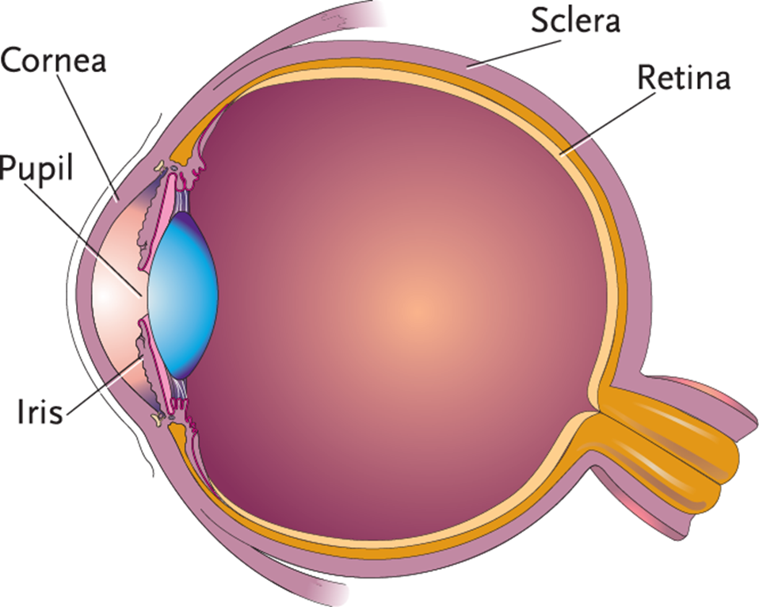
LO3, content 20
Transparency 4-11: Parts of the Eye

Slide 63
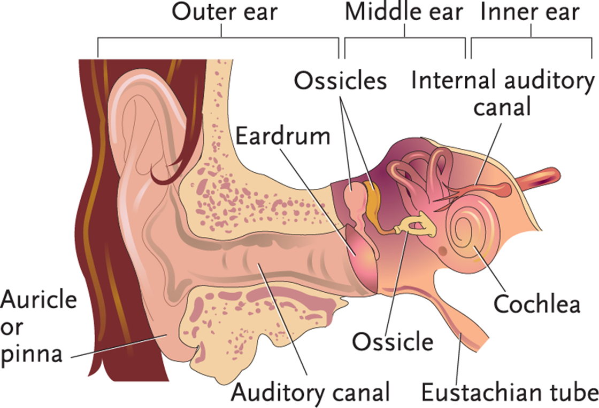
LO3, content 21
Transparency 4-11: Parts of the Ear

Slide 64
LO3, content 22
Describe the nervous system and related conditions
REMEMBER:
The other sense organs are the nose, tongue, and skin.

Slide 65
LO3, content 23
Describe the nervous system and related conditions
Normal changes of aging to the sense organs include the following:
  Reduced vision and hearing (sense of balance may be affected)
  Decreased senses of taste, touch, and smell

Slide 66
LO3, content 24
Describe the nervous system and related conditions
NAs can help by
  Helping residents keep eyeglasses clean
  Ensuring residents have proper lighting
  Helping residents remember to wear their hearing aids, and keeping hearing aids clean
  Facing residents when speaking, and speaking clearly and slowly
  Providing oral care often and offering foods with a variety of tastes and textures
  Helping as needed with regular bathing
  Being cautious when serving hot drinks or assisting with bathing in hot water

Slide 67
LO3, content 25
Describe the nervous system and related conditions
Think about this question:
Are there any other ways NAs can help with changes of aging related to the senses?

Slide 68
LO3, content 26
Describe the nervous system and related conditions
It is important to observe for and report the following:
  Changes in vision or hearing
  Signs of infection
  Dizziness
  Complaints of pain in eyes or ears

Slide 69
LO3, content 27
Describe the nervous system and related conditions
NAs should know these facts about vision impairment:
  Vision impairment can affect people of all ages.
  Some residents may wear eyeglasses or contacts.
  People over 40 are at risk for developing cataracts, glaucoma, and blindness.
  Cataracts may be corrected surgically.
  Glaucoma can occur suddenly or gradually, and is treated with medication and sometimes surgery.

Slide 70
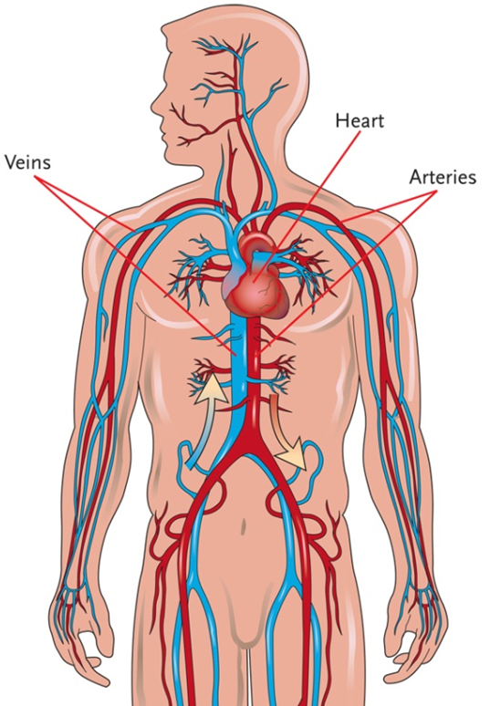
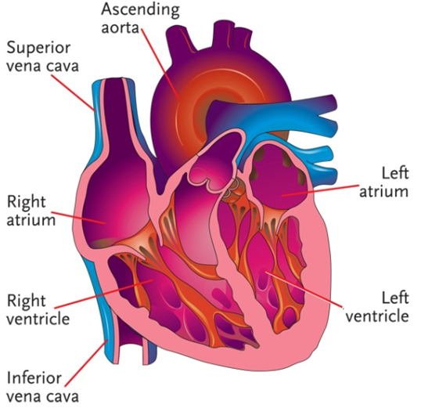
LO4, content 1
Transparency 4-13: The Circulatory System

Slide 71
LO4, content 2
Describe the circulatory system and related conditions
Remember these points about the circulatory system:
  Made up of heart, blood vessels, and blood
  Blood carries food, oxygen, and essential substances to cells.
  Heart has four chambers (two atria/upper chambers and two ventricles/lower chambers).
  Heart functions in two phases: resting phase—diastole (chambers fill with blood) and contracting phase—systole (ventricles pump blood).
  Major functions are to
    Supply food, oxygen, and hormones to cells
    Supply antibodies
    Remove waste products from cells
    Control body temperature

Slide 72
LO4, content 3
Describe the circulatory system and related conditions
Normal changes of aging to the circulatory system include the following:
  Less efficient heart
  Decreased blood flow
  Narrowed blood vessels

Slide 73
LO4, content 4
Describe the circulatory system and related conditions
NAs can help by
  Encouraging movement and exercise
  Allowing time for residents to complete activities and trying to prevent residents from tiring
  Layering clothing to help residents stay warm
  Making sure residents have socks, slippers, or shoes to help keep their feet warm

Slide 74
LO4, content 5
Describe the circulatory system and related conditions
Think about this question:
Are there any other ways NAs can help with changes of aging relating to the circulatory system?

Slide 75
LO4, content 6
Describe the circulatory system and related conditions
It is important to observe for and report the following:
  Changes in pulse rate
  Weakness or fatigue
  Loss of ability to perform ADLs
  Swelling of ankles, feet, fingers or hands
  Pale or blue hands, feet, or lips
  Chest pain
  Weight gain
  Shortness of breath, changes in breathing patterns, inability to catch breath
  Severe headache
  Inactivity, which can lead to circulatory problems

Slide 76
LO4, key terms 1
Describe the circulatory system and related conditions
Define the following terms:
hypertension (HTN)
  high blood pressure, regularly measuring 130/80 mm Hg or higher.
diuretics
  medications that reduce fluid volume in the body.

Slide 77
LO4, content 7
Describe the circulatory system and related conditions
NAs should know these facts about hypertension (HTN) or high blood pressure:
  Causes: hardening and narrowing of blood vessels (atherosclerosis), kidney disease, adrenal tumors, pregnancy or certain medications
  Symptoms: headache, blurred vision, and dizziness; sometimes there are no noticeable symptoms
  Guidelines released in late 2017 by the American Heart Association and American College of Cardiology changed parameters for what is considered hypertension. A systolic reading of 130 mm Hg or higher is now considered high blood pressure.

Slide 78
LO4, content 8
Transparency 4-14: Care Guidelines for Hypertension
Offer regular trips to the bathroom. Answer call lights promptly.
Encourage residents to follow their diet and exercise programs. Measure blood pressure as directed.

Slide 79
LO4, key term 2
Describe the circulatory system and related conditions
Define the following term:
angina pectoris
  chest pain, pressure, or discomfort.

Slide 80
LO4, content 9
Describe the circulatory system and related conditions
NAs should know these facts about coronary artery disease (CAD):
  Cause: vessels in coronary arteries narrow, reducing blood flow to heart
  Symptoms: angina pectoris

Slide 81
LO4, content 10
Transparency 4-15: Care Guidelines for Angina Pectoris
Encourage rest.
Nitroglycerin should be close by. The nitroglycerin bottle should be kept tightly closed.
Tell the nurse if resident needs help taking medication or if nitroglycerin patch comes off.
Residents may need to avoid heavy meals, overeating, intense exercise, and cold or humid weather.

Slide 82
LO4, content 11
Describe the circulatory system and related conditions
NAs should know these facts about myocardial infarction (MI) or heart attack:
  Caused by block of blood flow to heart muscle, which results in tissue death
  Area of dead tissue may be large or small
  Can result in serious heart damage or death
  Chapter 2 covers warning signs.

Slide 83
LO4, content 12
Transparency 4-16: Care Guidelines for Myocardial Infarction
A cardiac rehabilitation program usually consists of a low-cholesterol, low-fat and low-sodium diet; a regular exercise program; medications to regulate heart rate and blood pressure, to lower cholesterol and to lower triglycerides; blood testing; stopping smoking; avoiding cold temperatures; and a stress management program.
Encourage residents to follow their diet and exercise programs.
Be supportive if residents have quit or are trying to quit smoking.
Help residents avoid stress and listen if they want to talk. Report signs of stress.

Slide 84
LO4, content 13
Describe the circulatory system and related conditions
NAs should know these facts about congestive heart failure (CHF):
  Cause: failure of heart muscle to pump effectively due to damage
  Symptoms: fatigue, trouble breathing, coughing or gurgling with breathing, dizziness, confusion, fainting, pale or blue skin, low blood pressure, swelling of feet and ankles, bulging neck veins, weight gain

Slide 85
LO4, content 14
Transparency 4-17: Care Guidelines for Congestive Heart Failure
Medications can help control CHF.
Help residents to the toilet or commode when needed. Answer call lights promptly.
Encourage residents to follow diet orders or restrictions.
Allow for rest periods.
Measure intake and output of fluids as ordered.
Weigh residents as instructed.
Apply elastic leg stockings as ordered.
Assist with ROM exercises.
Extra pillows may help breathing. Keep the head of the bed elevated if it helps with breathing.
Assist with personal care and ADLs as needed.
High-potassium foods can help with dizziness.

Slide 86
LO4, content 15
Describe the circulatory system and related conditions
NAs should know these facts about peripheral vascular disease (PVD):
  Cause: fatty deposits in the blood vessels that harden
  Symptoms: cool arms and legs, swelling in hands and feet, pale or bluish hands or feet, bluish nail beds, ulcers on legs and feet
  Pain may be severe when walking but can decrease with rest.
  Treatment includes quitting smoking, medications, exercise, and surgery.

Slide 87
LO5, key terms 1
Describe the respiratory system and related conditions
Define the following terms:
respiration
  the process of breathing air into the lungs and exhaling air out of the lungs.
inspiration
  the process of inhaling air into the lungs.
expiration
  the process of exhaling air out of the lungs.

Slide 88
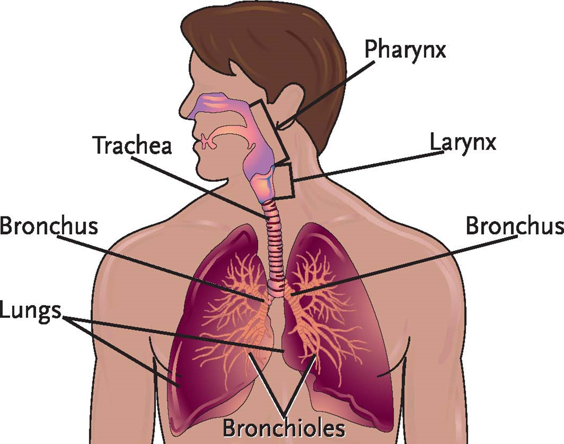
LO5, content 1
Transparency 4-18: The Respiratory System

Slide 89
LO5, content 2
Describe the respiratory system and related conditions
Remember these points about the respiratory system:
  Inspiration is breathing in and expiration is breathing out.
  Functions are
  To bring oxygen into body
  To eliminate carbon dioxide produced by the body

Slide 90
LO5, content 3
Describe the respiratory system and related conditions
Normal changes of aging to the respiratory system include the following:
  Loss of lung strength
  Decreased lung capacity
  Decreased oxygen in the blood
  Weakened voice

Slide 91
LO5, content 4
Describe the respiratory system and related conditions
NAs can help by
  Helping residents avoid exposure to cigarette smoke or polluted air
  Provide rest periods
  Encouraging exercise and regular movement
  Providing rest periods as needed
  Assisting with deep breathing exercises as ordered
  Assisting residents into positions that ease breathing

Slide 92
LO5, content 5
Describe the respiratory system and related conditions
Think about this question:
Are there any other ways NAs can help with changes of aging relating to the respiratory system?

Slide 93
LO5, content 6
Describe the respiratory system and related conditions
It is important to observe for and report the following:
  Changes in respiratory rate
  Shallow breathing or breathing through pursed lips
  Coughing or wheezing
  Nasal congestion or discharge
  Sore throat, difficulty swallowing, swollen tonsils
  Need to sit after mild exertion
  Pale, bluish, or gray color of lips, arms, or legs
  Pain in chest
  Discolored sputum (yellow, green, gray, or bloody)

Slide 94
LO5, content 7
Describe the respiratory system and related conditions
NAs should know these facts about chronic obstructive pulmonary disease (COPD):
  It is a chronic disease.
  Residents with COPD have trouble breathing, especially getting air out of the lungs.
  Two chronic lung diseases are grouped under COPD: chronic bronchitis and emphysema.
  Residents with COPD are at high risk of contracting pneumonia.

Slide 95
LO5, content 8
Describe the respiratory system and related conditions
Facts about COPD (cont’d):
  All body systems are affected when the lungs and brain do not get enough oxygen.
  Residents may be in constant fear of not being able to breathe and might need to sit upright to improve lung expansion. They may fear suffocation.
  Residents may have poor appetites and not sleep well, leading to weakness and feelings of general poor health.

Slide 96
LO5, content 9
Describe the respiratory system and related conditions
COPD can result in the following symptoms:
  Chronic cough or wheeze
  Trouble breathing
  Shortness of breath
  Pale, cyanotic, or reddish-purple skin
  Confusion
  General weakness
  Difficulty completing meals
  Fear and anxiety

Slide 97
LO5, content 10
Transparency 4-19: Care Guidelines for COPD
Observe and report symptoms getting worse.
Help resident sit upright. Offer pillows for support.
Offer plenty of fluids and small, frequent meals.
Encourage a well-balanced diet.
Keep oxygen supply available as ordered.
Be calm and supportive.
Use proper infection prevention practices.
Encourage independence with ADLs.
Remind residents to avoid exposure to infection.
Encourage pursed-lip breathing.
Encourage residents to save energy. Encourage rest.

Slide 98
LO5, content 11
Transparency 4-19: Care Guidelines for COPD (cont’d)
Report these signs and symptoms of COPD:
Temperature over 101°F
Changes in breathing patterns
Changes in color or consistency of lung secretions
Changes in mental state or personality
Refusal to take medications as ordered
Excessive weight loss
Increasing dependence

Slide 99
LO6, key term 1
Describe the urinary system and related conditions
Define the following term:
urinary incontinence
  the inability to control the bladder, which leads to an involuntary loss of urine.

Slide 100
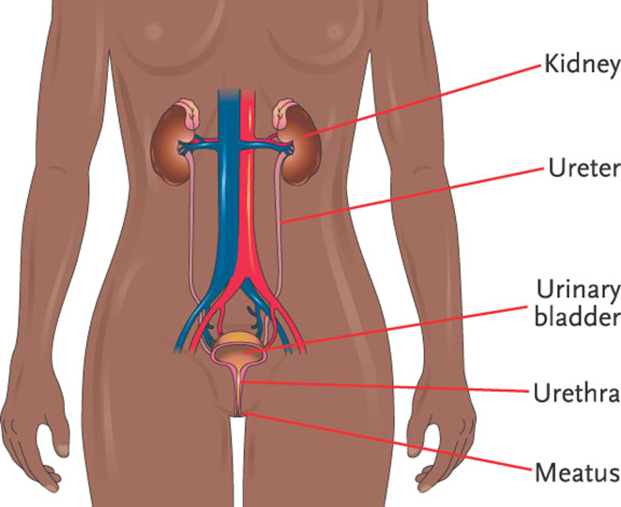
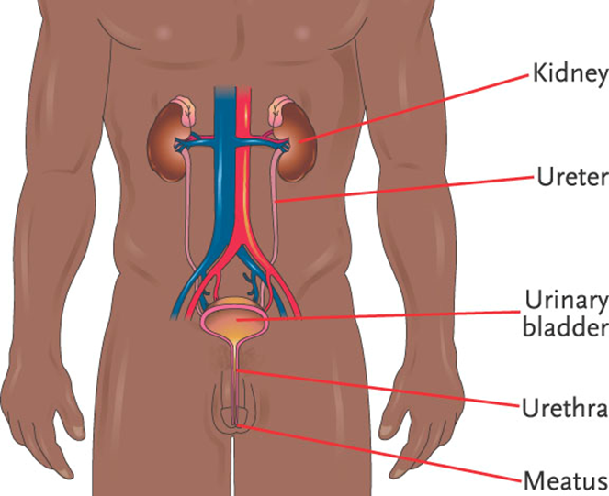
LO6, content 1
Transparency 4-20: The Urinary System

Slide 101
LO6, content 2
Describe the urinary system and related conditions
Remember these points about the urinary system:
  Composed of two kidneys, two ureters, one urinary bladder, and a single urethra
  Has two important functions:
  Eliminates waste products created by the cells
  Maintains the water balance in the body

Slide 102
LO6, content 3
Describe the urinary system and related conditions
Normal changes of aging to the urinary system include the following:
  Decreased ability of kidneys to filter blood
  Weakened bladder muscle tone
  Bladder holds less urine causing more frequent urination
  Bladder may not empty completely, causing more susceptibility to infection

Slide 103
LO6, content 4
Describe the urinary system and related conditions
NAs can help by
  Encouraging fluids
  Offering frequent trips to the bathroom
  Not showing frustration or anger if residents are incontinent
  Making sure residents are kept clean and dry

Slide 104
LO6, content 5
Describe the urinary system and related conditions
Think about this question:
Are there any other ways NAs can help with changes of aging relating to the urinary system?

Slide 105
LO6, content 6
Describe the urinary system and related conditions
It is important to observe for and report the following:
  Weight loss or gain
  Swelling in upper or lower extremities
  Pain or burning during urination
  Changes in urine (cloudy, odor, color)
  Changes in frequency or amount of urination
  Swelling in the abdominal/bladder area
  Complaints that bladder feels full or painful
  Urinary incontinence
  Pain in the kidney or back/flank region
  Inadequate fluid intake
  Confusion

Slide 106
LO6, content 7
Describe the urinary system and related conditions
NAs should know these facts about urinary incontinence:
  Can occur in people who are confined to bed, ill, elderly, paralyzed, or who have circulatory or nervous system diseases or injuries
  Stress that incontinence is not a normal part of aging and may signal an illness. It is a major risk factor for pressure ulcers

Slide 107
LO6, content 8
Transparency 4-21: Care Guidelines for Urinary Incontinence
Offer to assist with toileting often. Follow toileting schedules.
Answer call lights and requests for help immediately.
Document all episodes of incontinence carefully and accurately.
Wash urine off immediately and completely. Keep residents clean, dry, and free from odor.
Change wet or soiled clothing immediately. Change wet or soiled bed linen immediately. Use absorbent pads under linen.
Use disposable incontinence pads or briefs as needed to keep body wastes away from skin. Change wet briefs promptly and do not refer to them as diapers.
Encourage residents to drink plenty of fluids.
Be reassuring and understanding.

Slide 108
LO6, content 9
Describe the urinary system and related conditions
When changing incontinence briefs the NA should
  Make sure to have all needed items: protective pad, perineal care supplies, disposable wipes, gloves, and a clean brief
  Put on gloves before handling the brief
  Roll brief inward, soiled side inside, without spilling contents
  Working from front to back, carefully remove all urine and/or feces from resident’s skin
  Blot area dry after cleaning thoroughly
  Apply the clean brief

Slide 109
LO6, content 10
Describe the urinary system and related conditions
NAs should know these facts about urinary tract infection (UTI):
  Being bedbound is a risk factor for increased incidence of UTIs.
  Women are more likely than men to contract a UTI.
  Women should wipe the perineal area from front to back after elimination.

Slide 110
LO6, content 11
Transparency 4-22: Preventing Urinary Tract Infections
Encourage residents to wipe front to back and do the same when providing perineal care.
Give careful perineal care when changing incontinence briefs.
Encourage plenty of fluids which can help prevent UTIs. Fluids high in vitamin C help to acidify urine, which can prevent infection.
Offer to assist with toileting often. Answer call lights promptly.
Taking showers, rather than baths, helps prevent UTIs.
Report cloudy, dark, or foul-smelling urine, or if resident urinates often and in small amounts.
Report if the resident has a fever. Report new or worsening condition.

Slide 111
LO7, key terms 1
Describe the gastrointestinal system and related conditions
Define the following terms:
digestion
  the process of preparing food physically and chemically so that it can be absorbed into the cells.
absorption
  the transfer of nutrients from the intestines to the cells.
elimination
  the process of expelling wastes (made up of the waste products of food and fluids) that are not absorbed into the cells.
fecal incontinence
  the inability to control the bowels, leading to involuntary passage of stool.

Slide 112
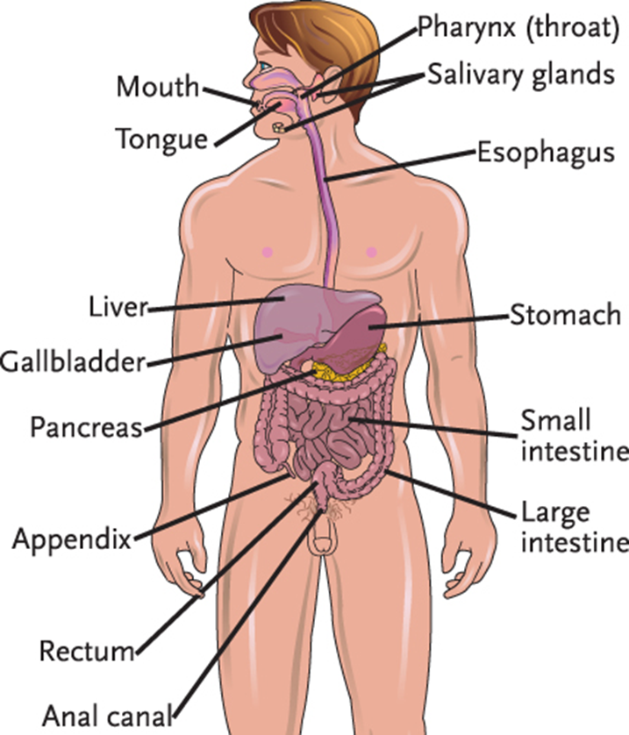
LO7, content 1
Transparency 4-23: The Gastrointestinal System

Slide 113
LO7, content 2
Describe the gastrointestinal system and related conditions
Remember these points about the gastrointestinal system:
  Digestion is the process of preparing food for absorption into the cells.
  Absorption is the transfer of nutrients from the intestines to the cells.
  Elimination is expelling wastes that are not absorbed into the cells.

Slide 114
LO7, content 3
Describe the gastrointestinal system and related conditions
Normal changes of aging to the gastrointestinal system include the following:
  Decreased saliva production affects chewing/swallowing.
  Dulled sense of taste may result in poor appetite.
  Decreased absorption of vitamins/minerals.
  Longer, less efficient digestion.
  More frequent constipation caused by body waste moving more slowly through the intestines.

Slide 115
LO7, content 4
Describe the gastrointestinal system and related conditions
NAs can help by
  Encouraging fluids and nutritious, appealing meals
  Allowing time to eat and making meal times enjoyable
  Providing regular oral care
  Making sure dentures are cleaned regularly
  Serve plenty of fluids with meals to prevent choking and constipation
  Helping residents with toileting so they have the opportunity to have a bowel movement around the same time each day

Slide 116
LO7, content 5
Describe the gastrointestinal system and related conditions
Think about this question:
Are there any other ways NAs can help with changes of aging relating to the gastrointestinal system?

Slide 117
LO7, content 6
Describe the gastrointestinal system and related conditions
It is important to observe for and report the following:
  Difficulty swallowing or chewing
  Fecal incontinence
  Weight gain or loss
  Loss of appetite
  Abdominal pain or cramping
  Diarrhea

Slide 118
LO7, content 7
Describe the gastrointestinal system and related conditions
Observe and report (cont’d):
  Nausea and vomiting (especially coffee grounds type)
  Constipation
  Flatulence
  Hiccups, belching
  Bloody, black, or hard stools
  Heartburn
  Poor nutritional intake

Slide 119
LO7, key terms 2
Describe the gastrointestinal system and related conditions
Define the following terms:
constipation
  the inability to eliminate stool, or the infrequent, difficult, and often painful elimination of a hard, dry stool.
enema
  a specific amount of water, with or without an additive, that is introduced into the colon to stimulate the elimination of stool.

Slide 120
LO7, content 8
Describe the gastrointestinal system and related conditions
NAs should know these facts about constipation:
  Causes: decreased fluid intake, poor diet, inactivity, medications, aging, disease, or ignoring the urge to eliminate
  Symptoms: abdominal swelling, gas, irritability, and record of no recent bowel movement.
  Treatment: increasing fiber and fluid intake, increasing activity, and possibly medication

Slide 121
LO7, content 9
Describe the gastrointestinal system and related conditions
NAs should know these facts about fecal impaction:
  Cause: hard stool that is stuck in the rectum and cannot be expelled; results from unrelieved constipation
  Symptoms: no stool for several days, oozing of liquid stool, cramping, abdominal swelling, and rectal pain
  Treatment: nurse or doctor inserts one or two gloved fingers into the rectum to break the mass into fragments so that it can be passed
  Prevention: a high-fiber diet, plenty of fluids, an increase in activity level, and possibly medication

Slide 122
LO7, content 10
Describe the gastrointestinal system and related conditions
NAs should know these facts about hemorrhoids:
  Cause: enlarged veins in the rectum and/or outside the anus resulting from an increase in pressure in the lower rectum due to straining during bowel movements, chronic constipation, obesity, pregnancy, and sitting for long periods of time on the toilet
  Symptoms: rectal itching, burning, pain, and bleeding
  Treatment: medications, compresses, sitz baths, and possibly surgery
  NAs should be careful to avoid causing pain while cleaning anal area

Slide 123
LO7, content 11
Describe the gastrointestinal system and related conditions
NAs should know these facts about diarrhea:
  Cause: frequent elimination of liquid or semi-liquid feces resulting from infections, microorganisms in food or water, irritating foods, and medications
  Symptoms: abdominal cramps, urgency, nausea, or vomiting can accompany diarrhea
  Treatment: medication, increase in certain fluids, and change of diet

Slide 124
LO7, content 12
Describe the gastrointestinal system and related conditions
NAs should know these facts about gastroesophageal reflux disease (GERD):
  Chronic condition in which the liquid contents of the stomach back up into the esophagus.
  Liquid can inflame and damage the lining of the esophagus, causing bleeding or ulcers.
  Scars from tissue damage can narrow the esophagus and make swallowing difficult.

Slide 125
LO7, content 13
Describe the gastrointestinal system and related conditions
Facts about GERD (cont’d):
  Heartburn is the most common symptom of GERD.
  Treatment: medication; serving the evening meal three to four hours before bedtime; not lying down until two to three hours after eating; using extra pillows to keep the body more upright during sleep; serving the largest meal of the day at lunchtime; eating smaller meals throughout the day; reducing fast foods, fatty foods, and spicy foods; stopping smoking; not drinking alcohol; and wearing loose clothing.

Slide 126
LO7, key terms 3
Describe the gastrointestinal system and related conditions
Define the following terms:
ostomy
  a surgically-created opening from an area inside the body to the outside.
stoma
  an artificial opening in the body.

Slide 127
LO7, content 14
Describe the gastrointestinal system and related conditions
NAs should know these facts about ostomies:
  May be necessary due to bowel disease, cancer, or trauma
  A colostomy is a surgically-created opening into the large intestine to allow stool to be expelled. With a colostomy, stool will generally be semi-solid. An ileostomy is a surgically-created opening into the end of the small intestine to allow stool to be expelled. With an ileostomy, stool will be liquid
  Disposable pouch fits over the stoma to collect the feces and is attached to the skin by adhesive. A belt may also be used to secure an ostomy bag

Slide 128
LO7, content 15
Describe the gastrointestinal system and related conditions
  NAs should know these guidelines for ostomy care:
  Make sure resident receives careful skin care.
  Empty and clean or replace the ostomy bag whenever stool is eliminated.
  Always wear gloves and wash hands carefully.
  Teach proper handwashing techniques to residents with ostomies.
  Be sensitive and supportive when working with residents with ostomies. Always provide privacy for ostomy care.

Slide 129
LO7, content 16
Caring for an ostomy
Equipment: disposable bed protector, bath blanket, clean ostomy pouching system, belt (if needed), disposable wipes (made for ostomy care), basin of warm water, soap, washcloth, 2 towels, plastic disposable bag, gloves
Identify yourself by name. Identify the resident by name.
Wash your hands.
Explain procedure to the resident. Speak clearly, slowly, and directly. Maintain face-to-face contact whenever possible.
Provide for resident’s privacy with curtain, screen, or door.
Adjust bed to a safe level, usually waist high. Lock bed wheels.

Slide 130
LO7, content 17
Caring for an ostomy
Put on gloves.
Place bed protector under resident. Cover resident with a bath blanket. Pull down the top sheet and blankets. Expose only the ostomy site. Offer resident a towel to keep clothing dry.
Undo the ostomy belt I used. Remove ostomy pouch carefully. Place it in the plastic bag. Note the color, odor, consistency, and amount of stool in the bag.
Wipe area around stoma with disposable wipes for ostomy care. Discard the wipes in the plastic bag.

Slide 131
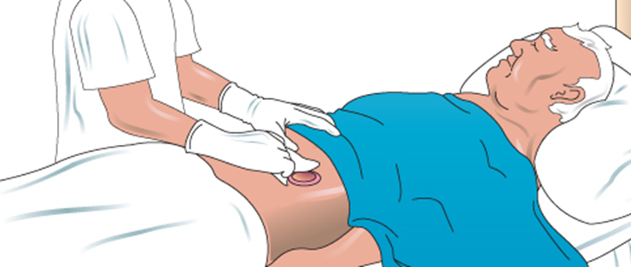
LO7, content 18
Caring for an ostomy
Using a washcloth and warm water, wash the area in one direction, away from the stoma. Rinse. Pat dry with another towel. Apply skin cream as ordered.
Place the clean ostomy drainage pouch on resident. Hold in place and seal securely. Make sure the bottom of the pouch is clamped.

Slide 132
LO7, content 19
Caring for an ostomy
Remove the bed protector and discard. Place soiled linens in proper container. Discard the plastic bag properly.
Remove and discard gloves.
Wash your hands.
Return bed to lowest position. Remove privacy measures.
Place call light within resident’s reach.
Report any changes in resident to the nurse. Note any changes in stoma and surrounding area. A normal stoma is red and moist and looks like the lining of the mouth. Call the nurse if the stoma is very red or blue or if swelling or bleeding is present.
Document procedure using facility guidelines.

Slide 133
LO8, key term 1
Describe the endocrine system and related conditions
Define the following terms:
glands
  organs that produce and secrete chemicals called hormones.
hormones
  chemical substances created by the body that control numerous body functions.

Slide 134
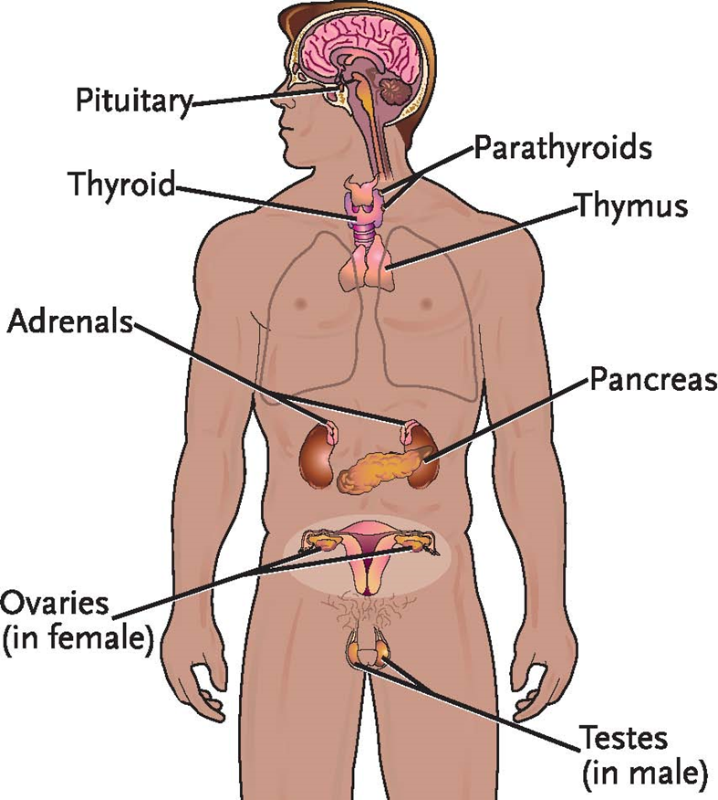
LO8, content 1
Transparency 4-2: The Endocrine System

Slide 135
LO8, content 2
Describe the endocrine system and related conditions
  Remember these points about the endocrine system:
  Glands secrete hormones, which are chemical substances that control numerous body functions.
  Hormones are carried by the blood to organs in order to achieve the following:
  Maintain homeostasis through hormone secretion
  Influence growth and development
  Regulate blood sugar levels
  Regulate calcium and phosphate levels
  Regulate body’s ability to reproduce
  Determine how fast cells burn food for energy

Slide 136
LO8, content 3
Describe the endocrine system and related conditions
Normal changes of aging to the endocrine system include the following:
  Decrease in levels of hormones, such as estrogen and progesterone
  Less production of insulin
  Less able to handle stress

Slide 137
LO8, content 4
Describe the endocrine system and related conditions
NAs can help by
  Encouraging proper nutrition
  Trying to eliminate or reduce stressors
  Offering encouragement and listening to residents

Slide 138
LO8, content 5
Describe the endocrine system and related conditions
Think about this question:
Are there any other ways NAs can help with changes of aging relating to the endocrine system?

Slide 139
LO8, content 6
Describe the endocrine system and related conditions
It is important to observe for and report the following:
  Headache
  Weakness
  Blurred vision
  Dizziness
  Irritability
  Sweating/excessive perspiration
  Change in “normal” behavior
  Confusion
  Change in mobility
  Change in sensation
  Numbness or tingling in arms or legs

Slide 140
LO8, content 7
Describe the endocrine system and related conditions
Observe and report (cont’d):
  Weight gain or weight loss
  Loss of appetite or increased appetite
  Increased thirst
  Frequent urination or change in urine output
  Hunger
  Dry skin
  Skin breakdown
  Sweet or fruity breath
  Sluggishness or fatigue
  Hyperactivity

Slide 141
LO8, key terms 2
Describe the endocrine system and related conditions
Define the following terms:
diabetes
  a condition in which the pancreas produces too little insulin or does not properly use insulin.
insulin
  a hormone that converts glucose from the blood and into the cells for energy for the body.
glucose
  natural sugar.

Slide 142
LO8, key terms 3
Describe the endocrine system and related conditions
Define the following terms:
pre-diabetes
  a condition that occurs when a person’s blood glucose levels are above normal but are not high enough for a diagnosis of type 2 diabetes.
gestational diabetes
  type of diabetes that appears in pregnant women who have never had diabetes before but who have high glucose levels during pregnancy.

Slide 143
LO8, content 8
Describe the endocrine system and related conditions
NAs should know these facts about diabetes:
  Pancreas produces too little insulin or does not properly use insulin.
  Glucose collects in blood, causing circulatory problems.
  Two types are type 1 (diagnosed in children and young adults, will continue throughout a person’s life) and type 2 (milder form).
  Pre-diabetes describes blood glucose levels above normal but not high enough for a diagnosis of type 2 diabetes.

Slide 144
LO8, content 9
Describe the endocrine system and related conditions
The following can be signs of diabetes:
  Excessive thirst
  Extreme hunger
  Frequent urination
  Weight loss
  High levels of blood sugar
  Glucose (sugar) in urine

Slide 145
LO8, content 10
Describe the endocrine system and related conditions
Signs of diabetes (cont’d):
  Sudden vision changes
  Tingling or numbness in hands or feet
  Feeling very tired much of the time
  Very dry skin
  Sores that are slow to heal
  More infections than usual

Slide 146
LO8, content 11
Describe the endocrine system and related conditions
Diabetes can cause the following complications:
  Changes in the circulatory system can cause heart attack, stroke, poor extremity circulation, poor wound healing, and kidney and nerve damage.
  Damage to eyes can cause vision loss and blindness.
  Diabetes can lead to leg and foot ulcers, infected wounds, and gangrene due to poor circulation and impaired wound healing.
  Insulin reaction and diabetic ketoacidosis are serious complications (see Chapter 2).

Slide 147
LO8, content 12
Transparency 4-25: Care Guidelines for Diabetes
Follow diet instructions exactly.
Encourage residents to follow their exercise programs.
Observe resident’s management of insulin doses.
Perform blood tests as directed.
Give foot care as directed.
Encourage comfortable, supportive footwear in breathable material.

Slide 148
LO9, key terms 1
Describe the endocrine system and related conditions
Define the following terms:
reproduce
  to create new human life.
gonads
  sex glands

Slide 149
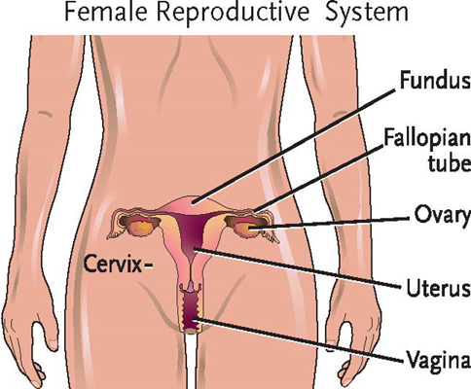
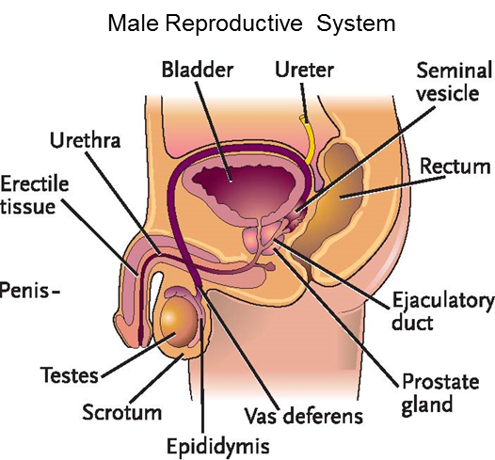
LO9, content 1
Transparency 4-2: The Reproductive System

Slide 150
LO9, content 2
Describe the endocrine system and related conditions
Remember these points about the reproductive system:
  Reproductive organs and hormones are different in males (testes, scrotum, testosterone) and females (ovaries, fallopian tubes, estrogen).
  Reproductive system allows humans to reproduce.

Slide 151
LO9, content 3
Describe the endocrine system and related conditions
Normal changes of aging to the reproductive system include the following:
  Female:
    Menstruation ends
    Decrease in estrogen leads to loss of calcium, causing brittle bones, and, potentially, osteoporosis
    Drier, thinner vaginal walls
  Male:
    Decrease in sperm production
    Enlarged prostate gland

Slide 152
LO9, content 4
Describe the endocrine system and related conditions
NAs can help by
  Providing privacy when necessary for sexual activity
  Respecting residents’ sexual needs and never judging any sexual behavior
  Keeping in mind that sexual behavior that seems inappropriate should be reported as it could be a sign of illness

Slide 153
LO9, content 5
Describe the endocrine system and related conditions
Think about this question:
Are there any other ways NAs can help with changes of aging relating to the reproductive system?

Slide 154
LO9, content 6
Describe the endocrine system and related conditions
It is important to observe for and report the following:
  Discomfort or difficulty with urination
  Discharge from penis or vagina
  Swelling of genitals
  Blood in urine or stool
  Breast changes, lumps, or discharge
  Sores on the genitals
  Redness or rash on the genitals
  Genital itching
  Reports of erectile dysfunction
  Reports of painful intercourse

Slide 155
LO9, content 7
Describe the endocrine system and related conditions
REMEMBER:
Residents have the right to sexual freedom and expression. They have a right to privacy and the meet their sexual needs.

Slide 156
LO9, content 8
Describe the endocrine system and related conditions
NAs should know these facts about vaginitis:
  Causes: bacteria, protozoa, fungus, or hormonal changes after menopause
  Symptoms: change in color, odor, and amount of vaginal discharge, itching, burning
  Treatment: oral medications, vaginal creams

Slide 157
LO9, content 9
Describe the endocrine system and related conditions
NAs should know these facts about benign prostatic hypertrophy:
  Occurs in men as they age
  Cause: enlarged prostate causes pressure on the urethra, which leads to problems urinating and emptying the bladder
  Treatment: medications or surgery
  Men are also at increased risk for prostate cancer as they age. Prostate cancer is usually slow-growing and responsive to treatment, so early detection is important.

Slide 158
LO9, content 10
Handout 4-1: Sexually Transmitted Infections
Sexually transmitted infections (STIs), or sexually transmitted diseases (STDs), are caused by sexual contact with an infected person. This contact includes sexual intercourse (vaginal and anal), contact of the mouth with the genitals or anus, and contact of the hands with the genital area. Some STIs can also be transmitted during pregnancy or childbirth. The human Immunodeficiency virus (HIV) and some kinds of hepatitis can be transmitted via needles as well as through sexual contact.
Sexually transmitted infections can cause a variety of signs and symptoms and health problems, which are detailed below. The transmission of some STIs can be reduced or stopped by using latex or polyurethane condoms.

Slide 159
LO9, content 11
Handout 4-1: Sexually Transmitted Infections (cont’d)
Chlamydia infection is caused by organisms introduced into the mucous membranes of the reproductive tract. Chlamydia can cause serious infection, including pelvic inflammatory disease (PID) in women. PID can lead to sterility. Signs and symptoms of chlamydia infection include yellow or white discharge from the penis or vagina, burning during urination, swelling of the testes, painful intercourse, and abdominal and low back pain. Chlamydia is treated with antibiotics.

Slide 160
LO9, content 12
Handout 4-1: Sexually Transmitted Infections (cont’d)
Syphilis is caused by bacteria. It can be treated effectively in the early stages, but if left untreated it can cause brain damage, mental health disorders, and even death. Babies born to mothers infected with syphilis may be born blind or with other serious birth defects. Syphilis is easier to detect in men than in women. This is due to open sores called chancres that form on the penis soon after infection. In women, these sores may form inside the vagina. However, the chancres are painless and can go unnoticed. If untreated, the infection progresses to rashes, headache, fever, weight loss and muscle aches. Then over time, if the infection is still not treated with penicillin or other antibiotics. It spreads to the heart, brain, and other vital organs. Untreated syphilis will eventually be fatal. The sooner the disease is treated, the better the person’s chances of preventing long-term damage and avoiding infection of others.

Slide 161
LO9, content 13
Handout 4-1: Sexually Transmitted Infections (cont’d)
Gonorrhea is caused by bacteria. It, like syphilis, is easier to detect in men than in women because many women with gonorrhea show no early symptoms. Men infected with gonorrhea will typically have a white, yellow or greenish discharge from the penis within a week after infection. Painful or swollen testes and burning during urination are other common symptoms in men. Symptoms in women include cloudy vaginal discharge, along with bleeding between periods. Rectal itching, soreness, bleeding or painful elimination of stool can occur in both men and women. If untreated, gonorrhea can cause blindness, joint infection, sterility, and pelvic inflammatory disease. Gonorrhea is treated with antibiotics.

Slide 162
LO9, content 14
Handout 4-1: Sexually Transmitted Infections (cont’d)
Genital herpes, unlike the other STIs discussed here, is caused by a virus—herpes simplex type 1 (HSV-1) or type 2 (HSV-2). HSV-2 is generally the cause of genital herpes. Genital herpes cannot be treated with antibiotics, nor can it be cured. Once infected with genital herpes, a person may suffer repeated outbreaks of the disease for the rest of his or her life. A herpes outbreak includes burning, painful, red sores on the genitals that may take weeks to heal. The sores are infectious, but a person with genital herpes can spread the infection even when sores are not present.
Some people infected with genital herpes never experience repeated outbreaks. The later episodes may not be as painful as the initial outbreak. Treatment with antiviral medication can help people stay symptom-free for longer periods of time. The medication can also help lessen the duration and intensity of the episodes. Babies born to women infected with genital herpes can be infected during birth. If a pregnant woman is experiencing
an outbreak, the baby is usually delivered by Cesarean
section, or C-section.

Slide 163
LO9, content 15
Handout 4-1: Sexually Transmitted Infections (cont’d)
Genital HPV infection is a sexually transmitted infection caused by human papillomavirus (HPV). HPV is a different virus than HIV and HSV (herpes). Genital HPV infection is spread primarily through genital contact and can infect the genital area of both men and women. This includes the penis, vulva, lining of the vagina, cervix, rectum, or anus. Many people have no signs or symptoms of HPV. Some HPV infections cause women to have an abnormal pap test. Genital warts may appear. They may also lead to the development of cervical cancer. Treatment to remove warts is done in a doctor's office through the use of medication. There is no cure for HPV, however, an HPV vaccine, licensed by the Food and Drug Administration (FDA) is available and is recommended for young women through age 26 and young men through age 21. It may help prevent genital warts and anal, vaginal, and vulvar cancers in women and genital warts and anal cancer in men.

Slide 164
LO10, content 1
Describe the immune and lymphatic systems and related conditions
Remember these points about the immune system:
  Nonspecific immunity protects the body from disease in general.
  Specific immunity protects the body against a particular disease invading the body at a given time.

Slide 165
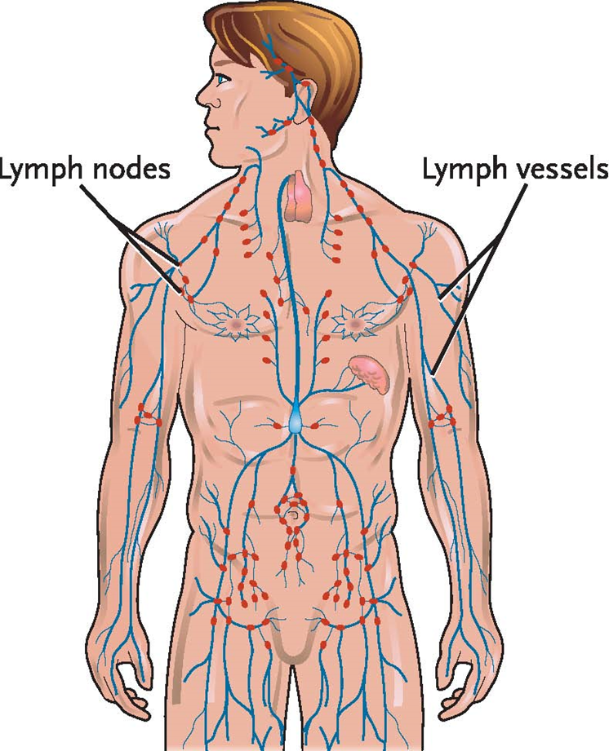
LO10, content 2
Transparency 4-27: The Lymphatic System

Slide 166
LO10, content 3
Describe the immune and lymphatic systems and related conditions
Remember these points about the lymphatic system:
  Functions of system are to remove excess fluids and waste products and to help the immune system fight infection.
  It is closely related to the circulatory system because lymph fluid, after being purified in the lymph nodes, flows into the bloodstream.
  It has no pump, but is circulated by muscle activity, massage, and breathing.

Slide 167
LO10, content 4
Describe the immune and lymphatic systems and related conditions
Normal changes of aging to the immune and lymphatic systems include the following:
  Weakened immune system increases risk of infections
  Takes longer to recover from an illness
  Decreased number and size of lymph nodes
  Decreased response to vaccines

Slide 168
LO10, content 5
Describe the immune and lymphatic systems and related conditions
NAs can help by
  Washing hands properly and keeping the resident’s environment clean to help prevent infection
  Assisting with personal hygiene as needed
  Encouraging proper nutrition and fluid intake
  Measuring and reporting vital signs accurately to detect possible infection

Slide 169
LO10, content 6
Describe the immune and lymphatic systems and related conditions
Think about this question:
Are there any other ways NAs can help with changes of aging relating to the immune and lymphatic systems?

Slide 170
LO10, content 7
Describe the immune and lymphatic systems and related conditions
It is important to observe for and report the following:
  Recurrent infections
  Swelling of lymph nodes
  Increased fatigue

Slide 171
LO10, content 8
Describe the immune and lymphatic systems and related conditions
NAs should know these facts about HIV/AIDS:
  Acquired immune deficiency syndrome (AIDS) is caused by the human immunodeficiency virus (HIV).
  HIV attacks the immune system and disables it.
  AIDS is the final stage of HIV infection in which infections, tumors, and central nervous system symptoms appear.
  HIV is transmitted by sexual contact, blood, and infected needles.
  Symptoms at transmission are like flu.
  Later symptoms include infections, tumors, and central nervous system symptoms.
  Late stage is AIDS dementia complex.

Slide 172
LO10, content 9
Describe the immune and lymphatic systems and related conditions
Signs and symptoms of AIDS include the following:
  Flu-like symptoms
  Appetite loss
  Weight loss
  Night sweats
  Swollen lymph nodes in the neck, underarms, or groin
  Severe diarrhea
  Dry cough
  Skin rashes

Slide 173
LO10, content 10
Describe the immune and lymphatic systems and related conditions
Signs and symptoms of AIDS (cont’d):
  Painful white spots in mouth or on the tongue
  Cold sores or fever blisters on the lips and flat, white ulcers in the mouth
  Warts on the skin and in the mouth
  Inflamed and bleeding gums
  Bruising that does not go away
  Low resistance to infection
  Kaposi’s sarcoma
  Pneumocystis jirovecci pneumonia, a lung infection
  AIDS dementia complex

Slide 174
LO10, content 11
Describe the immune and lymphatic systems and related conditions
REMEMBER:
Opportunistic infections invade the weakened body, worsening AIDS. Treatment is medication Drugs slow the progress, but there is no cure for the disease.

Slide 175
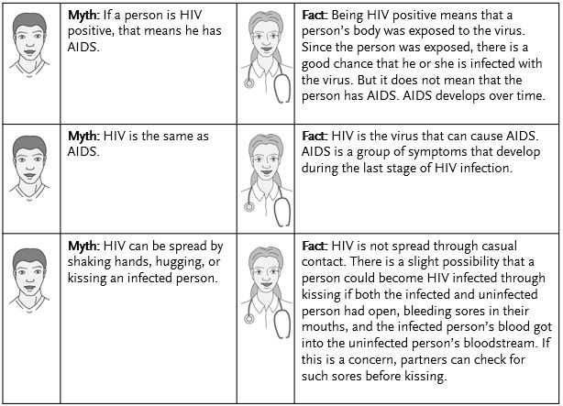
LO10, content 12
Transparency 4-2: Myths About HIV and AIDS

Slide 176
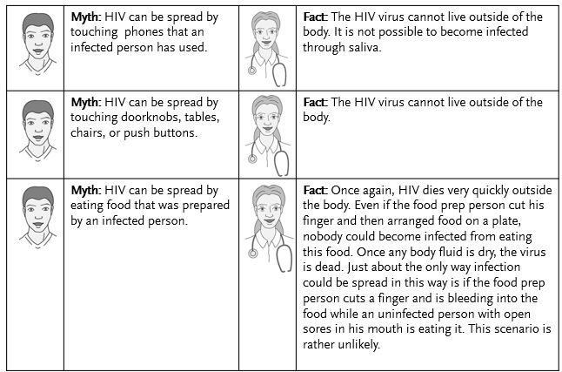
LO10, content 13
Transparency 4-2: Myths About HIV and AIDS (cont’d)

Slide 177
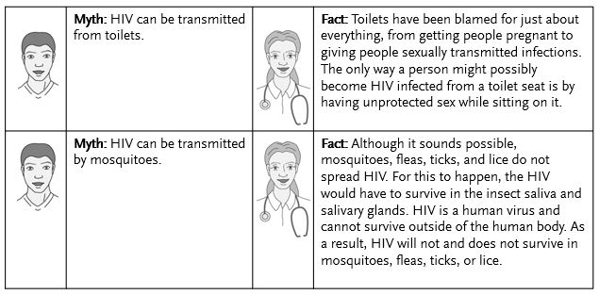
LO10, content 14
Transparency 4-2: Myths About HIV and AIDS (cont’d)

Slide 178
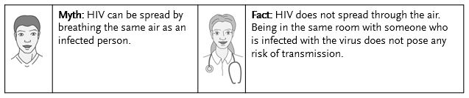
LO10, content 15
Transparency 4-2: Myths About HIV and AIDS
More information about HIV and AIDS is available at these websites:
aidsinfo.nih.gov, and cdc.gov/hiv

Slide 179
LO10, content 16
Transparency 4-28: Care Guidelines for HIV/AIDS
Follow Standard Precautions.
Wash hands often and keep everything clean.
High-protein, high-calorie, high-nutrient meals can help maintain healthy weight.
Some people with HIV/AIDS lose their appetite. Help make mealtimes pleasant and relaxing, and know residents’ favorite foods. Notify nurse of appetite loss or difficulty eating.
If residents have infections in the mouth, they may need food that is low in acid and spice and neither cold nor hot. Liquid meals and fortified drinks may help ease the pain of chewing. Warm rinses may help painful mouth sores. Give careful mouth care.
Small, frequent meals can help with nausea. High-fat and spicy foods should be avoided. Eating a soft, bland diet may help. Help ensure proper fluid intake.

Slide 180
LO10, content 17
Transparency 4-28: Care Guidelines for HIV/AIDS (cont’d)
If diarrhea is severe, doctor may order the BRAT diet (bananas, rice, applesauce, toast). This is helpful short-term. Good rehydration fluids include water, juice, caffeine-free soda, and broth. Avoid caffeinated beverages.
Numbness, tingling, and pain in the feet and legs is usually treated with medication. Wearing loose, soft slippers may help. A bed cradle may be used to keep sheets and blankets off legs and feet.
Residents may experience anxiety and depression. Treat them with respect and provide emotional support.
Provide a safe environment and close supervision of ADLs.

Slide 181
LO10, content 18
Describe the immune and lymphatic systems and related conditions
REMEMBER:
AIDS causes a great deal of emotional stress. NAs should be sure to provide emotional support and encouragement to residents with AIDS.

Slide 182
LO10, content 19
Describe the immune and lymphatic systems and related conditions
REMEMBER:
A resident’s HIV/AIDS status is confidential. It cannot be discussed with anyone. Violating this confidentiality is not only unethical, it is a violation of the law.

Slide 183
LO10, key terms 1
Describe the immune and lymphatic systems and related conditions
Define the following term:
tumor
  a cluster of abnormally-growing cells.

Slide 184
LO10, content 20
Describe the immune and lymphatic systems and related conditions
NAs should know these facts about cancer:
  General term used to describe a disease in which abnormal cells grow in an uncontrolled way
  Tumors can be benign (non-cancerous, usually grow slowly) or malignant (cancerous, can grow rapidly).
  There is no cure.
  It may spread to other areas of the body (metastasize), affecting other body systems.
  Often first appears in breast, colon, rectum, uterus, prostate, lungs, or skin

Slide 185
LO10, content 21
Describe the immune and lymphatic systems and related conditions
  Discuss the following known causes of cancer:
  Genetic factors
  Tobacco use
  Alcohol use
  Poor diet/obesity
  Lack of physical activity
  Certain infections
  Environmental exposure, such as radiation
  Sun exposure

Slide 186
LO10, content 22
Describe the immune and lymphatic systems and related conditions
Discuss the following warning signs of cancer identified by the American Cancer Society:
  Unexplained weight loss
  Fever
  Fatigue
  Pain
  Skin changes
  Change in bowel or bladder function

Slide 187
LO10, content 23
Describe the immune and lymphatic systems and related conditions
Warning signs of cancer (cont’d):
  Sores that do not heal
  Unusual bleeding or discharge
  Thickening or lump in breast or other part of body
  Indigestion or difficulty swallowing
  Recent change in wart or mole
  Nagging cough or hoarseness

Slide 188
LO10, content 24
Describe the immune and lymphatic systems and related conditions
There are three primary treatments for cancer:
  Surgery
  Chemotherapy
  Radiation therapy
  Targeted therapy
  Immunotherapy

Slide 189
LO10, content 25
Transparency 4-2: Care Guidelines for Cancer
Each case is different. Do not make assumptions.
Respect residents’ needs and be honest and sensitive. Have a positive attitude.
Encourage a variety of food and small portions. Try plastic utensils for residents receiving chemotherapy.
Watch for signs of pain and report them to the nurse. Help with comfort measures, such as repositioning and providing conversation, music or reading materials.
Give back rubs for comfort and to increase circulation.
Check the skin often to prevent pressure injuries. Keep the skin clean and dry. Do not apply lotion to areas receiving radiation therapy. Follow skin care orders.
Assist with oral care often. Use a soft-bristled toothbrush and a baking soda (or other prescribed) rinse.

Slide 190
LO10, content 26
Transparency 4-29: Care Guidelines for Cancer (cont’d)
Provide help with grooming.
Encourage visitors. Suggest good times of the day for visits. Get to know residents’ interests. Report signs of depression.
Be alert to needs not being met or stresses created by the illness.

Slide 191
LO10, content 27
Describe the immune and lymphatic systems and related conditions
The following are signs and symptoms to report when a resident has cancer:
  Increased weakness or fatigue
  Weight loss
  Nausea, vomiting, diarrhea
  Changes in appetite
  Fainting
  Signs of depression
  Confusion

Slide 192
LO10, content 28
Describe the immune and lymphatic systems and related conditions
Signs and symptoms to report when a resident has cancer (cont’d):
  Blood in stool or urine
  Changes in mental status
  Changes in skin
  New lumps, sores, rashes
  Increase in pain or unrelieved pain
  Blood in the mouth

