Slide 2
Chapter 6, LO1, key terms 1
Explain personal care of residents
Define the following terms:
hygiene
  practices to keep bodies clean and healthy.
grooming
  practices to care for oneself, such as caring for fingernails and hair.

Slide 3
LO1, content 1
Explain personal care of residents
NAs may provide the following a.m. care:
  Assisting with elimination needs and helping with perineal care
  Helping wash the face and hands
  Assisting with hair care, dressing, and shaving
  Assisting with mouth care

Slide 4
LO1, content 2
Explain personal care of residents
NAs may provide the following p.m. care:
  Assisting with elimination needs
  Helping wash the face and hands
  Giving a snack
  Assisting with mouth care
  Assisting with changing into nightclothes
  Giving a back rub

Slide 5
LO1, content 3
Transparency 6-1: Assisting with Personal Care
Help the resident be as independent as possible.
Be sensitive and professional.
Always explain what you will be doing.
Always provide privacy.
Allow the resident to make as many decisions as possible.
Observe the resident during care. Note and report signs and symptoms. Observe the resident's mental state.
Report any changes.
Leave the resident’s room clean and tidy.
Leave the bed in the lowest position and the call light within the resident’s reach.

Slide 6
LO1, content 4
Explain personal care of residents
NAs can promote residents’ dignity, respect and privacy during personal care by
  Encouraging residents to do as much as they are able to do and being patient
  Knocking and waiting for permission to enter the resident’s room
  Not interrupting residents while they are in the bathroom
  Leaving the room when residents receive or make phone calls
  Respecting residents’ private time and personal things
  Not interrupting residents while they are dressing
  Keeping residents covered whenever possible when helping with dressing

Slide 7
LO1, content 5
Explain personal care of residents
Think about these questions:
How else can NAs help promote privacy, respect, and dignity during personal care?
Why do you think that performing the task is only half the job?
What else do you think can be accomplished while providing personal care?

Slide 8
LO1, content 6
Explain personal care of residents
While providing personal care NAs should observe for and report the following:
  Skin color, temperature, or reddened areas
  Mobility
  Flexibility
  Comfort level or pain or discomfort
  Strength and ability to perform ADLs
  Mental and emotional state
  Complaints

Slide 9
LO2, key terms 1
Identify guidelines for providing skin care and preventing pressure injuries
Define the following terms:
pressure points
  areas of the body that bear much of the body weight.
bony prominences
  areas of the body where the bone lies close to the skin.
pressure injuries
  injuries or wounds that result from skin deterioration and shearing; also called pressure ulcers, pressure sores, bed sores or decubitus ulcers.

Slide 10
LO2, key terms 2
Identify guidelines for providing skin care and preventing pressure injuries
Define the following terms:
shearing
  rubbing or friction that results from the skin moving one way and the bone underneath it remaining fixed or moving in the opposite direction.
draw sheet
  an extra sheet placed on top of the bottom sheet; used for moving residents in bed.

Slide 11
LO2, key terms 3
Identify guidelines for providing skin care and preventing pressure injuries
Define the following terms:
foot drop
  A weakness of muscles in the feet and ankles that causes problems with the ability to flex the ankles and walk normally.
orthotic device, or orthosis
  a device that helps support and align a limb and improve its functioning.

Slide 12
LO2, content 1
Identify guidelines for providing skin care and preventing pressure injuries
REMEMBER:
Prevention is the key to skin health. Once a pressure injury forms, it can get bigger and deeper and become infected. Pressure injuries are painful and difficult to heal.

Slide 13
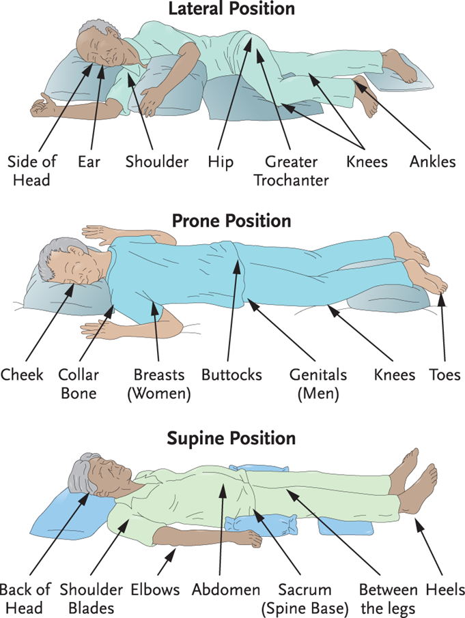
LO2, content 2
Transparency 6-2: Pressure Injury Danger Zones

Slide 14
LO2, content 3
Transparency 6-3: Observing the Skin
Pale, white, reddened, gray, or purple skin
Blisters, bruises, or wounds
Differences in the temperature of the skin compared to the area around it
Complaints of tingling, warmth, or burning
Dry, cracked, or flaking skin
Itching or scratching
Rash or any skin discoloration
Swelling
Fluid or blood draining
Broken skin
Changes in existing injury (size, depth, drainage, color, or odor)

Slide 15
LO2, content 4
Identify guidelines for providing skin care and preventing pressure injuries
NAs should remember these guidelines for skin care:
  Report changes in residents’ skin.
  Provide regular skin care.
  Reposition often, at least every two hours.
  Give frequent skin care for residents who are incontinent. Change clothing and linen often.
  Avoid scratching or irritating skin; report blisters or sores on feet.

Slide 16
LO2, content 5
Identify guidelines for providing skin care and preventing pressure injuries
Guidelines for skin care (cont’d):
  Massage skin frequently. Do not massage white, red, or purple areas.
  Avoid pulling or tearing skin.
  In overweight residents, pay special attention to skin under folds.
  Encourage residents to eat well-balanced meals and to drink plenty of fluids.
  Keep plastic or rubber materials from coming into contact with the skin.
  Follow the care plan and instructions.

Slide 17
LO2, content 6
Identify guidelines for providing skin care and preventing pressure injuries
Bed-bound residents are at a high risk for pressure injuries. When caring for these residents NAs should
  Keep bottom sheet tight and free of wrinkles and crumbs.
  Avoid shearing.
  Place an absorbent bed pad under the back and buttocks.
  Relieve pressure under bony prominences with pillows and other devices.
  Make bed or chair softer with flotation cushions.
  Use a bed cradle to keep top sheets from rubbing skin.
  Reposition residents seated in chairs or wheelchairs at least every hour if they cannot change positions easily themselves.

Slide 18
LO2, content 7
Identify guidelines for providing skin care and preventing pressure injuries
All of these positioning devices can help keep residents comfortable and reduce the risk of skin breakdown:
  Backrests
  Bed cradles
  Draw sheets
  Footboards
  Hand rolls
  Orthotic devices
  Trochanter rolls
  Abduction pillows

Slide 19
LO3, key terms 1
Describe guidelines for assisting with bathing
Define the following terms:
partial bath
  a bath given on days when a complete bath or shower is not done; includes washing the face, hands, underarms, and perineum.
perineum
  the genital and anal area.

Slide 20
LO3, content 1
Describe guidelines for assisting with bathing
Remember these guidelines for bathing:
  Baths are for health and relaxation.
  The face, hands, underarms, and perineum should be washed every day. Complete baths are necessary every other day or less often.
  Be gentle with the skin when bathing.
  Use facility-approved products.
  Keep room temperature comfortable.
  Be familiar with safety and assistive devices

Slide 21
LO3, content 2
Describe guidelines for assisting with bathing
Guidelines for bathing (cont’d):
  Gather supplies beforehand so a resident is not left alone while bathing.
  Make sure water temperature is safe and comfortable. Have resident test water temperature.
  Wear gloves while bathing a resident and change gloves before giving perineal care.
  Remove all soap from the skin.
  Keep a record of bathing schedules.

Slide 22
LO3, content 3
Giving a complete bed bath
Equipment: bath blanket, bath basin, soap, bath thermometer (if available), 2-4 washcloths, 2-4 bath towels, disposable absorbent pads, clean clothes, 2 pairs of gloves, orangewood stick, lotion, deodorant, brush or comb
When bathing, move resident’s body gently and naturally. Avoid force and over-extension of limbs and joints.
Identify yourself by name. Identify the resident by name.
Wash your hands.
Explain procedure to the resident. Speak clearly, slowly, and directly. Maintain face-to-face contact whenever possible.
Provide for resident’s privacy with curtain, screen, or door. Be sure the room is at a comfortable temperature and there are no drafts.
Adjust bed to a safe level, usually waist high. Lock bed wheels.

Slide 23
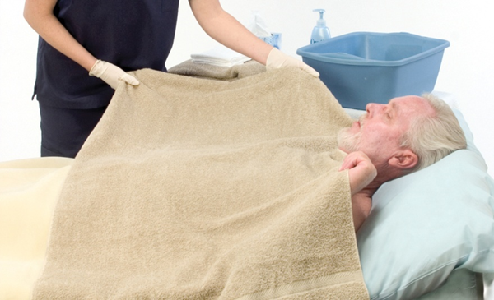
LO3, content 4
Giving a complete bed bath
Place a bath blanket or towel over the resident. Ask him to hold onto it as you remove or fold back top bedding. Remove gown, while keeping resident covered with bath blanket. Place clothing in proper container.

Slide 24
LO3, content 5
Giving a complete bed bath
Fill the basin with warm water. Test water temperature with thermometer or against the inside of your wrist. Water temperature should not be over 105°F. Have resident check water temperature to see if it is comfortable. Adjust if necessary. The water will cool quickly. Change the water when it becomes too cool, soapy, or dirty.
Put on gloves.
Ask the resident to participate in washing. Help him do this when needed.
Uncover only one part of the body at a time. Place a towel or bed pad under the part being washed.
Wash, rinse, and dry one part of the body at a time. Start at the head. Work down, and complete the front first. When washing, use a clean area of the washcloth for each stroke.

Slide 25
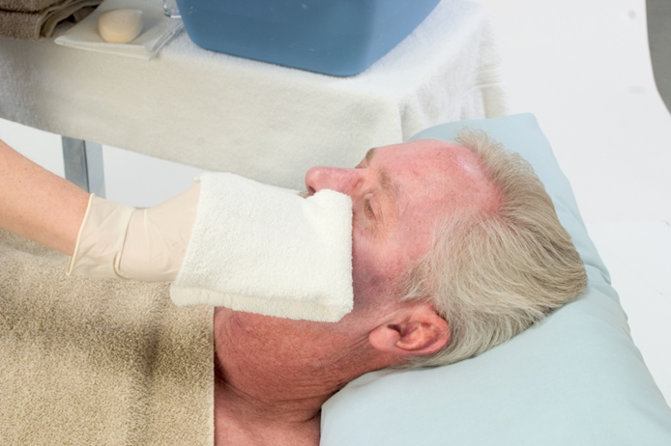
LO3, content 6
Giving a complete bed bath
Eyes, Face, Ears, and Neck: Wash face with wet washcloth (no soap). Begin with the eye farther away from you. Wash inner to outer area. Use a different area of the washcloth for each stroke. Repeat for the other eye. Wash the face from the middle outward. Use firm but gentle strokes. Wash the ears and behind the ears. Wash the neck. Rinse and pat dry.

Slide 26
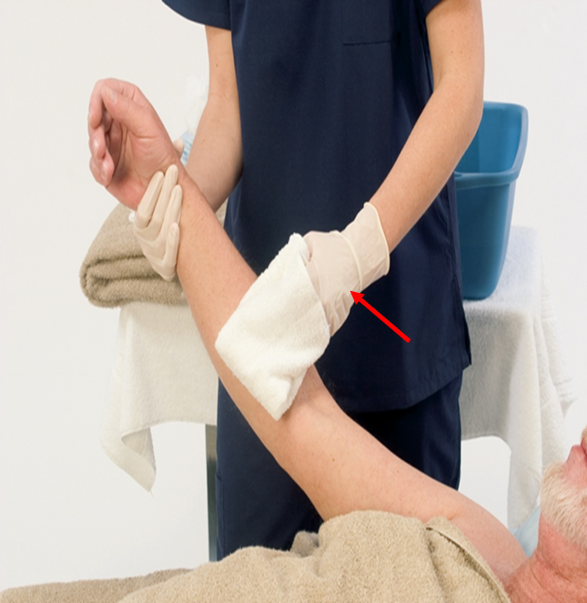
LO3, content 7
Giving a complete bed bath
Arms and Axillae: Begin with the arm farther away from you. Remove the arm from under the towel. With a soapy washcloth, wash the upper arm and underarm. Use long strokes from the shoulder down to the wrist. Rinse and pat dry. Repeat for the other arm..

Slide 27
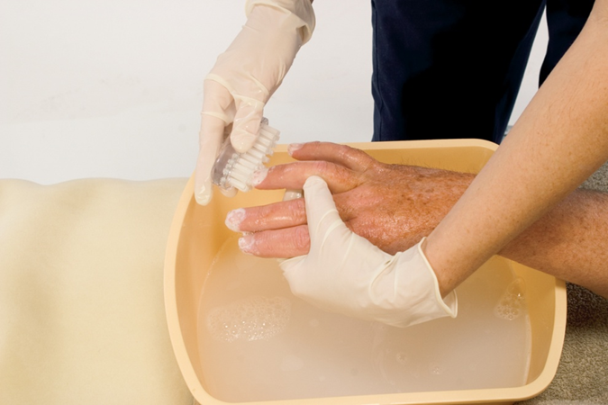
LO3, content 8
Giving a complete bed bath
Hands: Wash the far hand, including the fingers and fingernails. Clean under the nails with an orangewood stick. Rinse and pat dry. Make sure to dry between the fingers. Give nail care (see procedure later in this chapter). Repeat for the other hand. Put lotion on the resident’s elbows and hands.

Slide 28
LO3, content 9
Giving a complete bed bath
Chest: Place the towel across the resident’s chest. Pull the blanket down to the waist. Lift the towel only enough to wash the chest. Rinse it and pat dry. For a female resident, wash, rinse, and dry breasts and under breasts. Check the skin in this area for signs of irritation.
Abdomen: Keep towel across chest. Fold the blanket down so that it still covers the pubic area. Wash the abdomen, rinse, and pat dry. If the resident has an ostomy, give skin care around the opening (Chapter 4). Cover with the towel. Pull the cotton blanket up to the resident’s chin. Remove the towel.

Slide 29
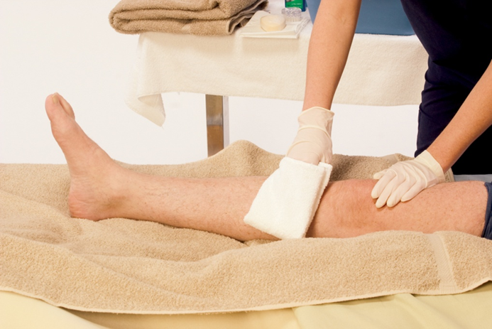
LO3, content 10
Giving a complete bed bath
Legs and Feet: Expose the far leg. Place a towel under it. Wash the thigh. Use long downward strokes. Rinse and pat dry. Do the same from the knee to the ankle.

Slide 30
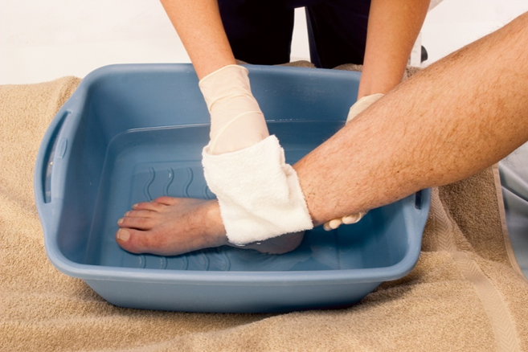
LO3, content 11
Giving a complete bed bath
Place another towel under the far foot. Move the basin to the towel. Place the foot into the basin. Wash the foot and between the toes. Rinse the foot and pat dry. Make sure the area between toes are dry. Apply lotion to the foot if ordered, especially at the heels. Do not apply lotion between the toes. Repeat steps for the other leg and foot.

Slide 31
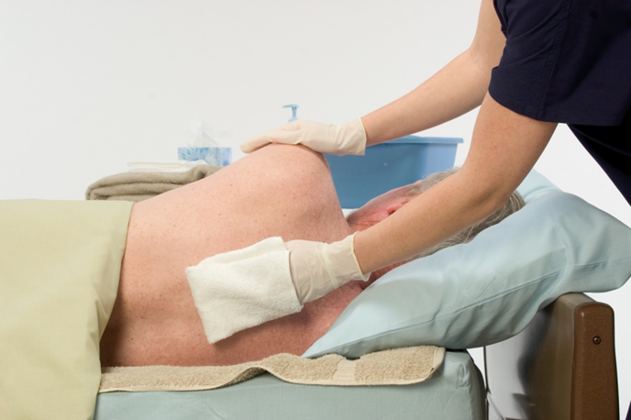
LO3, content 12
Giving a complete bed bath
Back: Help resident move to the center of the bed. Raise the far side rail (if used) for safety. Help the resident to turn onto his side, toward the raised side rail. Return to the working side of the bed. His back should be facing you. Fold the blanket away from the back. Place a towel lengthwise next to the back. Wash the back and neck with long, downward strokes. Rinse and pat dry. Apply lotion if ordered.

Slide 32
LO3, content 13
Giving a complete bed bath
Place the towel under the buttocks and upper thighs. Help the resident turn onto his back. If the resident is able to wash his perineal area, place a basin of clean, warm water, a washcloth, and towel within reach. Hand items to the resident as needed. If the resident wants you to leave the room, remove and discard gloves. Wash your hands. Leave side rails up (if used). Return bed to its lowest position. Leave supplies and the call light within reach.
If the resident cannot provide perineal care, you will do so. Remove and discard your gloves. Wash your hands and put on clean gloves. Provide privacy at all times.
Perineal area and buttocks: Change the bath water. Place a towel or bed pad under the perineal area including the buttocks. Wash, rinse, and dry perineal area. Work from front to back (clean to dirty). Expose the perineal area only.

Slide 33
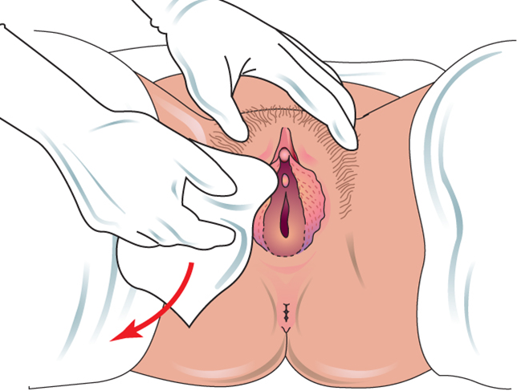
LO3, content 14
Giving a complete bed bath
For a female resident: Using water and a small amount of soap, wash the perineum from front to back. Use single strokes. Use a clean area of washcloth or a clean washcloth for each stroke.

Slide 34
LO3, content 15
Giving a complete bed bath
Working from front to back, wipe one side of the labia majora, the outside folds of perineal skin that protect the urinary meatus and the vaginal opening. Then wipe the other side, using a clean part of the washcloth. With your thumb and forefinger, gently separate the labia majora. Wipe from front to back on one side with a clean washcloth, using a single stroke. Using a clean area of the washcloth, wipe from front to back on the other side. Using another clean area of the washcloth, wipe from front to back down the center. Clean the perineum (area between vagina and anus) last with a front to back motion. Rinse the area thoroughly in the same way. Make sure all soap is removed. With a clean, dry towel or washcloth, dry entire perineal area. Move from front to back, using a blotting motion.
Ask the resident to turn on her side. Using a clean washcloth, wash and rinse buttocks and anal area. Work from front to back. Clean the anal area without contaminating the perineal area. With a clean, dry towel or washcloth, dry buttocks and anal area. Dry entire perineal area.

Slide 35
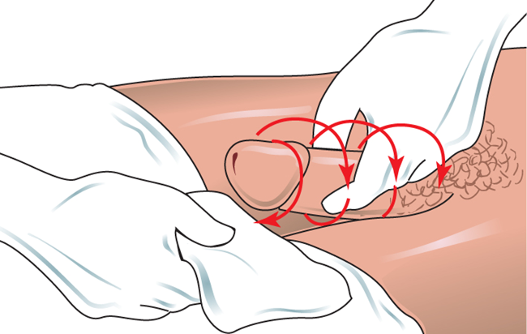
LO3, content 16
Giving a complete bed bath
For a male resident: If the resident is uncircumcised, pull back the foreskin first. Gently push skin toward the base of penis. Hold the penis by the shaft. Wash in a circular motion from the tip down to the base. Use a clean area of washcloth or clean washcloth for each stroke.

Slide 36
LO3, content 17
Giving a complete bed bath
Thoroughly rinse the penis and pat dry with a clean, dry towel or washcloth. If the resident is uncircumcised, gently return foreskin to normal position. Then wash the scrotum and groin. The groin is the area from the pubis (area around the penis and scrotum) to the upper thighs. Rinse and pat dry. Ask the resident to turn on his side. Using a clean washcloth, wash and rinse buttocks and anal area. Work from front to back. Clean the anal area without contaminating the perineal area. With a clean, dry towel or washcloth, dry buttocks and anal area.
Cover the resident with the blanket.
Empty, rinse, and dry bath basin. Place basin in designated dirty supply area or return to storage, depending on facility policy.
Place soiled clothing and linens in proper containers.
Remove and discard gloves.
Wash your hands.

Slide 37
LO3, content 18
Giving a complete bed bath
Provide deodorant. Place a towel over the pillow and brush or comb the resident’s hair (see procedure later in this chapter). Help resident put on clean clothing. Help resident into comfortable position with proper body alignment.
Return bed to lowest position. Leave side rails in the ordered position. Remove privacy measures
Place call light within resident’s reach.
Wash your hands.
Report any changes in resident to the nurse.
Document procedure using facility guidelines.

Slide 38
LO3, content 19
Giving a back rub
Equipment: cotton blanket or towel, lotion
Identify yourself by name. Identify the resident by name.
Wash your hands.
Explain procedure to resident. Speak clearly, slowly, and directly. Maintain face-to-face contact whenever possible.
Provide for resident’s privacy with curtain, screen, or door.
Adjust bed to a safe level, usually waist high. Lower the head of the bed. Lock bed wheels.

Slide 39
LO3, content 20
Giving a back rub
Position resident lying on his side or his stomach. Cover resident with a blanket or towel. Fold back the bed covers. Expose the back to the top of the buttocks. Back rubs can also be given with the resident sitting up.
Warm lotion by putting bottle in warm water for five minutes. Run your hands under warm water. Pour lotion on your hands. Rub them together. Always put lotion on your hands first, rather than on the resident’s skin.

Slide 40
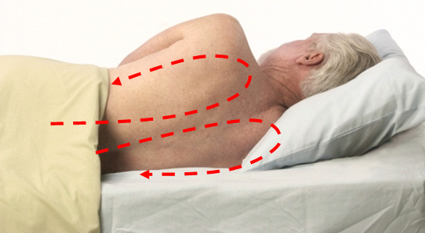
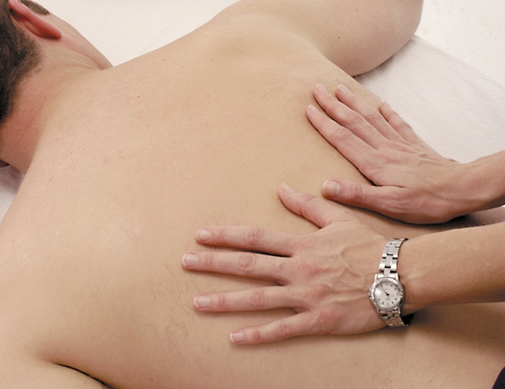


LO3, content 21
Giving a back rub
Place hands on each side of upper part of the buttocks. Use the full palm of each hand. Make long, smooth upward strokes with both hands. Move along each side of the spine, up to the shoulders. Circle your hands outward. Move back along outer edges of the back. At the buttocks, make another circle.
Move your hands back up to the shoulders. Without taking your hands off resident’s skin, repeat this motion for three to five minutes.

Slide 41
LO3, content 22
Giving a back rub
Knead with the first two fingers and thumb of each hand. Place them at base of the spine. Move upward together along each side of the spine. Apply gentle downward pressure with fingers and thumbs. Follow the same direction as with the long smooth strokes, circling at shoulders and buttocks.
Gently massage bony areas (spine, shoulder blades, hip bones). Use circular motions of your fingertips. Use little or no pressure. If any of these areas are white, red, or purple, do not massage them.
Let the resident know when you are almost through. Finish with some long, smooth strokes.
Dry the back if extra lotion remains on it.
Remove blanket or towel.

Slide 42
LO3, content 23
Giving a back rub
Help the resident get dressed. Help resident into comfortable position.
Store supplies. Place soiled clothing and linens in proper containers.
Return bed to lowest position. Remove privacy measures.
Place call light within resident’s reach.
Wash your hands.
Report any changes in resident to the nurse.
Document procedure using facility guidelines.

Slide 43

LO3, content 24
Shampooing hair in bed
Equipment: shampoo, hair conditioner (if requested), 2 bath towels, washcloth, bath thermometer, pitcher or handheld shower or sink attachment, waterproof pad, bath blanket, shampoo basin, comb and brush, hair dryer
Identify yourself by name. Identify the resident by name.

Slide 44
LO3, content 25
Shampooing hair in bed
Wash your hands.
Explain procedure to resident. Speak clearly, slowly, and directly. Maintain face-to-face contact whenever possible.
Provide for resident’s privacy with curtain, screen, or door. Be sure room is at a comfortable temperature and there are no drafts.
Arrange the supplies within reach.
Test water temperature with thermometer or against the inside of your wrist. Water temperature should be no higher than 105°F. Have resident check water temperature. Adjust if necessary.

Slide 45
LO3, content 26
Shampooing hair in bed
Remove all pillows and place the resident in a flat position. Adjust bed to a safe level, usually waist high. Lock bed wheels.
Place the waterproof pad under the resident’s head and shoulders. Cover the resident with the bath blanket. Fold back the top sheet and regular blankets.
Place the basin under the resident’s head. Place one towel across the resident’s shoulders.
Protect resident’s eyes with dry washcloth.
Use pitcher or attachment to wet hair thoroughly. Apply a small amount of shampoo to your hands and rub them together.

Slide 46
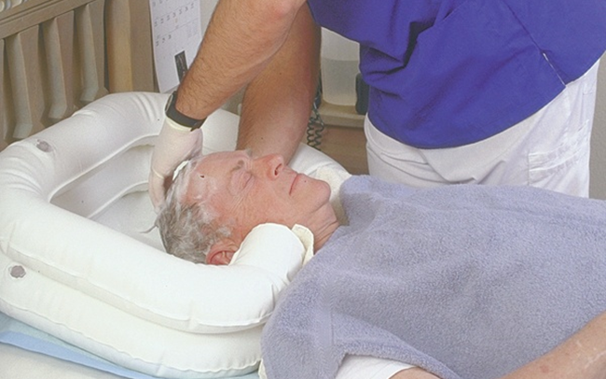
LO3, content 27
Shampooing hair in bed
Using both hands, massage the shampoo into a lather in the resident's hair. With your with fingertips (not fingernails) massage the scalp in a circular motion, from front to back. Do not scratch the scalp.
Rinse the hair until water runs clear. Use conditioner if resident wants it. Rinse as directed on container. Be sure to rinse the hair thoroughly to prevent the scalp from getting dry and itchy.

Slide 47
LO3, content 28
Shampooing hair in bed
Wrap resident’s hair in a clean towel. Remove the basin. Dry his face and neck with the washcloth or a towel.
Raise the head of the bed.
Gently rub the scalp and hair with the towel.
Comb or brush hair. Dry hair with a hair dryer on low setting if facility allows this. Style hair as resident prefers
Return bed to lowest position. Remove privacy measures.
Place call light within resident’s reach.
Empty, rinse, and wipe bath basin/pitcher. Take to proper area.
Clean comb or brush. Return hair dryer and comb or brush to proper storage.
Place soiled linen in proper container.

Slide 48
LO3, content 29
Shampooing hair in bed
Wash your hands.
Report any changes in resident to nurse.
Document procedure using facility guidelines.

Slide 49
LO3, content 30
Describe guidelines for assisting with bathing
REMEMBER:
It is very important to check the temperature of the water and have the resident check the temperature of the water before bathing. Bath water should be changed when it becomes too cool, soapy, or dirty.

Slide 50
LO3, content 31
Describe guidelines for assisting with bathing
REMEMBER:
Perineal care is a procedure. It may need to be done even if a full or partial bed bath is not needed. Always clean from front to back. Always perform perineal care as a step-by-step technique with different steps for males and females. Always turn the resident onto her side to clean the anal area and clean the anal area without contaminating the perineal area

Slide 51
LO3, content 32
Describe guidelines for assisting with bathing
REMEMBER:
NAs must protect residents’ privacy and dignity by keeping body parts covered with towels and bath blankets. This also helps the resident stay warm.
Procedures such as nail care, shampooing, and back rubs are often done at the time of bed baths.

Slide 52
LO3, content 33
Describe guidelines for assisting with bathing
NAs should remember these safety guidelines for showers and tub baths:
  Clean tub or shower before and after use.
  Be sure floor is dry.
  Be familiar with and use assistive devices as necessary.
  Have resident use safety bars to get into or out of tub or shower.
  Place items within reach.
  Do not leave the resident alone.
  Do not use bath oils, lotions, or powders.
  Test water temperature to make sure it is safe and comfortable.

Slide 53
LO3, content 34
Giving a shower or tub bath
Equipment: bath blanket, soap, shampoo, bath thermometer, 2-4 washcloths, 2-4 bath towels, clean clothes, nonskid footwear, 2 pairs of gloves, lotion, deodorant, hair dryer
Wash your hands.
Place equipment in shower or tub room. Put on gloves. Clean shower or tub area and shower chair. Place bucket under shower chair (in case resident has a bowel movement). Turn on heat lamp to warm the room, if available.
Remove and discard gloves. Wash your hands.

Slide 54
LO3, content 35
Giving a shower or tub bath
Go to resident’s room. Identify yourself by name. Identify the resident by name.
Wash your hands.
Explain procedure to resident. Speak clearly, slowly, and directly. Maintain face-to-face contact whenever possible.
Provide for resident’s privacy with curtain, screen, or door.
Help resident to put on nonskid footwear. Transport resident to shower or tub room.

Slide 55
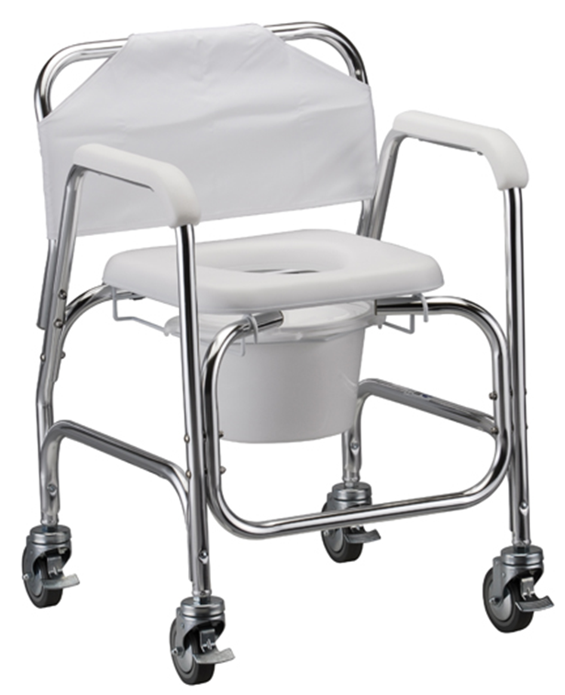
LO3, content 36
Giving a shower or tub bath
Wash your hands. Put on clean gloves.
Help resident remove clothing and shoes.
For a shower:
If using a shower chair, place it close to resident. Lock wheels. Safely transfer resident into the shower chair.

Slide 56
LO3, content 37
Giving a shower or tub bath
Turn on water. Test water temperature with thermometer or against the inside of your wrist. Water temperature should be no higher than 105°F. Have resident check water temperature. Adjust if necessary. Check temperature throughout the shower.
Unlock the shower chair and move it into the shower stall. Lock wheels.
Stay with resident during procedure.
Let resident wash as much as possible. Help her to wash her face.
Help the resident shampoo and rinse hair.
Using soap, help to wash and rinse the entire body. Move from head to toe (clean to dirty).
Turn off water. Unlock shower chair wheels. Roll resident out of shower.

Slide 57
LO3, content 38
Giving a shower or tub bath
For a tub bath:
Residents may need help to get into the bath, depending on their level of mobility. Safely transfer resident onto chair or tub lift, or help resident into bath.
Fill the tub halfway with warm water. Test water temperature with thermometer or against the inside of your wrist. Water temperature should be no higher than 105°F. Have resident check water temperature. Adjust if necessary.
Stay with resident during procedure.

Slide 58
LO3, content 39
Giving a shower or tub bath
Let resident wash as much as possible. Help her to wash her face.
Help resident shampoo and rinse hair.
Using soap, help to wash and rinse the entire body. Move from head to toe (clean to dirty).
Drain the tub. Cover resident with bath blanket while the tub drains.
Help resident out of tub and onto a chair.
Remaining steps for either procedure:
Give resident towel(s) and help to pat dry. Pat dry under the breasts, between skin folds, in the perineal area, and between toes.
Apply lotion and deodorant as needed
21. Place soiled clothing and linens in proper containers.

Slide 59
LO3, content 40
Giving a shower or tub bath
Remove and discard gloves.
Wash your hands.
Help resident dress and comb hair before leaving shower or tub room. Offer a hair dryer if needed. Put on nonskid footwear. Return resident to room.
Make sure resident is comfortable.
Place call light within resident’s reach.
Report any changes in resident to nurse.
Document procedure using facility guidelines.

Slide 60
LO4, key terms 1
Describe guidelines for assisting with grooming
Define the following terms:
pediculosis
  an infestation of lice.
safety razor
  a type of razor that has a sharp blade with a special safety casing to help prevent cuts; requires the use of shaving cream or soap.

Slide 61
LO4, key terms 2
Describe guidelines for assisting with grooming
Define the following terms:
disposable razor
  type of razor that is discarded in a biohazard container after one use; requires the use of shaving cream or soap.
electric razor
  type of razor that runs on electricity; does not require the use of soap or shaving cream.

Slide 62
LO4, content 1
Transparency 6-4: Assisting with Grooming
Residents should do as much for themselves as they can.
Let residents make as many choices as possible.
Be sensitive, professional, and respectful. Provide person-centered care.
Do not use same nail equipment on more than one resident.
Keep the feet clean and dry, and observe residents’ feet carefully.
Wear gloves when shaving residents.
Be gentle when handling residents’ hair.

Slide 63
LO4, content 2
Providing fingernail care
Equipment: orangewood stick, emery board, lotion, basin, soap, 2 washcloths, 2 towels, bath thermometer, gloves
Identify yourself by name. Identify the resident by name.
Wash your hands.
Explain procedure to resident. Speak clearly, slowly, and directly. Maintain face-to-face contact whenever possible.
Provide for resident’s privacy with curtain, screen, or door.
If resident is in bed, adjust bed to a safe level, usually waist high. Lock bed wheels.

Slide 64
LO4, content 3
Providing fingernail care
Fill the basin halfway with warm water. Test water temperature with thermometer or against the inside of your wrist. Water temperature should be no higher than 105°F. Have resident check water temperature. Adjust if necessary. Place basin at a comfortable level for the resident.
Put on gloves.
Soak the resident’s hands and nails in the basin of water. Soak all 10 fingertips for at least five minutes.

Slide 65
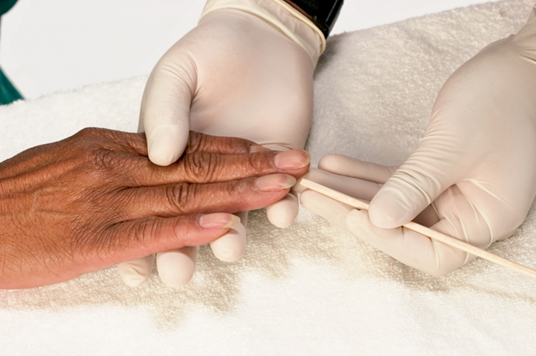
LO4, content 4
Providing fingernail care
Remove hands from water. Wash hands with soapy washcloth. Rinse. Pat hands dry with towel, including between fingers. Remove the hand basin.
Place resident’s hands on the towel. Gently clean under each fingernail with the orangewood stick.

Slide 66
LO4, content 5
Providing fingernail care
Wipe orangewood stick on towel after cleaning each nail. Wash resident’s hands again. Dry them thoroughly, especially between fingers.
Shape nails with an emery board or file. Move only in one direction (not back and forth). File in a curve. Finish with nails smooth and free of rough edges.
Apply lotion from fingertips to wrists. Remove excess, if any, with a towel or washcloth.
Empty, rinse, and dry basin. Place basin in designated dirty supply area or return to storage, depending on facility policy.
Place soiled clothing and linens in proper containers.
Remove and discard gloves. Wash your hands.

Slide 67
LO4, content 6
Providing fingernail care
Return bed to lowest position. Remove privacy measures.
Place call light within resident’s reach.
Report any changes in resident to the nurse.
Document procedure using facility guidelines.

Slide 68
LO4, content 7
Describe guidelines for assisting with grooming
NAs should observe for and report the following when providing foot care:
  Dry, flaking skin
  Non-intact or broken skin
  Discoloration of the feet
  Blisters
  Bruises
  Blood or drainage

Slide 69
LO4, content 8
Describe guidelines for assisting with grooming
Observe and report when providing foot care (cont’d):
  Long, ragged toenails
  Ingrown toenails
  Swelling
  Soft, fragile, or reddened heels
  Differences in temperature of the feet

Slide 70
LO4, content 9
Providing foot care
Equipment: basin, bath mat, soap, lotion, 2 washcloths, 2 towels, bath thermometer, clean socks, gloves
Identify yourself by name. Identify the resident by name.
Wash your hands.
Explain procedure to resident. Speak clearly, slowly, and directly. Maintain face-to-face contact whenever possible.
Provide for resident’s privacy with curtain, screen, or door.
If the resident is in bed, adjust bed to a safe level, usually waist high. Lock bed wheels.

Slide 71
LO4, content 10
Providing foot care
Fill the basin halfway with warm water. Test water temperature with thermometer or against the inside of your wrist. Water temperature should be no higher than 105° F. Have resident check water temperature. Adjust if necessary.
Place basin on the bath mat or bath towel on the floor (if the resident is sitting in a chair) or on a towel at the foot of the bed (if the resident is in bed). Make sure basin is in a comfortable position for resident. Support the foot and ankle throughout the procedure.
Put on gloves.
Remove resident’s socks. Completely submerge resident’s feet in water. Soak the feet for 10 to 20 minutes. Add warm water to basin as necessary.

Slide 72
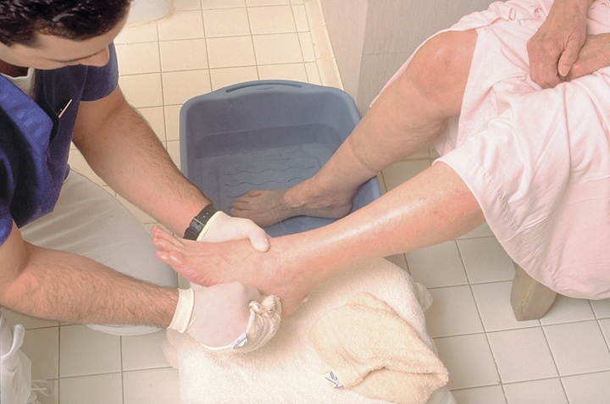
LO4, content 11
Providing foot care
Put soap on a wet washcloth. Remove one foot from the water. Wash entire foot, including between the toes and around nail beds.
Rinse entire foot, including between the toes.
With a clean, dry towel or washcloth, dry entire foot, including between the toes.
Repeat steps 10 through 12 for the other foot.

Slide 73
LO4, content 12
Providing foot care
Put lotion in hand. Warm lotion by rubbing hands together. Massage lotion into entire foot (top and bottom), except between the toes. Remove excess, if any, with a towel.
Help resident put on clean socks.
Empty, rinse, and dry basin. Place basin in designated dirty supply area or return to storage, depending on facility policy.
Place soiled clothing and linens in proper containers.
Remove and discard gloves. Wash your hands.
Return bed to lowest position. Remove privacy measures.
Place call light within resident’s reach.
Report any changes in resident to the nurse.
Document procedure using facility guidelines.

Slide 74
LO4, content 13
Describe guidelines for assisting with grooming
Remember these points when combing or brushing residents’ hair:
  Let residents choose their own hairstyles.
  Do not style residents’ hair in a childish manner.
  Handle hair gently.

Slide 75
LO4, content 14
Combing or brushing hair
Equipment: comb, brush, towel, mirror, hair care items requested by resident
Use hair care products that the resident prefers for his or her type of hair.
Identify yourself by name. Identify the resident by name.
Wash your hands.
Explain procedure to resident. Speak clearly, slowly, and directly. Maintain face-to-face contact whenever possible.
Provide for resident’s privacy with curtain, screen, or door.

Slide 76
LO4, content 15
Combing or brushing hair
If resident is in bed, adjust bed to a safe level, usually waist high. Raise the head of the bed so the resident is sitting up. Lock bed wheels.
Place a towel under the head or around the shoulders.
Remove any hair pins, hair ties or clips.
Remove tangles first by dividing hair into small sections. Hold lock of hair just above the tangle so you do not pull at the scalp. Gently comb or brush through the tangle. If the resident agrees, use a small amount of detangler or leave-in conditioner.

Slide 77
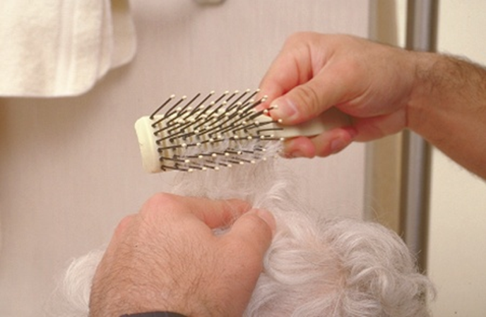
LO4, content 16
Combing or brushing hair
After tangles are removed, brush two-inch sections of hair at a time.
Neatly style hair as the resident prefers. Avoid childish hairstyles. Each resident may prefer different styles and hair products. Offer the mirror to the resident.

Slide 78
LO4, content 17
Combing or brushing hair
Return supplies to proper storage. Clean hair from comb or brush. Clean comb or brush.
Dispose of soiled linen in the proper container.
Return bed to lowest position. Remove privacy measures.
Place call light within resident’s reach.
Wash your hands.
Report any changes in resident to nurse.
Document procedure using facility guidelines.

Slide 79
LO4, content 18
Describe guidelines for assisting with grooming
Remember these points when assisting with shaving:
  Respect personal preferences regarding shaving.
  Wear gloves.
  Do not share razors between residents.
  Soften hair on face first if using disposable or safety razor.
  Shave in direction of hair growth.
  Use after-shave lotion if desired.
  Discard disposable shaving products properly.
  Do not use electric razors near water or oxygen.

Slide 80
LO4, content 19
Shaving a resident
Equipment: razor, basin filled halfway with warm water (if using a safety or disposable razor), 2 towels, washcloth, mirror, shaving cream or soap (if using a safety or disposable razor), after-shave lotion, gloves
Identify yourself by name. Identify the resident by name.
Wash your hands.
Explain procedure to resident. Speak clearly, slowly, and directly. Maintain face-to-face contact whenever possible.
Provide for resident’s privacy with curtain, screen, or door.

Slide 81
LO4, content 20
Shaving a resident
If resident is in bed, adjust bed to a safe level, usually waist high. Lock bed wheels.
Raise head of bed so resident is sitting up. Place towel across the resident’s chest, under his chin.
Put on gloves.
Shaving using a safety or disposable razor:
Soften the beard with a warm, wet washcloth on the face for a few minutes before shaving. Lather the face with shaving cream or soap.

Slide 82
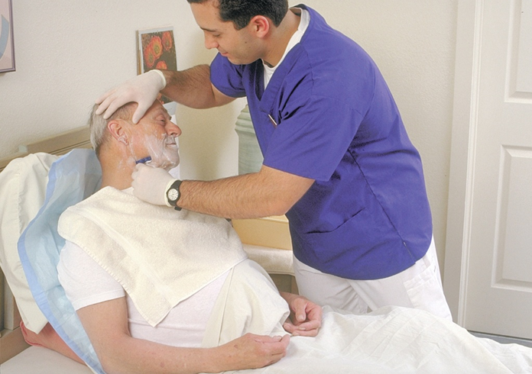
LO4, content 21
Shaving a resident
Hold skin taut. Shave in the direction of hair growth. Shave beard in short, downward, and even strokes on face and upward strokes on neck. Rinse the blade often in the basin to keep it clean and wet.

Slide 83
LO4, content 22
Shaving a resident
When you have finished, wash and rinse the resident’s face with a warm, wet washcloth. If he is able, let him use the washcloth himself. Use the towel to dry his face. Offer a mirror to resident.
Shaving using an electric razor:
Use a small brush to clean the razor. Do not use an electric razor near any water source or when oxygen is in use.

Slide 84
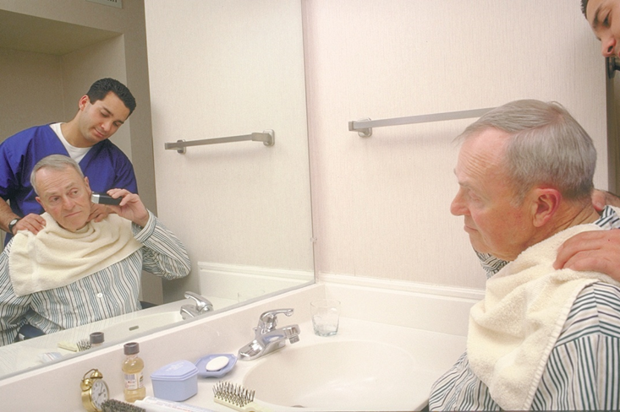
LO4, content 23
Shaving a resident
Turn on the razor and hold skin taut. Shave with smooth, even movements. If using a foil shaver, shave the beard with a back-and-forth motion in the direction of the hair growth. If using a three-head shaver, shave beard in circular motion with three-head shaver. Shave the chin and under the chin.
Offer a mirror to resident.

Slide 85
LO4, content 24
Shaving a resident
Apply after-shave lotion if the resident wants it.
Remove the towel. Place the towel and washcloth in proper container.
Clean the equipment and store it. Follow facility policy for a safety razor. For disposable razor, dispose of it in a biohazard container for sharps. For an electric razor, clean head of the razor. Remove whiskers, recap shaving head and return razor to case.
Remove and discard gloves. Wash your hands.
Make sure that resident and environment are free of loose hairs.
Return bed to lowest position. Remove privacy measures.
Place call light within resident’s reach.
Report any changes in resident to the nurse.
Document procedure using facility guidelines.

Slide 86
LO5, key terms 1
List guidelines for assisting with dressing
Define the following terms:
affected side
  a weakened due to a stroke or injury; also called weaker or involved side.
involved side
  a side of the body that is weakened due to a stroke or injury; also called weaker or affected side.

Slide 87
LO5, key terms 2
List guidelines for assisting with dressing
Define the following terms:
intravenous therapy (IV)
  the delivery of medication, nutrition, or fluids through a person's vein.
embolism
  an obstruction of a blood vessel, usually by a blood clot.

Slide 88
LO5, content 1
List guidelines for assisting with dressing
REMEMBER:
Do not refer to a resident’s affected or involved side as a “bad side” or a “bad” leg or arm.

Slide 89
LO5, content 2
Transparency 6-5: Assisting with Dressing
Refer to the weaker side as affected or involved.
Preferences should be followed. Allow residents to choose the clothing.
Encourage residents to dress in regular clothes during the daytime.
Let the resident do as much as possible to dress herself. Use assistive devices as directed.
Provide privacy.
Roll or fold down socks before putting them on.
Front-fastening bras are easier for residents to fasten by themselves.
Put back-fastening bras on the waist and fasten in front first before rotating around.
When dressing, start with the weaker arm or leg first. When undressing, start with the stronger side.

Slide 90
LO5, content 3
Dressing a resident with an affected (weak) right arm
Equipment: bath blanket, clean clothes of resident’s choice, nonskid footwear
When putting on items, move resident’s body gently and naturally. Avoid force and over-extension of limbs and joints.
Identify yourself by name. Identify the resident by name.
Wash your hands.
Explain procedure to resident. Speak clearly, slowly, and directly. Maintain face-to-face contact whenever possible.
Provide for resident’s privacy with curtain, screen, or door.

Slide 91
LO5, content 4
Dressing a resident with an affected (weak) right arm
If the resident is in bed, adjust bed to a safe level, usually waist high, lock the bed wheels.
Raise head of bed so that the resident is sitting up.
Ask the resident what she would like to wear. Dress her in the outfit she chooses.
Place a bath blanket over the resident. Ask her to hold onto it as you remove or fold back the top bedding to the foot of the bed. Remove the gown or top. Keep the resident covered with the bath blanket. Take clothes off the stronger side first when undressing. Then remove from the weaker side. Place top clothing in proper container. Move the bath blanket to cover the lower body.

Slide 92
LO5, content 5
Dressing a resident with an affected (weak) right arm
Help resident put on the top. If the top goes over the head, slide the top over the head first, then place the weaker arm through the sleeve before placing the garment on the stronger arm. Help the resident lean forward and smooth the top down. If the top fastens in the front, slide your hand through one sleeve and grasp the resident's hand on the weaker side, pulling it through. Help the resident lean forward and arrange the top across the back. Pull the second sleeve onto the stronger side as you did with the first one. Fasten the top.
Remove the bath blanket and place it in the proper container. Help the resident put on a skirt or pants. Put the weaker leg through the skirt or pants first. Then place the stronger leg through the skirt or pants. Have the resident raise her buttocks or turn the resident from side to side to pull the pants over the buttocks up to the waist. Fasten the pants or skirt if needed and make sure the clothing is comfortable.

Slide 93
LO5, content 6
Dressing a resident with an affected (weak) right arm
Roll one sock over the weaker foot. Make sure the heel of the sock is over the heel of the foot. Make sure there are no twists or wrinkles in the sock after it is on. Repeat for the other foot.
Starting with the weaker foot, slip on nonskid footwear. Use an assistive device if needed. Fasten one shoe securely and then put on the other shoe.
Finish with resident dressed appropriately. Make sure clothing is right-side-out and zippers and buttons are fastened.
Return be to lowest position. Remove privacy measures.
Place call light within resident’s reach.
Wash your hands.
Report any changes in resident to the nurse.
Document procedure using facility guidelines.

Slide 94
LO5, content 7
List guidelines for assisting with dressing
When dressing a resident with an IV an NA should remember the following:
  Never disconnect IV lines or turn off the pump.
  Always keep the IV bag higher than the IV site on the body.
  First remove clothing from the side without the IV. Then gather the clothing on the side with the IV. Lift clothing over the IV site. Move it up the tubing toward the IV bag. Lift the IV bag off its pole. Carefully slide the clothing over the bag. Place the bag back on the pole.

Slide 95
LO5, content 8
List guidelines for assisting with dressing
Dressing a resident with an IV (cont’d):
  Apply clean clothing first to side with the IV. Slide the correct arm opening over the bag, then over the tubing and the resident’s IV arm. Place the IV bag back on the pole.
  Check that the IV is dripping properly. Make sure none of the tubing is dislodged. Check to see that the IV site dressing is in place.

Slide 96
LO5, content 9
List guidelines for assisting with dressing
REMEMBER:
Anti-embolic stockings can help prevent swelling and blood clots and aid circulation. They should be applied in the morning, before the resident gets out of bed, so there is less swelling in the legs.

Slide 97
LO5, content 10
Applying knee-high elastic stockings
Equipment: elastic stockings
Identify yourself by name. Identify resident by name.
Wash your hands.
Explain procedure to resident. Speak clearly, slowly, and directly. Maintain face-to-face contact whenever possible.
Provide for resident’s privacy with curtain, screen, or door.

Slide 98
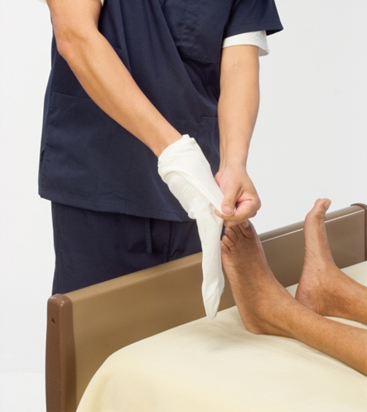
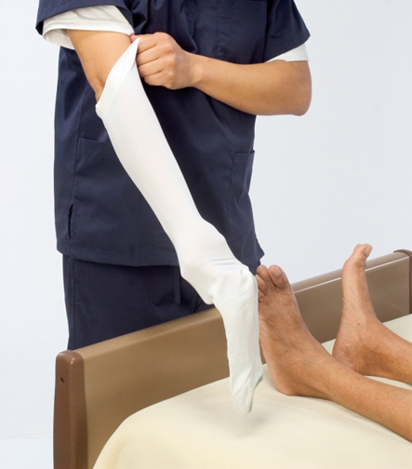
LO5, content 11
Applying knee-high elastic stockings
The resident should be in the supine position (on her back) in bed. With resident lying down, remove her socks, shoes, or slippers, and expose one leg. Expose no more than one leg at a time.
Turn stocking inside-out at least to heel area.

Slide 99
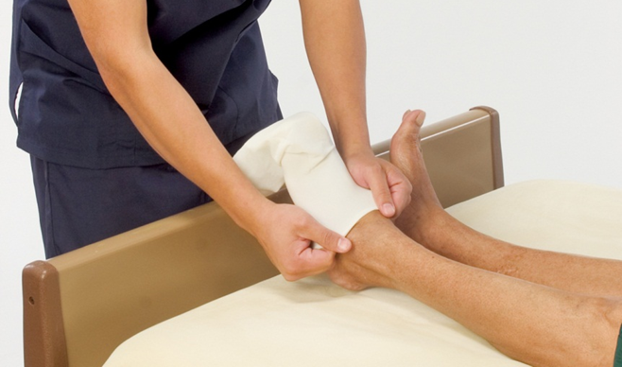
LO5, content 12
Applying knee-high elastic stockings
Gently place foot of stocking over the toes, foot, and heel. Make sure the heel is in the right place. The heel of the foot should be in heel of stocking.
Gently pull top of the stocking over the foot, heel, and leg.

Slide 100
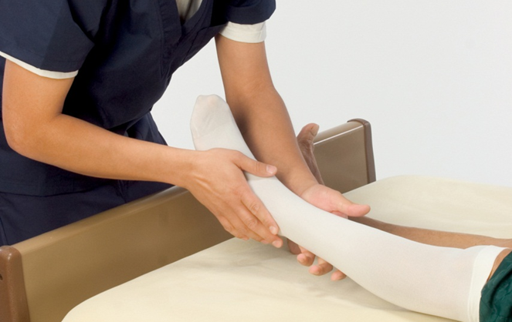
LO5, content 13
Applying knee-high elastic stockings
Make sure there are no twists or wrinkles in the stocking after it is on. It must fit smoothly. Make sure the heel of stocking is over the heel of foot. If the stocking has an opening in the toe area, make sure the opening is either over or under the toe area. This depends on the manufacturer’s instructions. Adjust if needed.
Repeat steps 6-9 for the other leg.

Slide 101
LO5, content 14
Applying knee-high elastic stockings
Place call light within resident’s reach.
Wash your hands.
Report any changes in resident to nurse.
Document procedure using facility guidelines.

Slide 102
LO6, key terms 1
Identify guidelines for proper oral hygiene
Define the following terms:
oral care
  care of the mouth, teeth, and gums.
aspiration
  the inhalation of food, fluid or foreign material into the lungs.
dentures
  artificial teeth.

Slide 103
LO6, content 1
Identify guidelines for proper oral hygiene
REMEMBER:
Oral care involves brushing the teeth, tongue, and gums, flossing the teeth with dental floss, caring for lips, and providing denture care.

Slide 104
LO6, content 2
Identify guidelines for proper oral hygiene
NAs should observe for and report the following when providing oral care:
  Irritation
  Raised areas
  Coated or swollen tongue
  Ulcers
  Flaky, white spots
  Dry, cracked, bleeding, or chapped lips
  Loose, chipped, broken, or decayed teeth
  Swollen, irritated, bleeding, or whitish gums
  Bad or fruity breath
  Reports of mouth pain

Slide 105
LO6, content 3
Identify guidelines for proper oral hygiene
When providing oral care for an unconscious resident NAs must remember the following:
  Regular oral care keeps the mouth clean and moist.
  Use as little liquid as possible and turn residents on their sides to avoid aspiration. Squeeze swabs after dipping them in solution to remove excess liquid.

Slide 106
LO6, content 4
Providing oral care
Equipment: toothbrush; toothpaste; emesis basin; gloves; clothing protector, towel, or washcloth; cup of water; lip moisturizer
Identify yourself by name. Identify the resident by name.
Wash your hands.
Explain procedure to resident. Speak clearly, slowly, and directly. Maintain face-to-face contact whenever possible.
Provide for resident’s privacy with curtain, screen, or door.

Slide 107
LO6, content 5
Providing oral care
If resident is in bed, adjust bed to a safe level, usually waist high. Raise the head of the bed to have resident in an upright sitting position. Lock bed wheels.
Put on gloves.
Place a clothing protector, towel or washcloth across the resident’s chest.
Wet the toothbrush. Put on small amount of toothpaste.
Clean entire mouth, including tongue and all surfaces of teeth and the gumline. Use gentle strokes. First brush inner, outer, and chewing surfaces of the upper teeth. Then do the same with the lower teeth. Use short strokes. Brush back and forth. Brush tongue.

Slide 108
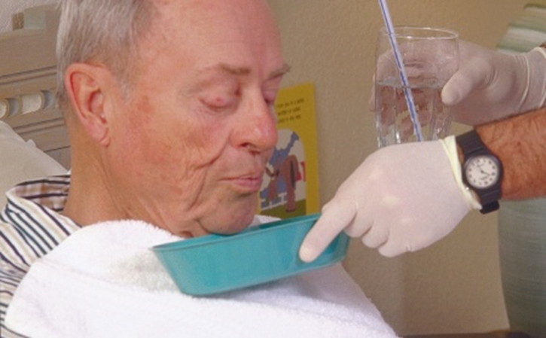
LO6, content 6
Providing oral care
Give the resident water to rinse the mouth. Place emesis basin under the resident’s chin, with the inward curve under the chin. Have resident spit water into emesis basin. Wipe resident’s mouth and remove towel. Apply lip moisturizer.
Rinse toothbrush and place in proper container. Empty, rinse, and dry basin. Place basin and toothbrush in designated dirty supply area or return to storage, depending on facility policy

Slide 109
LO6, content 7
Providing oral care
Place soiled clothing and linens in proper containers.
Remove and discard gloves. Wash your hands.
Return bed to lowest position. Remove privacy measures.
Place call light within resident’s reach.
Report any problems with teeth, mouth, tongue, or lips to the nurse. This includes odor, cracking, sores, bleeding, and any discoloration.
Document procedure using facility guidelines.

Slide 110
LO6, content 8
Providing oral care for the unconscious resident
Equipment: sponge swabs, tongue depressor, towel, emesis basin, gloves, glass of water, lip moisturizer, cleaning solution (check the care plan)
Identify yourself by name. Identify the resident by name. Even residents who are unconscious may be able to hear you. Always speak to them as you would to any resident.
Wash your hands.
Explain procedure to resident. Speak clearly, slowly, and directly. Maintain face-to-face contact whenever possible.
Provide for resident’s privacy with curtain, screen, or door.

Slide 111
LO6, content 9
Providing oral care for the unconscious resident
Adjust bed to a safe level, usually waist high. Lock bed wheels.
Put on gloves.
Turn resident on his side. Place a towel under his cheek and chin. Place an emesis basin next to the cheek and chin for excess fluid.
Hold the mouth open with the tongue depressor.(You can also use gentle pressure on the chin to open the mouth. Follow facility policy.)

Slide 112
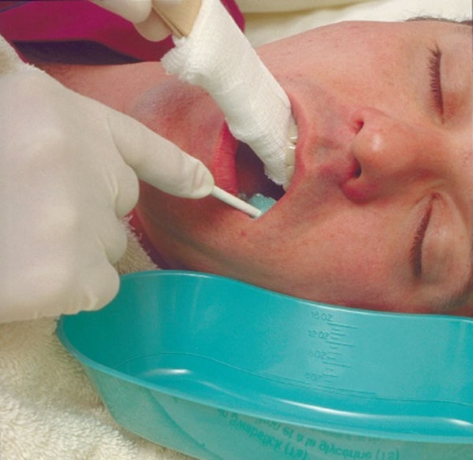
LO6, content 10
Providing oral care for the unconscious resident
Dip sponge swab in cleaning solution. Squeeze excess solution to prevent aspiration. Wipe teeth, gums, tongue, and inside surfaces of mouth. Remove debris with the swab. Change the swab often. Repeat this until the mouth is clean.
Rinse with clean swab dipped in water. Squeeze swab first to remove excess water.

Slide 113
LO6, content 11
Providing oral care for the unconscious resident
Remove the towel and basin. Pat lips or face dry if needed. Apply lip moisturizer.
Empty, rinse, and dry basin. Place basin in designated dirty supply area or return to storage, depending on facility policy.
Place soiled linens in the proper container.
Remove and discard gloves. Wash your hands.
Return bed to lowest position. Remove privacy measures.
Place call light within resident’s reach.
Report any problems with teeth, mouth, tongue, and lips to nurse. This includes odor, cracking, sores, bleeding, and any discoloration.
Document procedure using facility guidelines.

Slide 114
LO6, content 12
Flossing teeth
Equipment: dental floss, glass of water, emesis basin, gloves, towel
Identify yourself by name. Identify the resident by name.
Wash your hands.
Explain procedure to resident. Speak clearly, slowly, and directly. Maintain face-to-face contact whenever possible.
Provide for resident’s privacy with curtain, screen, or door.

Slide 115
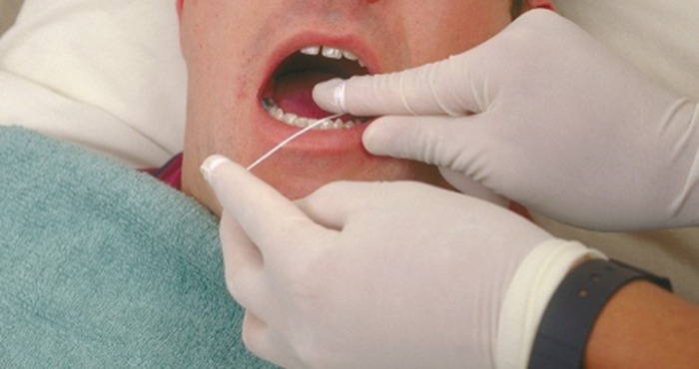
LO6, content 13
Flossing teeth
If resident is in bed, adjust bed to a safe level, usually waist high. Raise the head of the bed to have resident in an upright sitting position. Lock bed wheels.
Put on gloves.
Wrap the ends of floss securely around each index finger.

Slide 116
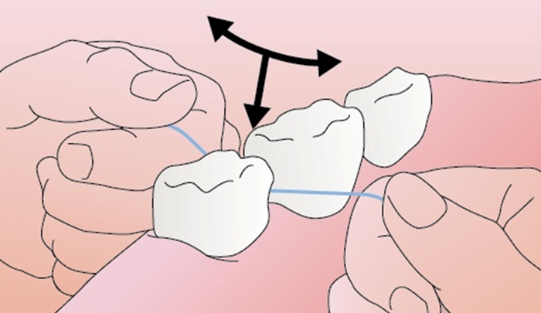
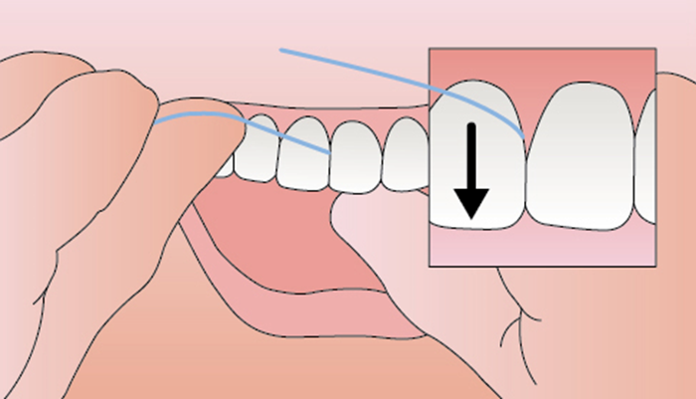
LO6, content 14
Flossing teeth
Start with the back teeth. Place floss between teeth. Move it down the surface of the tooth. Use a gentle sawing motion. Continue to the gum line. At the gum line, curve the floss. Slip it gently into the space between the gum and tooth. Then go back up, scraping that side of the tooth. Repeat this on the side of the other tooth.

Slide 117
LO6, content 15
Flossing teeth
After every two teeth, unwind floss from your fingers. Move it so you are using a clean area. Floss all teeth.
Occasionally offer water so that the resident can rinse debris from his mouth into the basin.
Offer resident a face towel when done flossing all teeth.
Discard floss. Discard water and rinse and dry the basin. Place basin in designated dirty supply area or return to storage, depending on facility policy.
Place soiled linen in the proper container.
Remove and discard gloves. Wash your hands.
Return bed to lowest position. Remove privacy measures.

Slide 118
LO6, content 16
Flossing teeth
Place call light within resident’s reach.
Allows resident to communicate with staff as necessary.
Report any problems with teeth, mouth, tongue, and lips to nurse. This includes odor, cracking, sores, bleeding, and any discoloration.
Document procedure using facility guidelines.

Slide 119
LO6, content 17
Identify guidelines for proper oral hygiene
NAs should remember the following guidelines about denture care:
  Dentures are expensive. Handle them carefully.
  Wear gloves when cleaning dentures.
  Report problems with dentures to the nurse.
  Do not use hot water to clean dentures because it may damage them.
  Place dentures in labeled cup or return them immediately to the resident.

Slide 120
LO6, content 18
Cleaning and storing dentures
Equipment: denture brush or toothbrush, denture cleanser or toothpaste, labeled denture cup, 2 towels, gloves
Wash your hands.
Put on gloves.
Line the sink or basin with a towel(s) and partially fill sink with water.
Handle dentures carefully. Hold them over the sink. Rinse dentures in clean, moderate/cool running water before brushing them. Do not use hot water.
Apply toothpaste or denture cleanser to brush.

Slide 121
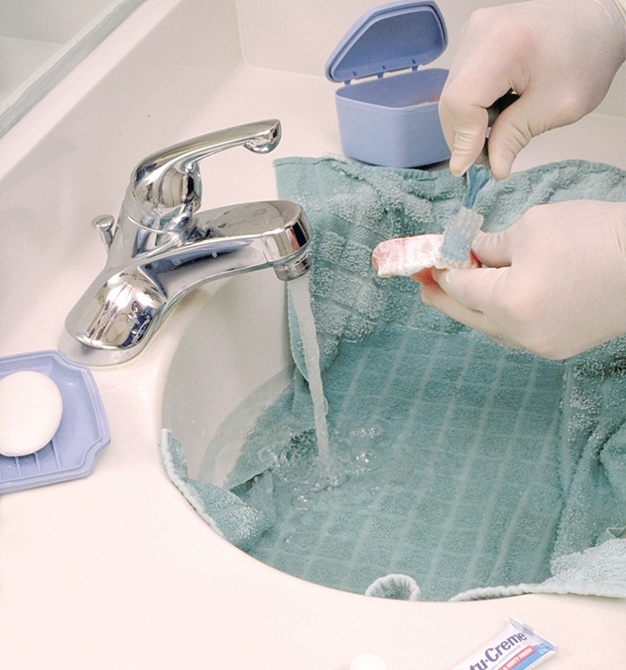
LO6, content 19
Cleaning and storing dentures
Brush dentures on all surfaces. This includes the inner, outer, and chewing surfaces of dentures, as well as the groove that will touch gum surfaces.
Rinse all surfaces of dentures under clean, moderate/cool water. Do not use hot water.
Rinse the denture cup before placing clean dentures in the cup.

Slide 122
LO6, content 20
Cleaning and storing dentures
Place dentures in clean, labeled denture cup with solution or moderate/cool water. Dentures should be completely covered with solution. Place the lid on the cup. Return the cup to where it is stored. Some residents will want to wear dentures all of the time. They will only remove them for cleaning. If the resident wants to continue wearing dentures, return them to him or her. Do not place them in the denture cup.
Rinse brush. Dry and return equipment to storage. Drain sink. Place soiled linens in the proper container.
Remove and discard gloves. Wash your hands.
Document procedure using facility guidelines. Report any change in appearance of dentures to the nurse.

Slide 123
LO7, key terms 1
Explain guidelines for assisting with toileting
Define the following terms:
fracture pan
  a bedpan that is flatter than a regular bedpan.
portable commode
  a chair with a toilet seat and a removable container underneath that is used for elimination; also called bedside commode.

Slide 124
LO7, content 1
Explain guidelines for assisting with toileting
REMEMBER:
A standard bedpan should be positioned with the wider end aligned with the resident’s buttocks. A fracture pan should be positioned with the handle toward the foot of the bed.

Slide 125
LO7, content 2
Explain guidelines for assisting with toileting
REMEMBER:
It is very important that NAs promote dignity and provide privacy while assisting residents with toileting.

Slide 126
LO7, content 3
Assisting resident with use of bedpan
Equipment: bedpan, bedpan cover, disposable bed protector, pad, bath blanket, toilet paper, disposable wipes, 2 towels, 2 pairs of gloves, supplies for perineal care
Identify yourself by name. Identify the resident by name.
Wash your hands.
Explain procedure to resident. Speak clearly, slowly, and directly. Maintain face-to-face contact whenever possible.
Provide for resident’s privacy with curtain, screen, or door.
Adjust bed to a safe level, usually waist high. Before placing bedpan, lower the head of the bed. Lock bed wheels.

Slide 127
LO7, content 4
Assisting resident with use of bedpan
Put on gloves.
Cover the resident with the bath blanket. Ask him to hold it while you pull down the top covers underneath. Do not expose more of the resident than you need to. Keep the resident covered from the chest down except when placing or removing the bedpan. Keeping him covered, ask the resident to remove his undergarments, or help him do so.
Ask the resident to raise his hips by pushing with his feet and hands at the count of three. If he needs help, place your arm under the small of his back and tell him to push with his heels and hands on your signal as you raise his hips.

Slide 128
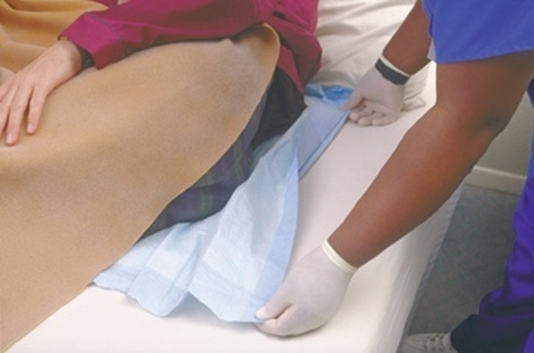
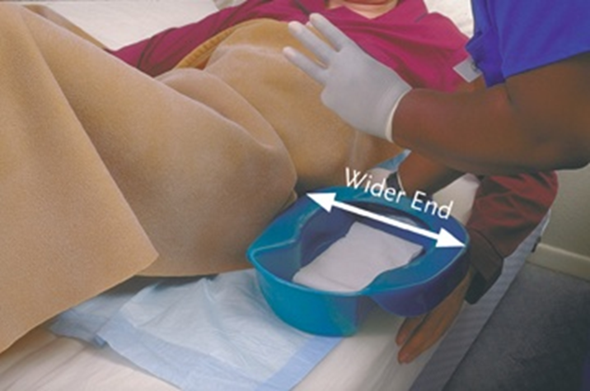
LO7, content 5
Assisting resident with use of bedpan
(cont’d) Place the bed protector under the resident’s buttocks and hips. Slide the bedpan in the correct position under his hips. A standard bedpan should be positioned with the wider end aligned with the resident's buttocks. A fracture pan should be positioned with the handle toward the foot of the bed.

Slide 129
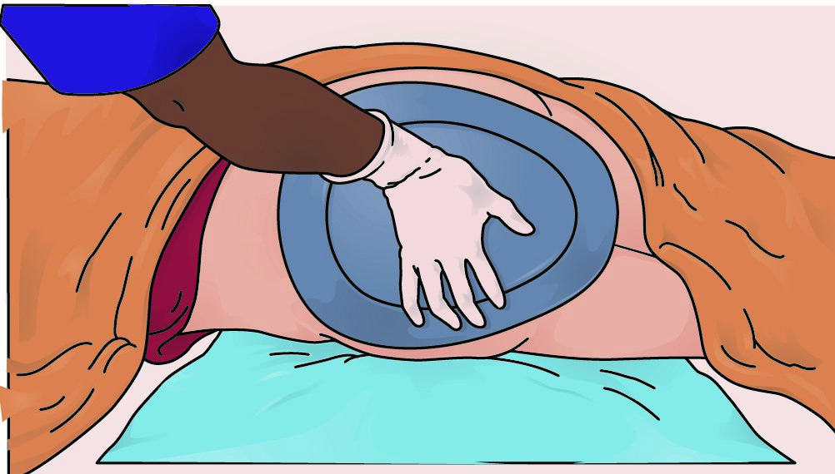
LO7, content 6
Assisting resident with use of bedpan
8. (cont'd) If the resident cannot assist in getting on the bedpan, raise the far side rail (if used). Help the resident to turn toward the raised rail. Place the protective pad on the area where the resident will lie on his back. Place the bedpan firmly against the resident's buttocks. Holding the bedpan securely, gently roll the resident back onto the bedpan. Keep the bedpan centered underneath.

Slide 130
LO7, content 7
Assisting resident with use of bedpan
Remove and discard gloves. Wash your hands.
Raise the head of the bed. Prop the resident into a semi-sitting position using pillows. Leave side rails up (if used). Return bed to its lowest position.
Make sure the bath blanket is still covering the resident. Place toilet paper and disposable wipes within resident’s reach. Ask resident to clean his hands with a wipe when finished if he is able.
Place the call light within resident’s reach. Ask resident to signal when done. Leave the room and close the door.
When called by the resident, return and wash your hands. Put on clean gloves.

Slide 131
LO7, content 8
Assisting resident with use of bedpan
Raise the bed to a safe level. Lower the head of the bed. Make sure resident is still covered.
Remove the bedpan carefully and cover it with a bedpan cover or towel.
Give perineal care if help is needed. Wipe from residents from front to back. Dry the perineal area. Help the resident put on an undergarment. Cover the resident and remove the bath blanket.
Remove and discard the bed protector. Discard disposable supplies. Place the towel and bath blanket in a hamper or bag.
Return the bed to lowest position. Leave side rails in ordered position. Remove privacy measures

Slide 132
LO7, content 9
Assisting resident with use of bedpan
Take bedpan to the bathroom. Note color, odor, and consistency of contents. Empty contents carefully into the toilet unless a specimen is needed or urine is being measured for intake/output monitoring. If you notice anything unusual about the stool or urine (for example, the presence of blood), do not discard it. Inform the nurse.
Turn the faucet on with a paper towel. Rinse the bedpan with cold water and empty it into the toilet. Flush the toilet. Place bedpan in proper area for cleaning or clean it according to policy.
Remove and discard gloves. Wash your hands.
Place call light within resident’s reach.
Report any changes in resident to the nurse.
Document procedure using facility guidelines hands.

Slide 133
LO7, content 10
Assisting a male resident with a urinal
Equipment: urinal, disposable bed protector, disposable wipes, 2 pairs of gloves
Identify yourself by name. Identify the resident by name.
Wash your hands.
Explain procedure to resident. Speak clearly, slowly, and directly. Maintain face-to-face contact whenever possible.
Provide for resident’s privacy with curtain, screen, or door.
Adjust bed to a safe level, usually waist high. Lock bed wheels.
Put on gloves.
Place a protective pad under the resident’s buttocks and hips, as in earlier procedure.

Slide 134
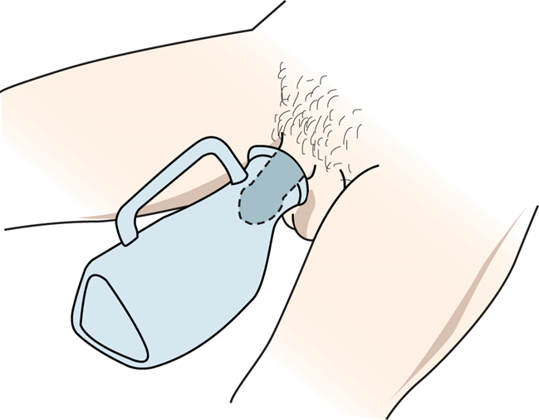
LO7, content 11
Assisting a male resident with a urinal
Hand the urinal to the resident. If the resident is not able to help himself, place urinal between his legs and position the penis inside the urinal. Replace covers.
Remove and discard gloves. Wash your hands.

Slide 135
LO7, content 12
Assisting a male resident with a urinal
Raise the head of the bed. Return bed to its lowest position. Place disposable wipes within resident’s reach. Ask the resident to clean his hands with a hand wipe when finished if he is able.
Place the call light within resident’s reach. Ask resident to signal when done. Leave the room and close the door.
When called by the resident, return and wash your hands. Put on clean gloves.
Discard disposable wipes.
Remove urinal or have resident hand it to you. Note color, odor, and qualities (for example, cloudiness) of contents. Empty contents into toilet unless specimen is needed or urine is being measured for intake/output monitoring.

Slide 136
LO7, content 13
Assisting a male resident with a urinal
Turn the faucet on with a paper towel. Rinse the urinal with cold water. Empty rinse water into the toilet. Flush the toilet. Place urinal in proper area for cleaning or clean it according to facility policy.
Remove and discard the bed protector. Remove and discard gloves. Wash your hands.
Leave bed in lowest position. Remove privacy measures.
Place call light within resident’s reach.
Report any changes in the resident to the nurse.
Document procedure using facility guidelines.

Slide 137
LO7, content 14
Assisting a resident to use a portable commode or toilet
Equipment: portable commode with basin, toilet paper, disposable wipes, towel, 3 pairs of gloves, supplies for perineal care
Identify yourself by name. Identify the resident by name.
Wash your hands.
Explain procedure to resident. Speak clearly, slowly, and directly. Maintain face-to-face contact whenever possible.
Provide for resident’s privacy with curtain, screen, or door.
Lock bed wheels. Adjust the bed to lowest position. Lock the be wheels. Make sure resident is wearing nonskid shoes and that the laces are tied. Help resident out of bed and to the portable commode or bathroom.

Slide 138
LO7, content 15
Assisting a resident to use a portable commode or toilet
Put on gloves.
If needed, help resident remove clothing and sit comfortably on toilet seat. Put toilet paper and disposable wipes within reach. Ask resident to clean his hands with a wipe when finished if he is able.
Remove and discard gloves. Wash your hands.
Provide privacy. Place the call light within resident’s reach. Ask resident to signal when done. Leave the room and close the door.
When called by the resident, return and put on clean gloves. Give perineal care if help is needed. Wipe from front to back. Dry the perineal area. Help the resident put on clothing.
Place the towel in a hamper or bag. Discard disposable supplies.
Remove and discard gloves. Wash your hands.
Help the resident back to bed.

Slide 139
LO7, content 16
Assisting a resident to use a portable commode or toilet
Put on clean gloves.
If using a portable commode, remove the waste container. Empty contents into the toilet unless a specimen is needed or the urine is being measured for intake/output monitoring.
Turn the faucet on with a paper towel. Rinse the container with cold water and empty it into the toilet. Flush the toilet. Place container in proper area for cleaning or clean it according to facility policy.
Remove and discard gloves. Wash your hands.
Make sure bed is in lowest position. Remove privacy measures.
Place call light within resident’s reach.
Report any changes in resident to the nurse.
Document procedure using facility guidelines.

Slide 140
LO7, content 17
Handout 6-1: Giving a Cleansing Enema
Giving a cleansing enema
Equipment: bath blanket, IV pole, enema solution, tubing and clamp, disposable bed protector, bedpan, bedpan cover, lubricating jelly, bath thermometer, tape measure, toilet paper, disposable wipes, robe, non-skid footwear, towel, supplies for perineal care, paper towel, 2 pairs of gloves
Identify yourself by name. Identify the resident by name.
Wash your hands.
Explain procedure to the resident. Speak clearly, slowly, and directly. Maintain face-to-face contact whenever possible.

Slide 141
LO7, content 18
Handout 6-1: Giving a Cleansing Enema (cont’d)
Provide for resident’s privacy with curtain, screen, or door.
Adjust bed to a safe level, usually waist high. Lock bed wheels.
Put on gloves
Place the bed protector under the resident. Ask the resident to remove his undergarments or help him do so.
Help the resident into left side-lying Sims’ position. Place the bedpan close to the resident's body. Cover with a bath blanket.
Place the IV pole beside the bed.
Clamp the enema tube. Prepare the enema solution. Fill bag with 500-1000 mL of warm water (105°F), and mix the solution. Check water temperature with bath thermometer.
Unclamp the tube. Let a small amount of solution run through the tubing to release the air. Re-clamp the tube.

Slide 142
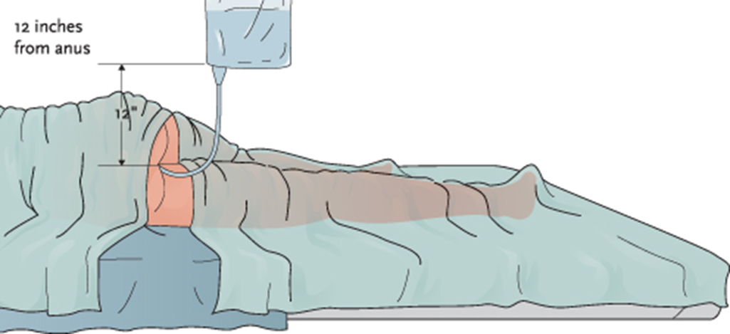
LO7, content 19
Handout 6-1: Giving a Cleansing Enema (cont’d)
Hang the bag on the IV pole. Using the tape measure, make sure the bottom of the enema bag is not more than 12 inches above the resident’s anus.

Slide 143
LO7, content 20
Handout 6-1: Giving a Cleansing Enema (cont’d)
Uncover the resident enough to expose the anus only.
Lubricate tip of tubing with lubricating jelly.
Ask the resident to breathe to relieve cramps during procedure.
Place one hand on the upper buttock. Lift to expose the anus. Ask the resident to take a deep breath and exhale. Using other hand, gently insert the tip of the tubing two to four inches into the rectum. Stop immediately if you feel resistance or if the resident complains of pain. If this happens, clamp the tubing. Tell the nurse.

Slide 144
LO7, content 21
Handout 6-1: Giving a Cleansing Enema (cont’d)
Unclamp the tubing. Allow the solution to flow slowly into the rectum. Ask resident to take slow, deep breaths. If resident complains of cramping, clamp the tubing and stop for a couple of minutes. Encourage him to take as much of the solution as possible.
Clamp the tubing before the bag is empty when the solution is almost gone. Gently remove the tip from the rectum. Place the tip into the enema bag. Do not contaminate yourself, the resident, or the bed linens.
Ask the resident to hold the solution inside as long as possible.
Help the resident to use bedpan, commode, or get to the bathroom. If the resident uses a commode or toilet, put on robe and nonskid footwear. Lower the bed to its lowest position before the resident gets up.
Remove and discard gloves. Wash your hands.

Slide 145
LO7, content 22
Handout 6-1: Giving a Cleansing Enema (cont’d)
Place toilet paper and wipes within resident’s reach. Ask the resident to clean his hands with the hand wipe when finished if he is able. If the resident is using the toilet, ask him not to flush it when finished.
Place the call light within resident’s reach. Ask resident to signal when done. Leave the room and close the door.
When called by the resident, return and wash your hands. Put on clean gloves.
Lower the head of the bed, if raised. Make sure resident is still covered.
Remove bedpan carefully and cover it with the bedpan cover.
Give perineal care if help is needed. Wipe from front to back. Dry the perineal area with a towel. Help the resident put on his undergarments. Cover the resident and remove the bath blanket.

Slide 146
LO7, content 23
Handout 6-1: Giving a Cleansing Enema (cont’d)
Remove the bed protector. Place the towel and bath blanket in a hamper or bag, and discard the disposable supplies.
Take bedpan to the bathroom. Call the nurse to observe enema results. Empty the contents of bedpan carefully into the toilet.
Turn the faucet on with a paper towel. Rinse the bedpan with cold water first and empty it into the toilet. Flush the toilet. Place bedpan in proper area for cleaning or clean it according to facility policy.
Remove and discard gloves.
Wash your hands.
Make resident comfortable.

Slide 147
LO7, content 24
Handout 6-1: Giving a Cleansing Enema (cont’d)
Return bed to lowest position. Remove privacy measures.
Place call light within resident’s reach.
Report any changes in resident to the nurse.
Document procedure using facility guidelines.

Slide 148
LO7, content 25
Handout 6-2: Giving a Rectal Suppository
Equipment: gloves, suppository, lubricant, bath blanket, toilet paper or disposable wipes
Identify yourself by name. Identify the resident by name.
Wash your hands.
Explain procedure to the resident. Speak clearly, slowly, and directly. Maintain face-to-face contact whenever possible.
Provide for resident’s privacy with curtain, screen, or door.

Slide 149
LO7, content 26
Handout 6-2: Giving a Rectal Suppository (cont’d)
Adjust bed to a safe level, usually waist high. Lock bed wheels.
Help resident into left-sided Sims’ position. Cover with a bath blanket.
Uncover resident enough to expose buttocks only.
Unwrap the suppository.
Put on gloves.
Lubricate suppository as needed.
Spread buttocks to expose anal area.
Insert the suppository, using your index finger. Place the suppository past the rectal sphincter, against the wall of the colon.

Slide 150
LO7, content 27
Handout 6-2: Giving a Rectal Suppository (cont’d)
Ask the resident to take deep breaths, as it will help him relax and retain the suppository.
Withdraw the finger and briefly hold toilet paper or a wipe against the anus.
Remove and discard gloves.
Wash your hands.
Remove bath blanket and cover the resident. Ask the resident to retain the suppository as long as possible. Make resident comfortable.
Provide a bedpan or assistance to the bathroom when needed.
Return bed to lowest position. Remove privacy measures.

Slide 151
LO7, content 28
Handout 6-2: Giving a Rectal Suppository (cont’d)
Place call light within resident’s reach.
Report any changes in resident to the nurse.
Document procedure using facility guidelines.

Slide 152
LO8, key terms 1
Explain the guidelines for safely positioning and moving residents
Define the following terms:
positioning
  the act of helping people into positions that promote comfort and health
supine
  a body position in which a person lies flat on his back.
lateral
  body position in which a person is lying on either side
prone
  a body position in which a person is lying on his stomach or front side of the body.

Slide 153
LO8, key terms 2
Explain the guidelines for safely positioning and moving residents
Fowler’s
  a semi-sitting body position in which a person’s head and shoulders are elevated 45 to 60 degrees.
Sims’
  a body position in which a person is lying on his left side with the upper knee flexed and raised toward the chest.
logrolling
  moving a person as a unit, without disturbing the alignment of the body.
dangle
  to sit up with the legs hanging over the side of the bed in order to regain balance and stabilize blood pressure.

Slide 154
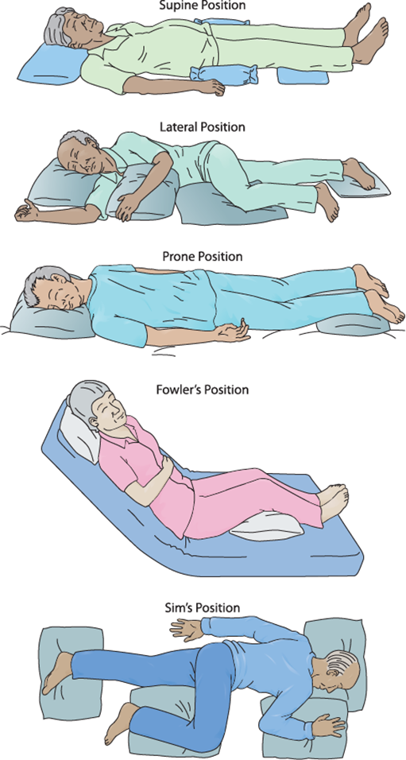
LO8, content 1
Transparency 6-6: Five Basic Positions

Slide 155
LO8, content 2
Moving a resident up in bed
Equipment: draw sheet or other device, coworker
Identify yourself by name. Identify the resident by name.
Wash your hands.
Explain procedure to resident. Speak clearly, slowly, and directly. Maintain face-to-face contact whenever possible.
Provide for resident’s privacy with curtain, screen, or door.
Adjust bed to a safe level, usually waist high. Lock bed wheels.
Lower the head of bed to make it flat. Move pillow to the head of the bed.
Stand on one side of the bed with your feet shoulder-width apart. Face the head of the bed. The foot that is closer to the head of the bed should be pointed toward the head of the bed. Your coworker should be standing on the other side of the bed.

Slide 156
LO8, content 3
Moving a resident up in bed
Both of you should roll the draw sheet up to the resident's side and grasp the sheet. One hand should be at the resident's shoulders, the other about level with the resident's hips. Use proper body mechanics.
Let resident know you will be moving her on the count of three. On three, both of you shift your body weight to your front leg. Help move the resident.
Place the pillow under the resident’s head
Return the bed to lowest position. Remove privacy measures
Place call light within resident’s reach.
Wash your hands.
Report any changes in resident to the nurse.
Document procedure using facility guidelines.

Slide 157
LO8, content 4
Moving a resident to the side of the bed
Equipment: draw sheet or other device
Identify yourself by name. Identify the resident by name.
Wash your hands.
Explain procedure to resident. Speak clearly, slowly, and directly. Maintain face-to-face contact whenever possible.
Provide for resident’s privacy with curtain, screen, or door.
Adjust the bed to a safe level, usually waist high. Lock bed wheels.

Slide 158
LO8, content 5
Moving a resident to the side of the bed
Lower the head of bed.
Stand on the side of the bed to which you are moving the resident. Stand with feet apart and bend your knees.
With a draw sheet: Roll the draw sheet up to the resident’s side and grasp the sheet. One hand should be at the resident’s shoulders, the other about level with the resident’s hips. Apply one knee against the side of the bed, and lean back with your body. On the count of three, slowly pull the draw sheet and resident toward you.

Slide 159
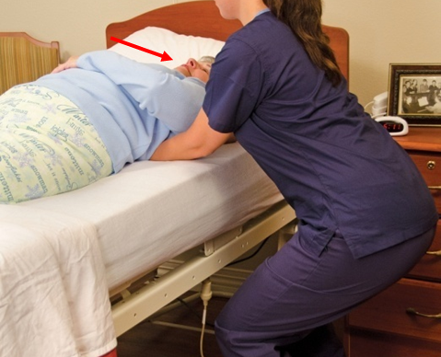
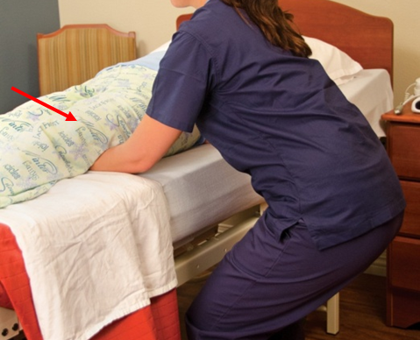
LO8, content 6
Moving a resident to the side of the bed
Without a draw sheet: Gently slide your hands under the resident’s head and shoulders and move them toward you. Gently slide your hands under her midsection and move it toward you. Gently slide your hands under the hips and legs and move them toward you.

Slide 160
LO8, content 7
Moving a resident to the side of the bed
Return bed to lowest position. Remove privacy measures.
Place call light within resident’s reach.
Wash your hands.
Report any changes in resident to the nurse.
Document procedure using facility guidelines.

Slide 161
LO8, content 8
Positioning a resident on his side
Identify yourself by name. Identify the resident by name.
Wash your hands.
Explain procedure to resident. Speak clearly, slowly, and directly. Maintain face-to-face contact whenever possible.
Provide for resident’s privacy with curtain, screen, or door.
Adjust bed to a safe level, usually waist high. Lock bed wheels.
Lower the head of bed to make it flat.
Move resident to side of bed nearest you using previous procedure.
Raise the far side rail (if used).

Slide 162
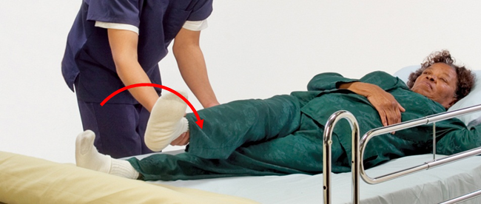
LO8, content 9
Positioning a resident on his side
Turning resident away from you:
Cross resident’s arm over his chest. Cross the near leg over the far leg

Slide 163
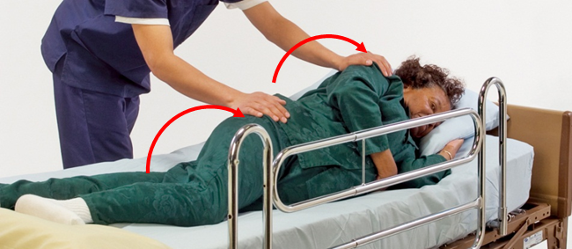
LO8, content 10
Positioning a resident on his side
Stand with feet shoulder-width apart. Bend your knees.
Place one hand on the resident’s shoulder. Place the other hand on the resident’s nearest hip.
While supporting the body, gently roll resident onto his side as one unit, toward raised side rail.

Slide 164
LO8, content 11
Positioning a resident on his side
Turning resident toward you:
Cross resident’s far arm over his chest. Move the arm on the side the resident is being turned to out of the way. Cross the far leg over the near leg.
Stand with feet shoulder-width apart. Bend your knees.
Place one hand on the resident’s far shoulder. Place the other hand on the far hip.

Slide 165
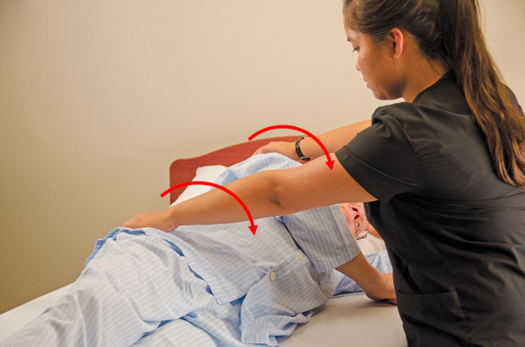
LO8, content 12
Positioning a resident on his side
While supporting the body, gently roll the resident onto side as one unit, toward you. Use your body to block the resident to prevent him from rolling out of bed.

Slide 166
LO8, content 13
Positioning a resident on his side
Position the resident properly:
  Head supported by pillow (resident’s face should not be obstructed by pillow)
  Shoulder adjusted so resident is not lying on his arm or hand
  Top arm supported by pillow
  Back supported by supportive device
  Top knee flexed
  Supportive device between legs with top knee flexed; knee and ankle supported
  Pillow under bottom foot so that toes and ankle are not touching the bed.

Slide 167
LO8, content 14
Positioning a resident on his side
Return bed to lowest position. Leave side rails in ordered position. Remove privacy measures.
Place call light within resident’s reach.
Wash your hands.
Report any changes in resident to the nurse.
Document procedure using facility guidelines.

Slide 168
LO8, content 15
Logrolling a resident
Equipment: draw sheet, coworker
Identify yourself by name. Identify the resident by name.
Wash your hands.
Explain procedure to resident. Speak clearly, slowly, and directly. Maintain face-to-face contact whenever possible.
Provide for resident’s privacy with curtain, screen, or door.
Adjust bed to a safe level, usually waist high. Lock bed wheels.

Slide 169
LO8, content 16
Logrolling a resident
Lower the head of bed to make it flat.
Both of you stand on the same side of the bed. One person stands at the resident’s head and shoulders. The other stands near the resident’s midsection.
Place a pillow under the resident's head to support the neck during the move.
Place the resident’s arms across his chest. Place a pillow between the knees.
Stand with feet shoulder-width apart. Bend your knees.

Slide 170
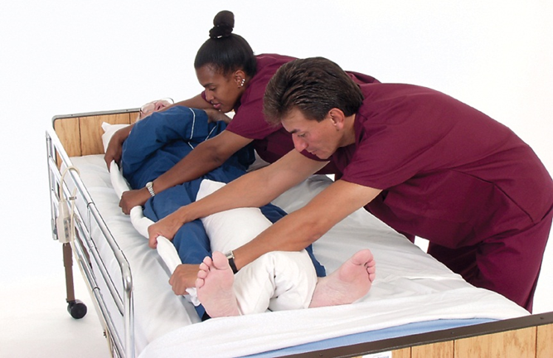
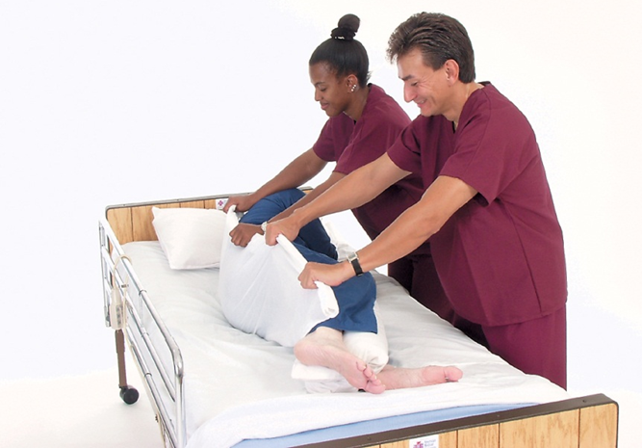
LO8, content 17
Logrolling a resident
Grasp the draw sheet on the far side.
12. On the count of three, gently roll the resident toward you. Turn the resident as a unit. Use your bodies to block the resident to prevent him from rolling out of bed.

Slide 171
LO8, content 18
Logrolling a resident
Reposition resident comfortably.
Return bed to lowest position.
Place call light within resident’s reach.
Wash your hands.
Report any changes in resident to the nurse.
Document procedure using facility guidelines.

Slide 172
LO8, content 19
Assisting a resident to sit up on side of bed: dangling
Identify yourself by name. Identify the resident by name.
Wash your hands.
Explain procedure to resident. Speak clearly, slowly, and directly. Maintain face-to-face contact whenever possible.
Provide for resident’s privacy with curtain, screen, or door.
Adjust bed height to lowest position. Lock bed wheels.

Slide 173
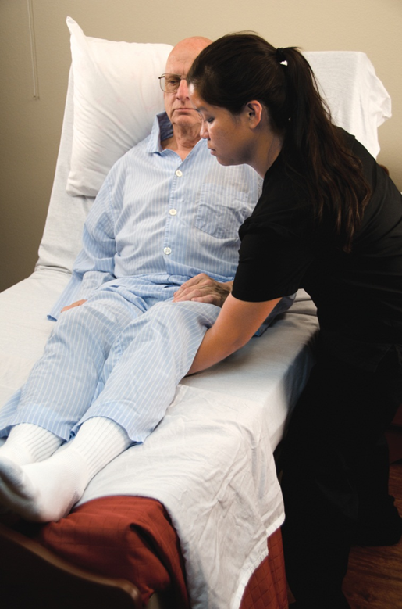
LO8, content 20
Assisting a resident to sit up on side of bed: dangling
Raise the head of bed to sitting position.
Stand with feet shoulder-width apart. Bend your knees.
Place one arm under the resident’s shoulder blades. Place the other arm under the resident’s thighs.

Slide 174
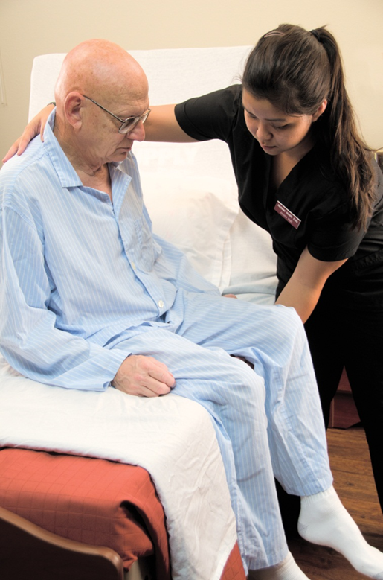
LO8, content 21
Assisting a resident to sit up on side of bed: dangling
On the count of three, slowly turn resident into sitting position with legs dangling over side of bed.
Ask resident to hold onto edge of mattress with both hands. Help the resident to put on nonskid shoes.

Slide 175
LO8, content 22
Assisting a resident to sit up on side of bed: dangling
Have resident dangle as long as ordered. The care plan may direct you to allow the resident to dangle for several minutes and then return him to lying down, or it may direct you to allow the resident to dangle in preparation for walking or a transfer. Follow the care plan. Do not leave the resident alone. If the resident is dizzy for more than a minute, have him lie down again and report to the nurse. Count his pulse and respiration rates and report to the nurse (you will learn how to measure vital signs in chapter 7).
Remove shoes.
Gently assist resident back into bed. Place one arm around resident’s shoulders. Place the other arm under resident’s knees. Slowly swing resident’s legs onto bed.

Slide 176
LO8, content 23
Assisting a resident to sit up on side of bed: dangling
Leave bed in lowest position. Remove privacy measures.
Place call light within resident’s reach.
Wash your hands.
Report any changes in resident to the nurse.
Document procedure using facility guidelines.

Slide 177
LO8, key terms 3
Explain the guidelines for safely positioning and moving residents
Define the following terms:
ergonomics
  the science of designing equipment, areas, and work tasks to make them safer and to suit the worker’s abilities.
transfer/gait belt
  a belt made of canvas or other heavy material that is used to help people who are weak, unsteady, or uncoordinated to transfer or walk.

Slide 178
LO8, content 24
Explain the guidelines for safely positioning and moving residents
REMEMBER:
Many facilities have adopted no-lift, zero-lift, or lift-free policies. NAs must know their facility's policies and follow them carefully.

Slide 179
LO8, content 25
Explain the guidelines for safely positioning and moving residents
REMEMBER:
When assisting a resident the NA must know which side is stronger and which is weaker and move the affected side first.

Slide 180
LO8, content 26
Explain the guidelines for safely positioning and moving residents
REMEMBER:
Transfer belts must be applied over clothing and not on bare skin. NAs should make sure skin is not caught in the belt.

Slide 181
LO8, content 27
Explain the guidelines for safely positioning and moving residents
Remember these guidelines for working with wheelchairs:
  Know how to use brake, armrests, and footrests.
  Lock before transfer; unlock after.
  Open by pulling on both sides. Close by lifting center of seat.
  Remove armrests by releasing the lock.
  Remove footrests by pulling back on lever and swinging out toward side of the chair.
  Lift or lower footrest by squeezing the lever and pulling up or pushing down.

Slide 182
LO8, content 28
Explain the guidelines for safely positioning and moving residents
Guidelines for working with wheelchairs (cont’d):
  Resident must use side of body that can bear weight and lift the side that cannot.
  Resident must be wearing nonskid footwear before transferring.
  Keep resident safe and comfortable during transfers. Ask the resident what help is needed.
  Assist resident as needed by having chair close and wheels locked. Use transfer belt and check alignment in chair. If the resident is dizzy upon standing, help him sit back down and report to the nurse
  Reposition resident at least every hour.

Slide 183
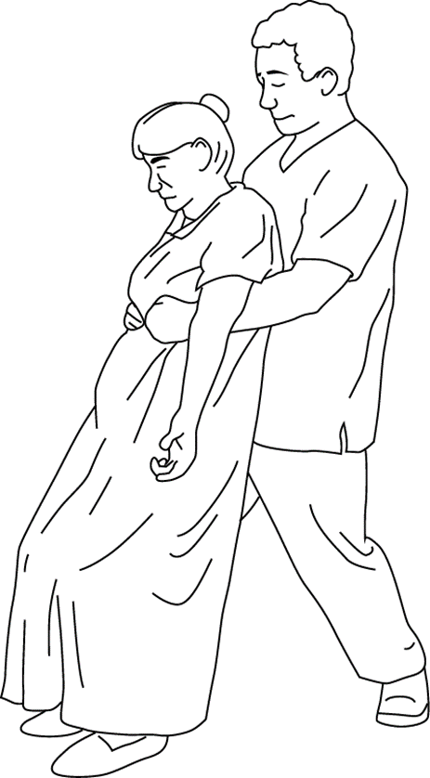
LO8, content 29
Transparency 6-7: Assisting a falling resident
Widen his stance.
Bring the resident’s body close to him.
Bend knees and support the resident.
Lower resident to floor.
Do not try to stop the fall.
Call for help.
Do not attempt to get resident up.

Slide 184
LO8, content 30
Transferring a resident from bed to wheelchair
Equipment: wheelchair, transfer belt, nonskid footwear, robe or folded blanket
Identify yourself by name. Identify the resident by name.
Wash your hands.
Explain procedure to resident. Speak clearly, slowly, and directly. Maintain face-to-face contact whenever possible.
Provide for resident’s privacy with curtain, screen, or door. Check the area to be certain it is uncluttered and safe.
Place wheelchair at the head of the bed, facing the foot of the bed, or at the foot of the bed, facing the head of bed. The arm of the wheelchair should be almost touching the bed. It should be placed on the resident’s stronger, or unaffected, side.

Slide 185
LO8, content 31
Transferring a resident from bed to wheelchair
Remove both wheelchair footrests close to the bed.
Lock wheelchair wheels.
Raise the head of the bed. Adjust bed level to lowest position. Lock bed wheels.
Assist resident into a sitting position. Make sure his feet are flat on the floor. Adjust the bed height if needed. Let the resident sit for a few minutes to adjust to the change in position.
Put nonskid footwear on the resident and fasten securely.

Slide 186
LO8, content 32
Transferring a resident from bed to wheelchair
Stand in front of and face the resident. Place your feet about shoulder-width apart.
Place the transfer belt around resident’s waist over his clothing (not on bare skin). Tighten the buckle until it is snug. Leave enough room to insert flat fingers/hand comfortably under the belt. Check to make sure that skin or skin folds (for example, breasts) are not caught under the belt. Grasp the belt securely on both sides, with hands in upward position.
Provide instructions to allow resident to help with the transfer. Instructions may include: “When you start to stand, push with your hands against the bed.” “Once standing, if you’re able, you can take small steps in the direction of the chair.” “Once standing, reach for the chair with your stronger hand.”

Slide 187

LO8, content 33
Transferring a resident from bed to wheelchair
With your legs, brace (support) resident’s lower legs to prevent slipping. This can be done by placing one or both of your knees in front of the resident’s knees. Or you can stand toe to toe with the resident. Bend your knees. Keep your back straight.
Count to three to alert resident. If possible, have the resident rock while counting to three. With hands still grasping

Slide 188
LO8, content 34
Transferring a resident from bed to wheelchair
(cont'd) the transfer belt on both sides and moving upward, slowly help resident to stand.
Tell the resident to take small steps in the direction of the chair while turning his back toward it. If more help is needed, help the resident pivot (turn) to stand in front of wheelchair with

Slide 189
LO8, content 35
Transferring a resident from bed to wheelchair
(cont’d) back of resident’s legs against wheelchair.
Ask the resident to put hands on wheelchair armrests if he is able. When the chair is touching the back of the resident’s legs, help him lower himself into the chair.
Reposition resident so that his hips touch the back of the wheelchair seat.
Attach footrests. Place the resident’s feet on the footrests. Check that the resident is in proper alignment. Gently remove the transfer belt. Place a folded blanket over the resident’s lap as appropriate.
Remove privacy measures.
Place call light within resident’s reach.
Wash your hands.
Report any changes in resident to the nurse.
Document procedure using facility guidelines.

Slide 190
LO8, content 36
Explain the guidelines for safely positioning and moving residents
NAs should know these guidelines for the safe use of mechanical lifts:
  It is safer for two people to transfer with these lifts and two people may be required.
  Keep chair or wheelchair near bed to only move the resident a short distance.
  Make sure the valves are working.
  Use the correct sling for the correct lift.

Slide 191
LO8, content 37
Explain the guidelines for safely positioning and moving residents
Guidelines for the safe use of mechanical lifts (cont’d):
  Check sling and straps for tears or fraying. Do not use mechanical lift if there are tears or holes.
  Open legs of the stand to its widest position before helping the resident into the lift.
  Pump up lift only to the point where the resident’s body clears the bed or chair.
  Be aware of where the release is located and how to operate it.

Slide 192
LO8, content 38
Transferring a resident using a mechanical lift
Equipment: wheelchair or chair, coworker, mechanical or hydraulic lift
This is a basic procedure for transferring using a mechanical lift. Ask someone to help you before starting.
Identify yourself by name. Identify the resident by name.
Wash your hands.
Explain procedure to resident. Speak clearly, slowly, and directly. Maintain face-to-face contact whenever possible.
Provide for resident’s privacy with curtain, screen, or door.

Slide 193
LO8, content 39
Transferring a resident using a mechanical lift
Lock bed wheels.
Position wheelchair next to bed. Lock brakes.
Help the resident turn toward you as described in previous procedure. Go to the far side of the bed. Position the sling under the resident, with the edge next to the resident’s back. Fanfold if necessary. Make the bottom of the sling even with the resident’s knees. Help the resident roll back to the middle of the bed. Spread out the fanfolded edge of the sling.
Roll the mechanical lift to bedside. Make sure the base is opened to its widest point. Push the base of the lift under the bed.
Place the overhead bar directly over the resident.

Slide 194
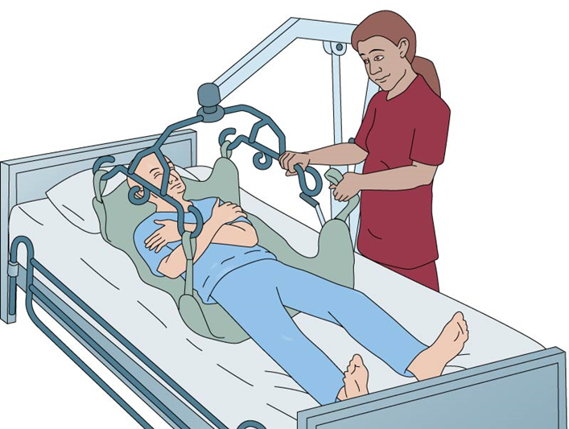
LO8, content 40
Transferring a resident using a mechanical lift
With the resident lying on his back, attach one set of straps to each side of the sling. Attach one set of straps to the overhead bar. Have coworker support the resident at the head, shoulders, and knees while being lifted. The resident’s arms should be folded across his chest. If the device has S hooks, they should face away from resident. Make sure all straps are connected properly and are smooth and straight.

Slide 195
LO8, content 41
Transferring a resident using a mechanical lift
Following manufacturer’s instructions, raise the resident two inches above the bed. Pause a moment for the resident to gain balance.
Have coworker help support and guide the resident’s body. You can then roll the lift so that the resident is positioned over the chair or wheelchair.
Slowly lower the resident into the chair or wheelchair. Push down gently on the resident’s knees to help the resident into a sitting, rather than reclining, position.
Undo the straps from the overhead bar to the sling. Remove sling or leave in place; follow facility policy.
Be sure the resident is seated comfortably and correctly in the chair or wheelchair. Remove privacy measures.

Slide 196
LO8, content 42
Transferring a resident using a mechanical lift
Place call light within resident’s reach.
Wash your hands.
Report any changes in resident to the nurse.
Document procedure using facility guidelines.

Slide 197
LO8, content 43
Handout 6-3: Transferring a Resident from Bed to Wheelchair
Transferring a resident to bed from wheelchair
Identify yourself by name. Identify the resident by name.
Wash your hands.
Explain procedure to resident. Speak clearly, slowly, and directly. Maintain face-to-face contact whenever possible.
Provide for resident’s privacy with curtain, screen, or door. Check the area to be certain it is uncluttered and safe.
Place wheelchair at the head of the bed, facing foot of the bed, or at the foot of bed, facing head of bed. The arm of the wheelchair should be almost touching the bed. It should be placed on resident’s stronger, or unaffected, side.
Remove both wheelchair footrests close to the bed
Lock wheelchair wheels.

Slide 198
LO8, content 44
Handout 6-3: Transferring a Resident from Bed to Wheelchair (cont’d)
Adjust bed level. The height of the bed should be equal to or slightly lower than the chair. Lock bed wheels.
Place the transfer belt around resident’s waist over clothing (not on bare skin). Tighten the buckle until it is snug. Leave enough room to insert flat fingers/hand comfortably under the belt. Check to make sure that skin or skin folds (for example, breasts) are not caught under the belt. Grasp the belt securely on both sides, with hands in upward position.
Provide instructions to allow resident to help with transfer.
With your legs, brace (support) resident’s lower extremities. This can be done by placing one or both of your knees against the resident’s knees. Or you can stand toe to toe with the resident. Bend your knees. Keep your back straight.

Slide 199
LO8, content 45
Handout 6-3: Transferring a Resident from Bed to Wheelchair (cont’d)
Count to three to alert resident. On three, with hands still grasping the transfer belt on both sides and moving upward, slowly help resident to stand.
Tell the resident to take small steps in the direction of the bed while turning her back toward the bed. Or, if more help is needed, help the resident pivot to stand in front of bed with back of her legs against bed. When she feels the bed, help her sit down on the side of the bed.
Make resident comfortable. Remove transfer belt.
Return bed to lowest position. Remove privacy measures.
Place call light within resident’s reach.
Wash your hands.
Report any changes in resident to the nurse.
Document procedure using facility guidelines.

