Slide 2
Chapter 7, LO1, content 1
Explain admission, transfer, and discharge of a resident
Residents moving into a long-term care facility may be experiencing any or all of the following:
  Fear
  Uncertainty
  Anger
  Loss of health, mobility, independence, family, friends, pets, plants

Slide 3
LO1, content 2
Explain admission, transfer, and discharge of a resident
REMEMBER:
Entering a long-term care facility can be especially difficult for lesbian, gay, bisexual, or transgender (LGBT) residents. LGBT residents may fear that they will not be accepted by staff or other residents. NAs must not judge LGBT residents, even if they believe that homosexuality is wrong. All residents should be made to feel comfortable and welcome in their new home.

Slide 4
LO1, content 3
Handout 7-1: Quiz: You are Moving!
Your house has been sold and you need to move in with your sister and her family for about six months or more. You need to work out some problems; perhaps you will even be staying with them permanently. You do not know for sure. You will share a room with your niece. Your space is six feet wide by 12 feet long.
There is a single bed, a chest of drawers, and a soft chair that you can use. There is also a screen available for your privacy. Decide what you will take with you. You can store anything you do not take, but you will not have access to any stored items until you move again.

Slide 5
LO1, content 4
Handout 7-1: Quiz: You are Moving! (cont’d)
Think of space. All six items must fit into your small room, or in your half of the closet, which is a five foot by three foot space. Name six things you will take with you. (Seven outfits of clothing count as one item.)
1. _________________________________________________
2. _________________________________________________
3. _________________________________________________
4. _________________________________________________
5. _________________________________________________
6. _________________________________________________

Slide 6
LO1, content 5
Handout 7-1: Quiz: You are Moving! (cont’d)
During the first week your niece, who is 5 years old, is looking at one of your treasured things while visiting, and accidentally drops and breaks it. How do you feel?
It is now the second week. You have still not received any of your mail, which you had notified the post office to forward. You mention this to your sister and she says offhandedly, “Oh, I did see some here yesterday. I don’t know where it is now.” Then she walks out of the room. What is your response?

Slide 7
LO1, content 6
Explain admission, transfer, and discharge of a resident
Think about these questions:
What did you decide to take with you to your sister's?
How did you feel as you tried to decide what to take?
Did anyone get angry? Sad? Frustrated?
How did you feel about your mail and your sister’s response to you?

Slide 8
LO1, content 7
Explain admission, transfer, and discharge of a resident
REMEMBER:
In many ways our homes are our personal museums. Residents’ personal property is important to them, and helps make the facility feel like home. It is very important that NAs respect residents’ right to have their belongings with them, as space permits, and to treat those belongings with respect.

Slide 9
LO1, content 8
Explain admission, transfer, and discharge of a resident
REMEMBER:
Residents’ Rights state that “the resident has the right to privacy in written communications, including the right to send and promptly receive mail that is unopened.”

Slide 10
LO1, content 9
Explain admission, transfer, and discharge of a resident
NAs should remember these guidelines for admission of a resident:
  Prepare the room before the resident arrives.
  When resident arrives, note the time and resident’s condition.
  Introduce yourself, giving your position. Address the resident by his formal name.
  Do not rush the admission process. Make sure the new resident feels welcome.
  Explain daily operations in the facility. Offer a tour. Introduce resident to everyone.

Slide 11
LO1, content 10
Explain admission, transfer, and discharge of a resident
Guidelines for admission of a resident (cont’d):
  Handle personal items with care and respect. Honor resident preferences when setting up the room.
  Observe the resident for anything that is missed during admission.
  Let residents adapt to their new homes at their own pace. However, signs of confusion or depression should be reported to the nurse.

Slide 12
LO1, content 11
Explain admission, transfer, and discharge of a resident
REMEMBER:
Residents need to receive a written copy of Residents’ Rights during the admission process, and must also be informed of their rights related to advance directives.

Slide 13
LO1, content 12
Admitting a resident
Equipment: may include admission paperwork (checklist and inventory form), gloves, and vital signs equipment
Identify yourself by name. Identify the resident by name.
Wash your hands.
Explain procedure to resident. Speak clearly, slowly, and directly. Maintain face-to-face contact whenever possible.

Slide 14

LO1, content 13
Admitting a resident
Provide for resident’s privacy with curtain, screen, or door. If the family is present, ask them to step outside until the admission process is over. Show them where they can wait. Let them know approximately how long the process will take.

Slide 15
LO1, content 14
Admitting a resident
If part of facility procedure, do these things:
  Measure the resident’s height and weight.
  Measure the resident’s baseline vital signs. Baseline signs are initial values that can then be compared to future measurements.
  Obtain a urine specimen if required.
  Complete the paperwork. Take an inventory of all the personal items.
  Help the resident put personal items away. Label personal items according to facility policy.
  Provide fresh water.
Show the resident the room and bathroom. Explain how to work the bed controls and the call light. Show the resident the telephone, lights, and television controls.

Slide 16
LO1, content 15
Admitting a resident
Introduce the resident to his roommate if there is one. Introduce other residents and staff.
Make sure resident is comfortable. Bring the family back inside if they were outside.
Place call light within resident’s reach.
Wash your hands.
Document procedure using facility guidelines.

Slide 17
LO1, content 16
Explain admission, transfer, and discharge of a resident
REMEMBER:
It is a resident’s legal right to be informed of transfers. The NA should explain the details of the transfer and pack the resident’s personal items carefully. Residents must also be informed of any room or roommate change, as well.

Slide 18
LO1, content 17
Transferring a resident
Equipment: may include a wheelchair, cart for belongings, the medical record, all of the resident’s personal care items and packed personal items
Identify yourself by name. Identify the resident by name.
Wash your hands.
Explain procedure to resident. Speak clearly, slowly, and directly. Maintain face-to-face contact whenever possible.
Collect items to be moved onto the cart. Take them to the new location. If the resident is going into the hospital, they may be placed in temporary storage.
Help the resident into the wheelchair (or onto a stretcher if one is used). Take him or her to proper area.

Slide 19
LO1, content 18
Transferring a resident
Introduce new residents and staff.
Help the resident to put personal items away.
Make sure that the resident is comfortable.
Place call light within resident’s reach.
Wash your hands.
Report any changes in resident to the nurse.
Document procedure using facility guidelines.

Slide 20
LO1, content 19
Explain admission, transfer, and discharge of a resident
REMEMBER:
It is important that the NA remain positive and encouraging when a resident is being discharged.

Slide 21
LO1, content 20
Explain admission, transfer, and discharge of a resident
The nurse may review the following information with a resident who is being discharged:
  Doctor or physical therapy appointments
  Home care or skilled nursing care, if it will be provided
  Medications
  Ambulation instructions
  Medical equipment needed
  Medical transportation
  Restrictions on activities
  Special exercises
  Special dietary requirements
  Community resources

Slide 22
LO1, content 21
Discharging a resident
Equipment: may include a wheelchair, cart for belongings, discharge paperwork, including the inventory list from admission, resident’s care items
Identify yourself by name. Identify the resident by name.
Wash your hands.
Explain procedure to resident. Speak clearly, slowly, and directly. Maintain face-to-face contact whenever possible.
Provide for resident’s privacy with curtain, screen, or door.
Measure the resident’s vital signs.

Slide 23
LO1, content 22
Discharging a resident
Compare the checklist to the items there. If all items are there, ask the resident to sign.
Put the personal items to be taken onto the cart and take them to pick-up area.
Help the resident dress and then into the wheelchair or onto the stretcher if used.
Help the resident to say his goodbyes to the staff and residents.
Take resident to the pick-up area. Help him into vehicle. You are responsible for the resident until he is safely in the vehicle and the door is closed.
Wash your hands.

Slide 24
LO1, content 23
Discharging a resident
Document procedure using facility guidelines. Include the following:
  The vital signs at discharge
  Time of discharge
  Method of transport
  Who was with the resident
  What items the resident took with her (inventory checklist)

Slide 25
LO2, key terms 1
Explain the importance of monitoring vital signs
Define the following term:
vital signs
  measurements—temperature, pulse, respirations, blood pressure, pain level— that monitor the functioning of the vital organs of the body.

Slide 26
LO2, content 2
Explain the importance of monitoring vital signs
NAs monitor, document, and report the following vital signs:
  Temperature
  Pulse
  Respiratory rate
  Blood pressure
  Pain level

Slide 27
LO2, content 3
Explain the importance of monitoring vital signs
Any of the following must be reported to the nurse:
  Resident has a fever.
  Respiratory or pulse rate is too rapid or too slow.
  Resident’s blood pressure changes.
  Pain is worsening or unrelieved.

Slide 28
LO2, content 4
Transparency 7-1: Ranges for Adult Vital Signs
Temp. Site Fahrenheit Celsius
Mouth (oral) 97.6°–99.6° 36.5°–37.5°
Rectum (rectal) 98.6°–100.6° 37.0°–38.1°
Armpit (axilla) 96.6°–98.6° 36.0°–37.0°
Ear (tympanic) 96.6°–99.7° 35.8°–37.6°
Temporal Artery 97.2°–100.1° 36.2°–37.8°
Normal Pulse Rate: 60–100 beats per minute
Normal Respiratory Rate: 12–20 respirations per minute
Blood Pressure
Normal Systolic Less than 120
Diastolic Less than 80
Low Less than 90/60
High Systolic of 130 or higher or diastolic of 80 or higher

Slide 29
LO2, content 5
Explain the importance of monitoring vital signs
REMEMBER:
It is important to protect residents’ privacy when taking vital signs. NAs must provide privacy while taking measurements, and must not discuss residents’ vital signs within earshot of others.

Slide 30
LO2, content 6
Explain the importance of monitoring vital signs
NAs should know these facts about body temperature:
  Age, illness, stress, environment, exercise, and the circadian rhythm all affect temperature.
  There are five sites for measuring:
  Mouth (oral temperature)
  Rectum (rectal temperature)
  Ear (tympanic temperature)
  Armpit (axillary temperature)
  Forehead (temporal artery temperature)
  Mercury-free thermometers are color-coded: green or blue for oral; red for rectal.

Slide 31
LO2, content 7
Explain the importance of monitoring vital signs
Facts about body temperature (cont’d):
  Digital thermometers are commonly used for oral, rectal, and axillary temperatures.
  Temporal artery thermometers measure heat over temporal artery with a gentle stroke or scan across the forehead.
  Tympanic thermometers are fast and accurate.
  Rectal temperatures are most accurate, but taking rectal temperature can be dangerous with some residents.
  Axillary temperatures are considered least accurate.
  Oral temperatures cannot be taken on someone who
    Is unconscious
    Has recently had facial or oral surgery

Slide 32
LO2, content 8
Explain the importance of monitoring vital signs
Facts about oral temperature (cont’d):
    Is younger than 5 years old
    Is confused or disoriented
    Is heavily sedated
    Is likely to have a seizure
    Is coughing
    Is using oxygen
    Has facial paralysis
    Has a nasogastric tube
    Has sores, redness, swelling, or pain in the mouth, or has an injury to the face or neck.

Slide 33
LO2, content 9
Measuring and recording oral temperature
Do not take an oral temperature on a resident who has smoked, eaten or drunk fluids, chewed gum, or exercised in the last 10 to 20 minutes.
Equipment: clean mercury-free, digital, or electronic thermometer, gloves, disposable sheath/cover for thermometer, tissues, pen and paper
Identify yourself by name. Identify the resident by name.
Wash your hands.
Explain procedure to resident. Speak clearly, slowly, and directly. Maintain face-to-face contact whenever possible.
Promotes understanding and independence.

Slide 34
LO2, content 10
Measuring and recording oral temperature
Provide for resident’s privacy with curtain, screen, or door.
Put on gloves.
Digital thermometer: Put on the disposable sheath. Turn on thermometer and wait until ready sign appears.
  Electronic thermometer: Remove the probe from base unit. Put on probe cover.
  Mercury-free thermometer: Hold the thermometer by the stem. Before inserting it in the resident’s mouth, shake thermometer down to below the lowest number (at least below 96°F or 35°C). (cont'd)

Slide 35
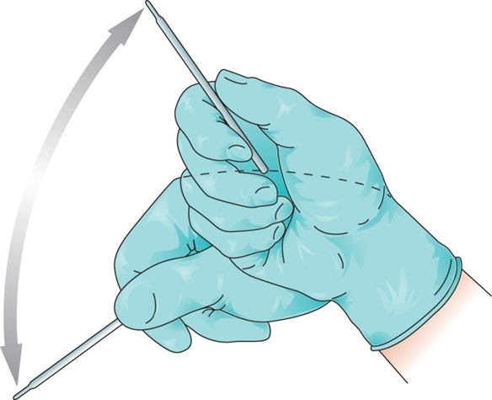
LO2, content 11
Measuring and recording oral temperature
To shake the thermometer down, hold it at the side opposite the bulb with the thumb and two fingers. With a snapping motion of the wrist, shake the thermometer. Stand away from furniture and walls while doing so.

Slide 36
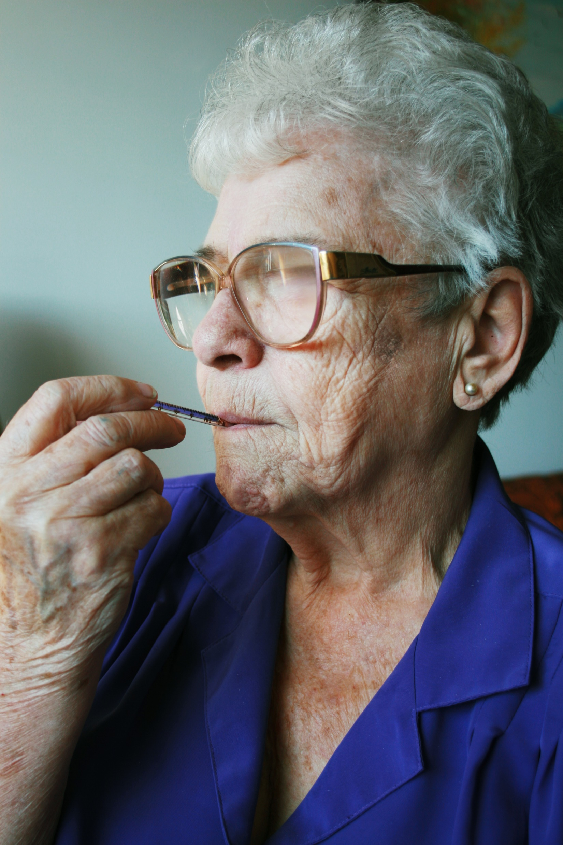
LO2, content 12
Measuring and recording oral temperature
Digital thermometer: Insert the end of digital thermometer into resident’s mouth, under tongue and to one side.
  Electronic thermometer: Insert the end of electronic thermometer into resident’s mouth, under tongue and to one side.
  Mercury-free thermometer: Put on disposable sheath if available. Insert bulb end of the thermometer into resident’s mouth, under tongue and to one side.

Slide 37
LO2, content 13
Measuring and recording oral temperature
For all thermometers: Tell the resident to hold the thermometer in her mouth with lips closed. Assist as necessary. Resident should breathe through her nose. Ask the resident not to bite down or talk.
  Digital thermometer: Leave in place until thermometer blinks or beeps.
  Electronic thermometer: Leave in place until you hear a tone or see a flashing or steady light.
  Mercury-free thermometer: Leave in place for at least three minutes.

Slide 38
LO2, content 14
Measuring and recording oral temperature
Digital thermometer: Remove the thermometer. Read temperature on display screen. Remember the temperature reading.
  Electronic thermometer: Read the temperature on the display screen. Remember the temperature reading. Remove the probe.
  Mercury-free thermometer: Remove the thermometer. Wipe with a tissue from stem to bulb or remove sheath. Discard the tissue or sheath. Hold the thermometer at eye level. Rotate until line appears, rolling the thermometer between your thumb and forefinger. Read the temperature. Remember the temperature reading.

Slide 39
LO2, content 15
Measuring and recording oral temperature
Digital thermometer: Using a tissue, remove and dispose of sheath. Replace the thermometer in case.
  Electronic thermometer: Press the eject button to discard the cover. Return the probe to the holder.
  Mercury-free thermometer: Clean thermometer with soap and water. Rinse with clean water and dry. Return it to case.
Remove and discard gloves.
Wash your hands.
Immediately record the temperature, date, time, and method used (oral).
Place call light within resident’s reach.
Report any changes in resident to the nurse.

Slide 40





LO2, content 16
Handout 7-2: Thermometer Worksheet
Write the temperature reading to the nearest tenth degree underneath each of the examples below

Slide 41




LO2, content 17
Handout 7-2: Thermometer Worksheet
Write the temperature reading to the nearest tenth degree underneath each of the examples below

Slide 42
LO2, content 18
Explain the importance of monitoring vital signs
NAs should remember these points about measuring a rectal temperature:
  NA must explain what he or she will do before starting.
  NA should be reassuring.
  NA must hold onto the thermometer at all times.
  NA must wear gloves.
  Thermometer must be lubricated for this procedure.
  The privacy of the resident is important.

Slide 43
LO2, content 19
Measuring and recording rectal temperature
Equipment: clean rectal digital, electronic, or mercury-free thermometer, lubricant, gloves, tissue, disposable sheath/cover, pen and paper
Identify yourself by name. Identify resident by name.
Wash your hands.
Provides for infection prevention.
Explain procedure to resident. Speak clearly, slowly, and directly. Maintain face-to-face contact whenever possible.
Provide for resident’s privacy with curtain, screen, or door.

Slide 44
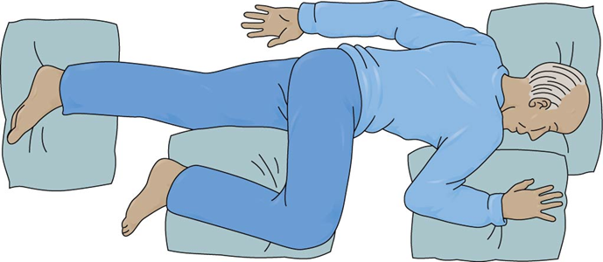
LO2, content 20
Measuring and recording rectal temperature
Adjust bed to a safe level, usually waist high. Lock bed wheels.
Help the resident to left-lying (Sims’) position.
Fold back linens to expose only the rectal area.
Put on gloves.

Slide 45
LO2, content 21
Measuring and recording rectal temperature
Digital thermometer: Put on the disposable sheath. Turn on thermometer and wait until ready sign appears.
  Electronic thermometer: Remove the probe from base unit. Put on probe cover.
  Mercury-free thermometer: Hold thermometer by stem. Shake the thermometer down to below the lowest number.
Apply a small amount of lubricant to tip of the bulb or probe cover (or apply pre-lubricated cover).

Slide 46
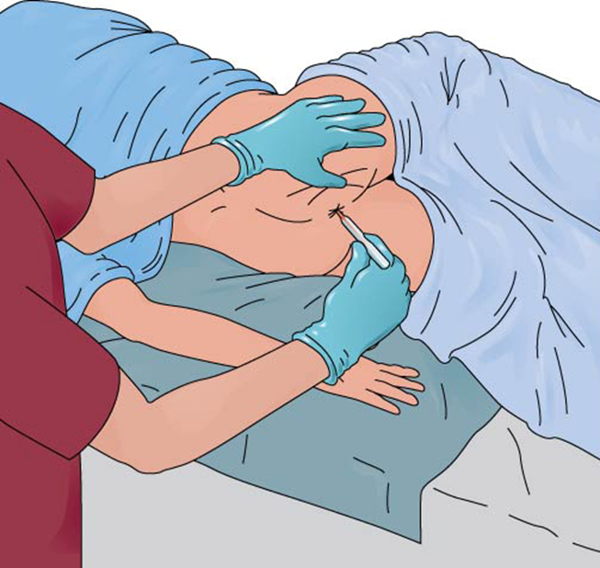
LO2, content 22
Measuring and recording rectal temperature
Separate the buttocks. Gently insert thermometer into rectum 1/2 to 1 inch. Stop if you meet resistance. Do not force the thermometer into the rectum.
Replace the sheet over buttocks. Hold on to the thermometer at all times.

Slide 47
LO2, content 23
Measuring and recording rectal temperature
Digital thermometer: Hold thermometer in place until thermometer blinks or beeps.
  Electronic thermometer: Leave in place until you hear a tone or see a flashing or steady light.
  Mercury-free thermometer: Leave in place for at least three minutes.
Gently remove the thermometer. Wipe with tissue from stem to bulb or remove sheath. Discard tissue or sheath.
Read the thermometer at eye level as you would for an oral temperature. Remember the temperature reading.
Digital thermometer: Clean thermometer according to policy and replace it in the case.
  Electronic thermometer: Press the eject button to discard cover. Return probe to holder.

Slide 48
LO2, content 24
Measuring and recording rectal temperature
  Mercury-free thermometer: Clean thermometer with soap and water. Rinse with clean water and dry. Return it to case.
Remove and discard gloves.
Wash your hands.
Assist the resident to a comfortable position.
Immediately record the temperature, date, time, and method used (rectal).
Place call light within resident’s reach.
Report any changes in resident to the nurse.

Slide 49
LO2, content 25
Explain the importance of monitoring vital signs
NAs should remember these points about tympanic and axillary temperatures:
  Tympanic thermometers are fast and accurate.
  The tympanic thermometer will only go into the ear ¼ - ½ inch.
  Axillary temperatures are much less reliable but can be safer for confused, disoriented, or uncooperative residents, or residents with dementia.

Slide 50
LO2, content 26
Measuring and recording tympanic temperature
Equipment: tympanic thermometer, gloves, disposable probe sheath/cover, pen and paper
Identify yourself by name. Identify the resident by name.
Wash your hands.
Explain procedure to resident. Speak clearly, slowly, and directly. Maintain face-to-face contact whenever possible.
Provide for resident’s privacy with curtain, screen, or door.
Put on gloves.

Slide 51
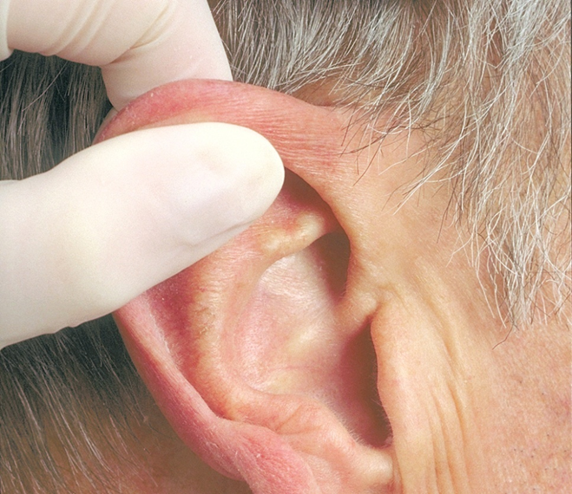
LO2, content 27
Measuring and recording tympanic temperature
Put a disposable sheath over earpiece of the thermometer. Position the resident’s head so that the ear is in front of you. Straighten the ear canal by gently pulling up and back on the outside edge of the ear. Insert the covered probe into the ear canal. Press the button.

Slide 52
LO2, content 28
Measuring and recording tympanic temperature
Hold thermometer in place either for one second or until thermometer blinks or beeps.
Read temperature. Remember temperature reading.
Discard sheath. Return thermometer to storage or to the battery charger if thermometer is rechargeable.
Remove and discard gloves.
Wash your hands.
Immediately record temperature, date, time, and method used (tympanic).
Place call light within resident’s reach.
Report any changes in resident to the nurse.

Slide 53
LO2, content 29
Measuring and recording axillary temperature
Equipment: clean mercury-free, digital, or electronic thermometer, gloves, tissues, disposable sheath/cover, pen and paper
Identify yourself by name. Identify resident by name.
Wash your hands.
Explain procedure to resident. Speak clearly, slowly, and directly. Maintain face-to-face contact whenever possible.
Provide for resident’s privacy with curtain, screen, or door.

Slide 54
LO2, content 30
Measuring and recording axillary temperature
Put on gloves.
Remove resident’s arm from sleeve of gown or shirt to allow skin contact with the end of the thermometer. Wipe axillary area with tissues before placing the thermometer.
Digital thermometer: Put on the disposable sheath. Turn on thermometer and wait until ready sign appears.
  Electronic thermometer: Remove the probe from base unit. Put on probe cover.
  Mercury-free thermometer: Hold the thermometer by the stem. Shake the thermometer down to below the lowest number.
Position thermometer (bulb end for mercury-free) in center of the armpit. Fold resident’s arm over him chest.

Slide 55
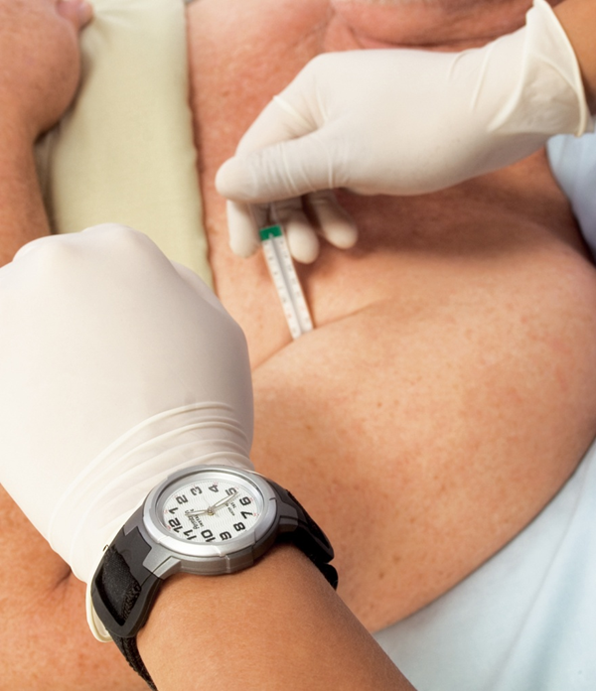
LO2, content 31
Measuring and recording axillary temperature
Digital thermometer: Leave in place until thermometer blinks or beeps.
  Electronic thermometer: Leave in place until you hear a tone or see a flashing or steady light.
  Mercury-free thermometer: Hold the thermometer in place, with the arm close against the side, for 8 to 10 minutes

Slide 56
LO2, content 32
Measuring and recording axillary temperature
Digital thermometer: Remove the thermometer. Read temperature on display screen. Remember the temperature reading.
  Electronic thermometer: Read the temperature on the display screen. Remember the temperature reading. Remove the probe.
  Mercury-free thermometer: Remove the thermometer. Wipe with a tissue from stem to bulb or remove sheath. Dispose of the tissue or sheath. Read the thermometer at eye level as you would for an oral temperature. Remember the temperature reading.
Digital thermometer: Using a tissue, remove and discard the sheath. Replace the thermometer in case.
  Electronic thermometer: Press the eject button to discard the cover. Return the probe to the holder.

Slide 57
LO2, content 33
Measuring and recording axillary temperature
  Mercury-free thermometer: Clean thermometer with soap and water. Rinse with clean water and dry. Return it to case.
Remove and discard gloves.
Wash your hands.
Put resident’s arm back into sleeve of gown.
Immediately record the temperature, date, time and method used (axillary).
Place call light within resident’s reach.
Report any changes in resident to the nurse.

Slide 58
LO2, key terms 2
Explain the importance of monitoring vital signs
Define the following terms:
radial pulse
  the pulse located on the inside of the wrist, where the radial artery runs just beneath the skin.
brachial pulse
  the pulse located inside the elbow, about one to one-and-a-half inches above the elbow.

Slide 59
LO2, content 34
Explain the importance of monitoring vital signs
NAs should remember these points about pulse:
  Pulse is the number of heartbeats per minute.
  Pulse is commonly taken at the wrist where the radial artery runs.
  Normal rate is 60-100 beats per minute for adults.
  Normal rate is 100-120 beats per minute for small children, as high as 120-140 for newborns.
  Pulse may be affected by exercise, fear, anger, anxiety, heat, medications, and pain.
  Rapid pulse may result from fever, dehydration, or heart failure.
  Slow/weak pulse may indicate infection.

Slide 60
LO2, content 35
Explain the importance of monitoring vital signs
NAs should remember these points about respiration:
  A breath includes both inspiration and expiration.
  Normal rate for adults is 12 to 20 breaths per minute.
  Normal rate for infants is 30 to 40 breaths per minute.
  Do the counting immediately after taking the pulse.
  Do not let person know you are counting breaths.

Slide 61
LO2, content 36
Measuring and recording radial pulse and counting and recording respirations
Equipment: watch with a second hand, pen and paper
Identify yourself by name. Identify the resident by name.
Wash your hands.
Explain procedure to resident. Speak clearly, slowly, and directly. Maintain face-to-face contact whenever possible.
Provide for resident’s privacy with curtain, screen, or door.

Slide 62
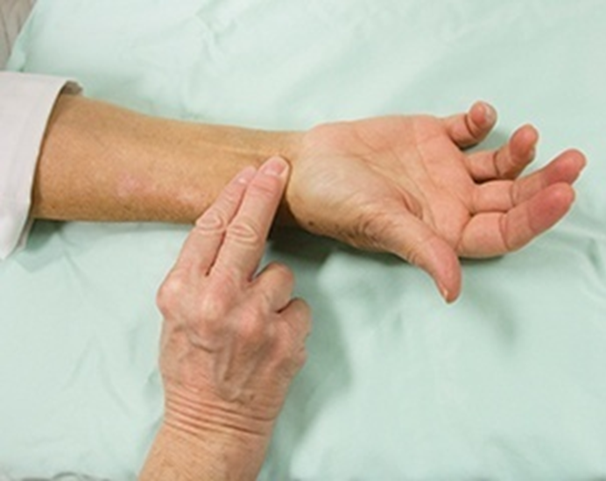
LO2, content 37
Measuring and recording radial pulse and counting and recording respirations
Place the tips of your index finger and middle finger on the thumb side of the resident's wrist. Locate the radial pulse.
Count beats for one full minute.

Slide 63
LO2, content 38
Measuring and recording radial pulse and counting and recording respirations
Keep your fingertips on the resident’s wrist. Count respirations for one full minute. Observe for the pattern and character of the resident’s breathing. Normal breathing is smooth and quiet. If you see signs of troubled, shallow, or noisy breathing, such as wheezing, report it.
Wash your hands.
Immediately record pulse rate, date, time, and method used (radial). Record the respiratory rate and the pattern or character of breathing.
Place call light within resident’s reach.
Report any changes in resident to the nurse. Report to the nurse if the pulse is less than 60 beats per minute, over 100 beats per minute, if the rhythm is irregular, or if breathing is irregular.

Slide 64
LO2, key terms 3
Explain the importance of monitoring vital signs
Define the following terms:
systolic
  first measurement of blood pressure; phase when the heart is at work, contracting and pushing blood out of the left ventricle of the heart.
diastolic
  second measurement of blood pressure; phase when the heart relaxes or rests.

Slide 65
LO2, content 39
Explain the importance of monitoring vital signs
NAs should remember these points about blood pressure:
  The two parts of the BP are systolic (top number) and diastolic (bottom number).
  Normal range for systolic is below 120 mm Hg.
  Normal range for diastolic is below 80 mm Hg.
  Brachial artery at the elbow is used.
  Equipment used is stethoscope and sphygmomanometer.
  A digital sphygmomanometer may be available. If so, you will be trained in its use.

Slide 66
LO2, content 40
Explain the importance of monitoring vital signs
Points about blood pressure (cont’d):
  A correctly-sized cuff must be used. The cuff must first be completely deflated.
  Never measure blood pressure on an arm that has an IV, a dialysis shunt, or any medical equipment. Avoid a side with a cast, recent trauma, paralysis from a stroke, burns or mastectomy.

Slide 67
LO2, content 41
Explain the importance of monitoring vital signs
REMEMBER:
It can be difficult to perfect the skill of hearing the first and last sounds of blood pressure. Practice will help build this skill.

Slide 68
LO2, content 42
Measuring and recording blood pressure (one-step method)
Equipment: sphygmomanometer (blood pressure cuff), stethoscope, alcohol wipes, pen and paper
Identify yourself by name. Identify the resident by name.
Wash your hands.
Explain procedure to the resident. Speak clearly, slowly, and directly. Maintain face-to-face contact whenever possible.
Provide for resident’s privacy with curtain, screen, or door.

Slide 69
LO2, content 43
Measuring and recording blood pressure (one-step method)
Before using stethoscope, wipe diaphragm and earpieces with alcohol wipes.
Ask the resident to roll up his sleeve so that the upper arm is exposed. Do not measure blood pressure over clothing.
Position resident’s arm with palm up. The arm should be level with the heart.
With the valve open, squeeze the cuff. Make sure it is completely deflated.

Slide 70
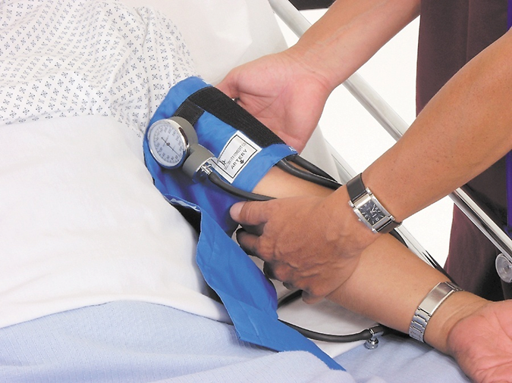
LO2, content 44
Measuring and recording blood pressure (one-step method)
Place blood pressure cuff snugly on resident’s upper arm. The center of the cuff with sensor/arrow is placed over the brachial artery (1-1½ inches above the elbow, toward inside of elbow).
Locate brachial pulse with your fingertips

Slide 71
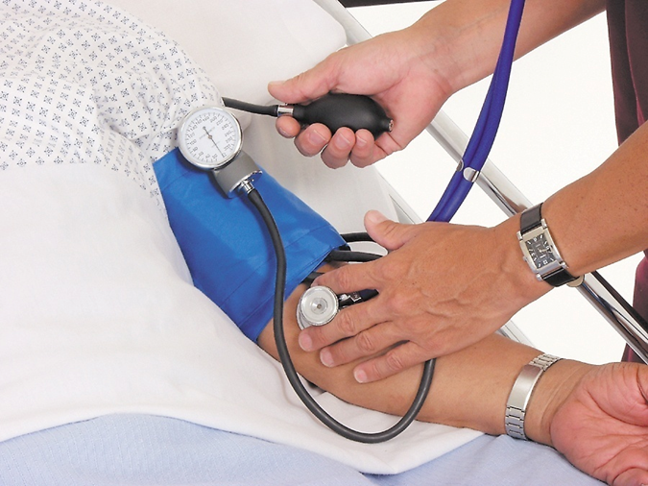
LO2, content 45
Measuring and recording blood pressure (one-step method)
Place the earpieces of the stethoscope in your ears.
Place the diaphragm of the stethoscope over brachial artery.
Close the valve (clockwise) until it stops. Do not over-tighten it.

Slide 72
LO2, content 46
Measuring and recording blood pressure (one-step method)
Inflate cuff to between 160 mmHg to 180 mm Hg. If a beat is heard immediately upon cuff deflation, completely deflate cuff. Re-inflate cuff to no more than 200 mm Hg.
Open the valve slightly with thumb and index finger. Deflate the cuff slowly.
Watch the gauge. Listen for the sound of the pulse.
Remember the reading at which the first pulse sound is heard. This is the systolic pressure.
Continue listening for a change or muffling of pulse sound. The point of a change or the point at which the sound disappears is the diastolic pressure. Remember this reading.
Open the valve. Deflate cuff completely. Remove cuff.

Slide 73
LO2, content 47
Measuring and recording blood pressure (one-step method)
Wash your hands.
Record both the systolic and diastolic pressures. Record the numbers like a fraction, with the systolic reading on top and the diastolic reading on the bottom (for example: 120/80). Note which arm was used. Use RA for right arm and LA for left arm.
Wipe diaphragm and earpieces of stethoscope with alcohol wipes. Store equipment.
Place call light within resident’s reach.
Wash your hands.
Report any changes in resident to the nurse.

Slide 74
LO2, content 48
Handout 7-3: Measuring and Recording Blood Pressure (Two-Step Method)
Equipment: sphygmomanometer (blood pressure cuff), stethoscope, alcohol wipes, pen and paper
Identify yourself by name. Identify the resident by name.
Wash your hands.
Explain procedure to resident. Speak clearly, slowly, and directly. Maintain face-to-face contact whenever possible.
Provide for resident’s privacy with curtain, screen, or door.
Ask the resident to roll up his sleeve so that the upper arm is exposed. Do not measure blood pressure over clothing.
Position resident’s arm with palm up. The arm should be level with the heart.

Slide 75
LO2, content 49
Handout 7-3: Measuring and Recording Blood Pressure (Two-Step Method)
With the valve open, squeeze the cuff. Make sure it is completely deflated.
Place blood pressure cuff snugly on resident’s upper arm. The center of the cuff with sensor/arrow is placed over the brachial artery (1-1½ inches above the elbow toward inside of elbow).
Locate the radial (wrist) pulse with fingertips.
Close the valve (clockwise) until it stops. Inflate cuff slowly, watching gauge.
Stop inflating when you can no longer feel the radial pulse. Note the reading. The number is an estimate of the systolic pressure.
Open the valve. Deflate cuff completely.

Slide 76
LO2, content 50
Handout 7-3: Measuring and Recording Blood Pressure (Two-Step Method)
Write down the estimated systolic reading.
Before using stethoscope, wipe diaphragm and earpieces of stethoscope with alcohol wipes.
Locate brachial pulse with fingertips.
Place earpieces of stethoscope in ears.
Place diaphragm of stethoscope over the brachial artery.
Close the valve (clockwise) until it stops. Do not over-tighten it.
Inflate the cuff to 30 mmHg above your estimated systolic pressure.
Open the valve slightly with thumb and index finger. Deflate cuff slowly.
Watch gauge. Listen for sound of the pulse.

Slide 77
LO2, content 51
Handout 7-3: Measuring and Recording Blood Pressure (Two-Step Method)
Remember the reading at which the first pulse sound is heard. This is the systolic pressure.
Continue listening for a change or muffling of pulse sound. The point of a change or the point at which the sound disappears is the diastolic pressure. Remember this reading.
Open the valve. Deflate cuff completely. Remove cuff.
Wash your hands.
Record both the systolic and diastolic pressures. Record the numbers like a fraction, with the systolic reading on top and the diastolic reading on the bottom (for example: 120/80). Note which arm was used. Use RA for right arm and LA for left arm.

Slide 78
LO2, content 52
Handout 7-3: Measuring and Recording Blood Pressure (Two-Step Method)
Wipe diaphragm and earpieces of stethoscope with alcohol wipes. Store equipment.
Place call light within resident’s reach.
Wash your hands.
Report any changes in resident to the nurse.

Slide 79
LO2, content 53
Explain the importance of monitoring vital signs
REMEMBER:
Pulse oximetry may be used to measure pulse rate, as well as blood oxygen level. It may be used when residents have had surgery, are on oxygen, are in intensive care, or have cardiac or respiratory problems.

Slide 80
LO2, content 54
Explain the importance of monitoring vital signs
NAs should remember these points about pain:
  It is as important to monitor as vital signs.
  It is uncomfortable and an individual experience.
  It is important to take complaints of pain seriously.
  NAs should observe and report carefully since care plans are based on their reports.
  NAs must ask questions to get accurate information.
  Pain is not a normal part of aging.

Slide 81
LO2, content 55
Explain the importance of monitoring vital signs
Signs of pain to observe for and report include the following:
  Increased pulse, respirations, and blood pressure
  Sweating
  Nausea
  Vomiting
  Tightening the jaw
  Squeezing eyes shut
  Holding or guarding a body part tightly
  Frowning
  Grinding teeth

Slide 82
LO2, content 56
Explain the importance of monitoring vital signs
Signs of pain (cont’d):
  Increased restlessness
  Agitation or tension
  Change in behavior
  Crying
  Sighing
  Groaning
  Breathing heavily
  Rocking
  Pacing
  Repetitive movements
  Difficulty moving or walking

Slide 83
LO2, content 57
Explain the importance of monitoring vital signs
REMEMBER:
A pain scale (such as the one shown on page 185 of the textbook) can help NAs monitor the pain of residents’ who have difficulties communicating verbally.

Slide 84
LO2, content 58
Explain the importance of monitoring vital signs
To help reduce pain an NA should
  Report complaints of pain or unrelieved pain immediately.
  Gently position the body in proper alignment. Use pillows for support. Help with changes of position if the resident wishes.
  Give back rubs.
  Ask if the resident would like to take a warm bath or shower.
  Help the resident to the bathroom or commode or offer the bedpan or urinal.
  Encourage slow, deep breathing.
  Provide a quiet and calm environment. Soft music may distract the resident.
  Be patient, caring, gentle, and responsive.

Slide 85
LO3, content 1
Explain how to measure weight and height
NAs should know these points about measuring weight and height:
  Resident will be weighed repeatedly during his or her stay, and any change in weight should be reported immediately.
  A pound is a unit of weight equal to 16 ounces. A kilogram is a unit of mass equal to 1000 grams; one kilogram equals 2.2 pounds.
  Some residents will be weighed on a wheelchair scale. The weight of the wheelchair may need to be subtracted from a resident’s weight.
  Residents may need to be weighed on a bed scale.
  There are 12 inches in one foot.

Slide 86
LO3, content 2
Measuring and recording weight of an ambulatory resident
Equipment: standing/upright scale, pen and paper
Identify yourself by name. Identify the resident by name.
Wash your hands.
Explain procedure to resident. Speak clearly, slowly, and directly. Maintain face-to-face contact whenever possible.
Provide for resident’s privacy with curtain, screen, or door.
Make sure resident is wearing nonskid shoes that are fastened before walking to scale.
Start with scale balanced at zero before weighing the resident.
Help resident to step onto the center of the scale. Be sure she is not holding, touching, or leaning against anything.

Slide 87
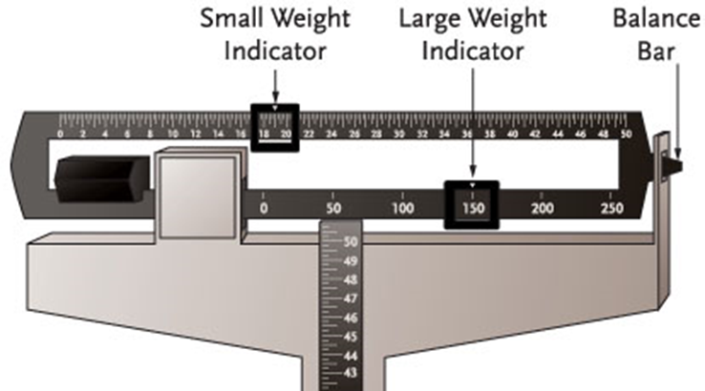
LO3, content 3
Measuring and recording height of an ambulatory resident
Determine resident’s weight. Balance the scale by making the balance bar level. Move the small and large weight indicators until the bar balances. Read the two numbers shown (on the small and large weight indicators) when the bar is balanced. Add these two numbers together. This is the resident’s weight.
Help resident to safely step off scale before recording weight.

Slide 88
LO3, content 4
Measuring and recording weight of an ambulatory resident
Wash your hands.
Provides for infection prevention.
Immediately record the resident’s weight in pounds (lb) or kilograms (kg), depending on facility policy.
Place call light within resident’s reach.
Report any changes in resident to the nurse.

Slide 89
LO3, content 5
Measuring and recording height of a resident
For residents who can get out of bed, you will measure height using a standing scale.
Equipment: standing scale, pen, and paper
Identify yourself by name. Identify the resident by name.
Wash your hands.
Explain procedure to resident. Speak clearly, slowly, and directly. Maintain face-to-face contact whenever possible.
Provide for resident’s privacy with curtain, screen, or door.
Make sure resident is wearing nonskid shoes that are securely fastened before walking to scale.

Slide 90
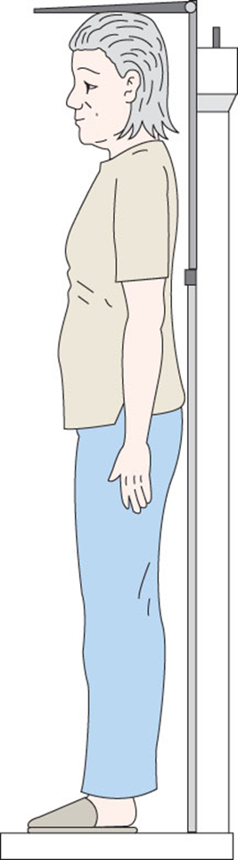
LO3, content 6
Measuring and recording height of a resident
Help resident to step onto scale, facing away from the scale.
Ask resident to stand straight if possible. Help as needed.
Pull up measuring rod from back of scale. Gently lower measuring rod until it rests flat on resident’s head.

Slide 91
LO3, content 7
Measuring and recording height of a resident
Determine the resident’s height.
Help resident off scale before recording height. Make sure measuring rod does not hit resident in the head while doing so.
Wash your hands.
Immediately record the resident’s height.
Place call light within resident’s reach.
Report any changes in resident to the nurse.

Slide 92
LO4, key terms 1
Explain restraints and how to promote a restraint-free environment
Define the following terms:
restraint
  a physical or chemical way to restrict voluntary movement or behavior.
restraint-free care
  an environment in which restraints are not kept or used for any reason.
restraint alternatives
  any intervention used in place of a restraint or that reduces the need for a restraint.

Slide 93
LO4, content 1
Explain restraints and how to promote a restraint-free environment
In the past, restraints were used for reasons including the following:
  Keep person from wandering
  Prevent falls
  Keep person from hurting self or others
  Keep person from pulling out tubing

Slide 94
LO4, content 2
Explain restraints and how to promote a restraint-free environment
NAs should know these important points about restraints:
  Restraints are now generally used only as a last resort.
  Restraints can only be used with a doctor’s order.
  It is against the law for staff to apply restraints for convenience or discipline.

Slide 95
LO4, content 3
Explain restraints and how to promote a restraint-free environment
Think about these questions:
Can restraints be used if staff do not have enough time to care for residents?
Can restraints be used if the resident has made a staff member mad by arguing with the staff member or being in a bad mood?
How would you feel if you were restrained in your chair or by side rails or other devices?

Slide 96
LO4, content 4
Transparency 7-2: Problems from Restraint Use
Pressure ulcers
Pneumonia
Risk of suffocation
Reduced blood circulation
Stress on the heart
Incontinence
Constipation
Weakened muscles and bones
Muscle atrophy (weakening or wasting away of the muscle)
Loss of bone mass
Poor appetite and malnutrition
Depression and/or withdrawal

Slide 97
LO4, content 5
Transparency 7-2: Problems from Restraint Use (cont’d)
Sleep disorders
Loss of dignity
Loss of independence
Stress and anxiety
Increased agitation (anxiety, restlessness)
Loss of self-esteem
Severe injury
Death

Slide 98
LO4, content 6
Handout 7-4: Restraint Alternatives
Make sure call lights are within reach. Respond to call lights promptly.
Improve safety measures to prevent accidents and falls. Improve lighting.
Ambulate the person when he or she is restless. The doctor or nurse may add exercises to the care plan.
Provide activities for those who wander at night.
Encourage activities and independence. Escort the resident to social activities. Increase visits and social interaction.
Give frequent help with elimination needs. Help with cleaning immediately after an episode of incontinence.
Offer food or drink. Offer reading materials.
Distract or redirect interest. Give the resident a repetitive task.

Slide 99
LO4, content 7
Handout 7-4: Restraint Alternatives (cont’d)
Decrease the noise level. Listen to soothing music. Offer massages or use relaxation techniques.
Reduce pain levels through medication. The resident should be monitored closely. Complaints of pain should be reported immediately.
Provide familiar caregivers. Increase the number of caregivers by using family and volunteers.
Use a team approach to meeting needs. Offer training to teach gentle approaches to difficult people.

Slide 100
LO4, content 8
Transparency 7-3: When a Resident is Restrained
The resident must be checked at least every 15 minutes. At regular, ordered intervals the following must be done:
Release the restraint or discontinue use.
Offer help with elimination. Check for episodes of incontinence and provide care.
Offer fluids and food.
Check for and report signs of skin irritation immediately.
Check for and report signs of swelling immediately.
Reposition the resident.
Ambulate resident if able.

Slide 101
LO5, key terms 1
Define fluid balance and explain intake and output (I&O)
Define the following terms:
intake (input)
  the fluid a person consumes; also called input.
output
  all fluid that is eliminated from the body; includes fluid in urine, feces, vomitus, perspiration, moisture that is exhaled in the air, and wound drainage.
fluid balance
  taking in and eliminating equal amounts of fluid.

Slide 102
LO5, content 1
Handout 7-4: Conversion Table
One milliliter (mL) is a unit of measure equal to one cubic centimeter (cc).
1 ounce (oz) = 30 milliliters (mL) or 30 cubic centimeters (cc)
2 oz = 60 mL
3 oz = 90 mL
4 oz = 120 mL
5 oz = 150 mL
6 oz = 180 mL
7 oz = 210 mL
8 oz = 240 mL
1/4 cup = 2 oz = 60 mL
1/2 cup = 4 oz = 120 mL
1 cup = 8 oz = 240 mL

Slide 103
LO5, content 2
Handout 7-5: Intake and Output Worksheet
Your resident/client drinks two 8-oz. glasses of water.
  The resident/client’s intake = ______mL or ______oz.
Your resident/client drinks 4 oz. of milk and eats 4 oz. of ice cream for lunch.
  What is the total intake in mL? ______mL
The resident/client is limited to 720 mL of liquids in 8 hours. How many glasses of water may he/she have? (Remember: 1 glass = 240 mL)
  Total number of glasses is______.
For the evening meal, the resident/client is served a 6-oz. bowl of soup, a 4 oz. cup of coffee, an 8-oz. glass of cranberry juice and a 3-oz. serving of sherbet.
  Total mL of intake is ______.

Slide 104
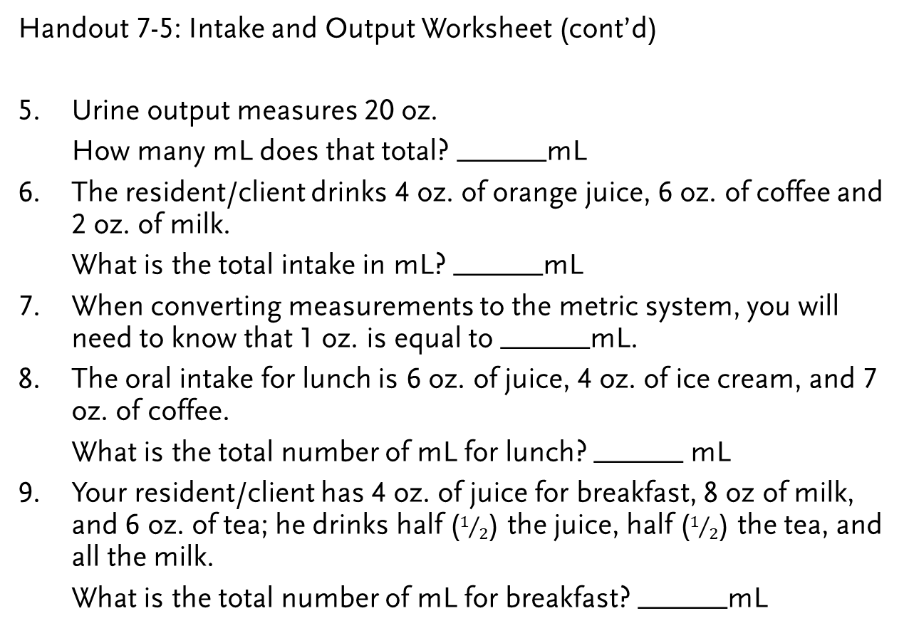
LO5, content 3
Handout 7-5: Intake and Output Worksheet (cont’d)
Urine output measures 20 oz.
  How many mL does that total? ______mL
The resident/client drinks 4 oz. of orange juice, 6 oz. of coffee and 2 oz. of milk.
  What is the total intake in mL? ______mL
When converting measurements to the metric system, you will need to know that 1 oz. is equal to ______mL.
The oral intake for lunch is 6 oz. of juice, 4 oz. of ice cream, and 7 oz. of coffee.
  What is the total number of mL for lunch? ______ mL
Your resident/client has 4 oz. of juice for breakfast, 8 oz of milk, and 6 oz. of tea; he drinks half ($1/2$) the juice, half ($1/2$) the tea, and all the milk.
  What is the total number of mL for breakfast? ______mL

Slide 105
LO5, content 4
Handout 7-5: Intake and Output Worksheet (cont’d)
Mrs. Brown receives a mid-morning snack. She receives supplemental liquid nourishment. The Ensure container is 8 oz. She drinks 4 oz.
  What is her total number of mL for her morning snack? ______mL
Mr. Jones drinks 8 oz. of ginger ale, 4 oz. of gelatin, and 4 oz. of tea with his evening meal.
  What is the total number of mL? ______mL
You calculate the resident/client’s total intake and output at the end of your eight-hour shift. The resident/client’s urinary output measures 10 oz. and oral intake measures 10. oz.
  Is the resident/client in fluid balance? ______

Slide 106
LO5, content 5
Handout 7-6: Basic Math
Addition
Subtraction
2,905 |  | 53,138
+174 |  | + 3,008
3,079 |  | 56,146
32,542 |  | 549,233
-8,710 |  | - 26,903
23,832 |  | 522,330

Slide 107
LO5, content 6
Handout 7-6: Basic Math (cont’d)
Multiplication
        4,962 79
        x 13 x 41
        14,886 79
        +49,620 +3,160
        64,506 3,239
Division
 | 34 |  | 39
22 | 748 | 14 | 546
 | -66 |  | -42
 | 88 |  | 126
 | -88 |  | -126
 | 0 |  | 0

Slide 108
LO5, content 7
Handout 7-6: Basic Math (cont’d)
Converting Decimals, Fractions, and Percentages
Decimals, fractions, and percentages are different ways of showing the same value. For example, one half can be written in the following ways:
As a decimal: 0.5
As a fraction: 1/2
As a percentage: 50%
Here are common values shown in decimal, fraction, and percentage forms:
Decimal | Fraction | Percentage
0.01 | 1/100 | 1%
0.1 | 1/10 | 10%
0.2 | 1/5 | 20%
0.25 | 1/4 | 25%
0.333 | 1/3 | 33 1/3%
0.5 | 1/2 | 50%
0.75 | 3/4 | 75%
1 | 1/1 | 100%

Slide 109
LO5, content 8
Handout 7-6: Basic Math (cont’d)
Follow these rules for converting decimals, fractions, and percentages:
To convert from decimal to a percentage, you will multiply by 100 and add a percent sign (%).
0.25 x 100 = 25%
To convert from a percentage to decimal, you will divide by 100 and delete the percent sign (%).
80% ÷ 100 = 0.8
To convert a fraction to a decimal, you will divide the top number by the bottom number.
3/4= 3 ÷ 4 = 0.75

Slide 110

LO5, content 9
Handout 7-6: Basic Math (cont’d)
To convert a decimal to a fraction, write the decimal over the number 1.
Step 1 $\frac{0.5}{1}$
Then multiply top and bottom by 10 for every number after the decimal point (10 for 1 number, 100 for 2 numbers, and so on.)
Step 2 $\frac{0.5}{1}$ $\frac{x10}{x10}$ = $\frac{5}{10}$
The resulting fraction is 5/10 (or 1/2 if you simplify the fraction).

Slide 111


LO5, content 10
Measuring and recording urinary output
Equipment: I&O sheet, graduate (measuring container), gloves
Wash your hands.
Put on gloves before handling bedpan/urinal.
Pour the contents of the bedpan or urinal into graduate. Do not spill or splash any of the urine.
Place graduate on flat surface. Measure the amount of urine at eye level. Keep container level.

Slide 112
LO5, content 11
Measuring and recording urinary output
(cont'd) Note the amount on paper, converting to mL if necessary. (If the amount is between measurement lines, you may need to round up to the nearest 25 mL. Follow policy.
After measuring urine, empty the graduate into toilet. Do not splash urine.
Rinse graduate. Pour rinse water into toilet.
Rinse bedpan/urinal. Pour rinse water into toilet. Flush the toilet.
Place graduate and bedpan/urinal in area for cleaning or clean and store according to facility policy.
Remove and discard gloves.
Wash hands before recording output.
Immediately document the time and amount of urine in output column on sheet. For example: 1545 hours, 200 mL urine.
Report any changes in resident to the nurse.

Slide 113
LO5, key terms 2
Define fluid balance and explain intake and output (I&O)
Define the following terms:
specimen
  a sample that is used for analysis in order to try to make a diagnosis.
routine urine specimen
  a urine specimen that can be collected any time a person voids.
void
  urinate.

Slide 114
LO5, key terms 3
Define fluid balance and explain intake and output (I&O)
Define the following terms:
hat
  in health care, a collection container that is sometimes inserted into a toilet to collect and measure urine or stool.
clean-catch specimen
  a urine specimen that does not include the first and last urine voided; also called mid-stream specimen.

Slide 115
LO5, content 12
Define fluid balance and explain intake and output (I&O)
NAs should remember these points about collecting urine specimens:
  NAs must wear gloves for these procedures.
  Tagging and storing specimens correctly is important.
  NAs should be sensitive to the fact that residents may find it embarrassing or uncomfortable to have others handling their body wastes.
  If an NA feels the task is unpleasant, he should not make it known. NAs must remain professional.

Slide 116
LO5, content 13
Define fluid balance and explain intake and output (I&O)
REMEMBER:
It is very important that NAs wash their hands and discard their gloves after collecting specimens.

Slide 117
LO5, content 14
Collecting a routine urine specimen
Equipment: urine specimen container with completed label (labeled with resident’s name, date of birth, room number, date, and time) and lid, specimen bag, 2 pairs of gloves, bedpan or urinal (if resident cannot use portable commode or toilet), hat for toilet (if resident uses portable commode or toilet), plastic bag, toilet paper, disposable wipes, paper towels, supplies for perineal care, lab slip
Identify yourself by name. Identify the resident by name.
Wash your hands.
Explain procedure to the resident. Speak clearly, slowly, and directly. Maintain face-to-face contact whenever possible.
Provide for resident’s privacy with curtain, screen, or door.
Put on gloves.

Slide 118
LO5, content 15
Collecting a routine urine specimen
Fit hat to toilet or commode, or provide resident with bedpan or urinal.
Ask resident to void into hat, urinal, or bedpan. Ask the resident not to put toilet paper in with the sample. Provide a plastic bag to discard toilet paper separately.
Make sure the bed is in its lowest position. Place toilet paper and disposable wipes within resident’s reach. Ask resident to clean his hands with a wipe when finished if he is able.
Remove and discard gloves. Wash your hands.
Place the call light within resident’s reach. Ask resident to signal when done. Leave the room and close the door.
When called by the resident, return and wash your hands. Put on clean gloves. Give perineal care if help is needed.
Take bedpan, urinal, or hat to the bathroom.

Slide 119
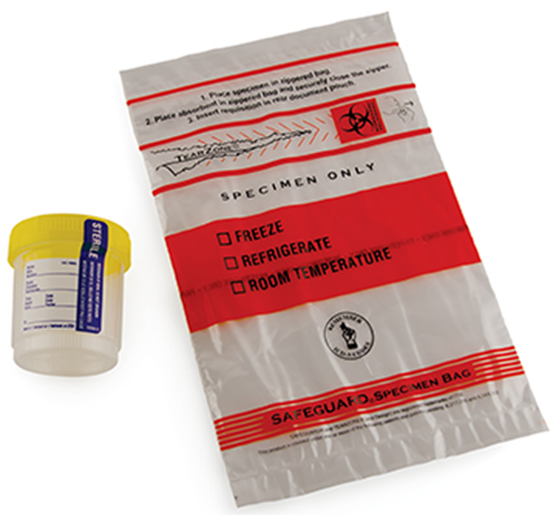
LO5, content 16
Collecting a routine urine specimen
Pour urine into the specimen container. Specimen container should be at least half full.
Cover the urine container with its lid. Do not touch the inside of container. Wipe off the outside with a paper towel.
Apply label. Place the container in a clean specimen bag. Seal the bag.

Slide 120
LO5, content 17
Collecting a routine urine specimen
Discard extra urine in the toilet. Turn the faucet on with a paper towel. Rinse the bedpan, urinal, or hat with cold water and empty it into the toilet. Flush the toilet. Place equipment in proper area for cleaning or clean it according to facility policy.
Remove and discard gloves.
Wash your hands.
Place call light within resident’s reach.
Report any changes in resident to the nurse.
Take specimen and lab slip to proper area. Document procedure using facility guidelines. Note amount and characteristics of urine.

Slide 121
LO5, content 18
Collecting a clean-catch (mid-stream) urine specimen
Equipment: specimen kit with container with completed label (labeled with resident’s name, date of birth, room number, date, and time) and lid, specimen bag, cleansing wipes, gloves, bedpan or urinal (if resident cannot use portable commode or toilet), plastic bag, toilet paper, disposable wipes, paper towels, towels, supplies for perineal care, lab slip
Identify yourself by name. Identify the resident by name.
Wash your hands.
Explain procedure to resident. Speak clearly, slowly, and directly. Maintain face-to-face contact whenever possible.
Provide for resident’s privacy with curtain, screen, or door.
Put on gloves.

Slide 122
LO5, content 19
Collecting a clean-catch (mid-stream) urine specimen
Open the specimen kit. Do not touch the inside of the container or the inside of the lid.
If the resident cannot clean his or her perineal area, you will do it. Use the cleansing wipes to do this. Be sure to use a clean area of the wipe or clean wipe for each stroke. See bed bath procedure in Chapter 6 for a reminder on how to give perineal care.
Ask the resident to urinate a small amount into the bedpan, urinal, or toilet, and to stop before urination is complete.
Place the container under the urine stream. Have the resident start urinating again. Fill the container at least half full. Ask the resident to stop urinating and remove the container. Have the resident finish urinating in bedpan, urinal, or toilet.

Slide 123
LO5, content 20
Collecting a clean-catch (mid-stream) urine specimen
After urination, provide a plastic bag so resident can discard toilet paper. Give perineal care if help is needed. Ask resident to clean his hands with a wipe if he is able.
Cover the urine container with its lid. Do not touch the inside of the container. Wipe off the outside with a paper towel.
Apply label. Place the container in a clean specimen bag. Seal the bag.
Discard extra urine in toilet. Turn the faucet on with a paper towel. Rinse the bedpan or urinal with cold water and empty it into the toilet. Flush the toilet. Place equipment in proper area for cleaning or clean it according to facility policy.

Slide 124
LO5, content 21
Collecting a clean-catch (mid-stream) urine specimen
Remove and discard gloves.
Wash your hands.
Place call light within resident’s reach.
Report any changes in resident to the nurse.
Take specimen and lab slip to proper area. Document procedure using facility guidelines. Note amount and characteristics of urine.

Slide 125
LO5, content 22
Collecting a stool specimen
Equipment: specimen container with completed label (labeled with resident’s name, date of birth, room number, date, and time) and lid, specimen bag, 2 pairs of gloves, 2 tongue blades, bedpan (if resident cannot use portable commode or toilet), hat for toilet (if resident uses portable commode or toilet), plastic bag, toilet paper, disposable wipes, paper towels, supplies for perineal care, lab slip
Identify yourself by name. Identify the resident by name.
Wash your hands.
Explain procedure to resident. Speak clearly, slowly, and directly. Maintain face-to-face contact whenever possible.
Provide for resident’s privacy with curtain, screen, or door.
Put on gloves.

Slide 126
LO5, content 23
Collecting a stool specimen
Ask the resident not to urinate when he is ready to move bowels. Ask him not to put toilet paper in with the sample. Provide a plastic bag to discard toilet paper separately.
Fit hat to toilet or commode, or provide resident with bedpan.
Make sure bed is in its lowest position. Place toilet paper and disposable wipes within resident’s reach. Ask resident to clean his hands with a wipe when finished if he is able.
Remove and discard gloves. Wash your hands.
Place the call light within resident’s reach. Ask resident to signal when done. Leave the room and close the door.
When called by the resident, return and wash your hands. Put on clean gloves. Give perineal care if help is needed.

Slide 127
LO5, content 24
Collecting a stool specimen
Using the two tongue blades, take about two tablespoons of stool and put it in the container. Without touching the inside of the container, cover it tightly. Apply the label and place container in a clean specimen bag.
Wrap tongue blades in toilet paper. Put them in plastic bag with used toilet paper. Discard bag in proper container.
Empty the bedpan or container into the toilet. Turn the faucet on with a paper towel. Rinse the bedpan with cold water and empty it into the toilet. Flush the toilet. Place equipment in proper area for cleaning or clean it according to facility policy.

Slide 128
LO5, content 25
Collecting a stool specimen
Remove and discard gloves.
Wash your hands.
Place call light within resident’s reach.
Report any changes in resident to the nurse.
Take specimen and lab slip to proper area. Document procedure using facility guidelines. Note amount and characteristics of stool.

Slide 129
LO5, content 26
Handout 7-7: Collecting a 24-Hour Urine Specimen
Collecting a 24-hour urine specimen
Equipment: 24 hour specimen container with lid, completed label (labeled with resident's name, date of birth, room number date, and time) bedpan or urinal (for residents confined to bed) hat for toilet (if resident can use portable commode or toilet), gloves, toilet paper, disposable wipes, supplies for perineal care, sign to alert other team members that a 24-hour urine specimen is being collected, form for recording output, laboratory slip
Identify yourself by name. Identify the resident by name.
Wash your hands.
Explain procedure to resident. Speak clearly, slowly, and directly. Maintain face-to-face contact whenever possible.
Provide for resident’s privacy with curtain, screen, or door.

Slide 130
LO5, content 27
Handout 7-7: Collecting a 24-Hour Urine Specimen (cont’d)
Place a sign on the resident's bed to let all care team members know that a 24-hour specimen is being collected. The sign might read "Save all urine for 24-hour specimen."
When starting the collection, have the resident completely empty the bladder. Discard the urine. Note the exact time of this voiding. The collection will run until the same time the next day.
Label the container with the resident’s name, date of birth, room number, and dates and times the collection period began and ended.
Wash hands and put on gloves each time the resident voids.
Pour urine from bedpan, urinal, or hat into the container. Container may be stored at room temperature, in the refrigerator, or on ice. Follow facility policy.

Slide 131
LO5, content 28
Handout 7-7: Collecting a 24-Hour Urine Specimen (cont’d)
After each voiding, help as necessary with perineal care. Ask the resident to clean his hands with a wipe after each voiding.
After each voiding, place equipment in proper area for cleaning or clean it according to facility policy.
Remove and discard gloves.
Wash your hands.
After the last void of the 24-hour period, remove the sign. Take specimen and lab slip to proper area. Document procedure using facility guidelines. Make sure to include the time of the last void before the 24-hour collection period began and the last void of the 24-hour collection period.

Slide 132
LO5, content 29
Handout 7-8: Collecting Sputum Specimen
Collecting a sputum specimen
Equipment: specimen container with completed label (labeled with resident’s name, date of birth, room number, date, and time) and lid, specimen bag, tissues, gloves, N95 or other ordered mask, laboratory slip
Identify yourself by name. Identify the resident by name.
Wash your hands.
Explain procedure to resident. Speak clearly, slowly, and directly. Maintain face-to-face contact whenever possible.
Provide for resident’s privacy with curtain, screen, or door.
Put on mask and gloves. Coughing is one way that TB bacilli can enter the air. Stand behind the resident if the resident can hold the specimen container by himself.

Slide 133
LO5, content 30
Handout 7-8: Collecting Sputum Specimen (cont’d)
Ask the resident to cough deeply, so that sputum comes up from the lungs. To prevent the spread of infectious material, give the resident tissues to cover his mouth. Ask the resident to spit the sputum into the specimen container.
When you have obtained a good sample (about two tablespoons of sputum), cover the container tightly. Wipe any sputum off the outside of the container with tissues. Discard the tissues. Apply label, and place the container in a clean specimen bag and seal the bag.
Remove and discard gloves and mask.
Wash your hands.
Place call light within resident’s reach.
Report any changes in resident to the nurse.
Take specimen and lab slip to proper area. Document procedure using facility guidelines.

Slide 134
LO6, key terms 1
Explain care guidelines for urinary catheters, oxygen therapy, and IV therapy
Define the following terms:
catheter
  a thin tube inserted into the body to drain or inject fluids.
urinary catheter
  a thin tube inserted into the bladder in order to drain or collect urine.
straight catheter
  a catheter that does not remain inside the person; it is removed immediately after urine is drained or collected.

Slide 135
LO6, key terms 2
Explain care guidelines for urinary catheters, oxygen therapy, and IV therapy
Define the following terms:
indwelling catheter
  a type of catheter that remains inside the bladder for a period of time; also called a Foley catheter.
condom catheter
  catheter that has an attachment on the end that fits onto the penis; also called Texas catheter.

Slide 136
LO6, content 1
Explain care guidelines for urinary catheters, oxygen therapy, and IV therapy
REMEMBER:
NAs never insert, irrigate, or remove catheters.

Slide 137
LO6, content 2
Explain care guidelines for urinary catheters, oxygen therapy, and IV therapy
NAs should remember these guidelines when a resident has a urinary catheter:
  Wash your hands thoroughly.
  Clean the genital area at least daily.
  Keep drainage bag lower than the resident’s hips or bladder to prevent infection and let gravity allow drainage.
  Keep drainage bag off floor.
  Keep tubing straight.

Slide 138
LO6, content 3
Explain care guidelines for urinary catheters, oxygen therapy, and IV therapy
NAs should observe for and report the following when a resident has a urinary catheter:
  Bloody or unusual-looking urine
  Bag not filling after several hours
  Bag filling suddenly
  Catheter not in place
  Urine leaking from catheter
  Resident reporting pain or pressure
  Odor

Slide 139
LO6, content 4
Explain care guidelines for urinary catheters, oxygen therapy, and IV therapy
REMEMBER:
It is very important to wear gloves while providing catheter care and to wash hands carefully afterwards.

Slide 140
LO6, content 5
Providing catheter care
Equipment: bath blanket, protective pads, bath basin with warm water, soap, bath thermometer, 2-4 washcloths or disposable wipes, towel, gloves
Identify yourself by name. Identify the resident by name.
Wash your hands.
Explain procedure to resident. Speak clearly, slowly, and directly. Maintain face-to-face contact whenever possible.
Provide for resident’s privacy with curtain, screen, or door.
Adjust bed to a safe level, usually waist high. Lock bed wheels.
Lower head of bed. Position resident lying flat on her back.
Remove or fold back top bedding. Keep resident covered with bath blanket.

Slide 141
LO6, content 6
Providing catheter care
Test water temperature with thermometer or on the inside of your wrist to ensure it is safe. Water temperature should be no higher than 105°F. Have resident check water temperature. Adjust if necessary.
Put on gloves.
Ask the resident to flex her knees and raise her buttocks off the bed by pushing against the mattress with her feet. Place a clean bed protector under her perineal area.
Expose only the area necessary to clean the catheter. Avoid overexposing the resident.
Place towel under the catheter tubing before washing.
Wet a washcloth in the basin. Apply soap to the washcloth. Clean area around the meatus. Use a clean area of the washcloth for each stroke.

Slide 142
LO6, content 7
Providing catheter care
Hold the catheter near meatus. Avoid tugging the catheter.
Clean at least four inches of catheter nearest meatus. Move in only one direction, away from the meatus. Use a clean area of the washcloth for each stroke.
Dip a clean washcloth in the water. Rinse area around the meatus, using a clean area of the washcloth for each stroke. With a clean, dry towel, dry the area around the meatus.

Slide 143
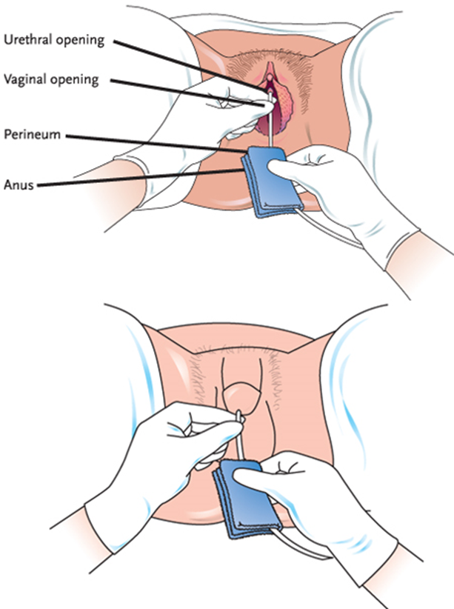
LO6, content 8
Providing catheter care
Dip a clean washcloth in the water. Rinse at least four inches of catheter nearest the meatus. Move in only one direction, away from meatus. Use a clean area of the washcloth for each stroke.
With a clean, dry towel, dry at least four inches of catheter nearest the meatus. Move in only one direction, away from meatus. Do not tug the catheter.

Slide 144
LO6, content 9
Providing catheter care
Remove bed protector from under resident and discard. Remove towel from under the catheter tubing and place in proper container. Replace top covers. Remove bath blanket and place in proper container.
Place used washcloths in proper container.
Empty the basin into the toilet and flush the toilet. Place basin in proper area for cleaning or clean and store it according to facility policy.
Remove and discard gloves.
Wash your hands.
Return bed to lowest position.
Place call light within resident’s reach.
Report any changes in resident to the nurse.
Document procedure using facility guidelines.

Slide 145
LO6, content 10
Emptying the catheter drainage bag
Equipment: graduate (measuring container), alcohol wipes, paper towels, gloves
Identify yourself by name. Identify the resident by name.
Wash your hands.
Explain procedure to resident. Speak clearly, slowly, and directly. Maintain face-to-face contact whenever possible.
Provide for resident’s privacy with curtain, screen, or door.
Put on gloves.
Place a paper towel on the floor under the drainage bag. Place the graduate on the paper towel.

Slide 146
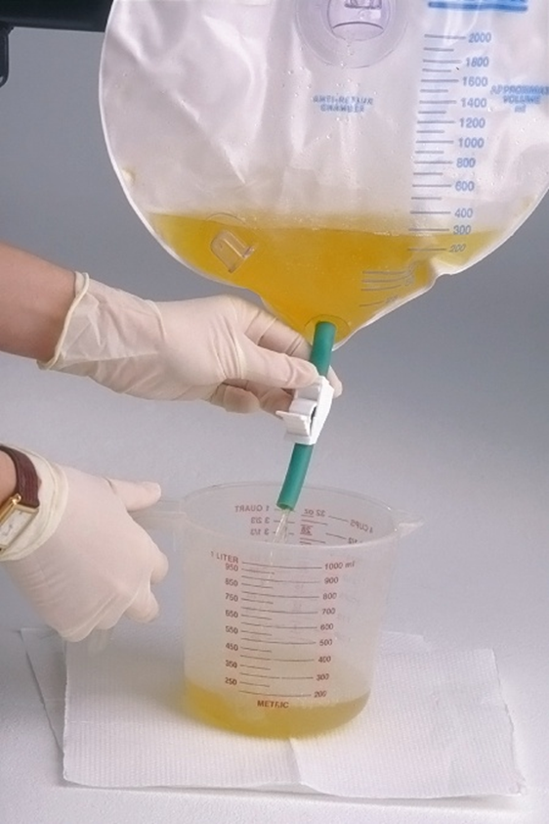
LO6, content 11
Emptying the catheter drainage bag
Open the clamp on the bag so that the urine flows out of the bag and into the graduate. Do not let spout or clamp touch the graduate.
When urine has drained from the bag, close the clamp. Using alcohol wipes, clean the drain spout. Place the drain spout back in its holder on the bag.

Slide 147
LO6, content 12
Emptying the catheter drainage bag
Go into the bathroom. Place graduate on a flat surface and measure at eye level. Note the amount and the appearance of the urine. Empty into toilet and flush toilet.
Clean and store graduate. Discard paper towels.
Remove and discard gloves.
Wash your hands.
Document procedure using facility guidelines. Note amount and characteristics of urine.

Slide 148
LO6, key terms 3
Explain care guidelines for urinary catheters, oxygen therapy, and IV therapy
Define the following terms:
oxygen therapy
  the administration of oxygen to increase the supply of oxygen to the lungs.
combustion
  the process of burning.
flammable
  easily ignited and capable of burning quickly.

Slide 149
LO6, content 13
Explain care guidelines for urinary catheters, oxygen therapy, and IV therapy
NAs should remember these guidelines for oxygen safety:
  Post No Smoking and Oxygen in Use signs. Do not allow smoking around oxygen equipment.
  Remove fire hazards. Report to nurse if resident does not want a fire hazard removed.
  Do not allow flames around oxygen (this includes candles).
  Do not use an extension cord with an oxygen concentrator.
  Do not place electrical cords or oxygen tubing under rugs or furniture.

Slide 150
LO6, content 14
Explain care guidelines for urinary catheters, oxygen therapy, and IV therapy
Guidelines for oxygen safety (cont’d):
  Avoid using fabrics such as nylon and wool.
  Report skin irritation from cannula or face mask.
  Do not use any petroleum-based products on resident or on any part of the cannula or mask.
  Learn how to turn oxygen off in case of fire if facility allows this. Never adjust oxygen setting.

Slide 151
LO6, key term 4
Explain care guidelines for urinary catheters, oxygen therapy, and IV therapy
Define the following term:
intravenous (IV) therapy
  the delivery of medication, nutrition, or fluids through a person’s vein.

Slide 152
LO6, content 15
Explain care guidelines for urinary catheters, oxygen therapy, and IV therapy
NAs should understand their role in caring for residents with IVs:
  NAs never insert or remove IV lines.
  NAs do not care for the IV site.
  NAs only observe the site for changes or problems and report if
    Tube/needle falls out
    Tubing disconnects
    Dressing is loose
    Blood is in tubing or around site

Slide 153
LO6, content 16
Explain care guidelines for urinary catheters, oxygen therapy, and IV therapy
  Observe the site for changes or problems and report if (cont'd)
    Site is swollen or discolored
    Resident complains of pain
    IV bag breaks or fluid level does not decrease
    IV fluid is not dripping or is leaking
    IV fluid is nearly gone
    Pump beeps
    Pump is dropped
    Resident complains of pain or has trouble breathing

Slide 154
LO6, content 17
Explain care guidelines for urinary catheters, oxygen therapy, and IV therapy
NAs must not
  Measure B/P on an arm with an IV line
  Get the IV site wet
  Pull or catch the tubing on anything
  Leave the tubing kinked
  Lower the IV bag below the site
  Touch the clamp
  Disconnect IV from pump or turn off alarm

Slide 155
LO6, content 18
Explain care guidelines for urinary catheters, oxygen therapy, and IV therapy
REMEMBER:
Extra care is required when performing some care procedures on a resident with an IV. NAs must be careful never to pull or catch on IV tubing when assisting with care.

Slide 156
LO6, content 19
Handout 7-9: Warm and Cold Applications
Nursing assistants may be allowed to prepare and apply warm and cold applications. NAs should only perform procedures that are assigned to them. They should never perform a procedure they are not trained or allowed to do.
Applying heat or cold to injured areas can have several positive effects. Heat relieves pain and muscular tension. It reduces swelling, elevates the temperature in the tissues, and increases blood flow. Increased blood flow brings more oxygen and nutrients to the tissues for healing. Cold applications can help stop bleeding. They help prevent swelling, reduce pain, and bring down high fevers. Applying ice bags or cold compresses immediately after an injury can stop bleeding and prevent swelling.

Slide 157
LO6, content 20
Handout 7-8: Warm and Cold Applications (cont’d)
Moist applications include the following:
Compresses (warm or cold)
Soaks (warm or cold)
Tub baths (warm)
Sponge baths (warm or cold)
Sitz baths (warm)
Ice packs (cold)
Dry applications include the following:
Aquamatic K-pad® (warm or cold)
Electric heating pads (warm)
Disposable warm packs (warm)
Ice bags (cold)
Disposable cold packs (cold)

Slide 158
LO6, content 21
Handout 7-8: Warm and Cold Applications (cont’d)
Application | Temperature | Timing | Special Considerations
Warm Compresses | No higher than 105° | Remove after 20 mins. | Cover with plastic wrap.
Warm soaks | No higher than 105° | Check temp. every five mins. | Observe for redness. Soak 15-20 mins.
Aquamatic K-pad | Pre-set | Remove after 20 mins. | Tubing should not hang below bed. Check water level and refill when necessary
Sitz baths | No higher than 105° | 20 mins. only | Fill 2/3 full. Provide privacy.
Ice packs |  | Check after 10 mons. Remove after 20 mins | Fill bag 2/3 full of ice. Cover bag; watch for blisters and white or pale skin.
Cold compresses | Cold water with ice | Check after five mins. Remove after 20 mins | Check for blisters, redness, and white or gray skin

Slide 159
LO7, content 1
Discuss a resident’s unit and related care
REMEMBER:
A resident’s room is her home. Residents’ living spaces and personal possessions should always be respected.

Slide 160
LO7, content 2
Discuss a resident’s unit and related care
The following equipment is usually found in a resident’s unit:
  Bed
  Bedside stand
  Urinal/bedpan and covers
  Wash basin
  Emesis basin
  Soap dish and soap

Slide 161
LO7, content 3
Discuss a resident’s unit and related care
Equipment usually found in a resident’s unit (cont’d):
  Bath blanket
  Toilet paper
  Personal hygiene items
  Overbed table
  Chair
  Call light
  Privacy screen or curtain

Slide 162
LO7, content 4
Discuss a resident’s unit and related care
REMEMBER:
Soiled items and bedpans and urinals should never be placed on an overbed table.

Slide 163
LO7, content 5
Discuss a resident’s unit and related care
REMEMBER:
Call lights must always be placed within residents’ reach and must be answered immediately, no matter how many times a resident has used the call button. NAs must respond kindly each time.

Slide 164
LO7, content 6
Discuss a resident’s unit and related care
REMEMBER:
Privacy curtains should be used every time care is performed. NAs should keep in mind that they do not block sound and should keep voices low during conversations and care.

Slide 165
LO7, content 7
Discuss a resident’s unit and related care
Guidelines for the resident’s unit are as follows:
  Clean the overbed table after each use.
  Keep the call light within reach.
  Keep equipment clean and in good condition. Report problems with equipment to nurse or according to facility guidelines.
  Layer clothing and bed covers for warmth. Keep residents away from drafty areas. The NA should not change the temperature for the NA’s comfort.

Slide 166
LO7, content 8
Discuss a resident’s unit and related care
Guidelines for the resident’s unit (cont’d):
  Remove meal trays promptly, then remove crumbs and straighten linens. Change linens if they are wet, soiled, or wrinkled.
  Re-stock personal supplies as needed. Keep water pitchers filled.
  Notify housekeeping department if trash needs to be emptied. Empty trash if housekeeping is not available or not on duty.
  Report signs of insects or pests immediately.
  Do not move residents’ belongings.
  Clean equipment and return it to proper storage. Tidy the area.

Slide 167
LO8, content 1
Explain the importance of sleep and perform proper bedmaking
Lack of sleep can cause the following problems:
  Decreased mental function
  Reduced reaction time
  Irritability
  Decreased immune system function

Slide 168
LO8, content 2
Explain the importance of sleep and perform proper bedmaking
Any of these factors can affect sleep patterns:
  Fear
  Stress
  Noise
  Diet
  Medications
  Illness
  Sharing a room with another person

Slide 169
LO8, content 3
Explain the importance of sleep and perform proper bedmaking
Think about these questions:
How do you feel when you don’t get enough sleep?
How does it affect your functioning during the next day?
Can you think of any other factors that might cause sleep problems for residents in a facility?

Slide 170
LO8, content 4
Explain the importance of sleep and perform proper bedmaking
NAs should observe for the following when a resident is not sleeping well:
  Sleeping too much during the day
  Eating or drinking items that contain caffeine late in the day
  Dressing in nightclothes during the day
  Eating heavy meals late at night
  Refusing prescribed medication
  Taking new medications
  Having TV, radio, computer, or light on late at night
  Pain

Slide 171
LO8, key terms 1
Explain the importance of sleep and perform proper bedmaking
Define the following terms:
occupied bed
  a bed made while a person is in the bed.
unoccupied bed
  a bed made while no person is in the bed.
closed bed
  a bed completely made with the bedspread and blankets in place.
open bed
  a bed made with linen folded down to the foot of the bed.

Slide 172
LO8, content 5
Explain the importance of sleep and perform proper bedmaking
Bedmaking is important for these reasons:
  Damp and wrinkled sheets are uncomfortable and may keep the resident from sleeping well.
  Microorganisms thrive in moist, warm places and damp, unclean bedding may cause infection or disease.
  Sheets that are not flat increase risk for pressure ulcers.

Slide 173
LO8, content 6
Explain the importance of sleep and perform proper bedmaking
NAs should remember these guidelines for bedmaking:
  Keep linens wrinkle-free and tidy.
  Wash your hands before handling clean linen.
  Place clean linen on a clean surface, such as chair or bedside stand. Do not place linen on the floor or in a contaminated area.
  Don gloves before removing bed linen.
  Look for personal items before removing linen.
  When removing linen, fold or roll linen so the dirtiest area is inside.

Slide 174
LO8, content 7
Explain the importance of sleep and perform proper bedmaking
Guidelines for bedmaking (cont’d):
  Do not shake linen or clothes.
  Bag soiled linen at point of origin, and do not take it to other residents’ rooms.
  Sort soiled linen away from care areas.
  Place wet linen in leakproof bags.
  Wear gloves when handling soiled linen. Hold soiled linen away from your body. If dirty linen touches your uniform, your uniform becomes contaminated.
  Change disposable bed protectors whenever they are soiled or wet, and dispose of them properly.

Slide 175
LO8, content 8
Making an occupied bed
Equipment: clean linen—mattress pad, fitted or flat bottom sheet, disposable bed protector (if needed), cotton draw sheet, flat top sheet, blanket(s), bedspread (if used), bath blanket, pillowcase(s), gloves
Identify yourself by name. Identify the resident by name.
Wash your hands.
Explain procedure to resident. Speak clearly, slowly, and directly. Maintain face-to-face contact whenever possible.
Provide for resident’s privacy with curtain, screen, or door.

Slide 176
LO8, content 9
Making an occupied bed
Place clean linen on clean surface within reach (e.g., bedside stand, overbed table, or chair).
Adjust bed to a safe level, usually waist high. Lower the head of the bed. Lock bed wheels.
Put on gloves.
Loosen top linen from the end of the bed on the working side.
Unfold bath blanket over the top sheet to cover the resident. Remove the top sheet. Keep the resident covered at all times with the bath blanket.

Slide 177
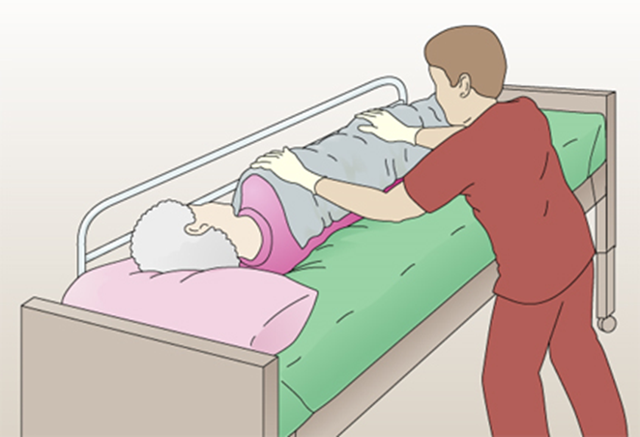
LO8, content 10
Making an occupied bed
You will make the bed one side at a time. Raise the far side rail (if used). Then go to the other side of the bed. Help the resident to turn onto her side toward the raised side rail.
Loosen the bottom soiled linen , mattress pad, and protector, if present, on the working side.
Roll the bottom soiled linen toward the resident, soiled side inside. Tuck it snugly against the resident’s back.

Slide 178
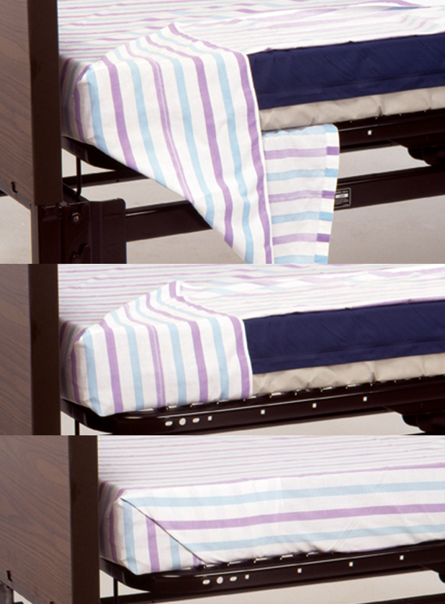
LO8, content 11
Making an occupied bed
Place the mattress pad (if used) on the bed, attaching elastic corners on the working side.
Place and tuck in clean bottom linen. Make hospital corners to keep bottom sheet wrinkle-free. Finish with the bottom sheet free of wrinkles.

Slide 179
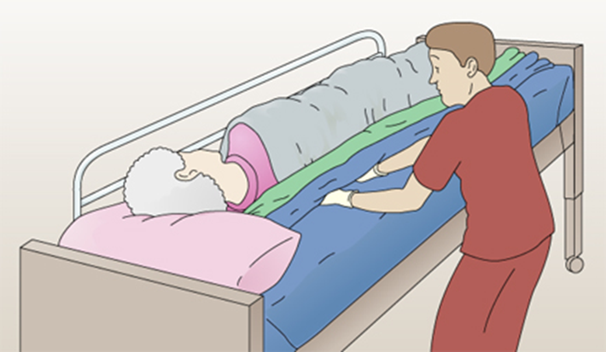
LO8, content 12
Making an occupied bed
Smooth the bottom sheet out toward the resident. Be sure there are no wrinkles in the mattress pad. Roll the extra material toward the resident. Tuck it under the resident’s body.
If using a disposable bed protector, unfold it and center it on the bed. Tuck the side near you under the mattress. Smooth it out toward the resident. Tuck as you did with the sheet.

Slide 180
LO8, content 13
Making an occupied bed
If using a draw sheet, place it on the bed. Tuck in on your side, smooth, and tuck as you did with the other bedding.
Raise side rail (if used) nearest you. Go to the other side of the bed and lower that side rail. Help the resident roll or turn onto clean bottom sheet toward you. Protect the resident from any soiled matter on the old linens.
Loosen the soiled linen. Check for any personal items. Roll linen from the head to the foot of the bed. Avoid contact with your skin or clothes. Place it in a hamper or bag. Never put it on the floor or furniture. Do not shake it. Soiled linens are full of microorganisms that should not be spread to other parts of the room.

Slide 181
LO8, content 14
Making an occupied bed
Pull the clean linen through as quickly as possible. Start with the mattress pad and wrap around corners. Pull and tuck in clean bottom linen just like the other side. Pull and tuck in bed protector and draw sheet (if used). Make hospital corners with the bottom sheet. Finish with bottom sheet free of wrinkles.
Ask resident to turn onto her back. Help as needed. Keep resident covered and comfortable, with a pillow under her head. Raise the side rail.
Unfold the top sheet. Place it over the resident and center it. Ask the resident to hold the top sheet. Slip the bath blanket or old sheet out from underneath. Put it in the hamper or bag.

Slide 182
LO8, content 15
Making an occupied bed
Place a blanket over the top sheet. Match the top edges. Tuck the bottom edges of top sheet, blanket and bedspread under the foot of the bed. Make hospital corners on each side. Loosen the top linens over the resident’s feet. At the top of the bed, fold the top sheet over the blanket about six inches.
Remove the pillow. Do not hold it near your face. Remove the soiled pillowcase by turning it inside out. Place it in the hamper or bag.
Remove and discard gloves. Wash your hands.

Slide 183
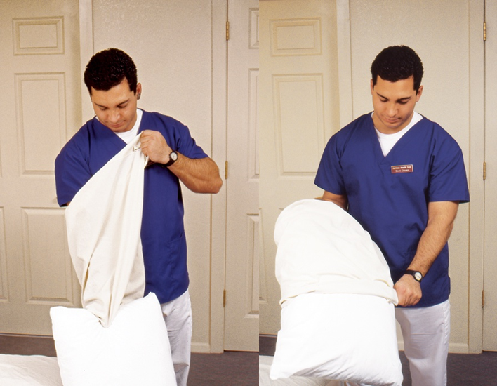
LO8, content 16
Making an occupied bed
With one hand, grasp the clean pillowcase at the closed end. Turn it inside out over your arm. Next, using the same hand that has the pillowcase over it, grasp one narrow edge of the pillow. Pull the pillowcase over it with your free hand. Do the same for any other pillows. Place them under resident’s head with open end away from door.
Make resident comfortable.

Slide 184
LO8, content 17
Making an occupied bed
Return bed to lowest position. Leave side rails in the ordered positions.
Place call light within resident’s reach.
Take laundry bag or hamper to proper area.
Wash your hands.
Report any changes in resident to the nurse.
Document procedure using facility guidelines.

Slide 185
LO8, content 18
Making an unoccupied bed
Equipment: clean linen—mattress pad, fitted or flat bottom sheet, disposable bed protector if needed, blanket(s), cotton draw sheet, flat top sheet, bedspread, pillowcase(s), gloves
Wash your hands.
Place clean linen on clean surface within reach (e.g., bedside stand, overbed table, or chair).
Adjust bed to a safe level, usually waist high. Put bed in flattest position. Lock bed wheels.
Put on gloves.
Loosen soiled linen. Roll soiled linen (soiled side inside) from head to foot of bed. Avoid contact with your skin or clothes. Place it in a hamper or bag. Do not put it on the floor or furniture. Remove pillows and pillowcases and place pillowcases in hamper or bag.
Remove and discard gloves. Wash your hands.

Slide 186
LO8, content 19
Making an unoccupied bed
Remake the bed. Start with the mattress pad and wrap around corners. Place and tuck in the clean bottom linen. Make hospital corners to keep the bottom sheet wrinkle-free. Put on the disposable bed protector and draw sheet, (if used), smooth, and tuck under sides of bed.
Place top sheet and blanket and bedspread (if used) over bed. Center these, tuck under end of bed, and make hospital corners. Fold down the top sheet over the blanket about six inches. Fold both top sheet and blanket down so resident can easily get into bed. If resident will not be returning to bed immediately, leave bedding up.
Put on clean pillowcases. Replace pillows.
Return bed to lowest position.
Take laundry bag or hamper to proper area.
Wash your hands.
Document procedure using facility guidelines.

Slide 187
LO9, content 1
Discuss dressings and bandages
NAs should remember these points about dressings:
  NAs do not change sterile dressings, which cover open or draining wounds.
  Non-sterile dressings are for wounds that have less chance of infection.
  NAs may change non-sterile dressings.

Slide 188
LO9, content 2
Changing a dry dressing using non-sterile technique
Equipment: package of square gauze dressings, adhesive tape, scissors, 2 pairs of gloves, plastic gloves
Identify yourself by name. Identify the resident by name.
Wash your hands.
Explain procedure to resident. Speak clearly, slowly, and directly. Maintain face-to-face contact whenever possible.
Provide for resident’s privacy with curtain, screen, or door.
Cut pieces of tape long enough to secure the dressing. Hang tape on the edge of a table within reach. Open the four-inch gauze square package without touching the gauze. Place the opened package on a flat surface.

Slide 189
LO9, content 3
Changing a dry dressing using non-sterile technique
Put on gloves.
Remove soiled dressing by gently peeling tape toward the wound. Lift dressing off the wound. Do not drag it over the wound. Observe dressing for any odor or drainage. Notice the color and size of the wound. Dispose of used dressing in proper container.
Remove and discard gloves in plastic bag. Wash your hands.

Slide 190
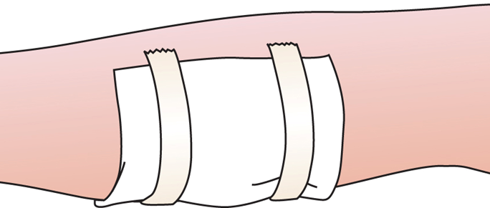
LO9, content 4
Changing a dry dressing using non-sterile technique
Put on clean gloves. Touching only outer edges of new gauze, remove it from package. Apply it to wound. Tape gauze in place. Secure firmly.
Discard supplies in proper container.
Remove and discard gloves.
Wash your hands.

Slide 191
LO9, content 5
Changing a dry dressing using non-sterile technique
Place call light within resident’s reach.
Report any changes in resident to the nurse.
Document procedure according to facility guidelines.

Slide 192
LO9, content 6
Discuss dressings and bandages
NAs should remember these points about elastic bandages:
  Elastic bandages hold dressings in place, secure splints, and support and protect body parts. They may decrease swelling from an injury.
  NAs may assist with use of an elastic bandage.
  Some states allow NAs to apply and remove elastic bandages. NAs must follow facility's policy.

Slide 193
LO9, content 7
Discuss dressings and bandages
If NAs are permitted to apply elastic bandages they must remember these guidelines:
  Keep area clean and dry.
  Apply snugly enough to control bleeding but make sure not to wrap too tightly, as this can decrease circulation.
  Wrap bandage evenly.
  Do not tie the bandage; use special clips.
  Remove bandage as indicated in care plan.

Slide 194
LO9, content 8
Discuss dressings and bandages
Guidelines for elastic bandages (cont’d):
  Ten to 15 minutes after bandage is applied, check for signs of poor circulation; loosen if any of these signs are present:
  Swelling
  Pale, gray, cyanotic or white skin
  Shiny, tight skin
  Skin that is cold to touch
  Sores
  Numbness
  Tingling
  Pain or discomfort

