Slide 2
Chapter 9, LO1, key terms 1
Discuss rehabilitation and restorative care
Define the following term:
rehabilitation
  care that is given by specialists to help restore or improve function after an illness or injury.
restorative care
  care given after rehabilitation to maintain a person's function, improve his quality of life and increase his independence.

Slide 3
LO1, content 1
Discuss rehabilitation and restorative care
Rehabilitation seeks to move the resident from
  Illness to health
  Disability to ability
  Dependence to independence

Slide 4
LO1, content 2
Discuss rehabilitation and restorative care
The goals of rehabilitation include the following:
  Help resident regain function or recover from illness
  Develop and promote a resident’s independence
  Help a resident to feel in control of his life
  Help resident accept or adapt to the limitations of a disability

Slide 5
LO1, content 3
Transparency 9-1: Assisting with Rehabilitation and Restorative Care
Be patient.
Be positive and supportive.
Focus on small tasks and small accomplishments.
Recognize that setbacks occur.
Be sensitive to the resident’s needs.
Encourage independence.
Provide privacy.
Involve residents in their care.

Slide 6
LO1, content 4
Discuss rehabilitation and restorative care
NAs should observe for and report the following signs and symptoms during rehabilitation and restorative care:
  Increase or decrease in abilities
  Change in attitude or motivation
  Change in general health
  Signs of depression or mood changes

Slide 7
LO2, content 1
Describe the importance of promoting independence and list ways exercise improves health
REMEMBER:
It is extremely important to encourage residents’ independence while assisting with or performing all tasks. Studies show that the more active a person is, the better the mind and body work.

Slide 8
LO2, content 2
Describe the importance of promoting independence and list ways exercise improves health
Lack of mobility can cause these problems:
  Loss of self-esteem
  Depression
  Anxiety
  Boredom
  Pneumonia
  Urinary tract infection
  Skin breakdown and pressure injuries
  Constipation

Slide 9
LO2, content 3
Describe the importance of promoting independence and list ways exercise improves health
Lack of mobility can cause these problems (cont’d):
  Blood clots
  Dulling of senses
  Muscle atrophy
  Contractures
  Problems with independence and self-esteem

Slide 10
LO2, content 4
Transparency 9-2:Regular Ambulation and Exercise
Regular ambulation and exercise help improve the following:
Quality and health of skin
Circulation
Strength
Sleep and relaxation
Mood
Self-esteem
Appetite
Elimination
Blood flow
Oxygen level

Slide 11
LO3, key terms 1
Discuss ambulation and describe assistive devices and equipment
Define the following terms:
ambulation
  walking.
ambulatory
  capable of walking.
assistive/adaptive devices
  special equipment that helps a person who is ill or disabled to perform activities of daily living.

Slide 12
LO3, content 1
Discuss ambulation and describe assistive devices and equipment
REMEMBER:
NAs should always check the care plan before helping a resident to ambulate, and must keep the resident’s limitations in mind.

Slide 13
LO3, content 2
Discuss ambulation and describe assistive devices and equipment
NAs should remember these guidelines for cane or walker use:
  Make sure cane or walker is in good condition.
  Make sure resident is wearing securely fastened, nonskid footwear.
  Resident should place cane on stronger side.
  Resident should place both hands on the walker, and walker should be placed no more than six inches in front of resident.
  Stay near resident on weaker side.
  Do not hang purses or clothing on walker.
  Report to nurse if cane or walker seems to be the wrong height.

Slide 14
LO3, content 3
Assisting a resident to ambulate
Equipment: gait belt, nonskid shoes for resident
Identify yourself by name. Identify the resident by name.
Wash your hands.
Explain procedure to resident. Speak clearly, slowly, and directly. Maintain face-to-face contact whenever possible.
Provide for resident’s privacy with curtain, screen, or door.
Adjust bed to lowest position. Lock bed wheels. Assist the resident into a sitting position. Make sure his feet are flat on the floor. Adjust the bed height if needed.

Slide 15
LO3, content 4
Assisting a resident to ambulate
Before ambulating, put nonskid footwear on the resident and fasten securely.
Stand in front of and face the resident. Place your feet about shoulder-width apart.
Place gait belt around the resident’s waist over his clothing (not on bare skin). Grasp belt securely on both sides with hands in the upward position.

Slide 16
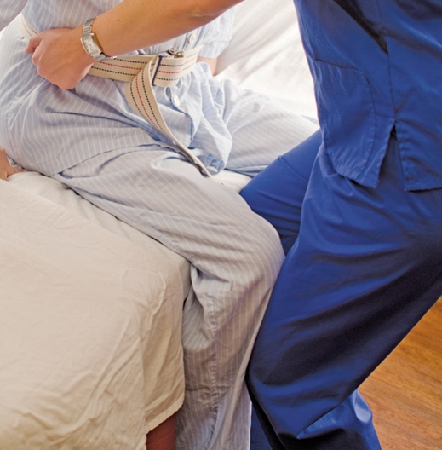
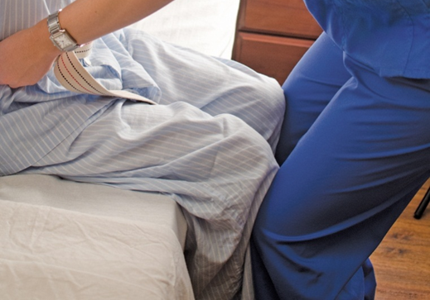
LO3, content 5
Assisting a resident to ambulate
If resident is unable to stand without help, brace (support) the resident’s lower extremities. This can be done by placing one or both of your knees against both of the resident’s knees. Bend your knees. Keep your back straight.

Slide 17
LO3, content 6
Assisting a resident to ambulate
Hold the resident close to your center of gravity. Provide instructions to allow the resident to help with standing. Tell the resident to lean forward, push down on the bed with his hands, and stand on the count of three. When you start to count, begin to rock. On three, with hands still grasping the gait belt on both sides and moving upward, rock your weight onto your back foot. Slowly help the resident to stand.

Slide 18
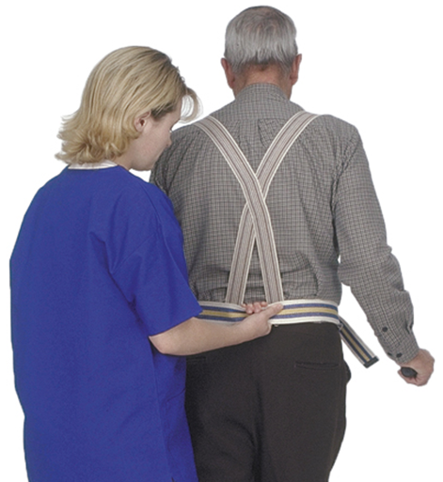
LO3, content 7
Assisting a resident to ambulate
Walk slightly behind and to one side of the resident for the full distance, while holding onto the gait belt. If the resident has a weaker side, stand on the weaker side. Use the hand that is not holding the belt to offer support on the weaker side. Ask the resident to look forward, not down at the floor, during ambulation.

Slide 19
LO3, content 8
Assisting a resident to ambulate
After ambulation, remove the gait belt. Help the resident to the bed or chair. Check that the resident is in proper alignment
Leave
bed in lowest position.
Place call light within resident’s reach.
Wash your hands.
Report any changes in resident to nurse.
Document procedure using facility guidelines.

Slide 20
LO3, content 9
Assisting with ambulation for a resident using a cane, walker, or crutches
Equipment: gait belt, nonskid shoes for the resident, cane, walker, or crutches
Identify yourself by name. Identify the resident by name.
Wash your hands.
Explain procedure to resident. Speak clearly, slowly, and directly. Maintain face-to-face contact whenever possible.
Provide for resident’s privacy with curtain, screen, or door.
Adjust bed to lowest position so that the feet are flat on the floor. Lock bed wheels.
Before ambulating, put nonskid footwear on resident and securely fasten.

Slide 21
LO3, content 10
Assisting with ambulation for a resident using a cane, walker, or crutches
Stand in front of and face resident. Place your feet about shoulder-width apart.
Place the gait belt around the resident’s waist over his clothing (not on bare skin). Grasp the belt securely on both sides with hands in the upward position.
If resident is unable to stand without help, brace (support) resident’s lower extremities (see previous procedure). Bend your knees. Keep your back straight. Help the resident to stand as described in the previous procedure.

Slide 22
LO3, content 11
Assisting with ambulation for a resident using a cane, walker, or crutches
Help as needed with ambulation.
Cane: Resident places cane about six inches, or a comfortable distance, in front of his stronger leg. He brings weaker leg even with cane. He then brings stronger leg forward slightly ahead of cane. Repeat.
Walker: Resident picks up or rolls the walker. He places it about six inches, or a comfortable distance, in front of him. All four feet or wheels of the walker should be on the ground before resident steps forward to the walker. The walker should not be moved again until the resident has moved both feet forward and is steady. The resident should never put his feet ahead of the walker.

Slide 23
LO3, content 12
Assisting with ambulation for a resident using a cane, walker, or crutches
Crutches: Resident should be fitted for crutches and taught to use them correctly by a physical therapist or nurse. The resident may use crutches several different ways. It depends on what his weakness is. No matter how they are used, weight should be on the resident’s hands and arms. Weight should not be on the underarm area.
Walk slightly behind and to one side of the resident for the full distance while holding the gait belt. If the resident has a weaker side, stand on the weaker side.
Watch for obstacles in the resident’s path. Ask the resident to look forward, not down at the floor, during ambulation.

Slide 24
LO3, content 13
Assisting with ambulation for a resident using a cane, walker, or crutches
Encourage resident to rest if he is tired. When a person
is tired, it increases the chance of a fall. Let the resident set the pace. Discuss how far he plans to go based
on the care plan.
After ambulation, remove gait belt. Help resident to the bed or chair. Check that the resident is in proper alignment.
Leave bed in lowest position.
Place call light within resident’s reach.
Wash your hands.
Report any changes in resident to nurse.
Document procedure using facility guidelines.

Slide 25
LO3, content 14
Discuss ambulation and describe assistive devices and equipment
REMEMBER:
There are many devices available to help people who are recovering from or adapting to a physical condition. NAs should be aware that residents may need time to adjust to using these devices. Residents using new aids to ambulation will likely be off-balance. NAs should stay close by and observe residents for signs of dizziness.

Slide 26
LO4, content 1
Explain guidelines for maintaining proper body alignment
REMEMBER:
Proper body alignment aids recovery and prevents injury to muscles and joints.

Slide 27
LO4, content 2
Transparency 9-3 Proper Body Alignment:
Observe principles of alignment.
Keep body parts in natural positions.
Prevent external rotation of hips.
Change positions often, at least every two hours.
Give back rubs as ordered.

Slide 28
LO5, key terms 1
Describe care guidelines for prosthetic devices
Define the following terms:
amputation
  the surgical removal of some or all of a body part, usually a hand, arm, leg, or foot.
phantom sensation
  warmth, itching, or tingling in a body part that has been amputated.

Slide 29
LO5, key terms 2
Describe care guidelines for prosthetic devices
Define the following terms:
phantom limb pain
  pain in a limb (or extremity) that has been amputated.
prosthesis
  a device that replaces a body part that is missing or deformed because of an accident, injury, illness, or birth defect; used to improve a person’s ability to function and/or to improve appearance.

Slide 30
LO5, content 1
Describe care guidelines for prosthetic devices
NAs should remember these guidelines for amputation and prosthetic devices:
  Be supportive.
  Help residents with their ADLs.
  Handle prostheses carefully and follow the care plan.
  Follow the nurse’s or therapist’s instructions in applying and removing the prosthesis. Follow manufacturer’s care directions.
  Keep prosthesis and skin under it dry and clean.
  Apply stump sock if ordered.

Slide 31
LO5, content 2
Describe care guidelines for prosthetic devices
Guidelines for amputation and prosthetic devices (cont’d):
  Observe skin on stump and watch for signs of breakdown.
  Never try to fix a prosthesis.
  Do not show negative feelings about the stump during care.
  Treat phantom limb pain as real pain.
  If caring for an artificial eye, wash your hands before handling the eye. Wear gloves. Never clean or soak the eye in rubbing alcohol – it will crack and destroy it.
  Store artificial eye in water or saline. Make sure container is labeled with resident’s name and room number.

Slide 32
LO6, key terms 1
Describe how to assist with range of motion exercises
Define the following terms:
range of motion (ROM)
  exercises that put a joint through its full arc of motion.
abduction
  moving a body part away from the midline of the body.
adduction
  moving a body part toward the midline of the body.
dorsiflexion
  bending backward.
rotation
  turning a joint.
extension
  straightening a body part.

Slide 33
LO6, key terms 2
Describe how to assist with range of motion exercises
Define the following terms:
flexion
  bending a body part.
pronation
  turning downward.
supination
  turning upward.
opposition
  touching the thumb to any other finger.

Slide 34
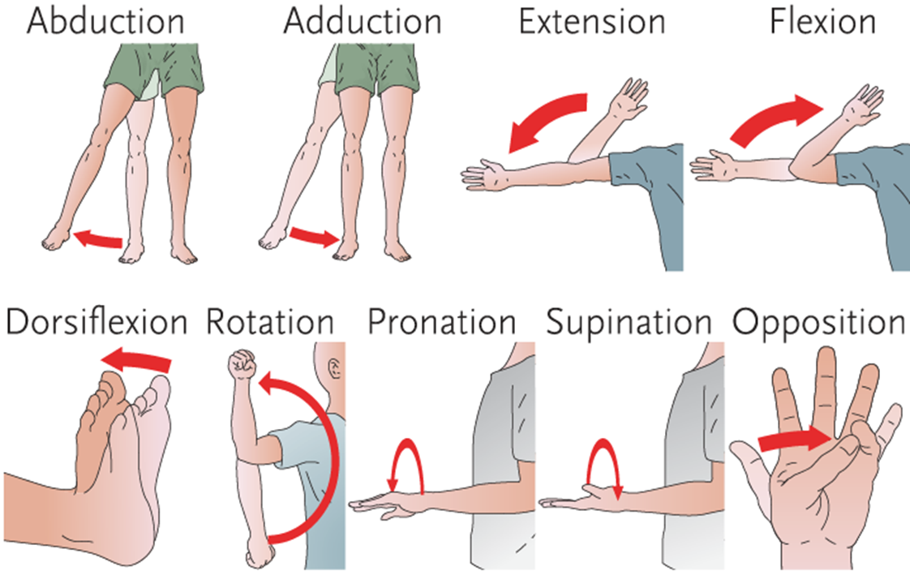
LO6, content 1
Transparency 9-4: Body Movements

Slide 35
LO6, content 2
Describe how to assist with range of motion exercises
There are different types of ROM exercises:
  PROM: NA does all the work and resident does none.
  AROM: NA encourages, but resident does all the work.
  AAROM: NA assists and supports the resident in doing the work.

Slide 36
LO6, content 3
Assisting with passive range of motion exercises
Identify yourself by name. Identify the resident by name.
Wash your hands.
Explain procedure to resident. Speak clearly, slowly, and directly. Maintain face-to-face contact whenever possible.
Provide for resident’s privacy with curtain, screen, or door.
Adjust bed to a safe level, usually waist high. Lock bed wheels.
Position the resident lying supine—flat on her back—on the bed. Use proper alignment. Ask the resident to let you know if she has any pain during the procedure.
While supporting the limbs, move all joints gently, slowly, and smoothly through the range of motion to the point of resistance. Repeat each exercise at least three times. Ask the resident if an exercise is causing pain. Stop if resident appears to be in pain or reports pain.

Slide 37
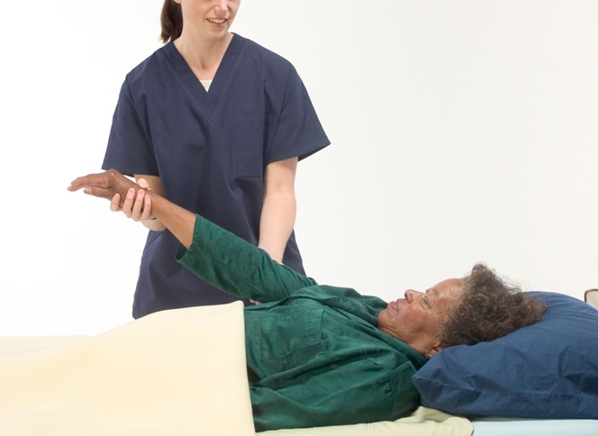

LO6, content 4
Assisting with passive range of motion exercises
Shoulder: Support the resident’s arm at the elbow and wrist while performing ROM for the shoulder. Place one hand under the elbow and the other hand under the wrist. Raise the straightened arm from the side position upward toward head to ear level. Return arm down to side of the body (extension/flexion).

Slide 38
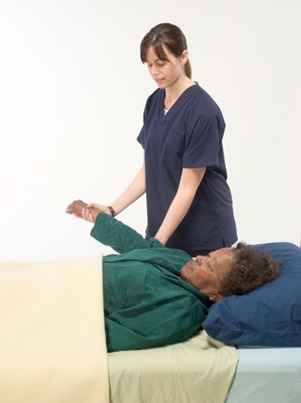
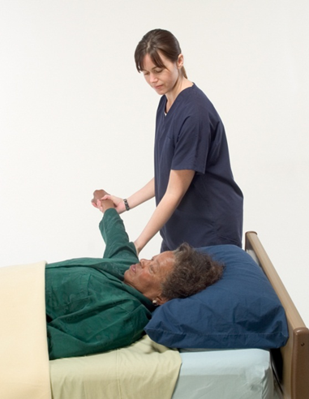

LO6, content 5
Assisting with passive range of motion exercises
  Move straightened arm away from side of body to shoulder level. Return arm to side of body (abduction/adduction).

Slide 39
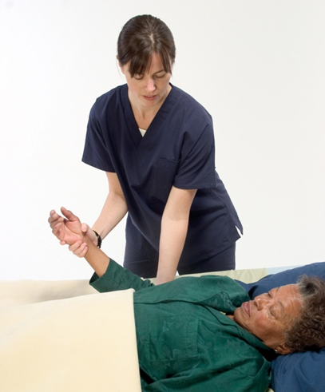

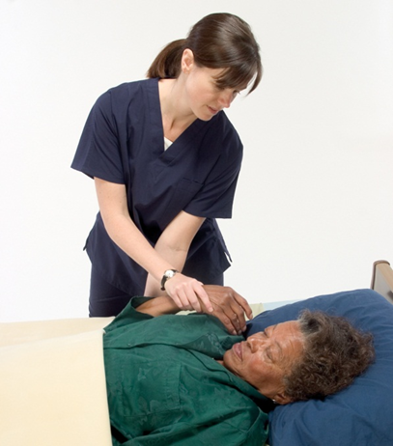

LO6, content 6
Assisting with passive range of motion exercises
Elbow: Hold the resident’s wrist with one hand and the elbow with the other hand. Bend the elbow so that the hand touches the shoulder on that same side (flexion). Straighten the arm (extension)

Slide 40
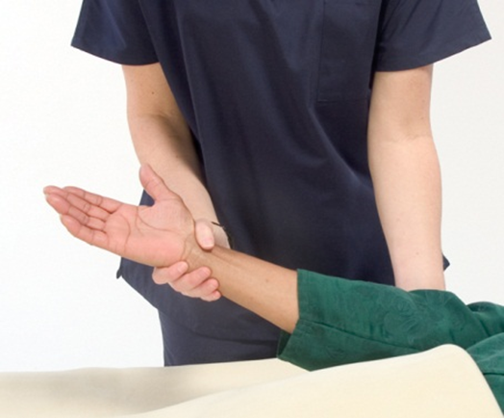


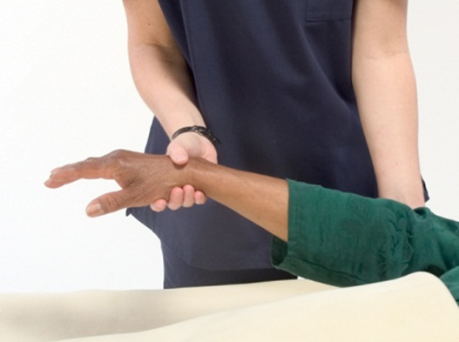


LO6, content 7
Assisting with passive range of motion exercises
  Exercise the forearm by moving it so the palm is facing downward (pronation) and then the palm is facing upward (supination).

Slide 41
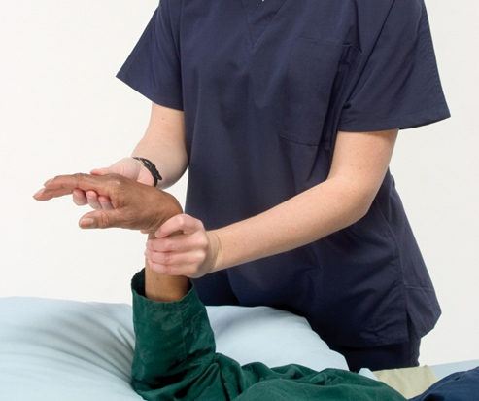

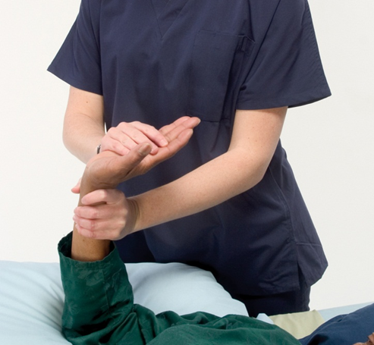

LO6, content 8
Assisting with passive range of motion exercises
Wrist: Hold the wrist with one hand. Use the fingers of the other hand to help move the joint through the motions. Bend the hand down (flexion); bend the hand backward (dorsiflexion)

Slide 42
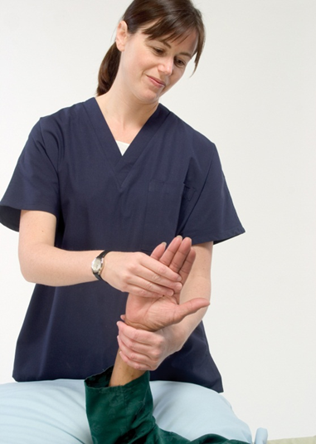

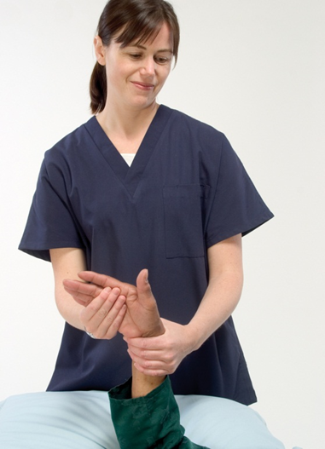

LO6, content 9
Assisting with passive range of motion exercises
  Turn the hand in the direction of the thumb (radial flexion). Then turn the hand in the direction of the little finger (ulnar flexion).

Slide 43
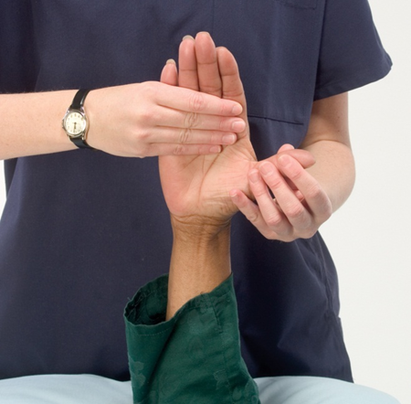

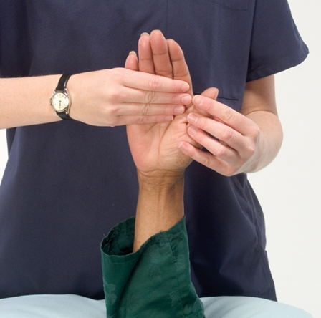

LO6, content 10
Assisting with passive range of motion exercises
Thumb: Move the thumb away from the index finger (abduction). Move the thumb back next to the index finger (adduction).

Slide 44
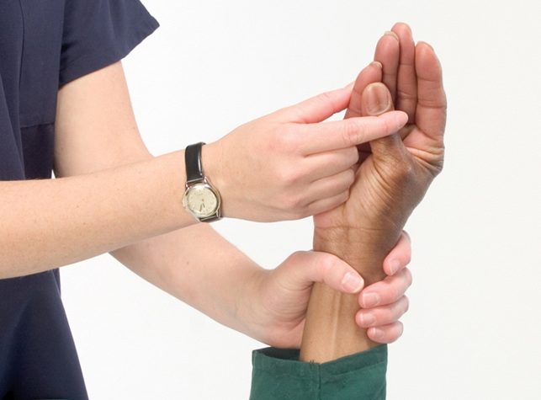
LO6, content 11
Assisting with passive range of motion exercises
  Touch each fingertip with the thumb (opposition).

Slide 45
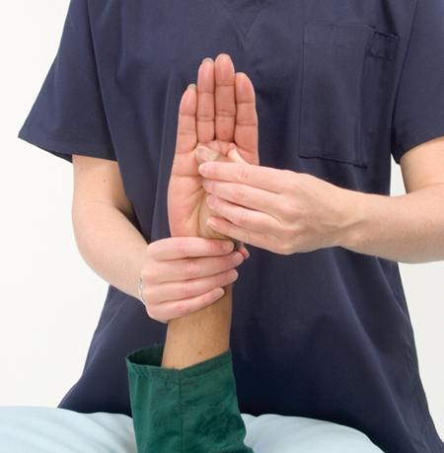

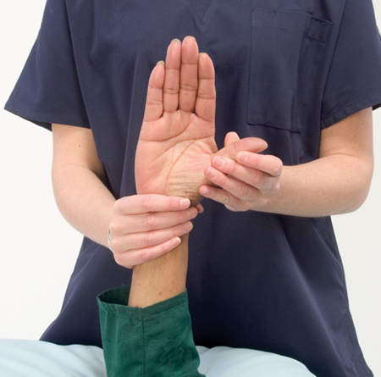

LO6, content 12
Assisting with passive range of motion exercises
  Bend thumb into the palm (flexion) and out to the side (extension).

Slide 46
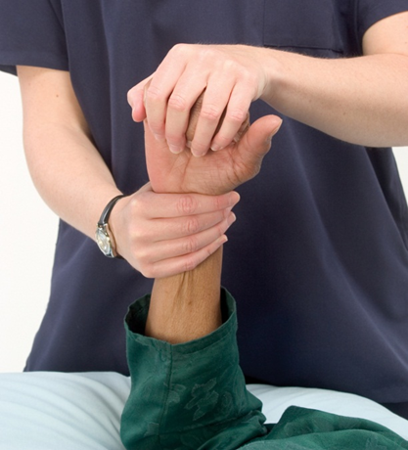
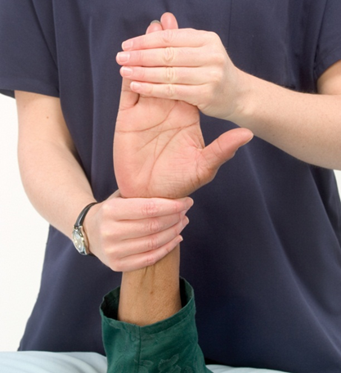
LO6, content 13
Assisting with passive range of motion exercises
Fingers: Make the hand into a fist (flexion). Gently straighten out the fist (extension).

Slide 47
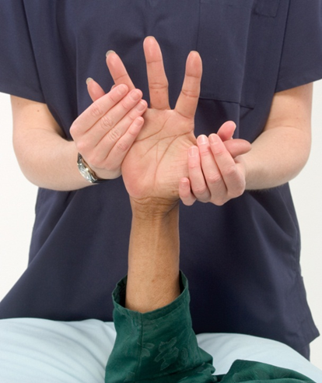

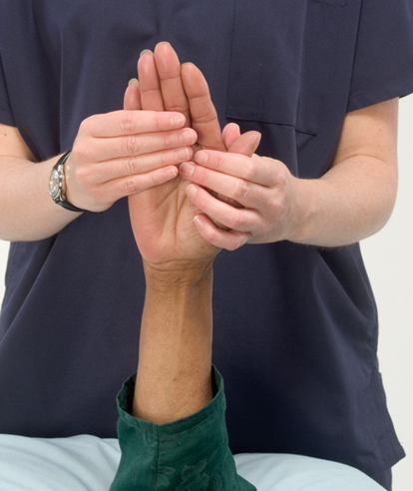


LO6, content 14
Assisting with passive range of motion exercises
  Spread the fingers and the thumb far apart from each other (abduction). Bring the fingers back next to each other (adduction).

Slide 48
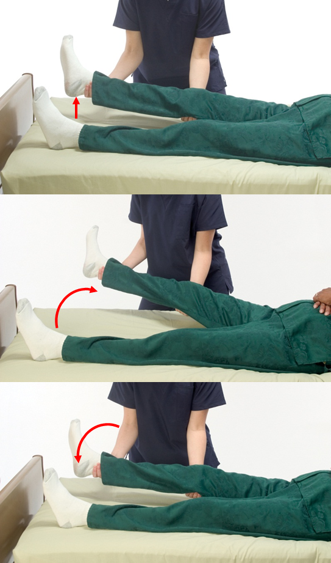
LO6, content 15
Assisting with passive range of motion exercises
Hip: Support the leg by placing one hand under the knee and one under the ankle. Straighten the leg and gently raise it upward. Move the leg away from the other leg (abduction). Move the leg toward the other leg (adduction).

Slide 49
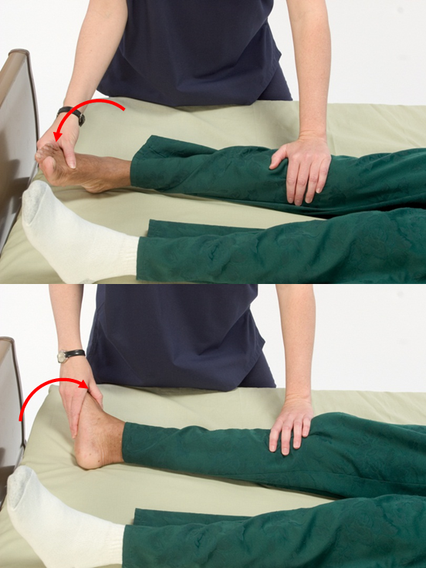
LO6, content 16
Assisting with passive range of motion exercises
  Gently turn the leg inward (internal rotation), then turn the leg outward (external rotation).

Slide 50
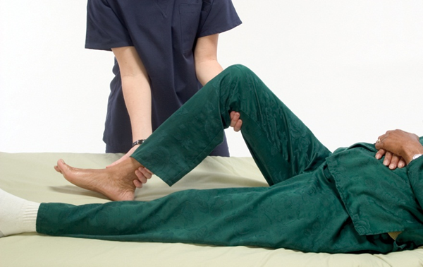
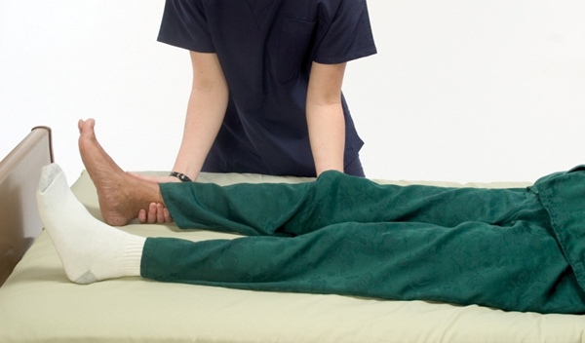
LO6, content 17
Assisting with passive range of motion exercises
Knee: Support the leg under the knee and under the ankle while performing ROM for the knee. Bend the knee to the point of resistance (flexion). Return leg to resident’s normal position (extension).

Slide 51
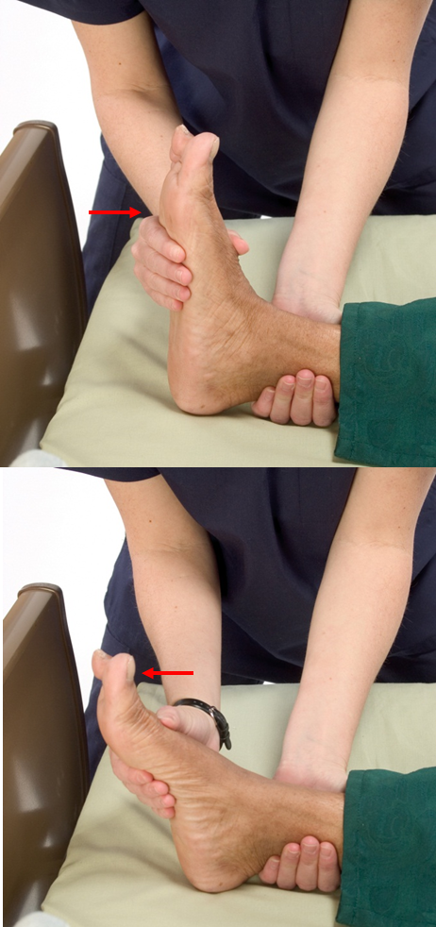
LO6, content 18
Assisting with passive range of motion exercises
Ankle: Support the foot and ankle close to the bed while performing ROM for the ankle. Push/pull foot up toward the head (dorsiflexion). Push/pull foot down, with the toes pointed down (plantar flexion).

Slide 52
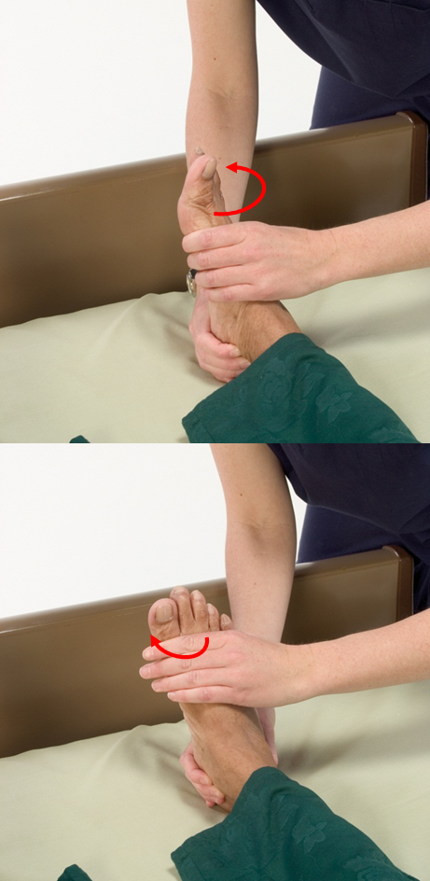
LO6, content 19
Assisting with passive range of motion exercises
  Turn the inside of the foot inward toward the body (supination). Bend the sole of the foot so that it faces away from the body (pronation).

Slide 53
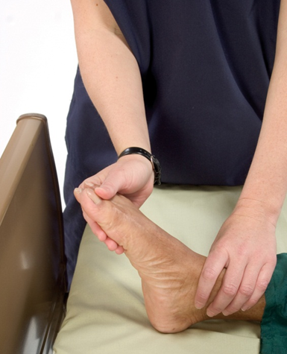
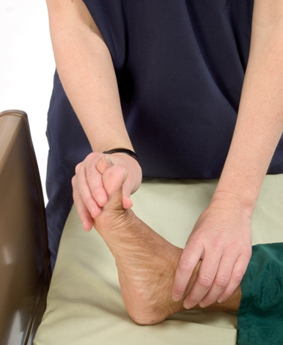
LO6, content 20
Assisting with passive range of motion exercises
Toes: Curl and straighten the toes (flexion and extension).

Slide 54
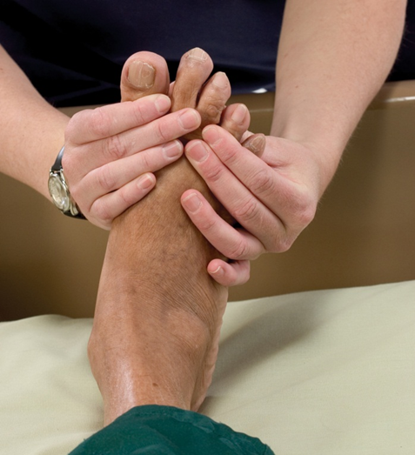

LO6, content 21
Assisting with passive range of motion exercises
  Gently spread the toes apart (abduction).

Slide 55
LO6, content 22
Assisting with passive range of motion exercises
Return resident to comfortable position. Return bed to lowest position.
Place call light within resident’s reach.
Wash your hands.
Report any changes in resident to nurse.
Document procedure using facility guidelines. Note any decrease in range of motion or any pain experienced by the resident. Notify the nurse or the physical therapist if you find increased stiffness or physical resistance. Resistance may be a sign that a contracture is developing.

Slide 56
LO7, content 1
List guidelines for assisting with bladder and bowel retraining
When assisting with bladder or bowel retraining it is important that NAs follow these guidelines:
  Follow Standard Precautions. Wear gloves.
  Explain the schedule to the resident. Follow the schedule.
  Keep a record of resident’s bladder and bowel habits. This will help you predict when a resident will need to eliminate.
  Offer a bedpan or a trip to the bathroom before long procedures.
  Encourage plenty of fluids.
  Encourage foods that are high in fiber.
  Answer call lights promptly.

Slide 57
LO7, content 2
List guidelines for assisting with bladder and bowel retraining
Guidelines for bowel and bladder retraining (cont’d):
  Provide privacy—both in the bed and in the bathroom.
  If resident has trouble urinating, try running water in the sink or suggest she lean forward slightly.
  Do not rush resident.
  Assist with careful perineal care.
  Discard wastes properly.
  Discard clothing protectors and incontinence briefs properly.

Slide 58
LO7, content 3
List guidelines for assisting with bladder and bowel retraining
Guidelines for bowel and bladder retraining (cont’d):
  If your facility uses washable bed protectors or briefs, follow Standard Precautions when handling these items.
  Keep an accurate record of urination and bowel movements, including episodes of incontinence.
  Praise successes and attempts to control bladder or bowels. However, do not talk to residents as if they were children.
  Never show frustration or anger.
  Be positive and patient. Praise and encouragement are essential. Report changes in the skin.

Slide 59
LO7, content 4
List guidelines for assisting with bladder and bowel retraining
REMEMBER:
It is very important that NAs keep a positive attitude when assisting residents who are going through retraining. Imagining what it would feel like to be unable to control elimination can help create empathy for the residents.

