Slide 1
CHAPTER 1
ELECTROCARDIOGRAPHY

Slide 2
Key Terms
Cardiovascular disease (C V D).
Coronary artery disease (C A D).
Electrocardiogram (E C G).
Electrocardiograph.
Myocardial infarction (M I; heart attack).
Notes:
LO 1.1: Describe the history and the importance of the ECG.
_____
Cardiovascular disease (CVD): Disease related to the heart and blood vessels (veins and arteries).
Coronary artery disease (CAD): Narrowing of the blood vessels surrounding the heart, causing a reduction of blood flow.
Electrocardiogram: A tracing of the heart’s electrical activity recorded by an electrocardiograph.
Electrocardiograph: An instrument used to record the electrical activity of the heart.
Myocardial infarction (MI; heart attack): Occlusion (blockage) of one or more of the coronary arteries causing lack of oxygen to the heart and death of the muscle tissue.

Slide 3
The E C G and Its History 1
Cardiovascular disease (C V D) ‒ #1 cause of death in United States.
Coronary artery disease (C A D).
Narrowing of heart arteries.
Affects 1 in 3 American adults.
Approximately 2,500 Americans die every day because of C A D.
Notes:
LO 1.1: Describe the history and the importance of the ECG.
-----
Approximately 2,500 Americans die every day because of CAD.
Hypertension is high blood pressure.

Slide 4
The E C G and Its History 2
Electrocardiograph.
Records heart’s electrical activity.
Produces electrocardiogram (E C G).
History.
Willem Einthoven (18 60 – 19 27).
Today’s machines.
Fast.
Digital communication.
Notes:
LO 1.1: Describe the history and the importance of the ECG.
-----
Einthoven invented the first electrocardiograph, for which he won the Nobel Prize in Physiology or Medicine in 1924.
Today’s advanced machines allow healthcare professionals to monitor patients from remote locations.

Slide 5
Learning Outcome 1.1 Apply Your Knowledge #1 1
What is the name of the instrument that allows the electrical activity of the heart to be studied?
Notes:
LO 1.1: Describe the history and the importance of the ECG.

Slide 6
Learning Outcome 1.1 Apply Your Knowledge #1 2
What is the name of the instrument that allows the electrical activity of the heart to be studied?
Answer:
The electrocardiograph
Notes:
LO 1.1: Describe the history and the importance of the ECG.

Slide 7
Learning Outcome 1.1 Apply Your Knowledge #2 1
Who was credited with the development of the first electrocardiograph?
Notes:
LO 1.1: Describe the history and the importance of the ECG.

Slide 8
Learning Outcome 1.1 Apply Your Knowledge #2 2
Who was credited with the development of the first electrocardiograph?
Answer:
Wilhelm Einthoven
Notes:
LO 1.1: Describe the history and the importance of the ECG.

Slide 9
Learning Outcome 1.2 Uses of an E C G 1
Key Terms
Automatic external defibrillator (A E D).
Cardiopulmonary resuscitation (C P R).
Cardiovascular technologist.
Code Blue.
Defibrillator.
Notes:
LO 1.2: Identify the uses of an ECG and opportunities for an electrocardiographer.
_____
Automatic external defibrillator (AED): A lightweight, portable device that recognizes an abnormal rhythm and determines whether it is considered a “shockable rhythm.”
Cardiopulmonary resuscitation (CPR): The provision of ventilations (breaths) and chest compressions (blood circulation) for a person who shows no signs of breathing or having a heartbeat.
Cardiovascular technologist:
Code Blue: A code blue indicates a medical emergency such as cardiac or respiratory arrest and notifies healthcare providers that assistance is needed immediately.
Defibrillator: A machine that produces and sends an electrical shock to the heart in an attempt to correct the electrical pattern of the heart.

Slide 10
Learning Outcome 1.2 Uses of an E C G 2
Key Terms
Dysrhythmia.
E C G monitor technician.
Electrocardiograph (E C G) technician.
Stat.
Telemedicine.
Notes:
LO 1.2: Identify the uses of an ECG and opportunities for an electrocardiographer.
_____
Dysrhythmia: Abnormal heartbeat.
ECG monitor technician: An individual who has the technical knowledge and skills to view and evaluate the electrical tracings of patients’ hearts on a monitor and, when necessary, alert the appropriate healthcare professional to treat abnormalities.
Electrocardiograph (ECG) technician: An individual who has advanced skills and can assist physicians with invasive cardiovascular diagnostic tests and procedures, such as angioplasty or cardiac device implants.
Stat: Immediately
Telemedicine: A monitoring system in which ECG tracings are communicated from a patient outside a medical facility to the physician via a telephone or digital system.

Slide 11
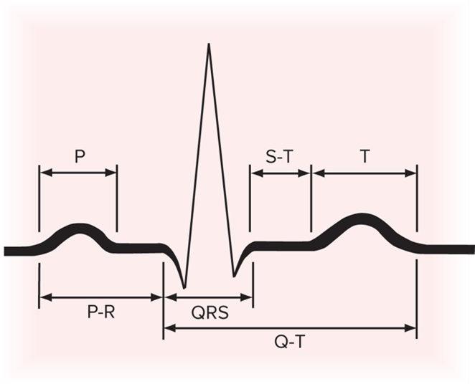
Uses of an E C G
Healthcare providers.
Study E C G to learn about patient’s heart.
Baseline tracing helps diagnose future abnormalities.
Access the text alternative for slide images.
Notes:
LO 1.2: Identify the uses of an ECG and opportunities for an electrocardiographer.
-----
The American Heart Association (AHA) recommends that individuals over the age of 40 have an ECG done annually as part of a complete physical.

Slide 12
Uses of an E C G—Hospital
12-lead E C G.
Routine—before surgery.
Code Blue—emergency E C G required stat.
Continuous monitoring.
Patients in C C U (cardiac care unit), S I C U (surgical intensive care unit), or E D (emergency department).
During surgery.
Telemetry monitoring.
Notes:
LO 1.2: Identify the uses of an ECG and opportunities for an electrocardiographer.
-----
The 12-lead ECG is one of the most commonly used ECGs in hospital settings.
CCU: cardiac care unit
SICU: surgical intensive care unit
ED: emergency department
Telemetry monitoring allows the patient to move around; the ECG tracing is transmitted in real time to a monitoring station.

Slide 13
Uses of an E C G—Doctors’ Offices and Ambulatory Care Clinics
12-lead E C G.
Routine—part of wellness exam.
Baseline recordings.
Treadmill stress testing.
Holter monitoring.
Notes:
LO 1.2: Identify the uses of an ECG and opportunities for an electrocardiographer.
-----
Conditions that can be detected using an ECG include heart rate or rhythm disorders, other cardiovascular disorders, electrolyte imbalances, certain drug toxicities, metabolic disorders, and congenital heart disease.
ECGs are also used to assess damage after an MI or after chest trauma or injury to the brain or spinal cord, to assess heart condition prior to surgery, assess the effects of medications, and evaluate pacemaker function.
Treadmill stress testing, or exercise electrocardiography, helps determine whether the patient’s heart is getting adequate blood flow during stress or exercise.
Holter monitoring monitors the heart for 24 to 48 hours, or even up to 30 days, while the patient performs usual daily activities. This monitoring can help find issues that do not show up during a 12-lead ECG.

Slide 14
Uses of an E C G—Outside of a Healthcare Facility: Portable E C G
During cardiac emergencies.
Portable E C G machines used at site of emergency.
Tracing transmitted to physician or assessed by emergency personnel.
Notes:
LO 1.2: Identify the uses of an ECG and opportunities for an electrocardiographer.
-----

Slide 15
Uses of an E C G—Outside of a Healthcare Facility: Defibrillator
Defibrillator.
Automatic external defibrillator (A E D).
Sudden cardiac arrest.
Serious dysrhythmias.
May suggest shock or cardiopulmonary resuscitation (C P R).
Notes:
LO 1.2: Identify the uses of an ECG and opportunities for an electrocardiographer.
-----
A defibrillator produces an electrical shock to the heart intended to correct the heart’s electrical pattern.
An AED recognizes abnormal heart rhythms and determines whether an electric shock will help correct it.
The best way to learn how to use an AED is to take a healthcare-provider-level CPR course. However, the AED does allow laypeople to perform defibrillation safely.

Slide 16
Uses of an E C G—Outside of a Healthcare Facility: Telemedicine
Telemedicine.
Transtelephonic monitoring.
Digital monitoring.
Types of telemedicine monitors.
Continuous.
Symptom-based.
Notes:
LO 1.2: Identify the uses of an ECG and opportunities for an electrocardiographer.
-----
Transtelephonic monitoring means “transmitted over the telephone.”
Digital monitoring allows ECG data to be recorded with a computer and then transmitted over the Internet to the healthcare facility.
Continuous monitoring records the ECG tracing constantly, so it can be used to record the tracing before, during, and after symptoms occur.
Symptom-based monitoring records only when activated by the patient, so it does not record the tracing before symptoms occur. However, it is faster to review because it does not record as much information.

Slide 17
Career Opportunities in E C G
Exclusively in E C G.
Electrocardiograph (E C G) technician.
E C G monitor technician.
Cardiovascular technologist.
As part of another profession.
Medical assistant.
Nurse.
Emergency medical technicians.
Paramedics.
Notes:
LO 1.2: Identify the uses of an ECG and opportunities for an electrocardiographer.
_____
ECG Technician:
Records the ECG and prepares a report for the clinician.
Determines accuracy of the tracing and recognizes interference abnormalities.
Usually employed in hospitals, but may work in: medical offices, cardiac rehabilitation centers, other health care facilities
ECG Monitoring Technician:
View and evaluate the electrical tracings
Employed by hospitals and other in-patient facilities
Alert the health care professional of abnormal heart rhythms.
Cardiovascular Technologist:
Requires extensive training
Assist physicians with invasive cardiovascular diagnostic tests, such as:
Angioplasty
Heart surgery
Implantation of artificial pacemakers
Performs ultrasounds on the blood vessels
Performs ECGs

Slide 18
Learning Outcome 1.2 Apply Your Knowledge #1 1
What device allows laypeople to provide emergency defibrillation to someone in cardiac arrest?
Notes:
LO 1.2: Identify the uses of an ECG and opportunities for an electrocardiographer.

Slide 19
Learning Outcome 1.2 Apply Your Knowledge #1 2
What device allows laypeople to provide emergency defibrillation to someone in cardiac arrest?
Answer:
An automatic external defibrillator (A E D)
Notes:
LO 1.2: Identify the uses of an ECG and opportunities for an electrocardiographer.

Slide 20
Learning Outcome 1.2 Apply Your Knowledge #2 1
Which healthcare professional views E C G tracings in real time and notifies a healthcare practitioner of any abnormalities?
Notes:
LO 1.2: Identify the uses of an ECG and opportunities for an electrocardiographer.

Slide 21
Learning Outcome 1.2 Apply Your Knowledge #2 2
Which healthcare professional views E C G tracings in real time and notifies a healthcare practitioner of any abnormalities?
Answer:
E C G monitor technician.
Notes:
LO 1.2: Identify the uses of an ECG and opportunities for an electrocardiographer.

Slide 22
Learning Outcome 1.3 Preparing for an E C G
Key Terms
Ethics.
Law.
Libel.
Medical professional liability.
Slander.
Notes:
LO 1.3: Troubleshoot legal, ethical, patient education, and communication issues related to the ECG.
_____
Ethics: Standards of behavior and concepts of right and wrong; based on moral values formed through the influence of family, culture, and society.
Law: A rule of conduct that is enforced by a controlling authority such as the government.
Libel: Writing defamatory words about someone; both illegal and unethical.
Medical professional liability: Healthcare professionals are legally responsible for their performance.
Slander: Making derogatory remarks or speaking defamatory words about someone; both illegal and unethical.

Slide 23
Legal and Ethical Issues
Laws.
Rules of conduct.
Enforced by controlling authority.
Ethics.
Standards of behavior.
Concepts of right and wrong.
Based on moral values.
Notes:
LO 1.3: Troubleshoot legal, ethical, patient education, and communication issues related to the ECG.
-----
Illegal acts are always unethical, but unethical acts are not always illegal.
Nevertheless, all healthcare personnel should act both lawfully and ethically at all times.

Slide 24
H I P A A
Health Insurance Portability and Accountability Act.
Federal law that sets national standards for electronic healthcare transactions.
Limits and secures use of electronic patient data.
Helps ensure patient privacy.
Notes:
LO 1.3: Troubleshoot legal, ethical, patient education, and communication issues related to the ECG.
-----
Established in 1996, HIPAA states that a patient’s information cannot be shared among healthcare professionals unless it is necessary for the patient’s treatment.

Slide 25
Ethics
Code of ethics.
Confidentiality.
Respect.
Dignity.
Acting professionally.
Cooperate with co-workers, supervisors, and other healthcare professionals.
Continue education and training.
Notes:
LO 1.3: Troubleshoot legal, ethical, patient education, and communication issues related to the ECG.
-----
A code of ethics is a standard of behavior or conduct as defined by a professional group or by an employer.
Confidentiality is a basic right of every patient. Breaches of confidentiality are unethical and illegal.
Treating patients with respect and dignity includes:
Respecting privacy.
Avoiding exposure of patient’s body (close door, pull curtain, or drape patient)
Having a third person present during certain procedures, depending on facility policy

Slide 26
Medical Professional Liability
Healthcare professionals are held accountable for:
Performing unlawful acts (Malfeasance).
Performing legal acts improperly (Misfeasance).
Failing to perform an act when necessary (Nonfeasance).
Notes:
LO 1.3: Troubleshoot legal, ethical, patient education, and communication issues related to the ECG.
Tom - Malfeasance, misfeasance and nonfeasance all are related to malpractice.
-----
Examples
Unlawful act: Keeping patient’s property if the patient leaves it behind
Legal act performed improperly: Reporting test results improperly
Failing to perform an act: Taking a break while you are supposed to be monitoring a patient

Slide 27
Slander and Libel
Slander.
Making derogatory remarks about someone.
Libel.
Writing defamatory words about someone.
Both slander and libel are illegal and unethical.
Notes:
LO 1.3: Troubleshoot legal, ethical, patient education, and communication issues related to the ECG.
-----
Derogatory remarks or words are those that harm the person’s reputation or are insulting or disrespectful.

Slide 28
Documentation
All medical care and treatment must be documented.
Part of the medical record.
Medical record can be used in court.
Complete documentation provides legal protection.
Provides for continuity of care.
Notes:
LO 1.3: Troubleshoot legal, ethical, patient education, and communication issues related to the ECG.
----
Documentation should include:
Patient identification and personal information
Patient medical history
Dates and times of all events: appointments, admissions, discharges, diagnostic tests
Diagnostic test results
Symptoms and reasons for all events
Physical examinations and records of results, including patient instructions
Medications and prescriptions
Informed consent when required
Name of legal guardian or representative, if patient cannot give informed consent
Informed consent: Patient’s signed consent that he or she understands the procedure and its risks, alternative procedures and their risks, and potential risks if the procedure is not performed.

Slide 29
Consent
Patient must provide consent before the procedure is performed.
Written consent.
Implied consent.
If patient cannot read:
Explain to patient with witness present.
Patient signs with X.
Witness signs as well.
Notes:
LO 1.3: Troubleshoot legal, ethical, patient education, and communication issues related to the ECG.
----
Documentation should include:
Patient identification and personal information
Patient medical history
Dates and times of all events: appointments, admissions, discharges, diagnostic tests
Diagnostic test results
Symptoms and reasons for all events
Physical examinations and records of results, including patient instructions
Medications and prescriptions
Informed consent when required
Name of legal guardian or representative, if patient cannot give informed consent
Informed consent: Patient’s signed consent that he or she understands the procedure and its risks, alternative procedures and their risks, and potential risks if the procedure is not performed.

Slide 30
Patient Education and Communication
Develop a positive relationship and atmosphere.
Reduce patient fears.
Explain the procedure clearly.
Answer questions.
Use simple terms.
Speak slowly and distinctly.
Notes:
LO 1.3: Troubleshoot legal, ethical, patient education, and communication issues related to the ECG.
-----
If necessary, explain that the ECG does not produce electricity; it is safe and harmless.
Maintain a friendly, confident manner to help increase the patient’s confidence in your ability.

Slide 31
Learning Outcome 1.3 Apply Your Knowledge #1 1
True or False: The practice of confidentiality is essential to the practice of ethics in medicine.
Notes:
LO 1.3: Troubleshoot legal, ethical, patient education, and communication issues related to the ECG.

Slide 32
Learning Outcome 1.3 Apply Your Knowledge #1 2
True or False: The practice of confidentiality is essential to the practice of ethics in medicine.
Answer:
True; confidentiality is an essential part of caring for the patient and is required by H I P A A.
Notes:
LO 1.3: Troubleshoot legal, ethical, patient education, and communication issues related to the ECG.

Slide 33
Learning Outcome 1.3 Apply Your Knowledge #2 1
Who should sign a consent form if a patient cannot read or write?
Notes:
LO 1.3: Troubleshoot legal, ethical, patient education, and communication issues related to the ECG.

Slide 34
Learning Outcome 1.3 Apply Your Knowledge #2 2
Who should sign a consent form if a patient cannot read or write?
Answer:
Explain the procedure to the patient with a witness present. Then have the patient place an “X” on the form and have the witness sign the form as well.
Notes:
LO 1.3: Troubleshoot legal, ethical, patient education, and communication issues related to the ECG.

Slide 35
Learning Outcome 1.4 Infection Control
Key Terms
Filtering facepiece respirator (F F R).
Isolation precautions.
Personal protective equipment (P P E).
Standard precautions.
Notes:
LO 1.4: Perform infection control measures required for the ECG.
_____
Filtering facepiece respirator (EFR): Specialized PPE mask to be worn when caring for patients with or with the potential for respiratory illnesses or contagious diseases.
Isolation precautions: The second level of steps taken to prevent the spread of infection; used when a specific infection is known or suspected. Examples include separating the infected person from others and using personal protective equipment.
Personal protective equipment (PPE): Devices such as gloves, gowns, face masks or shields, and eye protection designed to protect a healthcare worker from sources of infection.
Standard precautions: Procedures, such as performing hand hygiene and wearing gloves, that are used with all patients and are designed to prevent the spread of infection.

Slide 36
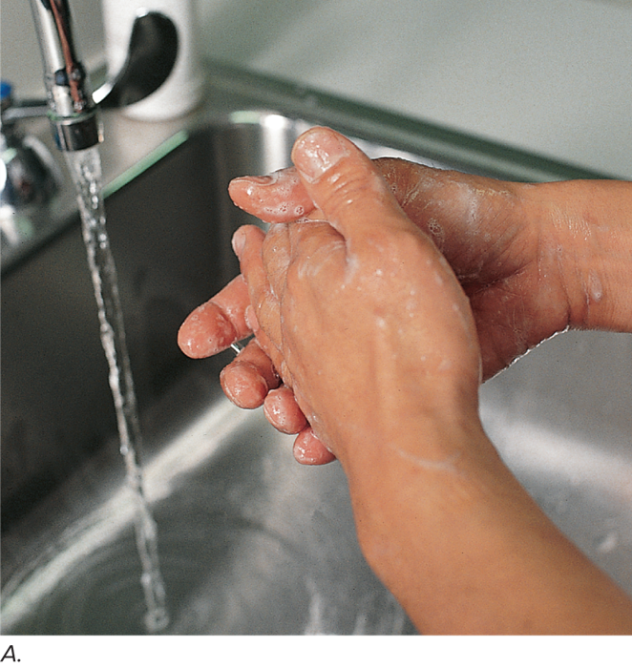
Standard Precautions 1
Perform hand hygiene.
Wear gloves when possibility of exposure to:
Blood.
Body fluids, secretions, and excretions (except sweat).
Nonintact skin.
Mucous membranes.
Jill Braaten/McGraw Hill
Notes:
LO 1.4: Perform infection control measures required for the ECG.
-----
Standard precautions are based on recommendations from the Centers for Disease Control and Prevention (CDC). They are applied for all patients.
Performing hand hygiene is the single most important thing you can do to prevent the spread of infection.
Wash hands or use an alcohol-based rub (if no visible soilage is present):
Between patients
Between procedures
Before putting on gloves
After removing gloves

Slide 37
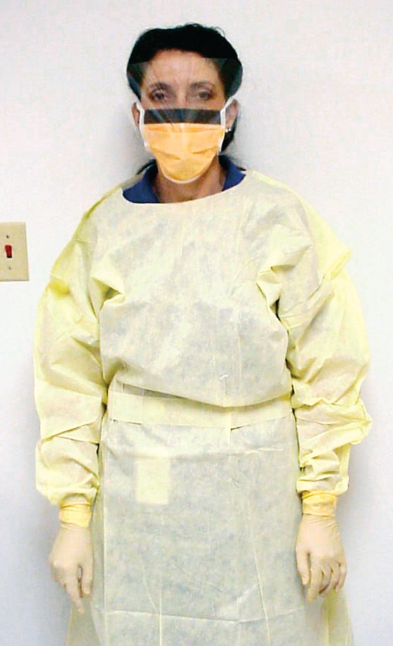
Standard Precautions 2
Standard precautions also include:
Wearing personal protective equipment (P P E) when required.
Avoiding artificial nails.
Keeping natural nails no more than ¼-inch long.
Total Care Programming, Inc.
Notes:
LO 1.4: Perform infection control measures required for the ECG.
-----
Personal protective equipment includes gloves, masks, eye protection, face shields, and gowns.

Slide 38
Isolation Precautions
Based on how the infectious agent is transmitted.
Airborne precautions.
Droplet precautions.
Contact precautions.
Notes:
LO 1.4: Perform infection control measures required for the ECG.
-----
Airborne precautions require special air handling, ventilation, and additional respiratory protection (N-95 or other filtering facepiece respirators).
Droplet precautions require mucous membrane protection (goggles, masks).
Contact precautions requires gloves and gowns for direct skin-to-skin contact or for contact with contaminated linen, equipment, etc.…

Slide 39
Learning Outcome 1.4 Apply Your Knowledge #1 1
You have been asked to perform an E C G on a patient who is in a wheelchair and cannot move to the procedure table by herself. The patient weighs 245 lb. What should you do?
Notes:
LO 1.4: Perform infection control measures required for the ECG.

Slide 40
Learning Outcome 1.4 Apply Your Knowledge #1 2
You have been asked to perform an E C G on a patient who is in a wheelchair and cannot move to the procedure table by herself. The patient weighs 245 lb. What should you do?
Answer:
If the patient cannot help, find a co-worker to help you move the patient.
Notes:
LO 1.4: Perform infection control measures required for the ECG.

Slide 41
Learning Outcome 1.4 Apply Your Knowledge #2 1
You are about to run an E C G on a patient known to have tuberculosis, which can be spread through the air to infect people close to the patient. What type of precautions should you use?
Notes:
LO 1.4: Perform infection control measures required for the ECG.

Slide 42
Learning Outcome 1.4 Apply Your Knowledge #2 2
You are about to run an E C G on a patient known to have tuberculosis, which can be spread through the air to infect people close to the patient. What type of precautions should you use?
Answer:
Airborne precautions, including a respirator, gloves, gown, and goggles or face shield.
Notes:
LO 1.4: Perform infection control measures required for the ECG.

Slide 43
Learning Outcome 1.5 Vital Signs
Key Terms
Auscultated blood pressure
Cardiac output
Diastolic blood pressure
Hypertension
Hypotension
Tilt table test
Systolic blood pressure
Vital signs
Notes:
LO 1.5: Compare basic vital sign measurements related to the ECG.
_____
Auscultated blood pressure: Blood pressure determined while listening with a stethoscope.
Cardiac output: The volume of blood the heart pumps per minute.
Diastolic blood pressure: The blood pressure measured when the heart relaxes; the minimum amount of pressure exerted against the vessel walls at all times.
Hypertension: High blood pressure.
Hypotension: A lower-than-normal blood pressure that can cause reduction of blood flow to vital organs.
Systolic blood pressure: The blood pressure measured when the left ventricle of the heart contracts.
Tilt table test: A test to determine whether a change in a patient’s blood pressure or heart rate due to a change of position is causing symptoms of lightheadedness or fainting.
Vital signs: Temperature, pulse, respiration, blood pressure, and pain assessment.

Slide 44
Vital Signs
Pulse.
Respiration.
Blood pressure.
Temperature.
Pulse oximetry.
Weight.
Pain assessment.
Notes:
LO 1.5: Compare basic vital sign measurements related to the ECG.
_____
Changes in vital signs may be a normal response to stress, heat, exertion, or other environmental factors. However, they may also be an indication of an abnormality that requires attention by healthcare professionals.
Normal ranges:
Pulse: 60 to 100 beats per minute (bpm)
Respirations: 12 to 20 per minute
Blood pressure: Systolic – less than 120; diastolic – less than 80

Slide 45
Pulse
Indirect measurement of cardiac output.
Usually measured at the radial or carotid artery.
Count for 1 minute.
Rate.
Rhythm.
Volume.
Notes:
LO 1.5: Compare basic vital sign measurements related to the ECG.
_____
The cardiac output is the volume of blood the heart pumps each minute.
Low cardiac output may result if the pulse is weak, irregular, or abnormally fast or slow.
Do not use your thumb to measure a patient’s pulse, because your thumb also has a pulse.

Slide 46
Respiration
Rate indicates oxygen supply to tissues.
Watch, listen, or feel for patient respirations.
Do not tell patient you are counting respirations.
Count for 1 minute.
Rate.
Rhythm.
Effort.
Irregularities.
Notes:
LO 1.5: Compare basic vital sign measurements related to the ECG.
_____
If the patient is aware that you are counting respirations, he or she may unconsciously alter the breathing pattern.
Rhythm: regular or irregular
Effort: normal, shallow, deep
Irregularities: hyperventilation, dyspnea, tachypnea, hyperpnea; rales, and rhonchi

Slide 47
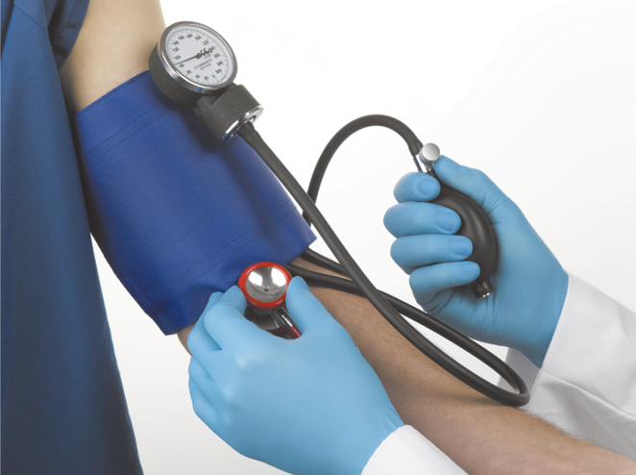
Blood Pressure
Force with which blood is pumped against the arterial walls.
Systole = contraction phase of heart = Systolic blood pressure.
Diastole = relaxation phase of heart = Diastolic blood pressure.
Jeffrey Coolidge/Stockbyte/Getty Images
Notes:
LO 1.5: Compare basic vital sign measurements related to the ECG.
_____
Systolic blood pressure represents the maximum amount of pressure exerted against the vessel walls.
Diastolic blood pressure represents the minimum amount of pressure, which is exerted against the vessel walls at all times.

Slide 48
Factors Affecting Blood Pressure
Hypertension - blood pressure numbers judged to be above normal.
Hypotension - blood pressure numbers judged to be below normal.
Internal factors.
Cardiac output.
Blood volume.
Vasoconstriction.
Blood viscosity.
Notes:
LO 1.5: Compare basic vital sign measurements related to the ECG.
_____
Vasoconstriction: constriction of the veins
Blood volume: Total amount of blood in the body
Blood viscosity: blood thickness
Essential hypertension (also known as Primary or Idiopathic hypertension): no identifiable cause
Secondary hypertension: caused by some other condition, such as kidney, heart disease or pregnancy

Slide 49
Measuring Blood Pressure
Place B P cuff (sphygmomanometer) 1 to 2 inches above antecubital space.
Determine palpatory pressure, if necessary.
Release cuff for 30 to 60 seconds.
Determine auscultated blood pressure.
Notes:
LO 1.5: Compare basic vital sign measurements related to the ECG.
_____
Sphygmomanometer: blood pressure cuff
Antecubital space: the inside of the bend of the elbow
Palpatory pressure: Approximate systolic blood pressure; finds target peak inflation and prevents overinflation
Never apply a blood pressure cuff over clothing.

Slide 50
Learning Outcome 1.5 Apply Your Knowledge #1 1
How can you count respirations without letting the patient know you are counting them?
Notes:
LO 1.5: Compare basic vital sign measurements related to the ECG.

Slide 51
Learning Outcome 1.5 Apply Your Knowledge #1 2
How can you count respirations without letting the patient know you are counting them?
Answer:
Tell the patient you want to listen to his or her lungs, or count the respirations while you have your fingers on the patient’s pulse.
Notes:
LO 1.5: Compare basic vital sign measurements related to the ECG.

Slide 52
Learning Outcome 1.5 Apply Your Knowledge #2 1
What is the difference between palpatory and auscultated blood pressure?
Notes:
LO 1.5: Compare basic vital sign measurements related to the ECG.

Slide 53
Learning Outcome 1.5 Apply Your Knowledge #2 2
What is the difference between palpatory and auscultated blood pressure?
Answer:
Palpatory blood pressure is an estimate of the patient’s systolic pressure and is used to find the target peak cuff inflation.
Auscultated blood pressure is a measurement of the systolic and diastolic blood pressure and is performed with a stethoscope.
Notes:
LO 1.5: Compare basic vital sign measurements related to the ECG.

Slide 54
Chapter 1 Summary
An E C G is.
A tracing of the heart’s electrical activity.
Used in the diagnosis of cardiovascular disease.
Uses of an E C G:
In the hospital as a part of a routine exam or during emergencies.
In doctors’ offices and clinics as part of a routine exam, stress test, or Holter monitoring.
Outside of healthcare facilities in emergencies or via telemedicine.
Notes:
LO 1.1: Describe the history and the importance of the ECG.
LO 1.2: Identify the uses of an ECG and opportunities for an electrocardiographer.

Slide 55
Chapter Summary 1
Legal and ethical issues in preparing for an E C G include:
Protecting patient information (H I P A A).
Practicing ethically and legally.
Understanding medical professional liability.
Avoiding slander and libel.
Documenting all care and treatment.
Obtaining informed consent when necessary.
Educating and communicating with the patient.
Notes:
LO 1.3: Troubleshoot legal, ethical, patient education, and communication issues related to the ECG.

Slide 56
Chapter Summary 2
Infection control procedures include use of standard precautions, personal protective equipment (P P E), and isolation precautions.
Vital signs include pulse, respiration, blood pressure, temperature, and pain assessment.
Vital signs provide information about the patient’s state of health.
Notes:
LO 1.4: Perform infection control measures required for the ECG.
LO 1.5: Compare basic vital sign measurements related to the ECG.

