Slide 1
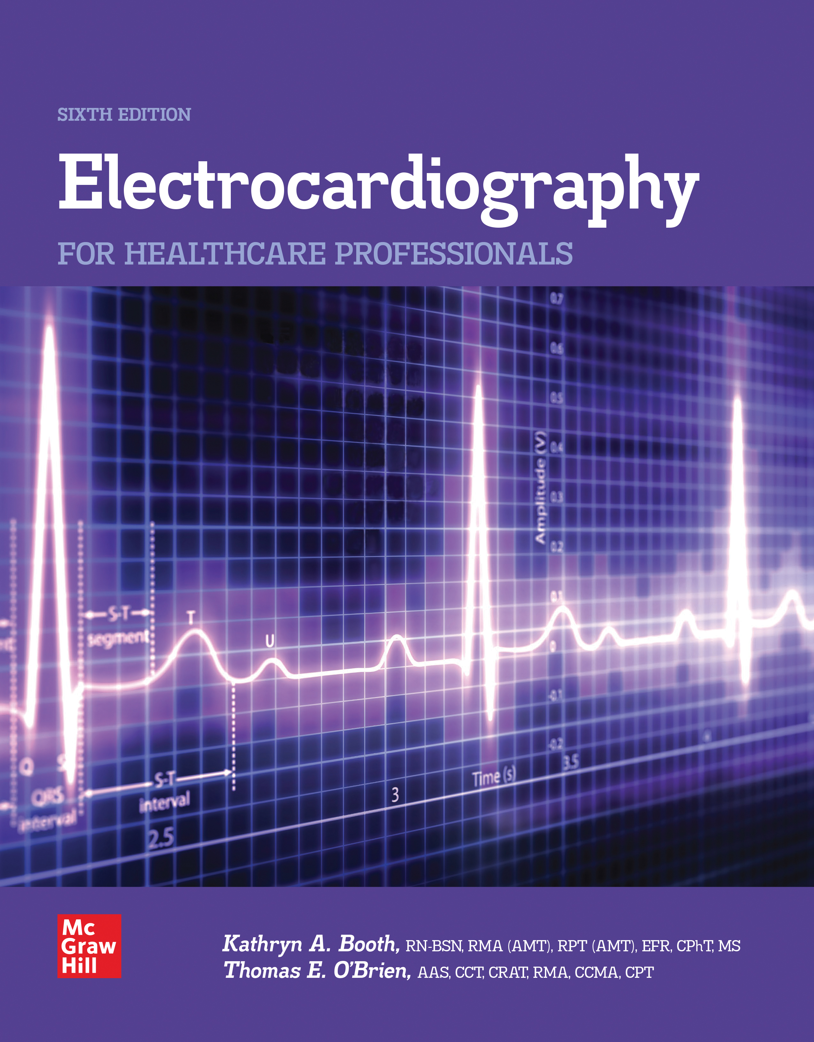
Chapter 3
The Electrocardiograph
Access the text alternative for slide images.
© McGraw Hill LLC. All rights reserved. No reproduction or distribution without the prior written consent of McGraw Hill LLC.

Slide 2
CHAPTER 3
Electrocardiograph

Slide 3
Learning Outcome 3.1
Producing the E C G Waveform
Key Terms
Augmented lead.
Bipolar lead.
Einthoven’s triangle.
Electrodes.
Leads.
Limb lead.
Precordial lead.
Unipolar lead.
Notes:
LO 3.1: Explain the three types of leads and how each is recorded.
-----
Augmented lead: Normally small ECG lead tracings that are increased in size by the ECG machine in order to be interpreted.
Bipolar lead: A type of ECG lead that measures the flow of electrical current in both directions.
Einthoven triangle: A triangle formed by three of the limb electrodes—the left arm, the right arm, and the left leg; it is used as a reference for the first six leads of the 12-lead ECG.
Electrodes: Small sensors placed on the skin to detect the electrical activity from the heart.
Leads: Covered wires that conduct the electrical impulse from the electrodes to the ECG machine.
Limb lead: Lead that attaches to the arms or legs.
Precordial lead: A type of lead placed on the chest in front of the heart; known as a V lead.
Unipolar lead: A type of ECG lead that measures the flow of electrical current in one direction only.

Slide 4
Producing the E C G Waveform
The 12-lead E C G produces a complete picture of the heart’s electrical activity.
The E C G waveform indicates how the heart is functioning electrically.
Each lead in a 12-lead E C G produces a single view from a slightly different angle.
Notes:
LO 3.1: Explain the three types of leads and how each is recorded.
-----
The 12 views provided by the 12-lead ECG provide information about how electrical impulses travel through various parts of the heart.

Slide 5
12-Lead E C G 1
10 lead wires.
Six chest leads.
Four limb leads.
Coded by color and letter.
Each lead is attached to an electrode.
Notes:
LO 3.1: Explain the three types of leads and how each is recorded.
-----
The term lead refers to the view on the ECG tracing, the physical location where the electrode is placed on the patient, and the cable that attaches the electrode to the ECG machine.
Chest leads are also referred to as Precordial leads.

Slide 6
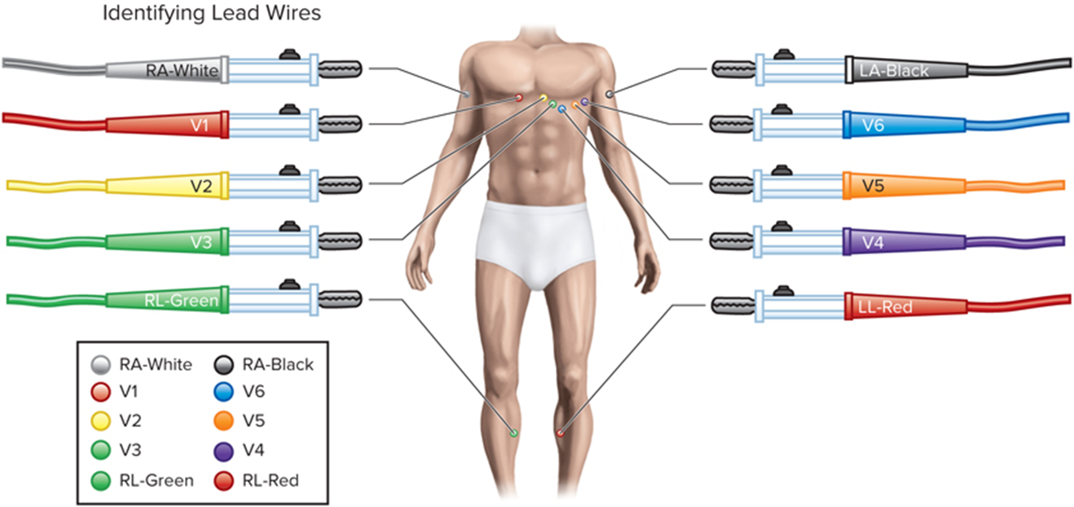
Identifying Lead Wires
Access the text alternative for slide images.
Notes:
LO 3.1: Explain the three types of leads and how each is recorded.
-----

Slide 7
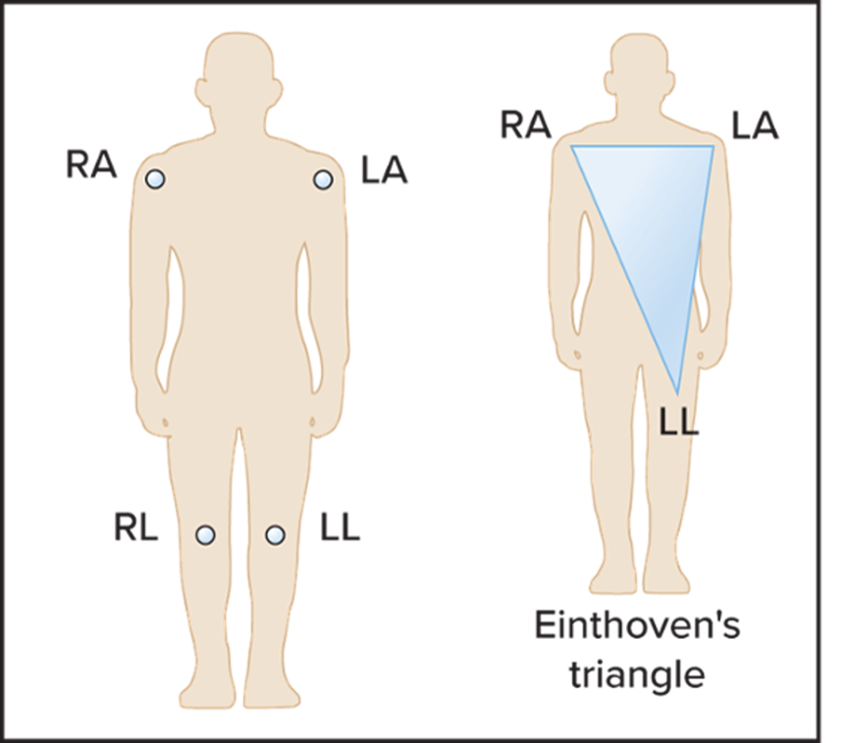
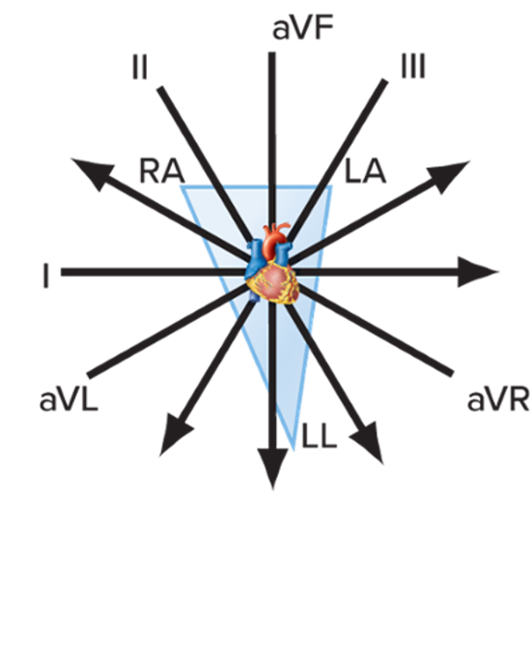
Einthoven’s Triangle
Access the text alternative for slide images.
Notes:
LO 3.1: Explain the three types of leads and how each is recorded.
-----
The Einthoven triangle is formed by the electrodes on the right arm, left arm, and left leg. The right leg is used only as a ground or reference electrode.

Slide 8
Waveform Types
Isoelectric – flat, no current flowing.
Positive – upright, current flows to positive electrode.
Negative – downward, current flows away from positive electrode.
Notes:
LO 3.1: Explain the three types of leads and how each is recorded.
-----

Slide 9
Types of Leads
10 lead wires.
Three standard leads.
Three augmented leads.
Six chest leads.
Produce 12 different views.
Notes:
LO 3.1: Explain the three types of leads and how each is recorded.
-----
The first three leads are known as standard limb leads and are bipolar.
The second three leads are known as augmented leads. They are unipolar leads.
Augmented leads must be increased in size by the ECG machine in order for the waveforms to be useful for clinical analysis.
The last six leads are the chest leads. Also known as precordial leads, they are unipolar.

Slide 10
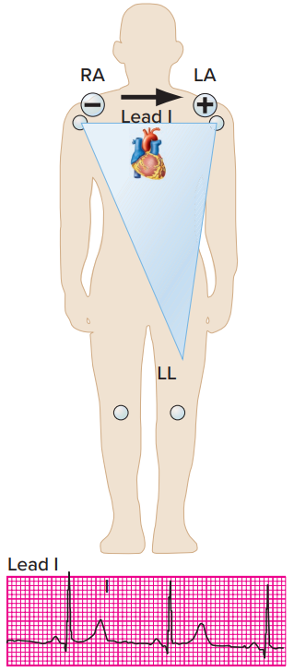
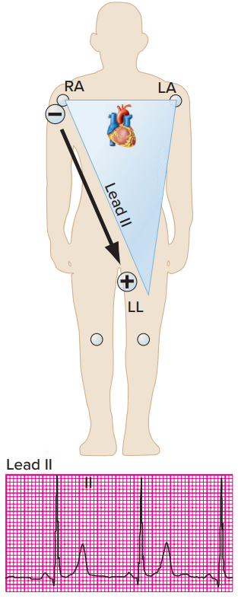
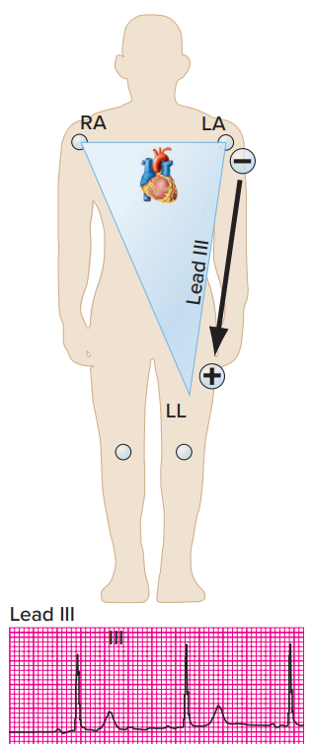
Standard Limb Lead Tracings
Access the text alternative for these images.
Notes:
LO 3.1: Explain the three types of leads and how each is recorded.
-----

Slide 11
Augmented Leads
a V R
Records activity from heart to right arm.
Usually produces a negative deflection.
a V L
Records activity from heart to left arm.
a V F
Records activity from heart to left leg.
Notes:
LO 3.1: Explain the three types of leads and how each is recorded.
-----
Known as augmented leads because their tracings are increased in size by the ECG machine. They are unipolar—they measure current in one direction only.
If aVR does not produce a negative deflection, check the electrodes or lead wires for incorrect placement.

Slide 12
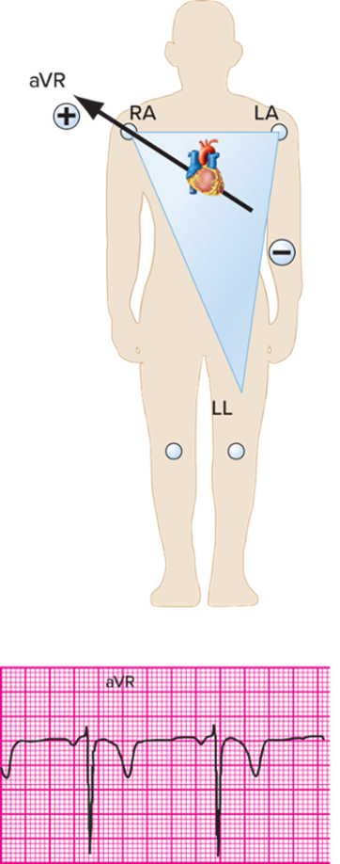
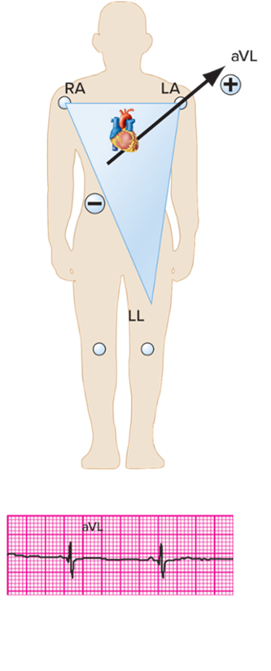
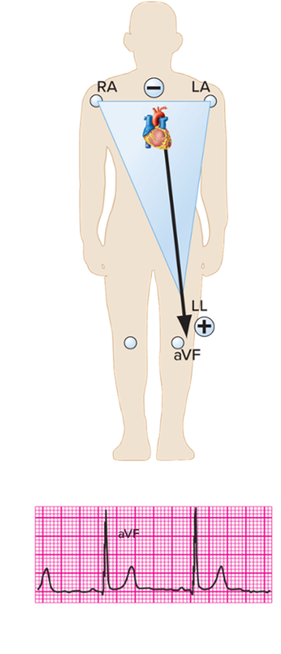
Augmented Lead Tracings
Access the text alternative for these images.
Notes:
LO 3.1: Explain the three types of leads and how each is recorded.
-----

Slide 13
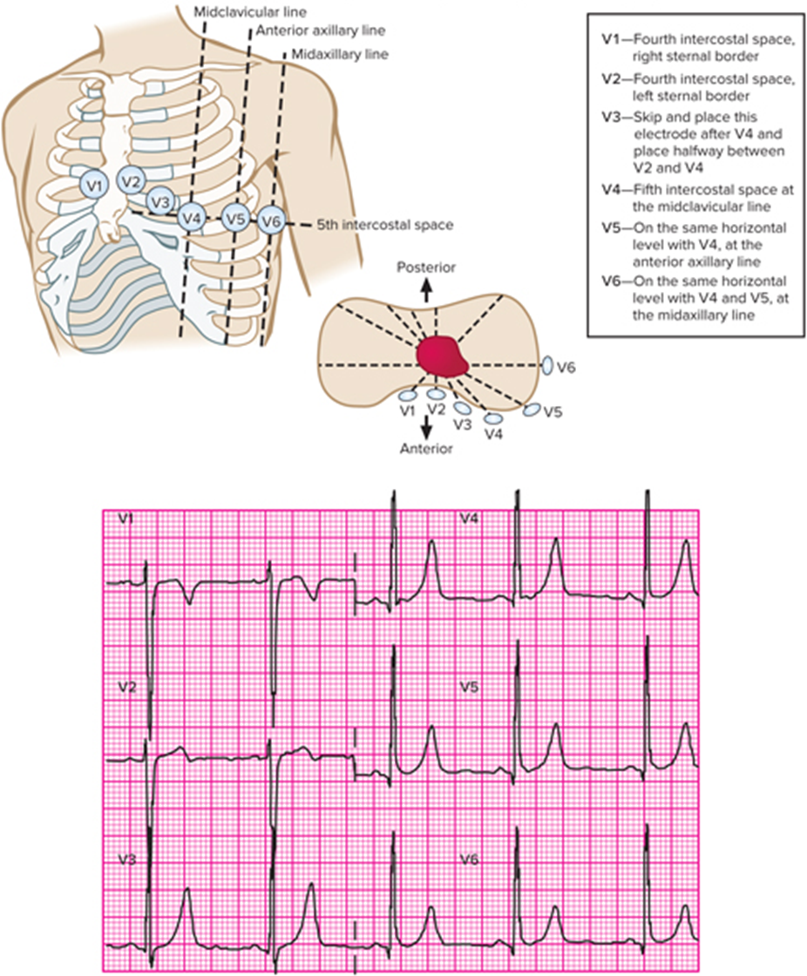
Chest Lead Placement and Tracings
Access the text alternative for slide images.
Notes:
LO 3.1: Explain the three types of leads and how each is recorded.
-----
The chest leads are unipolar.
Electrode placements:
V1 – 4th intercostal space, right sternal border
V2 – 4th intercostal space, left sternal border
V3 – Halfway between V2 and V4
V4 – 5th intercostal space at the midclavicular line
V5 – On the same horizontal level with V4, at the anterior axillary line
V6 – On the same horizontal level with V4 and V5, at the mid axillary line

Slide 14
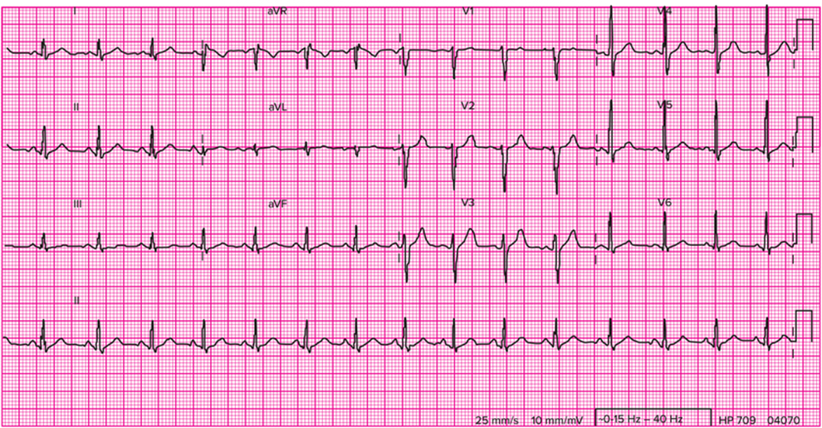
12-lead E C G 2
Each lead is identified and looks different on a 12-lead tracing.
Access the text alternative for these images.
Notes:
Lead tracings include I, II, III, aVR, aVL, aVF, and V1 to V6

Slide 15
Learning Outcome 3.1
Apply Your Knowledge #1 1
What are the names of the standard limb leads?
Notes:
LO 3.1: Explain the three types of leads and how each is recorded.
-----

Slide 16
Learning Outcome 3.1
Apply Your Knowledge #2 1
How many chest leads are there on a standard 12-lead E C G?
Notes:
LO 3.1: Explain the three types of leads and how each is recorded.
-----

Slide 17
Learning Outcome 3.1
Apply Your Knowledge #2 2
How many chest leads are there on a standard 12-lead E C G?
Answer:
Six
Notes:
LO 3.1: Explain the three types of leads and how each is recorded.
-----

Slide 18
Learning Outcome 3.2
E C G Machines
Key Terms
Input.
Multichannel recorder.
Output display.
Serial E C G comparison.
Signal processing.
Notes:
LO 3.2: Identify the functions of common ECG machines.
-----
Input: Data entered into an ECG machine, usually through electrodes on the skin surface.
Multichannel recorder: An ECG machine that monitors all 12 leads but records three leads at a time and switches automatically, recording each of the four sets of three leads.
Output display: The part of the ECG machine that displays the tracing for the electrical activity of the heart, usually in electronic or a printed form on a 12-lead ECG machine.
Serial ECG comparison: Multiple and frequent ECG tracings recorded at intervals based on the patient’s condition and compared to monitor changes.
Signal processing: The process within the ECG machine that amplifies the electrical impulse and converts it to a mechanical action that appears as a waveform on the output display.

Slide 19
E C G Machines
Weigh less than 10 pounds.
Most have the same basic parts.
Can be as small as a watch or credit card.
Read instructions before using.
Notes:
LO 3.2: Identify the functions of common ECG machines.
-----
Some ECG machines are as small as a credit card. Most, however, sit on a small cart that can be moved to the person requiring the ECG.

Slide 20
Multichannel E C G Machine
Monitors three to six leads at a time.
Recording time of approximately 10 seconds.
Notes:
LO 3.2: Identify the functions of common ECG machines.
-----
Multichannel recorders produce a full page that shows all 12 lead tracings.

Slide 21
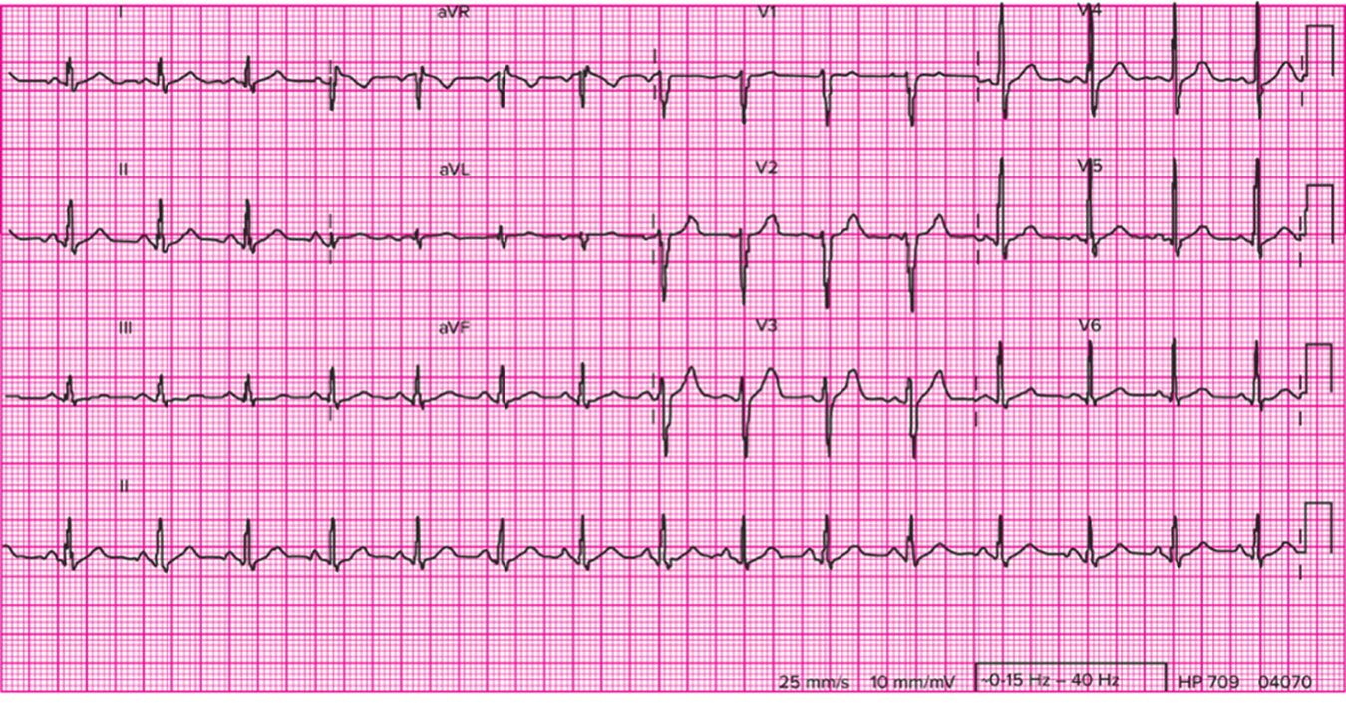
Multichannel E C G Recording
Access the text alternative for these images.
Notes:
LO 3.2: Identify the functions of common ECG machines.
-----

Slide 22
Primary E C G Machine Functions
Input.
Signal processing.
Output display.
Notes:
LO 3.2: Identify the functions of common ECG machines.
-----
Input: Impulse from electrodes
Signal processing: Amplifies electrical impulse inside the machine
Output display: Either a printed report or computer or other electronic screen

Slide 23
Other E C G Machine Functions
Computerized measurement and analysis.
Storage.
Communication.
Interpretation.
Notes:
LO 3.2: Identify the functions of common ECG machines.
-----
Computerized measurement and analysis provide a machine interpretation of the ECG. It is not meant to replace the physician’s interpretation.
The purpose of the machine interpretation is to help you quickly distinguish between normal and abnormal recordings.

Slide 24
Advancing Technologies
Single-channel to 3-lead to 12-lead machines.
Digital wireless technology.
Digital storage systems.
NOTE: Some systems are now able to integrate, manage, and streamline flow of cardiac information, including resting 12-lead E C G’s, exercise stress tests, and Holter monitoring. This integration results in faster distribution and analysis of the data.
Notes:
LO 3.2: Identify the functions of common ECG machines.
-----
Some systems are now able to integrate, manage, and streamline flow of cardiac information, including resting 12-lead ECGs, exercise stress tests, and Holter monitoring. This integration results in faster distribution and analysis of the data.

Slide 25
Learning Outcome 3.2
Apply Your Knowledge 1
What are the three primary functions of an E C G machine?
Notes:
LO 3.2: Identify the functions of common ECG machines.
-----

Slide 26
Learning Outcome 3.2
Apply Your Knowledge 2
What are the three primary functions of an E C G machine?
Answer:
Input, signal processing, and output display
Notes:
LO 3.2: Identify the functions of common ECG machines.
-----

Slide 27
Learning Outcome 3.3
E C G Controls
Key Terms
Artifact
Bradycardia
Gain
Hertz (H z)
Millimeter (m m)
Millivolt (m V)
Speed control
Tachycardia
Notes:
LO 3.3: Explain how each ECG machine control is used.
-----
Artifact: Unwanted marks on the ECG tracing caused by activity other than the heart’s electrical activity.
Bradycardia: A slow heart rate, usually less than 60 beats per minute.
Gain: A control on the ECG machine that increases or decreases the size of the deflections on the ECG tracing.
Hertz (Hz): A unit of frequency that indicates cycles or events per second.
Millimeter (mm): A unit of measurement to indicate time on the ECG tracing. Time is measured on the horizontal axis.
Millivolt (mV): A unit of measurement to indicate voltage on the ECG tracing. Voltage is measured on the vertical axis.
Speed control: A control on the ECG machine that regulates how fast or slow the paper runs during the tracing.
Tachycardia: A fast heart rate, usually greater than 100 beats per minute.

Slide 28
Speed Control
Regulates speed of paper.
Normally 25 mm/Seconds.
Changes must be noted on E C G report.
Very fast heart rates may require 50 mm/Seconds paper speed.
Notes:
LO 3.3: Explain how each ECG machine control is used.
-----
Reasons for changing the paper speed:
Patient with unusually rapid heart rate
ECG waveform parts too close together
Physician request

Slide 29
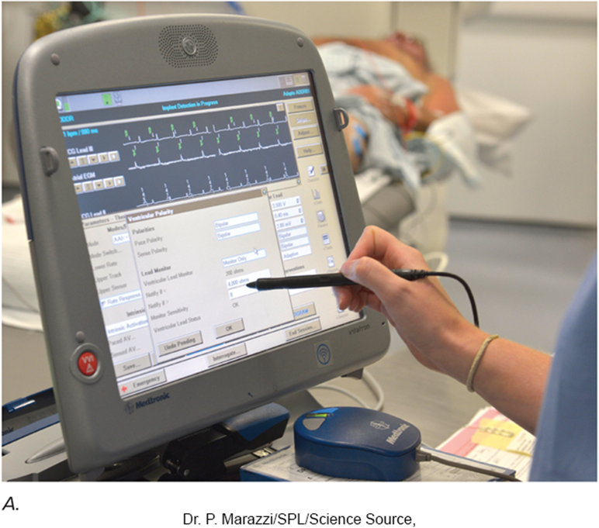
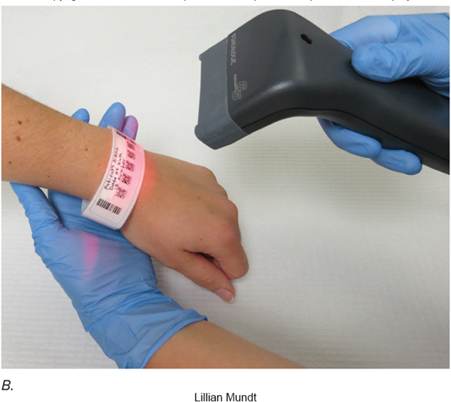
Gain Control
Controls height of waveform.
Normal setting is 10 m m/m V.
20 m m/m V doubles tracing size.
5 m m/m V reduces size by half.
Changes must be noted on E C G report.
Notes:
LO 3.3: Explain how each ECG machine control is used.
-----
Digital machines standardize wave output height automatically and place calibration marks at the beginning or end of the tracing for reference.

Slide 30
Artifact Filter
Normal setting between 40 and 150 H z.
Used to reduce artifact or abnormal marks on tracing.
Corrects only the printed output.
Computer interpretation not filtered.
Notes:
LO 3.3: Explain how each ECG machine control is used.
-----
Because the computer interpretation is based on the unfiltered tracing, it is imperative that the physician also interpret the tracing.
Note that some filtering can remove pacemaker spikes, so filtering must be used carefully.

Slide 31
L C D Display
Area where patient info is entered and with some machines tracings can be viewed.
Newer machines may indicate incorrect lead placement in the display.
Notes:
LO 3.3: Explain how each ECG machine control is used.
-----
LCD display: Liquid crystal diode

Slide 32
Other E C G Machine Controls
Heart rate limits.
Activate an audio alarm and marking on the tracing.
Bradycardia.
Tachycardia.
Lead Selector.
Runs each lead individually.
Notes:
LO 3.3: Explain how each ECG machine control is used.
-----
Bradycardia: abnormally slow heart rate
Tachycardia: abnormally fast heart rate

Slide 33
Learning Outcome 3.3
Apply Your Knowledge #1 1
True or False: Very fast heart rates may require a faster paper speed.
Notes:
LO 3.3: Explain how each ECG machine control is used.
-----

Slide 34
Learning Outcome 3.3
Apply Your Knowledge #1 2
True or False: Very fast heart rates may require a faster paper speed.
Answer:
True
Notes:
LO 3.3: Explain how each ECG machine control is used.
-----

Slide 35
Learning Outcome 3.3
Apply Your Knowledge #2 1
Which of the E C G controls can be used to make the tracing appear larger?
Notes:
LO 3.3: Explain how each ECG machine control is used.
-----

Slide 36
Learning Outcome 3.3
Apply Your Knowledge #2 2
Which of the E C G controls can be used to make the tracing appear larger?
Answer :
Gain
Notes:
LO 3.3: Explain how each ECG machine control is used.
-----

Slide 37
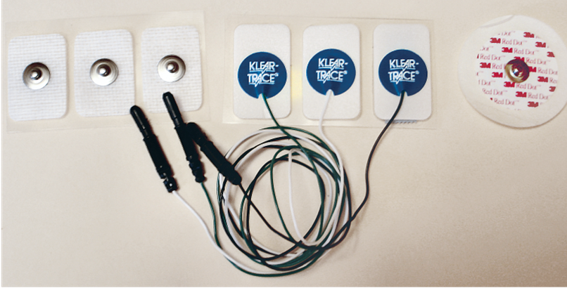
Learning Outcome 3.4
Electrodes
Sensors that pick up electrical activity, conducting to the E C G machine.
Ten electrodes are used for the 12-lead E C G.
Most electrodes are disposable.
Notes:
LO 3.4: Recognize common electrodes.
-----
Silver electrodes are sometimes used for hospitalized patients who require serial ECGs because they last longer and can be left on the patient and used for more than one recording. This is important because a slight change in electrode position can cause a change in the tracing.

Slide 38
Caution!!!
Disposable electrodes are used for only one E C G.
Exception: When second E C G is performed immediately after the first and electrodes have not been moved.
Expiration date must be checked prior to use.
Never mix electrode types!
Notes:
LO 3.4: Recognize common electrodes.
-----
When a second ECG is performed on the same patient, you may keep the electrodes in place. Check to make sure the electrodes are not disturbed or the gel has not dried out. This could result in inaccurate tracings.

Slide 39
Learning Outcome 3.4
Apply Your Knowledge 1
What are some advantages of using disposable electrodes?

Slide 40
Learning Outcome 3.4
Apply Your Knowledge 2
What are some advantages of using disposable electrodes?
Answer:
They reduce the possibility of cross-contamination; can be discarded for easier cleanup; gel is already applied.
Notes:
LO 3.4: Recognize common electrodes.
-----

Slide 41
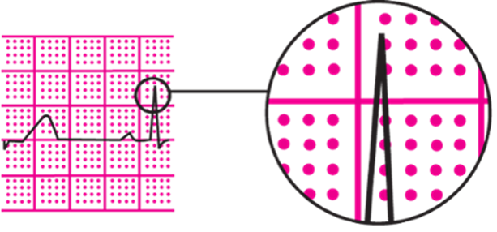
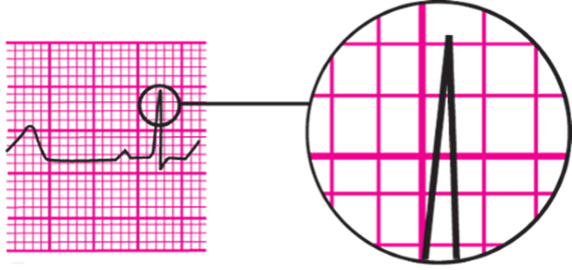
Learning Outcome 3.5
E C G Graph Paper
Dot Matrix
Requires less ink.
Easier to read.
Makes sharper photocopies.
Standard Grid
Less expensive.
Access the text alternative for these images.
Notes:
LO 3.5: Describe the ECG graph paper.
-----

Slide 42
Handling E C G Graph Paper
Graph paper may be heat/pressure-sensitive and easily erased.
Some graph paper requires no special handling/storage and is guaranteed for 50 years.
Notes:
LO 3.5: Describe the ECG graph paper.
-----
Substances such as alcohol, plastic, sunlight, and x-ray film can erase the tracing.

Slide 43
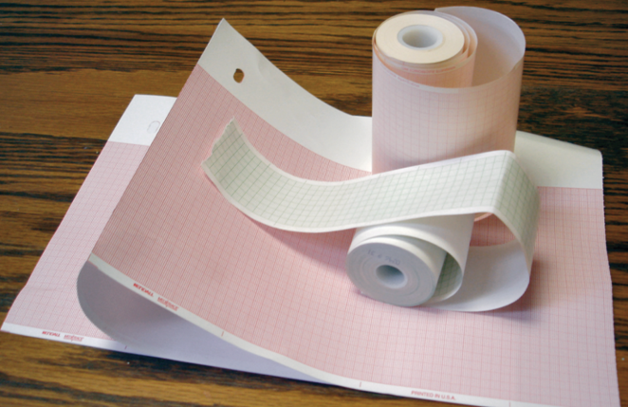
E C G Graph Paper Essentials
Paper supply.
Keep extra paper on E C G cart.
Read directions.
Know how to change the paper.
Law and ethics.
Tracings must be kept at least 7 years.
Total Care Programming, Inc.
Notes:
LO 3.5: Describe the ECG graph paper.
-----

Slide 44
Graph Paper Measurements
Small box.
1 m m by 1 m m
Represents 0.04 second horizontally at 25 m m/sec
Represents 0.1 m V vertically.
Large box.
5 m m by 5 m m
Represents 0.20 second horizontally at 25 mm/sec
Calibrated so that 1 cm = 1 mV vertically.
Notes:
LO 3.5: Describe the ECG graph paper.
-----
Always verify the calibration mark on the left side of the ECG before printing.

Slide 45
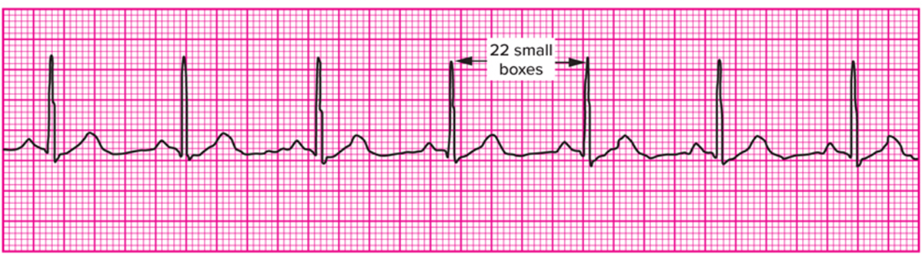
Example of Graph Paper Measurements
Access the text alternative for slide images.
Notes:
LO 3.5: Describe the ECG graph paper.
-----

Slide 46
Learning Outcome 3.5
Apply Your Knowledge 1
What substances can damage the E C G report?
Notes:
LO 3.5: Describe the ECG graph paper.
-----

Slide 47
Learning Outcome 3.5
Apply Your Knowledge 2
What substances can damage the E C G report?
Answer:
Alcohol, plastic, sunlight, and x-ray film can erase the E C G tracing.
Notes:
LO 3.5: Describe the ECG graph paper.
-----

Slide 48
Learning Outcome 3.6
Calculating Heart Rate
300 method (R-R method).
1500 method.
6-second method.
Notes:
LO 3.6: Calculate heart rates using an ECG tracing.
-----

Slide 49
Calculating Heart Rate Using the 300 Method (R-R method)
Least accurate method.
Incomplete boxes not counted.
Calculation.
Determine number of large boxes between two consecutive R waves.
Divide number into 300.
Notes:
LO 3.6: Calculate heart rates using an ECG tracing.
-----
Large Boxes Heart Rate (bpm)
1 300
2 150
3 100
4 75
5 60
6 50

Slide 50
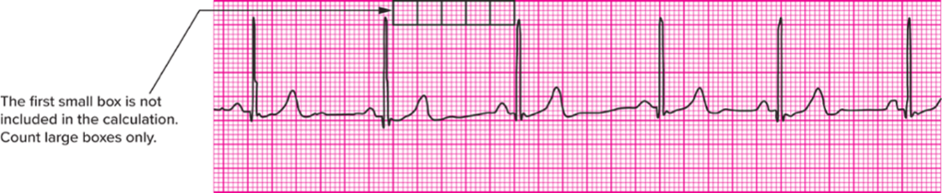
300 Method Example
Access the text alternative for these images.
Notes:
LO 3.6: Calculate heart rates using an ECG tracing.
-----
In this example, the heart rate is approximately 60 beats per minute.

Slide 51
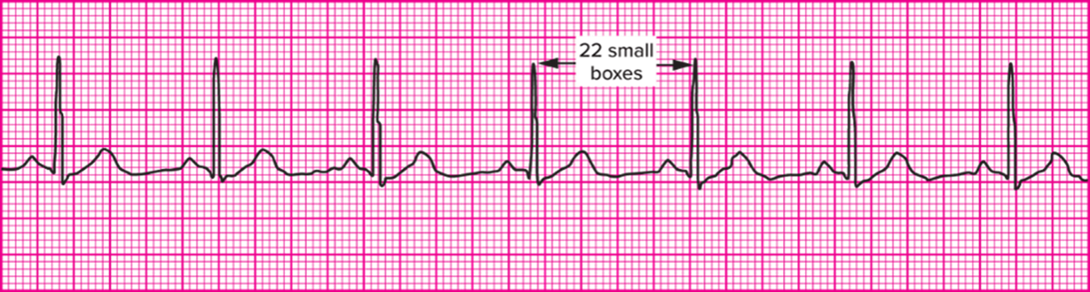
Calculating Heart Rate Using the 1500 Method
Count the number of small squares between two R waves.
Divide into 1,500.
Access the text alternative for these images.
Notes:
LO 3.6: Calculate heart rates using an ECG tracing.
-----
This is the most accurate method for determining the rate of a regular rhythm.
In this example: 1500 ÷ 22 = 68.18. The heart rate would be approximately 68 beats per minute.

Slide 52
Calculating Heart Rate Using the 6-Second Method
Identify a 6-second section of tracing.
Count the number of complete complexes in the 6-second section.
Multiply the number of complexes by 10.
Do not count incomplete complexes.
Notes:
LO 3.6: Calculate heart rates using an ECG tracing.
-----
Each complex counted must be a complete complex, including the P, QRS, and T waves.

Slide 53
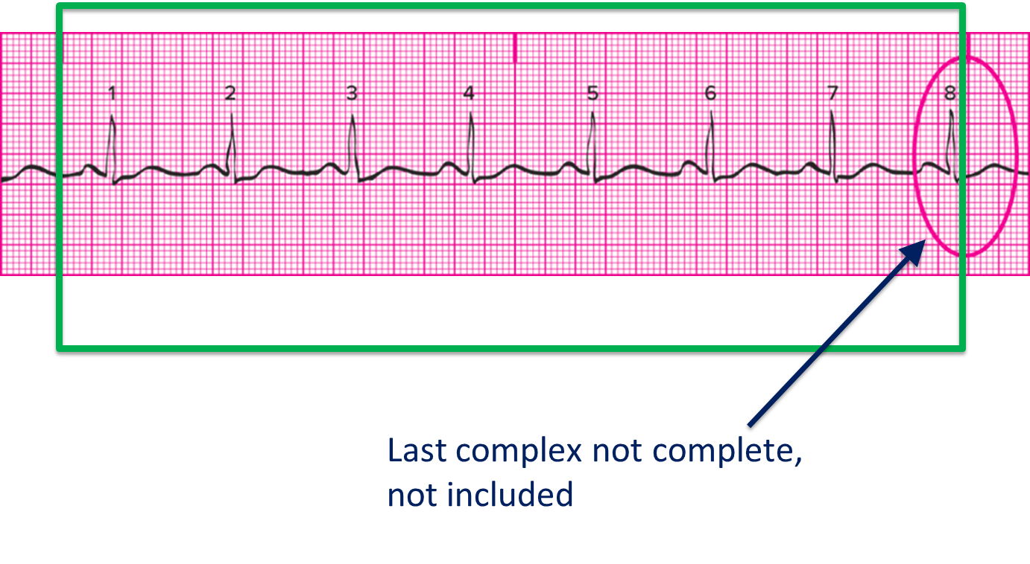
6-Second Example
Access the text alternative for these images.
Notes:
LO 3.6: Calculate heart rates using an ECG tracing.
-----
In this example, the 8th complex does not lie completely within the 6-second section, so it is not counted. The remaining 7 complexes are multiplied by 10 for an estimate of 70 bpm.

Slide 54
Learning Outcome 3.6
Apply Your Knowledge #1 1
Each large box is equal to how many seconds?
Notes:
LO 3.6: Calculate heart rates using an ECG tracing.
-----

Slide 55
Learning Outcome 3.6
Apply Your Knowledge #1 2
Each large box is equal to how many seconds?
Answer:
0.2 second
Notes:
LO 3.6: Calculate heart rates using an ECG tracing.
-----

Slide 56
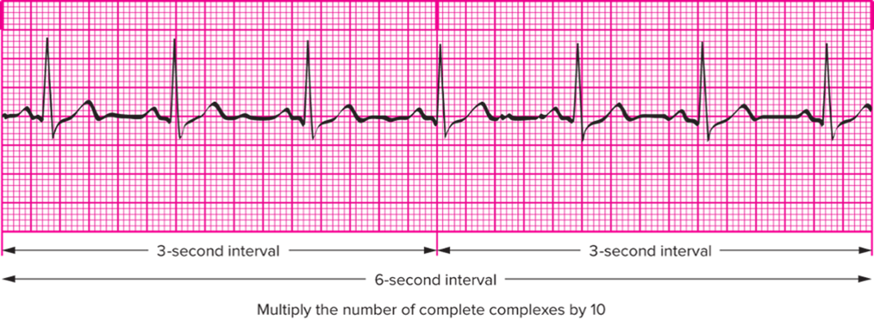
Learning Outcome 3.6
Apply Your Knowledge #2 1
Using the 6-second method, what is the approximate heart rate shown in this 6-second strip?
Access the text alternative for these images.
Notes:
LO 3.6: Calculate heart rates using an ECG tracing.
-----

Slide 57
Learning Outcome 3.6
Apply Your Knowledge #2 2
Using the 6-second method, what is the approximate heart rate shown in this 6-second strip?
Answer:
60 bpm; multiply 6 times 10. The last complex is not complete, so it is not counted.
Access the text alternative for these images.
Notes:
LO 3.6: Calculate heart rates using an ECG tracing.
-----

Slide 58
Chapter Summary 1
A 12-lead E C G uses 10 lead wires to produce 12 views of the electrical activity of the heart.
Standard, augmented, and chest leads are used to produce the E C G.
Standard leads are bipolar, and augmented and chest leads are unipolar.
Notes:
LO 3.1: Explain the three types of leads and how each is recorded.

Slide 59
Chapter Summary 2
Input, signal processing, and output display are the basic functions of the E C G.
Many advances have been made in E C G technology over the last 30 years.
E C G controls include a speed control, gain control, and artifact filter.
Various types of E C G electrodes are used for E C G machines, but most are disposable.
Notes:
LO 3.2: Identify the functions of common ECG machines.
LO 3.3: Explain how each ECG machine control is used.
LO 3.4: Recognize common electrodes.

Slide 60
Chapter Summary 3
The two most commonly used types of E C G graph paper are standard grid and dot matrix.
E C G machines are calibrated so that each box represents a specific time and voltage.
Heart rate can be calculated using three different methods: R-R interval, 1500 method, and 6-second method.
Notes:
LO 3.5: Describe the ECG graph paper.
LO 3.6: Calculate heart rates using an ECG tracing.

