Slide 1

CHAPTER 9
Heart Block Dysrhythmias

Slide 2
Learning Outcome 9.1
Heart Block Dysrhythmias
Occur when electrical activity has difficulty traveling along normal conduction pathway.
Ventricular depolarization is delayed or absent.
Degree of blockage depends on cause of delay or blockage and the area effected.
Three levels of heart blocks.
Notes:
LO 9.1: Describe the various heart block dysrhythmias.
-----
Three levels of heart block:
1st degree heart block
2nd degree AV block, Mobitz I (Wenckebach)
2nd degree AV block, Mobitz II
3rd degree block

Slide 3
Learning Outcome 9.1
Apply Your Knowledge 1
What is the cause of a heart block dysrhythmia?
Notes:
LO 9.1: Describe the various heart block dysrhythmias.
-----

Slide 4
Learning Outcome 9.1
Apply Your Knowledge 2
What is the cause of a heart block dysrhythmia?
Answer
The electrical current has difficulty traveling along the normal conduction pathway.
Notes:
LO 9.1: Describe the various heart block dysrhythmias.
-----

Slide 5
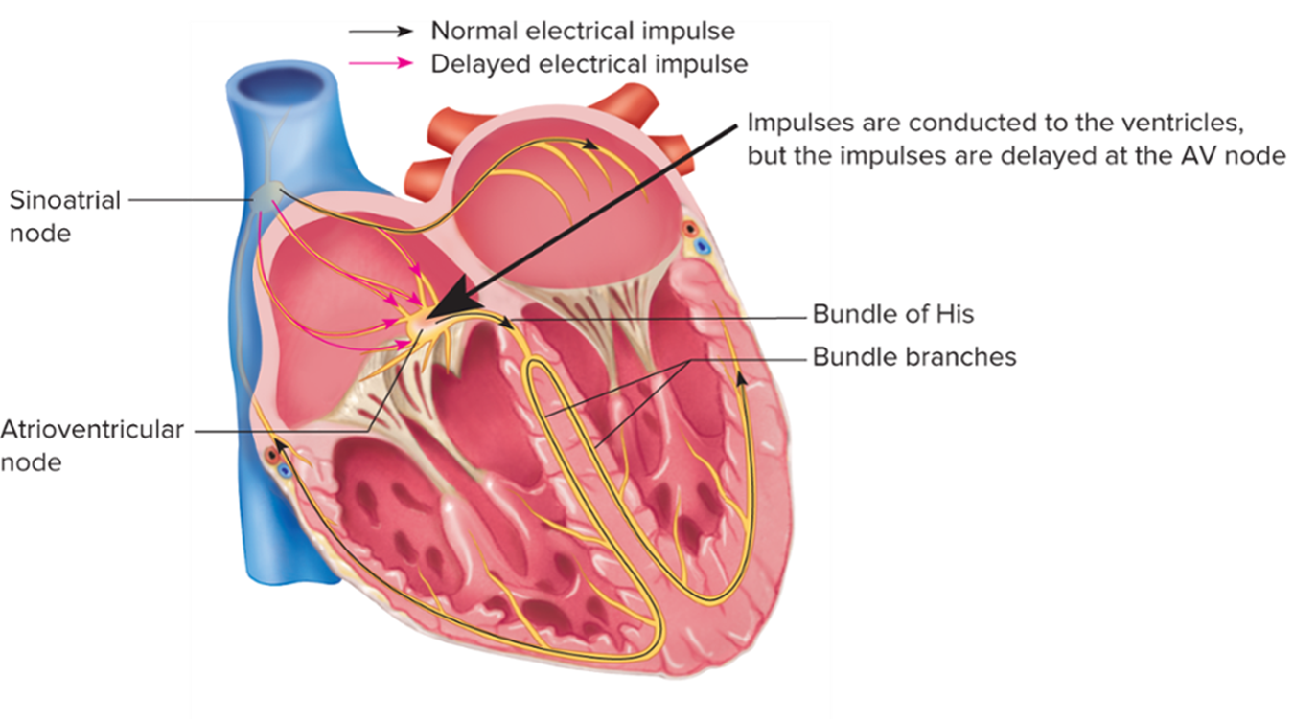
First Degree A V Block
Access the text alternative for slide images.
Notes:
LO 9.2: Analyze first degree atrioventricular (AV) block and its effect on the patient, including basic patient care and treatment.
-----
The delay in electrical conduction causes impulses to take longer to reach the ventricular conduction system. After the impulses reach the ventricles, conduction continues normally.

Slide 6
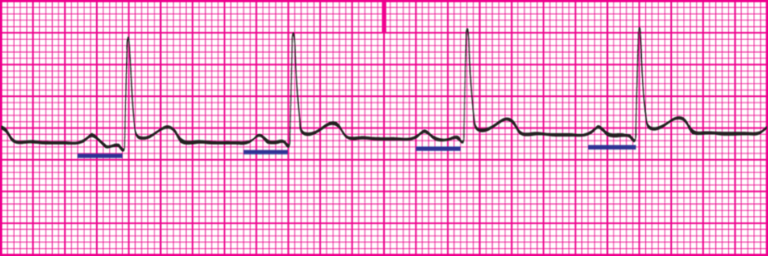
First Degree A V Block: Characteristics
Delay in electrical conduction from S A node to A V node.
Causes longer than normal P R interval.
Notes:
LO 9.2: Analyze first degree atrioventricular (AV) block and its effect on the patient, including basic patient care and treatment.
-----
The delay in electrical conduction causes impulses to take longer to reach the ventricular conduction system. After the impulses reach the ventricles, conduction continues normally.

Slide 7
First Degree A V Block: Criteria 1
Rhythm: P-P and R-R intervals are regular.
Rate: 60 to 100 beats per minutes (atria and ventricles)
P wave morphology.
Consistent morphology and shape.
P wave occurs before each Q R S complex.
Same number of P waves and Q R S complexes.
Notes:
LO 9.2: Analyze first degree atrioventricular (AV) block and its effect on the patient, including basic patient care and treatment.
-----

Slide 8
First Degree A V Block: Criteria 2
P R interval: Greater than 0.20 second.
Q R S duration and morphology: 0.06 to 0.10 second, within normal limits.
Notes:
LO 9.2: Analyze first degree atrioventricular (AV) block and its effect on the patient, including basic patient care and treatment.
-----

Slide 9
First Degree A V Block: What You Should Know
Cardiac output consistent with underlying rhythm.
Monitor for further degeneration and development of other heart blocks.
Observe cardiac output parameters.
Report developments that occur.
Notes:
LO 9.2: Analyze first degree atrioventricular (AV) block and its effect on the patient, including basic patient care and treatment.
-----
Observation of the cardiac output parameters will help you determine how well the patient is tolerating the dysrhythmia.

Slide 10
Learning Outcome 9.2
Apply Your Knowledge #1 1
True or False: A first degree atrioventricular block prevents impulses generated in the S A node from reaching the ventricles.
Notes:
LO 9.2: Analyze first degree atrioventricular (AV) block and its effect on the patient, including basic patient care and treatment.
-----

Slide 11
Learning Outcome 9.2
Apply Your Knowledge #1 2
True or False: A first degree atrioventricular block prevents impulses generated in the S A node from reaching the ventricles.
Answer:
False. A first degree A V block causes a delay in electrical conduction, but the impulse is not completely blocked from reaching the ventricles.
Notes:
LO 9.2: Analyze first degree atrioventricular (AV) block and its effect on the patient, including basic patient care and treatment.
-----

Slide 12
Learning Outcome 9.2
Apply Your Knowledge #2
What are the distinguishing characteristics of first degree A V block?
Notes:
LO 9.2: Analyze first degree atrioventricular (AV) block and its effect on the patient, including basic patient care and treatment.
-----

Slide 13
Learning Outcome 9.2
Apply Your Knowledge #2 2
What are the distinguishing characteristics of first degree A V block?
Answer:
The P R interval is constant and measures greater than 0.20 second.
Notes:
LO 9.2: Analyze first degree atrioventricular (AV) block and its effect on the patient, including basic patient care and treatment.
-----

Slide 14
Learning Outcome 9.3
Second Degree Atrioventricular (A V) Block, Type 1 (Mobitz Type 1 or Wenckebach)
Key Term
Blocked or nonconducted pulse
Notes:
LO 9.3: Analyze second degree atrioventricular (AV) block, Mobitz I, and its effect on the patient, including basic patient care and treatment.
-----
Blocked or nonconducted impulse: Impulse occurs too soon after the preceding impulse, causing a period when no other impulses can occur in the ventricles.

Slide 15
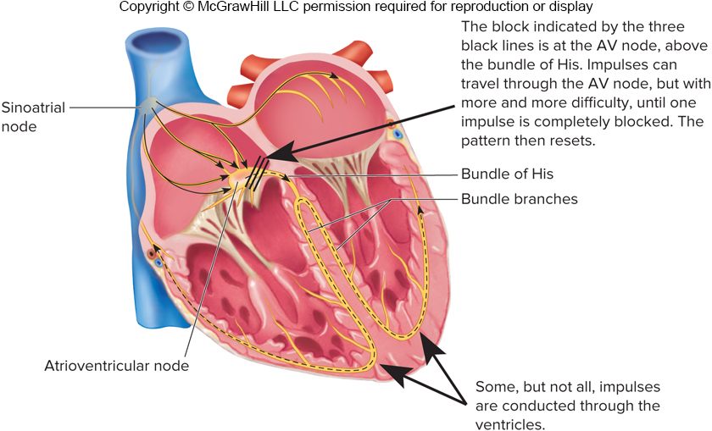
Second Degree A V Block, Type 1 1
Access the text alternative for slide images.
Notes:
LO 9.3: Analyze second degree atrioventricular (AV) block, Mobitz I, and its effect on the patient, including basic patient care and treatment.
-----
The delay in electrical conduction causes impulses to take longer to reach the ventricular conduction system. After the impulses reach the ventricles, conduction continues normally.

Slide 16
Second Degree A V Block, Type 1 2
Some electrical impulses are blocked at A V junction region.
Types of second degree A V block:
Type
(Mobitz
or Wenckebach)
Type
(Mobitz
Second degree A V blocks are the only blocks that have an irregular ventricular response.
Notes:
LO 9.3: Analyze second degree atrioventricular (AV) block, Mobitz I, and its effect on the patient, including basic patient care and treatment.
-----
If an impulse occurs too soon after the preceding impulse, it is not conducted because repolarization of the ventricles is not yet complete. When the impulse is blocked or nonconducted, the ventricles do not contract, so although the P wave (atrial depolarization) is present on the ECG tracing, there is no corresponding QRS complex.

Slide 17
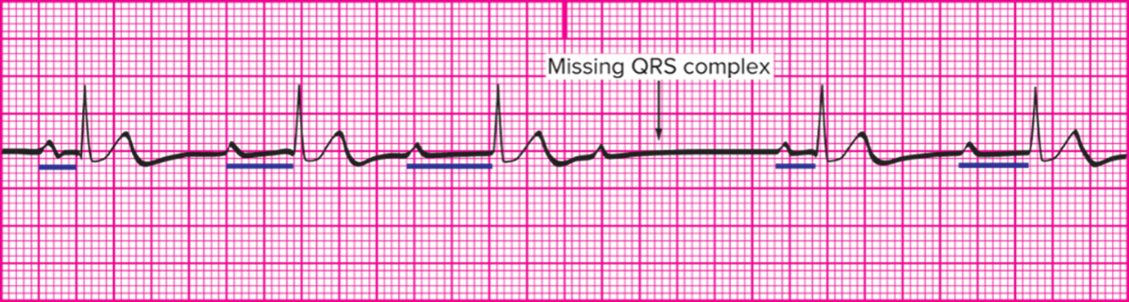
Second Degree A V Block, Type 1: Characteristics
Impulses are conducted with increasing difficulty.
P R interval increases until a Q R S complex is blocked, then resets in a regular pattern.
Notes:
LO 9.3: Analyze second degree atrioventricular (AV) block, Mobitz I, and its effect on the patient, including basic patient care and treatment.
-----
Second degree AV block, type I, is caused by diseased or injured AV node tissue that conducts impulses to the ventricular system, but each impulse is conducted more slowly than the previous one. When the conduction rate becomes so slow that another atrial impulse arrives before conduction, the ventricular impulse is blocked.

Slide 18
Second Degree A V Block, Type 1: Criteria 1
Rhythm.
P-P interval regular.
R-R interval irregular due to blocked impulses.
Rate.
Atrial rate: within normal limits.
Ventricular rate: slower than atrial rate.
Notes:
LO 9.3: Analyze second degree atrioventricular (AV) block, Mobitz I, and its effect on the patient, including basic patient care and treatment.
-----

Slide 19
Second Degree A V Block, Type 1: Criteria 2
P wave morphology.
Normal size.
Upright.
One P wave for every Q R S , with additional P waves.
P R interval: becomes progressively longer until Q R S wave is blocked, then cycle restarts.
Q R S duration and morphology: 0.06 to 0.10 second, within normal limits.
Notes:
LO 9.3: Analyze second degree atrioventricular (AV) block, Mobitz I, and its effect on the patient, including basic patient care and treatment.
-----

Slide 20
Second Degree A V Block, Type 1: What You Should Know
Patient may show signs of low cardiac output if ventricular rate decreases to 40 beats per minute or lower.
Condition usually results from inflammation around A V node.
Often temporary.
May resolve itself.
Monitor for further progression to third degree heart block.
Notes:
LO 9.3: Analyze second degree atrioventricular (AV) block, Mobitz I, and its effect on the patient, including basic patient care and treatment.
-----
Treatment is based on how the patient tolerates the rhythm, so the patient must be observed for signs of low cardiac output. Medication may be required if the patient experiences difficulties.

Slide 21
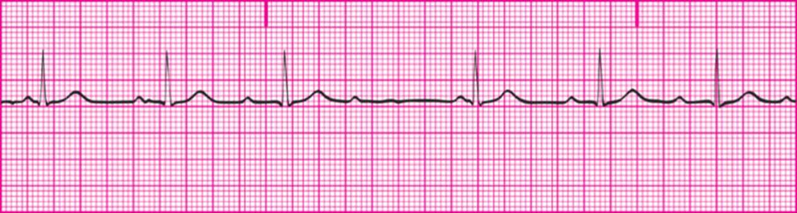
Learning Outcome 9.3
Apply Your Knowledge #1 1
Identify this type of A V block:
Notes:
LO 9.3: Analyze second degree atrioventricular (AV) block, Mobitz I, and its effect on the patient, including basic patient care and treatment.
-----

Slide 22
Learning Outcome 9.3
Apply Your Knowledge #1 2
Identify this type of A V block:
Answer:
Second degree A V block, type 1
Notes:
LO 9.3: Analyze second degree atrioventricular (AV) block, Mobitz I, and its effect on the patient, including basic patient care and treatment.
-----

Slide 23
Learning Outcome 9.3
Apply Your Knowledge #2 1
What are the distinguishing characteristics of second degree
A V block, type
Notes:
LO 9.3: Analyze second degree atrioventricular (AV) block, Mobitz I, and its effect on the patient, including basic patient care and treatment.
-----

Slide 24
Learning Outcome 9.3
Apply Your Knowledge #2 2
What are the distinguishing characteristics of second degree
A V block, type
Answer:
It has a cyclical prolonging P R interval until the Q R S is blocked; then the cycle resets and begins again.
Notes:
LO 9.3: Analyze second degree atrioventricular (AV) block, Mobitz I, and its effect on the patient, including basic patient care and treatment.
-----

Slide 25
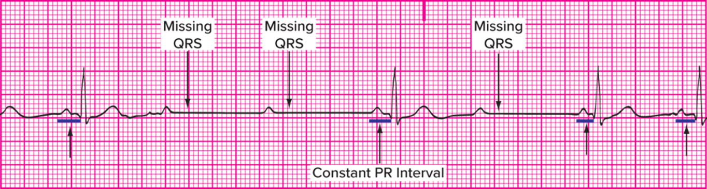
Learning Outcome 9.4
Second Degree Atrioventricular (A V) Block, Type 2 (Mobitz 2)
A V node selects electrical impulses to block.
Pattern may or may not exist.
Frequently progresses to third degree A V block.
Notes:
LO 9.4: Analyze second degree atrioventricular (AV) block, Mobitz II, and its effect on the patient, including basic patient care and treatment.
-----
When a pattern exists, such as two, three, or four P waves between each QRS complex, the ratio is included in the interpretation. For example, the rhythm might be stated as “second degree type II 3:1.”

Slide 26
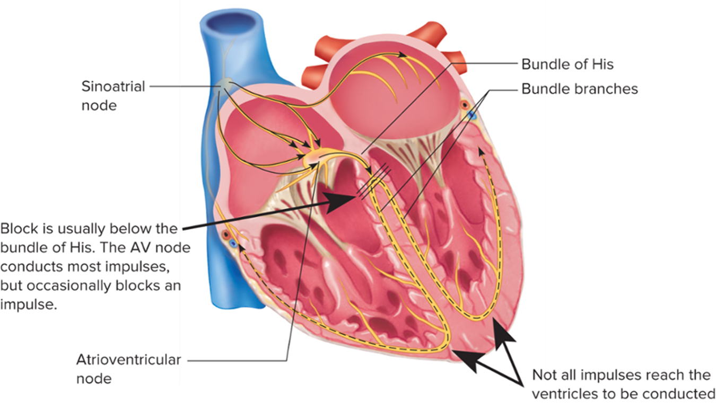
Second Degree A V Block, Type 2
Access the text alternative for slide images.
Notes:
LO 9.4: Analyze second degree atrioventricular (AV) block, Mobitz II, and its effect on the patient, including basic patient care and treatment.
-----
The delay in electrical conduction causes impulses to take longer to reach the ventricular conduction system. After the impulses reach the ventricles, conduction continues normally.

Slide 27
Second Degree A V Block, Type 2: Criteria 1
Rhythm.
P-P interval is regular.
R-R interval may be regular or irregular.
Rate.
Atrial rate: within normal limits.
Ventricular rate: slower than atrial rate.
Notes:
LO 9.4: Analyze second degree atrioventricular (AV) block, Mobitz II, and its effect on the patient, including basic patient care and treatment.
-----
The regularity of the R-R interval depends on the unpredictable nature of the blocked impulses. In some cases, the R-R intervals form a pattern.

Slide 28
Second Degree A V Block, Type 2: Criteria 2
P wave morphology.
Normal size.
Upright.
At least one P wave for every Q R S complex.
More P waves than Q R S complexes.
P R interval: Constant, even after Q R S block occurs.
Q R S duration and morphology: 0.06 to 0.10 second, within normal limits.
Notes:
LO 9.4: Analyze second degree atrioventricular (AV) block, Mobitz II, and its effect on the patient, including basic patient care and treatment.
-----
In second degree AV block, type II, QRS complexes are missing, but whenever a P wave has an associated QRS complex, the PR interval always measures the same.

Slide 29
Second Degree A V Block, Type 2: What You Should Know
Highly unstable dysrhythmia.
Observe patient for signs of low cardiac output.
Critical condition can progress quickly to third degree A V block or complete heart block.
Notes:
LO 9.4: Analyze second degree atrioventricular (AV) block, Mobitz II, and its effect on the patient, including basic patient care and treatment.
-----
Because second degree AV block, type II, is highly unstable and can progress quickly to complete heart block, close observation and monitoring are essential. It is also critical that you be able to distinguish between type I and type II.

Slide 30
Differences between Second Degree Heart Blocks
Type
P R interval varies.
Temporary condition.
Type
P R interval constant.
Chronic condition and more critical.
Remember:
Lengthen, lengthen, drop equals Wenckebach (Type 1).
Notes:
LO 9.4: Analyze second degree atrioventricular (AV) block, Mobitz II, and its effect on the patient, including basic patient care and treatment.
-----
Although type II is considered more critical than type I, both rhythms should be reported.

Slide 31
Learning Outcome 9.4
Apply Your Knowledge 1
What is the mnemonic to help you remember how to
distinguish between second degree A V block, types
Notes:
LO 9.4: Analyze second degree atrioventricular (AV) block, Mobitz II, and its effect on the patient, including basic patient care and treatment.
-----

Slide 32
Learning Outcome 9.4
Apply Your Knowledge 2
What is the mnemonic to help you remember how to
distinguish between second degree A V block, types
Answer:
“Lengthen, lengthen, drop equals Wenckebach”
Notes:
LO 9.4: Analyze second degree atrioventricular (AV) block, Mobitz II, and its effect on the patient, including basic patient care and treatment.
-----

Slide 33
9.5 Third Degree Atrioventricular (A V) Block (Complete)
Key Term
Dissociative
Notes:
LO 9.5: Analyze third degree atrioventricular (AV) block and its effect on the patient, including basic patient care and treatment.
-----
Dissociative: Not related at all; the atria and the ventricles beat entirely independently of each other.

Slide 34
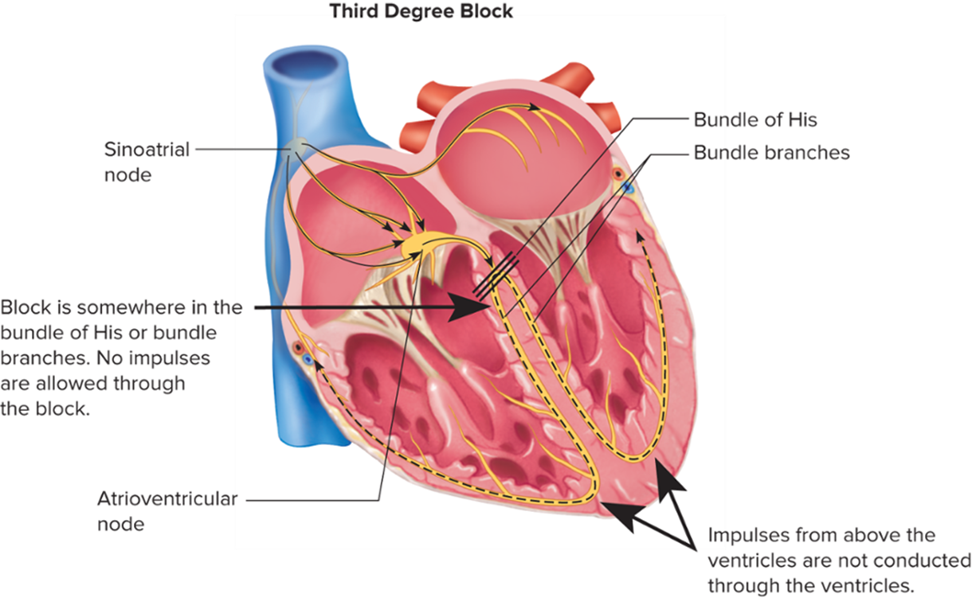
Third Degree A V Block (Complete) 1
Access the text alternative for slide images.
Notes:
LO 9.5: Analyze third degree atrioventricular (AV) block and its effect on the patient, including basic patient care and treatment.
-----
The delay in electrical conduction causes impulses to take longer to reach the ventricular conduction system. After the impulses reach the ventricles, conduction continues normally.

Slide 35
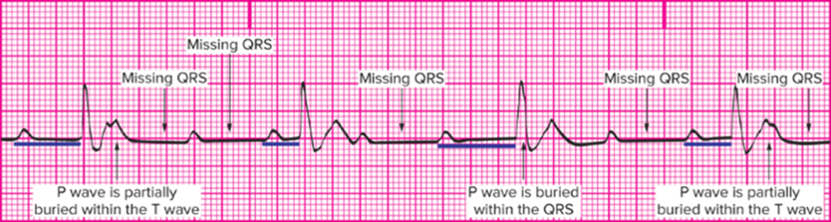
Third Degree A V Block (Complete) 2
All electrical impulses originating above the ventricles are blocked.
No correlation between atrial and ventricular depolarization.
P-P and R-R intervals are dissociative.
Notes:
LO 9.5: Analyze third degree atrioventricular (AV) block and its effect on the patient, including basic patient care and treatment.
-----
Both the P-P interval and the R-R interval are regular, but the PR interval is variable because the atria and ventricles are firing at different rates.

Slide 36
Third Degree A V Block: Criteria 1
Rhythm
P-P interval is regular.
R-R interval is regular, but different from P-P interval.
Rate
Atrial rate: 60 to 100 beats per minutes.
Ventricular rate: 20 to 40 bpm or 40 to 60 beats per minutes, depending on pacemaker site.
Notes:
LO 9.5: Analyze third degree atrioventricular (AV) block and its effect on the patient, including basic patient care and treatment.
-----
Regardless of the ventricular pacemaker site, the ventricular rate will be slower than the atrial rate.

Slide 37
Third Degree A V Block: Criteria 2
P wave morphology.
Normal size and morphology.
May be buried in Q R S complex or may occur before or after Q R S complex.
P waves outnumber Q R S complexes.
Third degree block is the only heart block in which the P waves can be buried inside a Q R S complex or T wave.
Notes:
LO 9.5: Analyze third degree atrioventricular (AV) block and its effect on the patient, including basic patient care and treatment.
-----
Not every P wave will have a QRS complex following it.

Slide 38
Third Degree A V Block: Criteria
P R interval: Varies because atria and ventricles are firing at different rates.
Q R S duration and morphology.
All complexes have the same duration and morphology.
May be within normal limits or wider depending on the location of the block.
Notes:
LO 9.5: Analyze third degree atrioventricular (AV) block and its effect on the patient, including basic patient care and treatment.
-----

Slide 39
Third Degree A V Block: What You Should Know
A V dissociation results in loss of atrial kick.
First responsibility: observe patient for signs of low cardiac output.
When ventricular heart rate is 40 or lower, patient may become unconscious.
Immediate medical intervention may be required.
Rhythm strips should be mounted and identified in patient’s record.

Slide 40
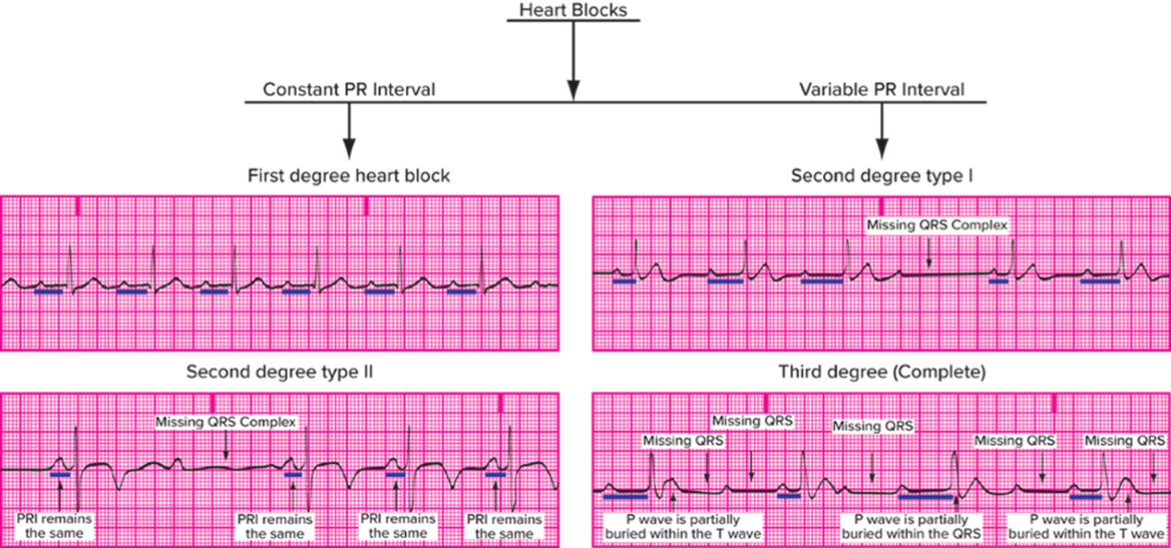
Learning Outcome 9.5
Comparing Heart Blocks
Access the text alternative for slide images.
Notes:
LO 9.5: Analyze third degree atrioventricular (AV) block and its effect on the patient, including basic patient care and treatment.
-----

Slide 41
Learning Outcome 9.5
Apply Your Knowledge 1
What are the distinguishing characteristics of third degree heart block?

Slide 42
Learning Outcome 9.5
Apply Your Knowledge 2
What are the distinguishing characteristics of third degree heart block?
Answer:
The P-P and R-R intervals are regular, but firing at different rates.
Notes:
LO 9.5: Analyze third degree atrioventricular (AV) block and its effect on the patient, including basic patient care and treatment.
-----

Slide 43
Chapter Summary 1
In heart block rhythms, the current has difficulty traveling the normal pathway.
First degree A V block is a delay in conduction from the S A node to the A V node that prevents an impulse from traveling to the ventricular conduction system.
Second degree A V block, type
has blocked or
nonconducted impulses from the S A node to the A V
junction; also called Wenckebach or Mobitz type
This occurs in a pattern showing prolonging P R intervals until the Q R S is blocked. Then the pattern resets and starts again.
Notes:
LO 9.1: Describe the various heart block dysrhythmias.
LO 9.2: Analyze first degree atrioventricular (AV) block and its effect on the patient, including basic patient care and treatment.
LO 9.3: Analyze second degree atrioventricular (AV) block, Mobitz I, and its effect on the patient, including basic patient care and treatment.

Slide 44
Chapter Summary 2
Second degree A V block, type
selects which impulses
it will block, resulting in periodic missing Q R S complexes;
also called Mobitz type
Third degree A V block is complete heart block (C H B); all impulses above the ventricles are blocked, so there is no correlation between atrial and ventricular depolarization.
Notes:
LO 9.4: Analyze second degree atrioventricular (AV) block, Mobitz II, and its effect on the patient, including basic patient care and treatment.
LO 9.5: Analyze third degree atrioventricular (AV) block and its effect on the patient, including basic patient care and treatment.

