Slide 1
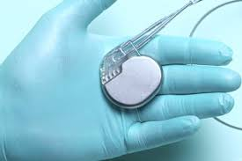
CHAPTER 11
PACEMAKER
RHYTHMS

Slide 2
Electronic Pacemakers
Also known as artificial pacemakers.
Deliver electrical impulse to myocardium, causing cells to depolarize.
Mimic normal pacemaker of the heart.
Notes:
LO 11.1: Identify the various types and functions of pacemakers.
-----
Because of the variety of pacemakers available on the market, you should always check in advance regarding the proper procedure for performing an ECG on a patient with a pacemaker.

Slide 3
Function of Pacemakers
Can pace atria, ventricles, or both.
Sometimes temporary, but usually surgically implanted under the skin.
Fastest pacemaker controls the heartbeat, whether inherent or artificial.
Notes:
LO 11.1: Identify the various types and functions of pacemakers.
-----
The function of a pacemaker is to stimulate a contraction.

Slide 4
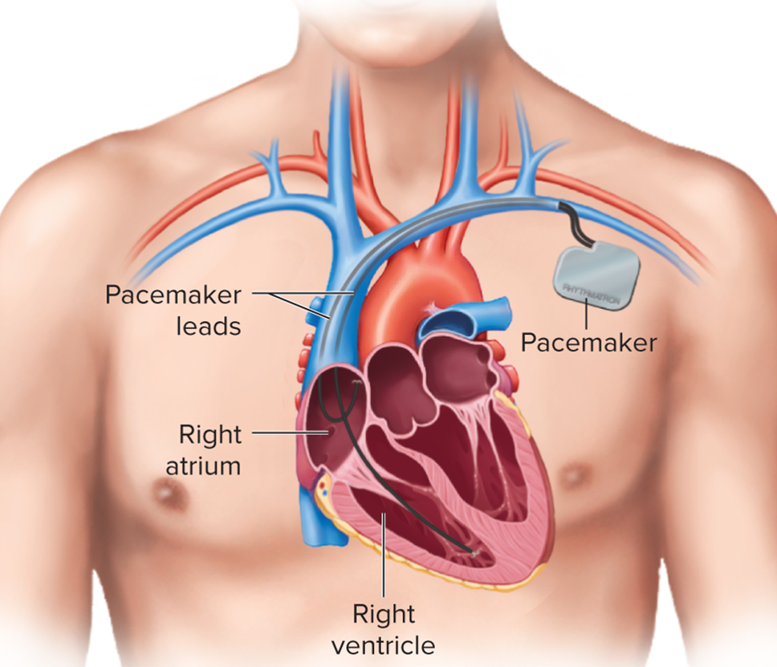
Pacemaker Placement
Implanted Pacemaker
Access the text alternative for slide images.
Notes:
LO 11.1: Identify the various types and functions of pacemakers.
-----
This atrioventricular pacemaker has leads that go to both the right atrium and the lower right ventricle.
Excellent short video - less than one minute. Click on the link. How is a Pacemaker Placed? on Vimeo
https://www.nhlbi.nih.gov/health/pacemakers/what-to-expect

Slide 5
Pacemakers
Who needs them?
https://vimeo.com/721228553
How is a pacemaker placed?
https://vimeo.com/721233928

Slide 6
Types of Pacing
Atrial pacing.
Ventricular pacing.
Atrioventricular sequential pacing.
Atriobiventricular pacing.
Notes:
LO 11.1: Identify the various types and functions of pacemakers.
-----
Atrial pacing is used alone when AV node and ventricular conduction are performing correctly.
Ventricular pacing is used to correct problems with the ventricular conduction system.
Atrioventricular sequential pacing stimulates the atria and ventricles sequentially, mimicking the normal cardiac conduction system and allowing for an atrial kick.
Atriobiventricular pacing stimulates the atria and both ventricles, instead of just the lower right ventricle.
Fixed-rate (asynchronous) pacemaker: Deliver’s electrical stimulation at constant rate
Demand (synchronous) pacemaker: Detects ventricular activity and either suppresses or discharges stimulation from pacemaker generator in order to make the impulse fall within the safe period of the QRS complex
Rate-responsive pacemaker: Speeds up or slows down the heart rate based on metabolic demands from the body; monitors sinus node rate, breathing, and blood temperature

Slide 7
Types of Pacemakers
Unipolar pacemaker.
Dual-chamber pacemaker.
Dual-site atrial pacing.
Biventricular pacing.
Implantable cardioverter defibrillator.
Notes:
LO 11.1: Identify the various types and functions of pacemakers.
-----
Unipolar pacemaker: Has a single contact with the heart; used mostly when AV conduction is likely to return.
Dual-chamber pacemaker: Has electrodes in the right atrium and the right ventricle; provides for coordination of the atria and ventricles.
Dual-site atrial pacemaker: Has electrodes in the right atrium and at or near the coronary sinus; may be used to treat one type of atrial fibrillation.
Atriobiventricular pacemaker: Has electrodes in the right atrium and both ventricles; used for heart failure.
Implantable cardioverter defibrillator: Senses a ventricular rate that exceeds the programmed cutoff rate; then defibrillator performs cardioversion/defibrillation.

Slide 8
Pacemaker Safety
Pacemaker’s electrical current is not dangerous to you or other people.
Skin does not conduct electricity.
Current cannot be transmitted to another person.
Notes:
LO 11.1: Identify the various types and functions of pacemakers.
-----

Slide 9
Learning Outcome 11.1
Apply Your Knowledge 1
What is the advantage of atrioventricular pacing?
Notes:
LO 11.1: Identify the various types and functions of pacemakers.
-----

Slide 10
Learning Outcome 11.1
Apply Your Knowledge 2
What is the advantage of atrioventricular pacing?
Answer:
It mimics the normal cardiac conduction system and allows for atrial kick.
Notes:
LO 11.1: Identify the various types and functions of pacemakers.
-----

Slide 11
Evaluating Pacemaker Function 1
Based on E C G tracings.
Verifies pacemaker effectiveness.
Determines presence of pulse with each captured beat.
Electrical capture.
Mechanical capture.
Notes:
LO 11.2: Analyze pacemaker rhythms and their effect on the patient, including basic patient care and treatment.
-----
Electrical capture refers to the evidence seen when viewing the cardiac tracing on the heart monitor or ECG machine.
Mechanical capture is the heart’s ability to respond to the electrical impulses generated by the pacemaker.

Slide 12
Evaluating Pacemaker Function 2
Electrical evidence on a heart monitor is not enough.
Heart may not be pumping well enough to sustain life.
Always remember to check the patient!
Notes:
LO 11.2: Analyze pacemaker rhythms and their effect on the patient, including basic patient care and treatment.
-----

Slide 13
Pacing Spike
Thin spike on E C G tracing indicating electrical current from pacemaker.
Evidence of depolarization should appear after the spike, depending on type of pacing.
Notes:
LO 11.2: Analyze pacemaker rhythms and their effect on the patient, including basic patient care and treatment.
-----
Pacemaker rhythms are distinguished by the conspicuous presence of a pacing spike prior to the waveform of the portion of the heart that is being paced.

Slide 14
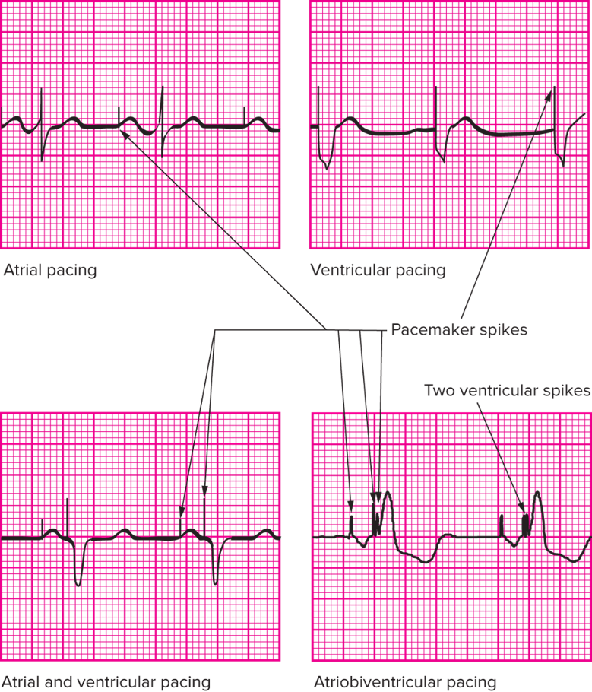
Types of Pacing Spikes
Atrial
Ventricular
Atrioventricular
Atriobiventricular
Access the text alternative for slide images.
Notes:
LO 11.2: Analyze pacemaker rhythms and their effect on the patient, including basic patient care and treatment.
-----

Slide 15
Chamber Depolarization
Atrial pacing spike
Followed by P wave indicating atrial depolarization
Ventricular pacing spike.
Followed by wide Q R S complex.
Similar to L B B B.
Notes:
LO 11.2: Analyze pacemaker rhythms and their effect on the patient, including basic patient care and treatment.
-----
The left ventricle is larger than the right ventricle, so it takes longer to depolarize; this makes it look similar to the electrical activity in left bundle branch block (LBBB).

Slide 16
Atrioventricular Delay
Similar to P R interval on normal rhythm tracing.
Measured from atrial spike to ventricular spike.
Normally programmed to 0.12 to 0.20 second.
Notes:
LO 11.2: Analyze pacemaker rhythms and their effect on the patient, including basic patient care and treatment.
-----

Slide 17
Measuring Atrioventricular Delay
Patient with normal P wave and ventricular pacing.
Measure from beginning of P wave to ventricular spike.
Patient with atrial pacer and normal Q R S.
Measure from pacing spike to beginning of Q R S.
Measurement should be less than set atrioventricular delay time.
Notes:
LO 11.2: Analyze pacemaker rhythms and their effect on the patient, including basic patient care and treatment.
-----

Slide 18
Seven Steps to Evaluating a Pacemaker E C G Tracing 1
Step 1: What are the rate and regularity of the paced rhythm?
Step 2: What are the rate and regularity of the intrinsic rhythm?
Step 3: Is the atrial lead sensing appropriate?
A V sequential pacemakers only.
Step 4: Is atrial capture present?
Atrial, A V sequential, and atriobiventricular pacemakers.
Notes:
LO 11.2: Analyze pacemaker rhythms and their effect on the patient, including basic patient care and treatment.
-----
Step 1: The pacemaker spikes should be spaced at regular intervals. If the patient’s own rhythm becomes faster than the paced rhythm, irregularities may occur.
Step 2: The fastest pacemaker site sets the heart rate, so if the patient’s inherent/intrinsic rate is faster than the pacemaker rhythm, the intrinsic rhythm controls the heart rate.
Step 3: Determine whether each P wave is preceded by a pacing spike. Sometimes the patient’s SA node or an ectopic focus will generate an atrial contraction without a pacemaker spike.
Step 4: Every atrial pacing spike should have a P wave after it. This indicates that the pacing impulse is causing the atrial cells to depolarize.

Slide 19
Seven Steps to Evaluating a Pacemaker E C G Tracing 2
Step 5: Is atrioventricular delay appropriate?
A V sequential and atriobiventricular pacemakers.
Step 6: Is ventricular sensing appropriate?
Step 7: is ventricular capture present?
Notes:
LO 11.2: Analyze pacemaker rhythms and their effect on the patient, including basic patient care and treatment.
-----
Step 5: Determine whether the actual atrioventricular delay interval is the same as the atrioventricular delay set on the pacemaker.
Step 6: Determine whether a wide QRS complex follows each ventricular pacing spike. If the patient’s own conduction system generates a normal P wave or QRS complex before the pacemaker sends a ventricular impulse, the pacemaker generator is inhibited , as evidenced by the absence of a ventricular spike.
Step 7: Every ventricular spike should have a wide QRS complex after it, indicating that the pacing spike produced ventricular depolarization.

Slide 20
Learning Outcome 11.2
Apply Your Knowledge 1
What term refers to the ability of the heart muscle to respond to electrical stimulation and depolarize the myocardial tissue?
Notes:
LO 11.2: Analyze pacemaker rhythms and their effect on the patient, including basic patient care and treatment.
-----

Slide 21
Learning Outcome 11.2
Apply Your Knowledge 2
What term refers to the ability of the heart muscle to respond to electrical stimulation and depolarize the myocardial tissue?
Answer:
Mechanical capture
Notes:
LO 11.2: Analyze pacemaker rhythms and their effect on the patient, including basic patient care and treatment.
-----

Slide 22
Pacemaker Complications Relative to the E C G Tracing
Weak battery complications
Slow firing rates.
Less effective sensing capabilities.
Less than predetermined electrical current.
Pacemaker generator complication.
Sensing capability too low for pacemaker to see normal contractions.
Electrical impulses triggered, not inhibited.
Notes:
LO 11.3: Summarize pacemaker complications relative to the ECG tracing.
-----

Slide 23
Reasons for Pacemaker Complications
Malfunctioning – failure to pace.
Malsensing – failure to sense.
Loss of capture – failure to depolarize.
Oversensing – perceiving sources other than the heart.
Undersensing – unable to detect any electrical activity.
Notes:
LO 11.3: Summarize pacemaker complications relative to the ECG tracing.
-----
These complications can be detected on the ECG tracing, so it is important to recognize normal and abnormal pacemaker rhythms and the possible complications.

Slide 24
Responsibility to Recognize Rhythms
Recognize normal pacemaker rhythms and possible complications.
Be aware of differences in E C G waveforms.
Presence of pacing spike.
Chamber depolarization characteristics.
Atrioventricular delay.
Notes:
LO 11.3: Summarize pacemaker complications relative to the ECG tracing.
-----
If you observe pacemaker complications, notify licensed personnel immediately for appropriate treatment and interventions.

Slide 25
Learning Outcome 11.3
Apply Your Knowledge 1
What is your responsibility in caring for patients with pacemakers?
Notes:
LO 11.3: Summarize pacemaker complications relative to the ECG tracing.
-----

Slide 26
Learning Outcome 11.3
Apply Your Knowledge 2
What is your responsibility in caring for patients with pacemakers?
Answer:
Recognizing normal pacemaker rhythms and possible complications.
Notes:
LO 11.3: Summarize pacemaker complications relative to the ECG tracing.
-----

Slide 27
Chapter Summary
Electronic or artificial pacemakers deliver an electrical impulse to the myocardium, causing cells to depolarize.
Atria, ventricles, or both can be paced.
Atrial pacing spikes, ventricular pacing spikes, or both may be visible on the E C G, depending on the type of pacing.
Evaluating pacemaker function includes seven steps, although not all steps are required for every type of pacemaker.
Pacemaker complications relative to the E C G include malfunctioning, malsensing, loss of capture, oversensing, and undersensing.
Notes:
LO 11.1: Identify the various types and functions of pacemakers.
LO 11.2: Analyze pacemaker rhythms and their effect on the patient, including basic patient care and treatment.
LO 11.3: Summarize pacemaker complications relative to the ECG tracing.

