Slide 1
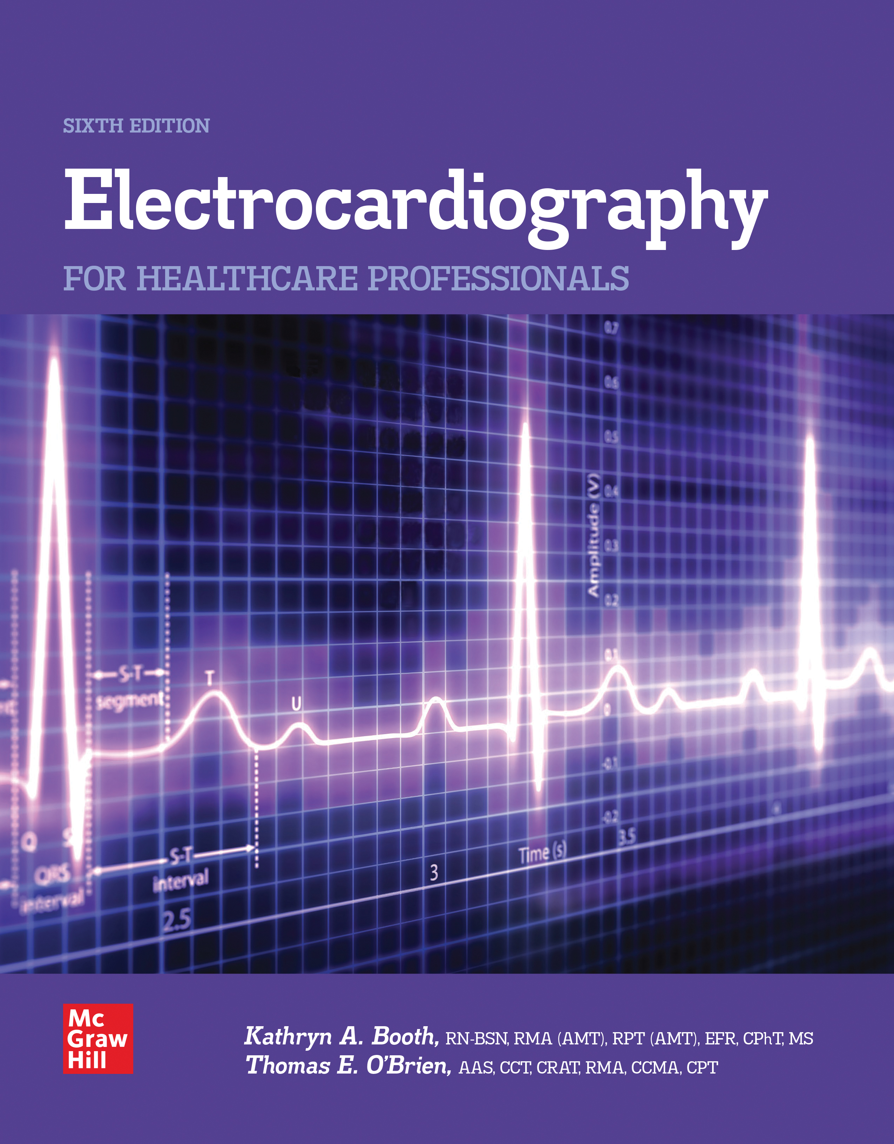
CHAPTER 4
PERFORMING
AN
ECG

Slide 2
Learning Outcome 4.1
Preparation for the E C G Procedure
Select a room away from electrical equipment and x-rays.
Turn OFF nonessential electrical equipment in the room.
Place E C G machine away from electrical cords.
Notes:
LO 4.1: Carry out preparation of the patient, room, and equipment for an ECG.
-----
Electrical currents can interfere with the ECG tracing. Minimizing the sources of electrical current helps you obtain a cleaner, more accurate ECG tracing.

Slide 3
Verification
Verify physician order for E C G.
Patient name, I D or medical record number, and date of birth.
Location, date, and time of recording.
Patient age, sex, race, cardiac and other medications.
Height and weight.
Any special condition or position of patient during the recording.
Notes:
LO 4.1: Carry out preparation of the patient, room, and equipment for an ECG.
-----
ECGs must be ordered by a physician or other authorized personnel, and an order form, requisition, or consult form must be completed before you perform the procedure.
In addition to the information shown on this slide, the order form must include the reason the ECG was ordered.

Slide 4
E C G Preparation Essentials
Billing information:
Must be entered in the computer or handwritten, depending on system used.
Patient information:
Enter on L C D panel or write it on the completed E C G.

Slide 5
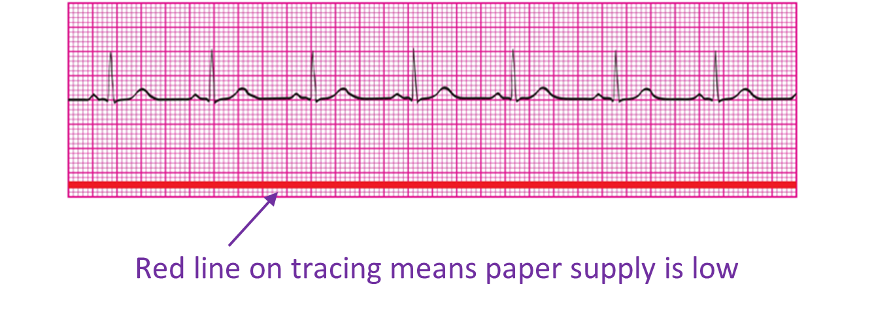
Before You Begin
Check paper supply and replace if red line is visible.
Read operator’s manual before replacing paper.
If paper is replaced, run machine to check for proper functioning and alignment.
Access the text alternative for these images.
Notes:
LO 4.1: Carry out preparation of the patient, room, and equipment for an ECG.
-----

Slide 6
Learning Outcome 4.1
Apply Your Knowledge 1
Why is it important to minimize external sources of electricity before running an E C G?
Notes:
LO 4.1: Carry out preparation of the patient, room, and equipment for an ECG.
-----

Slide 7
Learning Outcome 4.1
Apply Your Knowledge 2
Why is it important to minimize external sources of electricity before running an E C G?
Answer:
External currents can interfere with the E C G tracing.
Notes:
LO 4.1: Carry out preparation of the patient, room, and equipment for an ECG.
-----

Slide 8
Learning Outcome 4.2
Communicating with the Patient
Identify the patient.
Check the patient's name, identification number, and date of birth.
Introduce yourself and explain what you are going to do.
Notes:
LO 4.2: Describe the communication needed during the ECG procedure, including the actions to take if a patient refuses to allow an ECG to be performed.
-----
Often patients have the same or similar names. Checking to be sure you are performing the procedure on the correct patient is the first step in ensuring that you are providing patient safety.
According to TJC, every patient must be identified using at least two forms of identification.

Slide 9
Communication
Explain the procedure to the patient.
Answer all questions.
If the patient refuses the E C G, determine the cause.
Attempt to solve the problem.
Notify your supervisor if the patient still refuses.
Notes:
LO 4.2: Describe the communication needed during the ECG procedure, including the actions to take if a patient refuses to allow an ECG to be performed.
-----
Explain the procedure even if the patient is not able to respond. The patient may still be able to hear you.
Assure the patient that the procedure is harmless and painless.
If the patient absolutely refuses the ECG, you must document the patient’s refusal.

Slide 10
Preparing the Patient 1
Provide for privacy.
Patient removes clothing from the waist up.
Provide with drape, sheet, or hospital gown with opening in the front.
Patient removes jewelry that may interfere.
All electronic devices should be turned off and removed.
Position patient comfortably on back and provide pillow for head and knees, if preferred.
Notes:
LO 4.2: Describe the communication needed during the ECG procedure, including the actions to take if a patient refuses to allow an ECG to be performed.
-----
All jewelry and metal items should be removed, including belt buckles and watches as well as necklaces, wrist or ankle bracelets, and rings.
Electronic devices include cell or smartphones, PDAs, and MP3 players.

Slide 11
Preparing the Patient 2
Work from patient’s left side if possible.
Ensure that arms and legs are supported.
Ensure privacy.
Make sure bed/exam table is not touching wall or electrical equipment.
Ensure that patient is not touching metal.
Notes:
LO 4.2: Describe the communication needed during the ECG procedure, including the actions to take if a patient refuses to allow an ECG to be performed.
-----
It is best to work from the patient’s left side because most of the electrodes and leads are placed on the left side of the patient’s chest.
Covering the patient with a sheet or blanket not only provides privacy, but also may help reduce shivering, which can interfere with the ECG tracing.

Slide 12
Learning Outcome 4.2
Apply Your Knowledge 1
What should you do if a patient refuses the E C G procedure?
Notes:
LO 4.2: Describe the communication needed during the ECG procedure, including the actions to take if a patient refuses to allow an ECG to be performed.
-----

Slide 13
Learning Outcome 4.2
Apply Your Knowledge 2
What should you do if a patient refuses the ECG procedure?
Answer:
Determine the reason for the patient’s refusal. Try to fix the problem. Then, if needed, report to your supervisor and document the patient’s refusal.
Notes:
LO 4.2: Describe the communication needed during the ECG procedure, including the actions to take if a patient refuses to allow an ECG to be performed.
-----

Slide 14
Learning Outcome 4.3
Safety
Key Term
Body mechanics.
Notes:
LO 4.3: Identify at least three ways to provide for safety during the ECG procedure.
-----
Body mechanics: Using movements that maintain proper posture and avoid muscle and bone injuries.

Slide 15
Safety
Body mechanics.
Using movements that maintain proper posture and prevent injury.
Electrical safety.
Patient safety.
Keep side rail up on opposite side of bed or table.
Personal safety.
Hand hygiene.
P P E.
Notes:
LO 4.3: Identify at least three ways to provide for safety during the ECG procedure.
-----
Proper body mechanics include:
Maintain a wide base of support
Avoid twisting
Protect your back
Use your leg muscles, not your back, for lifting
Maintain proper body alignment

Slide 16
Learning Outcome 4.3
Apply Your Knowledge 1
What items should you check to ensure electrical safety with the E C G machine?
Notes:
LO 4.3: Identify at least three ways to provide for safety during the ECG procedure.
-----

Slide 17
Learning Outcome 4.3
Apply Your Knowledge 2
What items should you check to ensure electrical safety with the E C G machine?
Answer:
Check that the plug has a grounding prong, plug in the machine securely, ensure that the insulation is intact, remove the cord by pulling it out by the prong connection.
Notes:
LO 4.3: Identify at least three ways to provide for safety during the ECG procedure.
-----

Slide 18
Learning Outcome 4.4
Applying the Electrodes and Leads
Key Terms
Angle of Louis.
Anterior axillary line.
Intercostal space (I C S).
Midaxillary line.
Midclavicular line.
Suprasternal notch.
Notes:
LO 4.4 Demonstrate the procedure for applying the electrodes and lead wires for a 12-lead ECG and cardiac monitoring.
-----
Angle of Louis: A ridge about an inch or so below the suprasternal notch where the main part of the sternum and the top part of the sternum, known as the manubrium, are attached.
Anterior axillary line: An imaginary vertical line starting at the front axilla (armpit) that extends down the left side of the chest.
Intercostal space (ICS): The space between two ribs.
Midaxillary line: An imaginary vertical line that starts at the middle of the axilla (armpit) and extends down the side of the chest.
Midclavicular line: An imaginary line on the chest that runs vertically through the center of the clavicle. Note that this line may or may not run through the nipple, especially if the patient is obese or female with large breasts.
Suprasternal notch: The dip you feel at the anterior base of the neck just above the manubrium, where the clavicle attaches to the sternum.

Slide 19
Applying the Electrodes
Choose a flat, non muscular area.
Prep the skin with either an alcohol swab or electrolyte pad.
Dry skin completely before applying electrodes.
Clip hair if necessary, using tape to remove cut hairs.
Notes:
LO 4.4: Demonstrate the procedure for applying the electrodes and lead wires for a 12-lead ECG and cardiac monitoring.
-----
If the patient is diaphoretic (sweaty), use antiperspirant, tincture of benzoin, or Mastisol to help pads adhere to the skin.
Do not shave the area unless absolutely necessary, such as during an emergency. Clip the hair instead.

Slide 20
Placing the Limb Electrodes
Attach limb leads first.
Preferred sites.
Forearms.
Inside lower legs.
Alternate sites.
Deltoids.
Upper legs, as close to the trunk as possible.
Use same site on each limb.
Notes:
LO 4.4 Demonstrate the procedure for applying the electrodes and lead wires for a 12-lead ECG and cardiac monitoring.

Slide 21
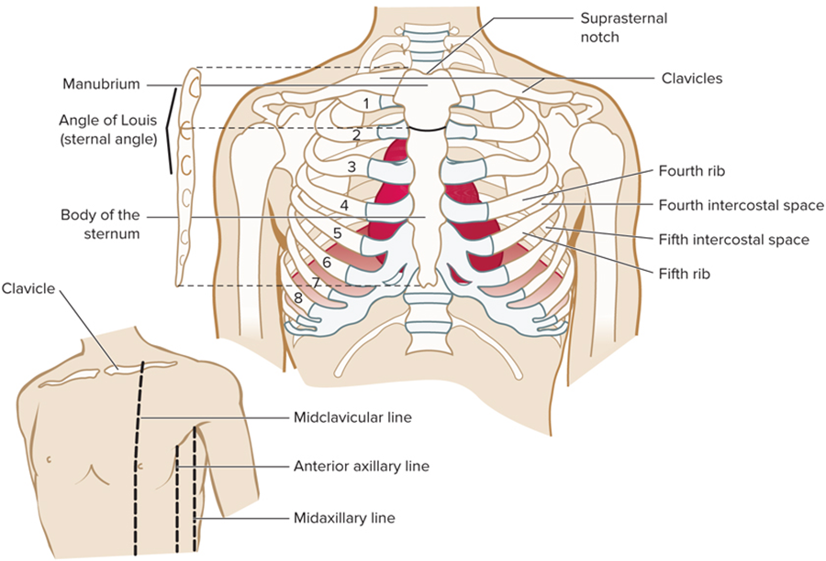
Anatomical Landmarks for Chest Electrodes
Access the text alternative for these images.
Notes:
LO 4.4 Demonstrate the procedure for applying the electrodes and lead wires for a 12-lead ECG and cardiac monitoring.
-----

Slide 22
Applying the Chest Electrodes
Apply V1 to the 4th intercostal space at the right sternal border.
Place V2 at the 4th intercostal space on the left sternal border.
Place V4 at the 5th intercostal space on the left midclavicular line.
Place V3 midway between V2 and V4.
Place V5 at the 5th intercostal space, left anterior axillary line.
Place V6 directly in line with V5 on the midaxillary line.
Notes:
LO 4.4 Demonstrate the procedure for applying the electrodes and lead wires for a 12-lead ECG and cardiac monitoring.
-----
To place V1, find the angle of Louis; then find the second rib, which is adjacent to the angle of Louis. Count down to the fourth intercostal space, and place V1 at the right sternal border at the fourth intercostal space.
Always locate and use the anatomical landmarks when placing the chest leads. Do not place them visually.
For a female with large breasts, either ask the woman to move the breasts, or use the back of your hand to lift the left breast and place the electrodes in the closest position possible. Do not place the electrodes on the breast.
Another method of placing V5 is to place V6 first, then place V5 midway between V4 and V6

Slide 23
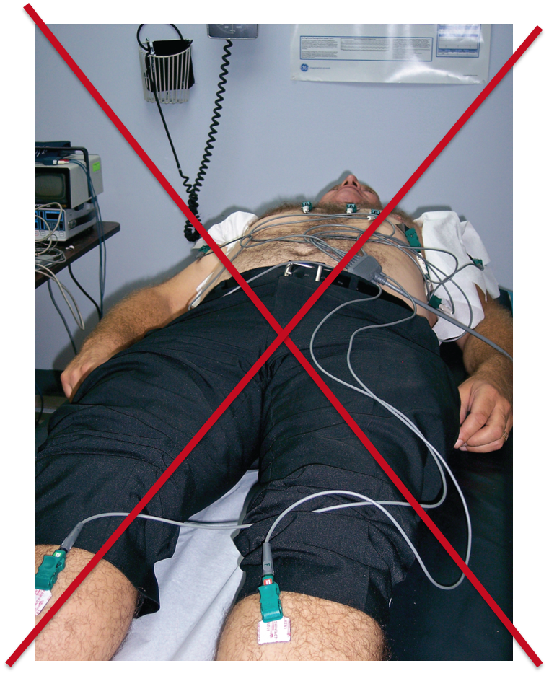
Applying the Leads: Incorrect
Avoid looping wires outside of body.
Verify that there is no tension on wires or electrodes.
Total Care Programming, Inc.
Notes:
LO 4.4: Demonstrate the procedure for applying the electrodes and lead wires for a 12-lead ECG and cardiac monitoring.
-----
The lead wire cables should follow the contours of the body.

Slide 24
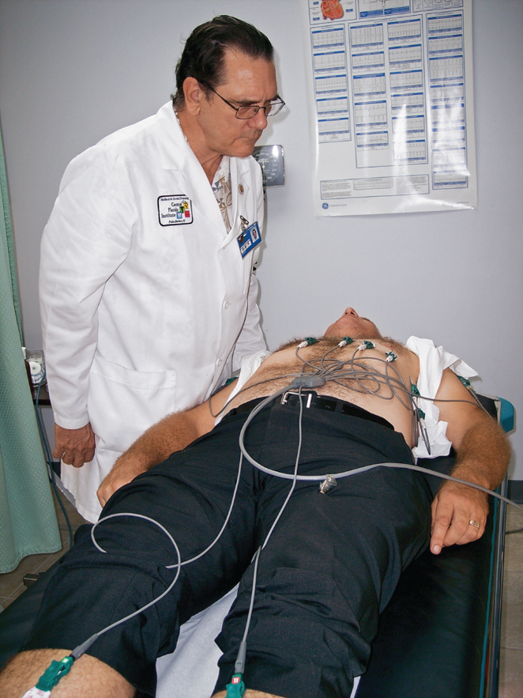
Applying the Leads: Correct
Avoid looping wires outside of body.
Verify that there is no tension on wires or electrodes.
Notes:
LO 4.4: Demonstrate the procedure for applying the electrodes and lead wires for a 12-lead ECG and cardiac monitoring.
-----
The lead wire cables should follow the contours of the body.

Slide 25
Learning Outcome 4.4
Apply Your Knowledge #1 1
Which anatomical landmark starts in the middle of the axilla and runs down the side of the chest?
Notes:
LO 4.4: Demonstrate the procedure for applying the electrodes and lead wires for a 12-lead ECG and cardiac monitoring.
-----

Slide 26
Learning Outcome 4.4
Apply Your Knowledge #1 2
Which anatomical landmark starts in the middle of the axilla and runs down the side of the chest?
Answer:
Midaxillary line
Notes:
LO 4.4: Demonstrate the procedure for applying the electrodes and lead wires for a 12-lead ECG and cardiac monitoring.
-----

Slide 27
Learning Outcome 4.4
Apply Your Knowledge #2 1
Where on the body should the V1 electrode be placed?
Notes:
LO 4.4: Demonstrate the procedure for applying the electrodes and lead wires for a 12-lead ECG and cardiac monitoring.
-----

Slide 28
Learning Outcome 4.4
Apply Your Knowledge #2 2
Where on the body should the V1 electrode be placed?
Answer:
The fourth intercostal space on the right sternal border.
Notes:
LO 4.4: Demonstrate the procedure for applying the electrodes and lead wires for a 12-lead ECG and cardiac monitoring.
-----

Slide 29
Learning Outcome 4.4
Apply Your Knowledge #3 1
Where is an acceptable alternate site for electrode placement on the upper extremity?
Notes:
LO 4.4: Demonstrate the procedure for applying the electrodes and lead wires for a 12-lead ECG and cardiac monitoring.
-----

Slide 30
Learning Outcome 4.4
Apply Your Knowledge #3 2
Where is an acceptable alternate site for electrode placement on the upper extremity?
Answer:
Deltoid (shoulder)
Notes:
LO 4.4: Demonstrate the procedure for applying the electrodes and lead wires for a 12-lead ECG and cardiac monitoring.
-----

Slide 31
Learning Outcome 4.5
Operating the E C G Machine: Preparation Checklist
Identify and communicate with patient.
Prepare patient and room.
Provide for patient privacy.
Provide for safety and infection control.
Locate and check equipment for functioning.
Load E C G graph paper, if necessary.
Attach electrodes and leads.
Notes:
LO 4.5: Describe the procedure for recording a 12-lead ECG.
-----
Before you run the ECG, make sure you have completed all of the appropriate preparations.

Slide 32
Operating the E C G Machine
Automatic machine.
Press “Run” or “Auto”.
Manual machine.
Make sure equipment is standardized and set to Lead 1.
Run a few complexes, insert standardization mark.
Notes:
LO 4.5: Describe the procedure for recording a 12-lead ECG.
-----
Check LCD for errors
On manual machines, set the standardization mark between the T wave of one complex and the P wave of the next.

Slide 33
Learning Outcome 4.5
Apply Your Knowledge 1
What should be done immediately after pressing the Run or Auto button when performing an E C G?
Notes:
LO 4.5: Describe the procedure for recording a 12-lead ECG.
-----

Slide 34
Learning Outcome 4.5
Apply Your Knowledge 2
What should be done immediately after pressing the Run or Auto button when performing an E C G?
Answer:
The L C D display should be checked for errors.
Notes:
LO 4.5: Describe the procedure for recording a 12-lead ECG.
-----

Slide 35
Learning Outcome 4.6
Checking the E C G Tracing
Key Terms
Alternating current (A C) interference.
Somatic tremor.
Wandering baseline.
Notes:
LO 4.6: Identify types of artifact and how to prevent or correct them.
-----
Alternating current (AC) interference: Unwanted markings on the ECG caused by other electrical current sources.
Somatic tremor: Involuntary muscle movement; also known as body tremor.
Wandering baseline: Artifact in which the tracing drifts away from the center of the graph paper. Also known as baseline shift.

Slide 36
Artifact Causes
Artifacts caused by:
Somatic tremor.
Wandering baseline.
A C interference.
Interrupted baseline.
Notes:
LO 4.6: Identify types of artifact and how to prevent or correct them.
-----
When an ECG tracing has an artifact, it may be difficult or impossible to read.

Slide 37
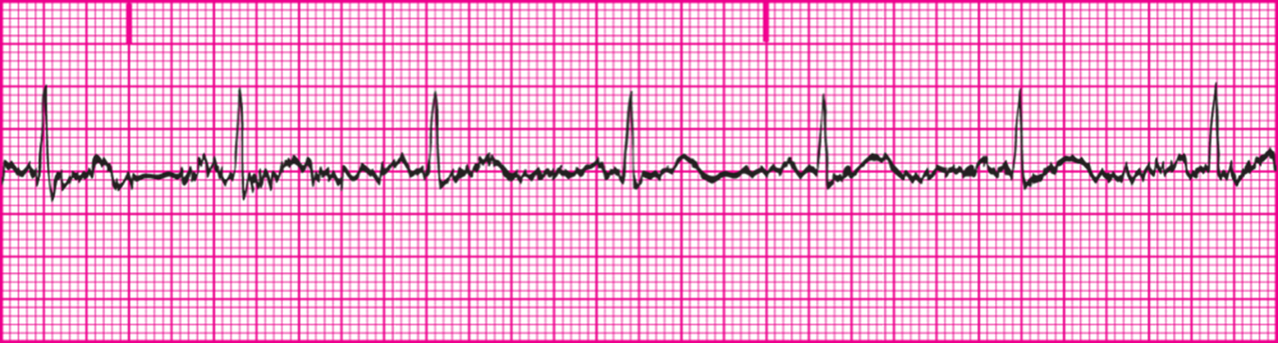
Somatic Tremor
Large spikes caused by muscle movement.
Access the text alternative for these images.
Notes:
LO 4.6: Identify types of artifact and how to prevent or correct them.
-----
Causes: shivering, muscle tension, pain, fear, talking, chewing gum, disorders such as Parkinson’s disease.
Can be corrected by:
Reassuring patient
Warming patient
Asking patient to take deep, slow breaths
Reminding patient not to move during procedure
Having patient put hands, palms down, beneath the buttocks

Slide 38
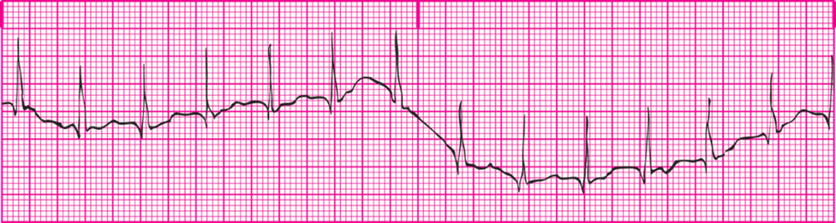
Wandering Baseline
A K A baseline shift.
Usually caused by improper electrode application.
Access the text alternative for these images.
Notes:
LO 4.6: Identify types of artifact and how to prevent or correct them.
-----
Causes: Poor skin preparation, pulling on electrodes, old, corroded, dirty electrodes or clips, oil, lotion, dirt, or hair on the skin under electrodes, dried out electrode gel.
Corrections:
Apply electrodes securely
Remove tension from lead wires
Clean skin properly with alcohol
Use only new, disposable electrodes

Slide 39
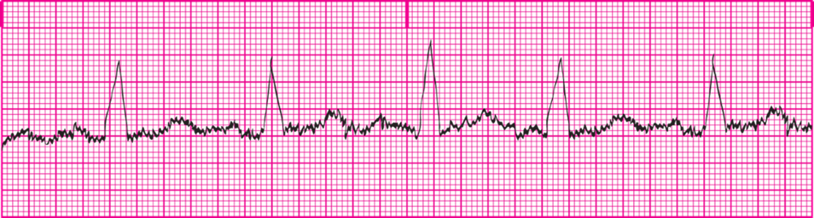
Alternating Current (A C) Interference
Small, uniform spikes caused by electricity radiated from other machines.
Common sources include improper grounding, lead wires crossed, corroded or dirty electrodes.
Access the text alternative for these images.
Notes:
LO 4.6: Identify types of artifact and how to prevent or correct them.
-----
Other sources of AC interference include:
High-tension wires
Power transformers
Diathermy machines
Electrocautery
IV pumps
Feeding tubes
X-ray machines
Electrical wires in walls, ceiling, and floor
Corrections:
Ensure that plug has ground prong and is plugged into grounded outlet
Wait until other procedures are done and unplug equipment
Reposition lead wires
Move bed away from wall

Slide 40
Interrupted Baseline
Causes.
Corroded or dirty electrode clips.
Damaged cable.
Corrections.
Clean electrode clips after each use.
Inspect cables and connections before each use, replacing as necessary.
Notes:
LO 4.6: Identify types of artifact and how to prevent or correct them.
-----

Slide 41
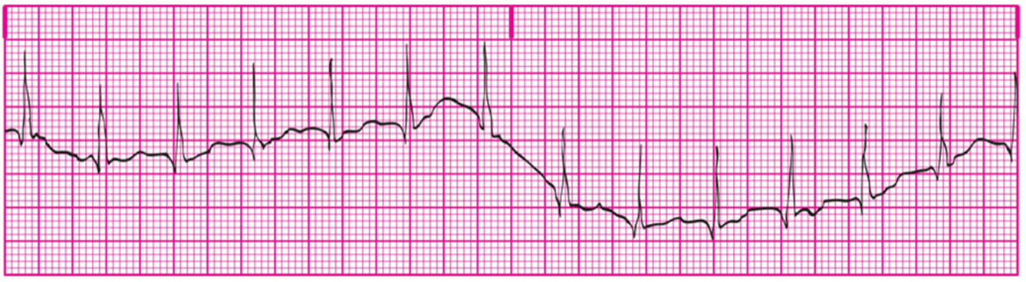
Learning Outcome 4.6
Apply Your Knowledge 1
Which type of artifact is shown here?
Access the text alternative for these images.
Notes:
LO 4.6: Identify types of artifact and how to prevent or correct them.
-----

Slide 42
Learning Outcome 4.6
Apply Your Knowledge 2
Which type of artifact is shown here?
Answer:
Wandering baseline
Access the text alternative for these images.
Notes:
LO 4.6: Identify types of artifact and how to prevent or correct them.
-----

Slide 43
Learning Outcome 4.7
Reporting E C G Results
Follow your facility’s policy.
Make copy, if required.
Fax or send tracing electronically, if required.
If ordered stat, immediately give tracing to your supervisor.
Notes:
LO 4.7: Describe how to report the ECG results.
-----
Remember, in a stat situation, the patient may have a condition that needs immediate treatment, so no time should be wasted. If your supervisor is not available when you finish the recording, ensure that the results are with the medical record, then find your supervisor or the ordering physician and notify him or her that the recording has been completed.

Slide 44
Billing
Complete designated information accurately.
Incomplete forms may adversely affect the facility’s finances.
Enter patient diagnosis and diagnostic code (I C D code).
Notes:
LO 4.7: Describe how to report the ECG results.
-----
Using the correct ICD-10 code helps ensure that the facility is properly reimbursed for the procedure.

Slide 45
Learning Outcome 4.7
Apply Your Knowledge 1
How should you report a stat E C G?
Notes:
LO 4.7: Describe how to report the ECG results.
-----

Slide 46
Learning Outcome 4.7
Apply Your Knowledge 2
How should you report a stat E C G?
Answer:
Give the results directly and immediately to your supervisor or the ordering physician.
Notes:
LO 4.7: Describe how to report the ECG results.
-----

Slide 47
Learning Outcome 4.8
Equipment Maintenance
Keep machine clean to prevent infection and present professional image.
Clean electrode clips and check for paste/gel.
Disinfect cables and reusable electrodes.
Inspect each wire for cracks or fraying; replace if necessary.
Store all equipment neatly.
Notes:
LO 4.8: Identify the steps for cleaning and caring for the ECG equipment.
-----
Always follow the manufacturer’s instructions for cleaning equipment.

Slide 48
Learning Outcome 4.8
Apply Your Knowledge
Give two reasons why the E C G machine should be kept clean.
Notes:
LO 4.8: Identify the steps for cleaning and caring for the ECG equipment.
-----

Slide 49
Learning Outcome 4.8
Apply Your Knowledge 2
Give two reasons why the E C G machine should be kept clean.
Answer:
To prevent infection and to present a professional image.
Notes:
LO 4.8: Identify the steps for cleaning and caring for the ECG equipment.
-----

Slide 50
Learning Outcome 4.9
Pediatric E C G
Identify yourself.
Keep explanations simple.
Avoid technical words.
Identify child by name.
Infants may need to use a pacifier or fall asleep for accurate E C G.
Notes:
LO 4.9: Explain variations for a pediatric ECG procedure.
-----
Use the word “stickers” to describe the electrodes. Explain you are going to take a “picture” of the patient’s heart.

Slide 51
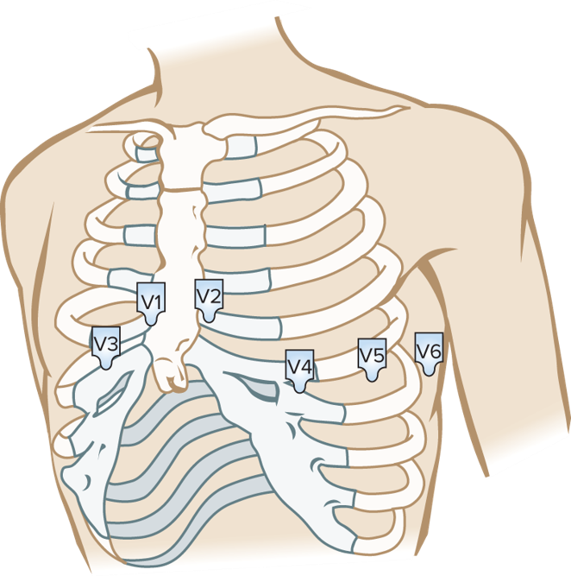
Pediatric E C G
Use smaller electrodes.
Paper speed may need to be adjusted for faster heart rates.
Proper placement of electrodes is more important than in adults.
V3 may require placement on the right side (V3R).
Access the text alternative for these images.
Notes:
LO 4.9: Explain variations for a pediatric ECG procedure.
-----
Give praise or a small reward after the recording has been completed successfully.

Slide 52
Learning Outcome 4.9
Apply Your Knowledge 1
True or False: For pediatric patients, it may be necessary to place the V5 electrode on the right side of the chest.
Notes:
LO 4.9: Explain variations for a pediatric ECG procedure.
-----

Slide 53
Learning Outcome 4.9
Apply Your Knowledge 2
True or False: For pediatric patients, it may be necessary to place the V5 electrode on the right side of the chest.
Answer:
False; the V3 electrode may be placed on the right side of the chest.
Notes:
LO 4.9: Explain variations for a pediatric ECG procedure.
-----

Slide 54
Cardiac Monitoring
Three electrodes are used.
R A: white cable/electrode.
L A: black cable/electrode.
F or L L: red cable/electrode.
Notes:
LO 4.10: Distinguish between a routine ECG and cardiac monitoring.
-----

Slide 55
Learning Outcome 4.10
Apply Your Knowledge 1
When do patients commonly require continuous cardiac monitoring?
Notes:
LO 4.10: Distinguish between a routine ECG and cardiac monitoring.
-----

Slide 56
Learning Outcome 4.10
Apply Your Knowledge 2
When do patients commonly require continuous cardiac monitoring?
Answer:
At emergency scenes, during or after surgery, or when they have cardiac, pulmonary, or electrolyte problems.
Notes:
LO 4.10: Distinguish between a routine ECG and cardiac monitoring.
-----

Slide 57
Learning Outcome 4.11
Special Patient Considerations
Key Terms
Dextrocardia.
Midscapular line.
Paraspinous line.
Posterior axillary line.
Notes:
LO 4.11: Summarize special patient circumstances when performing an ECG.
-----
Dextrocardia: When the heart is on the opposite or right side of the chest.
Midscapular line: Imaginary line on the back that runs vertically through the center of the scapula.
Paraspinous line: Imaginary line on the spine that runs vertically next to the spine.
Posterior axillary line: Imaginary line on the back that runs vertically from the shoulder down on the outer edge of the rib cage.

Slide 58
Special Patient Considerations 1
Females.
V1 and V2 may be placed higher due to implants or large breasts.
Place electrode under breast; make note on chart.
Mastectomy: make note on chart.
Amputees.
Place leads on upper chest and lower abdomen instead of on arms and legs.
Notes:
LO 4.11: Summarize special patient circumstances when performing an ECG.
If the patient has had a below the knee amputation, the leg leads may be placed on the thighs symetrically.
-----
Do not place electrodes on a woman’s breast. Place the electrode under the breast, as close as possible to the proper location, and note on the chart that V3, V4, and V5 are placed lower than required.
Women who have had a mastectomy may have fragile skin; be careful placing and removing the electrodes.

Slide 59
Special Patient Considerations 2
Pregnant patients: Place lower limb leads on thighs, not abdomen.
Geriatric patients: Apply electrodes carefully to avoid damaging thin skin.
Note nonstandard body positions on tracing. For example, a patient who is short of breath may need to have their head elevated.
Place electrodes on back only if necessary.
Notes:
LO 4.11: Summarize special patient circumstances when performing an ECG.
-----
For pregnant patients, document on the tracing that the patient is pregnant and the number of months.

Slide 60
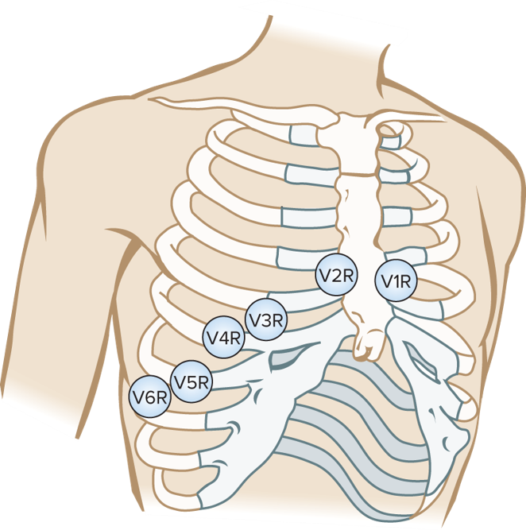
Dextrocardia
Dextrocardia—heart on right side.
Reverse leads from normal placement (mirror image).
a V R tracing will produce positive deflection.
Indicate “right-side” on chart.
Access the text alternative for these images.
Notes:
LO 4.11: Summarize special patient circumstances when performing an ECG.
-----

Slide 61
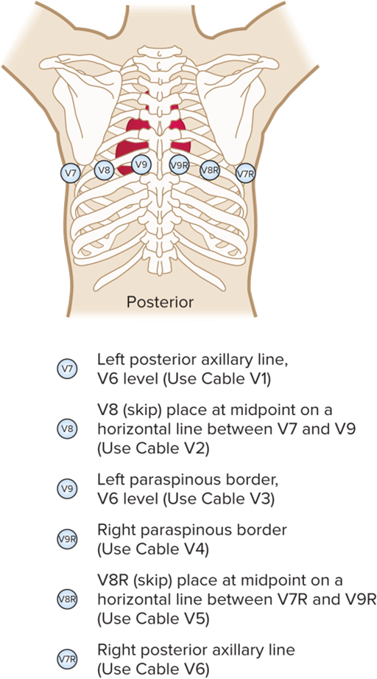
Posterior 12 Lead E C G
Electrode placement:
V7: left posterior axillary line.
V8: under left midscapular line.
V9: left paraspinal border.
Helps physician detect problems with right ventricle and posterior wall of left ventricle.
Access the text alternative for these images.
Notes:
LO 4.11: Summarize special patient circumstances when performing an ECG.
-----
Leads V7, V8, V9 are all at the V6 level
V7R-V9R: mirror image of left posterior view
V7: Use cable V1
V8: Use cable V2
V9: Use cable V3
V9R: Use cable V4
V8R: Use cable V5
V7R: Use cable V6

Slide 62
Learning Outcome 4.11
Apply Your Knowledge 1
A posterior E C G views which additional regions of the heart?
Notes:
LO 4.11: Summarize special patient circumstances when performing an ECG.
-----

Slide 63
Learning Outcome 4.11
Apply Your Knowledge 2
A posterior E C G views which additional regions of the heart?
Answer:
Right ventricle and posterior wall of left ventricle.
Notes:
LO 4.11: Summarize special patient circumstances when performing an ECG.
-----

Slide 64
Learning Outcome 4.12
Handling Emergencies
Key Term
Seizure.
Notes:
LO 4.12: Recall the steps for handling an emergency during the ECG.
-----
Seizure: An interruption of the electrical activity in the brain that causes involuntary muscle movement and sometimes unconsciousness.

Slide 65
Handling Emergencies
Cardiac or respiratory arrest.
Requires quick, efficient E C G.
Pre-enter patient information when possible.
Be prepared to run second E C G.
Leave electrodes in place.
Note “repeat E C G - same lead placement on tracing”.
Notes:
LO 4.12: Recall the steps for handling an emergency during the ECG.
-----
Stay out of the way until the ECG is needed.

Slide 66
Seizure Emergency
Stay with the patient.
Protect the patient from injury.
Call for help and report the seizure.
After the seizure, perform the E C G and note “post seizure.”
Notes:
LO 4.12: Recall the steps for handling an emergency during the ECG.
-----
Do not try to restrain the patient.

Slide 67
Learning Outcome 4.12
Apply Your Knowledge 1
If your patient has a seizure while an E C G is being performed, what should you do?
Notes:
LO 4.12: Recall the steps for handling an emergency during the ECG.
-----

Slide 68
Learning Outcome 4.12
Apply Your Knowledge 2
If your patient has a seizure while an E C G is being performed, what should you do?
Answer:
Stay with the patient, protect the patient from injury, call for help, and report the seizure.
Notes:
LO 4.12: Recall the steps for handling an emergency during the ECG.
-----

Slide 69
Chapter Summary 1
Patient, room, and equipment should be prepared before you begin the E C G recording.
If patient refuses an E C G, identify the reason, document, and notify the supervisor if needed.
Providing for safety includes using electrical equipment safely, using good body mechanics, and performing hand hygiene and wearing P P E as required.
Locate anatomical landmarks for applying the E C G electrodes, then apply the electrodes and leads symmetrically on the patient using the preferred or, if necessary, alternate placements.
Notes:
LO 4.1: Carry out preparation of the patient, room, and equipment for an ECG.
LO 4.2: Describe the communication needed during the ECG procedure, including the actions to take if a patient refuses to allow an ECG to be performed.
LO 4.3: Identify at least three ways to provide for safety during the ECG procedure.
LO 4.4: Demonstrate the procedure for applying the electrodes and lead wires for a 12-lead ECG and cardiac monitoring.

Slide 70
Chapter Summary 2
Press the “Run” or “Auto” button to begin the E C G; on a manual machine, standardize and set the machine to Lead 1.
Check the E C G tracing for artifact and eliminate it if possible.
Report the E C G results promptly and in the proper format.
Clean and maintain the E C G equipment according to the manufacturer’s instructions.
For a pediatric E C G, V3 may need to be placed on the right side of the chest.
Notes:
LO 4.5: Describe the procedure for recording a 12-lead ECG.
LO 4.6: Identify types of artifact and how to prevent or correct them.
LO 4.7: Describe how to report the ECG results.
LO 4.8: Identify the steps for cleaning and caring for the ECG equipment.
LO 4.9: Explain variations for a pediatric ECG procedure.

Slide 71
Chapter Summary 3
Cardiac monitoring may be required at emergency scenes, in the hospital during or after surgery, or when a patient has cardiac, pulmonary, or electrolyte problems.
Special patient considerations may be needed during an E C G for pregnant patients, amputees, and other patients with special needs.
During an emergency such as cardiac or respiratory arrest, the E C G needs to be performed as quickly and efficiently as possible.
Notes:
LO 4.10: Distinguish between a routine ECG and cardiac monitoring.
LO 4.11: Summarize special patient circumstances when performing an ECG.
LO 4.12: Recall the steps for handling an emergency during the ECG.

