Slide 1
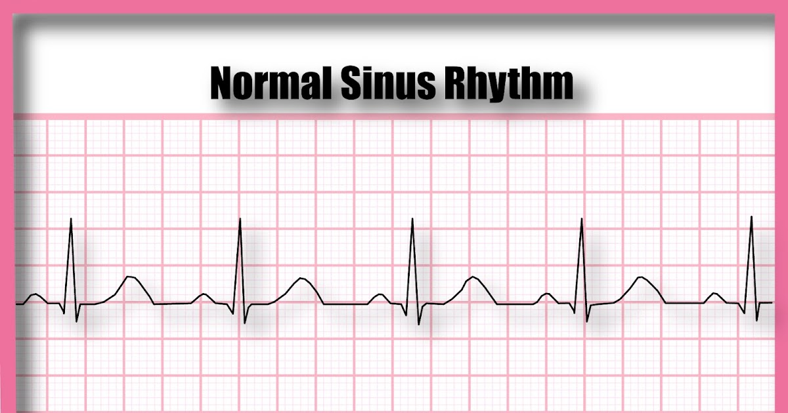
CHAPTER 5
RHYTHM
STRIP
INTERPRETATION

Slide 2
Electrical Stimulation 1
Polarization.
Cells are at peak resting energy.
Depolarization.
State of stimulation that precedes contraction.
Electrical activation of heart cells.
Causes the heart to contract.
Notes:
LO 5.1: Describe the heart activity that produces each part of the ECG waveform.
-----
In a polarized cell, the inside of the cell is negatively charged compared to the outside of the cell.
Depolarization occurs when the electrical charge is reversed across the cell membrane so the interior becomes positively charged compared to the outside of the cell.
The rapid change of polarization during depolarization is called action potential.

Slide 3


Electrical Stimulation 2
Repolarization.
State of cellular recovery following contraction.
Cell returns to a resting state.
Heart relaxes, allowing for refilling of the chambers.
Notes:
LO 5.1: Describe the heart activity that produces each part of the ECG waveform.
-----
As the cell repolarizes and returns to its resting state, the charges again reverse, so that the inside of the cell is negatively charged compared to the outside of the cell.

Slide 4
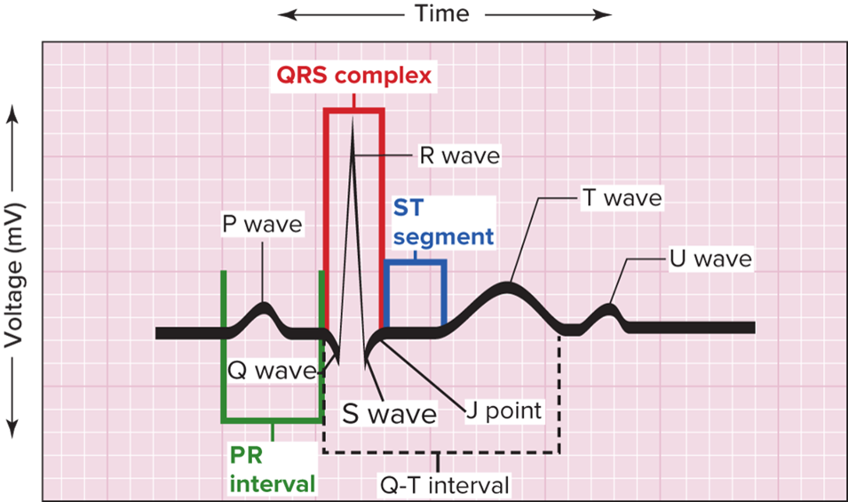
E C G Waveform
Recorded activity of depolarization and repolarization.
Isoelectric line or baseline.
Labeled P, Q, R, S, T, U.
Access the text alternative for slide images.
Notes:
LO 5.1: Describe the heart activity that produces each part of the ECG waveform.
-----
The isoelectric line or baseline refers to the tracing when no electrical activity is occurring.

Slide 5
P Wave
First positive deflection.
Represents atrial depolarization and atrial contraction.
Small compared to other E C G waves.
Notes:
LO 5.1: Describe the heart activity that produces each part of the ECG waveform.
-----
The atrial kick occurs during the short baseline segment that appears immediately after the P wave.

Slide 6
Q R S Complex 1
Consists of the Q, R, and S waves.
Q wave.
Represents conduction of impulse down the interventricular septum.
First negative deflection, occurs before the R wave.
Not always visualized on the E C G.
Less than 1/4 the height of the R wave.
Notes:
LO 5.1: Describe the heart activity that produces each part of the ECG waveform.
-----
The QRS complex represents ventricular depolarization and the resulting ventricular contraction. It reflects the time it takes for an electrical impulse to depolarize the interventricular septum down through the ventricular myocardium, causing the ventricles to contract.
Although atrial repolarization occurs during ventricular depolarization, it is not seen on the ECG because the larger voltage of the ventricular depolarization overshadows the voltage of atrial repolarization. Only the largest voltage is seen on the ECG tracing.

Slide 7
Q R S Complex 2
R wave.
First positive wave of the Q R S complex.
Represents conduction of electrical impulse to the left ventricle.
S wave.
First negative deflection after the R wave.
Represents conduction of electrical impulse through both ventricles.
Notes:
LO 5.1: Describe the heart activity that produces each part of the ECG waveform.
-----

Slide 8
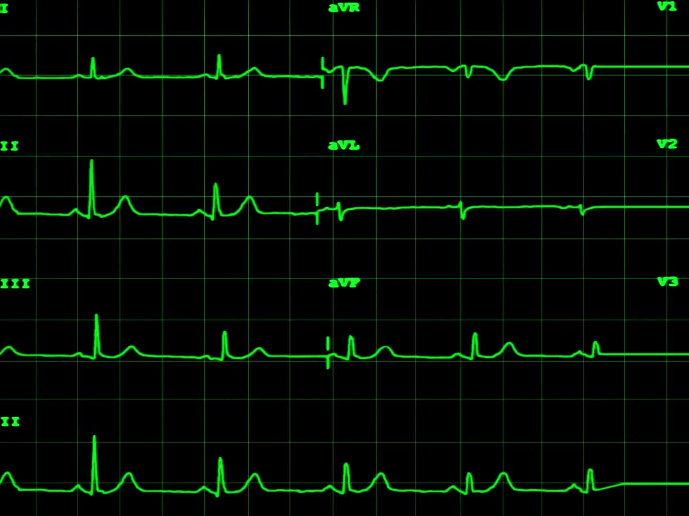
S T Segment
Measured from end of the S wave to the beginning of T wave.
Indicates end of ventricular depolarization and beginning of ventricular repolarization.
Normally on isoelectric line.
Elevation or depression of S T segment may result from ischemia.
Notes:
LO 5.1: Describe the heart activity that produces each part of the ECG waveform.
-----
The reason this segment is studied in a 12-lead ECG recording is to determine whether there is any ischemia or myocardial (heart) damage.
Ischemia occurs when there is a sudden loss or reduction in blood supply (oxygen) to a region of heart tissue.

Slide 9
T Wave
Represents ventricular repolarization.
Normal T wave is in same direction as R wave and P wave.
Notes:
LO 5.1: Describe the heart activity that produces each part of the ECG waveform.
-----
Unlike the rounded, symmetrical shape of the P wave, the T wave looks like a mountain with one sloping side, peaking toward the end instead of in the middle.

Slide 10

U Wave
Follows the T wave.
Represents repolarization of bundle of His and Purkinje fibers.
Not seen on all E C Gs.
Presence may indicate an electrolyte imbalance.
Notes:
LO 5.1: Describe the heart activity that produces each part of the ECG waveform.
-----
The U wave usually deflects in the same direction as the T wave and is more prominent when the heart rate is slow.

Slide 11
P R Interval
Measured from beginning of P wave to beginning of Q R S complex.
Normal length of time is 0.12 to 0.20 second.
Interval should be consistent.
Notes:
LO 5.1: Describe the heart activity that produces each part of the ECG waveform.
-----
The PR interval represents the time from initiation of the electrical impulse until the ventricles are stimulated by the impulse to start the contraction.

Slide 12
Q T Interval
Time required for ventricular depolarization and repolarization to occur.
Starts at beginning of Q R S complex and ends at end of T wave.
Includes Q R S complex, S T segment, and T wave.
Normally measures less than one-half of R-R interval.
Notes:
LO 5.1: Describe the heart activity that produces each part of the ECG waveform.
-----
Factors that can affect the QT interval include:
Heart rate
Coronary artery disease
Electrolyte imbalance
Antidysrhythmic medications
Longer-than-normal QT interval may indicate increased risk for certain ventricular dysrhythmias and sudden cardiac death.

Slide 13
R-R Interval
Time from start of one Q R S complex to start of next Q R S complex.
Used to calculate heart rate.
Notes:
LO 5.1: Describe the heart activity that produces each part of the ECG waveform.
-----
The R-R interval is used to calculate heart rate because they are the easiest waves to identify, so they can be identified and counted quickly for rapid heart rate calculations.

Slide 14
J Point
Junction of the Q R S complex and the S T interval.
Represents end of the Q R S complex and ventricular depolarization.
Important when measuring the length of the Q R S complex.
Notes:
LO 5.1: Describe the heart activity that produces each part of the ECG waveform.
-----
The J point is important when measuring the length of the QRS complex and interpreting the ECG tracing. A normal QRS complex is 0.06 to 0.1 second.

Slide 15
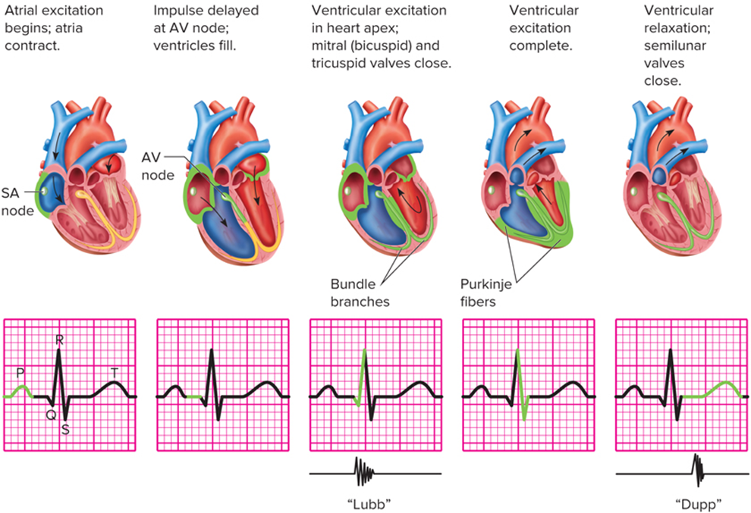
Electrical Activity in the Heart
Access the text alternative for slide images.

Slide 16
Learning Outcome 5.1 Apply Your Knowledge #1 1
Which wave on the E C G waveform represents ventricular repolarization?
Notes:
LO 5.1: Describe the heart activity that produces each part of the ECG waveform.

Slide 17
Learning Outcome 5.1 Apply Your Knowledge #1 2
Which wave on the E C G waveform represents ventricular repolarization?
Answer:
T wave
Notes:
LO 5.1: Describe the heart activity that produces each part of the ECG waveform.

Slide 18
Learning Outcome 5.1 Apply Your Knowledge #2 1
What is the normal length of time for the P R interval?
Notes:
LO 5.1: Describe the heart activity that produces each part of the ECG waveform.

Slide 19
Learning Outcome 5.1 Apply Your Knowledge #2 2
What is the normal length of time for the P R interval?
Answer:
0.12 to 0.20 second
Notes:
LO 5.1: Describe the heart activity that produces each part of the ECG waveform.

Slide 20
Learning Outcome 5.2 Rhythm Interpretation 1
E C G is an important tool for diagnosing and treating various cardiac diseases.
Determining cardiac dysrhythmia can be challenging.
E C G analysis involves a systematic approach.
Notes:
LO 5.2: Explain the process of evaluating ECG tracings and determining the presence of dysrhythmias.
-----
The ability to evaluate ECG waveforms is an important skill for healthcare professionals.
Always work within your scope of practice.

Slide 21
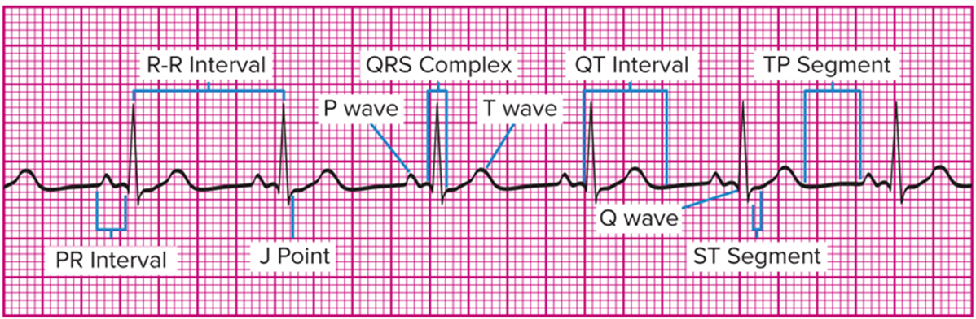
Learning Outcome 5.2 Rhythm Interpretation 2
The waves, segments and interval of the tracing are evaluated to determine the type of cardiac rhythm.
Access the text alternative for slide images.

Slide 22
Learning Outcome 5.2 Apply Your Knowledge 1
True or False: The best way to analyze an E C G recording is to gather the data and match it to specific rhythm criteria.
Notes:
LO 5.2: Explain the process of evaluating ECG tracings and determining the presence of dysrhythmias.
-----

Slide 23
Learning Outcome 5.2 Apply Your Knowledge 2
True or False: The best way to analyze an E C G recording is to gather the data and match it to specific rhythm criteria.
Answer:
True
Notes:
LO 5.2: Explain the process of evaluating ECG tracings and determining the presence of dysrhythmias.
-----

Slide 24
Learning Outcome 5.3 Identifying the Components of the Rhythm
Key Terms
J point.
Morphology.
Notes:
LO 5.3: Describe the criteria used to classify dysrhythmias, including rhythm, rate, P wave morphology, PR interval measurement, and QRS duration measurement.
-----
J point: A point on the QRS complex where the depolarization is completed and repolarization starts.
Morphology: Overall form and structure (shape).

Slide 25
Identifying Components of the Rhythm
Five-step process.
Rhythm (regularity).
Rate.
P wave morphology (shape).
P R interval.
Q R S duration and morphology.
used for rhythm evaluation.
Notes:
LO 5.3: Describe the criteria used to classify dysrhythmias, including rhythm, rate, P wave morphology, PR interval measurement, and QRS duration measurement.
-----
This process is used to analyze all dysrhythmias, regardless of category or complexity of the tracing.
Lead II is most often used for heart rhythm analysis because it provides the best view of atrial (P wave) activity.
It is important to start the analysis with rhythm regularity because it will dictate which heart rate determination technique that you will use.

Slide 26
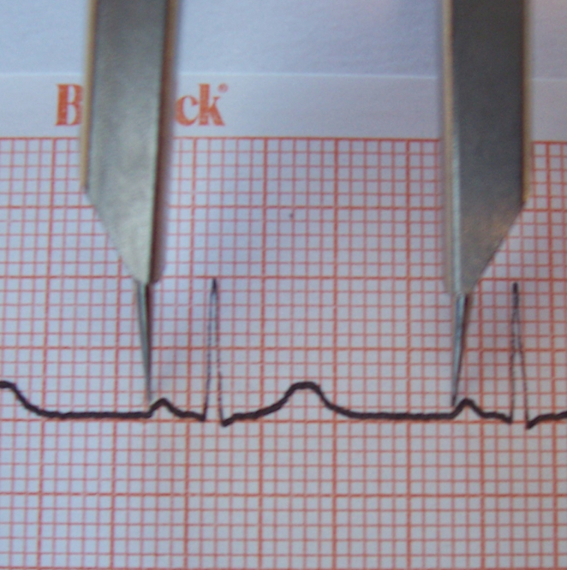
Identifying the Components of the Rhythm: Step One-1
Determining the E C G rhythm or regularity
Atrial: Measure P-P wave interval
Use calipers.
Measure several intervals.
Compare to determine whether rhythm is regular or irregular.
Notes:
LO 5.3: Describe the criteria used to classify dysrhythmias, including rhythm, rate, P wave morphology, PR interval measurement, and QRS duration measurement.
-----
The P wave represents atrial depolarization and is used to determine the regularity of atrial contractions.
Measure at least 6 seconds of the ECG tracing to determine whether the P waves occur in a regular or irregular rhythm.

Slide 27
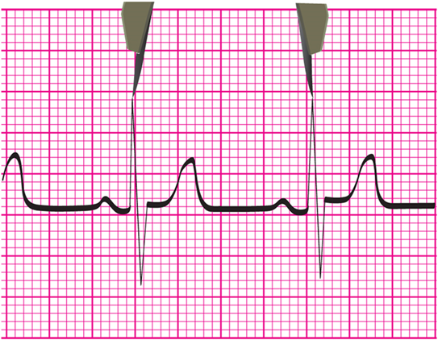
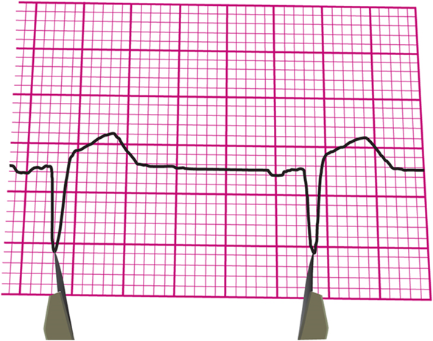
Identifying the Components of the Rhythm: Step One-2
Ventricular: Measure Q R S complex intervals:
The R-R wave interval is easiest.
If no R wave, use the Q and S wave junction.

Slide 28
Identifying the Components of the Rhythm: Step Two
Determining the atrial and ventricular rates.
Regular rhythm.
Arial rate: divide number of small boxes between P waves into 1,500.
Ventricular rate – divide number of small boxes between R waves into 1,500.
Irregular rhythm.
Use the 6-second method.
Notes:
LO 5.3: Describe the criteria used to classify dysrhythmias, including rhythm, rate, P wave morphology, PR interval measurement, and QRS duration measurement.
-----
This is similar to the 1500 method of measuring a person’s pulse.
An accurate measurement of heart rate is extremely important when the person has tachycardia or bradycardia.
The 6-second method is the same as for measuring a person’s pulse:
For the atrial rate, count the number of P waves in a 6-second strip and multiply by 10
For the ventricular rate, count the number of QRS complexes in a 6-second strip and multiply by 10

Slide 29
Identifying the Components of the Rhythm: Step Three
Identifying the P wave morphology.
Are shapes and waveforms all the same?
Does each P wave have a Q R S complex following it?
Notes:
LO 5.3: Describe the criteria used to classify dysrhythmias, including rhythm, rate, P wave morphology, PR interval measurement, and QRS duration measurement.
-----
Differences in P waves indicate different electrical pathways in the atria.
Extra P waves or QRS complexes indicate that the normal pathway was not used and that the atria and ventricles are not contracting together.

Slide 30
Identifying the Components of the Rhythm: Step Four 1
Measuring the P R interval.
Measure the distance from the start of the P wave to the start of the Q R S complex.
Normal range is 0.12 to 0.20 second.
Calculate in multiples of 0.02 because the human eye cannot determine 0.01 second.
Notes:
LO 5.3: Describe the criteria used to classify dysrhythmias, including rhythm, rate, P wave morphology, PR interval measurement, and QRS duration measurement.
-----
The PR interval measures the length of time it takes the electrical current to be initiated at the SA node and travel through the electrical current pathway to cause ventricular depolarization.
If the PR interval differs from one complex to the next, either the electrical current is being delayed for some reason or it may be initiating from locations other than the SA node.

Slide 31
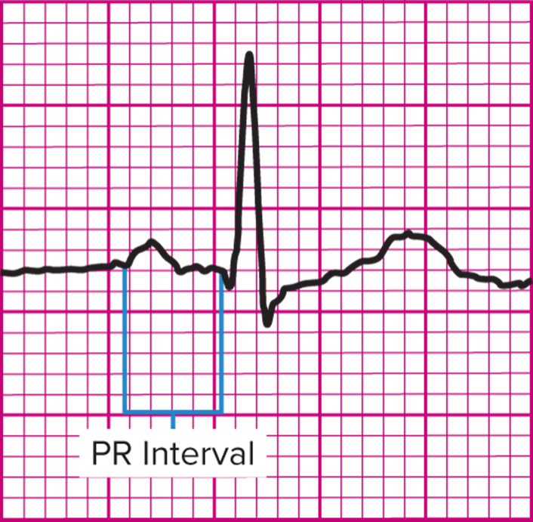
Identifying the Components of the Rhythm: Step Four 2
Notes:
LO 5.3: Describe the criteria used to classify dysrhythmias, including rhythm, rate, P wave morphology, PR interval measurement, and QRS duration measurement.
-----

Slide 32
Identifying the Components of the Rhythm: Step Five 1
Measuring the Q R S duration and analyzing the morphology.
Helps in discriminating between different dysrhythmias.
Normal limits 0.06 to 0.10 second.
Measure from beginning of Q R S complex to J point.
Notes:
LO 5.3: Describe the criteria used to classify dysrhythmias, including rhythm, rate, P wave morphology, PR interval measurement, and QRS duration measurement.
-----
J point: Where the S wave stops and the ST segment begins; signifies that depolarization is completed and repolarization is starting.

Slide 33
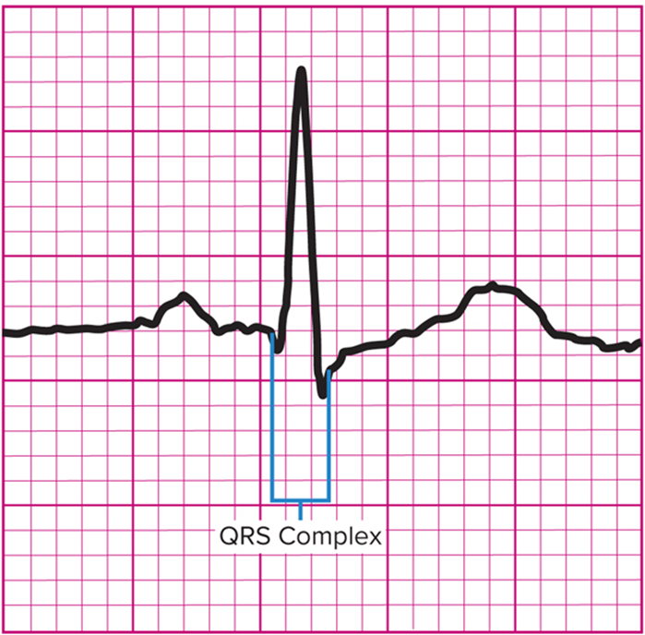
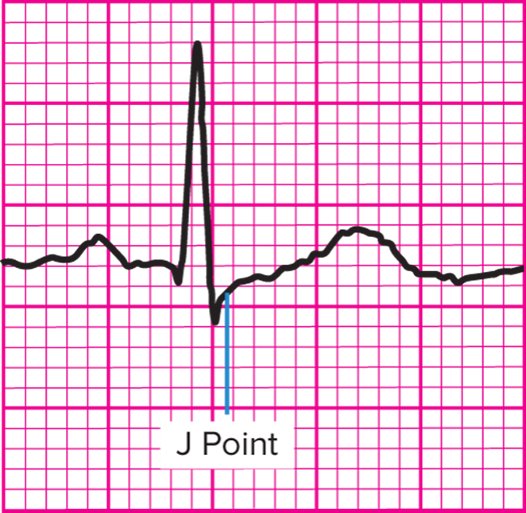
Identifying the Components of the Rhythm: Step Five 2
Access the text alternative for slide images.
Notes:
LO 5.3: Describe the criteria used to classify dysrhythmias, including rhythm, rate, P wave morphology, PR interval measurement, and QRS duration measurement.
-----

Slide 34
Identifying the Components of the Rhythm: Step Five 3
Important Q R S questions.
Are all Q R S complexes of equal length?
What is the actual measurement, and is it within normal limits?
Do all Q R S complexes look alike?
If not, are unusual Q R S complexes associated with ectopic beat?
Notes:
LO 5.3: Describe the criteria used to classify dysrhythmias, including rhythm, rate, P wave morphology, PR interval measurement, and QRS duration measurement.
-----

Slide 35



Learning Outcome 5.3 Apply Your Knowledge #1 1
What are the five steps in rhythm data gathering?
Notes:
LO 5.3: Describe the criteria used to classify dysrhythmias, including rhythm, rate, P wave morphology, PR interval measurement, and QRS duration measurement.
-----

Slide 36
Learning Outcome 5.3 Apply Your Knowledge #1 2
What are the five steps in rhythm data gathering?
Answer:
Rhythm.
Rate.
P wave configuration.
P R interval.
Q R S duration and morphology.
Notes:
LO 5.3: Describe the criteria used to classify dysrhythmias, including rhythm, rate, P wave morphology, PR interval measurement, and QRS duration measurement.
-----

Slide 37
Learning Outcome 5.3 Apply Your Knowledge #2 1
What is the normal range for the P R interval?
Notes:
LO 5.3: Describe the criteria used to classify dysrhythmias, including rhythm, rate, P wave morphology, PR interval measurement, and QRS duration measurement.
-----

Slide 38
Learning Outcome 5.3 Apply Your Knowledge #2 2
What is the normal range for the PR interval?
Answer:
0.12 to 0.20 second
Notes:
LO 5.3: Describe the criteria used to classify dysrhythmias, including rhythm, rate, P wave morphology, PR interval measurement, and QRS duration measurement.
-----

Slide 39
Chapter Summary
The parts of the E C G waveform are created by the electrical activity of the heart, including atrial and ventricular depolarization and repolarization.
The E C G waveform includes the P wave, Q R S complex, T wave, U wave (not always seen), P R interval, Q T interval, and S T segment. Evaluating an E C G requires basic knowledge of these components of the rhythm.
The process of evaluating an E C G tracing includes determining the rhythm, rate, P wave morphology, P R interval, and Q R S duration and morphology.

