Slide 1

Chapter 7
Atrial Dysrhythmias
Access the text alternative for slide images.
© McGraw Hill LLC. All rights reserved. No reproduction or distribution without the prior written consent of McGraw Hill LLC.

Slide 2
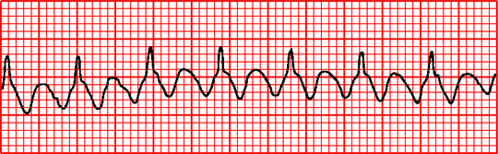
CHAPTER 7
ATRIAL DYSRYTHMIAS

Slide 3
Learning Outcomes
7.1 Summarize the similarities and differences between atrial dysrhythmias.
7.2 Analyze premature atrial complexes and their effect on the patient, including basic patient care and treatment.
7.3 Analyze wandering atrial pacemaker and its effect on the patient, including basic patient care and treatment.
7.4 Analyze multifocal atrial tachycardia and its effect on the patient, including basic patient care and treatment.
7.5 Analyze atrial flutter and its effect on the patient, including basic patient care and treatment.
7.6 Analyze atrial fibrillation and its effect on the patient, including basic patient care and treatment.

Slide 4
Introduction to Atrial Dysrhythmias
Atrial dysrhythmias
Caused by ectopic impulse in right or left atrium.
Occur from conditions that cause pressure on the atria.
Fastest impulse controls the heart rate
Ectopic impulses firing faster than the S A node override the S A node impulses.
Conditions that may cause atrial dysrhythmias.
Myocardial infarction that damages the atria.
Valvular problems.
Neurological influences.
Notes:
LO 7.1: Summarize the similarities and differences among atrial dysrhythmias.
-----
Atrial cells become unstable when an area of the heart becomes stressed or damaged. The unstable state may cause the cells to depolarize more easily.

Slide 5
Learning Outcome 7.1 Apply Your Knowledge 1
What conditions cause pressure on the atria resulting in atrial dysrhythmias?
Notes:
LO 7.1: Summarize the similarities and differences among atrial dysrhythmias.
-----

Slide 6
Learning Outcome 7.1 Apply Your Knowledge 2
What conditions cause pressure on the atria resulting in atrial dysrhythmias?
Answer:
Myocardial infarction that causes atrial damage, valvular problems, and/or neurological influences.
Notes:
LO 7.1: Summarize the similarities and differences among atrial dysrhythmias.
-----

Slide 7
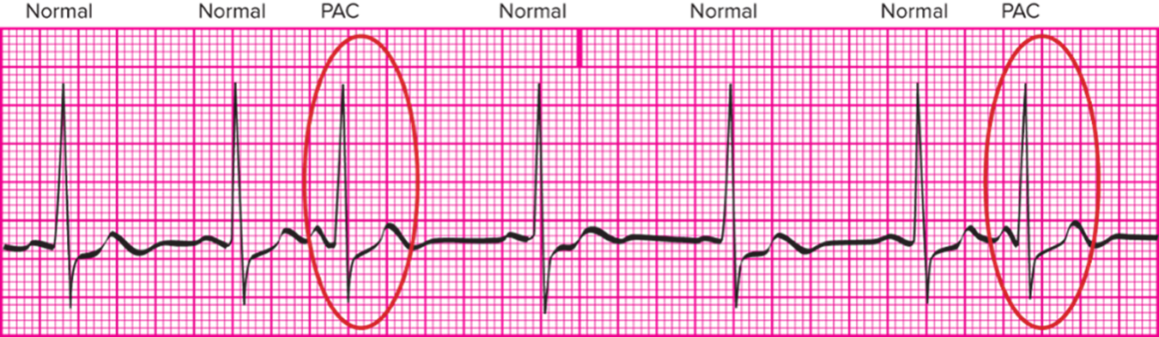
Premature Atrial Complexes (P A C’s)
Electrical impulses that originate in the atria and initiate an early impulse, disrupting the regular rhythm.
Often called P A C’s.
Access the text alternative for slide images.
Notes:
LO 7.2: Analyze premature atrial complexes and their effect on the patient, including basic patient care and treatment.
-----

Slide 8
Premature Atrial Complexes: Criteria 1
Rhythm: P-P and R-R intervals are constant except for early complexes.
Determine underlying rhythm.
Rate:
Atrial and ventricular rates usually within 60 to 100 bpm.
May be faster, depending on P A C frequency.
P wave morphology:
In normal complexes: Uniform shape.
In P A C s: May be flattened, notched, biphasic, or otherwise unusual.
Early P wave may be hidden within T wave.
Notes:
LO 7.2: Analyze premature atrial complexes and their effect on the patient, including basic patient care and treatment.
-----
Clues that the P wave is hidden within the T wave include:
Notched T wave
Pointed T wave
Taller-than-usual T wave

Slide 9
Premature Atrial Complexes: Criteria 2
P R interval.
Between 0.12 and 0.20 second.
Early beat may have different P R measurement, but within normal limit.
Q R S duration and morphology.
Between 0.06 and 0.10 second.
Within normal limits.
Notes:
LO 7.2: Analyze premature atrial complexes and their effect on the patient, including basic patient care and treatment.
-----

Slide 10
Identifying Premature Atrial Complexes
Determine the underlying sinus rhythm.
Label tracing with:
Underlying rhythm.
Type of P A C.
Examples:
Sinus bradycardia with trigeminal P A C s.
Sinus rhythm with occasional P A C s.
Notes:
LO 7.2: Analyze premature atrial complexes and their effect on the patient, including basic patient care and treatment.
-----
For more information about the various types and patterns of PACS, refer to the Ventricular Dysrhythmias chapter.

Slide 11
Premature Atrial Complexes: What You Should Know
Patient may experience the symptoms of low cardiac output.
Severity of patient’s complaint is related to the frequency of P A C s.
Frequent P A C s may indicate a more serious atrial dysrhythmia.
Notes:
LO 7.2: Analyze premature atrial complexes and their effect on the patient, including basic patient care and treatment.
-----
Each PAC prevents the atria from filling completely, which may cause low cardiac output.
Notify a licensed practitioner if symptoms of low cardiac output are present.

Slide 12
Learning Outcome 7.2 Apply Your Knowledge 1
What is the P A C pattern in which every third complex is a premature beat?
Notes:
LO 7.2: Analyze premature atrial complexes and their effect on the patient, including basic patient care and treatment.
-----

Slide 13
Learning Outcome 7.2 Apply Your Knowledge 2
What is the P A C pattern in which every third complex is a premature beat?
Answer:
Trigeminy
Notes:
LO 7.2: Analyze premature atrial complexes and their effect on the patient, including basic patient care and treatment.
-----

Slide 14
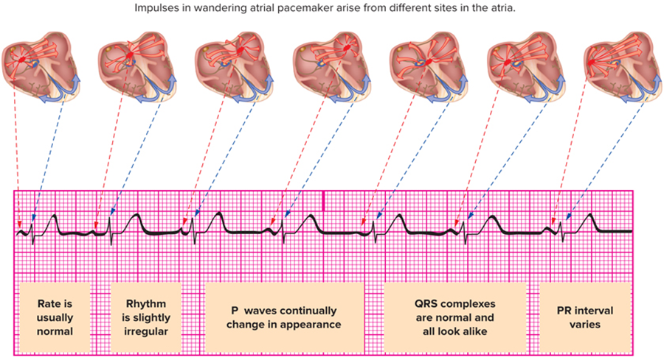
Learning Outcome 7.3 Wandering Atrial Pacemaker (W A P)
Pacemaker site shifts between the S A node, other sites in the atria, and/or the A V junction.
P wave morphology is different for each pacemaker site.
Access the text alternative for slide images.
Notes:
LO 7.3: Analyze wandering atrial pacemaker and its effect on the patient, including basic patient care and treatment.
-----
At least three different P wave morphologies in the same lead indicate a wandering atrial pacemaker.

Slide 15
Wandering Atrial Pacemaker: Criteria
Rhythm: Slightly irregular.
Rate: 60 to 100 beats per minute.
P wave morphology: Continuous change.
P R interval: Varies.
Q R S duration and morphology: Usually within normal limits.
Notes:
LO 7.3: Analyze wandering atrial pacemaker and its effect on the patient, including basic patient care and treatment.
-----

Slide 16
Wandering Atrial Pacemaker: What You Should Know
Wandering atrial pacemaker is normal in children, older adults, and well-conditioned athletes.
No signs or symptoms.
May be related to:
Organic heart disease.
Drug toxicity.
Notes:
LO 7.3: Analyze wandering atrial pacemaker and its effect on the patient, including basic patient care and treatment.
-----

Slide 17
Learning Outcome 7.3 Apply Your Knowledge 1
What characteristics differentiate wandering atrial pacemaker from other atrial dysrhythmias?
Notes:
LO 7.3: Analyze wandering atrial pacemaker and its effect on the patient, including basic patient care and treatment.
-----

Slide 18
Learning Outcome 7.3 Apply Your Knowledge 2
What characteristics differentiate wandering atrial pacemaker from other atrial dysrhythmias?
Answer:
Wandering atrial pacemaker has changing P wave configurations with at least three variations in one lead.
Notes:
LO 7.3: Analyze wandering atrial pacemaker and its effect on the patient, including basic patient care and treatment.
-----

Slide 19
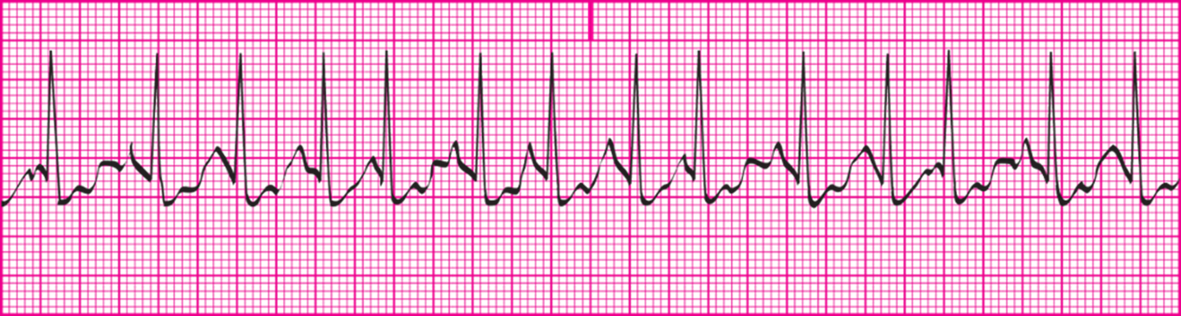
Learning Outcome 7.4 Multifocal Atrial Tachycardia (M A T)
Same characteristics as W A P, but with a rate of 101 to 150 beats per minute.
Frequently mistaken for atrial fibrillation.
Distinguishing feature: Visibly changing P waves.
Access the text alternative for slide images.
Notes:
LO 7.4: Analyze multifocal atrial tachycardia and its effect on the patient, including basic patient care and treatment.
-----
The P waves change in appearance from beat to beat and may be upright, rounded, notched, inverted, biphasic, or buried in the QRS complex.

Slide 20
Multifocal Atrial Tachycardia: What You Should Know
Usually triggered by another health condition.
Acute emphysema.
Congestive heart failure.
Acute mitral valve regurgitation.
Report to licensed practitioner.
Monitor patient’s vital signs and condition.
Notes:
LO 7.4: Analyze multifocal atrial tachycardia and its effect on the patient, including basic patient care and treatment.
-----

Slide 21
Learning Outcome 7.4 Apply Your Knowledge #1 1
What is the distinguishing characteristic of multifocal atrial tachycardia?
Notes:
LO 7.4: Analyze multifocal atrial tachycardia and its effect on the patient, including basic patient care and treatment.
-----

Slide 22
Learning Outcome 7.4 Apply Your Knowledge #1 2
What is the distinguishing characteristic of multifocal atrial tachycardia?
Answer:
Multifocal atrial tachycardia has a clearly changing P wave and a heart rate of 101 to 150 bpm.
Notes:
LO 7.4: Analyze multifocal atrial tachycardia and its effect on the patient, including basic patient care and treatment.
-----

Slide 23
Learning Outcome 7.4 Apply Your Knowledge #2 1
Which of the atrial dysrhythmias can be mistaken for atrial fibrillation?
Notes:
LO 7.4: Analyze multifocal atrial tachycardia and its effect on the patient, including basic patient care and treatment.
-----

Slide 24
Learning Outcome 7.4 Apply Your Knowledge #2 2
Which of the atrial dysrhythmias can be mistaken for atrial fibrillation?
Answer:
Multifocal atrial tachycardia
Notes:
LO 7.4: Analyze multifocal atrial tachycardia and its effect on the patient, including basic patient care and treatment.
-----

Slide 25
Atrial Flutter 1
Occurs when rapid impulse originates in atrial tissue.
Origin of ectopic focus.
Ischemic areas with enhanced automaticity (irritability).
Re-entry pathway.
Notes:
LO 7.5: Analyze atrial flutter and its effect on the patient, including basic patient care and treatment.
-----
A reentry pathway is an extra pathway that has developed in which a group of cells are generating an impulse faster than the SA node and the impulse is following an alternate route to the AV node, reaching it sooner than it would if it followed the normal conduction pathway.

Slide 26
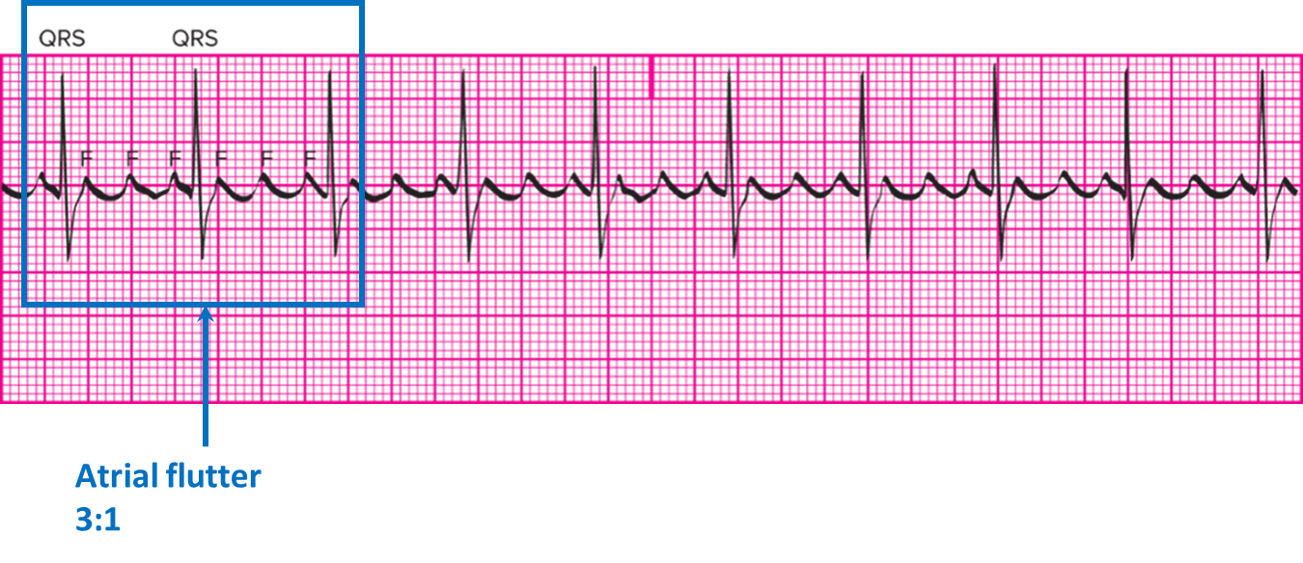
Atrial Flutter 2
Characteristic sawtooth pattern (F waves).
Ratio of F waves to Q R S complexes included in interpretation.
Access the text alternative for slide images.
Notes:
LO 7.5: Analyze atrial flutter and its effect on the patient, including basic patient care and treatment.
-----
Each F wave represents an atrial depolarization. The ratio of the F waves to QRS complexes tells how many times the atria depolarize between each ventricular depolarization.
A reentry pathway is an extra pathway that has developed in which a group of cells are generating an impulse faster than the SA node and the impulse is following an alternate route to the AV node, reaching it sooner than it would if it followed the normal conduction pathway.

Slide 27
Atrial Flutter: Criteria 1
Rhythm
P-P interval or flutter-to-flutter wave interval is constant.
R-R interval is usually regular, but may be irregular.
Rate: Atrial rate is 250 to 350 beats per minute
P wave morphology
P wave not seen.
Flutter (F) waves resemble saw-tooth or picket fence and
are seen in leads
Notes:
LO 7.5: Analyze atrial flutter and its effect on the patient, including basic patient care and treatment.
-----
The regularity of the R-R interval depends on the ability of the AV node to limit impulses to the ventricles.

Slide 28
Atrial Flutter: Criteria 2
P R interval: not identifiable.
Q R S duration and morphology: 0.06 to 0.10 second; within normal limits.
Notes:
LO 7.5: Analyze atrial flutter and its effect on the patient, including basic patient care and treatment.
-----
The PR interval cannot be measured because there are no P waves.

Slide 29
Atrial Flutter: What You Should Know
Loss of atrial kick reduces cardiac output by 10% to 30%.
Patients with increased heart rate demonstrate signs of low cardiac output.
Notify licensed practitioner.
Patient monitored continuously.
Treatment plan may include oxygen.
Indicate treatment or intervention on tracing.
Notes:
LO 7.5: Analyze atrial flutter and its effect on the patient, including basic patient care and treatment.
-----
The patient must be monitored continuously, because atrial flutter can progress to atrial fibrillation.

Slide 30
Learning Outcome 7.5 Apply Your Knowledge 1
What term is used to describe the sawtooth-shaped waves present in atrial flutter?
Notes:
LO 7.5: Analyze atrial flutter and its effect on the patient, including basic patient care and treatment.
-----

Slide 31
Learning Outcome 7.5 Apply Your Knowledge 2
What term is used to describe the sawtooth-shaped waves present in atrial flutter?
Answer:
Flutter (F) waves.
Notes:
LO 7.5: Analyze atrial flutter and its effect on the patient, including basic patient care and treatment.
-----

Slide 32
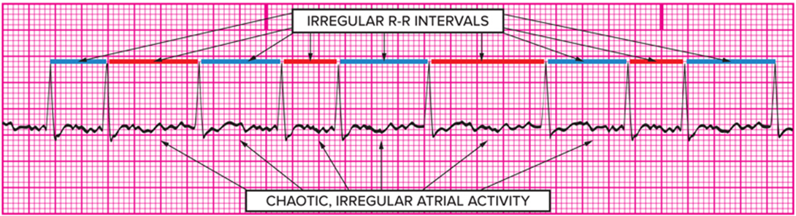
Atrial Fibrillation
Atrial fibrillation (A-fib) occurs when electrical impulses come from areas of reentry pathways or multiple ectopic foci and presents with classic chaotic fibrillatory or f waves.
Atrial fibrillation shows chaotic atrial electrical activity with irregular R-R intervals.
Access the text alternative for slide images.
Notes:
LO 7.6: Analyze atrial fibrillation and its effect on the patient, including basic patient care and treatment.
-----
Impulses result in depolarization of small groups of cells, not the whole atrium.
Atrial fibrillation often results in a 20% to 30% loss of stroke volume in patients with a normal heart, and even higher loss in patients with heart disease.

Slide 33
Atrial Fibrillation: Criteria 1
Rhythm
P-P interval cannot be determined.
R-R interval is irregular..
Rate
Atrial rate cannot be determined.
Electrical impulse activity rate is 375 to 700.
Notes:
LO 7.6: Analyze atrial fibrillation and its effect on the patient, including basic patient care and treatment.
-----
The atria are not contracting, so the rate of atrial contractions is 0 (or not determined). The numbers referred to are electrical impulse activity, not contractions.

Slide 34
Atrial Fibrillation: Criteria 2
P wave morphology
P waves cannot be identified.
Fibrillatory (f) waves may be identified.
P R interval: Cannot be identified.
Q R S duration and morphology: 0.06 to 0.10 second and irregular.
Notes:
LO 7.6: Analyze atrial fibrillation and its effect on the patient, including basic patient care and treatment.
-----

Slide 35
Atrial Fibrillation: What You Should Know
Patient exhibits signs of decreased cardiac output.
When heart rate is controlled, patient may be able to tolerate loss of atrial kick.
Blood collecting in atria can clot or form thrombi, which increases risk of embolism.
Cerebrovascular accident.
Myocardial infarction.
Pulmonary embolism.
Renal infarction.
Notes:
LO 7.6: Analyze atrial fibrillation and its effect on the patient, including basic patient care and treatment.
-----
When A-fib first occurs, ventricular response is often more than 100 bpm (uncontrolled A-fib).
Initial treatment goal of uncontrolled A-fib is to slow the ventricular response
Medications
Cardioversion
Report complications or vital sign changes to a licensed practitioner or physician.

Slide 36
Learning Outcome 7.6 Apply Your Knowledge 1
What is the major health risk for patients with atrial fibrillation?
Notes:
LO 7.6: Analyze atrial fibrillation and its effect on the patient, including basic patient care and treatment.
-----

Slide 37
Learning Outcome 7.6 Apply Your Knowledge 2
What is the major health risk for patients with atrial fibrillation?
Answer:
Thrombus formation and embolism due to blood collecting in the atria; embolism may cause serious effects such as M I, C V A, renal infarction, or pulmonary embolism.
Notes:
LO 7.6: Analyze atrial fibrillation and its effect on the patient, including basic patient care and treatment.
-----

Slide 38
Chapter Summary 1
Atrial dysrhythmias are caused by an ectopic impulse in either the right or the left atrium.
Premature atrial complexes (P A C s) originate in the atria and initiate an early impulse that interrupts the inherent regular rhythm.
In wandering atrial pacemaker (W A P), the pacemaker site shifts between the S A node, other sites in the atria, or the A V junction; the P wave configuration changes in appearance during the pacemaker shift.
Multifocal atrial tachycardia (M A T) has a P wave that changes from beat to beat and a heart rate of 101 to 150 beats per minute.
Notes:
LO 7.1: Summarize the similarities and differences among atrial dysrhythmias.
LO 7.2: Analyze premature atrial complexes and their effect on the patient, including basic patient care and treatment.
LO 7.3: Analyze wandering atrial pacemaker and its effect on the patient, including basic patient care and treatment.
LO 7.4: Analyze multifocal atrial tachycardia and its effect on the patient, including basic patient care and treatment.

Slide 39
Chapter Summary 2
Atrial flutter (A flutter) occurs when a rapid ectopic impulse originates in the atrial tissue and presents with a classic sawtooth appearance known as flutter or F waves.
Atrial fibrillation (A-fib) occurs when electrical impulses come from areas of re-entry pathways or multiple ectopic foci and presents with classic chaotic fibrillatory or f waves.
Notes:
LO 7.5: Analyze atrial flutter and its effect on the patient, including basic patient care and treatment.
LO 7.6: Analyze atrial fibrillation and its effect on the patient, including basic patient care and treatment.

