Slide 1

CHAPTER 8
Junctional Dysrhythmias

Slide 2
Learning Outcome 8.1 Introduction to Junctional Dysrhythmias
Key Terms
A V junction.
Retrograde.
Notes:
LO 8.1: Describe the various junctional dysrhythmias.
-----
AV junction: The AV node and surrounding tissue, including the bundle of His.
Retrograde: Moving backward.

Slide 3
Introduction to Junctional Dysrhythmias
A V junction can function as a backup pacemaker.
Junctional rhythms.
Result of electrical impulses coming from the A V node rather than S A node
Inverted P wave
P wave may occur before, during (hidden in), or after the Q R S complex.
Inherent rate of A V junction is 40 to 60 beats per minute.
The A V junction is a region of tissue within the heart that includes the A V node and Bundle of His.
Notes:
LO 8.1: Describe the various junctional dysrhythmias.
-----
In junctional rhythms, the electrical current from the AV junction, causing the atria to depolarize backward, or retrograde.
This reverse flow causes the inverted P wave that is characteristic of junctional dysrhythmias.
Atrioventricular (AV) junction is the area separating atria and the ventricles of the heart.[1] Specifically, when talking about the AV junction, the focus is put more on its contents, the AV node and the nonbranching bundle of His. https://www.ncbi.nlm.nih.gov/books/NBK546663/

Slide 4
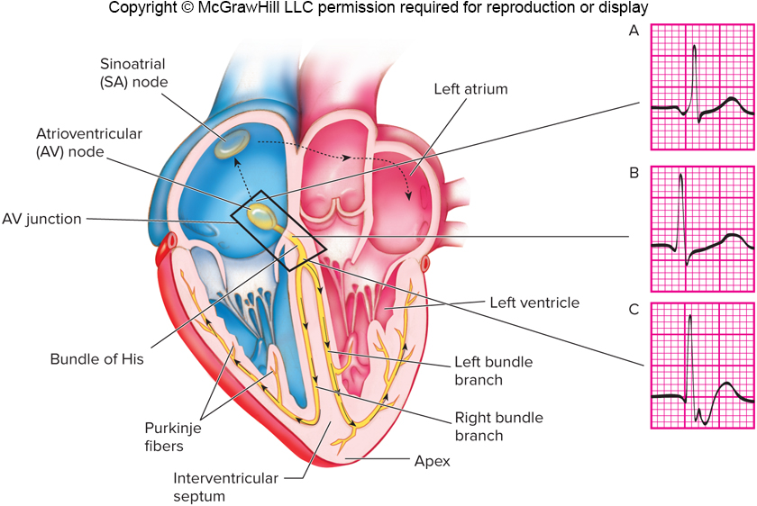
Junctional Rhythms
Access the text alternative for slide images.

Slide 5
Learning Outcome 8.1 Apply Your Knowledge #1 1
What causes the inverted P wave found with junctional rhythms?
Notes:
LO 8.1: Describe the various junctional dysrhythmias.
-----

Slide 6
Learning Outcome 8.1 Apply Your Knowledge #1 2
What causes the inverted P wave found with junctional rhythms?
Answer:
Electrical impulses are coming from the A V junction, causing depolarization of the atria to flow retrograde (backward), which causes the inverted P wave.
Notes:
LO 8.1: Describe the various junctional dysrhythmias.
-----

Slide 7
Learning Outcome 8.1 Apply Your Knowledge #2 1
What is the inherent rate of the A V node?
Notes:
LO 8.1: Describe the various junctional dysrhythmias.
-----

Slide 8
Learning Outcome 8.1 Apply Your Knowledge #2 2
What is the inherent rate of the A V node?
Answer:
40 to 60 beats per minute
Notes:
LO 8.1: Describe the various junctional dysrhythmias.
-----

Slide 9
Learning Outcome 8.2 Premature Junctional Complex
Key Term
Hypotension.
Notes:
LO 8.2 Analyze premature junctional complexes and their effect on the patient, including basic patient care and treatment.
-----
Hypotension: A lower than normal blood pressure that can cause reduction of blood flow to vital organs.

Slide 10
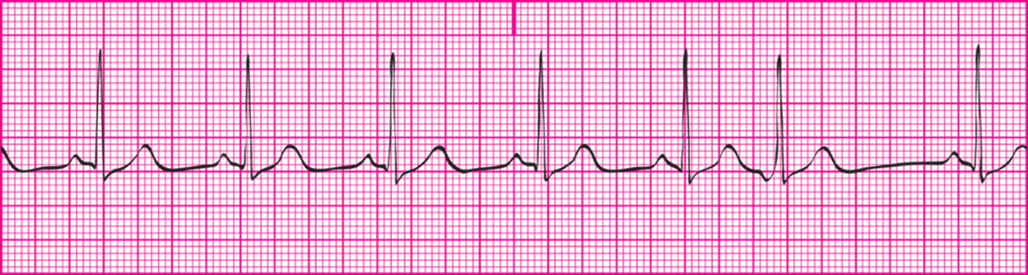
Premature Junctional Complex (P J C)
An early electrical impulse that originates from the A V junction
The P J C is the 6th complex on this tracing.
Notes:
LO 8.2 Analyze premature junctional complexes and their effect on the patient, including basic patient care and treatment.
-----
PJCs occur before the next expected sinus impulse, causing an irregularity in the underlying rhythm.

Slide 11
Premature Junctional Complex: Criteria
Rhythm: Occasionally or frequently irregular, depending on:
Underlying rhythm.
Number of P J Cs.
Rate: Depends on the underlying rhythm.
P wave morphology: Inverted, and may proceed, follow, or be buried in the Q R S complex.
Notes:
LO 8.2 Analyze premature junctional complexes and their effect on the patient, including basic patient care and treatment.
-----
Recall that the underlying rhythm is the rhythm that would be present if the abnormal impulses were ignored or removed from the tracing.

Slide 12
Premature Junctional Complexes: Criteria
P R interval: Depends on location of P wave
Shorter than normal if P wave precedes Q R S.
Absent if P wave is buried in Q R S.
Not measurable if P wave is after Q R S.
Q R S duration and morphology: 0.06 to 0.10 second, within normal limits
Notes:
LO 8.2 Analyze premature junctional complexes and their effect on the patient, including basic patient care and treatment.
-----
The PR interval can be measured only if the P wave, regardless of shape, occurs before the QRS complex.

Slide 13
Premature Junctional Complex: What You Should Know
Isolated P J Cs cause no signs or symptoms in healthy patients.
Patients may experience hypotension (low blood pressure) and low cardiac output if P J Cs occur more than four to six times per minute.
Notes:
LO 8.2 Analyze premature junctional complexes and their effect on the patient, including basic patient care and treatment.
-----
Recall that hypotension is a lower than normal blood pressure that can cause reduction of blood flow to vital organs.
More than 4 to 6 PJCs per minute indicates a more serious condition.

Slide 14
Learning Outcome 8.2 Apply Your Knowledge 1
What are the distinguishing characteristics of premature junctional complexes?
Notes:
LO 8.2 Analyze premature junctional complexes and their effect on the patient, including basic patient care and treatment.
-----

Slide 15
Learning Outcome 8.2 Apply Your Knowledge 2
What are the distinguishing characteristics of premature junctional complexes?
Answer:
P J Cs cause the rhythm to be irregular, and the inverted P wave may occur before, during, or after the Q R S complex.
Notes:
LO 8.2 Analyze premature junctional complexes and their effect on the patient, including basic patient care and treatment.
-----

Slide 16
Learning Outcome 8.3 Junctional Escape Rhythm 1
Key Term
Junctional escape rhythm.
Notes:
LO 8.3 Analyze junctional escape rhythm and its effect on the patient, including basic patient care and treatment.
-----
Junctional escape rhythm: A rhythm that occurs when the SA node fails to initiate the electrical activity and one of the backup pacemaker sites takes over. Also known as a junctional rhythm.

Slide 17
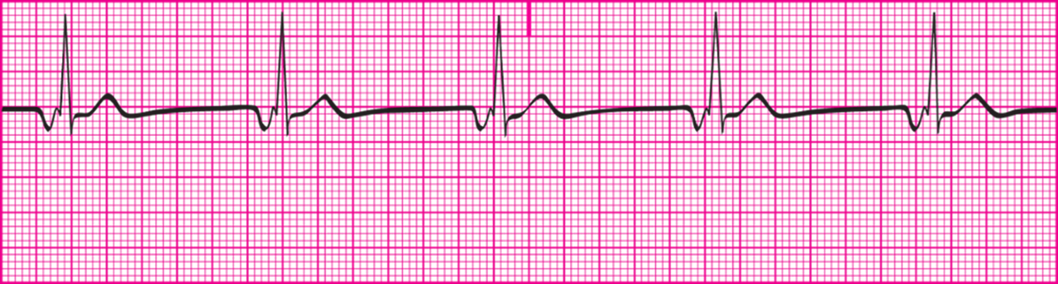
Learning Outcome 8.3 Junctional Escape Rhythm 2
Originates at A V junction.
Produces retrograde depolarization of atrial tissue.
Stimulates depolarization of ventricles.
Notes:
LO 8.3 Analyze junctional escape rhythm and its effect on the patient, including basic patient care and treatment.
-----
Escape rhythms occur when the SA node fails to generate electrical impulses and one of the heart’s backup pacemaker sites takes over.

Slide 18
Junctional Escape Rhythm: Criteria 1
Rhythm
P-P and R-R intervals are regular and have similar intervals.
P-P interval may be difficult to determine due to location of P wave.
Rate
Ventricular: 40 to 60 beats per minute.
Atrial: 40 to 60 beats per minutes, but may be unmeasurable.
Notes:
LO 8.3 Analyze junctional escape rhythm and its effect on the patient, including basic patient care and treatment.
-----

Slide 19
Junctional Escape Rhythm: Criteria 2
P wave morphology.
Usually inverted.
May follow, precede, or be hidden within Q R S complex.
P R interval:
Before the Q R S: less than 0.12 second and constant.
During or after Q R S: cannot be determined.
Q R S duration and morphology: 0.06 to 0.10 second.
Notes:
LO 8.3 Analyze junctional escape rhythm and its effect on the patient, including basic patient care and treatment.
-----

Slide 20
Junctional Escape Rhythm: What You Should Know
Slower heart rate can lead to low cardiac output.
Hypotension.
Confusion or disorientation.
Report junctional escape rhythm to a licensed practitioner for treatment.
Notes:
LO 8.3 Analyze junctional escape rhythm and its effect on the patient, including basic patient care and treatment.
-----
Patients with junctional escape rhythm lose the atrial kick because the interval between atrial depolarization and ventricular depolarization is shortened.

Slide 21
Learning Outcome 8.3 Apply Your Knowledge 1
What are the distinguishing characteristics of junctional escape rhythm?
Notes:
LO 8.3 Analyze junctional escape rhythm and its effect on the patient, including basic patient care and treatment.
-----

Slide 22
Learning Outcome 8.3 Apply Your Knowledge 2
What are the distinguishing characteristics of junctional escape rhythm?
Answer:
Heart rate between 40 and 60 beats per minutes, inverted P wave that occurs before, during, or after the Q R S complex.
Notes:
LO 8.3 Analyze junctional escape rhythm and its effect on the patient, including basic patient care and treatment.
-----

Slide 23
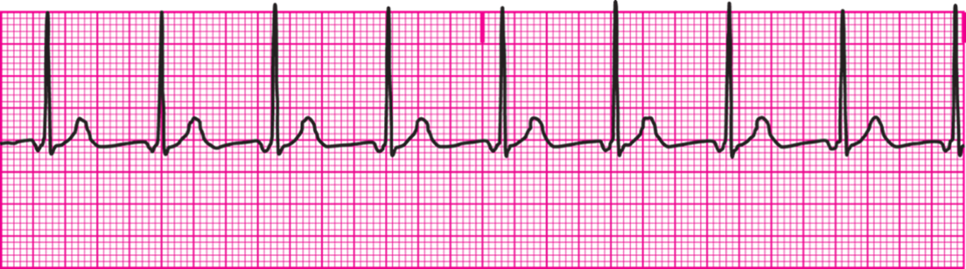
Learning Outcome 8.4 Accelerated Junctional Rhythm
Originates at A V junction.
Produces retrograde depolarization of atrial tissue.
Stimulates the depolarization of ventricles.
Notes:
LO 8.4: Analyze accelerated junctional rhythm and its effect on the patient, including basic patient care and treatment.
-----

Slide 24
Accelerated Junctional Rhythm: Criteria 1
Rhythm
P-P and R-R intervals are regular and similar
P-P interval may be difficult to measure due to the location of the P wave
Rate.
60 to 100 beats per minute.
Notes:
LO 8.4: Analyze accelerated junctional rhythm and its effect on the patient, including basic patient care and treatment.
-----
The atrial rate may not be measurable if the P waves are not identifiable.

Slide 25
Accelerated Junctional Rhythm: Criteria 2
P wave morphology
If seen, inverted
May precede, follow, or fall within Q R S complex
P R interval.
Before the Q R S: less than 0.12 second and constant.
During or after Q R S: cannot be determined.
Q R S duration and morphology: 0.06 to 0.10 second, within normal limits
Notes:
LO 8.4 Analyze accelerated junctional rhythm and its effect on the patient, including basic patient care and treatment.
-----
The P wave may not be visible at all on the tracing.
P waves that occur after the QRS complex cannot be used to determine the PR interval because the P wave is not associated with the next QRS complex.

Slide 26
Accelerated Junctional Rhythm: What You Should Know
Unlikely that patient will show signs of low cardiac output.
Observe patient for symptoms.
Report accelerated junctional rhythm to a licensed practitioner for treatment.
Notes:
LO 8.4: Analyze accelerated junctional rhythm and its effect on the patient, including basic patient care and treatment.
-----

Slide 27
Learning Outcome 8.4 Apply Your Knowledge 1
What are the distinguishing characteristics of accelerated junctional rhythm?
Notes:
LO 8.4: Analyze accelerated junctional rhythm and its effect on the patient, including basic patient care and treatment.
-----

Slide 28
Learning Outcome 8.4 Apply Your Knowledge 2
What are the distinguishing characteristics of accelerated junctional rhythm?
Answer:
Heart rate between 60 and 100 beats per minutes, inverted P wave that occurs before, during, or after the Q R S complex; P wave may be absent.
Notes:
LO 8.4: Analyze accelerated junctional rhythm and its effect on the patient, including basic patient care and treatment.
-----

Slide 29
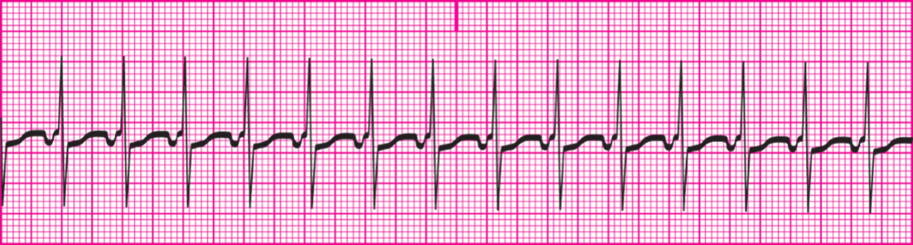
Learning Outcome 8.5 Junctional Tachycardia
Like junctional escape rhythm and accelerated junctional rhythm.
Heart rate is faster.
Notes:
LO 8.5: Analyze junctional tachycardia and its effect on the patient, including basic patient care and treatment.
-----
Like accelerated junctional rhythm, junctional tachycardia originates at the AV junction, produces retrograde depolarization of atrial tissue, and stimulates the ventricles to depolarize.

Slide 30
Junctional Tachycardia: Criteria 1
Rhythm
P-P and R-R intervals are regular and similar.
P-P may be difficult to measure due to location and increased heart rate.
Rate.
Ventricular: 100 to 180 beats per minute
Atrial: 100 to 180 beats per minut, but may not be measurable if P waves are not identifiable.
Notes:
LO 8.5: Analyze junctional tachycardia and its effect on the patient, including basic patient care and treatment.
-----

Slide 31
Junctional Tachycardia: Criteria 2
P wave morphology.
If seen, inverted.
May precede, follow, or fall within Q R S.
May not be visible on rhythm strip.
May need to increase paper speed on cardiac monitor.
P R interval.
Before the Q R S: less than 0.12 second and constant.
During or after Q R S: cannot be determined.
Q R S duration and morphology: 0.06 to 0.10 second, within normal limits
Notes:
LO 8.5: Analyze junctional tachycardia and its effect on the patient, including basic patient care and treatment.
-----

Slide 32
Junctional Tachycardia: What You Should Know
Patient may complain of palpitations or heart fluttering with faster rates.
Considered very serious or life threatening after a recent M I.
Report junctional tachycardia rhythm to a licensed practitioner for treatment.
Notes:
LO 8.5: Analyze junctional tachycardia and its effect on the patient, including basic patient care and treatment.
-----
The effect on the patient depends on the rate of junctional tachycardia. Some tachycardia is expected after exertion, such as walking down the hallway.
Faster rates often cause symptoms of low cardiac output.

Slide 33
Learning Outcome 8.5 Apply Your Knowledge 1
What are the distinguishing characteristics of junctional tachycardia?
Notes:
LO 8.5: Analyze junctional tachycardia and its effect on the patient, including basic patient care and treatment.
-----

Slide 34
Learning Outcome 8.5 Apply Your Knowledge 2
What are the distinguishing characteristics of junctional tachycardia?
Answer:
Heart rate between 100 and 180 beats per minutes, inverted P wave that occurs before, during, or after the Q R S complex; P wave may be absent.
Notes:
LO 8.5: Analyze junctional tachycardia and its effect on the patient, including basic patient care and treatment.
-----

Slide 35
Learning Outcome 8.6 Supraventricular Tachycardia (S V T)
Key Terms
Supraventricular.
Wolfe-Parkinson-White syndrome.
Delta wave.
Notes:
LO 8.6 Analyze supraventricular tachycardia and its effect on the patient, including basic patient care and treatment.
-----
Supraventricular: An ectopic focus originating above the ventricles in the atria or junctional region of the heart.
Wolfe-Parkinson-White syndrome: A type of supraventricular tachycardia in which an extra electrical pathway between an atrium and a ventricle short-circuits the normal pathway, resulting in tachycardia.
Delta wave: A widening at the beginning of the QRS complex due to ventricular pre-excitation.

Slide 36
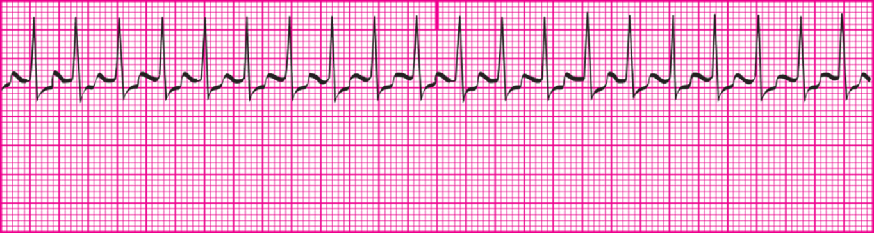
Supraventricular Tachycardia (S V T)
Category of rapid rhythms.
Originate in atria or A V junction.
Faster than 150 beats per minutes.
Notes:
LO 8.6 Analyze supraventricular tachycardia and its effect on the patient, including basic patient care and treatment.
-----
In many cases, the heart is beating so fast that it is difficult to determine whether the origin is the SA node, elsewhere in the atria, or the AV junction.
P waves are difficult to identify because the atria contract as soon as the ventricles relax.

Slide 37
Supraventricular Tachycardia: Criteria 1
Rhythm.
R-R usually regular.
If identifiable, P waves usually regular.
Rate.
Ventricular: 150 to 250 beats per minute.
Atrial: Difficult to determine unless P waves are identifiable.
Notes:
LO 8.6 Analyze supraventricular tachycardia and its effect on the patient, including basic patient care and treatment.
-----
Atrial activity may not be seen because of the ventricular activity occurring at the same time. The larger energy of the ventricular activity hides the atrial activity.

Slide 38
Supraventricular Tachycardia: Criteria 2
P wave morphology
Usually not identifiable at this heart rate, since P wave may lie inside T wave.
May occur before, during, or after Q R S complex.
P R interval: Usually unable to determine
Q R S duration and morphology.
Within normal limits if duration is 0.06 to 0.10 seconds.
Some rhythms result in narrow or wide Q R S complexes.
Notes:
LO 8.6 Analyze supraventricular tachycardia and its effect on the patient, including basic patient care and treatment.
-----

Slide 39
Supraventricular Tachycardia: What You Should Know
Patient may be in stable or unstable condition.
Observe patient for low cardiac output.
Notify licensed practitioner.
Treatment should begin as early as possible.
Notes:
LO 8.6 Analyze supraventricular tachycardia and its effect on the patient, including basic patient care and treatment.
-----
The effect on the patient may vary depending on the specific dysrhythmia.
Because tachycardia significantly increases myocardial oxygen demand, treatment should begin as soon as possible.

Slide 40
Law and Ethics
Know your role and scope of practice.
These depend on your training and place of employment.
Working outside your scope of practice is illegal.
Notes:
LO 8.6 Analyze supraventricular tachycardia and its effect on the patient, including basic patient care and treatment.
-----
You could be held liable for performing tasks that are not part of your role as a healthcare professional.

Slide 41
Learning Outcome 8.6 Apply Your Knowledge 1
Where in the heart does a supraventricular tachycardia originate?
Notes:
LO 8.6 Analyze supraventricular tachycardia and its effect on the patient, including basic patient care and treatment.
-----

Slide 42
Learning Outcome 8.6 Apply Your Knowledge 2
Where in the heart does a supraventricular tachycardia originate?
Answer:
Either in the atria or in the A V junction
Notes:
LO 8.6 Analyze supraventricular tachycardia and its effect on the patient, including basic patient care and treatment.
-----

Slide 43
Chapter Summary 1
The A V node and its surrounding area, including the bundle of His, are collectively known as the A V junction.
The inherent rate of the A V junction is 40 to 60 beats per minutes.
The P wave is usually inverted and can occur before, during, or after the Q R S complex, depending on where in the A V junction the impulse originates.
A premature junctional complex (P J C) is a single early electrical impulse that originates in the A V junction.
A junctional escape rhythm is one that originates at the A V junction, produces retrograde depolarization, and stimulates ventricular depolarization at a rate of 40 to 60 beats per minutes.
Notes:
LO 8.1: Describe the various junctional dysrhythmias.
LO 8.2: Analyze premature junctional complexes and their effect on the patient, including basic patient care and treatment.
LO 8.3: Analyze junctional escape rhythm and its effect on the patient, including basic patient care and treatment.

Slide 44
Chapter Summary 2
Accelerated junctional rhythm is like junctional escape rhythm but has a heart rate of 60 to 100 beats per minutes.
Junctional tachycardia is like junctional escape and accelerated junctional rhythms but has a heart rate of 100 to 180 beats per minutes.
Supraventricular tachycardia is a category of dysrhythmias that originate above the ventricles and have a heart rate above 150 beats per minutes.
Some S V Ts are reentry dysrhythmias, and others are reciprocating dysrhythmias.
Notes:
LO 8.4: Analyze accelerated junctional rhythm and its effect on the patient, including basic patient care and treatment.
LO 8.5: Analyze junctional tachycardia and its effect on the patient, including basic patient care and treatment.
LO 8.6: Analyze supraventricular tachycardia and its effect on the patient, including basic patient care and treatment.

