Slide 1
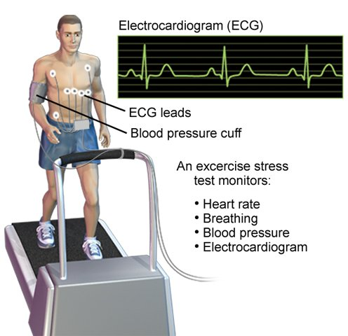
CHAPTER 12
CARDIAC STRESS TESTING

Slide 2
Learning Outcome 12.1
Cardiac Stress Testing
Key Terms
Cardiologist
Noninvasive
Notes:
LO 12.1: Describe exercise electrocardiography and identify its other names.
-----
Cardiologist: A physician who specializes in the study of the heart.
Noninvasive: Procedure that does not require entrance into a body cavity, tissue, or blood vessel.

Slide 3
What Is Cardiac Stress Testing? 1
Known as:
Exercise tolerance test.
Treadmill stress test.
Cardiac stress test.
Stress E C G.
Exercise treadmill test.
Notes:
LO 12.1: Describe exercise electrocardiography and identify its other names.
-----
Other exercise electrocardiography evaluation techniques include cycle and arm-ergometry.

Slide 4
What Is Cardiac Stress Testing? 2
Noninvasive procedure performed in presence of or when a cardiologist or physician is immediately available.
Usually involves an exercise treadmill.
Notes:
LO 12.1: Describe exercise electrocardiography and identify its other names.
-----
The level of exertion increases as the test progresses.
Patient is monitored continuously during an exercise stress test, including ECG, blood pressure, heart rate, skin temperature, oxygen saturation, and physical appearance.

Slide 5
Responsibilities during Exercise Electrocardiography
Provide for safety.
Prepare patient prior to procedure.
Attach electrodes properly.
Instruct patient to report symptoms.
Monitor patient:
Blood pressure.
E C G.
Notify abnormalities and document.
Notes:
LO 12.1: Describe exercise electrocardiography and identify its other names.
-----
The most important responsibilities of the healthcare professional are to provide for safety and to be prepared in case an emergency should arise.

Slide 6
Learning Outcome 12.1
Apply Your Knowledge 1
Why is exercise electrocardiography considered noninvasive?
Notes:
LO 12.1: Describe exercise electrocardiography and identify its other names.
-----

Slide 7
Learning Outcome 12.1
Apply Your Knowledge 2
Why is exercise electrocardiography considered noninvasive?
Answer:
It does not require entrance into a body cavity, tissue, or blood vessel.
Notes:
LO 12.1: Describe exercise electrocardiography and identify its other names.
-----

Slide 8
Learning Outcome 12.2
Why Is Exercise Electrocardiography Used?
Key Terms
Angina.
Coronary vascular disease (C V D).
Notes:
LO 12.2: Identify uses of exercise electrocardiography.
-----
Angina: An oppressive pain or pressure in the chest when the heart muscle does not receive enough oxygen due to partial or complete blockage of a coronary artery.
Coronary vascular disease (CVD): Narrowing of the coronary blood vessels, causing a reduction in the blood flow to the heart.

Slide 9
Why Is Exercise Electrocardiography Used? 1
Evaluate how the heart and blood vessels respond to physical activity.
Performed when physician suspects coronary vascular disease.
Determine problems that do not show up on resting E C G.
Notes:
LO 12.2: Identify uses of exercise electrocardiography.
-----
When the heart is exercised, it requires additional blood flow to provide oxygen to the myocardium. If a patient’s arteries are narrowed or obstructed, blood flow to certain areas of the heart cannot increase. This may cause specific changes in the ECG tracing (such as ST segment depression), as well as physical signs or symptoms in the patient (such as angina).
ST segment depression can also be caused by medications

Slide 10
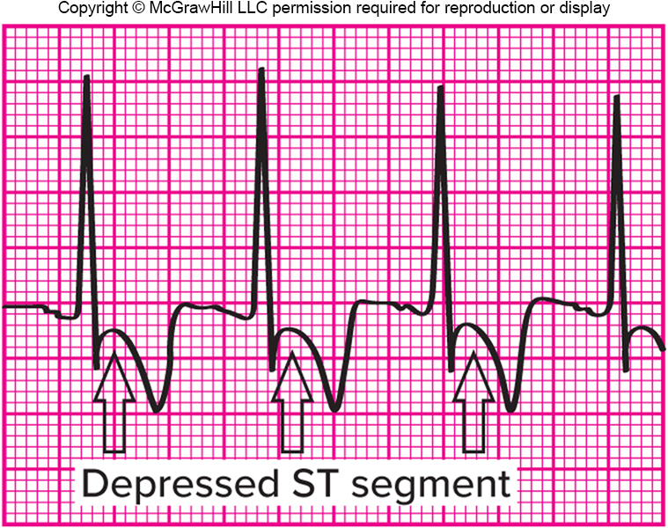
Why Is Exercise Electrocardiography Used? 2
Reveal signs of narrowed or obstructed arteries.
S T segment depression.
Angina.
Shortness of breath.
Palpitations.
Dizziness.
Access the text alternative for slide images.
Notes:
LO 12.2: Identify uses of exercise electrocardiography.
-----
When the heart is exercised, it requires additional blood flow to provide oxygen to the myocardium. If a patient’s arteries are narrowed or obstructed, blood flow to certain areas of the heart cannot increase. This may cause specific changes in the ECG tracing (such as ST segment depression), as well as physical signs or symptoms in the patient (such as angina).
ST segment depression can also be caused by medications

Slide 11
Why Is Exercise Electrocardiography Used? 3
Diagnose causes of chest pain.
After surgery or M I to determine cardiac function.
Screen for asymptomatic heart disease.
Set limitations for exercise programs.
Identify dysrhythmias that occur during exertion.
Evaluate effectiveness of cardiac drugs.
Assess patient blood pressure during exercise.
Determine risk of M I.
Notes:
LO 12.2: Identify uses of exercise electrocardiography.
-----

Slide 12
Learning Outcome 12.2
Apply Your Knowledge 1
A treadmill stress test is typically performed for what type of disease?
Notes:
LO 12.2: Identify uses of exercise electrocardiography.
-----

Slide 13
Learning Outcome 12.2
Apply Your Knowledge 2
A treadmill stress test is typically performed for what type of disease?
Answer:
Coronary artery disease.
Notes:
LO 12.2: Identify uses of exercise electrocardiography.
-----

Slide 14
Learning Outcome 12.3
Other Types of Exercise Electrocardiography
Key Terms
Chemical stress test.
Chemical stress echocardiogram.
Gamma camera.
Gate.
Echocardiogram.
Nuclear stress test.
Radiologist.
Sick sinus syndrome.
Stress echocardiogram.
Notes:
LO 12.3: Describe other types of cardiac stress testing.
-----
Chemical stress test: Stress test performed after administering medications that cause the heart rate to increase or the coronary blood vessels to dilate; performed on patients who cannot perform the exercise required in a regular stress test.
Chemical stress echocardiogram: A stress echocardiogram in which the heart is stressed by chemicals, rather than physical exercise.
Gamma camera: A camera that records the gamma radiation emitted by the radioactive tracers in a patient’s blood.
Gate: A selective technique in which a gamma camera is triggered by specific events captured by a three-lead ECG monitor.
Echocardiogram: Noninvasive diagnostic test that uses sound to study the heart, heart valves, and blood vessels.
Nuclear stress test: A stress test in which radionuclides (radioactive tracers) are administered to trace the path of blood through the heart.
Radiologist: A physician who specializes in the use of radioactive substances to diagnose and treat disease.
Sick sinus syndrome: A disease that affects the function of the SA node. It can result in bradycardia, tachycardia, or even cause pauses in the conduction such as sinus arrest.
Stress echocardiogram: A test that combines an exercise stress test with an echocardiogram to assess left ventricular wall motion both before and immediately after exercise.

Slide 15
Chemical Stress Test
Used when patient is unable to perform physical exercise
Performed under guidance of cardiologist or radiologist
Heart is stressed using chemicals:
Adenosine.
Persantine.
Dobutamine.
Lexiscan.
Notes:
LO 12.3: Describe other types of cardiac stress testing.
-----
Chemical stress tests may be done in a nuclear testing lab or in combination with echocardiography.

Slide 16
Nuclear Stress Test
Heart stressing chemical injected first.
Radioactive tracer injected before completion of stressing cycle.
Patient scanned with gamma camera.
Study is gated using 3-lead E C G.
Notes:
LO 12.3: Describe other types of cardiac stress testing.
-----
Depending on the protocol, the patient can be scanned prior to stressing or 3 to 24 hours after stressing to provide a baseline or resting series for comparison.
Actual scan times vary from 15 minutes to an hour for each phase. Gated studies on patients with irregular heart rates take the longest amount of time.
Gating techniques are used to improve temporal resolution and minimize imaging artifacts caused by cardiac motion. https://www.ajronline.org/doi/10.2214/ajr.182.4.1820993?mobileUi=0

Slide 17
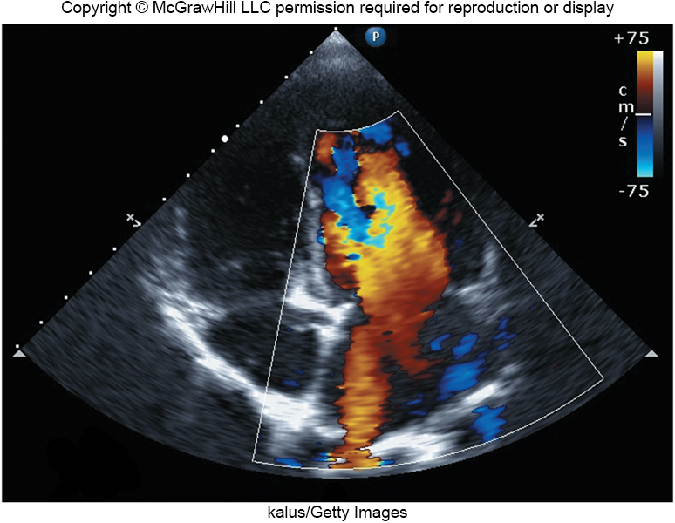
Echocardiogram
Uses sound to study heart, heart valves, and major blood vessels surrounding heart
Stress echocardiogram
Combines stress test with echocardiogram
Assesses left ventricular wall motion
kalus/Getty Images
Chemical stress echocardiogram.
Access the text alternative for slide images.
Notes:
LO 12.3: Describe other types of cardiac stress testing.
-----
The three phases of a stress echocardiogram are:
Resting scan
Immediate postexercise scan
Recovery phase scan
The cardiologist then compares the images from the three phases to assess for changes in left ventricular motion and contractility, which can predict the presence of ischemia in the coronary arteries.

Slide 18
Learning Outcome 12.3
Apply Your Knowledge 1
What type of diagnostic test uses both a chemical stressor and sound?
Notes:
LO 12.3: Describe other types of cardiac stress testing.
-----

Slide 19
Learning Outcome 12.3
Apply Your Knowledge 2
What type of diagnostic test uses both a chemical stressor and sound?
Answer:
Chemical stress echocardiogram.
Notes:
LO 12.3: Describe other types of cardiac stress testing.
-----

Slide 20
Learning Outcome 12.4
Preparing the Patient for Exercise Electrocardiography
Key Term
Beta blockers.
Notes:
LO 12.4: Prepare a patient for exercise electrocardiography.
-----
Beta blockers: Drugs used to treat hypertension which slow the patient’s heart rate.

Slide 21
Preparing the Patient for Exercise Electrocardiography
Describe the procedure and what to expect.
Before the procedure.
During the procedure/day of appointment.
After the procedure.
Obtain informed consent.
Test may take 45 minutes to 3 hours, depending on test being performed.
Notes:
LO 12.4: Prepare a patient for exercise electrocardiography.
-----
To provide informed consent, the patient must understand the treatment, why it is being performed, any risks involved, alternative treatments and their risks, and the risk involved if the patient refuses treatment.

Slide 22
Patient Instructions: Before the Test
Instruct on consumption of alcohol, caffeine, and tobacco based on facility protocol.
Provide guidelines for eating and drinking based on facility protocol.
Wear comfortable clothes and shoes.
Certain medications should not be taken—check physician’s order.
Beta blockers.
Notes:
LO 12.4: Prepare a patient for exercise electrocardiography.
-----

Slide 23
Day of Appointment 1
Verify that equipment is working, including crash cart.
Gather supplies.
Verify physician’s order.
Make sure paperwork is complete.
Medical history.
Informed consent.
Verify patient identity.
Verify that patient has complied with instructions.
Notes:
LO 12.4: Prepare a patient for exercise electrocardiography.
-----

Slide 24
Day of Appointment 2
Provide privacy or assist patient to change into gown.
Assist patient to exam table.
Obtain E C Gs and blood pressure as required by facility.
Explain stress test protocol.
Inform physician patient is ready.
Assist during treadmill stress test.
Assist patient to chair after test is complete.
Notes:
LO 12.4: Prepare a patient for exercise electrocardiography.
-----
Be sure to emphasize to the patient that he or she is to report any pain, shortness of breath, faintness, tingling sensations, numbness, or extreme fatigue immediately.
In addition, monitor the patient during the test for any signs of these conditions.
Providing for patient safety is your number one priority

Slide 25
Post-test Duties
Cooldown period.
Monitor and observe patient’s condition.
Obtain blood pressure and E C G’s, per facility.
After cooldown period.
Remove cables and electrodes.
Allow patient to dress.
Provide Post-test instructions.
File report per facility protocol.
Notes:
LO 12.4: Prepare a patient for exercise electrocardiography.
----
Be sure to maintain confidentiality of patient information at all times.
Posttest instructions include reminding the patient:
Avoid tobacco, caffeine, and alcohol for at least 3 hours.
Avoid extreme temperature changes, including hot showers or baths, for 2 hours.
Rest and recuperate after the test.
Physician will have results in 10 days (or refer to local policy or facility procedures).

Slide 26
Learning Outcome 12.4
Apply Your Knowledge #1 1
True or False: Informed consent may not be necessary before performing exercise electrocardiography, depending on facility policy.
Notes:
LO 12.4: Prepare a patient for exercise electrocardiography.
----

Slide 27
Learning Outcome 12.4
Apply Your Knowledge #1 2
True or False: Informed consent may not be necessary before performing exercise electrocardiography, depending on facility policy.
Answer:
False; informed consent is always required before performing exercise electrocardiography.
Notes:
LO 12.4: Prepare a patient for exercise electrocardiography.
----

Slide 28
Learning Outcome 12.4
Apply Your Knowledge #2 1
In addition to food and drink, which substances should the patient avoid prior to the procedure?
Notes:
LO 12.4: Prepare a patient for exercise electrocardiography.
----

Slide 29
Learning Outcome 12.4
Apply Your Knowledge #2 2
In addition to food and drink, which substances should the patient avoid prior to the procedure?
Answer:
Tobacco, alcohol, and caffeine.
Notes:
LO 12.4: Prepare a patient for exercise electrocardiography.
----

Slide 30
Learning Outcome 12.5
Providing Safety
Key Terms
Congestive heart failure (C H F).
Hypertension.
Hyperventilation.
Notes:
LO 12.5: Summarize safety measures that are used before, during, and after exercise electrocardiography.
-----
Congestive heart failure (CHF): Failure of the heart to pump an adequate amount of blood to the body tissues.
Hypertension: High blood pressure.
Hyperventilation: Breathing at an increased rate and depth of inspiration and expiration.

Slide 31
Providing Safety
Exercise electrocardiography patients are already at risk.
Some risk of M I or C V A during the procedure
Follow rules to provide for safety:
Physician should always be present during procedure.
Emergency equipment nearby, including crash cart.
Always monitor patient.
Patient must know to report symptoms.
Notes:
LO 12.5: Summarize safety measures that are used before, during, and after exercise electrocardiography.
-----
Patients undergoing exercise electrocardiography are generally at risk because of
Recent myocardial infarction
Current chest pain or other cardiac symptoms
History of coronary vascular disease
MI: Myocardial infarction
CVA: Cerebrovascular accident, or stroke
You must know the location of all emergency equipment.

Slide 32
Patients Who Should Not Have Exercise Electrocardiography
Change in resting E C G.
Abnormal heart rhythms.
Recent M I or unstable angina.
Pericarditis or myocarditis.
Uncontrolled hypertension.
Cardiovascular conditions.
C H F.
Acute infection.
Psychosis.
Notes:
LO 12.5: Summarize safety measures that are used before, during, and after exercise electrocardiography.
-----
Cardiovascular conditions that preclude exercise electrocardiography include:
Severe aortic stenosis
Aneurysm
Thrombophlebitis
Systemic or pulmonary embolism
Pericarditis: inflammation surrounding the heart
Myocarditis: inflammation of the heart muscle
Psychosis: significant emotional stress

Slide 33
Patient Safety
Patients having exercise electrocardiography may have cardiac or vascular disease.
Increased chance of:
Dizziness.
Syncopal episode.
Monitor patient’s carefully during position changes and hyperventilation.
Notes:
LO 12.5: Summarize safety measures that are used before, during, and after exercise electrocardiography.
-----
Syncopal episode: fainting

Slide 34
Preparing for Emergencies
Inform the patient of how they can expect to feel during the test, including mild fatigue, increased heart rate, perspiration, and increased respiratory rate.
Explain to the patient the need to report signs and symptoms such as chest or other pain, dizziness, weakness, or extreme fatigue.
Make sure the patient knows to stop the exercise if any pain or extreme fatigue is felt.
Make sure the physician or other licensed practitioner is present during the entire procedure.
Check to see that emergency equipment is close by, including a code or crash with defibrillator or A E D (automatic external defibrillator).
Observe and monitor the patient, and report any symptoms to the physician or other licensed practitioner immediately.

Slide 35
Learning Outcome 12.5
Apply Your Knowledge 1
What two medical emergencies is a patient at risk for while undergoing an exercise electrocardiography?
Notes:
LO 12.5: Summarize safety measures that are used before, during, and after exercise electrocardiography.
-----

Slide 36
Learning Outcome 12.5
Apply Your Knowledge 2
What two medical emergencies is a patient at risk for while undergoing an exercise electrocardiography?
Answer:
Myocardial infarction (M I) and cerebrovascular accident (C V A)
Notes:
LO 12.5: Summarize safety measures that are used before, during, and after exercise electrocardiography.
-----

Slide 37
Learning Outcome 12.6
Performing Exercise Electrocardiography
Gather Materials
Prior to patient’s arrival, prepare and assemble:
Blood pressure equipment.
Shaving equipment, abrasive cleaner, skin rasp.
Skin prep solution.
2×2 or 4×4 gauze.
Chest electrodes.
Stress test unit.
Lead wires.
Treadmill/cycle ergometer.
Adhesive tape belt.
Crash cart.
Notes:
LO 12.6: Explain the responsibilities of a healthcare professional during exercise electrocardiography.

Slide 38
Verify Patient Details
Verify that patient has followed instructions.
Confirm complete medical history.
Verify that informed consent form is signed.
Prepare electrode sites:
Use a clipper rather than shaving.
Rub site with skin prep, let dry.
Abrade skin using a skin rasp.
Notes:
LO 12.6: Explain the responsibilities of a healthcare professional during exercise electrocardiography.
-----
Skin can be abraded using a special prep pad, dry 4 x 4 gauze, skin rasp, or other abrasive cleaner.
Advise prepping the skin prior to shaving or using a skin rasp to reduce discomfort.

Slide 39
Performing Exercise Electrocardiography
Attach blood pressure cuff and electrodes.
Check and set artifact filters.
Perform pre-test blood pressures and 12-lead E C Gs.
Supine.
Sitting.
Hyperventilating.
Standing.
Notes:
LO 12.6: Explain the responsibilities of a healthcare professional during exercise electrocardiography.
-----
Placement of precordial leads for stress testing is almost the same as for a traditional 12-lead ECG.
Limb sensors are moved from the arms and legs to the upper chest and torso.
Increases safety by reducing chance of tripping over lead wires.
Machines may vary, so always check the manufacturer’s instructions for proper placement of the electrodes.
Having performing a blood pressure and ECG after the patient hyperventilates helps identify changes on the ECG that occur due to changes in breathing pattern.

Slide 40
Learning Outcome 12.6
Apply Your Knowledge
Why is a baseline E C G often performed after asking the patient to hyperventilate?
Notes:
LO 12.6: Explain the responsibilities of a healthcare professional during exercise electrocardiography.
-----

Slide 41
Learning Outcome 12.6
Apply Your Knowledge 2
Why is a baseline E C G often performed after asking the patient to hyperventilate?
Answer:
An E C G performed after hyperventilation helps identify changes on the E C G that result from changes in the patient’s breathing pattern.
Notes:
LO 12.6: Explain the responsibilities of a healthcare professional during exercise electrocardiography.
-----

Slide 42
Learning Outcome 12.7
Common Protocols
Key Terms
Maximal exercise.
Rate pressure product (R P P).
Submaximal exercise.
Target heart rate.
Notes:
LO 12.7: Compare common protocols followed in exercise electrocardiography.
-----
Maximal exercise: Target heart rate of 220 minus the age of the patient.
Rate pressure product (RPP): Systolic blood pressure multiplied by the heart rate; also known as double product.
Submaximal exercise: Target heart rate of 220 minus the age multiplied by a percentage between 60 and 85.
Target heart rate (THR): Heart rate measurement needed to truly exercise the heart.

Slide 43
Common Protocols 1
Test is divided into stages of 2 to 3 minutes each.
At end of each stage, blood pressure is checked, and E C G is repeated.
Level of exercise is then increased.
Physician determines which protocol to use.
Exercise period may last up to 15 minutes.
Depends on patient’s cardiac risk factor and ability.
Notes:
LO 12.7: Compare common protocols followed in exercise electrocardiography.
-----
Even if the patient doesn’t complain of symptoms, the physician may stop the test because of the patient’s blood pressure, ECG, or heart rhythm changes that are not perceived by the patient.
You can help reduce the patient’s fears by maintaining a sense of confidence, answering questions, and following safety precautions during exercise electrocardiography.

Slide 44
Common Protocols 2
Goal of test is target heart rate (T H R) without symptoms or complications.
T H R = [(220 − patient’s age) × (60%)]
to
T H R = [(220 − patient’s age) × (85%)]
Percentage used depends on the testing protocol.
Patient should not exceed T H R during test.
Notes:
LO 12.7: Compare common protocols followed in exercise electrocardiography.
-----
Achieving the TRS without symptoms or abnormalities is a good indication that the heart is functioning well.
The closer the patient gets to the THR, the more reliable the test results will be.

Slide 45
Bruce Protocol
Most commonly used protocol.
3-minute stages.
Speed starts at 1.7 miles per hour.
Grade starts at 10%.
Speed and grade increase with each stage.
Notes:
LO 12.7: Compare common protocols followed in exercise electrocardiography.
-----

Slide 46
Modified Bruce Protocol
Most commonly used for older patients and patients with cardiac disease.
3-minute stages.
Speed starts at 1.7 miles per hour.
Grade starts at 0%.
Grade increases with each stage.
Speed increases beginning at fourth stage.
Notes:
LO 12.7: Compare common protocols followed in exercise electrocardiography.
-----

Slide 47
Naughton Protocol
Better suited for sicker patients.
2-minute stages.
Speed stays at 2 miles per hour throughout test.
Grade starts at 0%.
Grade increases more gradually than in other protocols.
Notes:
LO 12.7: Compare common protocols followed in exercise electrocardiography.
-----

Slide 48
During the Procedure 1
Monitor the following:
Blood pressure.
Pulse.
Signs of cardiac distress.
You may also monitor:
Blood oxygen level.
Notes:
LO 12.7: Compare common protocols followed in exercise electrocardiography.
-----

Slide 49
During the Procedure 2
Watch patient closely, including:
Skin color.
Breathing pattern.
Amount of perspiration.
Facial expressions.
If you suspect a problem:
Ask the patient.
Report suspicion to licensed practitioner.
Notes:
LO 12.7: Compare common protocols followed in exercise electrocardiography.
-----

Slide 50
Rate Pressure Product (R P P)
Also called double product
Systolic blood pressure × heart rate
Used to estimate:
Oxygen utilization.
Myocardial work.
Heart’s response to workload.
Notes:
LO 12.7: Compare common protocols followed in exercise electrocardiography.
-----

Slide 51
Learning Outcome 12.7
Apply Your Knowledge 1
What two checks are performed near the end of each stage of the exercise electrocardiography procedure?
Notes:
LO 12.7: Compare common protocols followed in exercise electrocardiography.
-----

Slide 52
Learning Outcome 12.7
Apply Your Knowledge 2
What two checks are performed near the end of each stage of the exercise electrocardiography procedure?
Answer:
Blood pressure and E C G
Notes:
LO 12.7: Compare common protocols followed in exercise electrocardiography.
-----

Slide 53
Learning Outcome 12.8
After Exercise Electrocardiography
Key Term
False positive.
Notes:
LO 12.8: Explain the responsibilities of a healthcare professional after exercise electrocardiography.
-----
False positive: A diagnostic test result that indicates that disease is present, but in reality, no disease is present. A false positive is never considered a negative result. It is a positive result, albeit a falsely positive one.

Slide 54
After Exercise Electrocardiography
Monitor patient after test during “cooling-off” period.
6 to 15 minutes.
Stay with patient.
Observe for changes.
If patient asks about test results, refer patient to physician.
Notes:
LO 12.8: Explain the responsibilities of a healthcare professional after exercise electrocardiography.
-----

Slide 55
Factors Used to Interpret Results of Exercise Electrocardiography
E C G changes and symptoms (most important).
Heart rate and rhythm.
Blood pressure.
Changes in oxygen saturation.
Notes:
LO 12.8: Explain the responsibilities of a healthcare professional after exercise electrocardiography.
-----

Slide 56
Inconclusive Tests
Test does not verify or exclude abnormality.
Additional testing required.
Notes:
LO 12.8: Explain the responsibilities of a healthcare professional after exercise electrocardiography.
-----

Slide 57
Instructions for Patient after Exercise Electrocardiography
Rest for several hours.
Avoid extreme temperature changes.
Avoid stimulants (caffeine, tobacco, alcohol) for at least 3 hours.
No bath or shower for 2 hours.
Know when to expect test results.
Discuss results with physician.
Notes:
LO 12.8: Explain the responsibilities of a healthcare professional after exercise electrocardiography.
-----

Slide 58
False Positive Result
Occurs in approximately 5% of adults.
More common in females.
Can cause unnecessary fears and additional testing.
Physician is responsible for providing information.
Notes:
LO 12.8: Explain the responsibilities of a healthcare professional after exercise electrocardiography.
-----
Be aware of the problem of false positive results and be sensitive to the patient when concerns arise.

Slide 59
Learning Outcome 12.8
Apply Your Knowledge 1
For how many minutes should the patient be monitored following an exercise E C G?
Notes:
LO 12.8: Explain the responsibilities of a healthcare professional after exercise electrocardiography.
-----

Slide 60
Learning Outcome 12.8
Apply Your Knowledge 2
For how many minutes should the patient be monitored following an exercise E C G?
Answer:
6 to 15 minutes, depending on facility protocol and physician preference
Notes:
LO 12.8: Explain the responsibilities of a healthcare professional after exercise electrocardiography.
-----

Slide 61
Chapter Summary 1
Exercise electrocardiography is a noninvasive test that monitors the patient during exercise to diagnose problems that do not occur during resting tests.
Exercise electrocardiography is known by many names, including treadmill stress test, cardiac stress test, and stress E C G.
Exercise electrocardiography is used to evaluate the heart’s response to physical activity, blood pressure during exercise, exercise-induced symptoms, risk of M I, or effectiveness of cardiac medications.
Notes:
LO 12.1: Describe exercise electrocardiography and identify its other names.
LO 12.2: Identify uses of exercise electrocardiography.

Slide 62
Chapter Summary 2
A chemical stress test is used when a patient is unable to perform the exercise due to age, injury, or physical defect.
An echocardiogram uses sound to study the heart, its valves, and the major blood vessels surrounding the heart.
Educate the patient about how to prepare for the procedure, its complications, and what to report during the procedure itself.
Safety measures must always be followed because most patients having exercise electrocardiography are already at risk.
Notes:
LO 12.3: Describe other types of cardiac stress testing.
LO 12.4: Prepare a patient for exercise electrocardiography
LO 12.5: Summarize safety measures that are used before, during, and after exercise electrocardiography.

Slide 63
Chapter Summary 3
It is your responsibility to assemble all equipment and prepare the patient for the test, including running baseline blood pressures and 12-lead E C Gs.
Common exercise electrocardiography protocols include the Bruce, modified Bruce, and Naughton protocols.
Your responsibilities after the test include monitoring the patient and providing posttest instructions to the patient.
Notes:
LO 12.6: Explain the responsibilities of a healthcare professional during exercise electrocardiography.
LO 12.7: Compare common protocols followed in exercise electrocardiography
LO 12.8: Explain the responsibilities of a healthcare professional after exercise electrocardiography.

