Slide 1
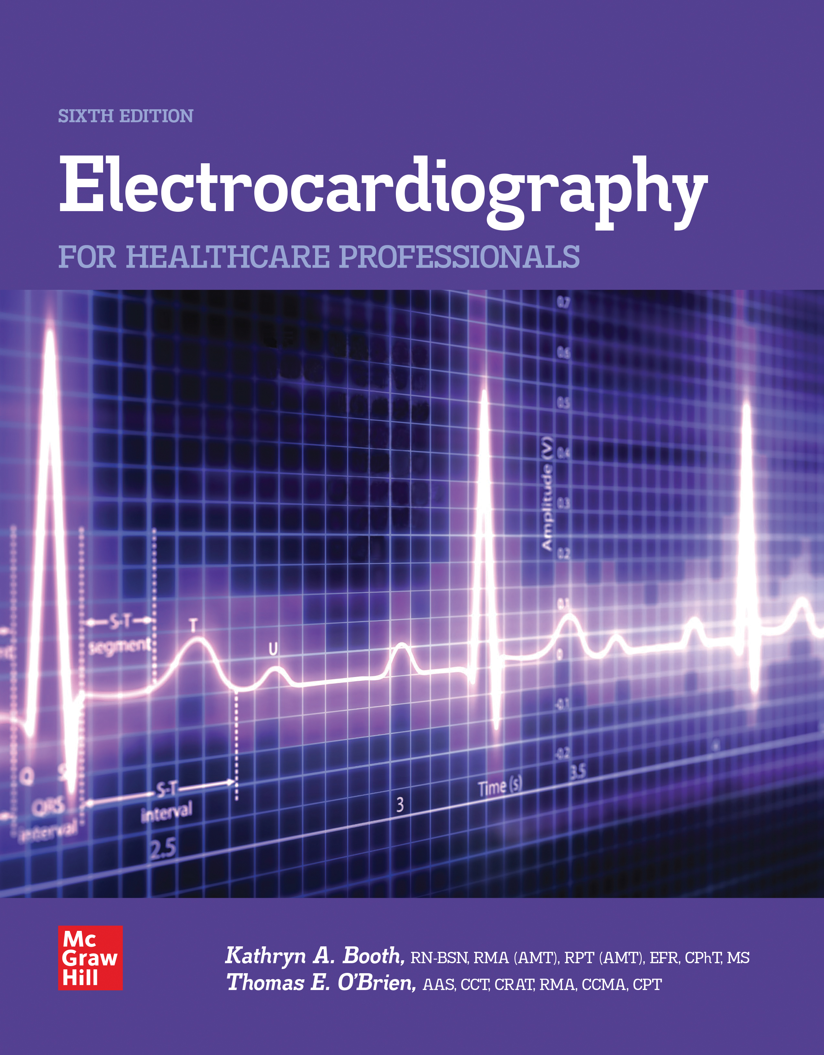
Chapter 13
Ambulatory Monitoring
Access the text alternative for slide images.
© McGraw Hill LLC. All rights reserved. No reproduction or distribution without the prior written consent of McGraw Hill LLC.

Slide 2
CHAPTER 13
AMBULATORY MONITORING

Slide 3
Learning Outcome 13.1
Ambulatory Monitoring
Key Terms
Ambulating.
Ambulatory monitoring.
Holter monitor.
Notes:
LO 13.1: Identify the purpose and function of ambulatory monitoring.
-----
Ambulating: Walking.
Ambulatory monitoring: The process of recording an ECG tracing for an extended period of time while a patient goes about his or her daily activities.
Holter monitor: An instrument that records the electrical activity of the heart during a patient’s normal daily activities; the Holter monitor is one type of ambulatory monitor.

Slide 4
What Is Ambulatory Monitoring? 1
Process of recording an E C G tracing while patient performs daily activities.
Typical ambulatory monitor is a small box strapped to waist or shoulder.
Box contains recording device.
Most are digital.
Notes:
LO 13.1: Identify the purpose and function of ambulatory monitoring.
-----
Ambulatory monitors get their name from the fact that patients ambulate, or walk around, while the recording is taking place.

Slide 5
What Is Ambulatory Monitoring? 2
Holter is one type of ambulatory monitor.
Requires 3 to 5 leads
Patient keeps diary:
Activities.
Symptoms.
Abnormal sensations.
Computer is used to view, print, and analyze tracing.
The term Holter is often used to mean any type of ambulatory monitor.
Notes:
LO 13.1: Identify the purpose and function of ambulatory monitoring.
-----
The patient is encouraged to move around and perform all normal daily activities during the monitoring period, which is usually 24 to 48 hours.

Slide 6
Your Responsibilities
You may be responsible for:
Applying and removing the monitor.
Providing patient education.
Ensuring that results are placed in patient’s chart.
Transferring content from the digital device.
Distinguishing artifact from cardiac dysrhythmias.
Notes:
LO 13.1: Identify the purpose and function of ambulatory monitoring.
-----

Slide 7
Learning Outcome 13.1
Apply Your Knowledge 1
How long does an ambulatory monitor typically remain on a patient?
Notes:
LO 13.1: Identify the purpose and function of ambulatory monitoring.
-----

Slide 8
Learning Outcome 13.1
Apply Your Knowledge 2
How long does an ambulatory monitor typically remain on a patient?
Answer:
24 to 48 hours
Notes:
LO 13.1: Identify the purpose and function of ambulatory monitoring.
-----

Slide 9
Learning Outcome 13.2
How Is Ambulatory Monitoring Used?
Key Terms
Antidysrhythmic.
Palpitations.
Stress E C G.
Syncope.
Notes:
LO 13.2: Explain why ambulatory monitoring is used in addition to the 12-lead ECG.
-----
Antidysrhythmic: Type of medication given to prevent cardiac rhythm abnormalities. Also known as antiarrhythmic.
Palpitations: Fast, irregular heartbeat sensation felt by the patient, which may or may not be associated with complaints of chest pain.
Stress ECG: Another name for exercise electrocardiography.
Syncope: Loss of consciousness (fainting).

Slide 10
Why Is Ambulatory Monitoring Used?
To capture abnormal heart rhythms when symptoms do not occur during 12-lead or stress E C G s.
To monitor effectiveness of antidysrhythmic drug therapy.
To evaluate pacemaker function.
To evaluate the heart after a myocardial infarction.
Notes:
LO 13.2: Explain why ambulatory monitoring is used in addition to the 12-lead ECG.
-----
Abnormal heart rhythms can occur randomly or spontaneously and may be sleep related,, disease related, or diet or stress induced. Whatever the reason for them, abnormal electrical behavior of the heart can be life threatening.
ST segment depression can also be caused by medications

Slide 11
Reasons for Ordering Ambulatory Monitoring
To determine the cause of possible cardiac symptoms:
Chest pain.
Light-headedness.
Syncope.
Dizziness.
Palpitations.
Notes:
LO 13.2: Explain why ambulatory monitoring is used in addition to the 12-lead ECG.
-----
The patient may have already had a 12-lead ECG and even a stress test. If the symptoms did not occur during these tests, ambulatory monitoring provides an extended chance to catch the reason for the symptoms on an ECG monitor.

Slide 12
Learning Outcome 13.2
Apply Your Knowledge 1
For what patient symptoms might a physician order ambulatory monitoring?
Notes:
LO 13.2: Explain why ambulatory monitoring is used in addition to the 12-lead ECG.
-----

Slide 13
Learning Outcome 13.2
Apply Your Knowledge 2
For what patient symptoms might a physician order ambulatory monitoring?
Answer:
Chest pain, light-headedness, syncope, dizziness, palpitations
Notes:
LO 13.2: Explain why ambulatory monitoring is used in addition to the 12-lead ECG.
-----

Slide 14
Learning Outcome 13.3
Types of Ambulatory Monitoring
Holter monitoring.
Cardiac event recording.
Telemetry monitoring.
Notes:
LO 13.3: Summarize the common types of ambulatory monitoring.
-----

Slide 15
Holter Monitoring
Complete tracing from the time the unit is applied until removal
Patient records in diary
Daily activities.
Abnormal experiences.
Symptoms.
Clock in unit correlates tracings with diary entries.
Notes:
LO 13.3: Summarize the common types of ambulatory monitoring.
-----
The patient is instructed to press the event button on the device and make a notation in the diary when experiencing any abnormal symptoms i.e. chest pain or pressure, dizziness, nausea, palpitations etc.

Slide 16
Cardiac Event Recording
Patient-activated.
Types.
Loop-memory monitor.
Symptom event monitor.
Wearable monitor with defibrillator.
Wireless 12-lead E C G.
Implantable loop recorder.
Notes:
LO 13.3: Summarize the common types of ambulatory monitoring.
-----
Because they only record when symptoms occur, cardiac event recordings are much shorter than the tracing from a Holter monitor, so they can be evaluated more quickly.

Slide 17
Loop-Memory Monitor
Memory on monitor can hold up to 5 minutes.
Provides physician with recording before, during, and after event.
Notes:
LO 13.3: Summarize the common types of ambulatory monitoring.
-----
Because the loop-memory monitor can retain the last 5 minutes of recording, pressing the activation button locks in the previous 5 minutes of tracing, so that the events leading up to the patient’s symptoms can be reviewed.

Slide 18
Symptom Event Monitor
Used when patient is experiencing symptoms
Handheld type
Placed against chest when experiencing symptoms.
Wristwatch type
Worn at all times.
Records bipolar lead I tracing.
Documents dysrhythmias that last more than a few seconds.
Notes:
LO 13.3: Summarize the common types of ambulatory monitoring.
-----
Placing the handheld type against the chest automatically triggers the device to begin recording.

Slide 19
Wireless 12-Lead E C G
10-cable device0
Attached like a traditional 12-lead E C G.
Patient can activate anywhere, at any time.
Sends data to physician’s office or monitoring facility.
Can be interpreted immediately.
Notes:
LO 13.3: Summarize the common types of ambulatory monitoring.
-----
For more information about attaching 12-lead ECGs, refer to the chapter Performing an ECG.

Slide 20
Telemetry Monitoring
Real-time monitoring
Inside medical facility.
Mobile cardiac telemetry.
Uses 3 or 5 electrodes on chest
Transmits to a central location where multiple patients may be monitored simultaneously
Patient diary not required
Notes:
LO 13.3: Summarize the common types of ambulatory monitoring.
-----
Real-time monitoring means that someone is viewing the ECG tracing as it occurs.
Telemetry monitoring technicians may require certification

Slide 21
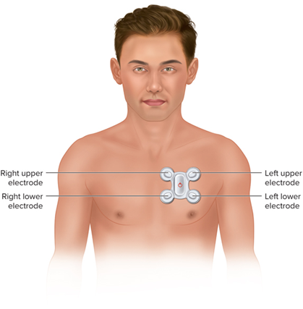
Mobile Cardiac Outpatient Telemetry (M C O T)
Automatically send data when cardiac anomaly is detected.
Hold up to 96 hours of data.
Unlimited number of events can be recorded and transmitted.
Notes:
LO 13.3: Summarize the common types of ambulatory monitoring.
-----
Transtelephonic monitoring was developed in the 1960s, after Holter monitoring was developed.
In addition to pacemaker function evaluation, it can be used for any patient requiring long-term monitoring.

Slide 22
Loose or Disconnected Electrodes
Instruct patient to press in center to reapply.
Patient must return to facility if electrode falls off and cannot be reapplied.
Notes:
LO 13.3: Summarize the common types of ambulatory monitoring.
-----
Always be sure to provide the patient with information about how and when to contact the facility if an electrode falls off or another problem occurs.

Slide 23
Learning Outcome 13.3
Apply Your Knowledge 1
Which ambulatory monitor can hold up to 5 minutes of tracing data and can be used to record and preserve the tracing before the patient activates the device?
Notes:
LO 13.3: Summarize the common types of ambulatory monitoring.
-----

Slide 24
Learning Outcome 13.3
Apply Your Knowledge 2
Which ambulatory monitor can hold up to 5 minutes of tracing data and can be used to record and preserve the tracing before the patient activates the device?
Answer:
Loop-memory monitor
Notes:
LO 13.3: Summarize the common types of ambulatory monitoring.
-----

Slide 25
Learning Outcome 13.4
Educating the Patient
Ensure that patient understands:
Monitoring procedure
Why procedure is being done
What the patient must do
Notes:
LO 13.4: Educate the patient about ambulatory monitoring.
-----

Slide 26
Patient Diary
Explain purpose of diary.
Record of events and symptoms that occur while monitor is in place.
Used in conjunction with E C G tracing.
Have patient repeat diary instructions.
Remind patient of any medication changes.
Notes:
LO 13.4: Educate the patient about ambulatory monitoring.
Events may include: chest pain or pressure, dizziness, nausea, palpitations etc.
-----

Slide 27
Diary—What Is Recorded
All usual and unusual activities:
Urinating, bowel movements.
Sexual activity.
Walking.
Emotional upset.
Eating.
Sleeping.
Chest pain or pressure.
Palpitations.
Dizziness.
Nausea.
Notes:
LO 13.4: Educate the patient about ambulatory monitoring.
-----

Slide 28
Law and Ethics
Refer patient question about medication indications, side effects, and precautions to the licensed practitioner.
Answering these questions is outside your scope of practice.
Notes:
LO 13.4: Educate the patient about ambulatory monitoring.
-----

Slide 29
What the Patient Should Know during Ambulatory Monitoring 1
Wear loose fitting clothing:
For comfort.
To reduce artifact.
Sponge baths are allowed.
No showers or tub baths.
When sleeping, make sure tension is not applied to leads.
Notes:
LO 13.4: Educate the patient about ambulatory monitoring.
-----

Slide 30
What the Patient Should Know during Ambulatory Monitoring 2
Avoid magnets, metal detectors, high-voltage areas, and electric blankets.
Check monitoring equipment for proper functioning.
Document patient education in the patient’s chart.
Notes:
LO 13.4: Educate the patient about ambulatory monitoring.
-----

Slide 31
Patient Education and Communication
Have patients tell you what they already know about ambulatory monitoring.
Explain what they don’t know.
Ask patients to repeat information back to you to ensure understanding.
Notes:
LO 13.4: Educate the patient about ambulatory monitoring.
-----

Slide 32
Learning Outcome 13.4
Apply Your Knowledge 1
True or False: Patients should be instructed to cover the monitor and electrodes with plastic before showering.
Notes:
LO 13.4: Educate the patient about ambulatory monitoring.
-----

Slide 33
Learning Outcome 13.4
Apply Your Knowledge 2
True or False: Patients should be instructed to cover the monitor and electrodes with plastic before showering.
Answer:
False. The patient should not shower or take a tub bath while the monitor is attached. Only sponge baths are allowed.
Notes:
LO 13.4: Educate the patient about ambulatory monitoring.
-----

Slide 34
Learning Outcome 13.5
Preparing the Patient
Emotional preparation:
Take time to explain each step of procedure.
Tell patient some fear is normal.
Allow patient to ask questions.
Physical preparation:
Electrode placement.
Patient should maintain all normal activities.
Notes:
LO 13.5: Prepare a patient for application of an ambulatory monitor.
-----
Answer the patient’s questions as completely as you can, within your scope of practice. If you do not know the answer to a question, ask a licensed practitioner or your supervisor.

Slide 35
Pediatric Patients
Consider the child’s age.
Use terms the child can understand.
Allow the child to touch the equipment prior to applying it.
Instruct both child and parent.
Notes:
LO 13.5: Prepare a patient for application of an ambulatory monitor.
-----
Children may be especially fearful of the procedure. Take additional time as needed to help a child understand the process and feel comfortable with it.

Slide 36
Learning Outcome 13.5
Apply Your Knowledge 1
What is the first step in reducing a patient’s fears about the ambulatory monitoring procedure?
Notes:
LO 13.5: Prepare a patient for application of an ambulatory monitor.
-----

Slide 37
Learning Outcome 13.5
Apply Your Knowledge 2
What is the first step in reducing a patient’s fears about the ambulatory monitoring procedure?
Answer:
The first step is to help the patient understand the procedure.
Notes:
LO 13.5: Prepare a patient for application of an ambulatory monitor.
-----

Slide 38
Learning Outcome 13.6
Gather Equipment
Monitor and holder.
New batteries and digital disk.
Electrodes.
Lead wires.
Alcohol and gauze.
Patient diary.
Skin prep materials.
Shaving equipment.
Tape.
Checklist for patient education.
Manufacturer’s instructions for monitor
Pen.
Notes:
LO 13.6: Describe the procedure for applying an ambulatory monitor correctly.
-----
Check the shoulder strap or belt for wear before using.

Slide 39
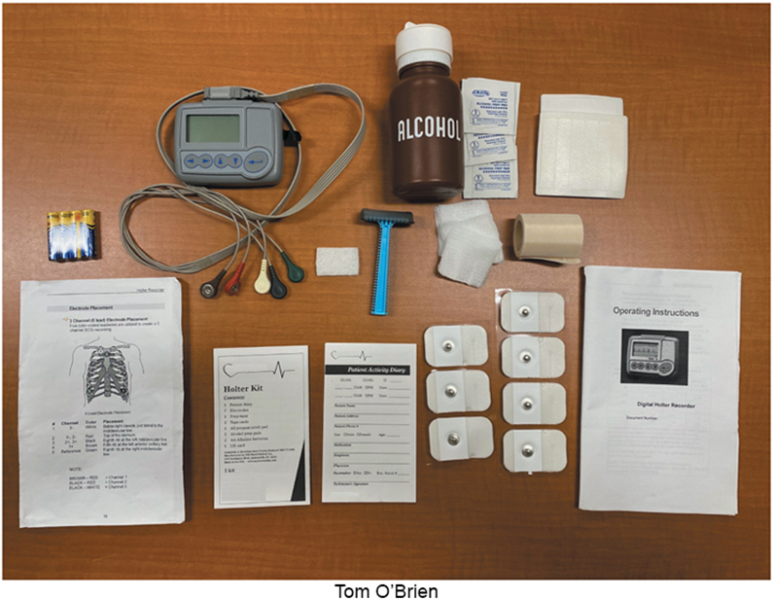
Prepare the Monitor
Make sure monitor is adequately charged.
Insert new batteries.
Insert new blank digital disk, if required.
Access the text alternative for slide images.
Notes:
LO 13.6: Describe the procedure for applying an ambulatory monitor correctly.
-----
Review the manufacturer’s instructions for exact preparation steps for the type of monitor you are using.

Slide 40
Place the Electrodes
Have patient remove clothing from waist up.
Provide drape.
Have patient sit or lie down and relax.
Prepare electrode sites:
Rub the site with an alcohol swab and let it dry
Dry shave electrode sites, if necessary (clip hair for telemetry monitoring).
Abrade skin.
Place electrodes at proper sites.
Notes:
LO 13.6: Describe the procedure for applying an ambulatory monitor correctly.
Note:
Always prep the skin prior to shaving and abrading the skin to reduce patient discomfort.
Attach electrodes to the cables prior to attaching the electrodes to the patient’s skin.
-----
Wet shaving is not done because soap film interferes with electrode adhesion.
After dry shaving, use tape to remove shaved hair.

Slide 41
Elderly Patients
Apply less pressure when abrading skin.
Avoid abrasive cleansers.
Use caution when applying and removing electrodes.
Notes:
LO 13.6: Describe the procedure for applying an ambulatory monitor correctly.
-----
Elderly patients and patients taking certain medications may have very fragile, thin skin. Manipulate the electrodes as little as possible when applying and removing them.

Slide 42
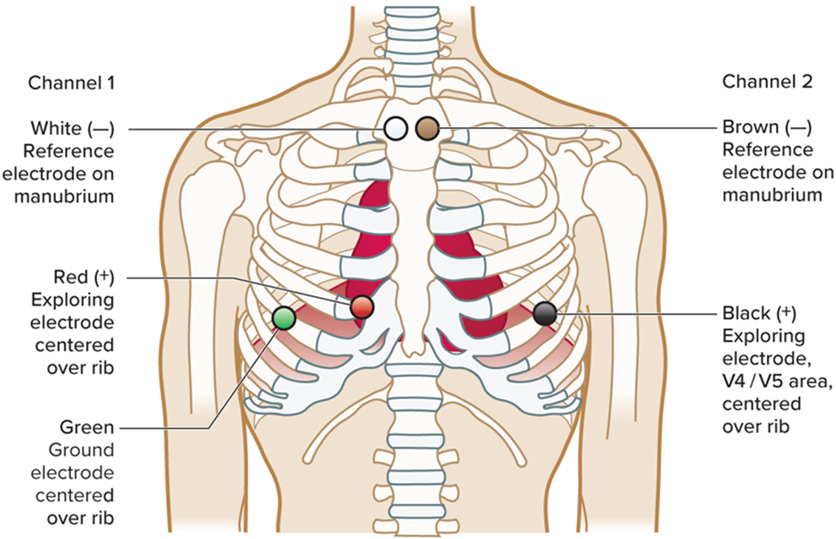
Apply the Monitor 1
Attach lead wires to electrodes
Access the text alternative for slide images.
Notes:
LO 13.6: Describe the procedure for applying an ambulatory monitor correctly.
-----
This is only one example of electrode placement. Placement and colors vary with the manufacturer. Always check the manufacturer’s instructions for correct placement.
If you cannot find the manufacturer’s instructions or do not understand them, consult your supervisor. Do not guess where the electrodes should go.

Slide 43
Apply the Monitor 2
Arrange lead wires comfortably on patient.
Tape each of the cables in place using a stress loop to reduce tugging and pulling on the electrodes during movement.
Tape each electrode in place.
Attach cable to electrocardiograph.
Run baseline E C G.
Have patient dress, then attach cable to monitor.
Check lead wires and electrodes.
Start monitor.
Notes:
LO 13.6: Describe the procedure for applying an ambulatory monitor correctly.
-----
The purpose of the baseline ECG tracing is to make sure the tracing is correct and that the machine is not malfunctioning.

Slide 44
Apply the Monitor 3
Have patient make first diary entry.
Review all patient instructions.
Set date and time for patient return.
Notes:
LO 13.6: Describe the procedure for applying an ambulatory monitor correctly.
-----
Make sure the beginning time is noted in the diary. Also be sure the patient knows how to get assistance in case problems arise.

Slide 45
Learning Outcome 13.6
Apply Your Knowledge 1
What should you do if you are unfamiliar with the ambulatory monitor assigned to the patient?
Notes:
LO 13.6: Describe the procedure for applying an ambulatory monitor correctly.
-----

Slide 46
Learning Outcome 13.6
Apply Your Knowledge 2
What should you do if you are unfamiliar with the ambulatory monitor assigned to the patient?
Answer:
First check the manufacturer’s instructions. If you cannot locate them or do not understand them, consult your supervisor.
Notes:
LO 13.6: Describe the procedure for applying an ambulatory monitor correctly.
-----

Slide 47
Learning Outcome 13.7
Removing the Ambulatory Monitor
Review patient’s diary.
Turn off monitor and detach lead wires.
Detach lead wires and cable from patient.
Remove tape and electrodes.
Clean skin.
Record removal procedure on patient’s chart.
Notes:
LO 13.7: Describe the procedure for removing the ambulatory monitor and reporting the results.
-----
Carefully document and label the report, diary, and digital disk with all required information as established by facility protocol.

Slide 48
Reporting Results 1
Follow manufacturer’s instructions to prepare recording for evaluation.
Machine or computer may provide initial analysis.
Final interpretation:
Physician within facility.
Sent to outside laboratory.
Notes:
LO 13.7: Describe the procedure for removing the ambulatory monitor and reporting the results.
-----
If the results are sent to an outside reference laboratory for interpretation, they are returned to the patient’s physician, who then explains them to the patient.

Slide 49
Reporting Results 2
Factors affecting accuracy of tracing results:
Improper lead attachment.
Incomplete patient diary.
Failure of patient to maintain normal routine.
If results are sent to an outside lab, report can take seven to ten days.
Notes:
LO 13.7: Describe the procedure for removing the ambulatory monitor and reporting the results.
-----

Slide 50
Abnormal Results 1
Abnormal results may indicate:
Electrical-conduction defects in heart’s rate and rhythm-controlling system.
Rhythm abnormalities.
Premature atrial or ventricular contractions.
Notes:
LO 13.7: Describe the procedure for removing the ambulatory monitor and reporting the results.
-----
Advise the patient to discuss the results of the ambulatory monitoring with his or her physician.

Slide 51
Abnormal Results 2
Additional testing that may be required:
Echocardiogram.
Coronary angiogram.
C T (computerized tomography) scan.
M R I (magnetic resonance imaging).
P E T (positron emission tomography) scan.
Notes:
LO 13.7: Describe the procedure for removing the ambulatory monitor and reporting the results.
-----

Slide 52
Learning Outcome 13.7
Apply Your Knowledge 1
What factors can affect the results of ambulatory monitoring?
Notes:
LO 13.7: Describe the procedure for removing the ambulatory monitor and reporting the results.
-----

Slide 53
Learning Outcome 13.7
Apply Your Knowledge 2
What factors can affect the results of ambulatory monitoring?
Answer:
Improper lead attachment, incomplete patient diary, patient failure to maintain a normal routine.
Notes:
LO 13.7: Describe the procedure for removing the ambulatory monitor and reporting the results.
-----

Slide 54
Chapter Summary 1
Ambulatory monitoring is the process of recording an E C G tracing for an extended period of time while the patient performs normal daily activities.
Ambulatory monitoring documents electrical activity in the heart and identifies abnormal heart behaviors that may not have occurred during 12-lead E C G or stress tests.
Types of ambulatory monitoring include continuous, intermittent, telemetry, and transtelephonic monitoring.
Notes:
LO 13.1: Identify the purpose and function of ambulatory monitors.
LO 13.2: Explain why ambulatory monitoring is used in addition to the 12-lead ECG.
LO 13.3: Summarize the common types of ambulatory monitoring.

Slide 55
Chapter Summary 2
Patients must be thoroughly instructed on proper use of the ambulatory monitor, including the need for diary entries and behavior during the monitoring period.
Patients should be prepared both emotionally and physically before the monitor is applied.
Applying an ambulatory monitor includes preparing the electrode sites, placing the electrodes, connecting the monitor, running a baseline E C G to confirm proper operation, and making the first diary entry.
Notes:
LO 13.4: Educate the patient about ambulatory monitoring.
LO 13.5: Prepare a patient for application of an ambulatory monitor.
LO 13.6: Describe the procedure for applying an ambulatory monitor correctly.

Slide 56
Chapter Summary 3
After the monitoring period, review the patient diary before removing the monitor.
After removing the monitor, make sure the results are evaluated and a report is placed in the patient’s medical record.
Notes:
LO 13.7: Describe the procedure for removing the ambulatory monitor and reporting the results.

