Slide 1
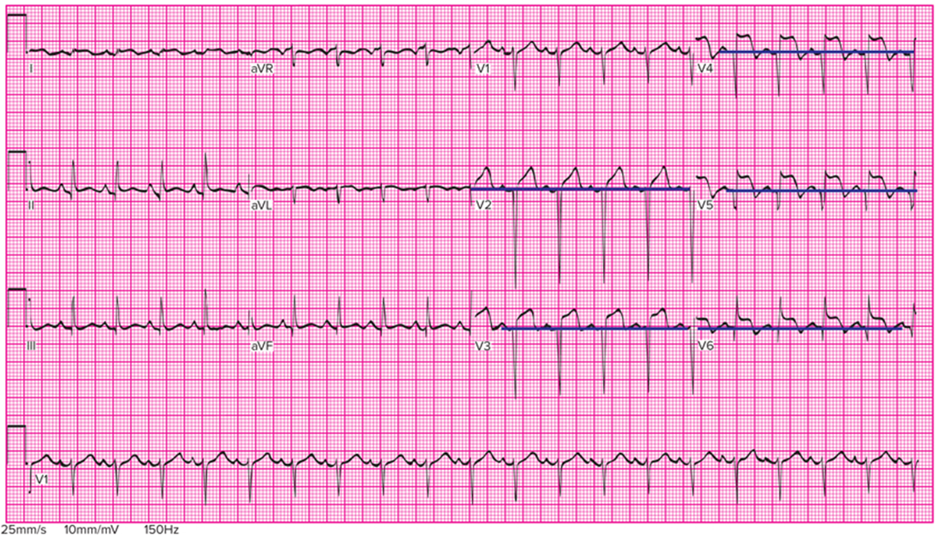
CHAPTER 14
CLINCAL PRESENTATION
AND
MANAGEMENT
OF THE
CARDIAC PATIENT

Slide 2
Coronary Arteries
Right coronary artery branches:
Posterior descending artery.
Marginal artery.
Left coronary artery branches:
Circumflex artery.
Left anterior descending artery.
Diagonal artery.
Notes:
LO 14.1: Describe the structure and location of arteries, including the coronary arteries.
-----
The posterior descending artery provides blood to the posterior wall of the heart.
The marginal artery supplies the walls of the right atrium and right ventricle.
The circumflex artery supplies blood to the lateral wall of the left ventricle.
The left anterior descending artery supplies blood to the anterior wall of the left ventricle.
The diagonal artery is a branch of the left anterior descending artery that supplies blood to the anterior and lateral walls of the lower left ventricle.

Slide 3
Arterial Layers
Tunica adventitia (externa):
Tough, fibrous connective tissue.
Keeps vessel open.
Tunica media:
Smooth muscle tissue.
Dilates and constricts to maintain blood pressure.
Tunica intima (interna):
Single-cell layer of endothelial cells.
Notes:
LO 14.1: Describe the structure and location of arteries, including the coronary arteries.
-----
The tunica adventitia is the outermost layer. The tunica media is the middle layer, and the tunica intima is the innermost layer.
The tunica intima is prone to disruption when atherosclerotic plaque is ruptured and peels away. The site forms a clot, which increasingly reduces blood flow and causes ischemia distally to the site.

Slide 4

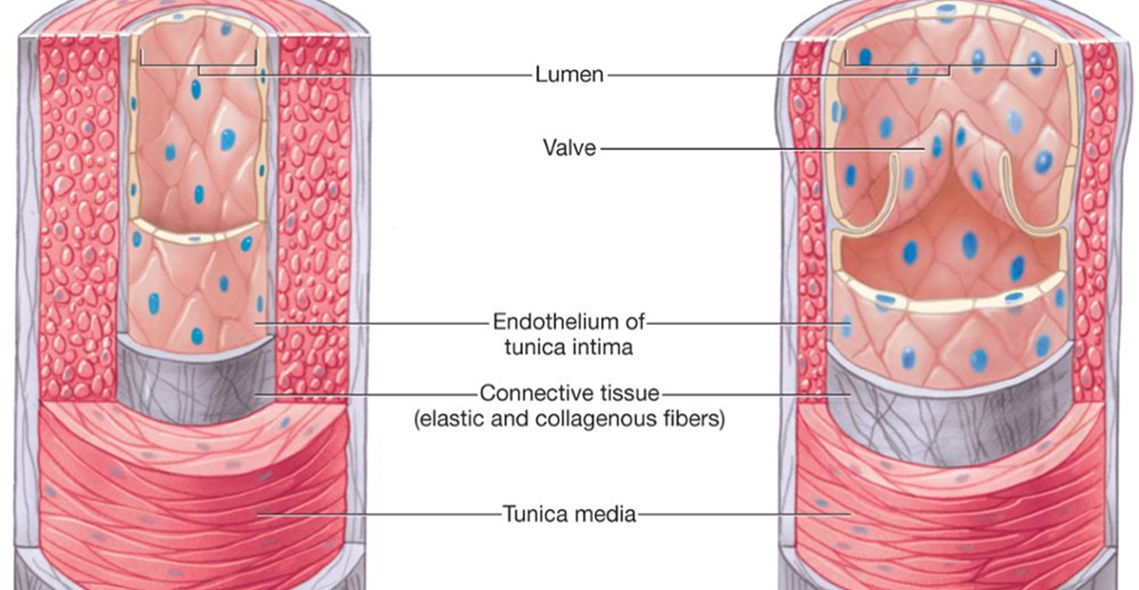
Blood Vessel Layers
Access the text alternative for slide images.
Notes:
LO 14.1: Describe the structure and location of arteries, including the coronary arteries.
NOTE: Arteries and veins each have the same layers, but arteries tunica media is much thicker (due to functioning under pressure).
Veins have valves, arteries do not have valves.
-----

Slide 5
Learning Outcome 14.1 Apply Your Knowledge 1
Name the three layers of an artery.
Notes:
LO 14.1: Describe the structure and location of arteries, including the coronary arteries.
-----

Slide 6
Learning Outcome 14.1 Apply Your Knowledge 2
Name the three layers of an artery going from the outermost layer to the innermost layer.
Answer:
Tunica adventitia, tunica media, tunica intima.
Notes:
LO 14.1: Describe the structure and location of arteries, including the coronary arteries.
-----

Slide 7
Non-Cardiac Causes of Chest Pain
Inflammation of the costal cartilage or lungs.
Gastric or esophageal irritation.
Gallbladder pain.
Dental pain.
Consider all chest discomfort or pain as being cardiac in origin until proven otherwise.
Notes:
LO 14.2: Describe typical cardiac symptoms and unstable angina.
-----
It is often difficult to determine whether a patient’s symptoms are cardiac in origin. To ensure patient safety, never assume that the patient just has a dental or gastric problem. Always assume that chest pain is cardiac-related until proven otherwise.

Slide 8
Cardiac Symptoms
Angina
Heart muscle not receiving enough oxygen.
May radiate to other locations (referred pain).
Ischemia
Lack of blood supply to an area of the heart.
Due to blockage of circulation to that area.
Notes:
LO 14.2: Describe typical cardiac symptoms and unstable angina.
-----
Referred pain: pain perceived at a location other than the site of the painful stimulus/ origin.

Slide 9
Other Symptoms of Blocked Arteries
Shortness of breath.
Sweating.
Chest pain.
Epigastric discomfort.
Neck pain.
Cough.
Back pain.
Squeezing sensation.
Dizziness.
Notes:
LO 14.2: Describe typical cardiac symptoms and unstable angina.
-----
Any of these symptoms could indicate a possible cardiac problem.

Slide 10
Unstable Angina
Warning sign that condition has worsened.
Pain.
More frequent or severe.
Increases to 3 or more times a day.
Occurs with less exertion.
Occurs at rest or awakens patient from sleep.
Symptoms last longer (20 minutes or more).
Less responsive to treatment.
Notes:
LO 14.2: Describe typical cardiac symptoms and unstable angina.
-----
Unstable angina is considered a state between angina and myocardial infarction.

Slide 11
Learning Outcome 14.2 Apply Your Knowledge 1
Why should all chest pain initially be treated as cardiac in origin?
Notes:
LO 14.2: Describe typical cardiac symptoms and unstable angina.
-----

Slide 12
Learning Outcome 14.2 Apply Your Knowledge 2
Why should all chest pain initially be treated as cardiac in origin?
Answer:
To protect the patient from an untreated myocardial infarction or other serious cardiac condition.
Notes:
LO 14.2: Describe typical cardiac symptoms and unstable angina.
-----

Slide 13
Women
1 in every 5 female deaths in 2020 was due to heart disease
Common cardiac symptoms in women:
Neck, jaw, shoulder, upper back, or upper belly discomfort.
Shortness of breath.
Pain in one or both arms.
Nausea , vomiting.
Sweating.
Light-headedness or dizziness.
Unusual fatigue.
Indigestion.
Notes:
LO 14.3: Summarize atypical patient types and presentation.
-----
Because cardiac symptoms are less predictable in women, it is important to be aware of other, subtler complaints that may indicate cardiac disease.
Females more likely to have MI symptoms unrelated to chest pain

Slide 14
Diabetics 1
Twice as likely to have a heart attack or stroke.
High blood glucose level.
Damages blood vessels.
Leads to atherosclerotic plaque accumulation.
Notes:
LO 14.3: Summarize atypical patient types and presentation.
-----
The blood vessels can accommodate up to 40% plaque accumulation by expanding, reshaping, or remodeling themselves.
When they can no longer maintain normal blood flow, complications such as myocardial infarction and stroke may occur.

Slide 15
Diabetics 2
Cardiac symptoms in diabetic patients:
Chest pain or discomfort.
Pain or discomfort in arms, back, jaw, neck, or stomach.
Shortness of breath.
Sweating, nausea.
Light-headedness.
Symptoms may be mild or absent due to neuropathy caused by diabetes creating a “silent M I.”
Notes:
LO 14.3: Summarize atypical patient types and presentation.
-----
Neuropathy caused by diabetes may result in lack of, or impaired perception of, pain during a heart attack.
Women with diabetes have an increased risk of heart disease because diabetes cancels out the benefits of naturally occurring protective hormones.

Slide 16
Elderly Patients
50% may have atypical cardiac symptoms.
Cardiac symptoms in the elderly.
Shortness of breath.
Nausea.
Profuse sweating.
Pain in the arms.
Syncope.
Weakness or fatigue.
More likely to delay medical treatment.
Notes:
LO 14.3: Summarize atypical patient types and presentation.
-----
Because elderly patients are likely to have milder symptoms, they are less likely than other patients to seek medical treatment.

Slide 17
Learning Outcome 14.3 Apply Your Knowledge 1
What three groups of patients often present with atypical cardiac symptoms?
Notes:
LO 14.3: Summarize atypical patient types and presentation.
-----

Slide 18
Learning Outcome 14.3 Apply Your Knowledge 2
What three groups of patients often present with atypical cardiac symptoms?
Answer:
Women, diabetics, and elderly patients.
Notes:
LO 14.3: Summarize atypical patient types and presentation.
-----

Slide 19
S T Segment Elevation M I (S T E M I) 1
75% to 80% of patients present with S T E M I
Complete coronary artery occlusion
Ischemia delays repolarization
E C G changes:
S T segment depression or elevation.
T wave inversion.
Pathologic Q wave.
Notes:
LO 14.4: Compare ST segment elevation and non-ST segment elevation.
-----
STEMI is the “classic” MI, which occurs as a result of a complete occlusion of a coronary artery.

Slide 20
S T Segment Elevation M I (S T E M I) 2
Access the text alternative for slide images.
Notes:
Anterolateral AMI (acute myocardial infarction).
The isoelectric line has been identified with dark blue lines.
Notice the ST segment elevation in V2 to V6 (V3 and V4 Anterior and V5 and V6 Lateral).
Note: ST elevation in V2 provides evidence of a growing (extension) MI.

Slide 21
Non-S T Segment Elevation M I (N S T E M I)
20% to 25% of patients present with N S T E M I.
Classic signs and symptoms are not present.
Occurs due to incomplete coronary artery occlusion.
Lab tests are needed to look for cardiac enzymes.
Notes:
LO 14.4: Compare ST Segment Elevation and Non-ST Segment Evaluation.
-----
NSTEMI is often called a “silent” MI because they do not have the classic MI symptoms, but may have only vague symptoms that are difficult to analyze.
Even though the artery is not completely occluded in NSTEMI, more people die from NSTEMI than from STEMI because the symptoms are less dramatic and more difficult to interpret.

Slide 22
Sudden Cardiac Arrest
Not the same thing as M I.
Heart stops beating due to failure of electrical system.
Both S T E M I and N S T E M I patients are at risk.
Notes:
LO 14.4: Compare ST Segment Elevation and Non-ST Segment Evaluation.
-----
While a myocardial infarction is caused by occlusion of a coronary artery, sudden cardiac arrest is an electrical event that occurs due to failure of the heart’s electrical system.

Slide 23
Learning Outcome 14.4 Apply Your Knowledge 1
Which type of myocardial infarction is often referred to as the “silent” M I?
Notes:
LO 14.4: Compare ST Segment Elevation and Non-ST Segment Evaluation.
-----

Slide 24
Learning Outcome 14.4 Apply Your Knowledge 2
Which type of myocardial infarction is often referred to as the “silent” M I?
Answer:
N S T E M I
Notes:
LO 14.4: Compare ST Segment Elevation and Non-ST Segment Evaluation.
-----

Slide 25
Heart Failure
Heart muscle is unable to pump.
Can affect the right or left side of the heart.
Most common cause is myocardial infarction.
Body tissues do not receive enough oxygen.
Cardiogenic shock.
Affects kidneys and liver.
Notes:
LO 14.5: Explain heart failure.
-----
When the kidneys are not sufficiently perfused with blood, urinary output is decreased.
When the liver is not sufficiently perfused, blood clotting proteins are reduced, increasing bleeding risk.

Slide 26
Left Ventricular Failure 1
Symptoms
Shortness of breath or trouble breathing.
Fatigue, confusion.
Tachycardia.
Anorexia.
Decreased or absent urine production.
Pallor.
Often causes pulmonary edema
Rales.
Notes:
LO 14.5: Explain heart failure.
-----
Pulmonary edema often occurs in left ventricular heart failure because when the left pump fails, blood backs up in the lungs.
Pulmonary edema can be defined as an abnormal accumulation of extravascular fluid in the lung parenchyma (thin-walled alveoli). This process leads to diminished gas exchange at the alveolar level, progressing to potentially causing respiratory failure.
https://www.ncbi.nlm.nih.gov/books/NBK557611/#:~:text=Pulmonary%20edema%20can%20be%20defined,to%20potentially%20causing%20respiratory%20failure.

Slide 27
Left Ventricular Failure 2
Common causes of left heart failure:
S T E M I.
Hypertension.
Cardiac dysrhythmias: Atrial fibrillation.
Left heart failure always leads to right heart failure.
Notes:
LO 14.5: Explain heart failure.
-----

Slide 28
Right Ventricular Failure 1
Symptoms
Hypotension.
Jugular vein distention.
Clear lung sounds.
Swelling, pitting edema.
Ascites (fluid collecting in abdominal cavity).
Notes:
LO 14.5: Explain heart failure.
-----
Hypotension is the result of less blood being pumped to the lungs and then returned to the left ventricle. Since the left ventricle can only pump the blood it receives, reduced cardiac output causes the hypotension.

Slide 29
Right Ventricular Failure 2
Common causes.
Left-sided heart failure.
Coronary artery disease.
Chronic lung disease.
Extensive right ventricular infarction.
Notes:
LO 14.5: Explain heart failure.
-----

Slide 30
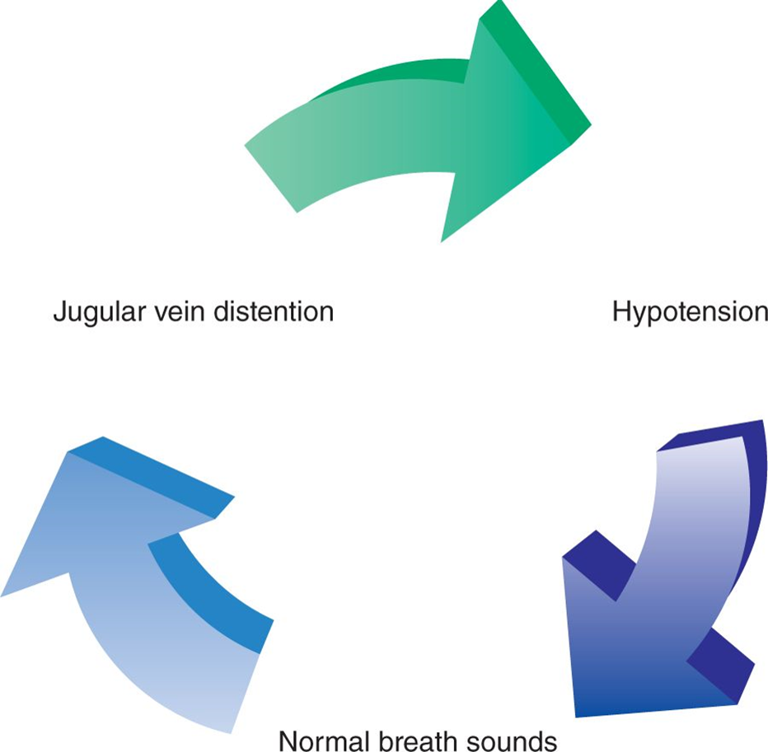
Clinical Triad of Right Ventricular Failure
Notes:
LO 14.5: Explain heart failure.
-----

Slide 31
Learning Outcome 14.5 Apply Your Knowledge 1
Which type of heart failure often results in pulmonary edema?
Notes:
LO 14.5: Explain heart failure.
-----

Slide 32
Learning Outcome 14.5 Apply Your Knowledge 2
Which type of heart failure often results in pulmonary edema?
Answer:
Left ventricular heart failure.
Notes:
LO 14.5: Explain heart failure.
-----

Slide 33
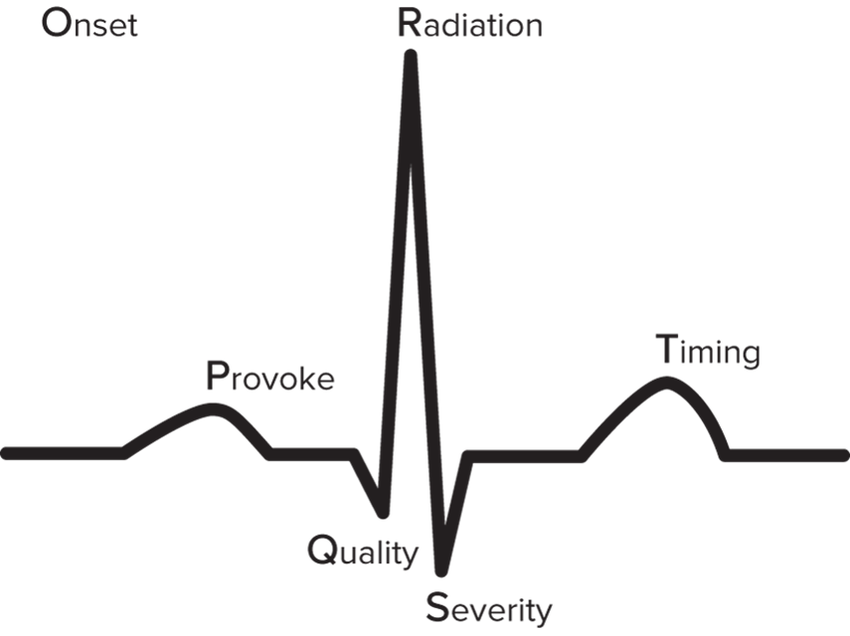
O-P-Q-R-S-T 1
Used to evaluate pain.
O—Onset.
P—Provoke.
Q—Quality.
R—Radiation.
S—Severity.
T—Time.
Access the text alternative for slide images.
Notes:
LO 14.6: Identify assessment and immediate treatment needed for the cardiac patient.
-----
Onset: What were you doing when it started? Did it occur suddenly or gradually?
Provoke: What provokes (causes) the pain or makes it better or worse?
Quality: Can you describe what the pain feels like? Is it sharp, dull, aching, and so on?
Radiation: Does the pain stay in one location or travel in a particular direction? Can you touch the spot that hurts the most?
Severity: Rate your pain on a scale of 0 to 10, with 0 = no pain and 10 = the most pain ever experienced.
Time: How long has it been going on?

Slide 34
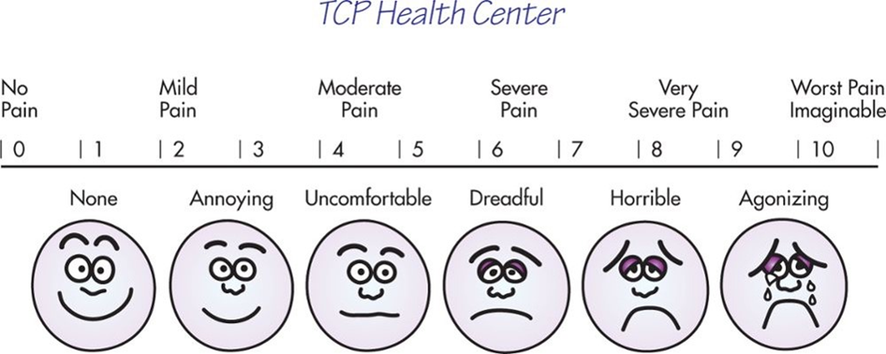
Visual Pain Scale
Used for people with language, educational, or other understanding barriers:
Access the text alternative for slide images.
Notes:
LO 14.6: Identify assessment and immediate treatment needed for the cardiac patient.
-----
Pediatric patients may find this scale easier to use, as well.

Slide 35
S-A-M-P-L-E
General information-gathering mnemonic
S—Signs and symptoms
A—Allergies
M—Medications
P—Previous history
L—Last intake
E—Events
Notes:
LO 14.6: Identify assessment and immediate treatment needed for the cardiac patient.
-----
S - Signs and symptoms: Things you can see, feel or measure; patient complaints
A - Allergies: Document any known allergies
M - Medications: Document all prescription, over-the-counter, and herbal medications
P - Previous history: Document information related to patient’s cardiac health or previous cardiac events
L - Last intake: Include food and liquids, how much and when
E - Events: Anything that led up to problem, including what they were doing when they first experienced the symptoms

Slide 36
Immediate Care
Tasks to be performed within 10 minutes of arrival.
Assess pain level: quality, duration, location, radiation.
Check vital signs, including pulse oximetry.
Start oxygen per local protocol.
Notify physician of patient with chest pain.
Obtain 12-lead E C G immediately and with each set of vitals.
Notify physician or treating practitioner of patient with chest pain.
Physician or treating practitioner interprets E C G.
Notes:
LO 14.6: Identify assessment and immediate treatment needed for the cardiac patient.
-----
When reporting the patient’s pulse, be sure to include regularity and strength as well as heart rate.
When reporting respirations, also include any patterns or respiratory symptoms, such as the patient breathing through the mouth or tissue around the neck or upper chest pulling back with each respiration (tracheal tugging).

Slide 37
Law & Ethics
If the patient will be undergoing an invasive procedure, an informed consent form must be signed before any narcotic medication is administered.
Informed consent is violated if the patient is chemically impaired by a narcotic when signing the document.
Notes:
LO 14.6: Identify assessment and immediate treatment needed for the cardiac patient.
-----

Slide 38
Additional Cardiac Tests
Coronary angiography
Done in cath lab.
Radiopaque dye is injected to visualize the heart structures and coronary arteries.
Electrocardiogram (E C G)
Serial E C G s are performed at regular intervals to observe subtle changes in cardiac complexes.
It is important to place the electrodes in the same location each time the E C G is performed.
Notes:
LO 14.6: Identify assessment and immediate treatment needed for the cardiac patient.
-----

Slide 39
Learning Outcome 14.6 Apply Your Knowledge 1
What are the two common memory devices used in assessment of the cardiac patient?
Notes:
LO 14.6: Identify assessment and immediate treatment needed for the cardiac patient.
-----

Slide 40
Learning Outcome 14.6 Apply Your Knowledge 2
What are the two common memory devices used in assessment of the cardiac patient?
Answer:
O-P-Q-R-S-T (evaluates pain) and S-A-M-P-L-E (gathers more information)
Notes:
LO 14.6: Identify assessment and immediate treatment needed for the cardiac patient.
-----

Slide 41
Thrombolytic and Fibrinolytic Agents
Both work by breaking down fibrin in blood clots.
Prevent or break down clots blocking coronary vessels.
Beneficial when lab or cardiovascular operating room is not immediately available.
Can be given in prehospital setting to expedite intervention:
Goal: door-to-drug or door-to-needle time of less than 30 minutes.
Notes:
LO 14.7: Discuss treatment modalities for the cardiac patient.
-----
The sooner a cardiac patient receives a thrombolytic or fibrinolytic agent, the better the patient’s chances of survival.

Slide 42
Conditions for Which Thrombolytic and Fibrinolytic Agents Should Not Be Used
Brain bleeding.
Stroke within last 3 months.
Head trauma within last 3 months.
Bleeding disorders.
Bleeding ulcers.
Pregnancy.
Uncontrolled hypertension.
Recent trauma or surgery.
Notes:
LO 14.7: Discuss treatment modalities for the cardiac patient.
-----
The conditions listed on this page would be made worse by thrombolytic or fibrinolytic agent administration, which can increase bleeding and decrease clotting time.

Slide 43
Angioplasty
Minimally invasive
Other names
Percutaneous coronary intervention (P C I).
Percutaneous transluminal coronary angioplasty (P T C A).
Should be performed quickly.
Within 90 minutes of patient arrival.
No more than 12 hours after M I.
Notes:
LO 14.7: Discuss treatment modalities for the cardiac patient.
-----
Dye is injected for fluoroscopic examination of the arteries to determine the specific location of blockage.
When the blockage is located, a catheter with a balloon is inserted. The balloon is inflated to compress the plaque, reestablishing blood flow.
The balloon is then deflated and the catheter is removed.

Slide 44
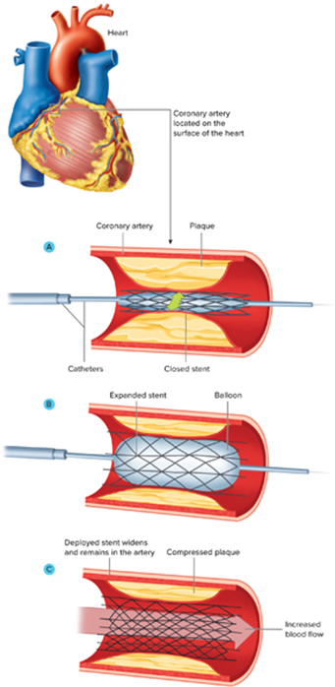
Stent
Tube of metal matrix
Helps prevent restenosis.
Some have medication that also help prevent stenosis.
Long-term dual antiplatelet therapy (D A P T).
Access the text alternative for slide images.
Notes:
LO 14.7: Discuss treatment modalities for the cardiac patient.
-----
This illustration shows the expanded stent in place, holding back the plaque against the arterial walls.
Note: Restenosis occurs when an artery that was opened with a stent or angioplasty becomes narrowed again. This phenomenon is due to vessel remodeling/recoil in case of no-stent strategy or regrowth of the intimal layer of the artery.
https://www.ncbi.nlm.nih.gov/pmc/articles/PMC5107494/

Slide 45
Coronary Artery Bypass Graft (C A B G) Surgery
Performed under anesthesia.
Patient placed on heart-lung machine.
Graft performed to reestablish blood flow.
Internal mammary artery.
Greater saphenous vein.
Notes:
LO 14.7: Discuss treatment modalities for the cardiac patient.
-----
When coronary angiography reveals extensive coronary artery disease or disease in the left main coronary artery, CABG is often performed to reestablish blood flow.
Disease of the left coronary artery is dangerous and requires immediate intervention, because it can lead to cardiogenic shock and sudden death by “widow maker.”

Slide 46
Left Ventricular Assist Device
Mechanical, battery-powered device.
Surgically implanted in the chest.
Helps pump blood throughout the body.
Uses
Severe (end-stage) heart failure.
People awaiting heart transplants.
Notes:
LO 14.7: Discuss treatment modalities for the cardiac patient.
-----
When coronary angiography reveals extensive coronary artery disease or disease in the left main coronary artery, CABG is often performed to reestablish blood flow.
Disease of the left coronary artery is dangerous and requires immediate intervention, because it can lead to cardiogenic shock and sudden death by “widow maker.”

Slide 47
Anticoagulants
Used to treat dysrhythmia or hypercoagulopathy.
Patients on anticoagulants are at high risk for bleeding and will bruise easily.
Coumadin (warfarin).
Decreases vitamin K activity.
Patients must take Coumadin at same time each day and have bleeding times checked on a regular basis.
Oral anticoagulants.
Patient must not have heart valve abnormalities.
Notes:
LO 14.7: Discuss treatment modalities for the cardiac patient.
-----
Patients on Coumadin therapy are given a restricted diet that limits the intake of foods high or moderately high in vitamin K, because a sudden increase in vitamin K reduces the effectiveness of the drug.
Patients on anticoagulants are at high risk for bleeding and will bruise easily

Slide 48
Enhanced External Counter Pulsation (E E C P) Therapy
Performed on patients with recurrent angina or patients unable to withstand major surgery.
Safe, non-invasive, well-tolerated procedure.
Inflatable pants are wrapped around the patient’s calves and upper and lower thighs.
Pants systematically inflate and deflate in coordination with the contraction and relaxation phases of the heart.
Notes:
LO 14.7: Discuss treatment modalities for the cardiac patient.
-----
EECP is noninvasive and well-tolerated.
The purpose of EECP is to increase intravascular pressure to promote the growth of new collateral blood vessels to bypass a blockage.
Each treatment lasts 1 hour per day. Treatments are given 5 days per week for 7 weeks.

Slide 49
Learning Outcome 14.7 Apply Your Knowledge 1
What item is used to help prevent restenosis after angioplasty has been used to open a coronary blood vessel?
Notes:
LO 14.7: Discuss treatment modalities for the cardiac patient.
-----

Slide 50
Learning Outcome 14.7 Apply Your Knowledge 2
What item is used to help prevent restenosis after angioplasty has been used to open a coronary blood vessel?
Answer:
A stent, with or without a medication that also helps prevent restenosis.
Notes:
LO 14.7: Discuss treatment modalities for the cardiac patient.
-----

Slide 51
Chapter Summary 1
The coronary arteries are responsible for supplying oxygen and nutrients to the heart muscle.
Coronary arteries have three layers: tunica adventitia, tunica media, and tunica intima.
All chest pain is considered cardiac until proven otherwise.
Anginal symptoms indicate the heart is not receiving enough oxygen.
Unstable angina indicates that angina has gotten worse.
Notes:
LO 14.1: Describe the structure and location of arteries, including the coronary arteries.
LO 14.2: Describe typical cardiac symptoms and unstable angina.

Slide 52
Chapter Summary 2
Women, diabetics, and elderly patients may have atypical symptoms of acute coronary syndrome.
S T E M I is the classic M I and occurs 75% to 80% of the time.
N S T E M I patients may be asymptomatic.
Heart failure occurs when the heart muscle is injured and is unable to pump effectively.
Left and right heart failure have different effects on the body.
Notes:
LO 14.3: Summarize atypical patient types and presentation.
LO 14.4: Compare ST segment elevation and non-ST segment elevation.
LO 14.5: Explain heart failure.

Slide 53
Chapter Summary 3
O-P-Q-R-S-T and S-A-M-P-L-E are common memory tools used to gather information from cardiac patients so medical care can be delivered immediately.
Interventional procedures such as angioplasty, stenting, and C A B G may be required in certain circumstances.
Other treatments include fibrinolytic therapy, anticoagulant therapy, or E E C P, depending on the patient’s diagnosis and state of health.
Notes:
LO 14.6: Identify assessment and immediate treatment needed for the cardiac patient.
LO 14.7: Discuss treatment modalities for the cardiac patient.

