Slide 1

CHAPTER 15
BASIC 12 LEAD ECG INTERPRETATION

Slide 2
The Views of a Standard 12 Lead E C G and Major Vessels
Leads V3 and V4
Views anterior wall of left ventricle.
Left coronary artery, left anterior descending branch.
Leads 1, aVL, V5, and V6
Views lateral wall of left ventricle.
Left coronary artery, left circumflex and diagonal branches.
Notes:
LO 15.1 Discuss the anatomical views represented on a 12-lead ECG and the coronary artery that commonly supplies each region of tissue.
-----

Slide 3
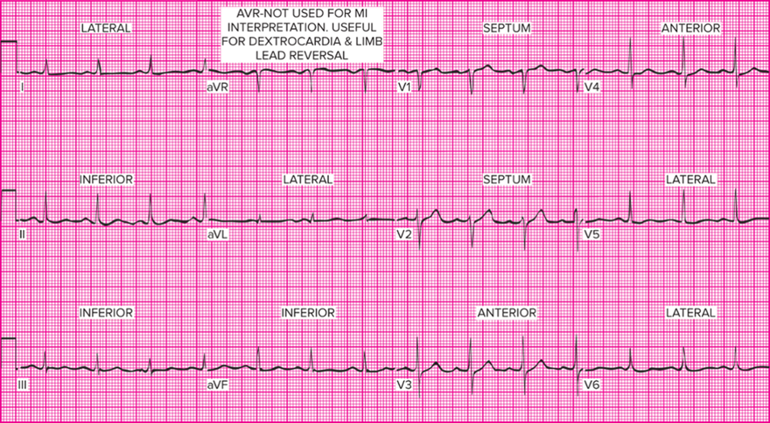
Typical 12 Lead E C G
Access the text alternative for slide images.
Notes:
LO 15.1 Discuss the anatomical views represented on a 12-lead ECG and the coronary artery that commonly supplies each region of tissue.
-----
This 12-lead tracing is labeled with the parts of the heart “viewed” by each lead.

Slide 4
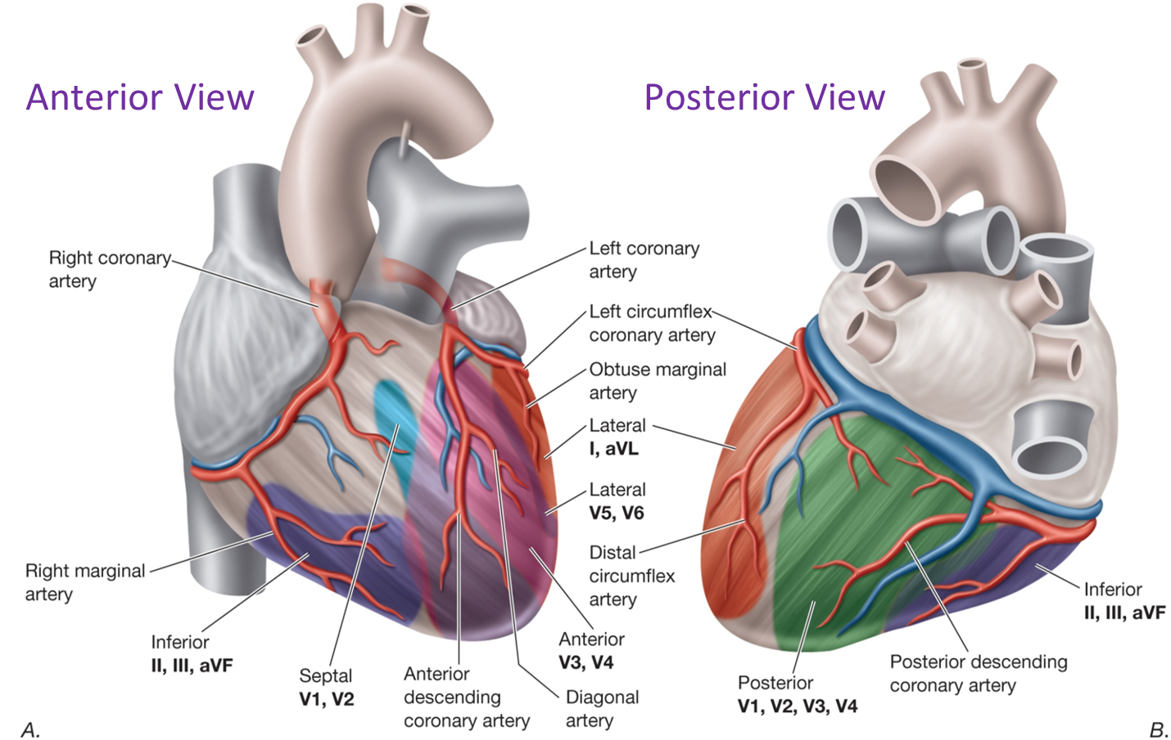
Coronary Arteries Viewed in 12 Lead E C G
Access the text alternative for slide images.
Notes:
LO 15.1 Discuss the anatomical views represented on a 12-lead ECG and the coronary artery that commonly supplies each region of tissue.
-----
Each lead views the electrical activity of different parts of the left ventricle. The shaded areas in this illustration show the areas viewed in each lead.

Slide 5
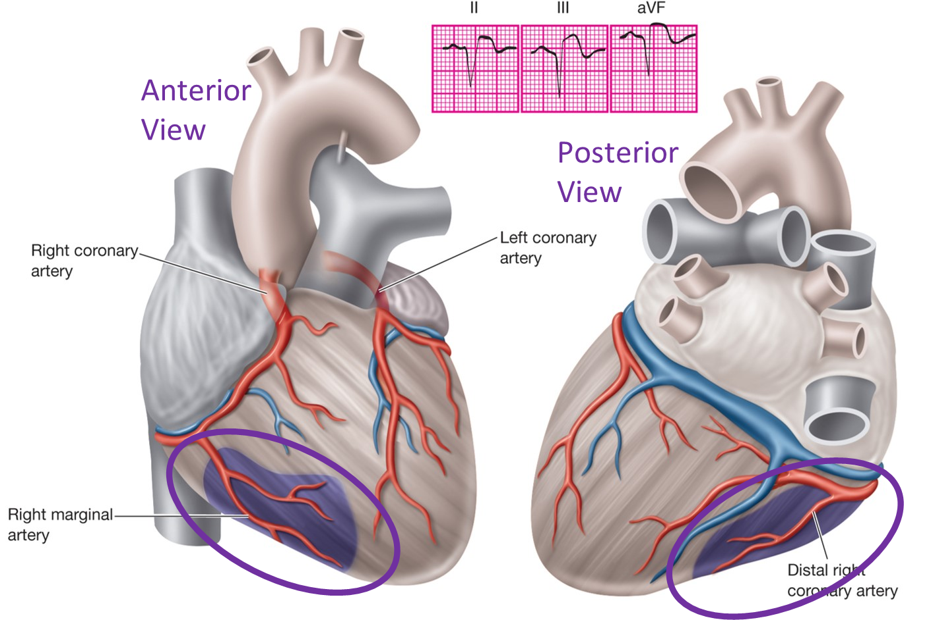
Inferior Infarction
Access the text alternative for slide images.
Notes:
LO 15.1 Discuss the anatomical views represented on a 12-lead ECG and the coronary artery that commonly supplies each region of tissue.
-----
An inferior infarction affects the tissue shown in purple and is caused by occlusion or partial occlusion of the right marginal or distal right coronary artery.
This damage is best seen in leads II, III, and aVF.

Slide 6
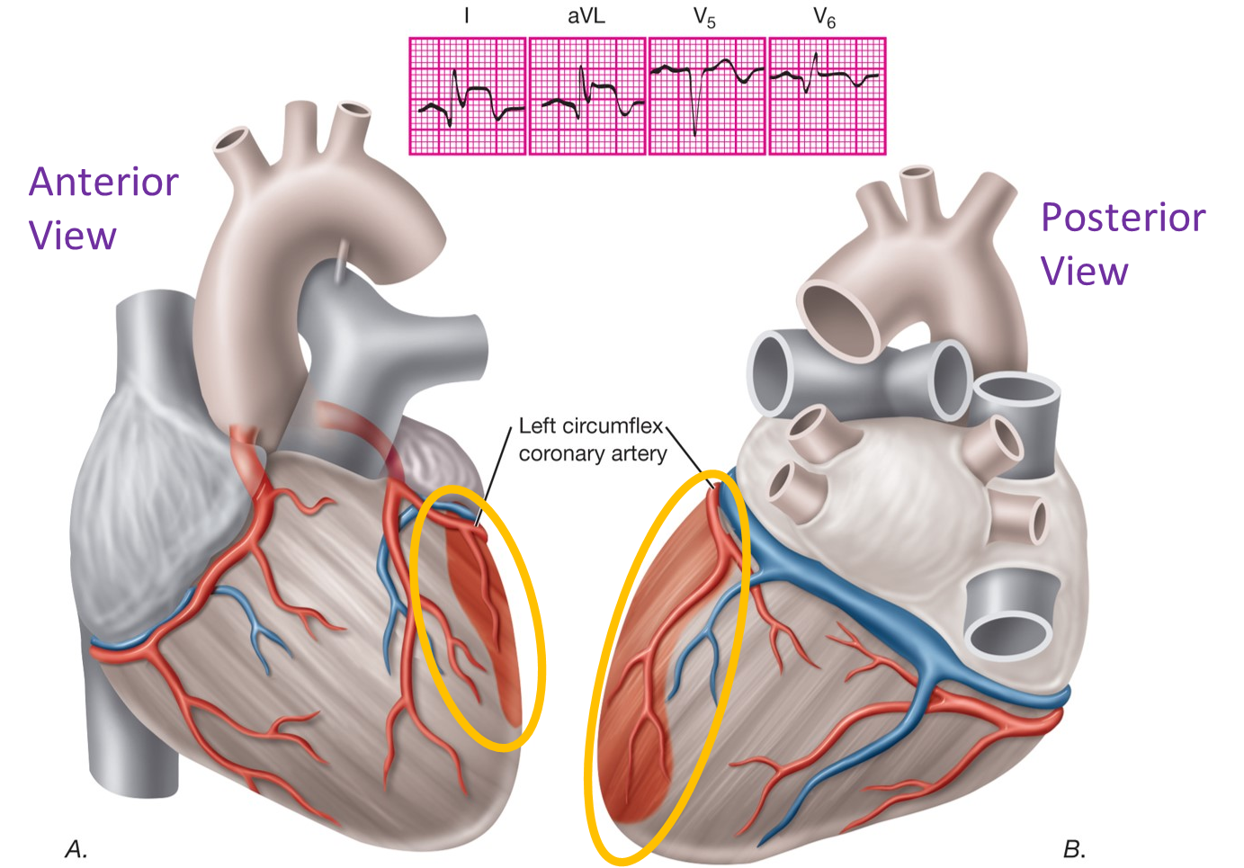
Lateral Infarction
Access the text alternative for slide images.
Notes:
LO 15.1 Discuss the anatomical views represented on a 12-lead ECG and the coronary artery that commonly supplies each region of tissue.
-----
A lateral infarction affects the tissue shown in orange and is caused by occlusion or partial occlusion of the circumflex branch of the left coronary artery.
This damage is best seen in leads I, aVL, V5, and V6.

Slide 7
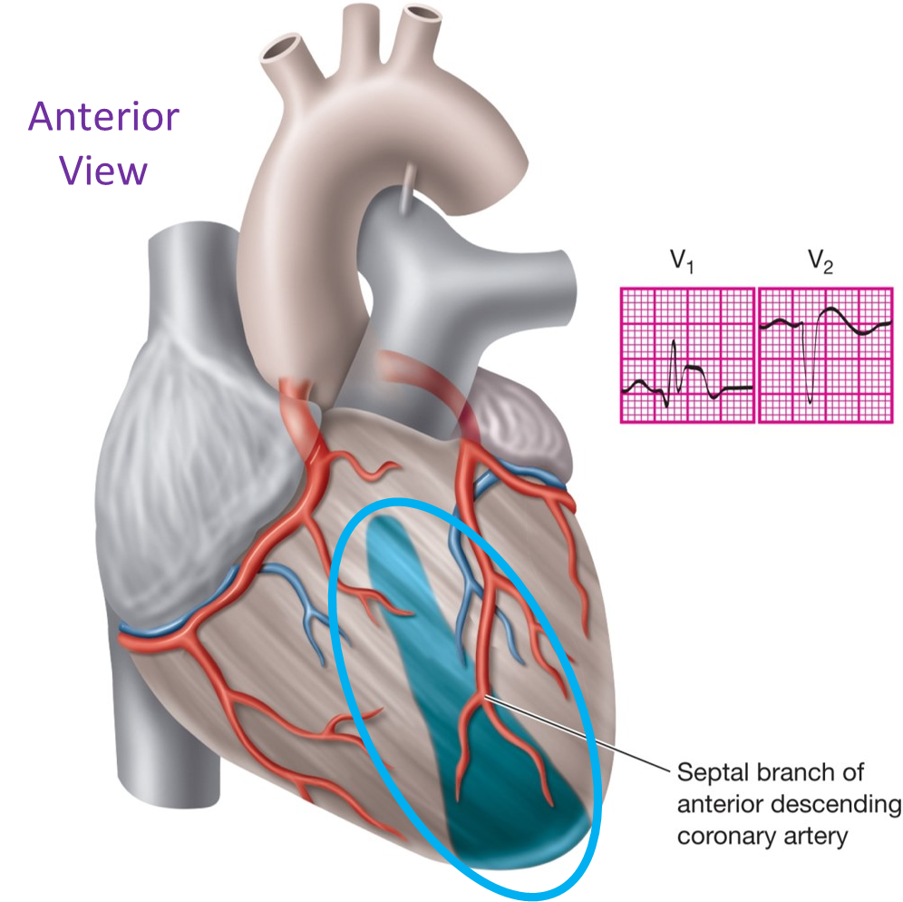
Septal Infarction
Access the text alternative for slide images.
Notes:
LO 15.1 Discuss the anatomical views represented on a 12-lead ECG and the coronary artery that commonly supplies each region of tissue.
-----
A septal infarction affects the tissue shown in blue and is caused by occlusion or partial occlusion of the septal branch of the anterior descending coronary artery.
This damage is best seen in leads V1 and V2.

Slide 8
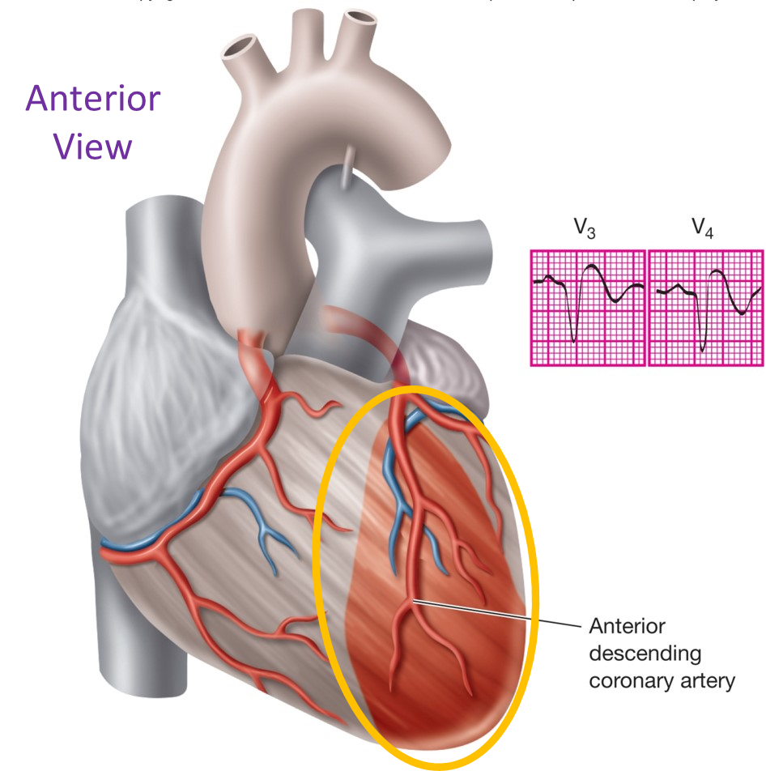
Anterior Infarction
Access the text alternative for slide images.
Notes:
LO 15.1 Discuss the anatomical views represented on a 12-lead ECG and the coronary artery that commonly supplies each region of tissue.
-----
A septal infarction affects the tissue shown in blue and is caused by occlusion or partial occlusion of the septal branch of the anterior descending coronary artery.
This damage is best seen in leads V1 and V2.

Slide 9
Learning Outcome 15.1
Apply Your Knowledge 1
The standard 12-lead E C G focuses directly on what part of the heart?
Notes:
LO 15.1 Discuss the anatomical views represented on a 12-lead ECG and the coronary artery that commonly supplies each region of tissue.
-----

Slide 10
Learning Outcome 15.1
Apply Your Knowledge 2
The standard 12-lead E C G focuses directly on what part of the heart?
Answer:
The left ventricle
Notes:
LO 15.1 Discuss the anatomical views represented on a 12-lead ECG and the coronary artery that commonly supplies each region of tissue.
-----

Slide 11
Anatomically Contiguous Leads
Two or more leads looking at same part of heart:
2, 3, aVF.
1, aVL.
Numerically consecutive chest leads:
V1, V2, V3, V4, V5, V6.
Notes:
LO 15.2: Identify common morphologic changes associated with ischemia, injury, and infarction.
-----

Slide 12
Five-Step Process for Basic Rhythm Interpretation
Step 1: Determine the E C G rhythm or regularity.
Step 2: Determine the atrial and ventricular rate.
Step 3: Identify the P wave morphology.
Step 4: Measure the P R interval.
Step 5: Measure the Q R S duration and analyze the configuration.
Notes:
LO 15.2: Identify common morphologic changes associated with ischemia, injury, and infarction.
-----
It is important to get into the habit of analyzing 12-lead ECGs the same way every time. This will help you avoid missing a step and possibly overlooking an important clue for interpretation.

Slide 13
Ischemia, Injury, and Infarction
After performing the first 5 steps:
View the leads in groups.
Focus on ischemia, injury, and infarction.
Look for S T segment deviation in 2 or more anatomically contiguous leads:
Depression.
Elevation.
Notes:
LO 15.2: Identify common morphologic changes associated with ischemia, injury, and infarction.
-----
Ischemia, injury, and infarction form a dangerous continuum of worsening cardiac conditions. The longer the blood flow to the myocardial tissue is interrupted, the worse the condition becomes.

Slide 14
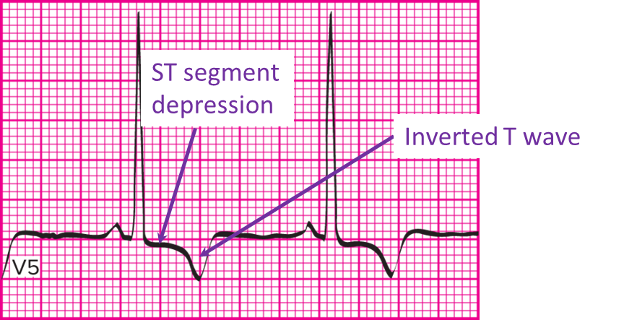
Myocardial Ischemia
S T segment depression of 1 mm or more.
Possible T wave inversion.
Occurs when blood flow to the myocardium is decreased for a short time.
Access the text alternative for slide images.
Notes:
LO 15.2: Identify common morphologic changes associated with ischemia, injury, and infarction.
-----
Remember that ST segment deviation must be seen in two or more anatomically contiguous leads.
This illustration shows ST segment depression of 1 mm and an inverted T wave, indications of myocardial ischemia.

Slide 15
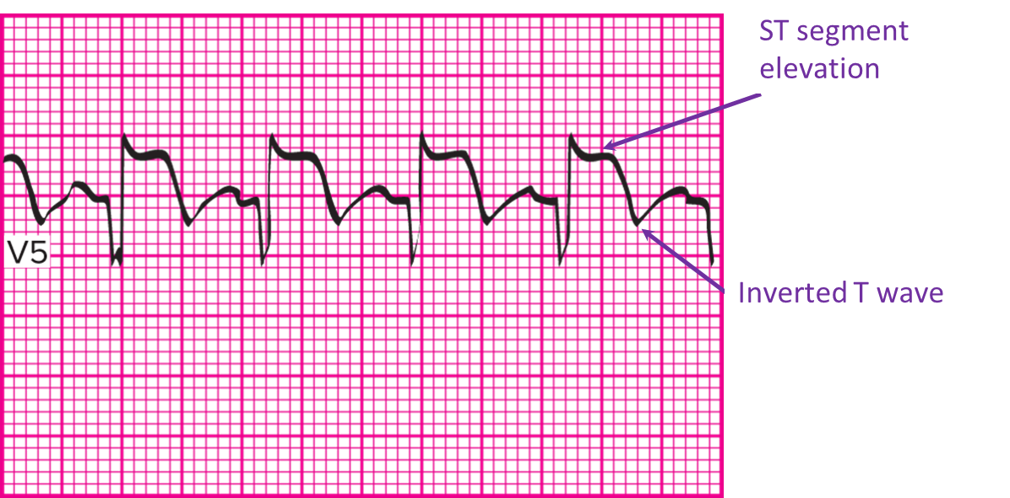
Myocardial Injury
S T segment elevation of 1 mm or more.
T wave inversion.
Occurs when blood flow to the myocardium is decreased for a longer time.
Access the text alternative for slide images.
Notes:
LO 15.2: Identify common morphologic changes associated with ischemia, injury, and infarction.
-----
Remember that ST segment deviation must be seen in two or more anatomically contiguous leads.
This illustration shows ST segment elevation of 3 to 4 mm and an inverted T wave, indications of myocardial injury.
Not all instances of ST segment elevation are indicative of myocardial injury, but ST segment elevation of any kind must always be reported.

Slide 16
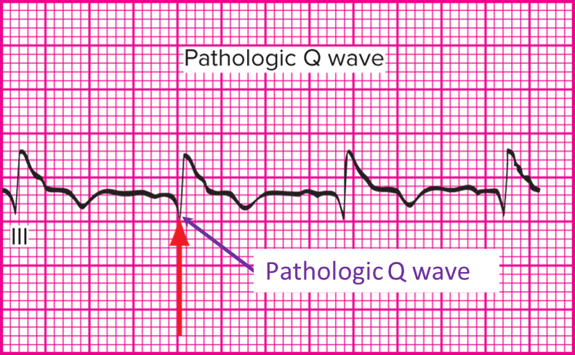
Myocardial Infarction 1
S T segment elevation of 1 mm or more.
T wave inversion.
Occurs when blood flow to the myocardium is decreased for a longer time.
Access the text alternative for slide images.
Notes:
LO 15.2: Identify common morphologic changes associated with ischemia, injury, and infarction.
-----
Like ST segment deviation, the pathologic Q wave must be seen in two or more anatomically contiguous leads.
This illustration shows a pathologic Q wave, which indicates myocardial death or infarction. A pathologic Q wave is one that measures 0.04 second or wider and Notice that the Q wave is almost half the height of the R wave.
In contrast, a physiologic Q wave is a normal one that measures less than 0.4 second and is less than 1/3 the height of the R wave in that lead.
.

Slide 17
Myocardial Infarction 2
Factors that determine seriousness:
Which coronary arteries are involved.
Location and extent of infarction.
Vital structures involved.
Time.
Remember that evidence of myocardial ischemia, injury, or infarction must be seen in at least two anatomically contiguous leads.
Notes:
LO 15.2: Identify common morphologic changes associated with ischemia, injury, and infarction.
-----

Slide 18
Learning Outcome 15.2
Apply Your Knowledge 1
What might you suspect if two or more anatomically contiguous leads show an elevated S T segment and an inverted T wave?
Notes:
LO 15.2: Identify common morphologic changes associated with ischemia, injury, and infarction.
-----

Slide 19
Learning Outcome 15.2
Apply Your Knowledge 2
What might you suspect if two or more anatomically contiguous leads show an elevated S T segment and an inverted T wave?
Answer:
Myocardial injury
Notes:
LO 15.2: Identify common morphologic changes associated with ischemia, injury, and infarction.
-----

Slide 20
Bundle Branch Block Dysrhythmias: Criteria 1
Specific characteristics of left or right B B B identifiable in leads V1 to V6.
Lead V1 used to distinguish L B B B and R B B B.
Majority of ventricular depolarization positively deflected = R B B B.
Majority of ventricular depolarization negatively deflected = L B B B.
Notes:
LO 15.4: Analyze bundle branch block and its effect on the patient, including basic patient care and treatment.
-----

Slide 21
Bundle Branch Block Dysrhythmias: Criteria 2
Rhythm
May be regular or irregular.
Depends on underlying rhythm.
Rate: Atrial and ventricular rates depend on basic rhythm.
P wave morphology: Morphology, deflection, and coordination with Q R S depend on basic rhythm.
P R interval: Within normal range of 0.12 to 0.20 second.
Notes:
LO 15.4: Analyze bundle branch block and its effect on the patient, including basic patient care and treatment.
-----
Although the P wave morphology will vary, the P wave will always be present if the rhythm initiates above the ventricles.

Slide 22
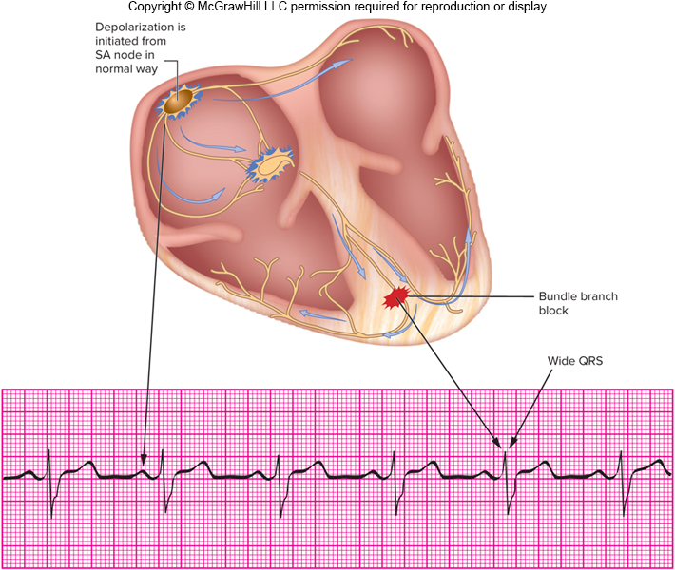
Bundle Branch Block Dysrhythmias: Criteria 3
Q R S duration: 0.12 second or greater
Access the text alternative for slide images.
Notes:
LO 15.4: Analyze bundle branch block and its effect on the patient, including basic patient care and treatment.
-----
The underlying rhythm shown here is normal sinus rhythm. Notice that the P waves are present, but the QRS complexes measure 0.14 second, indicating bundle branch block.

Slide 23
Bundle Branch Blocks: What You Should Know
Patient exhibits normal effects of basic rhythm.
Widening of Q R S complex must be reported to a licensed practitioner immediately.
Bundle branch block is not considered life-threatening.
Condition can deteriorate to complete heart block.
May require pacemaker or emergency cardiac care.
Notes:
LO 15.4: Analyze bundle branch block and its effect on the patient, including basic patient care and treatment.
-----
If the current becomes completely blocked in both bundle branches, this is considered a complete heart block.

Slide 24
Learning Outcome 15.3
Apply Your Knowledge 1
Describe the appearance of the Q R S complexes in bundle branch block.
Notes:
LO 14.5: Explain heart failure.
-----

Slide 25
Learning Outcome 15.3
Apply Your Knowledge 2
Describe the appearance of the Q R S complexes in bundle branch block.
Answer:
Wide Q R S complexes with a 0.12 second or greater duration
Notes:
LO 15.3: Analyze bundle branch block and its effect on the patient, including basic patient care and treatment.
-----

Slide 26
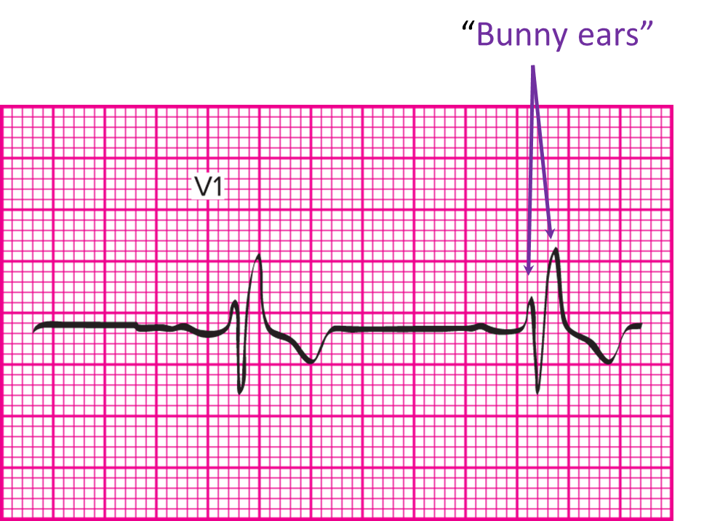
Right Bundle Branch Block (R B B B)
Q R S is positively deflected.
Classic R S R pattern in V1.
Access the text alternative for slide images.
Notes:
LO 15.4: Differentiate between left and right bundle branch blocks and how they relate to the 12-lead ECG.
-----
The RSR pattern in RBBB gives the appearance of “bunny ears,” so RBBB is sometimes called “bunny branch block.”

Slide 27
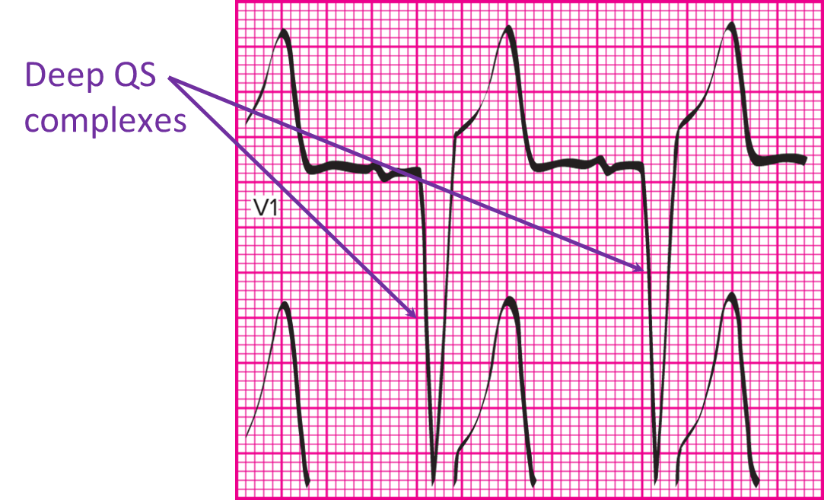
Left Bundle Branch Block (L B B B)
Q S complex or negative Q R S.
Access the text alternative for slide images.
Notes:
LO 15.4: Differentiate between left and right bundle branch blocks and how they relate to the 12-lead ECG.
-----
Deep QS complexes with no R wave are an indication of LBBB.

Slide 28
Determining Bundle Branch Block
P wave is present.
Q R S complex is 0.12 second or greater.
Notes:
LO 15.4: Differentiate between left and right bundle branch blocks and how they relate to the 12-lead ECG.
-----
The presence of the P wave indicates atrial activity, which rules out a dysrhythmia of ventricular origin.
Interpretation should include the underlying rhythm with comment on ventricular conduction delay or simply “wide” QRS

Slide 29
Learning Outcome 15.4
Apply Your Knowledge 1
Which lead is referenced to distinguish between right and left bundle branch blocks?
Notes:
LO 15.4: Differentiate between left and right bundle branch blocks and how they relate to the 12-lead ECG.
-----

Slide 30
Learning Outcome 15.4
Apply Your Knowledge 2
Which lead is referenced to distinguish between right and left bundle branch blocks?
Answer:
Lead V1
Notes:
LO 15.4: Differentiate between left and right bundle branch blocks and how they relate to the 12-lead ECG.
-----

Slide 31
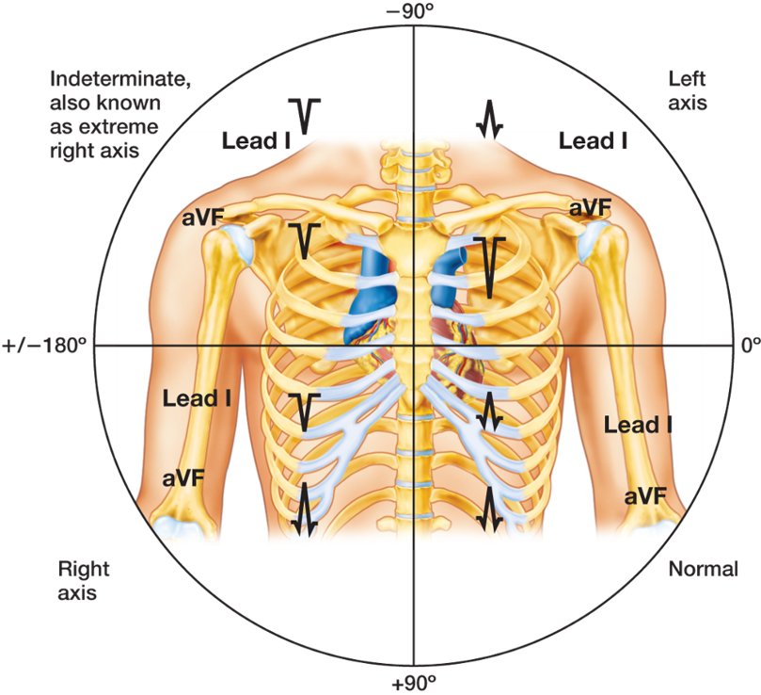
Electrical Axis Deviation
Changes that occur on 12-lead E C G due to position of patient’s heart.
Heart location affects deflection of Q R S complexes.
Access the text alternative for slide images.
Notes:
LO 15.5: Define axis deviation and the steps utilized to determine the presence of axis deviation.
-----
The normal location of the majority of the human heart is in the lower left quadrant of the chest.

Slide 32
Causes of Left Axis Deviation
Left ventricular hypertrophy.
Pregnancy.
Obesity.
Emphysema.
Hyperkalemia.
Notes:
LO 15.5: Define axis deviation and the steps utilized to determine the presence of axis deviation.
-----
Left axis deviation is the most common type of electrical axis deviation.

Slide 33
Causes of Right Axis Deviation
Right ventricular hypertrophy.
Anterolateral wall M I.
Right axis deviation is considered normal in children and tall, thin adults.
Notes:
LO 15.5: Define axis deviation and the steps utilized to determine the presence of axis deviation.
-----

Slide 34
Extreme Right Axis Deviation
Situs transversus or dextrocardia: Heart is on the right side of chest.
Pacemaker rhythms.
C O P D patients.
Hyperkalemia.
Extreme right axis deviation may also indicate lead reversal.
Notes:
LO 15.5: Define axis deviation and the steps utilized to determine the presence of axis deviation.
-----
If the tracing shows extreme right axis deviation, double-check lead placement to rule out simple lead reversal.

Slide 35
Determining the Presence of Axis Deviation
Step | Lead 1 | Lead aV F | Axis Deviation
Step 1 | Positive | Positive | None (normal axis)
Step 2 | Positive | Negative | Left axis deviation
Step 3 | Negative | Positive | Right axis deviation
Step 4 | Negative | Negative | Extreme right axis deviation
Notes:
LO 15.5: Define axis deviation and the steps utilized to determine the presence of axis deviation.
-----
Refer to leads I and aVF to determine axis deviation. If either of these leads has a predominantly negative ventricular depolarization, the electrical axis is considered abnormal.

Slide 36
Learning Outcome 15.5
Apply Your Knowledge 1
To which leads should you refer when determining the presence of axis deviation?
Notes:
LO 15.5: Define axis deviation and the steps utilized to determine the presence of axis deviation.
-----

Slide 37
Learning Outcome 15.5
Apply Your Knowledge 2
To which leads should you refer when determining the presence of axis deviation?
Answer:
Leads 1 and aV F
Notes:
LO 15.5: Define axis deviation and the steps utilized to determine the presence of axis deviation.
-----

Slide 38
Learning Outcome 15.6
Left Ventricular Hypertrophy
Abnormal thickening of ventricular wall:
The wall thickens due to chronic pressure overload.
Q R S complex shows greater amplitude:
Taller and deeper ventricular depolarization waves.
Notes:
LO 15.6: Describe left ventricular hypertrophy (LVH) and the steps to determine the presence of LVH.
-----
Chronically high peripheral vascular resistance forces the heart to work harder to maintain normal cardiac output. Over time, the harder work results in thicker muscle mass. The thicker muscle mass of the hypertrophic ventricle generates more electricity, which accounts for the greater amplitude.

Slide 39
Determining Left Ventricular Hypertrophy: Step 1
Refer to V1 and V2.
Select the deeper of the 2 views.
Measure from the isoelectric line down to the tip of the deepest Q S complex and count the millimetres.
Write this number down.
Notes:
LO 15.6: Describe left ventricular hypertrophy (LVH) and the steps to determine the presence of LVH.
-----

Slide 40
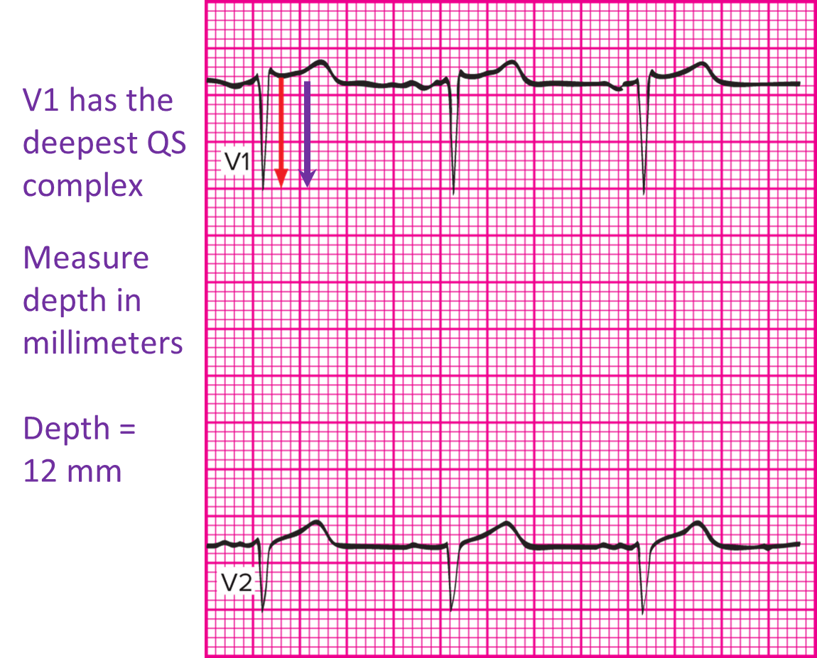
Step 1 Example
Access the text alternative for slide images.
Notes:
LO 15.6: Describe left ventricular hypertrophy (LVH) and the steps to determine the presence of LVH.
-----

Slide 41
Determining Left Ventricular Hypertrophy: Step 2
Refer to V5 and V6.
Measure and select the taller of the 2 views.
Measure from the isoelectric line to tip of tallest R wave and count the millimeters.
Write the number down.
Notes:
LO 15.6: Describe left ventricular hypertrophy (LVH) and the steps to determine the presence of LVH.
-----

Slide 42
Determining Left Ventricular Hypertrophy: Step 3
Add the two numbers together.
If the sum is 35 mm or more, clinically you would suspect left ventricular hypertrophy.
Notes:
LO 15.6: Describe left ventricular hypertrophy (LVH) and the steps to determine the presence of LVH.
-----

Slide 43
Step 3 Example
In our example:
12 mm + 24 mm = 36 mm
36 mm is more than 35 mm, so you must suspect left ventricular hypertrophy.
Notes:
LO 15.6: Describe left ventricular hypertrophy (LVH) and the steps to determine the presence of LVH.
-----

Slide 44
Learning Outcome 15.6
Apply Your Knowledge 1
When totalled, how many millimeters is the minimum necessary to clinically suspect left ventricular hypertrophy?
Notes:
LO 15.6: Describe left ventricular hypertrophy (LVH) and the steps to determine the presence of LVH.
-----

Slide 45
Learning Outcome 15.6
Apply Your Knowledge 2
When totalled, how many millimeters is the minimum necessary to clinically suspect left ventricular hypertrophy?
Answer:
35 mm
Notes:
LO 15.6: Describe left ventricular hypertrophy (LVH) and the steps to determine the presence of LVH.
-----

Slide 46
Chapter Summary 1
The leads of a 12-lead E C G provide 12 different “pictures” of the heart’s electrical activity, focusing on the left ventricle.
S T segment depression of 1 mm or more with possible T wave inversion indicates myocardial ischemia.
S T segment elevation of 1 mm or more with T wave inversion indicates myocardial injury.
A pathologic Q wave indicates tissue death or M I.
It is important to follow the same steps in the same order each time you interpret an E C G tracing.
Notes:
LO 15.1: Discuss the anatomical views represented on a 12-lead ECG and the coronary artery that commonly supplies each region of tissue.
LO 15.2: Identify common morphologic changes associated with ischemia, injury, and infarction.

Slide 47
Chapter Summary 2
Bundle branch blocks occur when one or both ventricular pathways are damaged due to cardiac disease, drugs, or other conditions.
Bundle branch blocks prevent current from traveling to one or both ventricles.
Left bundle branch block can be distinguished from right bundle branch block by viewing lead V1.
L B B B presents with a P wave and a Q S complex 0.12 second or more.
Notes:
LO 15.3: Analyze bundle branch block and its effect on the patient including basic patient care and treatment.
LO 15.4: Differentiate between left and right bundle branch blocks and how they relate to the 12-lead ECG.
LO 15.5: Define axis deviations and the steps utilized to determine the presence of axis deviation.
LO 15.6: Describe left ventricular hypertrophy (LVH) and the steps to determine the presence of LVH.

Slide 48
Chapter Summary 3
R B B B presents with a P wave and a R wave that has 2 points and a Q S complex of 0.12 second or more.
Electrical deviation causes changes in the E C G due to the position of the heart in the patient’s chest.
Left ventricular hypertrophy is a thickening of the ventricular wall due to pumping against increased vascular resistance.

