Slide 1
Chapter 36
Emergency Preparedness and Protective Practices

Slide 2
Introduction to Disaster and Emergency Planning
Possibility of a disaster or serious emergency at health care facility
May cause damage and/or threaten employees, patients, buildings
May cause harm or inability provide usual services

Slide 3
Introduction to Disaster and Emergency Planning (Cont.)
Organizations must plan ahead to:
Minimize damage
Facilitate recovery
So that services can be restored as efficiently as possible
Notes:
Why is disaster planning important for the medical office? (Planning can minimize damage and help restore services more efficiently.)

Slide 4
Categories of Disasters
Hazards are categorized as natural or man-made
Natural disaster:
Results from a natural hazard
Examples: volcanoes, tornados, earthquakes, hurricanes
Causes significant damage to the environment
Leads to environmental, financial, and human losses
Notes:
How are hazards broadly categorized? (Natural or man-made.)

Slide 5
Categories of Disasters (Cont.)
Man-made disaster
Refers to serious damage either directly or indirectly caused by:
Intentional or negligent human actions
Failure of a man-made system
Examples: fire, structural collapse, terrorism

Slide 6
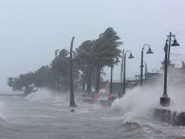
Natural Disasters
May occur with or without warning
Earthquakes: usually occur without warning
Hurricanes: develop over a period of days
Allows for some preparation

Slide 7
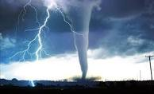
Natural Disasters (Cont.)
Must prepare when a hurricane or tornado is in the area
Exact track of the storm is difficult to predict
Medical office employees must be educated
About the response to take to the types of natural disasters
That tend to occur in their geographic area

Slide 8

Man-made Disasters
Amount of threat or damage from man-made hazards
Can vary considerably – examples
Fire in a wastebasket
Gunman
Bomb threat
Radiation incident

Slide 9
Man-made Disasters (Cont.)
Types of man-made hazards:
Crime
Fire
Terrorism
Industrial hazards
Structural collapse
Power outage
Radiation hazards
Chemical contamination
Notes:
What entity responds to industrial hazards, chemical contamination, and threats of radioactivity? (The National Response Center of the Environmental Protection Agency.)

Slide 10
Psychological Effects of Emergencies
Positive reaction to an emergency
Triggering of resources to meet the challenges
Negative reaction to an emergency
Often occurs when physical and emotional resources are depleted
Notes:
What are examples of individuals reacting positively to emergency situations? (Authorities and volunteers mobilizing to fill sandbags in response to a flood.)

Slide 11
Psychological Effects of Emergencies (Cont.)
Disasters that cause the most serious psychological effects are those that:
Occur without warning
Pose a serious threat to personal safety or have unknown health effects
Have an uncertain duration
Result from malicious intent or human error
Involve a symbol (such as the 9/11 attacks)
Notes:
Name some characteristics of disasters more likely to cause serious psychological effects (Disasters that occur without warning, threats to personal safety or unknown health effects, hazards of unknown duration, disasters caused by malice or human error, disasters with a symbolic significance.)

Slide 12
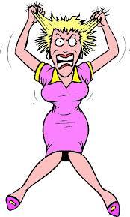
The Stress Response
Stress: The body's response to threat or change
Body’s response to stress: general adaptation syndrome (GAS)
Notes:
What is another name for general adaptation syndrome (GAS)? (The "fight or flight" response.)
What are the four stages of GAS? (The alarm reaction, the stage of resistance, the recovery phase, and the stage of exhaustion.)

Slide 13
The Stress Response (Cont.)
Alarm phase
Body senses a stress and begins to react
Epinephrine is released, which stimulates the sympathetic nervous system
Pupils dilate
Heart beats faster
Respirations become faster and deeper
Blood pressure rises
Body prepares to fight or run away
Individual’s attention becomes narrowly focused on the perceived threat
Notes:
What is the body's response to threat in the alarm reaction stage (stage 1)? (Increased production of adrenal hormones.)

Slide 14
The Stress Response (Cont.)
Resistance phase
Stress remains, but the body adapts
May occur within hours or days
Levels of adrenal hormones may
Remain slightly high
Drop back to normal
Recovery or Exhaustion phase
Parasympathetic system begins to regain control
Body returns to normal level of function
Notes:
What is the body's response to threat in the resistance stage (stage 2)? (The body adapts and adrenal hormone levels return to normal or slightly above normal.)

Slide 15
The Stress Response (Cont.)
If stress persists causes:
Increase in blood pressure
Elevated glucose level
Increased metabolism
Increased pressure within the eye
Leads to fatigue, hunger, and headaches
Notes:
What is the name of the stage in which stress remains and the body can no longer cope? (Stage 3, Exhaustion.)
What are the body's physical reactions to persistent stress? (Fatigue, hunger, headaches.)

Slide 16
The Stress Response (Cont.)
Chronic stress
Body is unable to maintain the response
Immune system is compromised
Individual is more prone to a variety of illnesses

Slide 17
Managing Anxiety
Anxiety: normal part of the "fight or flight response"
Anxiety: A feeling of worry or uneasiness, often triggered by an event with an uncertain outcome
Individual who is moderately to severely anxious
Not able to notice details
Not able to think as clearly
Emergency procedures that have been learned and practiced
Keep anxiety level from rising
Notes:
How do practiced response procedures help to reduce the effects of anxiety? (Learned procedures help individuals decide what to do without having to think through all the possibilities, and people feel more confident when they have a plan to respond to a threat.)
What are the symptoms of a full-blown anxiety attack? (Hyperventilation, rapid heart rate, unresponsiveness, loss of control of emotions.)

Slide 18
Managing Anxiety
Severe anxiety in an emergency situation
Tends to immobilize an individual
Stimulates anxiety in others
Symptoms of an anxiety attack:
Hyperventilation
Rapid heart rate
Unresponsive
Assist highly anxious person
Give the anxious person directions in short sentences
Help person to breathe deeply
Direct the person where to go if: a dangerous area must be evacuated; the person should take cover
Notes:
What interventions can help alleviate moderate anxiety, severe anxiety, and panic? (Maintaining a calm manner, encouraging slow, deep breaths, providing a quiet area for the patient.)
See Figure 36-6 to see the levels of anxiety.

Slide 19
Emergency Action Plan
Required by OSHA for almost all businesses
Must include:
Means of reporting fires and other emergencies
Evacuation procedures and emergency escape routes
Notes:
Emergency preparedness is the process of making plans to prevent, respond, and recover from an emergency situation.
What federal agency requires most businesses to have a formal emergency action plan? (The Occupational Safety and Health Administration [OSHA].)

Slide 20
Emergency Action Plan (Cont.)
Must include:
Procedures for employees who remain
For critical operations that need to be completed
A way to account for all employees after evacuation
Designation of rescue and medical duties
Who to contact for additional information or clarification
Notes:
Why do you think having a formal emergency action plan is important? (Planning can minimize damage, facilitate the efficient restoration of services; having a plan helps people to decide what to do without having to think through all the possibilities; individuals feel more confident when they have a plan to respond to a threat.)

Slide 21
Emergency Action Plan (Cont.)
Components of an emergency action plan
Preferred mean of reporting fires and other emergencies
Dialing 911
Dialing internal emergency phone numbers
Activation of manual alarm system
Notes:
Would every emergency require 911? Why or why not?

Slide 22
Emergency Action Plan (Cont.)
Components of an emergency action plan
Emergency evacuation plan
Emergency evacuation procedures
Type of evacuation
Exit routes – an evacuation floor plan is necessary
Notes:
How would an exit route be marked on map?

Slide 23
Emergency Action Plan (Cont.)
Evacuation floor plan should include the following:
Employee’s current location
Primary and secondary exit routes
Manual fire alarm boxes
Portable fire extinguishes
Emergency exit doors
Notes:
Does your current room or building have an evacuation plan posted? What does it look like?
See Figure 36-7 to see an example of an evacuation floor plan.

Slide 24
Emergency Action Plan (Cont.)
Evacuation floor plan should include the following:
Wheelchair accessible exits
Shelter-in-place areas
Assembly areas

Slide 25
Emergency Action Plan (Cont.)
Components of an emergency action plan
Procedures for employees who remain behind to perform critical operations before evacuation
Procedures to account for all employees after an evacuation
Notes:
How would you determine which employees remain behind? What critical operations need to be considered?
How might you account for employees after an evacuation?

Slide 26
Emergency Action Plan (Cont.)
Components of an emergency action plan
Procedures for employees performing rescue or medical duties
Known as evacuation wardens
Individuals who can be contacted for further information under the plan

Slide 27
Lesson 36.2 Objectives
List and describe the elements of a fire.
State the five elements that must be included in a fire prevention plan.
Identify methods of fire prevention for the medical office.
List and describe safety measures used for fire protection in the medical office.

Slide 28
Lesson 36.2 Objectives (Cont.)
List and describe the five classes of fire.
Identify the steps included in the RACE response.
Identify the education and training that must be provided to medical assistants related to medical office emergency situations.

Slide 29
Lesson 36.2 Objectives (Cont.)
State the purpose of emergency practice drills.
Describe the role of the medical assistant in disasters and serious emergencies.

Slide 30
Fire Safety in the Medical Office
Common fire hazards in the medical office
Heating equipment that is:
Poorly maintained
Too close to flammable materials
Overloaded electrical circuits
Improper use of stoves or microwave ovens
Improper storage of oxygen
Cleaning supplies and other combustible materials
Notes:
What types of equipment should be inspected and maintained to reduce the risk of fire in the medical office? (Heating equipment, washers and dryers, electrical cords.)

Slide 31
Fire Safety in the Medical Office
Shipping boxes and other trash should be removed as soon as possible
To prevent build-up of flammable material
Important to avoid:
Using damaged electrical cords
Using extension cords
Overloaded plug strips
Notes:
How might you maintain the cords and wires in the medical office?

Slide 32
Fire Safety in the Medical Office (Cont.)
Inspect cords and plugs for fraying or cracking
Replace if damaged
Cords should not obstruct walkways
Pose a tripping hazard

Slide 33
Fuel Source
Fuel sources found in the medical office
Patient charts
Furniture
Drapes and rugs
Office equipment
Chemicals used for sterilization and disinfection
Laboratory testing chemicals
Trash
Notes:
How might you deal with each potential fuel source to prevent a fire emergency?

Slide 34
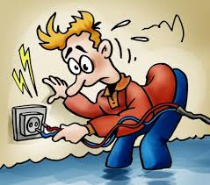
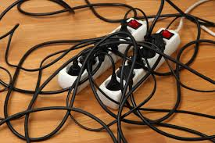
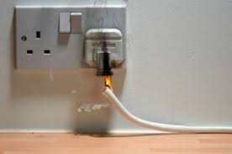
Ignition Source (Heat)
Common ignition sources in the medical office
Open flames
Faulty electrical equipment
Hot surface
Sparks
Notes:
Also discuss oxygen with students – the air around us has about a 21% oxygen content, and most fires only require an atmosphere of 16% to burn.
Many medical offices store oxygen in their facilities to administer to patients as necessary.
If something catches fire, oxygen will make the flame hotter and cause it to burn faster and more vigorously.

Slide 35
Components of a Fire Prevention Plan
Five elements (required by OSHA)
A list of all major fire hazards including:
Proper handling and storage of fire hazards
Potential ignition sources and controls
Types of fire protection equipment necessary
Notes:
A fire prevention plan is a written document that identifies flammable and combustible materials stored in the workplace and ways to control workplace fire hazards.

Slide 36
Components of a Fire Prevention Plan (Cont.)
Five elements (required by OSHA)
Procedures to control accumulation of flammable and combustible waste materials
Procedures for regular maintenance of safeguards installed on heat-producing equipment
Name/job title of employees responsible for maintaining equipment
Name/job title of employees responsible for control of fuel source hazards.
Notes:
Methods of fire prevention for the medical office are presented in Box 36-1.

Slide 37
Fire Protection in the Medical Office
Fire protection for an office building is the responsibility of:
Landlord
Office condominium association (if the units are condominiums)
Fire protection for the contents of the office
Responsibility of office staff

Slide 38
Fire Protection in the Medical Office (Cont.)
Many states require sprinklers in commercial and office buildings
No smoking signs should be clearly posted in the waiting area
Exits should be clearly marked
Post an emergency evacuation map near the door to the waiting room
Lighted exit signs should be tested by
Shutting off lights in the room
Notes:
How can lighted exit signs be tested? (Turning off the lights.)

Slide 39
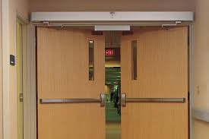
Fire Protection in the Medical Office (Cont.)
Large office or free-standing clinics
May have fire doors
Designed to contain fire on one side of the door from going into another area of the building
Never prop open
Notes:
What is the function of a fire door? (Fire doors contain the fire on one side of the door, preventing its spread to other areas of the building.)

Slide 40
Fire Protection in the Medical Office (Cont.)
Whenever possible: records should be stored in fire-resistant file cabinets
Smoke detector laws vary by state, in terms of:
How many must be in an office
Where they must be placed
Smoke detectors may be wired into the:
Security and safety alarm system
Sprinkler system
Notes:
What is the preferred method to backup computer files? (On a network, Internet system, or at another location.)

Slide 41
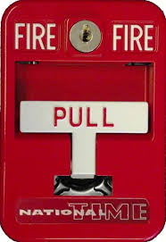
Fire Protection in the Medical Office (Cont.)
Fire alarm pull stations
Frequently located in building corridors
Alert entire building and notify fire department directly

Slide 42
Fire Protection in the Medical Office (Cont.)
If the office has battery-operated smoke detectors:
Test monthly
Change batteries every 6 months
Medical office should:
Have a fire safety plan
Provide training to all employees
Perform regular fire drills
According to local and/or state building codes
Notes:
How can you tell if batteries should be changed on battery-operated smoke detectors? (Press the test button on the device; batteries should be changed every 6 months, and the date should be noted on the detector.)

Slide 43
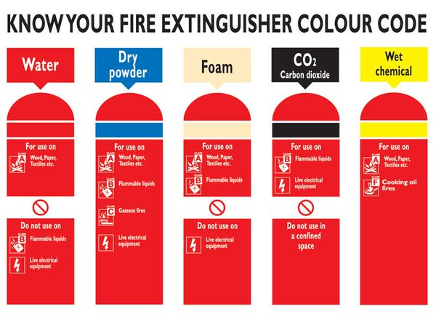
Fire Protection in the Medical Office (Cont.)
Classes of fire
Class A: ordinary combustibles
Class B: flammable liquids
Class C: electrical equipment
Class D: combustible metals
Class K: cooking media

Slide 44
Fire Protection in the Medical Office (Cont.)
Fire extinguisher: A portable device that discharges foam or another material to extinguish a fire
Position in each room near the exit
May also be located in the corridors of a large building
Important for:
Putting out small fires
Clearing an exit path from a room that is on fire
Extinguishers should be placed near the door
To prevent fire from getting between the person and the exit
Staff should be trained to use the fire extinguishers
Notes:
Why are fire extinguishers placed near the exit of each room? (So that the fire does not get between the person and the extinguisher, and so the person can clear a path out of an area that is on fire.)
Within what distance should extinguishers be located from flammable liquids stored in containers? (Within a 50-foot travel distance.)
Table 36-1 lists and describes the five fire classifications along with the type of extinguisher (by label) that can be used to extinguish each class of fire.

Slide 45
Fire Protection in the Medical Office (Cont.)
Activating a fire extinguisher:
Pull out the pin
Aim the nozzle at base of fire
To prevent fire from getting fuel
Squeeze handle slowly
Until the foam or other material is released
Sweep nozzle from side to side
To cover all parts of the fire until the fire is out
Notes:
See Procedure 36-1: Demonstrating Proper Use of a Fire Extinguisher.

Slide 46
Fire Protection in the Medical Office (Cont.)
Activating a fire extinguisher:
The person can move toward the fire as it gets smaller
Acronym to remember these steps:
PASS: Pull, Aim, Squeeze, Sweep
Notes:
What does the acronym PASS stand for? (Pull, Aim, Squeeze, Sweep.)

Slide 47
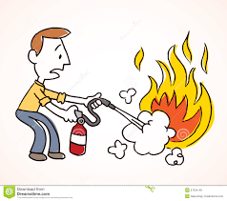
Emergency Response to a Fire
RACE: used to identify the steps in responding to a fire
Step 1: Rescue any person who is directly threatened by fire
Patient safety is always a first priority
Step 2: Activate the emergency response system
Using a fire pull alarm
Using the telephone to call 911
Notes:
What is the first priority when responding to a fire? (Patient safety is always a first priority.)
See Procedure 36-2: Participating in a Mock Exposure Event.

Slide 48
Emergency Response to a Fire (Cont.)
Step 3: Confine the fire by closing doors
Feel doors for heat
Do not open any door if:
It is warm
If you see smoke leaking out around the door frame
Turn off fans and air conditioners
Step 4: Extinguish the fire or Evacuate the area
If the fire is small: use a fire extinguisher
If the fire cannot be extinguished
Evacuate the area following the fire safety plan
Notes:
What signs indicate that you should not open a door in a fire emergency? (Feel the door for heat. Do not open a door if it is warm or if you see smoke around the door frame.)

Slide 49
Employee Education and Training
Employees must be oriented to the Emergency Action Plan
Training should be reviewed annually
Notes:
When are employees trained in emergency procedures? (During orientation to the facility, and usually annually.)

Slide 50
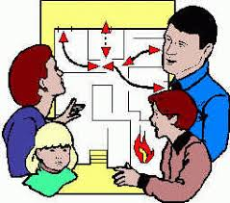
Employee Education and Training (Cont.)
Training must include:
Fire hazards of materials and processes used in the office
Example: use of oxygen
Evacuation plan
Alarm systems
Reporting procedures
Types of potential emergencies
Use of fire extinguishers

Slide 51
Emergency Practice Drills
May be required at specific intervals
Depends on:
Municipal or state laws for the type of building
Insurance requirements
Fire drills may be announced or unannounced
Reminds employees to review:
Emergency escape routes
Procedures to respond to a fire

Slide 52

Emergency Practice Drills (Cont.)
Simulated disaster drills
Often involve several community agencies
Allow participants to practice skills needed in a disaster
Allow organizations and communities to:
Evaluate the effectiveness of their systems
Identify potential weaknesses
Notes:
What are the reasons for involving multiple organizations and agencies in disaster drills? (This involvement allows communities to evaluate their disaster response systems and identify potential weaknesses.)

Slide 53
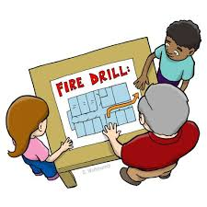
Medical Assistant’s Role
The medical assistant is an important team member in:
Developing and implementing the emergency action plan
Contributing to emergency preparedness in the community
Making recommendations to supplement emergency equipment
Serving on a committee to review or revise the emergency plan
Participating in all fire drills and disaster drills
Participating in the review of the effectiveness of the drill
Providing emergency first aid or CPR

Slide 54
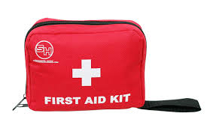
Medical Assistant’s Role (Cont.)
In an actual disaster, the MA may be responsible for:
Providing emergency first aid
Conducting patient interviews
Helping to calm victims
Documenting services provided
Notes:
How can medical assistants help in the event of a real disaster? (Provide emergency first aid, help to calm victims, document services, perform other procedures.)

Slide 55

Medical Assistant’s Role (Cont.)
Should have contact information for the following:
Emergency medical services (911)
Poison Control Center
Local hospitals
Local and state health departments
State HAZMAT response team
Notes:
What does HAZMAT mean? (It’s an acronym constructed from “hazardous materials.”)

