Slide 1
The Cardiovascular System
Chapter 6

Slide 2
Learning Outcomes
6.1 Describe circulation and the purpose of the vascular system.
6.2 Identify and describe the structures and functions of the different types of blood vessels.
6.3 Locate and name the veins most commonly used for phlebotomy procedures.
6.4 Identify the major components of blood and describe the major functions of each.
6.5 Define hemostasis and describe the basic coagulation process.
6.6 Describe how A B O and Rh blood types are determined.
Notes:
Introduction
Knowing the location of blood vessels, especially the most commonly used veins, and the composition of blood is essential to performing venipuncture. This chapter takes a deeper look into the cardiovascular system and its components and functions, as well as its impact on blood tests specifically done for the cardiovascular system.
The cardiovascular system comprises the heart, blood vessels, and blood. It is responsible for circulation.

Slide 3
Key Terms 1
Agglutination.
Antecubital fossa.
Antibody.
Anticoagulant.
Antigen.
Aorta.
Arteriole.
Artery.
Atrium (atria).
Cytoplasm.
Deoxygenated.
Diapedesis.
Eosinophil.
Erythrocyte.
Fibrin.
Fibrinogen.
Granulocyte.
Hematoma.
3

Slide 4
Key Terms 2
Monocyte.
Mononuclear.
Myeloid.
Natural killer (N K) cell.
Neutrophil.
Oxygenated.
Phagocytosis.
Plasma.
Polymorphonuclear.
Pulmonary artery.
Tunica media.
Valves.
Vein.
4

Slide 5
Learning Outcome 6.1
The Heart and Circulation

Slide 6
Introduction to the Heart and Circulation
Average adult.
8 to 12 pints of blood.
70,000 miles of blood vessels (vascular system).
Phlebotomist must understand:
Blood composition.
Blood circulation.
Blood function.
Locations of blood vessels.
Notes:
LO 6.1 Describe circulation and the purpose of the vascular system.
Notes:
The cardiovascular system comprises the heart, blood vessels, and blood. This system transports nutrients, gases, and hormones throughout the body and transports wastes to the appropriate systems for excretion.

Slide 7
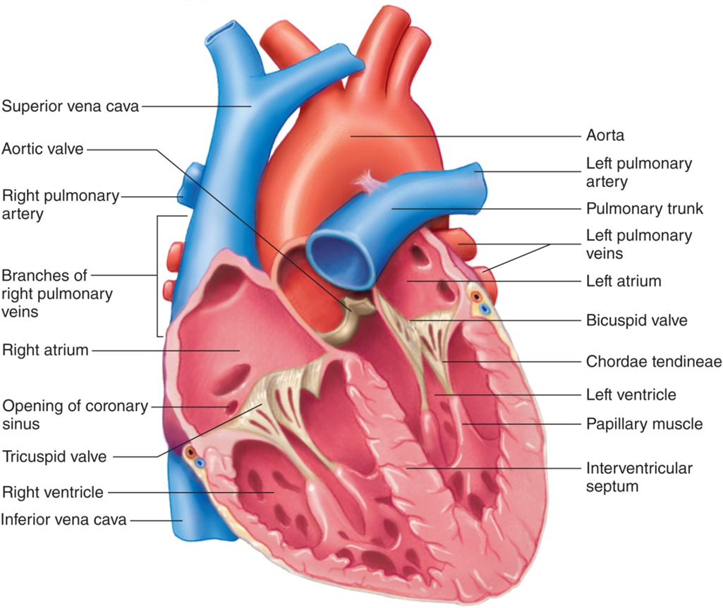
Chambers of the Heart
Right atrium.
Right ventricle.
Left atrium.
Left ventricle.
Access the text alternative for these images
Notes:
LO 6.1 Describe circulation and the purpose of the vascular system.
Notes:
The heart has four chambers, divided into left and right halves by a septum. The upper chambers, or atria, receive blood from other parts of the body and pass it through valves to the lower chambers, or ventricles, to be pumped out. The valves open in one direction only, keeping the blood flowing in only one direction inside the heart. Valves also separate the heart from the aorta (aortic semilunar valve) and pulmonary arteries (pulmonary semilunar valve) to prevent blood from flowing back into the heart once it has been pumped out.
Right atrium: Receives deoxygenated blood from the body
Right ventricle: Sends deoxygenated blood to the lungs for oxygenation and removal of carbon dioxide
Left atrium: Receives oxygenated blood from the lungs
Left ventricle: Sends oxygenated blood throughout the body
Aorta: Largest artery in the body
Pulmonary arteries: Arteries that transport deoxygenated blood to the lungs

Slide 8
Layers of the Heart 1
Endocardium.
Myocardium.
Epicardium.
Visceral.
Parietal.
Pericardial fluid.
Notes:
LO 6.1 Describe circulation and the purpose of the vascular system.
Notes:
The epicardium of the heart consists of two membranes. The inner visceral membrane is a serous membrane that is attached to the heart. The outer parietal membrane is fibrous. The space between the visceral and parietal membranes is filled with pericardial fluid that reduces friction around the heart. The two membranes and the enclosed fluid is known as the pericardial sac.

Slide 9
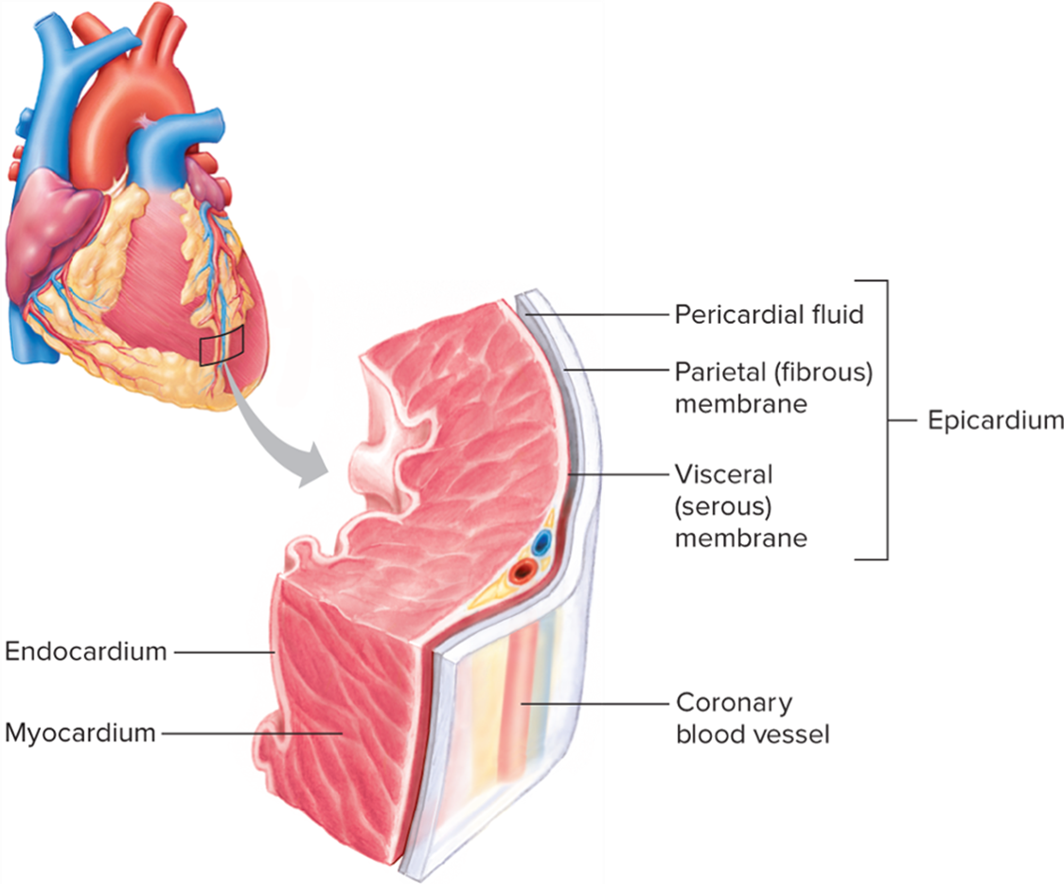
Layers of the Heart 2
Access the text alternative for these images
Notes:
LO 6.1 Describe circulation and the purpose of the vascular system.

Slide 10
Types of Circulation
Coronary.
Provides blood supply to the heart muscle.
Pulmonary.
Sends deoxygenated blood to lungs for oxygenation.
Sends oxygenated blood back to heart.
Systemic.
Sends oxygenated blood throughout the body.
Picks up nutrients, hormones, and waste.
Notes:
LO 6.1 Describe circulation and the purpose of the vascular system.
Notes:
Coronary circulation: Oxygenated blood flows from the left ventricle, through the aorta, and directly into the coronary arteries to supply oxygenated blood to the heart muscle. Deoxygenated blood flows through the coronary veins to the coronary sinus and from there directly into the right atrium.
Pulmonary circulation: Deoxygenated blood (blood with a low concentration of oxygen and a high concentration of carbon dioxide) flows from the right ventricle to the lungs for removal of carbon dioxide and for reoxygenation (respiration). The oxygenated blood then continues through the pulmonary veins to the left atrium.
Systemic circulation: Oxygenated blood (blood with a high concentration of oxygen and a low concentration of carbon dioxide) flows from the left ventricle through the arteries to all parts of the body, delivering oxygen to the body cells. The blood also picks up nutrients, hormones, and wastes and delivers them to the proper systems for processing. Deoxygenated blood returns through the veins to the vena cava and from there to the right atrium of the heart, ready for pulmonary circulation.

Slide 11
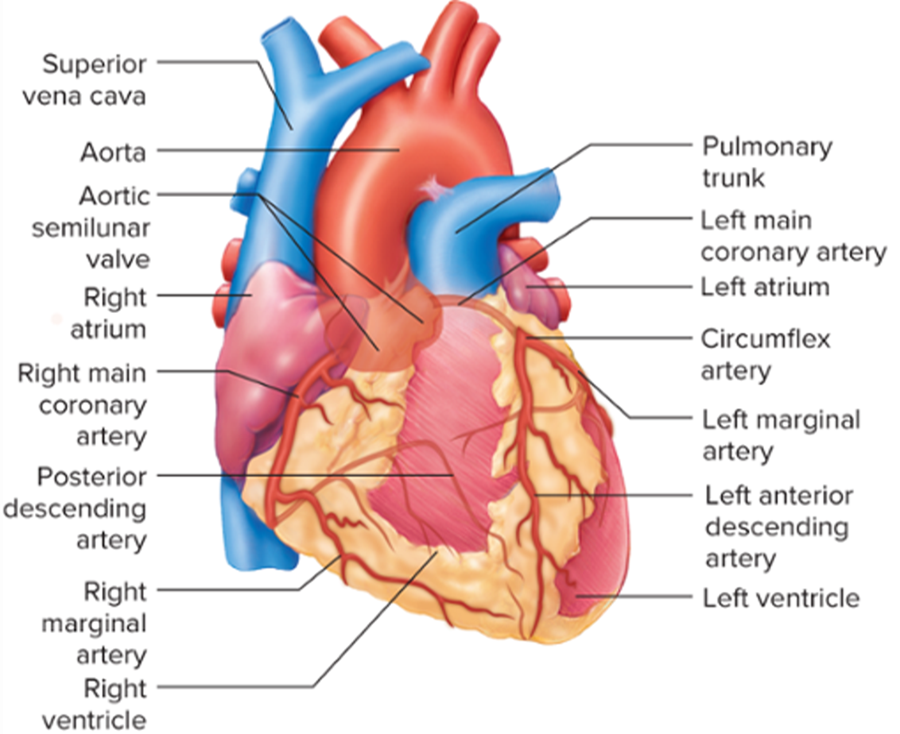
Coronary Circulation: Coronary Arteries
Access the text alternative for these images
Notes:
LO 6.1 Describe circulation and the purpose of the vascular system.

Slide 12
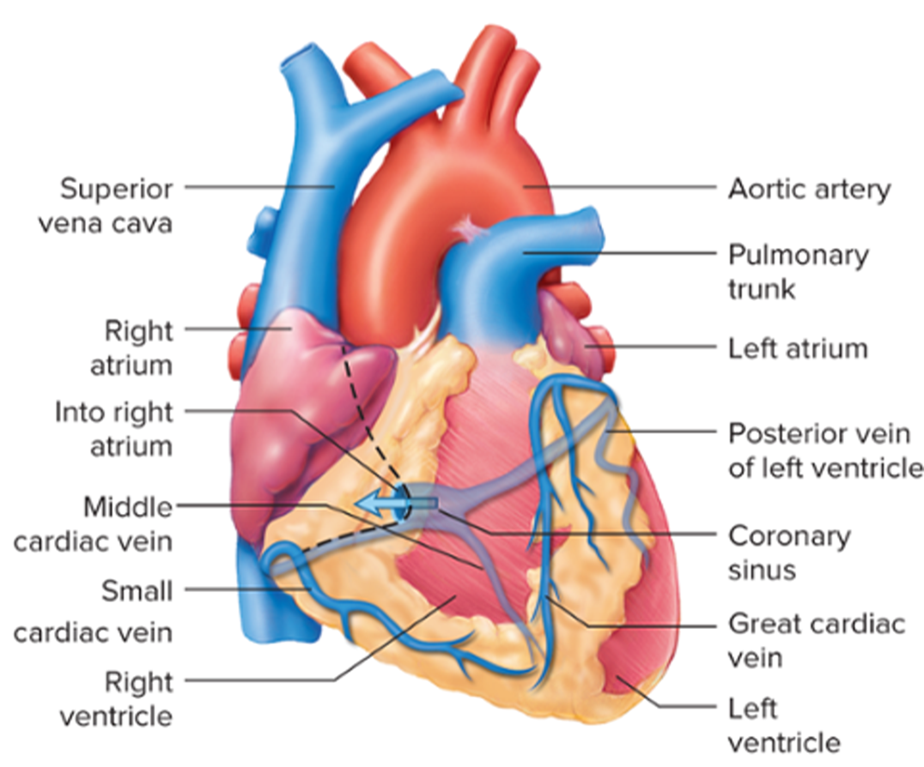
Coronary Circulation: Coronary Veins
Access the text alternative for these images
Notes:
LO 6.1 Describe circulation and the purpose of the vascular system.

Slide 13
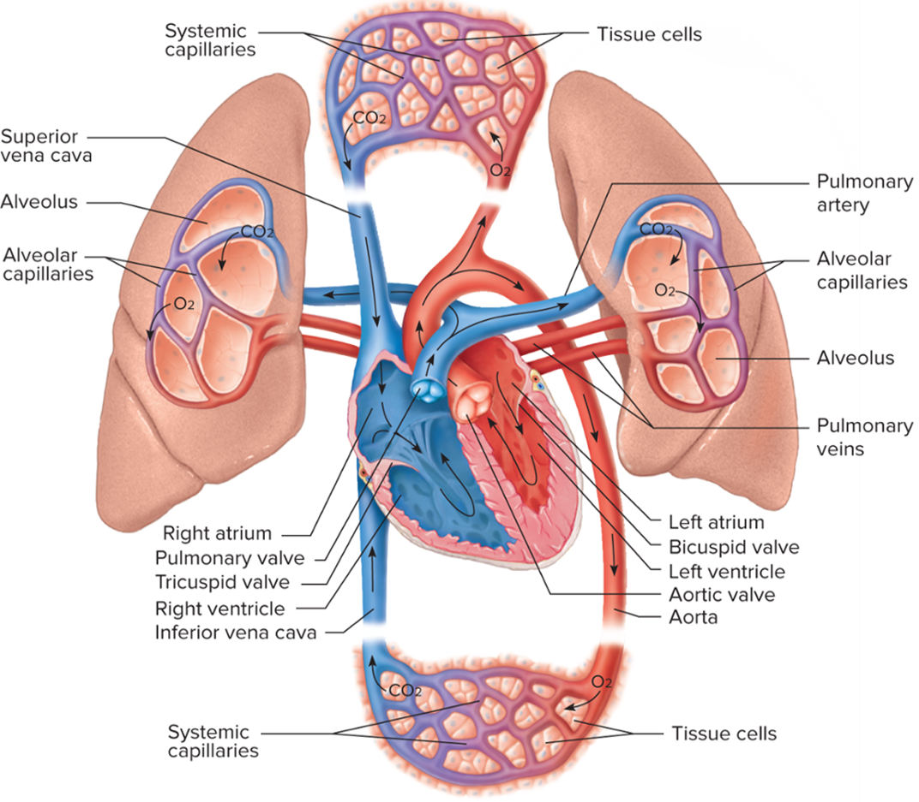
Pulmonary and Systemic Circulation
Access the text alternative for these images
Notes:
LO 6.1 Describe circulation and the purpose of the vascular system.
Notes:
Pulmonary circulation occurs when deoxygenated blood is transported to the lungs for gas exchange.
Systemic blood vessels carrying oxygenated blood pick up essential nutrients from the digestive tract and deliver them, along with oxygen, to all other cells of the body. Systemic circulation also removes waste products from the body cells and delivers them to the kidneys and lungs for processing and expulsion from the body.

Slide 14
Arterial versus. Venous Blood
Arterial Blood
Venous Blood
Oxygenated.
Pumped by the heart to the body cells.
Deoxygenated.
Larger concentration of carbon dioxide.
Pumped by the heart to the lungs.
Notes:
LO 6.1 Describe circulation and the purpose of the vascular system.
Notes:
Arterial blood is bright red because it contains oxyhemoglobin and is rich in oxygen.
Venous blood is dark red because it contains deoxyhemoglobin and is oxygen-poor. It contains a higher concentration of carbon dioxide than oxygen.
Oxygenated: Carrying a high concentration of oxygen
Deoxygenated: Carrying a low concentration of oxygen

Slide 15
Learning Outcome 6.2
Blood Vessels

Slide 16
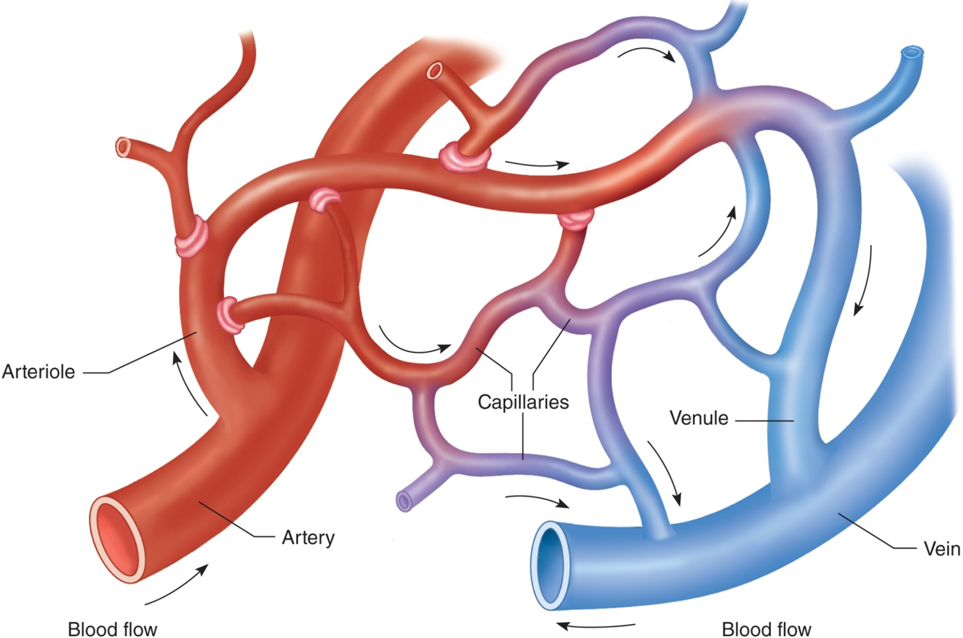
Gas Exchange
Access the text alternative for these images
Notes:
LO 6.4 Identify and describe the structures and functions of the different types of blood vessels.
Notes:
Arterial (oxygenated) blood is transported from the heart through the body’s largest artery, the aorta. The aorta branches repeatedly to form other, smaller arteries, then arterioles, and finally tiny capillaries.
Gas exchange occurs at the capillary level. Blood delivers oxygen and nutrients to the body cells at the same and picks up carbon dioxide for removal through the lungs.
The capillaries connect to venules, which combine to form larger veins, eventually carrying deoxygenated blood to the superior and inferior vena cavae, which return the blood to the heart. From the heart, it is pumped to the lungs for gas exchange and reoxygenation, and the cycle repeats.

Slide 17
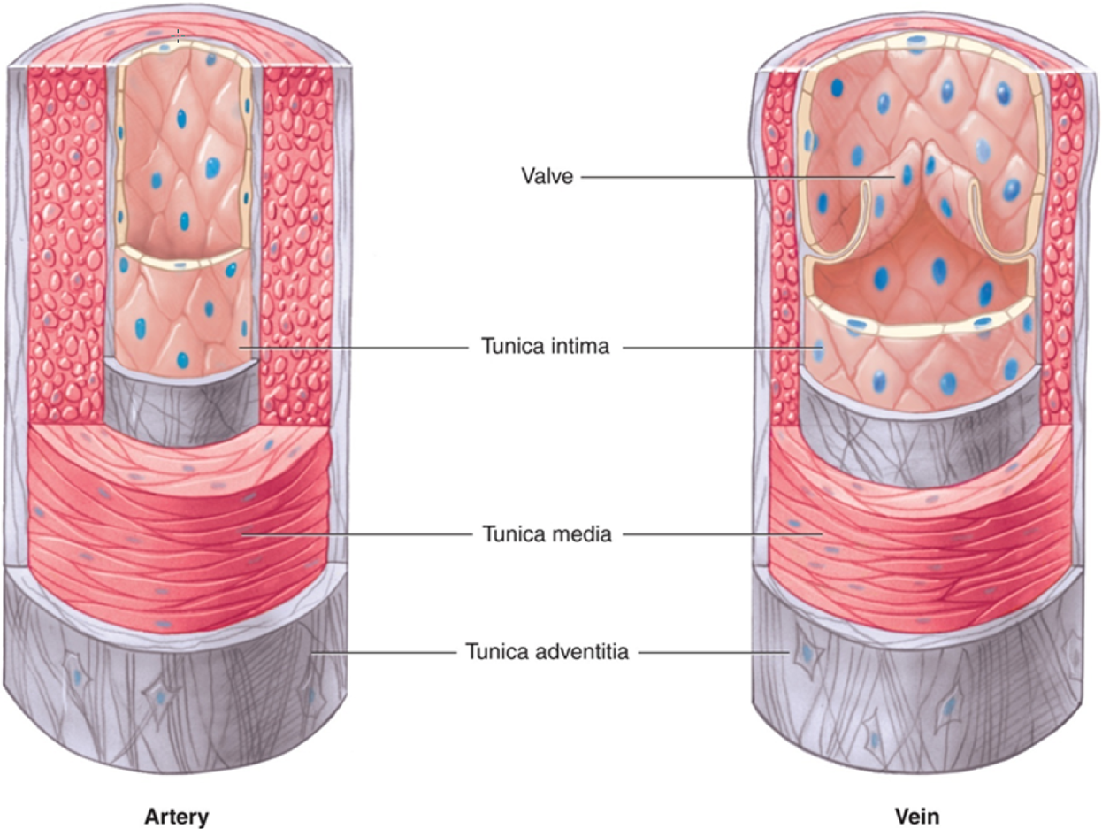
Structure of Blood Vessels
Notes:
LO 6.2 Identify and describe the structures and functions of the different types of blood vessels.
Notes:
Both arteries and veins have three layers:
Tunica intima
Innermost, smooth layer
Direct contact with blood
Tunica media
Middle layer
Thickest of the three layers
Contracts and relaxes
Tunica adventitia
Outer covering
Protects and supports the vessel
In addition, veins have valves at intervals to prevent the backflow of blood.

Slide 18
Arteries
Efferent vessels – transport blood away from the heart.
Carry blood under high pressure.
Are elastic, muscular, and thick–walled.
Most carry oxygenated blood, which is bright red.
Notes:
LO 6.2 Identify and describe the structures and functions of the different types of blood vessels.
Notes:
Arteries:
Known as efferent vessels because they carry blood away from the heart
All arteries except the pulmonary arteries carry oxygenated blood; the pulmonary arteries carry deoxygenated blood from the heart to the lungs
Arterial walls are thicker than walls in veins because the arteries transport blood under high pressure
The aorta branches into smaller arteries, which divide further into smaller arterioles, until they reach the capillaries
Refer to Figure 6-7 in the textbook for an illustration of the major arteries in the human body.

Slide 19
Capillaries
Smallest blood vessels.
Link arterioles to venules.
Site of all gas exchange.
Thin walls are one cell thick to allow for gas and nutrient exchange.
Notes:
LO 6.2 Identify and describe the structures and functions of the different types of blood vessels.
Notes:
Capillaries:
Carry out exchange of gases: bring oxygen to the body cells and remove carbon dioxide and nitrogenous waste
Deliver nutrients and molecules to cells
Remove waste products from cells

Slide 20
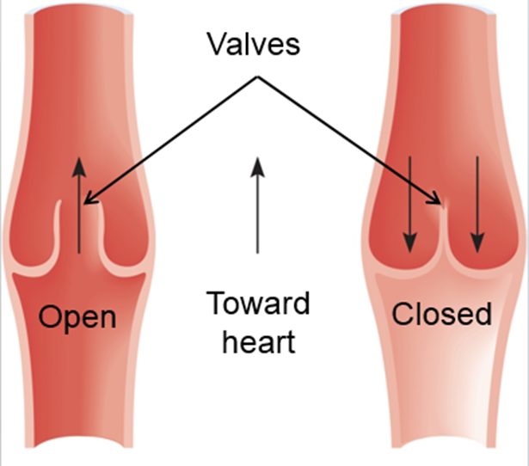
Veins
Afferent vessels – transport deoxygenated blood toward the heart.
Thinner walls and lower pressure than arteries.
Contain one–way valves.
Store about 65% to 70% of the body’s total blood volume.
Blood is a darker red because it contains less oxygen than the blood in arteries.
Notes:
LO 6.2 Identify and describe the structures and functions of the different types of blood vessels.
Notes:
Veins:
Known as afferent vessels because they carry blood toward the heart
All veins except the pulmonary veins carry deoxygenated blood; the pulmonary veins carry oxygenated blood from the lungs to the heart
One-way valves keep blood moving in the right direction
Refer to Figure 6-8 in the textbook for an illustration of the major veins in the body. Notice that the names of the veins are similar to those of nearby arteries.

Slide 21
Artery or Vein?
At a venipuncture site, a vein will feel bouncy and resilient whereas an artery will feel firm and will pulsate.
In case of accidental arterial puncture:
Withdraw the needle.
Apply firm pressure for at least 5 minutes.
Instruct patient to remain still.
Notify a nurse to assist in hematoma prevention.
Notes:
LO 6.2 Identify and describe the structures and functions of the different types of blood vessels.
Notes:
Because arteries are under higher pressure than veins, firm pressure must be held for a longer time to ensure that the bleeding has stopped.
Hematoma: Collection of blood under the skin due to leakage of blood from a punctured vein or artery

Slide 22
Learning Outcome 6.3
Veins for Phlebotomy

Slide 23
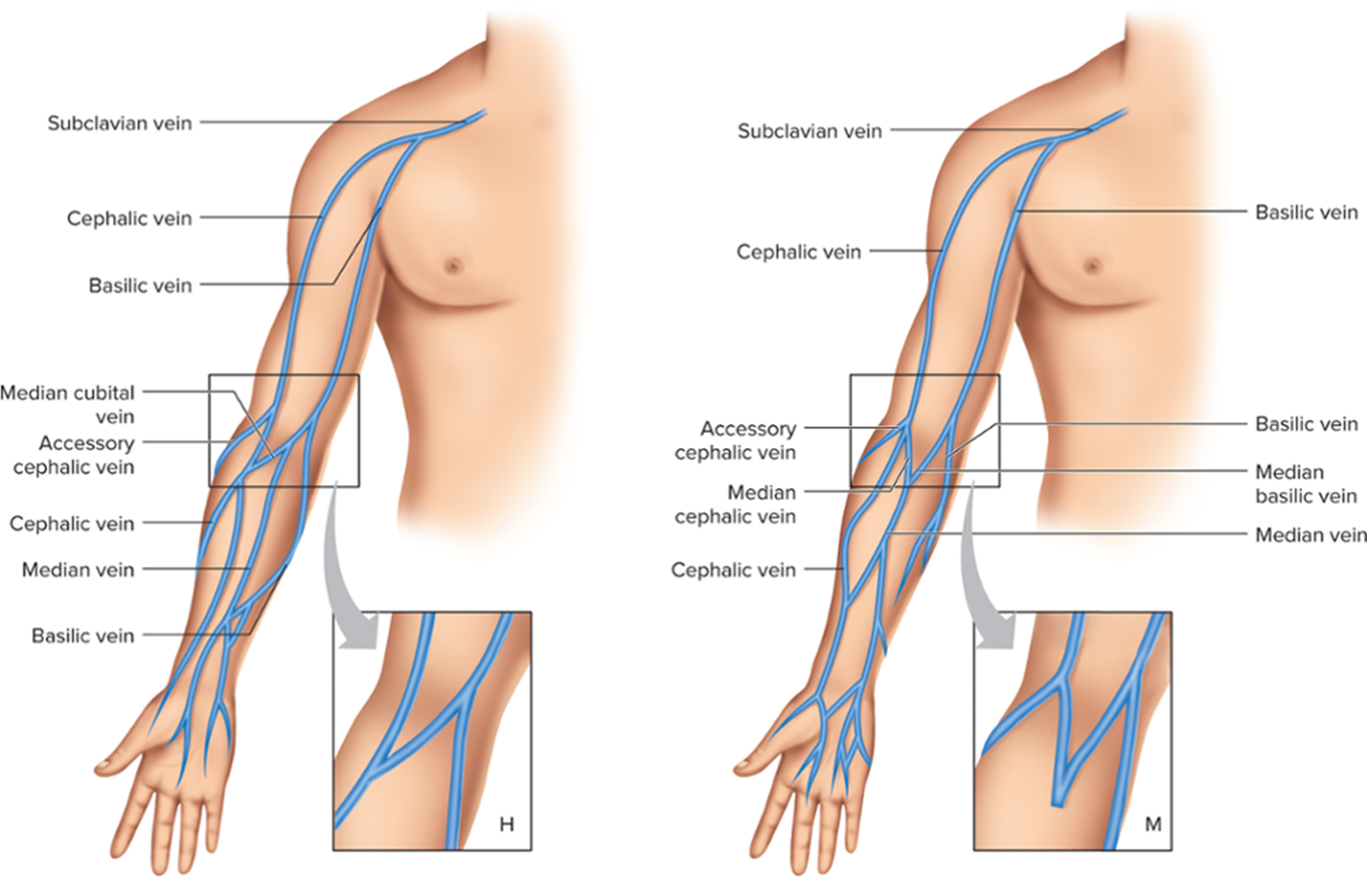
Veins in the Antecubital Fossa
Access the text alternative for these images
Notes:
LO 6.3 Locate and name the veins most commonly used for phlebotomy procedures.
Notes:
Antecubital fossa:
Inside of the elbow
Most common site for phlebotomy
Median cubital vein: best site (largest and best-anchored)
Cephalic vein: also well-anchored but harder to palpate
Basilic vein: easy to palpate but tends to roll; also lies closer to the median nerve and brachial artery
The two most common vein patterns are the H pattern and the M pattern.

Slide 24
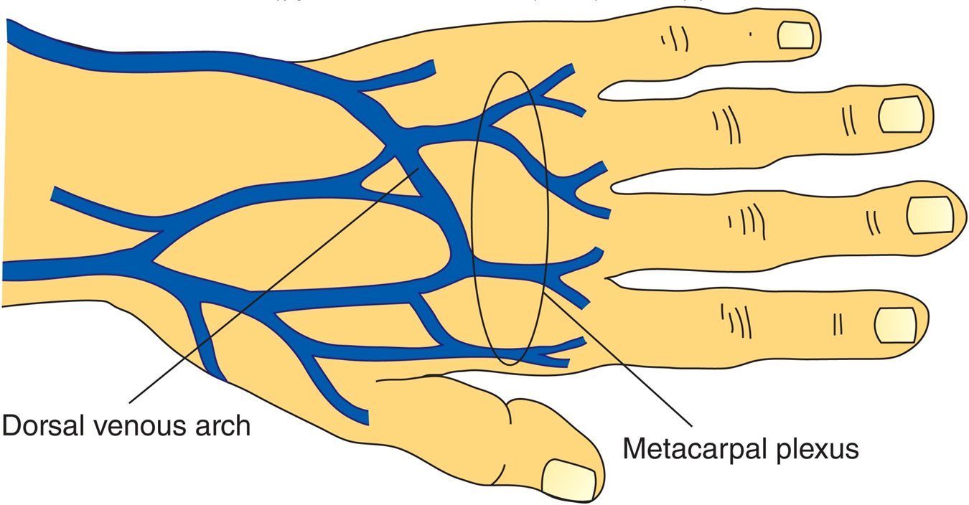
Veins in the Back of the Hand
Notes:
LO 6.3 Locate and name the veins most commonly used for phlebotomy procedures.
Notes:
The phlebotomist may also use veins in the back of the hand (dorsal arch) if the antecubital veins are not accessible.
Smaller and more difficult to use
Butterfly needle is usually required
Phlebotomists should not use veins in the head, legs, or feet.

Slide 25
Selecting a Vein
After properly selecting a vein:
Use proper phlebotomy techniques.
Avoid probing at the site.
Accidental nerve puncture.
May cause temporary or permanent loss of function.
Constitutes an act of negligence.
Notes:
LO 6.3 Locate and name the veins most commonly used for phlebotomy procedures.
Notes:
Patients have been awarded millions of dollars in compensation for loss of function. Always follow proper techniques and never probe for the vein at the selected site.

Slide 26
Chapter Summary 1
The vascular system consists of a network of vessels that, along with the heart, provides for circulation of the blood.
The three types of circulation are coronary, pulmonary, and systemic.
Blood vessels have three layers: tunica intima, tunica media, and tunica adventitia.
Notes:
6.1 Describe circulation and the purpose of the vascular system.
6.2 Identify and describe the structures and functions of the different types of blood vessels.

Slide 27
Chapter Summary 2
All arteries except the pulmonary artery carry oxygenated blood to the body cells.
All veins except the pulmonary veins carry deoxygenated blood to the heart.
The veins most commonly used for phlebotomy are the median cubital, cephalic, and basilic veins in the antecubital fossa.

Slide 28
STOP HERE
CH 6.4-6.6

Slide 29
Learning Outcome 6.4
Composition of Blood

Slide 30
Functions of Blood
Transports oxygen and nutrients to body cells and tissues.
Transports hormones to target areas.
Eliminates waste materials from body cells.
Maintains water balance for body cells and tissues.
Transports antibodies and protective substances throughout the body to attack pathogens.
Helps regulate body temperature.
Helps maintain acid–base balance.
Notes:
LO 6.4 Identify the major components of blood and describe the major functions of each.

Slide 31
Blood Components
Cellular Components
Liquid Component
Erythrocytes.
Leukocytes.
Platelets.
Plasma.
Water.
Solutes.
Notes:
LO 6.4 Identify the major components of blood and describe the major functions of each.
Notes:
When blood is allowed to settle, it separates into cellular (formed elements) and liquid components.
Formed elements:
Make up about 45% of the total blood volume
Almost 99% of cells are RBCs
Erythrocytes: red blood cells
Leukocytes: white blood cells
Platelets: thrombocytes
Plasma:
Water makes up 90% to 92% of plasma
Solutes are dissolved chemicals, including:
Electrolytes
Enzymes
Glucose
Hormones
Lipids
Proteins
Metabolic substances

Slide 32
Formation of Blood Cells
Myeloid Stem Cells
Lymphoid Stem Cells
Red blood cells.
Platelets.
Granulocytes.
Monocytes.
Lymphocytes.
B cells.
T cells.
Notes:
LO 6.4 Identify the major components of blood and describe the major functions of each.
Notes:
The formed elements of blood originate from stem cells (the cells from which specific body cells are formed).
Hematopoietic (blood-forming) compartments:
Myeloid: developed from bone marrow
Lymphoid: developed from the lymphatic system
Granulocyte: White blood cell containing granules of various colors and chemical makeup; basophils, eosinophils, and neutrophils
For a diagram of how blood cells originate from stem cells, see Figure 6-13 in the textbook.

Slide 33
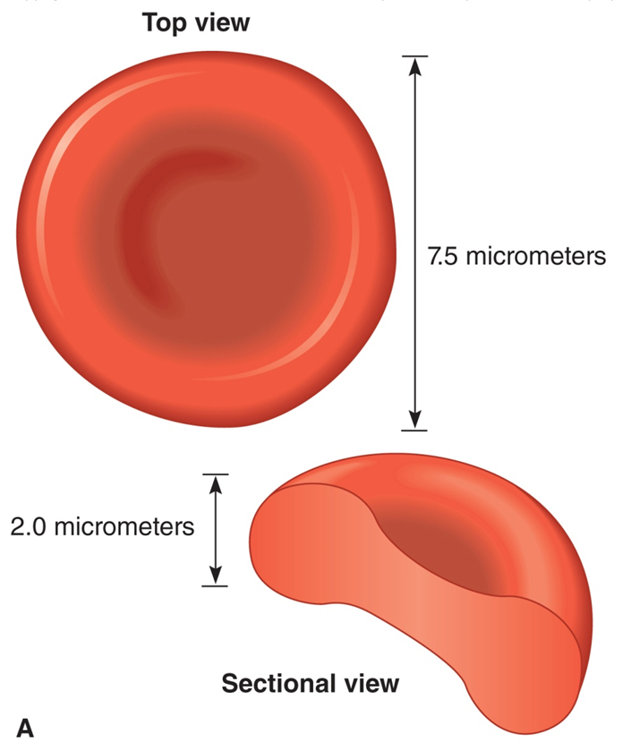
Erythrocytes (R B Cs)
Originate in bone marrow.
Biconcave.
Lifespan of 120 days.
Contain hemoglobin.
Deliver oxygen to cells.
Remove carbon dioxide from cells.
Notes:
LO 6.4 Identify the major components of blood and describe the major functions of each.
Notes:
Red blood cells are biconcave—they resemble donuts with a depression in the center instead of a hole. They contain hemoglobin, which allows them to carry oxygen to all body cells and remove carbon dioxide from the cells.
Normal values—adult males:
RBCs: 4.7–6.1 million/μL of blood
Hgb: 14–18 g/dL of blood
Normal values—females and children:
RBCs: 4.2–6.4 million/μL of blood
Hgb: 12–16 g/dL of blood
The normal values for red blood cells and hemoglobin are higher in infants for the first several weeks after birth.
An abnormally low hemoglobin level and/or decrease in the number of red blood cells is called anemia.

Slide 34
Anemia
Abnormally low hemoglobin level and/or decrease in red blood cells.
Symptoms.
Weakness.
Headache.
Pale skin color.
Difficulty breathing.
Notes:
LO 6.4 Identify the major components of blood and describe the major functions of each.
Notes:
Conditions that may cause a decrease in hemoglobin or in RBC numbers include:
Sickle cell anemia
Hemophilia
Some forms of cancer
Dietary deficiency of iron, folate, and/or vitamin B₁₂

Slide 35
Jaundice
Caused by elevated levels of bilirubin.
Bilirubin is produced during breakdown of R B Cs.
Processed in liver.
Deposited in intestines for elimination.
Due to some types of anemia that cause R B Cs to be destroyed prematurely.
Hemolysis.
Notes:
LO 6.4 Identify the major components of blood and describe the major functions of each.
Notes:
Jaundice: Yellow coloration of the skin and eyes
Hemolysis: Destruction of red blood cells
In newborns, who normally have a higher level of red blood cells and hemoglobin, the liver may not be able to keep up with the bilirubin produced by hemolysis. Because excessive bilirubin may damage the internal organs, infants who have an excess of bilirubin are often placed under ultraviolet lamps. Bilirubin is light-sensitive, so light can break it down.

Slide 36
Leukocytes (W B Cs)
Not confined to vascular spaces.
Diapedesis.
Responsible for phagocytosis.
Round and clear (when not stained).
Notes:
LO 6.4 Identify the major components of blood and describe the major functions of each.
Notes:
Diapedesis: The process of passing through capillary walls to enter tissues
Phagocytosis: The process of surrounding and destroying foreign substances, including pathogens
Leukocyte values:
Normally 5,000 to 10,000 WBCs/mm³
Bacterial infections cause increase
Leukemia and other disorders cause decrease
There are two main categories of leukocytes: polymorphonuclear (granulocytes; those with multiple-lobed nuclei) and mononuclear (those with single-lobed nuclei).
Polymorphonuclear leukocytes: neutrophils, eosinophils, basophils
Mononuclear leukocytes: monocytes, lymphocytes

Slide 37
Categories of Leukocytes
Polymorphonuclear/ Granulocytes
Mononuclear
Neutrophils.
Eosinophils.
Basophils.
Monocytes.
Lymphocytes.
Notes:
LO 6.4 Identify the major components of blood and describe the major functions of each.
Notes:
Polymorphonuclear WBCs have a nucleus that is segmented into two or more lobes.
Mononuclear WBCs have a single-lobed nucleus.
Another system divides WBCs into myeloid cells and lymphoid cells.
Myeloid
Granulocytes
Monocytes
Lymphoid
T-cell lymphocyte: Type of lymphocyte that originates from the lymphoid tissue and assists the immune system through interactions with other leukocytes
B-cell lymphocyte: Type of lymphocyte that produces antibodies upon stimulation
Natural killer (NK) cells: Type of lymphocytes that can attack and destroy tumor cells or cells that have been infected by viruses

Slide 38
Polymorphonuclear W B Cs: Neutrophils
Most numerous white blood cells.
Nucleus has 3 or 4 lobes.
Perform phagocytosis.
Count increases during bacterial infection or inflammation.
Notes:
LO 6.4 Identify the major components of blood and describe the major functions of each.
Notes:
Neutrophils show neutral staining in tan, lavender, or pink with tan-colored granules.
60% to 70% of total WBC count (up to 80% in newborns and 20% to 30% in young children)
Aid in immune defense
Perform phagocytosis
Release pyrogens and use lysosomal enzymes to destroy bacteria
Pus: Substance containing old leukocytes, pathogens, and other debris; created at the site of infection once the white blood cells undergo phagocytosis

Slide 39
Polymorphonuclear W B Cs: Eosinophils
Bilobed nucleus.
Cytoplasmic granules.
Perform phagocytosis.
Destroy parasites.
Count increases during allergic reactions and parasitic infections.
Notes:
LO 6.4 Identify the major components of blood and describe the major functions of each.
Notes:
Eosinophils have a bilobed nucleus; granules stain orange-red.
1% to 4% of total WBC count
Assist with inflammatory response
Perform phagocytosis
Secrete chemicals that destroy certain parasites
Cytoplasm: Area of the cell outside the nucleus

Slide 40
Polymorphonuclear W B Cs: Basophils
Nucleus usually bilobed.
Cytoplasmic granules.
Release histamine.
Release heparin.
Count increases with chronic inflammation and during healing from infection.
Notes:
LO 6.4 Identify the major components of blood and describe the major functions of each.
Notes:
Basophils are usually bilobed but may have three lobes; granules stain deep blue.
0% to 1% of total WBC count—least common of all WBC types
Assist with inflammatory response by releasing histamine
Release heparin for anticoagulation

Slide 41
Polymorphonuclear W B Cs: Monocytes
Largest type of W B C.
Fine cytoplasmic granules.
Single, kidney–shaped nucleus.
Perform phagocytosis.
Count increases with chronic infections.
Notes:
LO 6.4 Identify the major components of blood and describe the major functions of each.
Notes:
Monocytes have a single, kidney-shaped nucleus, and fine granules may be seen in the cytoplasm.
2% to 6% of total WBC count
Become macrophages to phagocytize dying cells, microorganisms, and foreign substances
Chronic infections such as tuberculosis increase cell count

Slide 42
Polymorphonuclear W B Cs: Lymphocytes
Single, round nucleus.
Two types.
B–cell lymphocytes.
T–cell lymphocytes.
Count increases during viral infections.
Notes:
LO 6.4 Identify the major components of blood and describe the major functions of each.
Notes:
Lymphocytes have a single, round nucleus and very little cytoplasm. They are very active in the immune defense.
20% to 30% of total WBC count (40% to 60% in young children)
B-cell lymphocytes produce antibodies to fight specific foreign antigens
T-cell lymphocytes interact with other cells to produce an immune response

Slide 43
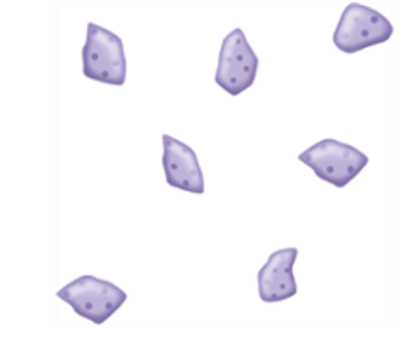
Platelets (Thrombocytes)
Smallest formed element.
Fragments of megakaryocytes.
Life span of 9 to 12 days.
Help prevent blood loss.
Notes:
LO 6.4 Identify the major components of blood and describe the major functions of each.
Notes:
Megakaryocytes are the largest cells in the bone marrow. Platelets are fragments of these large cells.
Platelets are the first cells to arrive at the site of an injury.
Stick to injury site
Form platelet plug to slow or stop bleeding
Secrete serotonin to constrict blood vessels, decreasing blood loss

Slide 44
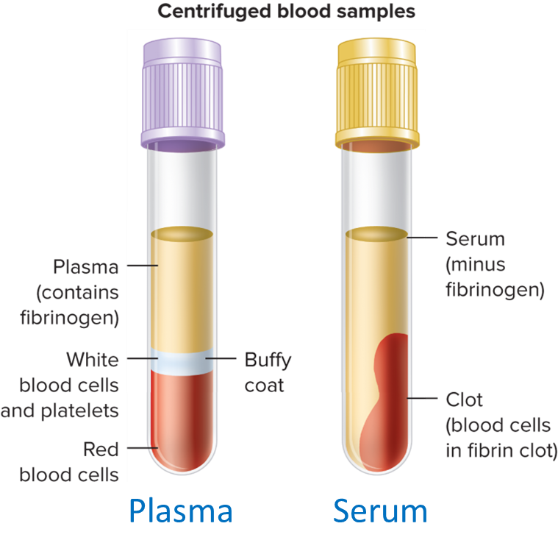
Plasma and Serum
Plasma.
Liquid portion of unclotted blood.
Pale yellow liquid.
Mostly water.
Contains several important solutes.
Serum.
Liquid portion of clotted blood.
Clotting factors depleted.
Access the text alternative for these images
Notes:
LO 6.4 Identify the major components of blood and describe the major functions of each.
Notes:
Serum: Liquid portion of clotted (coagulated) blood
Plasma: Liquid portion of unclotted (uncoagulated) blood
Blood that is collected in a tube containing an anticoagulant and is then centrifuged separates into three distinct layers: plasma, buffy coat (WBCs and platelets), and red blood cells.
Anticoagulant: Agent that prevents blood from clotting
Centrifugation: The spinning of test tubes at a high speed around a central axis to separate the components of the test tube contents
Plasma composition:
90% to 92% water
Nutrients: cholesterols, fatty acids, amino acids, glucose
Hormones: thymosin, insulin
Electrolytes: sodium potassium, calcium, magnesium, chloride
Proteins: fibrinogen, globulins, albumin
Waste: urea, uric acid, creatinine, xanthine
Protective substances: antitoxins, opsonins, agglutinin, bacteriolysins
Fibrinogen: Protein that aids in clotting
Globulins: Proteins that serve as antibodies
Albumin: Protein that assists in regulating blood pressure

Slide 45
Plasma versus. Serum
Plasma | Serum
Fluid obtained when anticoagulated blood has been centrifuged | Fluid obtained when coagulated blood has been centrifuged
Collected in a tube with an anticoagulant (purple or lavender top) | Collected in a tube without an anticoagulant; will clot within 10 to 30 minutes
Fibrinogen is present | Fibrinogen is absent
Can be processed and tested immediately | Must be kept in an upright (standing) position to coagulate before testing
Given to patients who lack blood cells | Preferred fluid for testing blood groups and diagnosis of disease
Notes:
LO 6.4 Identify the major components of blood and describe the major functions of each.

Slide 46
Safety of Immunocompromised Patients
Have decreased capacity to fight infection.
W B C count is low.
Require extra measures to prevent infection.
Standard precautions, hand hygiene, and P P E must be used.
Patients may be in protective isolation rooms.
Notes:
LO 6.4 Identify the major components of blood and describe the major functions of each.

Slide 47
Learning Outcome 6.5
Hemostasis and Blood Coagulation

Slide 48
Hemostasis
Stops flow of blood from injury.
Involves four major events:
Blood vessel spasm (vasoconstriction).
Platelet plug formation.
Coagulation.
Fibrinolysis.
Notes:
LO 6.5 Define hemostasis and describe the basic coagulation process.

Slide 49
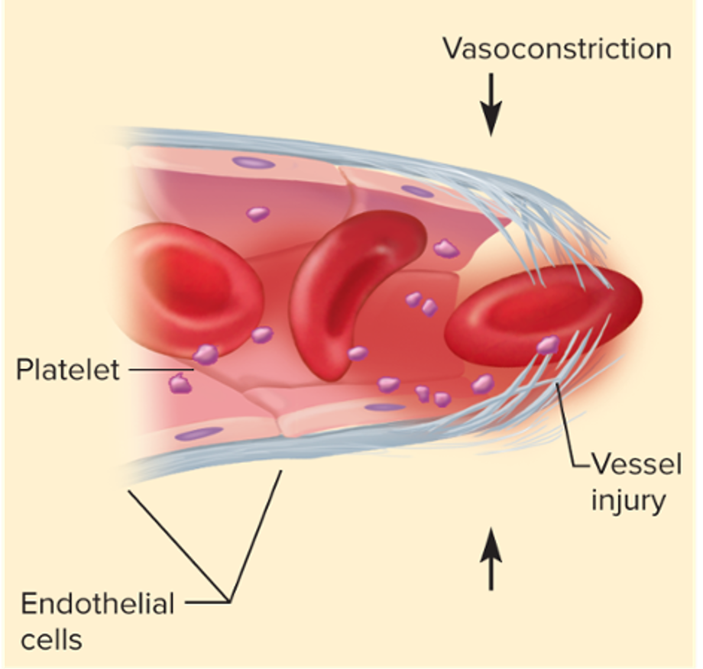
Step 1: Blood Vessel Spasm
Access the text alternative for these images
Notes:
LO 6.5 Define hemostasis and describe the basic coagulation process.
Notes:
The first step in hemostasis is blood vessel spasm, or vasoconstriction. The decrease in diameter of the blood vessel decreases the amount of blood flowing through the vessel. If the blood vessel is small and the injury is limited, this alone may stop the bleeding.

Slide 50
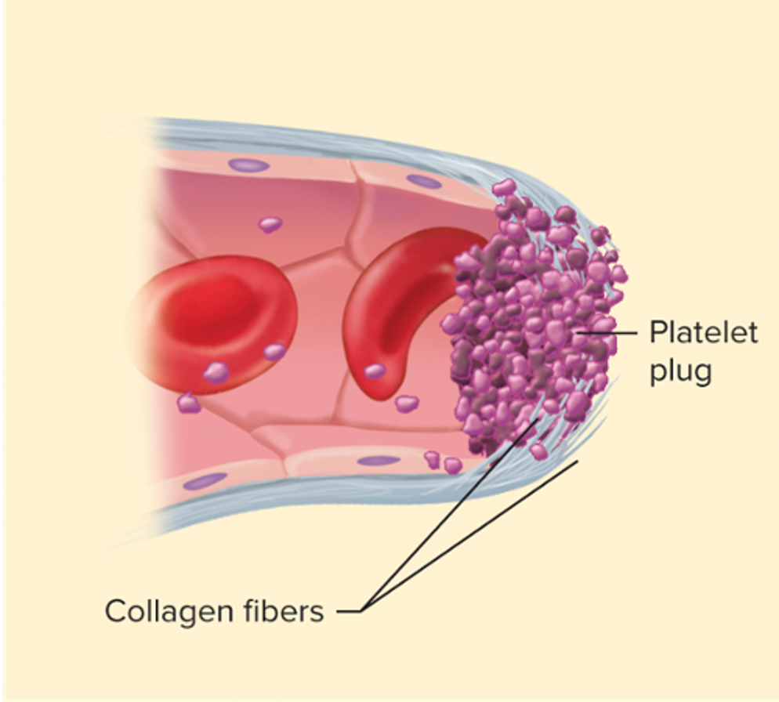
Step 2: Platelet Plug Formation
Access the text alternative for these images
Notes:
LO 6.5 Define hemostasis and describe the basic coagulation process.
Notes:
If vasoconstriction is not enough to stop the bleeding, the blood vessel releases chemical signals to call platelets to the injured site. Platelets begin to cluster at the site of injury and clump together to form a platelet plug. This process is known as primary hemostasis.

Slide 51
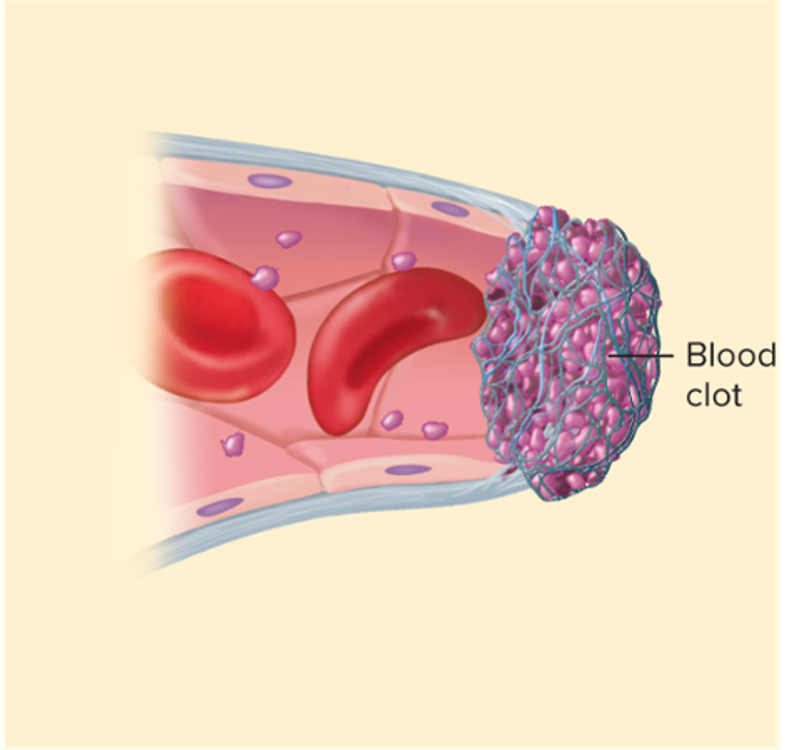
Step 3: Blood Clotting
Access the text alternative for these images
Notes:
LO 6.5 Define hemostasis and describe the basic coagulation process.
Notes:
Coagulation, or blood clotting, is the third step in hemostasis. It requires the presence of specific clotting factors to form a clot. The clotting factors come together and form thrombin, an enzyme that converts fibrinogen into fibrin. The fibrin adheres to the injury site, trapping blood cells and other particles to form a clot. This process is known as secondary hemostasis.
Fibrin: Filamentous protein formed by the action of thrombin on fibrinogen
The following slide describes coagulation in more detail. LO 6.5 Define hemostasis and describe the basic coagulation process.
Notes:
Coagulation, or blood clotting, is the third step in hemostasis. It requires the presence of specific clotting factors to form a clot. The clotting factors come together and form thrombin, an enzyme that converts fibrinogen into fibrin. The fibrin adheres to the injury site, trapping blood cells and other particles to form a clot. This process is known as secondary hemostasis.
Fibrin: Filamentous protein formed by the action of thrombin on fibrinogen
The following slide describes coagulation in more detail.

Slide 52
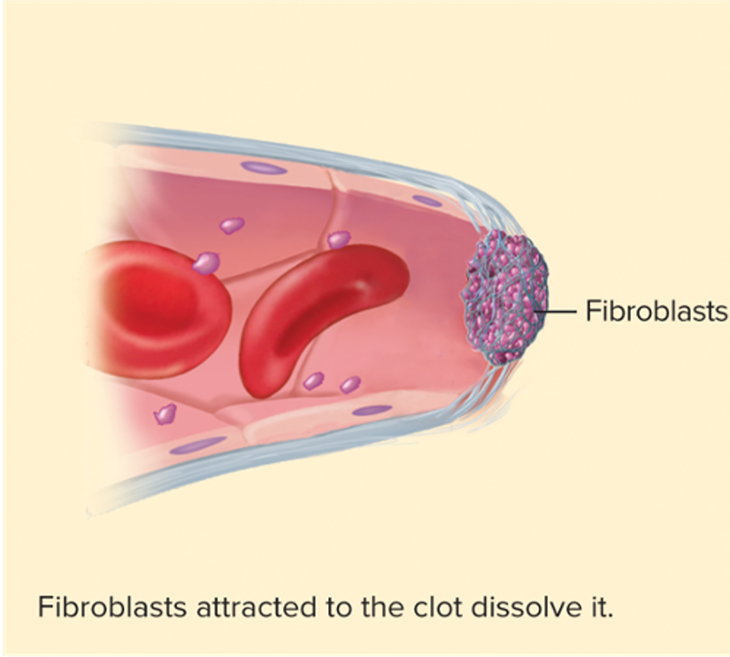
Step 4: Fibrinolysis
Access the text alternative for these images
Notes:
LO 6.5 Define hemostasis and describe the basic coagulation process.
Notes:
Clot formation stimulates the growth of fibroblasts and smooth muscle cells to repair the vessel wall. As the wall becomes more stable, the fibrin begins to break down in the process of fibrinolysis. This results in the dissolution of the clot, which returns the vessel to its normal state.
The following slide describes the process of fibrinolysis in more detail.

Slide 53
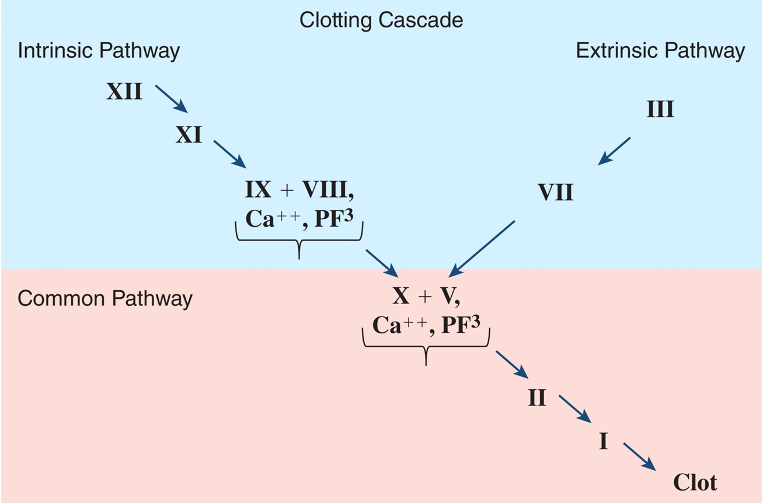
Step 3 Detail: Clotting Cascade
Access the text alternative for these images
Notes:
LO 6.5 Define hemostasis and describe the basic coagulation process.
Notes:
The “waterfall cascade” model of coagulation consists of three pathways: intrinsic, extrinsic, and common.
(Note: In this diagram, the red factors with “a” represent activated factors.)
Intrinsic pathway:
The intrinsic pathway of coagulation becomes activated when Factor XII comes in contact with collagen or immune system pathways that produce bradykinins. Fletcher factor (prekallikrein, a protease that activates kinins) and Fitzgerald factor (high-molecular-weight kininogen) can also activate Factor XII.
Activated Factor XII activates Factor XI, which in turn activates Factor IX.
Factor IX forms a complex with its co-factor, Factor VIII, calcium, and platelet phospholipid PF3.
This complex activates the first enzyme in the common pathway, Factor X.
Extrinsic pathway:
The extrinsic pathway of coagulation begins with the introduction of tissue substances into the bloodstream. This occurs when skin is cut or other tissue damage occurs.
Tissue thromboplastin (Factor III) activates Factor VII.
Factor VII activates the first enzyme in the common pathway, Factor X.
Common pathway:
The common pathway clotting cascade begins with the activation of Factor X by the intrinsic pathway, extrinsic pathway, or both.
Activated Factor X forms a complex with its co-factor, Factor V, calcium, and platelet phospholipid PF3.
This complex activates prothrombin (Factor II) to become thrombin.
Thrombin converts fibrinogen (Factor I) to fibrin monomers, which can polymerize to form a weak gel.
Thrombin simultaneously activates Factor XIII, which crosslinks fibrin polymers to form a stabilized clot.

Slide 54
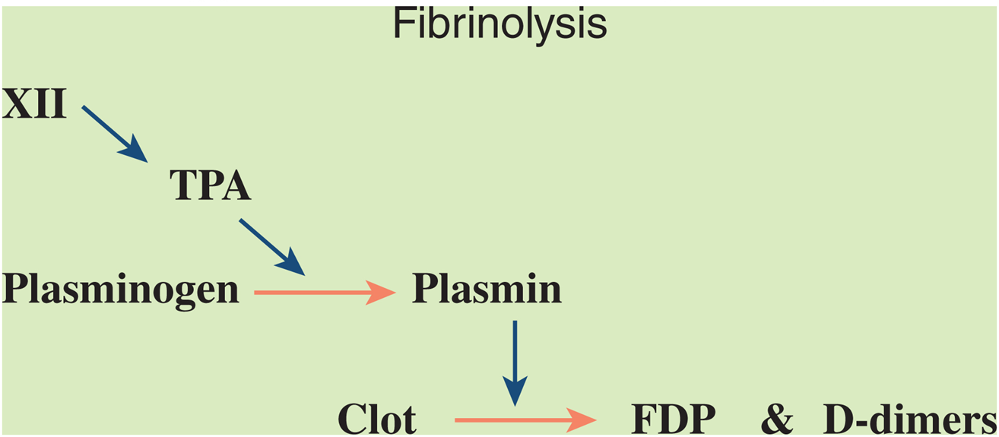
Step 4 Detail: Fibrinolysis Cascade
Access the text alternative for these images
Notes:
LO 6.5 Define hemostasis and describe the basic coagulation process.
Notes:
Fibrinolysis is initiated by the action of activated Factor XII on Tissue Plasminogen Activator (TPA). TPA converts plasminogen to plasmin, which lyses or degrades clots into FDPs (fibrin degradation products), the most prevalent being D-dimers.

Slide 55
Lack of Clotting Factors
Some patients must be monitored closely following venipuncture.
Patients on anticoagulants.
Patients lacking natural clotting ability.
Apply manual pressure for minimum of 3 to 5 minutes.
Ensure that bleeding has stopped.
Notes:
LO 6.5 Define hemostasis and describe the basic coagulation process.

Slide 56
Learning Outcome 6.6
A B O and Rh Blood Types

Slide 57
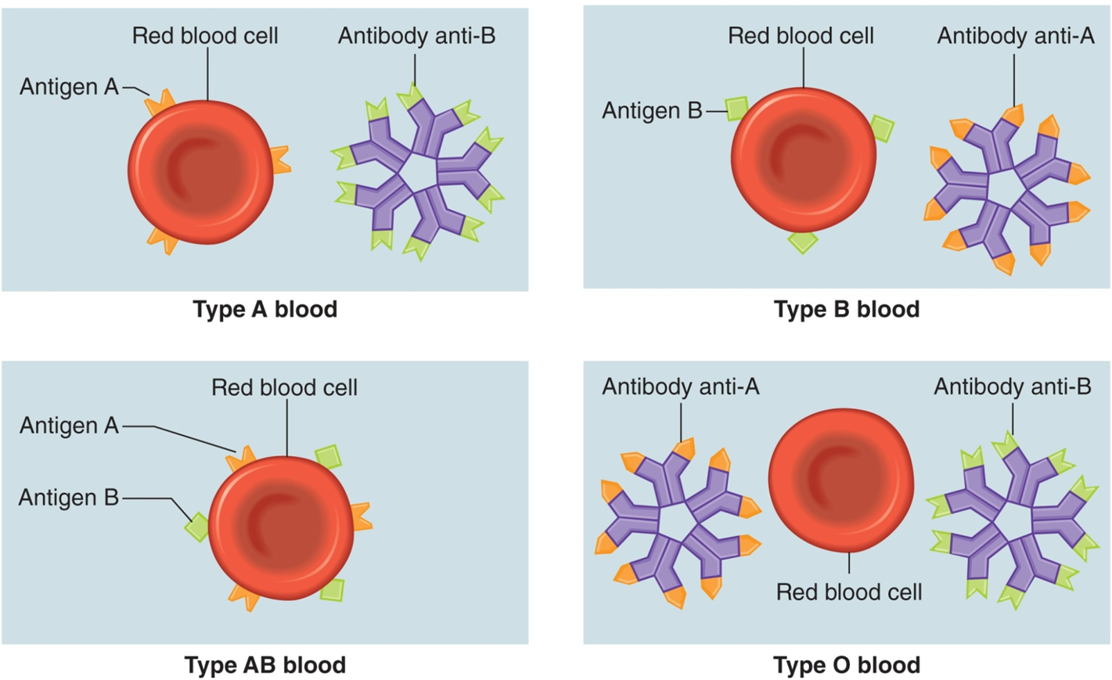
A B O Blood Types
Access the text alternative for these images
Notes:
LO 6.6 Describe how ABO and Rh blood types are determined.
Notes:
Blood types are classified according to the presence of:
Antigens on the surface of red blood cells
Antigens in plasma
Antigen: Substance that causes the formation of an antibody when introduced into blood or tissue
Antibody: Complex protein substance produced in the presence of foreign substances, such as bacteria, viruses, lipids, or carbohydrates, in order to protect the body
If antigens on the red blood cells bind to antibodies in the plasma, agglutination, or clumping, occurs.
Type A: Antigen A on red blood cells, antibody B in plasma
Type B: Antigen B on red blood cells, antibody A in plasma
Type AB: Antigens A and B on red blood cells, no antibodies in plasma
Type O: No antigens on red blood cells, antibody A and antibody B in plasma

Slide 58
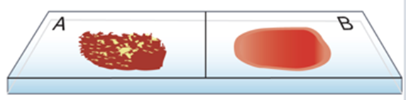
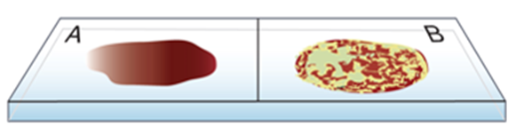
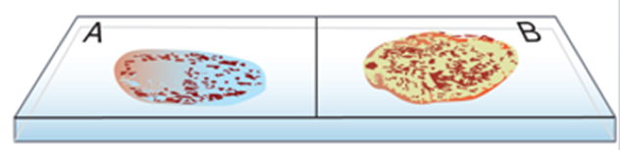
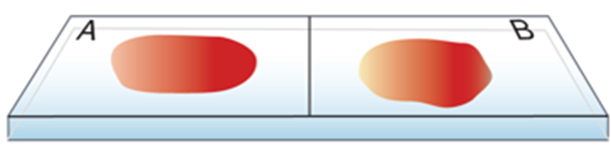
Agglutination of A B O Blood Types
Blood type A
Blood type B
Blood type A B
Blood type O
Access the text alternative for these images
Notes:
LO 6.6 Describe how ABO and Rh blood types are determined.
Notes:
Antiserum containing antibodies to A or B is used to determine ABO blood type.
In this illustration, the A and B on the slides refers to the type of antiserum (anti-A or anti-B) applied to the blood sample.
Type A blood clumps with anti-A antibodies but not with anti-B antibodies.
Type B blood clumps with anti-B antibodies but not with anti-A antibodies.
Type AB blood clumps with both anti-A and anti-B antibodies.
Type O blood does not clump with anti-A or anti-B antibodies.

Slide 59
A B O Compatibility
Blood Type | Can Accept Cells From | Can Donate Cells To
A | A, O | A, A B
B | B, O | B, A B
A B | A, B, A B, O | A B
O | O | O, A, B, A B
Notes:
LO 6.6 Describe how ABO and Rh blood types are determined.

Slide 60
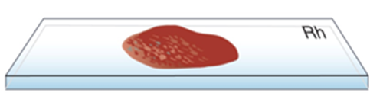
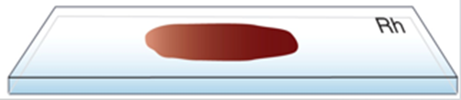
Rh Factor
Rh–positive
Rh–negative
Access the text alternative for these images
Notes:
LO 6.6 Describe how ABO and Rh blood types are determined.
Notes:
In this illustration, the Rh on the slides refers to the type of antiserum (anti-D) applied to the blood sample.
Rh antigen: Protein originally found on the red blood cells of Rhesus monkeys
People who are Rh-positive have an additional antigen—antigen D—on their RBCs. Antiserum containing antibody D is used to determine the Rh factor.
Rh-positive blood clumps in the presence of anti-D antibodies.
Rh-negative blood does not clump in the presence of anti-D antibodies.
Clinically, it is very important for a female to know her Rh type if she becomes pregnant.
O negative blood is truly the universal donor because it has no A, B, or D antigens that can cause the recipient to form antibodies.

Slide 61
Complications Due to Rh Factor
Rh–negative patients make antibodies to antigen D if given Rh positive blood.
An Rh negative woman can form antibodies to antigen D if her baby is Rh positive.
Clinically, it is very important for a female to know her Rh type if she becomes pregnant.
Notes:
LO 6.6 Describe how ABO and Rh blood types are determined.
Notes:
If a patient is transfused with blood that contains antigens to which he/she has an antibody, agglutination occurs in the patient’s blood. If not reversed, agglutination is followed by hemolysis—the destruction of red blood cells.
Even in emergencies, patient blood is typed and cross-matched to avoid a transfusion reaction.

Slide 62
Chapter Summary 2
Blood transports oxygen, nutrients, antibodies, and hormones to cells; removes wastes from cells; and maintains water balance.
The major components of blood are the cellular components (erythrocytes, leukocytes, and platelets) and plasma.
White blood cells include neutrophils, eosinophils, basophils, monocytes, and lymphocytes.
Platelets are essential for clotting.
Notes:
6.3 Locate and name the veins most commonly used for phlebotomy procedures.
6.4 Identify and describe the major components of blood and describe the major functions of each.

Slide 63
Chapter Summary 3
Plasma is the liquid portion of uncoagulated blood.
Serum is the liquid portion of clotted blood.
Hemostasis includes blood vessel spasm (vasoconstriction), platelet plug formation, coagulation, and fibrinolysis.
A B O and Rh blood types are determined by the type of antigen found on the red blood cells.
Notes:
6.4 Identify and describe the major components of blood and describe the major functions of each.
6.5 Define hemostasis and describe the basic coagulation process.
6.6 Describe how ABO and Rh blood types are determined.

