Slide 1
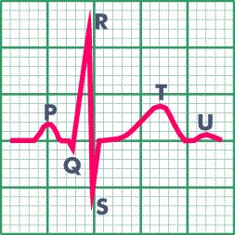
Heart Rhythms, Let’s Keep It Simple!
Kathryn McBroom, RN/NMO 71/73
Steps to Rhythm Interpretation:
Is it regular or irregular?
What is the rate
  (too slow or too fast)?
Is there a P for every QRS?
Is there a QRS for every P?
What is the P-R interval?
Is the R to R interval regular?
What is the QRS duration
  (QRS wide or narrow)?

Slide 2
OK, you have analyzed your strip.
When assessing your patient, what do you look for?
Is your patient:
  Alert and oriented
  Skin warm and dry
  Short of breath (at rest or post activity, remember to ask)
  Experiencing palpitations (is the pulse slow/fast,
  regular/irregular).
  Complaining of lightheadedness or dizziness
Be sure to obtain a set of vital signs

Slide 3

Normal Sinus Rhythm
Originates in the SA node, follows appropriate conduction pathways.
Rhythm: Regular
Rate: 60-100 bpm
Every P has a QRS and every QRS has a P
PRI: .12-.20 seconds
QRS: .8 -.12 seconds, narrow

Slide 4
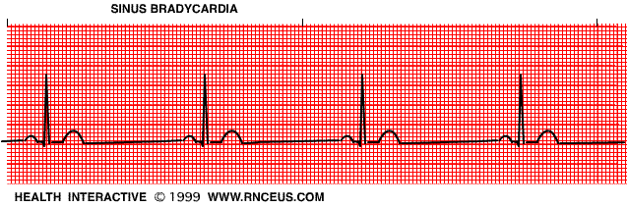
Sinus Bradycardia
Originates in the SA note. Rate is slower because of sympathetic input or excessive vagal tone.
Seen most often with inferior MI, hypoxia, hypothermia, or drug reactions.
Patient may be asymptomatic.
Rate: < 60 bpm
Every P has a QRS and every QRS has a P
PRI: .12 - .20 seconds
QRS: .8 - .12 seconds, narrow

Slide 5

Sinus Tachycardia
Originates in the SA node. Rapid rhythm which occurs with increased oxygen demand ( exercise, infection, hypovolemia, hypoxia, MI, and to stimulant drugs).
Rhythm: regular/fast
Rate: > 100 bpm
Every P has a QRS and every QRS has a P
PRI: .12 - .20 seconds
QRS: normal

Slide 6
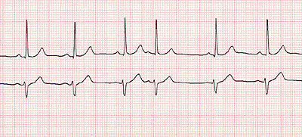
Premature Atrial complex (PAC)
Originates in the atria. Occurs before the normal beat is expected. May occur in the healthy heart.
Can be triggered by anxiety, fever, increased sympathetic input, caffeine and other stimulants, drug interactions, AMI, cardiac ischemia, valvular heart disease, and fever
Rhythm: Irregular with PAC’s
Rate: dependent on rhythm
Every P has a QRS and every QRS has a P
PRI: .12 - .20, may differ from underlying rhythm
QRS: dependent on rhythm

Slide 7
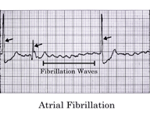
Atrial Fibrillation
Most common cardiac arrhythmia.
May occur with hypertension, ischemia, mitral valve and pericardial disease, MI, aging.
Increased risk for developing atrial thrombus and systemic embolism. Treatment includes anticoagulation, drugs to slow ventricular conduction (rate control) and/or chemical or d/c cardioversion.
Rhythm: irregularly irregular
Rate: slow or fast
No identifiable P’s
QRS usually narrow but may be wide with conduction defect

Slide 8
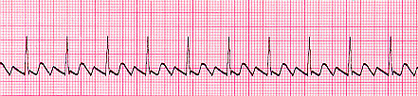
Atrial Flutter
Characterized by “saw tooth” atrial activity
Conduction ratio to the ventricles 2:1 – 8:1. ( usually 2:1-4:1)
Caused by a reentrant circuit located in the right atrium.
May occur in COPD, hypoxia, intrinsic cardiac disease, valve disease, pericarditis or post operatively.
If >150 bpm, may seriously compromise cardiac output.
Treatment is rate control, cardioversion, surgical or catheter ablation.
Rate: atrial rate 250-400 (generally 300bpm)

Slide 9
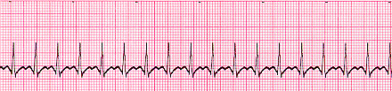
Supraventricular Tachycardia/Atrial Tachycardia
There are several different types of SVT/AT, depending on the site of reentry (originates above ventricle)
accessory pathway, atrioventricular node, atrium
If this rhythm starts and stops suddenly it is called paroxysmal SVT.
MD may consider vagal maneuvers, antiarrhythmia medications, RFA or surgical modification at site of entry
Rhythm: Regular
Rate: 150-250 bpm
PRI: Dependent on location of “circuit”
QRS: Normal, if accessory pathway used – prolonged (>.12) with delta wave (WPW)

Slide 10
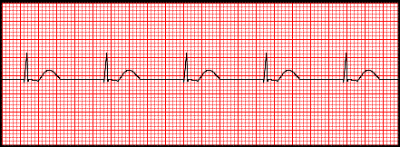
Junctional Rhythm
An escape rhythm serves as a protective mechanism when higher centers in the conduction system fail to fire.
Occurs with increased vagal tone to the sinoatrial node, hypoxemia, and digitalis toxicity
Rhythm: Regular
Rate: 40 – 60 bpm
P wave:
  Before QRS, inverted and P-R interval is < .12
  After QRS and usually inverted
  Absent
QRS: < .12 seconds, unless prolonged by aberrant conduction

Slide 11
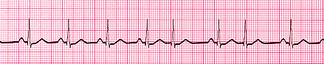
Premature Junctional complex (PJC)
Originates in the atrioventricular junction.
Depending on when the impulse occurs, the P wave may fall before, during or after the QRS complex.
May occur with ischemia, hypoxemia, valvular disease, digitalis.
Rhythm: Irregular with PJC’s
Rate: dependent on rhythm
P wave:
  Before QRS, inverted and P-R interval is < .12
  After QRS and usually inverted
  Absent
PRI: .12 seconds or less
QRS: < .12 seconds

Slide 12
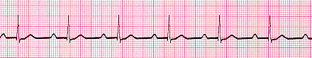
First Degree AV Block
Occurs when impulses from the atria are consistently delayed during conduction through the AV node.
First degree AV block is a constant and prolonged PR interval.
May result from insult to the AV node, hypoxemia, MI, ischemia, increased vagal tone, aging, beta blockers, calcium channel blockers, digitalis toxicity but is also seen in normal conduction.
Rhythm: Regular
Every P has a QRS and every QRS has a P
PRI: > .20 seconds
QRS < .12

Slide 13
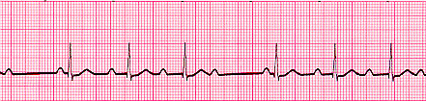
Second Degree AV Block
Mobitz I (Wenkebach)
Wenckebach is characterized by progressive delay at the AV node until the impulse is completely blocked. Possible causes are insult to the AV node, hypoxemia, MI, digitalis toxicity, ischemia, and increased vagal tone. This conduction usually does not progress to higher degree heart blocks.
No treatment needed if patient is asymptomatic
Rhythm: Irregular
PRI: progressive lengthening of PRI until dropped beat.
(long, longer, drop)
QRS is usually < .12

Slide 14
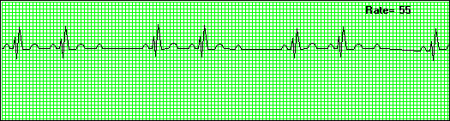
Second Degree AV Block, Mobitz II
Because the ventricle rate is slow, cardiac output may be decreased
May progress to third degree heart block.
Occurs when some impulses from SA node fail to reach the ventricles
Usually occurs with AMI, degenerative changes in conduction, progressive CAD
Problem usually occurs at the Bundle of HIS or it’s branches
Rhythm is irregular (because of dropped beats)
PRI: remains constant until a block of the AV conduction, resulting is a P wave not being followed by a QRS
Is there a P for every QRS (YES); is there a QRS for every P (NO)?
Treatment: the aim is to improve cardiac output. Consider temporary pacing or permanent pacemaker. Close monitoring and BP support.

Slide 15

Third Degree Heart Block
No conduction through the AV node (“divorced heart”).
Atrial and Ventricular rate and rhythm are independent of one another
Treatment: temp. or permanent pacing
Rhythm is regular (ventricular and atrial, but at diff. rates)
Rate:
  Atrial: 60 to 100
  Ventricular 40 to 60
PRI: will vary with no pattern or regularity
QRS: origin of impulse determines QRS width.
  From AV node: QRS will be normal
  From Purkinje system: QRS will be wide, rate < 40

Slide 16
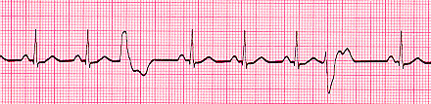
Premature Ventricular Contraction
PVC complex may be isolated or occur in pairs or clusters
Primary cause: electrical irritability
Potential for developing dysrhthmias increases in patients with ischemia or progressive heart disease
Treatment: none unless symptomatic
Rhythm: irregular
P wave: usually absent
QRS: greater than .12 seconds and “wide and bizarre”

Slide 17

PVC’s in Couplets
A pattern of two PVC’s following a normal complex. Remember: Three or more PVC’s in a row is VT
A result of ventricular irritability
QRS: > .12 and wide and bizarre
Treatment: close monitoring to assess possibility of ventricular tachycardia, monitor labs (potassium and magnesium)

Slide 18
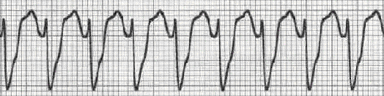
Ventricular Tachycardia
Three or more beats originating in the ventricle
VT without pulse is treated like ventricular fibrillation (see ACLS algorithm)
Rate usually regular, 100 - 250 bpm
P wave: may be absent, inverted or retrograde
QRS: complexes bizarre, > .12
Rhythm: may be irregular but usually regular

Slide 19
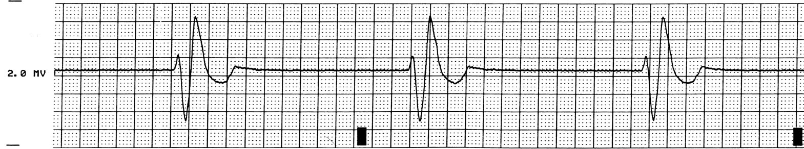
Idioventricular Rhythm
Escape rhythm (safety mechanism) to prevent ventricular standstill
HIS/purkinje system takes over as the heart’s pacemaker
Treatment: pacing
Rhythm: regular
Rate: 20-40 bpm
P wave: absent
QRS: > .12 seconds (wide and bizarre)

Slide 20
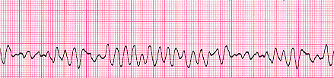
Ventricular Fibrillation
Pt is pulseless i.e. dead
No organized electrical activity
No cardiac output
Causes: MI, ischemia, untreated VT, underlying CAD, acid base imbalance, electrolyte imbalance, hypothermia,
Treatment: ALWAYS immediate unsynchronized defibrillation (see ACLS algorithm).
Rhythm: irregular-coarse or fine, wave form varies in size and shape
No discernible complexes

Slide 21
Pulseless Electrical Activity (PEA)
Electrical activity without pulse (no muscle contraction)
  Any rhythm can be seen on monitor, but pt. is pulseless
Causes: MI, hypovolemia, hypoxia, hypothermia, hypo/hyperkalemia, tension pneumothorax, cardiac tamponade, massive pulmonary embolism, acidosis, and drug overdose
Treatment: Identify and correct underlying cause (see ACLS algorithm)
Requires rapid identification and treatment
Rhythm: evidence of organized electrical activity but without pulse
PRI: may appear normal
QRS: may appear normal
“Insert any rhythm here”
Any rhythm can be seen on the monitor

Slide 22

Asystole
Ventricular standstill, no electrical activity, no cardiac output
Occurs in cardiac arrest, may follow VF or PEA
Remember! No defibrillation with Asystole
Treatment: Epinephrine and Atropine, consider causes (pulmonary embolism, acidosis, tension pneumothorax, hypo/hyperkalemia, hypoxia, cardiac tamponade, hypothermia, drug overdose, MI)
Rate: absent due to absence of ventricular activity. Occassional P wave may be identified. Patient will not have a pulse.

Slide 23
Heart Rhythm Quiz
1. In Second Degree Type I AV block, the PR interval:
a. Varies according to the ventricular response rate
b. Progressively lengthens until a QRS complex is dropped.
c. Remains constant despite an irregular ventricular rhythm.
d. Is un-measurable
2. You see a rhythm with a narrow complex on the monitor that has a P for QRS and a rate of 165.
It is:
    Sinus tachycardia
    Atrial tachycardia
    Atrial fibrillation
    Junctional tachycardia
3. In third degree heart block (CHB) the ventricular response (QRS) is:
    Narrow or wide and regular
    Wide and irregular
    Narrow and irregular
    Regular except when a beat is dropped
4. When 2 or more PVC’s are seen on a strip, it is important to use the following descriptors if
applicable:
    Couplet/triplet
    Multifocal/ Unifocal
    Groupings (bigeminy, trigeminy etc.)
    All of the above
5. Characteristics of Normal sinus rhythm are:
a. Regular, normal rate with Normal PR and QT intervals
b. A P wave for every QRS complex, all P waves are similar in size and shape
c. All QRS complexes are similar in size and shape
d. All of the above

Slide 24
References
Lippincott Manual of Nursing Practice, eighth edition, pp. 420-429
Lippincott, Williams and Wilkins, ECG Interpretation, 3rd edition, pp. 65-159
American Heart Association, ACLS for Healthcare Providers - Algorithm Review.
www.americanheartassociation.com
www.cardiacarrhythmias.com
www.googleimages.com
www.rnceus.com
www.PERD.LLC

