Slide 1
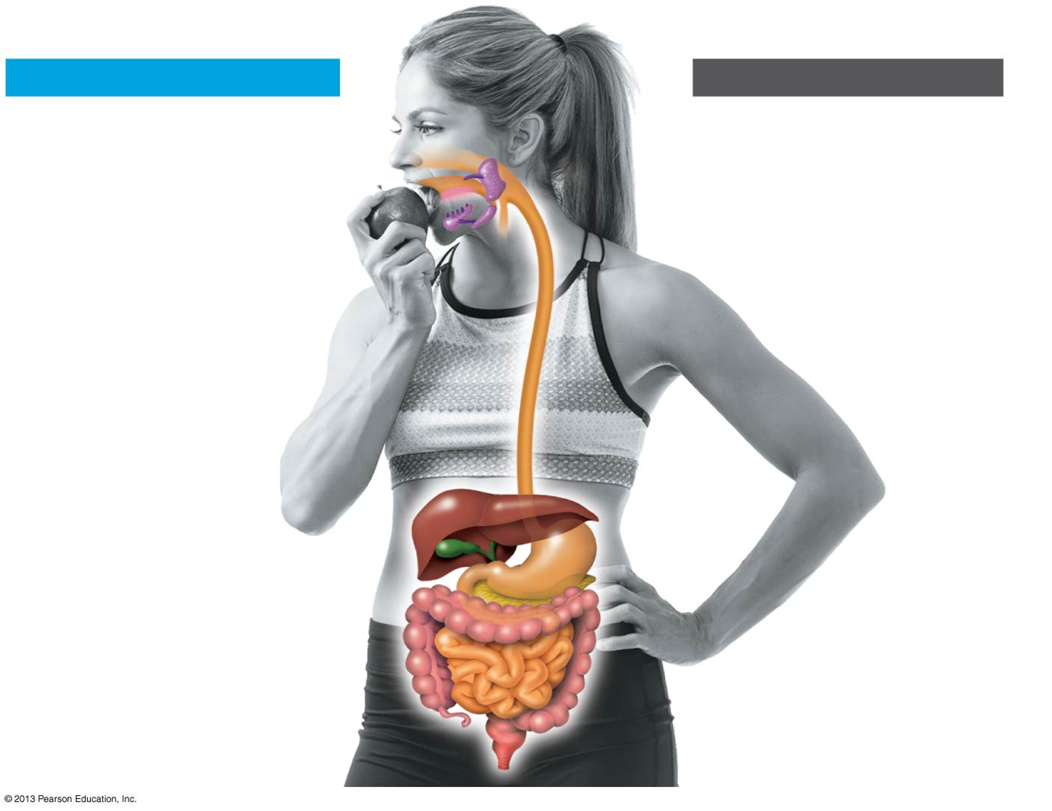
Chapter 22
0
Nutrition and Digestion

Slide 2
Animal Diets
  Food provides the raw materials that animals, including people, need to
    build tissue and
    fuel cellular work.
  Herbivores mainly feed on plants or algae.
  Carnivores mainly eat other animals.
  Omnivores eat
    animals and
    plants or algae.

Slide 3
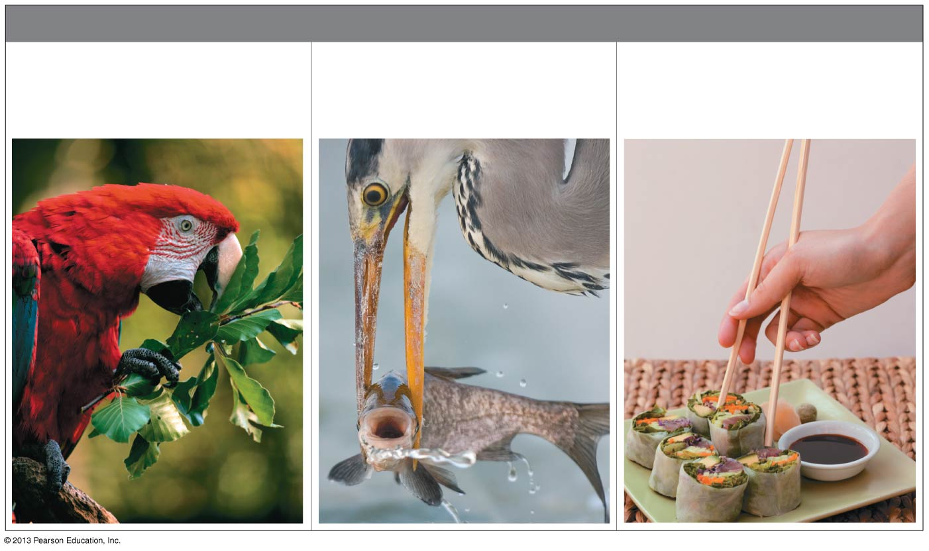
Figure 22.1
ANIMAL DIETS
Herbivore
(mainly eats plants
or algae)
Carnivore
(mainly eats animals)
Omnivore
(regularly eats animals as
well as plants or algae)
Notes:
Figure 22.1 Animal diets

Slide 4
The Four Stages of Food Processing
  Ingestion is another word for eating.
  Digestion is the breakdown of food into molecules small enough for the body to absorb.
  Absorption is the uptake of the small nutrient molecules by cells lining the digestive tract.
  Elimination is the disposal of undigested materials left over from food.

Slide 5
Digestion: A Closer Look
The dismantling of food molecules is necessary because food molecules are
too large to cross the membranes of animal cells and
different from molecules that make up an animal’s body.

Slide 6
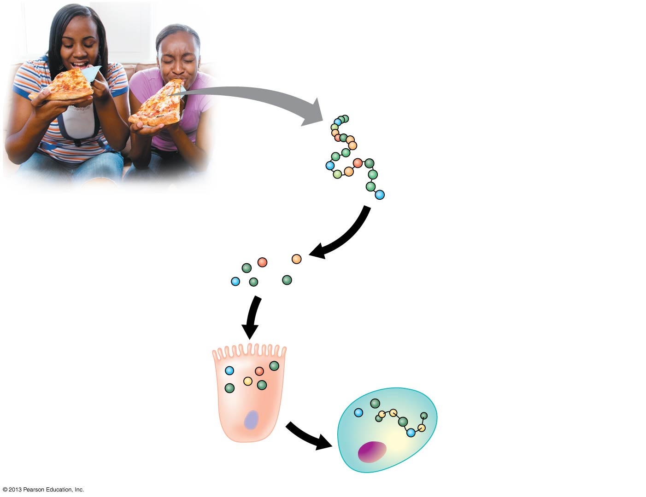
Figure 22.2
Cheese protein
(a polymer of
amino acids in
a specific sequence)
Amino acid
monomer
1
Breakdown of protein
by human digestive
system
Amino acids
2
Absorption of amino acids by cells lining the
small intestine; transport via bloodstream to
other cells
Human protein
3
Cells use amino acids
from the cheese and
other foods to produce
new human proteins
Notes:
Figure 22.2 From cheese protein to human protein

Slide 7
Digestion: A Closer Look
Chemical digestion proceeds via hydrolysis, chemical reactions that break down polymers into monomers using water in the process.
Like most biological reactions, digestion also requires enzymes.

Slide 8
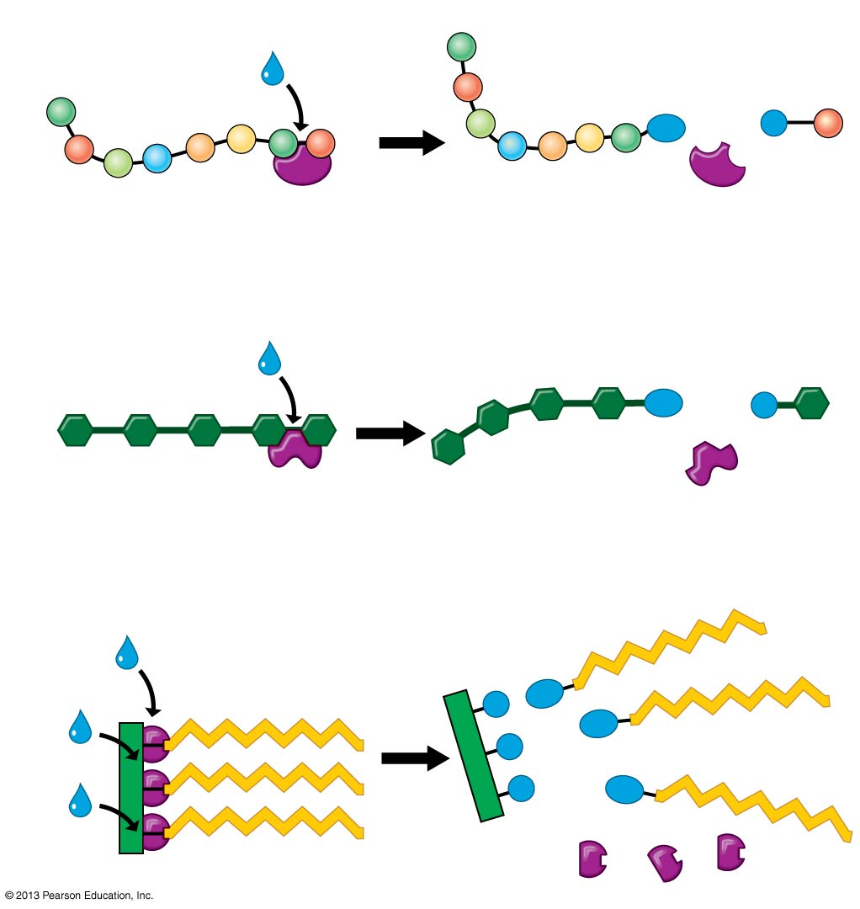
Figure 22.3
Protein
H₂O
Amino acid
OH
H
Enzyme (pepsin)
Carbohydrate
Sugar
H₂O
OH
H
Enzyme (amylase)
Fat
Fatty acid
H₂O
Glycerol
H₂O
H
OH
OH
H
H₂O
H
OH
Enzyme (lipase)
Notes:
Figure 22.3 Chemical digestion: hydrolysis of food molecules

Slide 9
Digestive Compartments
  How do animals digest their food without digesting themselves?
  In animals, chemical digestion is contained safely within some kind of compartment
  As a cell engulfs food by phagocytosis,
    a food vacuole forms,
    which then fuses with a lysosome filled with digestive enzymes, and
    as food is digested, small food molecules pass through the vacuole membrane into the cytoplasm, which nourishes the cell.

Slide 10
Digestive Compartments
  Food vacuoles are the simplest of all digestive compartments.
  Sponges are the only animals that digest food solely within their cells.
  Gastrovascular cavities
    are digestive compartments surrounded by cells and
    have only a single opening.
  A digestive tube, or alimentary canal, has two separate openings:
    a mouth and
    an anus.

Slide 11
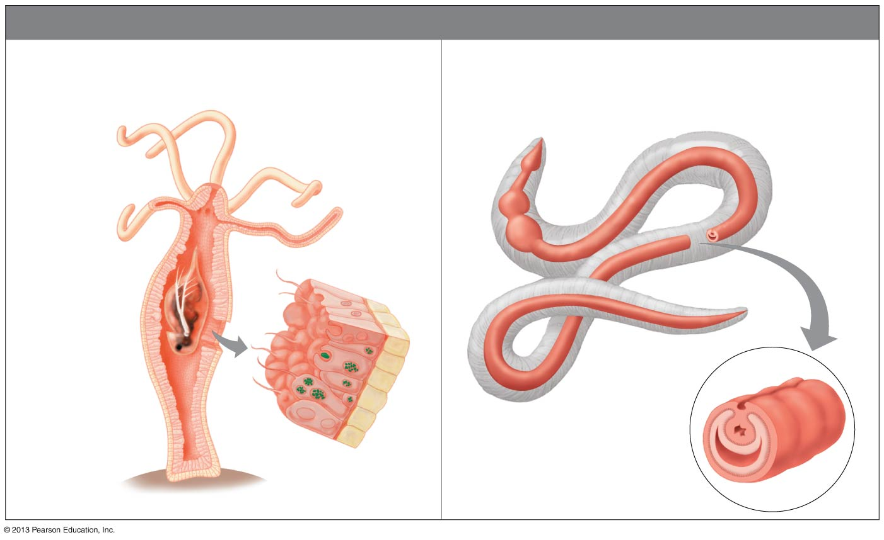
Figure 22.4
MAIN TYPES OF DIGESTIVE COMPARTMENTS
Gastrovascular Cavity
(compartment with single opening)
Alimentary Canal (Digestive Tract)
(tube from mouth to anus)
Single
opening
Mouth
Digested
food
particle
Anus
Food
(water flea)
Intestine
Gastrovascular
cavity
Interior of
intestine
Newly
engulfed
food particle
Hydra
Earthworm
Notes:
Figure 22.4 Main types of digestive compartments in animals

Slide 12
A TOUR OF THE HUMAN DIGESTIVE SYSTEM System Map
  The human digestive system consists of
    a digestive tube, the alimentary canal (or gut), and
    accessory organs that secrete digestive chemicals

Slide 13

Figure 22.5
ACCESSORY ORGANS
ALIMENTARY CANAL
Oral cavity (mouth)
Tongue
Pharynx
Salivary glands
Esophagus
Liver
Gallbladder
Stomach
Pancreas
Small intestine
Colon of large intestine
Appendix
Rectum
Anus
Notes:
Figure 22.5 The human digestive system

Slide 14
The Mouth
  The mouth, or oral cavity, functions in
    ingestion and
    the preliminary steps of digestion.
  Chemical digestion begins in the mouth with the secretion of saliva from salivary glands.
  The muscular tongue
    tastes,
    shapes food into a ball, and
    pushes the food to the back of the mouth for swallowing.

Slide 15
The Pharynx
  The pharynx
    connects the mouth to the esophagus and
    opens to the trachea, which leads to the lungs.
  During swallowing, a reflex
    moves the opening of the trachea upward and
    tips the epiglottis to close the trachea entrance

Slide 16
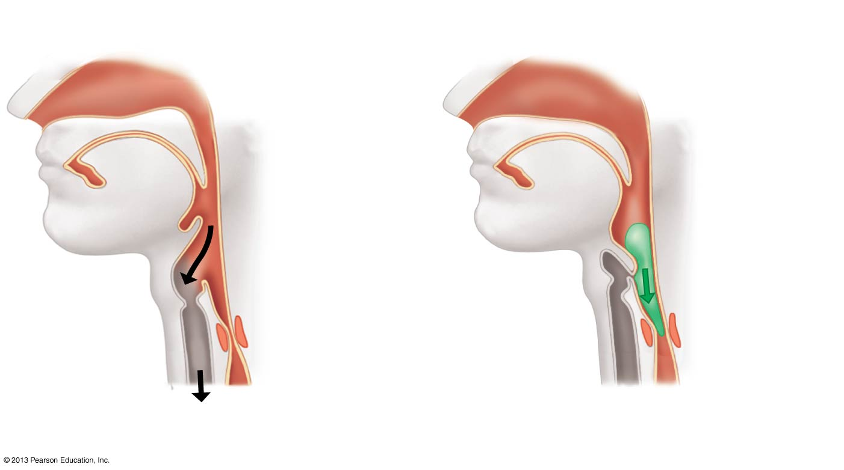
Figure 22.7
BREATHING
SWALLOWING
Epiglottis
up
Epiglottis
down
Pharynx
Adam’s
apple
Air flowing
into open
trachea
(windpipe)
Esophagus
closed
Trachea
closed
Food flowing
into open
esophagus
Notes:
Figure 22.7 The epiglottis controls whether the pharynx is open to the lungs (left) or the stomach (right).

Slide 17
The Esophagus
  The esophagus
    is a muscular tube,
    connects the pharynx to the stomach, and
    moves food down by peristalsis, alternating waves of muscular contraction and relaxation

Slide 18
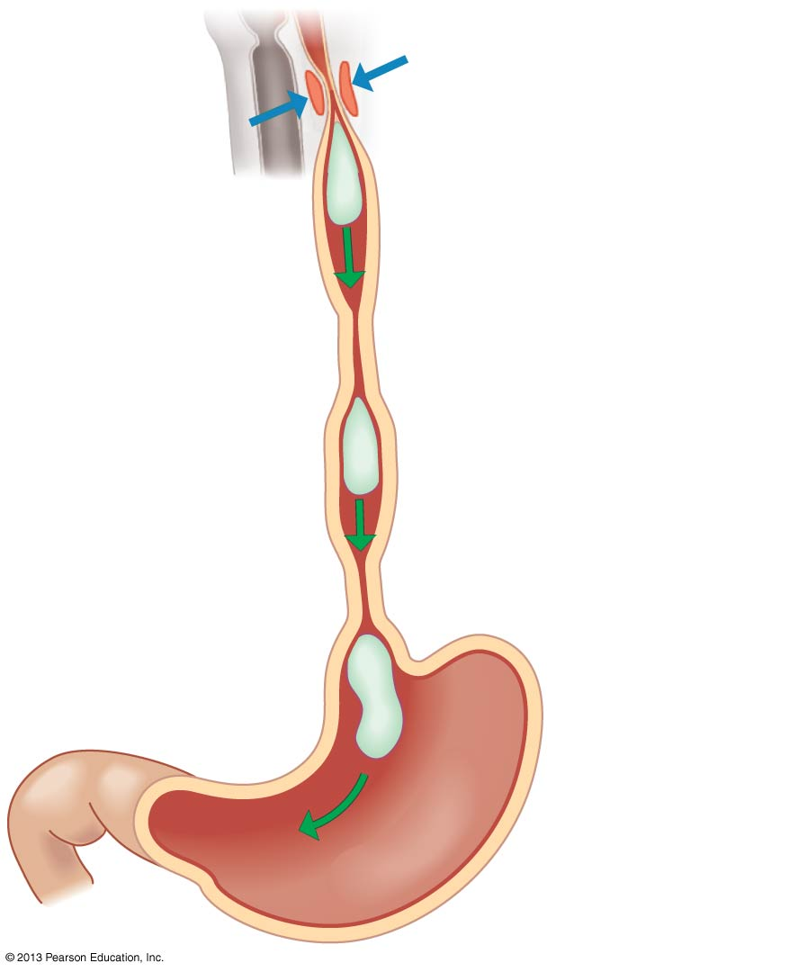
Figure 22.8
Esophageal sphincter
(contracted)
Food ball
Relaxed muscles
Contracted muscles
Relaxed muscles
Stomach
Notes:
Figure 22.8 The esophagus and peristalsis

Slide 19
The Stomach
  The stomach
    can store food for several hours and
    churns food into a thick soup called chyme.
  Fluid in the stomach contains gastric juice,
  made of
    strong acid,(HCL)
    digestive enzymes,
    mucus, and
    the enzyme pepsin, which digests proteins

Slide 20
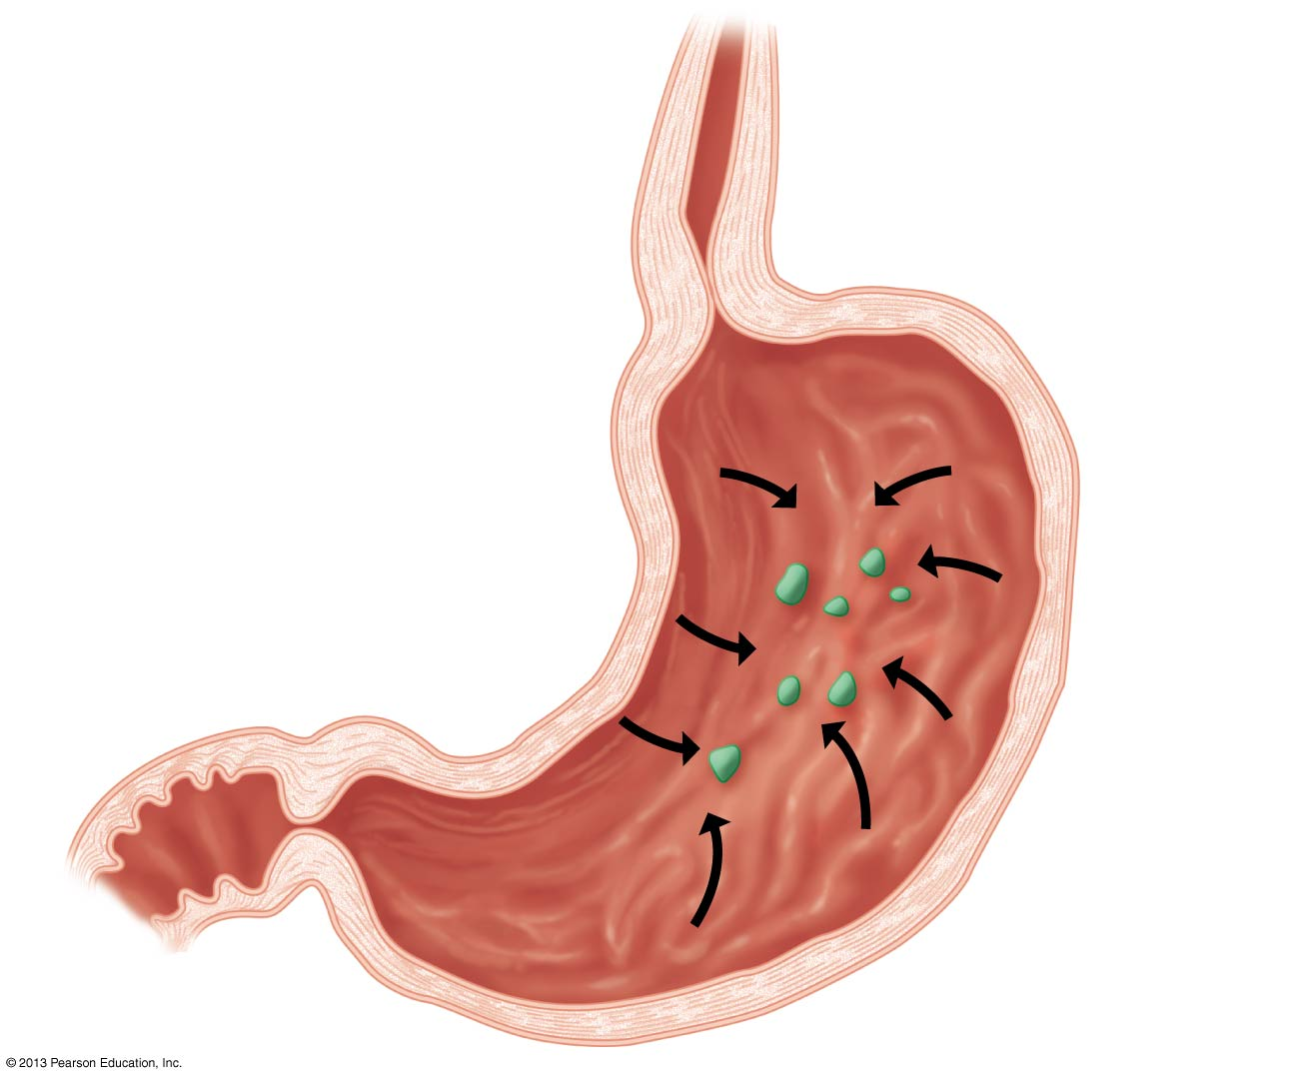
Figure 22.9
Stomach lining secretes
gastric juice (acid, enzyme
molecules, and mucus)
Esophagus
Sphincters control
the flow into and
out of the stomach
Accordion-like
folds allow the
stomach to expand.
Small intestine
Food particle
Notes:
Figure 22.9 The human stomach

Slide 21
Stomach Ailments
  Heartburn is caused by backflow of chyme into the esophagus.
  Gastric ulcers are
    erosions of the stomach lining and
    often caused by the bacterium Helicobacter pylori

Slide 22
Weight Loss Surgeries
  The most common weight loss surgery in the United States is gastric bypass.
    Staples are used to reduce the stomach to about the size of a chicken egg.
    The first 18 inches of the small intestine are bypassed by attaching the downstream intestine directly to the reduced stomach pouch.
  As a result,
    patients quickly feel full when eating and
    the body’s ability to absorb food is reduced.

Slide 23
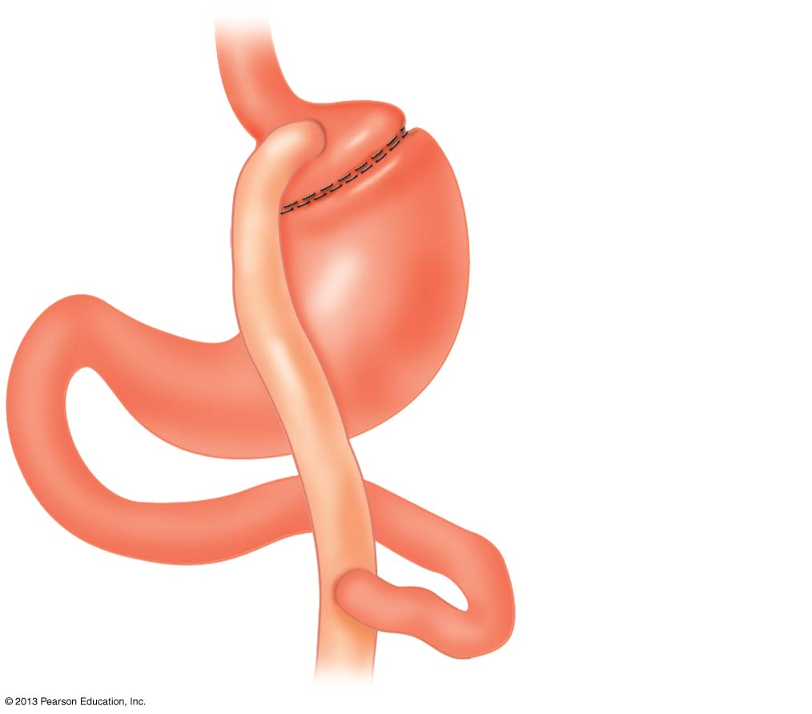
Figure 22.10
Esophagus
Small stomach pouch
Staples
New attachment
Bypassed portion
of stomach
Tube through which
food is bypassed
Small intestine
Notes:
Figure 22.10 Gastric bypass surgery

Slide 24
The Small Intestine
  The small intestine is
    the longest part of the alimentary canal and
    the major organ for chemical digestion and absorption of nutrients into the bloodstream.
Chemical Digestion in the Small Intestine
  Most chemical digestion occurs in the duodenum, the first part of the small intestine.
  In the duodenum, chyme from the stomach mixes with
    pancreatic juice,
    bile, and
    a digestive juice secreted by the intestinal lining.

Slide 25
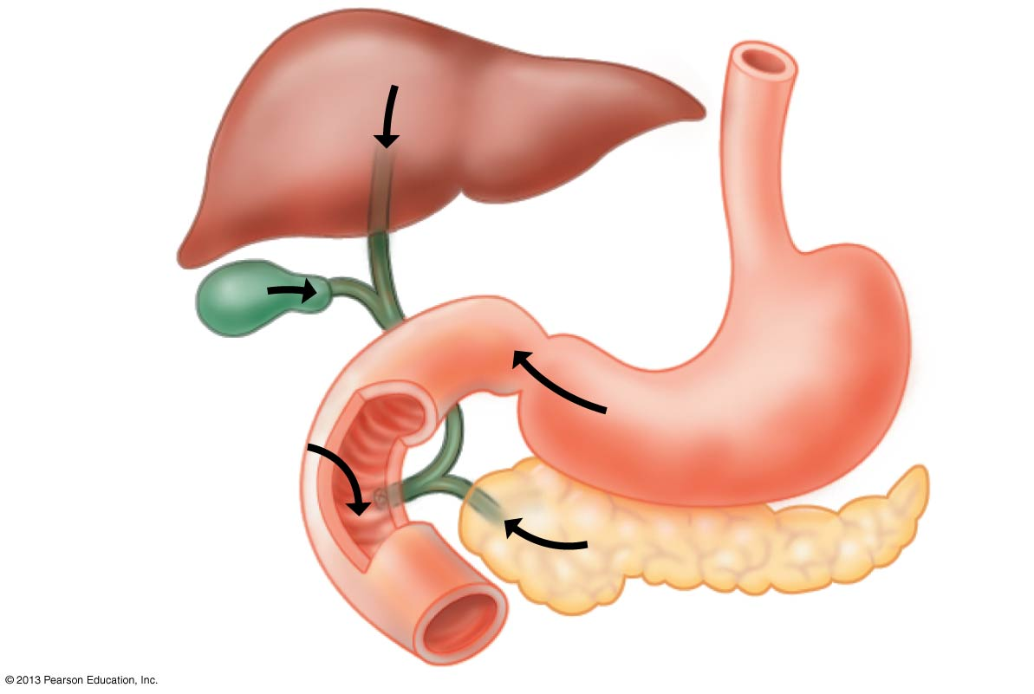
Figure 22.11
Bile
Liver
Stomach
Bile
Gallbladder
Chyme
Intestinal enzymes
Pancreatic juice
Duodenum of
small intestine
Pancreas
Notes:
Figure 22.11 The duodenum

Slide 26
Chemical Digestion in the Small Intestine
  The pancreas secretes juice that
    neutralizes stomach acids in the duodenum and
    aids in digestion.
  The liver secretes bile, which
    is stored in the gallbladder and
    helps digest fats.

Slide 27
Absorption of Nutrients
  In the duodenum, nutrients are
    completely digested and
    ready to be absorbed.
  Nutrients only enter the body if they are absorbed into the walls of the digestive tract.

Slide 28
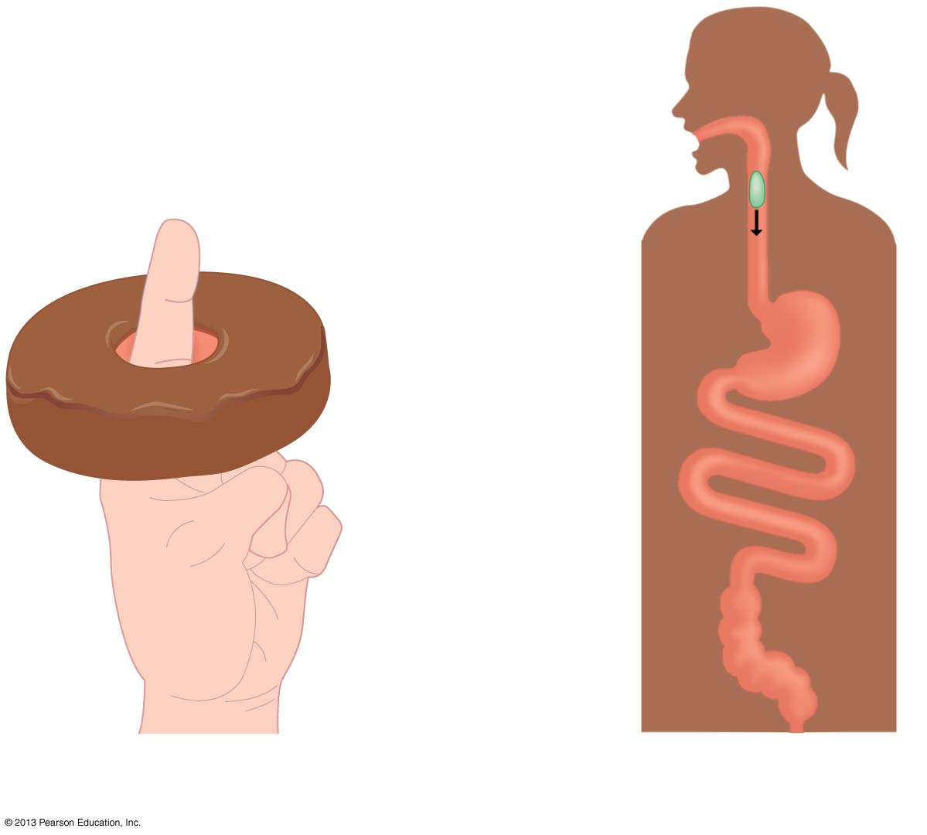
Figure 22.12
Mouth
Alimentary
canal
Anus
A finger through a hole
Food through the alimentary canal
Notes:
Figure 22.12 Nutrients within the small intestine are not yet inside the body.

Slide 29
Absorption of Nutrients
  Villi and microvilli on the surface of the small intestine increase
    the surface area and
    capacity for absorption.

Slide 30
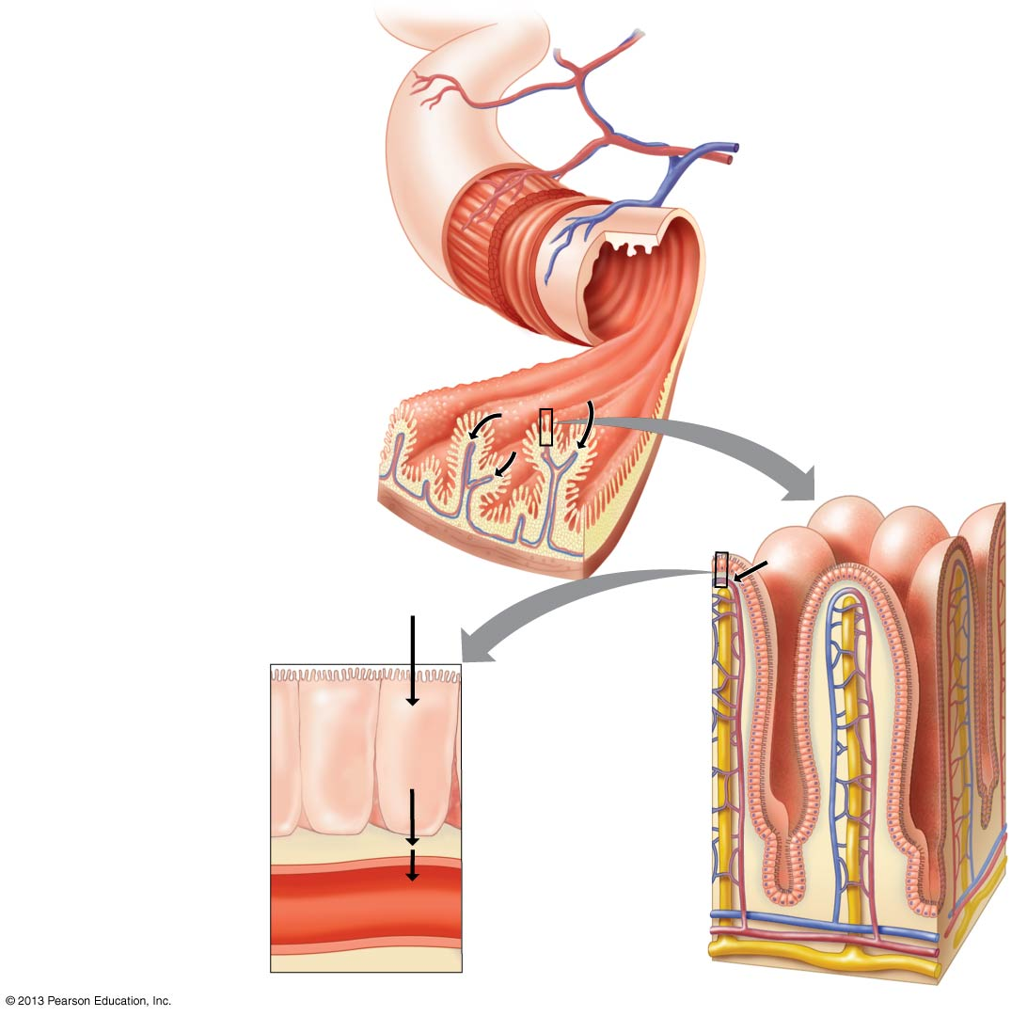
Figure 22.13
Blood vessels
Muscle
layers
Interior of
intestine
Intestinal wall
Nutrient
absorption
Villi
Interior of
intestine
Nutrient
absorption
Nutrient
absorption
Microvilli
Epithelial
cells
Blood
capillaries
Blood
Lymphatic
vessel
Epithelial cells and
blood capillary
Villi
Notes:
Figure 22.13 The small intestine and nutrient absorption

Slide 31
The Large Intestine
  The large intestine is
    shorter, but wider, than the small intestine and
    about 1.5 meters in length.
  At the junction of the small and large intestine is a small, finger-like extension called the appendix.
    The appendix contains white blood cells that make minor contributions to the immune system.
    Appendicitis is a bacterial infection of the appendix.

Slide 32
The Large Intestine
  The colon
    forms the main portion of the large intestine,
    absorbs water from the alimentary canal, and
    produces feces, the waste product of food.
    The rectum
    forms the last 15 cm (6 inches) of the large intestine and
    stores feces until elimination.
    The anus
    consists of two sphincters and
    regulates the opening of the rectum.

Slide 33
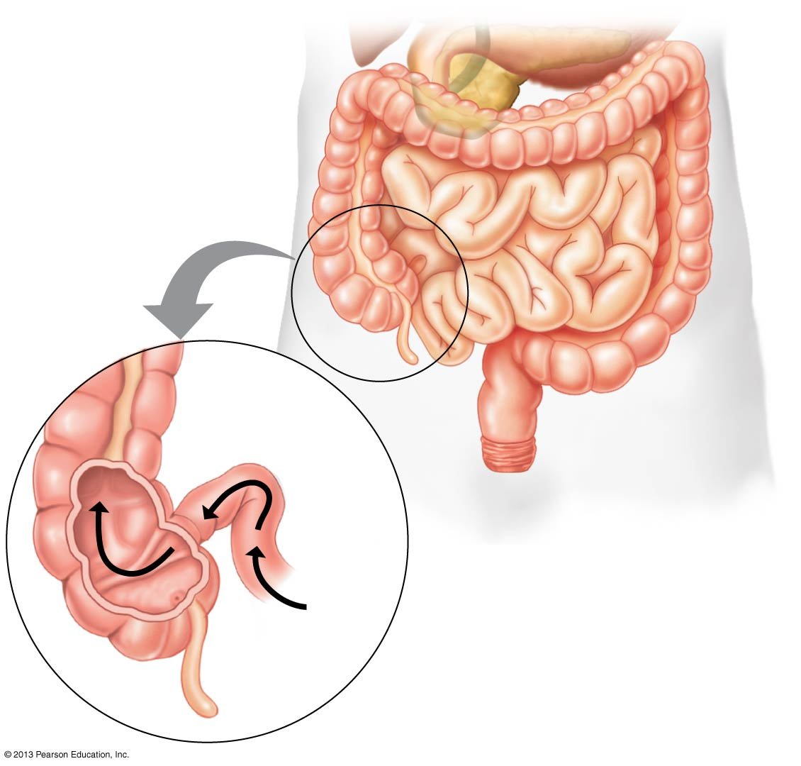
Figure 22.14
Colon of
large
intestine
Small
intestine
Sphincter
End
of small
intestine
Rectum
Anus
Nutrient
flow
Appendix
Notes:
Figure 22.14 The large intestine and its connection to the small intestine

Slide 34
The Large Intestine
Food processing takes place along the alimentary canal.

Slide 35
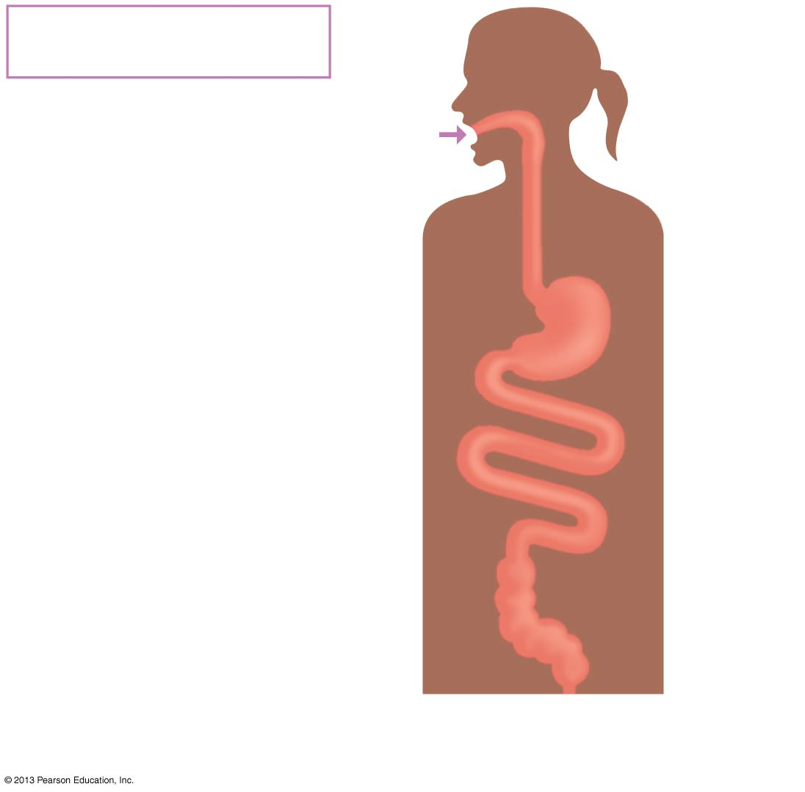
Figure 22.15-1
Ingestion
Food into mouth
Mouth
Food
Stomach
Small
intestine
Large
intestine
Anus
Notes:
Figure 22.15 Review of food processing in the human alimentary canal (step 1)

Slide 36
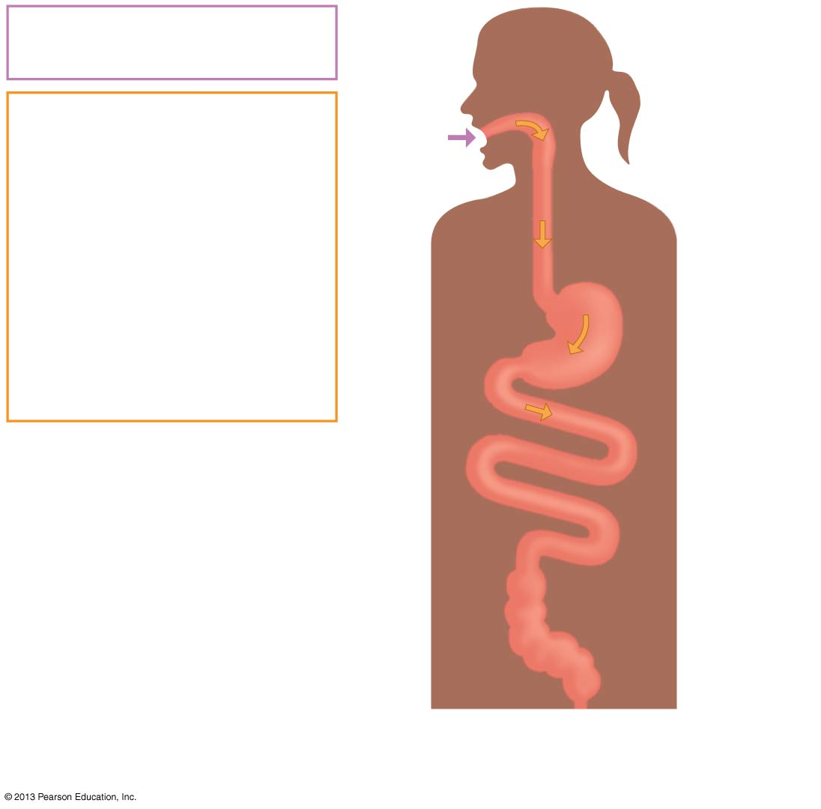
Figure 22.15-2
Ingestion
Food into mouth
Mouth
Digestion
Mechanical digestion
Chewing in mouth
Churning in stomach
Food
Chemical digestion
Saliva in mouth
Acid and pepsin in
stomach
Enzymes in small
intestine
Stomach
Small
intestine
Large
intestine
Anus
Notes:
Figure 22.15 Review of food processing in the human alimentary canal (step 2)

Slide 37
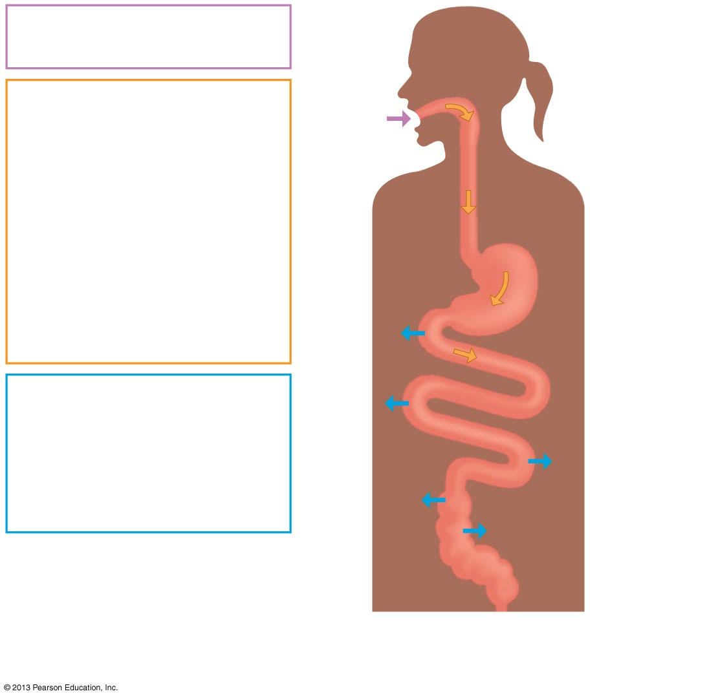
Figure 22.15-3
Ingestion
Food into mouth
Mouth
Digestion
Mechanical digestion
Chewing in mouth
Churning in stomach
Food
Chemical digestion
Saliva in mouth
Acid and pepsin in
stomach
Enzymes in small
intestine
Stomach
Absorption
Nutrients and water
in small intestine
Small
intestine
Water in large
intestine
Large
intestine
Anus
Notes:
Figure 22.15 Review of food processing in the human alimentary canal (step 3)

Slide 38
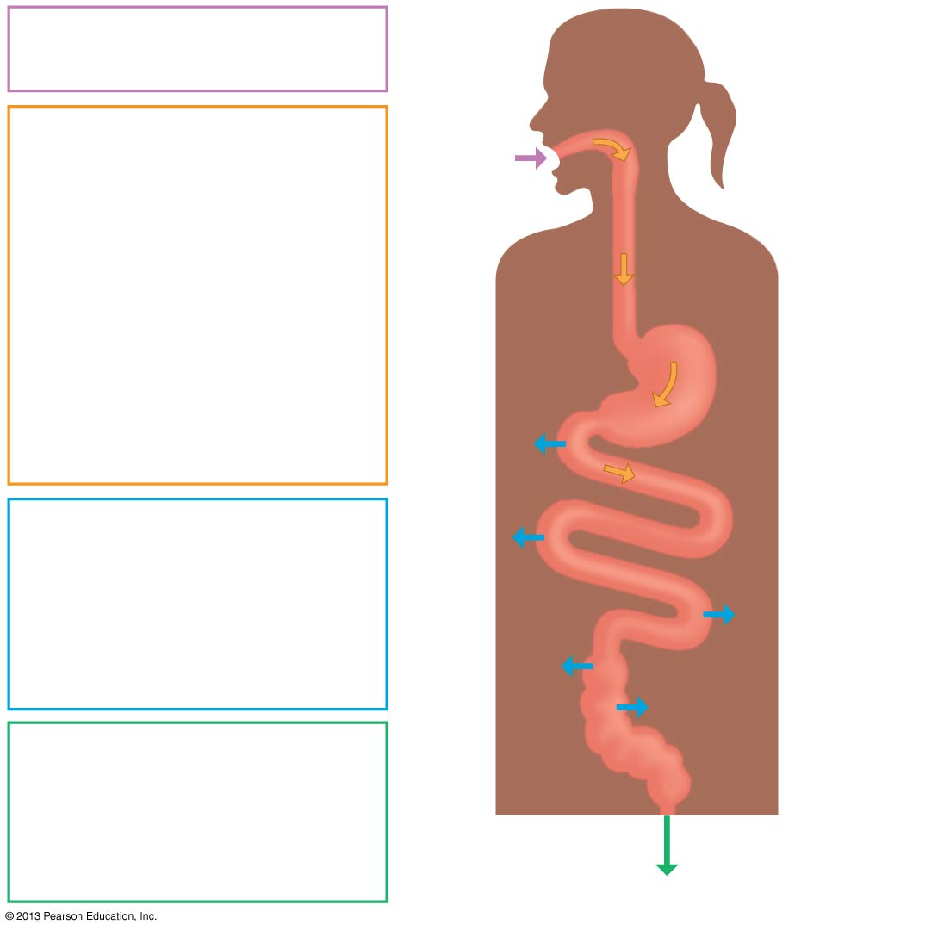
Figure 22.15-4
Ingestion
Food into mouth
Mouth
Digestion
Mechanical digestion
Chewing in mouth
Churning in stomach
Food
Chemical digestion
Saliva in mouth
Acid and pepsin in
stomach
Enzymes in small
intestine
Stomach
Absorption
Nutrients and water
in small intestine
Small
intestine
Water in large
intestine
Elimination
Feces formed in
large intestine
Large
intestine
Anus
Elimination from anus
Feces
Notes:
Figure 22.15 Review of food processing in the human alimentary canal (step 4)

Slide 39
HUMAN NUTRITIONAL REQUIREMENTS
  Proper nutrition provides
    fuel for cellular work,
    materials for building molecules, and
    essential nutrients for health.
  Cells use cellular respiration to
    extract energy stored in food molecules and
    generate molecules of ATP to do work.

Slide 40
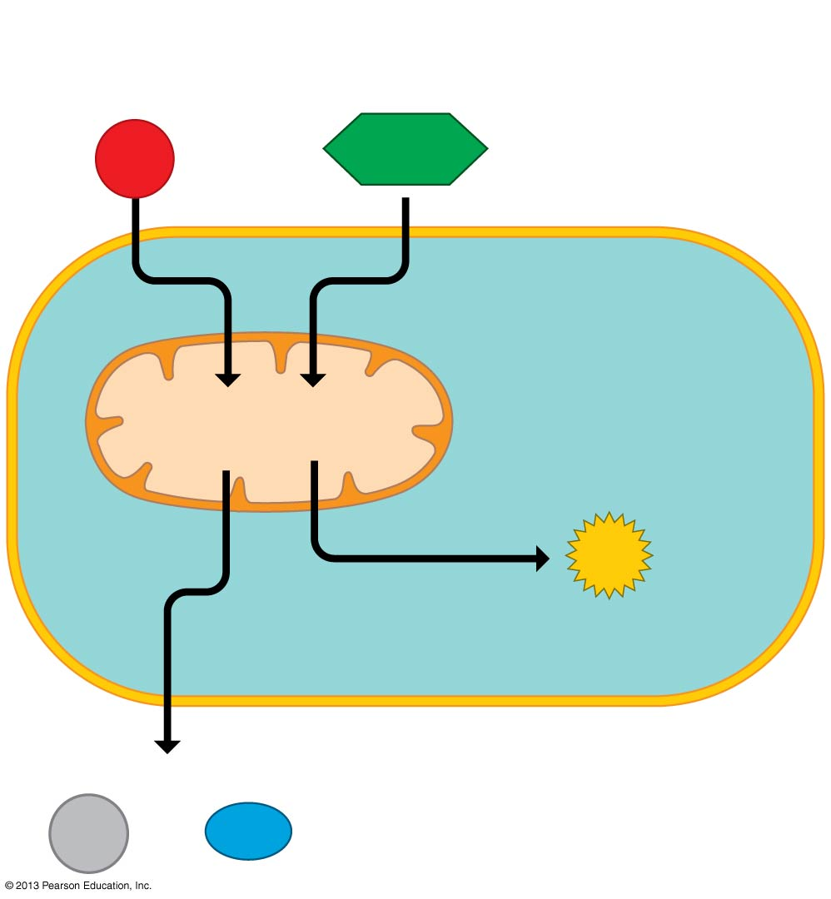
Figure 22.16
“Fuel”
(organic molecules
such as glucose)
O₂
C₆H₁₂O₆
Mitochondrion
Cellular
respiration
ATP
Cell
(energy for
cellular work)
“Exhaust”
CO₂
and
H₂O
Notes:
Figure 22.16 Review of cellular respiration

Slide 41
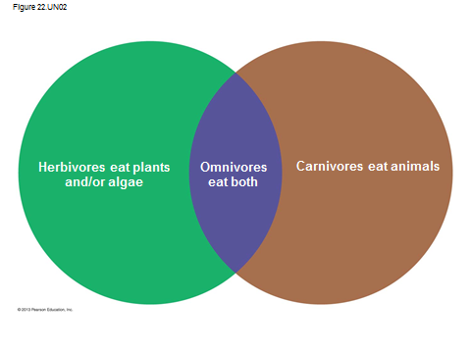
Review

Slide 42
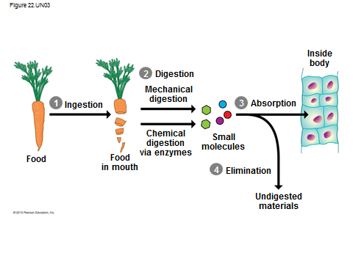
The Four Stages of Food Processing

Slide 43
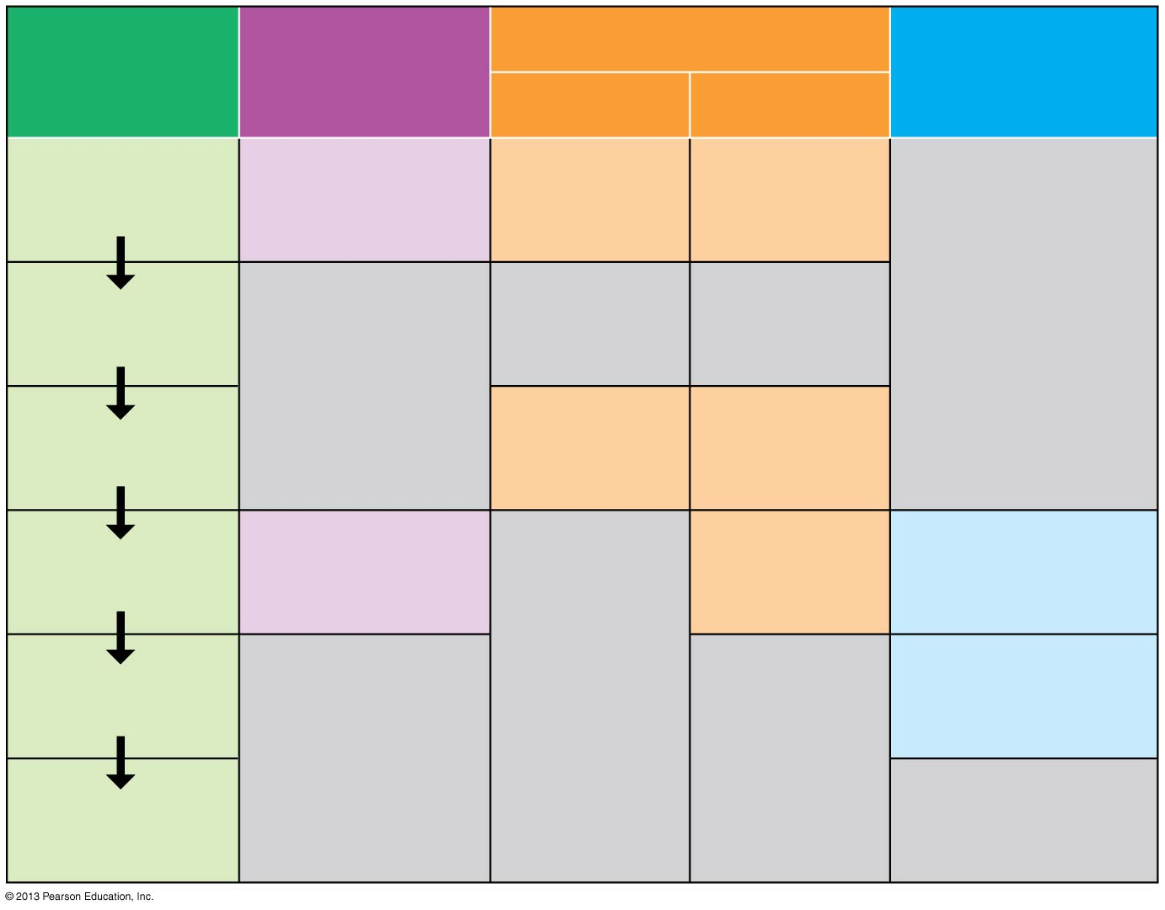
Figure 22.UN04
Alimentary
canal
Accessory
organs
Digestion
Absorption
Mechanical
Chemical
Mouth
(oral cavity)
Salivary
amylase
Salivary glands
Chewing
Pharynx and
esophagus
Acid and
pepsin (in
gastric juice)
Stomach
Churning
Liver,
gallbladder,
pancreas
Other
enzymes
Nutrients
and water
Small
intestine
Large
intestine
Water
Anus
Notes:
Figure 22.UN04 Summary of Key Concepts: Human Digestive System Map

Slide 44
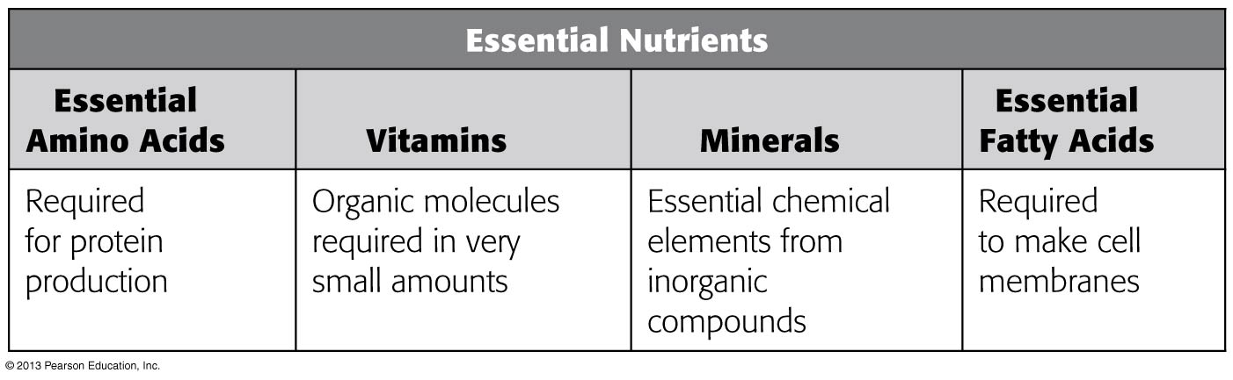
Figure 22.UN05
Notes:
Figure 22.UN05 Summary of Key Concepts: Food as Building Material

