Slide 1
Introduction to Clinical Pharmacology Chapter 18 Antidementia Drugs

Slide 2
Learning Objectives
Compare and contrast the clinical manifestations of Alzheimer disease (AD).
Explain the uses, general drug actions, general adverse reactions, contraindications, precautions, and interactions associated with the administration of antidementia drugs.
Distinguish important preadministration and ongoing assessment activities the nurse should perform with the client taking an antidementia drug.
List nursing diagnoses particular to a client taking an antidementia drug.
Examine ways to promote an optimal response to therapy, how to manage common adverse reactions, and important points to keep in mind when educating clients about the use of antidementia drugs.

Slide 3
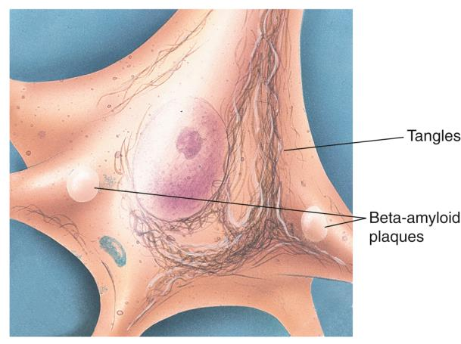
What Is Dementia?
Dementia—overall term for a variety of diseases and conditions that involve decrease in cognitive functioning (i.e., memory, attention, language, communication, and problem-solving)
Alzheimer disease—type of dementia with amyloid plaques and tangled nerve bundles which slow or block transmission within the brain

Slide 4
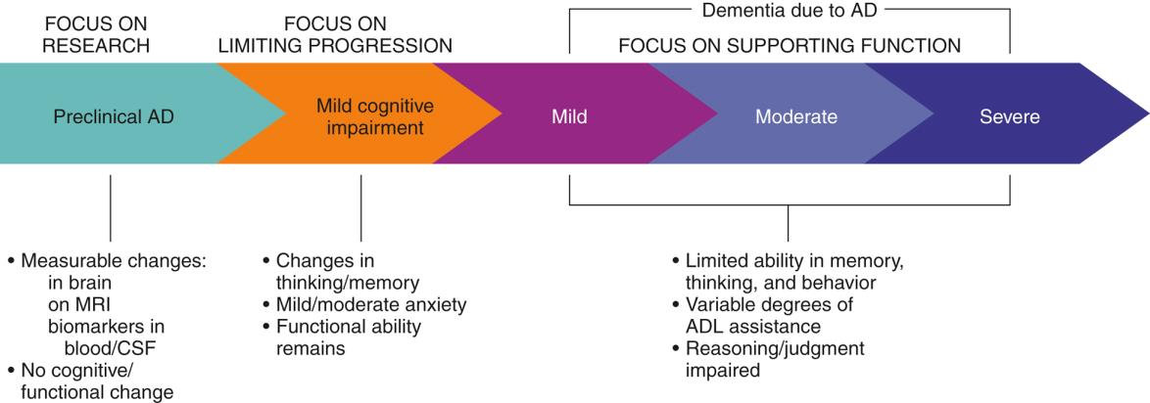
Continuum of Alzheimer Disease Progression
Preclinical
Mild cognitive impairment
Mild
Moderate
Severe

Slide 5
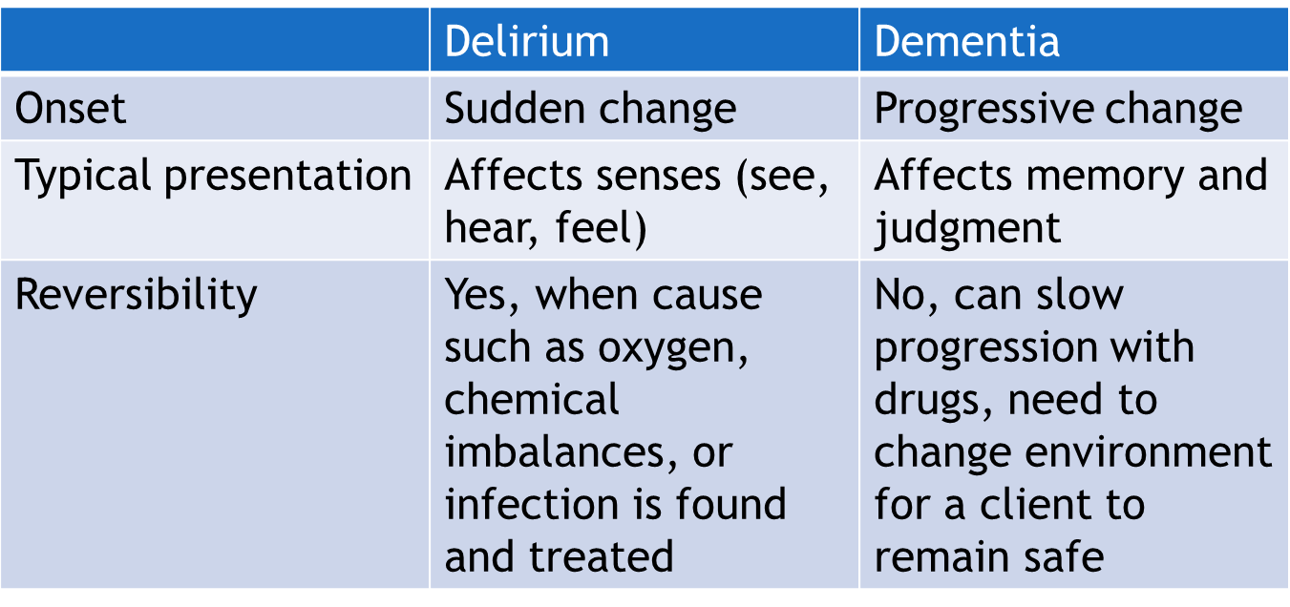
Dementia versus Delirium

Slide 6

Antidementia Drugs—Actions #1
Cholinesterase Inhibitors
Increase the levels of acetylcholine in the central nervous system by inhibiting its breakdown and slowing neural destruction
Slow but do not stop the progress of the disease
Example: donepezil

Slide 7

Antidementia Drugs—Actions #2
NMDA Receptor Antagonist
Decreases the excitability of neurotransmission caused by an excess of the amino acid glutamate in the central nervous system
NDMA blocker attaches to the nerve cell receptors and helps prevent cell damage
Example: memantine

Slide 8
Antidementia Drugs—Uses
To treat early and moderate stages of dementia associated with Alzheimer disease
Investigational use for severe cognitive decline associated with vascular or Parkinson dementia
Drugs are best used early as they slow the progression of AD

Slide 9

Antidementia Drugs—Adverse Reactions
General Adverse Reactions:
Anorexia
Confusion
Nausea
Vomiting
Diarrhea
Dizziness
Headache

Slide 10

Antidementia Drugs—Contraindications and Precautions
Contraindicated in clients with:
known hypersensitivity to the drugs
pregnancy and lactation
confusion from delirium
Use cautiously in clients with:
renal disease, bladder obstruction
seizure disorders
sick sinus syndrome
GI bleeding
asthma
a history of ulcer disease

Slide 11
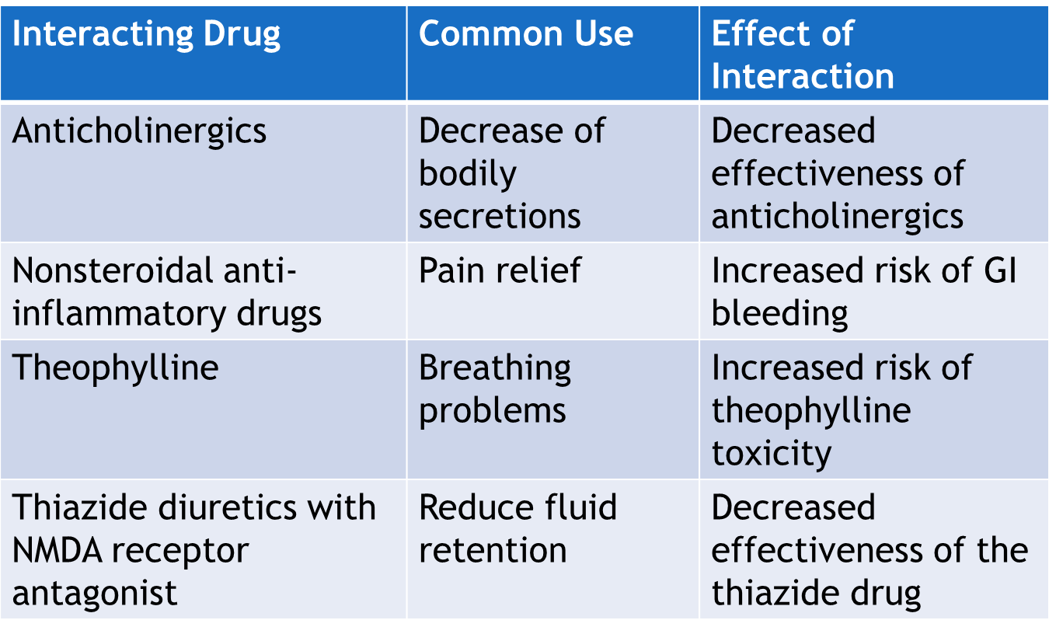
Antidementia Drugs—Interactions

Slide 12
Nursing Process—Client Receiving an Antidementia Drug #1
Preadministration Assessment
Objective Data
Description of general appearance, orientation to person, place, and time
Observation of behavior during interview (e.g., inappropriate answers to questions)
Obtain body weight & vital signs
Cognitive screen (e.g., Mini-Mental Status Examination)
Other cognitive and functional ability testing

Slide 13
Nursing Process—Client Receiving an Antidementia Drug #2
Pre-administration Assessment
Subjective Data
Current history of symptoms
Comparison of client and family member report of ability to perform activities of daily living and self-care
Unusual activity, wandering, angry outbursts
Review the chart for drugs that may cause changes in mental health

Slide 14

Nursing Process—Client Receiving an Antidementia Drug #3
Ongoing Assessment
Includes both mental and physical assessment, often using standardized assessment tools or instruments
Initial assessments will be compared with ongoing assessments to monitor client’s improvement after taking antidementia drugs
Effects of antidementia drugs may take several weeks

Slide 15
Nursing Process—Client Receiving an Antidementia Drug #4
Nursing Diagnoses
Malnutrition: Less Than Body Requirements related to anorexia, nausea, or vomiting
Injury Risk related to dizziness, syncope, clumsiness, or the disease process

Slide 16
Nursing Process—Client Receiving an Antidementia Drug #5
Planning
Expected client outcomes may include:
Optimal response to therapy
Management of common adverse drug reactions
Absence of injury
Confidence in an understanding of the prescribed medication regimen

Slide 17
Nursing Process—Client Receiving an Antidementia Drug #6
Implementation
Promoting Optimal Response to Therapy
When drugs are no longer successful at slowing the progression of the disease, environmental factors may need to change
If the client is hospitalized, monitor vitals signs and complete other assessments to determine if the changes in cognition are due to delirium rather than dementia
Continue cholinesterase inhibitors during hospitalization. If therapy is discontinued, the client loses any benefit they received over the prior 6 weeks of treatment

Slide 18
Nursing Process—Client Receiving an Antidementia Drug #7
Implementation
Promoting Optimal Response to Therapy
Apply transdermal forms of antidementia drugs to a new, clean, dry, hairless area of the body that the client cannot easily reach
The same site should not be used more than once every 2 weeks; document the location of application and track for 14 days—teach caregivers

Slide 19
Nursing Process—Client Receiving an Antidementia Drug #8
Implementation
Monitoring and Managing Client Needs
Malnutrition: Less Than Body Requirements
Attention to dosing of medications can be helpful to decrease adverse GI reactions and promote nutrition (especially with rivastigmine)
Remove oral dosing syringe provided in protective container when rivastigmine is administered as oral solution
The use of namzaric (combined cholinesterase inhibitor and NMDA receptor antagonist) is taken only once daily and may be easier to take for some clients with dementia

Slide 20

Nursing Process—Client Receiving an Antidementia Drug #9
Implementation
Monitoring and Managing Client Needs
Malnutrition: Less Than Body Requirements
Keep mealtime simple and calm; offer client well-balanced foods that are easy to chew and digest
Offer frequent small meals and a variety of different foods (consistency and flavor)
Encourage fluids

Slide 21

Nursing Process—Client Receiving an Antidementia Drug #10
Implementation
Monitoring and Managing Client Needs
Injury Risk
Provide the client with appropriate assistive devices for ambulation and offer assistance with ambulation
Provide a controlled and safe environment (e.g., bed alarms, bed in low position, night lights, and frequent monitoring)
Client should always wear a medical identification bracelet

Slide 22

Nursing Process—Client Receiving an Antidementia Drug #11
Implementation—Educating the Client and Family
Develop a teaching plan for the client and family to include:
Keep all appointments with primary care provider—dose changes may be needed to achieve best results
Report any adverse effects
Take the drug exactly as prescribed; correct and routine administration is key to effectiveness
Do not drive or perform other hazardous tasks while drowsy—consider referral for driving evaluation consultation with provider

Slide 23
Nursing Process—Client Receiving an Antidementia Drug #12
Implementation—Educating the Client and Family
Develop a teaching plan for the client and family to include:
Talk to primary health care provider before taking any nonprescription medications
Track the administration of the drug
Notify primary health care provider if client has a history of ulcers, feels faint, experiences stomach pains, vomits blood or substance that looks like coffee grounds, or has bloody or black stool
Remember that the antidementia drugs slow the progression of the disease but do not cure the dementia

Slide 24
Nursing Process—Client Receiving an Antidementia Drug #13
Evaluation
Was the therapeutic effect achieved? Has cognitive function maintained?
Were adverse reactions: identified, reported, and managed?
Client maintains an adequate nutritional status
No injury is evident
Did client (if able) and family express confidence and demonstrate understanding of drug regimen?

Slide 25
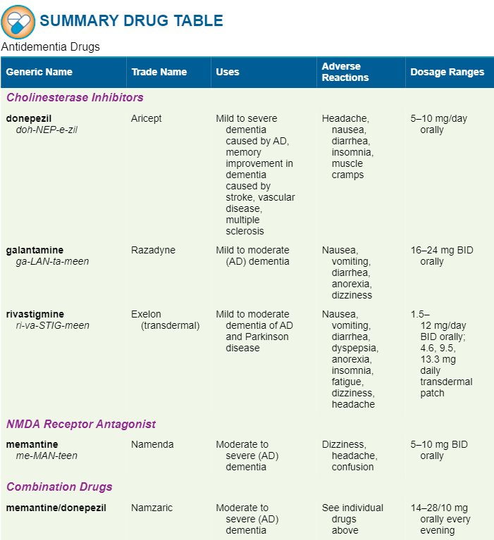

Slide 26

Pharmacology in Practice Exercise #1
In the following stage of Alzheimer disease, there are brain changes detectable on an MRI but no cognitive changes. Which stage of the disease is being described?
Stage 1
Stage 2
Stage 3
Notes:
A) Stage 1 – The first stage of the disease can last up to 20 years before diagnosis and includes measurable changes in the brain on MRI; biomarkers may be present in the blood or cerebrospinal fluid, but there are o changes in cognitive or functional ability.

Slide 27
Pharmacology in Practice Exercise #2
A client with dementia also may have delirium. Which of the following signs indicate a cognitive problem is due to delirium and not dementia? Select all that apply.
Sudden onset
Client feels itchy
Placing oxygen may resolve it
Progressive changes
Irreversible
Notes:
A) Sudden onset, B) Client feels itchy, C) Placing oxygen may resolve it – Delirium is different from dementia in that is has a sudden onset, may be resolved by interventions such as oxygen if due to hypoxia, and typically involves the senses rather than memory or judgement. Deentia is both progressive and irreversible.

Slide 28
Pharmacology in Practice Exercise #3
A client with moderate dementia of the Alzheimer type repeatedly spits out pills. They are being changed to a transdermal patch. Where should the nurse place a cholinesterase inhibitor transdermal patch so the client can’t easily remove it?
Upper arm
Side of thigh
Chest
Lower back
Notes:
D) Lower back – Because the client is experiencing dementia, the site for application should be where the client is not able to pick at or remove the patch. The upper or lower portions of the back are recommended for the patch administration.

