Slide 1
Introduction to Clinical Pharmacology Chapter 28 Antiepileptics

Slide 2
Learning Objectives
List the different types of drugs used as antiepileptics.
Explain the general drug actions, uses, adverse reactions, contraindications, precautions, and interactions of antiepileptics.
Distinguish important preadministration and ongoing assessment activities the nurse should perform with the client receiving an antiepileptic.
List nursing diagnoses particular to a client taking an antiepileptics.
Examine ways to promote an optimal response to therapy, how to manage common adverse reactions when administering the antiepileptics, and important points to keep in mind when educating a client about the use of antiepileptics.

Slide 3
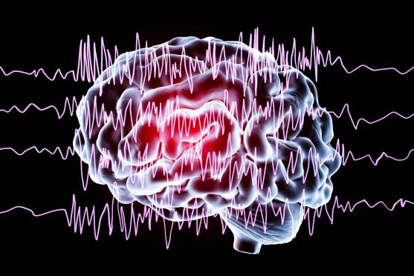
Seizure Disorders
Idiopathic
Hereditary seizure disorder
Acquired seizure disorder
Treatment goal is to treat the underlying cause of the seizure

Slide 4
Antiepileptics
Antiepileptics or anticonvulsants are drugs used to manage seizure disorders
Drug categories used as antiepileptics
hydantoins
carboxylic acid derivatives
succinimides
Benzodiazepines
Non-specified drugs

Slide 5
Antiepileptics—Actions #1
Hydantoins stabilize the hyperexcitability postsynaptically in the motor cortex of the brain.
Carboxylic acid derivatives increase levels of gamma (γ)-aminobutyric acid (GABA), which stabilizes cell membranes.
Succinimides depress the motor cortex, creating a higher threshold before nerves react to the convulsive stimuli

Slide 6
Antiepileptics—Actions #2
Benzodiazepines elevate the seizure threshold by decreasing the postsynaptic excitation
Nonspecified drugs have differing properties; for example, gabapentin is a GABA agonist, and topiramate blocks the seizure activity rather than raising the threshold

Slide 7

Antiepileptics—Uses #1
Prophylactically to prevent seizures after trauma, neurosurgery, or with a brain tumor
Treatment of seizures of all types
Neuropathic pain
Bipolar disorders
Anxiety disorders

Slide 8
Antiepileptics—Uses #2
Examples
Lorazepam—status epilepticus
Phenytoin—ongoing seizure control
Clobazam—adjuvant for Lennox–Gastaut syndrome

Slide 9
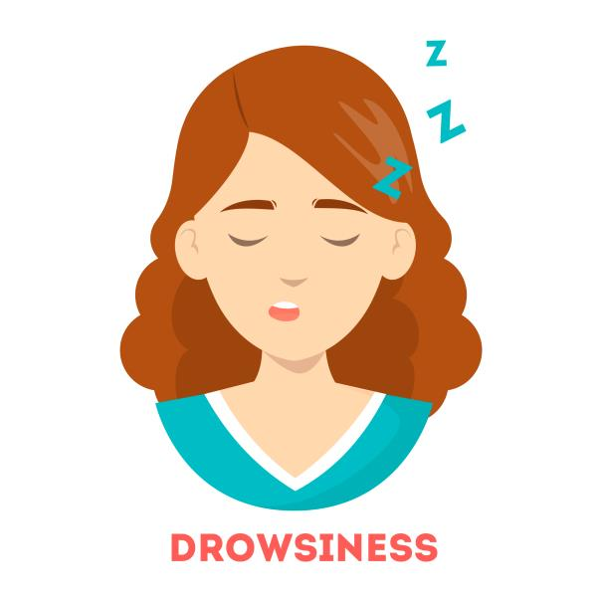
Antiepileptics—Adverse Reactions #1
Central Nervous System Reactions:
Drowsiness, somnolence
Weakness, dizziness
Headache
Nystagmus
Ataxia
Slurred speech

Slide 10

Antiepileptics—Adverse Reactions #2
Gastrointestinal System Reactions:
Nausea, vomiting
Anorexia
Constipation
Diarrhea
Gingival hyperplasia
Acute liver failure (Felbamate)

Slide 11

Antiepileptics—Adverse Reactions #3
Other Reactions:
Skin rashes
Pruritus
Urticaria

Slide 12
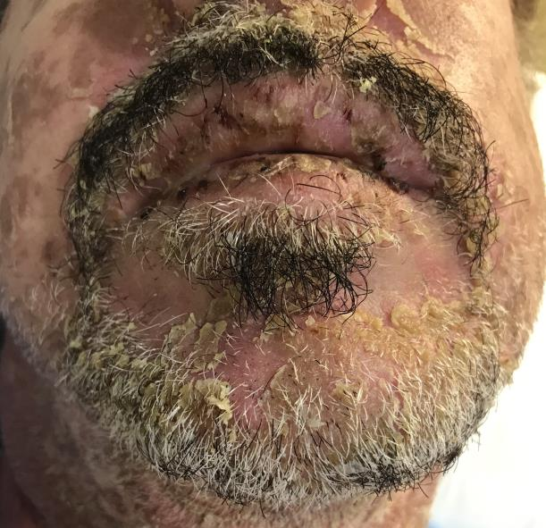
Antiepileptics—Adverse Reactions #4
Severe Adverse Reactions:
Stevens-Johnson syndrome (Lamotrigine)
Hematologic changes; pancytopenia, leukopenia, aplastic anemia, thrombocytopenia with select antiepileptics (Carbamazepine and Felbamate)

Slide 13

Antiepileptics—Contraindications #1
Contraindicated in clients with:
known hypersensitivity to the drugs
Phenytoin is contraindicated in clients with:
bradycardia, sinoatrial block, Adams-Stokes syndrome, and second- and third-atrioventricular block
pregnancy and lactation

Slide 14
Antiepileptics—Contraindications #2
Ethotoin is contraindicated in clients with:
hepatic abnormalities
Succinamides are contraindicated in clients with:
Bone marrow depression
hepatic or renal impairment
Oxcarbazepine contraindicated in clients with:
dementia

Slide 15
Antiepileptics—Contraindications #3
Carbamazepine is contraindicated in clients:
who have taken MAOIs within the last 14 days
bone marrow suppression
hepatic or renal impairment
who are pregnancy
Valproic acid is contraindicated in clients with:
renal impairment
pregnancy

Slide 16
Antiepileptics—Precautions #1
Use cautiously in clients with liver or kidney disease and neurologic disorders.
The newer mediations such as Eslicarbazepine and Oxcarbazepine can cause hyponatremia
Benzodiazepines are used cautiously
during pregnancy
in clients with psychosis
in clients with acute narrow-angle glaucoma
in elderly or debilitated clients

Slide 17
Antiepileptics—Precautions #2
Phenytoin and Lacosamide are used cautiously in clients with:
severe myocardial insufficiency and hepatic impairment
Non-specified antiepileptics are used cautiously in clients with:
glaucoma or increased ocular pressure
a history of cardiac, renal, or liver dysfunction
psychiatric disorders

Slide 18
Antiepileptics—Interactions #1
Interacting Drug | Common Use | Effect of Interaction
Antibiotics/ antifungals | Anti-infective agent | Increased effect of the antiepileptic
Tricyclic antidepressants | Manage depression | Increased effect of the antiepileptic
Salicylates | Pain relief | Increased effect of the antiepileptic
Cimetidine | Control GI upset | Increased effect of the antiepileptic
Theophylline | Treatment of respiratory problems | Decrease serum levels of the antiepileptic

Slide 19
Antiepileptics—Interactions #2
Interacting Drug | Common Use | Effect of Interaction
Antiepileptics medications | Reduce seizure activity | May increase seizure activity
Protease inhibitors | Treatment of HIV | Increased carbamazepine levels resulting in toxicity
Oral contraceptives | Birth control | Decreased effectiveness of birth control resulting in breakthrough bleeding or pregnancy
Analgesics or alcohol | CNS depressants | Increased depressant effect
Antidiabetic medications | Manage diabetes mellitus | Increase blood glucose levels

Slide 20

Nursing Process—Client Receiving an Antiepileptic #1
Pre-administration Assessment
Prior to initial administration of the drug.
Objective Data
Description of seizures
Frequency of seizures
Average length of a seizure
Vital signs (respiratory rate & depth)

Slide 21
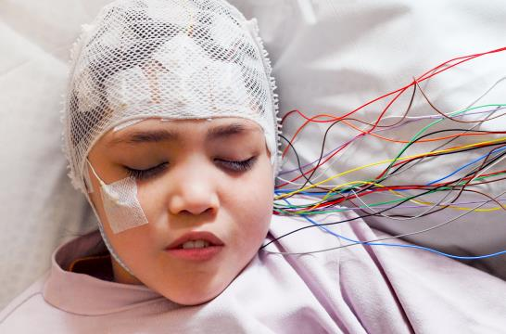
Nursing Process—Client Receiving an Antiepileptic #2
Pre-administration Assessment
Prior to initial administration of the drug.
Objective Data
Neurological diagnostic testing—electroencephalogram (EEG), computed axial tomography (CAT) scan, and magnetic resonance imaging (MRI) scan
Laboratory tests—complete blood count, lumbar puncture (LP), and hepatic and renal function tests

Slide 22
Nursing Process—Client Receiving an Antiepileptic #3
Pre-administration Assessment
Prior to initial administration of the drug.
Subjective Data
Description of the aura (sensation preceding seizure)
Description of the degree of impairment of consciousness
Description of anything that seems to bring on the seizure
Medical history, history of head or other injury
Family history of seizure activity
List of all current drugs

Slide 23
Nursing Process—Client Receiving an Antiepileptic #4
Ongoing Assessment
Treatment with antiepileptics is indefinite
Ongoing assessment is important
Carefully document each seizure with regard to time of occurrence; duration of seizure; psychic or motor activity occurring before, during, after seizure
Dosage adjustments are based on client’s response to therapy, as well as occurrence of adverse reactions.
Serum plasma levels of anticonvulsant are measured regularly to monitor for toxicity

Slide 24
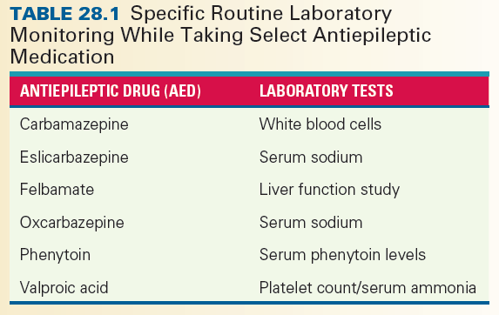
Nursing Process—Client Receiving an Antiepileptic #5
Ongoing Assessment
Monitor for adverse reactions including signs that the body is not able to fight infection; laboratory tests

Slide 25
Nursing Process—Client Receiving an Antiepileptic #6
Ongoing Assessment
Assessment questions to ask during a seizure in an inpatient setting:
What is your name?
What are you feeling?
What do you see?
Where are you and where do you live?
Touch your left ear.
What is this called? (hold up a familiar object)

Slide 26
Nursing Process—Client Receiving an Antiepileptic #7
Nursing Diagnosis
Injury Risk related to seizure disorder, drowsiness, ataxia and vision disturbances
Altered Skin Integrity related to adverse reactions (rash)
Infection Risk related to immunosuppression secondary to drug therapy
Impaired Oral Mucous Membranes related to gum overgrowth secondary to Hydantoins

Slide 27
Nursing Process—Client Receiving an Antiepileptic #8
Planning
Expected client outcomes depend on the type and severity of the seizure but may include:
Optimal response to therapy
Management of adverse drug reactions
Confidence in an understanding of the prescribed medication regimen

Slide 28
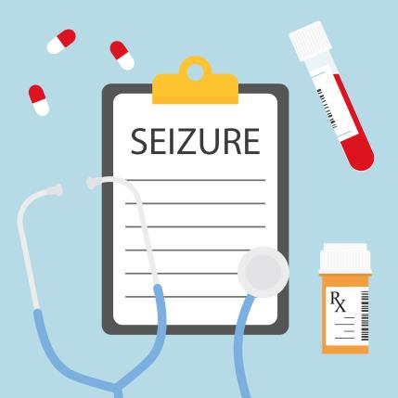
Nursing Process—Client Receiving an Antiepileptic #9
Implementation
Promoting Optimal Response to Therapy
Make notation on the care plan and inform all health care team members that client is on an antiepileptic
Do not omit or miss a dose except by order of primary health care provider
If discontinuing drug, drug is gradually withdrawn

Slide 29
Nursing Process—Client Receiving an Antiepileptic #10
Implementation
Promoting Optimal Response to Therapy—Hydantoins
Monitor serum levels of Phenytoin regularly due to possibility of a genetically linked inability to metabolize Phenytoin to detect toxicity
Therapeutic levels = 10 to 20 mcg/mL; greater than 20 mcg/mL is toxic level
Phenytoin can be given orally or parenterally; should be administered with food if taken orally; IV route is preferred if given parenterally
Monitor serum levels more frequently in clients receiving phenytoin through enteral feeding tube

Slide 30
Nursing Process—Client Receiving an Antiepileptic #11
Implementation
Promoting Optimal Response to Therapy - Benzodiazepines
Dosage of benzodiazepines is highly individualized; increase the dosage cautiously to avoid adverse reactions, particularly in elderly and debilitated clients
IV Lorazepam acts and wears off quickly; continue to monitor for seizures
Do not mix Diazepam with other drugs
When used to control seizures, Diazepam is administered over 2 minutes

Slide 31
Nursing Process—Client Receiving an Antiepileptic #12
Implementation
Monitoring and Managing Client Needs
Injury Risk
Assist the client with all ambulatory activities
Use caution when giving an oral preparation as aspiration of tablet, capsule, or liquid may occur if client experiences drowsiness
Test swallowing ability of client by offering small sips of water before giving drug

Slide 32
Nursing Process—Client Receiving an Antiepileptic #13
Implementation
Monitoring and Managing Client Needs
Injury Risk
Seizure precautions: prevent falls and other injuries until seizures are controlled by the drug
Clients on Vigabatrin should see an ophthalmologist for vision screenings regularly due to risk of loss of vision
Clients on antiepileptics can develop photosensitivity so should be advised to stay out of the sun and wear sunscreen and protective clothing

Slide 33
Nursing Process—Client Receiving an Antiepileptic #14
Implementation
Monitoring and Managing Client Needs
Altered Skin Integrity
Carbamazepine, Eslicarbazepine, Lamotrigine, and Phenytoin often produce hypersensitivity
Risk for severe skin rashes is higher in Asian population; consider genetic testing
Carefully examine all affected areas and provide an accurate description and report findings to the primary health care provider
If severe rash is present, drug is not resumed
If mild rash is present therapy might be resumed after rash disappears

Slide 34
Nursing Process—Client Receiving an Antiepileptic #15
Implementation
Monitoring and Managing Client Needs
Infection Risk
Be alert for signs of pancytopenia, such as sore throat, fever, general malaise, bleeding of the mucous membranes, epistaxis, easy bruising and report immediately
Routine laboratory tests, such as complete blood counts and differential counts, should be performed periodically

Slide 35
Nursing Process—Client Receiving an Antiepileptic #16
Implementation
Monitoring and Managing Client Needs
Infection Risk
If bone marrow suppression is evident, primary health care provider may discontinue or change antiepileptics
If pancytopenia develops, implement protective measures (e.g., soft-bristled toothbrush and extremities protected from injury)

Slide 36
Nursing Process—Client Receiving an Antiepileptic #17
Implementation
Monitoring and Managing Client Needs
Impaired Oral Mucous Membranes
Long-term administration of Hydantoins can cause gingivitis and gingival hyperplasia
Periodically inspect mouth, teeth, gums of clients in a hospital or long-term clinical setting
Report any changes in gums or teach to the primary health care provider
Teach clients to perform oral care after each meal

Slide 37

Nursing Process—Client Receiving an Antiepileptic #18
Implementation—Educating the Client and Family
When client receives diagnosis of epilepsy, nurse must assist client and family to adjust to diagnosis
Instruct family members in care of client before, during, and after seizures
Explain importance of restricting some activities until seizures are controlled by drugs

Slide 38

Nursing Process—Client Receiving an Antiepileptic #19
Implementation—Educating the Client and Family
Assist client to look for other modes of transportation in order to continue typical activities or employment
Review adverse drug reactions associated with the prescribed anticonvulsant with the client and family members
Referral to social work, discharge planning coordinator, or public health nurse as needed

Slide 39
Nursing Process—Client Receiving an Antiepileptic #20
Implementation—Educating the Client and Family
Teach client and family:
To monitor for adverse reactions and report to primary health care provider
To take the medication as prescribed and not to stop or omit doses or change medications without direction from a provider; discontinuation may cause a recurrence of seizures
That blood levels will be monitored
To not put anything in the person’s mouth if they are having a seizure

Slide 40
Nursing Process—Client Receiving an Antiepileptic #21
Implementation—Educating the Client and Family
Teach client and family:
To not drive or do hazardous activities; drink alcohol, or take nonprescription medications unless approved by a primary health care provider
To avoid alcohol unless directed otherwise by primary health care provider
To wear a medical alert bracelet
To keep a record of all seizures

Slide 41
Nursing Process—Client Receiving an Antiepileptic #22
Implementation—Educating the Client and Family
Hydantoins:
Inform dentist and other primary health care providers of use of this drug; notify primary care provider about any adverse reactions
Brush and floss teeth after each meal and make periodic dental appointments for oral examination and care
Take medication with food and shake suspensions immediately prior to use
Do not take discolored capsules

Slide 42
Nursing Process—Client Receiving an Antiepileptic #23
Implementation—Educating the Client and Family
Succinimides:
Take drug with food for GI upset
Notify primary health care provider of and adverse reactions
Vigabatrin
Periodic vision assessment and restricted administration through the SHARE program is required to recognize and reduce vision loss

Slide 43
Nursing Process—Client Receiving an Antiepileptic #24
Evaluation
Was the therapeutic effect achieved and convulsions controlled?
Were adverse reactions: identified, reported, and managed?
No injury evident
Skin and mucous membranes remain intact; mucous membranes moist
No evidence of infection is seen
Did client and family express confidence and demonstrate understanding of drug regimen?

Slide 44

Pharmacology in Practice Exercise #1
Which of the following are ways to categorize the seizure disorders? Select all that apply.
Voluntary
Hereditary
Idiopathic
Acquired

Slide 45
Pharmacology in Practice Exercise #2
A nurse is caring for a client who has a history of status epilepticus. Which drug should be available in parenteral form should this happen to the client again?
Phenytoin
Lorazepam
Barbiturate
Diazepam

Slide 46

Pharmacology in Practice Exercise #3
A client prescribed an antiepileptic complains of chronic pain and requests an analgesic to be taken over time. Which possible interaction of analgesics with antiepileptics should the nurse monitor for in this client?
Increased carbamazepine levels
Increased seizure activity
Increased blood glucose levels
Increased depressant effect

