Slide 1
Introduction to Clinical Pharmacology Chapter 30 Upper Respiratory System Drugs

Slide 2
Learning Objectives
Compare and contrast the classes of medications used for upper respiratory system problems.
Explain the uses, general drug actions, adverse reactions, contraindications, precautions, and interactions of intranasal steroids, antitussives, mucolytics, expectorants, antihistamines, and decongestants.
Distinguish important preadministration and ongoing assessment activities that should be performed on the client receiving intranasal steroids, antitussive, mucolytic, expectorant, antihistamine, or decongestant.
List nursing diagnoses particular to a client taking intranasal steroids, antitussive, mucolytic, expectorant, antihistamine, or decongestant.
Examine ways to promote an optimal response to therapy, manage common adverse reactions, and educate the client about the use of intranasal steroids, antitussive, mucolytic, expectorant, antihistamine, or decongestant.

Slide 3
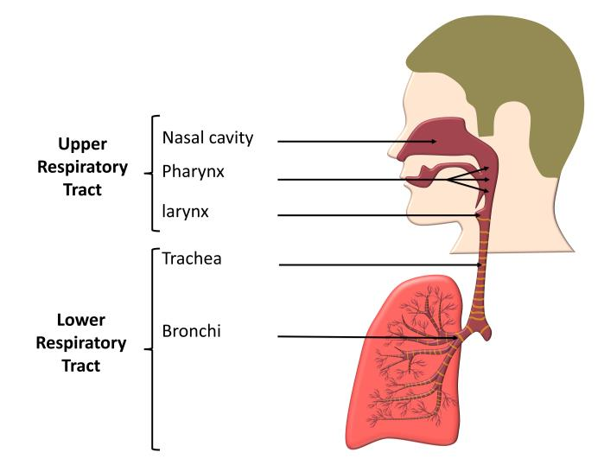
Common Conditions of the Upper Respiratory System
Rhinitis
Nasal congestion
Sneezing
Cough
Postnasal drip
Sore throat
Common colds

Slide 4
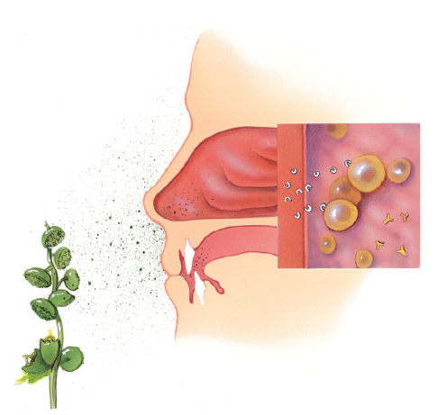
Histamine Production

Slide 5

Upper Respiratory System Drug Classes
Intranasal Steroids
Antihistamines
Decongestants
Antitussives
Expectorants
Mucolytics

Slide 6
Intranasal Steroids—Actions and Uses
Actions
Also known as glucocorticoids
Inhibit the response of cells such as mast cells, neutrophils, eosinophils, and macrophages and reduce mediators such as histamine which have an anti-inflammatory effect
Uses
First-line treatment for symptoms of allergic rhinitis
Nonallergic rhinitis
Nasal polyps
Chronic sinusitis

Slide 7

Inhaled Steroids—Adverse Reactions
Adverse Reactions:
Mild and unpleasant smell or taste
Dry nasal passages and epistaxis
Fungal infections (rarely)

Slide 8

Inhaled Steroids—Contraindications and Precautions
Contraindicated in clients with:
known hypersensitivity to steroids
pregnancy
Use cautiously in clients:
taking systemic steroids
taking budesonide (increased blood levels of budesonide)
in children—slowed growth rate

Slide 9
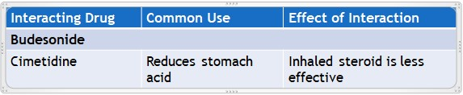
Inhaled Steroids—Interactions

Slide 10
Antihistamines—Actions
Actions
Antihistamines block most, but not all, of the effects of histamine
First-generation antihistamines bind nonselectively to central and peripheral H₁ receptors and may result in CNS stimulation or depression
Other first-generation drugs may have additional effects: antipruritic (anti-itching) or antiemetic (antinausea) effects
Second-generation antihistamines are selective for peripheral H₁ receptors and, as a group, are less sedating; ex. Azelastine, Loratadine, Fexofenadine, Cetirizine

Slide 11
Antihistamines—Uses #1
Uses
Seasonal and perennial allergies
Allergic and vasomotor rhinitis
Allergic conjunctivitis
Mild and uncomplicated angioneurotic edema and urticaria
Allergic reactions to drugs, blood, or plasma
Coughs caused by colds or allergy

Slide 12
Antihistamines—Uses #2
Uses
Adjunctive therapy in anaphylactic shock
Treatment of parkin-like symptoms
Relief of nausea and vomiting
Relief of motion sickness
Sedation
Adjuncts to analgesics

Slide 13
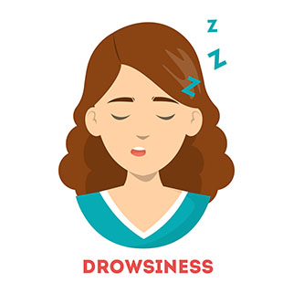
Antihistamines—Adverse Reactions #1
Central Nervous System Reactions:
Drowsiness or sedation
Disturbed coordination

Slide 14
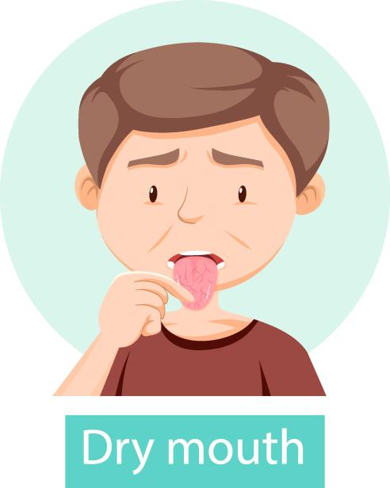
Antihistamines—Adverse Reactions #2
Respiratory System Reactions:
Dryness of mouth, nose, throat
Thickening of bronchial secretions

Slide 15

Antihistamines—Adverse Reactions #3
Severe Adverse Reactions:
Hypersensitivity
Large doses can cause hyperthermia, tachycardia, confusion, sedation, delirium, hallucinations, blurry vision, dizziness, constipation, urinary retention, arrhythmias, seizures, and cardiac arrest

Slide 16
Antihistamines—Contraindications #1
Contraindicated in clients with:
pregnancy
First-generation antihistamines: clients with known hypersensitivity to the drugs, newborns, premature infants, nursing mothers, individuals undergoing monoamine oxidase therapy, and in clients with angle-closure glaucoma, peptic ulcer, symptomatic prostatic hypertrophy, and bladder neck obstruction

Slide 17
Antihistamines—Contraindications #2
Contraindicated in clients with:
Second-generation antihistamines: clients with known hypersensitivity
Cetirizine is contraindicated in clients who are hypersensitive to hydroxyzine

Slide 18
Antihistamines—Precautions
Use cautiously in clients with:
bronchial asthma
cardiovascular disease
narrow-angle glaucoma
hypertension
impaired kidney function
urinary retention
pyloroduodenal obstruction
hyperthyroidism

Slide 19
Antihistamines—Interactions #1
Interacting Drug | Common Use | Effect of Interaction
Rifampin | Antitubercular agent | May reduce the absorption of the antihistamine (e.g., fexofenadine)
MAOIs | Antidepressant agent | Increased anticholinergic and sedative effects of the antihistamine
CNS depressants (e.g., opioid analgesics or alcohol) | Pain relief | Possible additive CNS depressant effect

Slide 20
Antihistamines—Interactions #2
Interacting Drug | Common Use | Effect of Interaction
Beta blockers | Management of cardiovascular disease | Risk of increased cardiovascular effects (e.g., with diphenhydramine)
Aluminum- or magnesium-based antacids | Relief of GI problems or upset | Decreased concentrations of drug in blood (e.g., fexofenadine)

Slide 21
Decongestants—Actions
Actions
sympathomimetic drugs, which produce localized vasoconstriction of the small blood vessels of the nasal membranes
vasoconstriction reduces swelling

Slide 22
Decongestants—Uses
Uses
Used to treat congestion associated with:
Common cold
Hay fever
Sinusitis
Allergic rhinitis
Congestion associated with rhinitis

Slide 23
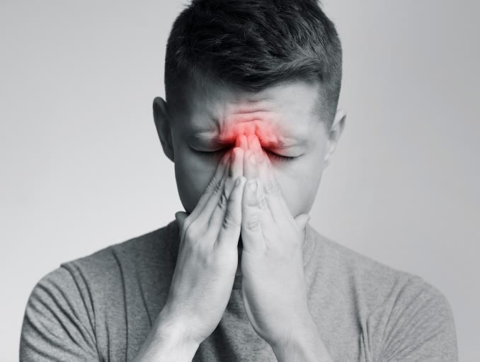
Decongestants—Adverse Reactions#1
Topical Reactions:
Nasal burning
Nasal stinging
Nasal dryness

Slide 24

Decongestants—Adverse Reactions#2
Oral Administration Reactions:
Tachycardia and other cardiac arrhythmias
Blurred vision
Nausea and vomiting

Slide 25
Decongestants—Contraindications and Precautions
Contraindicated in clients with:
known hypersensitivity to the drug or clients taking MAOIs
Use cautiously in clients with:
thyroid disease
diabetes mellitus
hypertension, cardiovascular disease, coronary artery disease, or peripheral vascular disease
prostatic hypertrophy
glaucoma

Slide 26
Decongestants—Interactions
Interacting Drug | Common Use | Effect of Interaction
MAOIs | Antidepressant agent | Severe headache, hypertension, and possibly hypertensive crisis
Beta adrenergic blocking drugs | Management of cardiovascular disease | Initial hypertension episode followed by bradycardia

Slide 27
Antitussives, Expectorants, and Mucolytics—Actions
Antitussives depress the cough center located in the medulla and are called centrally acting drugs (e.g., Codeine); another mechanism is to act peripherally by anesthetizing stretch receptors in the respiratory passages (e.g., Benzonatate)
Expectorants increase the production of respiratory secretions, which in turn appears to decrease the viscosity of the mucus. (e.g., Guaifenesin)
Mucolytics reduce the viscosity of secretions by direct action on the mucus (e.g., Acetylcysteine)

Slide 28
Antitussives, Expectorants, and Mucolytics—Uses
Antitussives treat nonproductive cough
Expectorants help bring up respiratory secretions
Mucolytic acetylcysteine treats the following:
Acute bronchopulmonary disease
Tracheostomy care
Pulmonary compliance with cystic fibrosis
Pulmonary complications associated with surgery/anesthesia
Posttraumatic chest conditions
Atelectasis due to mucous obstruction
Acetaminophen overdosage

Slide 29
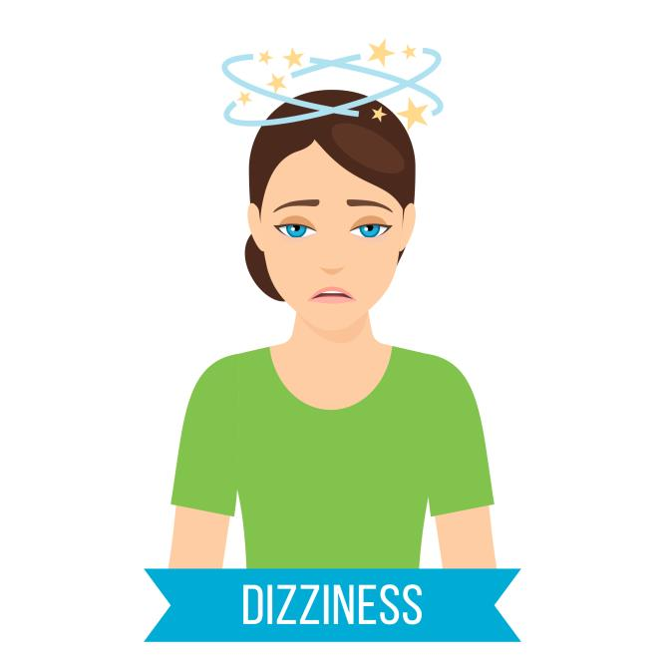
Antitussives, Expectorants, and Mucolytics—Adverse Reactions
Adverse Reactions when combined with an antihistamine:
Lightheadedness
Dizziness
Drowsiness
Sedation

Slide 30
Antitussives, Expectorants, and Mucolytics—Contraindications
Contraindicated in:
clients with known hypersensitivity to the drugs
premature infants or during labor when delivery of a premature infant is anticipated
clients with asthma (Mucolytics)
pregnancy (Iodide)

Slide 31
Antitussives, Expectorants, and Mucolytics—Precautions #1
Antitussives—use with caution in:
Clients with a persistent cough or a cough with excessive secretions, a high fever, persistent headache, and nausea and vomiting
Antitussives containing codeine are used with caution in clients during pregnancy, acute asthmatic attack, pre-existing respiratory disorders, acute abdominal conditions, head injury, increased intracranial pressure, convulsive disorders, hepatic or renal impairment, and prostatic hypertrophy

Slide 32
Antitussives, Expectorants, and Mucolytics—Precautions #2
Expectorants—use with caution in clients with:
Pregnancy and labor
persistent cough
severe respiratory insufficiency
asthma
elderly or debilitation

Slide 33
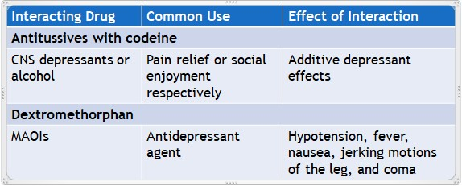
Antitussives, Expectorants and Mucolytics—Interactions #1

Slide 34
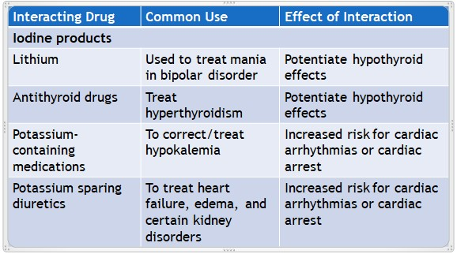
Antitussives, Expectorants and Mucolytics—Interactions #2

Slide 35

Nursing Process—Client Receiving an Upper Respiratory System Drug #1
Pre-administration Assessment
Objective Data
Vital signs
Weight (for pediatric clients)
Auscultate breath sounds
Color and amount of any sputum present

Slide 36

Nursing Process—Client Receiving an Upper Respiratory System Drug #2
Pre-administration Assessment
Subjective Data
Type and duration of symptoms
Description of activity disruption by symptoms
Health history (especially regarding seasonal allergies or allergens in household)
Remedies attempted before seeking care

Slide 37

Nursing Process—Client Receiving an Upper Respiratory System Drug #3
Ongoing Assessment
Ask client about diminishing or worsening symptoms
If client returns to ambulatory setting or is in an inpatient setting, assess the client’s lung sounds and monitor vital signs

Slide 38
Nursing Process—Client Receiving an Upper Respiratory System Drug #4
Nursing Diagnosis
Injury Risk related to drowsiness, dizziness, or sedation
Ineffective Airway Clearance related to pooling of or thick secretions
Impaired Oral Mucous Membranes related to dry mouth, nose, and throat

Slide 39
Nursing Process—Client Receiving an Upper Respiratory System Drug #5
Planning
Expected client outcomes depend on the reason for administration of the drug but include:
Optimal response to therapy
Management of adverse drug reactions
Confidence in an understanding of the prescribed medication regimen

Slide 40
Nursing Process—Client Receiving an Upper Respiratory System Drug #6
Implementation
Promoting Optimal Response to Therapy
Clients should be advised that if a cough lasts for more than 10 days or is accompanied by a fever, chest pain, severe headache, or skin rash that the client should consult the primary health care provider
Take height and weight annually of children taking long term inhaled steroids and compare to previous growth chart documentation
Reinforce teaching points specific to each medication

Slide 41
Nursing Process—Client Receiving an Upper Respiratory System Drug #7
Implementation
Monitoring and Managing Client Needs
Injury Risk
Assist the client with ambulation
Clear path to bathroom of hazards
Place the call light within easy reach and instruct to call before attempting to get out of bed and ambulating
In outpatient settings advise client not to engage in activities that require a clear mind or operation of equipment

Slide 42
Nursing Process—Client Receiving an Upper Respiratory System Drug #8
Implementation
Monitoring and Managing Client Needs
Ineffective Airway Clearance
In an inpatient setting have suction equipment readily available
In clients with thick sputum encourage fluids (up to 2000 mL per day if not contraindicated)
Instruct client to deep breathe and cough
Document color, amount, and consistency of sputum
Notify PCP if there are any changes in sputum

Slide 43

Nursing Process—Client Receiving an Upper Respiratory System Drug #9
Implementation
Monitoring and Managing Client Needs
Ineffective Airway Clearance
Teach the client to take INS exactly as prescribed to avoid rebound nasal congestion
Suggest that the client use nasal saline irrigation using a “neti pot”

Slide 44

Nursing Process—Client Receiving an Upper Respiratory System Drug #10
Implementation
Monitoring and Managing Client Needs
Impaired Oral Mucous Membranes
Offer the client sips of water or ice chips to relieve symptoms of dry mouth, nose, and throat with the administration of antihistamines

Slide 45
Nursing Process—Client Receiving an Upper Respiratory System Drug #11
Implementation—Educating the Client and Family
Review the dosage regimen and possible adverse drug reactions with the client
Advise the client to read OTC drug labels carefully, follow the dosage recommendations and consult a PHCP if the cough persists for more than 10 days, the color of sputum changes, or the client develops fever or chest pain
For clients receiving acetylcysteine, the respiratory therapist typically gives the client and family instruction on how to maintain the equipment and administer the drug; the nursing role is to evaluate the client or family’s level of understanding of the drug regimen and has the opportunity to get all questions and answers addressed

Slide 46

Nursing Process—Client Receiving an Upper Respiratory System Drug #12
Implementation—Educating the Client and Family
Teach the Client and Family:
Take the medication exactly as directed; do not exceed recommended dose
Avoid respiratory/allergy irritants
Drink fluids (1500 mL to 2000 mL per day)
Swallow tablet whole and do not chew it
Do not break open or chew capsules
Do not drink for 30 minutes after using a lozenge

Slide 47

Nursing Process—Client Receiving an Upper Respiratory System Drug #13
Implementation—Educating the Client and Family
Teach the Client and Family
To treat dry mouth, take frequent sips of water or suck on sugarless hard candy or chew sugarless gum
Initial use may result in drowsiness; caution when driving or performing hazardous activities; effect will subside over time
To avoid alcohol or drugs

Slide 48

Nursing Process—Client Receiving an Upper Respiratory System Drug #14
Implementation—Educating the Client and Family
Teach the Client and Family:
Teach methods to prevent and/or treat rebound congestion
Teach the client the proper use of a nasal spray devise; do not allow tip of container to touch nasal mucosa. Do not share with other people.
Teach signs of nasal fungal infection for clients using INS; discontinue use and report to primary health care provider

Slide 49
Nursing Process—Client Receiving an Upper Respiratory System Drug
Evaluation
Was the therapeutic effect achieved and cough relieved?
Were adverse reactions: identified, reported, and managed?
No evidence of injury
Client has a clear airway
Mucous membranes are moist and intact
Did client and family express confidence and demonstrate understanding of drug regimen?

Slide 50

Pharmacology in Practice Exercise #1
Given below, in random order are the steps of the inflammatory response to injury. Arrange the steps of the inflammatory response in the order they are likely to occur in most situations.
Dilation of the arterioles
Increased capillary permeability
Release of histamine
Escape fluid from blood vessels
Localized redness
Localize swelling

Slide 51
Pharmacology in Practice Exercise#2
What information should be obtained from the client by the nurse and documented prior to the recommendation of an antitussive? Select all that apply.
Type of cough
Presence of sputum
Home remedies used to treat the cough
Vital signs of the last PHCP visit

Slide 52

Pharmacology in Practice Exercise#3
A nurse in a rehab facility is caring for a client with a tracheostomy who has a severe cough. The PHCP has prescribed acetylcysteine for the client. What is typically the nurse’s role when the drug is to be inserted into the tracheostomy?
Ensure that the client is not receiving any other drug therapy
Ensure that suction equipment is at the client’s bedside
Ensure that the client gets continuous oxygen supply
Ensure that the client keeps drinking warm water

