Slide 1
Introduction to Clinical Pharmacology Chapter 31 Lower Respiratory System Drugs

Slide 2
Learning Objectives
Explain the uses, general drug actions, general adverse reactions, contraindications, precautions, and interactions of the bronchodilators and antiasthma drugs.
Distinguish important preadministration and ongoing assessment activities the nurse should perform on the client taking a bronchodilator or an antiasthma drug.
List nursing diagnoses particular to a client taking a bronchodilator or an antiasthma drug.
Examine ways to promote an optimal response to therapy, how to manage common adverse reactions, and important points to keep in mind when educating a client about the use of bronchodilators or antiasthma drugs.

Slide 3
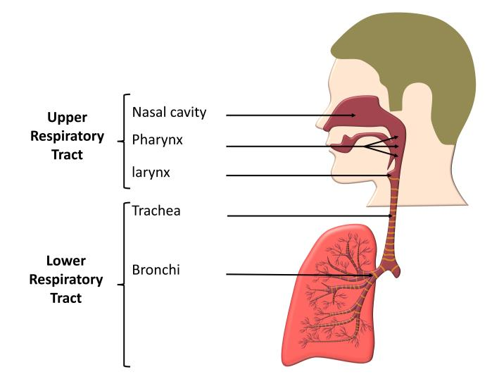
Common Conditions of the Lower Respiratory System
COPD
Asthma
Chronic bronchitis
Chronic obstructive bronchitis
Emphysema
Lower respiratory tract infections

Slide 4
Asthma/Chronic Pulmonary Disorder Mediations
Long-Term Control Medications
Step-wise approach
Inhaled corticosteroids
Mast cell stabilizers
Leukotriene formation inhibitors
Leukotriene receptor agonists
Immunomodulators
Quick-Relief Medications
Inhaled short-acting beta₂-adrenergic (β₂-adrenergic) agonists (SABAs)
Oral steroids

Slide 5
Adrenergic Bronchodilators—Actions and Uses
Actions
Simulates beta₂-adrenergic receptors resulting in a relaxation of the smooth muscles and an opening of the bronchi or bronchodilation; relieves respiratory distress
Uses (Bronchoconstriction)
Bronchospasm associated with acute and chronic bronchial asthma
Exercise-induced bronchospasm
Bronchitis
Emphysema
Bronchiectasis
Other obstructive pulmonary diseases

Slide 6

Adrenergic Bronchodilators—Adverse Reactions #1
Cardiovascular System Reactions:
Tachycardia
Palpations
Cardiac arrhythmias
Hypertension

Slide 7

Adrenergic Bronchodilators—Adverse Reactions #2
Other Reactions:
Nervousness
Anxiety
Insomnia

Slide 8

Adrenergic Bronchodilators—Contraindications
Contraindicated in clients with:
known hypersensitivity to the drug
Cardiac arrhythmias associated with tachycardia
Organic brain damage
Cerebral arteriosclerosis
Narrow-angle glaucoma
Acute bronchospasm (Salmeterol)

Slide 9
Adrenergic Bronchodilators—Precautions
Use cautiously in clients with:
hypertension
cardiac dysfunction
hyperthyroidism
glaucoma
diabetes
prostatic hypertrophy
history of seizures
pregnancy
lactation

Slide 10
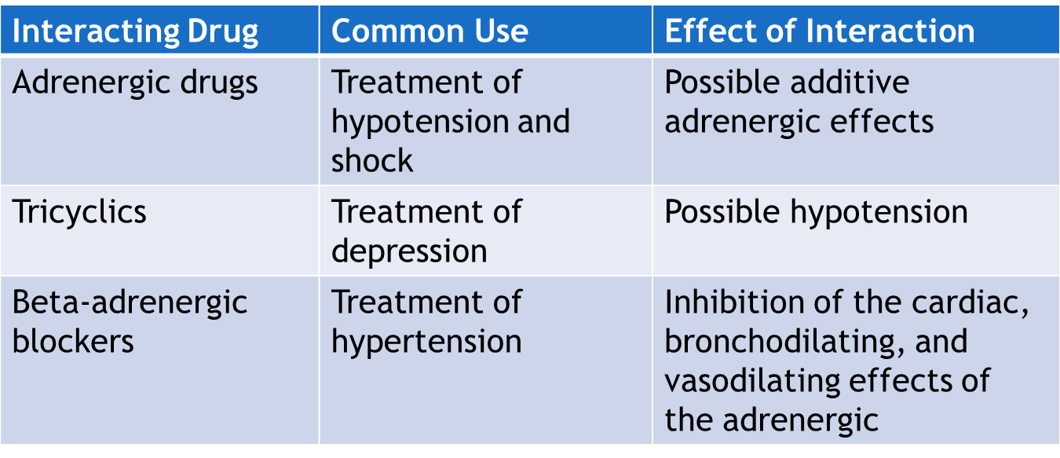
Inhaled Steroids—Interactions #1

Slide 11
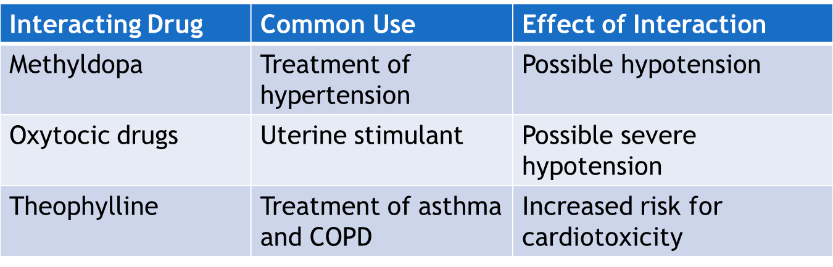
Inhaled Steroids—Interactions #2

Slide 12
Xanthine Derivative Bronchodilators—Actions and Uses
Actions
Stimulate the central nervous system to promote bronchodilation; cause direct relaxation of the smooth muscle to the bronchi
Uses
Symptomatic relief or prevention of bronchial asthma
Treatment of reversible bronchospasm associated with chronic bronchitis and emphysema

Slide 13

Xanthine Derivative Bronchodilators-Adverse Reactions #1
Central Nervous System Reactions:
Restlessness
Irritability
Headache
Nervousness
Tremors

Slide 14
Xanthine Derivative Bronchodilators—Adverse Reactions #2
Cardiovascular System Reactions:
Tachycardia
Palpations
ECG changes
Increased respirations

Slide 15

Xanthine Derivative Bronchodilators-Adverse Reactions #3
Other Reactions:
Nausea
Vomiting
Fever
Hyperglycemia
Flushing
Alopecia

Slide 16
Xanthine Derivative Bronchodilators—Contraindications
Contraindicated in clients with:
Known hypersensitivity to the drugs
Peptic ulcers
Seizure disorders
Serious uncontrolled arrhythmias

Slide 17
Xanthine Derivative Bronchodilators—Precautions
Use cautiously in clients with:
cardiac disease
hypoxemia
hypertension
congestive heart failure
liver disease
older adult
habitual alcohol use
Pregnancy and lactation

Slide 18
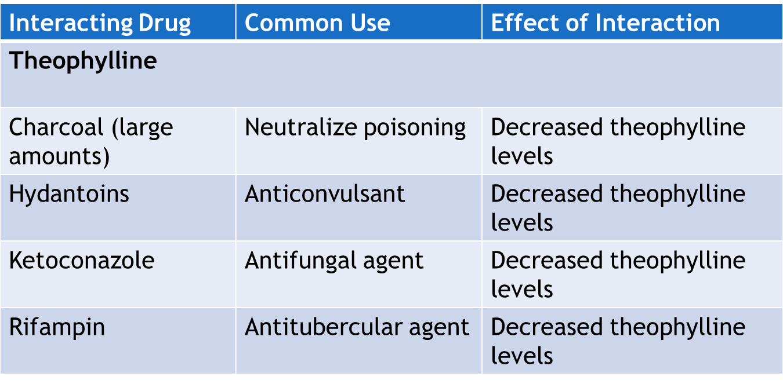
Xanthine Derivative Bronchodilators—Interactions #1

Slide 19
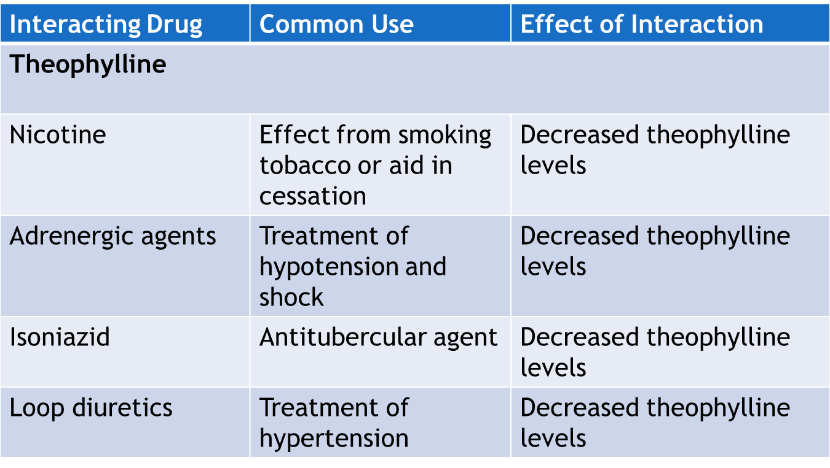
Xanthine Derivative Bronchodilators—Interactions #2

Slide 20
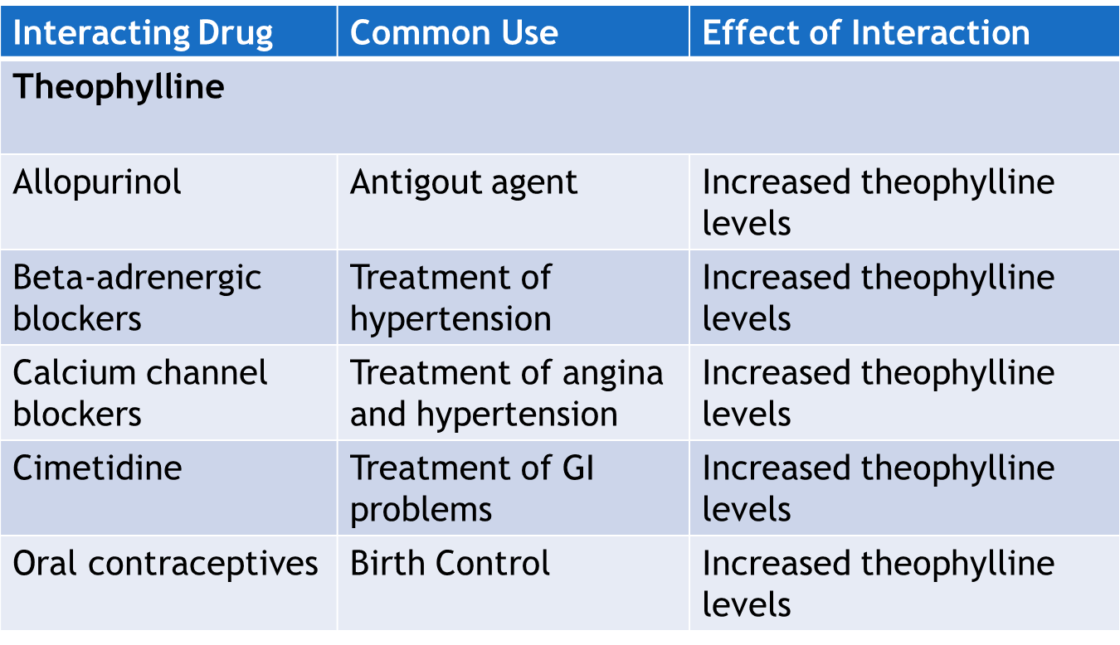
Xanthine Derivative Bronchodilators—Interactions #3

Slide 21
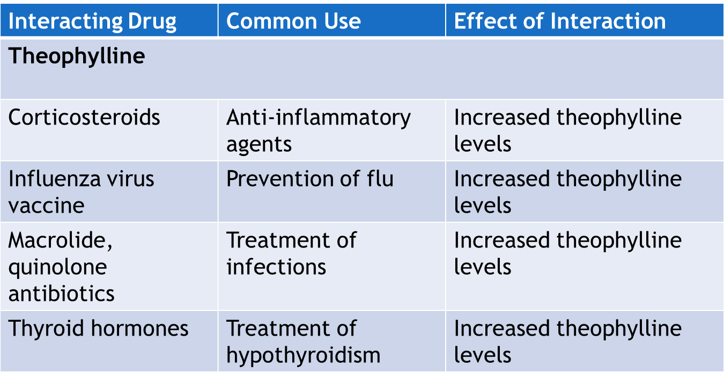
Xanthine Derivative Bronchodilators—Interactions #4

Slide 22
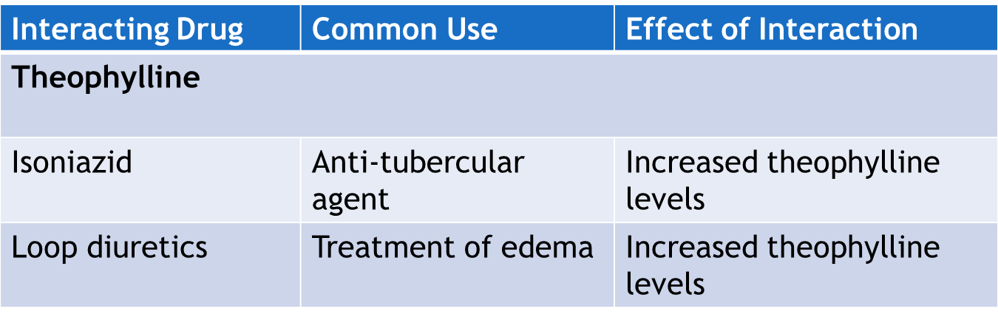
Xanthine Derivative Bronchodilators—Interactions #5

Slide 23
Antiasthma-Specific Drugs: Inhaled Corticosteroids—Actions
Actions
given by inhalation and reduce airway hyperresponsiveness
Reduce the number of mast cells in the airway
Block reaction to allergens
Increase the sensitivity of the ẞ₂ receptors; increased the effectiveness of ẞ_{2—}receptor agonist drugs
Beclomethasone and flunisolide decrease inflammatory process directly in the airways

Slide 24
Antiasthma-Specific Drugs: Inhaled Corticosteroids—Uses
Uses
Management and prophylactic treatment of inflammation associated with asthma
Intranasal treatment of nasal polyps and rhinitis
Upper respiratory system conditions

Slide 25

Antiasthma-Specific Drugs: Inhaled Corticosteroids—Adverse Reactions
Respiratory System Reactions:
Throat irritation
Hoarseness
Upper respiratory tract infection
Fungal infection of the mouth and throat

Slide 26
Antiasthma-Specific Drugs: Inhaled Corticosteroids—Contraindications
Contraindicated in clients with:
known hypersensitivity to the drug
acute bronchospasm
status asthmaticus
other acute episodes of asthma

Slide 27
Antiasthma-Specific Drugs: Inhaled Corticosteroids—Precautions
Use cautiously in clients with:
compromised immune systems
glaucoma
kidney disease
liver disease
convulsive disorder
diabetes
pregnancy and lactation

Slide 28
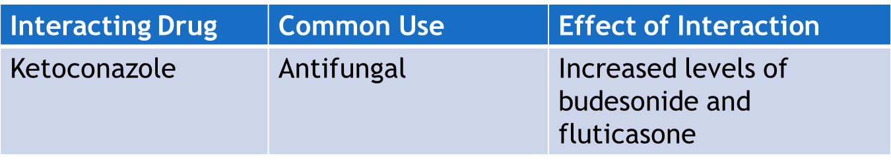
Antiasthma-Specific Drugs: Inhaled Corticosteroids—Interactions

Slide 29
Mast Cell Stabilizer—Actions and Uses
Actions
Thought to stabilize the mast cell membrane, possibly preventing calcium ions from entering mast cells; thus, preventing the release of inflammatory mediators such as histamine and leukotrienes (Ex. Cromolyn)
Uses
Treatment of asthma in combination with other drugs
Treatment of allergic rhinitis
To prevent exercise-induced bronchoconstriction

Slide 30

Mast Cell Stabilizer-Adverse Reactions
Respiratory System Reactions:
Throat irritation and dryness
Unpleasant taste sensation
Cough or wheeze
Can also cause nausea

Slide 31
Mast Cell Stabilizer-Contraindications and Precautions
Contraindicated in:
clients with known hypersensitivity to the drugs
acute asthma attacks
Use cautiously in:
pregnancy and lactation
impaired renal or hepatic function
No significant interactions have been reported

Slide 32
Leukotriene Modifiers and Immunomodulators—Actions
Actions
Leukotrienes are primarily responsible for bronchoconstriction
Zileuton acts by decreasing the formation of leukotrienes
Montelukast and zafirlukast inhibit leukotriene receptor sites in the respiratory tract; prevent airway edema and facilitate bronchodilation
Omalizumab modulates the immune response by preventing binding of immunoglobulin to the receptors of basophils and mast cells; limits allergic reaction

Slide 33
Leukotriene Modifiers and Immunomodulators—Uses
Prophylaxis and treatment of chronic asthma in adults and children over the age of 12 years
Omalizumab is an adjunctive therapy for clients 12 years of age and older sensitive to allergens; Omalizumab is a monoclonal antibody

Slide 34

Leukotriene Modifiers and Immunomodulators—Adverse Reactions
Headache
Flu-like symptoms
Immunoglobulators can cause anaphylactic reactions

Slide 35
Leukotriene Modifiers and Immunomodulators—Contraindications
Contraindicated in clients with:
known hypersensitivity to the drug
acute bronchospasm
liver disease (Zileuton)
lactation
Use cautiously in clients with:
pregnancy

Slide 36
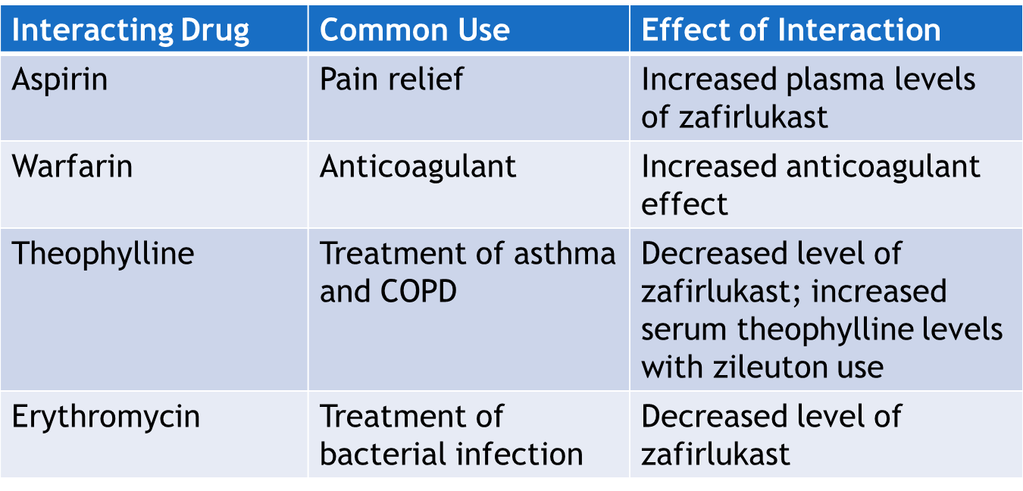
Leukotriene Modifiers and Immunomodulators—Interactions

Slide 37

Nursing Process—Client Receiving a Lower Respiratory System Drug #1
Pre-administration Assessment
Objective Data
Vital signs (including pulse oximetry)
Peak flow meter reading
Auscultate breath sounds
Description of sputum
Signs of hypoxia
Cyanosis of skin or mucous membranes
Laboratory tests: ABG, PFT

Slide 38

Nursing Process—Client Receiving a Lower Respiratory System Drug #2
Pre-administration Assessment
Subjective Data
Type and duration of symptoms
Description of any environmental triggers
Description of activity disruption by symptoms
Health history (especially regarding seasonal allergies or allergens in household)
Remedies attempted before seeking care

Slide 39

Nursing Process—Client Receiving a Lower Respiratory System Drug #3
Ongoing Assessment—Acute Asthma Attack
Assess the respiratory status about 30 minutes after drug is administered and every 4 hours (or more often if needed) and whenever drug is administered
Focused respiratory assessment
Keep record of intake and output
Report any imbalance
After administration observe the client for the effectiveness of the drug

Slide 40
Nursing Process—Client Receiving a Lower Respiratory System Drug #4
Ongoing Assessment—Stable Chronic
Client self-monitors
Utilize asthma action plan to assess and treat appropriately
Nurse asks client about changes seen on the asthma action plan (i.e., have client’s status been in the green, yellow, or red zone)
Monitor for chest pain and changes in ECG in clients with a history of cardiovascular problems
Pulmonary function tests and comparison to baseline

Slide 41
Nursing Process—Client Receiving a Lower Respiratory System Drug #5
Nursing Diagnosis
Anxiety related to feelings of breathlessness
Ineffective Airway Clearance related to bronchospasm
Impaired Oral Mucous Membranes related to dryness or irritation
Malnutrition Risk: Less Than Body Requirements related to decreased appetite caused by nausea, heartburn, or unpleasant taste

Slide 42
Nursing Process—Client Receiving a Lower Respiratory System Drug #6
Planning
Expected client outcomes depend on the reason for administration of the drug but include:
Optimal response to therapy
Management of adverse drug reactions
Confidence in an understanding of the prescribed medication regimen

Slide 43

Nursing Process-Client Receiving a Lower Respiratory System Drug #7
Implementation
Promoting Optimal Response to Therapy
Careful monitoring of the client
Instruction on proper administration of various drugs

Slide 44
Nursing Process—Client Receiving a Lower Respiratory System Drug #8
Implementation
Promoting Optimal Response to Therapy
Quick Relief for Acute Symptom Intervention
Instruct client to administer 2 to 4 puffs of the inhaled SABA when acute distress occurs; up to 3 treatments in 20-minute intervals may be administered
Consider the use of nebulized drugs if metered dose inhaler is difficult to use or ineffective for the client
ICS and SABA—reduces inflammation and dilates bronchioles
Racemic epinephrine—to relieve croup symptoms in children
Antibiotics and mucolytics treat lung infections or loosen secretions of cystic fibrosis clients

Slide 45
Nursing Process—Client Receiving a Lower Respiratory System Drug #9
Implementation
Promoting Optimal Response to Therapy
Quick Relief for Acute Symptom Intervention
For a client in an urgent care or emergency care, epinephrine is administered subcutaneously for bronchospasm; minimize distractions while preparing; therapeutic effects last from 5 minutes to 4 hours
Rapid theophyllinization is sometimes indicated through loading doses given orally or IV over 12 to 24 hours
Monitor client closely for theophylline toxicity (Theophylline levels 10mcg/L - 20mcg/L)
Monitor IV site to monitor for extravasation

Slide 46
Nursing Process—Client Receiving a Lower Respiratory System Drug #10
Implementation
Promoting Optimal Response to Therapy
Long-Term Control of Symptoms
Teach the client to use the stepwise method of self-care created by the primary health care provider to control respiratory mucosal inflammation
Teach the client to refrain from swallowing the ICS’s and to rinse the mouth thoroughly after using the inhaler
When taking oral corticosteroids, children are at risk for growth reduction so monitor rate of growth (height and weight); older adults are at risk of osteoporosis so calcium and vitamin D supplements may be prescribed

Slide 47
Nursing Process—Client Receiving a Lower Respiratory System Drug #11
Implementation
Promoting Optimal Response to Therapy
Long-Term Control of Symptoms
Teach clients that formoterol comes in a capsule but is administered through an Aerolizer inhaler; do not take orally
Mast cell stabilizer cromolyn must be tapered if it is going to be discontinued; when administered orally, must be given 30-90 minutes before meals and at bedtime.
Oral cromolyn comes in an ampule and is poured into water to administer (do not administer with other liquids)
Monitor for signs of Theophylline toxicity such as: anorexia, nausea, vomiting, diarrhea, confusion, abdominal cramping, headache, restlessness, insomnia, tachycardia, arrhythmias, or seizures.

Slide 48
Nursing Process—Client Receiving a Lower Respiratory System Drug #12
Implementation
Promoting Optimal Response to Therapy
Long-Term Control of Symptoms
Never administer leukotriene receptor antagonists, inhibitors, and immunomodulators during an acute asthma attack (given orally and can worsen the attack)
Before giving Zileuton and during therapy review hepatic aminotransferase levels for signs of liver dysfunction
Clients are monitored after the injection of mepolizumab (given once a month) in a clinic setting for the development of anaphylaxis; teach client the reaction can occur up to 4 days following the injection

Slide 49

Nursing Process—Client Receiving a Lower Respiratory System Drug #13
Implementation
Monitoring and Managing Client Needs
Anxiety
Reassure the client that the medications will help relieve difficulty with breathing
Speak and act in a calm manner
Closely monitor the client’s respiratory rate and blood pressure and report and significant changes

Slide 50

Nursing Process—Client Receiving a Lower Respiratory System Drug #14
Implementation
Monitoring and Managing Client Needs
Ineffective Airway Clearance
Check the blood, pressure, pulse, respiratory rate, pulse oximetry, and response to the drug every 5 to 15 minutes until the client’s condition stabilizes and respiratory distress is relieved

Slide 51
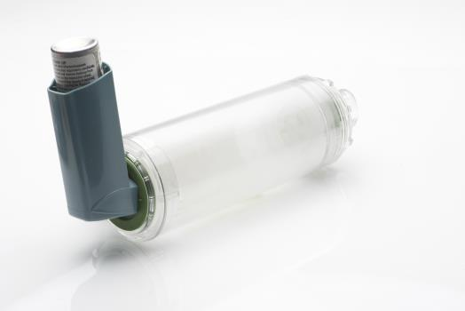
Nursing Process—Client Receiving a Lower Respiratory System Drug #15
Implementation
Monitoring and Managing Client Needs
Impaired Oral Mucous Membranes
Inhalers can cause infection with Candida albicans
Instruct client to use strict oral hygiene, cleans the inhaler, and use proper technique when taking the inhaled drug
Ensure the client brushes teeth daily after treatment

Slide 52

Nursing Process—Client Receiving a Lower Respiratory System Drug #16
Implementation
Monitoring and Managing Client Needs
Malnutrition: Less Than Body Requirements
Clients experiencing nausea as an adverse effect should be offered frequent small meals rather than three large meals
Meals should be followed by oral care
Limit fluids
Teach the client and family to have a clean relaxed atmosphere during meals

Slide 53
Nursing Process—Client Receiving a Lower Respiratory System Drug #17
Implementation
Monitoring and Managing Client Needs
Malnutrition: Less Than Body Requirements
Clients taking theophylline can experience heartburn
Instruct client to remain in an upright position and sleep with head of bed elevated
If the antiasthma drug creates a bad taste in the mouth, instruct the client to take frequent sips of water, suck on sugarless candy, or chew gum

Slide 54

Nursing Process—Client Receiving a Lower Respiratory System Drug #18
Implementation—Educating the Client and Family
Nurse’s role is to instruct the client and family in:
methods to monitor the condition
control triggers in the environment
manage medications properly for optimal breathing

Slide 55

Nursing Process—Client Receiving a Lower Respiratory System Drug #19
Implementation—Educating the Client and Family
Teach the Client and Family:
To monitor breathing status and regulate medications based on the asthma action plan
How to use a peak flow meter and when to notify the primary health care provider
How to use an inhaler or nebulizer correctly and how to care for equipment

Slide 56
Nursing Process—Client Receiving a Lower Respiratory System Drug #20
Evaluation
Was the therapeutic effect achieved and cough relieved?
Were adverse reactions: identified, reported, and managed?
Anxiety is managed successfully
Client has a clear patent airway
Mucous membranes are moist and intact
Nutrition is adequately maintained
Did client and family express confidence and demonstrate understanding of drug regimen?

Slide 57

Pharmacology in Practice Exercise#1
A client has been prescribed a step care approach regiment for the treatment of asthma. Which of the following drugs may be given as adjuncts to bronchodilator therapy in such a case? Select all that apply.
Decongestants
Inhaled corticosteroids
Uricosuric agents
Mast cell stabilizers
Immunomodulators

Slide 58
Pharmacology in Practice Exercise#2
A client was using a nicotine patch to stop smoking when they were started on theophylline for emphysema. After successfully stopping smoking and ready to stop using the nicotine patch, which of the following would be warranted?
Theophylline dose should be decreased
Theophylline dose should be discontinued
Theophylline dose should be increased
Theophylline dose should remain the same

Slide 59

Pharmacology in Practice Exercise#3
A client complains of nausea after receiving an antiasthma medication. Which of the following instructions should the nurse provide to alleviate the client’s symptoms? Select all that apply.
Keep the head of the bed elevated
Eat frequent small meals
Monitor blood pressure closely
Limit fluids with meals
Rinse mouth properly after eating

