Slide 1
Introduction to Clinical Pharmacology Chapter 32 Diuretics

Slide 2
Learning Objectives
List the five general types of diuretics.
Explain the uses, general drug actions, adverse reactions, contraindications, precautions, and interactions of the diuretics.
Distinguish important preadministration and ongoing assessment activities that the nurse should perform on the client taking a diuretic.
List nursing diagnoses particular to a client taking a diuretic.
Examine ways to promote an optimal response to therapy, how to manage common adverse reactions, and important points to keep in mind when educating clients about the use of diuretics.

Slide 3

Common Conditions That Cause Edema
Heart failure
Endocrine disturbances
Kidney and liver diseases
Fluid overload from other causes

Slide 4
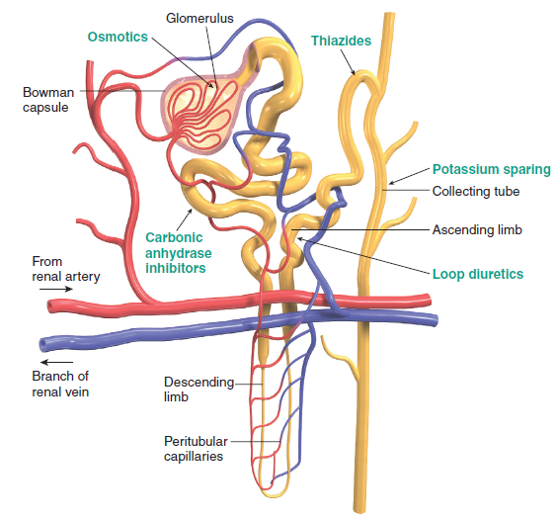
Five Types of Diuretics
Loop diuretics
Thiazides and related diuretics
Potassium-sparing diuretics
Osmotic diuretics
Carbonic anhydrase inhibitors

Slide 5
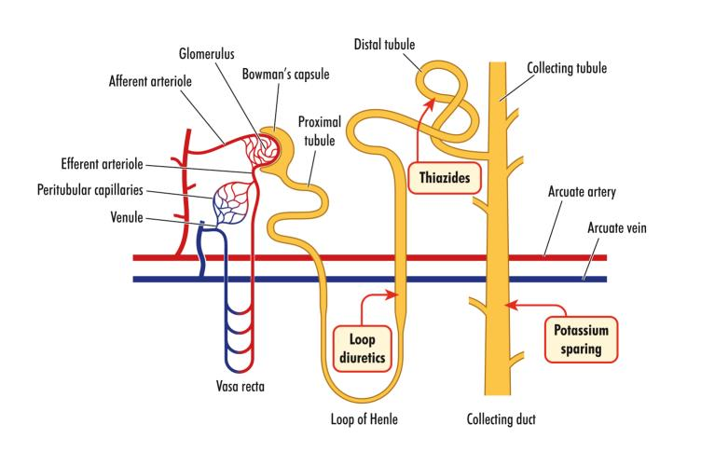
Diuretics—Actions #1
Loop diuretics:
Increase the reabsorption of sodium and chloride in the ascending portion of the loop of Henle
Blocking the action of reabsorption in the portion of the nephron where a high percentage of sodium and fluid are usually reabsorbed is very effective

Slide 6
Diuretics—Actions #2
Thiazide and related diuretics:
Inhibit reabsorption of sodium and chloride ions in the early distal tubule of nephron
Results in excretion of sodium, chloride, and water
Often the first drug used in the treatment of hypertension

Slide 7
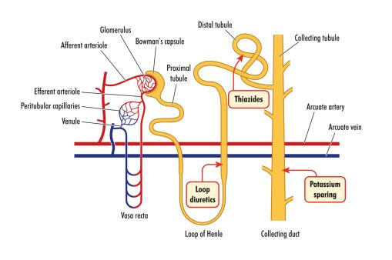
Diuretics—Actions #3
Potassium-sparing diuretics:
Works by blocking the reabsorption of sodium in the collecting tubules; increases sodium and water in the urine; reduces the excretion of potassium
Spironolactone: antagonizes the action of aldosterone
Aldosterone: enhances the reabsorption of sodium in the distal convoluted tubules of the kidney
When aldosterone is inhibited, sodium (but not potassium) and water are ewxcreted

Slide 8
Diuretics—Actions #4
Osmotic diuretics:
Increase the density of the filtrate in the glomerulus
Prevents the selective reabsorption of water
Sodium and chloride excretion is also increased
Carbonic anhydrase inhibitors:
Sulfonamides without bacteriostatic action that inhibit the enzyme carbonic anhydrase
Results in the excretion of sodium, potassium, bicarbonate, and water

Slide 9
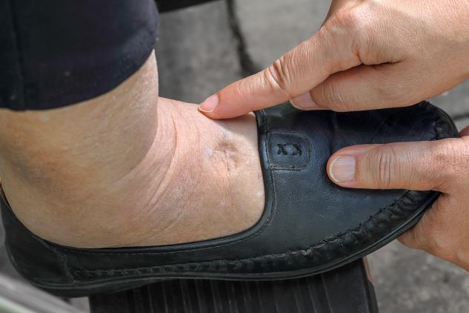
Diuretics—Uses #1
Used in the treatment of:
edema
hypertension
renal disease
cerebral edema
seizures and altitude sickness
acute glaucoma (infrequently and given topically) for increased intraocular pressure

Slide 10

Diuretics—Uses #2
Used in the treatment of:
male-to-female hormonal therapy for gender dysphoria (spironolactone)
short term management of ascites (ethacrynic acid)
premenstrual bloating or weight loss (nonprescription)

Slide 11
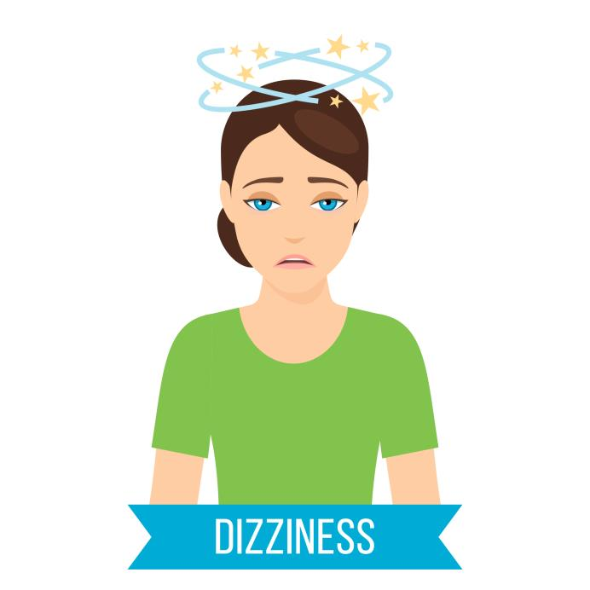
Diuretics—Adverse Reactions #1
Neuromuscular System Reactions:
Dizziness
Lightheadedness
Headache
Weakness
Fatigue

Slide 12
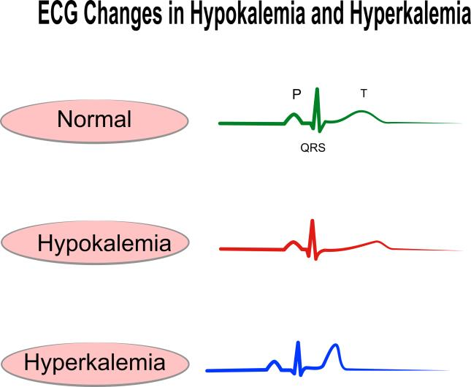
Diuretics—Adverse Reactions #2
Cardiovascular System Reactions:
Orthostatic hypotension
Electrolyte imbalances
Glycosuria

Slide 13

Diuretics—Adverse Reactions #3
Gastrointestinal System Reactions:
Anorexia
Nausea
Vomiting

Slide 14

Diuretics—Adverse Reactions #4
Other Reactions:
Photosensitivity
Extremity paresthesias
Flaccid muscles from hypokalemia
Hyperkalemia (potassium sparing)
Gynecomastia (spironolactone)

Slide 15

Pharmacology in Practice Exercise #1
A nurse is caring for a client with edema due to heart failure. The primary health care provider has prescribed spironolactone for the client. Which of the following adverse reactions to the drug should the nurse monitor for in the client?
Vertigo
Paresthesias
Hyperkalemia
Anorexia

Slide 16

Diuretics—Contraindications
Contraindicated in clients with:
known hypersensitivity to the drug
electrolyte imbalances
severe kidney or liver dysfunction
anuria
active intracranial bleeding (mannitol)
hyperkalemia (potassium-sparing)
pediatrics (potassium sparing)

Slide 17
Diuretics—Precautions
Use cautiously in clients with:
renal dysfunction; during pregnancy (pregnancy category C), lactation
Thiazide and loop diuretics:
Used cautiously in clients with gout, liver disease, diabetes, systemic lupus erythematosus, or diarrhea; pregnancy category B and C
Potassium-sparing diuretics:
Used cautiously in clients with liver disease or diabetes

Slide 18
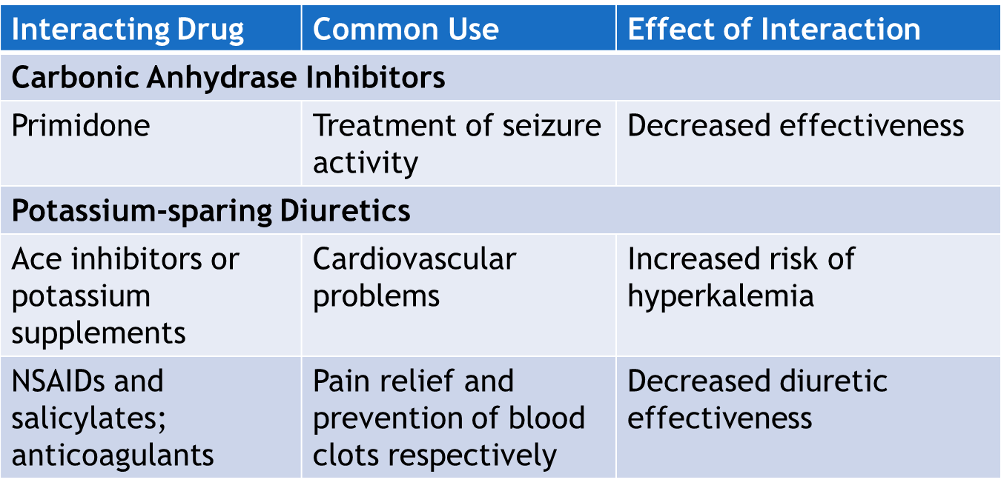
Diuretics—Interactions #1

Slide 19
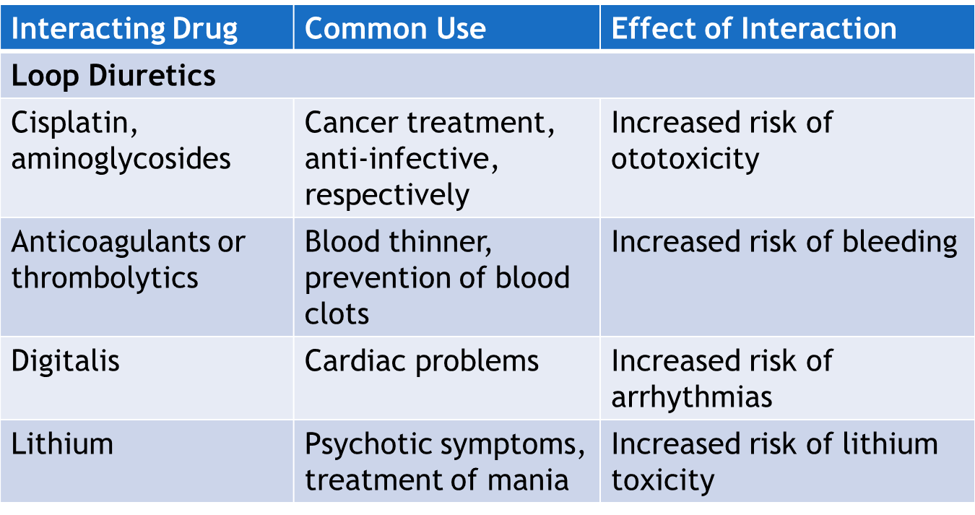
Diuretics—Interactions #2

Slide 20
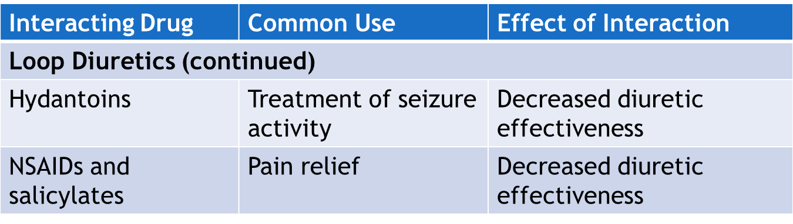
Diuretics—Interactions #3

Slide 21
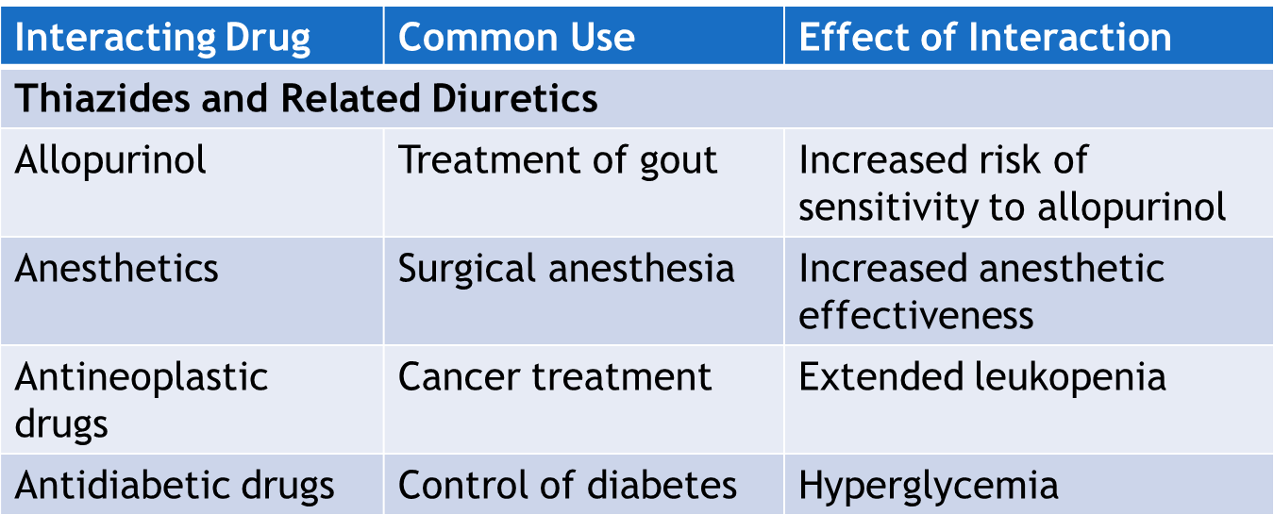
Diuretics—Interactions #4

Slide 22

Pharmacology in Practice Exercise #2
A primary health care provider has prescribed treatment with an antihypertensive drug along with a diuretic to a client as a treatment for hypertension. The client informs the nurse about his preference for herbal extracts over medical drugs. What information regarding herbal extracts should the nurse provide to the client? Select all that apply
No herbal diuretic should be taken unless approved by the PHCP
Some herbal extracts have been associated with renal damage
Herbal Extracts are more effective than caffeine
Most plant and herbal extracts available as diuretics are nontoxic
Consume diuretic teas like juniper berries

Slide 23

Nursing Process—Client Receiving a Diuretic #1
Preadministration Assessment
Objective Data
Vital signs
Weight
Description of edema and skin turgor
Description of lung sounds and effort of breathing
Body circumference measurements for peripheral edema on extremities
Input and output
Laboratory tests: Electrolytes
Hepatic and renal function tests

Slide 24

Nursing Process—Client Receiving a Diuretic #2
Preadministration Assessment (continued)
Subjective Data
Ability to engage in toilet activities with increased urination; ambulation difficulty
Medical history of fluid status conditions
Family history of diseases effecting fluid
Current list of all drugs; diuretics taken in the past

Slide 25

Nursing Process—Client Receiving a Diuretic #3
Ongoing Assessment
Measure and record fluid intake and output
Report to the primary health care provider any marked decrease in the fluid output
Weigh the client daily
With an outpatient client, ensure client understands to monitor weight daily, and contact provider based on established parameters

Slide 26
Nursing Process—Client Receiving a Diuretic #4
Nursing Diagnosis
Increased Urinary Frequency related to action of the diuretics causing increased bladder filling
Hypovolemia/Dehydration related to excessive diuresis secondary to the administration of a diuretic
Injury Risk related to lightheadedness, dizziness, or cardiac arrhythmias

Slide 27
Nursing Process—Client Receiving a Diuretic #5
Planning
Expected client outcomes depend on the reason for administration of the drug but include:
Optimal response to therapy
Management of adverse drug reactions
Confidence in an understanding of the prescribed medication regimen

Slide 28

Nursing Process—Client Receiving a Diuretic #6
Implementation
Promoting Optimal Response to Therapy
Client with Hypertension
On and outpatient basis, client should be instructed to monitor their blood pressure and pulse
On an inpatient basis, vital signs are monitored frequently

Slide 29
Nursing Process—Client Receiving a Diuretic #7
Implementation
Promoting Optimal Response to Therapy
Client with Edema
Weigh the client daily
Assess the blood pressure, pulse, respiratory rate every 4 hours or more frequently
Assess fluid intake and output every 8 hours or more frequently if needed
Examine areas of edema daily and record findings in the client’s chart
Monitor general appearance of area with edema

Slide 30
Nursing Process—Client Receiving a Diuretic #8
Implementation
Promoting Optimal Response to Therapy
Client with Increased Intracranial Pressure (Mannitol)
Mannitol is given via IV; inspect solution prior to administration; give at rate to maintain urinary output of 30 to 50 mL/hr
Monitor the urine output, blood pressure, pulse, and respiratory rate
Perform neurologic assessments at specific time intervals
Monitor for signs and symptoms indicating decrease in intracranial pressure

Slide 31

Nursing Process—Client Receiving a Diuretic #9
Implementation
Promoting Optimal Response to Therapy
Client with Renal Compromise (Thiazide Diuretics)
Monitor renal function periodically
Monitor nonprotein nitrogen, BUN, serum uric acid concentrations and serum glucose concentration periodically
Monitor for any joint pain or discomfort

Slide 32
Pharmacology in Practice Exercise #3
A nurse is caring for a client with renal dysfunction. The PHCP has prescribed a metolazone drug for the client. What should the nurse monitor in the client before administering the drug? Select all that apply.
Serum cholesterol levels
Levels of serum electrolytes
Fluid loss every hour
Creatinine clearance levels
Blood urea nitrogen levels

Slide 33
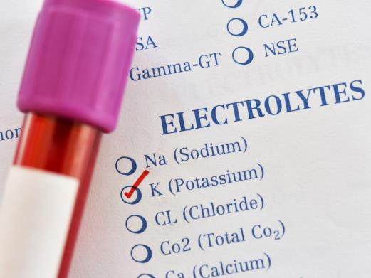
Nursing Process—Client Receiving a Diuretic #10
Implementation
Promoting Optimal Response to Therapy
Client at Risk of Electrolyte Balances
Monitor for signs and symptoms of electrolyte imbalances
Monitor potassium level in clients taking potassium-sparing diuretics frequently; if serum potassium >5.3 mEq/mL the diuretic is stopped and contact provider

Slide 34
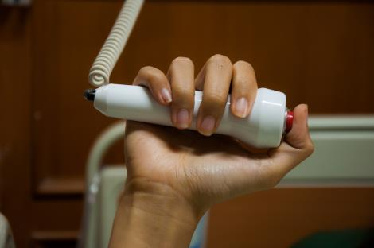
Nursing Process—Client Receiving a Diuretic #11
Implementation
Monitoring and Managing Client Needs
Increased Urinary Frequency
Explain the purpose and effects of the drug to enhance understanding, adherence to drug therapy, and reduce anxiety
Administer the drug early in the day
Make sure that client on bed rest has a call light and a bedpan or urinal within easy reach

Slide 35

Nursing Process—Client Receiving a Diuretic #12
Implementation
Monitoring and Managing Client Needs
Hypovolemia/Dehydration
Encourage clients to eat and drink all food and fluids served at mealtime (potassium rich foods if on a potassium if indicated)
Encourage fluids at frequent intervals throughout the day
Monitor fluid intake and output

Slide 36
Nursing Process—Client Receiving a Diuretic #13
Implementation
Monitoring and Managing Client Needs
Hypovolemia/Dehydration
Assess for signs and symptoms of dehydration or electrolyte imbalance
Dry mouth, thirst, weakness, lethargy, drowsiness, restlessness, muscle pains or cramps, confusion, GI disturbances, hypotension, oliguria, tachycardia, and seizures
Notify health care provider if urinary output is low, if urine is concentrated, or for signs and symptoms of electrolyte imbalance or dehydration

Slide 37

Nursing Process—Client Receiving a Diuretic #14
Implementation
Monitoring and Managing Client Needs
Injury Risk
Frequently monitor pulse rate and rhythm
Report any significant changes in pulse rate or rhythm to the provider
Assist clients who are dizzy but allowed out of bed with ambulatory activities

Slide 38

Nursing Process—Client Receiving a Diuretic #15
Implementation—Educating the Client and Family
Explain the importance of taking the drug at prescribed time intervals and as directed
Advise about the importance of completing the entire course of treatment
Emphasize the importance of taking the drug with food or milk if GI upset occurs
Advise the client to take the drug early in the morning unless the provider directed otherwise

Slide 39

Nursing Process—Client Receiving a Diuretic #16
Implementation—Educating the Client and Family (continued)
Do not reduce fluid intake to reduce the need to urinate
Instruct client to avoid alcohol and nonprescription drugs
Emphasize observing caution while driving or performing hazardous tasks
Explain necessary interventions if dizziness or weakness or signs of dehydration or electrolyte imbalance occurs; notify provider

Slide 40

Nursing Process—Client Receiving a Diuretic #17
Implementation—Educating the Client and Family (continued)
Instruct client to weigh themselves daily and track their weight; notify provider if weight loss or gain exceeds 3 to 5 pounds in a week.
If foods or fluids high in potassium are recommended by the provider, educate the client about potassium-rich food and fluid sources; caution client not to exceed daily recommended amount
Explain the importance of avoiding exposure to sunlight or ultraviolet light

Slide 41
Nursing Process—Client Receiving a Diuretic #18
Implementation—Educating the Client and Family (continued)
Explain to clients with diabetes mellitus and who take loop or thiazide diuretics to contact health care provider if increase in blood glucose level
Clients on potassium-sparing diuretics: teach clients to avoid eating foods or drinking fluids high in potassium
Clients on thiazide diuretics: explain the necessity of contacting the primary health care provider if sudden joint pain occurs
Clients on carbonic anhydrase inhibitors: explain the necessity of contacting the primary health care provider immediately if eye pain is not relieved or increased; if be being used for a client with seizures, all seizures should be documented

Slide 42
Nursing Process—Client Receiving a Diuretic #19
Evaluation
Was the therapeutic effect achieved and did diuresis occur?
Were adverse reactions: identified, reported, and managed?
Urinary elimination occurs without incident
Fluid volume problems are corrected
No injury is evident
Did client and family express confidence and demonstrate understanding of drug regimen?

Slide 43

Turn and Talk—Case Study
A client is admitted to the hospital for treatment of significant edema associated with heart failure. The physician has ordered furosemide (Lasix) IV 1 mg/kg every 6 hours
The client weighs 150 pounds, how many milliliters should the nurse administer every 6 hours if furosemide is available in a 20-mg/mL vial?
During the administration of furosemide, what adverse reactions should the nurse monitor with the client?
The use of furosemide can result in hypokalemia. What are the signs of hypokalemia?

