Slide 1
Introduction to Clinical Pharmacology
Chapter 33
Antihyperlipidemic Drugs

Slide 2
Learning Objectives #1
Compare and contrast cholesterol, high-density lipoprotein (HDL), low-density lipoprotein (LDL), and triglyceride levels and how they contribute to the development of heart disease.
Define therapeutic life changes (TLCs) and how they affect cholesterol levels.
Explain the uses, general drug actions, general adverse reactions, contraindications, precautions, and interactions of antihyperlipidemic drugs.

Slide 3
Learning Objectives #2
4. Distinguish important pre-administration and
ongoing assessment activities the nurse
should perform on the client taking an
antihyperlipidemic drug.
List nursing diagnoses particular to a client taking an antihyperlipidemic drug.
Examine ways to promote an optimal response to therapy, how to manage common adverse reactions, and important points to keep in mind when educating clients about the use of antihyperlipidemic drugs.

Slide 4
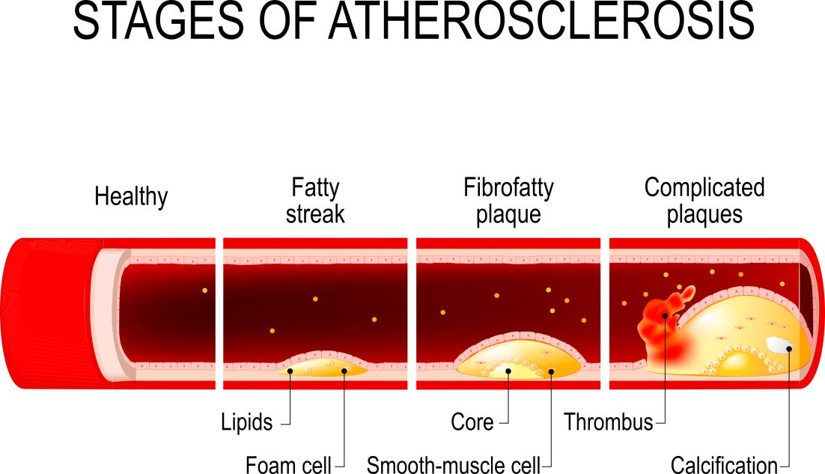
Atherosclerosis
Atherosclerosis

Slide 5
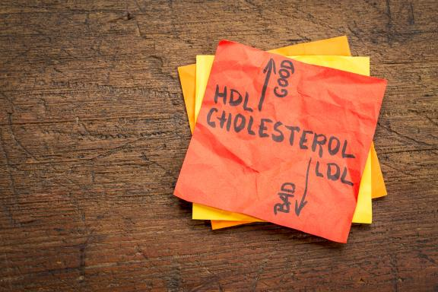
Lipoproteins
Low-density lipoproteins (LDLs):
  Transport cholesterol to the peripheral cells
  Elevation of LDLs:
  Atherosclerotic plaque formation
  Increases the risk for heart disease
High-density lipoproteins (HDLs):
  Take cholesterol from the peripheral cells and transport it to the liver
  Physical activity raises the HDL cholesterol levels

Slide 6
Cholesterol Levels
    HDL cholesterol: protects against heart disease
    The higher the LDL level, the greater the risk for heart disease
    Drugs used to treat hyperlipidemia:
      HMG-CoA reductase inhibitors
      Bile acid resins
      Fibric acid derivatives
      Niacin

Slide 7

Therapeutic Life Changes
    The primary health care provider prescribes life changes as a first line of defense in preventing and treating hyperlipidemia
      Cholesterol-lowering diet
      Physical activity
      Smoking cessation
      Weight management
      TLC diet is low saturated-fat, low cholesterol, includes 200 mg if dietary cholesterol per day

Slide 8
HMG-CoA Reductase Inhibitors—Actions
    Also known as “statins”
    HMG-CoA reductase:
      An enzyme that is a catalyst during the manufacture of cholesterol
    Inhibits the manufacture of cholesterol or promotes the breakdown of cholesterol
    Lowers the blood levels of cholesterol and serum triglycerides

Slide 9
HMG-CoA Reductase Inhibitors—Uses
  Used in the treatment of:
    hyperlipidemia
    primary prevention of coronary events
    secondary prevention of cardiovascular events

Slide 10
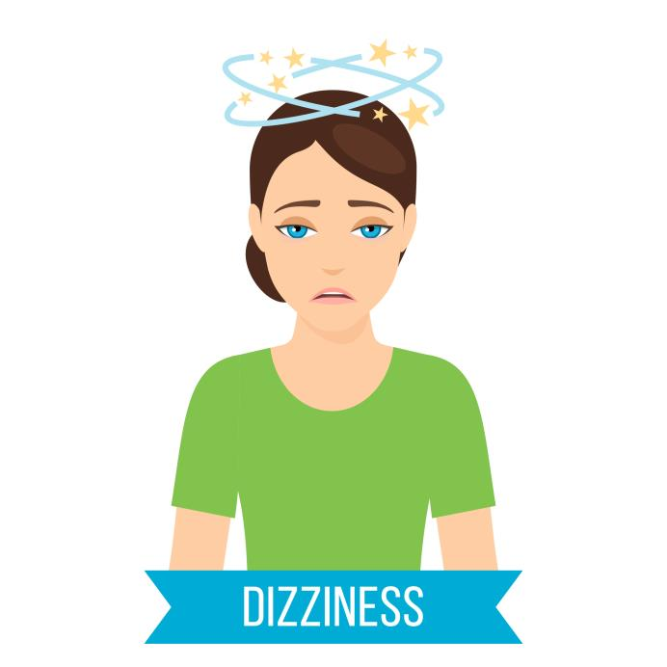
HMG-CoA Reductase Inhibitors—Adverse Reactions #1
Neuromuscular System Reactions:
  Headache
  Dizziness
  Insomnia
  Memory or cognitive impairment

Slide 11

HMG-CoA Reductase Inhibitors—Adverse Reactions #2
Gastrointestinal System Reactions:
  Flatulence
  Abdominal pain
  Cramping
  Constipation
  Nausea
  Hyperglycemia in nondiabetic

Slide 12

HMG-CoA Reductase Inhibitors—Adverse Reactions #3
Serious Reactions:
  Leg pain or cramping
  Rhabdomyolysis

Slide 13

HMG-CoA Reductase Inhibitors—Contraindications
Contraindicated in clients with:
  known hypersensitivity to the drug
  liver disorders
  pregnancy
  lactation

Slide 14
HMG-CoA Reductase Inhibitors—Precautions
Use cautiously in clients with:
diabetes
a history of alcoholism
non-alcohol-related liver disease
acute infection
hypotension
trauma
endocrine disorders
visual disturbances
myopathy

Slide 15
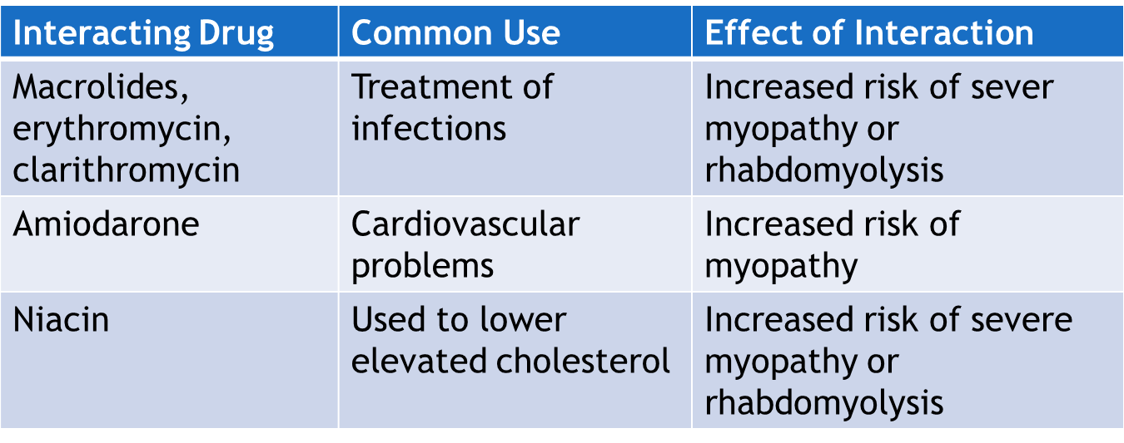
HMG-CoA Reductase Inhibitors—Interactions #1

Slide 16
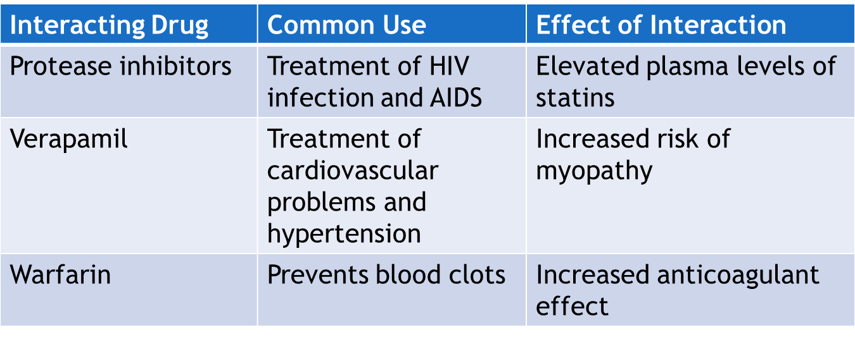
HMG-CoA Reductase Inhibitors—Interactions #2

Slide 17
PCSK9 Inhibitors—Actions, Uses, and Adverse Reactions
    Proprotein convertase subtilisin/kexin type 9 (PCSK9) is an enzyme that binds with LDL and prevents it from being removed from the blood
    Actions: PCSK9 inhibitors are monoclonal antibodies that block the enzyme process and lowers LDL cholesterol
    Used in clients with genetic familial hyperlipidemia at high risk for cardiovascular disease
    Administered subcutaneously once or twice a month
    Adverse Reaction: cognitive adverse reactions

Slide 18
Bile Acid Resins—Action
  Bile: manufactured, secreted by liver; stored in the gallbladder; emulsifies fat and lipids
  Bile acid resins bind to bile acids to form an insoluble substance that cannot be absorbed in the intestine; excreted in the feces
  Increased loss of bile acids:
    Liver uses cholesterol to manufacture more bile
    Decrease in cholesterol levels

Slide 19
Bile Acid Resins—Uses
  Used in the treatment of:
    hyperlipidemia
    gallstone dissolution in clients where surgery is not recommended
    pruritis associated with partial biliary obstruction (cholestyramine only)

Slide 20
Bile Acid Resins—Adverse Reactions
General Adverse Reactions:
  Constipation
  Aggravation of hemorrhoids
  Abdominal cramps
  Flatulence
  Nausea
  Tingling (Niacin)
  Increased bleeding tendencies related to vitamin K malabsorption and vitamin A and D deficiencies

Slide 21
Bile Acid Resins—Contraindications and Precautions
Contraindicated in clients with:
  known hypersensitivity to the drug
  biliary obstruction (bile acid resins)
Use cautiously in clients with:
diabetes
liver disease
peptic ulcer
kidney disease
pregnancy (bile acid resins)
lactation

Slide 22
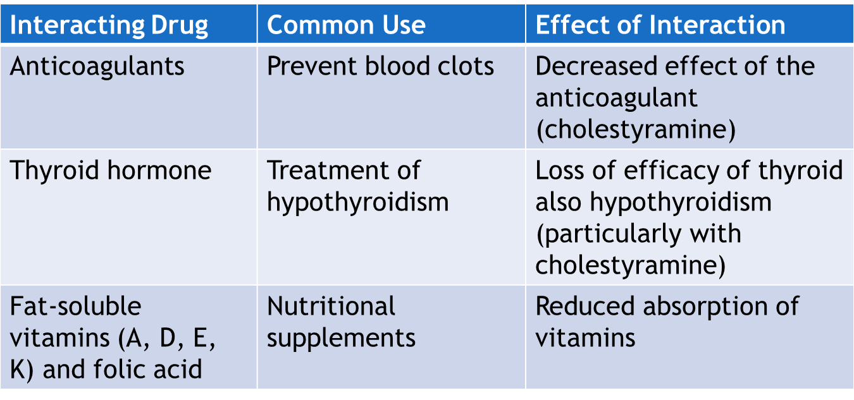
Bile Acid Resins—Interactions #1

Slide 23
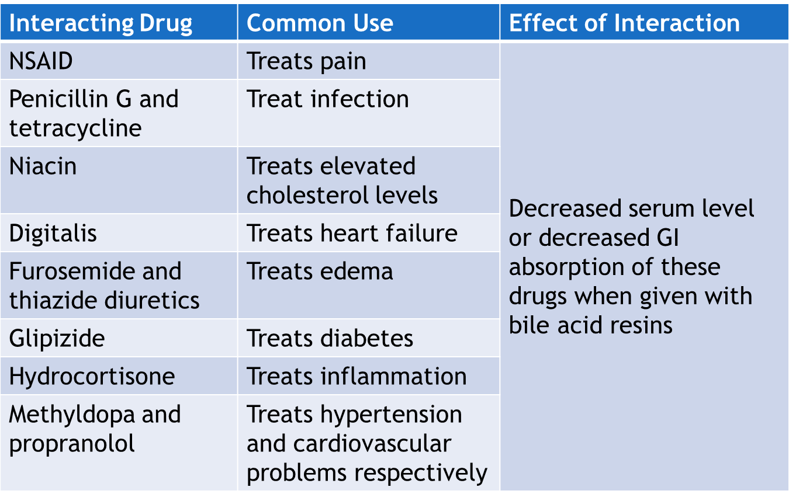
Bile Acid Resins—Interactions #2

Slide 24
Fibric Acid Derivatives—Action
  Work in a variety of ways
  Fenofibrate reduces very-low-density lipoproteins and stimulates the catabolism of triglyceride-rich lipoproteins; decreases plasma triglycerides and cholesterol
  Gemfibrozil increases the excretion of cholesterol in the feces and reduces the production of triglycerides by the liver; lowers serum lipid levels

Slide 25
Fibric Acid Derivatives—Uses
  Used in the treatment of:
    Varies by the drug
    Fenofibrate: used as adjunctive treatment for reducing LDLs, total cholesterol, and triglycerides in clients with hyperlipidemia
    Gemfibrozil treats clients with very high serum triglyceride levels at risk for abdominal pain and pancreatitis who do not respond to dietary modifications

Slide 26
Fibric Acid Derivatives—Adverse Reactions
General Adverse Reactions:
  Nausea
  Vomiting
  GI upset
  Diarrhea
  Cholelithiasis or cholecystitis

Slide 27
Fibric Acid Derivatives—Contraindications and Precautions
Contraindicated in clients with:
  known hypersensitivity to the drug
  hepatic or renal dysfunction
  primary biliary cirrhosis (Fenofibrate)
Use cautiously in clients with:
pregnancy
lactation

Slide 28
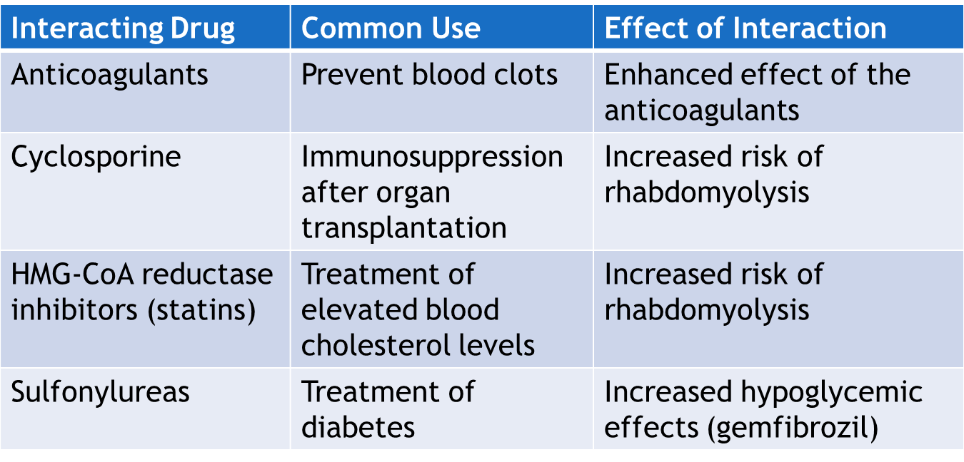
Fibric Acid Derivatives—Interactions

Slide 29
Misc. Antihyperlipidemic Drugs—Actions
  Niacin’s (nicotinic acid) mechanism of lowering blood lipid levels is not fully understood
  Bempedoic acid inhibits the synthesis of cholesterol in the liver
  Ezetimibe inhibits the absorption of cholesterol in the small intestine; decrease in cholesterol in the liver

Slide 30
Misc. Antihyperlipidemic Drugs—Uses
  Used in the treatment of:
    Varies by the drug
    Niacin is used as adjunctive therapy for lowering very high serum triglyceride levels in clients at risk of pancreatitis and where the response to dietary control is inadequate
    Bempedoic acid and ezetimibe are used in combination with other antihyperlipidemics in lipid-lowering treatments

Slide 31
Misc. Antihyperlipidemic Drugs—Adverse Reactions #1
Gastrointestinal System Reactions:
  Nausea
  Vomiting
  Abdominal pain
  Diarrhea

Slide 32
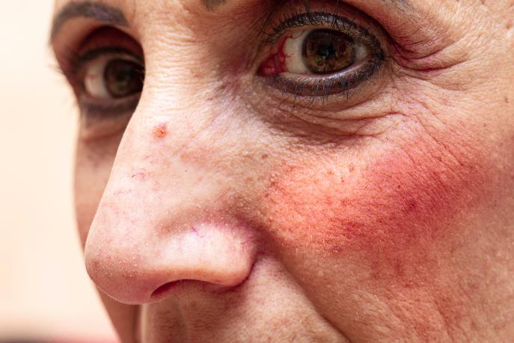
Misc. Antihyperlipidemic Drugs—Adverse Reactions #2
Other Reactions:
  Severe, generalized flushing of the skin
  Sensation of warmth
  Severe itching or tingling
  Generalized muscle aches and flu-like symptoms

Slide 33
Misc. Antihyperlipidemic Drugs—Contraindications
Niacin contraindicated in clients with:
  known hypersensitivity
  active peptic ulcer
  hepatic dysfunction
  arterial bleeding
Bempedoic acid and Ezetimibe contraindicated in clients with:
  pregnancy
  lactation

Slide 34
Misc. Antihyperlipidemic Drugs—Precautions
Niacin is used cautiously in clients with:
renal dysfunction
high alcohol consumption
unstable angina
gout
Pregnancy or lactation

Slide 35

Nursing Process—Client Receiving an Antihyperlipidemic Drug #1
Pre-administration Assessment
Objective Data
  Vital signs
  Weight
  Inspect skin and eyelids for evidence of xanthomas
  Laboratory tests: lipid profile and others specific to the client (e.g., liver function, blood glucose, HbA1c)

Slide 36

Nursing Process—Client Receiving an Antihyperlipidemic Drug #2
Pre-administration Assessment
Subjective Data
  Dietary history
  Medical history of cholesterol/cardiac issues
  Current list of all drugs and supplements

Slide 37
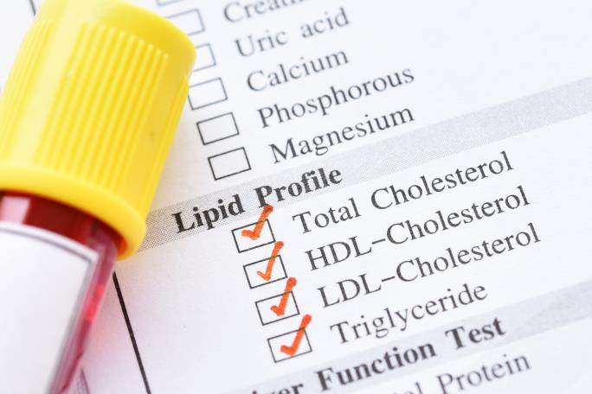
Nursing Process—Client Receiving an Antihyperlipidemic Drug #3
Ongoing Assessment
  Frequently monitor blood cholesterol and triglyceride levels
  Monitor liver function tests, such as serum transaminase levels or fractionated (indirect) bilirubin levels
  Periodic lipid profiles

Slide 38
Nursing Process—Client Receiving an Antihyperlipidemic Drug #4
Nursing Diagnosis
  Constipation related to antihyperlipidemic drugs
  Malabsorption Risk/Risk for imbalanced nutrition related to malabsorption of vitamins
  Altered Skin Integrity Risk related to rash and flushing
  Nausea related to antihyperlipidemic drugs
  Injury Risk related to dizziness

Slide 39
Nursing Process—Client Receiving an Antihyperlipidemic Drug #5
Planning
  Expected client outcomes depend on the reason for administration of the drug but include:
    Optimal response to therapy
    Management of adverse drug reactions
    Confidence in an understanding of the prescribed medication regimen

Slide 40
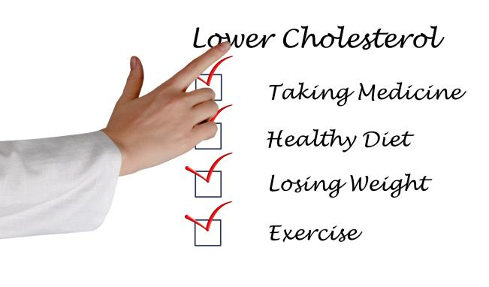
Nursing Process—Client Receiving an Antihyperlipidemic Drug #6
Implementation
  Promoting Optimal Response to Therapy
    Explain drug regimen and possible adverse reactions
    Emphasize the importance of following printed dietary guidelines
    Discuss with the client minimizing high-fat bedtime snacks due to statins not absorbing well when administered with a high-fat meal

Slide 41

Nursing Process—Client Receiving an Antihyperlipidemic Drug #7
Implementation
  Monitoring and Managing Client Needs
    Constipation
      Assess especially older adults for hard stools and difficulty passing stools
      Instruct the client to increase fluid intake, eat foods high in dietary fiber, exercise daily
      If a stool softener is ordered, teach client how to take the stool softener

Slide 42

Nursing Process—Client Receiving an Antihyperlipidemic Drug #8
Implementation
  Monitoring and Managing Client Needs
    Malnutrition
      When bile acid resins used for long-term therapy: administer vitamins A, D in water-soluble form or parenterally

Slide 43

Nursing Process—Client Receiving an Antihyperlipidemic Drug #9
Implementation
  Monitoring and Managing Client Needs
    Altered Skin Integrity Risk
      Educate the client taking niacin that they may experience moderate to severe generalized flushing of the skin, a sensation of warmth, and severe itching or tingling
      Advise the client to contact the primary health care provider if the skin reactions are severe or cause extreme discomfort

Slide 44

Nursing Process—Client Receiving an Antihyperlipidemic Drug #10
Implementation
  Monitoring and Managing Client Needs
    Nausea
      Instruct client to take drug with meal
      Provide client with several small meals rather than three large meals
      Notify the provider if nausea is severe or if vomiting occurs

Slide 45

Nursing Process—Client Receiving an Antihyperlipidemic Drug #11
Implementation
  Monitoring and Managing Client Needs
    Injury Risk
      Monitor client closely for risk of falls/dizziness
      Place call light within easy reach
      Assist the client with ambulation as needed

Slide 46
Nursing Process—Client Receiving an Antihyperlipidemic Drug #12
Implementation
  Monitoring and Managing Client Needs
    Potential complication:
    Vitamin K deficiency: include foods high in vitamin K in the client’s diet; teach client to monitor for bruising; parenteral vitamin K may be indicated
    Rhabdomyolysis: be alert for unexplained muscle pain, muscle tenderness, or weakness, especially if accompanied by malaise or fever; symptoms should be reported to provider

Slide 47

Nursing Process—Client Receiving an Antihyperlipidemic Drug #13
Implementation—Educating the Client and Family
  Provide and review the recommended client with the client and family
  Explain the importance of taking the drug at prescribed time intervals and as directed
  Explain the necessity of contacting the primary health care provider immediately if symptoms occur

Slide 48

Nursing Process—Client Receiving an Antihyperlipidemic Drug #14
Implementation—Educating the Client and Family
  Statins
    Inform client that statins should be taken in the evening or at bedtime
    Do not take statins with grapefruit juice
    Take antacids at least 2 hours after rosuvastatin
    Teach the client that statins may cause photosensitivity and to wear sunscreen and protective clothing

Slide 49

Nursing Process—Client Receiving an Antihyperlipidemic Drug #15
Implementation—Educating the Client and Family
  Self-Management Skills
    Empower clients by supporting efforts rather than telling them to participate in strategies for self-care
    Encourage clients to reduce their cardiovascular risk by using cardiovascular risk calculator educational tools on the internet appropriate for their age, cholesterol level, and blood pressure

Slide 50

Nursing Process—Client Receiving an Antihyperlipidemic Drug #16
Implementation—Educating the Client and Family
  Bile Acid Resins
    Take the drug before meals unless otherwise directed
    Cholestyramine powder must be mixed with 2 to 6 ounces of water or a noncarbonated beverage and shaken
    Colestipol granules must be mixed in liquids, soup, cereal, carbonated beverage, or pulpy fruits; use about 90 mL of liquid

Slide 51

Nursing Process—Client Receiving an Antihyperlipidemic Drug #17
Implementation—Educating the Client and Family
  Bile Acid Resins
    Colestipol tablets should be swallowed whole, one at a time with a full glass of water
    Do not sip or hold liquid preparations in the mouth; tooth discoloration and enamel decay
    GI symptoms may occur but usually subside with continued therapy
    Eat foods high in dietary fiber (Cholestyramine)

Slide 52

Nursing Process—Client Receiving an Antihyperlipidemic Drug #18
Implementation—Educating the Client and Family
  Gemfibrozil: teach client to observe caution while driving or performing hazardous tasks; notify provider if nausea, vomiting, or diarrhea occurs
  Niacin: take with meals; can cause flushing, warmth, itching, and headache; provider may prescribe aspirin to take 30 minutes before niacin to reduce adverse effects
  Ezetimibe: teach client to take at least 2 hours before or 4 hours after a bile acid sequestrant; report adverse effects to provider

Slide 53
Nursing Process—Client Receiving an Antihyperlipidemic Drug #19
Evaluation
  Was the therapeutic effect achieved and did serum lipid levels decrease?
  Were adverse reactions: identified, reported, and managed?
    Client reports adequate bowel movements
    Client maintains an adequate nutritional status
    Nausea is controlled
    No injury is evident
  Did client and family express confidence and demonstrate understanding of drug regimen?

Slide 54

Pharmacology in Practice Exercise#1
Which of the following are examples of modifiable risk factors for hyperlipidemia? Select all that apply
Weight
Diet
Postmenopausal
Age older than 55 years (women)
Age older than 45 years (men)

Slide 55

Pharmacology in Practice Exercise #2
A client is prescribed atorvastatin for hyperlipidemia. The nurse checks the client’s medical record for which of the following contraindicated conditions?
Visual disturbances
Biliary obstruction
Serious liver disorders
Renal dysfunction

Slide 56
Pharmacology in Practice Exercise#3
A nurse is caring for an older client using bile acid sequestrants. What should the nurse monitor for in the client? Select all that apply.
Difficulty in passing stools
Hard, dry stools
Constipation
Mouth dryness
Urinary hesitancy

