Slide 1
Introduction to Clinical Pharmacology
Chapter 34
Antihypertensive Drugs

Slide 2
Learning Objectives #1
Compare and contrast the various types of hypertension and risk factors involved.
Identify normal and abnormal blood pressure levels for adults.
List the various types of drugs used to treat hypertension.
Explain the general drug actions, uses, adverse reactions, contraindications, precautions, and interactions of the antihypertensive drugs.
Distinguish important preadministration and ongoing assessment activities the nurse should perform for the client taking an antihypertensive drug.

Slide 3
Learning Objectives #2
Explain why blood pressure determinations are important during therapy with an antihypertensive drug.
List nursing diagnoses particular to a client taking an antihypertensive drug.
Examine ways to promote an optimal response to therapy, how to manage adverse reactions, and important points to keep in mind when educating clients about the use of an antihypertensive drug

Slide 4
Blood Pressure and Hypertension
Blood pressure: force of blood against artery walls; normal is considered 120/80 mm Hg or lower
Hypertension: high blood pressure that stays elevated over time; blood pressure of 130/90 mm Hg or higher
Prehypertension: elevated blood pressure; at risk of developing hypertension; occurs when the systolic blood pressure falls between 120 and 129 mm Hg and the diastolic blood pressure remains between 80 and 89 mm Hg.

Slide 5
Types of Hypertension
Primary essential hypertension: high blood pressure that does not have a know cause
Secondary hypertension: high blood pressure that is caused by another medical condition; caused by condition that affect the kidneys, arteries, heart, endocrine system, or during pregnancy

Slide 6
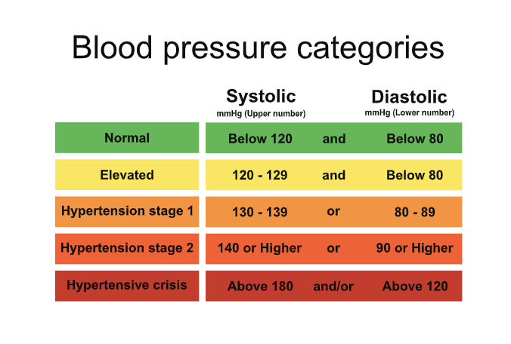
Normal and Abnormal Blood Pressure Levels in Adults

Slide 7
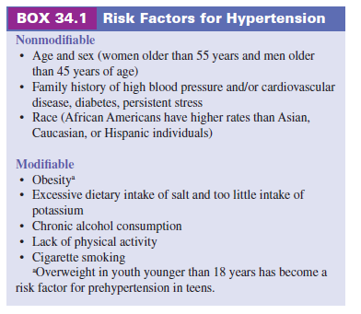
Risk Factors for Hypertension

Slide 8
Nonpharmacologic Treatment of Hypertension
    Weight loss (if the client is overweight)
    Stress reduction (e.g., relaxation techniques, meditation, and yoga)
    Regular aerobic exercise
    Smoking cessation (if applicable)
    Moderation of alcohol consumption
    Dietary changes, such as a decrease in sodium (salt) intake

Slide 9
Drugs Used to Treat Hypertension#1
    Diuretics—for ex. Furosemide & Hydrochlorothiazide
    ẞ-Adrenergic blocking drugs—for ex. Atenolol & Propranolol
    Antiadrenergic drugs (centrally acting)—for ex. Clonidine & Methyldopa
    Antiadrenergic drugs (peripherally acting)—for ex. Doxazosin & Prazosin
    Calcium channel blocking drugs—for ex. Amlodipine & Diltiazem

Slide 10
Drugs Used to Treat Hypertension#2
    Angiotensin-converting enzyme inhibitors (ACEIs)—for ex. Benazepril, Quinapril, & Enalapril
    Angiotensin II receptor antagonists—for ex. Irbesartan & Losartan
    Vasodilating drugs—for ex. Hydralazine & Minoxidil
    Direct renin inhibitors (Aliskiren)
    Selective aldosterone receptor antagonists (SARAs; Eplerenone)

Slide 11
Antihypertensive Drugs—Actions
    Drugs with vasodilating properties (adrenergic blocking and calcium-channel blocking) creates an increase in the lumen of the arterial blood vessels, thus increasing the space available for blood to circulate and decreasing blood pressure
    Diuretics: increase the excretion of sodium
    Angiotensin-converting enzyme inhibitors (ACEIs): inhibit the activity of ACE, which converts angiotensin I to angiotensin II and causes vasoconstriction and secretion of aldosterone (retention of sodium and water); prevention of this process means that sodium and water are not retained and blood pressure decreases

Slide 12
Antihypertensive Drugs—Actions
    Calcium channel blockers: inhibit the movement of calcium ions across the cell membranes of cardiac and arterial muscle cells; results in less calcium available for the transmission of nerve impulses and blood vessels relax; increases the supply of oxygen to the heart and reduces the heart’s workload
    Angiotensin II receptor antagonists: block the binding of angiotensin II at various receptor sites in the vascular smooth muscle and adrenal gland; blocks the vasoconstrictive effect of the renin-angiotensin system and release of aldosterone; results in lowering blood pressure [i.e. Losartan]

Slide 13
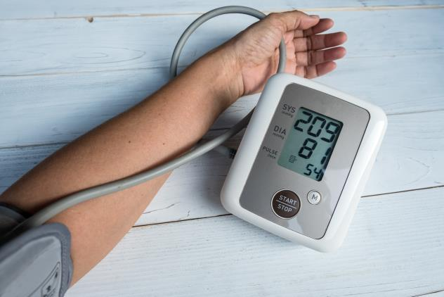
Antihypertensive Drugs—Uses
    Used in the treatment of hypertension and heart failure
    Different types of hypertensives are often prescribed to be taken together if the client’s hypertension does not respond to just one drug therapy
    Nitroprusside is used via IV to treat hypertensive emergencies

Slide 14
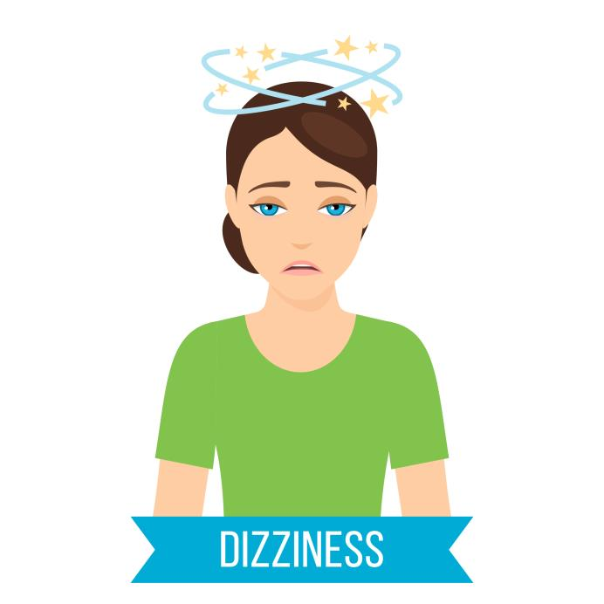
Antihypertensive Drugs—Adverse Reactions#1
Central Nervous System Reactions:
  Fatigue
  Depression
  Dizziness
  Headache
  Syncope

Slide 15

Antihypertensive Drugs—Adverse Reactions#2
Respiratory System Reactions:
  Upper respiratory infections
  Cough

Slide 16

Antihypertensive Drugs—Adverse Reactions#3
Gastrointestinal System Reactions:
  Abdominal pain
  Nausea
  Diarrhea
  Constipation
  Gastric irritation
  Anorexia

Slide 17
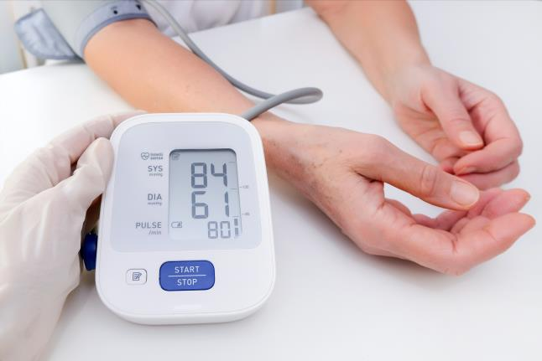
Antihypertensive Drugs—Adverse Reactions#4
Other Reactions:
  Rash
  Pruritis
  Dry mouth
  Tachycardia
  Hypotension
  Proteinuria
  Neutropenia
  Orthostatic hypotension

Slide 18

Antihypertensive Drugs—Contraindications
Contraindications:
  known hypersensitivity to the drugs
  ACEIs and angiotensin II receptor blockers: impaired renal function, salt or volume depletion, bilateral stenosis, angioedema, pregnancy, and lactation
  Calcium channel blockers: sick sinus syndrome, second- or third-degree heart block, hypotension, ventricular dysfunction, and cardiogenic shock

Slide 19
Antihypertensive Drugs—Precautions#1
Use cautiously in clients with:
Renal or hepatic impairment
Electrolyte imbalances
Lactation and pregnancy

Slide 20
Antihypertensive Drugs—Precautions#2
Calcium-channel blockers: heart failure, renal or hepatic impairment, pregnancy and lactation
ACEIs: sodium depletion, hypovolemia, coronary or cerebrovascular insufficiency, clients receiving diuretic therapy or dialysis
Angiotensin II receptor antagonists: renal or hepatic dysfunction, hypovolemia, volume or salt depletion, and in clients receiving high doses of diuretics

Slide 21
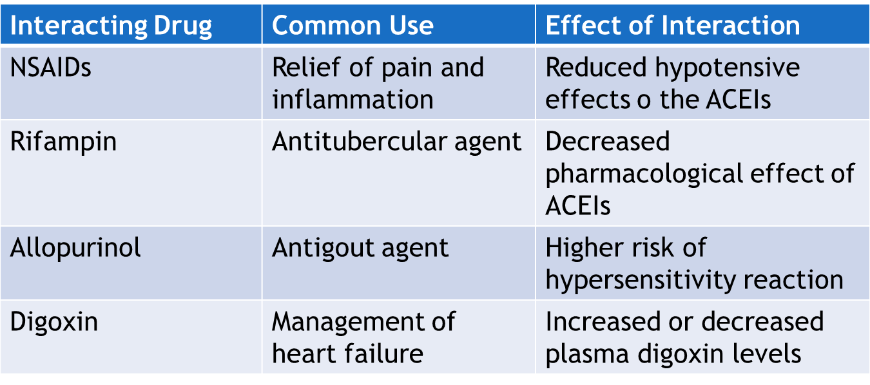
ACE Inhibitor Drug—Interactions #1

Slide 22
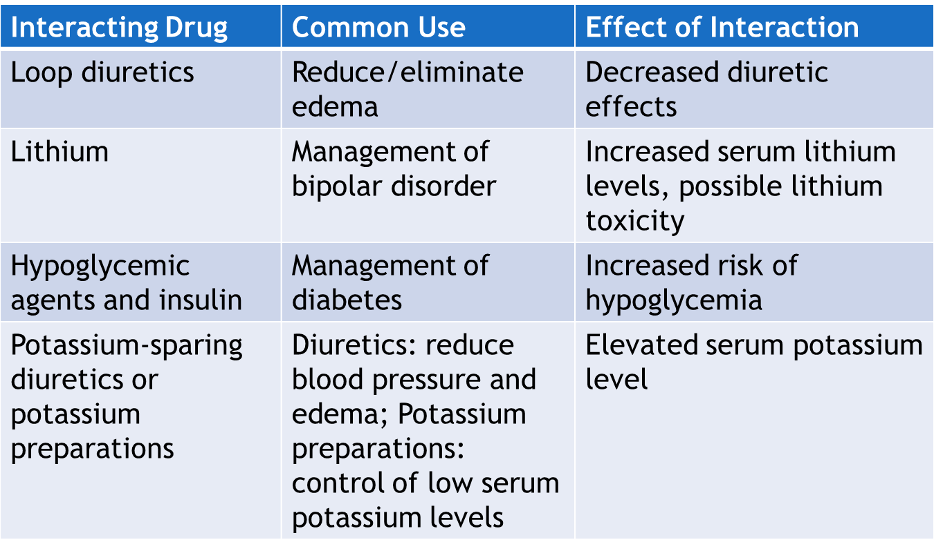
ACE Inhibitor Drug—Interactions #2

Slide 23
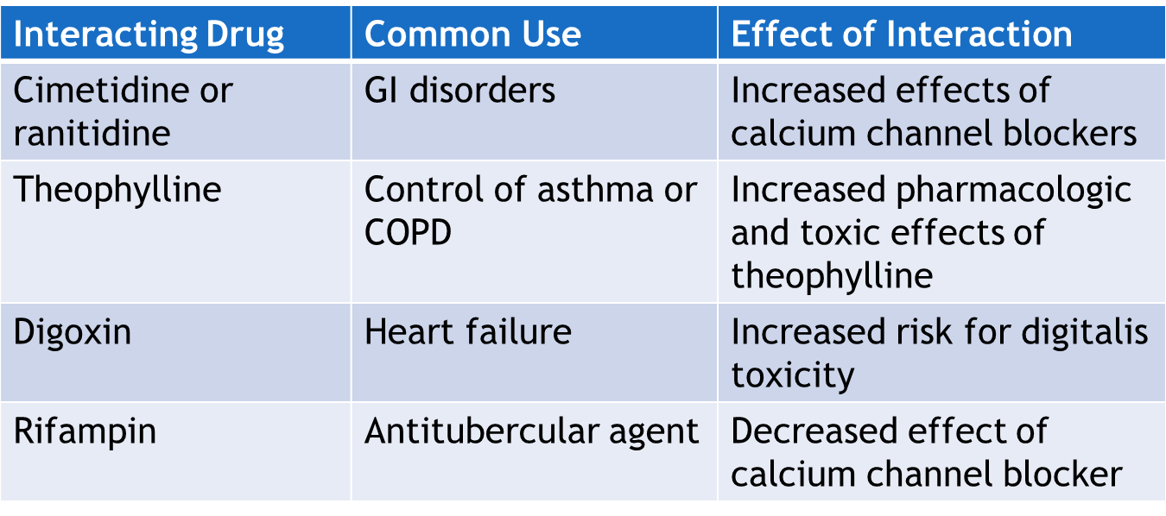
Calcium Channel Blockers—Interactions

Slide 24
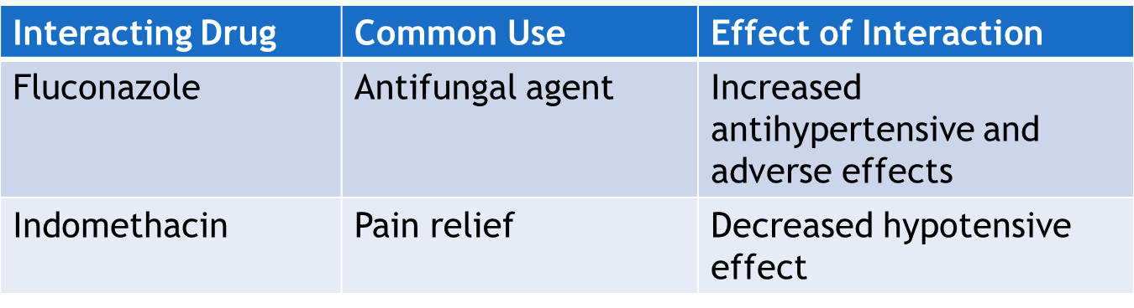
Angiotensin II Receptor Antagonists—Interactions

Slide 25

Nursing Process—Client Receiving an Antihypertensive Drug #1
Pre-administration Assessment
Objective Data
  Vital signs
  Blood pressure readings in lying, sitting, and standing positions (Doxazosin)
  Weight
  Laboratory tests: lipid profile and pregnancy test

Slide 26

Nursing Process—Client Receiving an Antihypertensive Drug #2
Pre-administration Assessment
Subjective Data
  Medical history of hypertension and modifiable factors
  Current list of all drugs and supplements

Slide 27
Nursing Process—Client Receiving an Antihypertensive Drug #3
Ongoing Assessment
  Frequently monitor blood pressure and take blood pressure readings in same arm with client in the same position
  Blood pressure measurement before each administration of the drug
  Hold the drug if the blood pressure is significantly lower than baseline
  Menopausal women: use of birth control while on ACEIs and angiotensin II receptor antagonists
  Assess for edema and weight gain of more than 2 lbs or more per day

Slide 28
Nursing Process—Client Receiving an Antihypertensive Drug #4
Nursing Diagnosis
  Dehydration related to excessive diuresis secondary to administration of a diuretic
  Injury Risk related to dizziness or lightheadedness secondary to postural or orthostatic hypotensive episodes
  Impaired Sexual Functioning related to impotence secondary to effects of antihypertensive drugs
  Activity Intolerance related to fatigue and weakness
  Acute Pain (acute headache) related to antihypertensive drugs

Slide 29
Nursing Process—Client Receiving an Antihypertensive Drug #5
Planning
  Expected client outcomes depend on the reason for administration of the drug but include:
    Optimal response to therapy
    Blood pressure maintained in an acceptable range
    Management of adverse drug reactions
    Confidence in an understanding of the prescribed medication regimen

Slide 30
Nursing Process—Client Receiving an Antihypertensive Drug #6
Implementation
  Promoting Optimal Response to Therapy—ACEIs
    ACEIs should be taken 1 hour before or 2 hours after meals
    The sustained-release capsules should not be crushed, opened or chewed
    Teach the client to refrain from using potassium-based salt substitutes (hyperkalemia)
    Support client if they develop a dry cough; report to primary health care provider
    If a significant drop in blood pressure occurs after the first dose, notify the provider

Slide 31
Nursing Process—Client Receiving an Antihypertensive Drug #7
Implementation
  Promoting Optimal Response to Therapy—Clonidine
    Clonidine transdermal patch:
      apply to hairless area of intact skin and keep in place for 7 days; select a different area of the body for each application
      reinforce loose patch with tape
      date and time the patch application and the date/time of the removal

Slide 32
Nursing Process—Client Receiving an Antihypertensive Drug #8
Implementation
  Promoting Optimal Response to Therapy—Other Antihypertensives
    Aliskiren: advise client to hold the drug if angioedema occurs and notify the primary health care provider
    Nitroprusside: for hypertensive emergency; continuous monitoring of blood pressure and cardiovascular status; significant hypotension may occur
    Most antihypertensive drugs can be given with or without food. If GI upset occurs, give with food.
    When taking diuretics, electrolytes should be monitored for hyponatremia

Slide 33

Nursing Process—Client Receiving an Antihypertensive Drug #9
Implementation
  Monitoring and Managing Client Needs
    Dehydration
      Observe for dehydration and electrolyte imbalances
      Encourage client to drink oral fluids up to 2000 mL/day unless contraindicated
      Monitor for hyponatremia, hypokalemia, and other electrolyte imbalances

Slide 34

Nursing Process—Client Receiving an Antihypertensive Drug #10
Implementation
  Monitoring and Managing Client Needs
    Injury Risk
      If orthostatic hypotension occurs, teach client to rise slowly from laying to sitting to standing (1 to 2 minutes in each position) or to seek assistance getting out of a chair or bed

Slide 35
Nursing Process—Client Receiving an Antihypertensive Drug #11
Implementation
  Monitoring and Managing Client Needs
    Impaired Sexual Functioning
      Provide and open and understanding atmosphere to establish rapport and trust
      Allow client to express feelings
      Provide client educational literature in native language
      If sexual patterns are negatively affected, encourage other means of intimacy
      Encourage client to discuss the use of erectile dysfunction medications with provider

Slide 36

Nursing Process—Client Receiving an Antihypertensive Drug #12
Implementation
  Monitoring and Managing Client Needs
    Activity Intolerance
      Encourage client to walk and ambulate as they can tolerate and to gradually increase activity
      Teach client to plan rest periods
      Reassure client that fatigue diminishes after 4 to 6 weeks of therapy

Slide 37

Nursing Process—Client Receiving an Antihypertensive Drug #13
Implementation
  Monitoring and Managing Client Needs
    Acute Pain
      Client may develop a headache as an adverse effect
      Encourage client to remain in bed with a cool cloth on forehead and offer client back or neck rub
      Teach client to use guided imagery or progressive body relaxation
      Notify primary health care provider if nursing measures are not successful

Slide 38

Nursing Process—Client Receiving an Antihypertensive Drug #14
Implementation—Educating the Client and Family
  Educate all clients that blood pressures should be checked periodically
  Emphasize the importance of drug therapy and following the therapeutic drug regimen; if patient stops taking medication this may result in rebound hypertension
  Educate the client about the adverse reactions and to contact the primary health care provider if adverse reactions occur

Slide 39

Nursing Process—Client Receiving an Antihypertensive Drug #15
Implementation—Educating the Client and Family
  Teach client to use blood pressure machine or community resources to measure blood pressure and to keep a blood pressure record
  Avoid the use of nonprescription drugs unless the primary health care provider is consulted
  Avoid alcohol and if the drug causes drowsiness, avoid driving or performing hazardous tasks

Slide 40
Nursing Process—Client Receiving an Antihypertensive Drug #16
Implementation—Educating the Client and Family
  Teach client about diet restrictions and to avoid salt substitutes unless a particular brand is approved by the primary health care provider
  If client is at risk for orthostatic hypotension, teach client and family safety methods to prevent injury and falls at home

Slide 41
Nursing Process—Client Receiving an Antihypertensive Drug #17
Evaluation
  Was the therapeutic effect achieved and was blood pressure controlled?
  Were adverse reactions: identified, reported, and managed?
    No evidence of dehydration
    No injury is evident
    Client is satisfied with sexual activity
    Client engages in activity as able
    Client is free of headache pain
  Did client and family express confidence and demonstrate understanding of drug regimen?

Slide 42

Pharmacology in Practice Exercise #1
A nurse is presenting an educational session to clients on the consequences of untreated hypertension. Which of the following may develop if hypertension is not treated? Select all that apply.
Adrenal tumor
Blindness
Stroke
Heart disease
Obesity

Slide 43

Pharmacology in Practice Exercise #2
A client with diabetes mellitus and hypertension is on insulin and enalapril for hypertension. Which of the following interactions would occur with the combined administration of both drugs?
Increased risk of hypersensitivity reaction
Increased risk of electrolyte imbalance
Increased risk of hypoglycemia
Increased risk of hypotensive effect

Slide 44
Pharmacology in Practice Exercise #3
A client has developed a headache following the use of prazosin for hypertension. Which of the following instructions should the nurse provide the client receiving prazosin? Select all that apply.
Lie down and elevate legs above head level
Withhold administration of prazosin
Apply a cool cloth over the forehead
Engage in progressive body relaxation
Take an analgesic drug for the pain

