Slide 1
Introduction to Clinical Pharmacology Chapter 37 Cardiotonic and Antiarrhythmic Drugs

Slide 2
Learning Objectives #1
Compare and contrast heart failure in relationship to left ventricular failure, right ventricular failure, neurohormonal activity, and treatment options.
Describe the different types of cardiac arrhythmias.
Explain the uses, general drug actions, general adverse reactions, contraindications, precautions, and interactions of the cardiotonic and antiarrhythmic drugs.
Discuss the use of other drugs with positive inotropic action.

Slide 3
Learning Objectives #2
Distinguish important preadministration and ongoing assessment activities the nurse should perform on the client taking a cardiotonic or antiarrhythmic drug.
List nursing diagnoses particular to a client taking a cardiotonic or antiarrhythmic drug.
Identify the symptoms of digitalis toxicity.
Examine ways to promote an optimal response to therapy, how to manage common adverse reactions, and important points to keep in mind when administering cardiotonic and antiarrhythmic drugs.

Slide 4
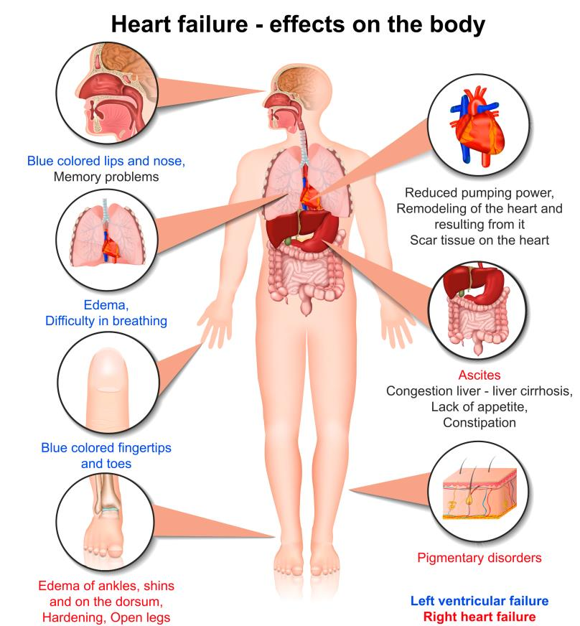
Heart Failure
Heart cannot pump enough blood to meet the tissue needs of the body, commonly called congestive heart failure

Slide 5
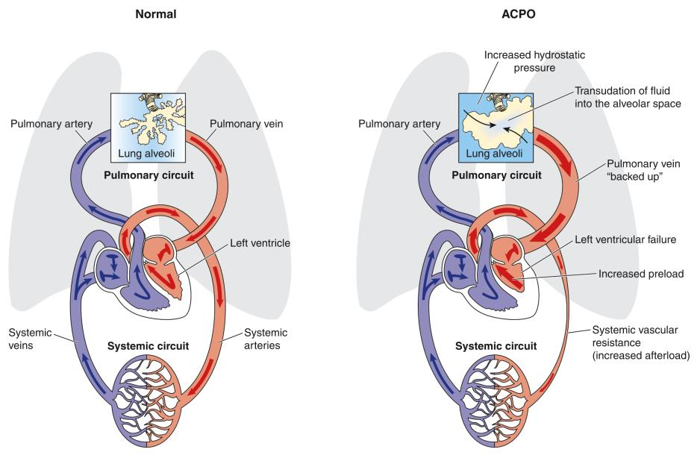
Left Ventricular Dysfunction
Condition in which fluids back up previous to the left ventricle of the heart and is characterized by shortness of breath and moist cough in HF

Slide 6
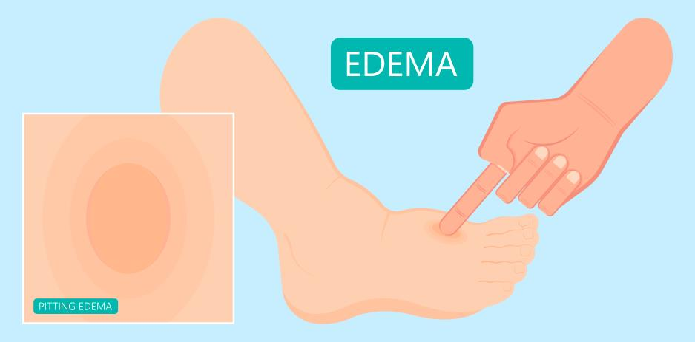
Right Ventricular Dysfunction
Condition in which fluid backs up previous to the right ventricle of the heart and is characterized by peripheral edema and venous congestion in heart failure

Slide 7
Neurohormonal Activity
In heart failure, the body activates the neurohormonal compensatory mechanisms which result in:
increased secretions of neurohormones by the sympathetic nervous system (epinephrine and norepinephrine)
activation of the renin–angiotensin–aldosterone system
remodeling of cardiac tissue (hypertrophy)
Resulting in arteriolar vasoconstriction, tachycardia, myocardial contractility, and cardiac necrosis which leads to worsening of heart failure and reduced ability of the heart to contract effectively

Slide 8
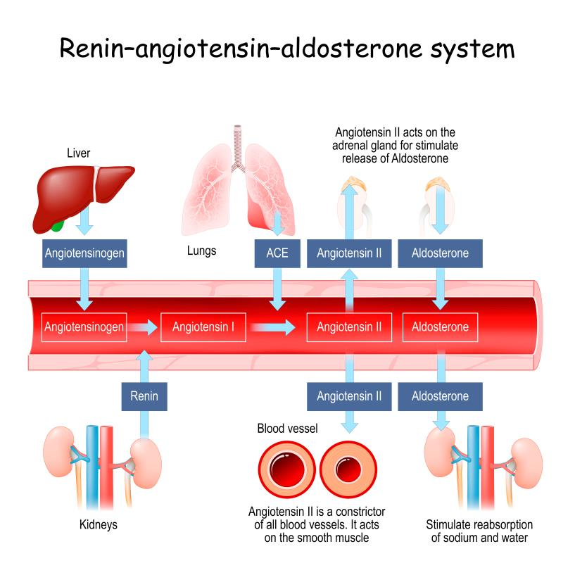
Renin—Angiotensin—Aldosterone System
Activation of the renin—angiotensin—aldosterone (RAA) system occurs because of decreased perfusion to the kidneys. As the RAA system is activated, angiotensin II and aldosterone levels increase, which increases the blood pressure, adding to the workload of the heart

Slide 9

Cardiotonics
Class of drugs that are used to increase the efficiency and improve the contraction of the heart muscle which leads to improved blood flow to all tissues of the body
Also called cardiac glycosides or digitalis glycosides
Example: Digoxin

Slide 10
Cardiotonics—Actions
Increase cardiac output through positive inotropic activity (increase in force of the contraction)
Slow the conduction velocity through the AV node in the heart and decrease the heart rate through a negative chronotropic effect
Ivabradine blocks the if channel and inhibits the passing of the SA node of the heart; slows the heart rate and allows blood to fill the heart chamber
Milrinone has inotropic action

Slide 11
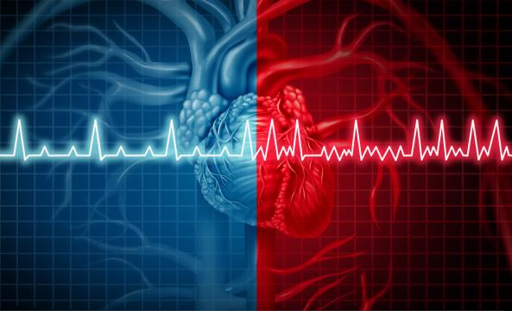
Cardiotonics—Uses
Used for:
Heart failure
Atrial fibrillation
Milrinone is used for the short-term management of severe heart failure not controlled by digitalis

Slide 12

Cardiotonics—Adverse Reactions #1
Central Nervous System Reactions:
Headache
Weakness
Drowsiness
Visual disturbances (blurring or yellow halo with digoxin; increased brightness with ivabradine)

Slide 13

Cardiotonics—Adverse Reactions #2
Other Reactions:
Arrhythmias
Nausea
Anorexia
Digitalis toxicity

Slide 14

Cardiotonics—Contraindications
Contraindicated in clients with:
known hypersensitivity to the drugs
digitalis toxicity
ventricular failure
ventricular tachycardia
cardiac tamponade
restrictive cardiomyopathy
AV block

Slide 15
Cardiotonics—Precautions
Used cautiously in clients with:
electrolyte imbalance (especially hypokalemia, hypocalcemia, and hypomagnesemia)
thyroid disorders
severe carditis
heart block
MI
severe pulmonary disease
acute glomerulonephritis
impaired renal or hepatic function
pregnancy
lactation

Slide 16
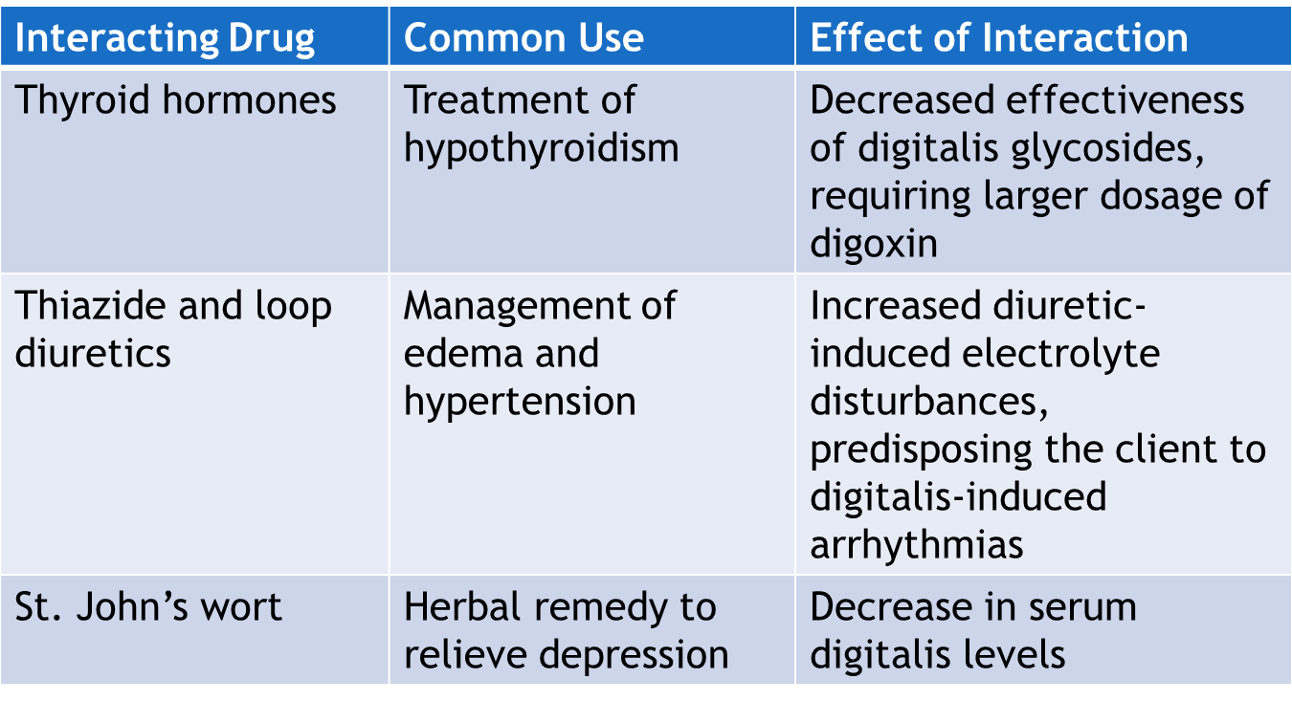
Cardiotonics—Interactions #1

Slide 17
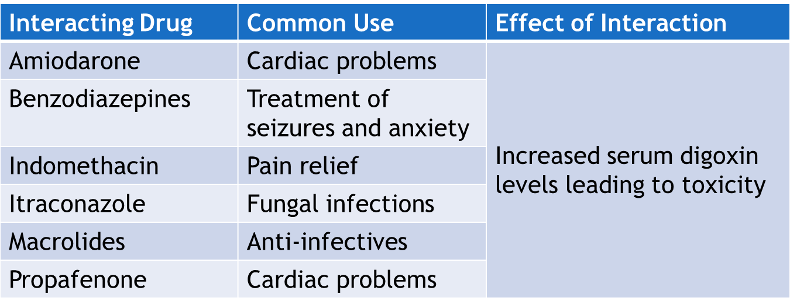
Cardiotonics—Interactions #2

Slide 18
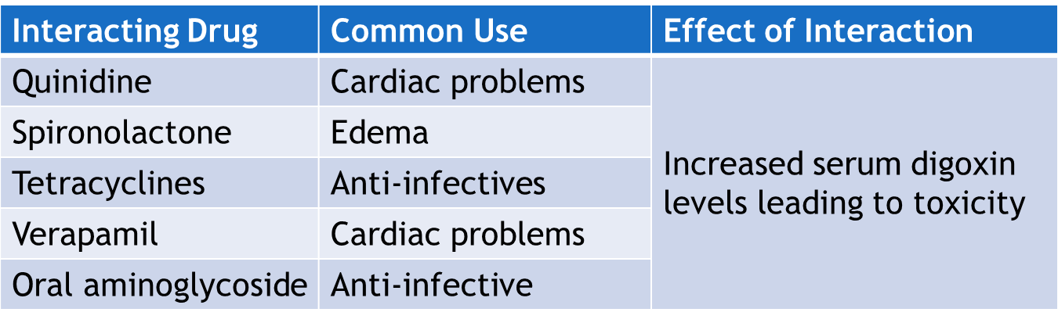
Cardiotonics—Interactions #3

Slide 19
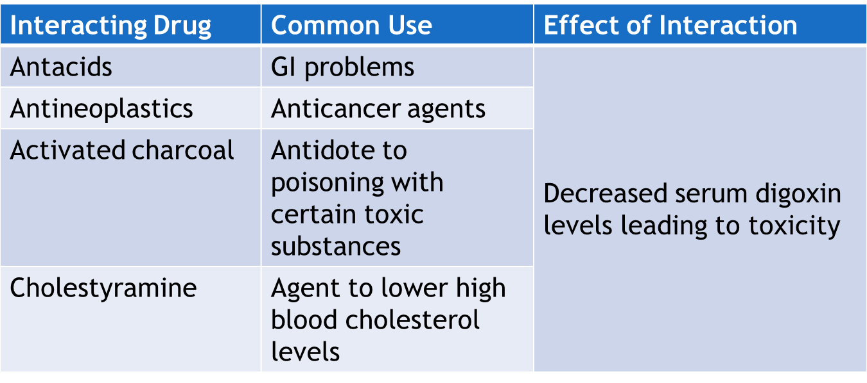
Cardiotonics—Interactions #4

Slide 20
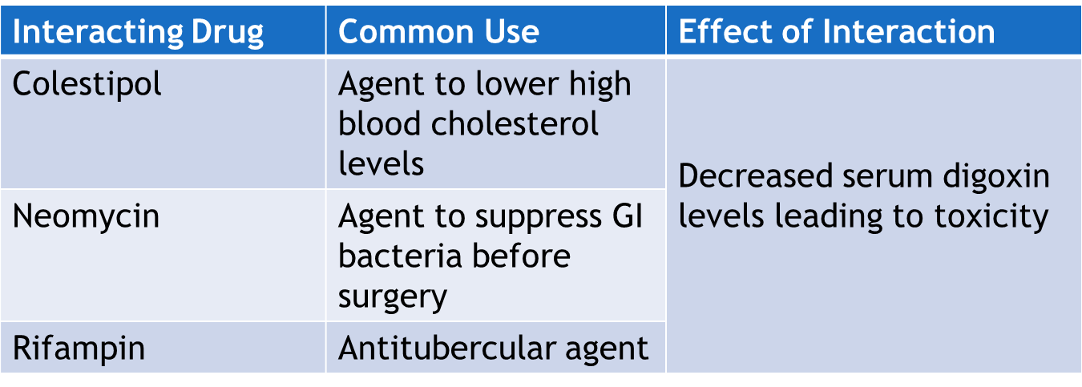
Cardiotonics—Interactions #5

Slide 21
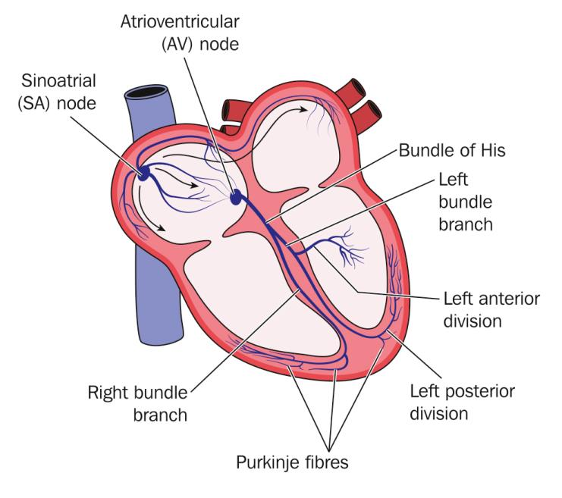
Arrythmias
An arrhythmia is an abnormal heart rate or rhythm; also called dysrhythmia
The blood pumping becomes inefficient due to the pumping action being too slow or too fast
Causes:
Emotional stress
Hypoxia
Electrolyte imbalance

Slide 22
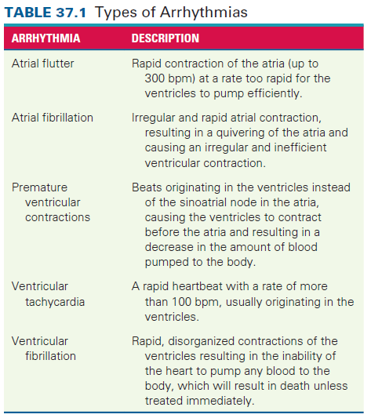
Types of Arrythmias

Slide 23
Antiarrhythmic Drugs—Actions #1
The pathophysiology of the cardiac condition guides the use of drugs to treat cardiac conduction problems. There are five basic classes (and several subclasses) of antiarrhythmic drugs.
Class I: have a membrane-stabilizing or anesthetic effect on the cells of the myocardium
Class IA: produce moderate slowing of cardiac conduction; prolong the action potential duration
Class IB: selectively depress cardiac conduction; shorten the action potential duration
Class IC: profound slowing of conduction; slight effect on repolarization; profound slowing of conduction

Slide 24
Antiarrhythmic Drugs—Actions #2
The pathophysiology of the cardiac condition guides the use of drugs to treat cardiac conduction problems. There are five basic classes (and several subclasses) of antiarrhythmic drugs.
Class II Beta-Adrenergic Blockers: indirectly block calcium channels and block catecholamine-caused arrhythmias.
Class III Potassium Channel Blockers: prolongation of repolarization
Class IV Calcium Channel Blockers: depression of depolarization (phase 4); lightening of phase 1 and 2 of repolarization
Class V Other Agents: digoxin, adenosine, and magnesium sulfate used for specific arrhythmias

Slide 25

Antiarrhythmic Drugs—Uses
Used to treat clients with:
premature ventricular tachycardia
ventricular tachycardia
premature atrial contractions
paroxysmal atrial tachycardia
other atrial arrhythmias (e.g., atrial fibrillation)
tachycardia when rapid but short-term control of ventricular rate is desirable
myocardial infarction (propranolol)

Slide 26

Antiarrhythmic Drugs—Adverse Reactions #1
Central Nervous System Reactions:
Lightheadedness
Weakness
Somnolence

Slide 27
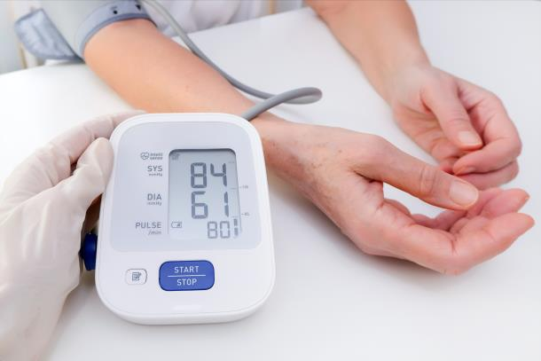
Antiarrhythmic Drugs—Adverse Reactions #2
Cardiovascular System Reactions:
Hypotension
Arrhythmias
Bradycardia

Slide 28
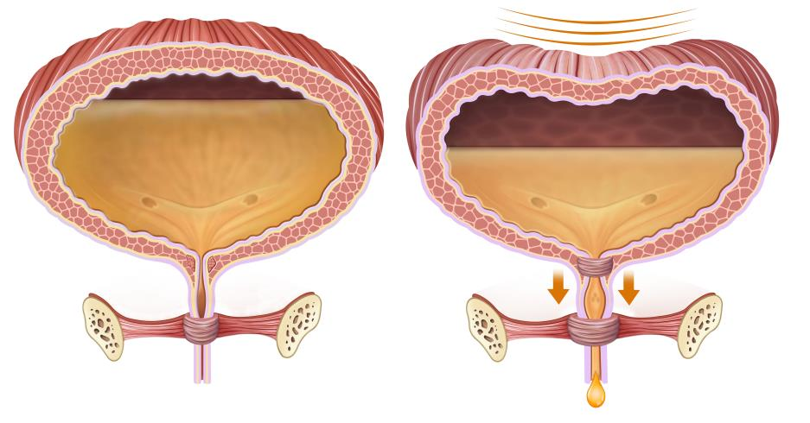
Antiarrhythmic Drugs—Adverse Reactions #3
Other Reactions:
Urinary retention
Local inflammation

Slide 29
Antiarrhythmic Drugs—Contraindications
Contraindicated in clients with:
known hypersensitivity to the drugs
pregnancy (pregnancy category D) and lactation
second- or third-degree AV block (if no pacemaker)
severe heart failure
aortic stenosis
hypotension
cardiogenic shock
myasthenia gravis or systemic lupus erythematosus (quinidine)

Slide 30
Antiarrhythmic Drugs—Precautions
Used cautiously in clients with:
hepatic disease
electrolyte disturbances
heart failure (quinidine, flecainide, and disopyramide)
renal impairment
pregnancy or lactation
myasthenia gravis, urinary retention, glaucoma, or prostate enlargement (disopyramide)

Slide 31
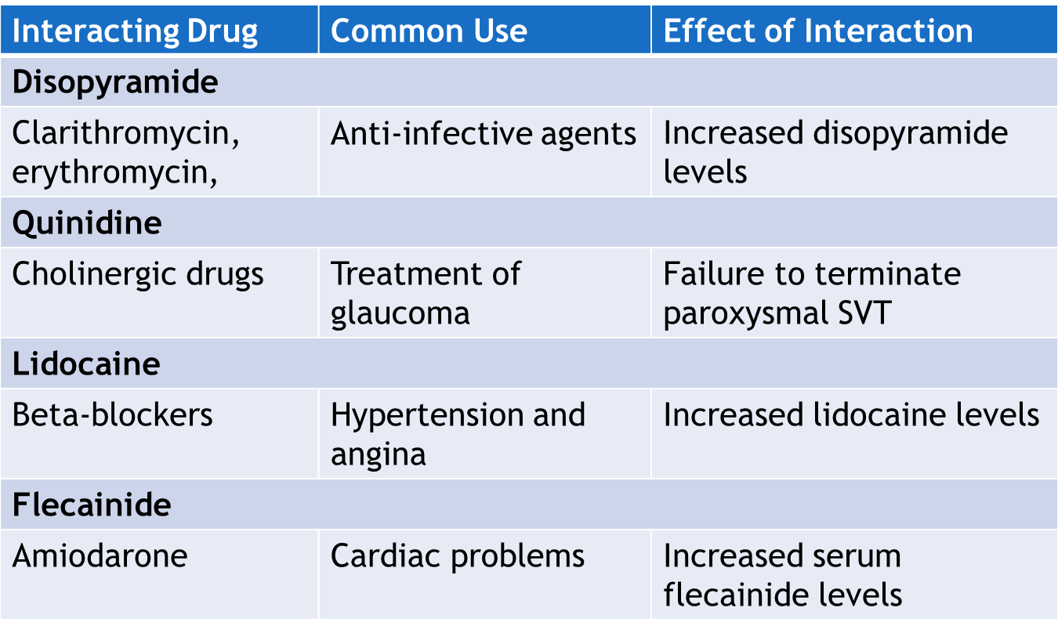
Antiarrhythmic Drugs—InteractionS
*See table 37.1 for more interactions of antiarrhythmics

Slide 32

Nursing Process—Client Receiving a Cardiotonic Drug—Digoxin #1
Pre-administration Assessment
Objective Data
Vital signs
Inspect physical appearance, noting skin color, temperature, and jugular vein distention
Auscultate the lungs for unusual sounds
Inspect sputum and note the appearance
Palpate for pedal pulses and peripheral edema
Weigh the client
Lab tests: ECG, renal and hepatic
function tests, CBC, serum
electrolytes

Slide 33

Nursing Process—Client Receiving a Cardiotonic Drug—Digoxin #2
Pre-administration Assessment
Subjective Data
History of cardiac episodes
Pain assessment if experiencing pain
Medical/family history
Current list of all drugs and supplements taken

Slide 34

Nursing Process—Client Receiving a Cardiotonic Drug—Digoxin #3
Ongoing Assessment
Before administering each dose of a cardiotonic, the nurse takes the apical pulse rate for 60 seconds and records it in the designated area on the chart or the medication administration record
Pulse rate below 60 bpm and above 100 bpm in adults: withhold the drug and inform the primary healthcare provider
For pediatric clients: withhold the drug if the child’s pulse rate is below 70 bpm or below 90 bpm in an infant

Slide 35

Nursing Process—Client Receiving a Cardiotonic Drug—Digoxin #4
Ongoing Assessment
Weigh the client daily and measure intake and output
Auscultate the lungs for crackles and assess for peripheral edema
Assess serum electrolyte levels for signs of hypokalemia, hypomagnesemia, or hypercalcemia

Slide 36
Nursing Process—Client Receiving a Cardiotonic Drug—Digoxin #5
Nursing Diagnosis
Malnutrition Risk related to anorexia, nausea, vomiting
Activity Intolerance related to weakness and drowsiness
Injury Risk related to dizziness, lightheadedness

Slide 37
Nursing Process—Client Receiving a Cardiotonic Drug—Digoxin #6
Planning
Expected client outcomes depend on the reason for administration of the drug but include:
Optimal response to therapy
Management of adverse drug reactions
Confidence in an understanding of the prescribed medication regimen

Slide 38

Nursing Process—Client Receiving a Cardiotonic Drug—Digoxin #7
Implementation
Promoting Optimal Response to Therapy
Monitor serum levels of digoxin closely; drawn immediately before the next dose or 6 to 8 hours after the last dose (therapeutic levels = 0.8 to 2 ng/mL)
Monitor for signs of toxicity in frail elderly clients (toxicity = greater than 2 ng/mL)
Monitor periodic ECGs, serum electrolytes, and hepatic and renal function tests

Slide 39
Nursing Process—Client Receiving a Cardiotonic Drug—Digoxin #8
Implementation
Promoting Optimal Response to Therapy
Monitor clients on diuretics for hypokalemia
Monitor clients in the ICU for hypomagnesemia
When giving a cardiotonic via IV, administer slowly (over at least 5 minutes); assess administration site for redness and infiltration
Oral tablets and capsules can be given without regard to meals or fluids; tablets can be crushed and mixed with meals; do not alternate between capsules and tablets

Slide 40
Nursing Process—Client Receiving a Cardiotonic Drug—Digoxin #9
Implementation
Monitoring and Managing Client Needs
Malnutrition Risk
Observation of the client for signs of digitalis toxicity such as anorexia, vomiting, and nausea
Carefully consider any client complaint or comment, document, and report to provider
If the nausea and anorexia is not resulting from toxicity, but from an adverse reaction to the drug, offer frequent small meals rather than large meals
Restrict fluid at meals and 1 hour prior to meals
Help the client maintain good oral hygiene

Slide 41

Nursing Process—Client Receiving a Cardiotonic Drug—Digoxin #10
Implementation
Monitoring and Managing Client Needs
Activity Intolerance
Client may experience weakness and drowsiness as adverse reactions to digoxin
Nurse plans a gradual increase in activities as tolerance increases and plans adequate rest periods throughout the day
Nurse assists with activities and ambulation as necessary

Slide 42
Nursing Process—Client Receiving a Cardiotonic Drug—Digoxin #11
Implementation
Potential Complication
Digitalis Toxicity
Observe for signs of digitalis toxicity and notify provider
GI: anorexia, nausea, vomiting, diarrhea
Muscular: weakness and lethargy
CNS: headache, drowsiness, visual disturbances, confusion, disorientation, delirium
Cardiac: changes in pulse rate or rhythm, ECG changes (bradycardia, tachycardia, premature ventricular contractions)

Slide 43
Nursing Process—Client Receiving a Cardiotonic Drug—Digoxin #12
Implementation
Potential Complication
Digitalis Toxicity
Digoxin toxicity can be successfully treated by simply withdrawing the drug
If severe bradycardia develops, the provider may order atropine

Slide 44

Nursing Process—Client Receiving a Cardiotonic Drug—Digoxin #13
Implementation
Monitoring and Managing Client Needs
Injury Risk
Hypotension and bradycardia from cardiotonic and antiarrhythmic drugs can cause dizziness and lightheadedness; orthostatic hypotension can occur
Client is at risk of falls
Assist clients not on complete bed rest to ambulate until symptoms subside
Advise client to make position changes slowly

Slide 45

Nursing Process—Client Receiving a Cardiotonic Drug—Digoxin #14
Implementation—Educating the Client and Family
The client and family must understand that the prescribed drug must be taken exactly as directed by the primary healthcare provider; same time each day; do not switch between caplets and tablets
Show the client or a family member the correct technique for taking the pulse; take pulse before taking drug; do not take drug if pulse is less than 60 bmp or greater than 100 bpm

Slide 46

Nursing Process—Client Receiving a Cardiotonic Drug—Digoxin #15
Implementation—Educating the Client and Family
Teach the client to:
keep a log of pulses taken prior to drug administration
avoid nonprescription drugs unless their use has been approved by their provider
contact the provider if adverse reactions develop
carry medical identification describing disease process and drug regimen
follow dietary recommendations
use effective birth control (ivabradine)

Slide 47
Nursing Process—Client Receiving a Cardiotonic Drug—Digoxin #16
Evaluation
Was the therapeutic effect achieved and is the heart beating more effectively?
Were adverse reactions: identified, reported, and managed?
Client maintains adequate nutrition status
Client carries out activities of daily living
No injury is evident
Did client and family express confidence and demonstrate understanding of drug regimen?

Slide 48

Pharmacology in Practice Exercise #1
A client is diagnosed with heart failure and started on digoxin. The client informs the nurse that he is taking a benzodiazepine for anxiety. Which of the following interventions should the nurse implement?
Increase the dosage of digoxin
Monitor for signs of digoxin toxicity
Increase the dosage of benzodiazepine
Monitor for signs of reduced effectiveness of digoxin

Slide 49
Pharmacology in Practice Exercise #2
A nurse reviews the drug history of a client who has been prescribed disopyramide for the treatment of arrhythmia. Which of the following drugs, if taken concurrently can decrease the levels of disopyramide?
Erythromycin
Quinidine
Thioridazine
Rifampin

Slide 50

Pharmacology in Practice Exercise #3
A client is being digitalized for heart failure. The primary healthcare provider assessing the client orders the analysis of serum electrolytes. Which of the following electrolyte changes indicated digoxin toxicity and needs to be reported? Select all that apply.
Hyponatremia
Hypokalemia
Hypomagnesemia
Hypocalcemia
Hypophosphatemia

