Slide 1
Build a Jack-O-Lantern
Build a Jack-O-Lantern
www.ControlAltAchieve.com @ericcurts

Slide 2
Directions…
Copy and paste items from the following slides onto your pumpkin.
If you need different pictures, you can search for more by clicking “Insert” then “Image” then “Search”.
When done building, write about your Jack-O-Lantern in the textbox. You can describe it, tell a story, or explain who it is.
When all done you can download a picture of your Jack-O-Lantern and writing by clicking “File” then “Download as” then “PNG image”.
For more directions, go to www.ControlAltAchieve.com/jackolantern
Template backgrounds from www.slidescarnival.com

Slide 3
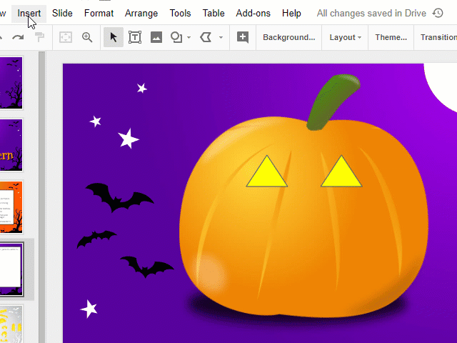
Optional…
You can also use the "Shape" tool to add other shapes.
Click "Insert" then "Shape" then choose the shape you want.
Drag to create the shape.
Rotate and resize as needed.
Color with "Fill color" tool.
www.ControlAltAchieve.com

Slide 4
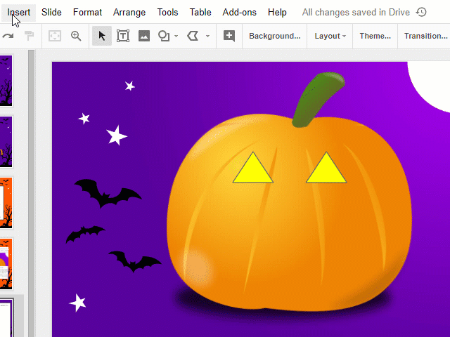
Optional…
You can also use the "Polyline" tool to make custom shapes.
Click "Insert" then "Line" then "Polyline".
Click endpoints to create the shape.
Color with "Fill color" tool.
www.ControlAltAchieve.com

Slide 5

Write about your Jack-O-Lantern…
www.ControlAltAchieve.com

Slide 6






















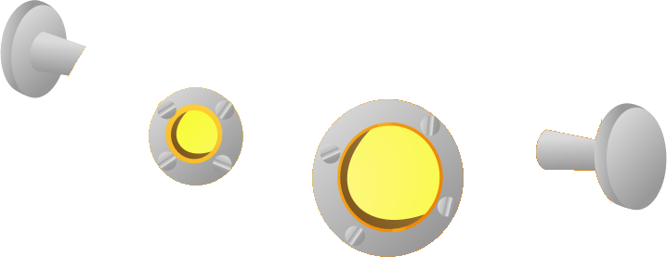



Eyes #1

Slide 7






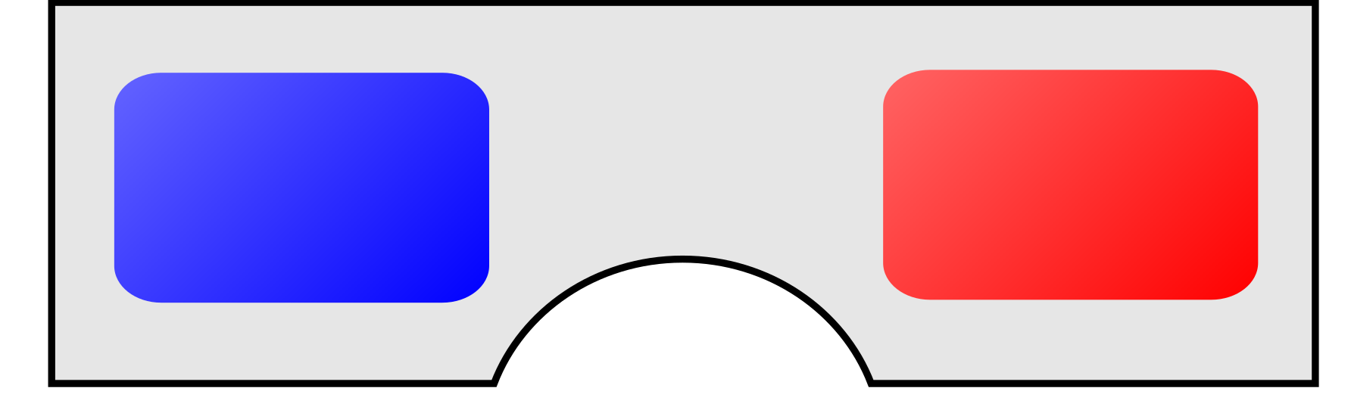

















Eyes #2

Slide 8

























Mouths #1

Slide 9




























Mouths #2

Slide 10












Arms

Slide 11

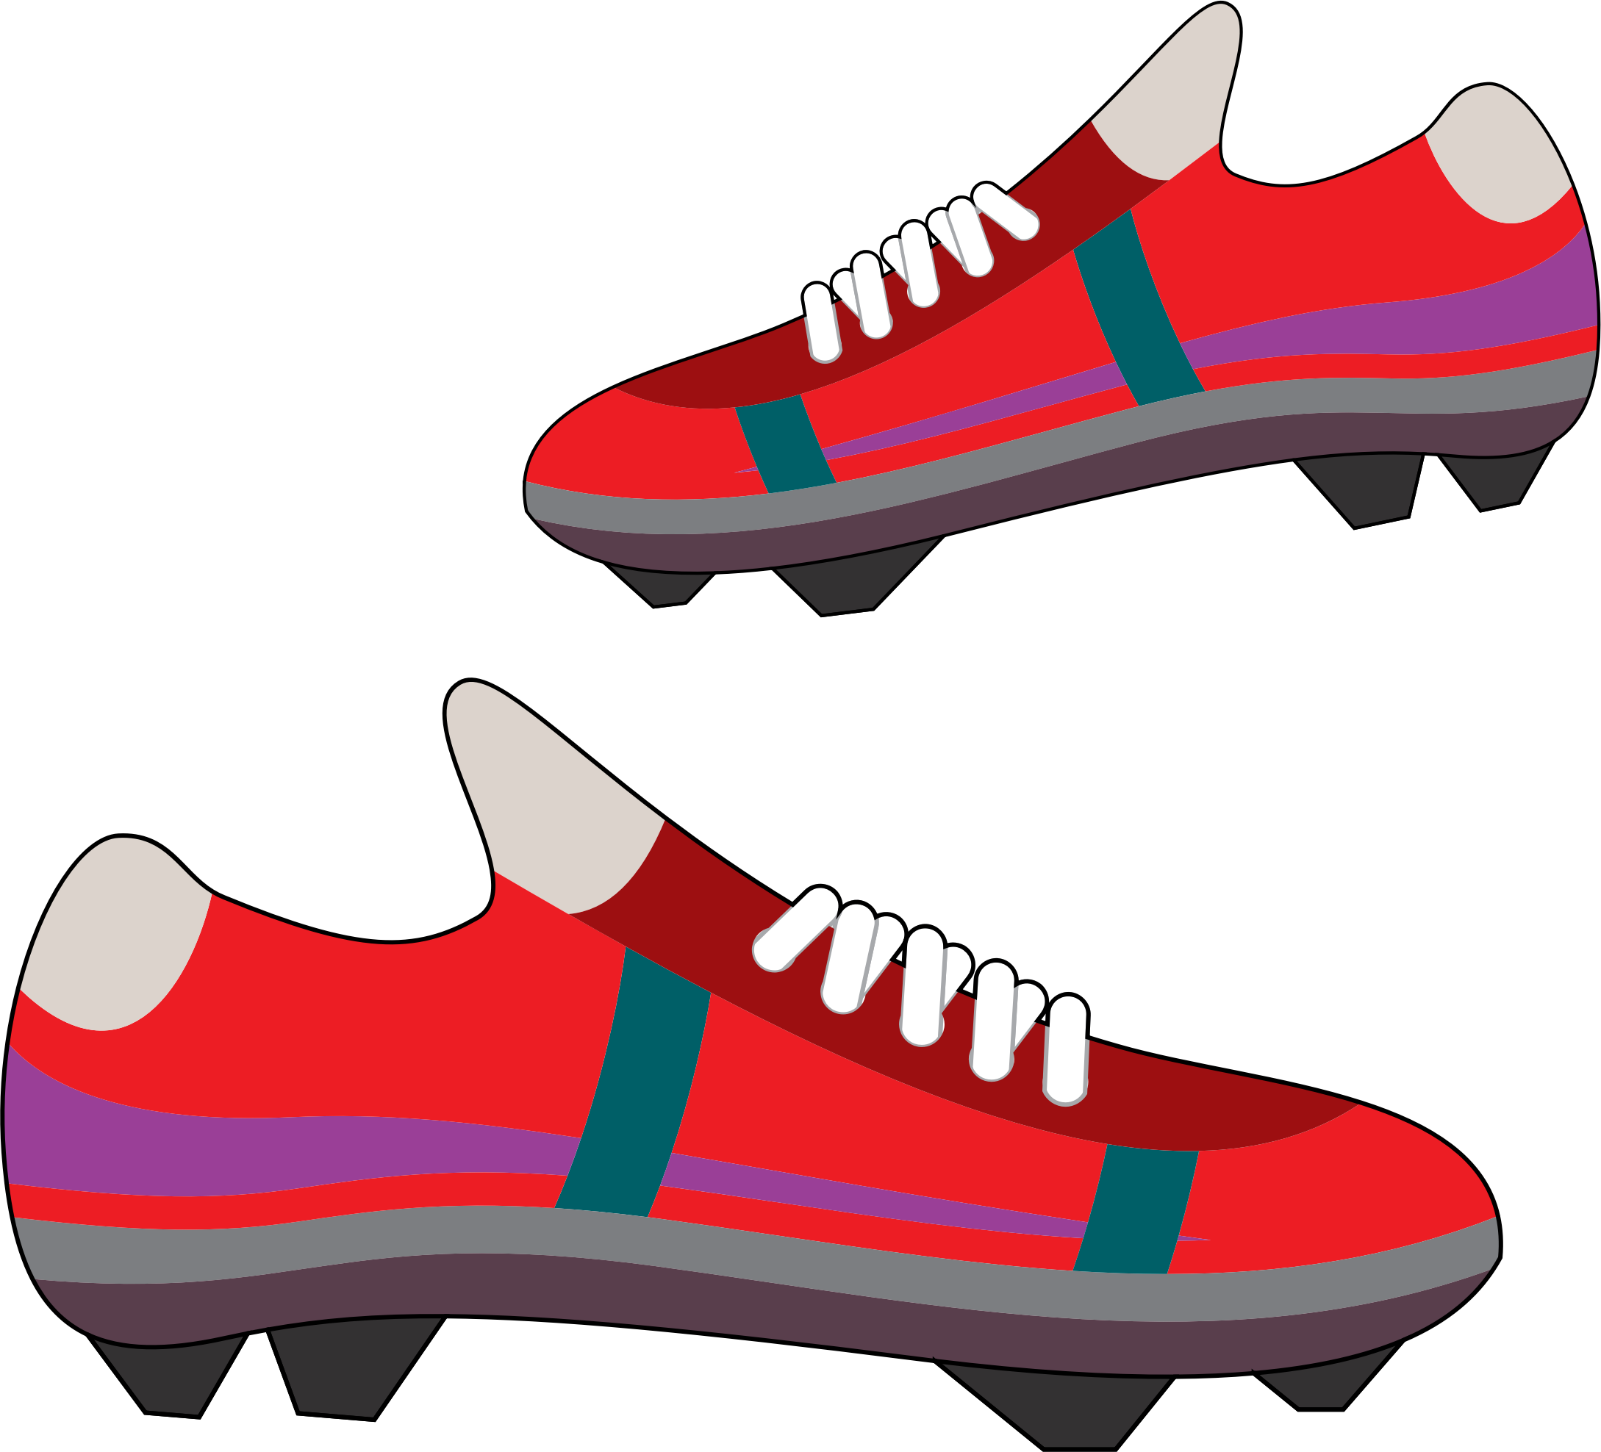







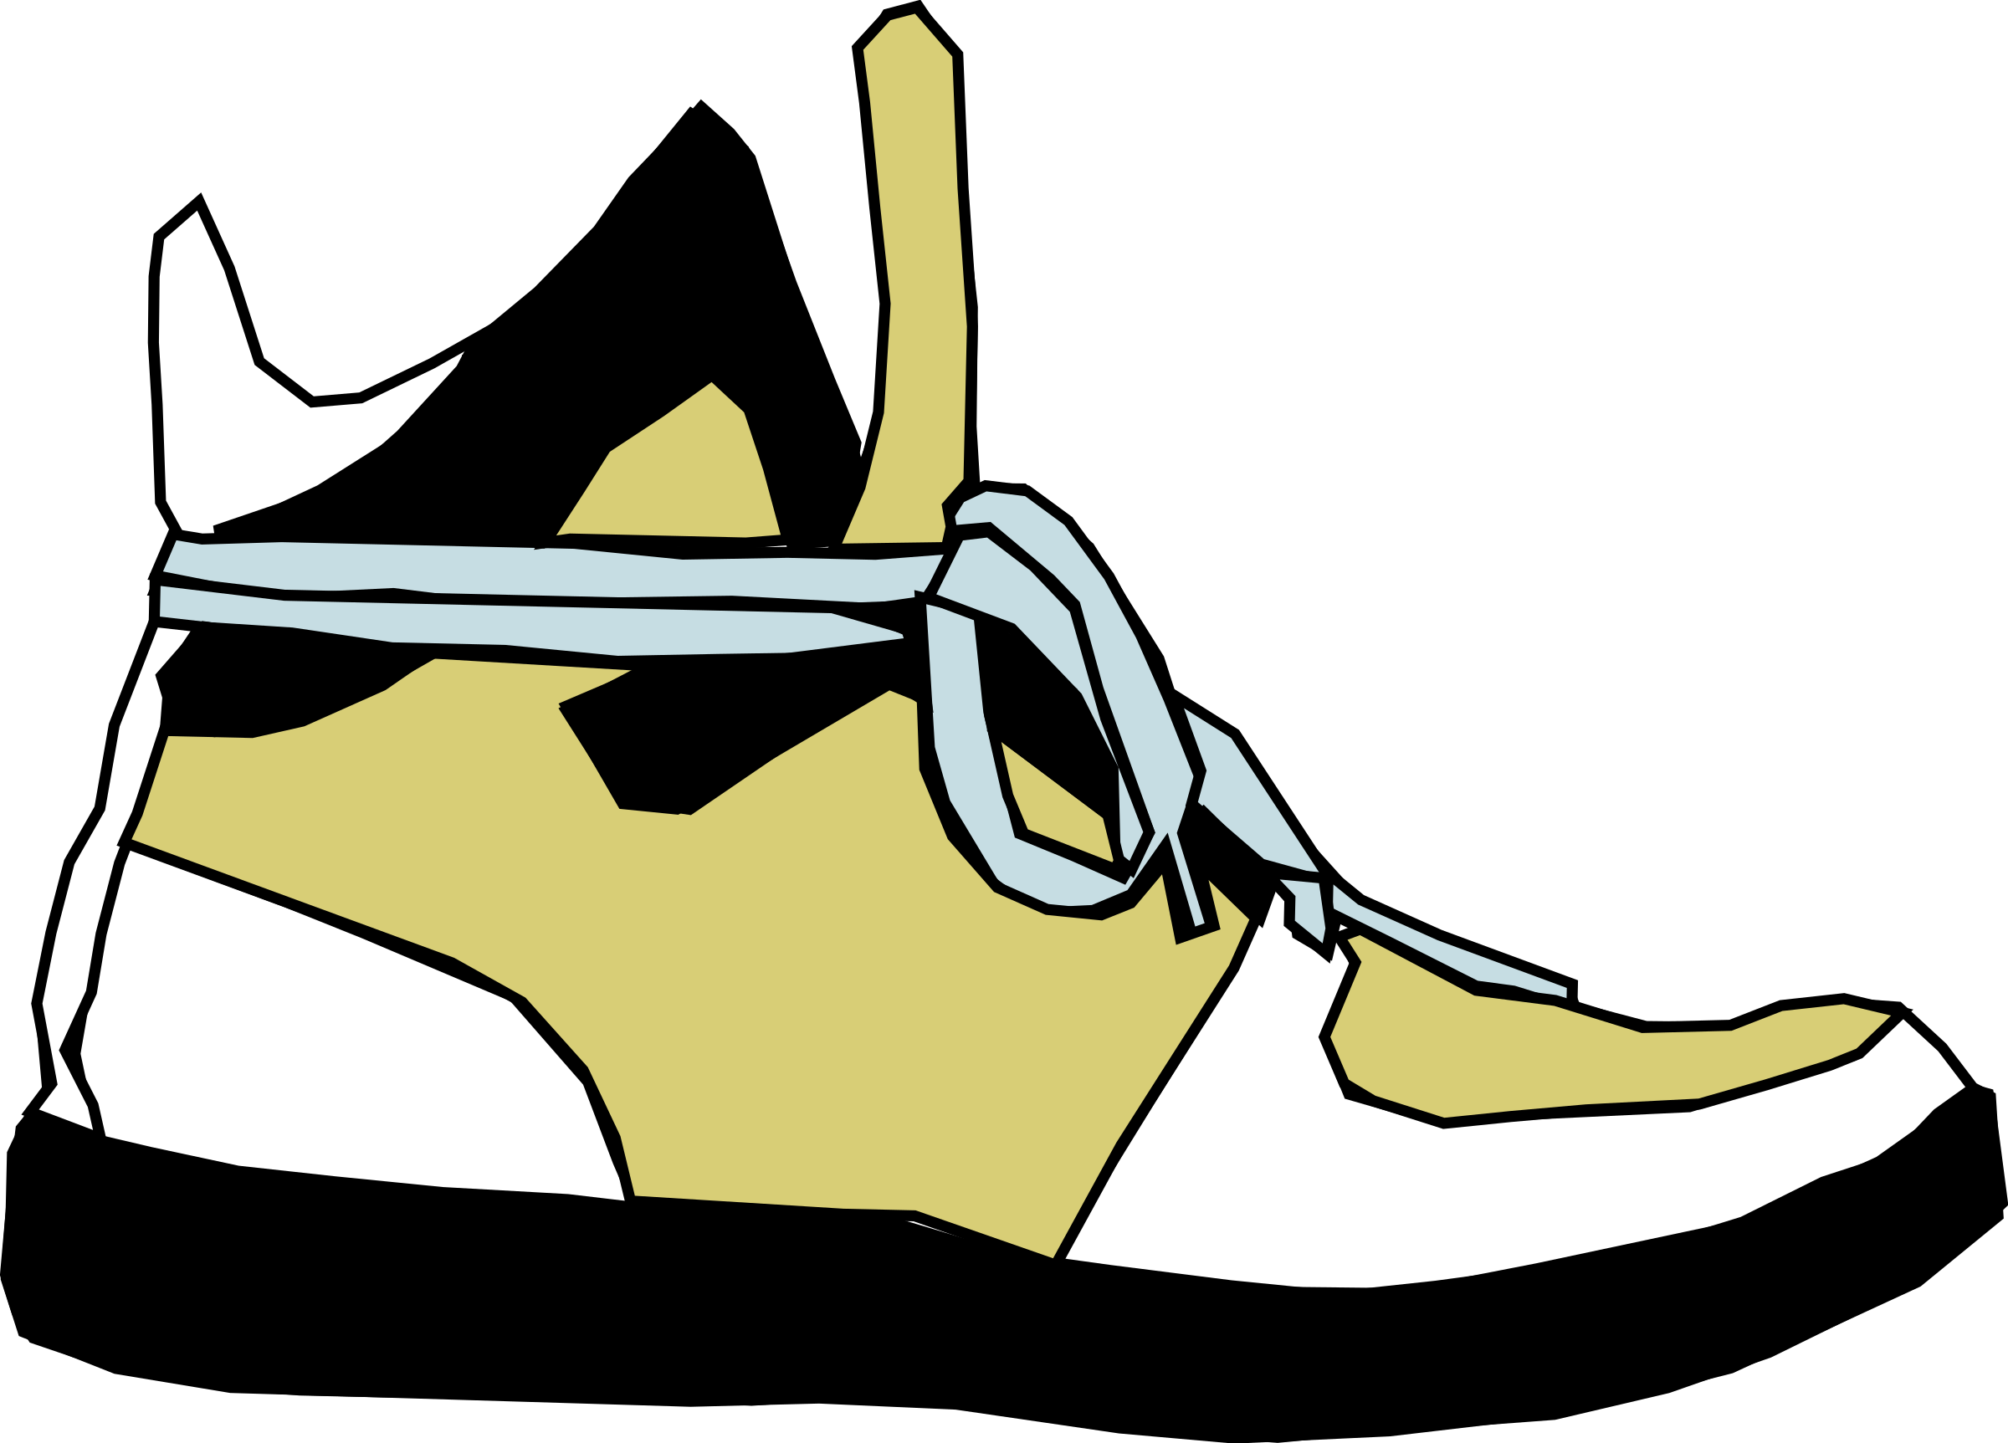




Feet

Slide 12











Hats #1

Slide 13










Hats #2

