Slide 1
Continents
By

Slide 2
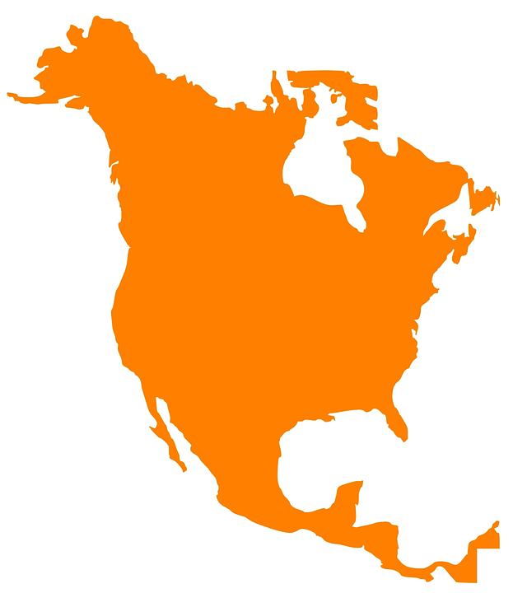
North America

Slide 3

South America

Slide 4

Africa

Slide 5

Australia

Slide 6
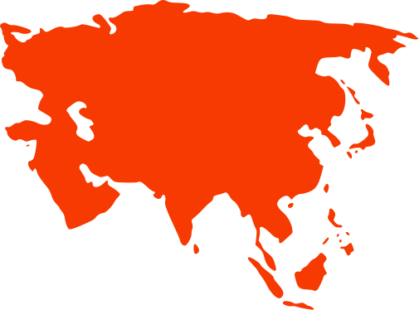
Asia

Slide 7

Europe

Slide 8
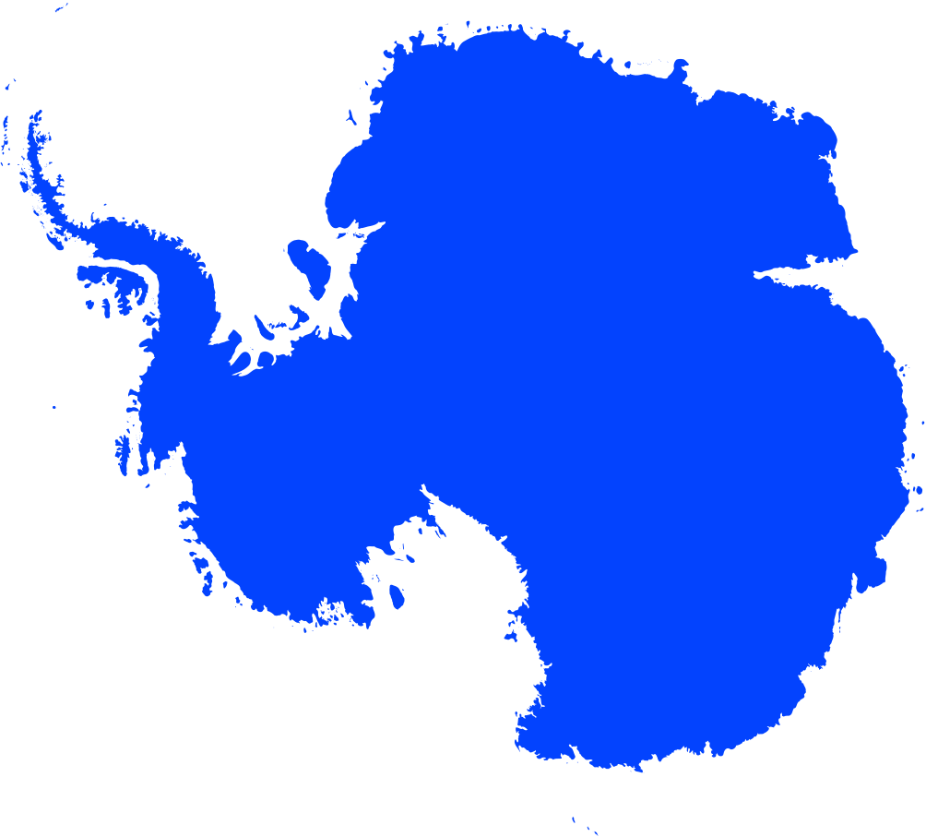
Antarctica

