Slide 1



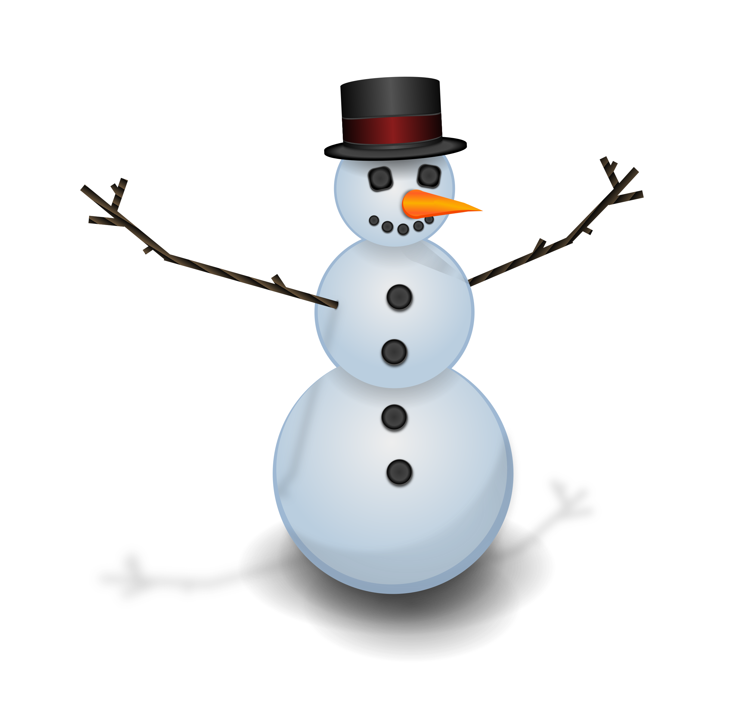

Build a Snowman
Build a Snowman

Slide 2
Directions…
Copy and paste items from the following slides onto your snowman.
If you need different pictures, you can search for more by clicking “Insert” and then “Image” then “Search”.
When done building, write about your snowman or snowwoman in the textbox. You can describe them, tell a story about them, or explain who they are.
When all done you can download a picture of your snowman and writing by clicking “File” then “Download as” then “PNG image”.
For more directions, go to www.ControlAltAchieve.com/snowman
www.ControlAltAchieve.com

Slide 3
Write about your snowman...

Slide 4













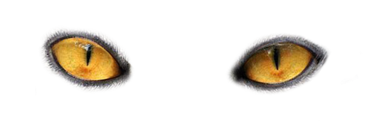
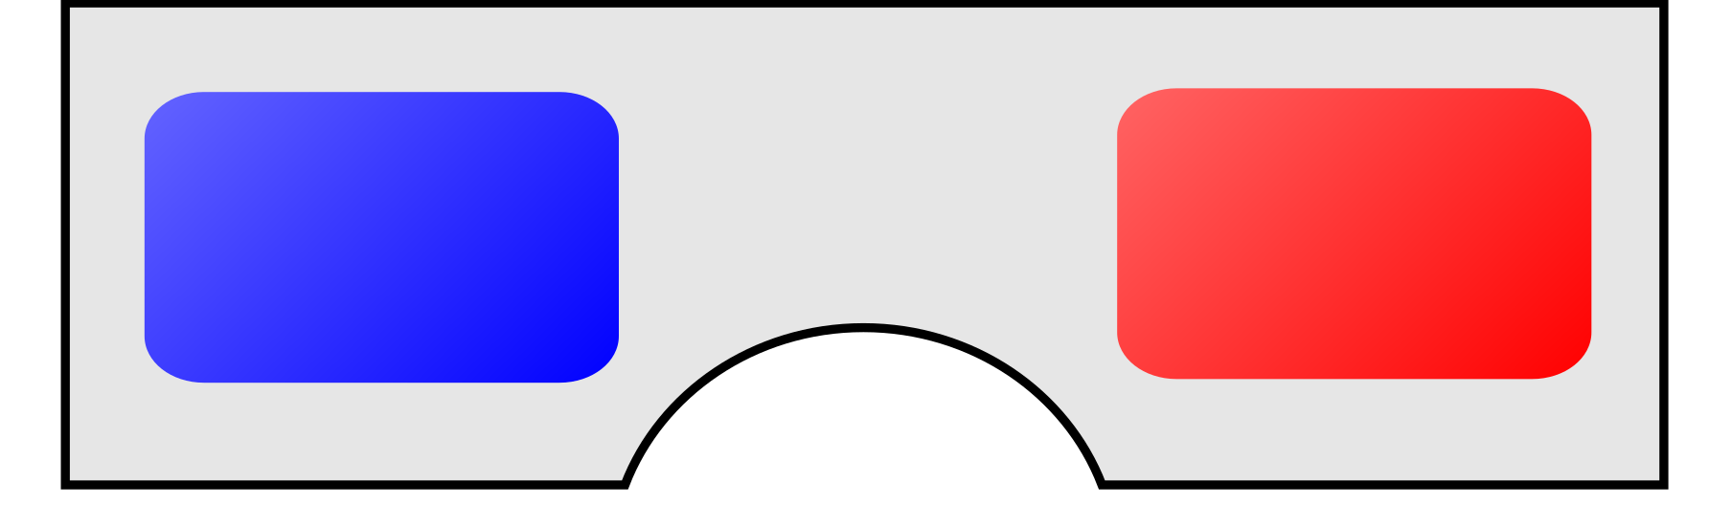

















Eyes

Slide 5





























Mouths

Slide 6
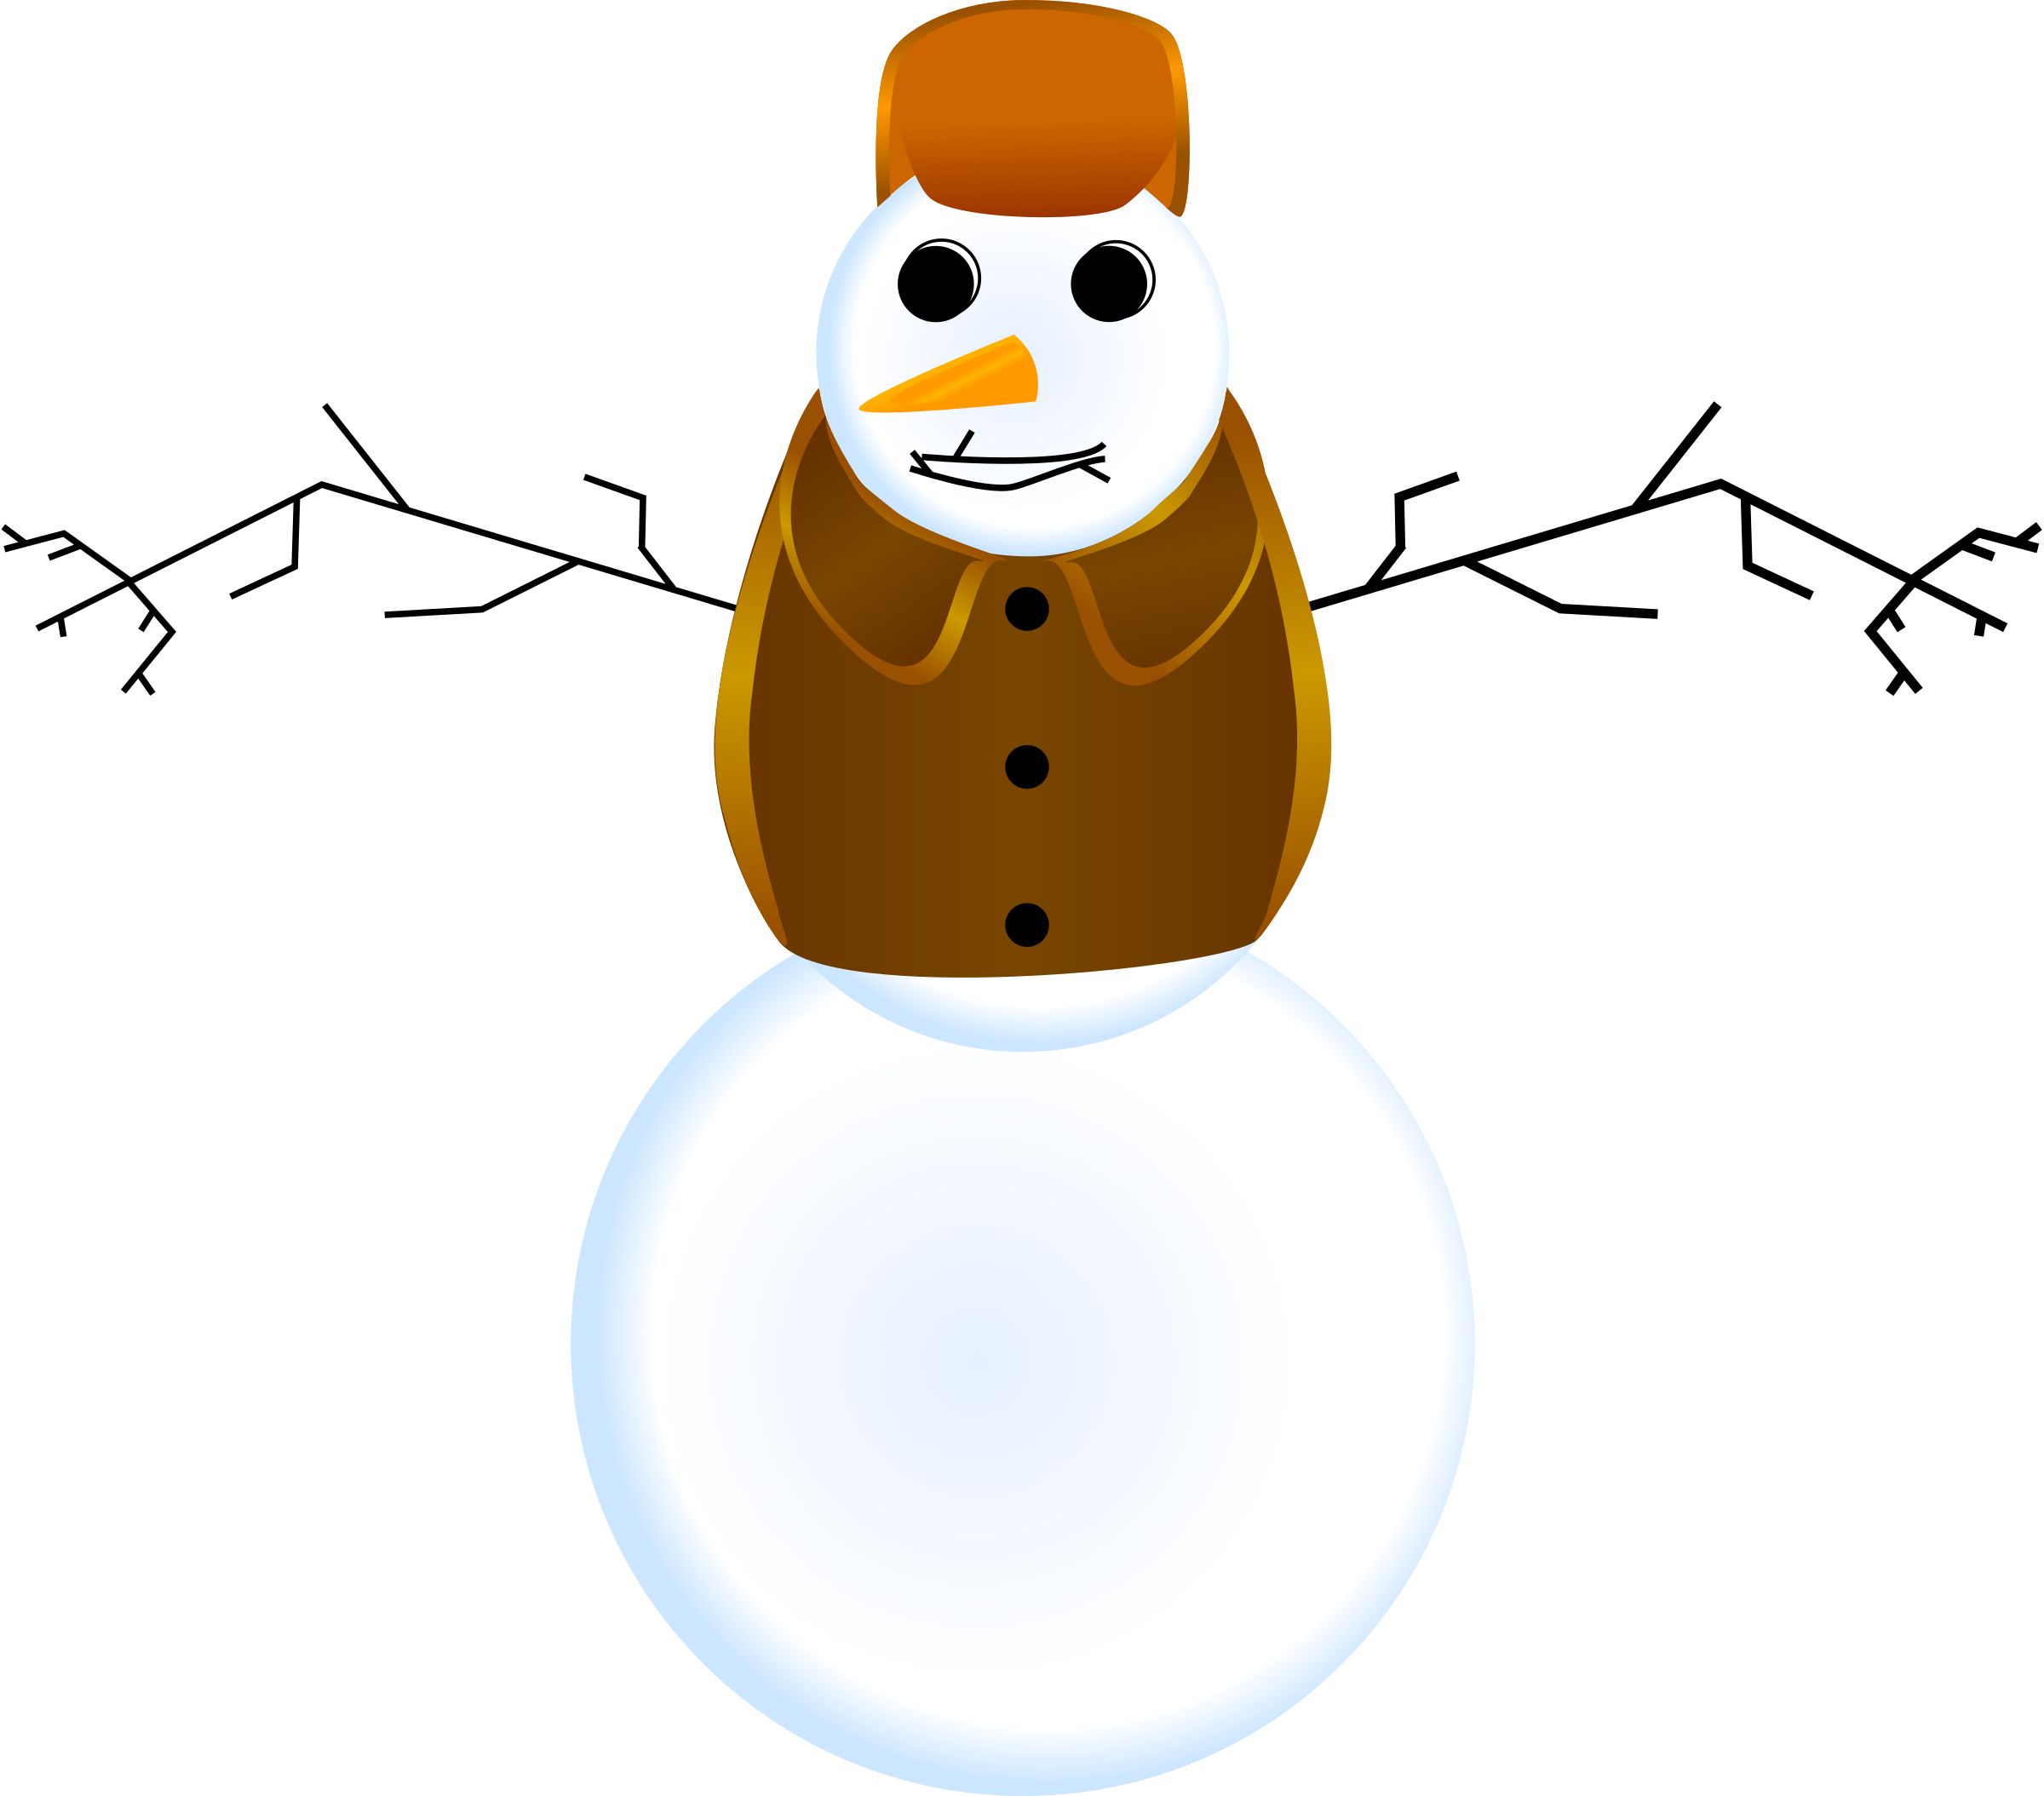






Arms

Slide 7

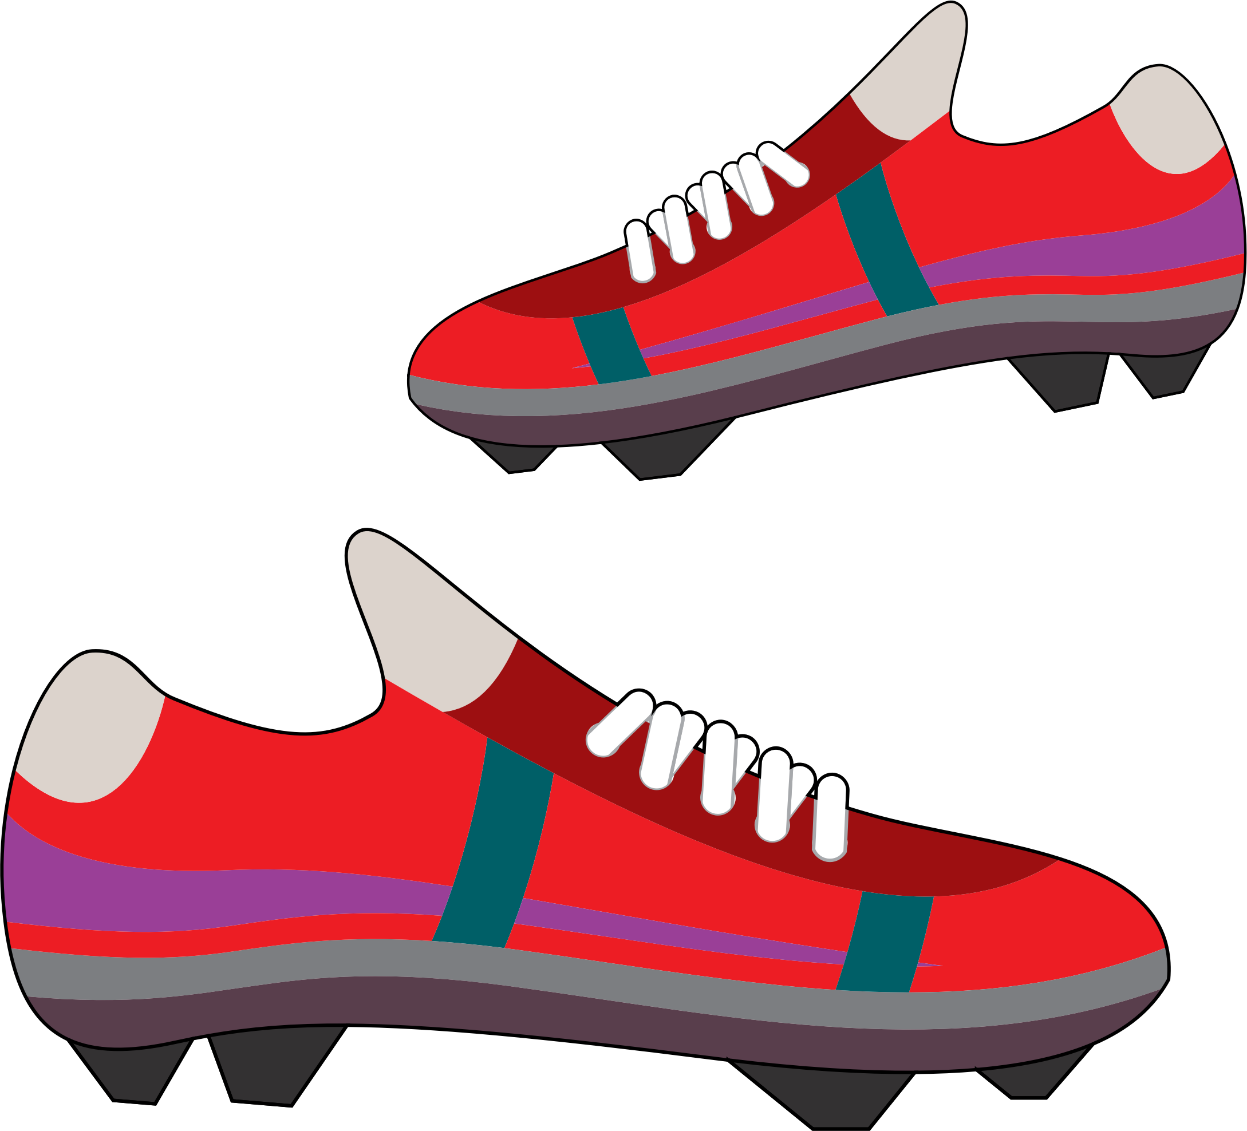


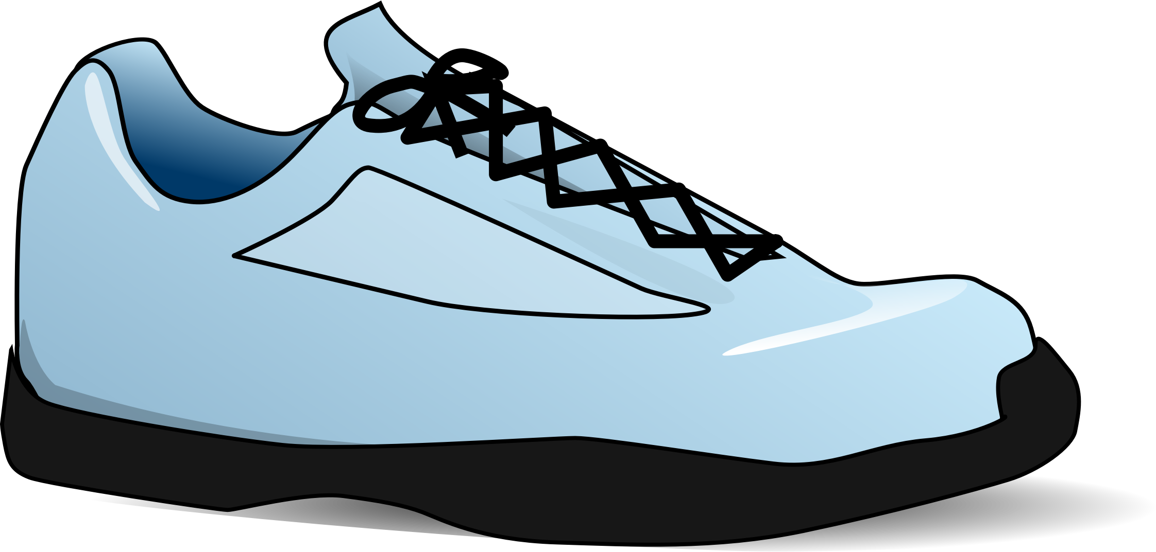



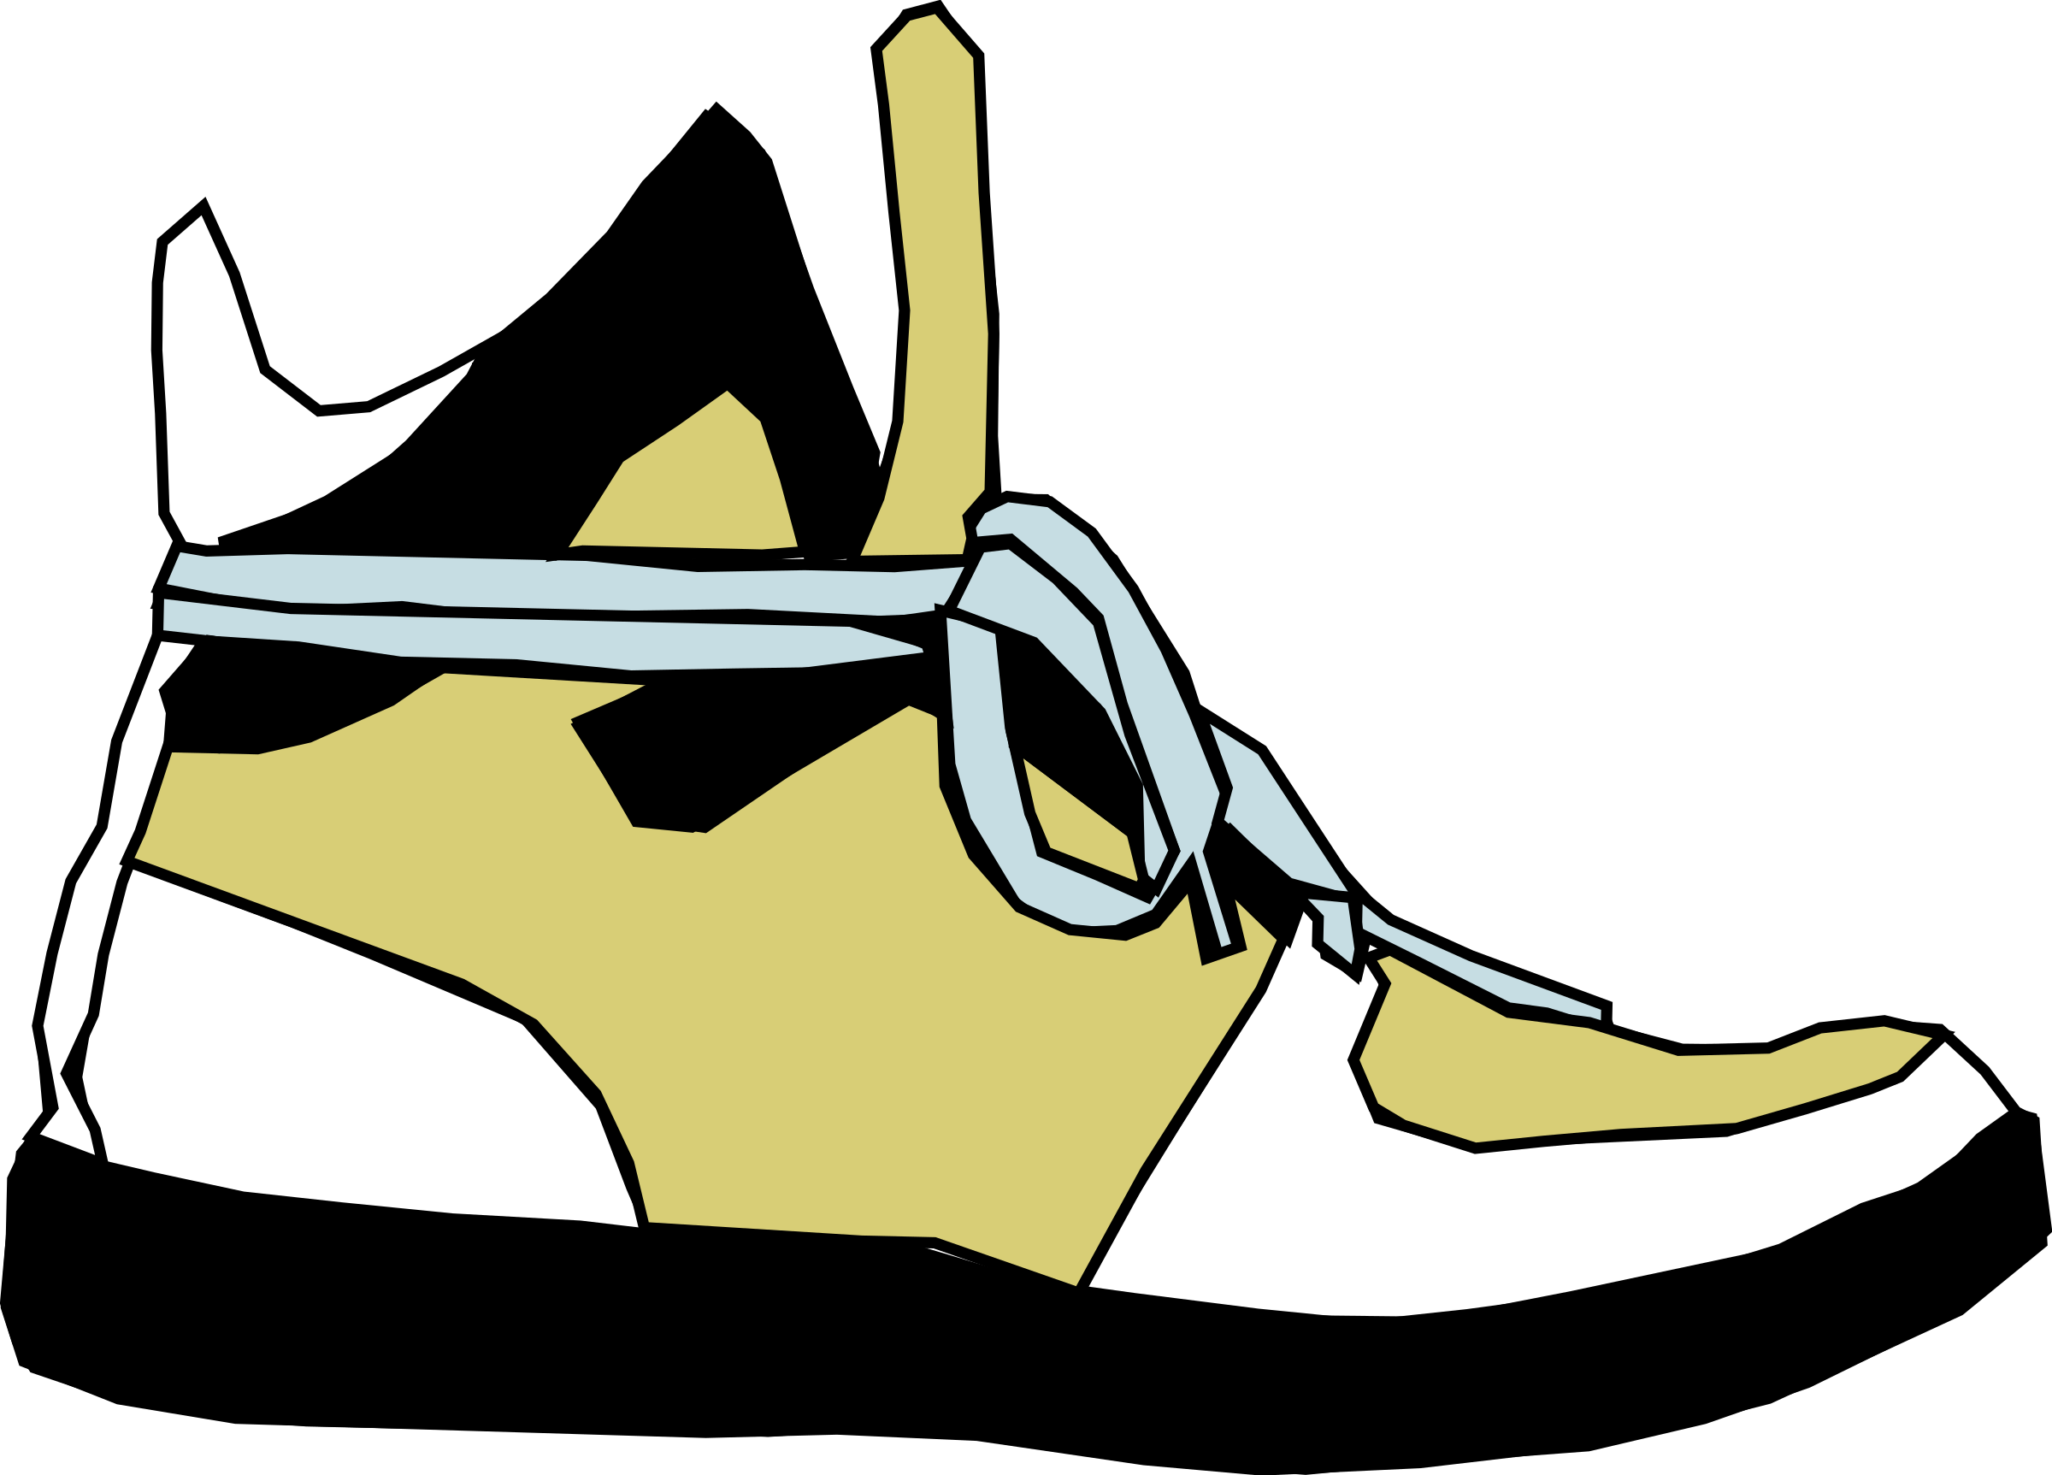


Feet

Slide 8










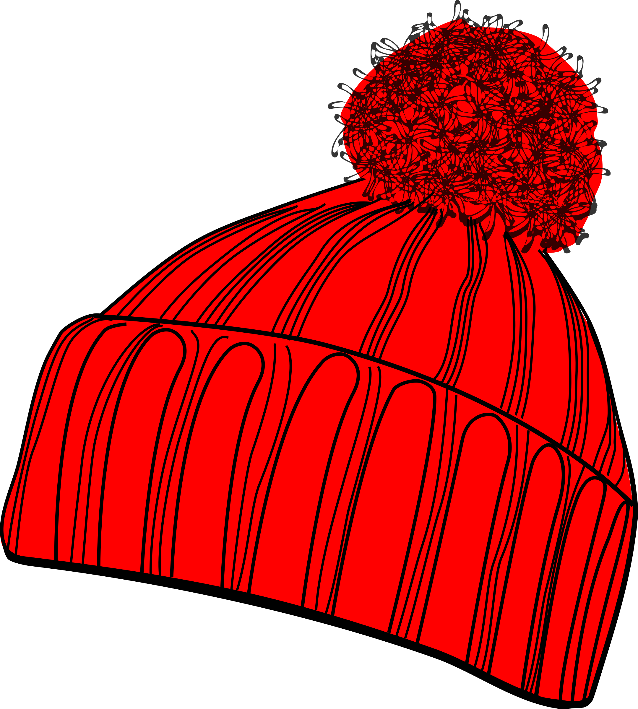











Hats

Slide 9



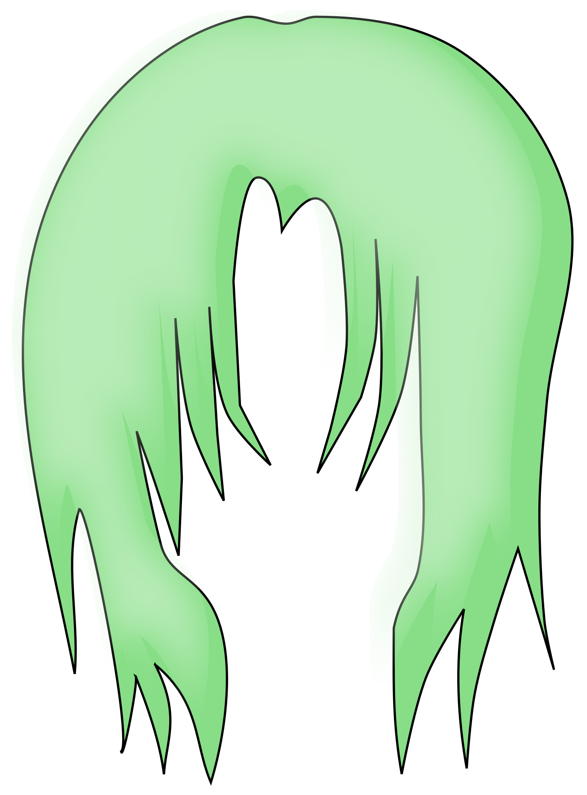

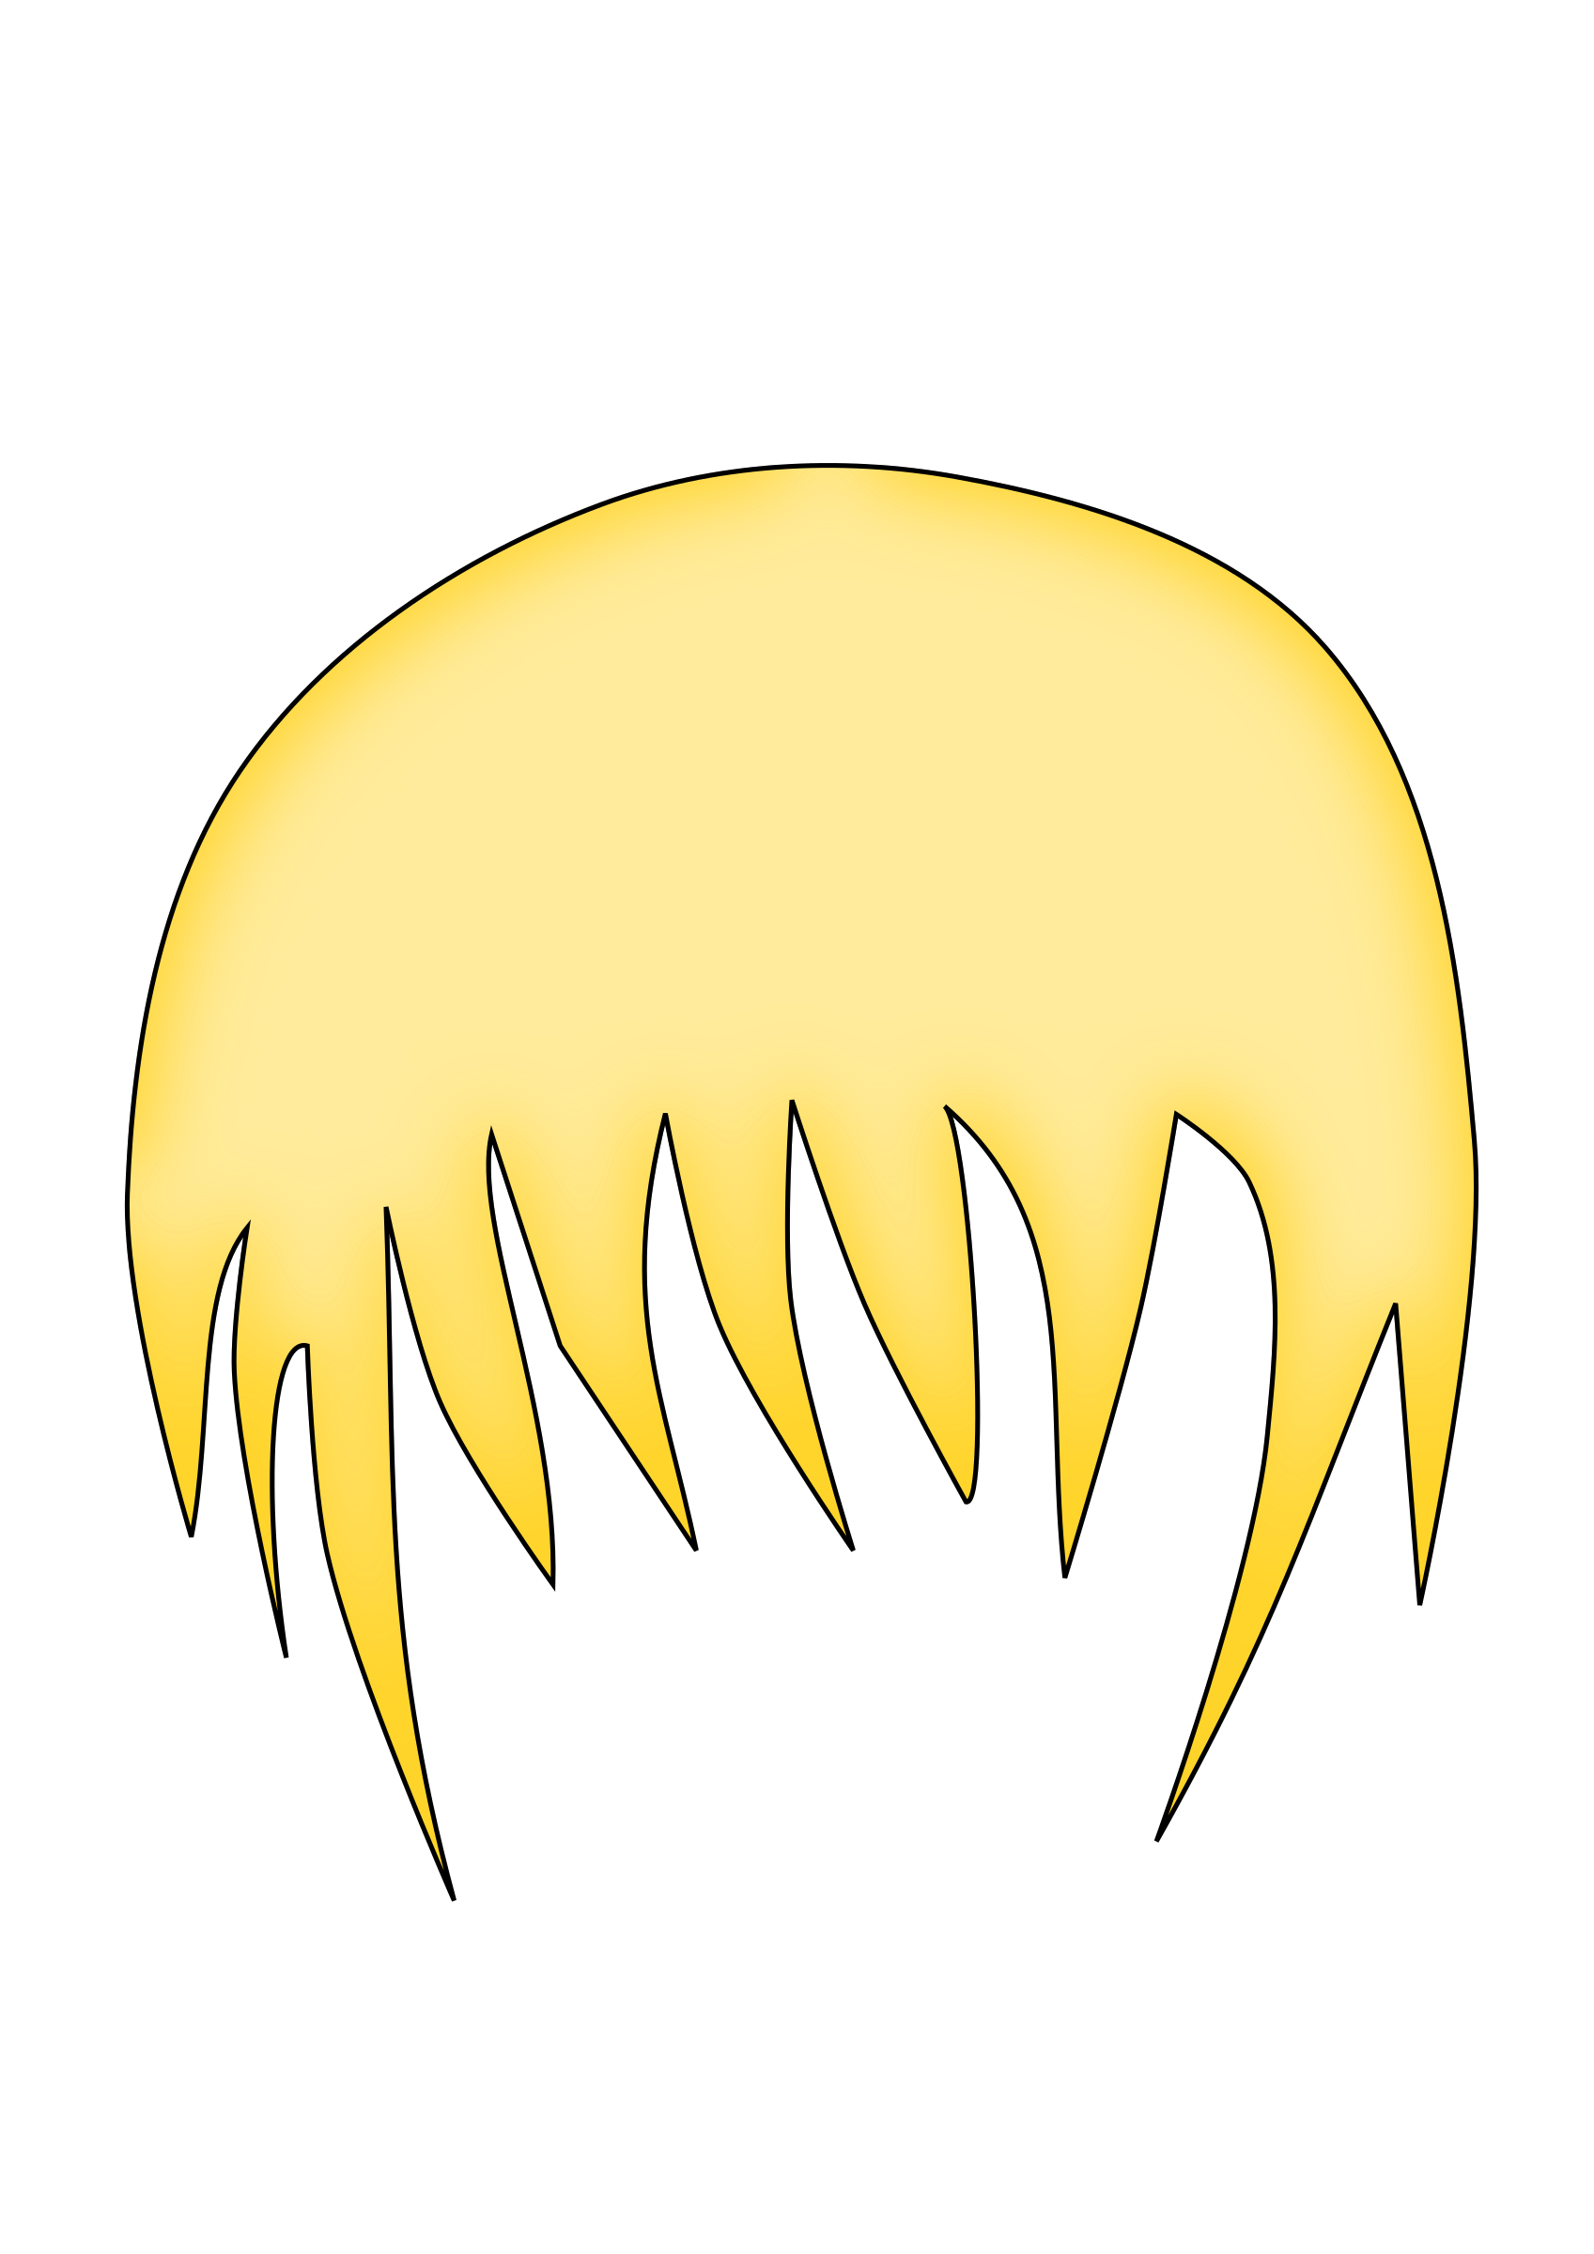




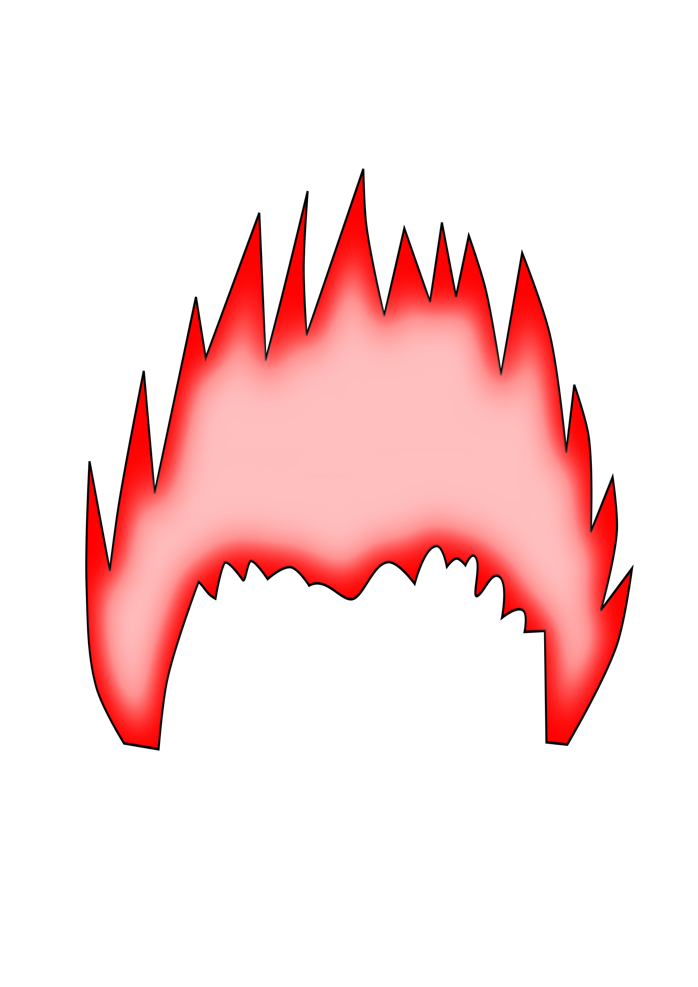





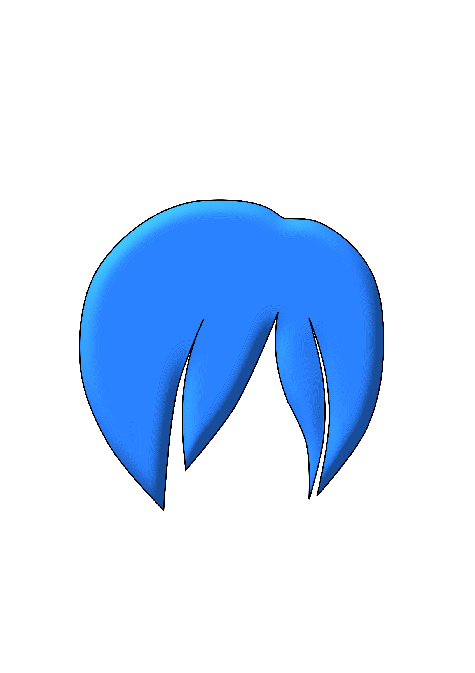


Hair

Slide 10

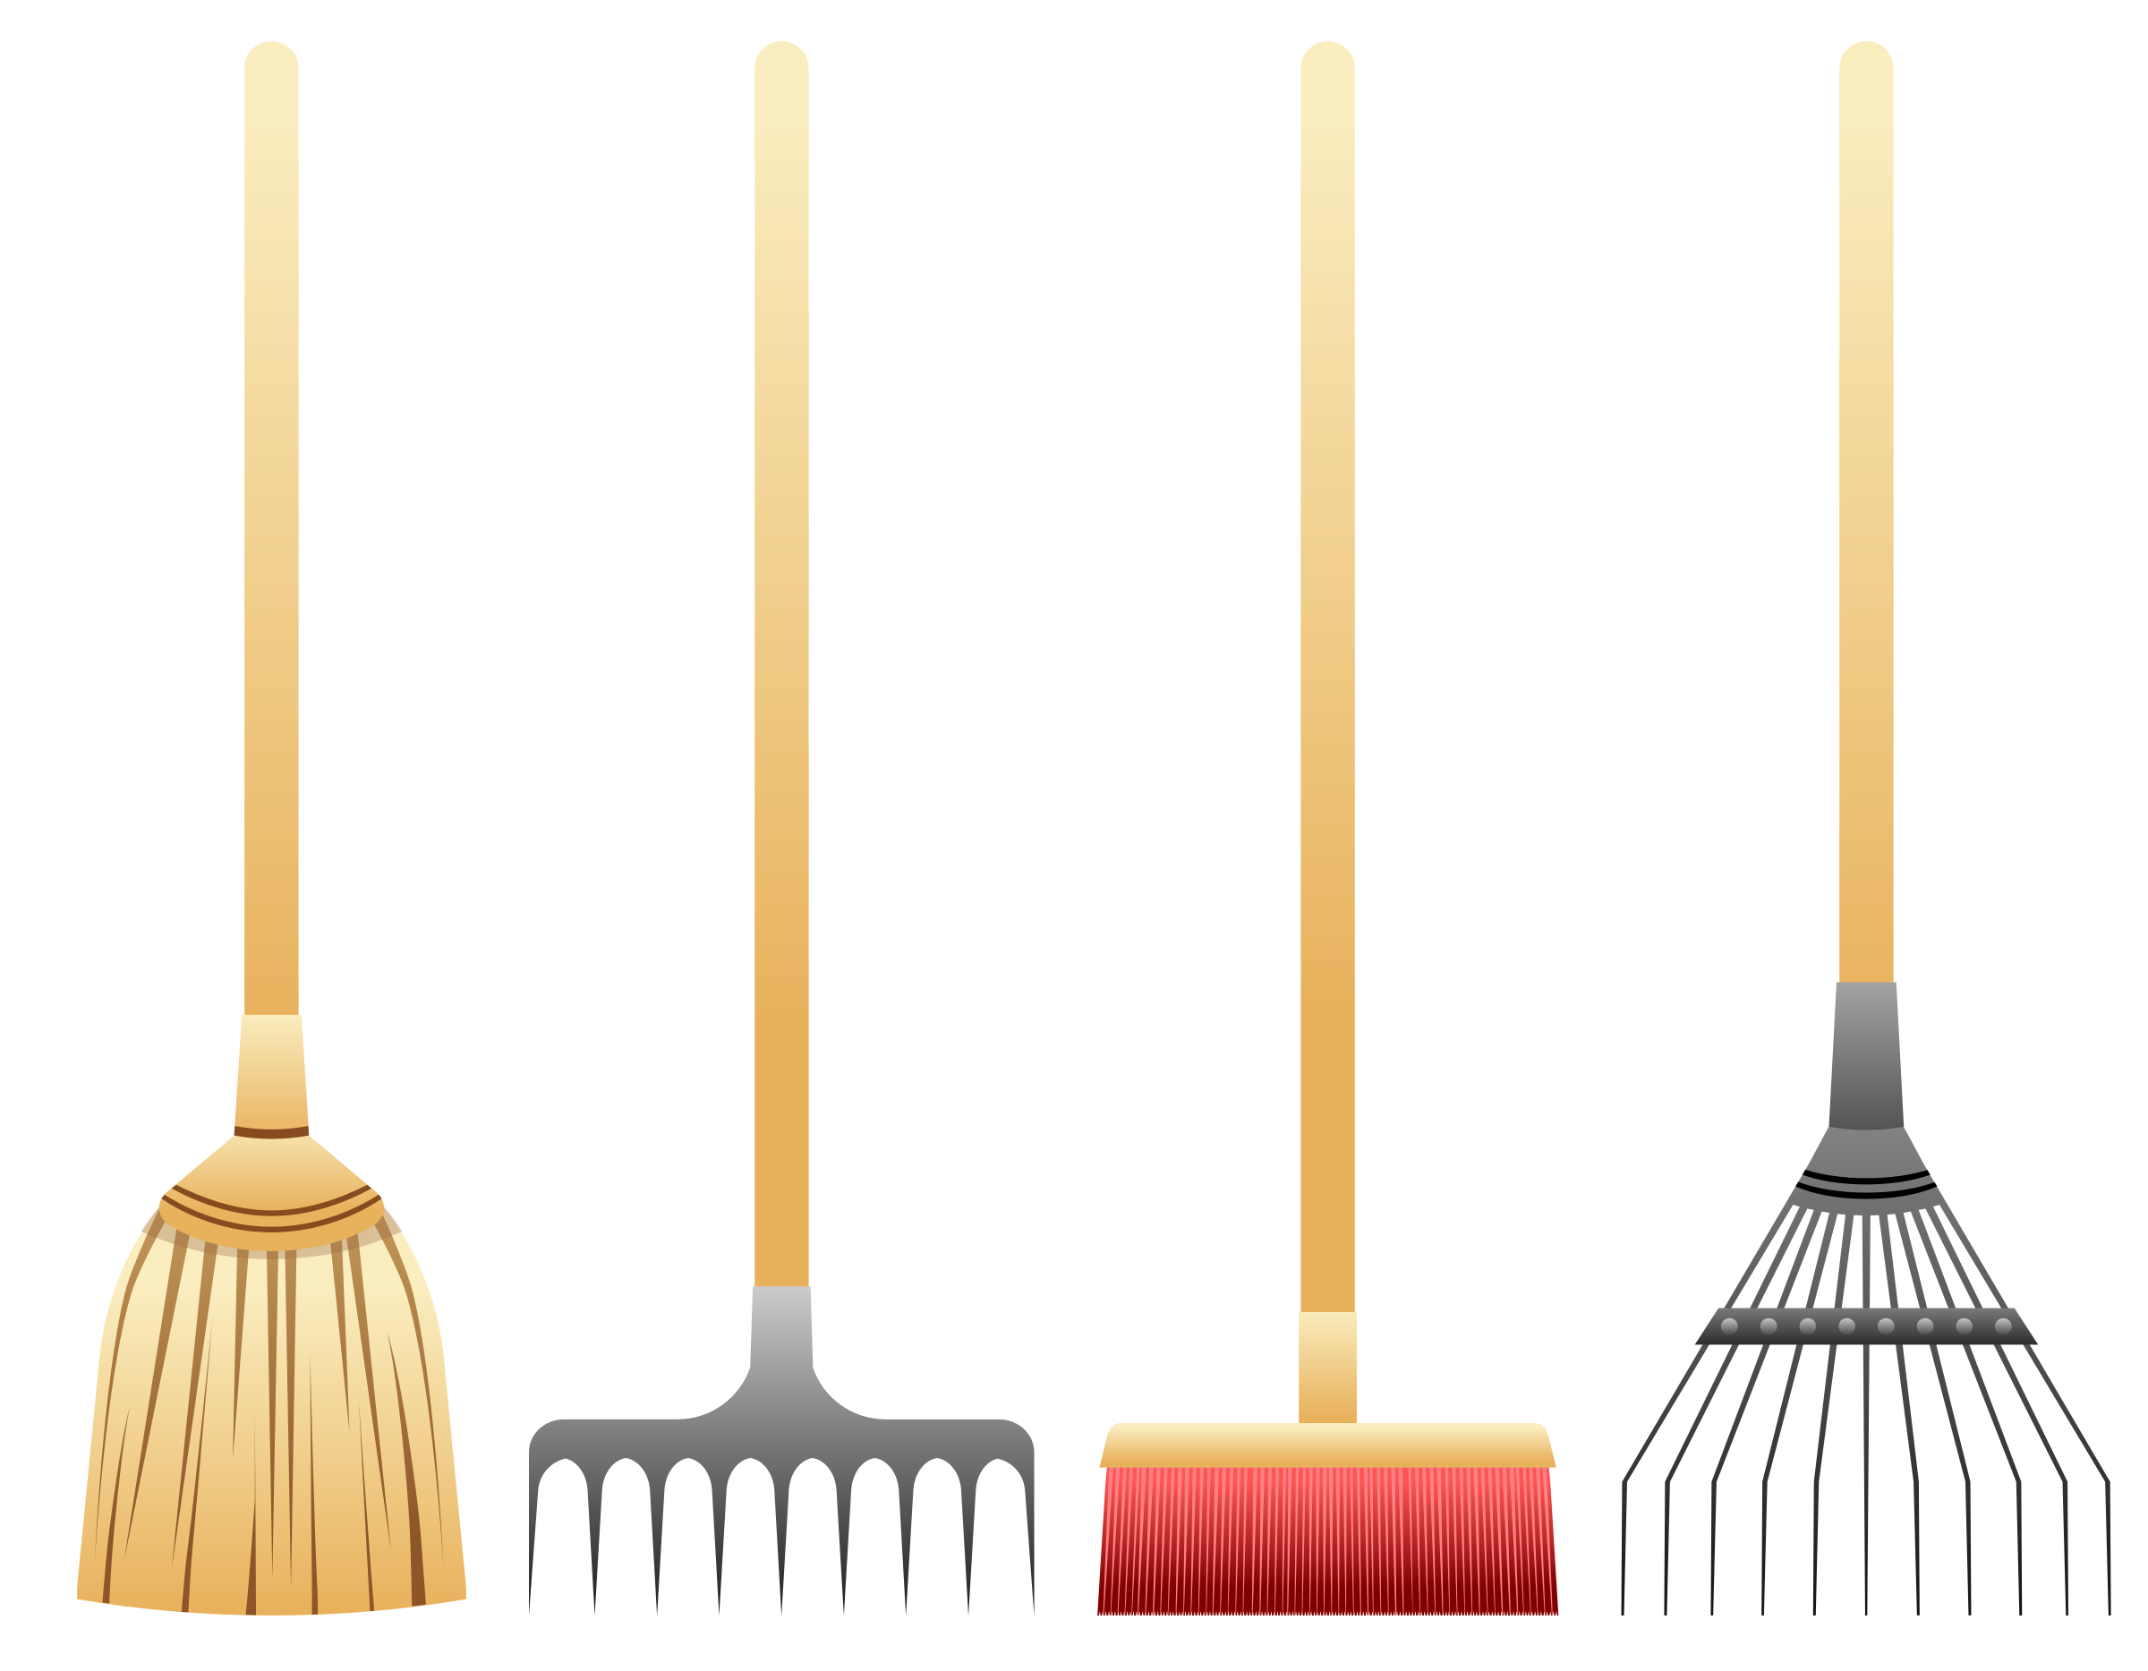
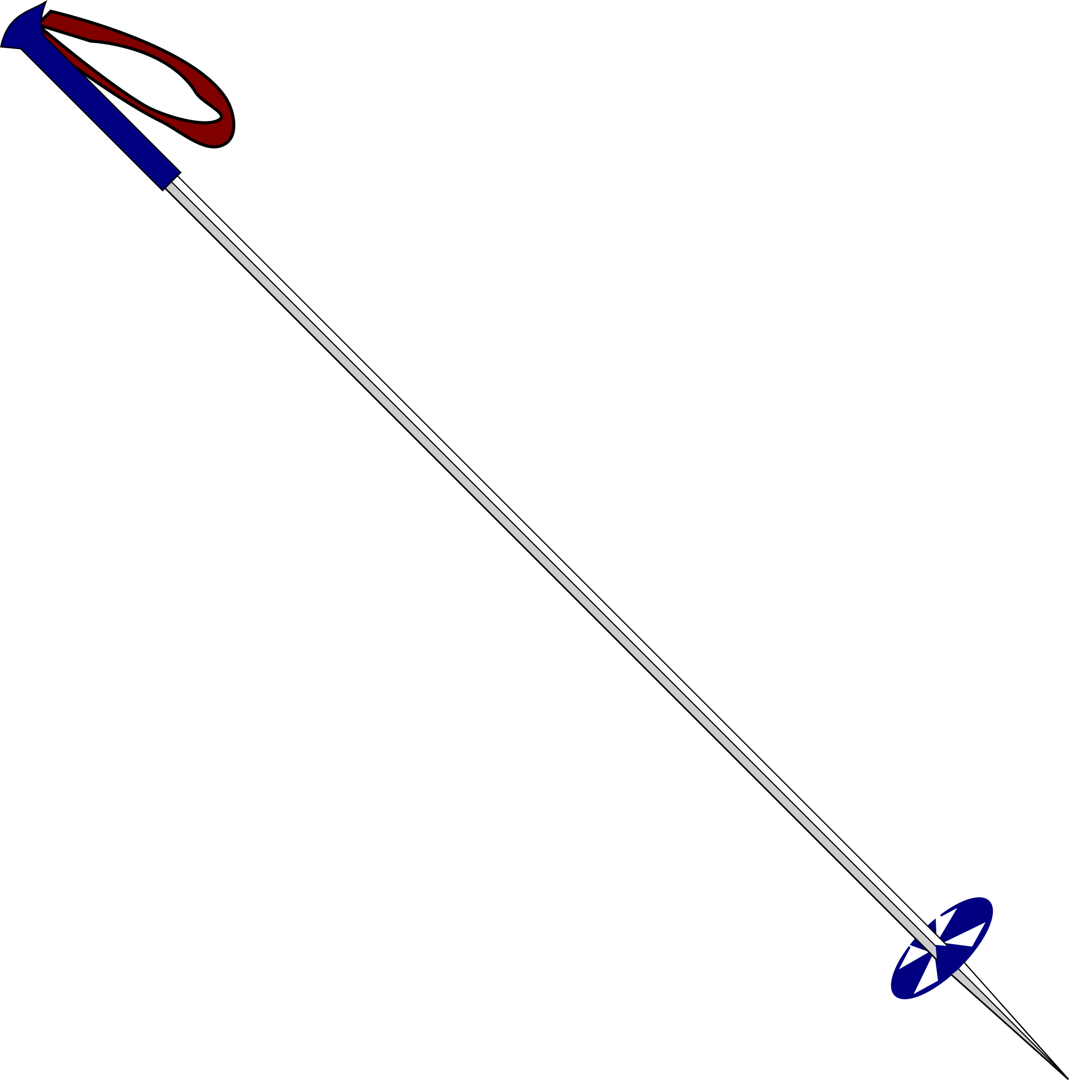










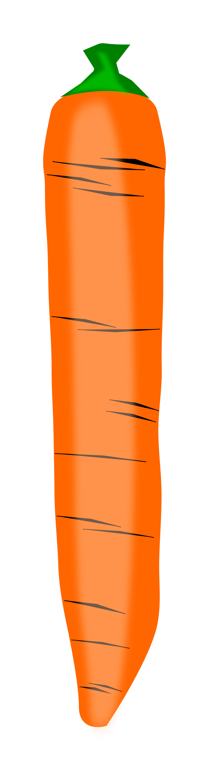
Extras

