Slide 1
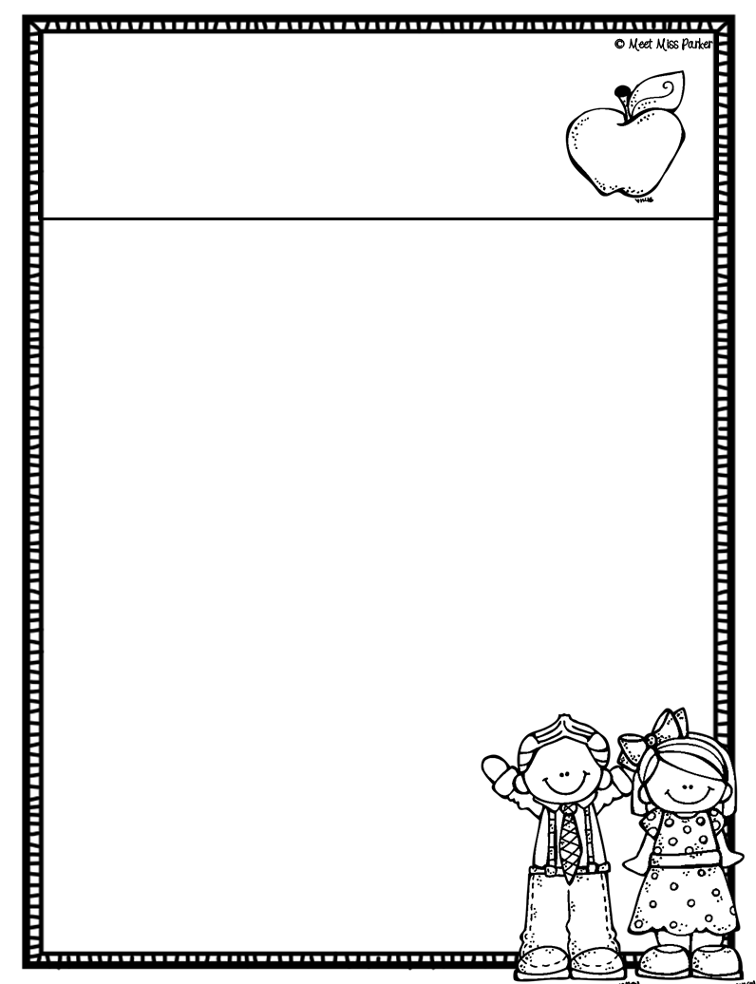
Miss Parker’s
class news
A Note from the Teacher
What’s Happening in...
Homework reminder
Dates to remember
Thank You, Miss Parker

