Slide 1
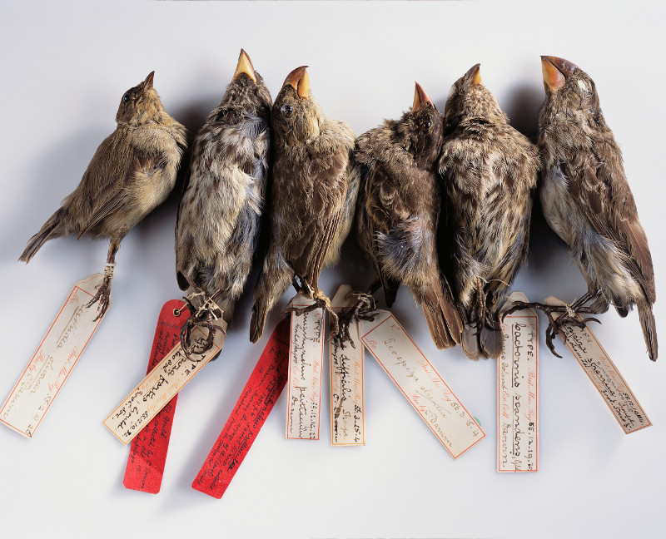
Evolution
Specimens of finches collected by Charles Darwin during the second voyage of the HMS Beagle.

Slide 2
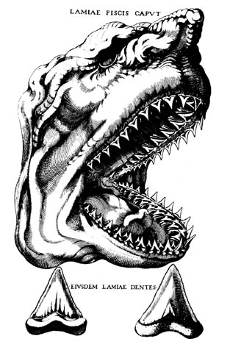
The Fossil Record
Scientists of the 17th and 18th centuries were struggling to explain fossils – imprints or remains of organisms found in rock.
  Philosophers had suggested
  that the fossils fell from the sky,
  or grew naturally in rock.
In 1667, Nicholas Steno was
studying a large shark that had
been caught by fishermen
and noticed its teeth resembled
stony objects found in some rocks.

Slide 3
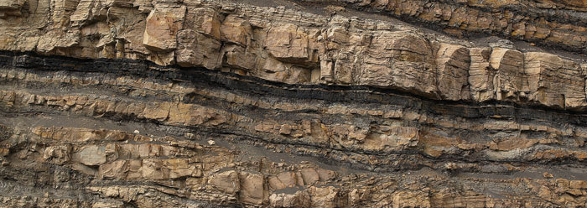
Steno questioned how solid objects, such as the fossilized teeth, could be found in other solid objects, or rocks.
  He eventually concluded that the horizontal rock layers, or strata, had formed around the fossils.

Slide 4
Steno realized that the youngest layers of rock were on the top, and the oldest on the bottom.
  This helped begin the process of determining the approximate age of each fossil.

Slide 5
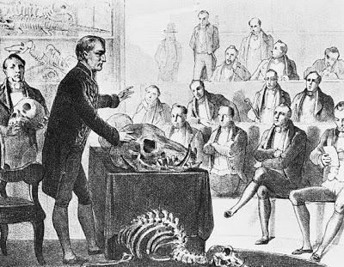
Catastrophism
A French scientist named Georges Cuvier studied fossils throughout the 18th century.
  He is considered one of the pioneers of paleontology.
Cuvier made two extremely important observations from the fossils he studied.

Slide 6
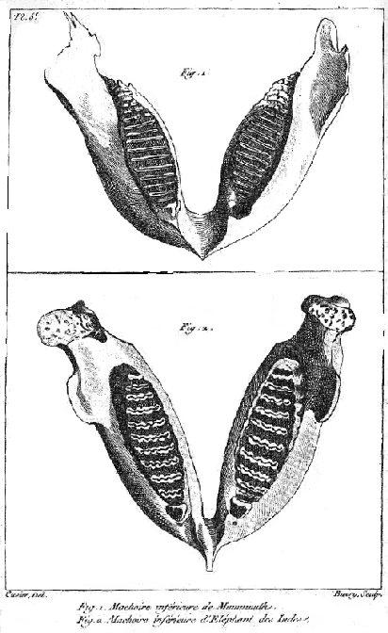
First, Cuvier noted that younger fossils taken from upper rock strata resembled modern species much more than older fossils.
  He published the differences between fossils and modern specimens, clearly establishing them as separate species.
Figure 1: Lower jaw of a mammoth fossil.
Figure 2: Lower jaw of an Indian elephant.

Slide 7
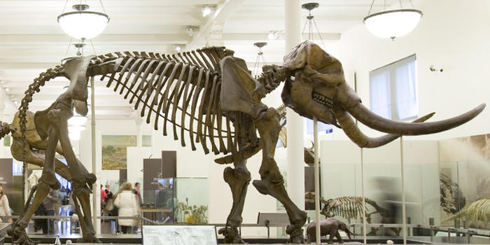
Second, Cuvier published multiple examples of large mammal fossils that resembled no living species.
The American Mastodon

Slide 8
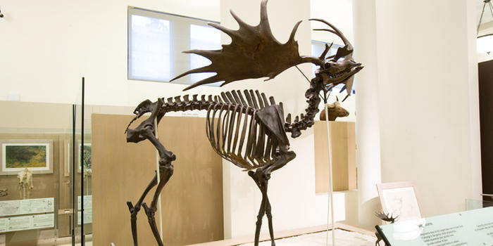
The Irish Elk

Slide 9
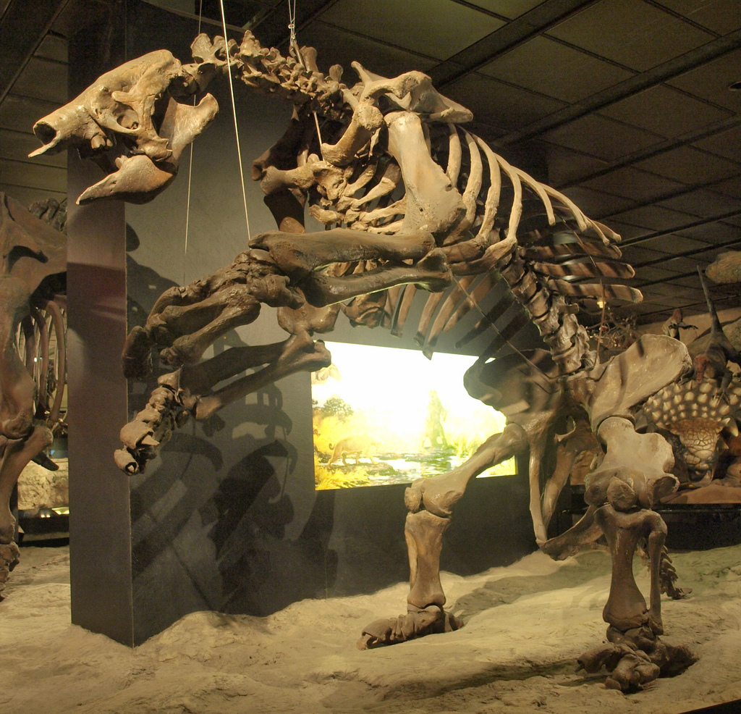
Giant Ground Sloth

Slide 10
Although he did not coin the terms, Cuvier had documented evidence of two very important evolutionary processes:
  Extinction, or the complete disappearance of a species from the Earth.
  The emergence of a new species, called speciation.
Cuvier explained the extinction of the giant vertebrates he studied as the result of periodic catastrophes, or natural disasters that wiped out some of the species.
  This idea is now called catastrophism, and many scientists at the time linked it to the flood described in the Bible.

Slide 11
Gradualism
A geologist named Charles Lyell disagreed with Cuvier and his theory of catastrophism.
Lyell favored uniformitarianism, the idea that the Earth had been slowly and steadily transformed over time by a series of tiny changes.
  Erosion, or the movement of sediments by wind and water.
  Rise and fall of the ocean level.
  Volcanic eruptions and earthquakes.

Slide 12
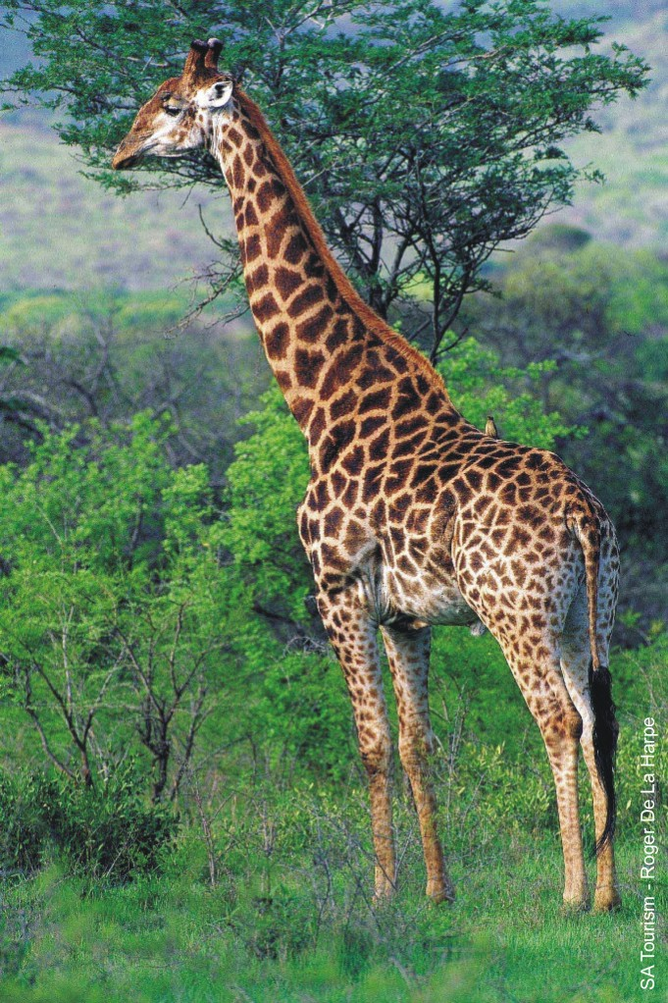
Uniformitarianism influenced many scientists who were seeking to explain the adaptations, or variations present in living organisms that aided in their survival.
Jean-Baptiste Lamarck hypothesized that animals adapted to their environment by their muscles and organs changing over time due to their use or disuse.
  These acquired traits would then be passed on to the next generation.

Slide 13
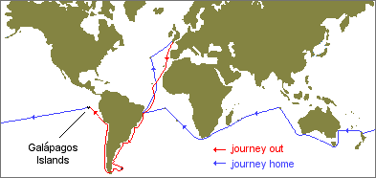
Charles Darwin
Charles Darwin was a naturalist who had a copy of Charles Lyell’s book on geology with him as he traveled to South America on a ship, the HMS Beagle.
In February 1835, he witnessed the Earth’s changes first hand during a massive 8.2 magnitude earthquake in Concepción, Chile.

Slide 14
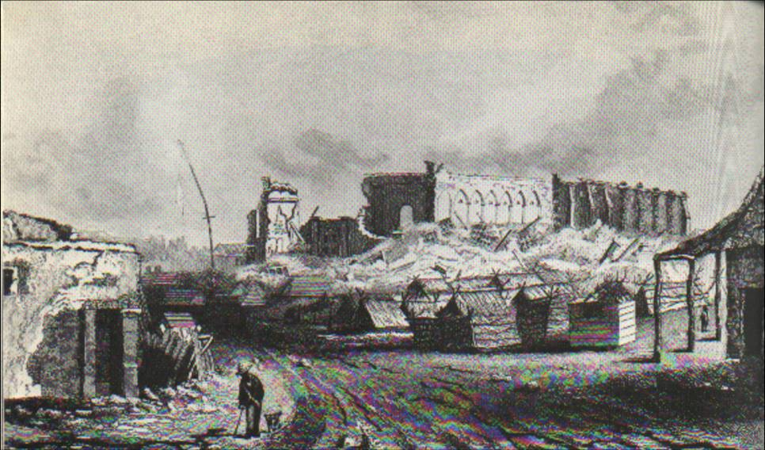
The earthquake devastated the city, but Darwin noted that it also affected marine life.
Clusters of mussels could be found, several feet above the shoreline, dead and rotting.
  Given enough time, Darwin believed that these mussel shells would one day be fossils at the top of the Andes mountains.

Slide 15
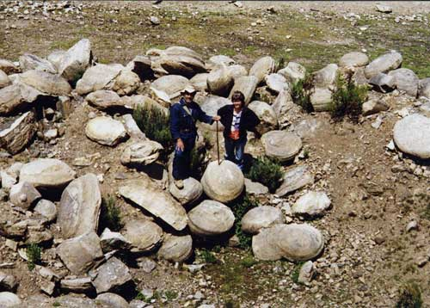
Darwin ascended part of the Andes and confirmed that, indeed, fossils of ancient marine shellfish were present.
  He knew the earth must be millions of years old, if not older.

Slide 16
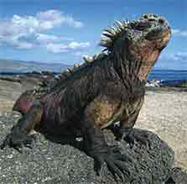
The last stop of the Beagle was at the Galapagos Islands, a series of volcanic islands west of Ecuador.
One of the most striking things about the animals on the island was their lack of fear towards humans.
  After watching a lizard that was partly buried in the sand, he wrote this:
  “I then walked up and pulled
  it by the tail; at this it was
  greatly astonished, and soon
  shuffled up to see what was
  the matter; and then stared
  me in the face, as much as to
  say, “What made you pull my tail?”

Slide 17
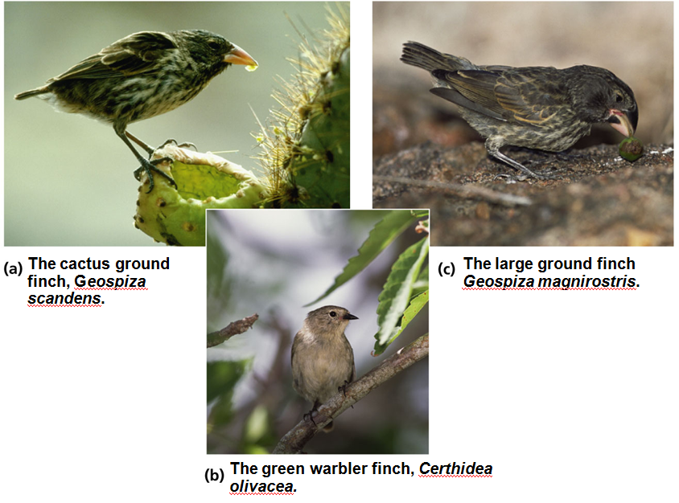
Darwin collected a series of specimens, including taking birds from each of the islands.
  He initially assumed the birds were all of the same species, but experts in England discovered that they were related but different species.

Slide 18
Each species differed mainly in the size of shape of their beaks.
  Each was adapted for a different food source – crushing seeds, picking out insects, or eating cactus flowers.

Slide 19
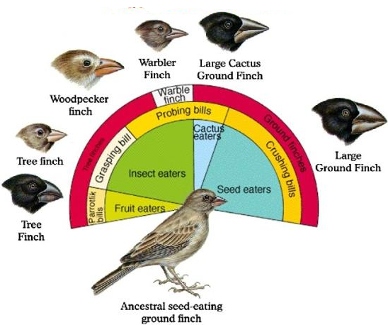
Adaptive Radiation
Darwin had discovered an important evolutionary process called adaptive radiation, where a species rapidly diversifies into new forms.
  This occurs most
  often when the
  organism
  encounters a new
  or changed
  ecosystem.
  New ecosystems
  have new niches,
  or spaces and roles
  that organisms
  within it play.

Slide 20
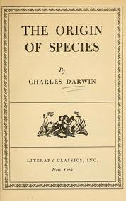
Artificial Selection
Darwin had established that adaptive radiation was occurring in living organisms, but how?
In his book, Origin of Species, he discussed a familiar example: dog breeding.

Slide 21
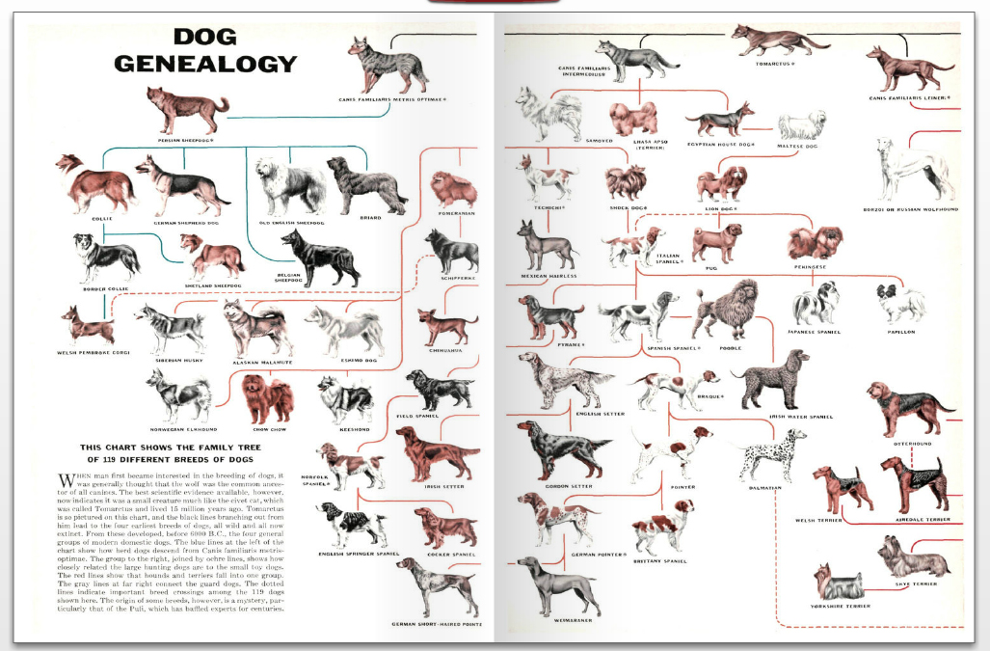
All breeds of dogs are originally descended from gray wolves.
  They all have very different characteristics, because humans selectively bred them for traits such as size, coloration, temperament, etc. This is called artificial selection.

Slide 22
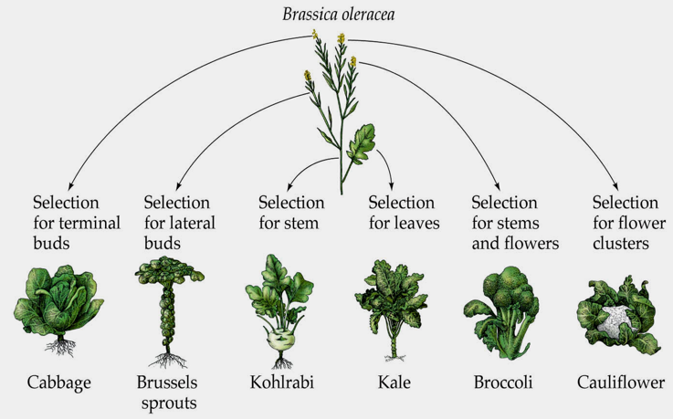
Artificial selection by breeding also applies to plants.
  Cabbage, brussels sprouts, and many other vegetables are all derived from the same plant – wild mustard.

Slide 23
Natural Selection
Darwin felt that a similar process was occurring in nature, where traits favorable for a species surviving and reproducing in the wild were selected for.
  This is called natural selection.
Darwin based this idea on a series of observations and inferences.

Slide 24
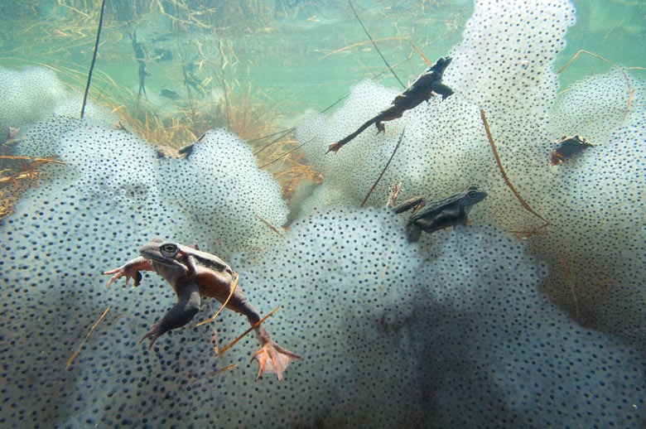
The first observation is that all species are capable of producing more offspring than the environment can support.
  This term for this level of reproduction is super fecundity.

Slide 25
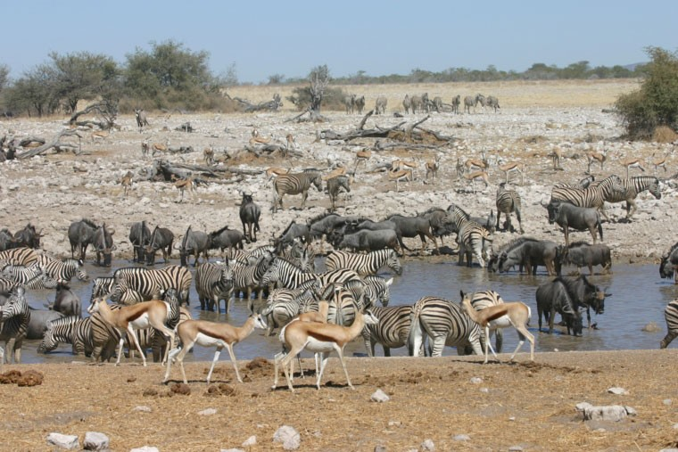
The second observation is that, in general, population numbers tend to be stable.
  How does this reconcile with super fecundity?
The third observation is that there are limited resources, or substances required for normal growth and development of an organism in any given environment.
  Resources could
  include food,
  water, shelter,
  etc.

Slide 26
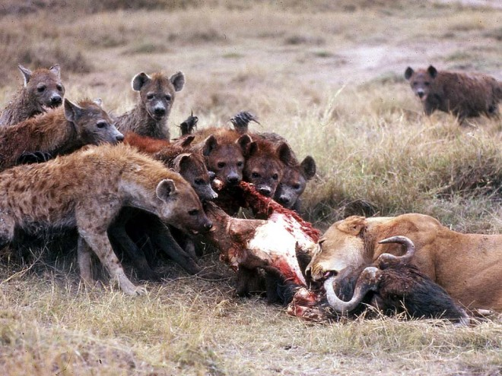
Competition
The first three observations led Darwin to a very important inference: organisms will compete with each other for access to a resource.
  If this occurs amongst members of the same species, it is called intraspecific competition.
  If this occurs between members of a different species, it is called interspecific competition.

Slide 27
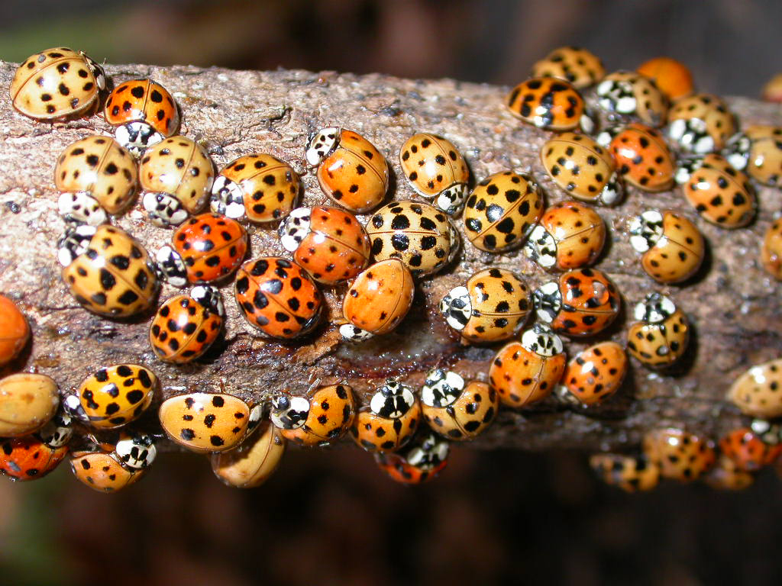
The fourth observation is that individuals within a population will vary in many of their traits.
Multicolor Asian Lady Beetle, Harmonia axyridis

Slide 28
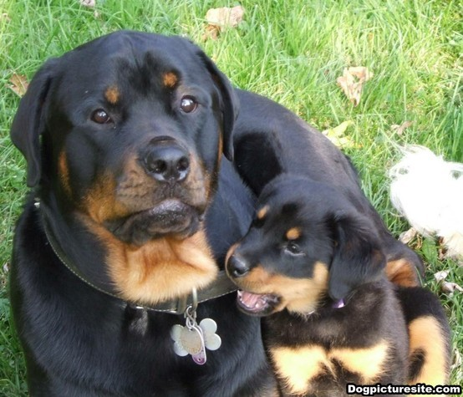
To make his fifth observation, Darwin consulted with plant and animal breeders and confirmed that that many differences in traits possessed by individuals are passed on to their offspring.

Slide 29
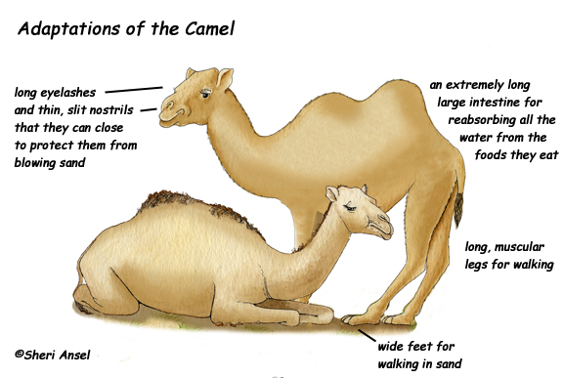
The Theory of Evolution
Darwin combined his observations and inferences to form the basis of the theory of evolution.
  Survival depends, in part, on inherited traits.
  Individuals that reproduce the most will pass those traits on to their offspring.

Slide 30
Natural selection is the engine that drives the evolution; the extinction of some species and the speciation of new ones.
  Over time, organisms will adapt to their environment.
  If the environment changes, different adaptations will be favored.

Slide 31
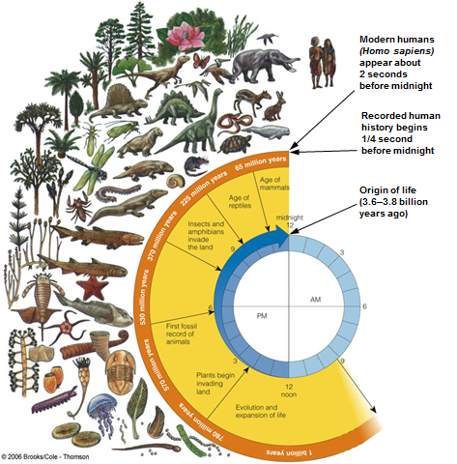
Natural selection is a slow process, with the current diversity of life gradually emerging over billions of years.

Slide 32
Four ecological factors will “encourage” natural selection to favor certain individuals in a population.
  Physiological stress, inappropriate levels of a critical environmental factor.
    Moisture, Light, pH
  Predation, when one organism is hunted and killed by another.
  Competition, the result of other organisms attempting to use same resources.
  Sexual Selection occurs when the female (usually) responds to specific behaviors or physical traits.

Slide 33
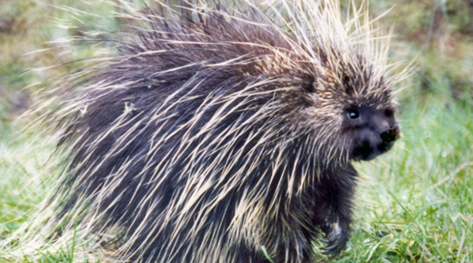
Predation
The presence of predators will cause encourage the selection of individuals with traits to defend against or evade those predators.
North American Porcupine

Slide 34
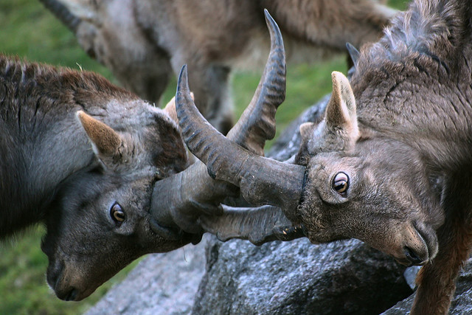
Competition
Likewise, both interspecific and intraspecific competition will ensure that weaker, “less fit” individuals survive and reproduce less often.
  This is the evolutionary basis of males that fight over access to females.
Apline Ibex

Slide 35
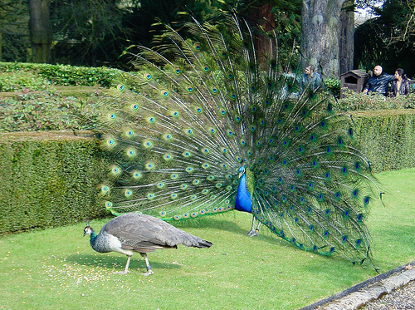
Sexual Selection
Darwin struggled to understand why evolution would produce birds with brightly-colored males, once writing, “The sight of a feather in a peacock’s makes me sick.”
  A male bird that
  is able to grow a
  bright, colorful,
  large train of tail
  feathers must be
  healthy, and thus
  would be a
  suitable mate!

Slide 36
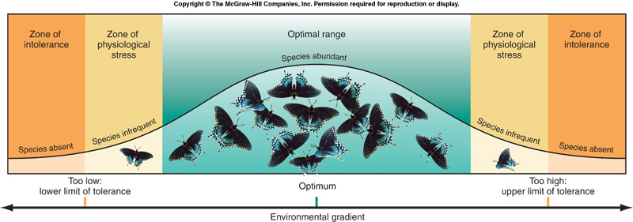
Physiological Stress
When the right level of an environmental factor is present, population levels will be growing or at their peak. This is the optimal range for that factor.
  At the zone of physiologic stress, levels of the factor are too high or too low. Weaker, less-adapted individuals are selected against.
  At the zone of intolerance, the population dies out.

Slide 37
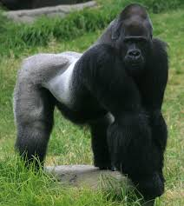
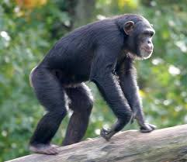
Types of Adaptations
Since Darwin published his theory, the adaptations present in living organisms have been classified into three types:
  Physical adaptations are structural differences in coloration, body shape, musculature, etc.
  Behavioral adaptations include migration, or marking a territory.
  Physiologic adaptations, such as skin tanning, occur at the cell or tissue level in an organism.
The gorilla is physically adapted for living and feeding on the ground, while chimpanzees gather food from trees.

Slide 38
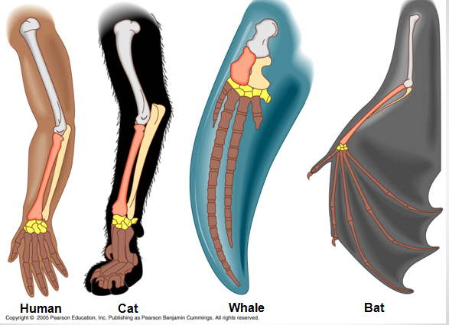
Evidence of Evolution
Evolution has become widely-accepted theory due to the volume of evidence.
One example is homologous structures, which are specific anatomical parts that show variations on a common design.

Slide 39
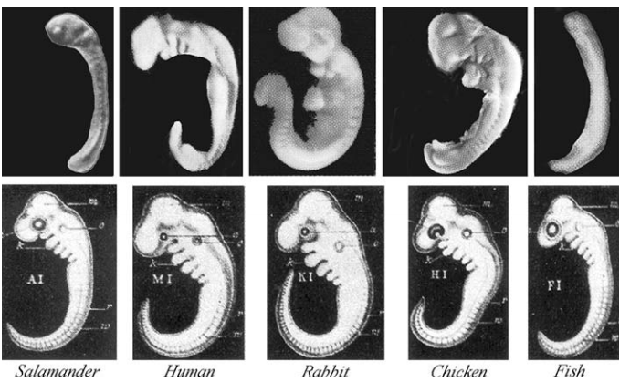
Embryologists have found many similarities in the unborn/unhatched or embryo stage of animals.
  All vertebrates have gill slits present in the pharynx region of their embryos.

Slide 40
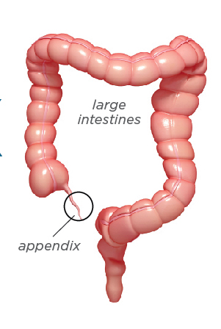
Vestigial organs are shrunken remnants of structures that were more useful in the ancestral form of a species.
  In humans, the appendix is considered a vestigial structure from an ancestor that ate more plant stems and leaves.

Slide 41
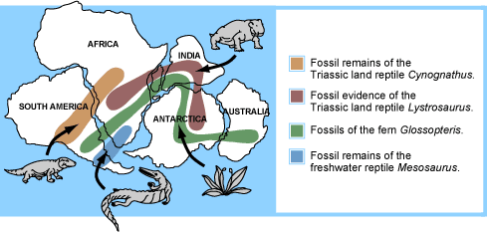
Biogeography is the study of the geographic distribution of species.
  Darwin noted that the species he observed on the Galapagos Islands were much more similar to those in nearby South America, as opposed to more distant-but-ecologically-similar islands.
  Fossils of animals and plants alive during the time of the supercontinent Pangaea are now found across multiple continents.

Slide 42
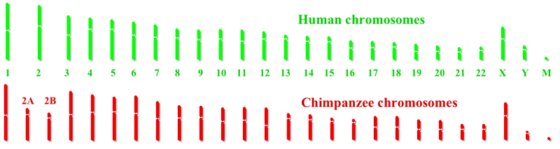
Molecular homologies are sequences of DNA in chromosomes or sequences of amino acids in proteins that are identical or nearly-identical.
  The total genome of humans, chimpanzees, and bonobos is about 99% the same.

Slide 43
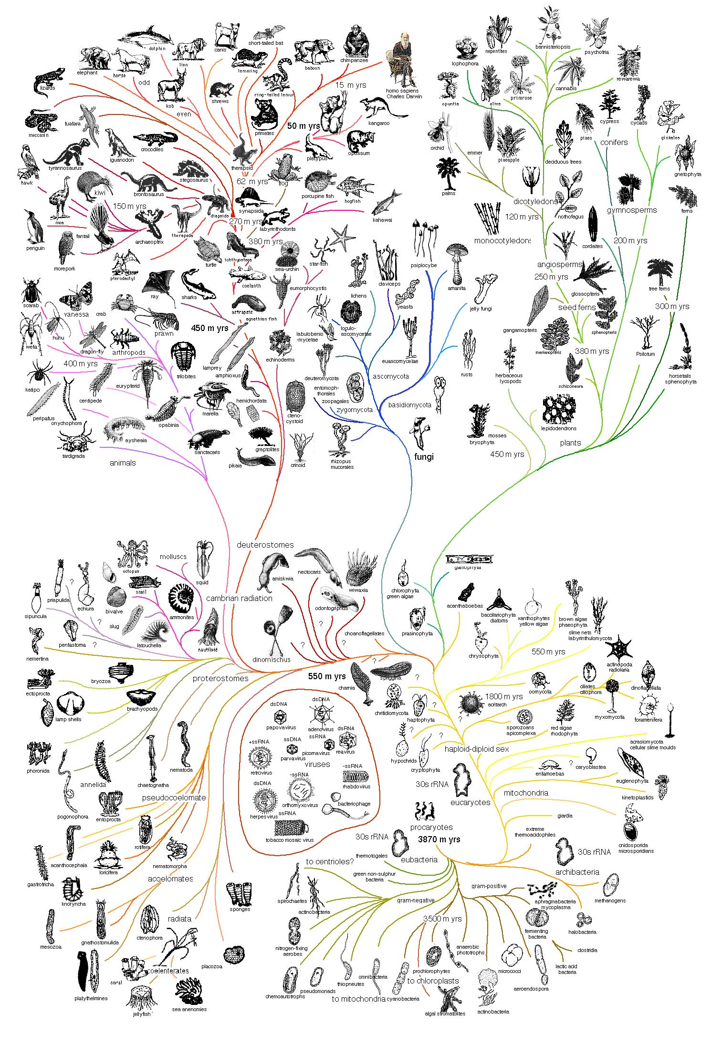
Darwin saw evolution as a “tree of life”, with each modern organism a descendent of some common ancestor.

Slide 44
Macro- and Microevolution
All of the observations made prior to Darwin were part of macroevolution, where entire species change, go extinct, or diverge into new species.
For macroevolution to be possible, there must also be a microevolution -- mechanism that causes changes with the frequencies of alleles within a population.
  Today, we know that cause of these individual differences in alleles to be random mutations within DNA.

Slide 45
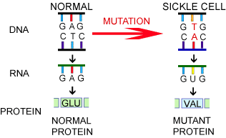
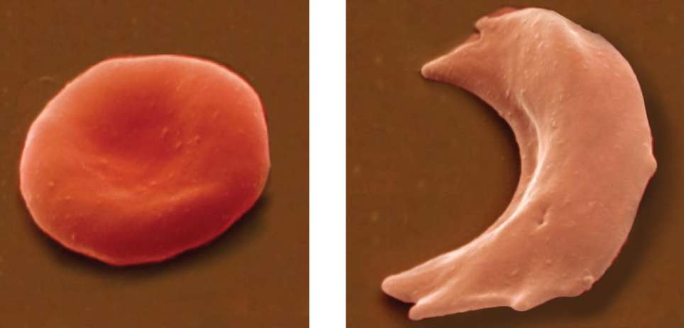
The gene for sickle-cell anemia in humans, for example, is the result of a single substitution mutation.
  This changes the shape of the hemoglobin protein in red blood cells, thus changing the shape of the entire cell.

Slide 46
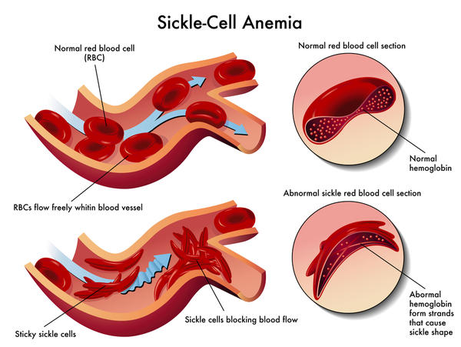
Sickle cells can get stuck in small blood vessels, do not live as long, and do not transport oxgeyn as well.
  This causes tissues to become oxygen-deprived.

Slide 47
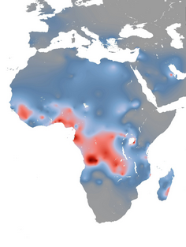
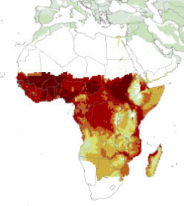
Individuals with sickle-cell anemia or heterozygous carriers have the advantage of being highly resistant to the disease malaria.
  The gene pool, or total collection of genes, is much more likely to contain the allele for sickle-cell anemia when malaria is prevalent.
Sickle cell gene frequency in Africa. Source: University of Oxford study.
Distribution of malaria transmission in Africa. Source: American Journal of Tropic Medicine and Hygeine Study.

Slide 48
Hardy-Weinberg
Two scientists independently observed that the frequency of each allele for a trait within a population will remain constant unless certain factors are operating.
  This is called the Hardy-Weinberg principle.

Slide 49
Hardy-Weinberg equilibrium is only possible if all of the mechanisms that cause microevolution are not present.
  Populations must be very large.
  There must be no movement (and thus no gene flow) between populations.
  No mutations can occur.
  Matings must be completely random (no sexual selection).
  The allele must not affect changes of survival and reproduction of the individual (natural selection).
Very rarely are all five conditions met, so allele and genotype frequencies are almost always changing.

Slide 50
To estimate the frequency of alleles in a gene pool, the Hardy-Weinberg equation is used.
  p² + 2pq + q² = 1
p² = frequency of AA (homozygous dominant)
2pq = frequency of Aa (heterozygous
q² = frequency of aa (homozygous recessive)

Slide 51
Example Calculation
About 90,000 out of 5.4 million births in Nigeria in 1988 had the recessive disease sickle-cell anemia. What percentage of the population are carriers?
  p = normal pq = carrier q = sickle cell anemia
First, solve for q². This is the proportion of the population with the disease.
  q² = 90,000/5,400,000 = 0.0167
Next, solve for q. This is the frequency of the recessive allele for sickle cell anemia in the gene pool.
  q = √0.0167 = 0.13
  In other words, 13% of the alleles in this gene pool are sickle-cell alleles.

Slide 52
If q is 0.13 (13%), then p must be 0.87 (87%).
We can then use the Hardy-Weinberg equation to estimate the frequency of each allele combination.
  p² + 2pq + q² = 1
  (0.87)² + 2(0.87)(0.13) + (0.13)² = 1
p² (homozygous dominant / normal) = 0.757 or 75.7%
2pq (heterozygous / carrier ) = 0.226 or 22.6%
q² (homozygous recessive / diseased) = 0.017 or 1.7%

