Slide 1


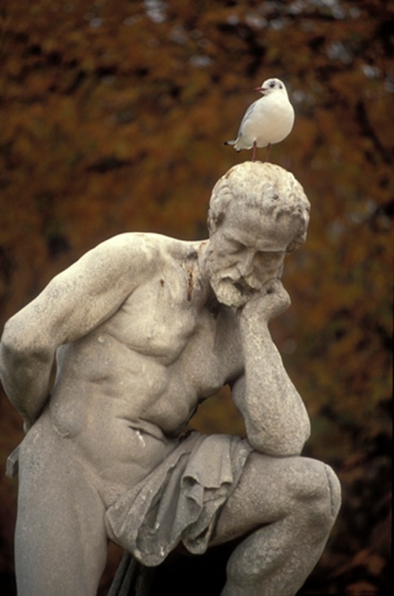

Brainstorming & Planning

Slide 2
Step 1 – Read Prompt Carefully
Realizing that homework is an important part of the learning process, many teachers assign tasks even on weekends.
Think about your weekend homework experiences.
Write to convince your principal to require or abolish the practice of giving homework on weekends.

Slide 3
Step 2. Create your thesis statement.
Unfold the paper and write thesis statement at the top of the paper.

Slide 4
Mr. Noack, please abolish the practice of teachers giving homework on weekends.

Slide 5
ADD REASONS
Reason One. Students are less likely to complete homework on weekends. | Reason Two
Reason Three.

Slide 6
ADD AT LEAST 3 DETAILS UNDER EACH REASON
Reason One- Students are less likely to complete it. Grades are negatively affected. Students copy from friends. Students never learn the material. | Reason Two – High school teachers tend to give weekend homework that is much like a project. Teachers don’t collaborate, so a student may have several projects over a short weekend. Projects should be given over longer periods of time.
Reason Three -Students have many responsibilities beyond school. Sports teams. Family chores. Church activities.

Slide 7
Elaborate on at least one detail
Reason One- (TRANSITION) Students are less likely to complete it. Grades are negatively affected. Students copy from friends. *My friend John’s referral. Students never learn the material. | Reason Two –(TRANSITION) High school teachers tend to give weekend homework that is much like a project. Teachers don’t collaborate, so a student may have several projects over a short weekend. Projects should be given over longer periods of time. * As a second language learner, I need more time.
Reason Three- (TRANSITION)Students have many responsibilities beyond school. Sports teams. Family responsibilities. Church activities. * Many teens are Sunday school teachers. Part-time jobs. | In conclusion, Yes, As you can see, weekend homework is detrimental to a teenager’s life. Please, Noack, consider the lives of the students in your school, and abolish the homework requirement. Grades, home life and involvement in activities will all suffer due to homework stress.

Slide 8
Write a quick conclusion. (In case you run out of time, it’s a way to “end” it!)
Reason One *(TRANSITION) Students are less likely to complete it. Grades are negatively affected. Students copy from friends. *My friend John’s referral. Students never learn the material. | Reason Two – (TRANSITION) High school teachers tend to give weekend homework that is much like a project. Teachers don’t collaborate, so a student may have several projects over a short weekend. Projects should be given over longer periods of time. * As a second language learner, I need more time.
Reason Three-(TRANSITION) Students have many responsibilities beyond school. Sports teams. Family responsibilities. Church activities. * Many teens are Sunday school teachers. Part-time jobs. | Conclusion: Restate thesis Review main points Power message

Slide 9
Many people believe that sports programs are a necessary component of high school life, while others believe that it is a detriment to learning.
Think about sports in your high school. Do you believe it helps or harms students?
Write to convince school board members to eliminate or continue the sports programs in district high schools.

Slide 10
Write to convince school board members to eliminate or continue to support the sports programs in district high schools.
School board members, please continue to support the sports programs in district high schools.
OR School board members, please eliminate the sports programs in district high schools.

