Slide 1
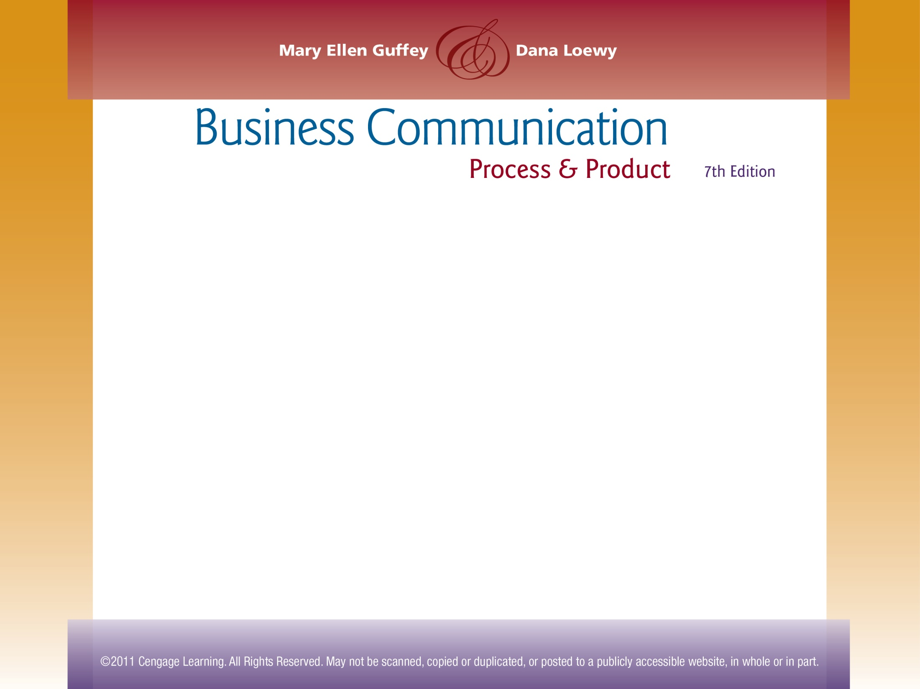

Chapter 1
Effective and Ethical Communication at Work

Slide 2
Topics in This Chapter
Communication Skills and Career Success
The Communication Process
Barriers to Interpersonal Communication
Flows of Information in Organizations
Ethics in the Workplace
Barriers to Organizational Communication

Slide 3
Why You Need to Build Career Skills
Necessary for hiring
A top skill set sought by employers
Critical for promotion
Essential for effective job
performance
More important now
as a result of technology
Learned through instruction
and practice

Slide 4
Expectations of Workers in
Today’s Information Age
Work with words, figures, and data.
Generate, process, and exchange information.
Think critically.
Make decisions.
Take charge of your career.
Continue learning all your life.

Slide 5
Critical Thinking, Decision Making and Problem Solving – Get Ready!
Identify and clarify
Gather information
Evaluate evidence
Consider options
Problem
Choose best option and test it

Slide 6
Trends Affecting You in Today’s Workplace
Heightened global competition
Flattened management hierarchies
Expanded team-based management
Innovative communication technology
New work environments
Increasingly diverse workforce
Renewed emphasis on ethics

Slide 7
Success in the Workplace
Success for you in the new global and diverse workplace requires excellent communication skills!

Slide 8
The Communication Process – Basic Model
Noise
Feedback travels to sender
Noise
5
Noise
Noise
4
Sender has idea
Sender encodes idea in message
Message travels over channel
Receiver decodes message
1
2
3
Noise
Possible
additional feedback to receiver
Noise
6
Noise
Noise
Notes:
8

Slide 9
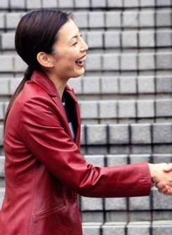

The Communication Process –
Expanded Model
Stimulus
Sending Channel
Encoding
Encoding
Understanding
BARRIERS
Understanding
Decoding
Decoding
Feedback Channel
Person A
Person B
Notes:
8

Slide 10
Factors That Shape Understanding
Communication climate
Context and setting
Background, experiences
Knowledge, mood
Values, beliefs, culture

Slide 11
Barriers That Create Misunderstandings
Bypassing
Differing frames of reference
Lack of language skills
Poor listening skills
Emotional interference
Physical distractions

Slide 12
Overcoming Barriers That
Cause Misunderstandings
Realize that communication is imperfect.
Adapt the message to the receiver.
Improve your language and listening skills.
Question your preconceptions.
Encourage feedback.

Slide 13
Organizational Communication
Functions
  Internal
  External
New emphasis
  Interactive
  Mobile
  Instant
Forms
  Oral
  Written
Delivery
  Electronic
  Hard copy

Slide 14

Communication and Formal Channels
Written channels
  Memos, letters
  Annual report
  Company newsletter
  Bulletin board postings
  Orientation manual

Slide 15
Communication and Formal Channels
Written channels
  Memos, letters
  Annual report
  Company newsletter
  Bulletin board postings
  Orientation manual

Slide 16

Communication and Formal Channels
Oral channels
  Telephone
  Face-to-face conversation
  Company meetings
  Team meetings

Slide 17
Communication and Formal Channels
Electronic channels
  E-mail
  Instant/text messaging
  Voicemail
  Videoconferencing
  Blogging
  Social networks
  Wikis
  Microblogging
  Web chat

Slide 18
Formal Channels of Information Flow
Managers
Supervisors
Upward flow
Horizontal flow
Coworkers
Coworkers
Downward flow
Subordinates

Slide 19
Formal Channels of Information Flow
Managers
Supervisors
Policies
Procedures
Directives
Goals and Motivation
Flows from
decision makers
to workers
Subordinates

Slide 20
Formal Channels of Information Flow
Managers
Supervisors
Feedback
Progress
Problems
Suggestions
Flows from
employees to
decision makers
Subordinates

Slide 21
Formal Channels of Information Flow
Task coordination, problem solving, conflict
resolution, idea generation, team building,
goals clarification
Flows among workers
at the same level
Coworkers
Coworkers

Slide 22
Informal Channels of Information Flow:
The Grapevine
Carry unofficial messages
Flows haphazardly
Can be remarkably accurate
Is mostly disliked by
management
Thrives where official
information is limited
Notes:
The drinking fountain is my photo.

Slide 23
Obstacles to the Flow of Organizational Information
Lack of trust, turf wars, fear of reprisal
Uneven reward systems
Closed communication climate
Little official communication

Slide 24

Obstacles to the Flow of Organizational Information
Top-heavy organizational structure
Long lines of communication
Filtering, prejudice, ego involvement
Poor communication skills

Slide 25
Surmounting Obstacles to
Effective Communication
Encourage open, trusting environment for interaction and feedback.
Flatten the organizational structure.
Provide more information through formal channels.

Slide 26

Surmounting Obstacles to
Effective Communication
Train managers and employees to improve communication skills.
Establish hotline and ombudsman programs.
Establish fair reward system for individual and team achievement.
Encourage full participation in teams.

Slide 27
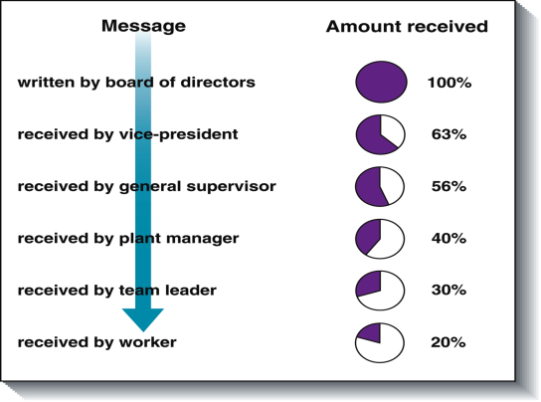
Message Distortion
Downward Communication Through Five Levels of Management

Slide 28
Understanding Ethical Behavior on the Job
What is ethical behavior?
Doing the right thing given the circumstances

Slide 29
Common Ethical Traps to Avoid on the Job
The false necessity trap - convincing yourself that no other choice exists
The doctrine of relative filth - comparing your unethical behavior with someone else’s even more unethical behavior

Slide 30
Common Ethical Traps to Avoid on the Job
The rationalization trap - justifying unethical actions with excuses
The self-deception trap - persuading yourself, for example, that a lie is not really a lie
The ends-justify-the-means trap - using unethical methods to accomplish a goal

Slide 31
Goals of Ethical Business Communicators
Abide by the law.
Tell the truth.
Label opinions.
Be objective.
Communicate clearly.
Use inclusive language.
Give credit.

Slide 32

Tools for Doing the Right Thing
Is the action you are considering legal?
How would you see the problem if you were on the opposite side?
What are alternate solutions?
Can you discuss the problem with someone you trust?
How would you feel if people you care about learned of your action?

Slide 33
How to Respond Ethically to Gossip
Run, don’t walk, away from anyone gossiping.
End rumors about others.
Attack rumors about yourself.
Limit the personal tidbits you share about yourself and keep them on the light side.
Avoid any form of coworker belittlement.
Build coworkers up; don’t tear them down.

Slide 34
End

