Slide 1
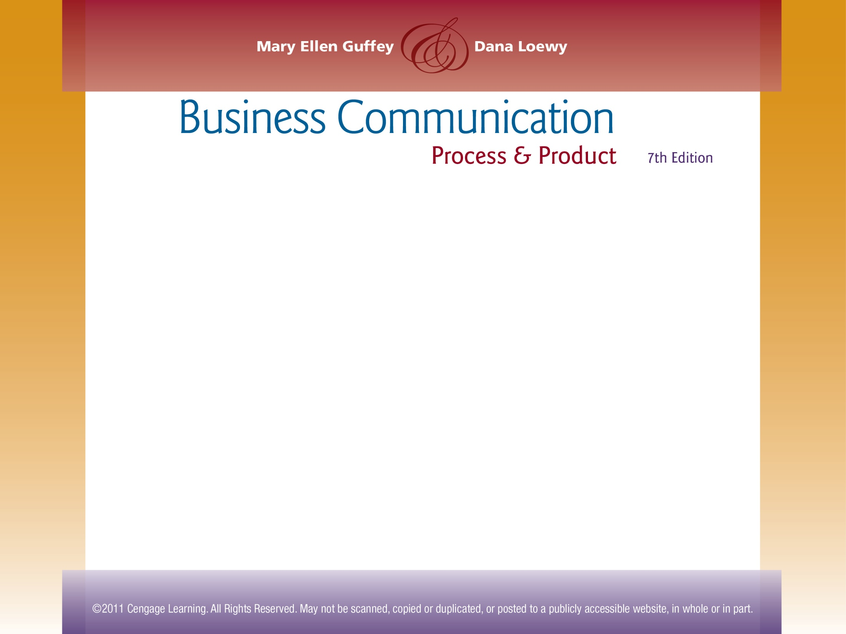
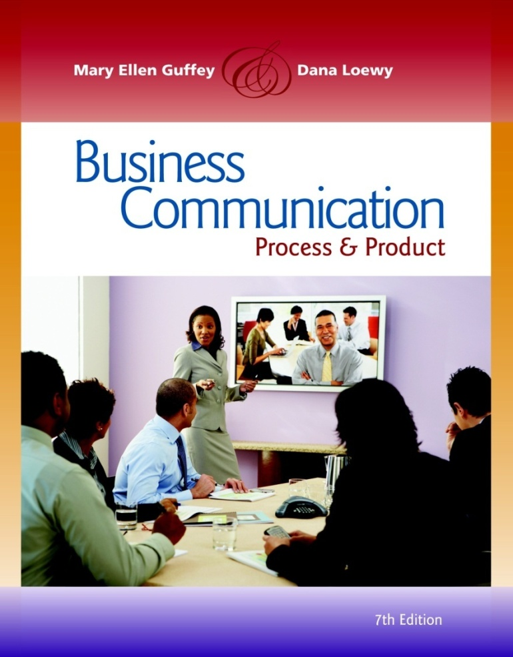
Chapter 10
Persuasive and Sales Messages

Slide 2
Topics in This Chapter
Understanding Persuasion and How to Use it Effectively and Ethically
Applying the 3-x-3 Writing Process to Persuasive Messages
The Four Major Elements in Successful Persuasive Messages
Requesting Favors and Actions

Slide 3
Topics in This Chapter
How to Write an Effective Complaint Letter
Persuading Within Organizations
Preparing Persuasive Direct-Mail and
E-Mail Sales Messages
Persuasive Techniques in High- and Low-Context Cultures

Slide 4
Understanding Persuasion and How to Use it Effectively and Ethically
Persuasion is the ability to use argument or discussion to influence an individual’s beliefs or actions.

Slide 5
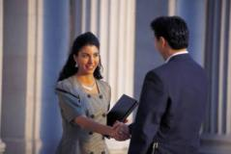
Understanding Persuasion and How to Use it Effectively and Ethically
What persuasive techniques are effective?
  Establishing credibility
  Making a reasonable, precise request
  Tying facts to benefits
  Recognizing the power of loss
  Expecting and overcoming resistance
  Sharing solutions and compromising

Slide 6
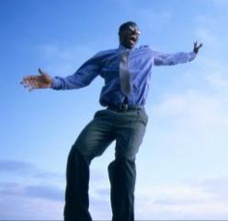
Understanding Persuasion and How to Use it Effectively and Ethically
What techniques improve persuasion?
  Avoid sounding preachy or parental.
  Resist pulling rank.
  Avoid making threats.
  Soften your words when persuading upward.
  Be enthusiastic.
  Be positive and likeable.

Slide 7
Applying the 3-x-3 Writing
Process to Persuasive Messages
Phase 1: Analyze, Anticipate, Adapt
  What do you want the receiver to do or think?
  Does the receiver need to be persuaded?
  How can you adapt your message to appeal to this receiver?
1

Slide 8
Applying the 3-x-3 Writing
Process to Persuasive Messages
Phase 2: Research, Organize, Compose
  What information do you need? Where can you locate it?
  Which strategy is better – direct or indirect?
2

Slide 9
Applying the 3-x-3 Writing
Process to Persuasive Messages
Phase 3: Revise, Proofread, Evaluate
  Is the message clear and concise?
  Is the message conversational?
  Are format, grammar, and mechanics correct?
  Will the message achieve its purpose?
3

Slide 10
Four Major Elements in
Successful Persuasive Messages
Gain Attention
Build Interest
Reduce Resistance
Motivate Action

Slide 11
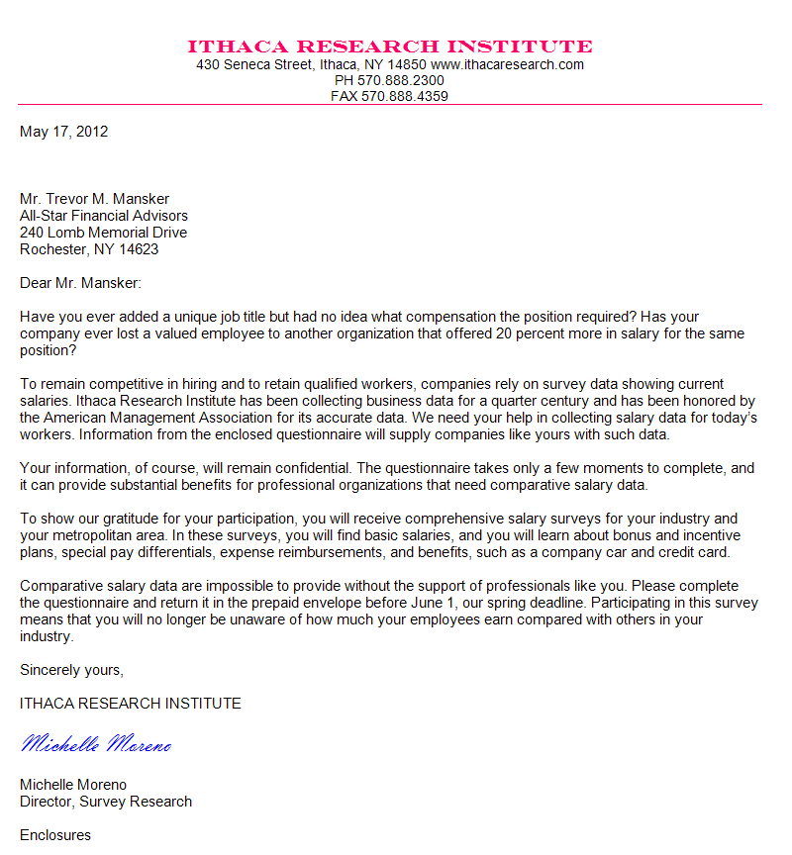
Requesting Favors and Actions
Prewrite
  Determine your purpose. Know exactly what you are requesting.
  Anticipate the reaction of your audience.

Slide 12
Requesting Favors and Actions
Gain Attention
  Use the indirect strategy instead of blurting out the request immediately.

Slide 13
Requesting Favors and Actions
Gain Attention
  Begin with a problem description, unexpected statement, compliment, praise, related facts, reader benefit, or (here) stimulating question.

Slide 14
Requesting Favors and Actions
Build Interest
  Develop interest by using facts, statistics, examples, testimonials, and specific details.

Slide 15
Requesting Favors and Actions
Build Interest
  Establish your credibility, if necessary, by explaining your background and expertise.
  Tie facts to direct or indirect benefits.

Slide 16

Requesting Favors and Actions
Direct Benefit:
  If you accept our invitation to speak, you will have an audience of 50 potential customers for your products.
Indirect Benefit:
  Your appearance would prove your professionalism and make us grateful for your willingness to give something back to the profession.

Slide 17
Requesting Favors and Actions
Reduce Resistance
  Anticipate objections and provide counterarguments.
  Suggest what might be lost if the request is not granted.

Slide 18
Requesting Favors and Actions
Reduce Resistance
  In requesting favors or making recommendations, show how the receiver or others will benefit.

Slide 19
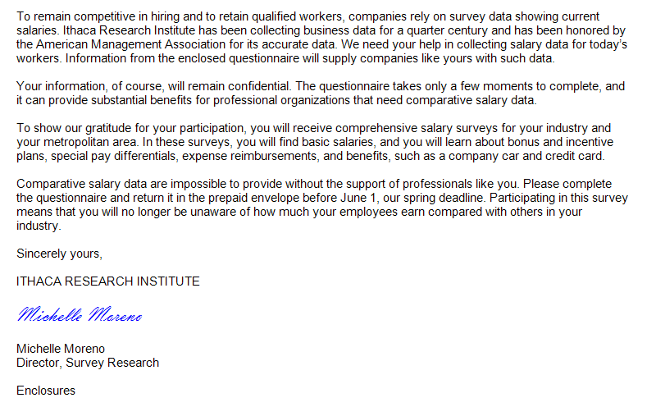
Requesting Favors and Actions
Motivate Action
  Make a precise request; include a deadline.
  Repeat a benefit, provide details, or offer an incentive.

Slide 20
“Before” – Ineffective Request
  Dear Dr. Thomas:
  Because you know Atlanta and live here in our town, we thought about asking you to speak at our GSU Business Awards banquet April 28.
  A few students on campus have read and admired your book Beyond Race and Gender, which appeared last spring and became a bestseller across the nation. We were amazed that a local author is now the nation’s diversity management guru. But what exactly did you mean when you said that America is no longer a melting pot of ethnic groups--it’s an “American mulligan stew”?
  Georgia State University doesn’t have any funds for honoraria, so we can invite only local speakers. The Reverend James R. Jones and Vice Mayor Rebecca A. Timmons were speakers in the past. Our awards banquet gets started at 6 p.m. with a social hour, followed by dinner at 7 and the speaker from 8:30 until 9. If you require, we can arrange transportation for you and your guest.
  Although you are a very busy person, we hope you will agree to this invitation. Thank you in advance. Please notify our advisor, Professor Alexa North.
  Sincerely yours,

Slide 21

Critical Thinking Questions
What is the purpose of the letter on the previous slide?
How do you think the reader will react to the message?
What could be used to attract the attention of the reader in the opening? Write an appropriate opening.
What information could be used to build interest in the body?

Slide 22
Critical Thinking Questions
What are some of the arguments the receiver might offer to resist the invitation? Could any counterarguments be offered?
What could be used to motivate the reader to accept?
Should an end date be used in the closing? What information could be added to the closing to make it easier for the receiver to respond? Write an appropriate closing.

Slide 23
“After” – Improved Request
  Dear Dr. Thomas:
  Your book Beyond Race and Gender stimulated provocative discussion across the nation and on our campus when it first appeared last spring.
  Business students at Georgia State University now consider you the nation’s diversity management guru, and for that reason they asked me to use all my powers of persuasion in this invitation. Because we admire your work, we would like you to be our keynote speaker at the GSU Business Awards banquet April 28.
  As students at an urban campus in a metropolitan area, we are keenly aware of diversity issues. In your words, America is no longer a melting pot of ethnic groups; it is now an “American mulligan stew.” We would like to hear more about the future workforce and how managers can maximize the contribution of all employees.
  Although we can’t offer you an honorarium, we can promise you a fine dinner at the GSU Faculty Club and an eager and appreciative audience of over 100 business students and faculty. Speakers in the past have included the Reverend James R. Jones and Vice Mayor Rebecca A. Timmons.

Slide 24
“After” – Improved Request
  Dr. Thomas Page 2 March 3, 2012
  The evening includes a social hour at 6 p.m., dinner at 7 p.m., and your remarks from 8:30 until 9. So that you won’t have to worry about transportation or parking, we will arrange a limousine for you and your guest.
  Please make this our most memorable banquet yet. Just call our adviser, Professor Alexa North, at 356-9910 before April 1 to accept this invitation.
  Sincerely yours,

Slide 25
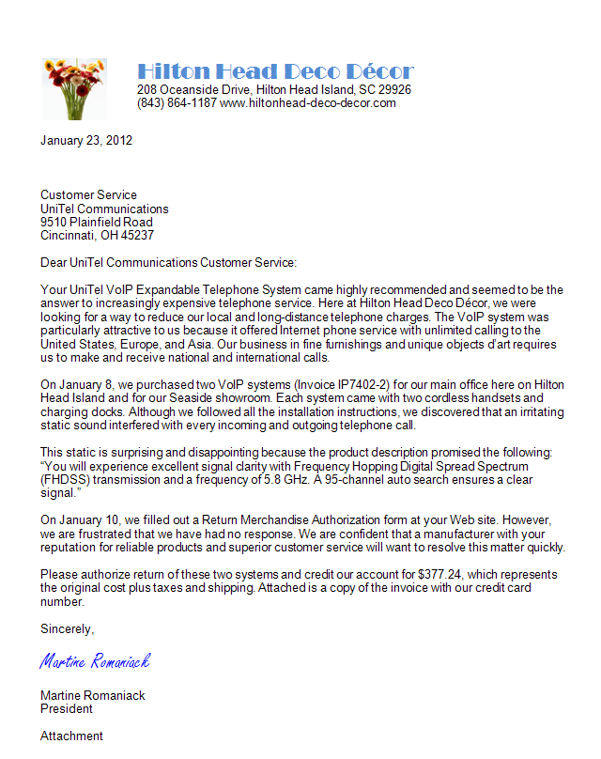
How to Write an Effective Complaint Letter
Begin with a point of agreement, statement of the problem, brief review of the action you have taken to resolve the problem, or (here) compliment. Keep the tone objective, rational, and unemotional.
Provide identifying data.

Slide 26
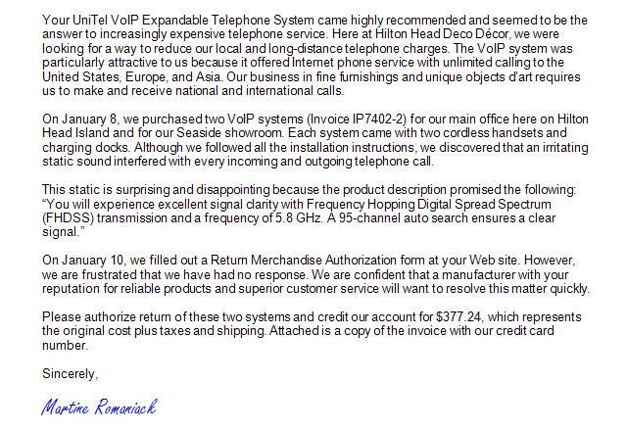
How to Write an Effective Complaint Letter
Prove that your claim is valid; explain why the receiver is responsible.
Describe your feelings and your disappointment.
Appeal to the receiver’s fairness, ethical and legal responsibilities, and desire for customer satisfaction.

Slide 27
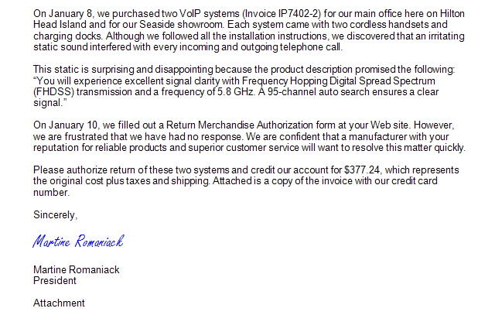
How to Write an Effective Complaint Letter
Avoid sounding angry, emotional, or irrational.
Close by telling exactly what you want the receiver to do.
Enclose document copies supporting your claim.

Slide 28
Persuading Within Organizations
Prewrite
Gain Attention
Build Interest
Reduce Resistance
Motivate Action
  Know your purpose. Make sure it is doable and attainable.
  Profile the audience. Play What if scenarios to anticipate the receiver’s reactions.

Slide 29
Persuading Within Organizations
Prewrite
Gain Attention
Build Interest
Reduce Resistance
Motivate Action
  Make the reader aware of a problem by using a startling statement, providing a significant fact related to the request, describing possible benefits, asking a stimulating question, or offering compliments.
  Establish credibility, but don’t pull rank.

Slide 30
Persuading Within Organizations
Prewrite
Gain Attention
Build Interest
Reduce Resistance
Motivate Action
  Use facts, statistics, examples, and details to build a solid foundation for your request.
  Strive for a personal but professional tone.
  Soften your words when persuading upwards.

Slide 31
Persuading Within Organizations
Prewrite
Gain Attention
Build Interest
Reduce Resistance
Motivate Action
  Recognize any weakness in your proposal and suggest well-reasoned counterarguments.
  Consider a strong dollars-and-cents appeal for requests involving budgets in requests flowing upward.
  Avoid sounding preachy, parental, or overly authoritarian in requests flowing downward.

Slide 32
Persuading Within Organizations
Prewrite
Gain Attention
Build Interest
Reduce Resistance
Motivate Action
  State a specific request including a deadline, if appropriate.
  Suggest ways to make the response effortless and painless.
  Repeat a major benefit.
  Include an incentive or reason to act.
  Express appreciation, if appropriate.

Slide 33
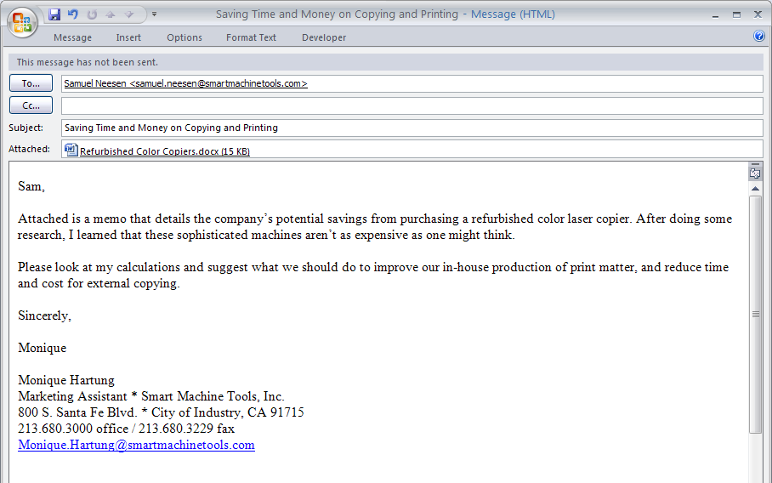
Businesspeople Send Memos as E-Mail Attachments to Persuade
Send a memo as an e-mail attachment accompanied by a polite, short e-mail
  To keep the document format in MS Word intact
  When the message is too long to paste into an e-mail message

Slide 34
Businesspeople Send Memos as E-Mail Attachments to Persuade
Prevent premature rejection of the message by including subject lines in the persuasive memo and e-mail that announce the purpose of the message without disclosing the actual request
By John S. Donnellan

Slide 35
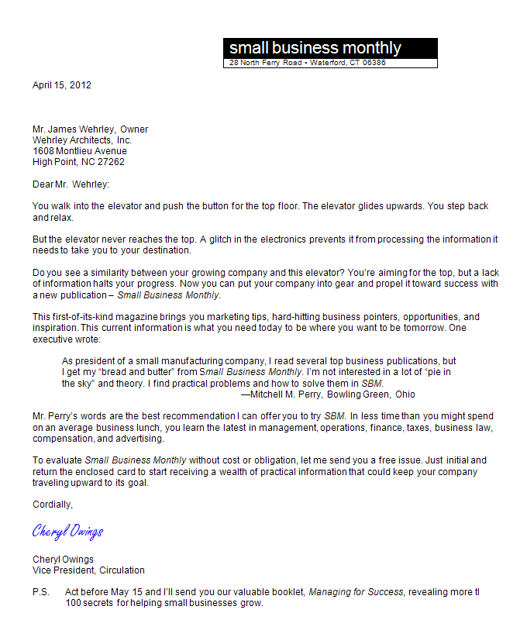
Preparing Persuasive Direct-Mail and
E-Mail Sales Messages
Prewrite
  Analyze your product or service. What makes it special? What central points should you emphasize? How does it compare with the competition?

Slide 36
Preparing Persuasive Direct-Mail and
E-Mail Sales Messages
Prewrite
  Profile your audience. How will this product or service benefit this audience?

Slide 37
Preparing Persuasive Direct-Mail and
E-Mail Sales Messages
Prewrite
  Decide what you want the audience to do at the end of your message.
  For e-mails, send only to those who have opted in.

Slide 38
Preparing Persuasive Direct-Mail and
E-Mail Sales Messages
Gain Attention
  Describe a product feature, present testimonials, make a startling statement, or (here) show the reader in an action setting.

Slide 39
Preparing Persuasive Direct-Mail and
E-Mail Sales Messages
Gain Attention
  Offer something valuable, promise a significant result, or describe a product feature.

Slide 40
Preparing Persuasive Direct-Mail and
E-Mail Sales Messages
Gain Attention
  Suggest a solution to a problem, offer a relevant anecdote, use the receiver’s name, or mention a meaningful current event.

Slide 41
Preparing Persuasive Direct-Mail and
E-Mail Sales Messages
Build Interest
  Describe the product in terms of what it does for the reader.
  Show how the product or service saves or makes money, reduces effort, improves health, produces pleasure, or boosts status.

Slide 42
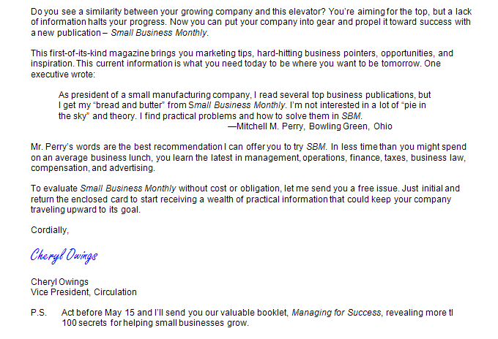
Preparing Persuasive Direct-Mail and
E-Mail Sales Messages
Reduce Resistance
  Counter anticipated reluctance with attractive warranties, trial offers, free samples, money-back guarantees, or (here) testimonials.

Slide 43
Preparing Persuasive Direct-Mail and
E-Mail Sales Messages
Reduce Resistance
  Build credibility with results of performance tests, polls, or awards.
  If price is not a selling feature, describe it in small units, show it as savings, or tell how it compares favorably with the competition.

Slide 44
Preparing Persuasive Direct-Mail and
E-Mail Sales Messages
Motivate Action
  Close by repeating a central selling point and with clear instructions for easy action.
  Prompt the reader to act immediately with a gift, incentive, limited offer, or deadline.

Slide 45
Preparing Persuasive Direct-Mail and
E-Mail Sales Messages
Motivate Action
  Put the strongest motivator in a postscript.
  In e-mails, include an opportunity to opt out.

Slide 46
Writing Successful E-Mail Sales Messages
Communicate only with those who have given permission.
Craft a catchy subject line.
Keep the main information “above the fold.”
Make the message short, conversational, and focused.
Convey urgency.
Sprinkle testimonials throughout the copy.
Provide a means for opting out.

Slide 47
Persuasive Techniques in
High-Context Cultures
Persuasive Techniques in High-Context Cultures
Indirectness
Politeness
Soft-Sell Approach
Relationship Appeal
Long-Term Goal
Collectivist View
Much of Asia, Africa, South America, and the Middle East

Slide 48
Persuasive Techniques in
Low-Context Cultures
Persuasive Techniques in Low-Context Cultures
Directness
Superlatives
Hard-Sell Approach
Short-Term Goal
“You” View
Much of Northern Europe, North America, Scandinavia, and Australia

Slide 49
End

