Slide 1


Chapter 11
Report and Research Basics

Slide 2
Topics in This Chapter
Understanding Report Essentials
Audience Analysis and Report Organization
Informational Reports
The Ten Truths You Should Know About Reports
Analytical Reports

Slide 3
Topics in This Chapter
Applying the Writing Process to Reports
Documenting Data
Creating Effective Visual Aids
Gathering Information From Secondary and Primary Sources

Slide 4
Understanding Report Essentials
Business Reports Have One or More of These Purposes
Convey Information
Solve Problems
Answer Questions

Slide 5
Understanding Report Essentials
Report Functions and Types
Informational reports
Analytical reports
Organizational Strategies
Direct strategy
Writing Style
Formal
Informal
Indirect strategy
Report Formats
Letter
Memo (often with e-mail cover note)
Manuscript
Preprinted forms
Digital

Slide 6
Ten Truths You Should Know About Reports
1
Everyone writes reports.
Most reports flow upward.
Most business reports are informal.
2
3

Slide 7
Ten Truths You Should Know About Reports
4
Three formats are most popular:
  Memo (often with e-mail cover note)
  Letter format
  Manuscript format
Reports differ from memos and letters.
Today’s reports take advantage of computer technologies.
5
6

Slide 8
Ten Truths You Should Know About Reports
7
Many reports are joint efforts.
Ethical report writers interpret facts fairly.
Writers impose organization on data.
The writer is the reader’s servant.
8
9
10

Slide 9
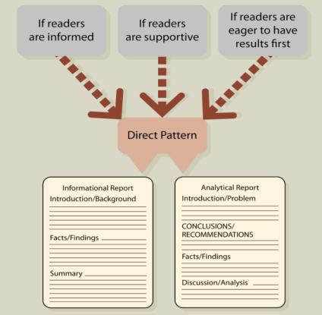
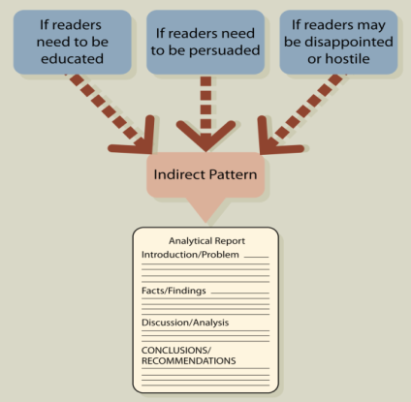
Audience Analysis and Report Organization
The Direct Pattern
The Indirect Pattern

Slide 10
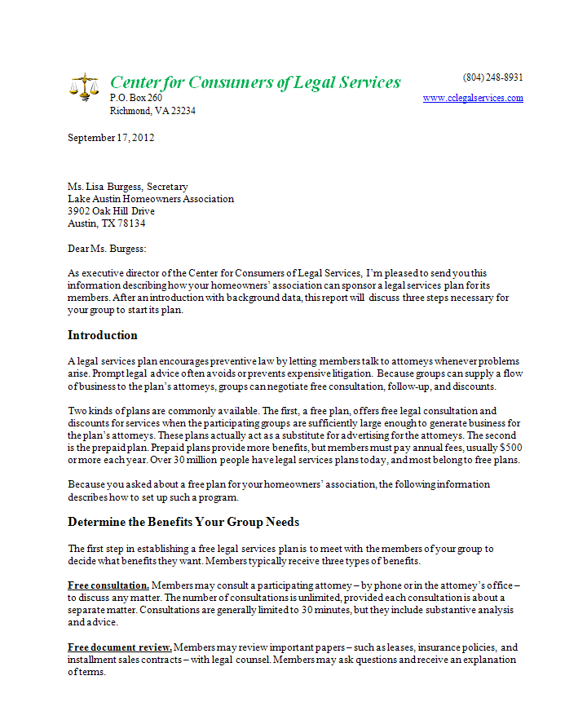
Informational Report – Letter Format
Tips for Letter Reports:
  Use letter format for short, informal reports sent to outsiders.
  Organize the facts section into logical divisions identified by consistent headings.

Slide 11
Informational Report – Letter Format
Tips for Letter Reports:
  Single-space the body.
  Double-space between paragraphs.
  Leave two blank lines above each side heading.

Slide 12
Informational Report – Letter Format
Tips for Letter Reports:
  Create side margins of 1 to 11/4 inches.
  Add a second-page heading, if necessary, consisting of the addressee’s name, the date, and the page number.

Slide 13
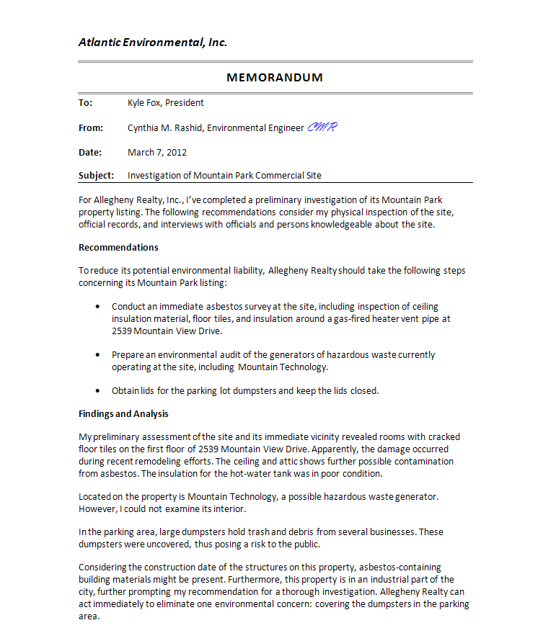
Analytical Report – Memo Format
Tips for Memo Reports:
  Use memo format for short (ten or fewer pages) informal reports within an organization.
  Leave side margins of 1 to 11/4 inches.
  Sign your initials on the From line.

Slide 14
Analytical Report – Memo Format
Tips for Memo Reports:
  Use an informal, conversational style.
  Put recommendations first for direct analytical reports and last for indirect analytical reports.

Slide 15
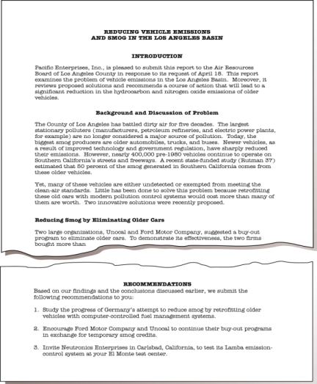
Analytical Report – Manuscript Format

Slide 16
Applying the Writing Process to Reports
1. Analyze the problem and purpose
2. Anticipate the audience and issues
3. Prepare a work plan
4. Conduct research
5. Organize, analyze, interpret, and illustrate the data
6. Compose the first draft
7. Revise, proofread, and evaluate

Slide 17

Elements of a Work Plan for a Formal Report
Statement of the problem
Statement of the purpose, including scope, limitations, and significance
Research strategy, including a description of potential sources and methods of collecting data
Tentative outline that factors the problem into manageable chunks
Work schedule

Slide 18

Gathering Information From
Secondary Sources
Print resources:
  Books – card catalog, online catalog
  Periodicals – print indexes, electronic indexes

Slide 19
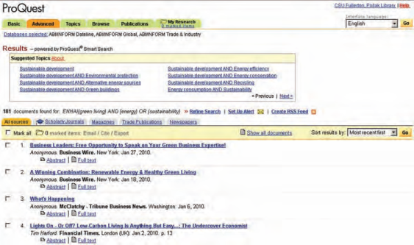
Gathering Information From
Secondary Sources
Electronic databases:
  LexisNexis Academic
  ABI/INFORM
  Factiva
  EBSCO
ABI/INFORM (ProQuest) search result

Slide 20


Gathering Information From Primary Sources
Surveys (for example, low-cost Web survey software, such as SurveyMonkey and Zoomerang)
Interviews
Observation and experimentation

Slide 21

Tips for Searching the Web
Use two or three search tools.
Know your search tool.
Understand case sensitivity.
Use nouns as search terms and up to eight words in a query.
Combine keywords into phrases.

Slide 22

Tips for Searching the Web
Omit articles and prepositions.
Use wild cards.
Learn basic Boolean search strategies.
Bookmark the best Internet sites.
Keep trying.
Repeat your search a week later.

Slide 23
Evaluating Web Sources
Currency
When last updated?
Authority
Who publishes or sponsors the page?
What makes the presenter an authority?
Date of Web page?
Anything out of date?
Is contact address available?

Slide 24
Evaluating Web Sources
Content
Is the purpose of the page to entertain, inform, convince, or sell?
Who is the intended audience?
How does the content compare with content elsewhere?
Accuracy
Do the facts seem reliable?
Errors in spelling, grammar, usage?
Evidence of bias?

Slide 25

Documenting Data
Crediting sources:
  Strengthens your argument
  Protects you from charges of plagiarism
  Instructs readers

Slide 26

Documenting Data
To avoid plagiarism, you must give credit whenever you use:
  Another person's ideas, opinions, examples, or theory
  Any facts, statistics, charts, and drawings that are not common knowledge
  Another person's exact spoken or written words
  Paraphrases of another person's spoken or written words

Slide 27

Documenting Data
Practice the fine art of paraphrasing:
  Read the original material intently to comprehend its full meaning.
  Write your own version without looking at the original.
  Avoid repeating the grammatical structure of the original and merely replacing words with synonyms.
  Reread the original to be sure you covered the main points but did not borrow specific language.

Slide 28

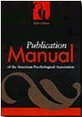
Two Documentation Formats
Modern Language Association
American Psychological Association
Author’s name and page (Smith 100) placed in text
Complete references in Works Cited
Author’s name, date of publication, and page number placed near the text reference (Jones, 2011, p. 99)
Complete references listed at the end of the report in References

Slide 29
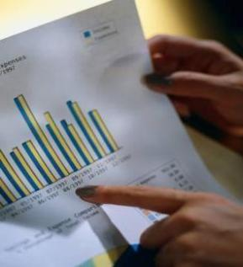
Creating Effective Visual Aids
The functions of graphics are to:
  Clarify data
  Create visual interest
  Condense and simplify data
  Make numerical data meaningful

Slide 30
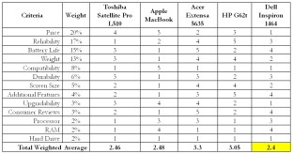
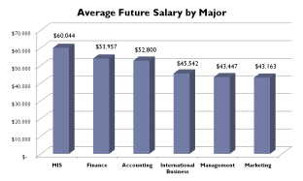
Creating Effective Visual Aids
Find the right graphic to fit the objective:
  Table – to show exact figures and values
  Bar chart – to compare related items

Slide 31
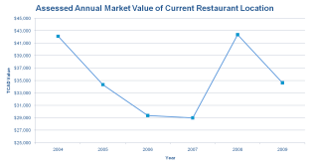
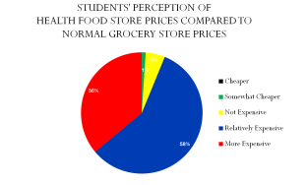
Creating Effective Visual Aids
Find the right graphic to fit the objective:
  Line chart – to demonstrate changes in quantitative data over time
  Pie chart – to visualize a whole unit and the proportion of its components

Slide 32
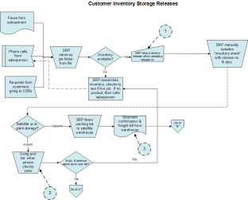
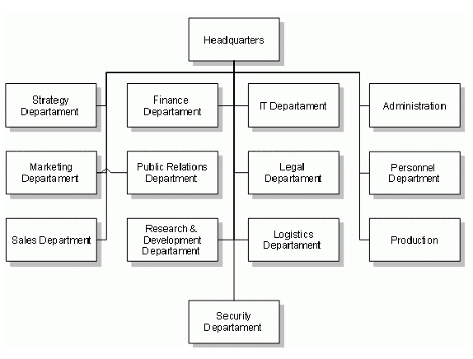
Creating Effective Visual Aids
Find the right graphic to fit the objective:
  Flow chart – to display a process or procedure
  Organization chart – to define a hierarchy of elements

Slide 33

Creating Effective Visual Aids
Find the right graphic to fit the objective:
  Photograph, map, illustration – to create authenticity, to spotlight a location, and to show an item in use
By John S. Donnellan

Slide 34
End

