Slide 1


Chapter 12
Informal Business Reports

Slide 2
Topics in This Chapter
Devices for Interpreting Data
Tips for Drawing Report Conclusions
Tips for Making Report Recommendations
Possible Methods for Organizing Report Information
Structural Cues for Reports

Slide 3
Topics in This Chapter
Informational Report Content
Analytical Report Content
Typical Informational Reports
Sample Reports
Typical Short Analytical Reports

Slide 4
Interpreting Data
You are looking for
Meanings
Relationships
Answers!

Slide 5
Interpreting Data
Devices for tabulating and analyzing data
  Table - systematic columns and rows
  The mean (arithmetic average), median (middle point in a range of values), and mode (most frequent value)
  Correlation – relationships between variables
  Grid – boxes of rows and columns to sort data
  Decision matrix – grid that allows comparison among weighted criteria

Slide 6
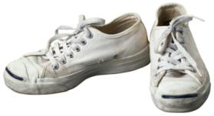
Mean, Median, Mode
Shoe Sizes
14
12
12
12
12
12
12
11
11
11
11
10
10
9
8
8
7
6
6
6
200
The Athletic Department is collecting data on shoe sizes for male and female players. Here are the shoe sizes for 20 people:
  What is the mean?
  What is the median?
  What is the mode?
How can such statistical values be important to report writers?

Slide 7
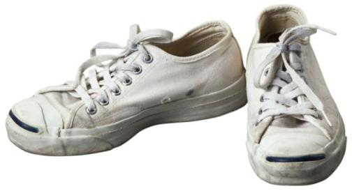
Mean, Median, Mode
Shoe Sizes
14
12
12
12
12
12
12
11
11
11
11
10
10
9
8
8
7
6
6
6
200
Answers:
  Mean (average value) = 10
  Median (middle point in range of values) = 11
  Mode (most frequent value) = 12

Slide 8
Tips for Drawing Report Conclusions
1
Interpret and summarize the findings.
  Tell what your findings (collected data) mean.
Relate the conclusions to the report problem.
  Focus only on conclusions that help solve the original problem.
2

Slide 9
Tips for Drawing Report Conclusions
3
Limit the conclusions to the data presented.
  Do not introduce new material.
Be objective.
  Avoid exaggerating or manipulating the data to prove a point.
4

Slide 10
Tips for Drawing Report Conclusions
5
Use consistent criteria.
  In evaluating options, use the same criteria for each alternative.
Enumerate each conclusion.
  Number and list each item. Present each conclusion in parallel form.
6

Slide 11
Tips for Making Report Recommendations
1
Suggest actions.
  What specific procedures can help solve the report problem?
Focus on recommendations that are practical and agreeable.
  Suggest feasible actions that would be acceptable to this audience.
2

Slide 12
Tips for Making Report Recommendations
3
Present recommendations separately.
  Enumerate each in a statement beginning with a verb. For example:
  1. Invest half of the income in growth funds.
  2. Invest half of the income in bonds.
Describe how to implement the recommendations, if requested.
  Some writers present detailed plans for executing the recommendations.
4

Slide 13
Report Conclusions and Recommendations
Conclusion: Survey results show that the biggest student complaint centered on long registration lines.
Recommendation: Begin a registration reservation system in which students sign up for specific registration time slots.
Notes:
8

Slide 14
Possible Methods for
Organizing Report Information
Time
Component
Importance
Arrange data by chronology: e.g., 2004, 2005, 2006.
Arrange data by classifications: location, geography, division, product, or part. A report discussing company profits could be organized by product.
Order data from most important to least important, or vice versa.

Slide 15
Possible Methods for
Organizing Report Information
Convention
Organize data according to prescribed categories. Proposals, for example, are organized by staff, budget, schedule, and so forth.
Criteria
Arrange data by evaluative categories. In a report comparing fax equipment, organize by such areas as price, warranty, speed, print quality, and so on.

Slide 16

Structural Cues for Reports
Introductions
  Discuss purpose and significance of report.
  Preview main points and order of development.
Transitions
  however
  on the contrary
  therefore
  moreover

Slide 17
Structural Cues for Reports
Headings
  Write short but clear headings.
  Experiment with wording that tells who, what, when, where, and why.
  Include at least one heading per report page.
  Try to create headings that are grammatically balanced at a given level. For example:
  Creating Team Motivation
  Treating Employees Like Customers (not Employees Should Be Treated Like Customers)

Slide 18
Structural Cues for Reports
Headings
  Integrate headings gracefully. Try not to repeat the exact wording from the heading in the following sentence.
  Avoid using the heading as an antecedent to a pronoun. For example, avoid:
  CUSTOMER SURVEYS
  These are . . .

Slide 19
Levels of Report Headings
  REPORT, CHAPTER, AND PART TITLES
  The title of a report, chapter heading, or major part should be centered in all caps.
  First-Level Subheading
  Headings indicating the first level of division are centered and bolded. Whether a report is single-spaced or double-spaced, most writers triple-space (leaving two blank lines) before and double-space (leaving one blank line) after a first-level heading.
  Second-Level Subheading
  Headings that divide topics introduced by first-level subheadings are bolded and begin at the left margin. For that reason, a second-level subheading is also called a side heading.
  Third-level subheading. Because it is part of the paragraph that follows, a third-level subheading is also called a paragraph subheading. It should appear in boldface print.

Slide 20
Informational Report Content
Introduction
Body
Summary/
Conclusion
  Identify the report and its purpose.
  Present a brief overview of the report’s organization, especially for longer reports.
  Provide brief background information when readers are unfamiliar with the topic.

Slide 21
Informational Report Content
Introduction
Body
Summary/
Conclusion
  Group facts or findings into three to five roughly equal, discrete segments.
  Organize by time, component, importance, criteria, convention, or some other method.
  Supply functional or talking heads (at least one per page) to describe each section.

Slide 22
Informational Report Content
Introduction
Body
Summary/
Conclusion
  Use an informal, conversational writing style unless the audience expects a formal tone.
  Use bullets, numbered and lettered lists, headings, underlined items, and white space to enhance readability.

Slide 23
Informational Report Content
Introduction
Body
Summary/
Conclusion
  When necessary, briefly review the main points and discuss what action will follow.
  If relevant, express appreciation or describe your willingness to provide further information.

Slide 24
Analytical Report Content
Introduction
Findings
Conclusions/Recommen-dations
  Explain why the report is being written. For research studies, include the significance, scope, limitations, and methodology of the investigation.
  Preview the report’s organization.
  Summarize the conclusions and recommendations for receptive audiences.

Slide 25
Analytical Report Content
Introduction
Findings
Conclusions/Recommen-dations
  Discuss the pros and cons of each alternative. For receptive audiences, consider placing the recommended alternative last.
  Establish criteria to evaluate alternatives. In “yardstick” studies, create criteria to use in measuring each alternative consistently.

Slide 26
Analytical Report Content
Introduction
Findings
Conclusions/Recommen-dations
  Support the findings with evidence: facts, statistics, expert opinion, survey data, and other proof.
  Use headings, enumerations, lists, tables, and graphics to focus emphasis.

Slide 27
Analytical Report Content
Introduction
Findings
Conclusions/Recommen-dations
  Develop reasonable conclusions that answer the research question. Justify the conclusions with highlights from the findings.
  Make recommendations, if asked. Use action verbs. Explain recommendations that need explaining.

Slide 28

Typical Informational Reports
Periodic or activity reports
  Describe production, sales, shipping, service, and other recurring activities.
Trip, convention, conference reports
  Describe an event, summarize three to five main points of interest, itemize expenses, and analyze the event’s value.

Slide 29
Typical Informational Reports
Progress and interim reports
  Explain continuing projects including work completed, work in progress, future activities, and completion date.
Investigative reports
  Examine problems and supply facts; provide little analysis.
By John S. Donnellan

Slide 30

Typical Short Analytical Reports
Justification/recommendation reports
  Make recommendations to management; provide data to solve problems and make decisions.
Feasibility reports
  Analyze problems and predict whether alternatives will be practical or advisable.
Yardstick reports
  Establish criteria and evaluate alternatives by measuring against the “yardstick” criteria.

Slide 31
Student Progress Report
DATE: January 2, 2007
TO: Cheryl Bryant, Director
OAS Recycling Program
FROM: Alan Christopher
OAS Business Senator
SUBJECT: Progress of Recycling Study at South Bay College
This report describes the progress of my project with OAS to study the Sun Coast University recycling program and to recommend ways to increase participation.
Background
Although results from the campus recycling program are satisfactory, OAS feels the participation could increase. As a result, OAS asked me to lead a campaign to learn more
AC

Slide 32
Student Progress Report
about campus attitudes toward recycling and to suggest ways to improve the program. I agreed to collect secondary data by reading periodicals about recycling efforts in other parts of the country. More importantly, I agreed to collect primary data by conducting a campus survey.
Work Completed
To date, I have completed the secondary research, which included using the library and databases to find current articles about recycling programs in other areas. Several references had particularly relevant data that will be useful for this report. To collect data from the campus population, my business communication class and I developed a pilot questionnaire. We tried it out on 28 people and then revised it. Then we administered our revised questionnaire to a random sample of 220 individuals.
Work to Be Completed
The questionnaire data must now be tabulated. I plan to work with a committee of three other students in counting questionnaire responses. After making tables and analyzing the data, I will discuss the findings with the class. We will draw conclusions from the findings

Slide 33
Student Progress Report
Ms. Cheryl Bryant Page 2 January 2, 2012
and discuss ways to improve participation in the recycling program. A group discussion is a good way to brainstorm for ideas to improve the program. Because I don't expect problems, I should be able to submit the final report to you by our January 18 deadline.

Slide 34
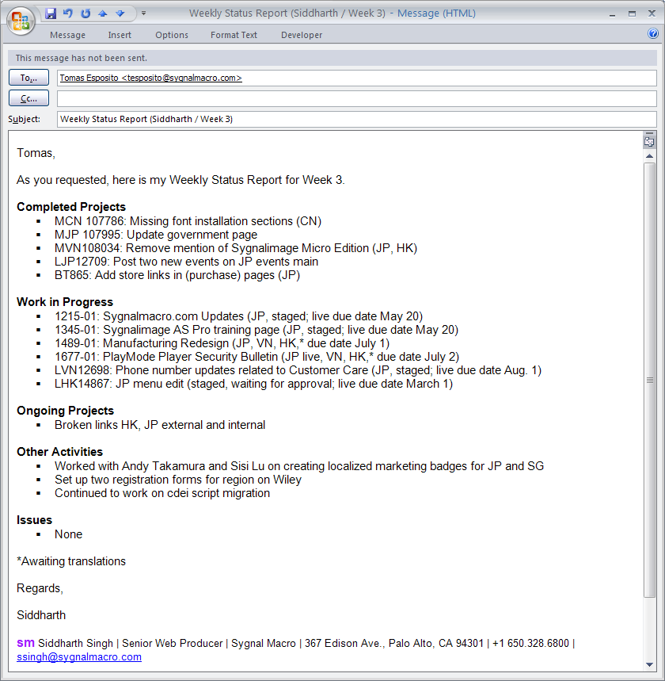
Periodic (Activity) Report – E-Mail Format
Sends internal informational report by e-mail as required weekly by manager
Uses abbreviations for China (CN), Japan (JP), Hong Kong (HK), and so on, familiar to readers
Employs bulleted lists and abbreviated project descriptions for high “skim value”

Slide 35
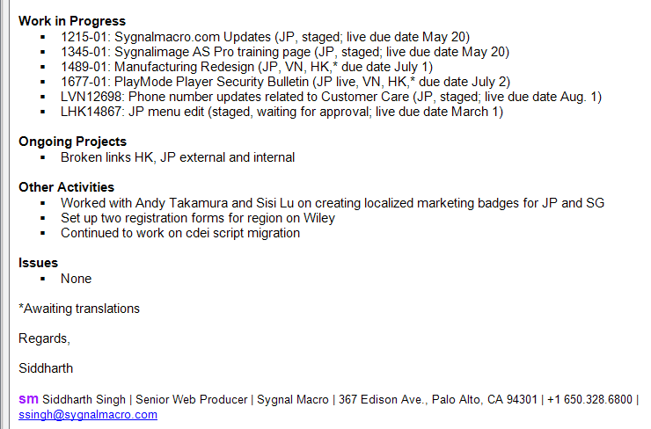
Periodic (Activity) Report – E-Mail Format
Includes internal project numbers to identify assignments
Clearly labels the tasks as completed, pending, and ongoing
Provides full contact information in prepared signature block

Slide 36
End

