Slide 1


Chapter 13
Proposals, Business Plans, and Formal Business Reports

Slide 2
Topics in This Chapter
Preparing Proposals
Preparing Effective Business Plans
Preparing Formal Reports
Formal Report Components

Slide 3
Components of Formal and
Informal Proposals
Appendix
Authorization
Budget
Staffing
Schedule
Background, Problem, Purpose
Introduction
List of Figures
Table of Contents
Title Page
Abstract or Summary
Letter of Transmittal
Copy of RFP (optional)
Generally appear in both
formal and informal proposals:
Optional in informal proposals:

Slide 4
Preparing Proposals
Introduction
Staffing
Background, Problem, Purpose
Proposal, Plan, Schedule
Budget, Authorization

Slide 5
Preparing Proposals
Introduction
  Explain why the proposal is being made.
  Develop a persuasive “hook,” such as (a) extraordinary results; (b) low costs or speedy results; (c) an exclusive, remarkable resource; (d) a serious problem and a promise of a solution later; or (e) a key issue or benefit that represents the heart of the proposal.

Slide 6
Preparing Proposals
Background, problem, purpose
  Discuss the proposal’s significance, goals, or purposes.
  For unsolicited proposals, describe an existing problem.
  For solicited proposals, show that you fully understand the problem and its ramifications.

Slide 7
Preparing Proposals
Proposal, Plan, Schedule
  Present your plan for solving the problem.
  Describe implementation and evaluation.
  Outline a schedule showing dates.

Slide 8
Preparing Proposals
Staffing
  Explain the specific credentials and expertise of the key personnel for the project.
  Show how your support staff and resources are superior.

Slide 9
Preparing Proposals
Budget, Authorization
  Itemize costs carefully. Proposals are contracts.
  Present a deadline for the bid figures.
  Ask for approval, and make it easy to reply.

Slide 10

Preparing Effective Business Plans
Letter of transmittal or executive summary
  Explain your reason for writing.
  Provide contact information for all principals.
  Describe your business concisely.
  Introduce parts of your plan.
  Ask for support.
Table of contents
  List topics and page numbers.

Slide 11

Preparing Effective Business Plans
Company description
  Identify business form (proprietorship, partnership, corporation, and so on)
  Specify business type (merchandising, service?)
  For existing businesses, explain founding, growth, sales, and profit.

Slide 12

Preparing Effective Business Plans
Product or service description
  Explain what you are providing and how it will benefit customers.
  Describe why your idea is better than existing products or services.

Slide 13
Preparing Effective Business Plans
Market analysis
  Discuss market characteristics, trends, and projected growth.
  Describe customer behavior, complementary products and services, and barriers to entry.
  Identify your customers and how you will attract, hold, and increase your market share.
  Specify the strengths and weaknesses of competitors.

Slide 14

Preparing Effective Business Plans
Operations and management
  Explain how you will run your business: location, equipment, personnel, and management.
  Emphasize experienced and well-trained staff and advisors.

Slide 15

Preparing Effective Business Plans
Financial analysis
  Outline a realistic start-up budget.
  Present an operating budget that projects costs.
  Explain how much money you have and will need.
Appendixes
  Provide extras, such as managers’ résumés, promotional materials, and product photos.

Slide 16
Preparing Formal Reports
Analyze the report problem and purpose.
  Develop a problem question (Are customers satisfied with our service?) and a purpose statement. (The purpose of this report is to investigate customer satisfaction and to recommend areas for improvement.)
1

Slide 17
Preparing Formal Reports
Anticipate the audience and issues.
  Consider primary and secondary audiences. What do they already know? What do they need to know?
  Divide the major problem into subproblems for investigation.
2

Slide 18
Preparing Formal Reports
Prepare a work plan.
  Include problem and purpose statements.
  Describe sources and methods of data collection.
  Prepare a project outline and work schedule.
3

Slide 19

Preparing Formal Reports
Collect data.
  Search secondary sources.
  Gather primary data.
4

Slide 20


Preparing Formal Reports
Document data sources.
  Prepare note cards or printouts citing all references (author, date, source, page, and quotation). Use one documentation format consistently.
5

Slide 21
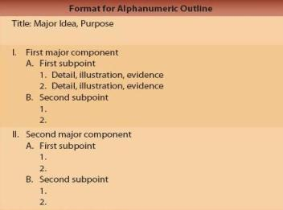
Preparing Formal Reports
Interpret and organize the data.
  Arrange the collected data in tables, grids, or outlines to help you visualize relationships and interpret meanings.
  Organize the data into an outline.
6

Slide 22
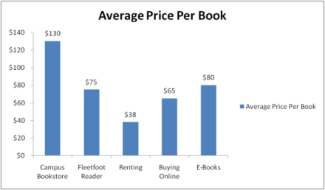
Preparing Formal Reports
Prepare graphics.
  Make tables, charts, and illustrations – but only if they serve a function. Use graphics to clarify, condense, simplify, or emphasize your data.
7

Slide 23
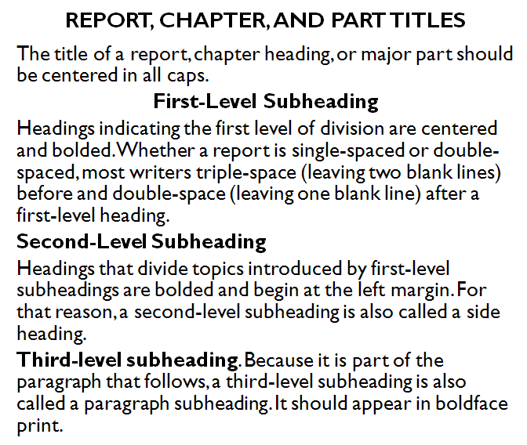
Preparing Formal Reports
Compose the first draft.
  Write the first draft knowing that you will revise it later.
  Use appropriate headings and transitional expressions to guide the reader.
8

Slide 24
Preparing Formal Reports
Revise and proofread.
  Revise to eliminate wordiness, ambiguity, and redundancy. Look for ways to improve readability, such as bulleted or numbered lists. Proofread three times for (1) word and content meaning, (2) grammar and mechanics, and (3) formatting.
9

Slide 25

Preparing Formal Reports
Evaluate the product.
  Decide whether the report will achieve its purpose. Encourage feedback so that you can improve future reports.
10

Slide 26
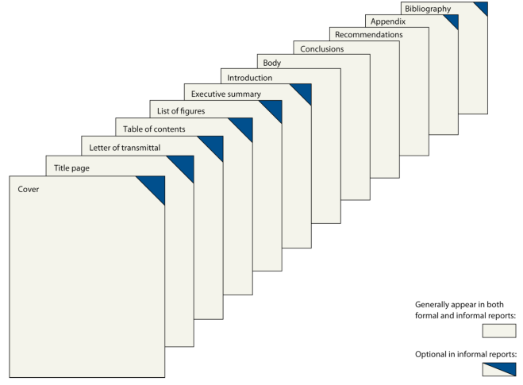
Components in Formal and Informal Reports
References

Slide 27

Formal Report Components: Front Matter
Cover and title page
  Choose a professional binder or cover.
  Balance the following parts on the title page:
    Name of report in all caps
    Receiver’s name, title, and organization
    Author’s name, title, and organization
    Date submitted

Slide 28
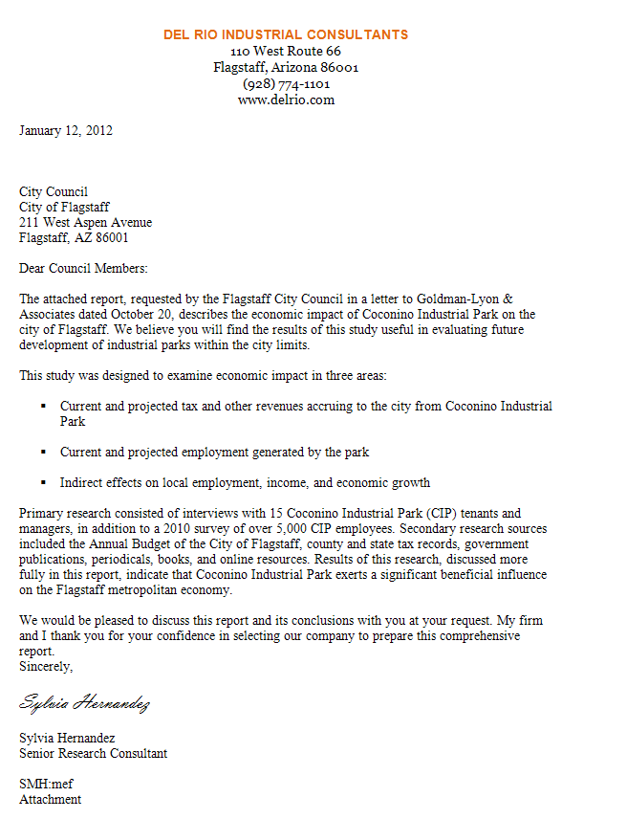
Formal Report Components: Front Matter
Letter or memo of transmittal
  Announce the topic and explain who authorized it.
  Briefly describe the project and preview the conclusions – if the reader is supportive.

Slide 29
Formal Report Components: Front Matter
Letter or memo of transmittal
  Close by expressing appreciation for the assignment, suggesting follow-up actions, acknowledging the help of others, and offering to answer questions.

Slide 30
Formal Report Components: Front Matter
Table of contents
  Show the beginning page number where each report heading appears in the report.
List of figures
  Include a list of tables, illustrations, or figures showing the title of each and its page number.
  Place the list of figures on the same page with the table of contents if possible.

Slide 31
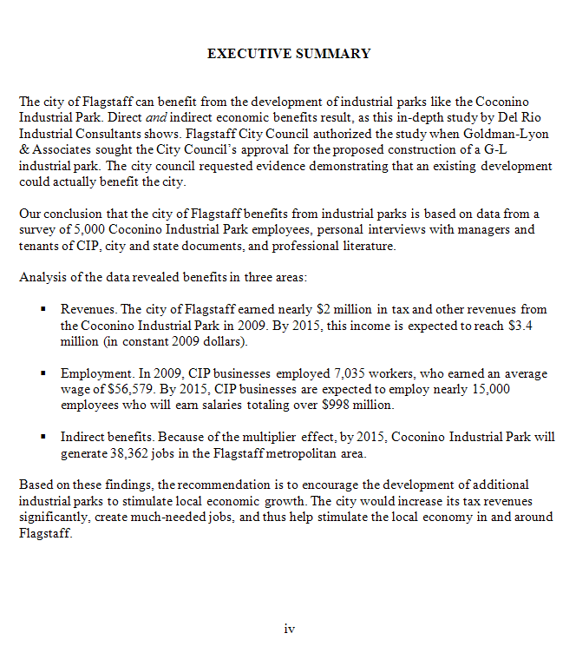
Formal Report Components: Front Matter
Executive summary
  Summarize the report purpose, findings, conclusions, and recommendations.
  Include strategic words and sentences.
  Prepare an outline with headings.
  Fill in your outline.

Slide 32
Formal Report Components: Front Matter
Executive summary
  Begin with the purpose.
  Follow the report sequence.
  Eliminate nonessential details.
  Restrict the length to no more than 10 percent of the original document.

Slide 33
Formal Report Components: Front Matter
Introduction
  Describe events leading to the problem or need.
  Explain the report topic and why it is important.
  Clarify the scope and limitations of the report.
  Orient readers with a preview of the report structure.

Slide 34
Formal Report Components: Front Matter
Introduction
  Identify who authorized the report.
  Consider reviewing relevant literature.
  Describe secondary and primary data sources.
  Define key terms.

Slide 35

Formal Report Components: Body
Body
  Discuss, analyze, and interpret the research findings or proposed solution to the problem.
  Arrange the findings in logical segments that follow your outline.
  Use clear, descriptive headings.

Slide 36

Formal Report Components: Back Matter
Conclusions and recommendations
  Explain what the findings mean in relation to the problem.
  Make enumerated recommendations, if requested.
  Suggest actions for solving the problem.
By John S. Donnellan

Slide 37
Formal Report Components: Back Matter
Appendix
  Include items of interest to some readers, such as data-gathering tools like questionnaires.
Works Cited or References
  List all references in “Works Cited” or “References” if footnotes are not provided.
  Optionally, include a bibliography showing all the works cited (and perhaps consulted), arranged alphabetically.

Slide 38
End

