Slide 1


Chapter 14
Business Presentations

Slide 2
Topics in This Chapter
Preparing Effective Oral Presentations
Building Audience Rapport Like a Pro
Techniques for Gaining and Keeping Audience Attention
Methods for Organizing an Oral Presentation
Outlining an Oral Presentation

Slide 3
Topics in This Chapter
Planning Visual Aids, Handouts, and Multimedia Presentations
Combating Stage Fright
Adapting to International and Cross-Cultural Audiences
Polishing Your Delivery and Following Up
Improving Telephone and Voice Mail Skills
Eight Steps to a Powerful Multimedia Presentation

Slide 4

Preparing Effective Oral Presentations
Know your purpose.
  Decide what you want your audience to believe, remember, or do when you finish.
  Aim all parts of your talk toward your purpose.

Slide 5

Preparing Effective Oral Presentations
Know your audience.
  Analyze the age, gender, education, experience, knowledge, and size of your audience.
  Decide what organizational pattern, delivery style, and supporting material will work best.

Slide 6

Preparing Effective Oral Presentations
Organize the introduction.
  Capture attention with a promise, startling fact, question, quotation, problem, or story.
  Establish your credibility by identifying your position, expertise, knowledge, or qualifications.
  Preview your main points.

Slide 7
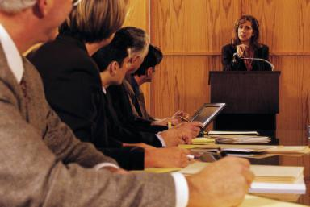
Preparing Effective Oral Presentations
Organize the body of your presentation.
  Develop two to four main points.
  Streamline your topic and summarize its principal parts.
  Arrange by one or more of the methods in this chapter.

Slide 8
Methods for Organizing an Oral Presentation
1
Chronology
  Example: Describe the history of a problem, organized from the first sign of trouble to the present.
Geography/space
  Example: Arrange a discussion of the changing demographics of the workforce by regions, such as East Coast, West Coast, and so on.
2

Slide 9
Methods for Organizing an Oral Presentation
3
Topic/function/conventional grouping
  Example: Organize a report discussing mishandled airline baggage by the names of airlines.
Value/size
  Example: Arrange a report describing fluctuations in housing costs by house value groups (houses that cost $100,000, $200,000, and so on).
4

Slide 10
Methods for Organizing an Oral Presentation
5
Journalism pattern
  Example: Explain how identity thieves ruin your good name by discussing who, what, when, where, why, and how.
Simple/complex
  Example: Organize a report explaining genetic modification of plants by discussing simple seed production, progressing to complex gene introduction.
6

Slide 11
Methods for Organizing an Oral Presentation
7
Importance
  Example: Organize from most important to least important the reasons a company should move its headquarters to a specific city.
Problem/solution
  Example: Discuss a problem and then discuss its possible solutions.
8

Slide 12
Methods for Organizing an Oral Presentation
9
Best case/worst case
  Example: Analyze whether two companies should merge by presenting the best-case result (e.g., improved market share) and worst-case result (e.g., devalued stock).
Comparison/contrast (pro/con)
  Example: Compare organic farming methods with those of modern industrial farming.
10

Slide 13

Preparing Effective Oral Presentations
Organize the conclusion.
  Summarize your main themes.
  Leave the audience with a specific and memorable “takeaway.” Tell how listeners can use this information, why you have spoken, or what you want them to do.
  Include a statement that allows you to leave the podium gracefully.

Slide 14

Building Audience Rapport Like a Pro
Effective imagery
  Analogy: A wiki is similar to a collection of post-it notes.
  Metaphor: Time is a river flowing from the past into the future.
  Simile: Launching a hedge fund is like buying a lottery ticket.

Slide 15

Building Audience Rapport Like a Pro
Effective imagery
  Personal anecdote: I started this business in my garage . . . .
  Personalized statistics: Consumers paid $28 billion for coffee last year. That means that every coffee drinker in this room spent $364 last year on coffee.

Slide 16

Building Audience Rapport Like a Pro
Effective imagery
  Worst- and best-case scenario: In a worst-case scenario, spammers may now work with overseas organized crime groups, employing Trojan-horse attacks that can turn PCs into “zombie” machines that spew out spam under the noses of their unwitting owners.

Slide 17
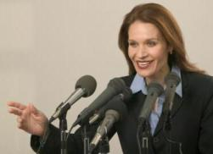
Building Audience Rapport Like a Pro
Verbal signposts
  Previewing
    Now we will consider the opposite view.
    Next I'm going to discuss . . . .
  Summarizing
    You see, then, that the most important elements are . . .
    Let me review the major problems I have presented . . . .

Slide 18
Building Audience Rapport Like a Pro
Verbal signposts
  Switching directions
    Up to this point, I have talked only about . . . ; now let's look at . . . .
    Those are all good reasons to support the proposal. But let's also consider the negatives.

Slide 19
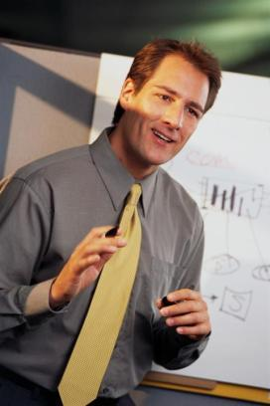
Building Audience Rapport Like a Pro
Nonverbal messages
  Look terrific!
  Animate your body.
  Speak extemporaneously.
  Punctuate your words.
  Get out from behind the podium.
  Vary your facial expression.

Slide 20
Nine Techniques for Gaining and Keeping Audience Attention
1
A promise
  By the end of the presentation, you will be able to . . .
Drama
  Tell a moving story; describe a serious problem.
2

Slide 21
Nine Techniques for Gaining and Keeping Audience Attention
3
Eye contact
  Command attention at the beginning by making eye contact with as many people as possible.
Movement
  Leave the lectern area. Move toward the audience.
4

Slide 22
Nine Techniques for Gaining and Keeping Audience Attention
5
Questions
  Ask for show of hands. Use rhetorical questions.
Demonstrations
  Include a member of the audience.
6

Slide 23
Nine Techniques for Gaining and Keeping Audience Attention
7
Samples/gimmicks
  Award prizes to participants; pass out samples.
Visuals
  Use a variety of visual aids.
8

Slide 24
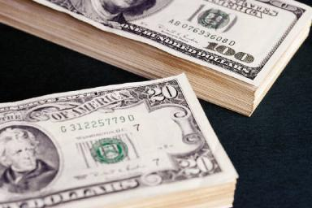
Nine Techniques for Gaining and Keeping Audience Attention
9
Self-Interest
  Tell the audience what’s in it for them.

Slide 25
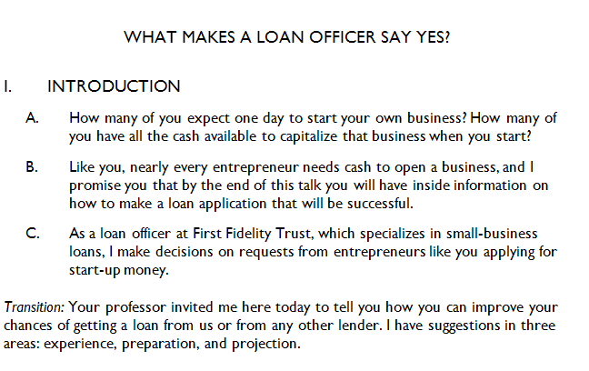
Outlining an Oral Presentation
Captures attention
Involves audience
Identifies speaker
Previews three main points

Slide 26
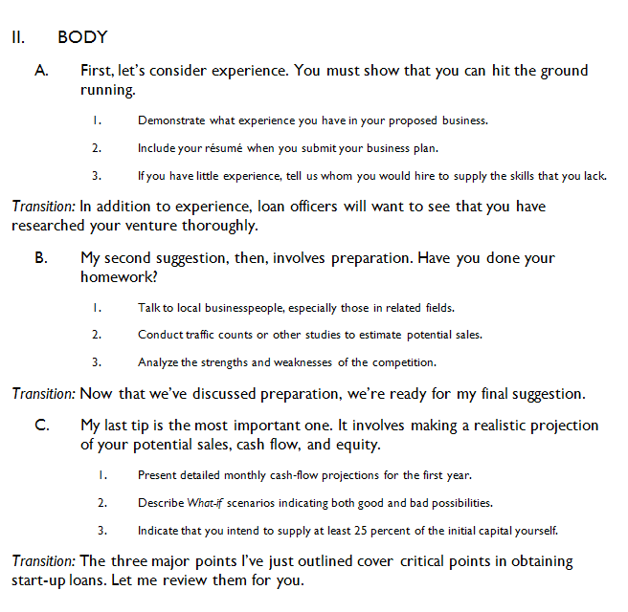
Outlining an Oral Presentation
Establishes main points

Slide 27
Outlining an Oral Presentation
Develops coherence with three planned transitions

Slide 28
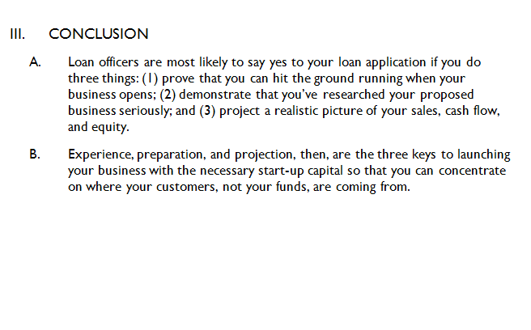
Outlining an Oral Presentation
Summarizes main points
Provides final focus

Slide 29
Planning Visual Aids, Handouts, and Multimedia Presentations
Select the medium carefully.
Consider the size of audience and degree of formality desired.
Consider cost, ease of preparation, and potential effectiveness.

Slide 30
Planning Visual Aids, Handouts, and Multimedia Presentations
Highlight main ideas.
Focus on major concepts only.
Avoid overkill. Showing too many graphics reduces their effectiveness.
Keep all visuals simple.

Slide 31
Planning Visual Aids, Handouts, and Multimedia Presentations
Ensure visibility.
Use large type for slides and transparencies.
Be sure all audience members can see.

Slide 32
Planning Visual Aids, Handouts, and Multimedia Presentations
Enhance comprehension.
Give the audience a moment to study a visual before discussing it.
Paraphrase its verbal message; don’t read it.

Slide 33
Planning Visual Aids, Handouts, and Multimedia Presentations
Practice using your visual aids.
Rehearse your talk, perfecting your handling of the visual aids.
Talk to the audience and not to the visual.

Slide 34

Eight Steps to a Powerful
Multimedia Presentation
Start with the text.
  Write out the entire content of your presentation before making any slides.
1

Slide 35
Eight Steps to a Powerful
Multimedia Presentation
Select background and fonts.
  Select or create a template with consistent font styles, font sizes, and an appropriate background.
2

Slide 36
Eight Steps to a Powerful
Multimedia Presentation
Choose images that help communicate your message.
  Use only relevant clipart, photographs, or maps – with permission.
3

Slide 37
Eight Steps to a Powerful
Multimedia Presentation
Create graphics.
  Illustrate your slides by using Shapes, SmartArt, and Chart.
  Avoid too many bullet points, too many details, and too much text. Observe the 6-x-6 rule: No more than six words per line and six lines per slide. Exception: when audiences will view slides without a narrator.
4

Slide 38
Eight Steps to a Powerful
Multimedia Presentation
Add special effects wisely.
  Consider animating bullet points.
  Consider motion, animation, and transitions.
5

Slide 39
Eight Steps to a Powerful
Multimedia Presentation
Create hyperlinks to approximate the Web-browsing experience.
  Consider making your presentation interactive by linking to other slides, other programs, or to the Internet.
6

Slide 40
Eight Steps to a Powerful
Multimedia Presentation
Engage your audience by asking for interaction.
  Present polling questions when audience feedback is necessary. These questions are useful for surveys, opinion polls, group decision making, voting, quizzes, tests, and other applications. Audience members use hand-held devices that an add-in PowerPoint device reads.
7

Slide 41
Eight Steps to a Powerful
Multimedia Presentation
Move your presentation to the Internet.
  Consider various alternatives for posting your presentation to the Internet or your company’s intranet, such as as slide shows, Web conferences, Web-based presentations with narration, or PDF documents.
8

Slide 42

Polishing Your Delivery and Following Up
Before your presentation
  Choose a delivery method.
  Prepare thoroughly.
  Rehearse repeatedly.
  Time yourself.
  Check the room.
  Greet members of the audience.
  Practice stress reduction.
  Focus on converting fear into excitement.

Slide 43

Polishing Your Delivery and Following Up
During your presentation
  Begin with a pause.
  Present your first sentence from memory.
  Maintain eye contact.
  Control your voice and vocabulary.
  Skip the apologies.
  Incorporate pauses when appropriate.

Slide 44
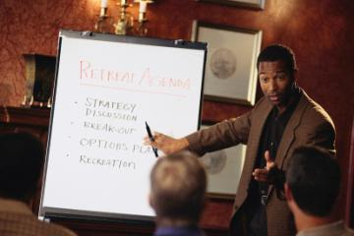
Polishing Your Delivery and Following Up
During your presentation
  Move naturally.
  Use visual aids effectively.
  Avoid digressions.
  Summarize your main points and arrive at the high point of your talk.

Slide 45

Polishing Your Delivery and Following Up
After your presentation
  Distribute handouts.
  Encourage questions.
  Repeat questions.
  Reinforce your main points.
  Keep control.
  Avoid Yes, but answers.
  End with a summary and appreciation.

Slide 46
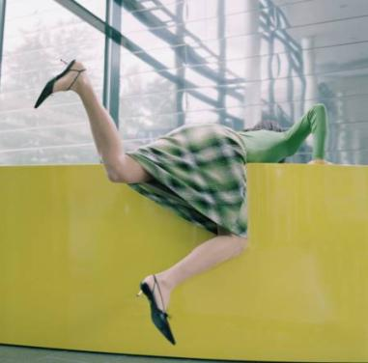
Combating Stage Fright
Symptoms of stage fright
  Fight-or-Flight response
  Dry mouth
  Sweaty hands
  Increased heartbeat
  Stomach butterflies

Slide 47
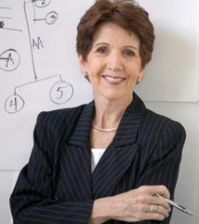
Combating Stage Fright
Reducing the effects of stage fright
  Know your topic and come prepared.
  Breathe deeply.
  Convert your fear.
  Use positive self-talk.
  Take a sip of water.
  Ignore any stumbles.
  Shift the spotlight to your visuals.
  Feel proud when you finish.

Slide 48
Adapting to International and Cross-Cultural Audiences
Anticipate expectations and perceptions that differ from what you consider normal.
Decide whether your presentation style should be more formal than it normally is.
Consider breaking your talk into short segments.
Match your presentation and your nonverbal messages to the expectations of your audience.

Slide 49
Adapting to International and Cross-Cultural Audiences
Consider explaining important concepts in several ways using different words.
Consider asking audience members to relay their understanding back to you.
Remember that audience members may be too polite to acknowledge that they don’t understand.
Provide handouts in English and in the target language.

Slide 50
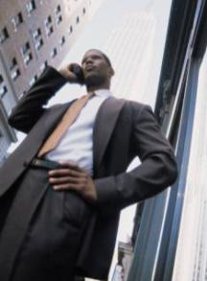
Improving Telephone and Voice Mail Skills
Making calls
  Plan a mini agenda.
  Use a three-point introduction consisting of (1) your name, (2) your affiliation, and (3) a brief explanation of why you are calling.
  Be cheerful and accurate.
  Bring it to a close.
  Avoid telephone tag.
  Leave complete voice-mail messages.
By John S. Donnellan

Slide 51

Improving Telephone and Voice Mail Skills
Receiving calls
  Identify yourself immediately.
  Be responsive and helpful.
  Take messages carefully.
  Be cautious when answering calls for others.
  Be courteous by returning your calls promptly.
  Explain when transferring calls.

Slide 52
End

