Slide 1


Chapter 3
Intercultural
Communication

Slide 2
Topics in This Chapter
The Importance of Intercultural Communication
Dimensions of Culture
How We Form Judgments of Others
Ways to Broaden Intercultural Competence
How to Make Ethical Decisions in Other Countries

Slide 3

Reasons for the Increasing Importance of Intercultural Communication
The globalization of markets
Technological advancements
Global connectivity
An intercultural workforce

Slide 4
Globalization of Markets
Mergers, acquisitions, and buyouts stir growth beyond national boundaries.
American companies in global markets must adapt to other cultures.
New trade agreements, declining domestic markets, and middle-class growth drive global markets.

Slide 5

Technological Advancements and
Global Interconnectivity
The development of new transportation and information technologies fuel the explosive growth of global markets.
The Internet and the Web are changing the way we live, the way we do business, and the way we communicate.

Slide 6

Expanding Intercultural Workforce
Immigration makes intercultural communication increasingly necessary.
Business communicators must learn to adapt to an intercultural workforce and multinational companies.

Slide 7
Characteristics of Culture
Culture
Is Learned
Is Inherently Logical
Forms Our Self-Identity and Community
Combines Visible and Invisible
Is Dynamic
Notes:
8

Slide 8
Dimensions of Culture
Culture
Context
Individualism
Formality
Communi-cation Style
Time
Orientation
Notes:
8

Slide 9

Context
  Low-context cultures tend to be logical, linear, and action-oriented.
  High-context cultures tend to be relational, collectivist, intuitive, and contemplative.
Context
North America, Germany, Scandinavia
Japan, China, Arab countries
Notes:
8

Slide 10
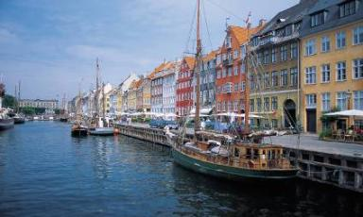
Individualism
  High-context cultures tend to prefer group values, duties, and decisions.
  Low-context cultures tend to prefer individual initiative, self-assertion, and personal achievement.
Individualism
Notes:
8

Slide 11
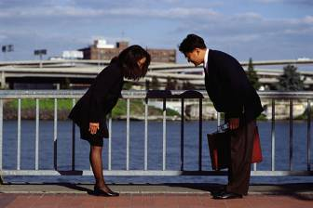
Formality
  Some cultures may prefer greater formality in dress, speech, and social interaction.
  North Americans place less emphasis on tradition, ceremony, and social rules.
Formality
Notes:
8

Slide 12

Communication Style
  High-context cultures rely on nonverbal cues and the total picture to communicate.
  Meanings are embedded at many sociocultural levels.
  Low-context cultures emphasize words, directness, and openness.
  People tend to be informal, impatient, and literal.
Communication
Style
Notes:
8

Slide 13


Time Orientation
  Time is precious to North Americans.
  Time correlates with productivity, efficiency, and money.
  Time is seen as unlimited and never-ending in some cultures.
  South Americans have a more relaxed concept of time.
Time
Orientation
=
Notes:
8

Slide 14
Characteristics of High-Context and Low-Context Cultures
High Context
Japanese
  Arab
  Latin American
  Spanish
  English
  Italian
  French
  North American
  Scandinavian
  German
  Swiss
High-context cultures are relational, collectivist, intuitive, and contemplative.
Low-context cultures are logical, linear, individualistic, and action-oriented.
Low Context

Slide 15
Proverbs Reflect Culture
U.S. Proverbs
  He who holds the gold makes the rules.
  Waste not, want not.
  The early bird gets the worm.
  If at first you don’t succeed, try, try again.

Slide 16

Proverbs Reflect Culture
Chinese Proverbs
  A man who waits for a roast duck to fly into his mouth must wait a very, very long time.
  A man who says it cannot be done should not interrupt a man doing it.

Slide 17


Proverbs Reflect Culture
Other Proverbs
  No one is either rich or poor who has not helped himself to be so. (German)
  Words do not make flour. (Italian)
  Wealth that comes in at the door unjustly, goes out at the windows. (Egyptian)

Slide 18
How We Form Judgments
Stereotype
An oversimplified behavioral pattern applied uncritically to groups
Negative!

Slide 19
How We Form Judgments
Prototype
A mental representation based on characteristics that are flexible and open to new definitions
Positive

Slide 20
How We Form Judgments
Prejudice
A rigid attitude based on erroneous beliefs or preconceptions
Negative!

Slide 21

Question
Why is it important to make generalizations in describing cultural prototypes?

Slide 22
Question
Are all generalizations invalid?

Slide 23
Techniques to Broaden
Your Intercultural Competence
Descriptiveness – giving descriptive feedback instead of judgmental feedback
Nonjudgmentalism – being tolerant, which helps prevent defensive reactions
Supportiveness – encouraging others with head nods, eye contact, and facial expressions

Slide 24

Intercultural Proficiency
Requires a conscious effort
Leads to more satisfying relationships
Makes work life more productive, gratifying, and effective

Slide 25
Increased Intercultural Proficiency Can Reduce Ethnocentric Reactions
Ethnocentrism is the belief in the superiority of one’s own race and culture.
Ethnocentrism causes us to judge others by our values.
Ethnocentrism causes us to expect others to react as we would, while others expect us to behave as they would.

Slide 26

Techniques for Bridging the
Gap Between Cultures
Tolerance – being open-minded and empathetic
Helping others save face – raising their social standing through positive comments
Patience – for example,
letting others express their
thoughts without finishing
their sentences for them

Slide 27
How to Improve Oral Communication
With Intercultural Audiences
Learn foreign phrases.
Use simple English.
Speak slowly and enunciate clearly.
Observe eye messages.
Encourage accurate
feedback.

Slide 28
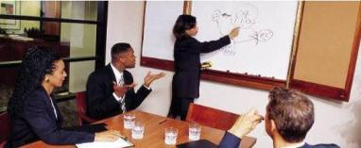
How to Improve Communication
With Intercultural Audiences
Check frequently for comprehension.
Accept blame.
Listen without interrupting.
Smile when appropriate.
Follow up in writing.

Slide 29
How to Improve Written Communication
With Intercultural Audiences
Consider local styles.
Observe titles and rank.
Use short sentences and short
paragraphs.
Avoid ambiguous expressions.

Slide 30
How to Improve Written Communication
With Intercultural Audiences
Strive for clarity.
Use correct grammar.
Cite numbers carefully.
Accommodate readers in
organization, tone, and style.

Slide 31

How to Make Ethical
Decisions Across Borders
Broaden your view of other cultures.
Avoid reflex judgments.
Find alternatives.
Refuse business if options violate your basic values.
Embrace transparency.
Don’t rationalize shady decisions.
Resist legalistic strategies.

Slide 32
Tips for Improving Communication Among Diverse Workplace Audiences
Seek training.
Understand the value of
differences.
Don’t expect conformity.
Learn about your cultural
self.
Make fewer assumptions.
Build on similarities.

Slide 33
End

